Slide 1
Trajectories and radiation of charged particles in the pulsar magnetosphere
Shan Chang
Co-author: Li Zhang, Zejun Jiang and Xiang Li
Department of astronomy, Yunnan University
2021.07

Slide 2
01
Introduction
Content
Trajectories of particles
02
03
Synchro-curvature spectrum
04
Summary

Slide 3
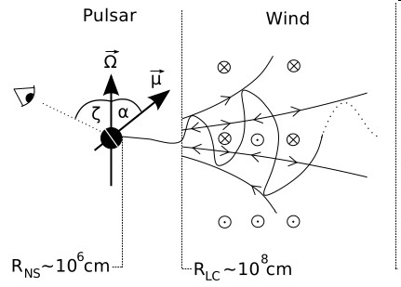
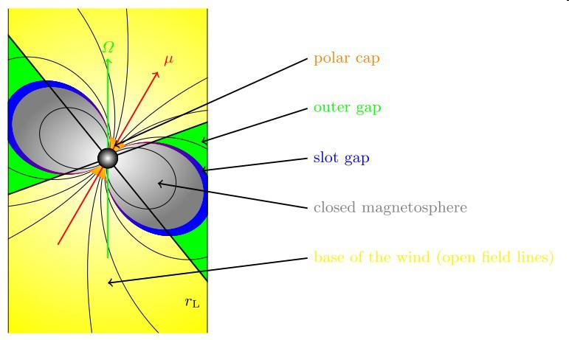
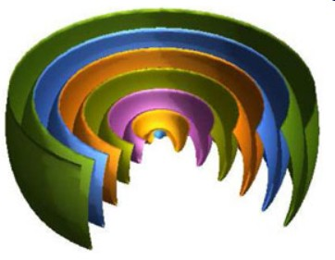
Introduction
a. PSRs in the theoretical model
Radiation inside the light cylinder
Radiation outside the light cylinder
TPC
Striped Wind
Cheng et al.2000,Dyks & Rudak 2003,
Harding et al.2008, Zhang et al.2004 Chang et al.2018
Petri & Kirk 2005, Petri 2009, Chang et al.2019a
Basic assumption: accelerated particles move outwards from the polar cap along the magnetic field lines

Slide 4
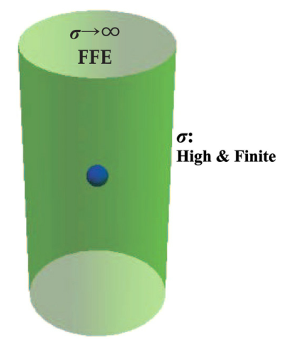
b. PSRs in the simulation
FIDO (Force-free Inside and Dissipative Outside)
$E_{||}=0$ inside the light cylinder
σ goes from 0 to finite outside the light cylinder
along trajectories , the velocity reads:
Kalapotharakos et al.2012,2014,2018
Aristotelian electrodynamics (AE) solution

Slide 5
c. Some ideas
Assumption:
the vacuum electromagnetic field (Deutsch 1955) inside the light cylinder
Method:
solve kinematic equation of particles to get the velocity of a particle
Aim:
research the particle trajectory and radiation of pulsars

Slide 6
Trajectories of particles
a. The Deutsch’s solution of electromagnetic fields
Magnetic fields:
Electric fields:

Slide 7
b. Particle trajectories
The motion of an ultra-relativistic charged particle in the electricm(E) and magneticm(B) fields can be expressed as
since

Slide 8
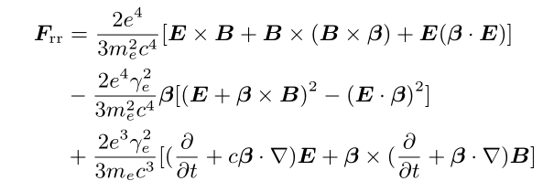
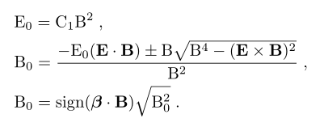
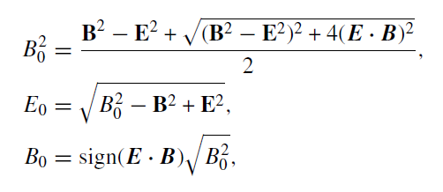
Lorentz force
radiation reaction force
after simplification,
AE solution:
Li et al. 2012

Slide 9
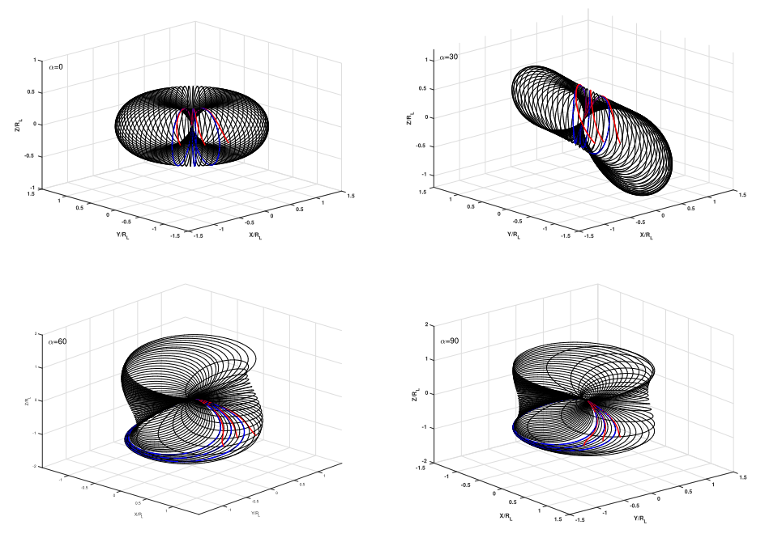
pitch angle between trajectories and field lines:

Slide 10
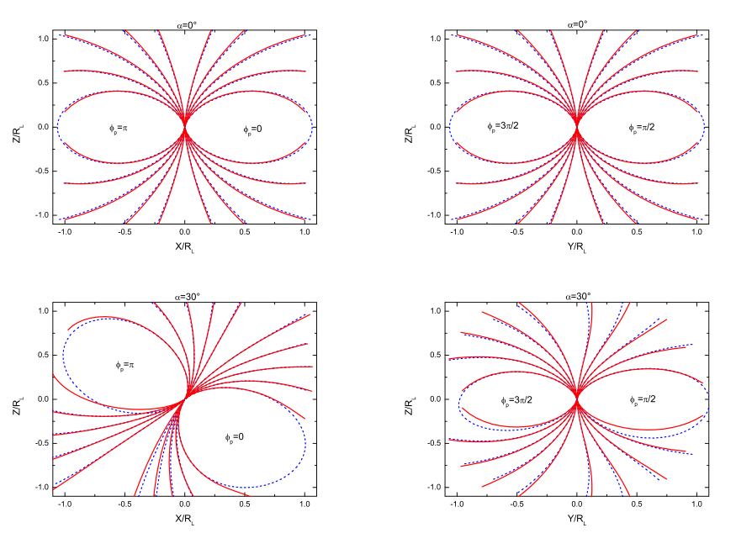
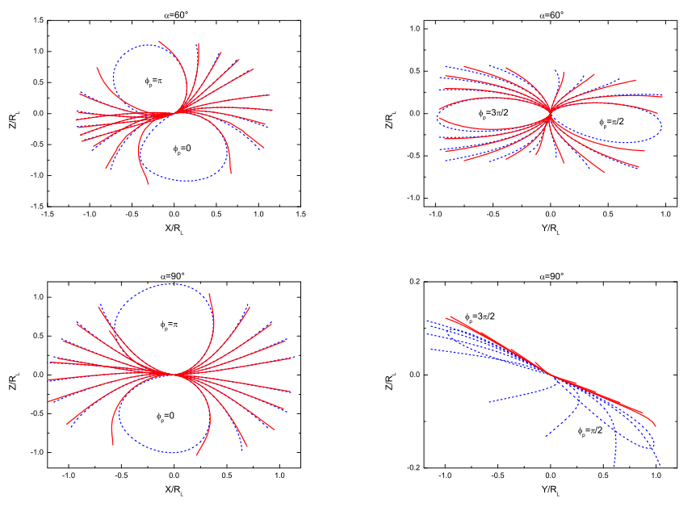
Particle trajectory with (r,$θ$, $φ$):
r－ range from neutron
star surface to R_{L}
$θ$－r_{ovc} range from 0 to 1
$φ−ϕp$ range from 0 to 2$π$

Slide 11
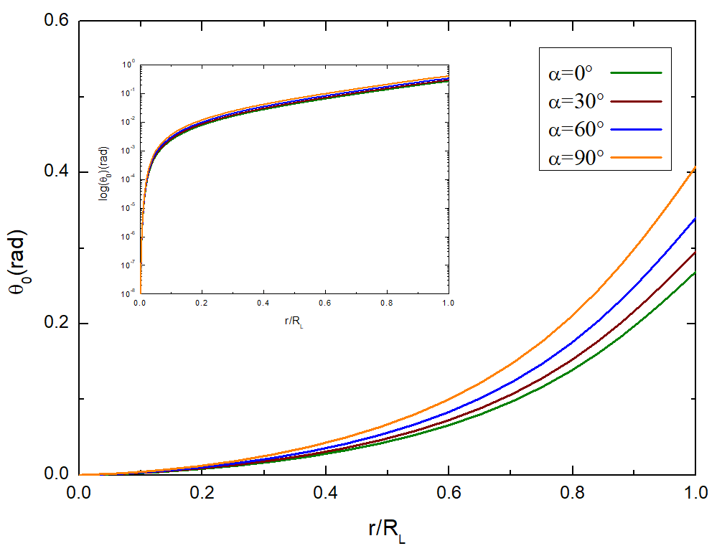
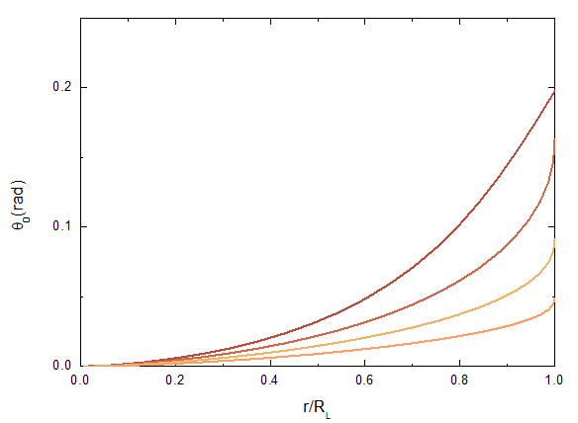
pitch angle vs. magnetic inclination angle
pitch angle vs. radial radius
pitch angle vs. magnetic field lines

Slide 12
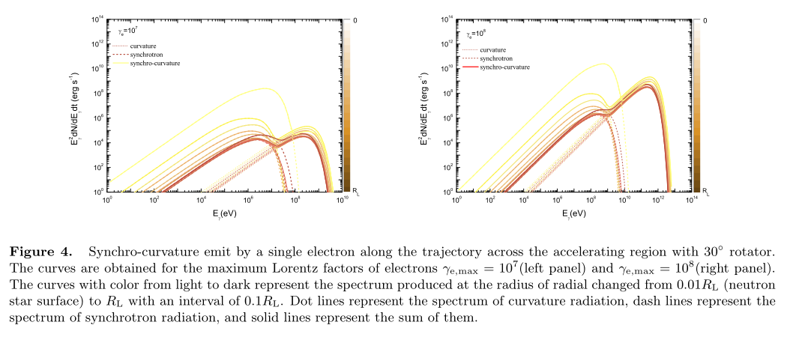
Synchro-curvature spectrum
a. a single electron
Chang et al. 2021 in prep.

Slide 13
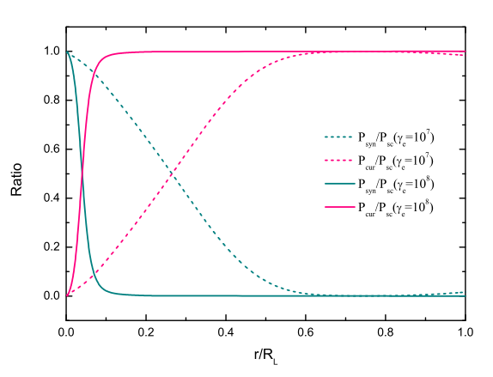
power ratio

Slide 14
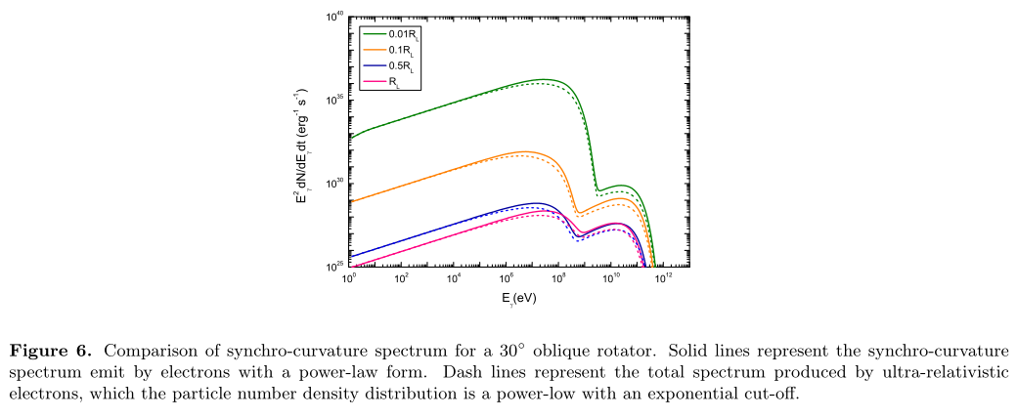
c. a power law distribution with
an exponential cut-off
b. a power law distribution

Slide 15
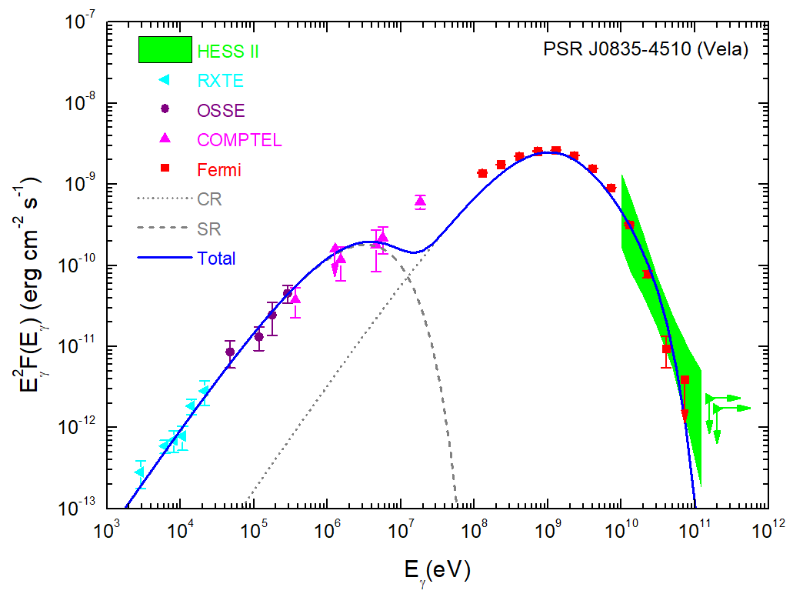
d. apply to the Vela pulsar

Slide 16
Summary
01
The form of the velocity flow is very similar to that of the AE solution, and the velocity of them are all consist of three components.
02
The pitch angle between trajectories and field lines increases with increasing r, α and r_{ovc}, respectively.
03
Synchro-curvature spectrum present the structure of double peaks, and the shape of spectrum is depends on the radiation position.
04
The model represent observations of Vela pulsar well.
Thanks！

