Slide 1
Frequency Dependent Polarization of Repeating FRBs as a Probe of Magneto-ionic Environments
Speaker: Yi Feng
Di Li, Weiwei Zhu, Bing Zhang, Wenbin Lu, Yongkun Zhang, Pei Wang, Shi Dai, Ryan Lynch, Jinchen Jiang, Jiarui Niu, Heng Xu, Chenchen Miao, Chenhui Niu, Lei Qian, Chao-Wei Tsai, Bojun Wang, Mengyao Xue, Yuanpei Yang, Jumei Yao, Youling Yue, Mao Yuan, Songbo Zhang, Lei Zhang, Dejiang Zhou
Notes:
我的报告题目是利用重复暴的线偏振随频率的变化研究重复暴周围的环境

Slide 2
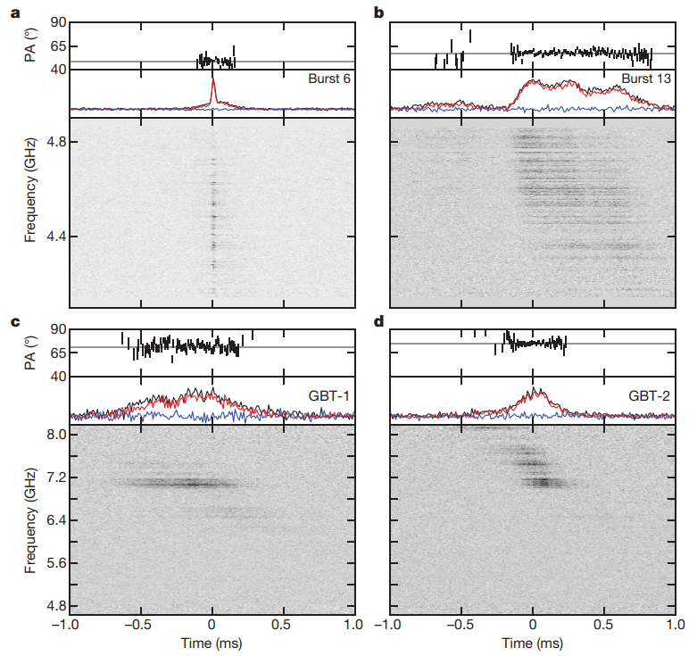
100% linear polarization of FRB 121102
Black: Stokes I
Red: linear polarization
Blue: circular polarization
FRB 121102
GBT & AO C-band
100% linear polarization
RM ~ 10⁵ rad/m²
extreme magneto-ionic environment
Michilli et al. 2018
Notes:
第一个发现的重复暴是；GBT和Arecibo c波段的观测得到100; RM是，说明FRB121102所处的环境非常极端。一般情况下；黑色

Slide 3
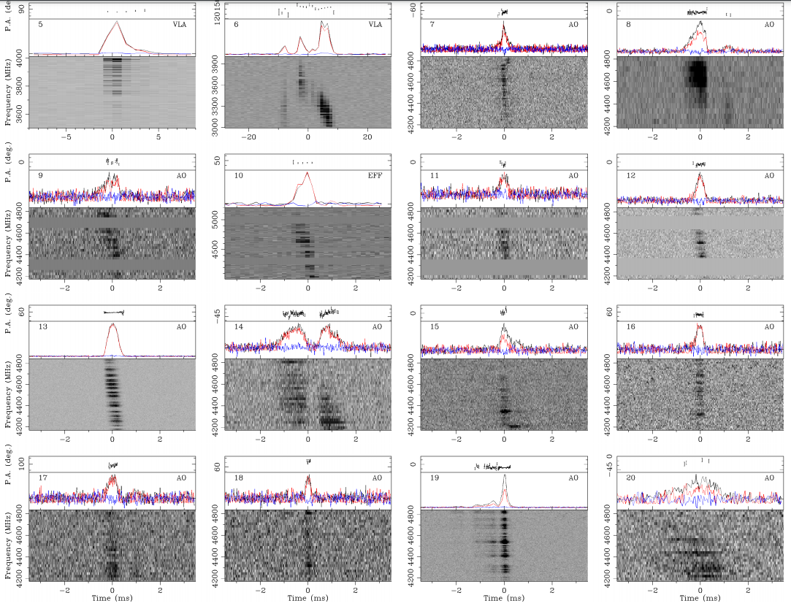
100% linear polarization of FRB 121102
Bursts 8, 15, 19, and 20 suffer from poor polarisation
calibration, resulting in unreliable polarisation fractions
FRB 121102
GBT & AO C-band
100% linear polarization
Hilmarsson et al. 2021
Notes:
后续探测到的也是

Slide 4
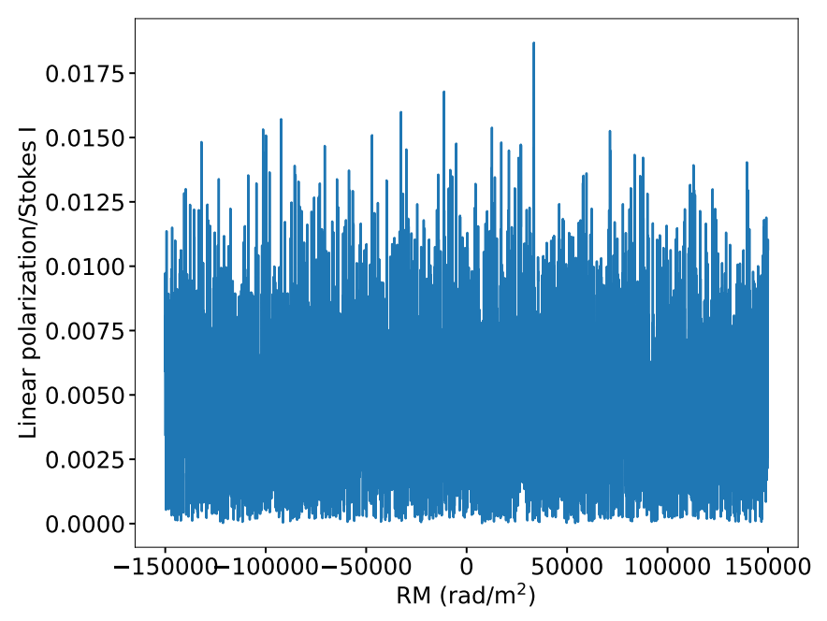
Rotation measure search of FRB 121102 with FAST
No linear polarization
at L-band!
Li & Wang et al. 2021 Nature accepted
Notes:
FAST也对FRB 121102进行了观测。李菂老师领导我们在19年一共探测到1652，对其能量等的详细分析已经被Nature接收，王培会在大会上报告。令人惊讶的是，我并没有探测到。

Slide 5
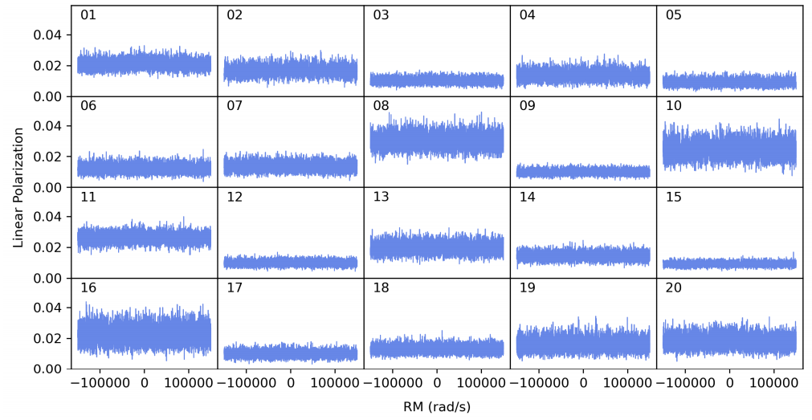
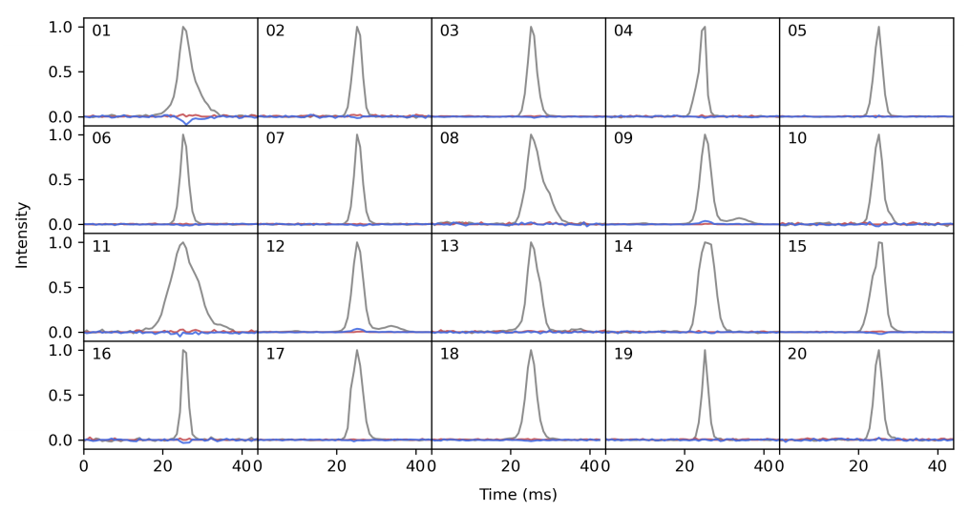
Rotation measure search of FRB 121102 with FAST
Feng & Li et al. in prep
Notes:
我对1000多个的RM进行搜寻，并没有RM，线偏振为0。FRB121102从100->0是个非常神奇的现象。我们看看其他的重复暴，看是否121102是特例，还是所有的重复暴都满足类似的规律。

Slide 6
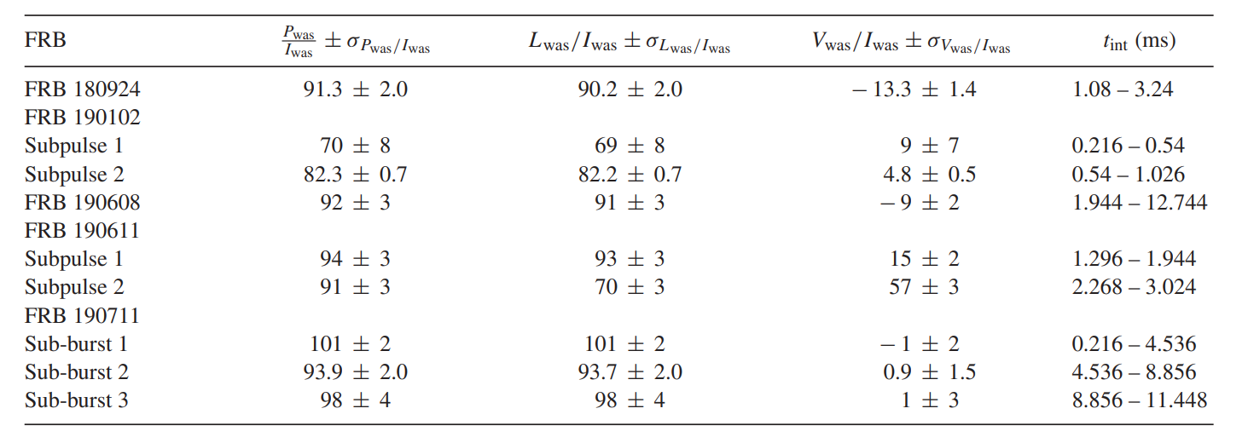
Polarization properties of other fast radio bursts
repeater
ASKAP 1300MHz
Day et al. 2020
Notes:
这张表展示的是

Slide 7
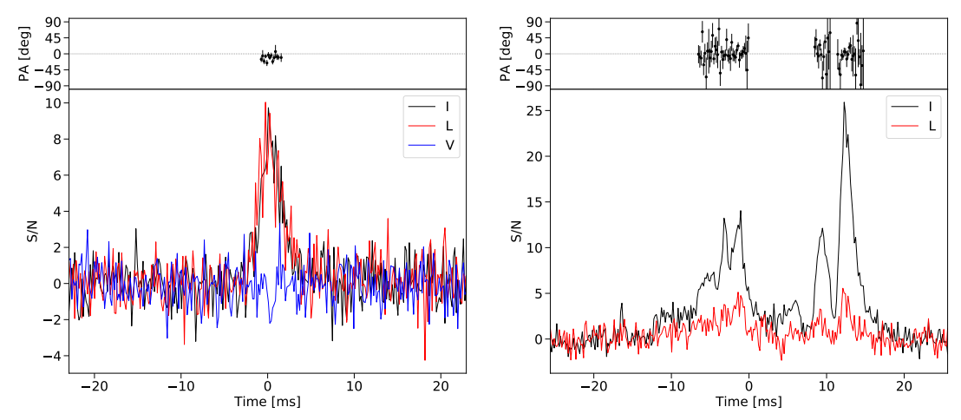
FRB 190604
100% linear
FRB 190303
20% linear
CHIME 600MHz
Fonseca et al. 2020

Slide 8
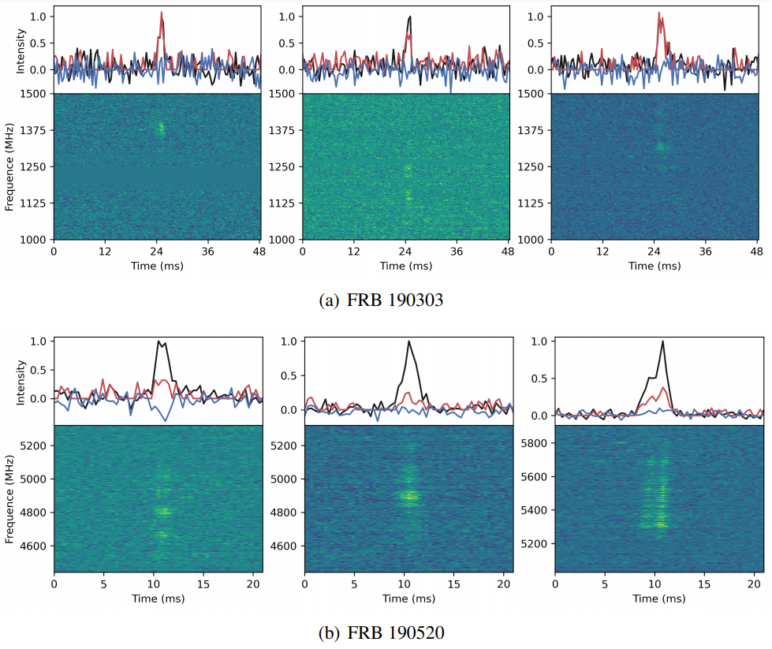
FRB 190303
FAST L-band
100% linear polarization
FRB 190520
Niu & Li et al. submitted
FAST L-band non-detection
GBT C-band ~40%
RM ~ 3000 rad/m²
Feng & Li et al. in prep
Notes:
后续利用FAST。190520是FAST发现的第一个重复暴

Slide 9
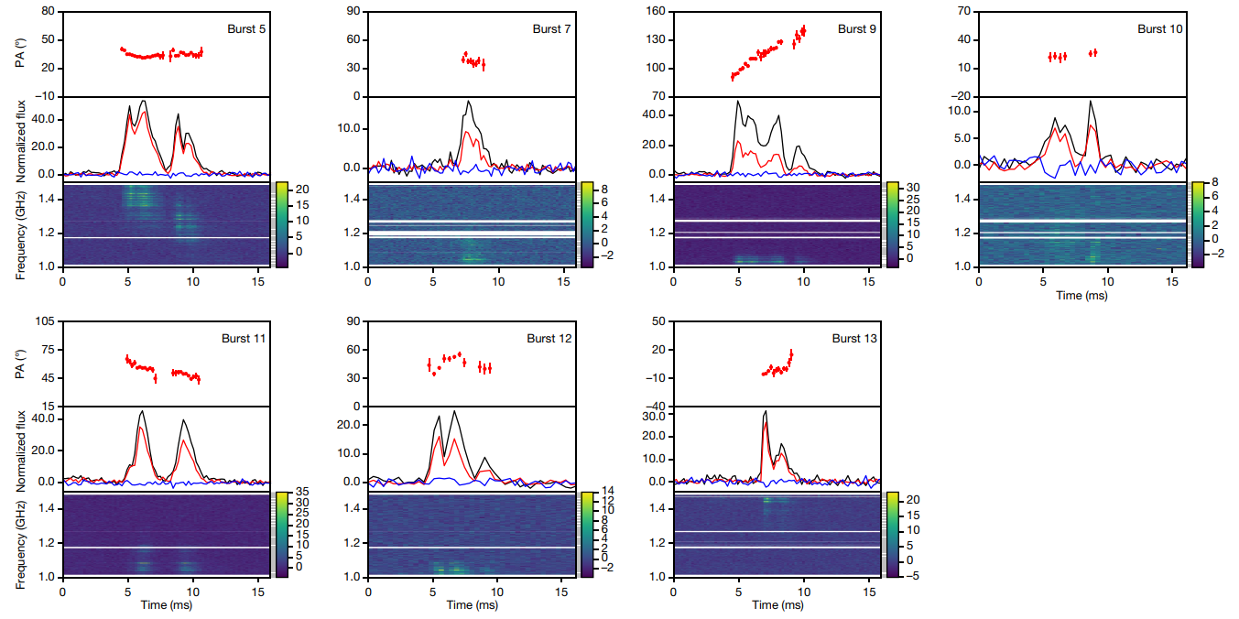
Luo et al. 2020
Notes:
高频L高，低频L低的特征。举例

Slide 10
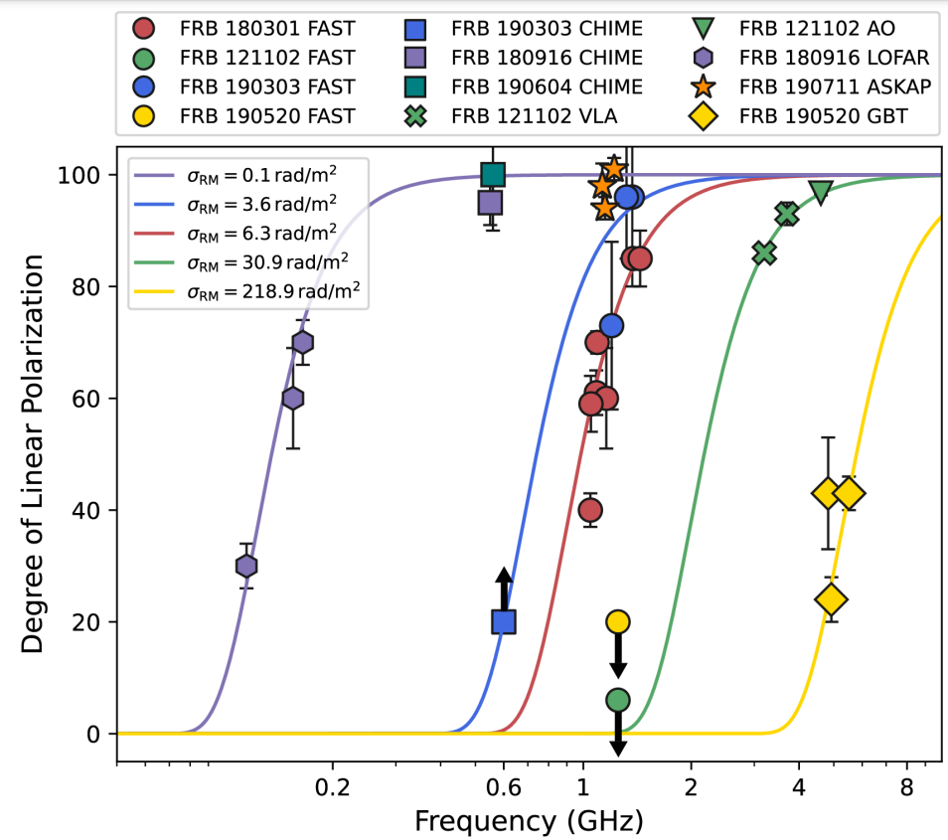
Feng & Li et al. in prep
Notes:
都有演化；相对于100%， 非100%有消偏振现象

Slide 11
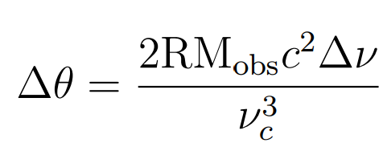
Depolarization effects
1 intra-channel depolarization
Can be ruled out
2 Intrinsic frequency evolution of linear polarization
Pulsar: degree of polarization tends to decrease going from lower to higher frequencies
Disfavor a direct analogous pulsar-like-magnetosphere origin of repeaters
3 RM scatter
Notes:
最后只剩下一种情况，RM scatter。脉冲通过不同的路径的RM不一样导致的消偏振现象。

Slide 12
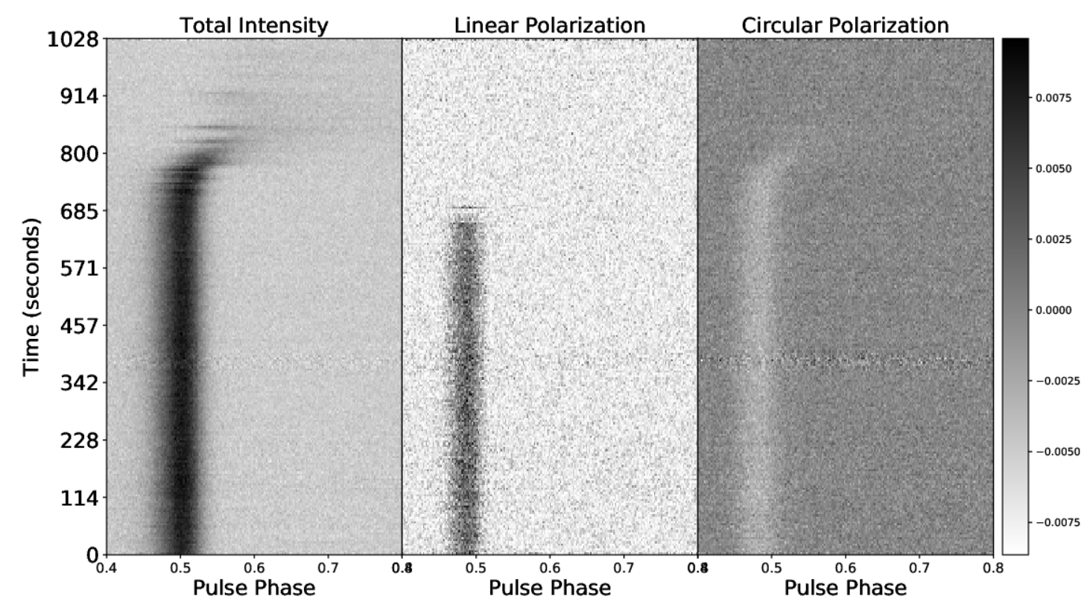
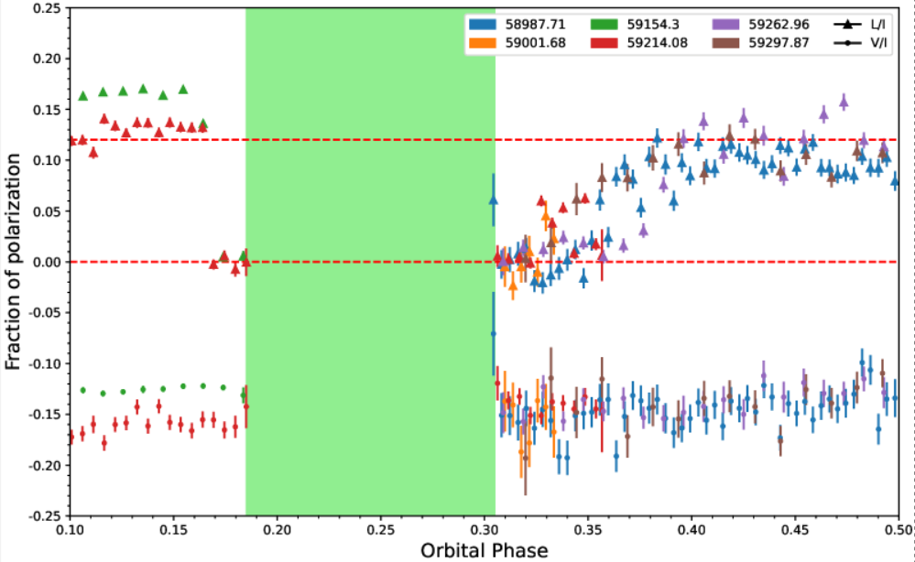
Miao, Zhu & Wang et al. in prep
Notes:
在脉冲星中观测到过

Slide 13
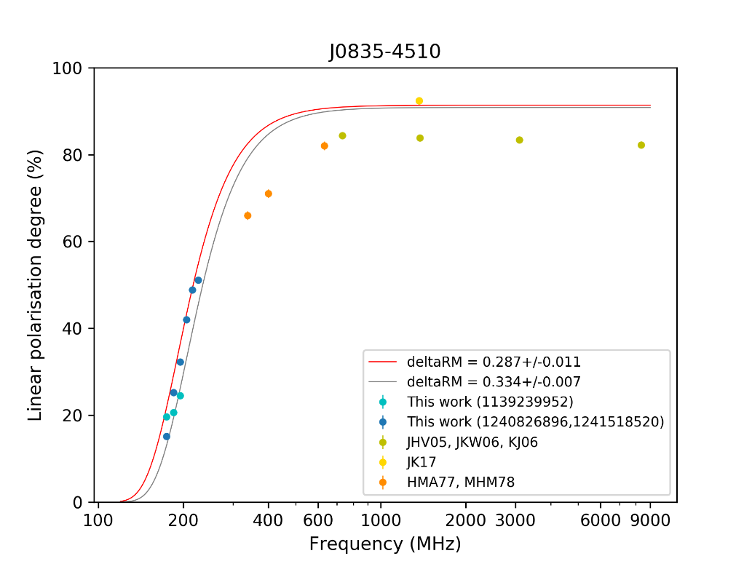
Revisiting the %L vs. freq. for J0742 & the Vela pulsar
credit: Xue
Also see Xue’s talk
Notes:
Xue利用MWA对两颗脉冲星的RM scatter进行了测量。

Slide 14
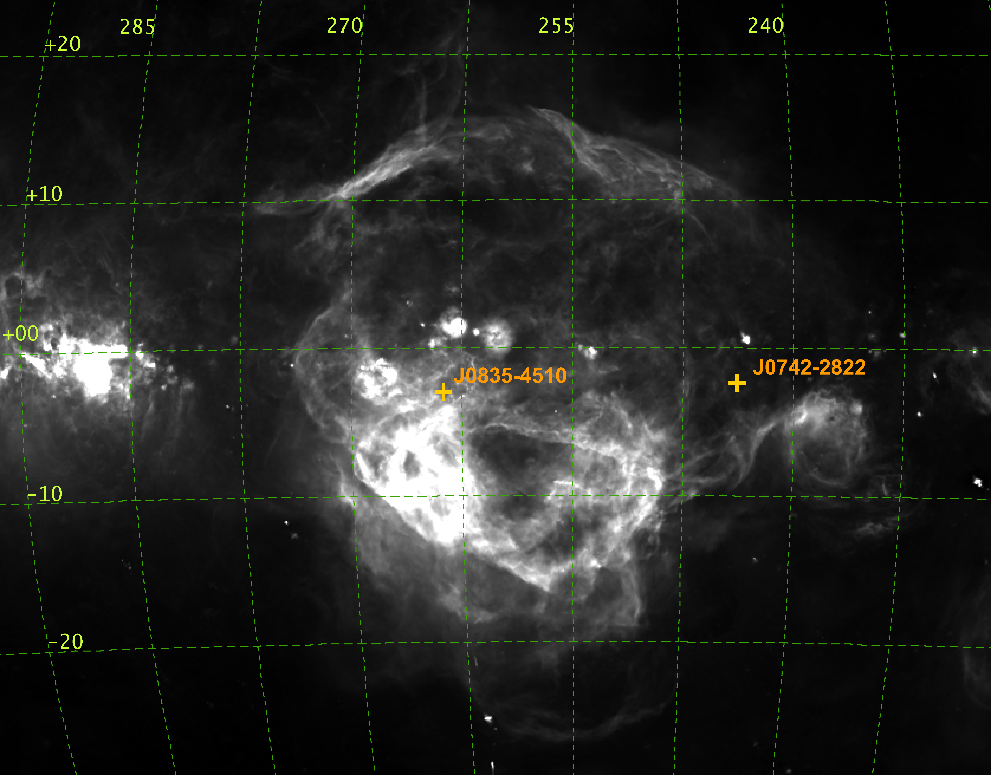
Is there a clump of turbulent plasma in front of PSR J0742-2822?
The Gum Nebula
Another well-known pulsar, the Vela pulsar (J0835-4510)
Finkbeiner (2003)
Powered with Aladin
credit: Xue
Notes:
湍动的等离子体

Slide 15
%L ∝ exp(-2λ⁴ σ_{RM}²)
Feng & Li et al. in prep
Notes:
RM scatter描述的L随频率演化

Slide 16
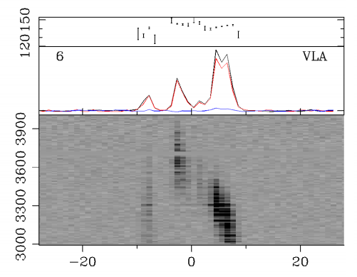
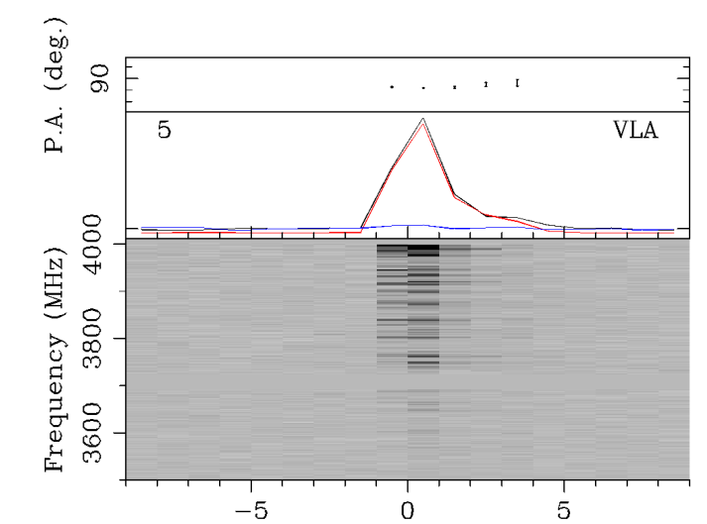
Hilmarsson et al. 2021

Slide 17
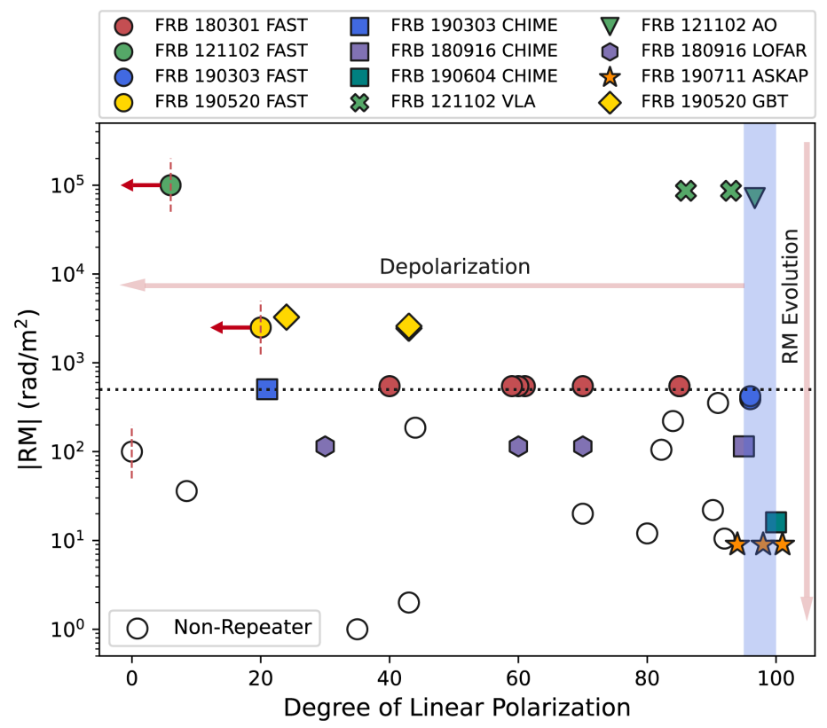
It is possible to classify FRBs using polarization properties!
Feng & Li et al. in prep

Slide 18
Summary
RM scatter reveals environment of repeaters
(magnetar wind, HII region etc)
The environment of FRB 190520 is more extreme than that of FRB 121102 in terms of RM scatter!
Emission mechanism
It is possible to classify FRBs using polarization properties！

