Slide 1

X-ray timing analysis based on Crab pulsar
reporter：Mengna Han（韩孟纳）
National Time Service Center , CAS

Slide 2
The Report Outline
1
Research background
2
Development status at home and abroad
3
Observation data processing of X-ray pulsars
4
Timing analysis of X-ray pulsars
5
Conclusion and prospect

Slide 3

Research Background
一 Overview of deep space navigation
Deep space exploration refers to the exploration that breaks away from the earth's gravitational field and enters the solar system and cosmic space. The definition of "deep space" recognized by the international spacesuit community is the space 2 million kilometers away from the earth.
Deep space navigation is the process of determining the current position of the spacecraft in deep space , predicting and revising its flight path so that it is within an acceptable error range of the expected trajectory.
Two ways to implement deep space navigation ：
Ground-based navigation
Autonomous navigation

Slide 4
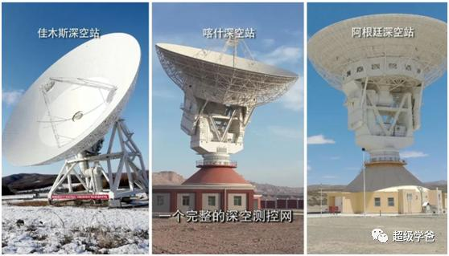
Research Background
Ground-based navigation
In 2009, China began to design and construct a global deep space measurement and control network. At present, China's deep space monitoring network is composed of two deep space stations distributed in the northeast and northwest of China and one deep space station located in the west of Argentina in South America. It is one of the three deep space monitoring networks with complete functions and global layout in the world.
China's deep space monitoring network
Under the condition of long distance, long delay and weak signal, high precision navigation is always the key problem to be solved in deep space measurement and control technology!

Slide 5
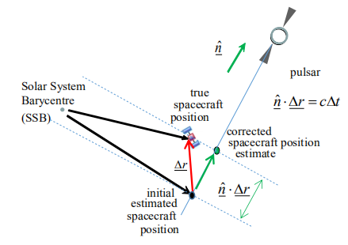
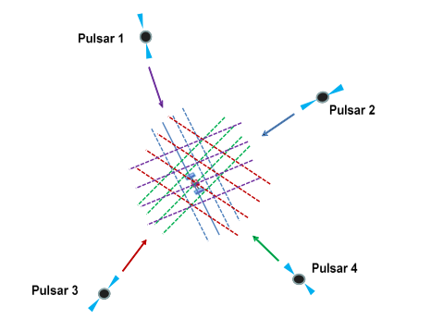
Research Background
Autonomous navigation - pulsar navigation in deep space
Two characteristics of pulsars
The long term stability of the rotation period is excellent
It has multi-band radiation characteristics
The XNAV system can observe three pulsars with an error of up to 10 km in three-dimensional positioning, and does not require system support for three months.
The positioning accuracy is not dependent on the space position of the spacecraft, so it is more suitable for deep space exploration.
Shemar, et al

Slide 6

Research Background
Introduction to the XPNAV-1 satellite ：
Launch time ：2016/11/10
altitude ：500km
Orbital period ：90min
load ：Wolter-1 detector （0.5-10keV)、MCP detector(1-10keV)
Core goal: to verify the ability of domestic X-ray detector to detect pulsars
XPNAV-1 is mainly used to verify the performance of the spaceborne X-ray detector and its adaptability to the space environment, and improve the pulsar navigation algorithm by accumulating in-orbit observation data, so as to lay a foundation for the future deep space navigation of spacecraft.
XPNAV-1 Satellite

Slide 7

Research Background
The object of XPNAV-1—Crab pulsar
X-ray Pulsar Navigation System
X-ray detector (photon counter and imager)
Spaceborne atomic clocks
Spaceborne computing equipment
Solar System Planetary Parameter Database
Navigation model algorithm library
Multi-band image of the Crab pulsar

Slide 8
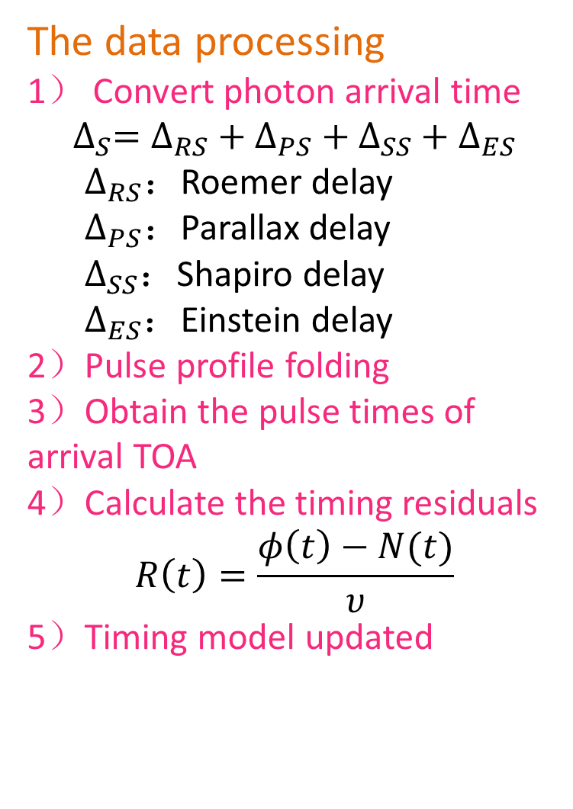
Observation data processing of X-ray pulsar
The data processing
1） Convert photon arrival time
$$∆_{S}=∆_{RS}+∆_{PS}+∆_{SS}+∆_{ES}$$
  $∆_{RS}：$Roemer delay
  $∆_{PS}：$Parallax delay
  $∆_{SS}$：Shapiro delay
  $∆_{ES}$：Einstein delay
2）Pulse profile folding
3）Obtain the pulse times of arrival TOA
4）Calculate the timing residuals
$$R\left(t\right)=\frac{φ\left(t\right)−N(t)}{υ}$$
5）Timing model updated
Standard pulse profile
Pre-fit timing residual
The RMS of pre-fit timing residuals is 29.4853μs

Slide 9
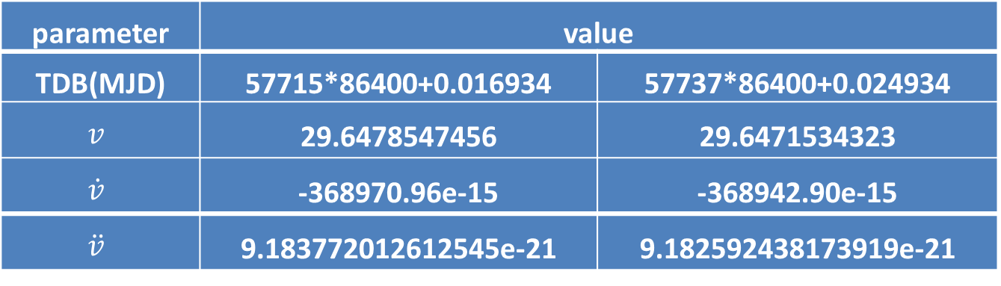
Timing analysis of X-ray pulsars
The data published by XPNAV-1 satellite involves two pulsar rotation parameters, which can be used to construct standard pulse profiles respectively.
parameter | value
TDB(MJD) | 57715*86400+0.016934 | 57737*86400+0.024934
$$v$$ | 29.6478547456 | 29.6471534323
$$\dot{v}$$ | -368970.96e-15 | -368942.90e-15
$$\ddot{v}$$ | 9.183772012612545e-21 | 9.182592438173919e-21
Bin=256
The RMS of pre-fit timing residuals is 6.31913μs

Slide 10
Timing analysis of X-ray pulsars
The folded integral pulse profile when the number of subphase intervals is different
Bin=256,1536,2816,4096,5376,6656
When the pulse profile is folded, the larger the subphase interval, the lower the SNR of the pulse profile.
The pulse profile needs to be smoothed and de-noised.

Slide 11
Timing analysis of X-ray pulsars
Comparison of three kernel regression smoothing methods
When the same kernel width is used, compared with the other two kernel regression methods, Gaussian kernel regression can effectively remove the random noise in the pulse profile and retain the peak feature of the signal, and the smoothing effect is the best.

Slide 12
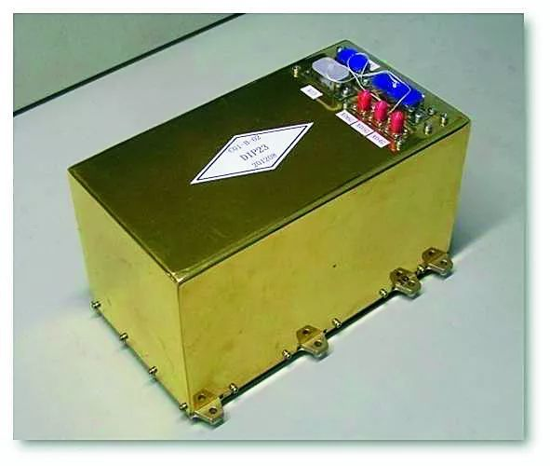
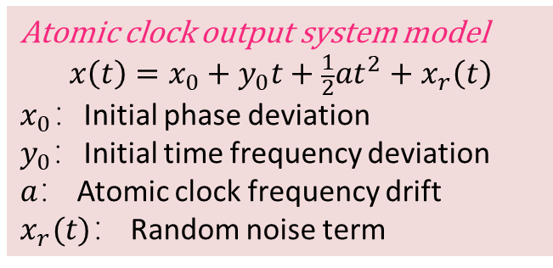
Timing analysis of X-ray pulsars
The influence of frequency deviation of reference clock on timing results
Spaceborne atomic clocks
For the spaceborne atomic clock, due to the instability of the output frequency of the frequency source and the change of the space magnetic field environment in which the spacecraft is located, there will be a frequency deviation between its output frequency and the nominal frequency, which will affect the accuracy of the spacecraft's local time.
Atomic clock output system model
$$x\left(t\right)=x_{0}+y_{0}t+\frac{1}{2}at^{2}+x_{r}\left(t\right)$$
$x_{0}：$Initial phase deviation
$y_{0}$：Initial time frequency deviation
$a：$ Atomic clock frequency drift
$x_{r}(t)：$ Random noise term

Slide 13
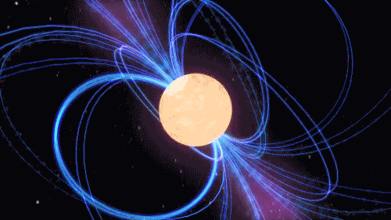

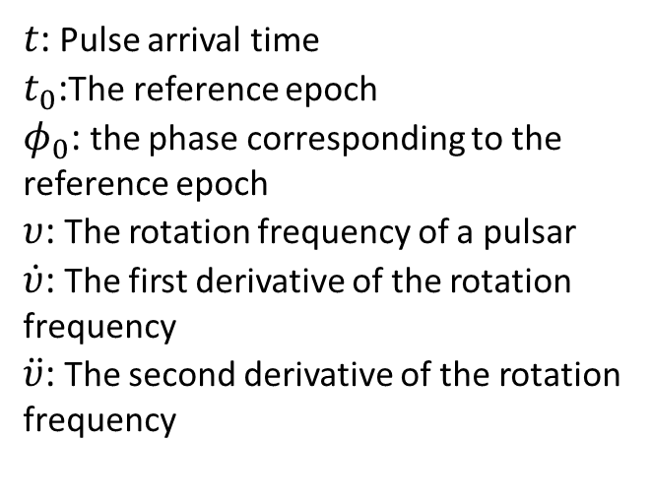
Timing analysis of X-ray pulsars
The influence of the stability of the reference clock on the timing results
Measurement of phase
$$φ(t\text{)}\text{=}φ_{0}+υ\left(t−t_{0}\right)+\frac{1}{2}\dot{υ}{\left(t−t_{0}\right)}^{2}+\frac{1}{6}\ddot{v}{\left(t−t_{0}\right)}^{3}+⋯$$
$t$: Pulse arrival time
$t_{0}$:The reference epoch
$φ_{0}$: the phase corresponding to the reference epoch
$υ$: The rotation frequency of a pulsar
$\dot{υ}$: The first derivative of the rotation frequency
$\ddot{υ}$: The second derivative of the rotation frequency
If the rotation parameters of the pulsar are correct, the clock deviation, frequency deviation and frequency drift of the atomic clock will all make the recorded photon arrival time inaccurate, which will eventually lead to the existence of constant deviation, linear term and quadratic term of the pre-fit timing residuals respectively.

Slide 14


Timing analysis of X-ray pulsars
Simulate the photon arrival time recorded by reference clock with frequency deviation
1）For the earth orbit satellite, the conversion formula from proper time to coordinate time TCG is ：
$∆t=\int_{τ0}^{τ}{(1+\frac{U}{c^{2}}}+\frac{v^{2}}{2c^{2}})d$τ
$where，U$ is the gravitational potential generated by the earth at the satellite, and the gravitational potential of the satellite is related to the position of the satellite。$v$is the velocity of the satellite relative to the center of the earth.
2）The relation between TT and TCG：
$\frac{d_{TT}}{d_{TCG}}≡1−L_{G}$
3） The relation between proper time and TT：
$$\frac{d_{τ}}{d_{TT}}=\frac{1−\frac{U}{c^{2}}−\frac{v^{2}}{2c^{2}}}{1−L_{G}}$$
$$=\frac{1−\frac{GM}{c^{2}\left(r+h\right)}−\frac{v^{2}}{2c^{2}}}{1−L_{G}}$$
$$≈(1−\frac{GM}{c^{2}\left(r+h\right)}−\frac{v^{2}}{2c^{2}})(1+L_{G})$$
If XPNAV-1 uses its own atomic clock, the rate of change of the atomic clock with respect to the TT travel time is $−2.69409×{10}^{−10}$。
This value is taken as the reference clock frequency deviation value, and the time when the photon reaches the detector is simulated when the reference clock frequency deviation exists : Change the moment of photon arriving at the spacecraft $t_{0} into t=t_{0}+k(t_{i}−t_{0})$

Slide 15
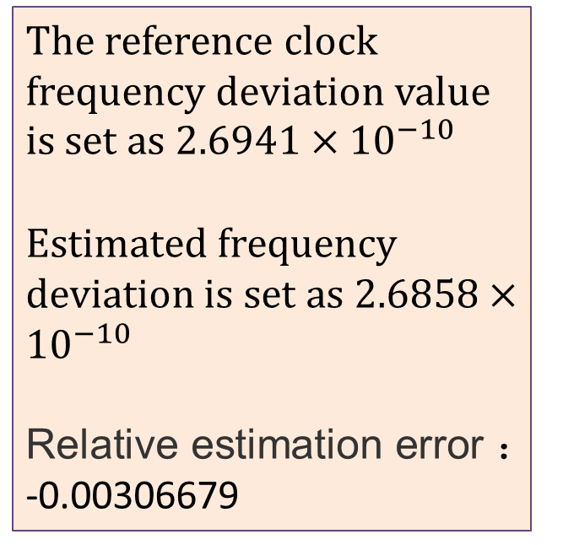
Timing analysis of X-ray pulsars
The influence of frequency deviation of reference clock on timing results
Simulation of the observation data of Crab pulsar with the frequency deviation of XPNAV-1 satellite reference clock shows a linear variation trend in the pre-fit timing residuals.
The reference clock frequency deviation value is set as $2.6941×{10}^{−10}$
Estimated frequency deviation is set as $2.6858×{10}^{−10}$
Relative estimation error ：
-0.00306679

Slide 16
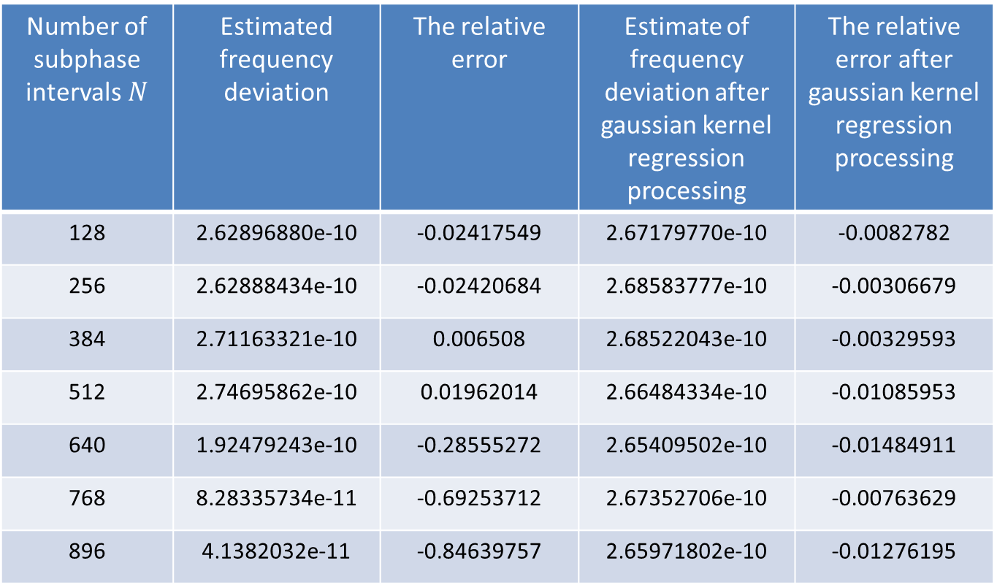
Timing analysis of X-ray pulsars
The frequency deviation correction results of the corresponding reference clock when the number of sub-phase intervals is different
Number of subphase intervals$N$ | Estimated frequency deviation | The relative error | Estimate of frequency deviation after gaussian kernel regression processing | The relative error after gaussian kernel regression processing
128 | 2.62896880e-10 | -0.02417549 | 2.67179770e-10 | -0.0082782
256 | 2.62888434e-10 | -0.02420684 | 2.68583777e-10 | -0.00306679
384 | 2.71163321e-10 | 0.006508 | 2.68522043e-10 | -0.00329593
512 | 2.74695862e-10 | 0.01962014 | 2.66484334e-10 | -0.01085953
640 | 1.92479243e-10 | -0.28555272 | 2.65409502e-10 | -0.01484911
768 | 8.28335734e-11 | -0.69253712 | 2.67352706e-10 | -0.00763629
896 | 4.1382032e-11 | -0.84639757 | 2.65971802e-10 | -0.01276195

Slide 17
Timing analysis of X-ray pulsars
Results Analysis
The degree of deviation between the estimated drift rate and the true value is different when the number of sub-phase interval is different.
When the number of sub-phase intervals is 256±128, the estimated drift rate of clock difference is in better agreement with the true value.
Gaussian kernel regression can effectively improve the effect of bin number on frequency deviation estimation.

Slide 18
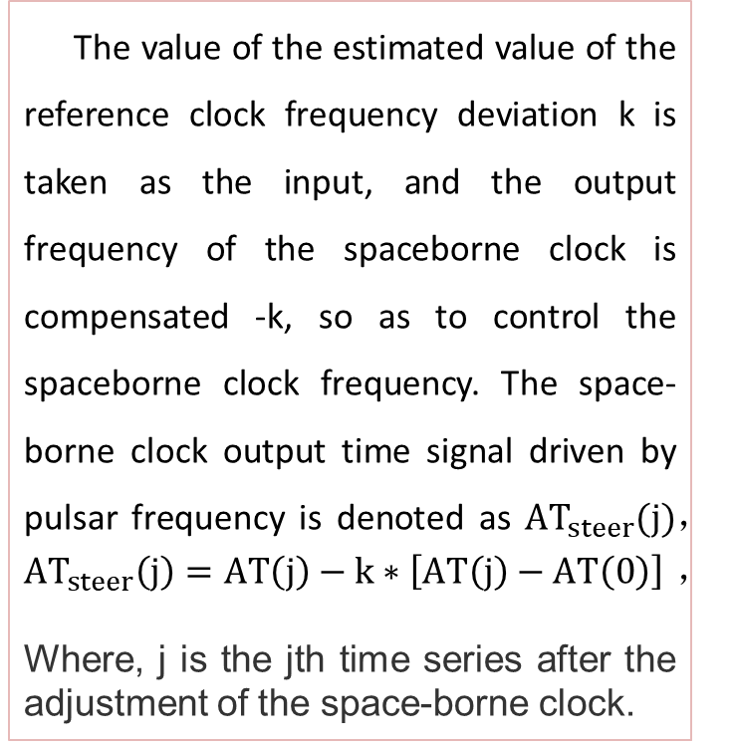
Timing analysis of X-ray pulsars
The pre-fit timing residuals after correction of the frequency deviation of the reference clock
The value of the estimated value of the reference clock frequency deviation k is taken as the input, and the output frequency of the spaceborne clock is compensated -k, so as to control the spaceborne clock frequency. The space-borne clock output time signal driven by pulsar frequency is denoted as ${AT}_{steer}(j)$，
${AT}_{steer}\left(j\right)=AT\left(j\right)−k∗\left[AT\left(j\right)−AT\left(0\right)\right]$，
Where, j is the jth time series after the adjustment of the space-borne clock.
There was no linear variation trend
in the pre-fit timing residuals.

Slide 19
Conclusion
1. There was no systematic variation trend of pre-fit timing residuals, which confirmed the validity of XPNAV-1 satellite observation data.
2. The frequency deviation of spaceborne atomic clocks can be corrected to some extent by pulsar observation.
3. When the number of sub-phase intervals is 256±128, the estimated drift rate of clock difference is in better agreement with the true value.
4. After Gaussian kernel regression processing of pulse profile, the estimated frequency deviation of the pulse profile is in better agreement with the real value.
Crab pulsar is relatively young, has glitch phenomenon, and is much less stable than the millisecond pulsar. In the practical application, by observing the millisecond pulsar whose rotation is more stable, the quadratic polynomial fitting can be carried out for the pre-fit timing residuals, and the clock error, frequency deviation and drift term of the space-based atomic clock can be corrected by the polynomial coefficient fitting.

Slide 20
Prospect
The stability of the millisecond pulsar is comparable to that of an atomic clock, and based on this, the time based on pulsar can be established.
Provide an independent means for the realization of the terrestrial time.
It is based on astrophysical processes and is not easy to interfere with.
It rotates steadily for billions of years, and could serve deep space.
The pulsar time can be constructed by simultaneously observing the millisecond pulsar in X-ray and radio frequency bands. It can becomes a natural time benchmark.

Slide 21
Thanks！

