Slide 1
Breaking index and the evolution of PSR B0950+08
指导老师：周霞 袁建平
新疆天文台：黄海涛
2021.7.14 FPS 10 @ Qilu Normal University, Jinan

Slide 2
Outline
Observation of PSR B0950+08
The evolution model
Simulation and the results
Conclusions and the discussions

Slide 3
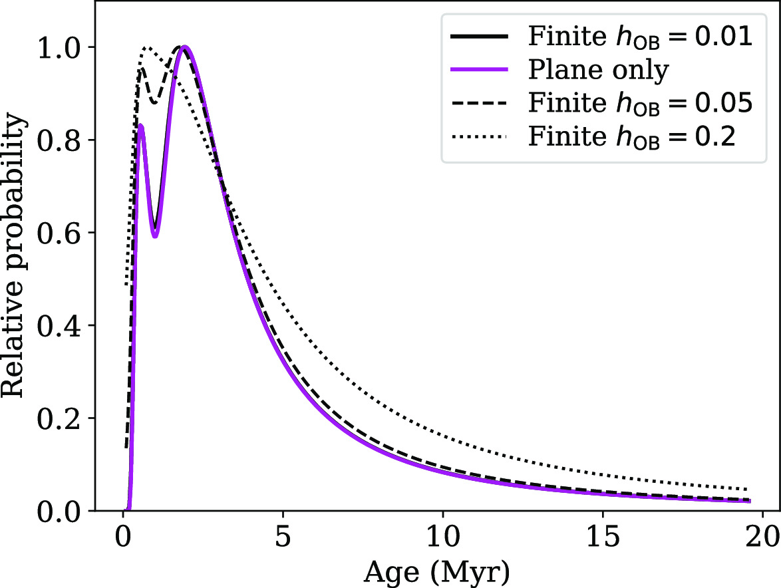
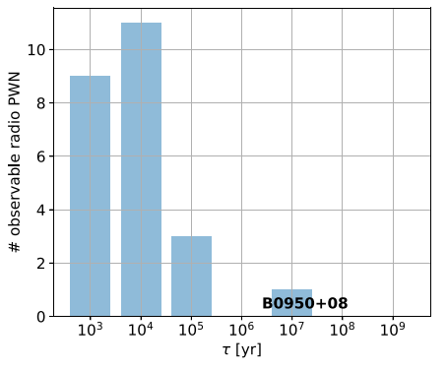
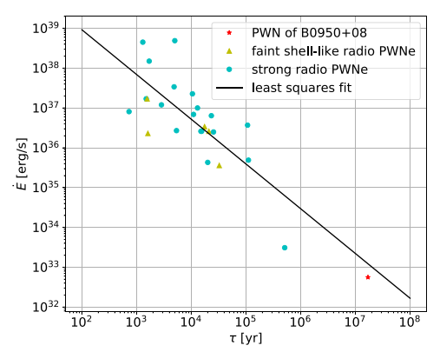
Observation of PSR B0950+08
The ages of PSR B0950+08 (J0953+0755)
kinematic age (Igoshev A. P., 2019, MNRAS, 482, 3415):
(68 percent credible intervals)
Off-pulse emission of PSR B0950+08 due to pulsar wind nebula(PWNe) (D. Ruan et al,MNRAS 2020)
(Igoshev A. P., 2019, MNRAS, 482, 3415)
From the distribution of $\dot{E}$:
$$t≈17 Myr$$
(D. Ruan et al,MNRAS 2020)

Slide 4
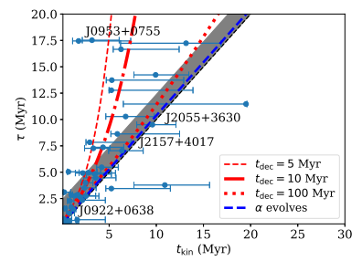
Observation of PSR B0950+08
The observation from NanShan Radio Telescope
According to the standard magnetic dipole radiation model:
τ_{char}=17.43 Myr
Q: $τ_{kine}={1.9}_{−0.6}^{+5.5} Myr$ ? $τ_{char}=17.43 Myr$ ?
From Igoshev A. P. et al, (2019):There maybe a large initial period or magnetic field decay
Telescope | UAO
time span | 2000.01.04(51548)-2014.07.08(56700)
Centre frequency | 1.540 GHz
ToAs | 655
length of each ToA | $$\sim 958 s$$
$$ν$$ | $3.951548 s$
$$\dot{ν}$$ | $−3.594661×{10}^{−15} s^{−2}$
(Igoshev A. P., 2019, MNRAS, 482, 3415)

Slide 5
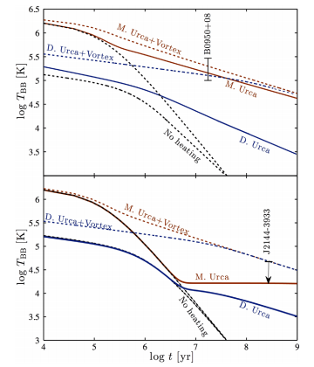
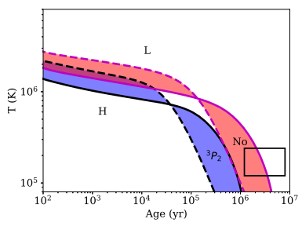
surface temperature (Pavlov G. G.et al, 2017, ApJ, 850, 79):
$τ_{char}=17.43 Myr$ → Old but still warm pulsar
From Pavlov G G et al :
Vortex creep heating
or
chemical heating and only M.Urca allowed with initial period $P_{0}<10 ms$
(Pavlov G G et al, APJ, 1996, 467(1Pt1):p.370-384.)
(Andrei P. Igoshev, MNRAS,2018)

Slide 6
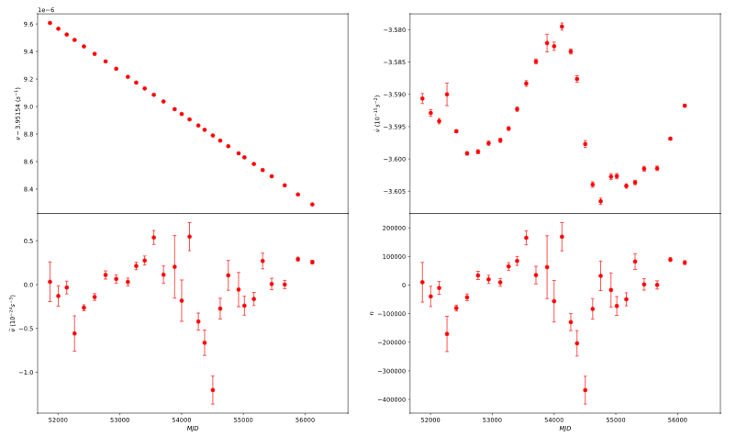
Observation of PSR B0950+08
The observation from NanShan Radio Telescope

Slide 7
The evolution models
the evoluton of magnetic field :
long-term decay:
power law
or exponential
short-term oscillation :
Fourier series
spin-down:
plasma filled magnetosphere
instantaneous magnetic dipole
magnetic obliquity angle decay with constant magnetic field
or?
thermal evolution:
rota-chemical heating
or?
vortex creep heating

Slide 8
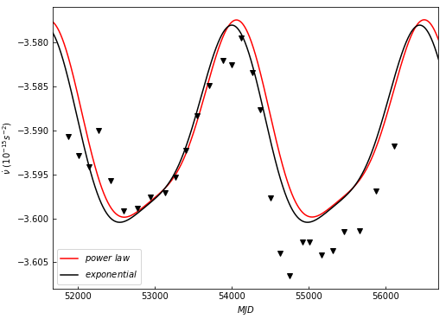
simulations and the results
The distribution of frequency derivative:

Slide 9
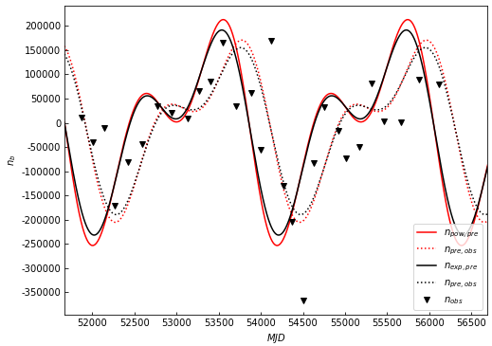
simulations and the results
The distribution of braking indices:

Slide 10
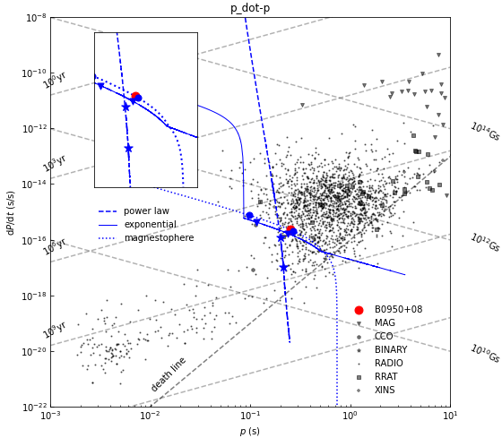
simulations and the results
The path of evolution in P-dP/dt diagram
magnetic field decay:
power law
exponential
magnetic obliquity angle decay :

Slide 11
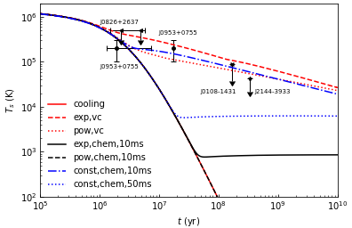
simulations and the results
The thermal evolution

Slide 12
Conclusions and the discussions
The distribution of spin frequency derivative and braking indices can be explained by the magnetic field decay model, which with long-term decay modulated by short-term oscillation, both of power law and exponential model can account for this distribution.
From the simulation of rotational evolution, we obtain the age of B0950+08 is 1.026 Myr, 9.6826 Myr and 14.8215 Myr from power law decay, exponential decay and magetic obliquity angle decay, respectively.

Slide 13
Conclusions and the discussions
The surface temperature of B0950+08 can be explained by vortex creep heating with magnetic field decay, the effect of chemical heating sensitive to the initial rotation period, for those old but still warm pulsars,it can be explained by chemical heating with constant magnetic field,which require P₀<10 ms.

Slide 14
Thans for listening

