Slide 1
FPS10
Jul.13-15, 2021, Qilu N U
Thermal Evolution of NS with Pion Condensation: Possible Fast Cooling in a Low-Symmetry-Energy Model
Helei Liu (刘荷蕾)
School of Physical Science and Technology, Xinjiang University
2021.7.15

Slide 2
Today’s Contents
Introduction
  The observation and theory of neutron star thermal evolution
  Cooling of transiently accreting neutron star
Slow cooling of neutron star with low symmetry energy EoS
Methods and results
  Cooling of Isolated neutron stars with pion condensation
  Quiescent luminosities of accreting neutron stars with pion condensation
Conclusions & Future Perspective

Slide 3


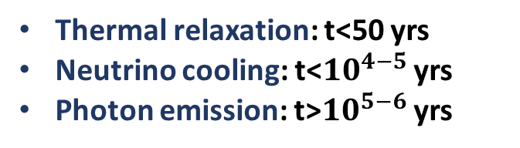

The basic observation and theory of neutron star thermal evolution
Schema of NS cooling:
Thermal relaxation: t<50 yrs
Neutrino cooling: t<${10}^{4−5}$ yrs
Photon emission: t>${10}^{5−6}$ yrs
SUPERNOVA
NS
t∼1 s,
T∼>10 MeV
ν
ν
ν
ν
ν
ν
HOT NS
(PNS)
$$\text{t}≲{10}^{4−5} \text{yr}$$
ν
ν
ν
ν
γ
γ
$$t≳100 \text{s}$$
T∼ MeV
$$\text{t}≲{10}^{7} \text{yr}$$
$$T≲10 \text{eV}$$
NS
UNBSERVABLE
Lattimer & Prakash, 2004

Slide 4
Observation of isolated NS cooling
Lim, et al, 2015
Posselt & Pavlov 2018

Slide 5
Thermal evolution equations
Physics input:
Equation of state
Neutrino emission
  Standard cooling
    Modified URCA
    Bremsstrahlung process
  fast cooling
    Direct URCA
    Pion condensation process
    ...
  PBF
heating
  Isolated NS (no)
  Accreting NS (nuclear burning, deep crustal heating, shallow heating …)
Hydrostatic equations:
Energy transport equation
Energy balance equation
Thorne, ApJ, 1977

Slide 6

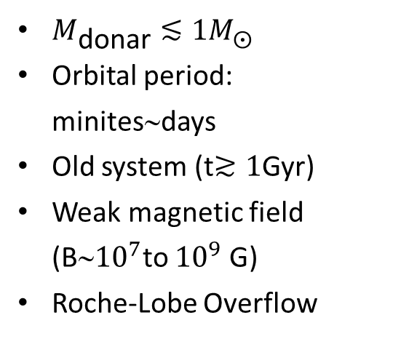
Cooling of transiently accreting neutron star
Low-mass x-ray binaries
(LMXBs)
Soft x-ray transients
(SXRTs)
$M_{\text{donar}}≲1M_{⨀}$
Orbital period: minites∼days
Old system (t$≳1$Gyr)
Weak magnetic field (B∼${10}^{7}$to ${10}^{9}$ G)
Roche-Lobe Overflow
  Active phase
    accretion rate ∼10⁻¹⁰-10⁻⁸ M yr⁻¹
    Lx∼10³⁶⁻³⁹ erg/s
    Weeks to months to years
  Quiescent phase
    little accretion
    Lx∼10³²⁻³⁴ erg/s
(NASA website)

Slide 7
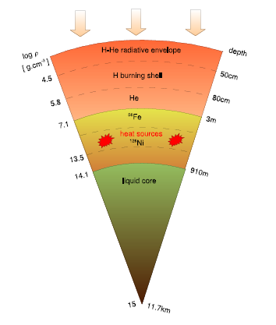

compression/heating of the envelope
compression/heating of the crust
thermonuclear fussion Type I X-ray Bursts
e-captures, n-emission, pycnonuclear reactions
“Deep crustal heating”: 1∼2 MeV/nuc
P. Haensel et al, 1990,2003,2008
$Q_{i}=6.03{\dot{M}}_{−10}\frac{q_{i}}{\text{MeV}}{10}^{33}$ erg s⁻¹
Crustal heating is suitable to explain the quiescent emission from transiently accreting NSs
N Chamel, P Haensel . Living Rev. Relativity 2008
Brown, ApJ, 1998

Slide 8
Cooling observations of soft X-ray transients
Steady state
Crust cooling
Wijnands et al, 2017

Slide 9
additional shallow heat source?
at lower densities: 10⁸-10¹⁰ g/cm³
model dependent, shallow heating strength (amount and depth) varies from source to source, from one outburst to another in the same source (Parikh et al, 2017; Ootes et al, 2018; Deibel et al, 2015)
But …the origin and nature of the shallow heat source remains a puzzle
MAXI J0556-332
IGR J17480-2446
Degenaar et al, 2011
Parikh, et al, 2017

Slide 10
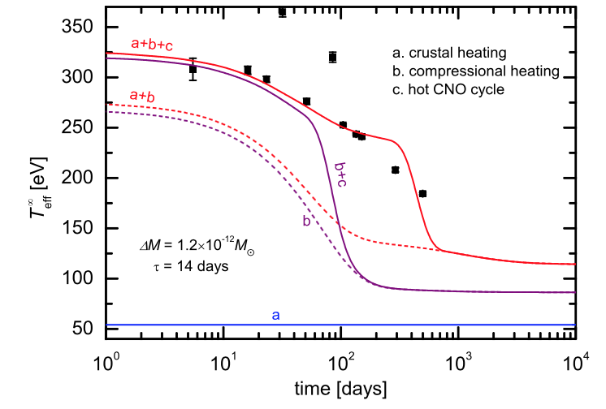
Light curve of MAXI J0556-332
How about quiescent luminosity with shallow heating?
Liu et al, JPSJ,2017
Liu et al, PTEP, 2020
deep crusral heating
compressional heating
hot CNO cycle
Shallow heating affect the quiescent luminosity of accreting NS especially at high accretion rate

Slide 11
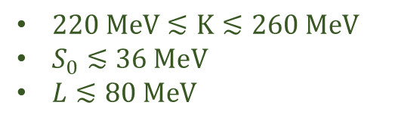
Slow cooling of NS with low symmetry energy EoS
Energy per nucleon:
Togashi: bare nuclear pothential (Togashi, et al, 2017)
Shen: relativistic mean field theory with several meson coupling terms(Shen, et al, 1998/2011)
LS220: Skyrme energy-density function (Lattimer, et al, 1991)
Terrestrial experiments:
$220 \text{MeV}≲\text{K}≲260 \text{MeV}$
$S_{0}≲36 \text{MeV}$
$L≲80 \text{MeV}$
Garg, et al, 2018
Hebeler, et al, 2013
Akira Dohi, et al, 2019

Slide 12
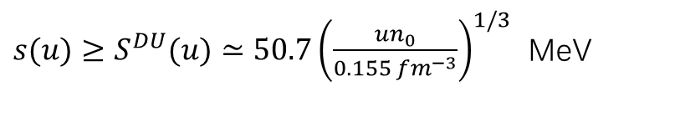

Slow cooling of NS with low symmetry energy EoS
The conditions for DU process
Akira Dohi, et al, 2019
$Y_{p}≥Y_{p}^{DU}=1/9$ or
DU process of Togashi EoS is prohibited
Standard scenario+exotics? (exotic particles such as hyperons, pions, kaons, and quarks )
$s(u)≥S^{DU}(u)≃50.7{\left(\frac{un_{0}}{0.155 {fm}^{−3}}\right)}^{1/3}$ MeV

Slide 13
Akira Dohi, et al, 2019
Shen EoS cools rapidly at any masses
The observational data can be explained with the effect of superfluidity
LS220 EoS is suitable to account for the observational data.

Slide 14
Cooling models with low symmetry energy and the pion condensation
Dohi & Liu, et al, 2021, submitted
Pion condensation in the core of NS which soft the eos
The neutrino emission due to pion condensation appear
Umeda, 1994
Muto, 1993
Matsuo, et al, 2018

Slide 15
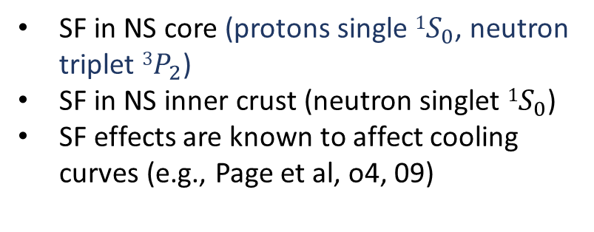
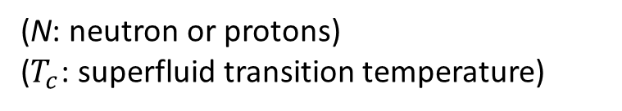

Nuclear Superfluidity (SF)
Based on the BCS theory, Cooper paring ([NN]) occurs in NS due to the attractive nuclear force
$$N+N→\left[NN\right]+v+\overline{v}$$
at $T<T_{c}\sim {10}^{8−10}$ K
(N: neutron or protons)
($T_{c}$: superfluid transition temperature)
SF in NS core (protons single ${1S}_{0}$, neutron triplet ${3P}_{2}$)
      SF in NS inner crust (neutron singlet ${1S}_{0}$)
      SF effects are known to affect cooling curves (e.g., Page et al, o4, 09)
Page et al, 2013

Slide 16
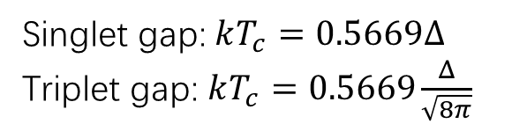
Effect of Superfluid:
Suppression of heat capacities and emission mechanisms
    Enhanced emission due to Cooper paring of nucleons
Singlet gap: $kT_{c}=0.5669Δ$
Triplet gap: $kT_{c}=0.5669\frac{Δ}{\sqrt{8π}}$
$$Δ_{0},k_{0},k_{1},k_{2} \text{and} k_{3} \text{are} \text{fit} \text{parameters}$$
Wynn C. G. Ho et al, 2015

Slide 17
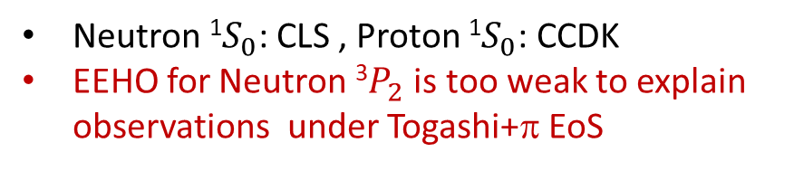
Cooling of Isolated neutron stars with pion condensation
Dohi & Liu, et al, 2021, submitted
EoS, surface composition, superfluidity are important
NS cooling is too fast with Togashi+π EoS
Neutron ¹$S_{0}$: CLS , Proton ¹$S_{0}$: CCDK
EEHO for Neutron ³$P_{2}$ is too weak to explain observations under Togashi+π EoS

Slide 18

Cooling of Isolated neutron stars with pion condensation
Dohi & Liu, et al, 2021, submitted
EoS, surface composition, superfluidity are important
NS cooling is too fast with Togashi+π EoS
Neutron ¹$S_{0}$: CLS , Proton ¹$S_{0}$: CCDK
TTav for Neutron ³$P_{2}$ explain observations well under Togashi+π EoS

Slide 19
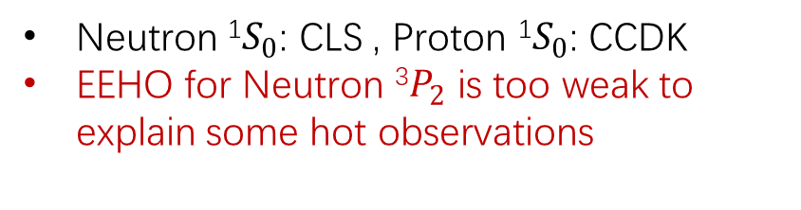
Quiescent luminosities of accreting neutron stars with pion condensation
Liu & Dohi, PRD, 2021
Heating curves with TM1,Togashi+π, TM1e+π located too low, superfluidity is needed
Neutron ¹$S_{0}$: CLS , Proton ¹$S_{0}$: CCDK
EEHO for Neutron ³$P_{2}$ is too weak to explain some hot observations

Slide 20

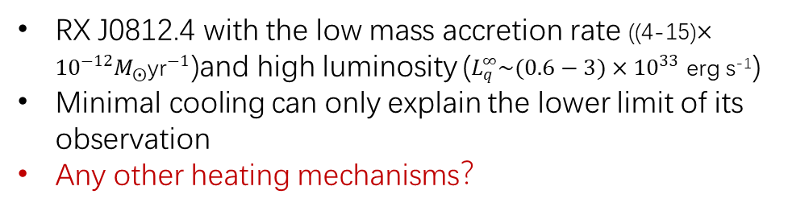
RX J0812.4 with the low mass accretion rate ((4-15)$×{10}^{−12}M_{⨀}{\text{yr}}^{−1}$)and high luminosity ($L_{q}^{∞}\sim (0.6−3)×{10}^{33}$ erg s⁻¹)
Minimal cooling can only explain the lower limit of its observation
Any other heating mechanisms？
Strong neutron ³$P_{2}$ superfluidity TTav can fit cooling observations
Liu & Dohi, PRD, 2021

Slide 21
Summary & future work plan
In terms of NS cooling observations, we have a possibility to extract information of various physics, which are thought to work inside NSs, such as follows
Cooling Observations
Uncertain Physics
Isolated NS
Soft X-ray transients
Equation of state
Exotic particles and Superfluidity
Future work plan:u
Studying the possible heating mechanism in the soft x-ray transients
Studying the short-term NS thermal evolution of NS with the effect of X-ray burst
THANKS!

