Slide 1
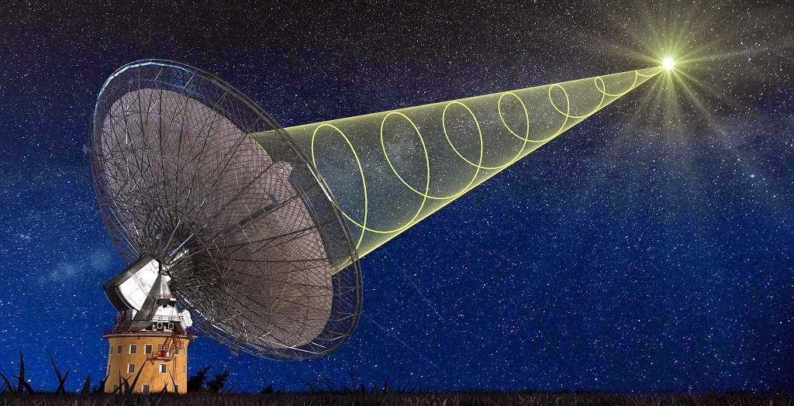
快速射电暴的研究进展
王发印
南京大学
Collaborators: G.Q. Zhang, Q. Wu, Z.Y. Zhao, Z.L. Tu, H.Yu, J.S. Wang, Y.P. Yang, Z.G.Dai
Future Pulsar Symposium 10 @ 齐鲁师范学院 2021. 7. 15

Slide 2
Outline
What are FRBs?
Observations and physical models
FRB cosmology
Prospects

Slide 3
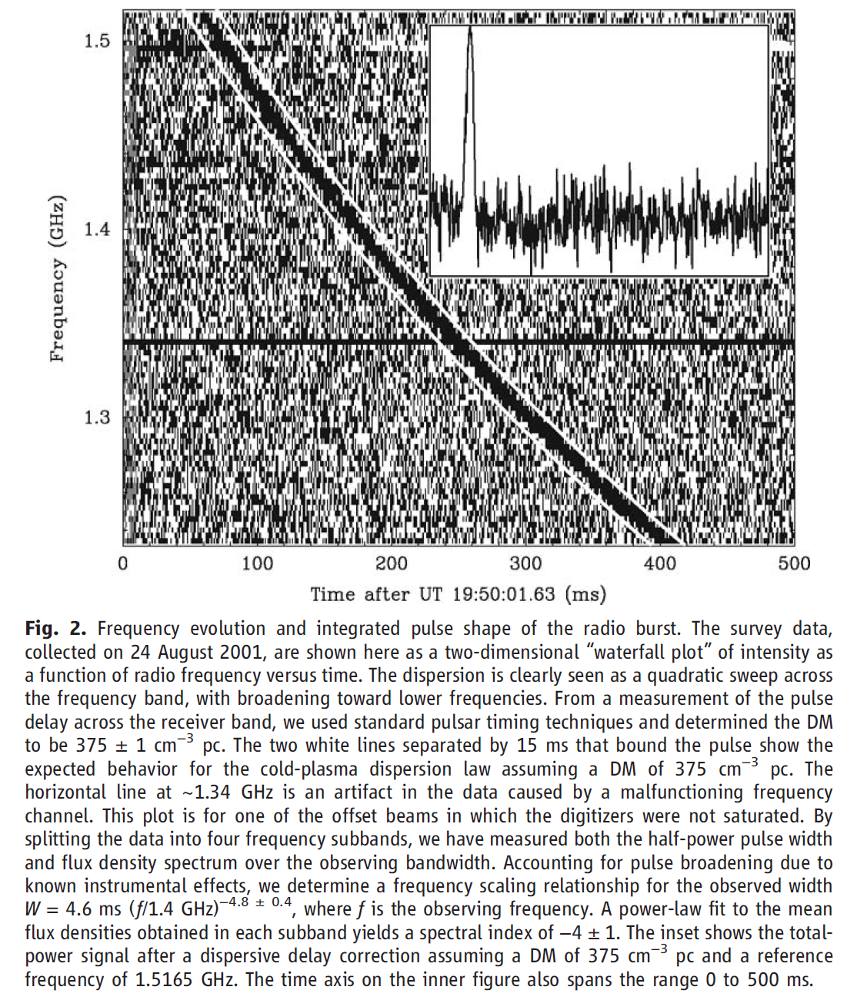
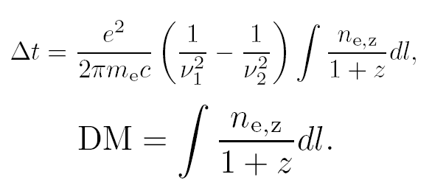
Fast radio bursts
Fast radio burst (FRB) was first discovered by Lorimer et al. (2007). FRB 010724;
FRBs are further confirmed with a large sample (Thornton et al. 2013; Spitler et al. 2014; Champion et al. 2015; Spitler et al. 2016…).
Parkes
Lorimer et al. 2007, Science

Slide 4
Main observation progress of FRBs
2007: discovery (Lorimer et al. 2007, Science)
2016: repeater (FRB 121102, Spitler et al. 2016)
2017: localization (FRB 121102 at z=0.19; Chatterjee et al. 2017, Nature)
2018: extreme large rotation measure~10^5 rad m⁻² (Michilli et al. 2018, Nature)
2019: several localizations (Bannister et al. 2019, Sci.; Ravi et al. 2019, Sci.;…)
2019: >1600 bursts from FRB 121102 by FAST (Li et al. 2021)
2020: periodicity (16 days for FRB 180916, CHIME/FRB 2019, Nature)
2020: polarization angle swings (FRB 180301; FAST 2020, Nature)
2020: FRB 200428 from a Galactic magnetar (CHIME/FRB 2020; STARE2 2020; FAST 2020)
2021: FRB 200120E from a globular cluster in M81 (Kirsten et al. 2021)

Slide 5
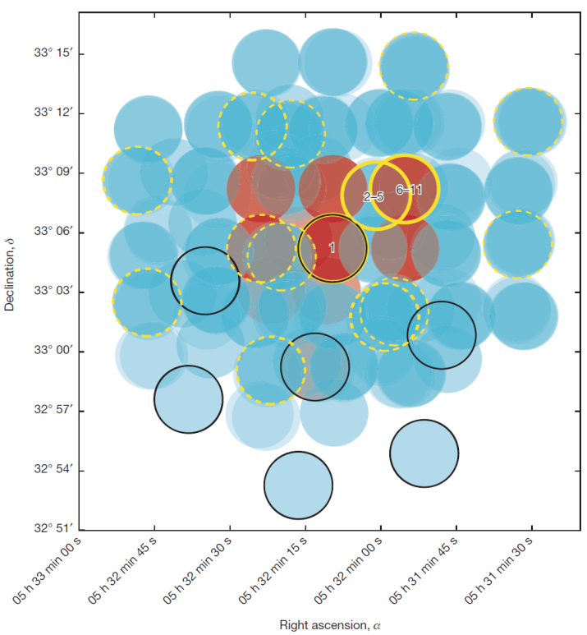
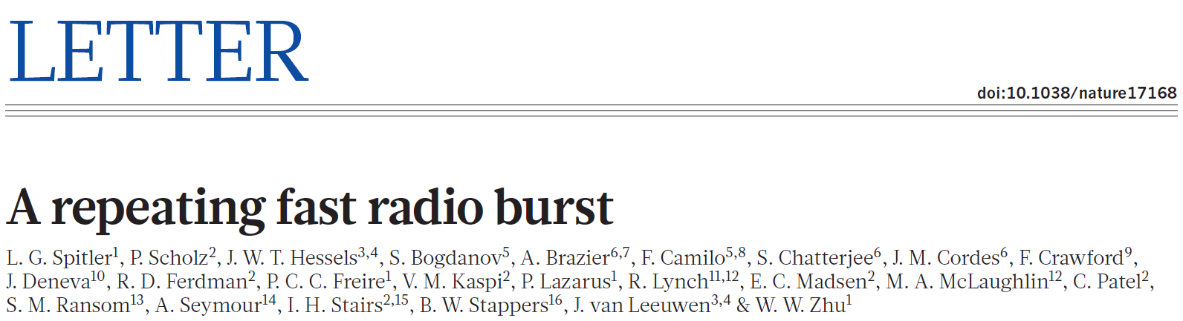
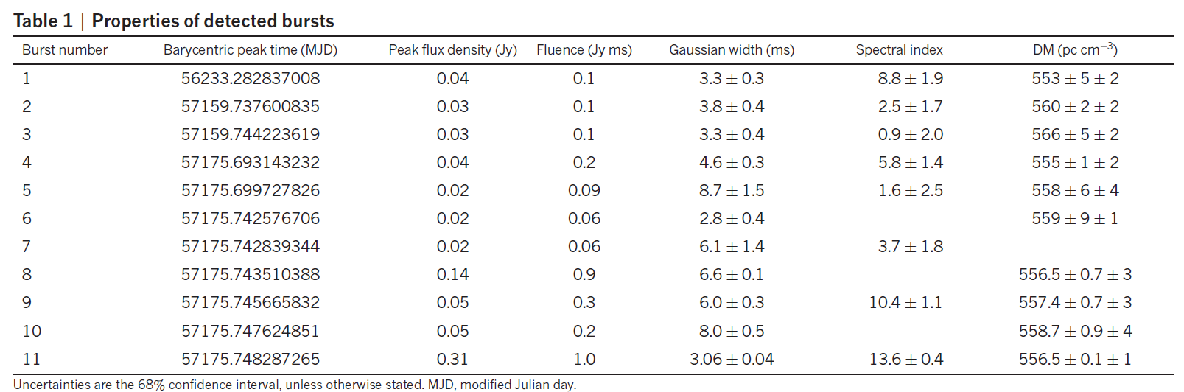
FRB 121102: the first repeating FRB!
>1600 bursts observed by FAST
Spitler et al. 2016, Nature, 531, 202
Arecibo

Slide 6
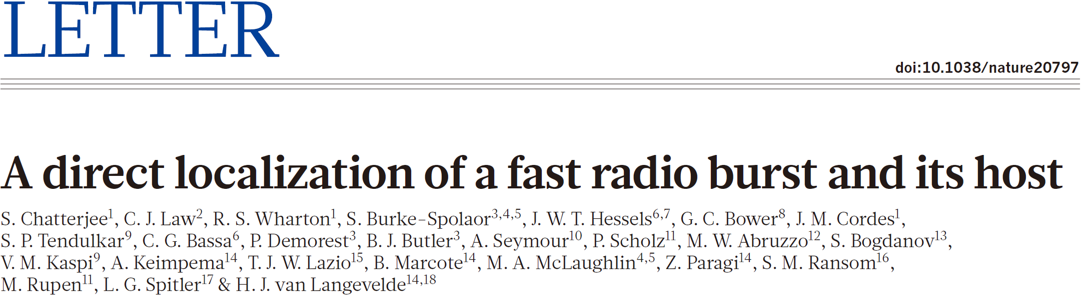
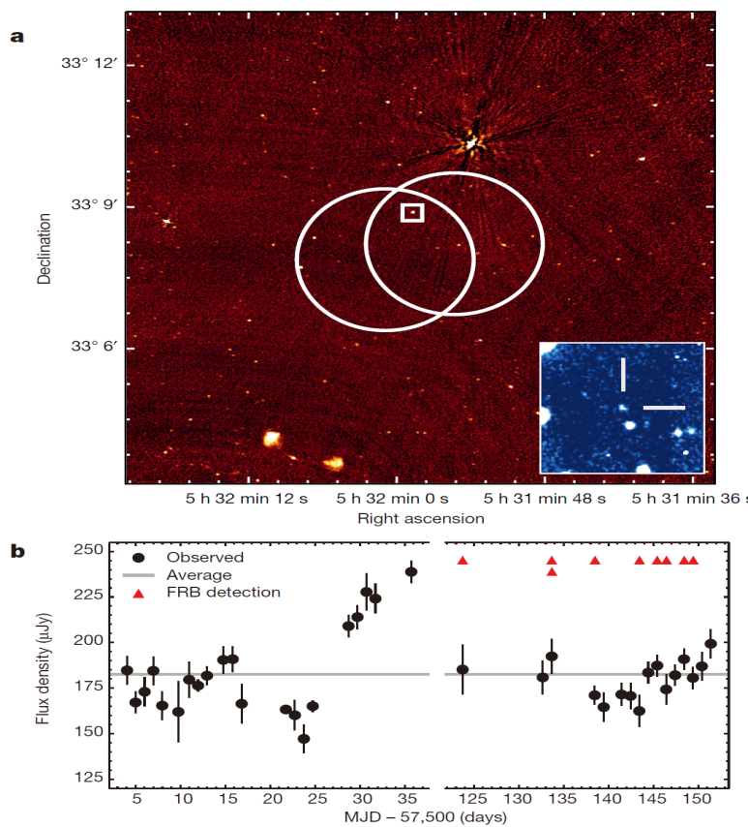
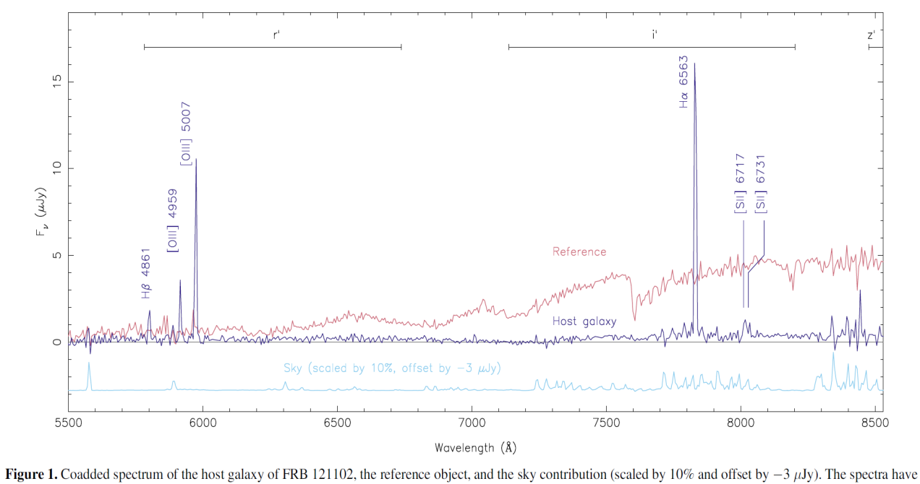
Cosmological FRB!
FRB 121102
VLA
z=0.19, burst energy:10³⁸erg
Arecibo
Tendulkar et al. 2017
a low-mass, low-metallicity, dwarf galaxy, with high star formation rate.

Slide 7
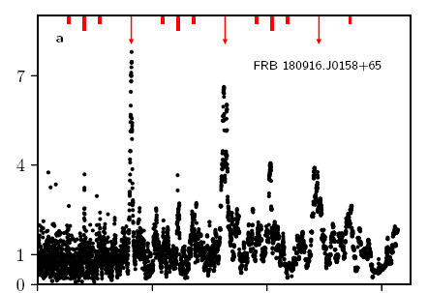
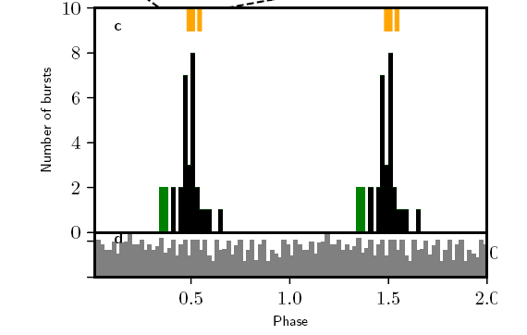
Period of FRB activity
FRB 180916
CHIME/FRB 2020
Possible models:
orbital: Lyutikov+ 20; Ioka & Zhang 20; Dai & Zhong 20; Gu+ 20
precession: Zanazzi & Lai 20; Yang & Zou 20, Levin+20; Sob’yanin 20; Tong+ 20;…
Rajwade+ 2020
FRB 121102

Slide 8
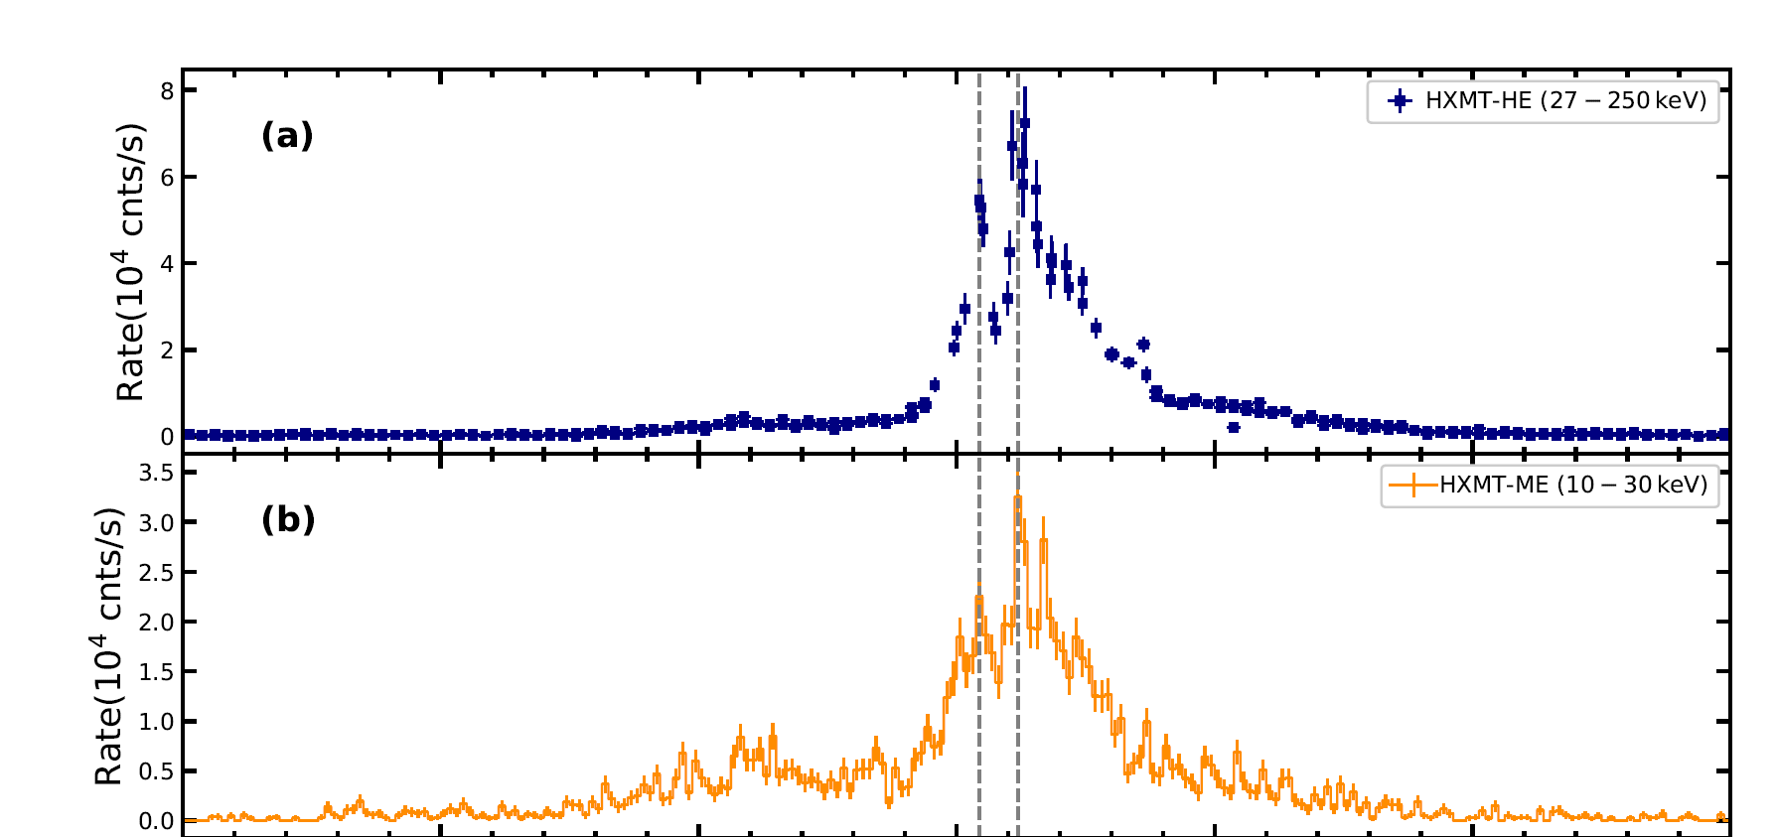
FRB 200428 associated with a magnetar burst
FRB 200428: two peaks, separation 28 ms from Galactic SGR J1935+2154.
The two components of X-ray burst each ccurred within about 3 ms of the respective arrival times of the CHIME burst components.
Radio: CHIME, STARE2, FAST, VLA, LOFAR
High energy: INTEGRAL, AGILE, NICER, Swift, HXMT
CHIME/FRB Collaboration, 2020
HXMT arXiv: 2005.11071

Slide 9
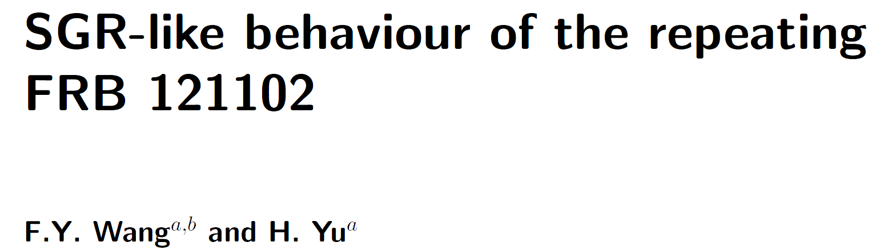
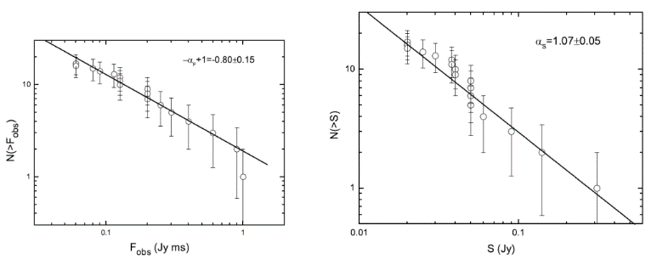
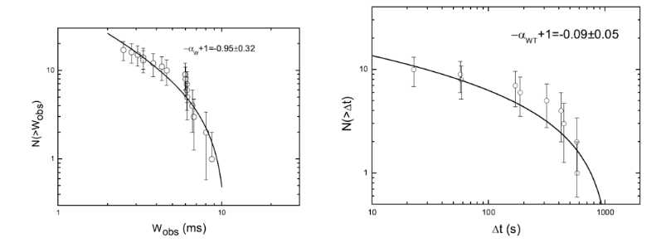
我们研究了重复FRB121102的流量，持续时间和等待时间的分布，发现与SGR bursts相似，预示其中心能源可能是磁星。
这些分布可以用自组织临界理论(SOC)解释，waiting time分布符合non-stationary Poisson process（爆发率随时间变化）。
SOC广泛应用于地震、太阳耀斑、恒星耀斑、伽玛暴等。
Wang, F. Y.* & Yu, H., 2017, JCAP, 03, 023

Slide 10
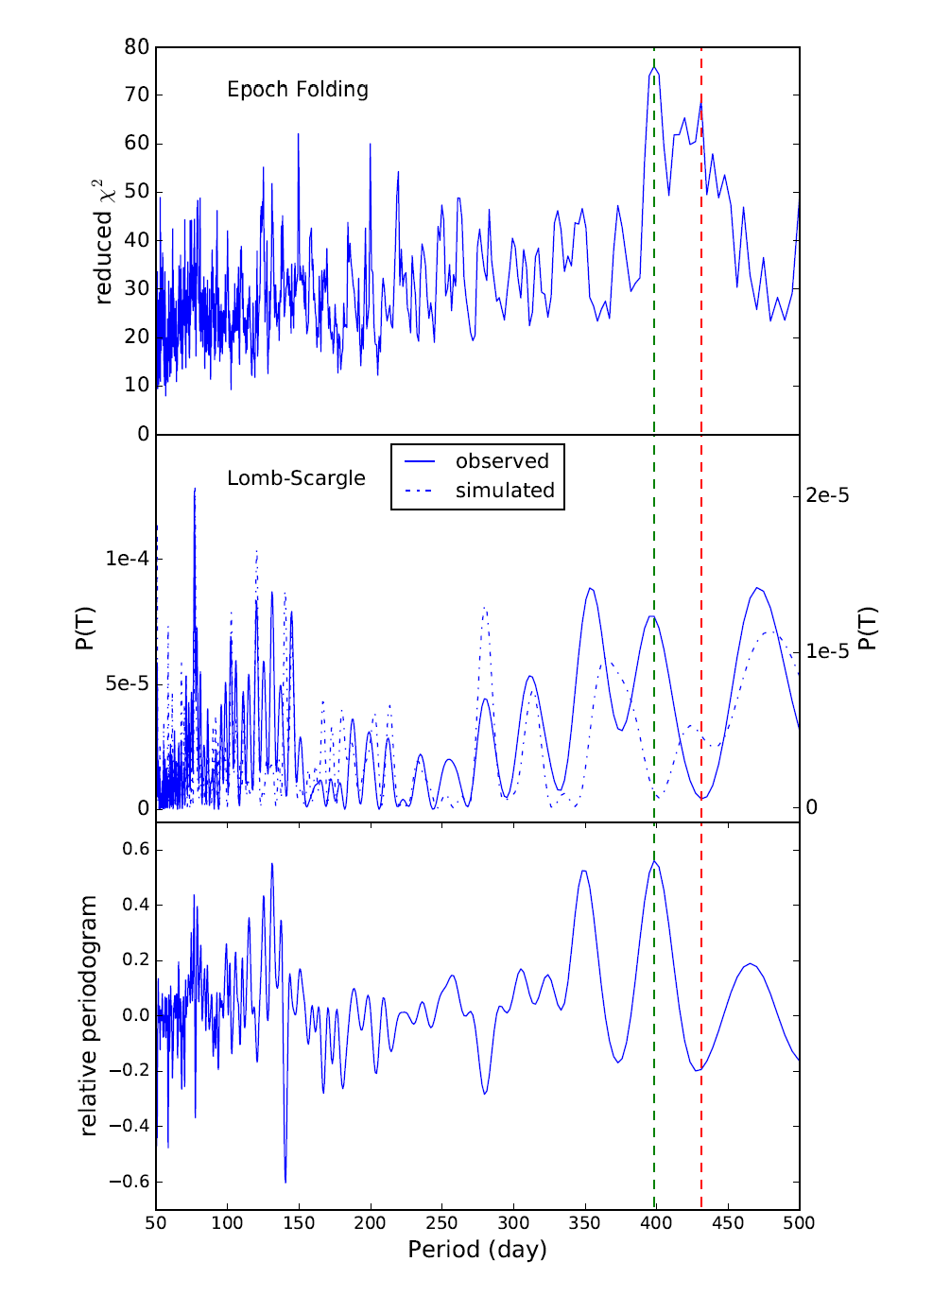
Period of SGR 1806-20 X-ray bursts?
>3000 bursts observed by RXTE between 1996
and 2009.
Peaks at about 400 days from epoch folding and Lomb-Scargle methods.
The observation windows are considered (dash
curve in the middle panel).
Other peaks in the periodograms with unknown reasons.
Zhang, Tu & Wang FY* 2021, ApJ, 909, 83

Slide 11
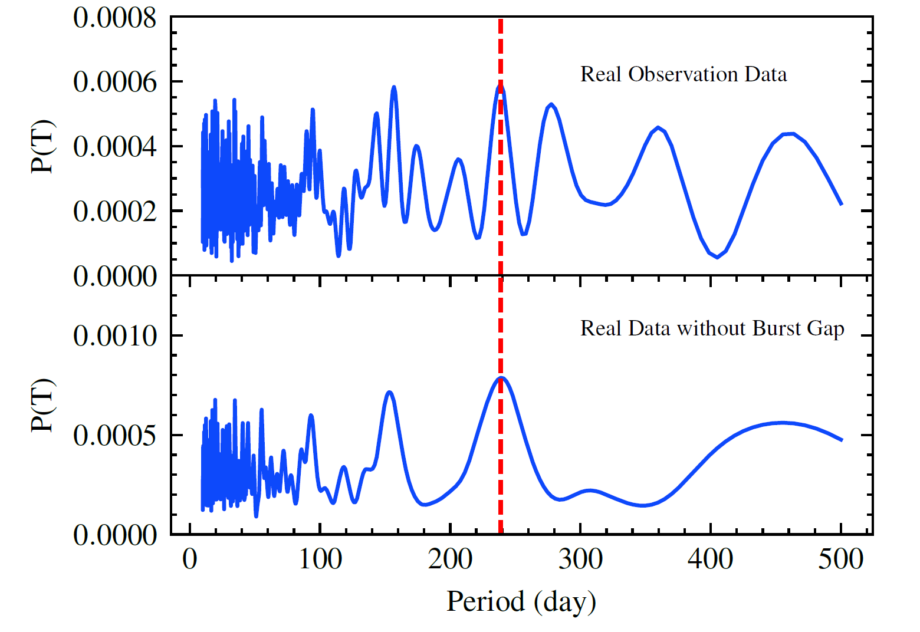
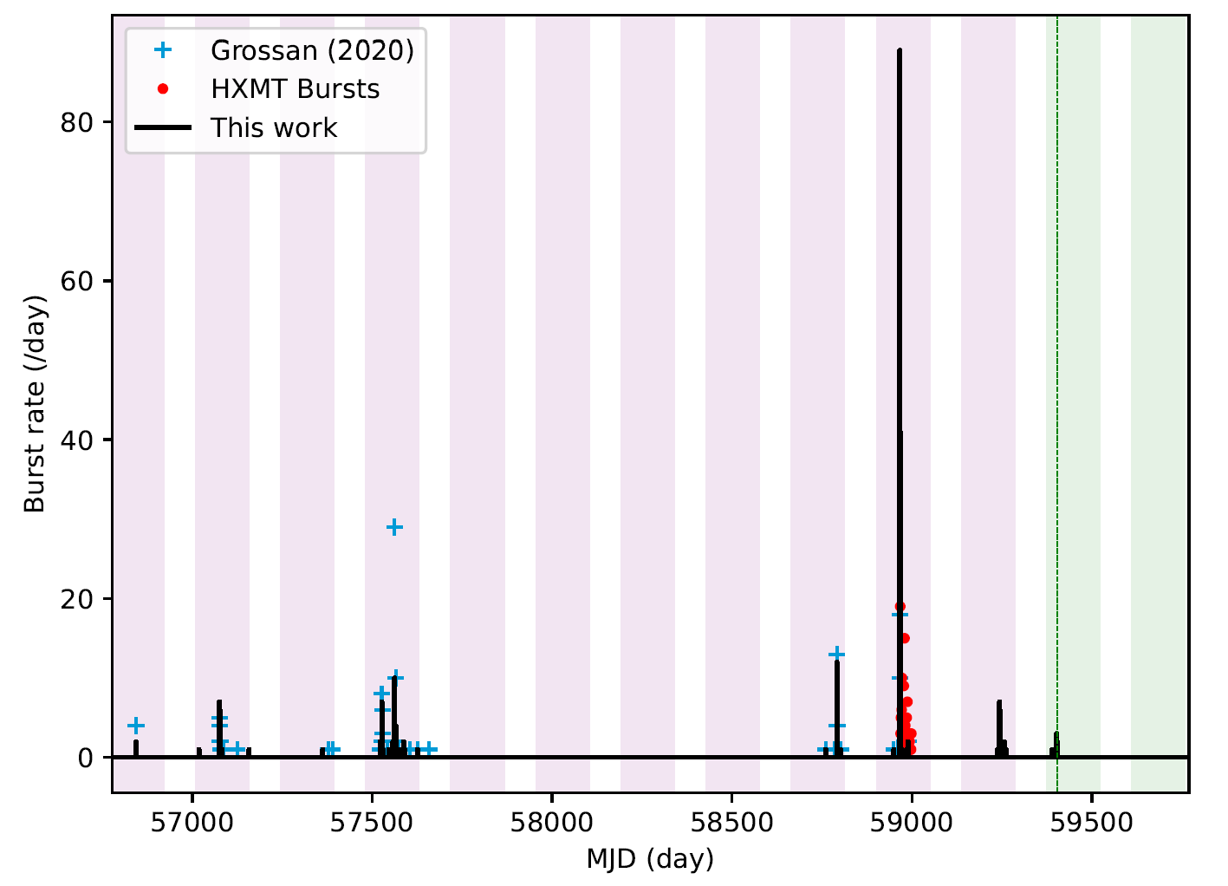
Period of SGR J1935 X-ray bursts?
P~237 day
255 bursts in 8.5-year Fermi/GBM observation
Zou et al. arXiv: 2107.03800

Slide 12
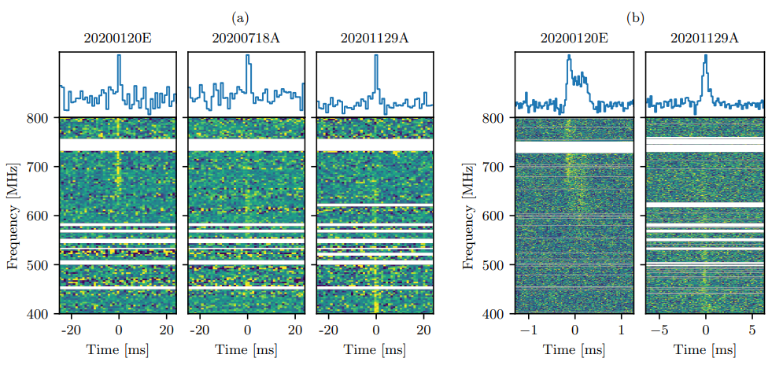
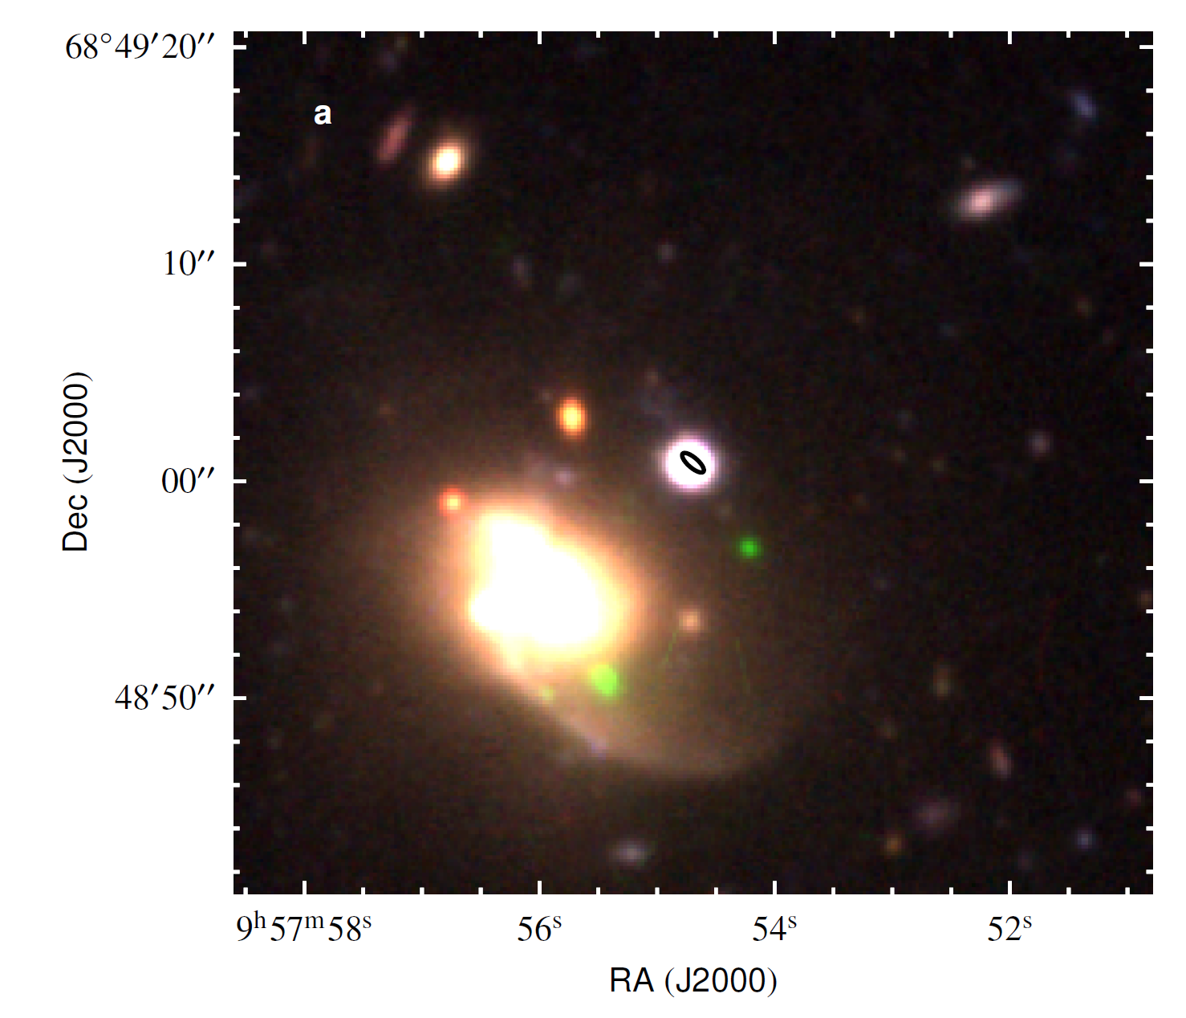
FRB 200120E from a globular cluster in M81
arXiv:2105.11445
Because such globular clusters host old stellar populations, this association challenges FRB models that invoke magnetars formed in a core-collapse supernova as powering FRB emission, favors compact-binary-merger origin.

Slide 13
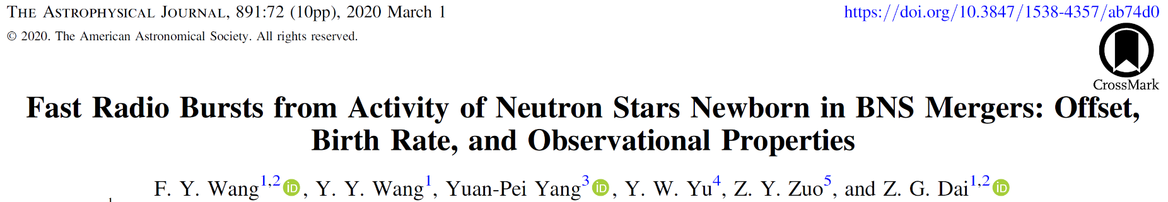
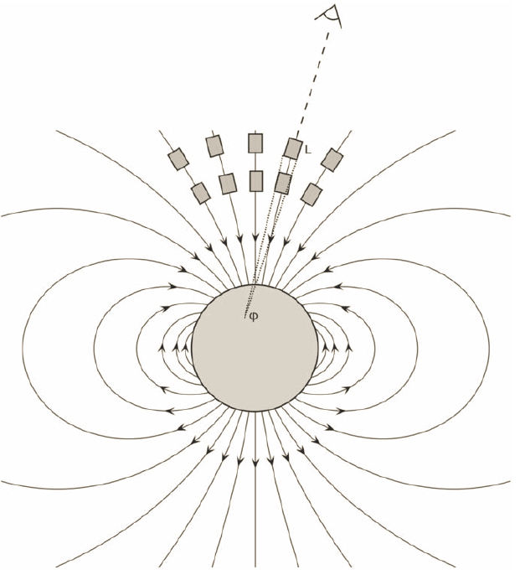
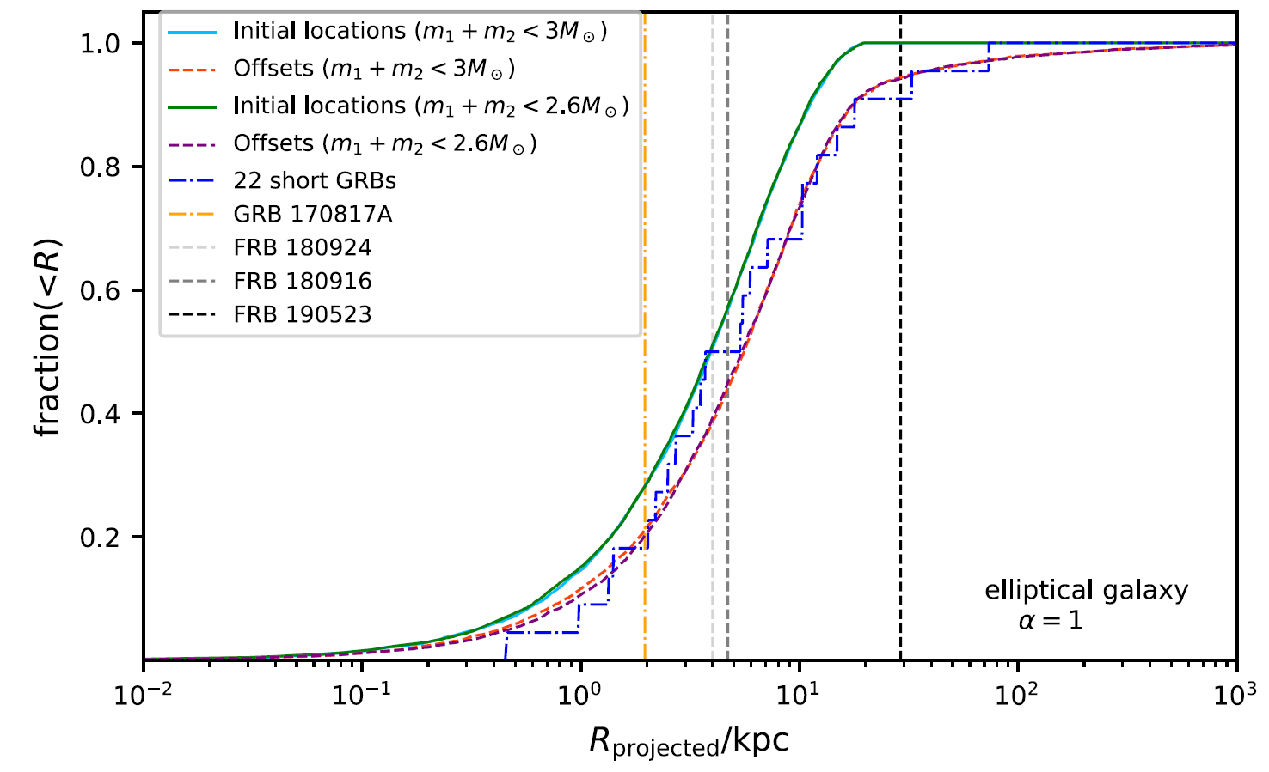
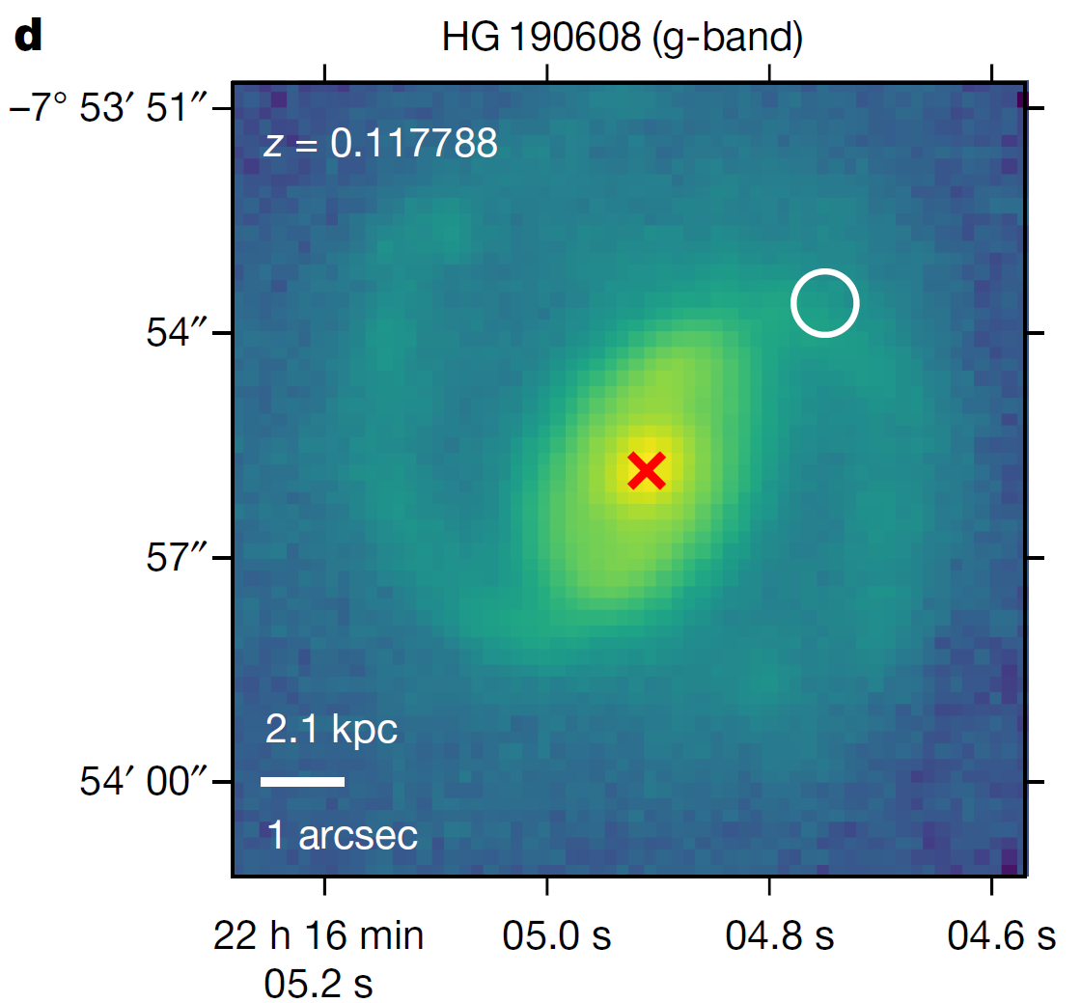
FRBs are produced by magnetar activity formed by BNS mergers.
coherent curvature radiation

Slide 14
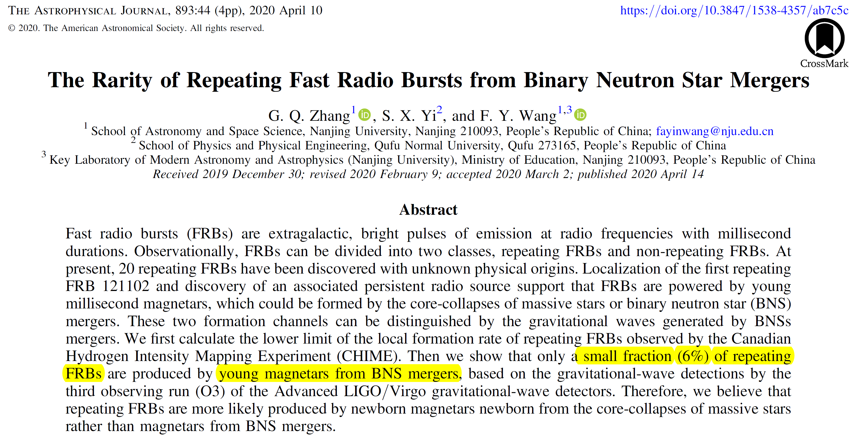

Slide 15
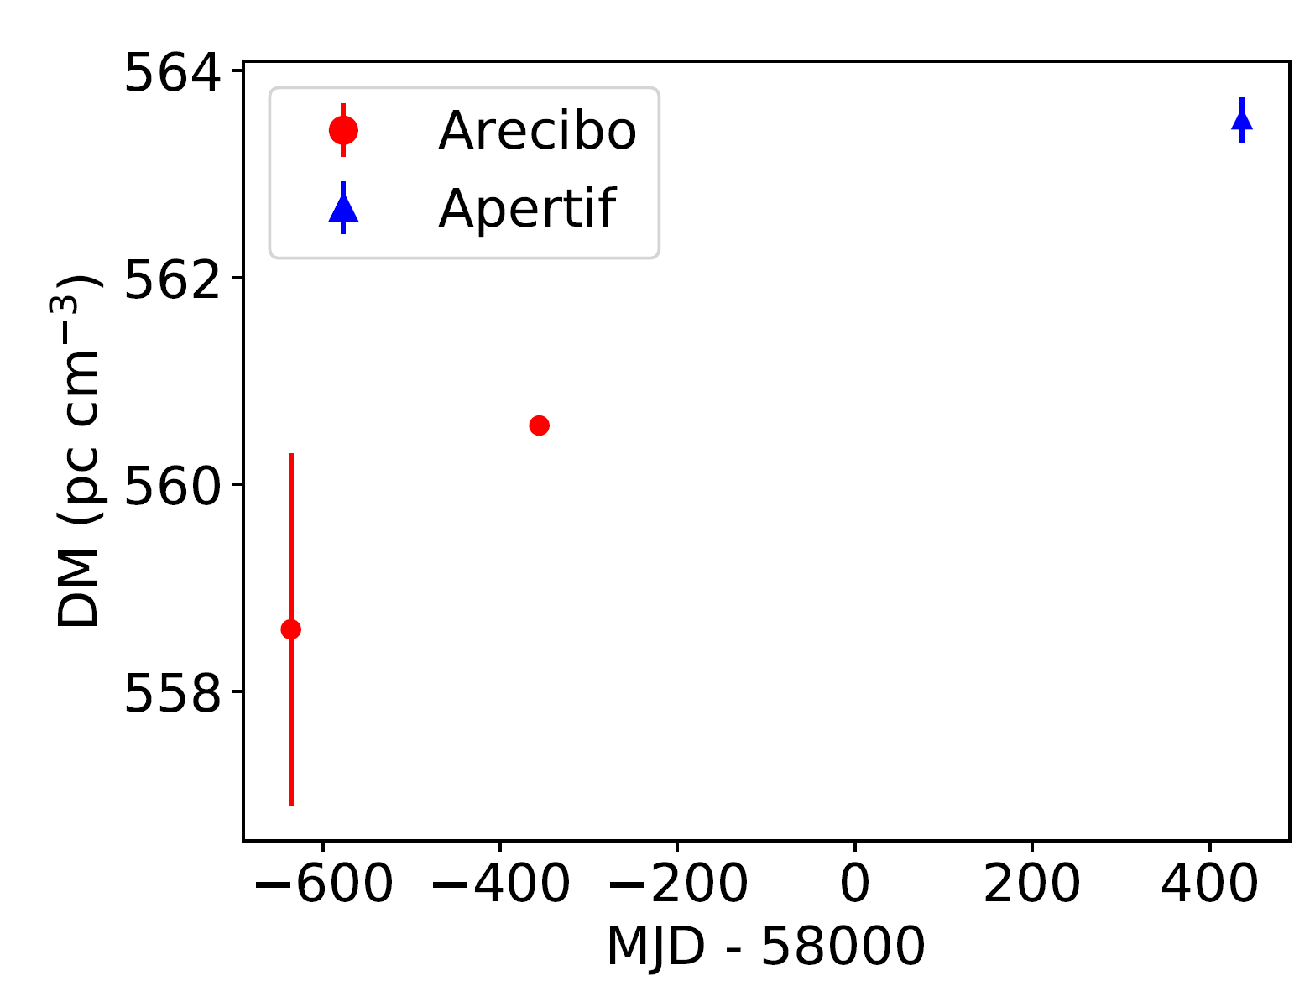
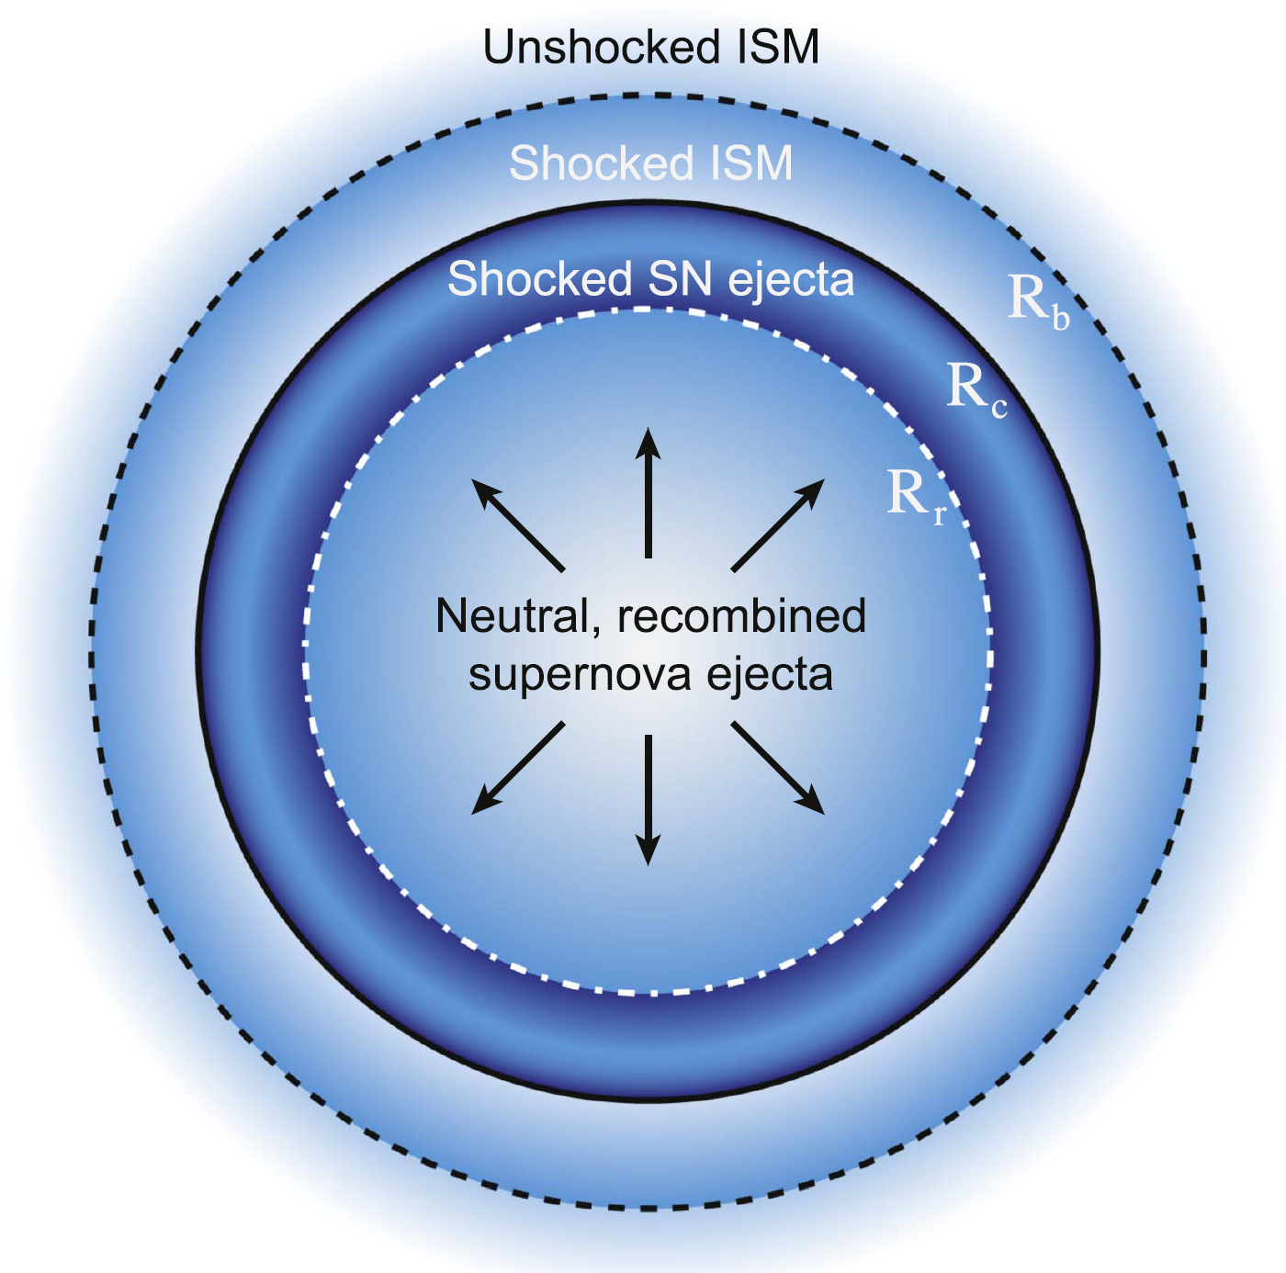
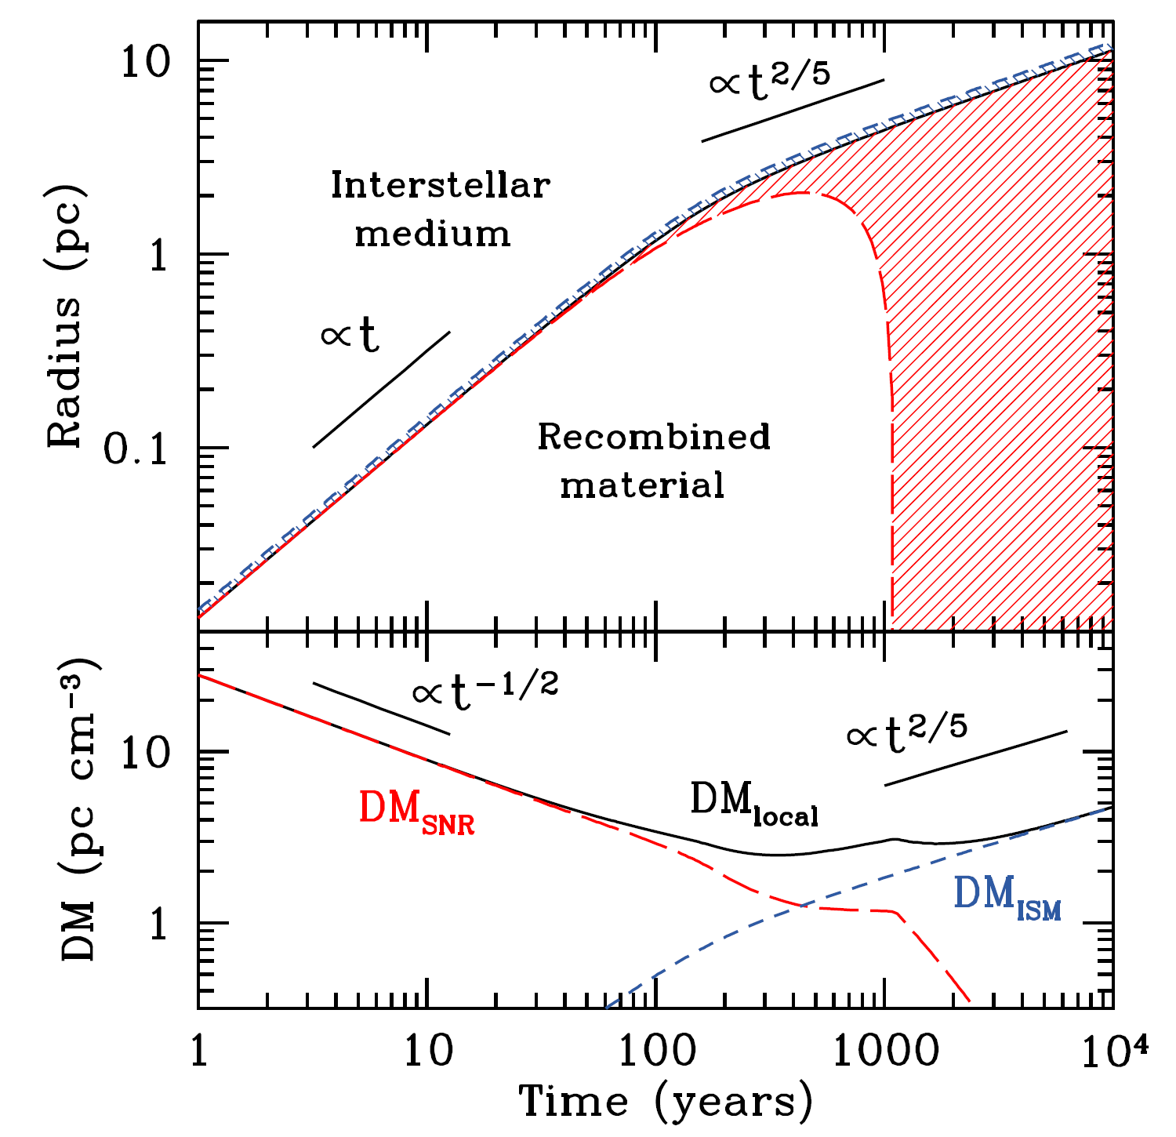
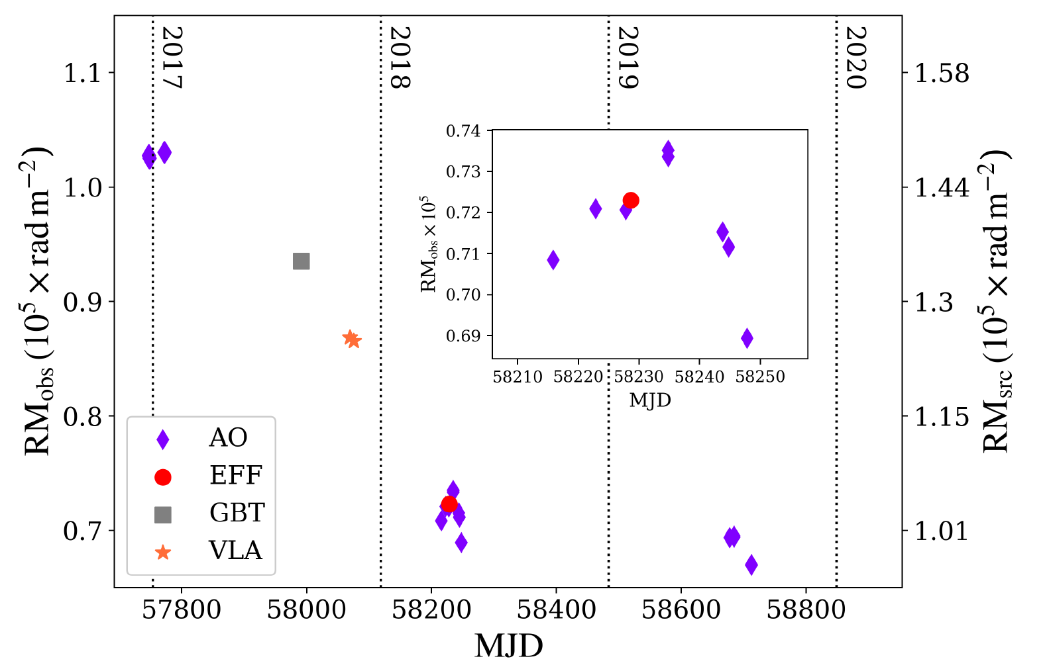
FRB 121102: DM increases and RM decreases
1 pc/cm^3 per year
Oostrum+ 2020
Yang & Zhang 2017; Piro 2018

Slide 16
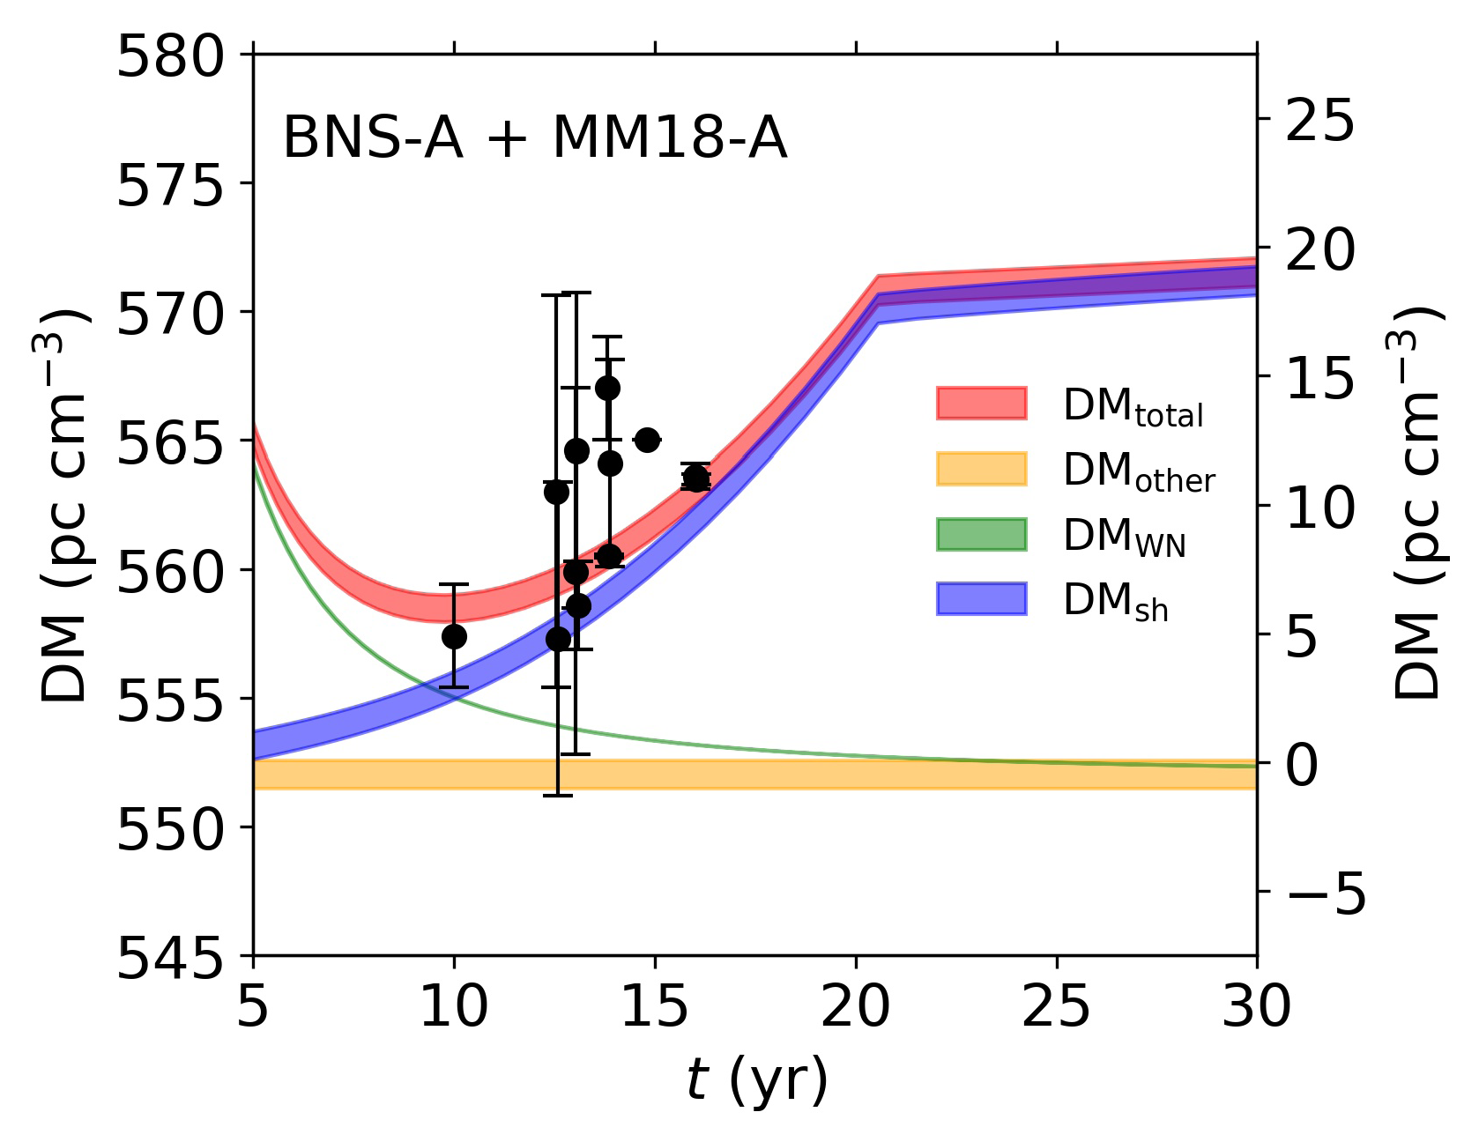
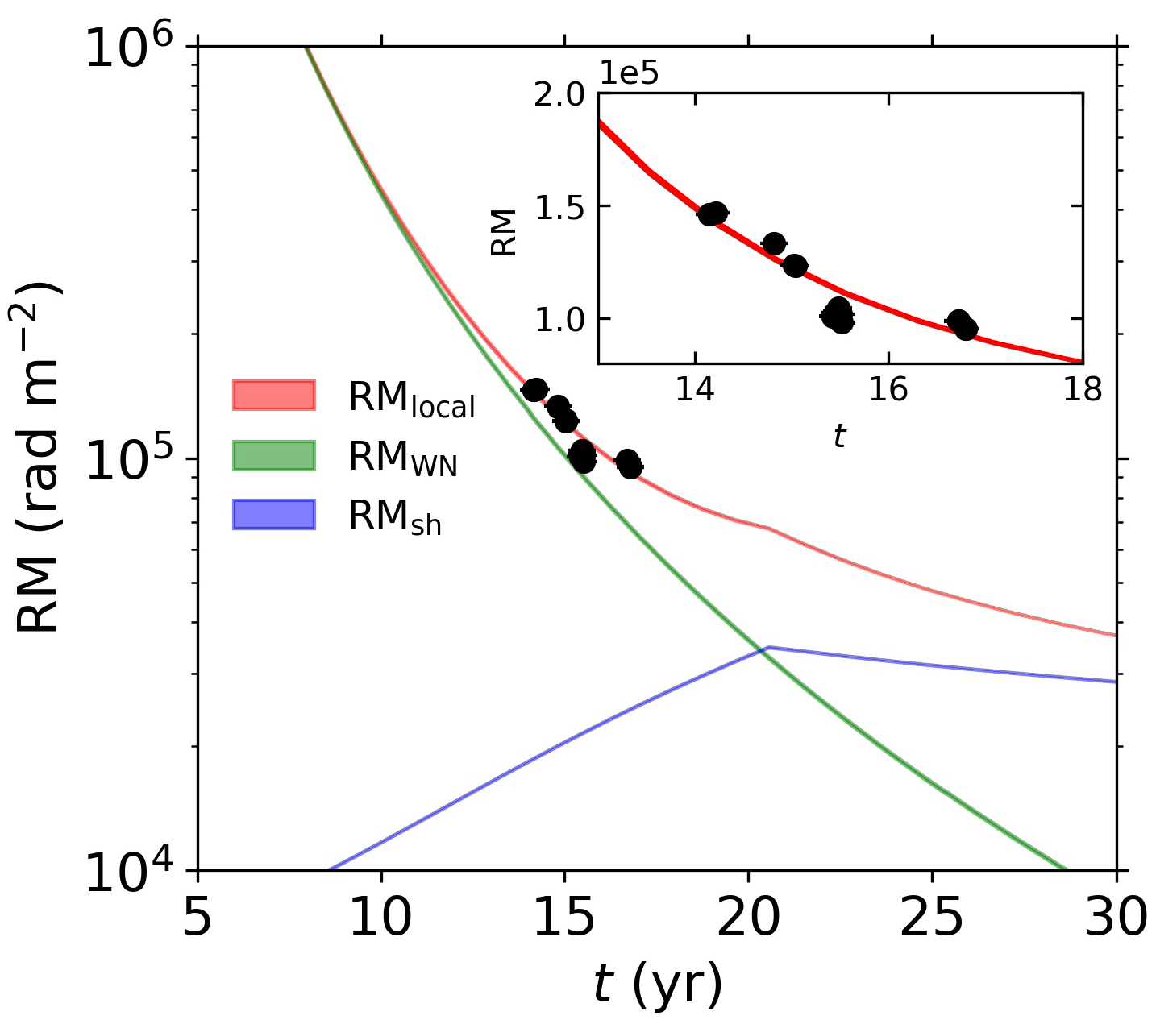
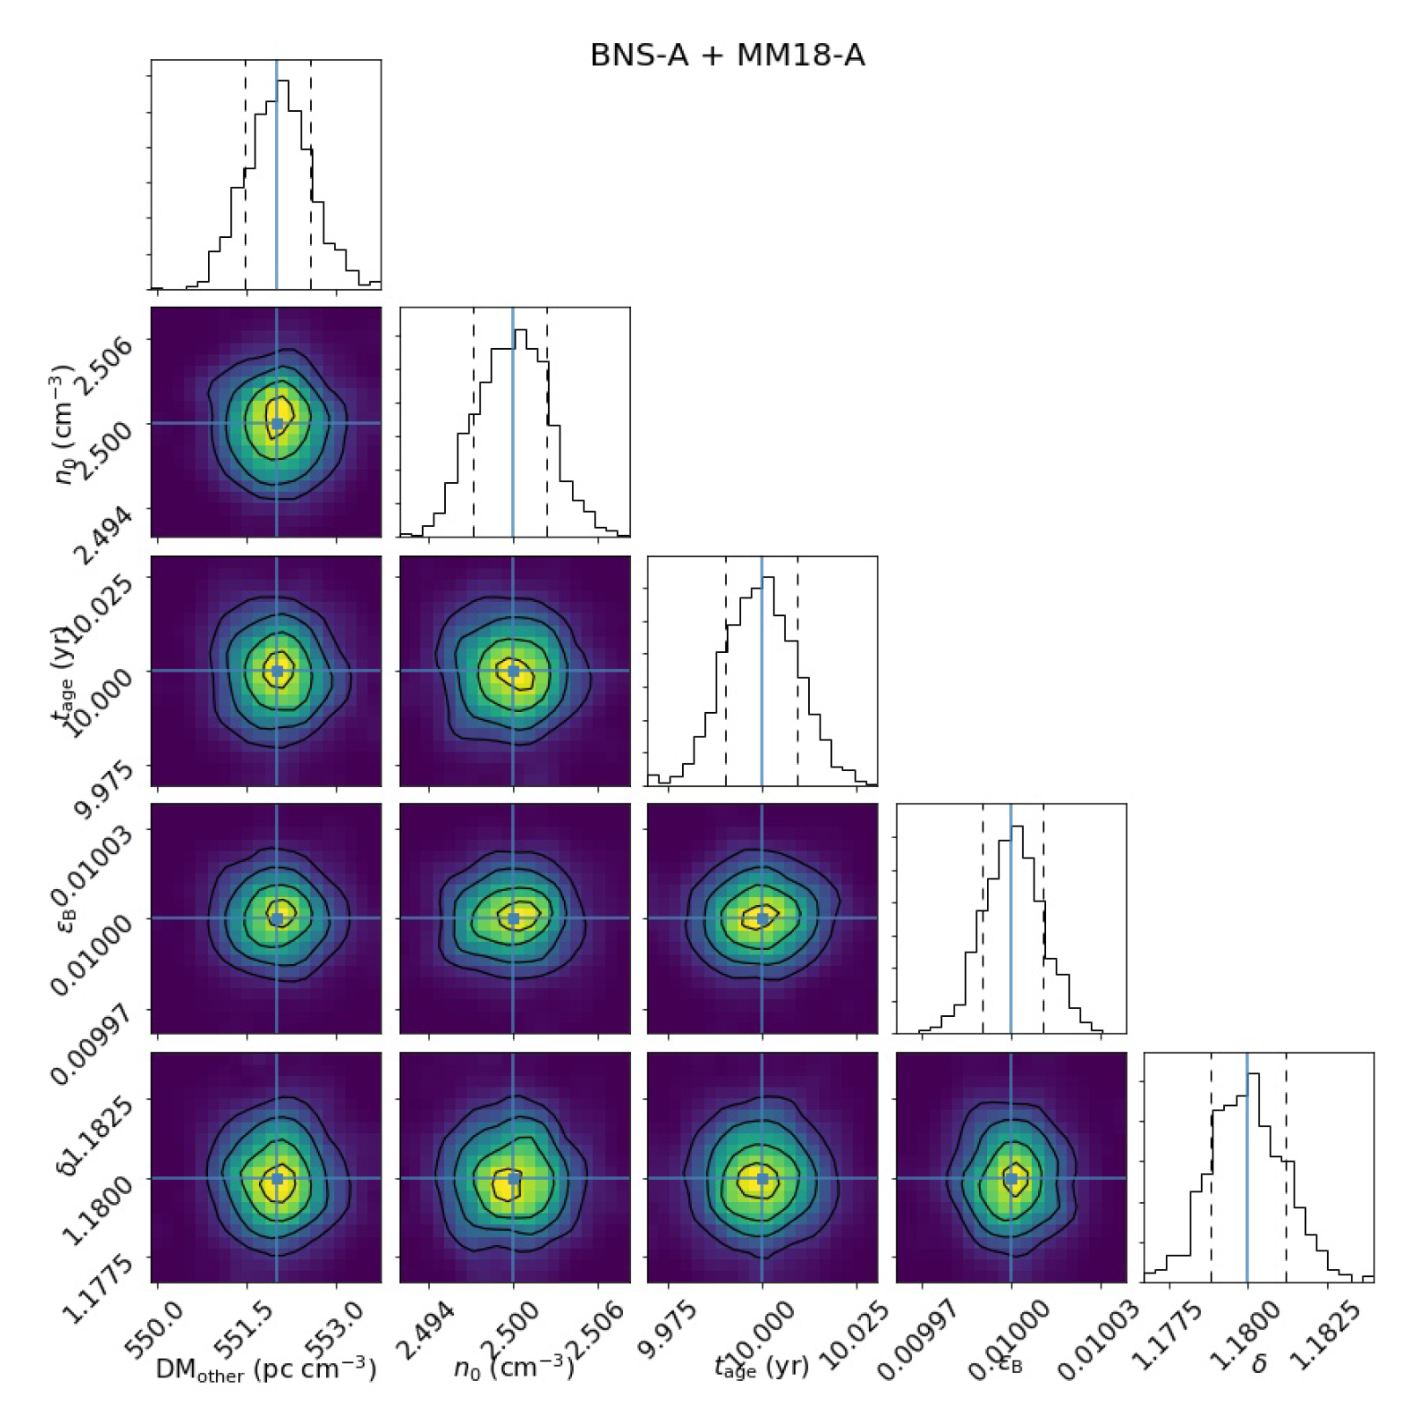
Binary neutron stars merger
Zhao, Zhang, Wang, Tu, Wang FY*, 2021, ApJ
M_{ej}=0.01 solar mass, E_{k}=10^51 erg
the source age is 9~10 yr when it was first detected in 2012, and the ambient density is about 3 cm^-3.

Slide 17
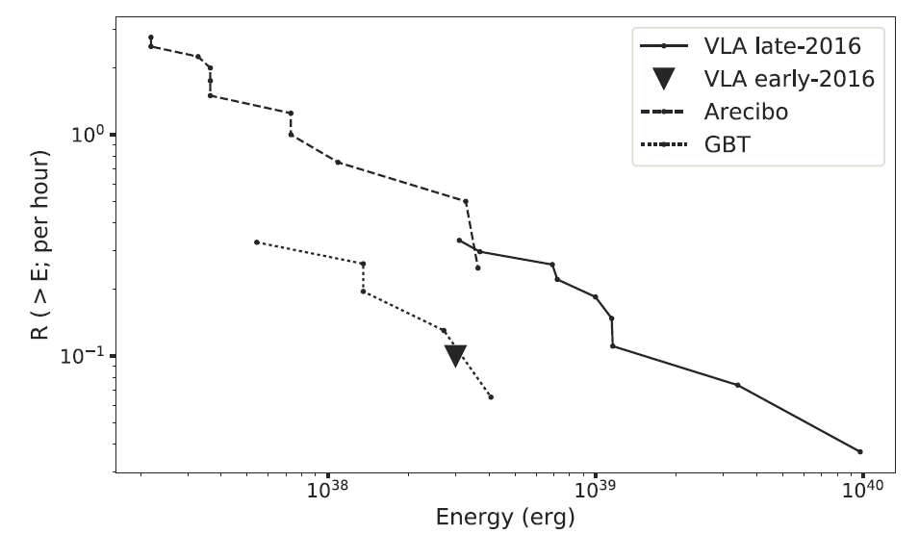
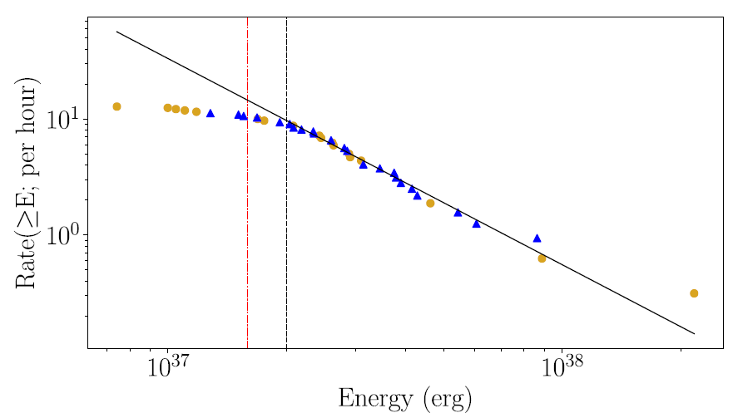
dN/dE~E^{-1.7}
Law et al. 2017, ApJ
dN/dE~E^{-2.7}
Gourdji et al. 2019, ApJL

Slide 18
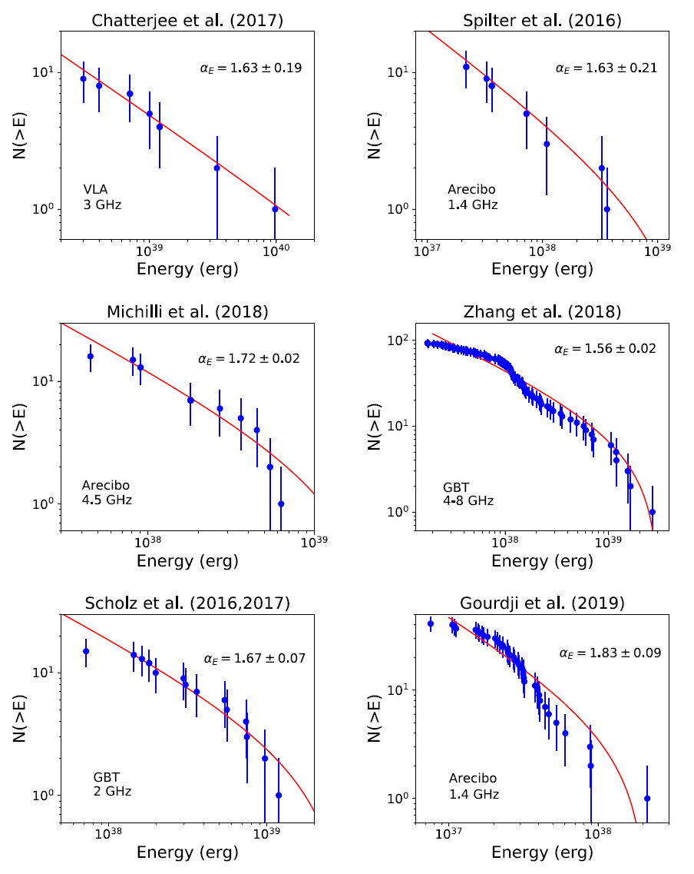
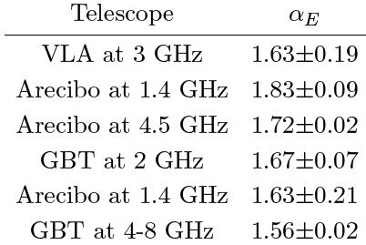
FRB 121102: universal energy distribution
dN/dE~E^{-1.6~-1.7}
Wang FY & Zhang 2019, ApJ

Slide 19
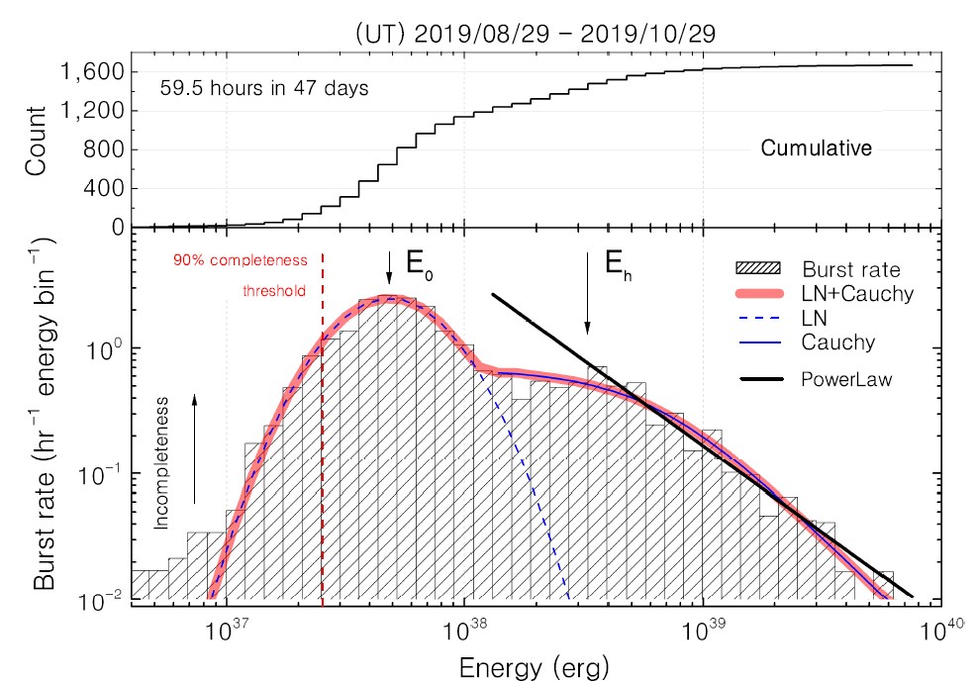

Confirmed by FAST at high-energy end.
Bimodal energy distribution is time dependent, i.e. bright bursts only appear in first 20 days (Wang Pei’s talk).

Slide 20
FRB properties
Number: 500+ FRBs reported, 20+ repeaters, 14 localized (>1000+ discovered)
Intrinsic durations: a few ms
Dispersion measure: 100-2600 pc cm⁻³
Frequency: 150 MHz - 7 GHz
Brightness temperature: 10³⁷K (coherent emission)
Energy: 10³⁴ - 10⁴² erg
Polarization: strong linear polarization, up to 100%
Time-frequency down-drifting
Burst rate: a few thousands /day/sky

Slide 21
Theoretical models
Collapse of supra-massive neutron stars to black holes (Falcke & Rezzolla 2013; Zhang 2014)
Magnetospheric activity after NS-NS mergers (Totani 2013)
Mergers of binary white dwarfs (Kashiyama et al. 2013)
Magnetar radio bursts (Popov et al. 2007, 2013; Kulkarni et al. 2014; Pen & Connor 2015)
Cosmic sparks from superconducting strings (Vachaspati 2008; Yu et al. 2014; Cai et al. 2012)
Evaporation of primordial black holes (Keane et al. 2012)
White holes (Barrau et al. 2014); Flaring stars (Loeb et al. 2013; Maoz et al. 2015)
Supergiant radio pulses (Cordes & Wasserman 2015; Connor et al. 2015; Pen & Connor 2015)
Axion miniclusters, axion stars (Tkachev 2015; Iwazaki 2015)
NS-Asteroid collisions (Geng & Huang 2015; Dai et al. 2016)
Dark matter-induced collapse of NSs (Fuller & Ott 2015)
Higgs portals to pulsar collapse (Bramante & Elahi 2015)
Soft gamma repeaters (Katz 2016, Beloborodov 2017, Metzger et al. 2019)
Giant pulse from rapid rotating pulsars (Lyutikov et al. 2016)
Compact binary model (Gu et al. 2016)
BH binary (Zhang 2016; Liu et al. 2016)
Mergers of neutron stars (Wang et al. 2016; Zhang 2016)
……

Slide 22
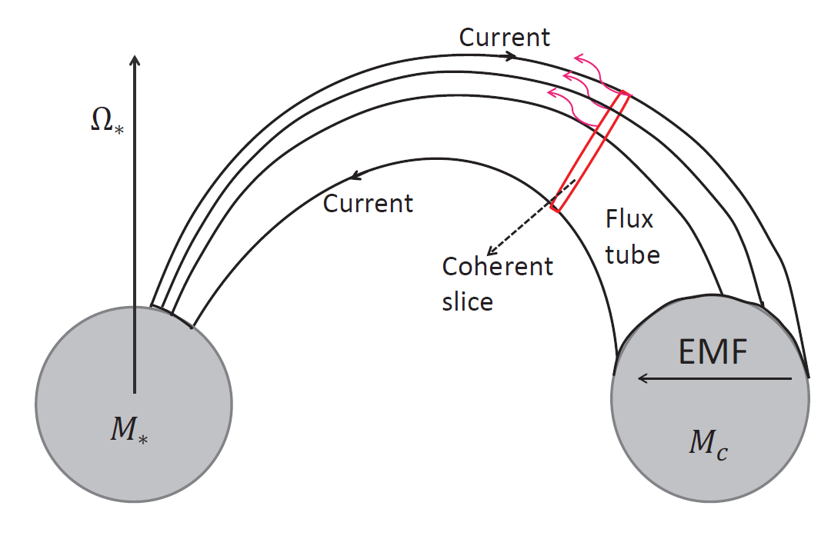

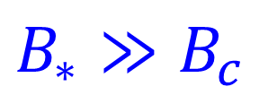

Model for non-repeating FRBs:
Final inspiral of two neutron stars
E = v×B/c
Wang, Yang, Wu, Dai & Wang 2016, ApJL, 822, L7

Slide 23
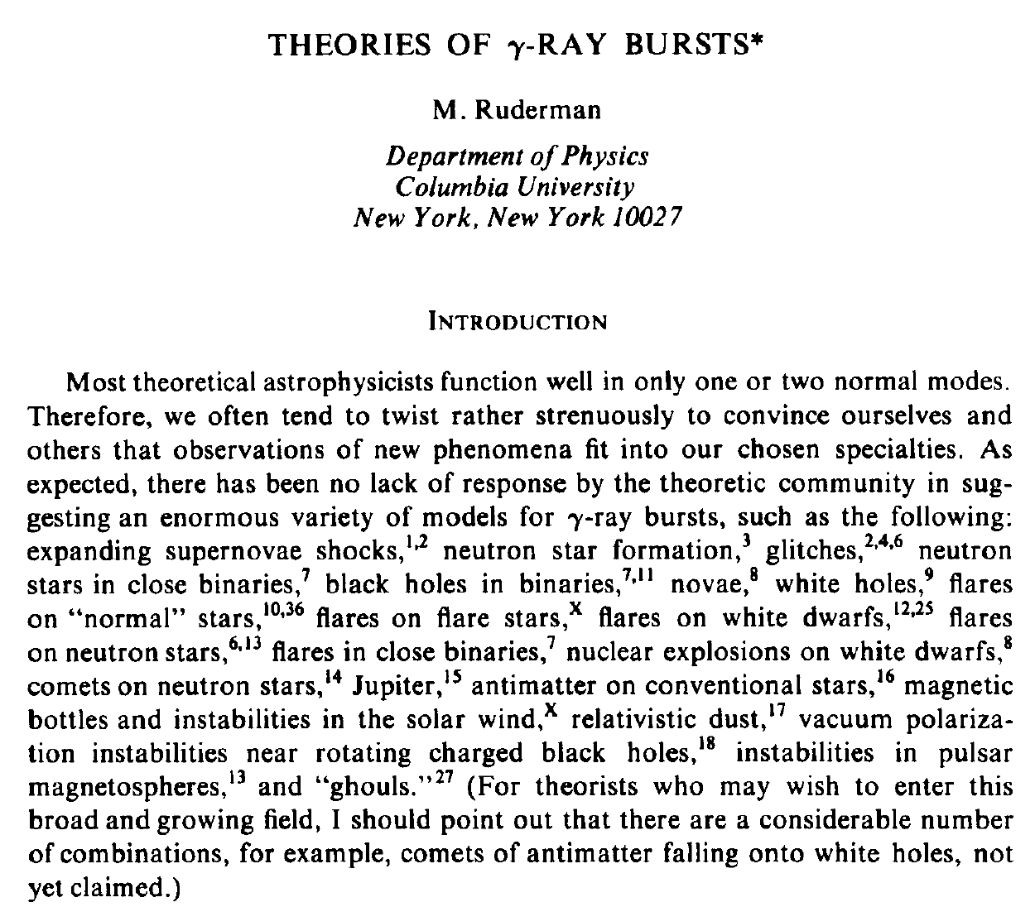
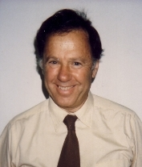
1975

Slide 24
Central engine models
Repeating models
Non-repeating models
Mergers of compact binaries, exotic models…
magnetars
Other models: pulsars, interaction models,…
Core collapse
NS+NS
AIC
Multi-messenger: GWs, FRBs, GRBs, kilonova, neutrinos?

Slide 25
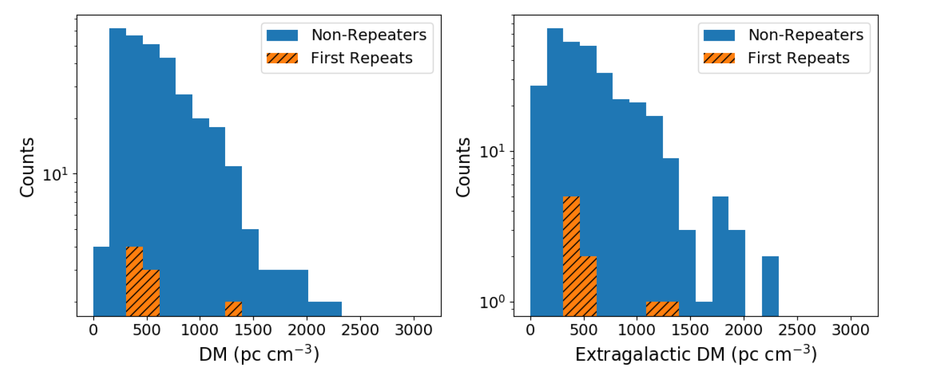
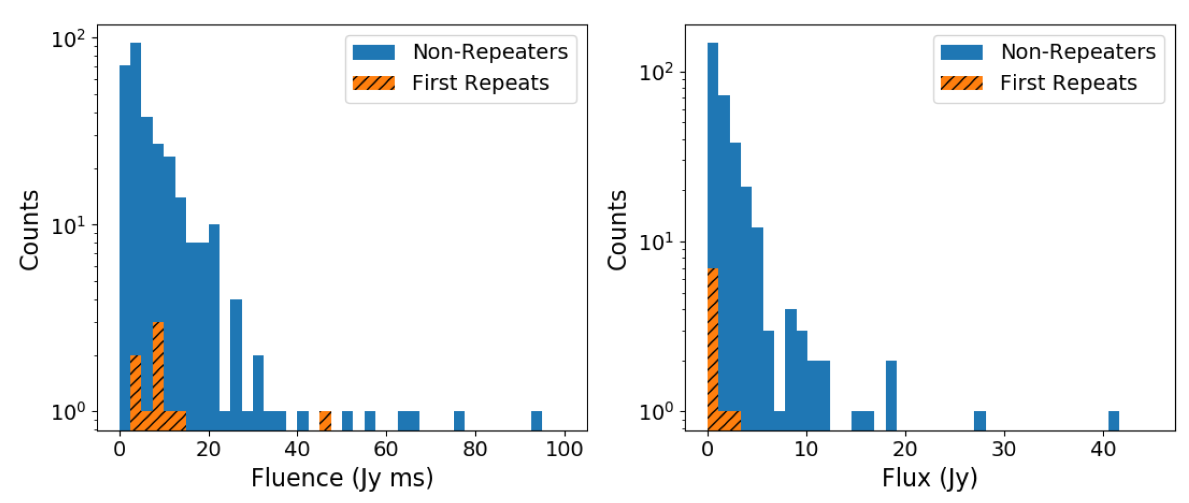
Population: Repeating vs non-repeating?
CHIME/FRB 2021

Slide 26
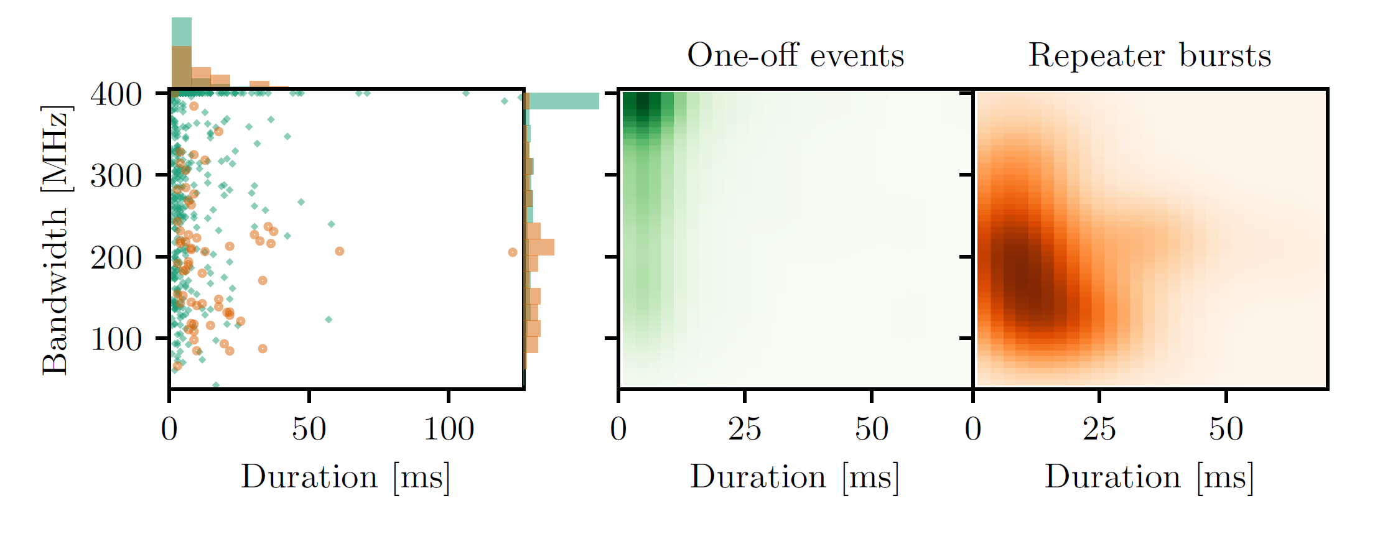
CHIME/FRB 2021
Bursts from repeating sources, on average, have larger widths
bursts from repeating sources, on average, are narrower in bandwidth.

Slide 27
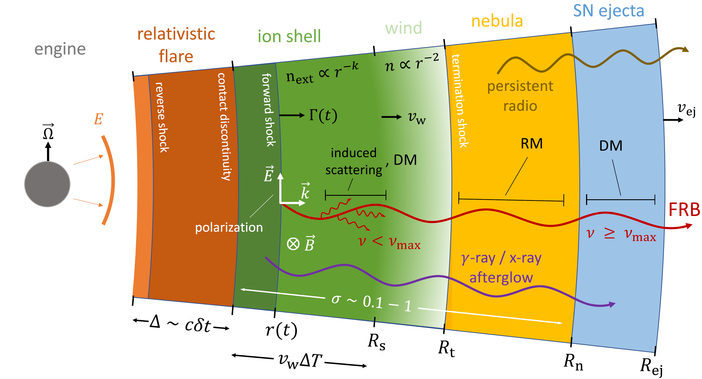
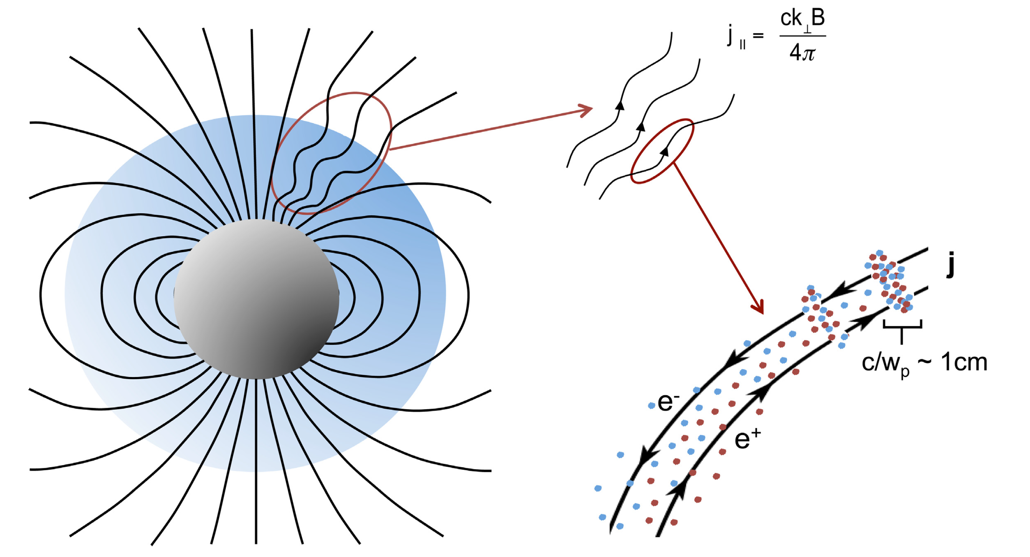
Radiation Mechanisms
There are two competing radiation mechanisms, coherent curvature radiation and synchrotron maser radiation. They can explain most of FRB observations. However, they both face challenges.
far away
close in
Kumar & Bosnjak 2020
Metzger et al. 2019
Swings of polarization angle of FRB 080301 (Luo et al. 2020)
Large baryon mass 10⁻³ solar mass (Wu, Zhang, Wang FY, Dai 2020)
bunch formation and maintenance? Melrose (2017)

Slide 28
3. FRB cosmology
simultaneous measurement of z and dispersion measure of IGM (DM_{IGM}) – two important quantities to study the universe.
Baryon density (Macquart et al. 2020;…)
Dark energy (Zhou et al. 2014; Gao et al. 2014; Walters et al. 2018;…)
Test Einstein’s Equivalent Principle (Wei et al. 2015;…)
Large scale structure (McQuinn 2014; Masui & Sigurdson 2015)
Measure cosmic proper distance (Yu & Wang FY 2017)
Measure Hubble parameter H(z) (Wu, Yu & Wang FY 2020)
Dark matter (Munoz et al. 2016; Wang & Wang FY 2018)
Hubble constant and curvature (Li et al. 2018; Wu et al. 2021)

Slide 29
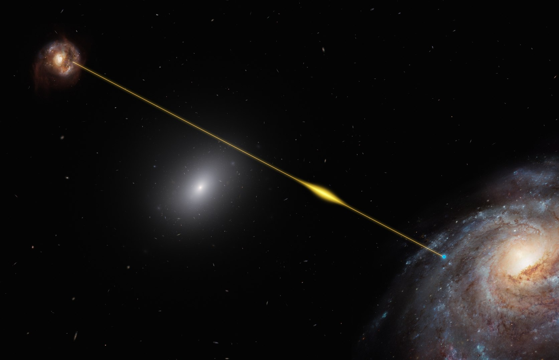

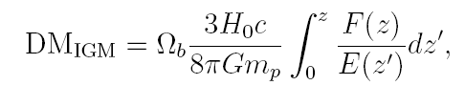
FRB
Host galaxy
Intergalactic medium
Line of sight
Milky Way
halo
The discovery of FRBs at cosmological distances has opened a powerful window for the Universe, such as baryon contents, cosmological distance, intergalactic medium, Hubble constant and compact-object dark matter models.

Slide 30
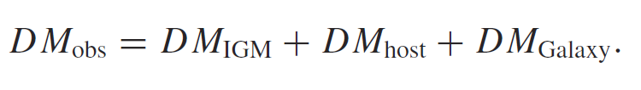
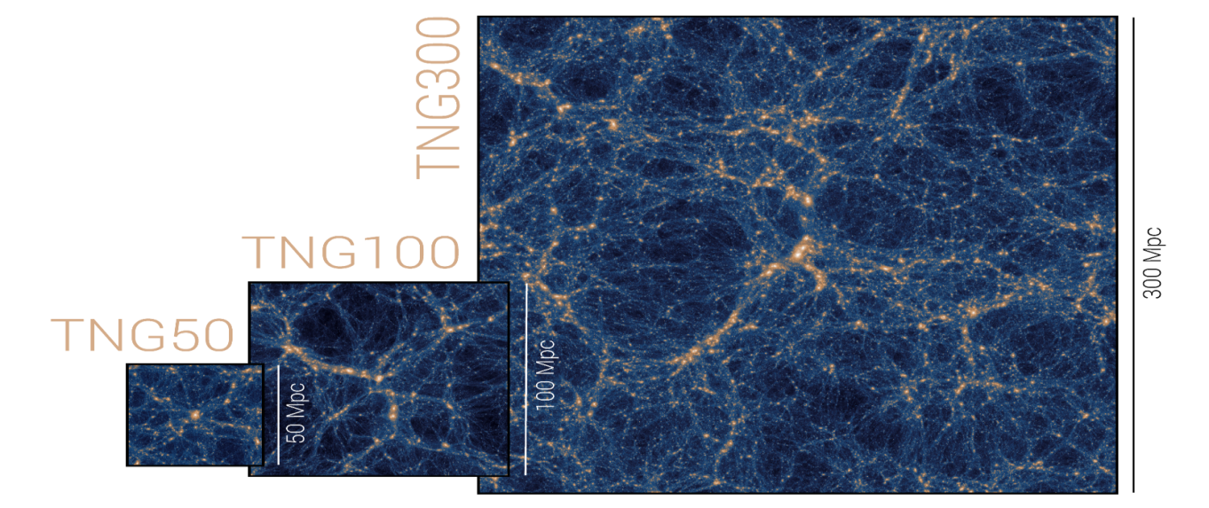
Host galaxy and IGM DMs from cosmological simulations
Illustris TNG
The IllustrisTNG project is a suite of state-of-the-art cosmological galaxy formation simulations (Pillepich et al. 2018). Each simulation in IllustrisTNG evolves a large swath of a mock Universe taking into account a wide range of physical processes that drive galaxy formation. The simulations give detailed distributions of particles, dark matter, SFR, metallicity and etc.

Slide 31




We select 1000 galaxies similar to observed FRB galaxies, 500 FRBs in each galaxies, each FRB has 10 random directions.
repeater
non-repeater

Slide 32




Slide 33

DM_{IGM}-z relation

Slide 34



Slide 35





Measurement of Hubble Constant
The averaged DM_{IGM}
Wu, Zhang, Wang FY 2021
Likelihood function
14 FRBs, ${\text{H}}_{\text{0}}\text{=}{\text{69.99}}_{ \text{− 4.88}}^{\text{+6.42}}$ km s⁻¹ Mpc⁻¹
Precision : < 10 %
If 100 localized FRBs, ~3%

Slide 36


statistical cross-correlations with large-scale structure
CHIME/FRB Project, arXiv:2106.04354

Slide 37
Prospects
Open Questions:
Are all FRBs repeating? One-off FRBs?
What is the coherent mechanism (curvature or maser)?
All FRBs have period? Physical mechanisms (precession or binary)?
Are there engines other than magnetars that power FRBs?
FRB, GRB, SLSNe and GW associations?
Instruments:
Current: FAST, CHIME, ASKAP, VLA, EVN, Arecibo, GBT, MeerKAT, DSA,…
Future: FASTA, SKA, QTT,…
FRBs will become important cosmological probes (d, H₀, baryon, IGM, reionization, LSS…).

Slide 38


