Slide 1
On the surface treatment of quark matter and quark stars
FAST/Future Pulsar Symposium 10
Qilu Normal University (QNU), Jinan, Shandong
Xia, Cheng-Jun (夏铖君)
NingboTech University

Slide 2
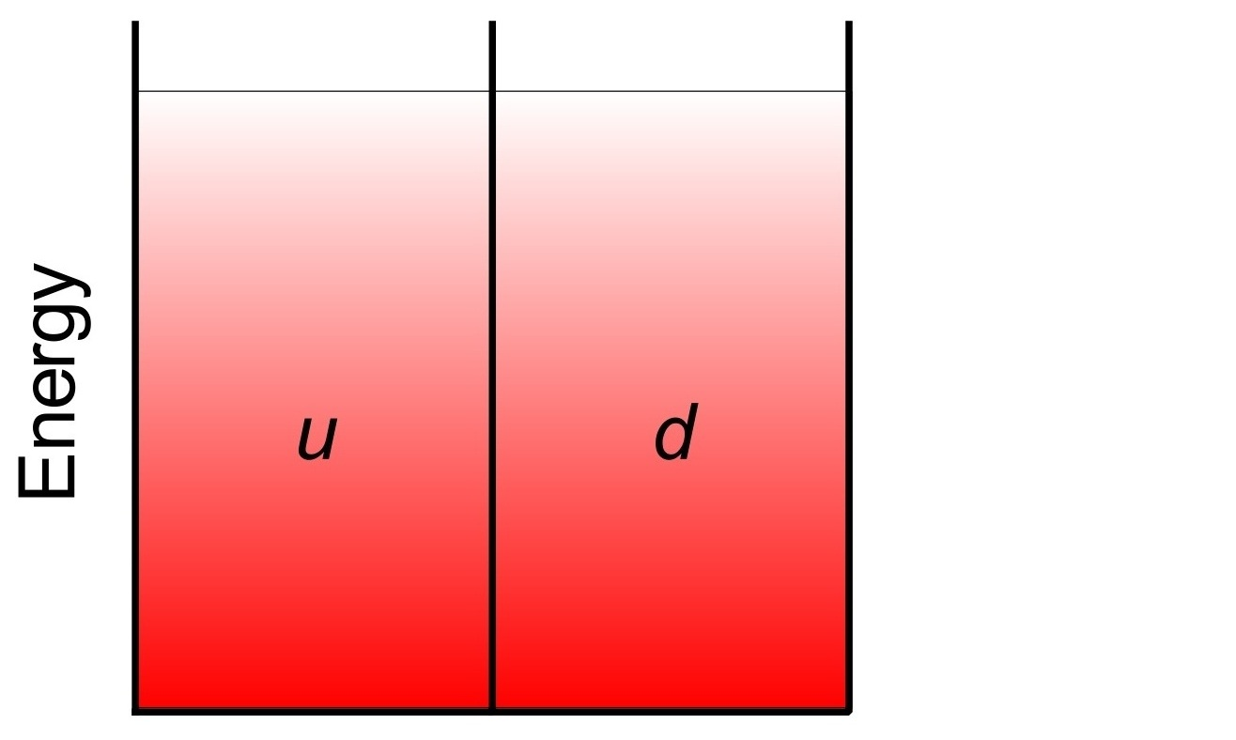
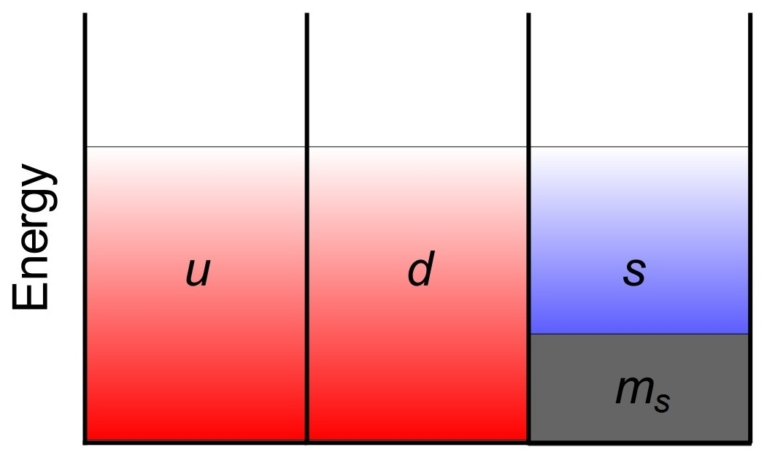
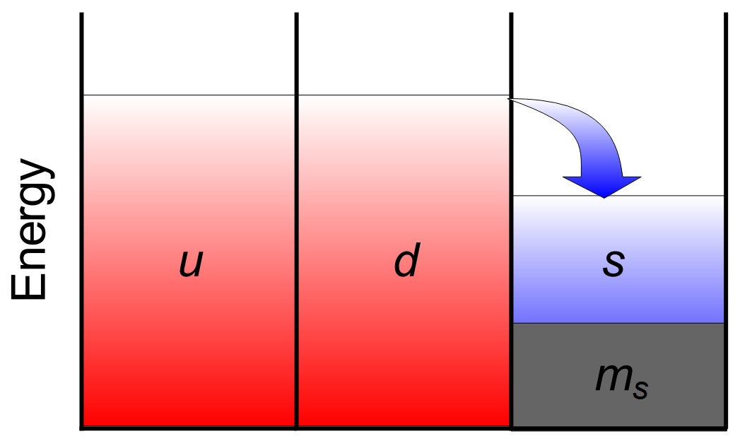
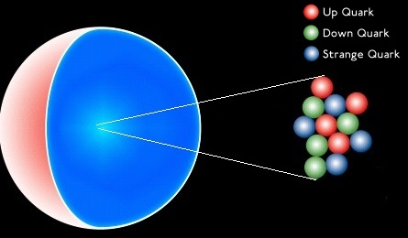
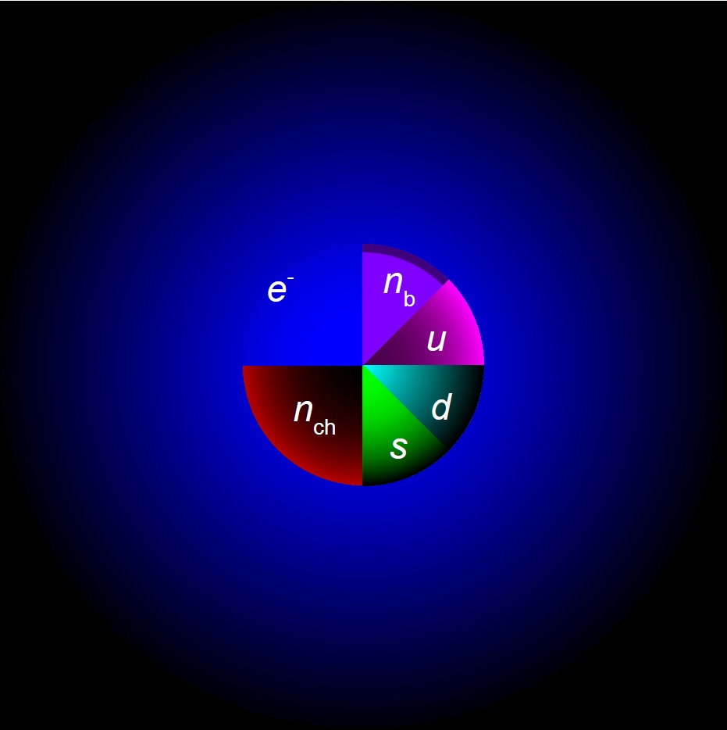
Strange quark matter (SQM)
Witten-Bodmer hypothesis
Bodmer first suggested a low energy nuclear state called “collapsed nuclei”
[Bodmer1971_PRD4-1601];
Witten reported on the stability of SQM consisting of approximately equal numbers of u, d and s quarks, suggesting that SQM could indeed be stable even at zero external pressure
[Witten1984_PRD30-272].
Strange stars
Strangelets

Slide 3
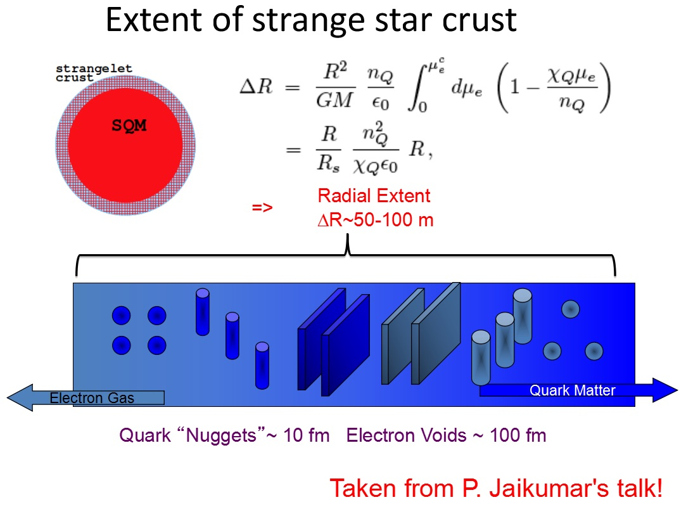
Strangelet crusts
Alford_Han_Reddy2012_JPG39-065201
The shaded region correspond to the results obtained with B^{1/4}= 152 ± 7 MeV.
[Xia_Peng_Zhao_Zhou2016_PRD93-085025]

Slide 4
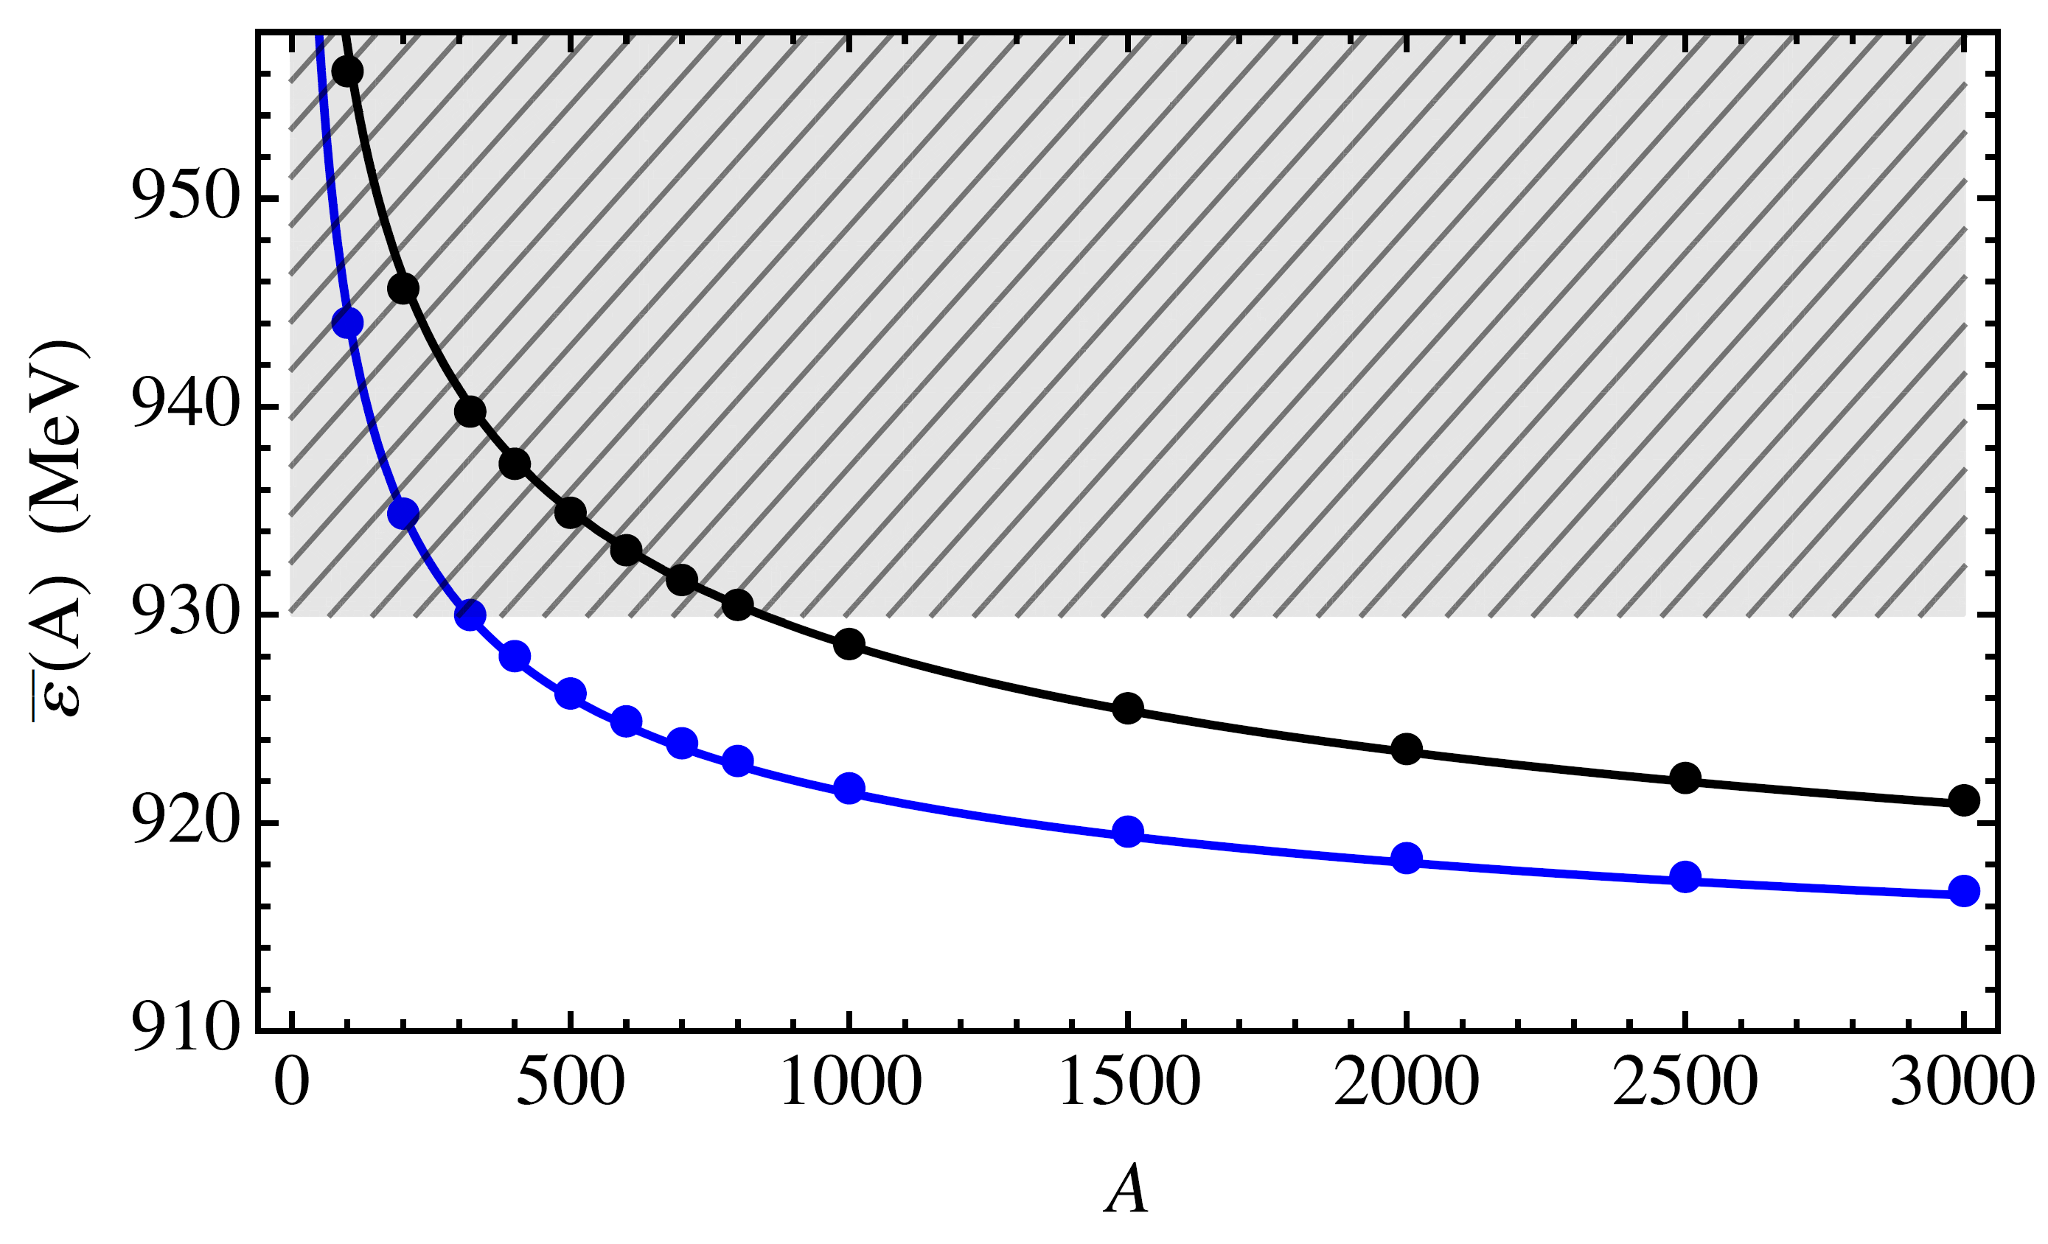
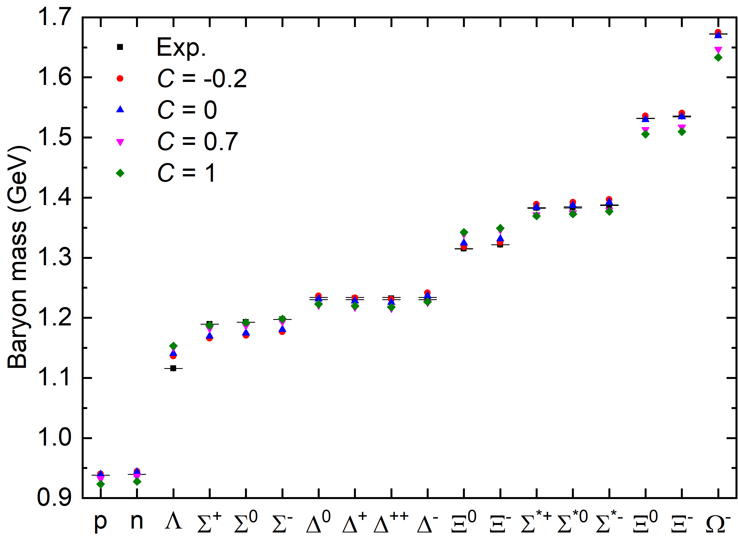
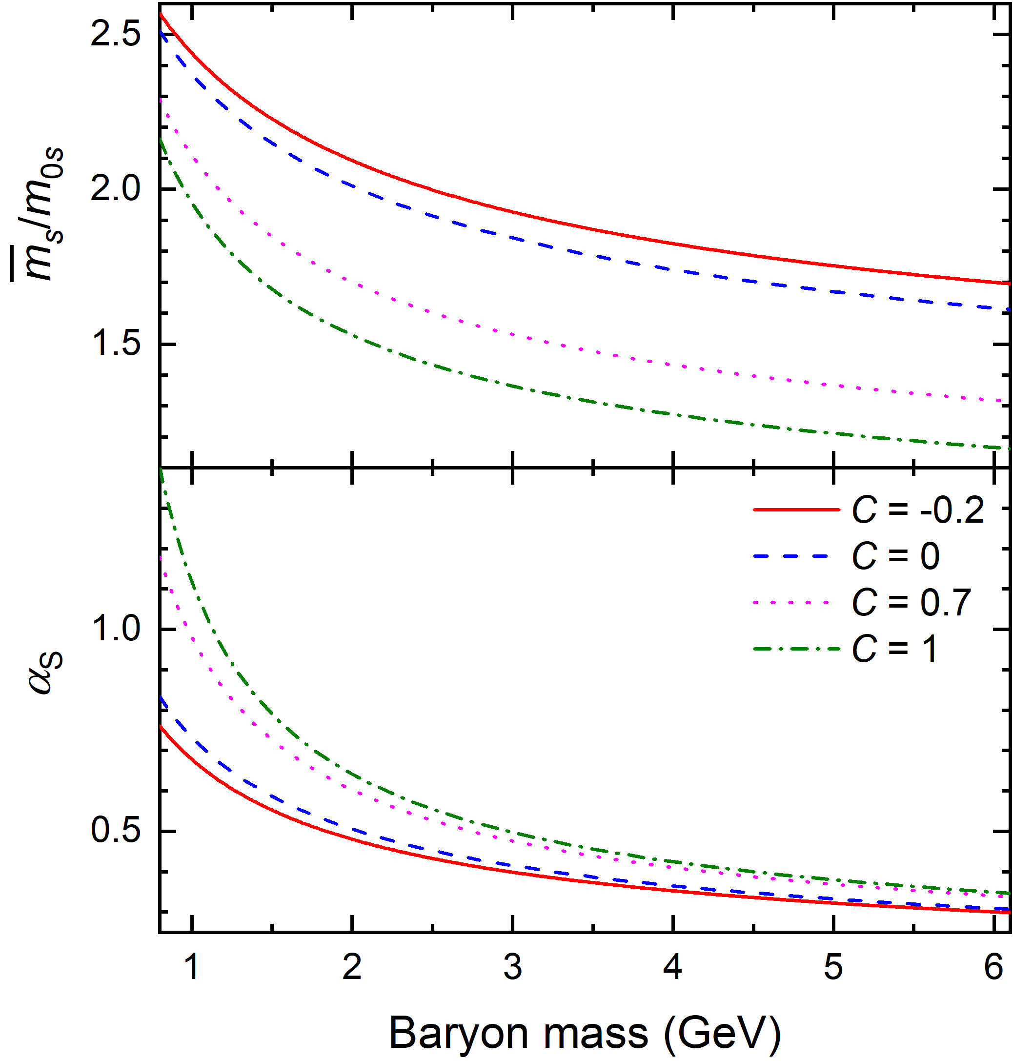
Unstable SQM and stable udQM
Holdom_Ren_Zhang2018_PRL120-222001
udQM nuggets
Hybrid stars
Crust
Crust
NM
NM
MP
QM
QM
udQM stars

Slide 5
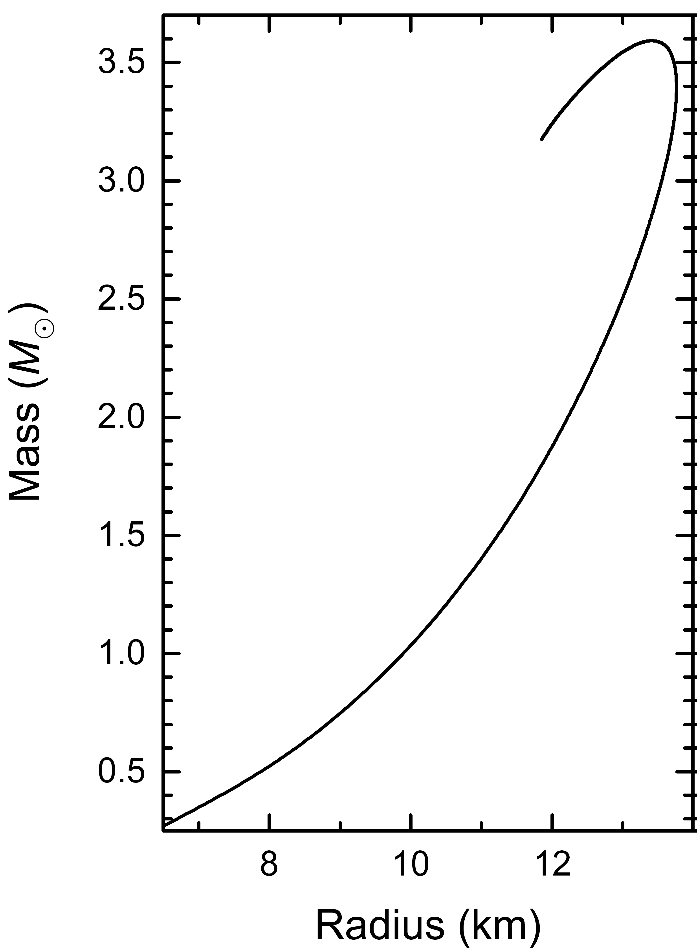
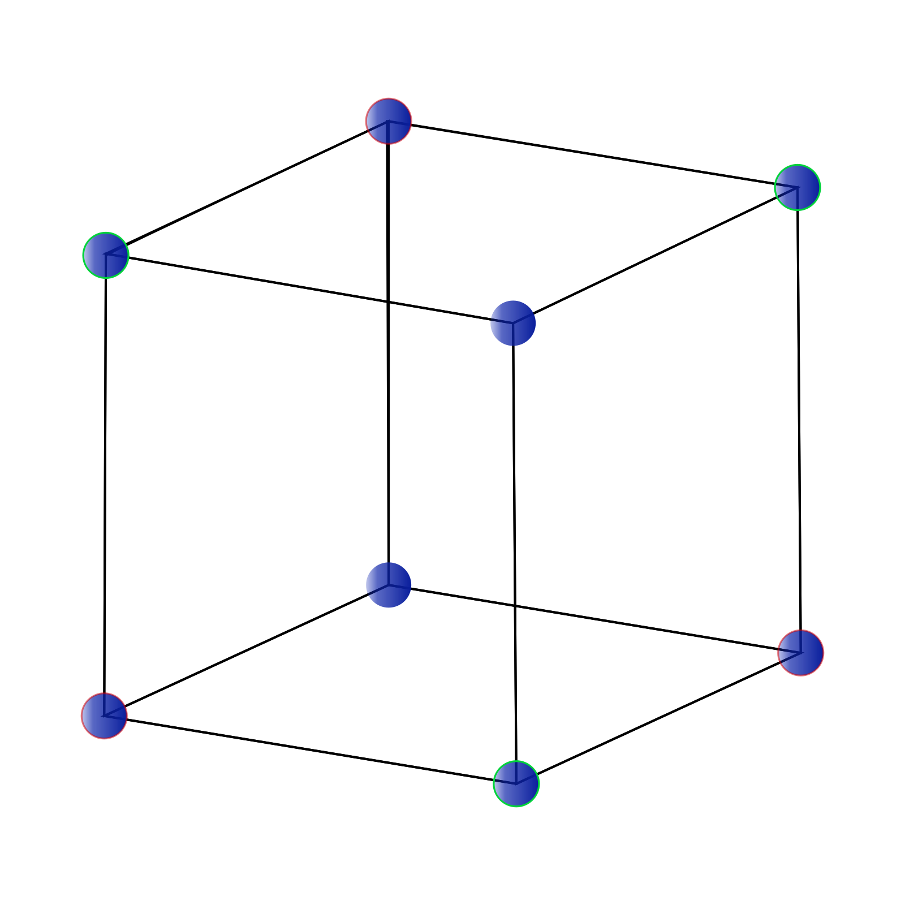

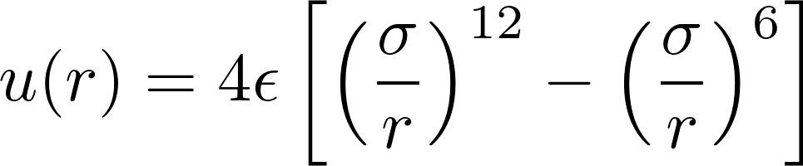
Strangeon matter
A_{q}= 2, 3, 4...
Sakai_Shimizu_Yazaki2000_PTPS137-121
Yong Gao's talk
Taken from wikipedia
Lennard-Jones potential
Lai_Xu2009_MNRS398-L31
ϵ = 50 MeV, σ = 2.63 fm, A_{q} = 6, M_{q} = 975 A_{q} MeV

Slide 6
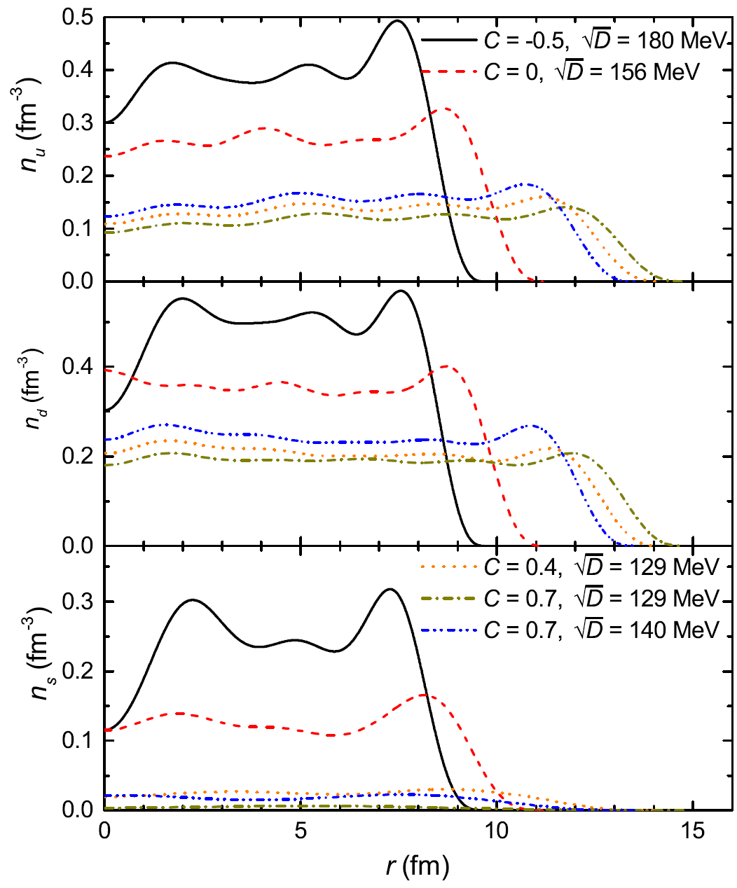
Equivparticle model
The Lagrangian density
A = 1059
with
Quark mass scaling [Xia_Peng_Chen_Lu_Xu2014_PRD89-105027]
The confinement parameter is connected to the string tension σ₀, the chiral restoration density ρ*, and the sum of the vacuum chiral condensates [Peng_Chiang _Yang_Li_Liu1999_PRC61-015201]. The perturbative strength parameter C is linked to the strong coupling constant α_{s}.
Xia2019_AIPCP2127-020029

Slide 7
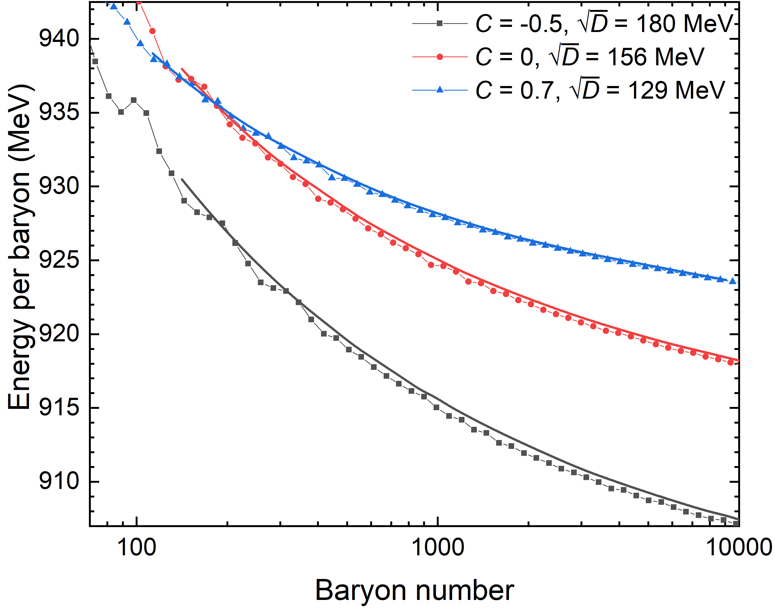
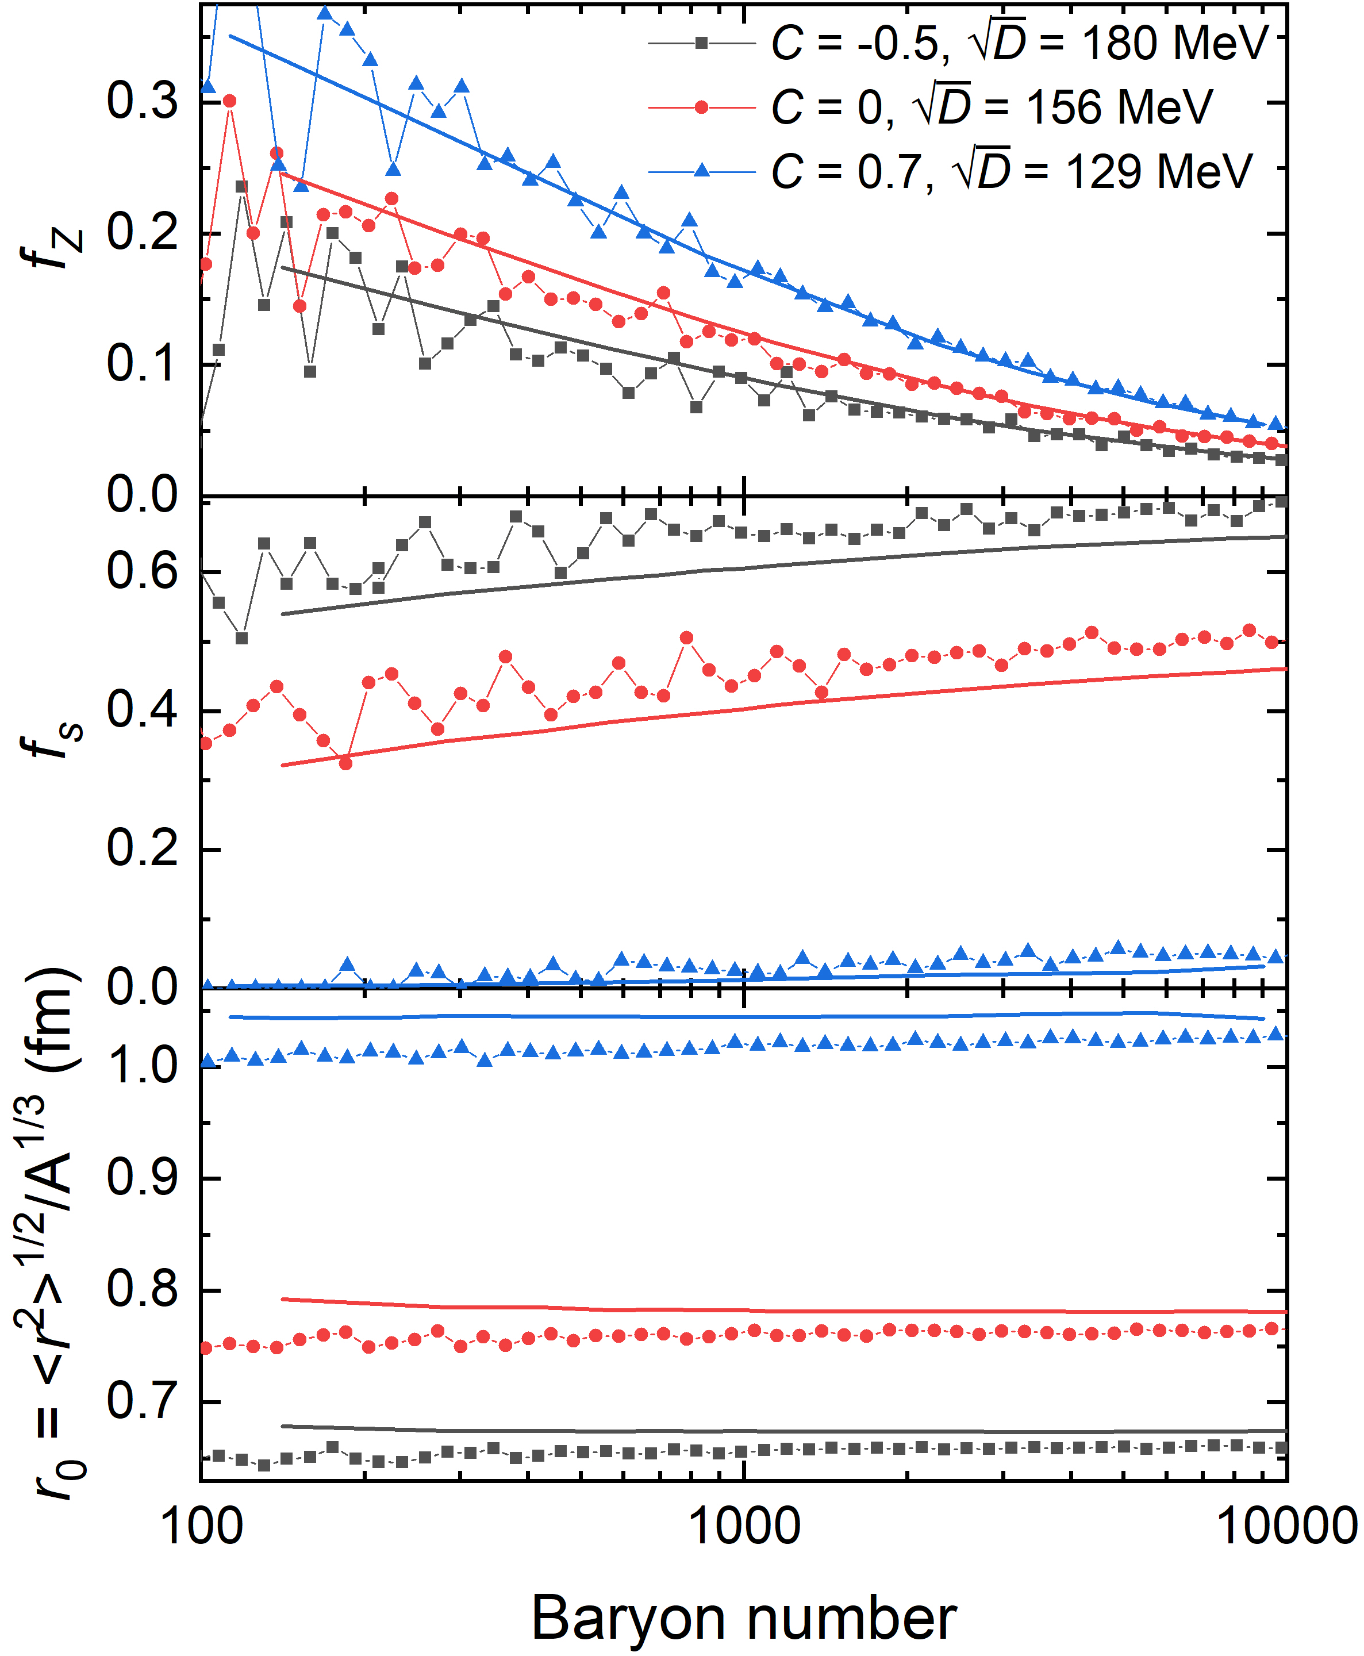
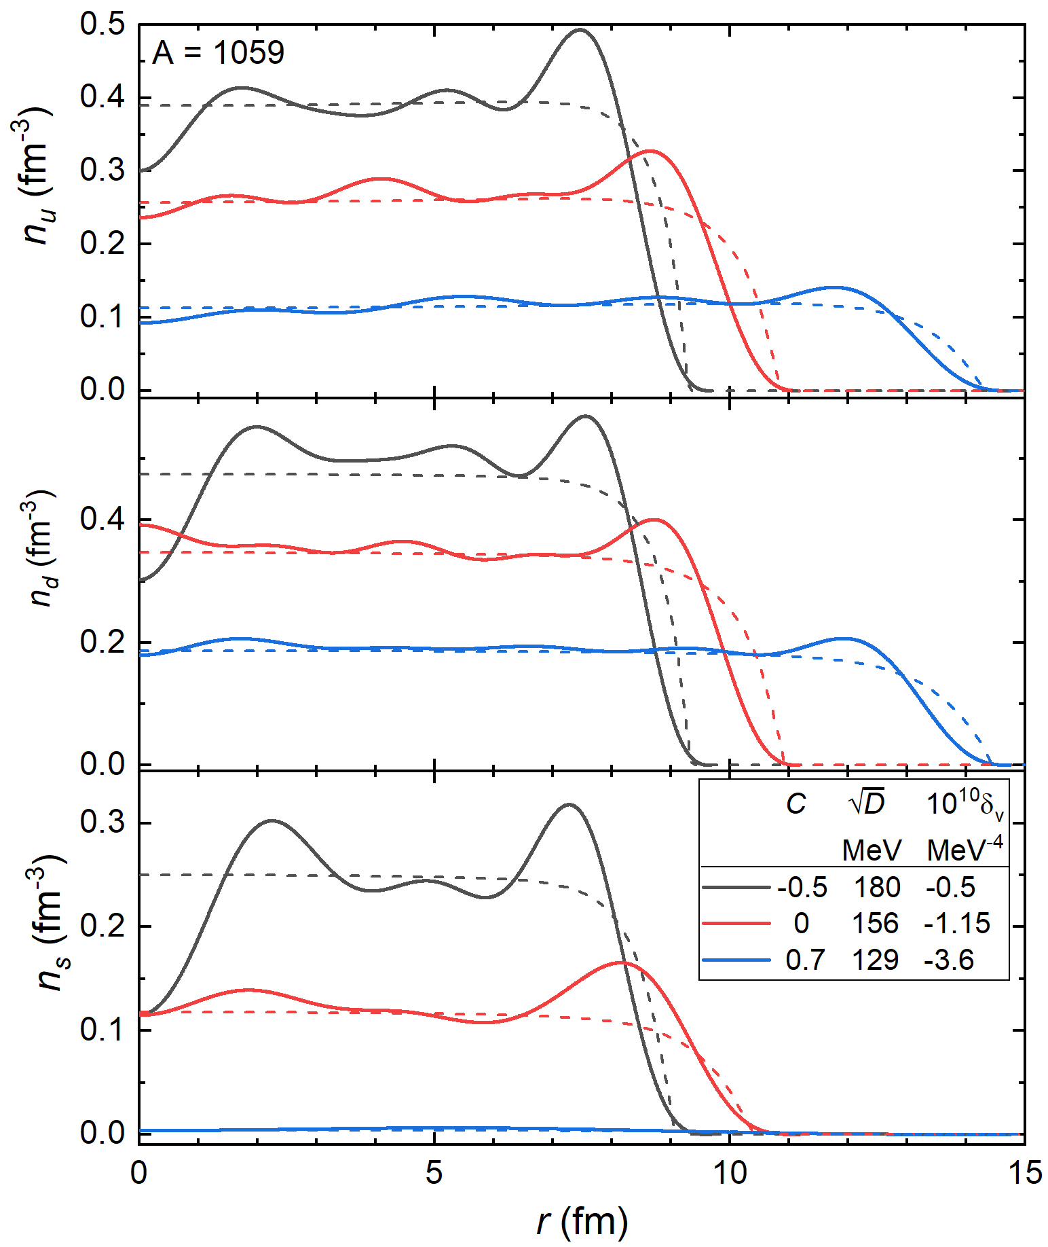
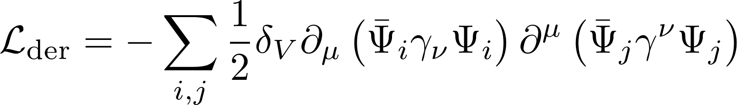
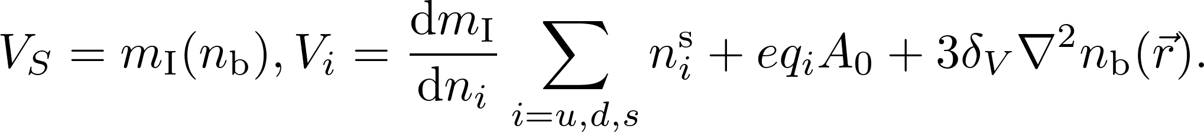

Density derivative term
In the framework of Thomas-Fermi approximation, to account for the average interface effects, we add
n_{b}
The density profiles are solved iteratively inside a spherically symmetric box [Levit1984_PLB139-147].

Slide 8
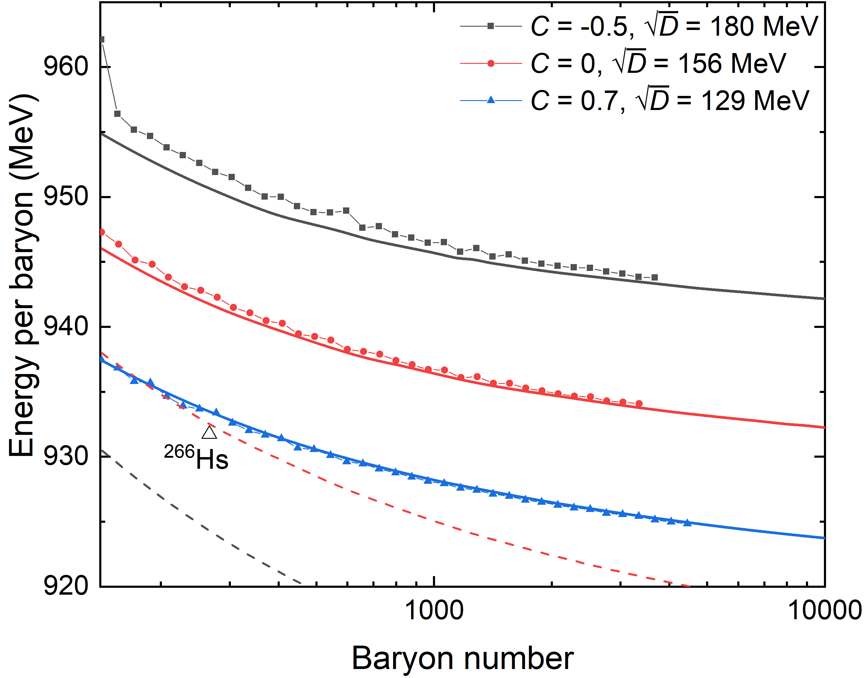
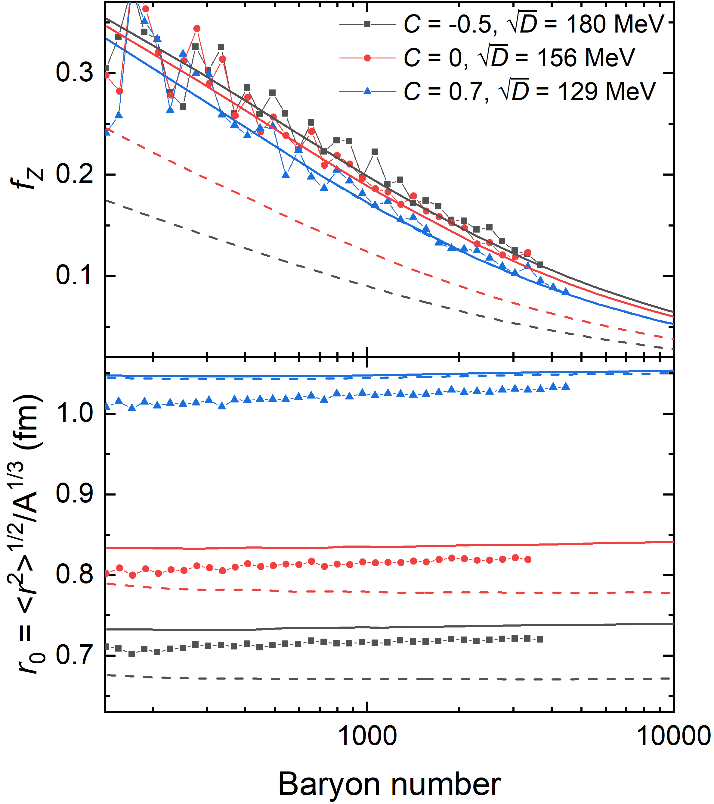
udQM nuggets
Dashed: strangelets; Solid: udQM nuggets

Slide 9
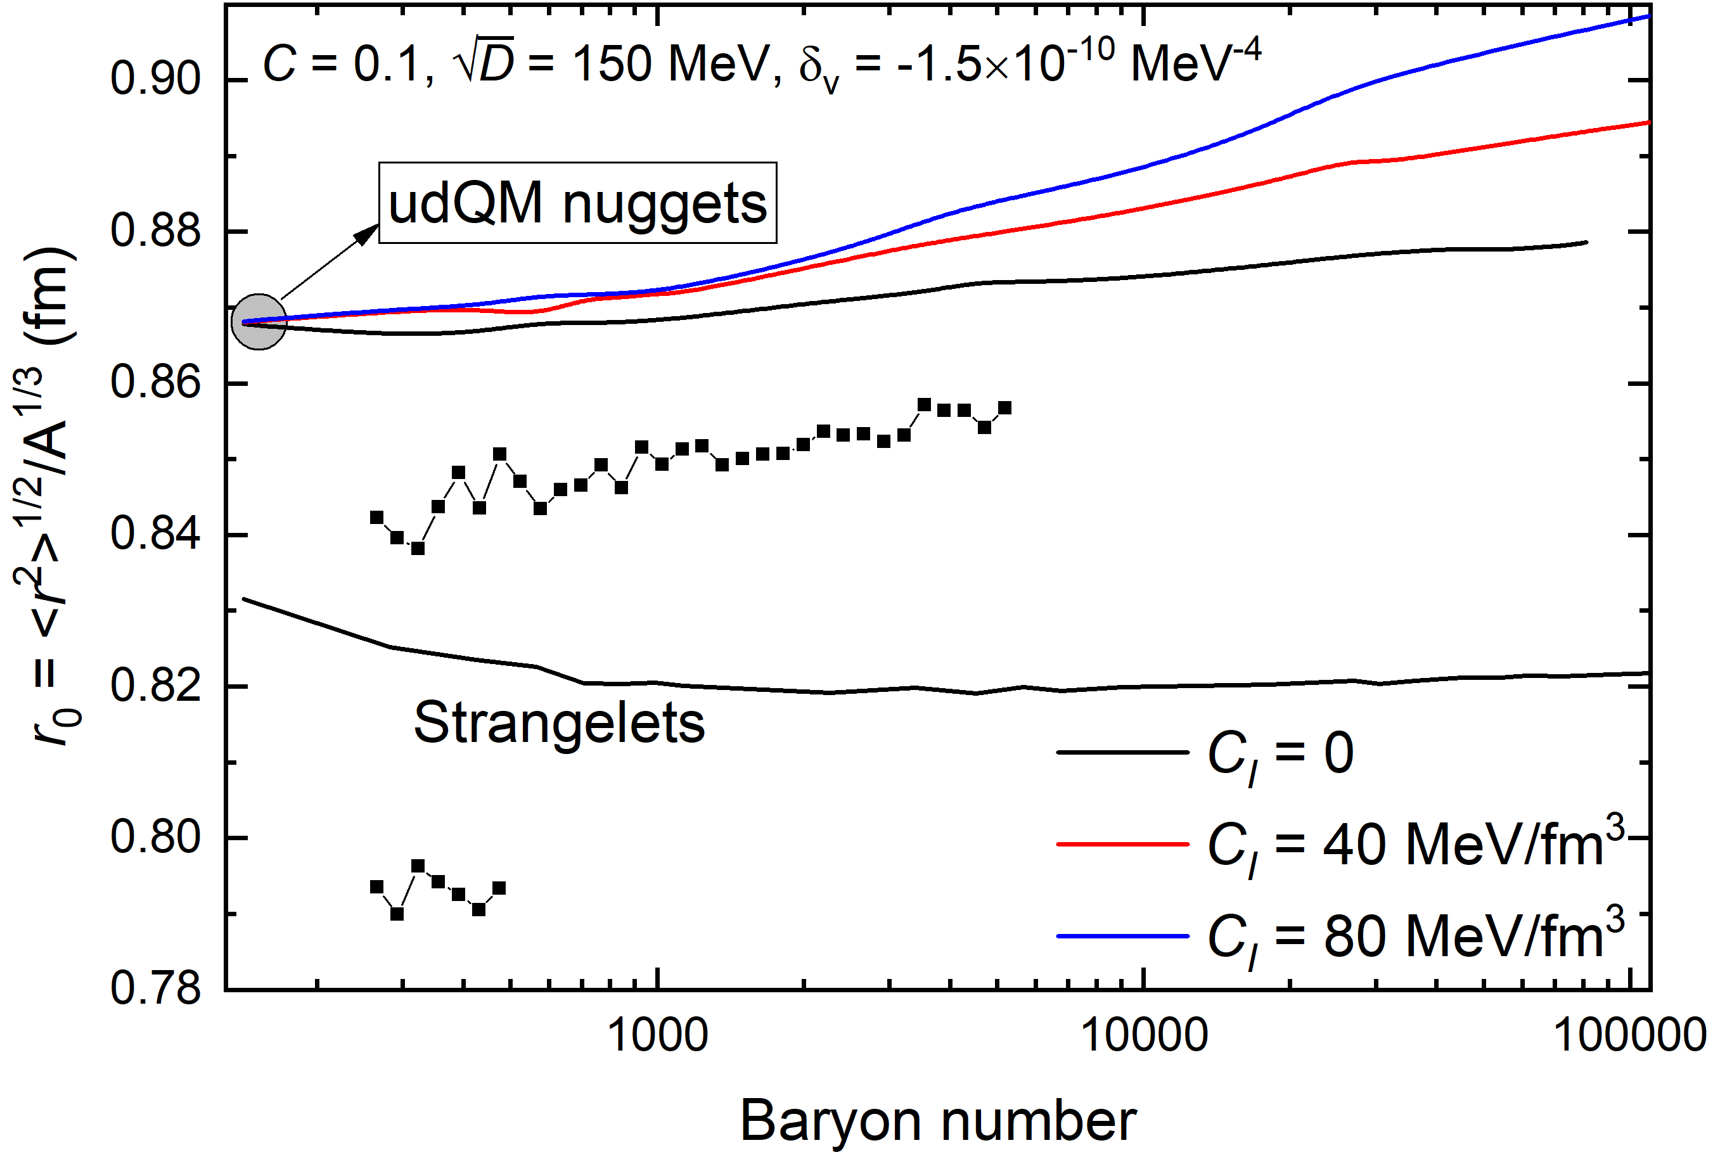
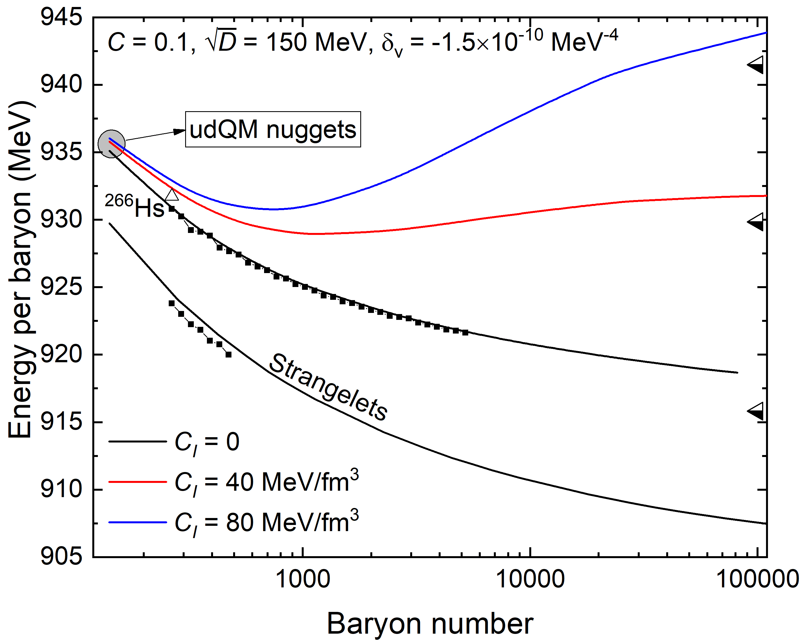
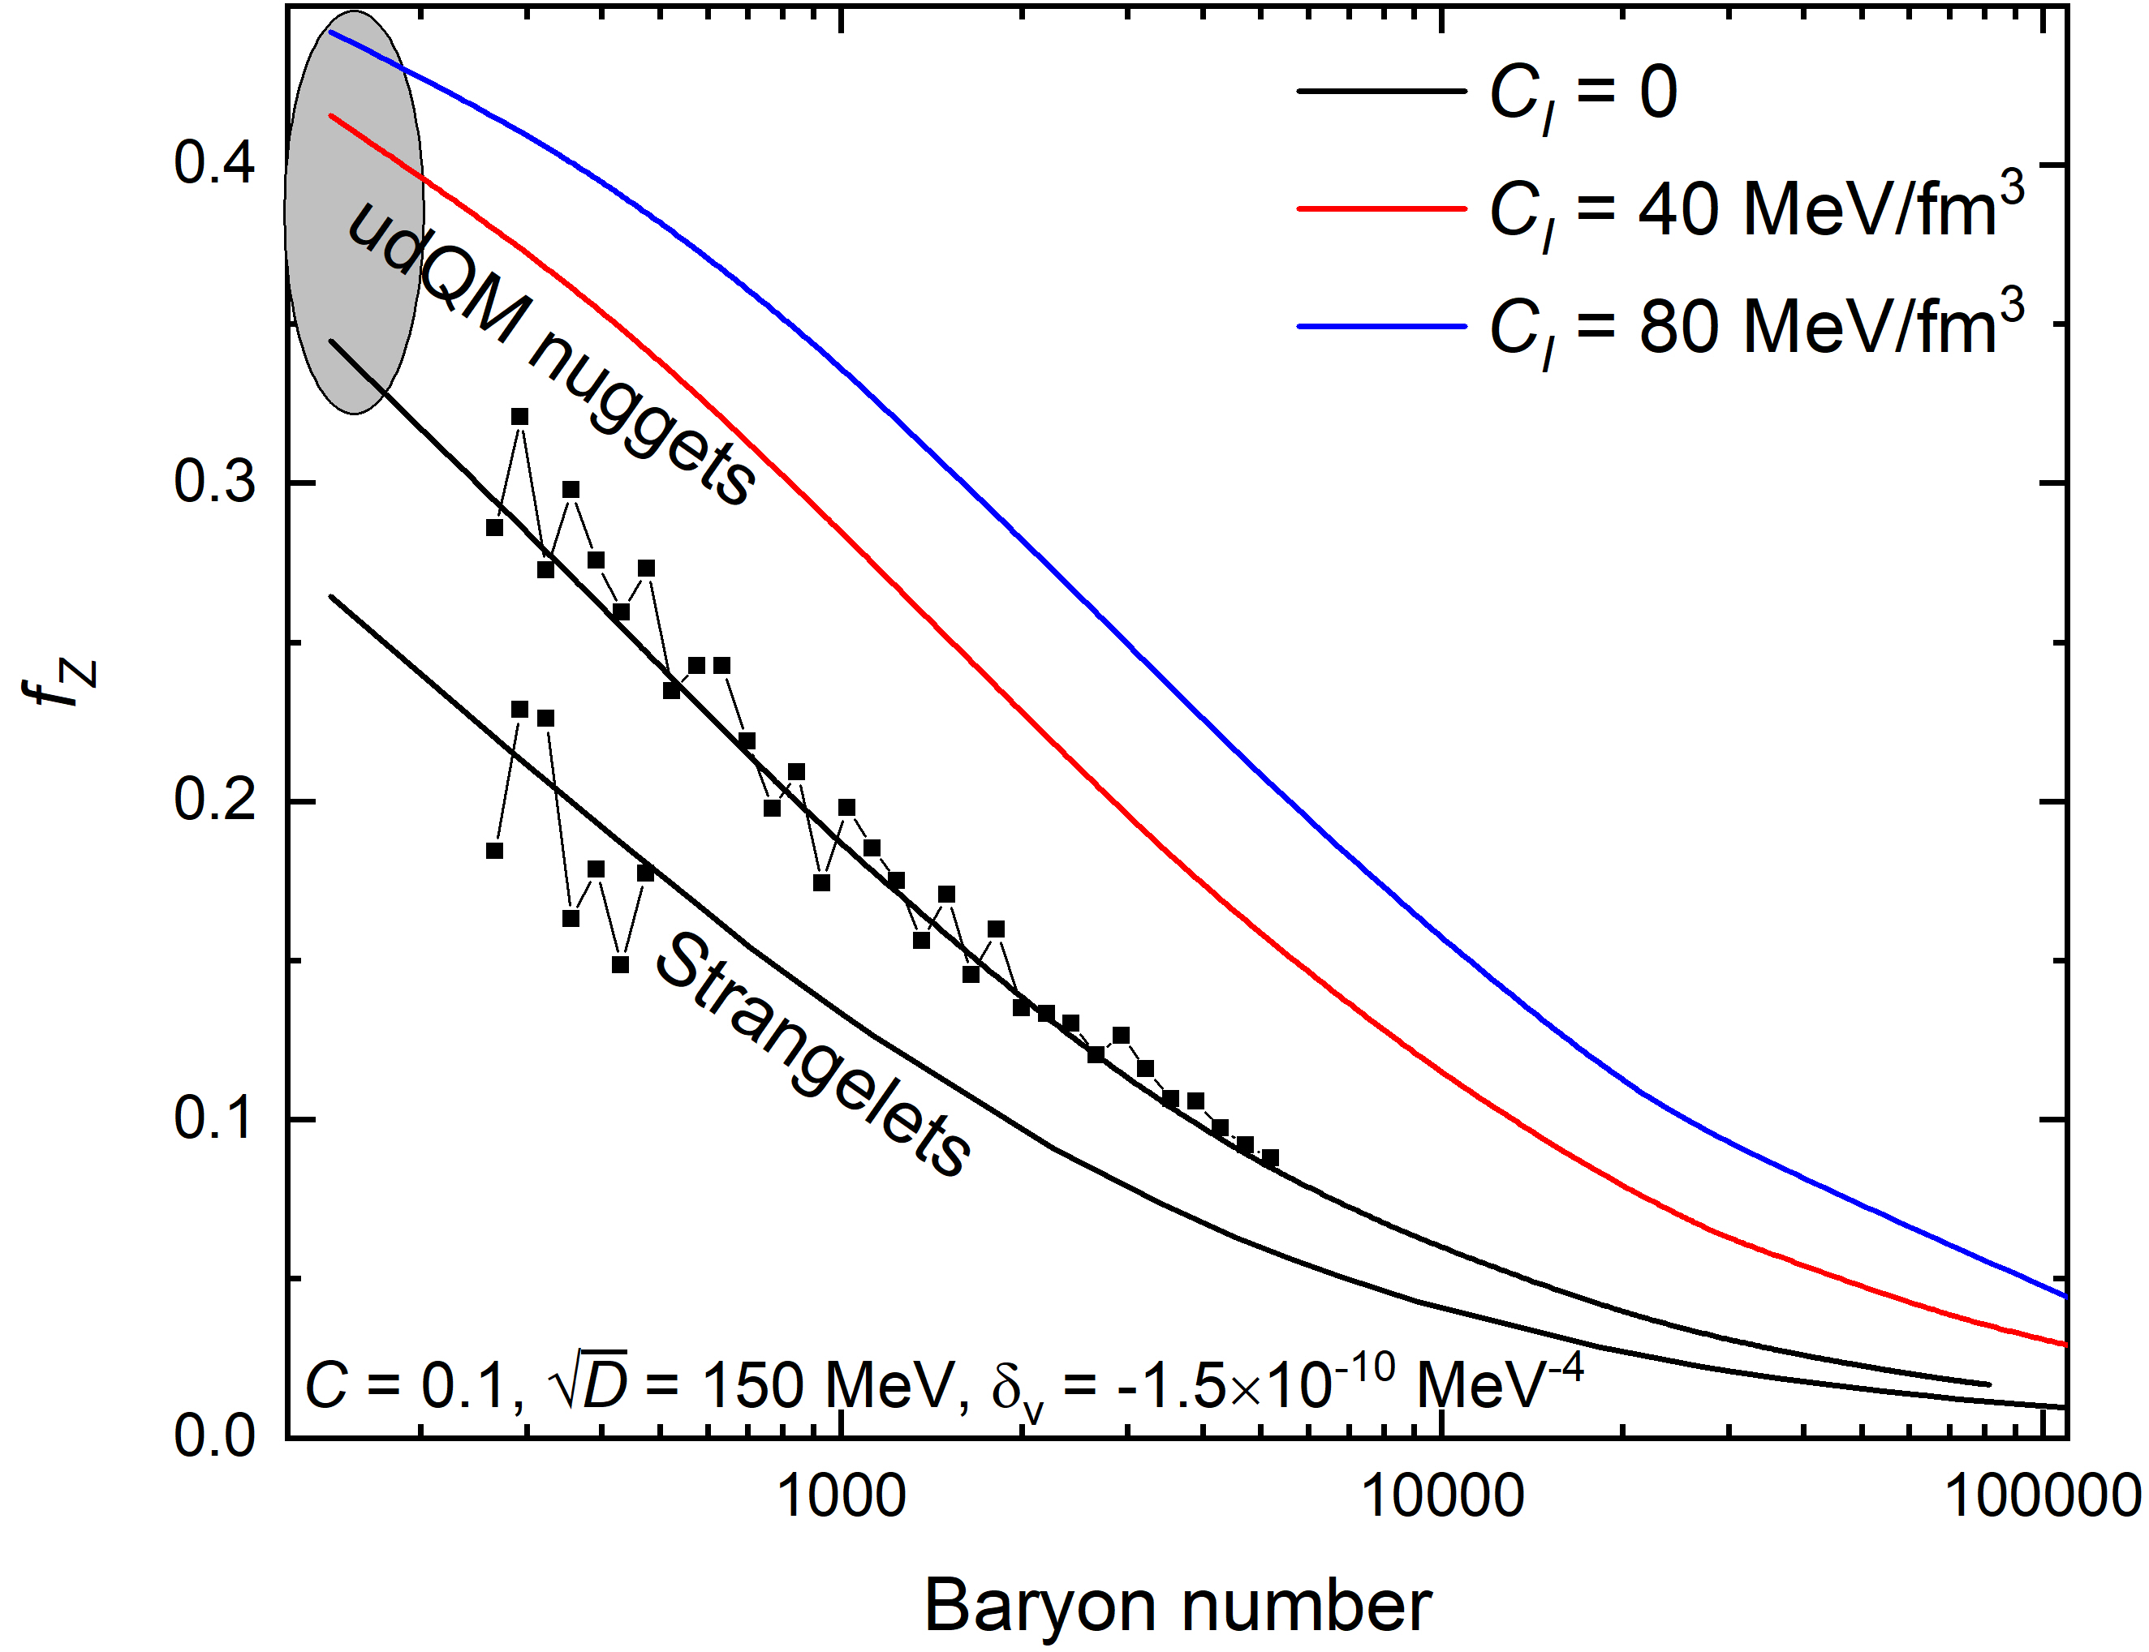
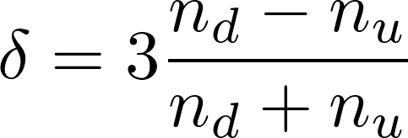
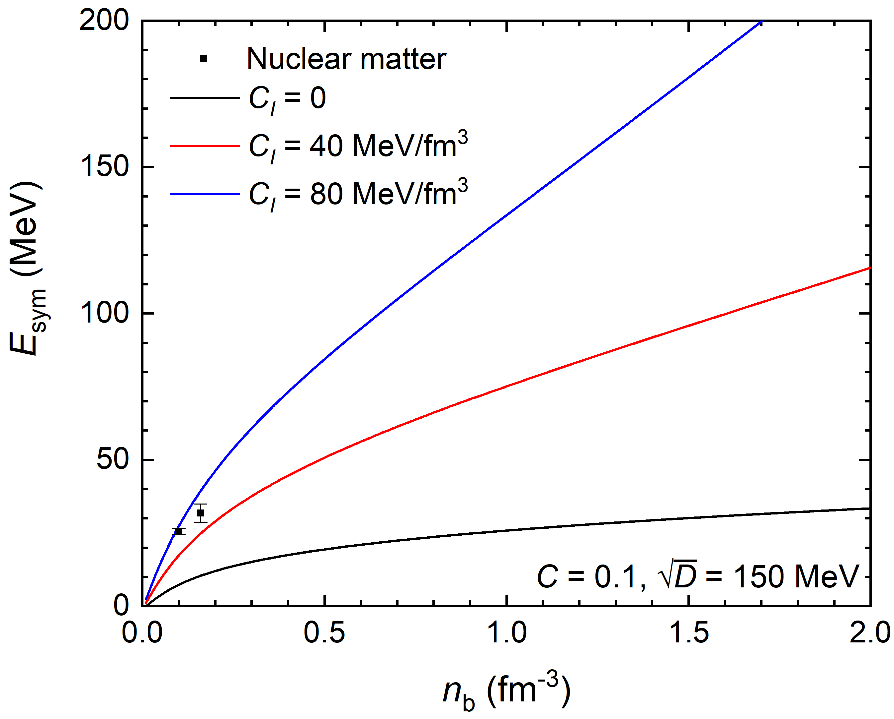
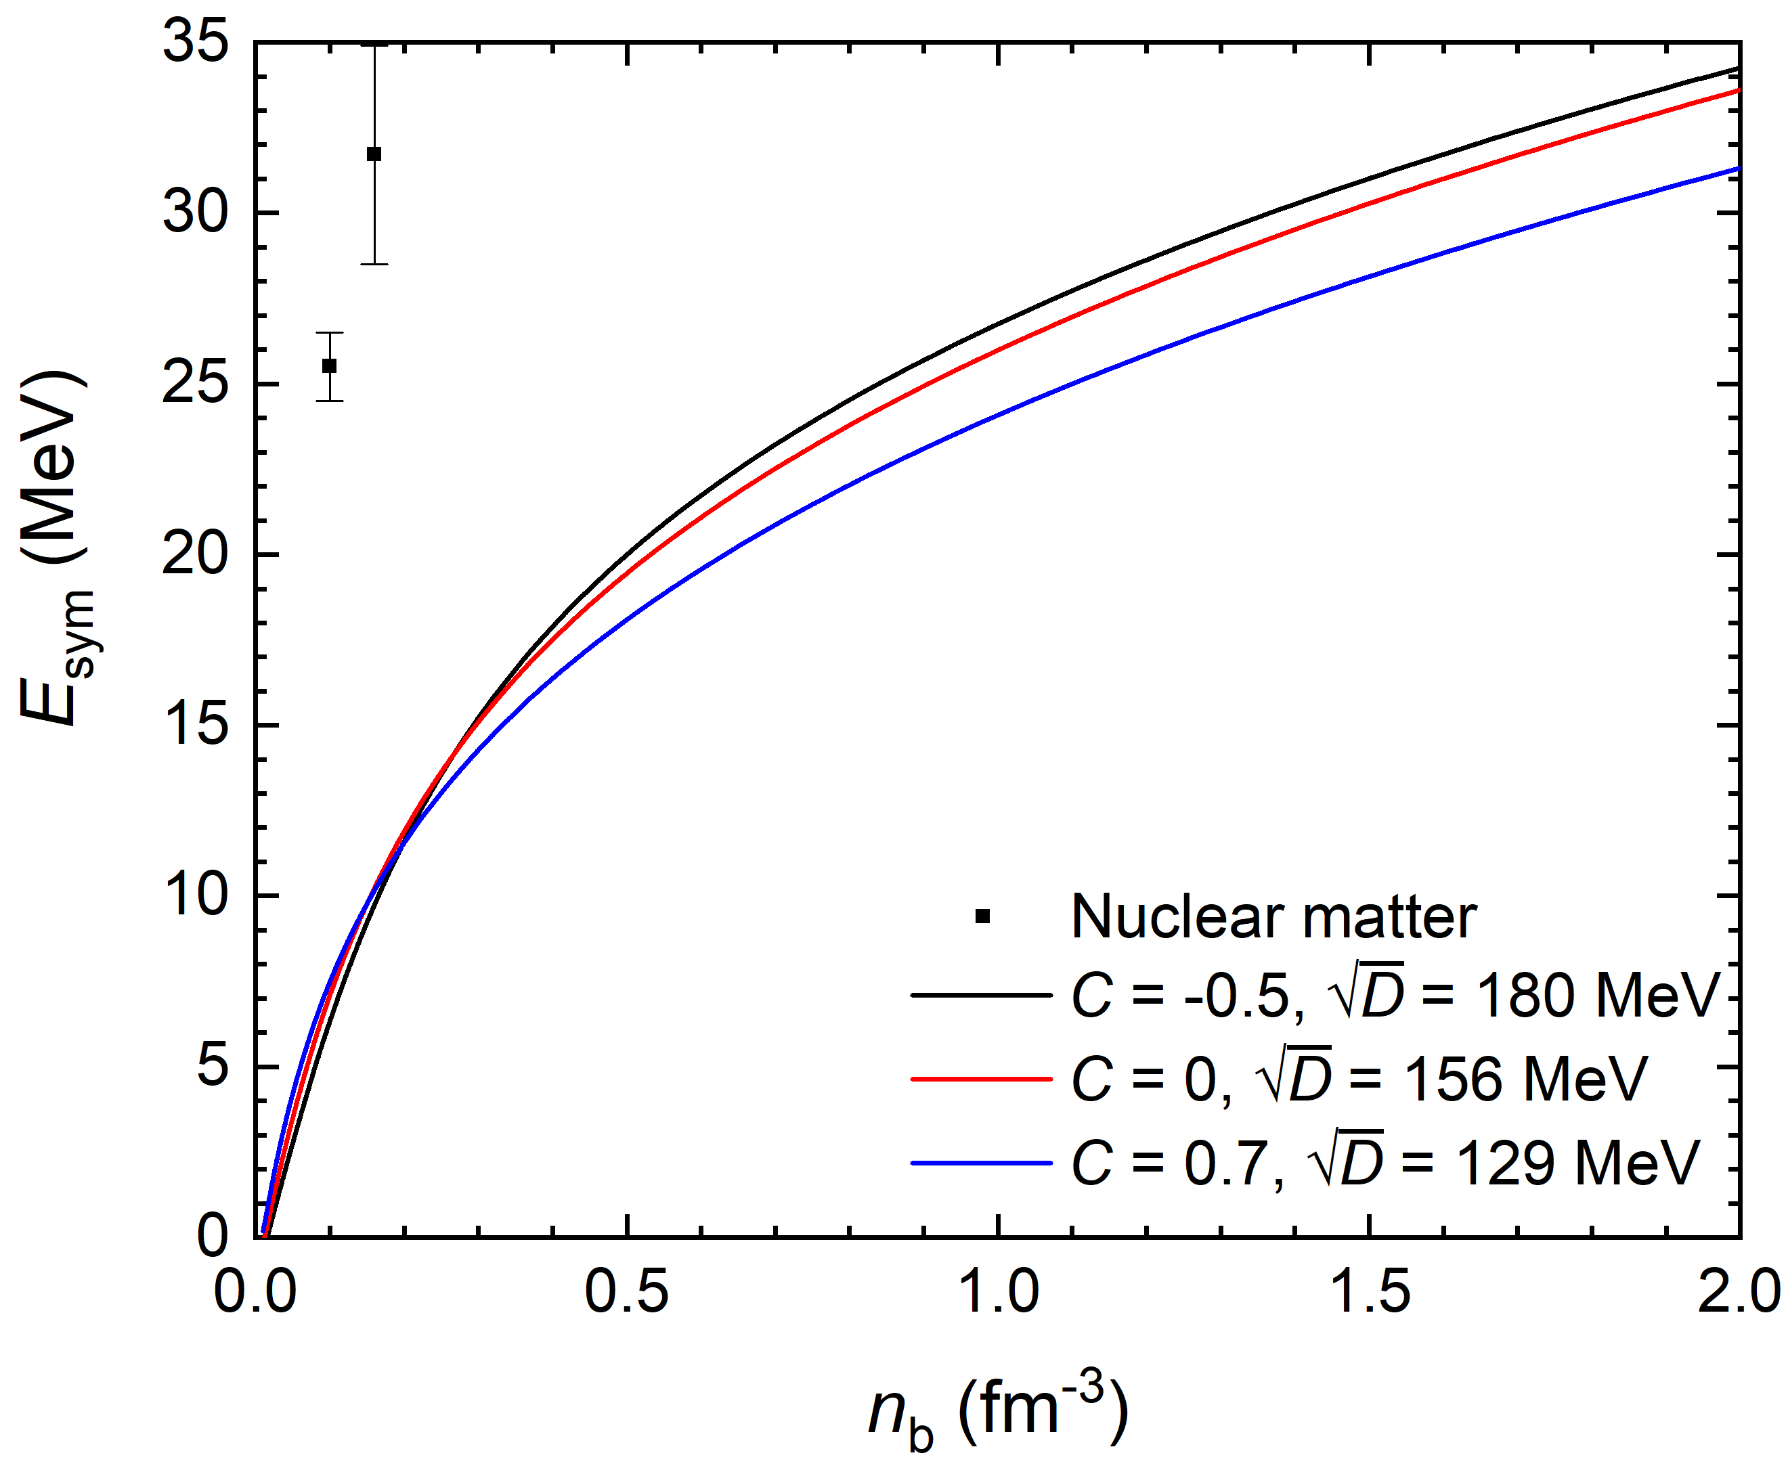
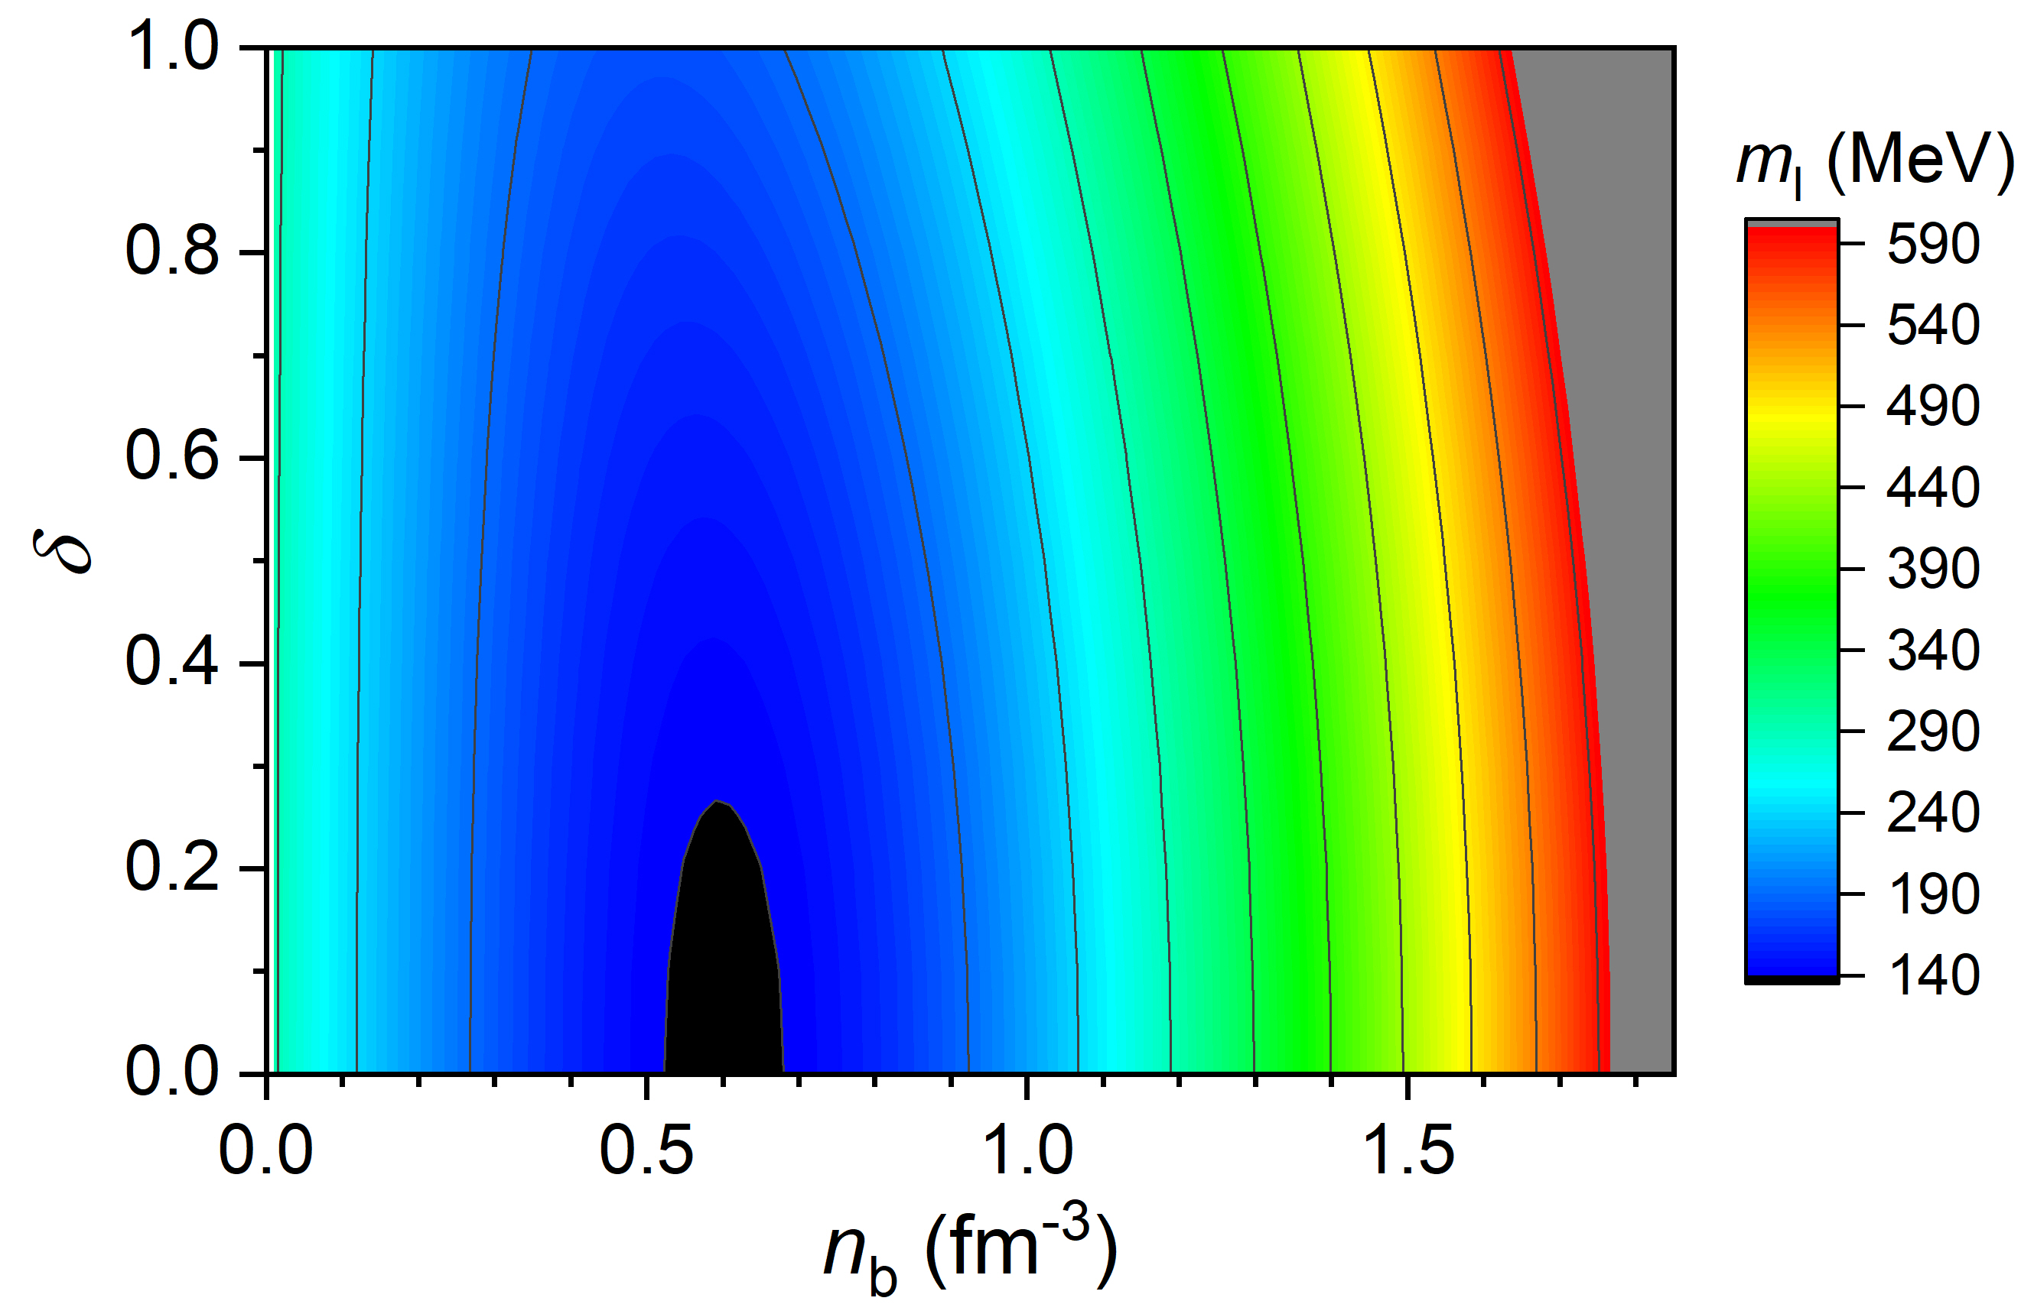
Symmetry energy of udQM
K = 240 MeV,
E_{sym} = 31.6 MeV,
L = 58.9 MeV.
NM
C_{I} ≈ 80 MeV/fm³
Adding a third term for quark matter symmetry energy:

Slide 10
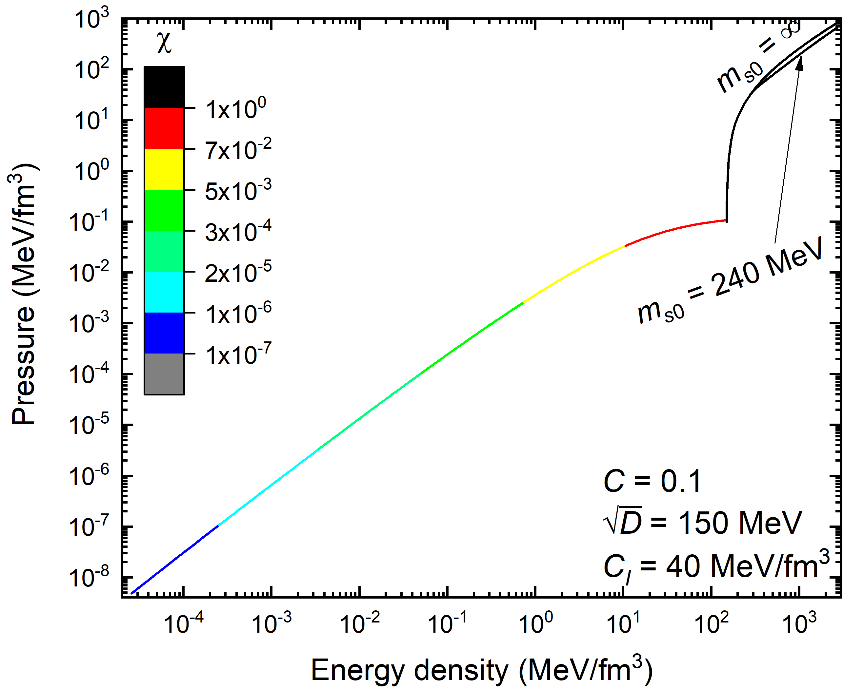
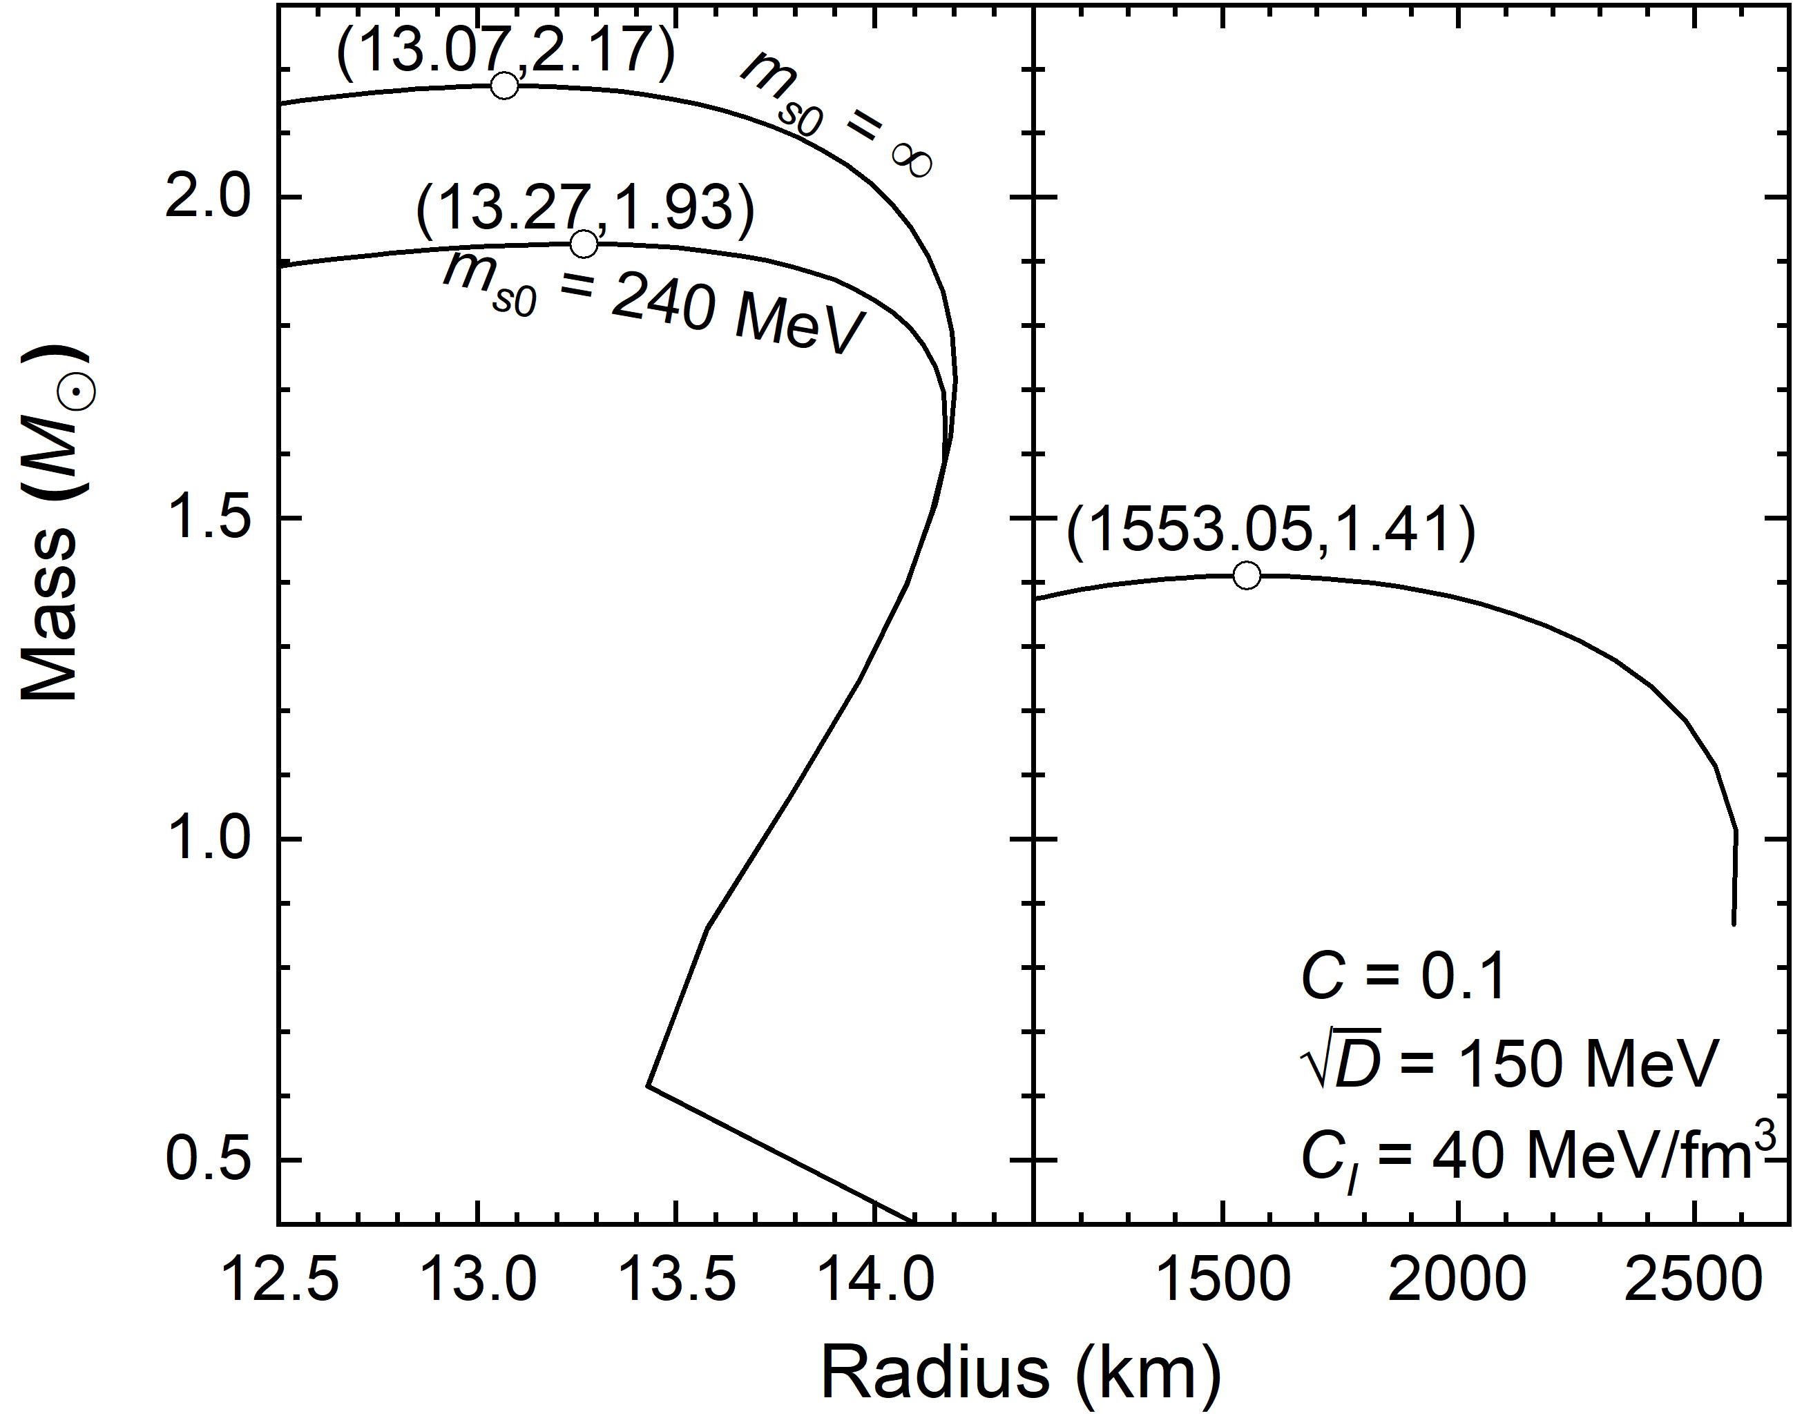
udQM crusts
Neglect charge screening and assume vanishing surface tension:

Slide 11
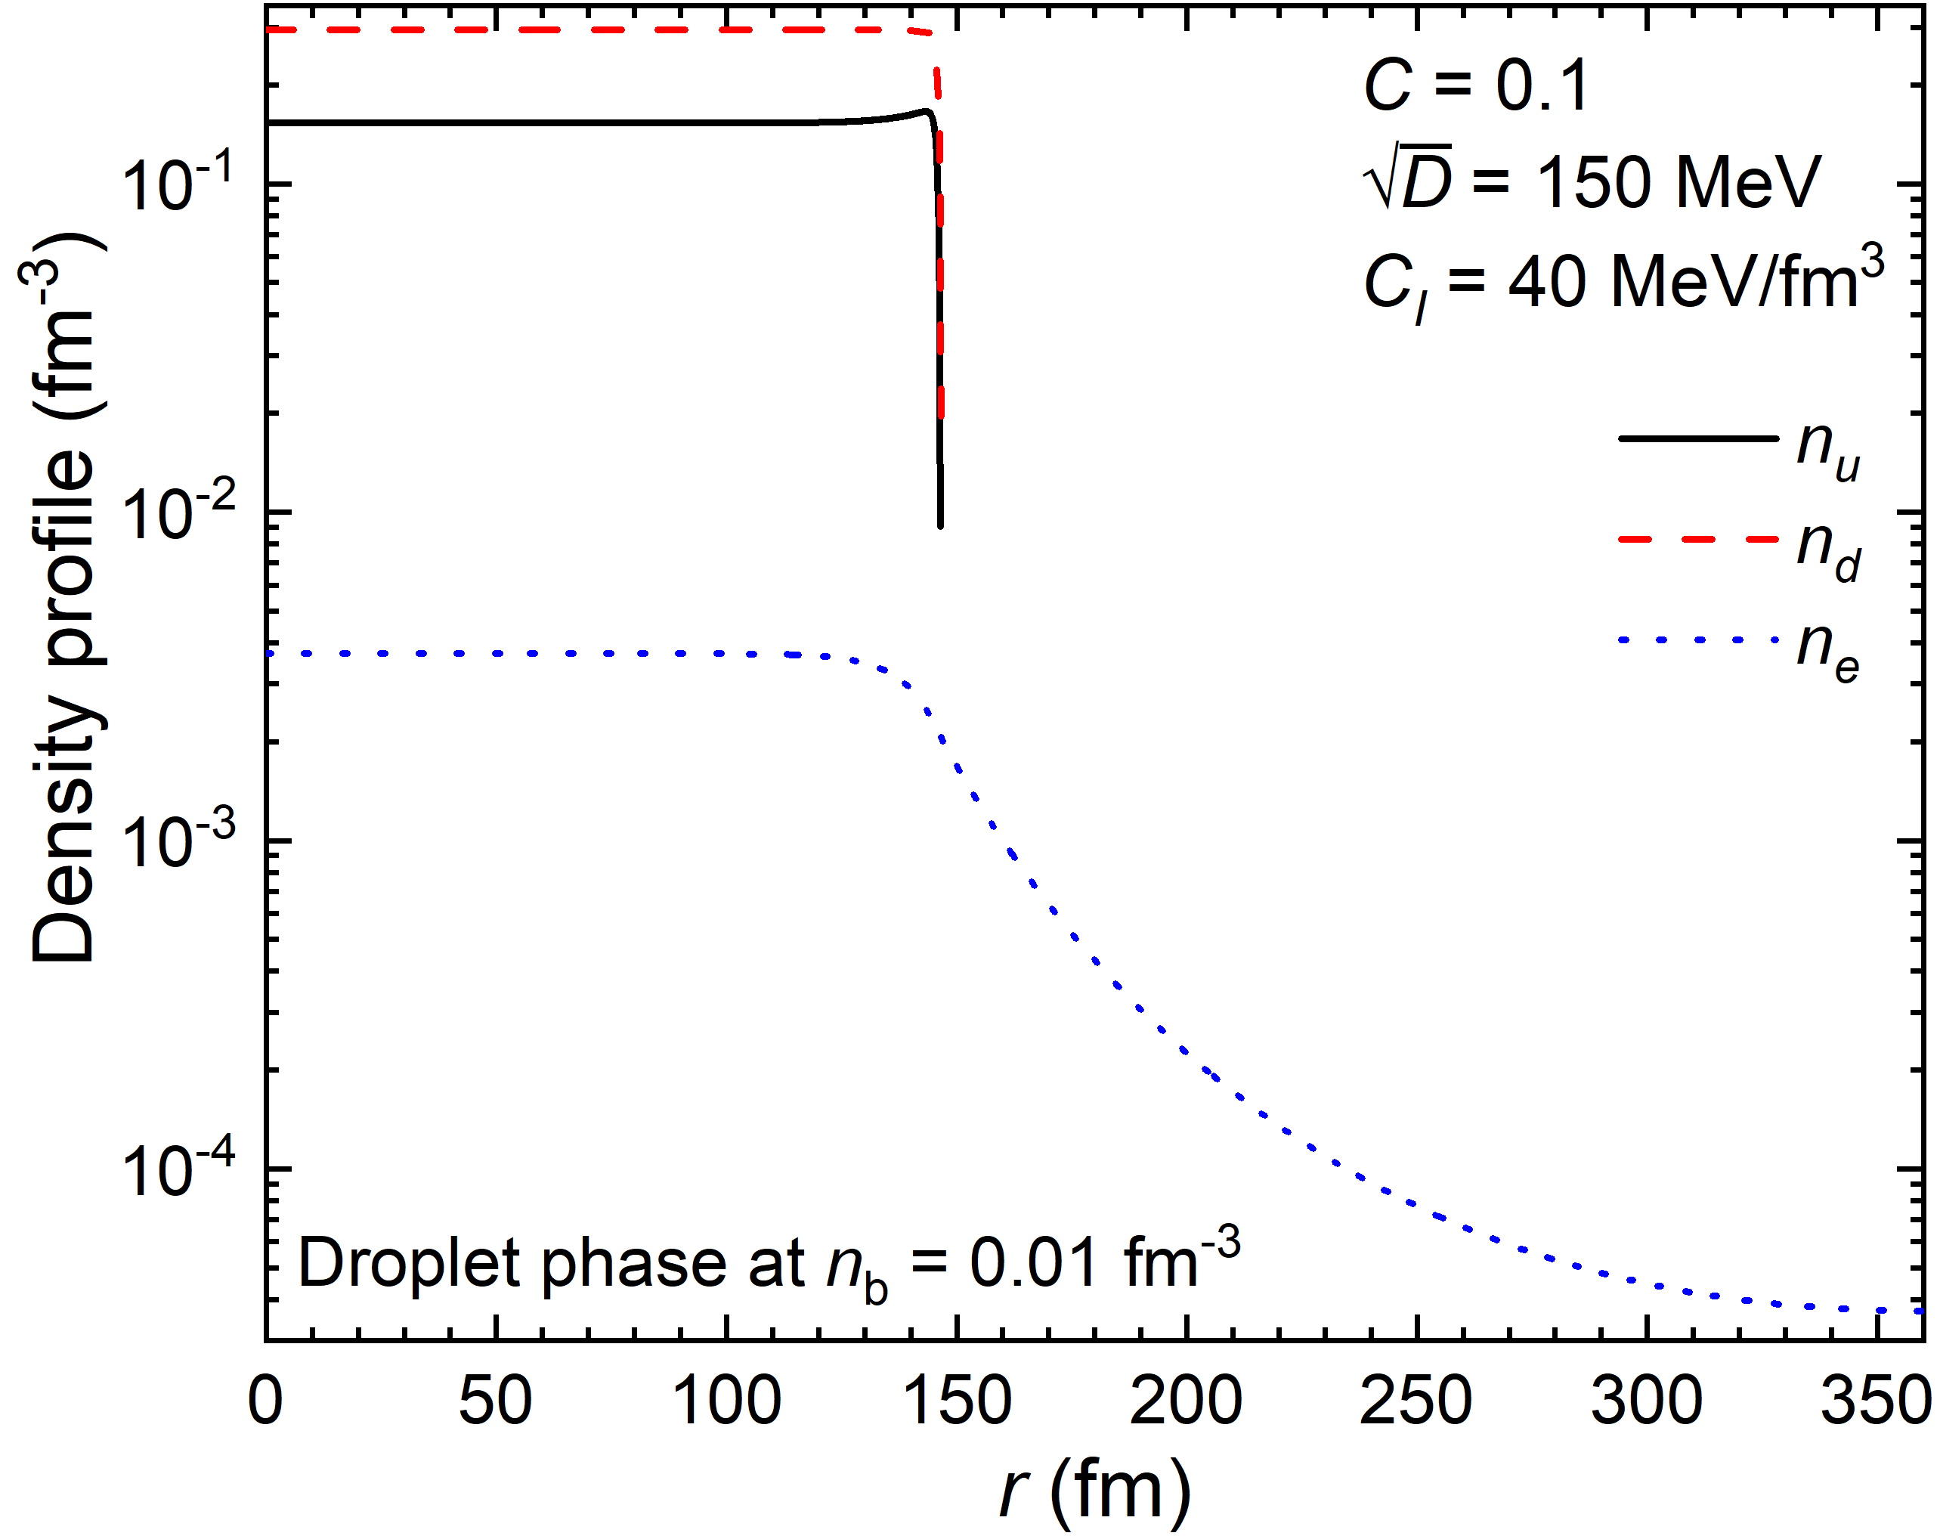
Full calculation

Slide 12
Summary
Adopting a density derivative term and the Thomas-Fermi approximation, we investigate the interface effects of quark matter. It is found that
the density derivative term well reproduces the results obtained by solving Dirac equations;
possible existence of udQM nuggets in the framework of the equivparticle model;
the symmetry energy of udQM is smaller than NM, which can be increased by introducing an additional term in the quark mass scaling;
the possible existence of udQM nuggets (A ≈ 1000) that are more stable than others, quark star crusts and white dwarfs made of udQM nuggets.
Outlook: strong interactions among quark clusters (strangeons), shell effects, one-gluon-exchange interactions, etc.
Thank you!!!

