Slide 1
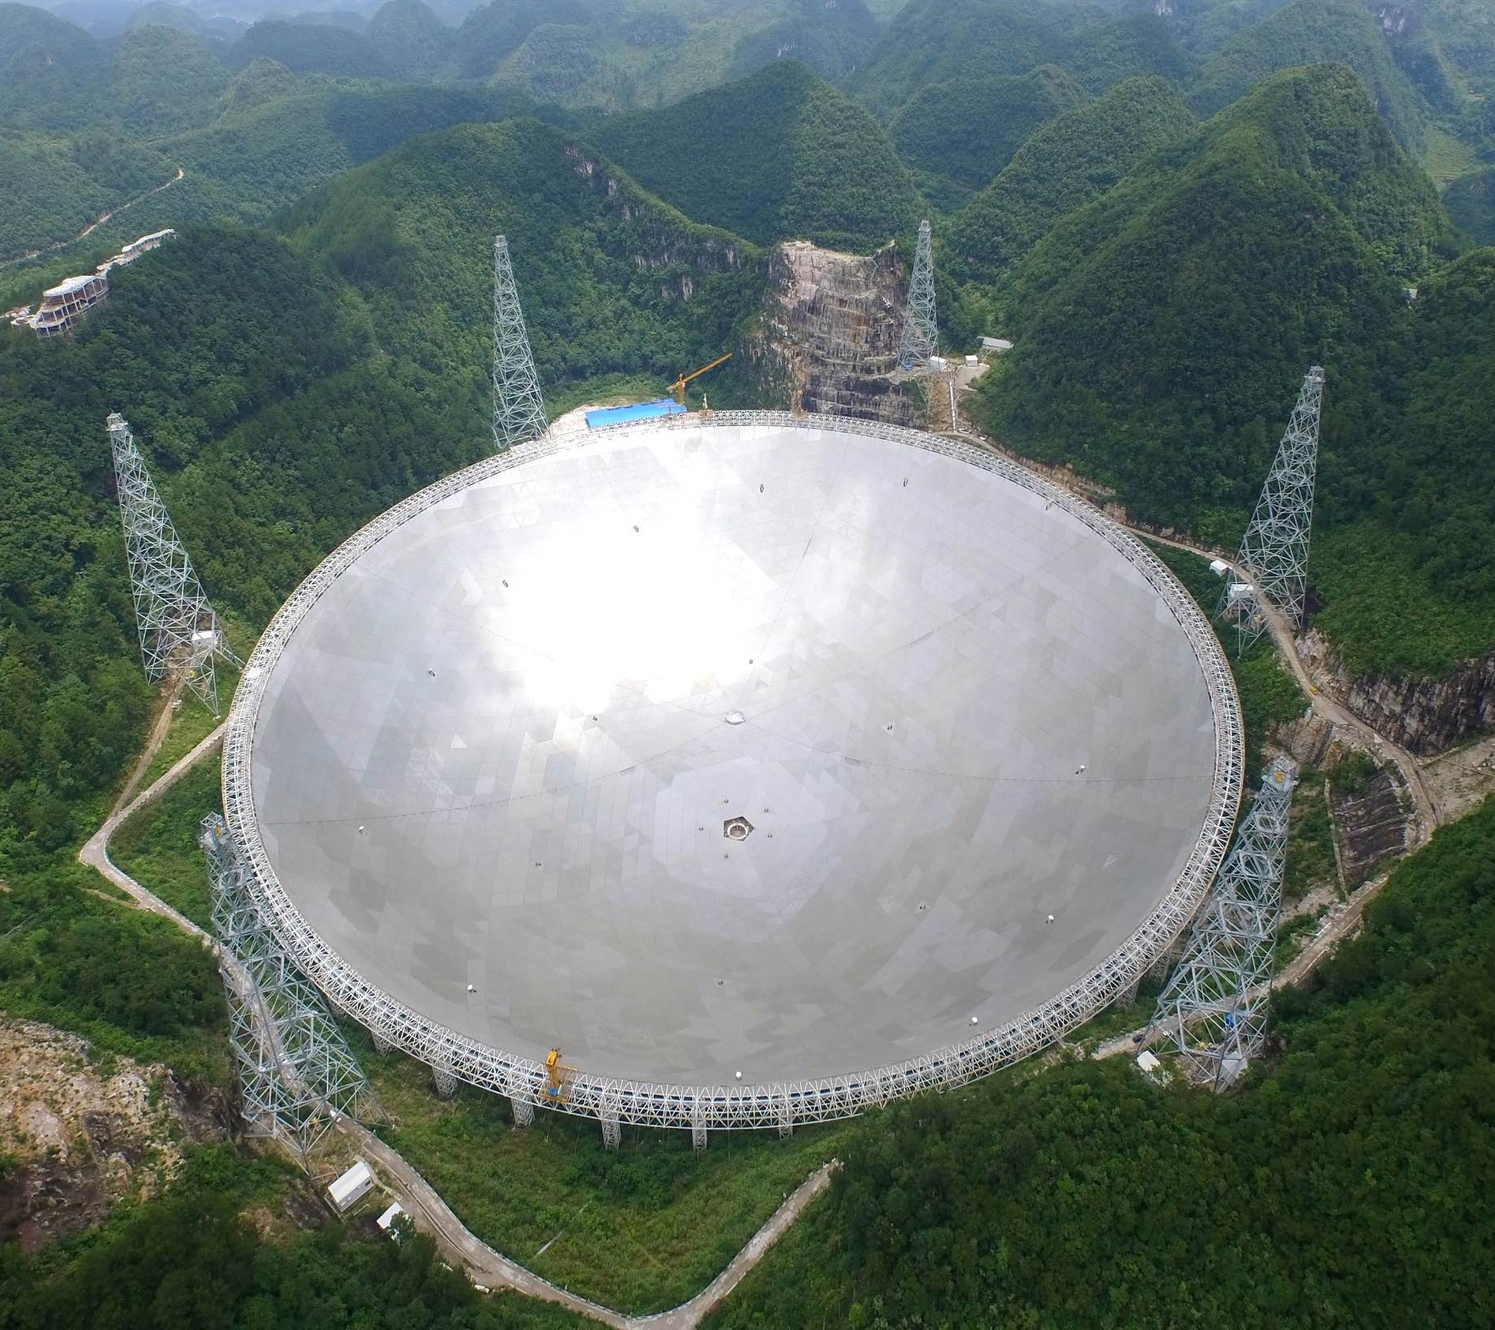
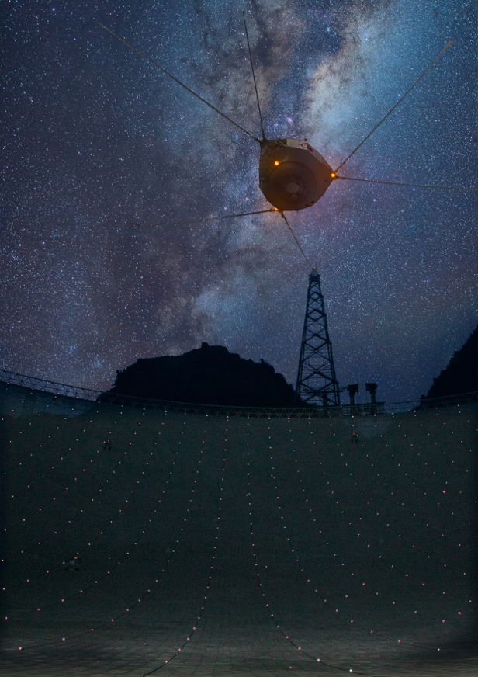
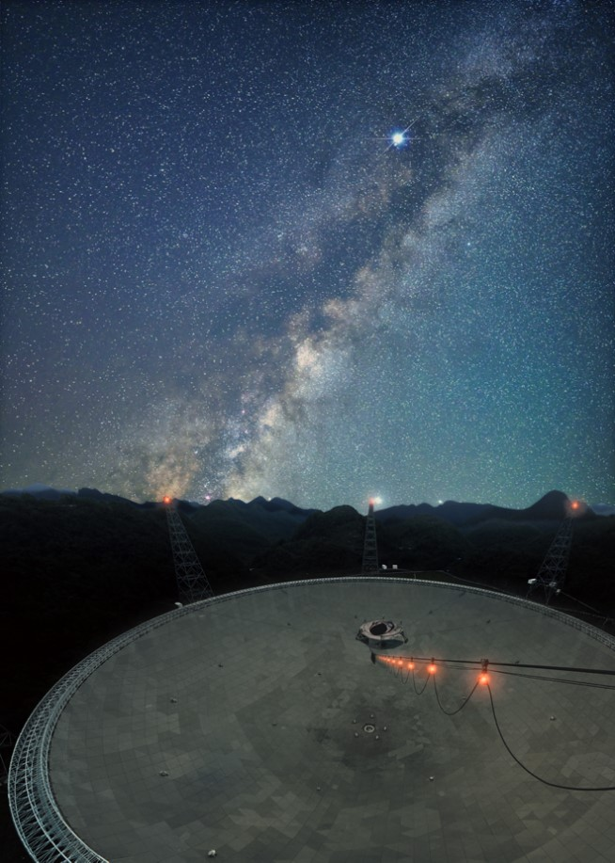
Progresses of
Chinese Pulsar Timing Array
Heng Xu(胥恒), Peking University (PKU)
Supervisor, PI of CPTA: Kejie Lee(李柯伽), PKU
2021.07.13
@ FAST
@ Huang et al.
@ Huang et al.

Slide 2
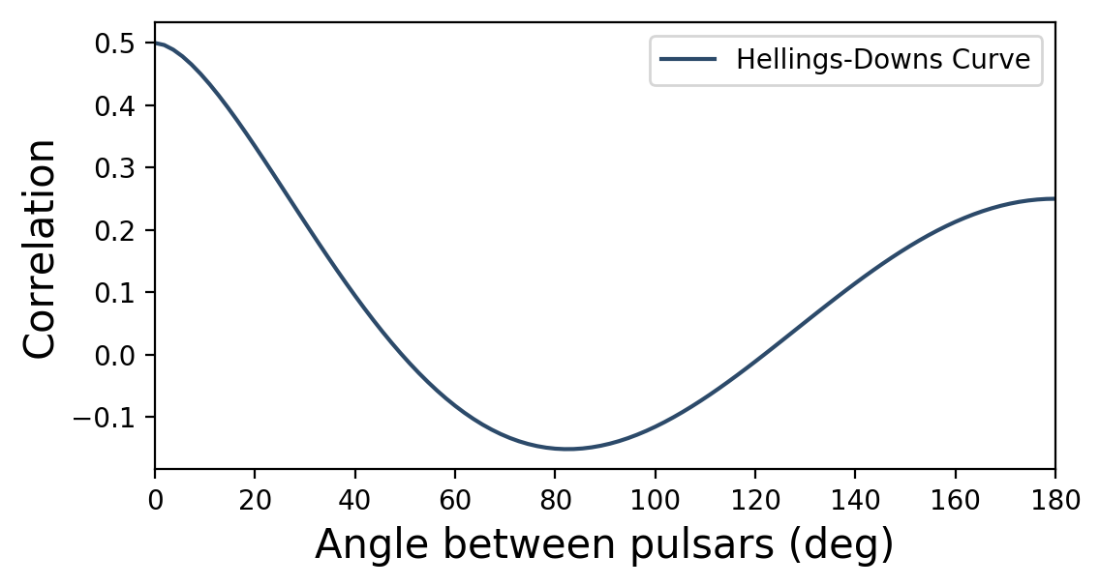
Pulsar Timing Arrays
You need an array!

Slide 3
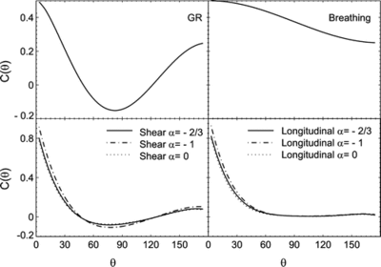
Pulsar Timing Arrays
Lee, Janet and Price., 2008

Slide 4
Pulsar Timing Arrays
FPS correlation curve
Correlation
Angle
Credit: RenXin Xu

Slide 5
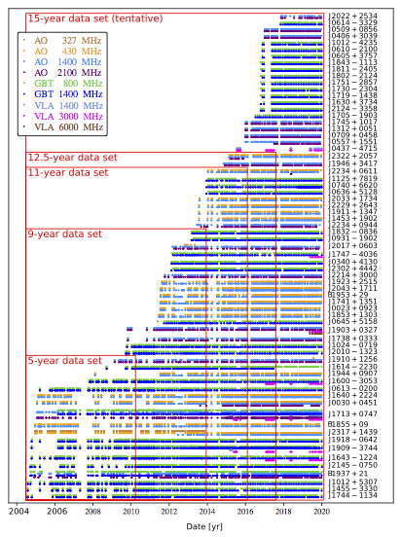
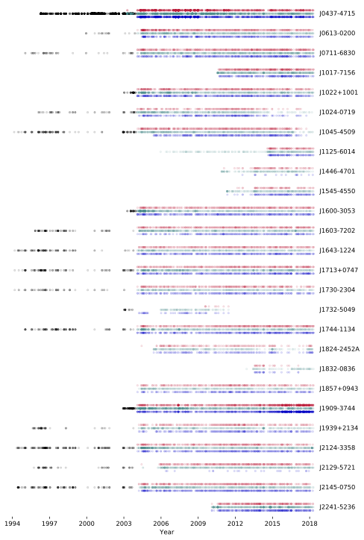
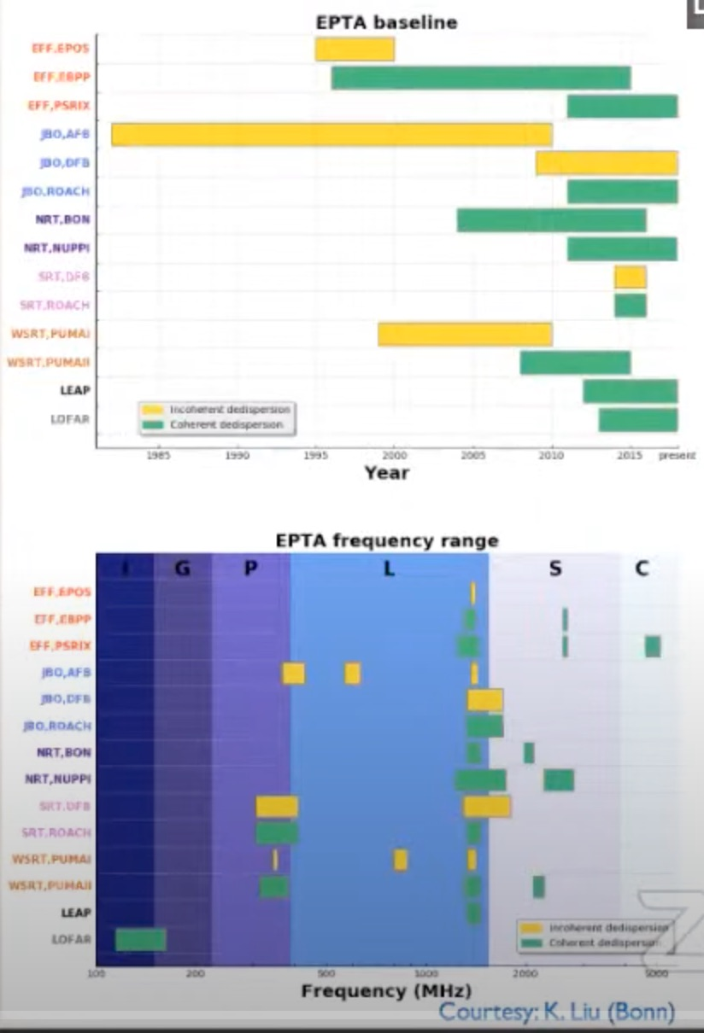
Pulsar Timing Arrays
http://nanograv.org
NANOGrav 2004 —
InPTA ~ 3 years
MeerKAT PTA ~ 3 years
Fermi PTA ~ 11 years
Kerr et al., 2020
PPTA 1994 —
@Guillemot
EPTA ~1980s —

Slide 6
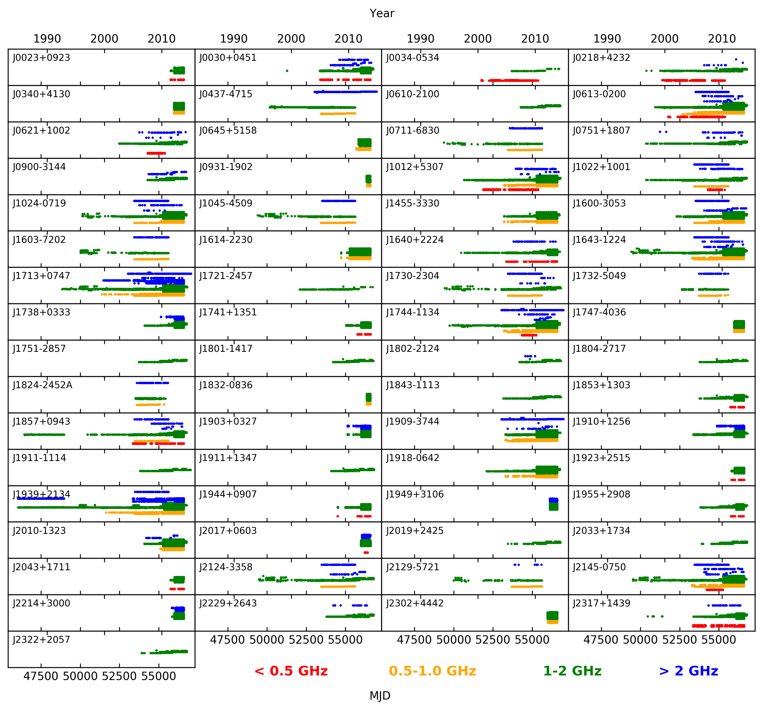
IPTA DR2, Perera et al, 2019
IPTA ~1980s—

Slide 7
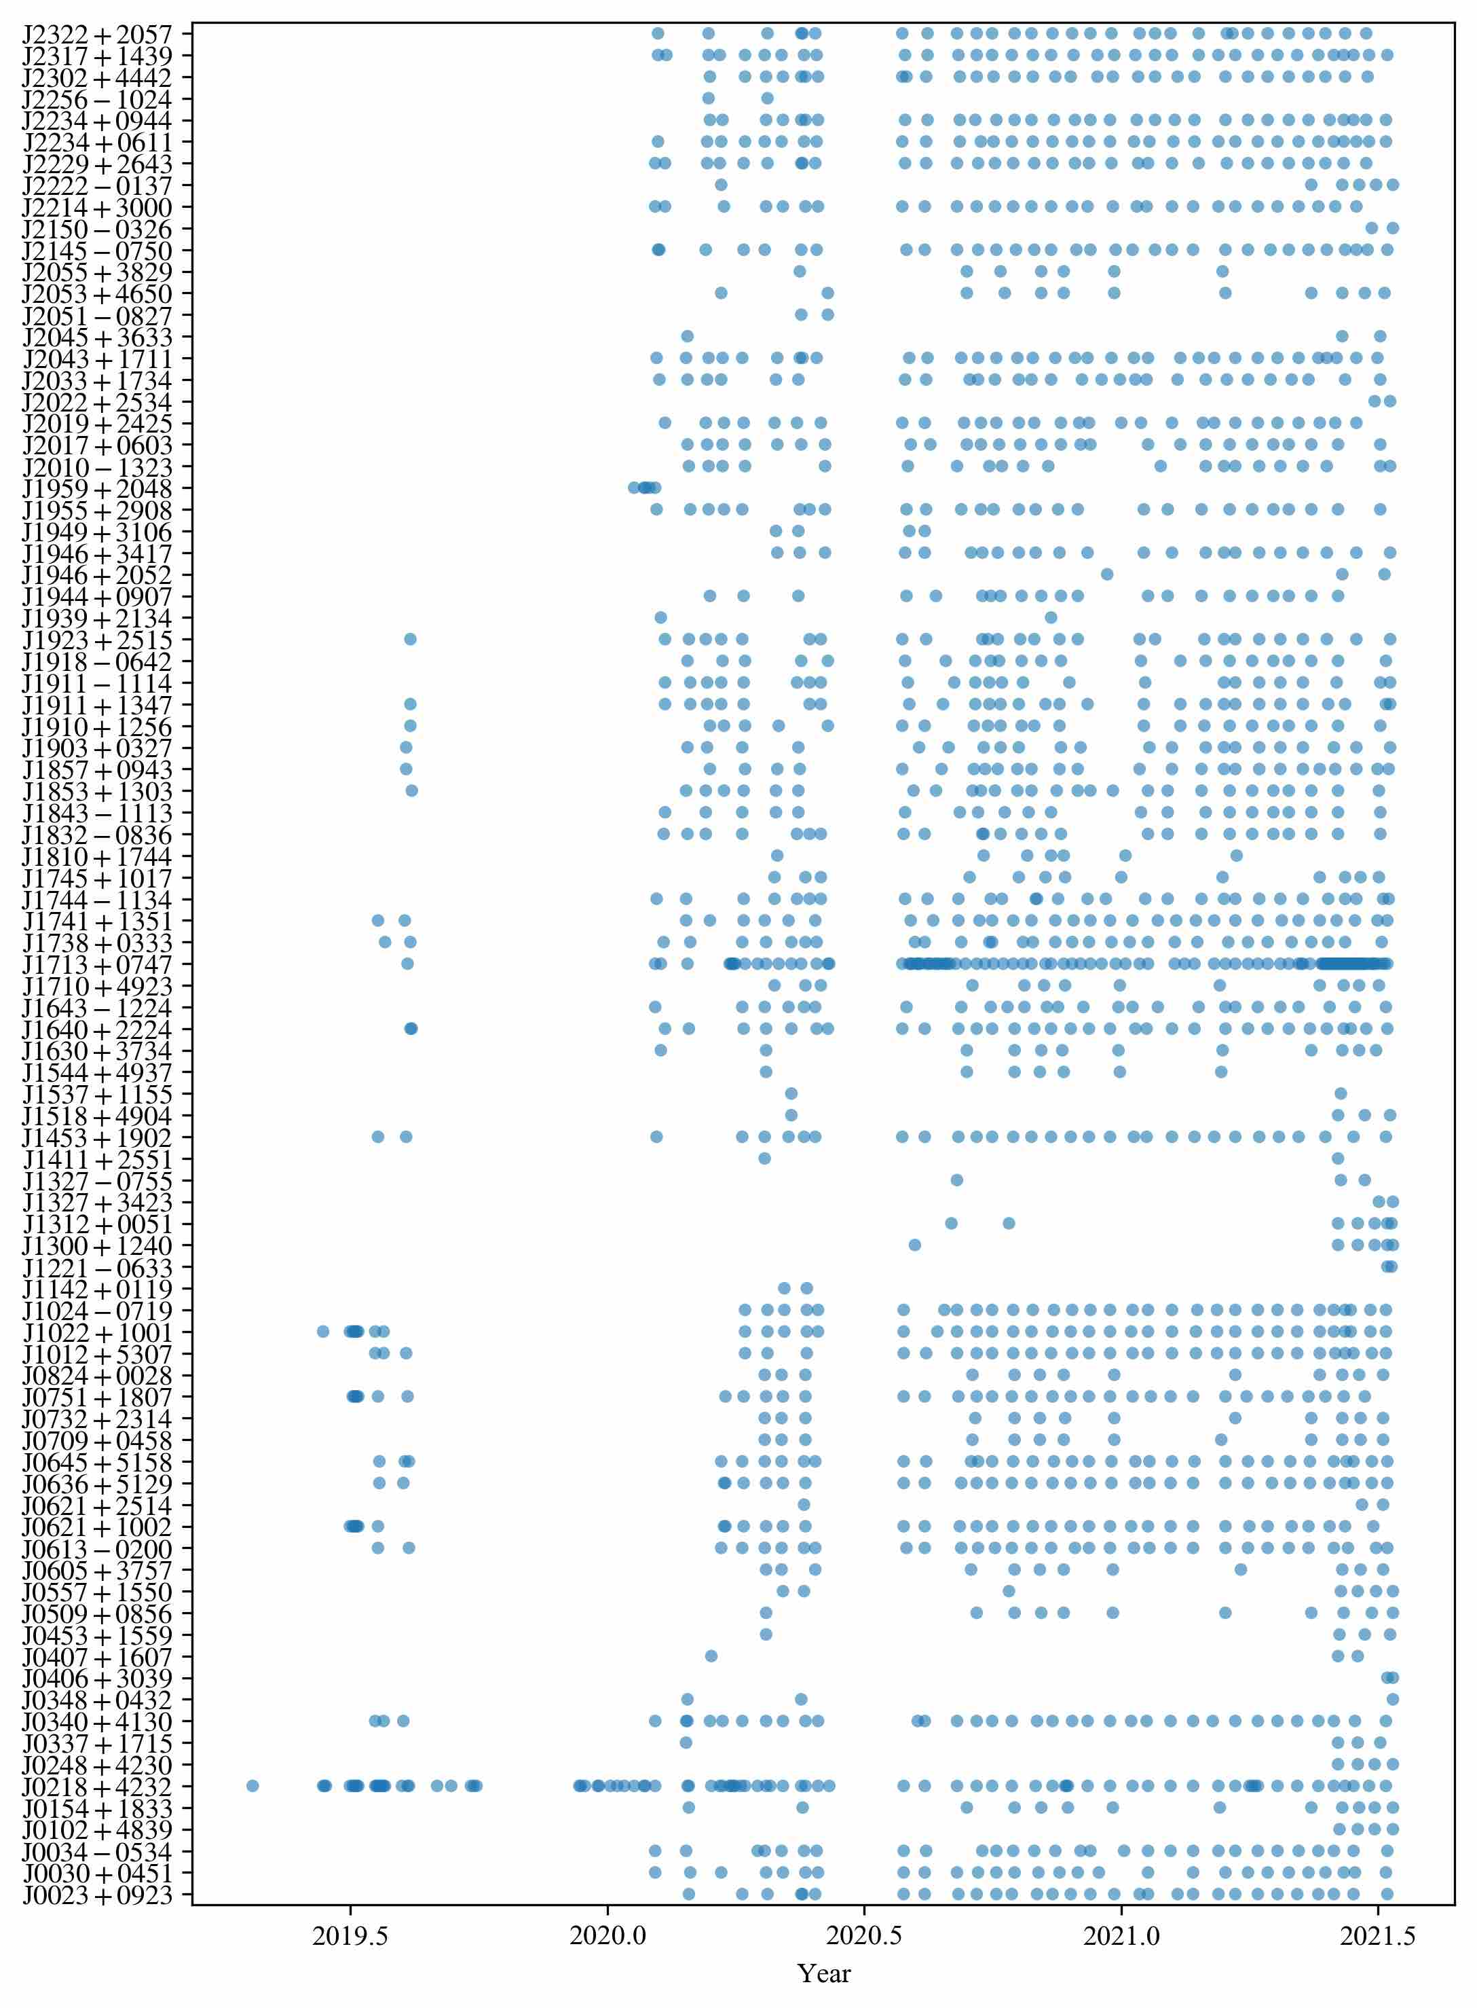
CPTA Data: Overview
FAST: Tsys~20 K, Gain~16 K/Jy (Jiang et al., 2020)
FAST 19Beam receiver @1.25 GHz (500 MHz bandwidth)
Data: psrfits data, incoherent dedispersion
~80 pulsars (most pulsars dec>0 deg)
Data span >~1.5 years
2-week cadence if possible
Less observations for some pulsars due to the shortage of observation time

Slide 8
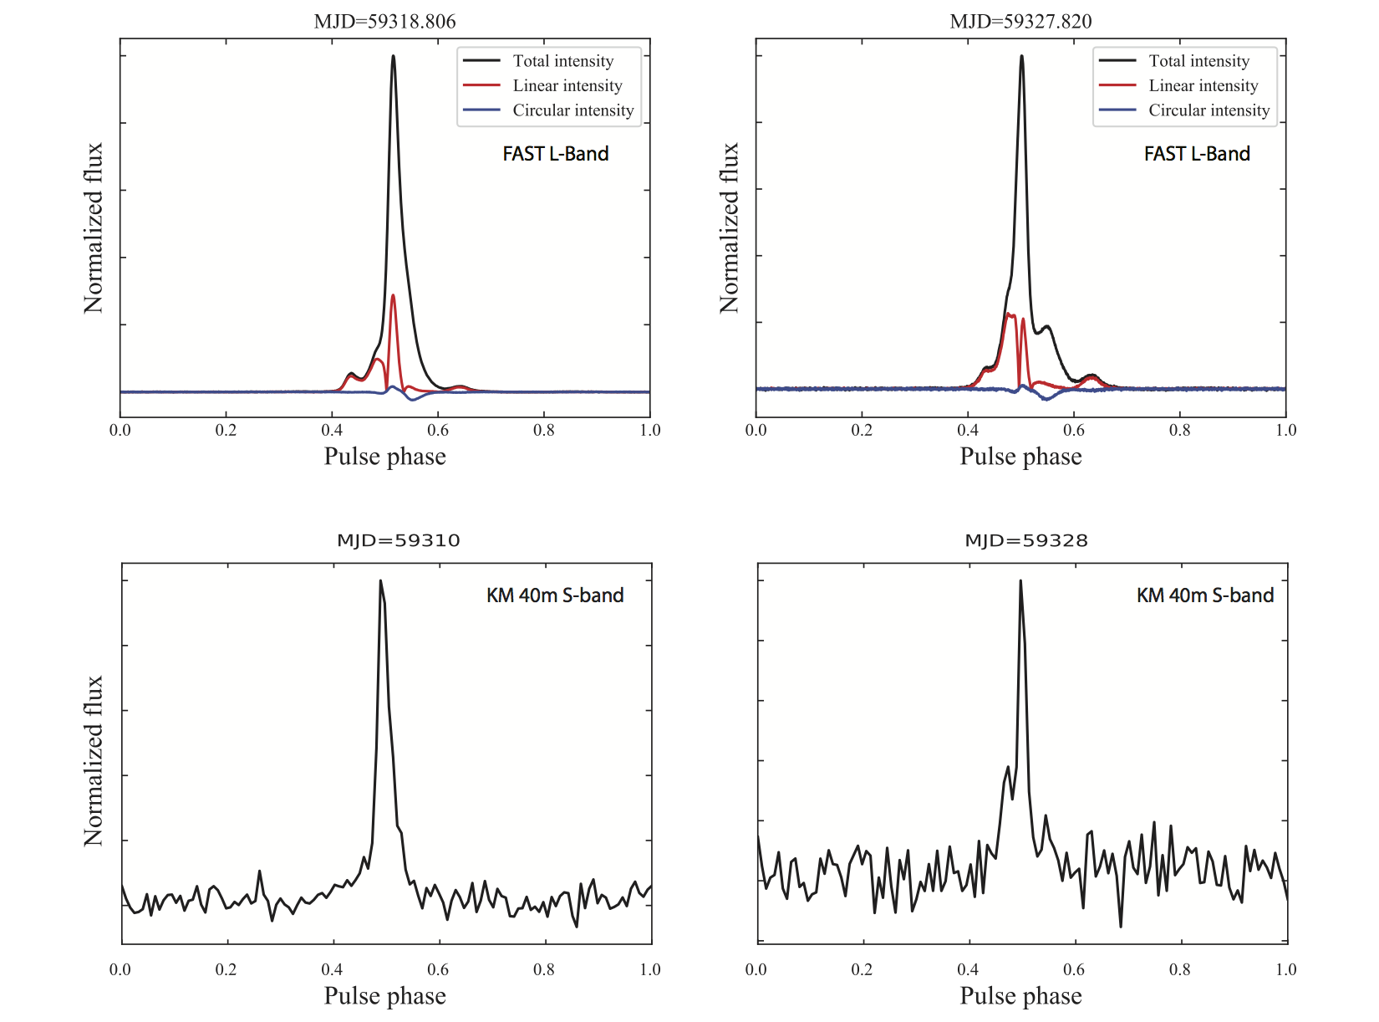
Pulse Profile of J1713+0747 changed!
Glitch?+Sustainable Profile Changing
Xu, Huang, Lee et al., 2021, Atel 14642

Slide 9
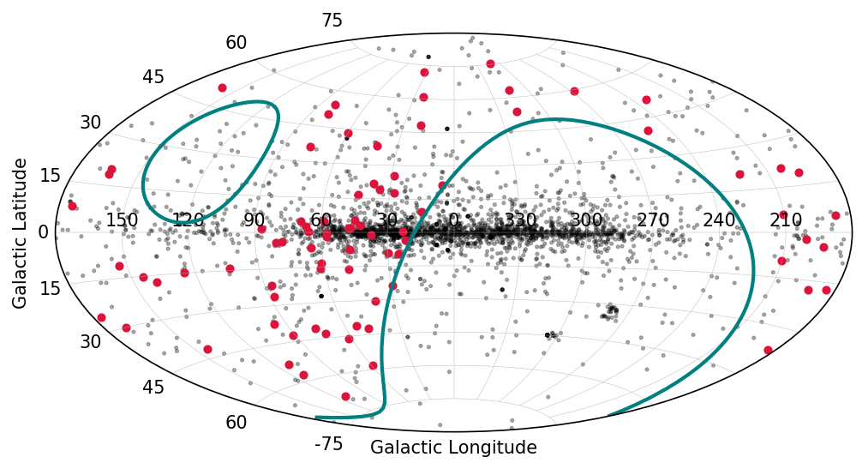
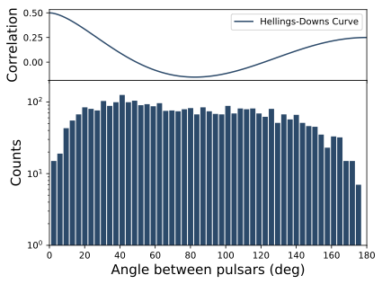
CPTA Data

Slide 10
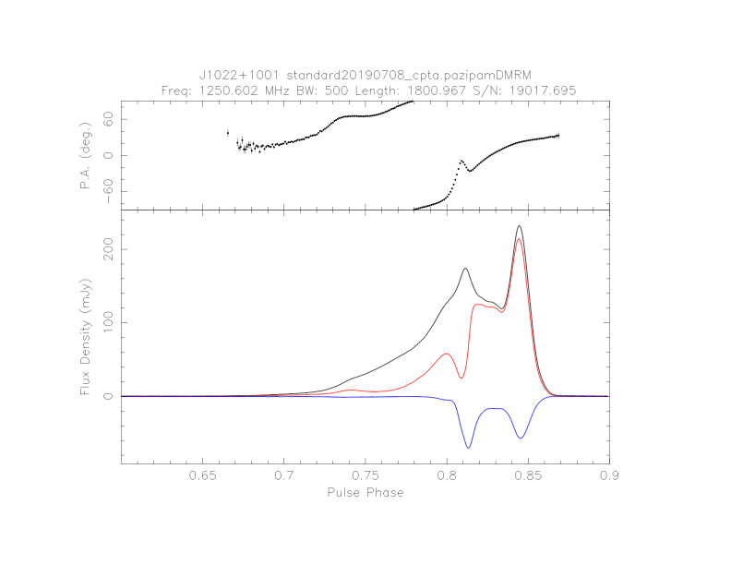
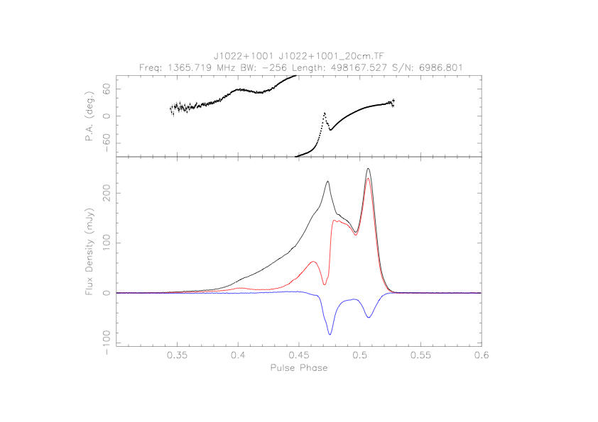
CPTA Data: Polarisation
High quality polarimetry
FAST
Parkes, Dai et al., 2015
Luo et al, 2020

Slide 11
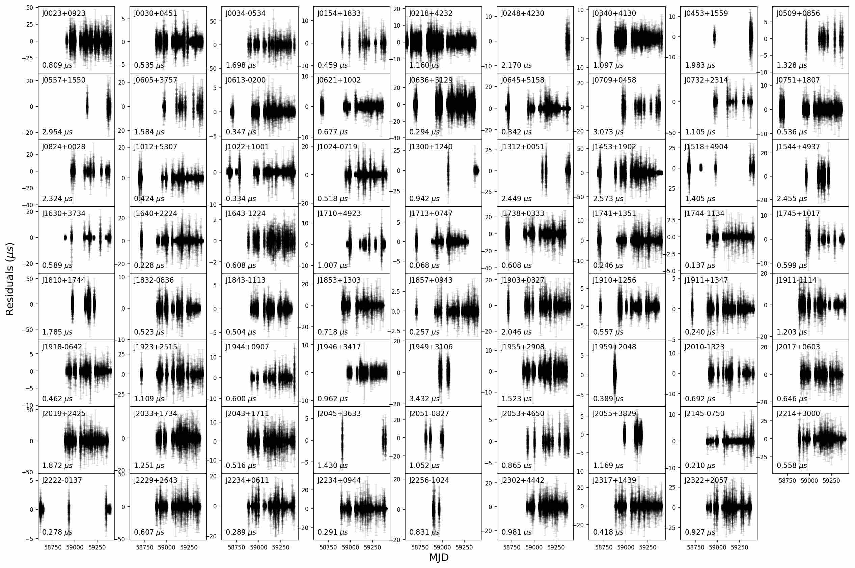
CPTA data-Timing Residuals
64 channels, 15 or 20 mins integration

Slide 12
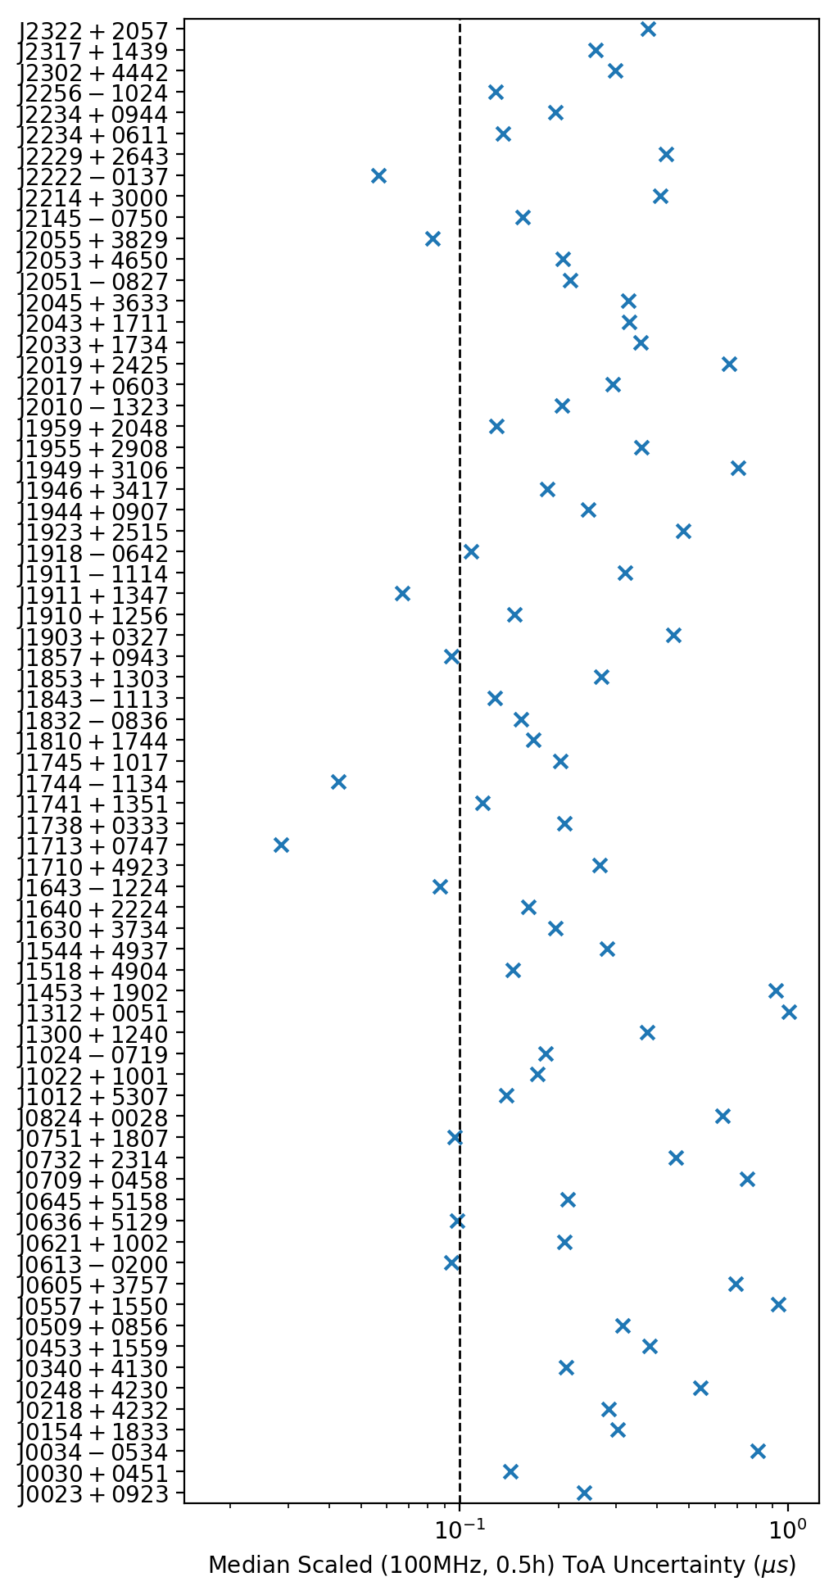
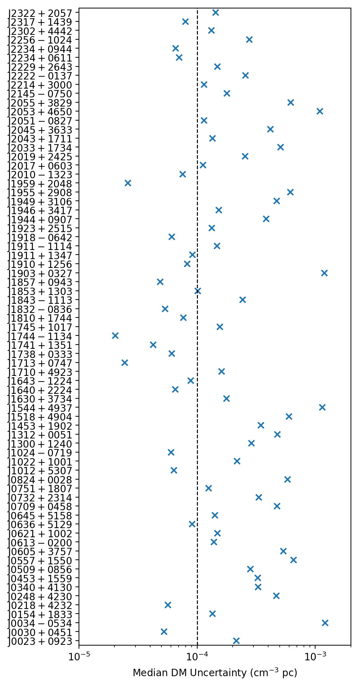
CPTA Data: ToA and DM Uncertainties
100 ns
10⁻⁴ cm⁻³ pc

Slide 13
CPTA Data
High quality polarimetric data
Good timing precision: 100-200ns level precision for >50 pulsars
Precise DM measurements with only L-band data
Jitter dominates for strong pulsars while radiometer noise dominates for weak pulsars
Special advantage for timing weak pulsars with FAST
No obvious red noise detected in single pulsar short dataset

Slide 14
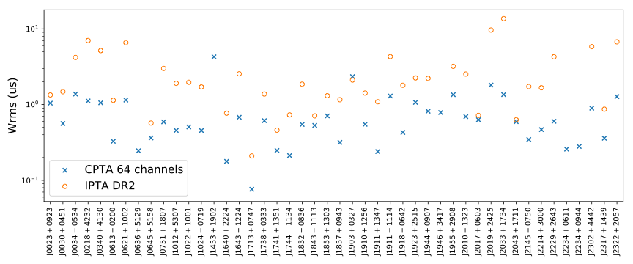
Sensitivity of CPTA
The timing at CPTA is in the 100 ns regime. (The best pulsar J1713+0747, ~65 ns for 15mins integration time).
CPTA timing precisions are 5-20 times better than IPTA.

Slide 15
Coherent dedispersion backend further strengthens CPTA

Slide 16
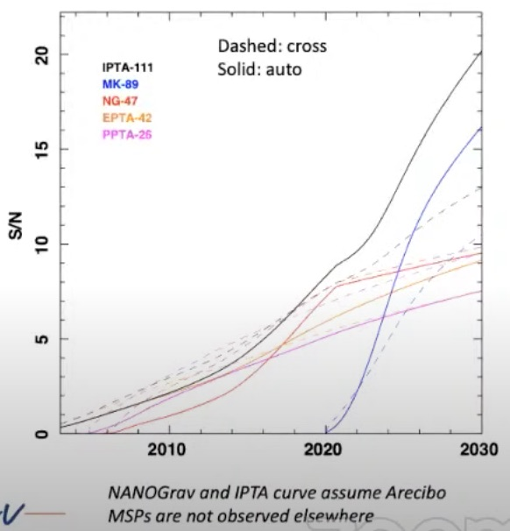
Conclusion
FAST CPTA timing dataset is of high quality
A large shortage of FAST observation time
Data length is still too short compared with IPTA
Detailed timing study of J1713+0747 profile changing event is under working
Lose of Arecibo!
Credit: R. Shannon

Slide 17
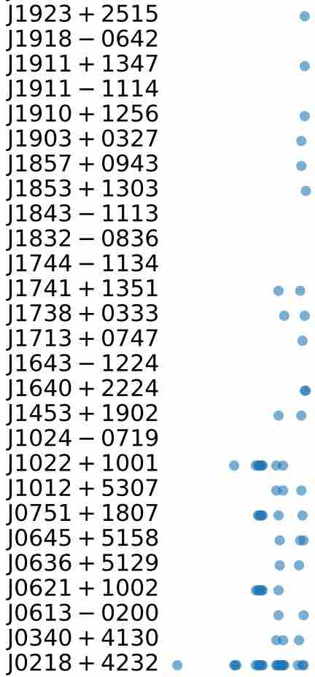
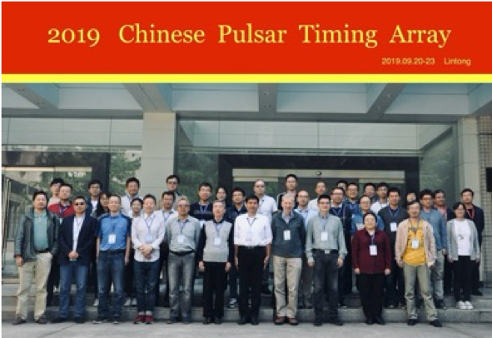
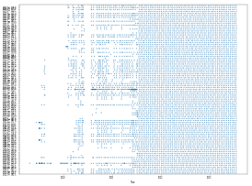
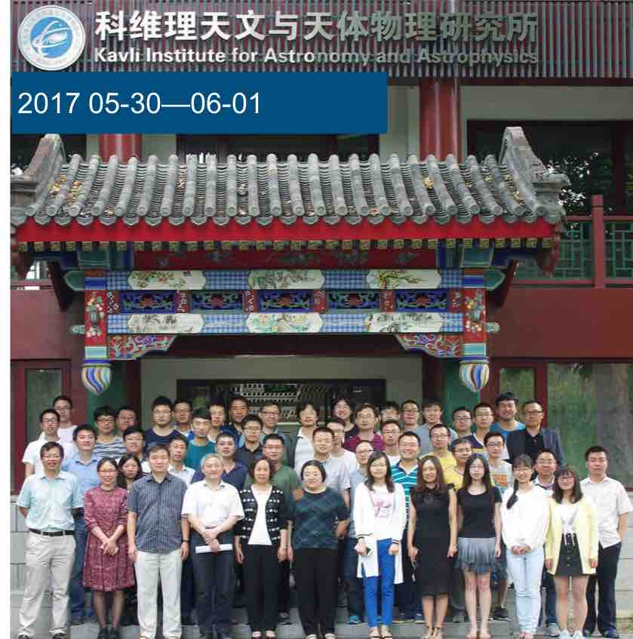
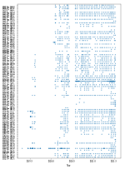
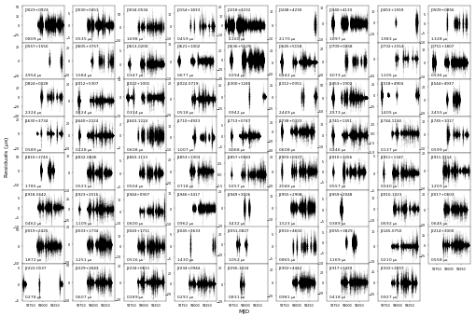
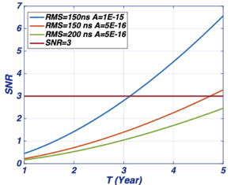
2017
2019
2021
Future?
Credit: KJ Lee
Credit: Sammy Griner’ mom

Slide 18
Thanks!

Slide 19
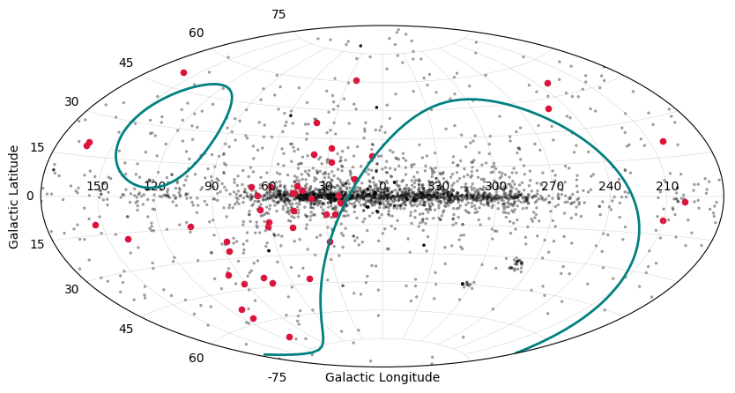
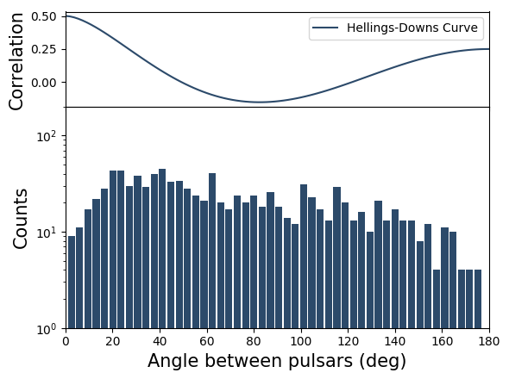
New PTA pulsars for CPTA

