Slide 1
A systematic study on frequency evolution behavior of pulsar pulse profiles
Xin Xu (许鑫)
Supervisor: Prof. Qijun Zhi
Guizhou Normal University

Slide 2
Outline
Background and Motivation
1
Results
2
Summary
3
Guizhou Normal University

Slide 3
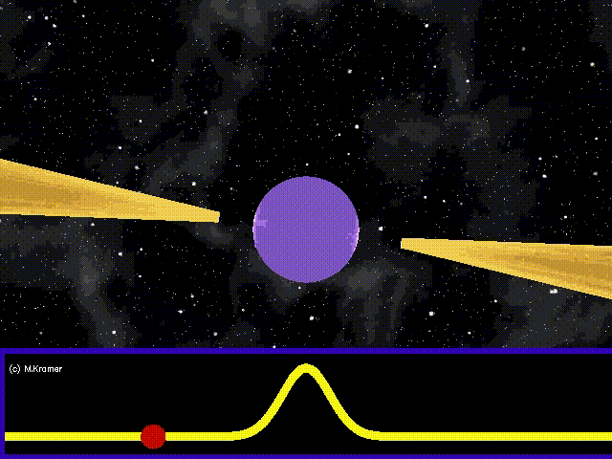
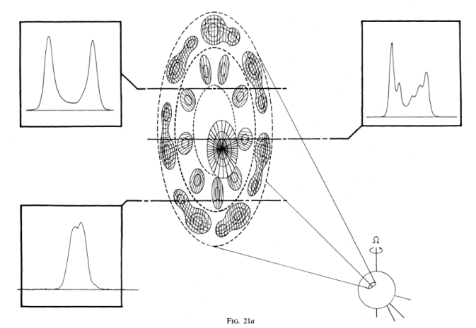
Background and Motivation:
Pulsar:
Formation: supernova explosion, white dwarfs collapse .
Mass：1.4$M_{s}$
radius ：~10km
magnetic field：~${{10}^{8}−10}^{15}G$
Period: 1.4ms – 23.5s
Density:10^14 g / cm^3
---------------------------------------------------------------------
（Figure from the network）
Emission beam：core, inner cone and outer cone.
As the line of sight sweeps through different positions, different radiation profiles will be obtained .
(Rankin 1983a)
Guizhou Normal University

Slide 4
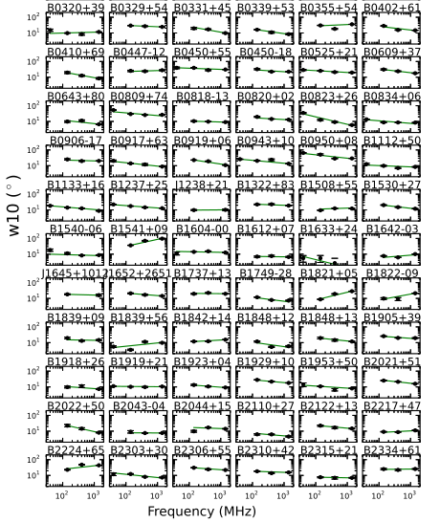
Background and Motivation:
Frequency dependence of pulse width ：
one power law functions ：
$$W=Af^{α}$$
2. more power law functions：
$$\left\{\begin{aligned}W_{1}=A_{1}f^{α_{1}} \\ W_{2}=A_{2}f^{α_{2}}\end{aligned}\right.$$
3. a simple power-law function with a constant term ：
W$=Af^{α}+W_{0}$
(Pilia et al. 2016)
Guizhou Normal University

Slide 5
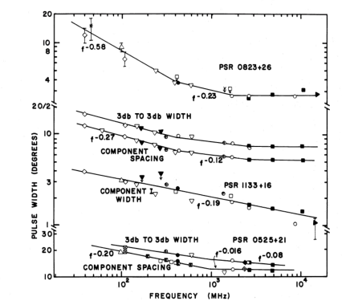
Background and Motivation:
Frequency dependence of pulse width ：
one power law functions ：
$$W=Af^{α}$$
2. more power law functions：
$$\left\{\begin{aligned}W_{1}=A_{1}f^{α_{1}} \\ W_{2}=A_{2}f^{α_{2}}\end{aligned}\right.$$
3. a simple power-law function with a constant term ：
W$=Af^{α}+W_{0}$
(Rankin 1983b)
Guizhou Normal University

Slide 6
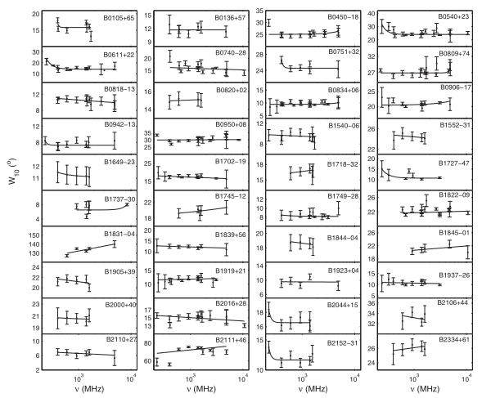
Background and Motivation:
Frequency dependence of pulse width ：
one power law functions ：
$$W=Af^{α}$$
2. more power law functions：
$$\left\{\begin{aligned}W_{1}=A_{1}f^{α_{1}} \\ W_{2}=A_{2}f^{α_{2}}\end{aligned}\right.$$
3. a simple power-law function with a constant term ：
W$=Af^{α}+W_{0}$
The frequency range of the research is small, which makes the conclusions drawn have limitations。
(chen & wang 2014)
Guizhou Normal University

Slide 7
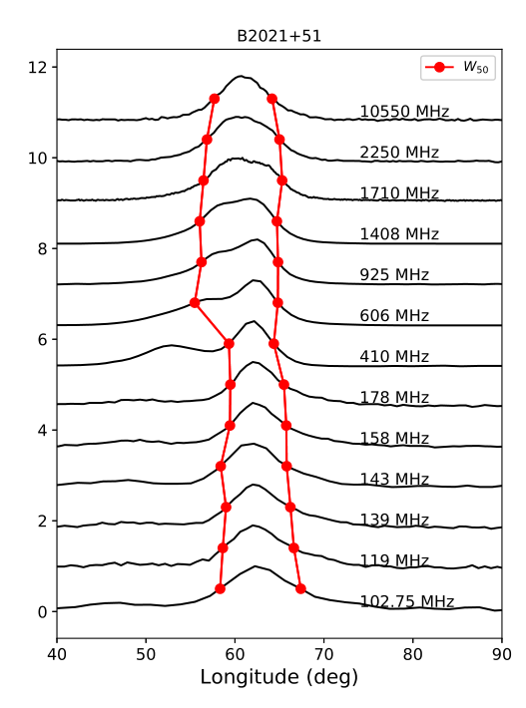
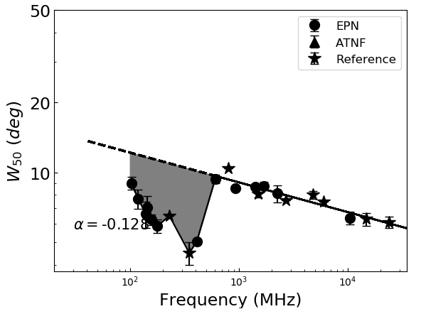
conal-single profile
core-single profile:
(Rankin 1983a)
conal-double profile
triple profile
multiple profile
Source: EPN, ATNF and recently published papers.
high frequency range: Comply with power law distribution
middle frequency range: The pulse width suddenly drops and then gradually recovers (have “absorption” features)
low frequency range: Width is fully restored
Guizhou Normal University

Slide 8
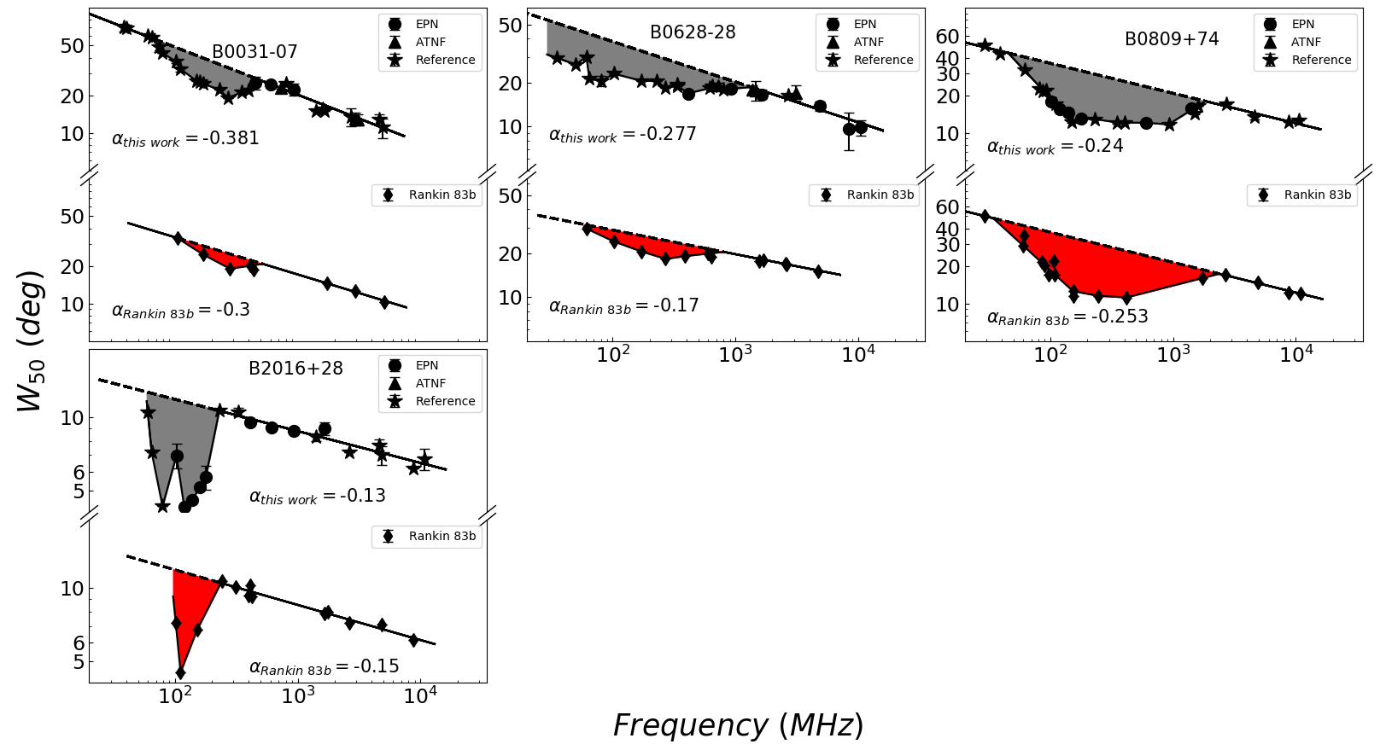
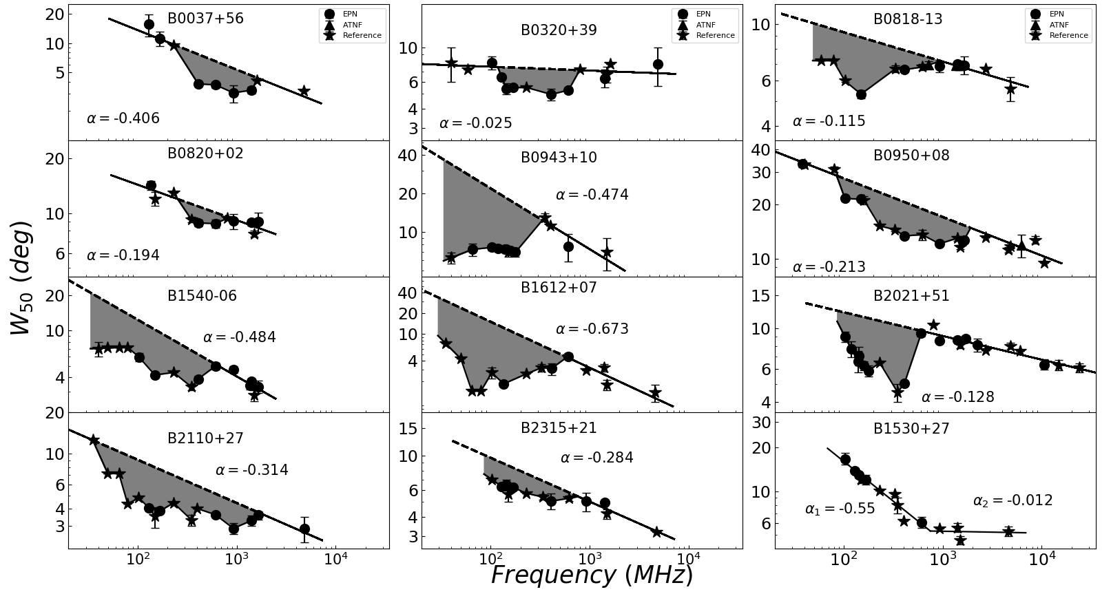
Results:
conal-single profile：
In the left, each panel shows the comparison between our results and that of Rankin 1983.
The image on the right is our newly added results of frequency evolution in W50 for 12 pulsars.
→ B1530+27：Lack of “absorption” features.
Guizhou Normal University

Slide 9
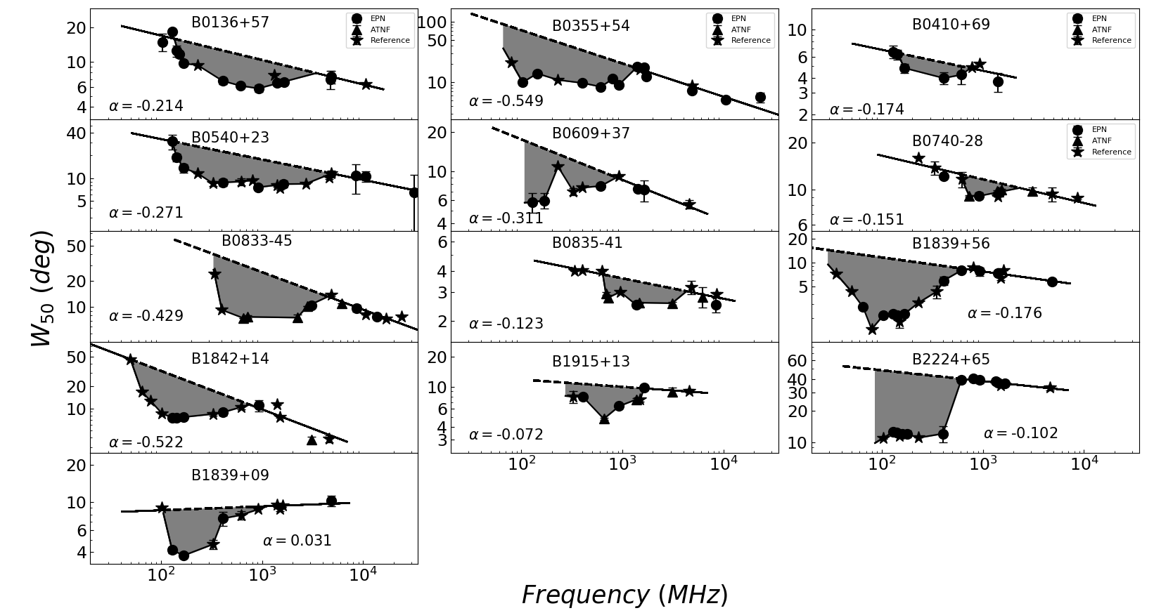
Results:
core-single profile:
→B0823+26: the width tends to widen as the frequency increases over 2GHz, $α=0.032$
have such a wide “absorption” feature so that the results we give are all within the absorption range.
B1839+09: the pulse width increases with frequency in high frequency, and the pulse profiles of these pulsars also have “absorption” features.
Guizhou Normal University

Slide 10
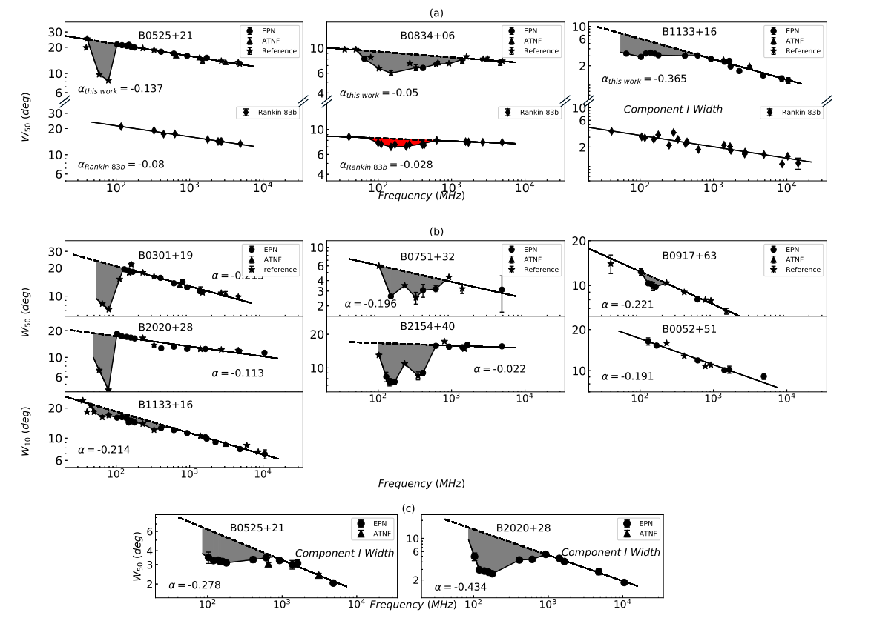
Results:
conal-double profile
Rankin 1983: the well-resolved double profiles haven’t the “absorption” features.
→B0052+21，B1133+16 …: the “absorption” features that is just at a lower frequency range or has a less obvious absorption strength.
→ the first component of the well-resolved double profiles has the same phenomenon
→B0052+51：haven’t the “absorption” features. > lack of data?
Guizhou Normal University

Slide 11
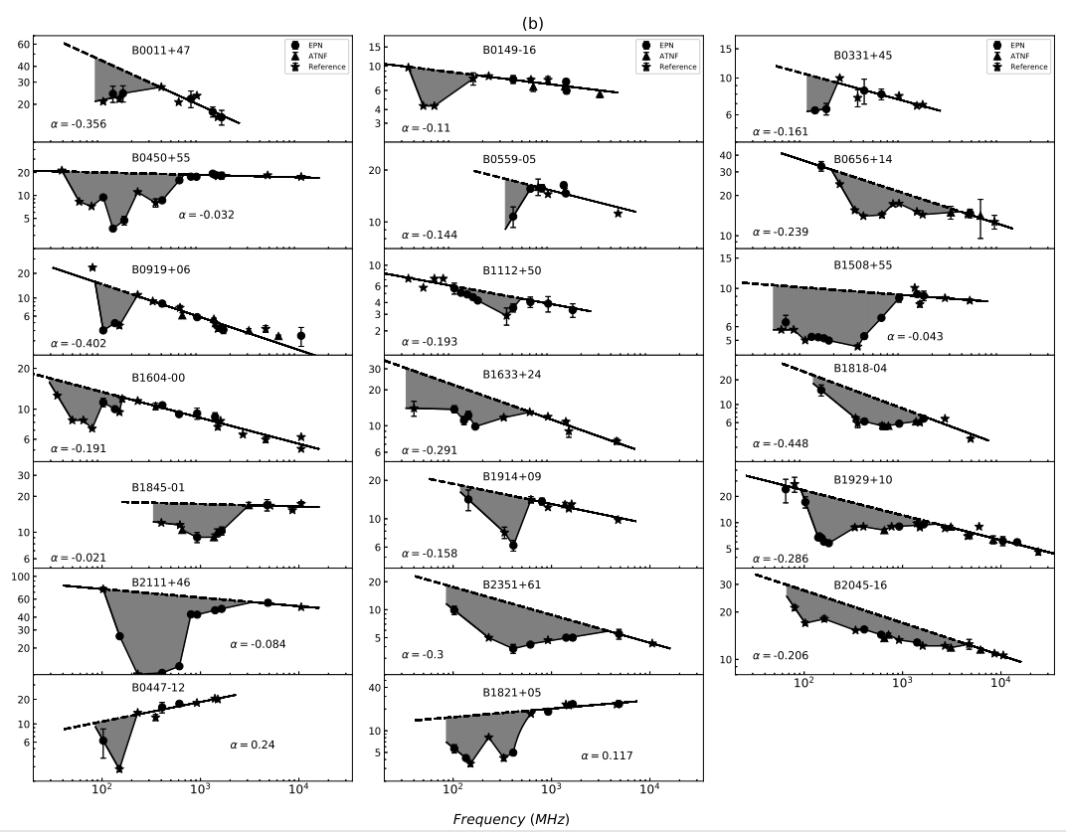
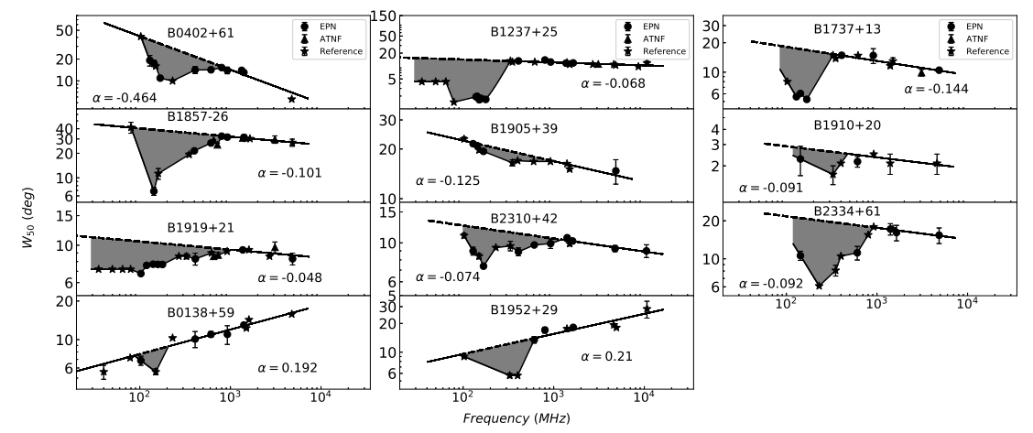
Results:
triple profile :
multiple profile:
Guizhou Normal University

Slide 12
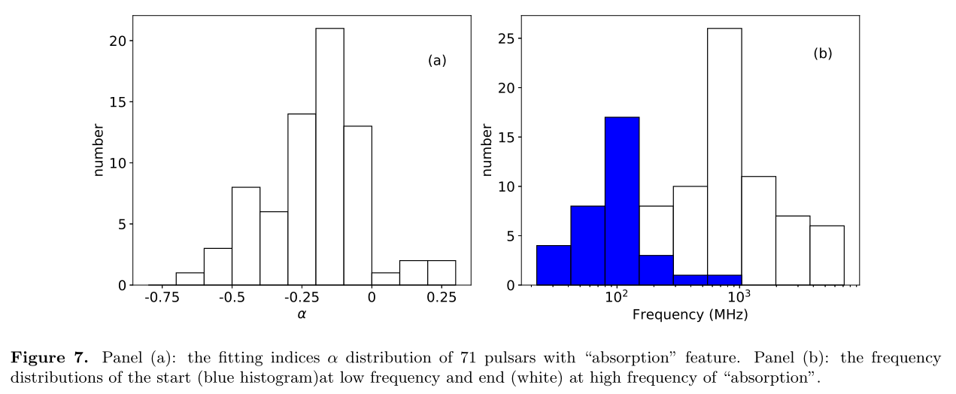
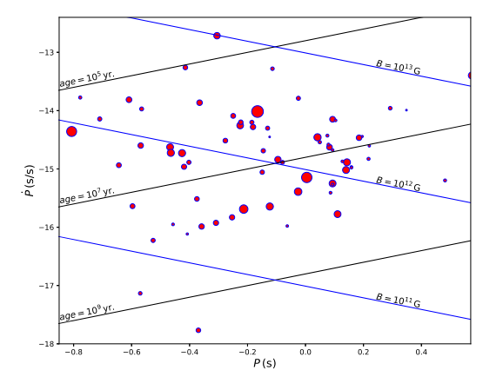
Results:
→ $α\sim −0.15$。
→“absorption” features appear at the frequency range from 100 MHz to 800 MHz for most pulsars
→ No direct correlations between absorption strength and pulsar parameters (period, period derivative, magnetic field and age) are found.
Guizhou Normal University

Slide 13
Summary:
A total of 74 pulsars have been counted, of which 71 show “absorption” features, which indicates that the absorption is an universal phenomenon, and five of them exhibit different frequency dependence in high frequency and have “absorption” feature.
Conal-double profile: the “absorption” features that is just at a lower frequency range or has a less obvious absorption strength. the first component of the well-resolved double profiles has the same phenomenon
The “absorption” features appear in the frequency range of 100 MHz - 800 MHz, and the evolution trend of W50 at frequencies less than ∼100 MHz and large than ∼800 MHz can be described as a power-law function.
We quantify the absorption intensity and analyze the correlation between the absorption intensity and the pulsar parameters. It is found that there is no direct correlation between them.
Guizhou Normal University

Slide 14
THANKS YOU
Thanks!

