Slide 1
并合后中子星的性质讨论
俞云伟
华中师范大学
合作者：李少泽，吴光磊，高鹤，戴子高， 张冰，郑小平

Slide 2
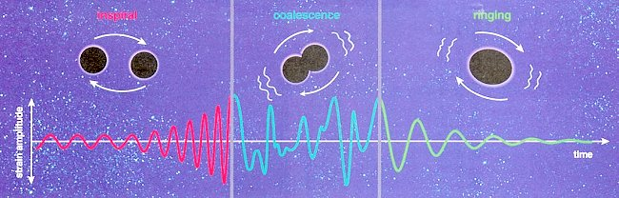
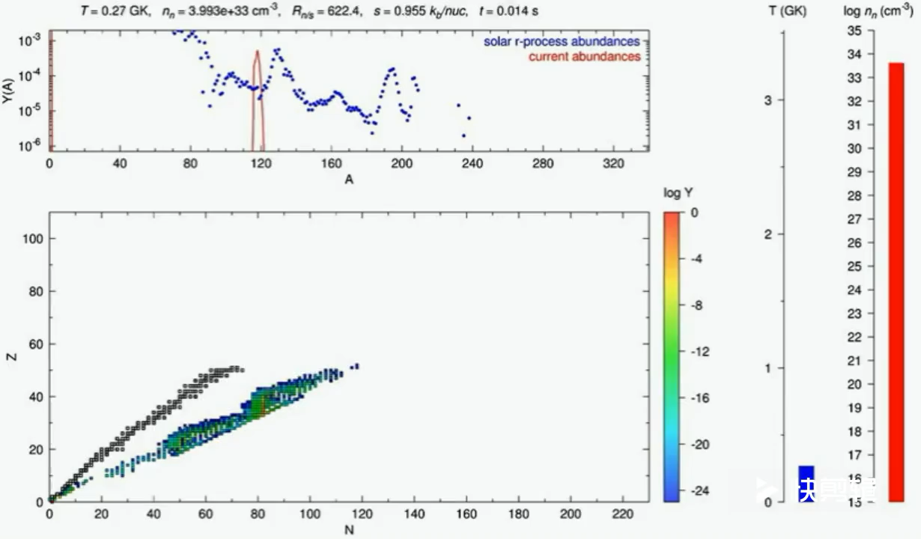
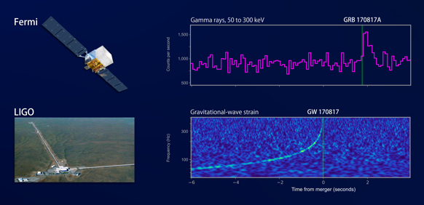
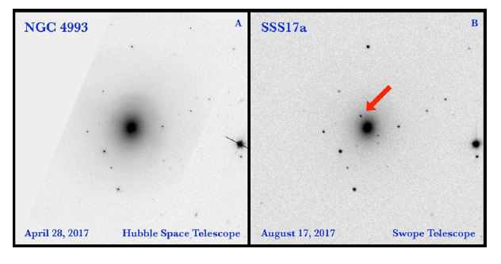
双中子星并合的产物是什么？

Slide 3
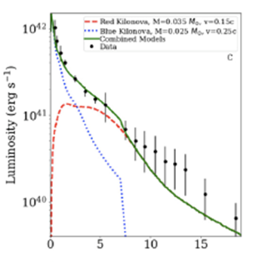
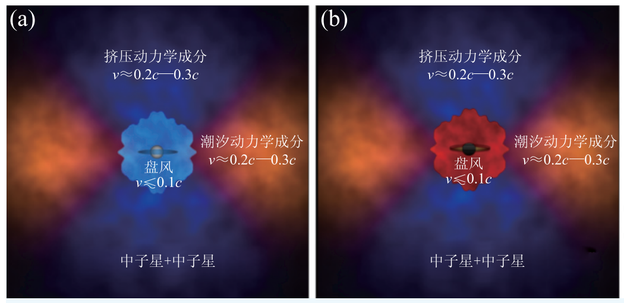
Merger ejecta and central engine
The wind component of the merger ejecta could not be heavy enough to power the blue kilonova.
An extra central engine is required.
Kasen et al. 2017, Nature
Kilpatrick et al. 2017, 358,1583

Slide 4
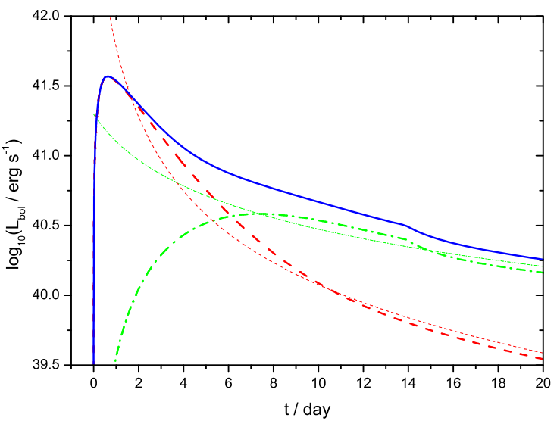
Merger ejecta and central engine
The wind component of the merger ejecta could not be heavy enough to power the blue kilonova.
An extra central engine is required.
YWY, Liu, Dai, 2018, ApJ, 861, 114
Kasen et al. 2017, Nature

Slide 5
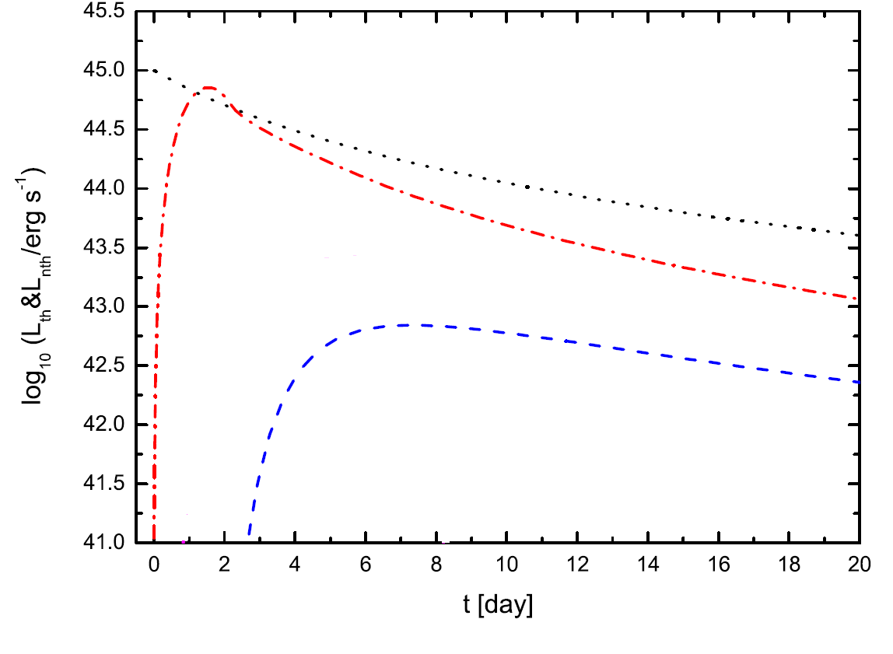
Non-thermal emission from the NS
The wind component of the merger ejecta could not be heavy enough to power the blue kilonova.
An extra central engine is required.
PWN emission
（non-thermal）
Kilonova emission
（thermal）
YWY, Chen, Li 2019, ApJL, 877, L21

Slide 6
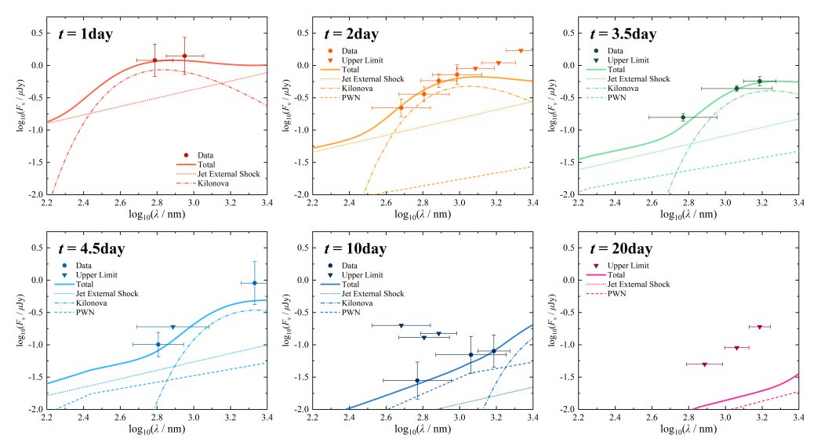
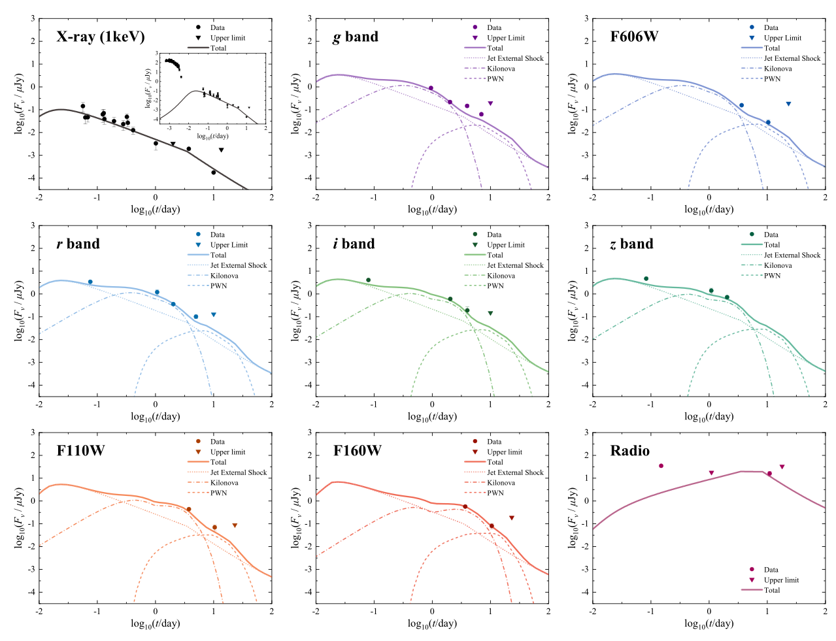
Non-thermal emission from the NS
Wu, YWY, Zhu, 2021, A&A, submitted

Slide 7
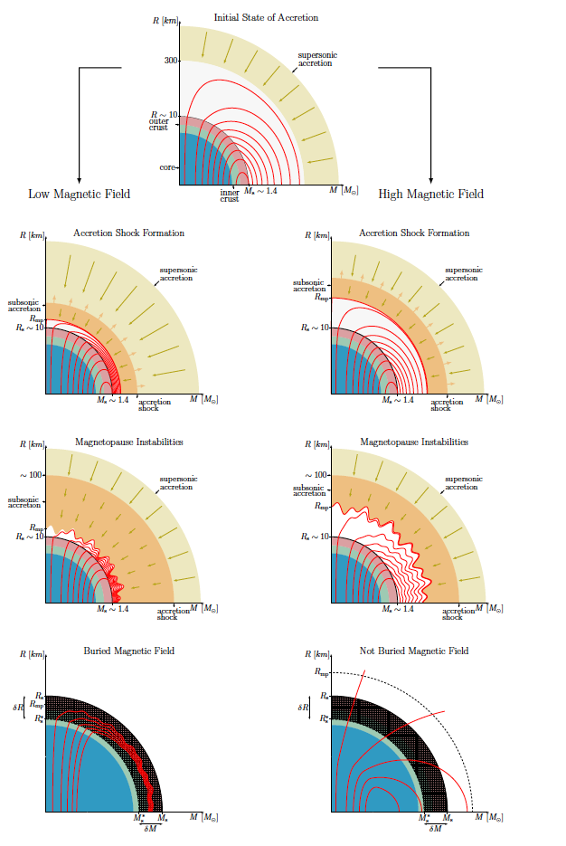
A low-field remnant magnetar?
The serious suppression of the MDR may be indicated by the steep decay after an afterglow plateau.
AT2017gfo’s luminosity indicates the MDR of the remnant NS is suppressed seriously, if the NS is a magnetar intrinsically.
GW radiation
Magnetic dipole radiation
YWY, Liu, Dai, 2018, ApJ, 861, 114
Torres-Forné et al. 2016
The open field lines could be buried by fallback material and also expelled to be within the light cylinder.

Slide 8
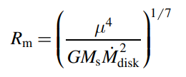
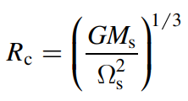
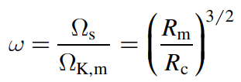
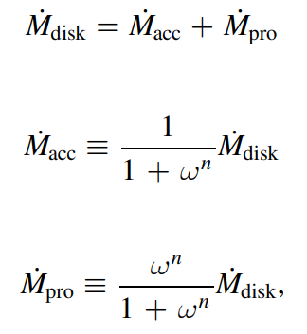
Early evolution of the remnant NS
propeller recycling
NS
Relic disk
Li, YWY, Gao, Zhang 2021, ApJ, 907, 87

Slide 9
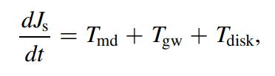

Early evolution of the remnant NS
propeller recycling
NS
Relic disk
Li, YWY, Gao, Zhang 2021, ApJ, 907, 87

Slide 10
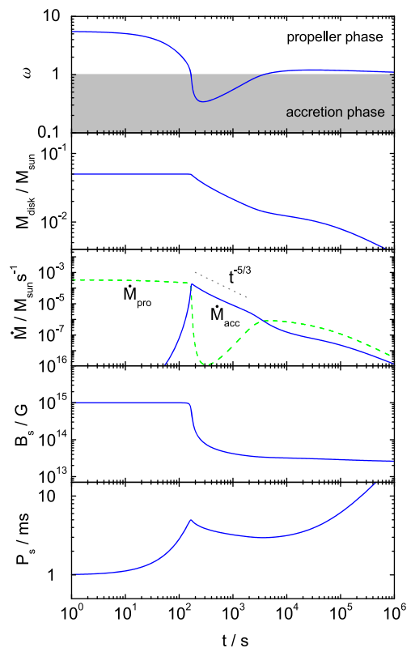
Early evolution of the remnant NS
propeller recycling
NS
Relic disk
Li, YWY, Gao, Zhang 2021, ApJ, 907, 87

Slide 11
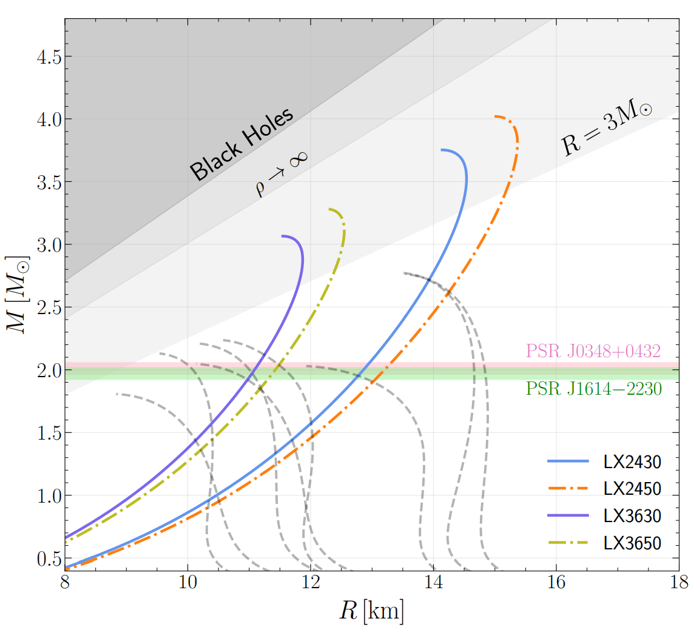
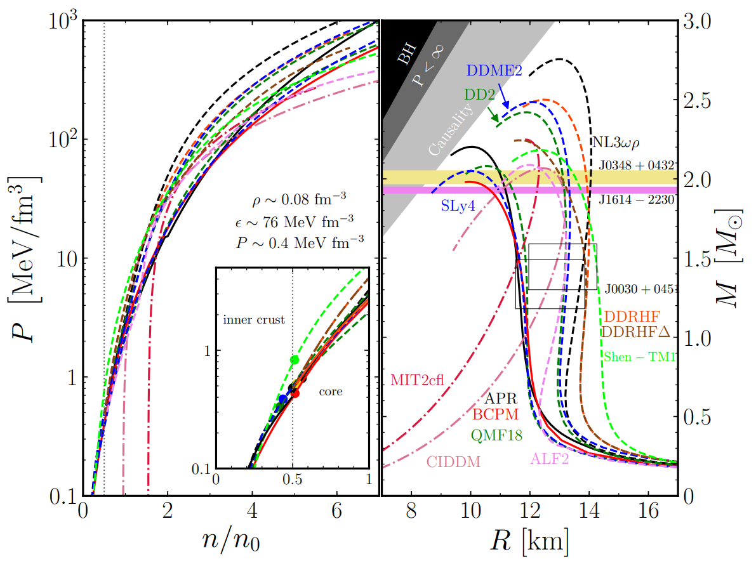
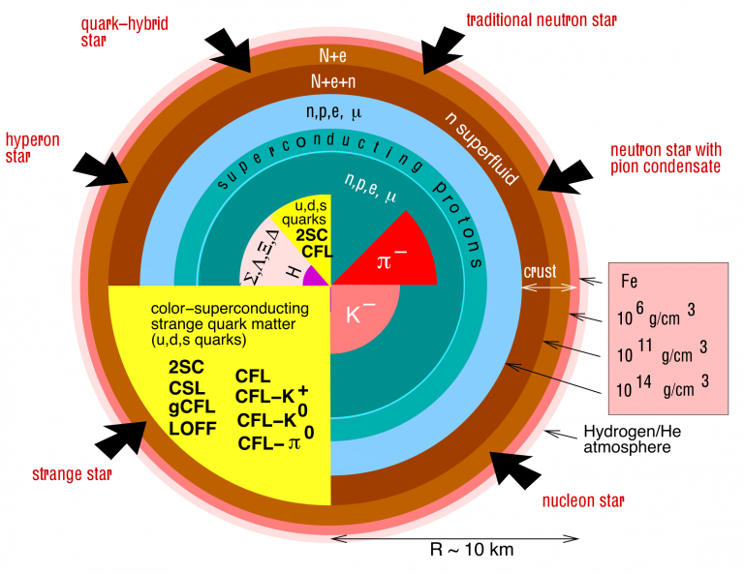
What’s the nature of the remnant NS?
高勇的报告
取自朱镇宇博士论文

Slide 12
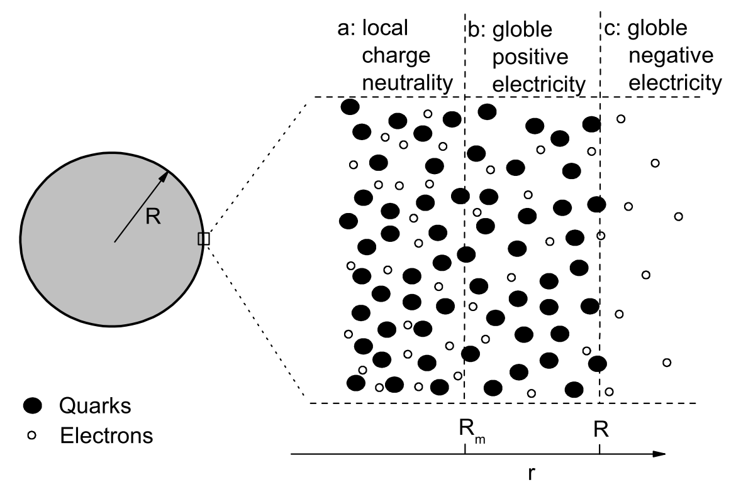
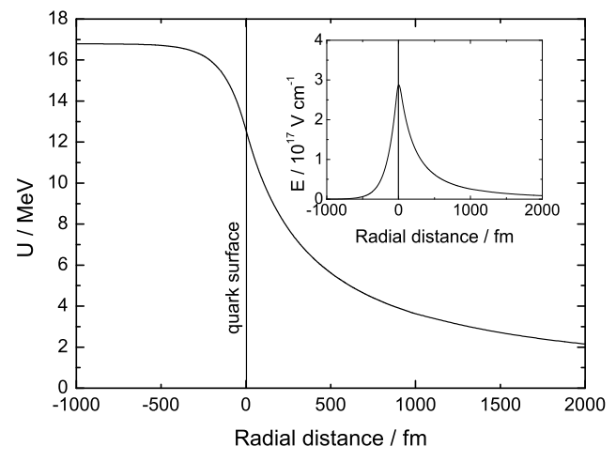

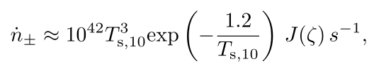
Electron-positron outflow from a post-merger proto-SS
-
+
-
+
-
+
-
+
-
+
-
+
-
+
+
-
-
+
-
+
-
+

Slide 13
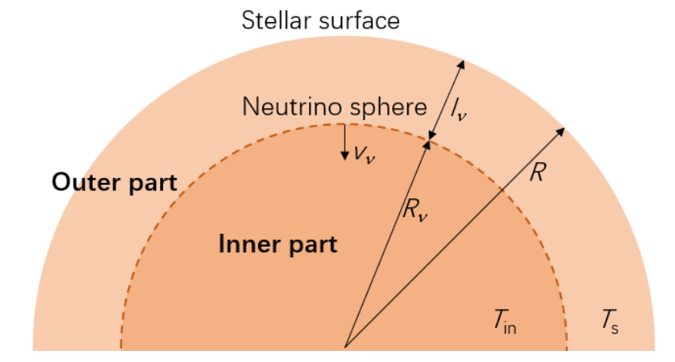
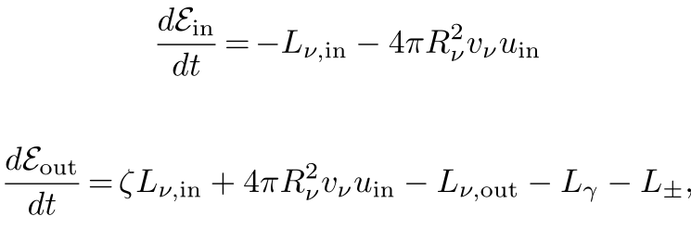
Electron-positron outflow from a post-merger proto-SS
Li, YWY, Gao, Dai, Zheng 2021, in preparation

Slide 14
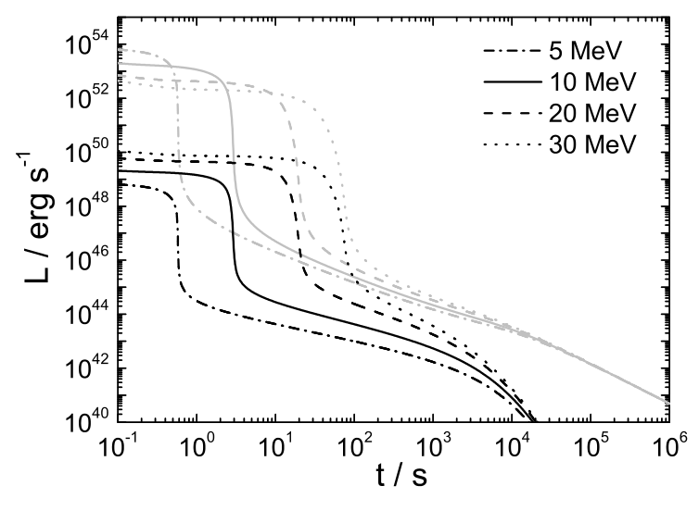
Electron-positron outflow from a post-merger proto-SS
Li, YWY, Gao, Dai, Zheng 2021, in preparation

Slide 15
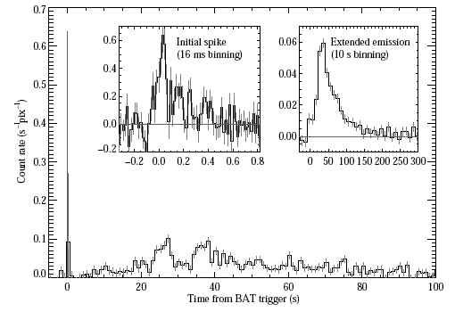
Electron-positron outflow from a post-merger proto-SS
-
+
-
+
-
+
-
+
-
+
-
+
-
+
+
-
-
+
-
+
-
+
短伽马射线暴的延展辐射

Slide 16
Thanks for your attention!

