Slide 1
Highly sensitive observations of spider pulsars with FAST
王双强
中国科学院新疆天文台
2022.8 湘潭

Slide 2
Outlines
Background
Some black widows
Summary
Notes:
5f13f3af-77ba-47ff-af48-9dcb50e9732d

Slide 3
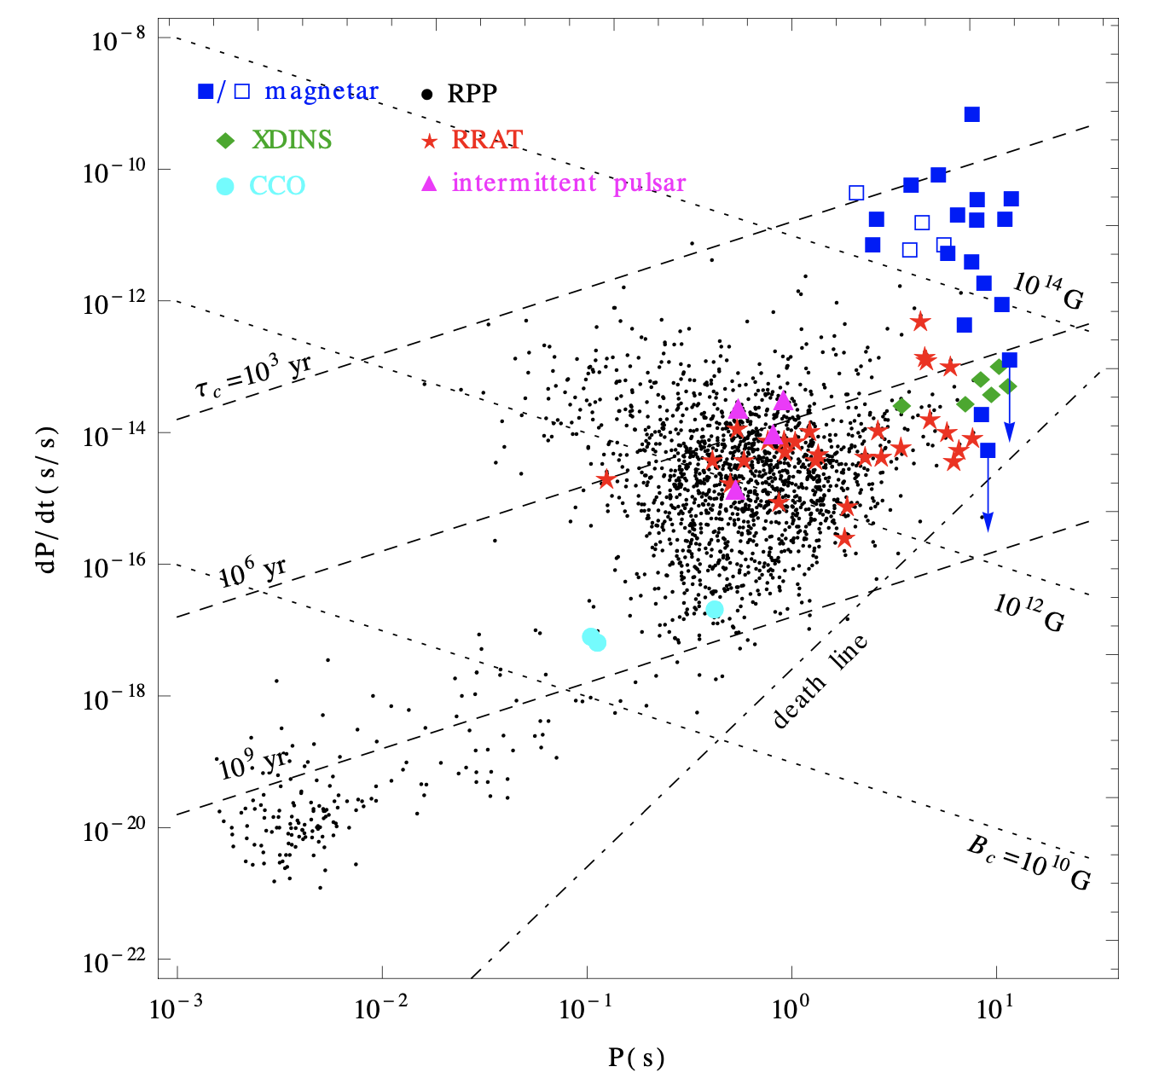
Background
Millisecond pulsar
PSR J1841−0500: 辐射消失时间大约580天，周期导数从-4.165(1)×10^-14 s/s 减少到 -1.67×10^-14
观测跨度：2011年9月-2018年4月
Discovered at radio waveband (PSR B1937+21) with Arecibo (Backer et al. 1982)
Most radio MSPs are in binaries, 30% are isolated
Spun-up (“recycled”) by accretion in LMXBs (Alpar et al. 1982)
Tong et al. (2015)

Slide 4
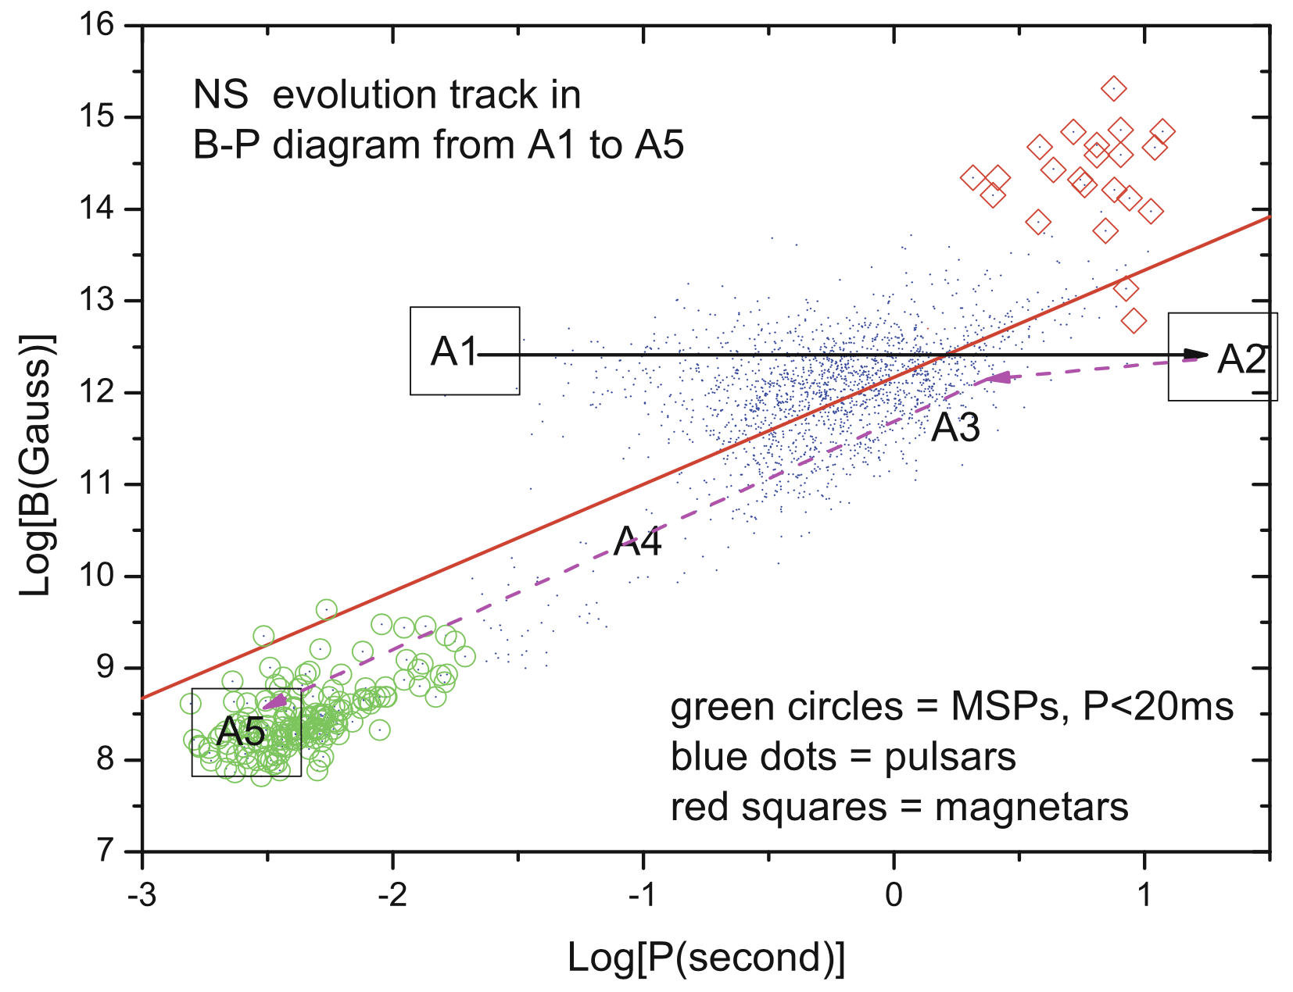
Background
Formation
PSR J1841−0500: 辐射消失时间大约580天，周期导数从-4.165(1)×10^-14 s/s 减少到 -1.67×10^-14
观测跨度：2011年9月-2018年4月
After born, pulsar period increases as the energy lose.
When the companion over flow the Roche lobe, accretion starts with decreasing period and magnetic field
A MSP generates after accreting about 0.2 solar mass.
(1) Accretion Powered MSPs: SAX J1808.4-3658
(2) Transitional pulsar: PSR J1023+0038…
Zhang et al. 2016

Slide 5
PSR J1023+0038: The “Missing Link”
System had accretion disk in 2001 but not after 2003
Eclipsing (“redback”) binary radio MSP (P = 1.69 ms, Pb = 4.47 hr) discovered in 2009
PSR J1841−0500: 辐射消失时间大约580天，周期导数从-4.165(1)×10^-14 s/s 减少到 -1.67×10^-14
观测跨度：2011年9月-2018年4月
Radio pulsar emission ceased on June 23rd, 2013
Average X-ray flux increased by ~order of magnitude
Fermi LAT flux increased about 5-fold!

Slide 6
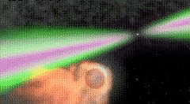
Binary evolution
Spider pulsars
PSR J1841−0500: 辐射消失时间大约580天，周期导数从-4.165(1)×10^-14 s/s 减少到 -1.67×10^-14
观测跨度：2011年9月-2018年4月
Redbacks (RBs) and black widows (BWs) are subpopulations of MSPs in close binary systems.
The companion masses of RBs: 0.2 ∼ 0.4M⊙, BWs: 0.02 ∼ 0.05M⊙
The high energy emission of the pulsars irradiate the companions.
Radio eclipse.
The predecessor of isolated MSP!!!

Slide 7
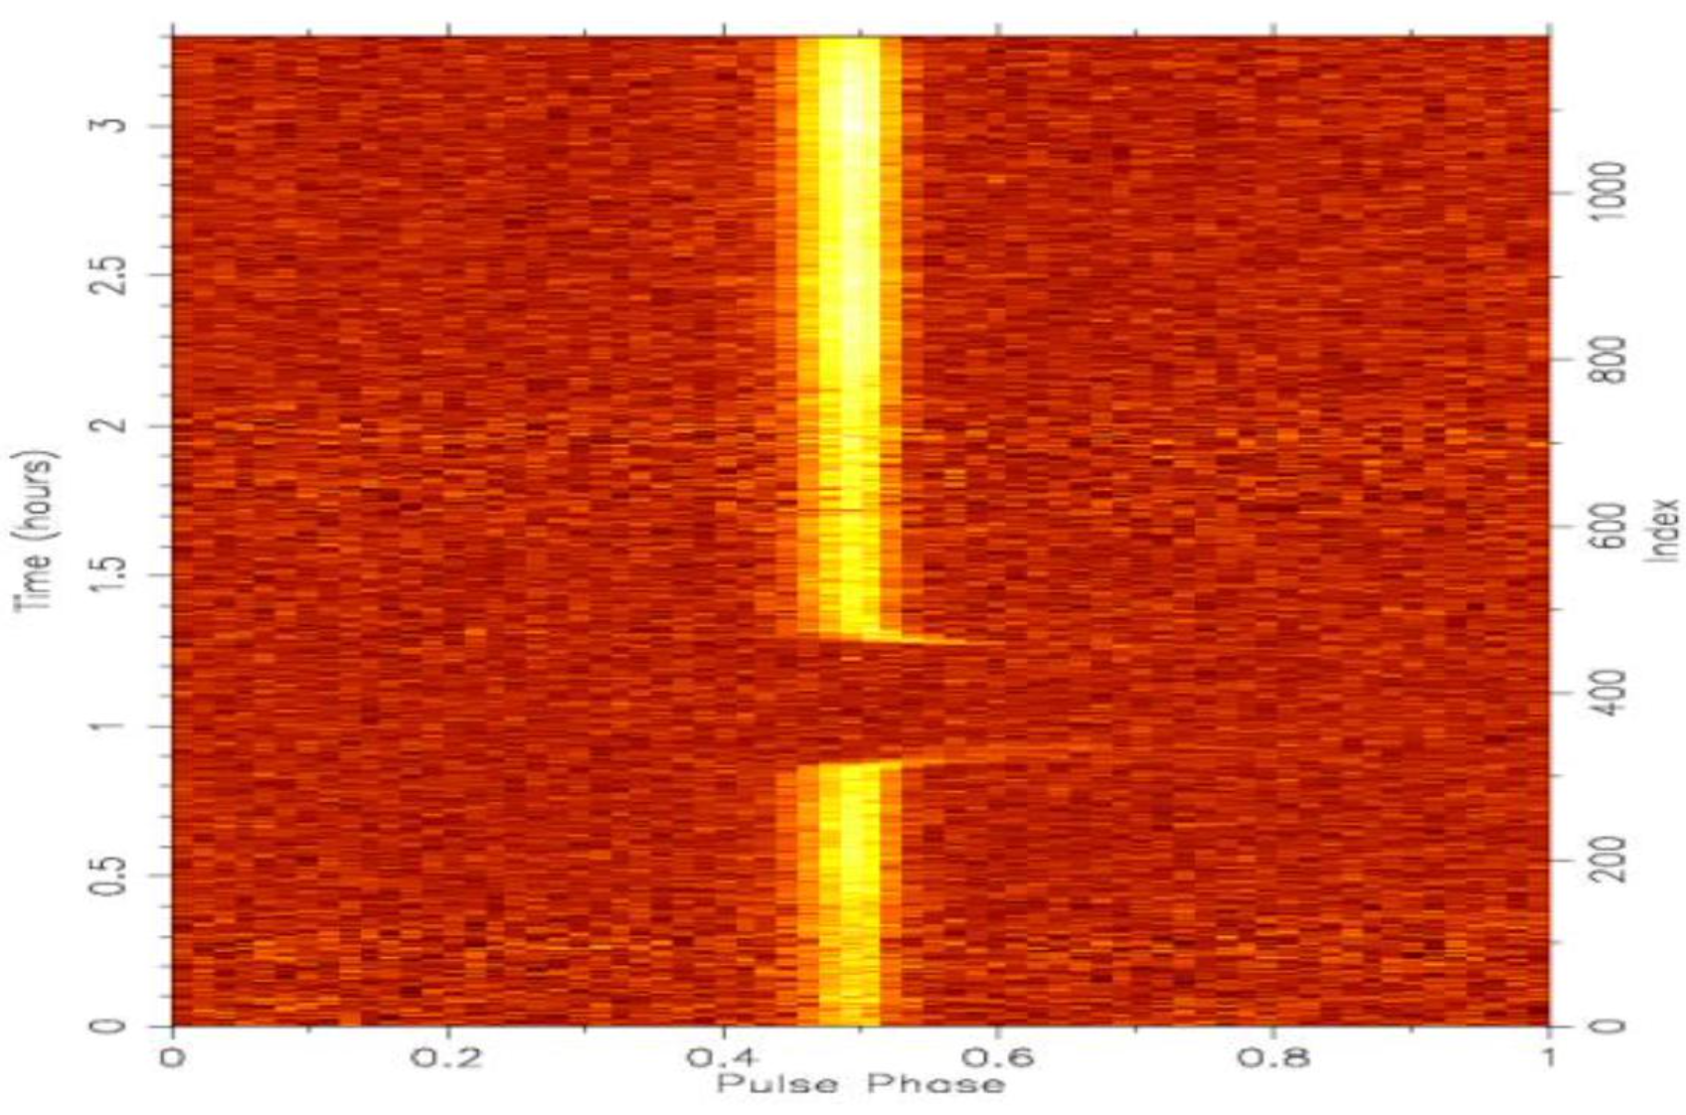
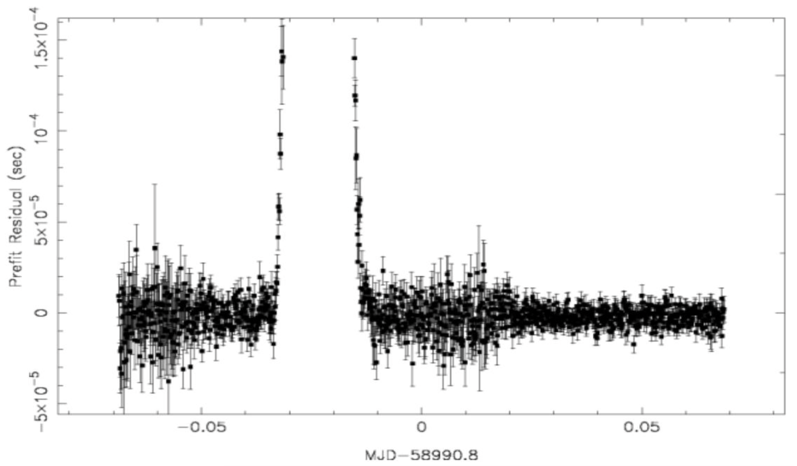
19C13: J1720−0533
Black widow!!!
PSR J1841−0500: 辐射消失时间大约580天，周期导数从-4.165(1)×10^-14 s/s 减少到 -1.67×10^-14
观测跨度：2011年9月-2018年4月
The thirteenth pulsar that discovery in CRAFTS, confirmed to be a black widow by ZD2020_6.
Spin period 3.26 ms, Orbital period 3.16 hr.
Companion mass 0.034 solar mass.
Radio eclipse .

Slide 8
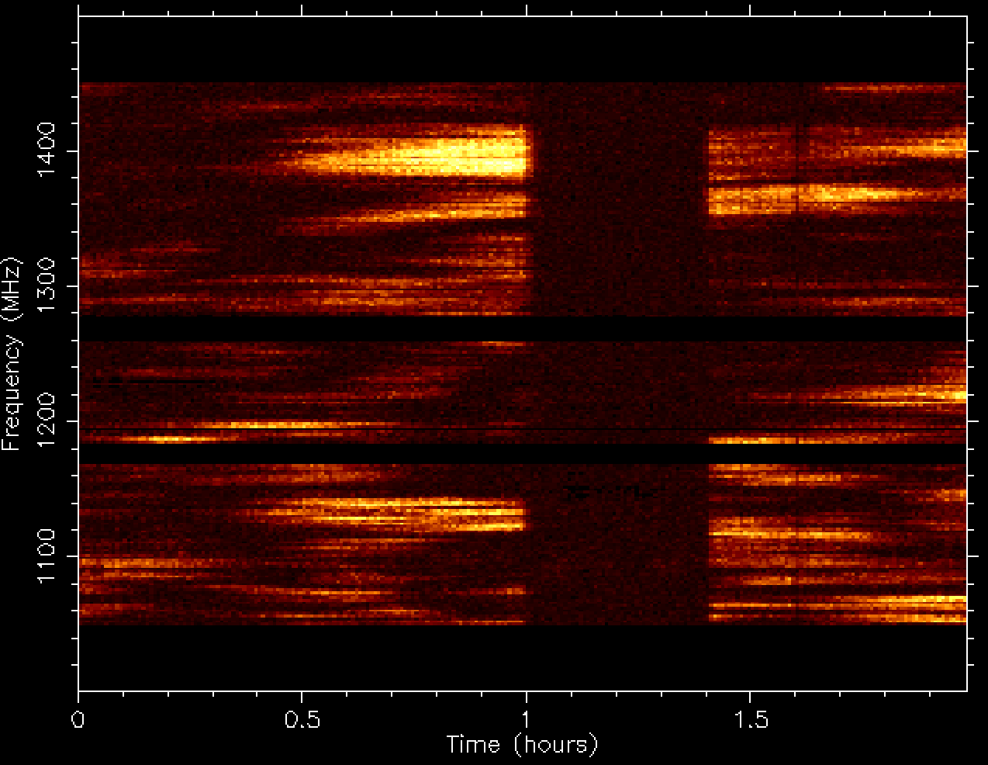
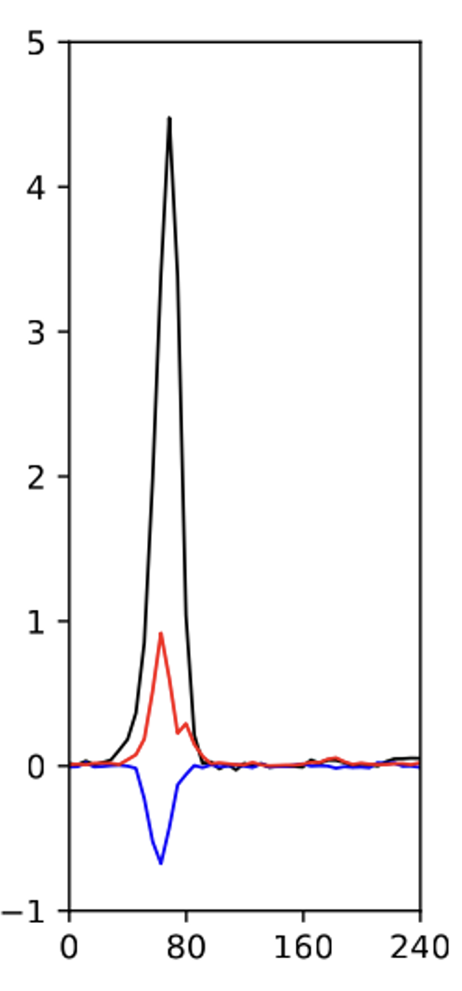
19C13-follow up: PT2020_0022
Scintillation maximum during the eclipse
PSR J1841−0500: 辐射消失时间大约580天，周期导数从-4.165(1)×10^-14 s/s 减少到 -1.67×10^-14
观测跨度：2011年9月-2018年4月

Slide 9
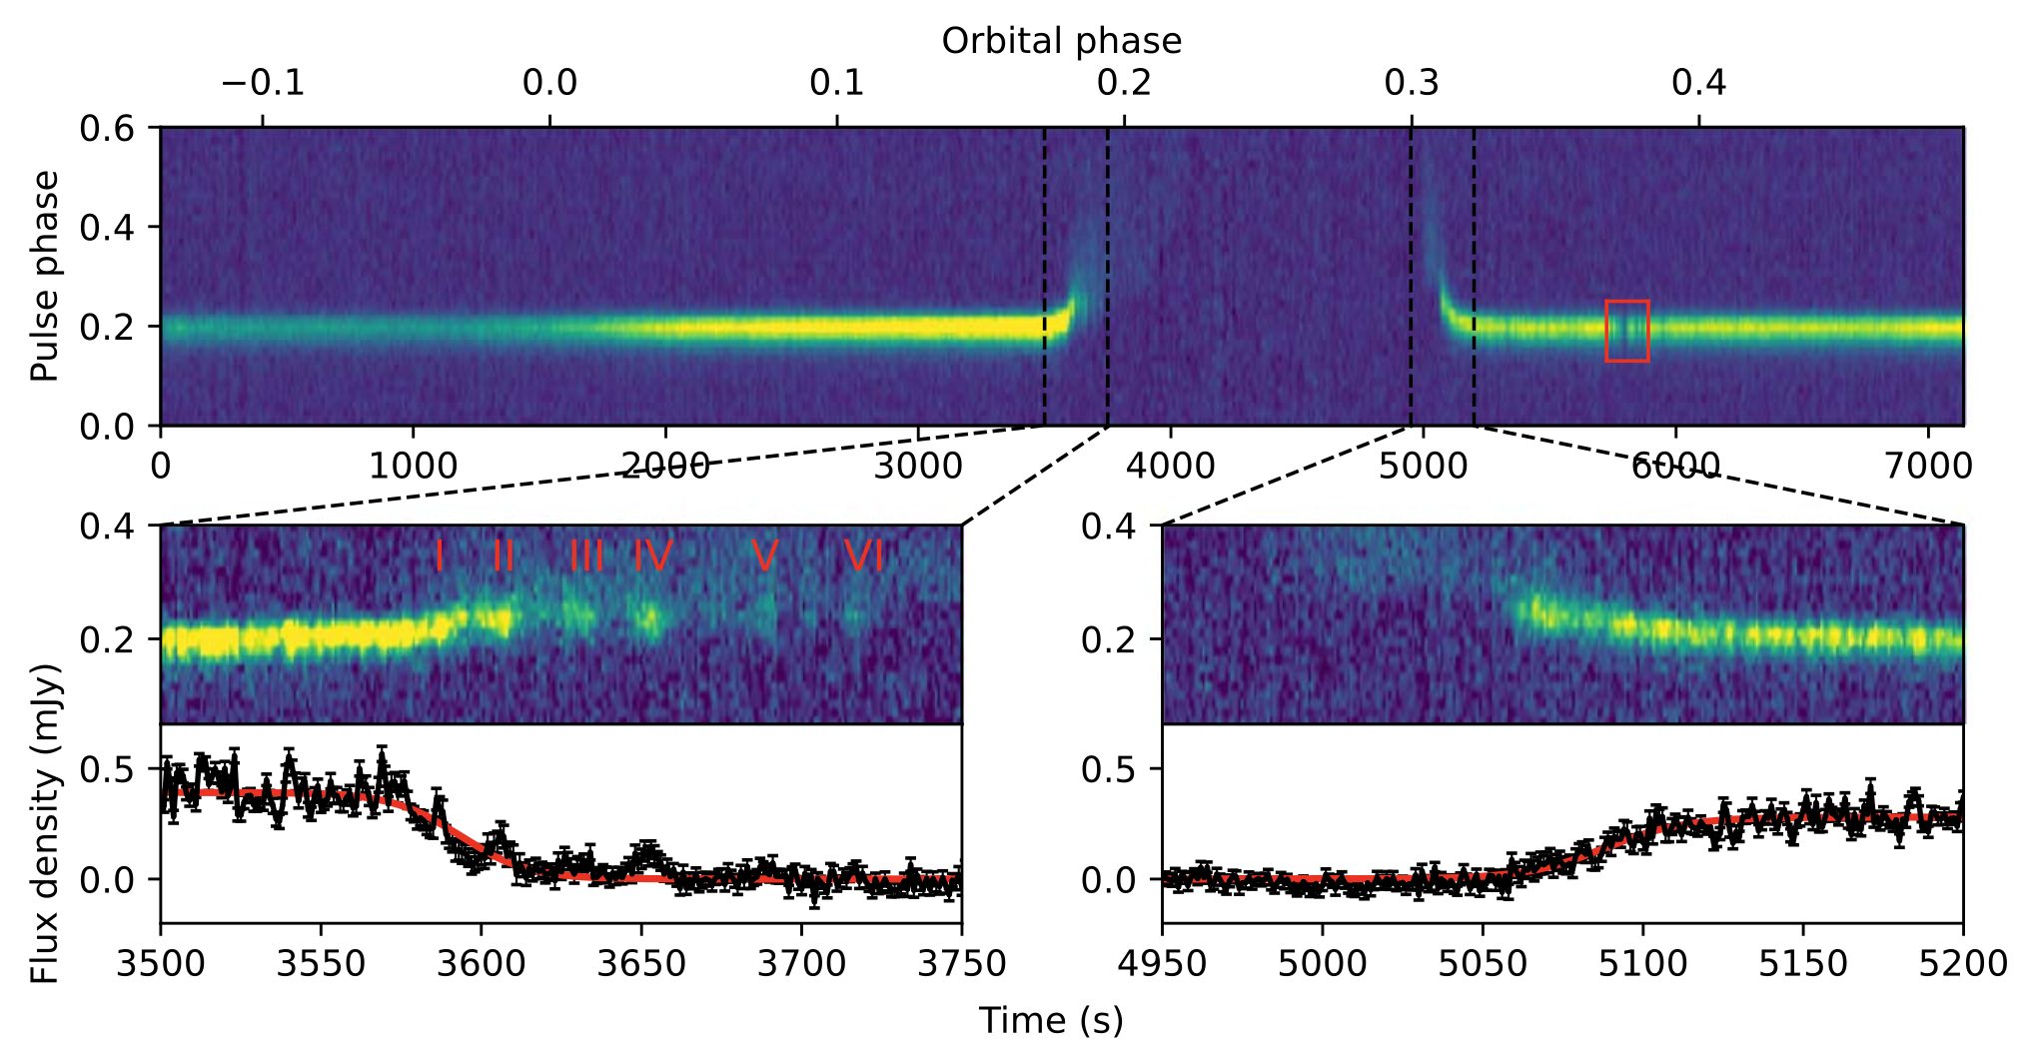
19C13
PSR J1841−0500: 辐射消失时间大约580天，周期导数从-4.165(1)×10^-14 s/s 减少到 -1.67×10^-14
观测跨度：2011年9月-2018年4月
A eclipse is clearly seen with the duration of 1495 s, about 13% of the orbital period
The pulse emission of this pulsar during the ingress show a modulation.
No such modulations are detected during the egress of the eclipse of this pulsar.

Slide 10
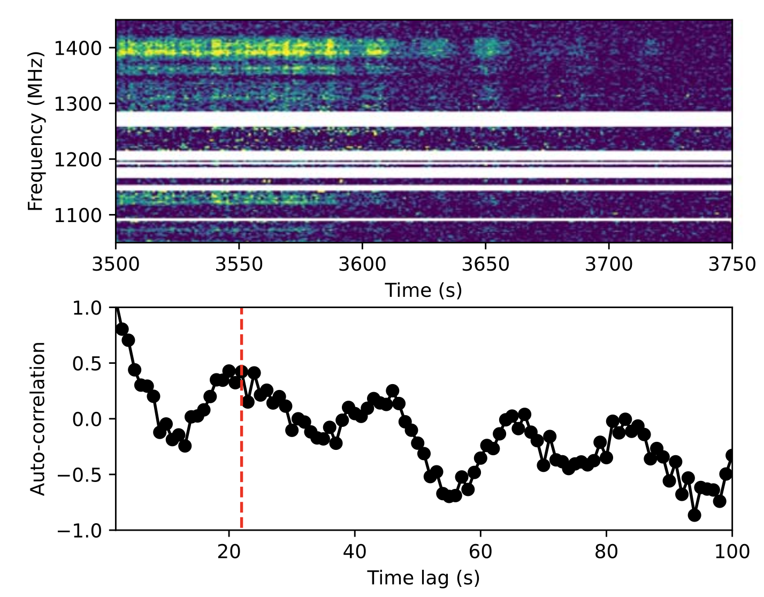
19C13
Dynamic spectrum during ingress
PSR J1841−0500: 辐射消失时间大约580天，周期导数从-4.165(1)×10^-14 s/s 减少到 -1.67×10^-14
观测跨度：2011年9月-2018年4月
The emission modulations are clearly seen at about 1125 MHz and 1400 MHz.
There are quasi-periodic pulse emission variations with a modulation period of ∼22 s during the ingress of the eclipse.

Slide 11
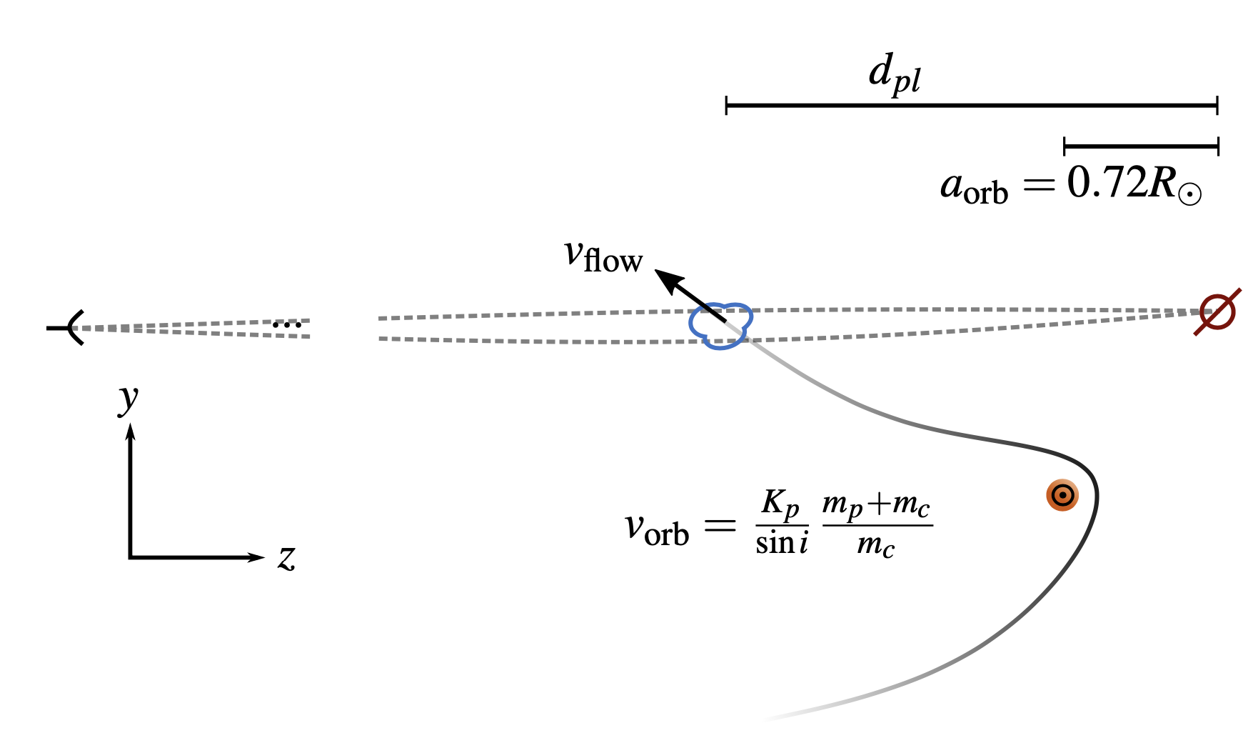
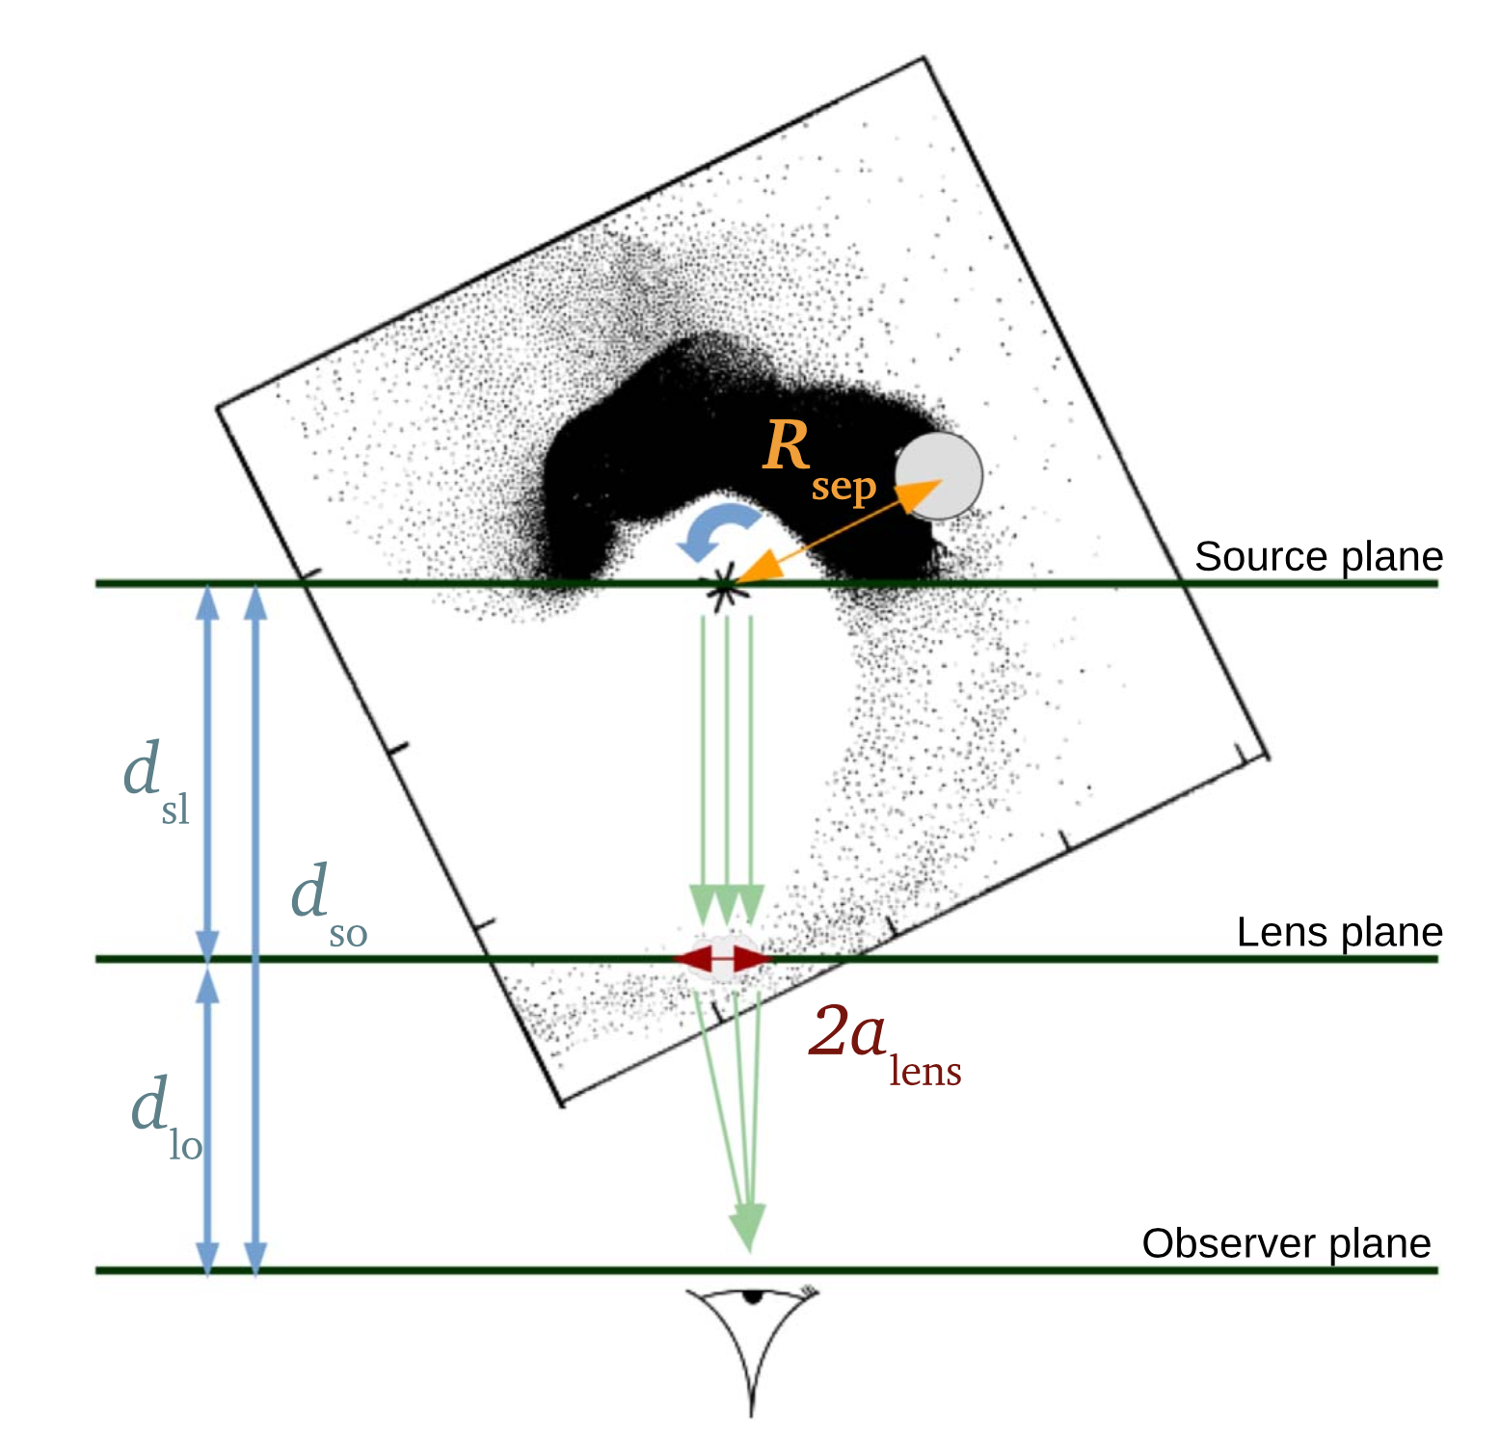
19C13
Plasma lensing!!!
PSR J1841−0500: 辐射消失时间大约580天，周期导数从-4.165(1)×10^-14 s/s 减少到 -1.67×10^-14
观测跨度：2011年9月-2018年4月
The size of the lens is:
The distance from the pulsar to the lens is:
The maximum pulse amplification is 1.6
Using the model of 1D lens model of Cordes et al. (2017), we obtained that the lens size alens~23000 km
Demonstrates the causal link between DM and lensing.
F. X. Lin et al. (2021)
Bilous et al. (2021)

Slide 12
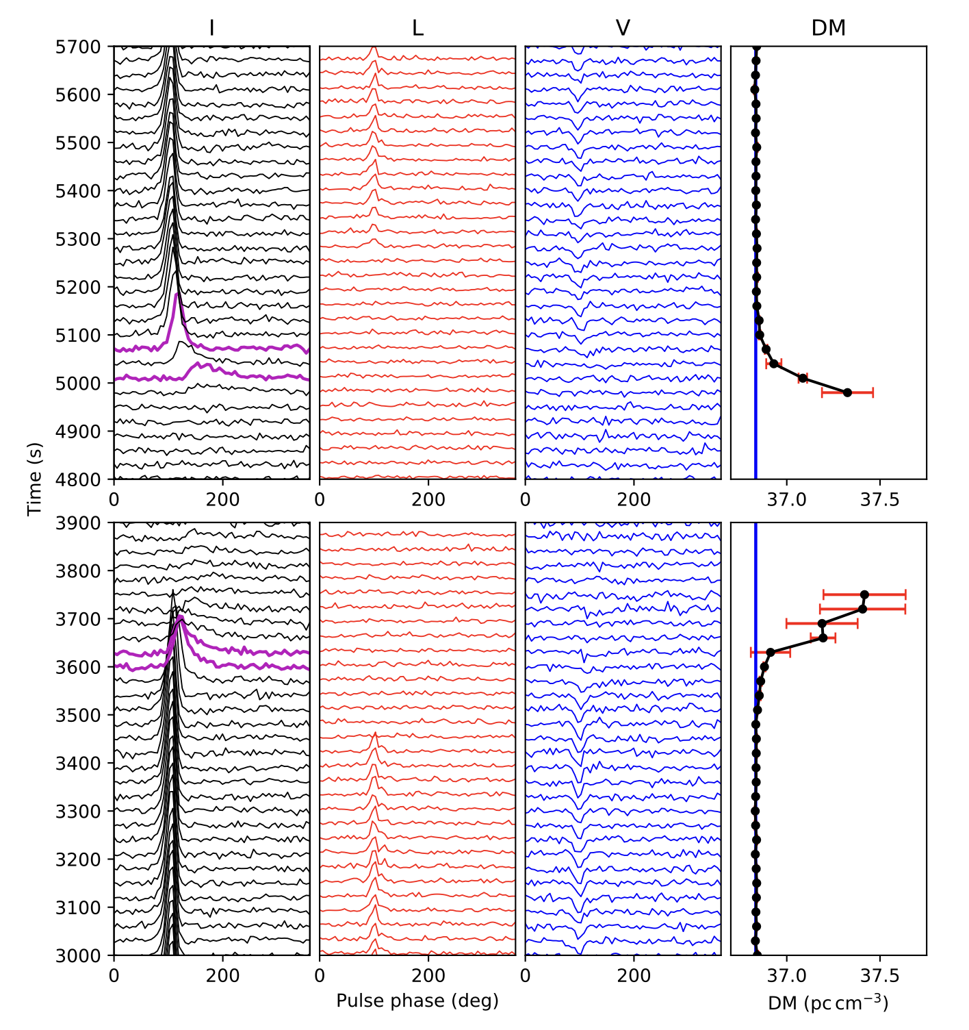
19C13
Depolarization
PSR J1841−0500: 辐射消失时间大约580天，周期导数从-4.165(1)×10^-14 s/s 减少到 -1.67×10^-14
观测跨度：2011年9月-2018年4月
The linear polarization of the pulsar disappears before the eclipse, even before there is a visually obvious change in DM.
The circular polarization remains unchanged.
The maximum DM variation is: 0.6 ${cm}^{−3}pc$
The estimated mass-loss rate from the companion is: ${10}^{−12} M_{⨀}$/yr

Slide 13
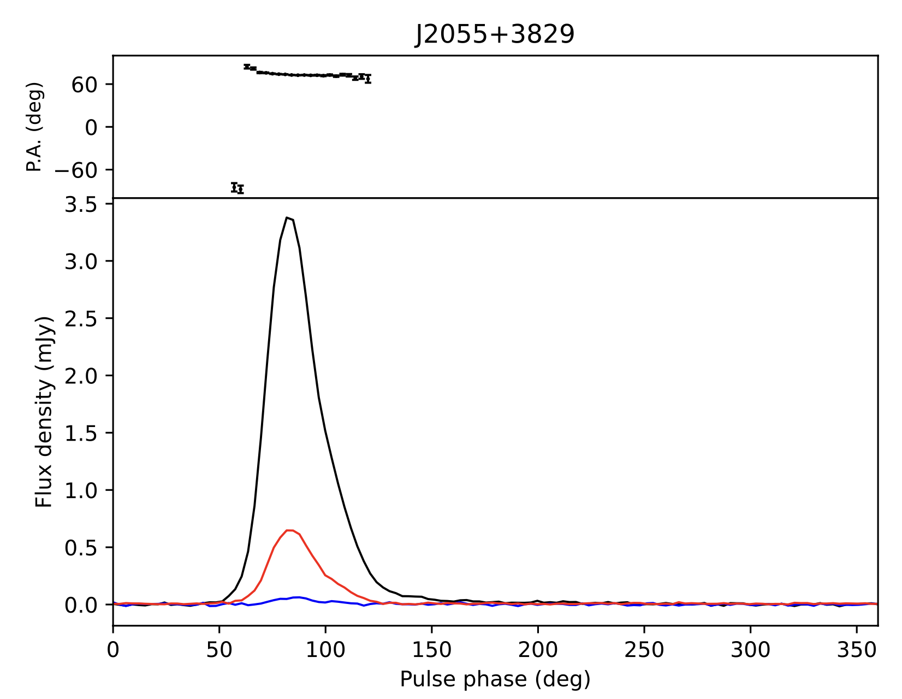
PSR J2055+3829
Polarization profile
PSR J1841−0500: 辐射消失时间大约580天，周期导数从-4.165(1)×10^-14 s/s 减少到 -1.67×10^-14
观测跨度：2011年9月-2018年4月
The BW PSR J2055+3829 has a spin period of 2.1 ms and an orbit period of 3.1 hr, which was discovered by the SPAN512 survey.
Our observation duration is 11640s, covering the entire orbit.
Have a simple one peak profile with the $F_{L}$= 18.1%, $F_{C}$=2.2%

Slide 14
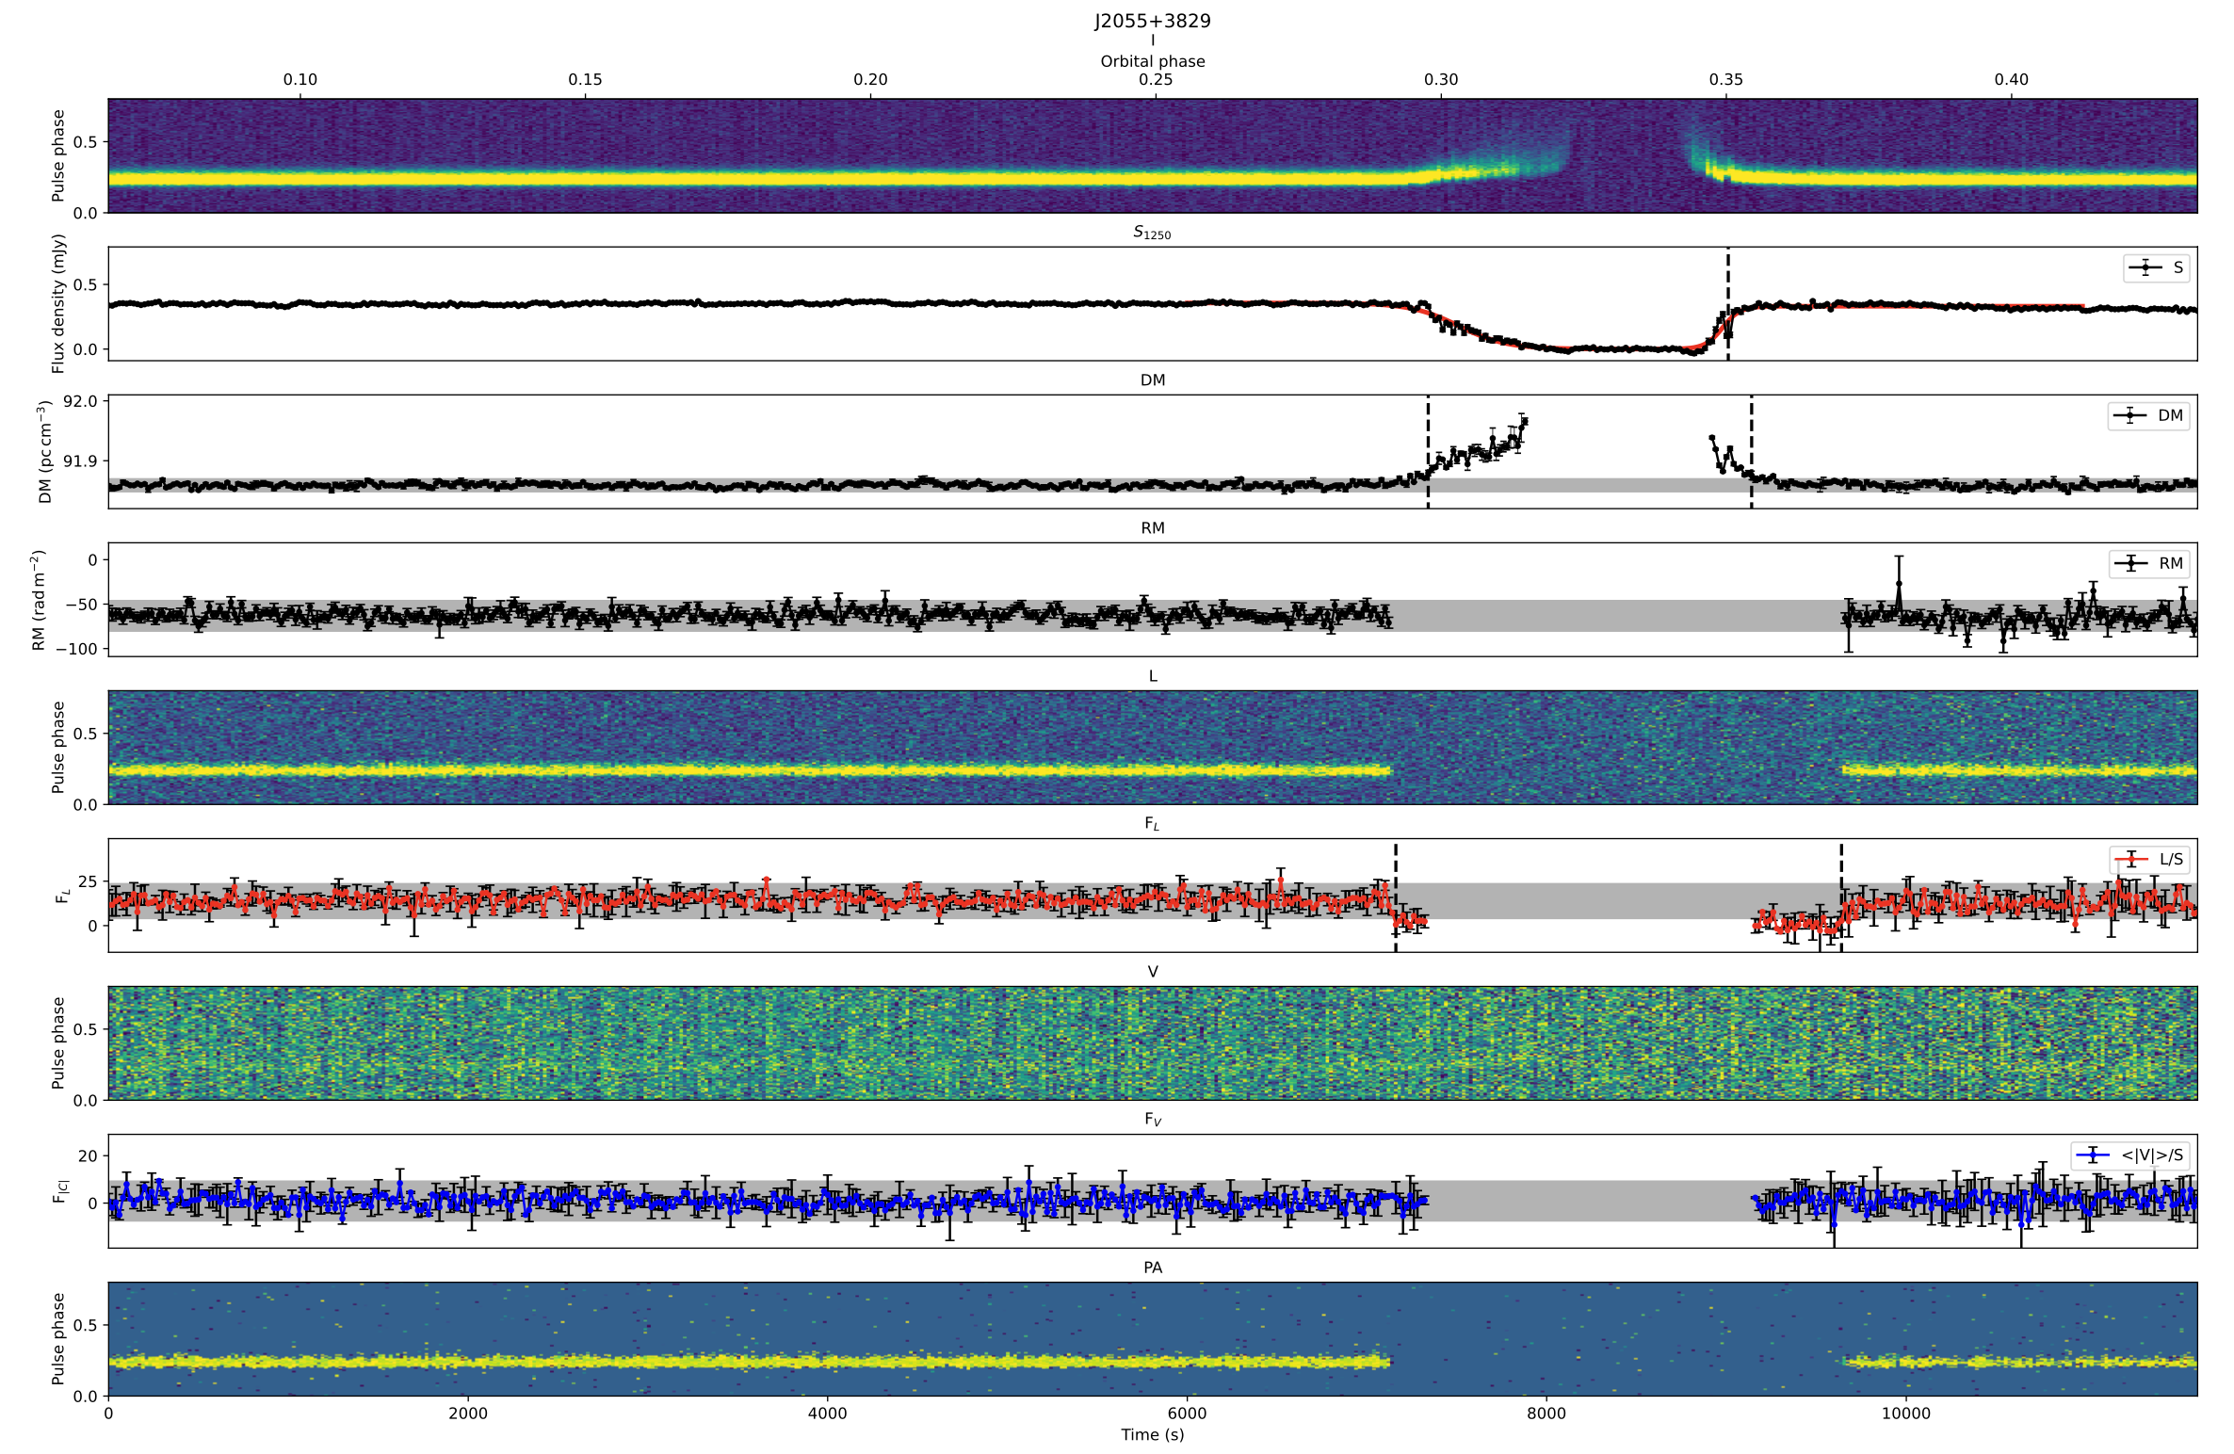
PSR J2055+3829
PSR J1841−0500: 辐射消失时间大约580天，周期导数从-4.165(1)×10^-14 s/s 减少到 -1.67×10^-14
观测跨度：2011年9月-2018年4月
The eclipse duration is 1467s, about 13% of the orbital period
The linear polarizations of both of them decrease before there are significant changes in both DMs and circular polarizations.

Slide 15
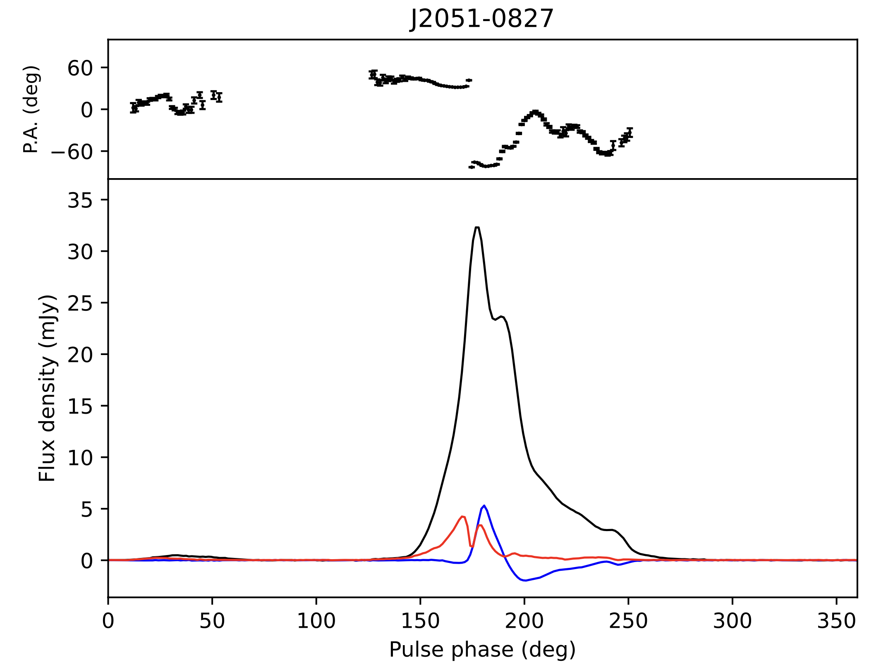
PSR J2051−0827
Polarization profile
PSR J1841−0500: 辐射消失时间大约580天，周期导数从-4.165(1)×10^-14 s/s 减少到 -1.67×10^-14
观测跨度：2011年9月-2018年4月
PSR J2051−0827 is the second discovered BW with a 4.5 ms spin period and a 2.38 hr orbital period
Shows radio eclipses at bellow 1 GHz,
Our observation duration is 8940s, covering the entire orbit.
Detect a weak inter pulse for the first time
Polarization: $F_{L}$= 8.9%, $F_{|C|}$=9.3%
A jump of ∼90 deg in the PA swings

Slide 16
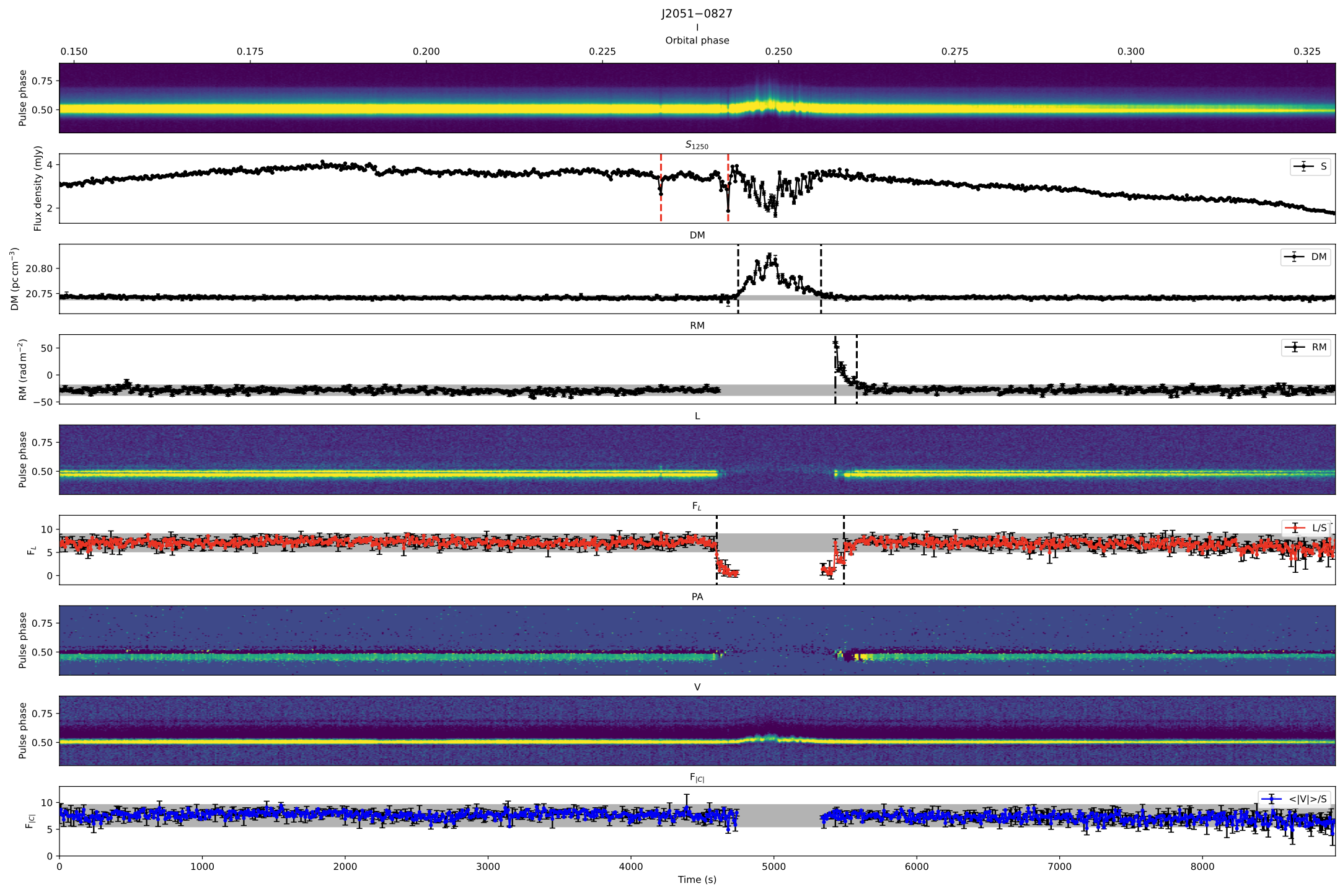
PSR J2051−0827
PSR J1841−0500: 辐射消失时间大约580天，周期导数从-4.165(1)×10^-14 s/s 减少到 -1.67×10^-14
观测跨度：2011年9月-2018年4月
The linear polarizations of both of them decrease before there are significant changes in both DMs and circular polarizations.
A regular rise in RM near eclipse, which provides an evidence of the changes of Faraday rotation.

Slide 17
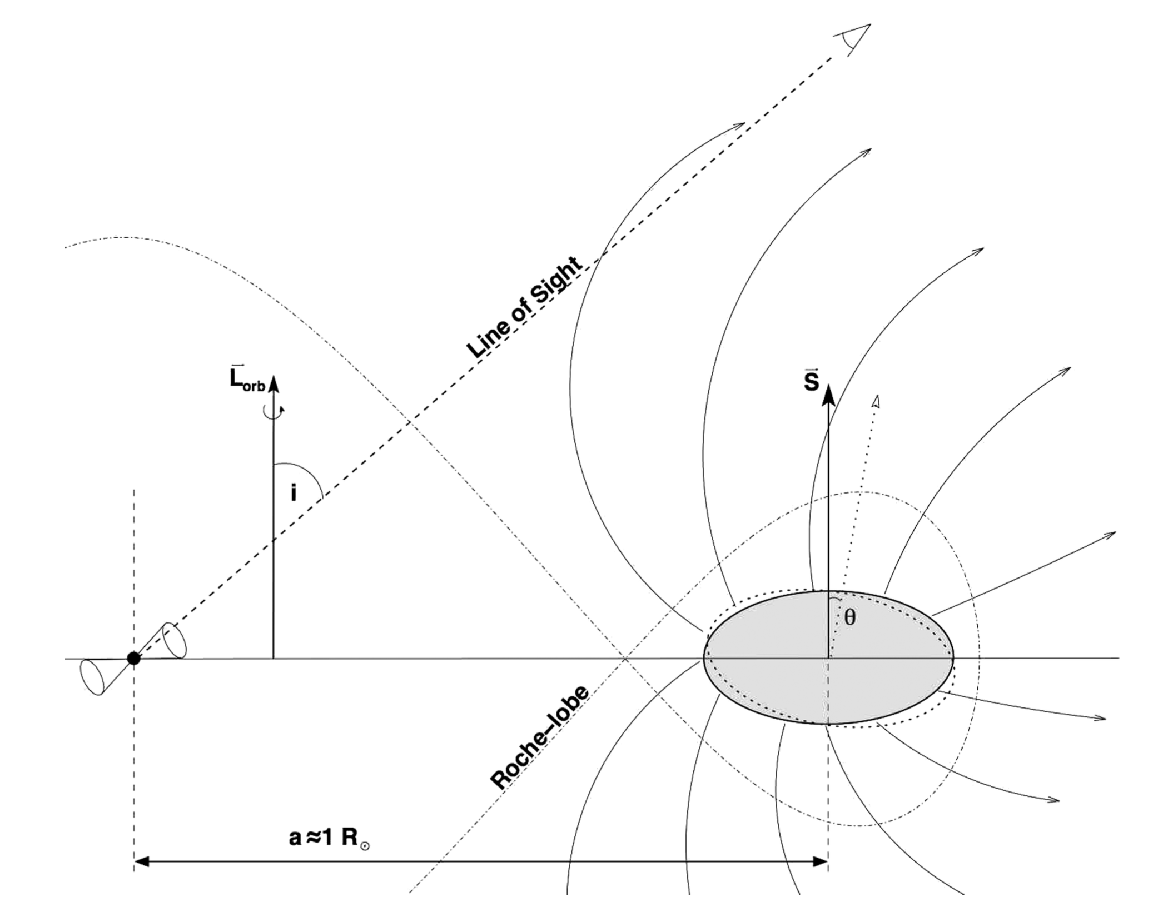
PSR J2051−0827
Our results suggest that there may be significant magnetic field in the eclipse mediums of spider pulsars, and the magnetic field extends beyond the plasma.
Magnetic field of medium
The line-of-sight magnetic filed strength in the eclipse medium:
The deviation of phase difference between the top and bottom of the band is less than one full rotation. The perpendicular magnetic field strength:
The maximum $∆R$M=89 rad $m^{−2}$, $B_{||}\sim$0.7 G
$B_{⊥}<$0.05 G
Lazaridis et al. 2011

Slide 18
Depolarization mechanism in spider pulsar
The depolarization has been seen in many spider pulsars, You et al. (2018) attribute this phenomenon to the multipath propagation in the eclipse medium.
Our highly sensitive observation find that the linear polarization decrease before there are obvious changes in DM, which do not support the multipath propagation.
We we suggest that the rapid fluctuations of the parallel component of the magnetic field in the eclipse medium due to the companion’s orbital motion maybe provide the most promising explanation of the depolarization.
We assume that the RM variations have a normal distribution with standard deviation $σ_{RM}$.
The depolarization due to RM variations could be described as:
The $σ_{RM}$ for PSR J1720−0533, PSR J2055+3829 and PSR J2051−0827 are 21, 21 and 18 rad $m^{−2}$, respectively.

Slide 19
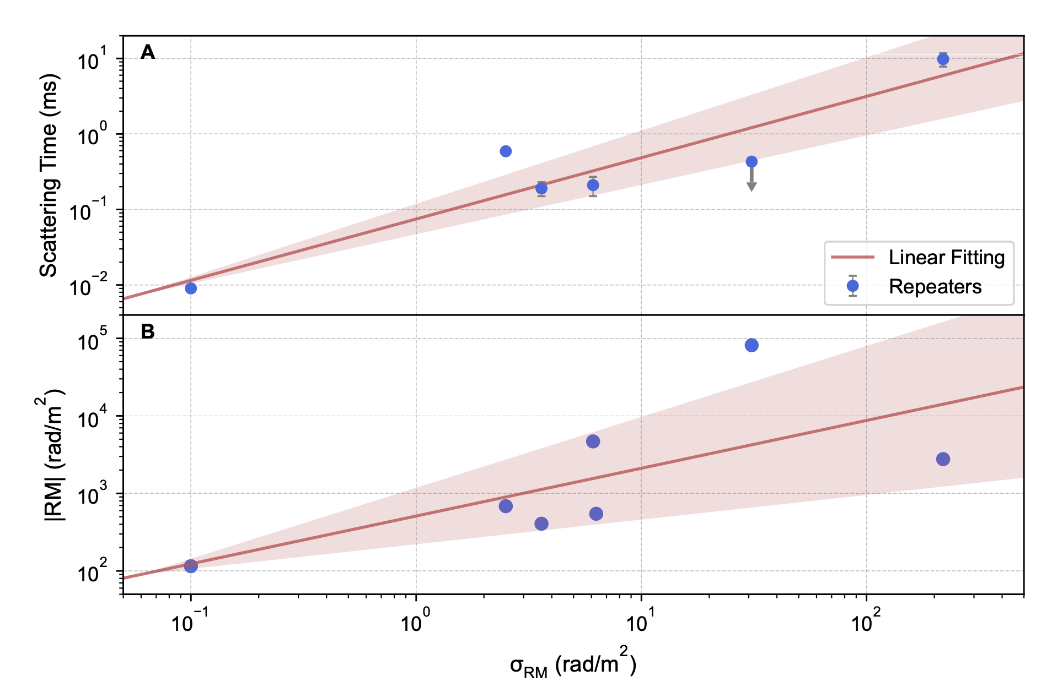
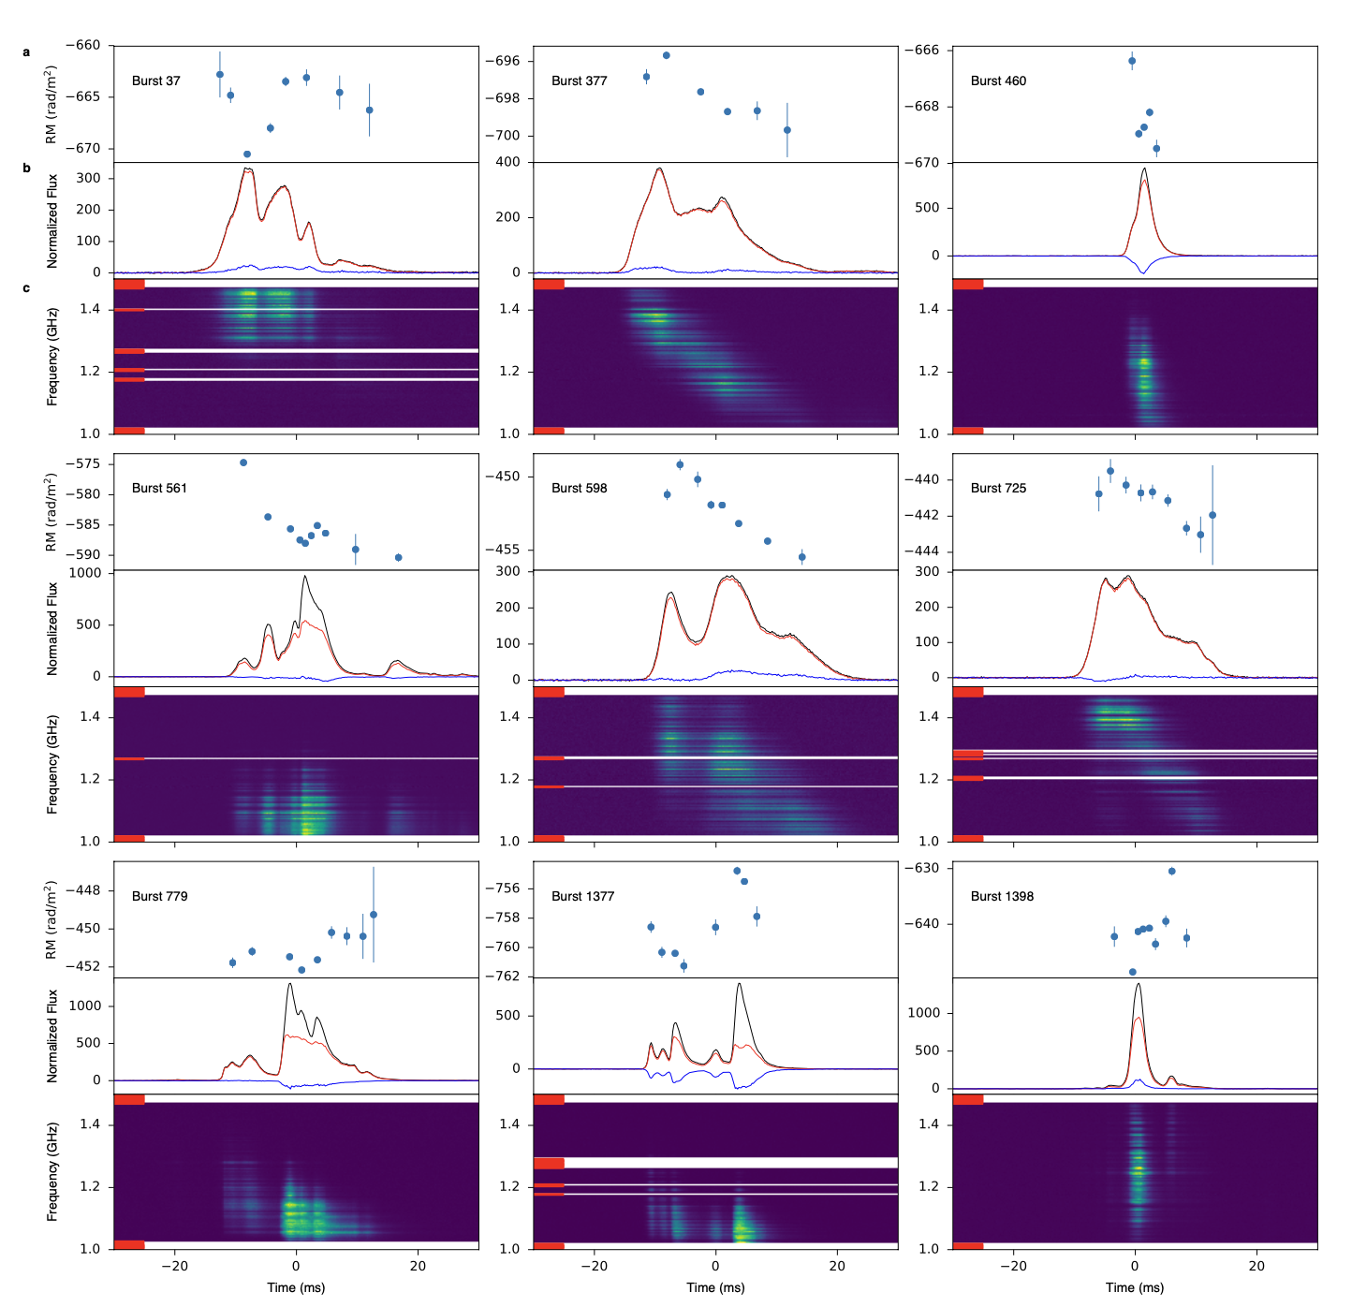
Depolarization in FRB
The depolarization has been seen in repeating FRBs, Feng et al. (2022) attribute this phenomenon to the multipath propagation$, σ_{RM}$ and pulse scattering originate maybe from a single plasma screen.
However, for some repeaters, the scattering timescale is much smaller with large RM variation, i.e. FRB 20201124A (−887 to −362 rad m^(−2)) (Xu et al. 2021).
We we suggest that the rapid fluctuations of the parallel component of the magnetic field maybe provide another explanation of the depolarization in repeating FRBs.
Feng et al. (2022)
Xu et al. (2021)

Slide 20
Summary
For 19C13, because of scintillation maximum, we find plasma lensing phenomenon which demonstrates the causal link between DM and lensing.
A regular rise in RM is seen during eclipse egress of PSR J2051-0827, which provides evidence of the changes of Faraday rotation for the first time. $B_{||}\sim$0.7 G, $B_{⊥}<$0.05 G.
By polarization analysis, we find that the linear polarization decreases before there are significant changes in DM, which suggests that the magnetic field extends beyond the plasma.
The depolarization phenomenon maybe result from the rapid variations of the magnetic field of the eclipse medium, rather than multipath propagation.
This mechanism maybe provide another explanation of the depolarization in repeating FRBs.
By fitting the DM variations during the eclipse, we estimated the mass-loss rate from the companion to be in the range of ${{10}^{−13}−10}^{−12} M_{⨀}$/yr.
PSR J1841−0500: 辐射消失时间大约580天，周期导数从-4.165(1)×10^-14 s/s 减少到 -1.67×10^-14
观测跨度：2011年9月-2018年4月

Slide 21
THANKS！
Notes:
a6414941-c53d-4459-9628-18bba4efe50e

