Slide 1
The Multiple Images of the Plasma Lensing Fast Radio Bursts (FRBs)
Reporter：Yu-Bin Wang (王榆斌)
Supervisor：Xia Zhou (周霞)
XinJiang Astronomical Observatory, CAS
2022/8/4

Slide 2
Outline
Physics of plasma lens and Background
Results compared with observations and predictions in some FRBs
Discussion and Summary

Slide 3
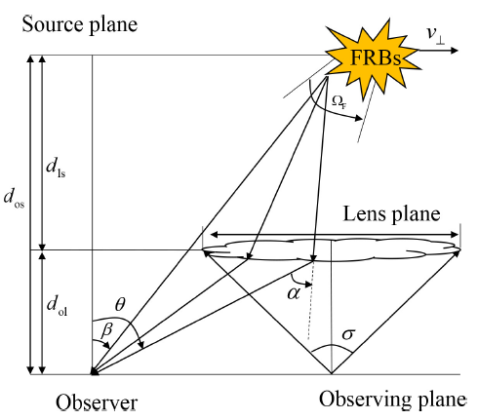
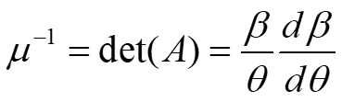
The Physics of Plasma Lens
The dispersion relation:
The dispersive potential:
Lensing equation:
(Wang et al. 2022)

Slide 4

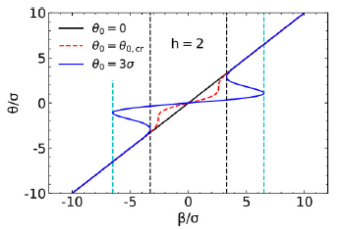
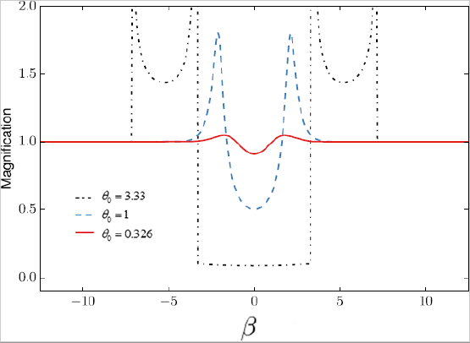
The Gaussian lens
The Gaussian lens:
where
Young diagram:
Source with long timescale:
Third image
Second image
First image

Slide 5
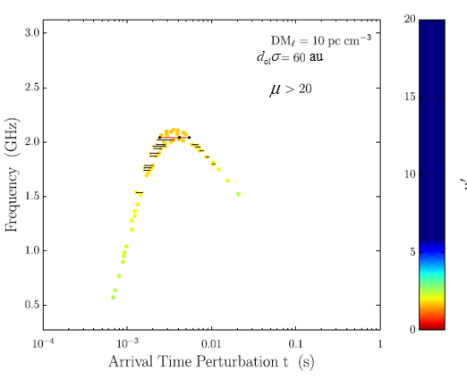
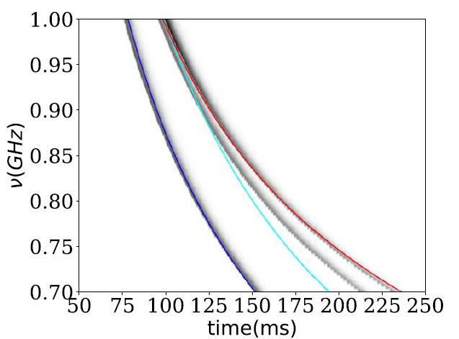
The theory compared with observations
Source with short timescale:
The higher order effects (Er et al. 2020):
Times of Arrival (Cordes et al. 2017):

Slide 6
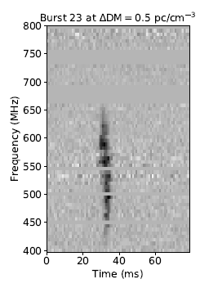
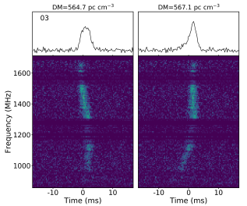
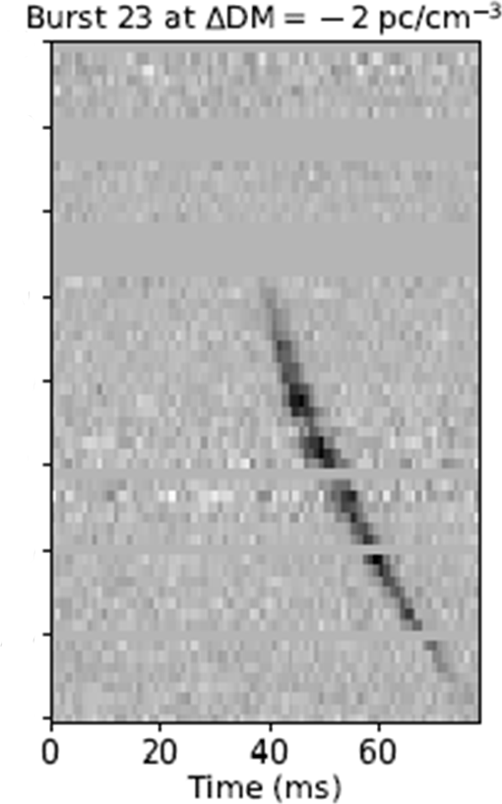
The theory compared with observations
Source with short timescale:
FRB 180916.J0158+65
FRB 121102
(Platts et al. 2021)
(Amiri et al. 2020)

Slide 7
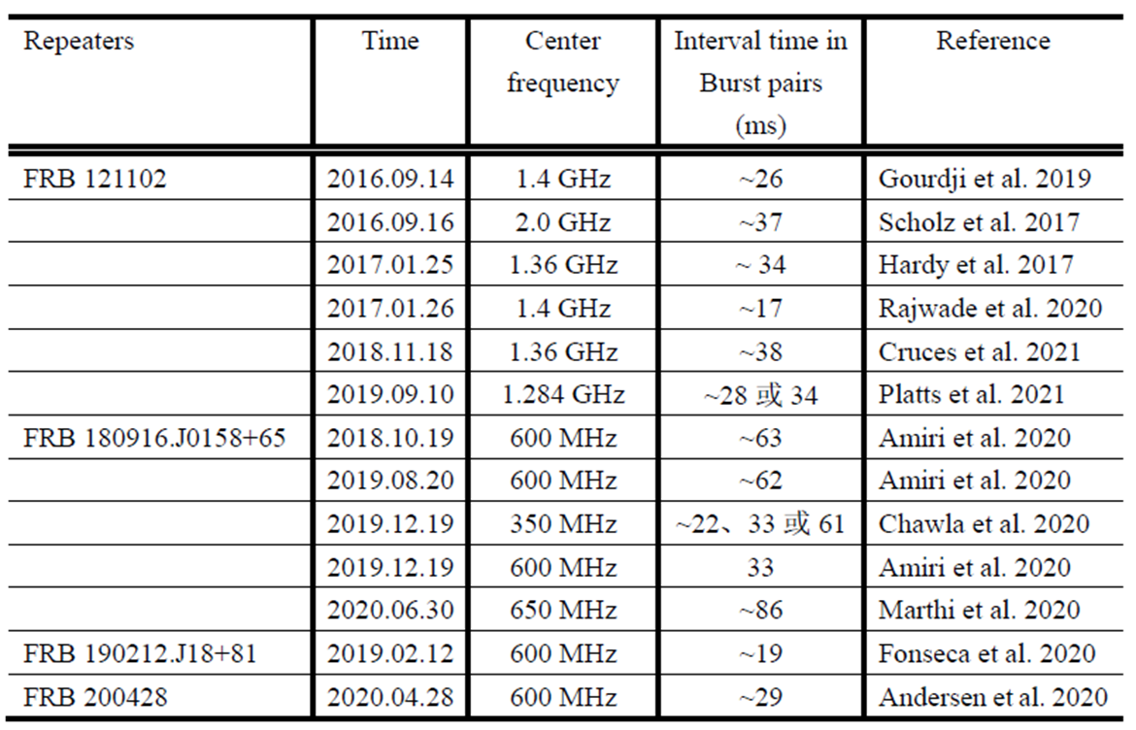
The theory compared with observations
Burst pair in FRBs：

Slide 8
Our purpose
Plasma lens:
The multiple images can be caused by plasma lens, some images should be inverse properties by comparing with classical dispersion relation.
The interval time between multiple images should be the order of tens of millisecond and frequency dependent.
Dispersion measure (DM) and the DM difference between multiple images are also frequency dependent, which is found in the statistical results of FRB 180916.J0158+65.

Slide 9
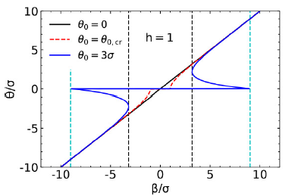
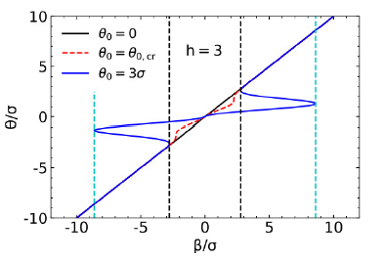
The exponential lens
The exponential lens:
Young diagram:
Third image
Second image
First image
(Wang et al. 2022)

Slide 10
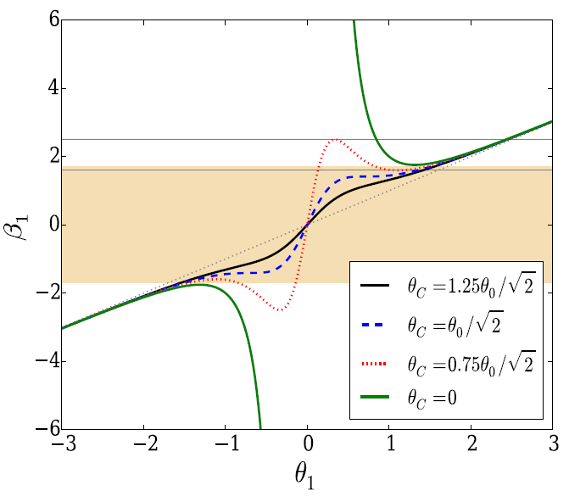
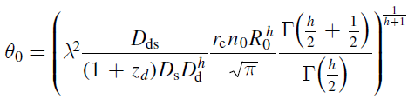
The exponential lens
The power-law lens:
Young diagram for :
Where:
(Er et al. 2018)

Slide 11
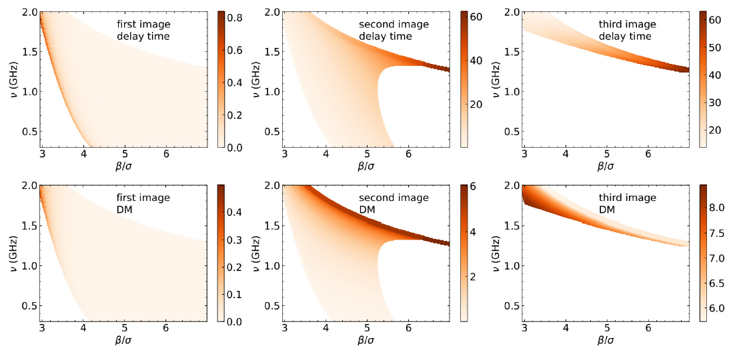
Results
The Gaussian lens:
(Wang et al. 2022)

Slide 12
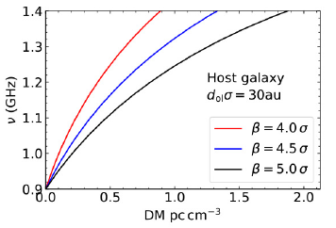
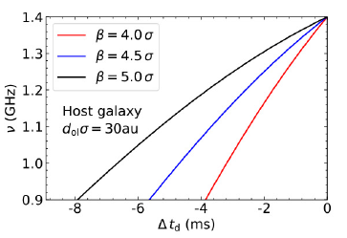
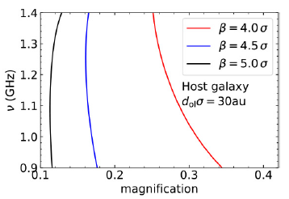
Results
The Gaussian lens for the second image:
Delay time:
(Wang et al. 2022)

Slide 13

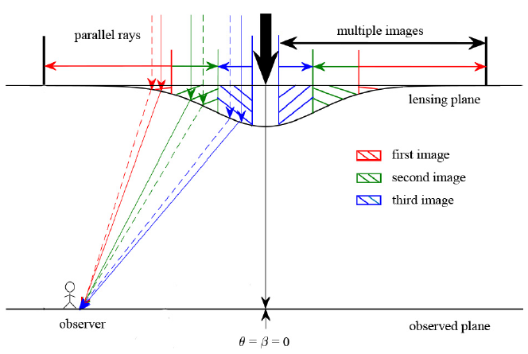
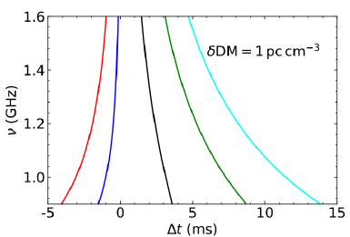
Results
The higher order effects for the second image :
To sum up:
,
,
,
,
(Wang et al. 2022)

Slide 14
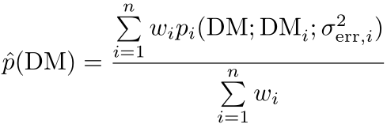
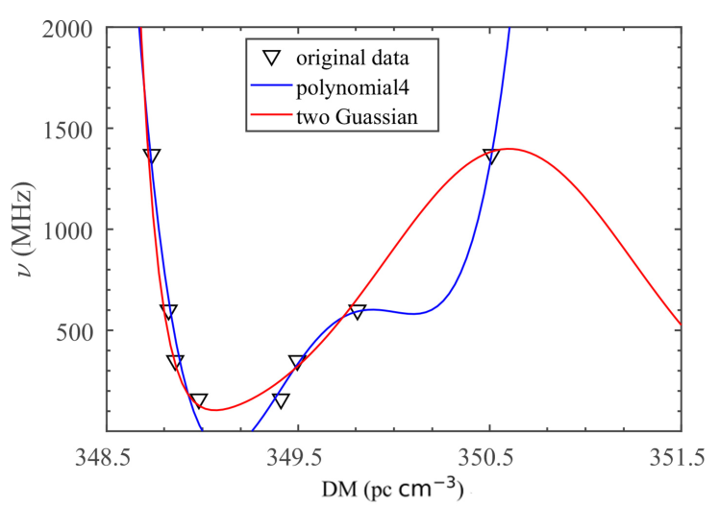
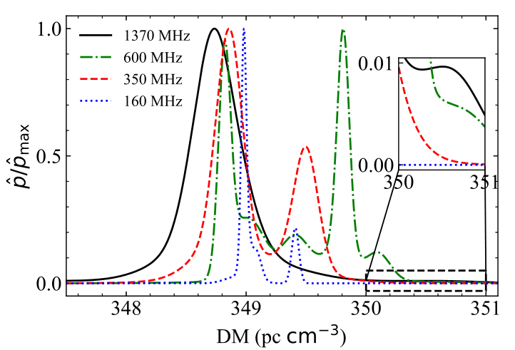
Statistics on FRB 180916.J0158+65
The total distribution density of DM:
The frequency-dependent DM:
(Wang et al. in prep)

Slide 15
Discussion and Summary
The multiple images can have the frequency dependent delay time and DM.
The frequency dependent DM of some repeaters, such as FRB 180916.J0158+65, may be multiple-component distributions.
Due to greater event rate in FRB and their observations by multiband, the detailed dispersion properties of some repeating FRBs can reveal the properties of plasma in the source environment and propagation path.
Thanks for your attention!

