Slide 1

Revisiting the event rate and energy function of fast radio bursts: Are they originate from compact binary mergers?
张子良
Supervisor: 俞云伟
Institute of Astrophysics
华中师范大学

Slide 2
Outline
Introduction
FRB introduction
Statistical approach
Experience from GRB study
2. Models
Two assumption of FRB event rate
Star formation rate model / compact binary merger model
Constrain energy function
Monte Carlo method
3. Results

Slide 3
Outline
Introduction
FRB introduction
Statistical approach
Experience from GRB study
2. Models
Two assumption of FRB event rate
Star formation rate model / compact binary merger model
Constrain energy function
Monte Carlo method
3. Results

Slide 4
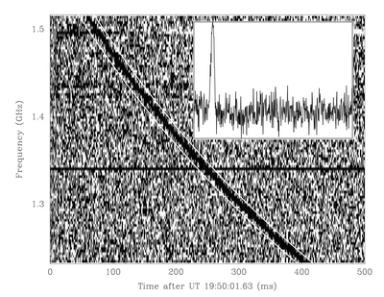
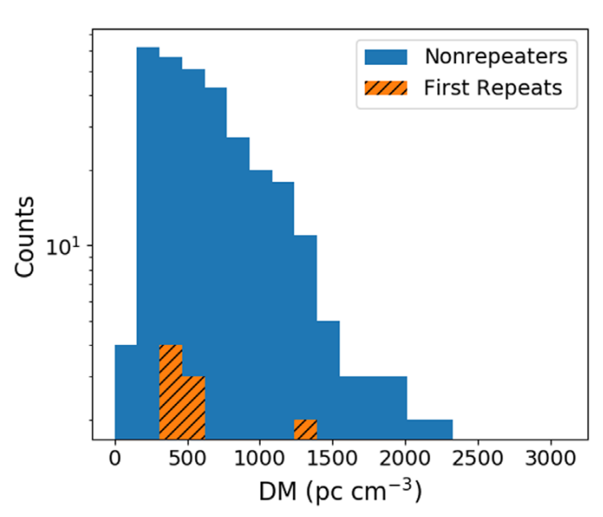
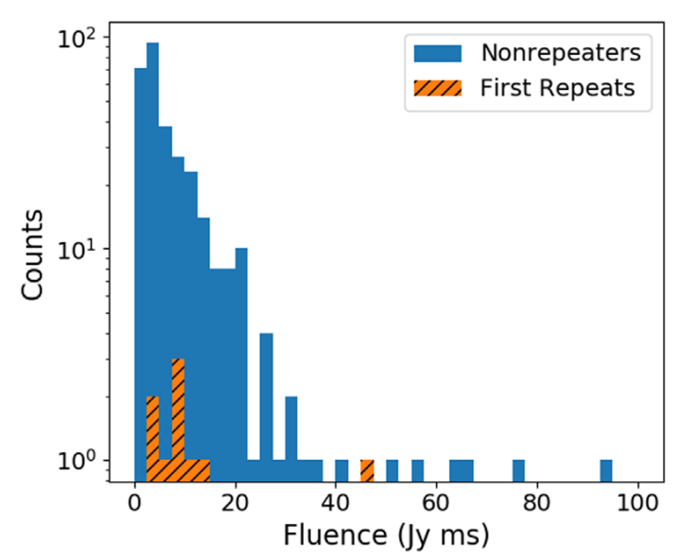
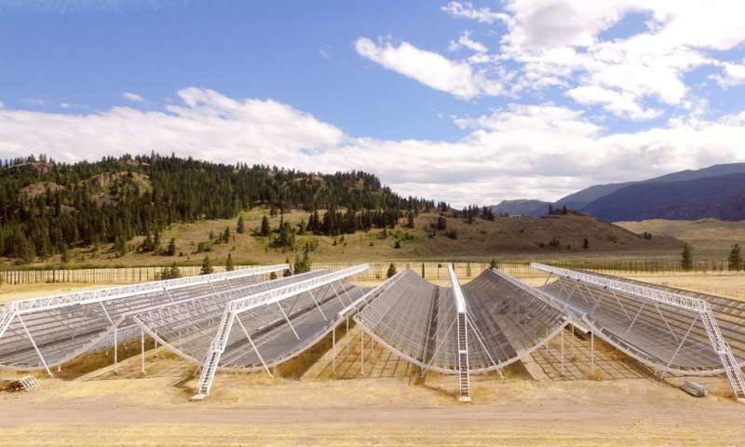
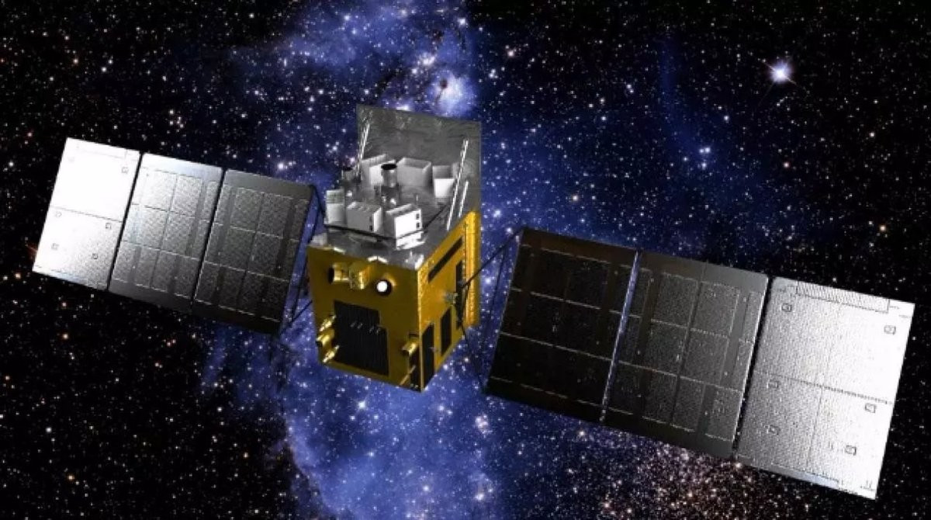
FRB introduction
FRBs are mysterious transients. What is the progenitor of FRB?
Short duration and high energy
Magnetar?
FRB 200428 confirm!
Where these magnetars from?
core-collapse of massive stars?
mergers of compact binaries?
Lorimer et al. (2007)
CHIME/FRB Collaboration et al. (2021)

Slide 5
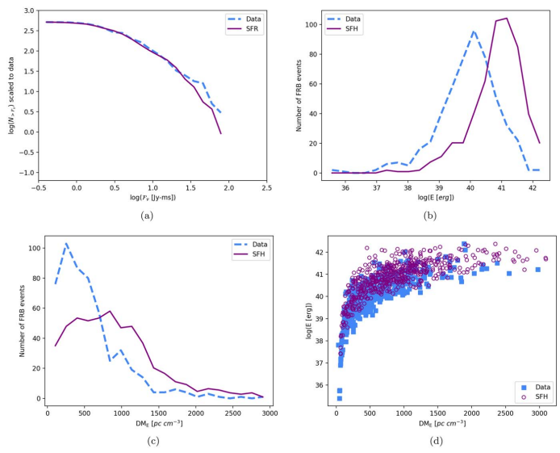
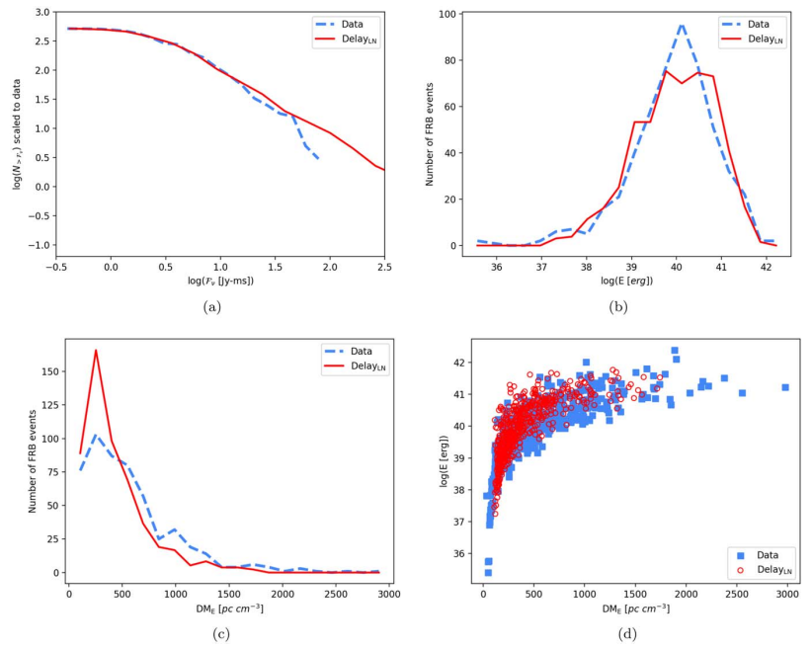
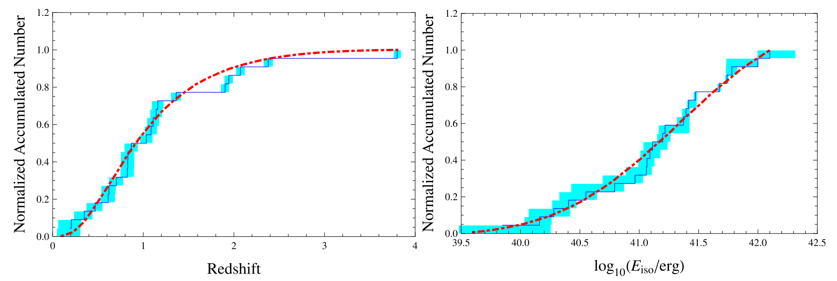
Statistical approach
10Gyr delay
Cao, Yu, Zhou, 2018, ApJ, 858, 89
Yu et al. 2014, JCAP, 11, 040
Zhang, R. C., & Zhang, B. (2022)

Slide 6
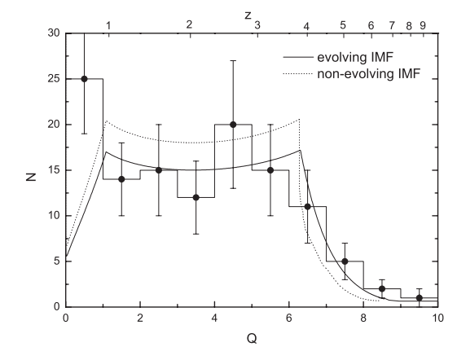
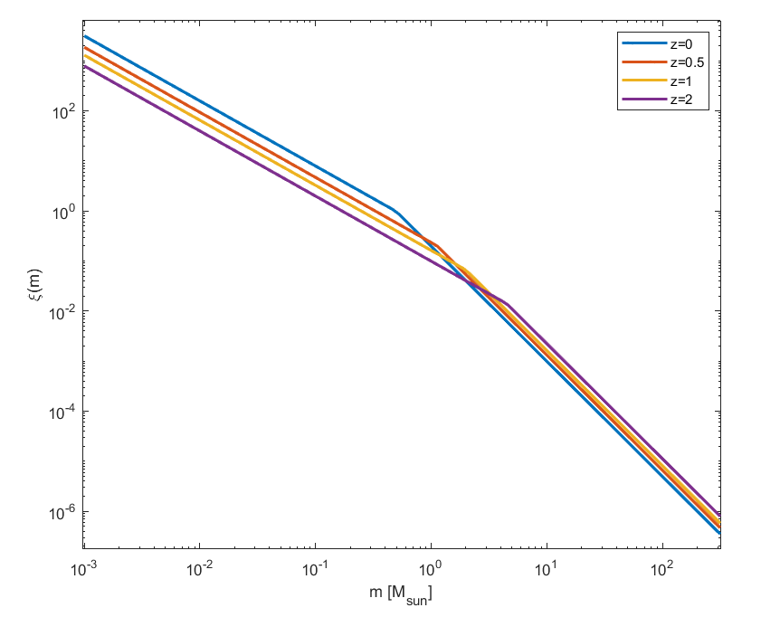


Experience from GRB study
Evolving with redshift
Wang & Dai (2011)
Davé (2008)

Slide 7
Outline
Introduction
FRB introduction
Statistical approach
Experience from GRB study
2. Models
Two assumption of FRB event rate
Star formation rate model / compact binary merger model
Constrain energy function
Monte Carlo method
3. Results

Slide 8
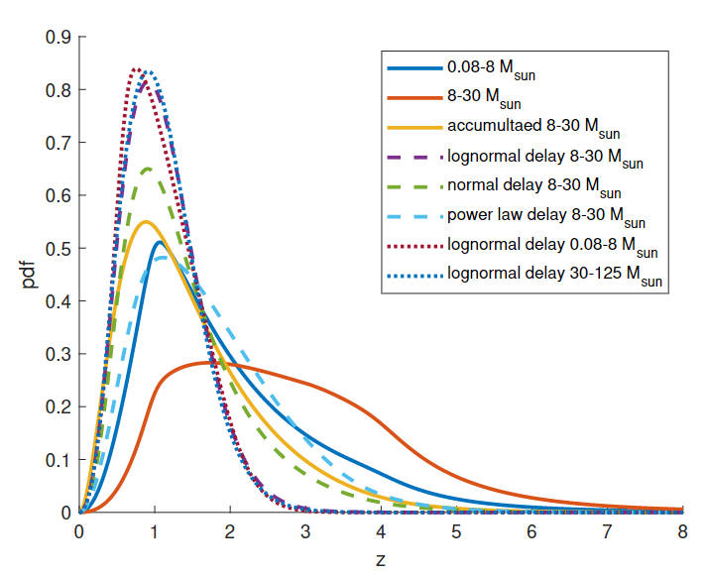

Two assumption of FRB event rate
NS originated from the traditional channel of the core-collapse of massive stars
Star formation rate
NS originated from mergers of compact binaries
Compact binaries merger rate
Star formation rate with delay time
Zhang & Yu 2022, in preparation

Slide 9






Star formation rate model
Compact binaries merger model
Star formation rate
Effect from evolving initial mass function
Gaussian delay
2. Lognormal delay
3. Power-law delay
（m1,m2）mass range
Davé (2008)

Slide 10
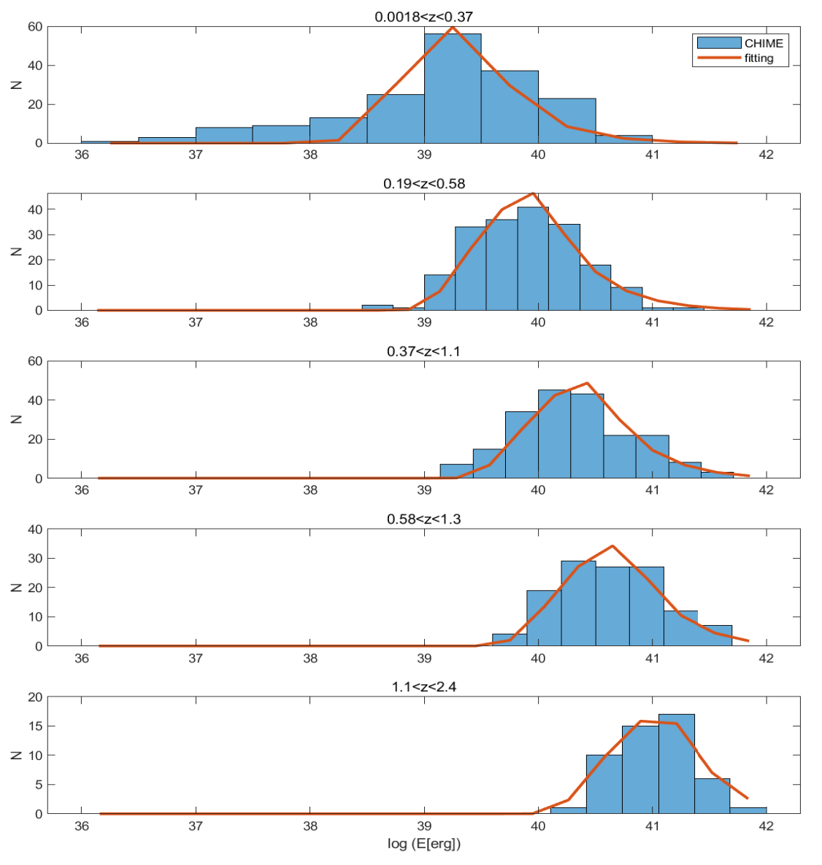
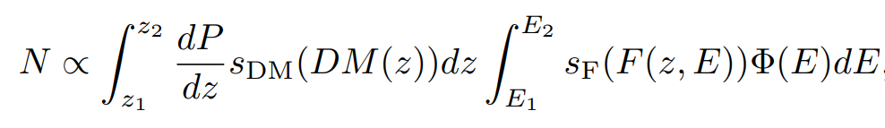
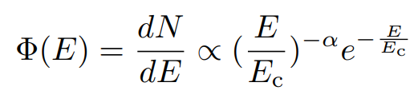


Constrain energy function
Divide samples into six redshift intervals
FRBs in each energy bin：
Obtain parameters by fitting
Zhang & Yu 2022, in preparation

Slide 11
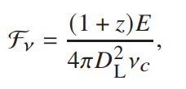

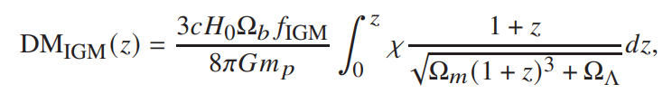
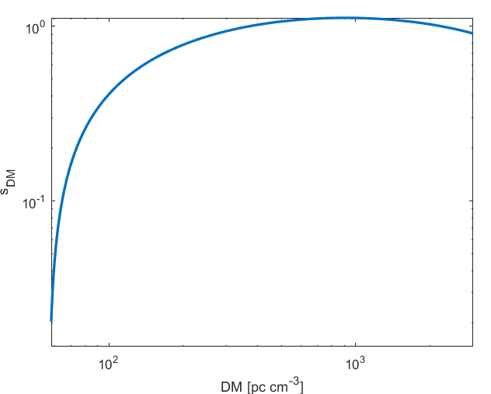
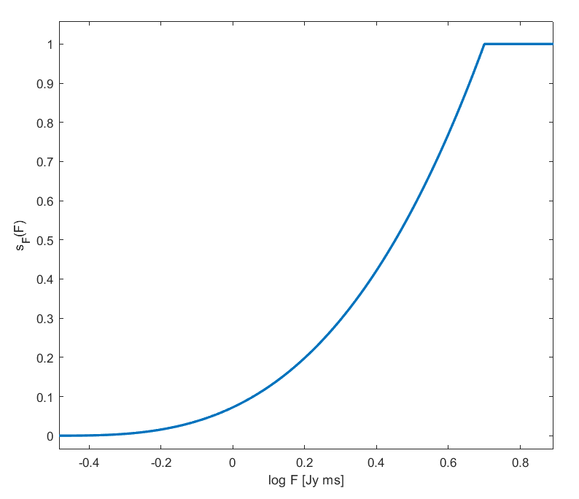
A “mock” FRB with（E, z）
Monte Carlo method (lottery)
Simulate a redshift by Monte Carlo mothod
Observed DM
Observed Fluence
Simulate an energy
DM selection effect
Fluence selection effect
Observed FRB

Slide 12
Outline
Introduction
FRB introduction
Statistical approach
Experience from GRB study
2. Models
Two assumption of FRB event rate
Star formation rate model / compact binary merger model
Constrain energy function
Monte Carlo method
3. Results

Slide 13
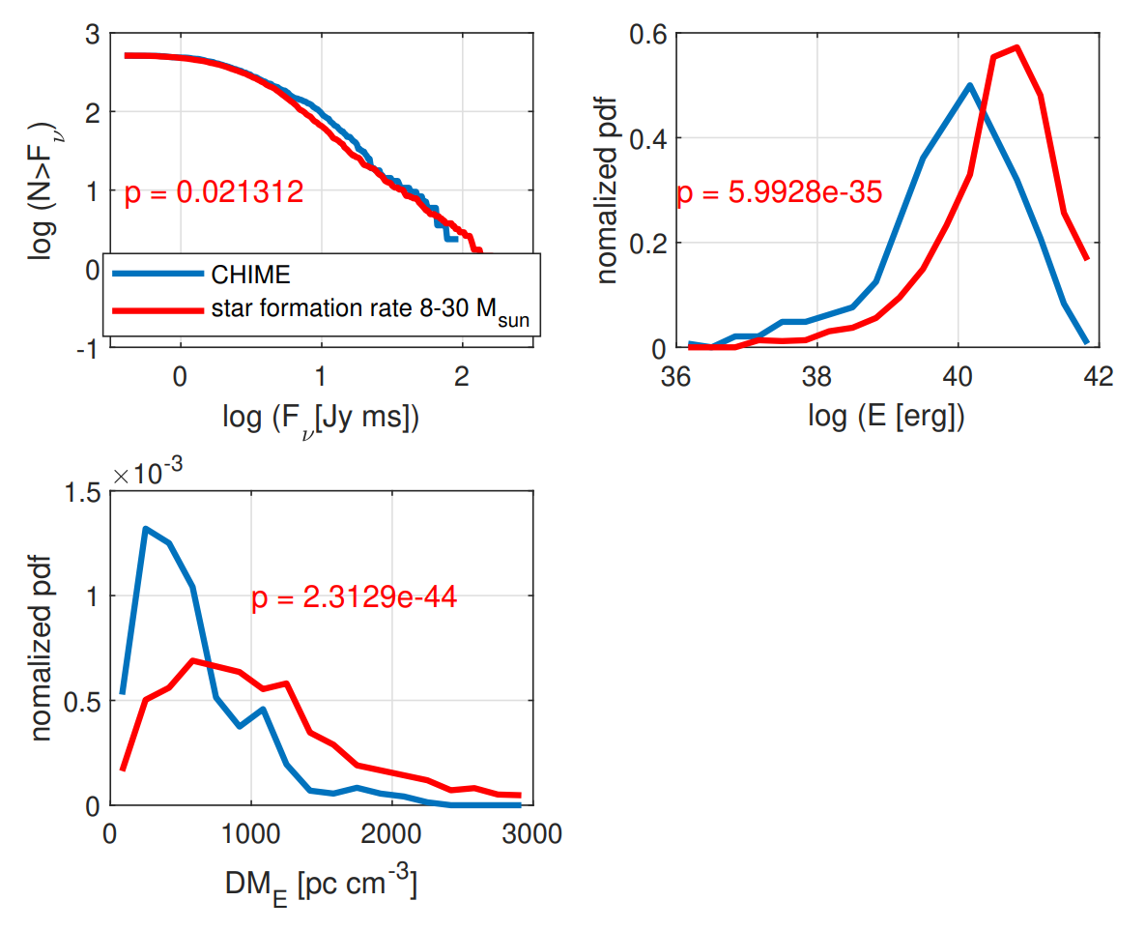
Star formation rate model

Slide 14
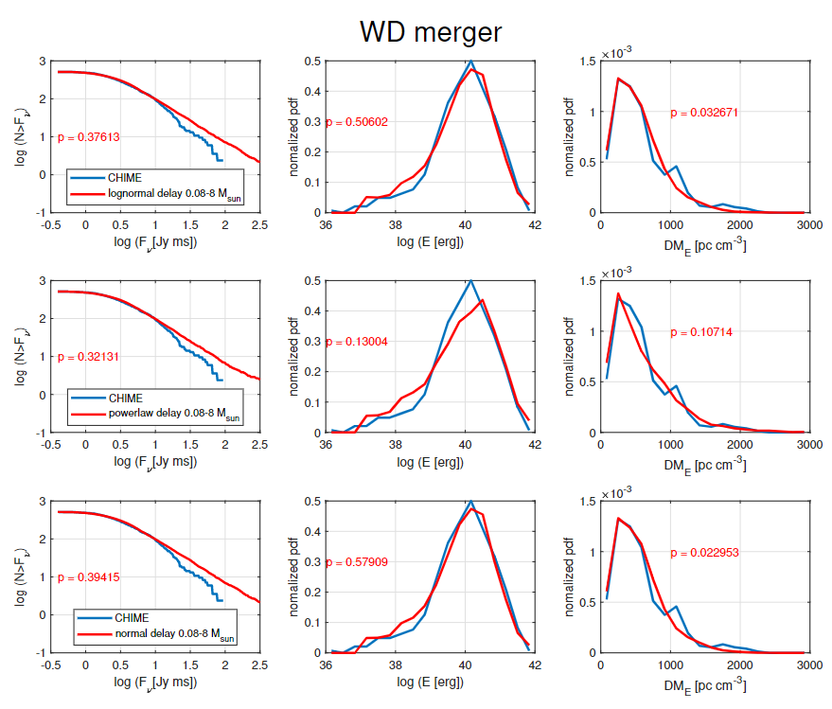

Compact binary merger
Gyr
Gyr
Gyr
Zhang & Yu 2022, in preparation

Slide 15
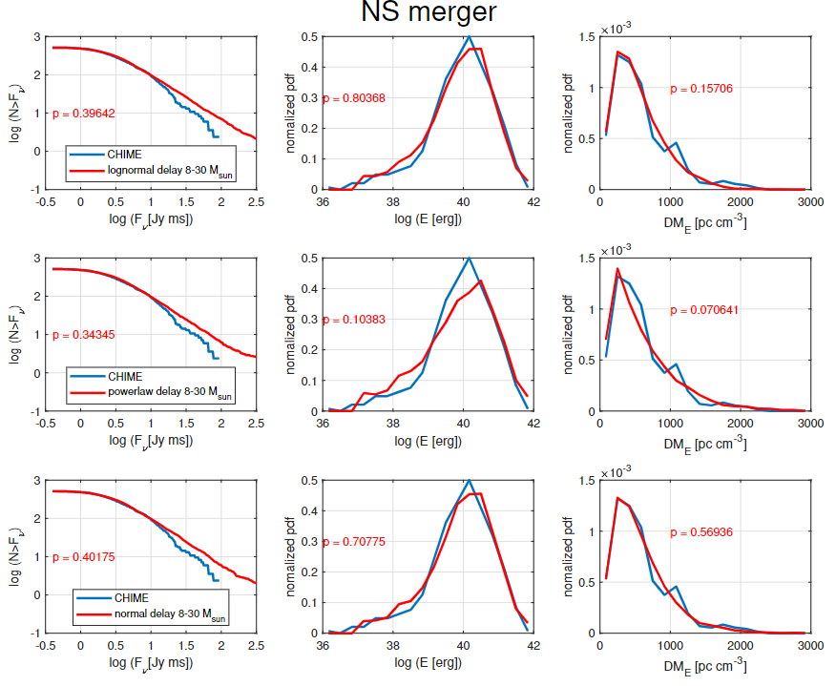

Compact binary merger
Gyr
Gyr
Gyr
Zhang & Yu 2022, in preparation

Slide 16
Summary
Introduce evolving initial mass function and selection effects
The CHIME FRB population do not track the cosmic star formation rate
Delayed models are favored with reasonable parameters
Strongly suggests that FRBs may associate with compact star mergers, especially BWD mergers and BNS mergers.

