Slide 1
Threshold mass of prompt collapse for binary quark stars
Enping Zhou
2022/08/04 @ FPS11, Xiangtan
PRD 103 123011 2021；arXiv:2111.00958
In collaboration with:
Masaru Shibata, Kenta Kiuchi, Antonios Tsokaros, Koji Uryu
科技部SKA专项“脉冲星理论研究支撑”资助

Slide 2
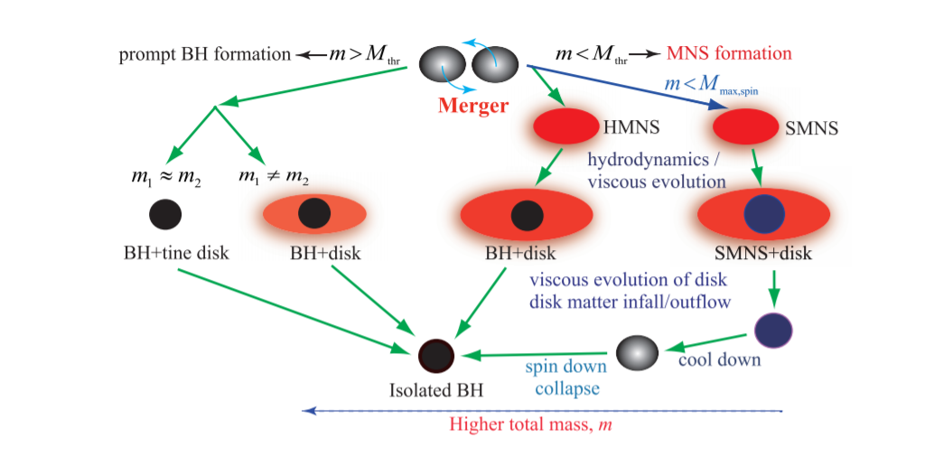
Post-merger evolution channels for BNS
The relation between total mass and several threshold masses determines the evolution channel in the post-merger.
Hotokezaka & Shibata 2019

Slide 3
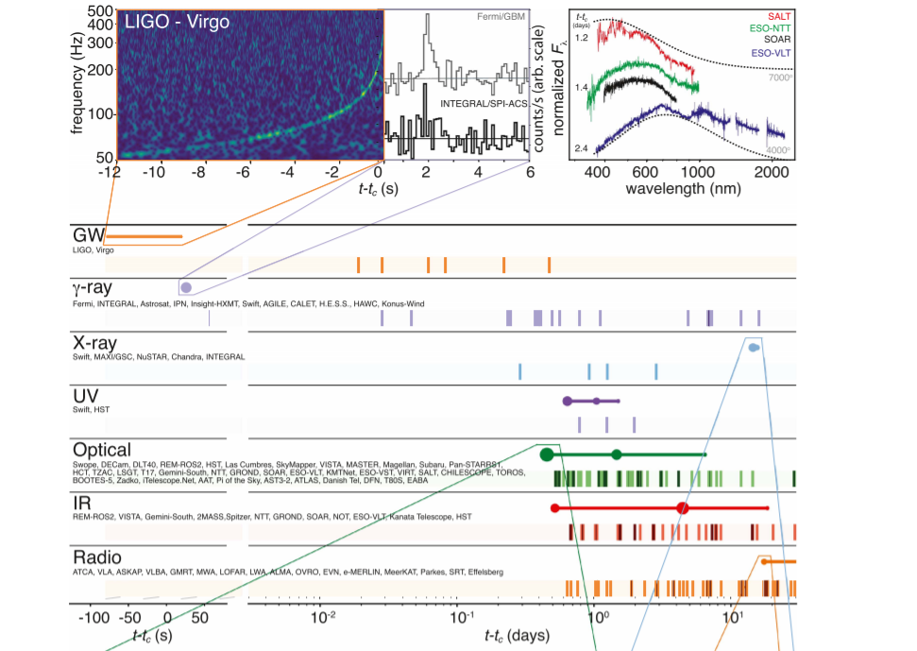
Implications of observation
Observation
->
evolution channel
->
Threshold mass(es)
GW170817
favors a delayed collapse to BH scenario; model dependently favors a short-lived HMNS remnant
(M_tot < M_thr;
M_tot > M_kep)
Abbott et al. 2017

Slide 4
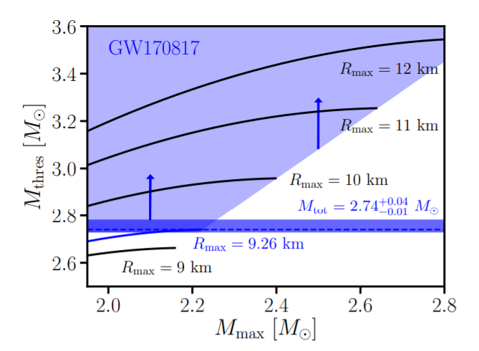
Implication of no prompt collapse
M_thres=
A(R_max)M_tov^2 + B M_tov + c
By universal relations, constraints of no-/prompt collapse could be translated into constraints on these properties.
Bauswein et al. 2017

Slide 5
An obvious tension
For MIT bag model with M_tov =2.1 M_sun,
we have found M_thr=3.05 M_sun but M_max,spin =3.10 M_sun
Hotokezaka & Shibata 2019
Either, BQS does not follow the universal relation of BNS case.
Or, this scenario should be different for BQS mergers. Or both?

Slide 6
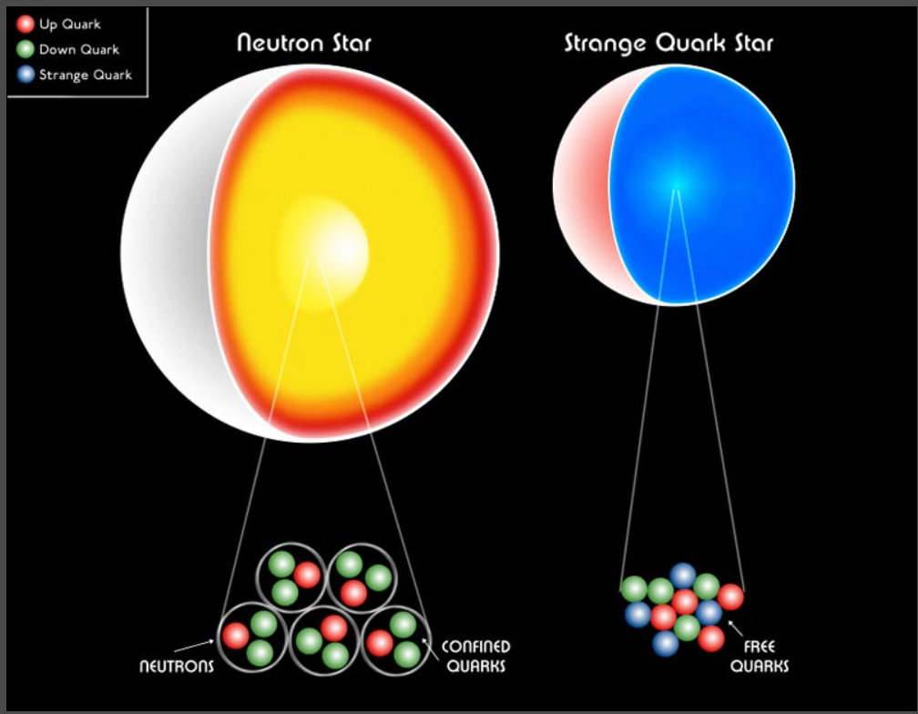
Difficulties in evolving QS
Finite surface density
Surface enthalpy smaller than unity

Slide 7
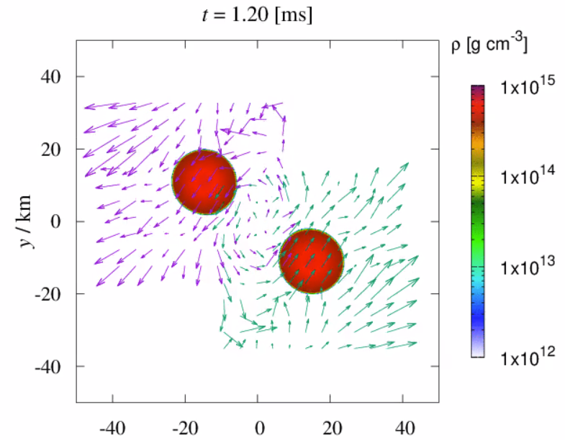
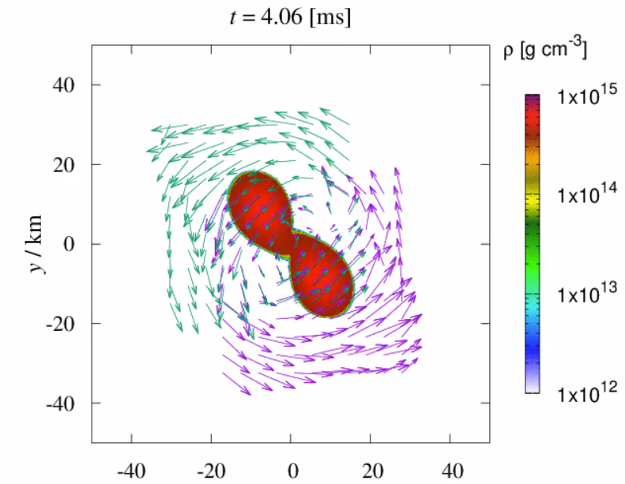
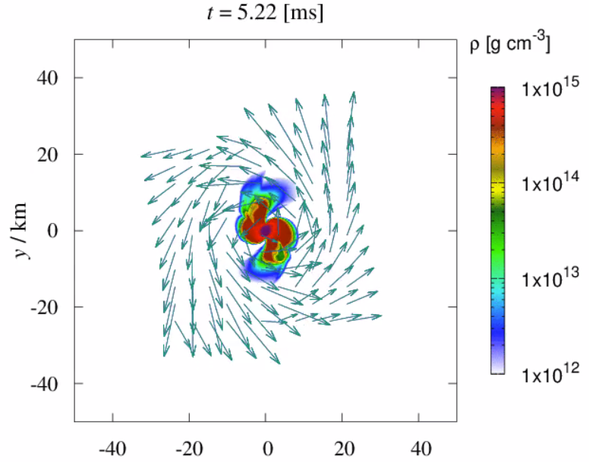
Threshold mass of BQS mergers
Collapse happens ~1 ms after merger, comparable to dynamical timescales.
MIT310 starts at ~ 40 km separation

Slide 8
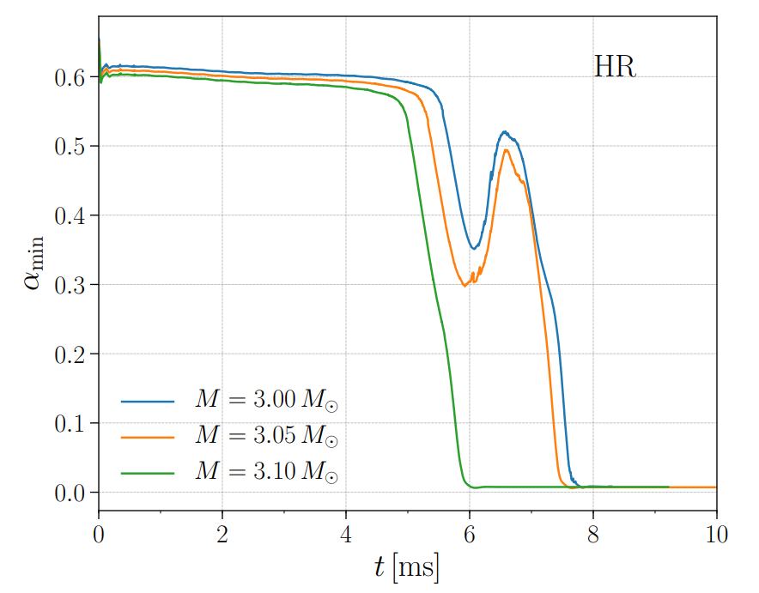
Threshold mass of BQS mergers
Quantitatively, the tt component of the spacetime
metric in the center shows the dynamics of the collapse.
Zhou et al. 2021

Slide 9
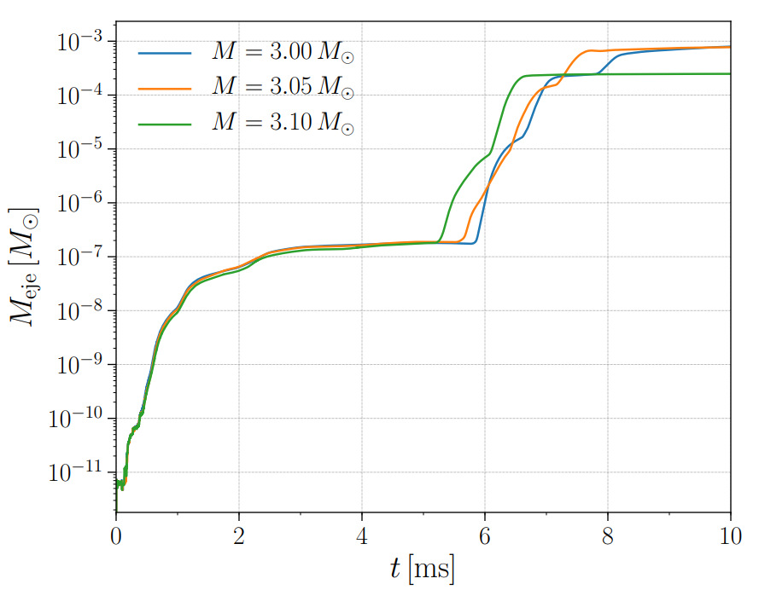
Threshold mass of BQS mergers
M_thr in between 3.05 and 3.10 solar mass
Consistent with BNS universal relation.
But why?
Zhou et al. 2021

Slide 10
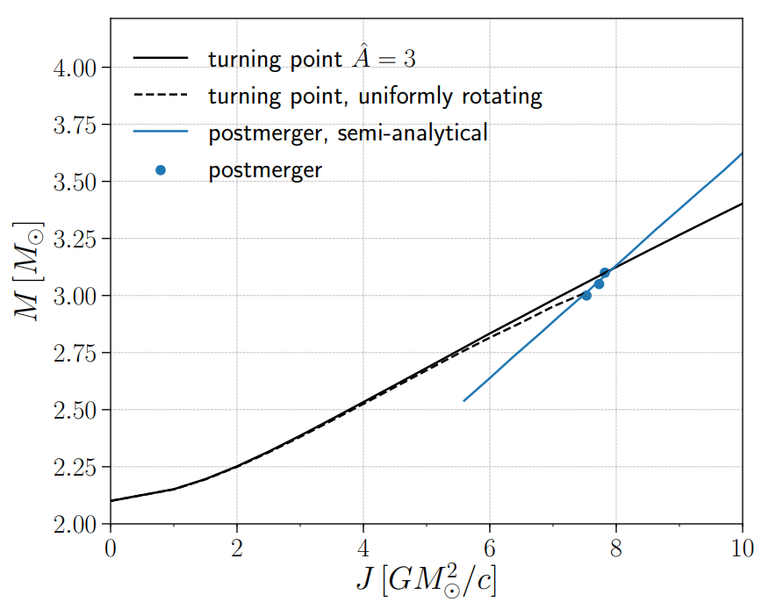
Threshold mass of BQS mergers
QSs could support more massive remnant, as long as the remnant could have enough angular moment.
However, the merger leaves similar amount of angular momentum, regardless of the EoS.
Zhou et al. 2021

Slide 11
Threshold mass of BQS mergers
Angular momentum loss
Gravity-bound
Self-bound
by
strong interaction
Inspiral dynamics determined by finite size effect which can be characterized with
k_2 and compactness
Threshold mass

Slide 12
Summary
Post-merger evolution channels for BQS and their comparison with BNS
BQS/BNS consistency | √ | ×
M_thr for prompt collapse | √
Dividing mass for remnant lifetime |  | ×
Ejecta mass/disc mass |  | ×
GW features | √
Potentially could be used to distinguish QS/NS

