Slide 1
GW from PBH Inspiraling inside Compact Star A Novel Probe for Dense Matter EoS
Collab.: Ze-Cheng Zou (邹泽城), Yong-Feng Huang (黄永锋*)
Zou, Z.-C. & Huang, Y.-F. 2022, ApJL, 928:L13

Slide 2
PBHs as Dark Matter
Carr & Kühnel (2020)

Slide 3
Dynamical Constraint
Capela et al. (2013)

Slide 4
Dynamical Constraint
… survival of stars does not constrain PBHs, but … could be constrained if we can work out the observational signature of this process.” (Montero-Camacho et al. 2019)

Slide 5
Observational Signatures?
Transmutation
FRBs (Fuller & Ott 2015, Abramowicz et al. 2018, Kainulainen et al. 2021)
r-process nucleosynthesis (Fuller et al. 2017)
GRBs & e⁺ (Takhistov 2019)
Solar-mass BHs (Takhistov et al. 2021)
GWs?

Slide 6
GWs as Observational Signature
… is monochromatic with frequency $f_{⋆}∼kHz$ and with a constant amplitude estimated as
”
(italic font set by the original authors)
Génolini et al. (2020)
Horowitz & Reddy (2019)

Slide 7
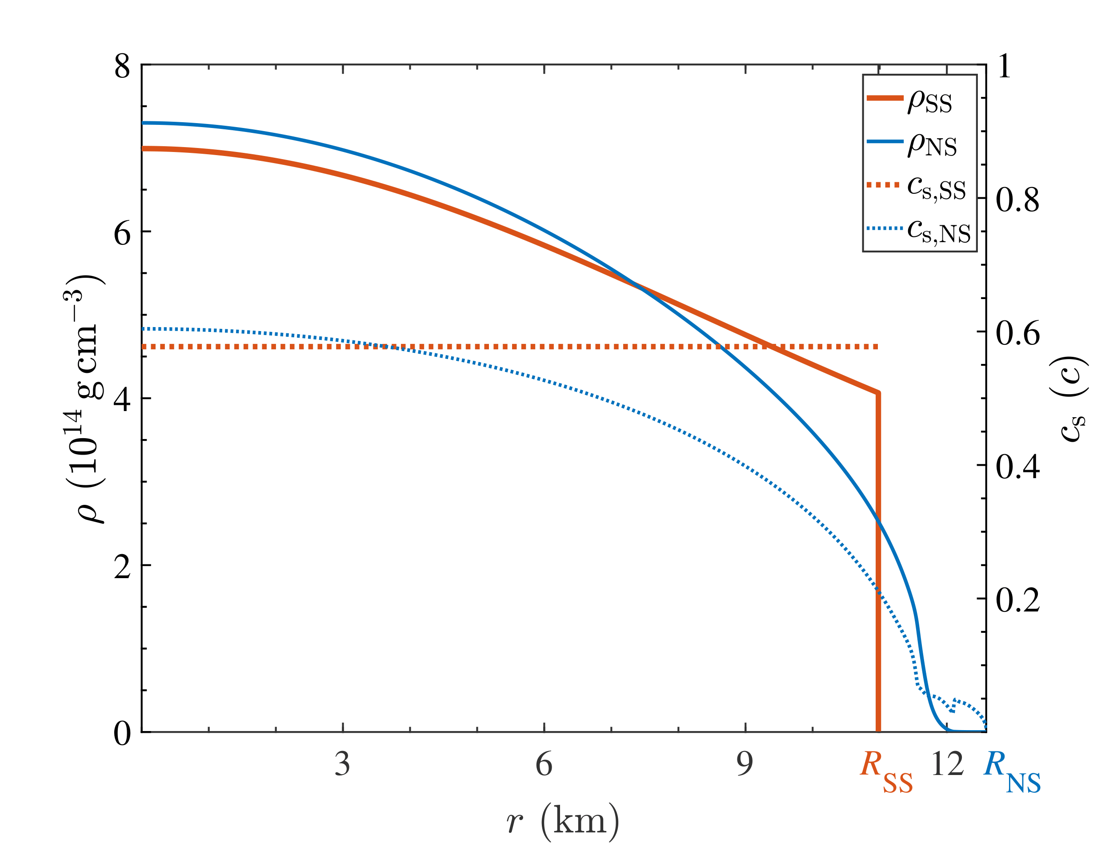
Dependence on Stellar Structure
Energy-losing channels
Dynamical friction
Accretion
Post-Newtonian (GW)
Stellar structure
Neutron star (BSk 24)
Strange star (MIT-Bag)
Zou & Huang (2022)

Slide 8
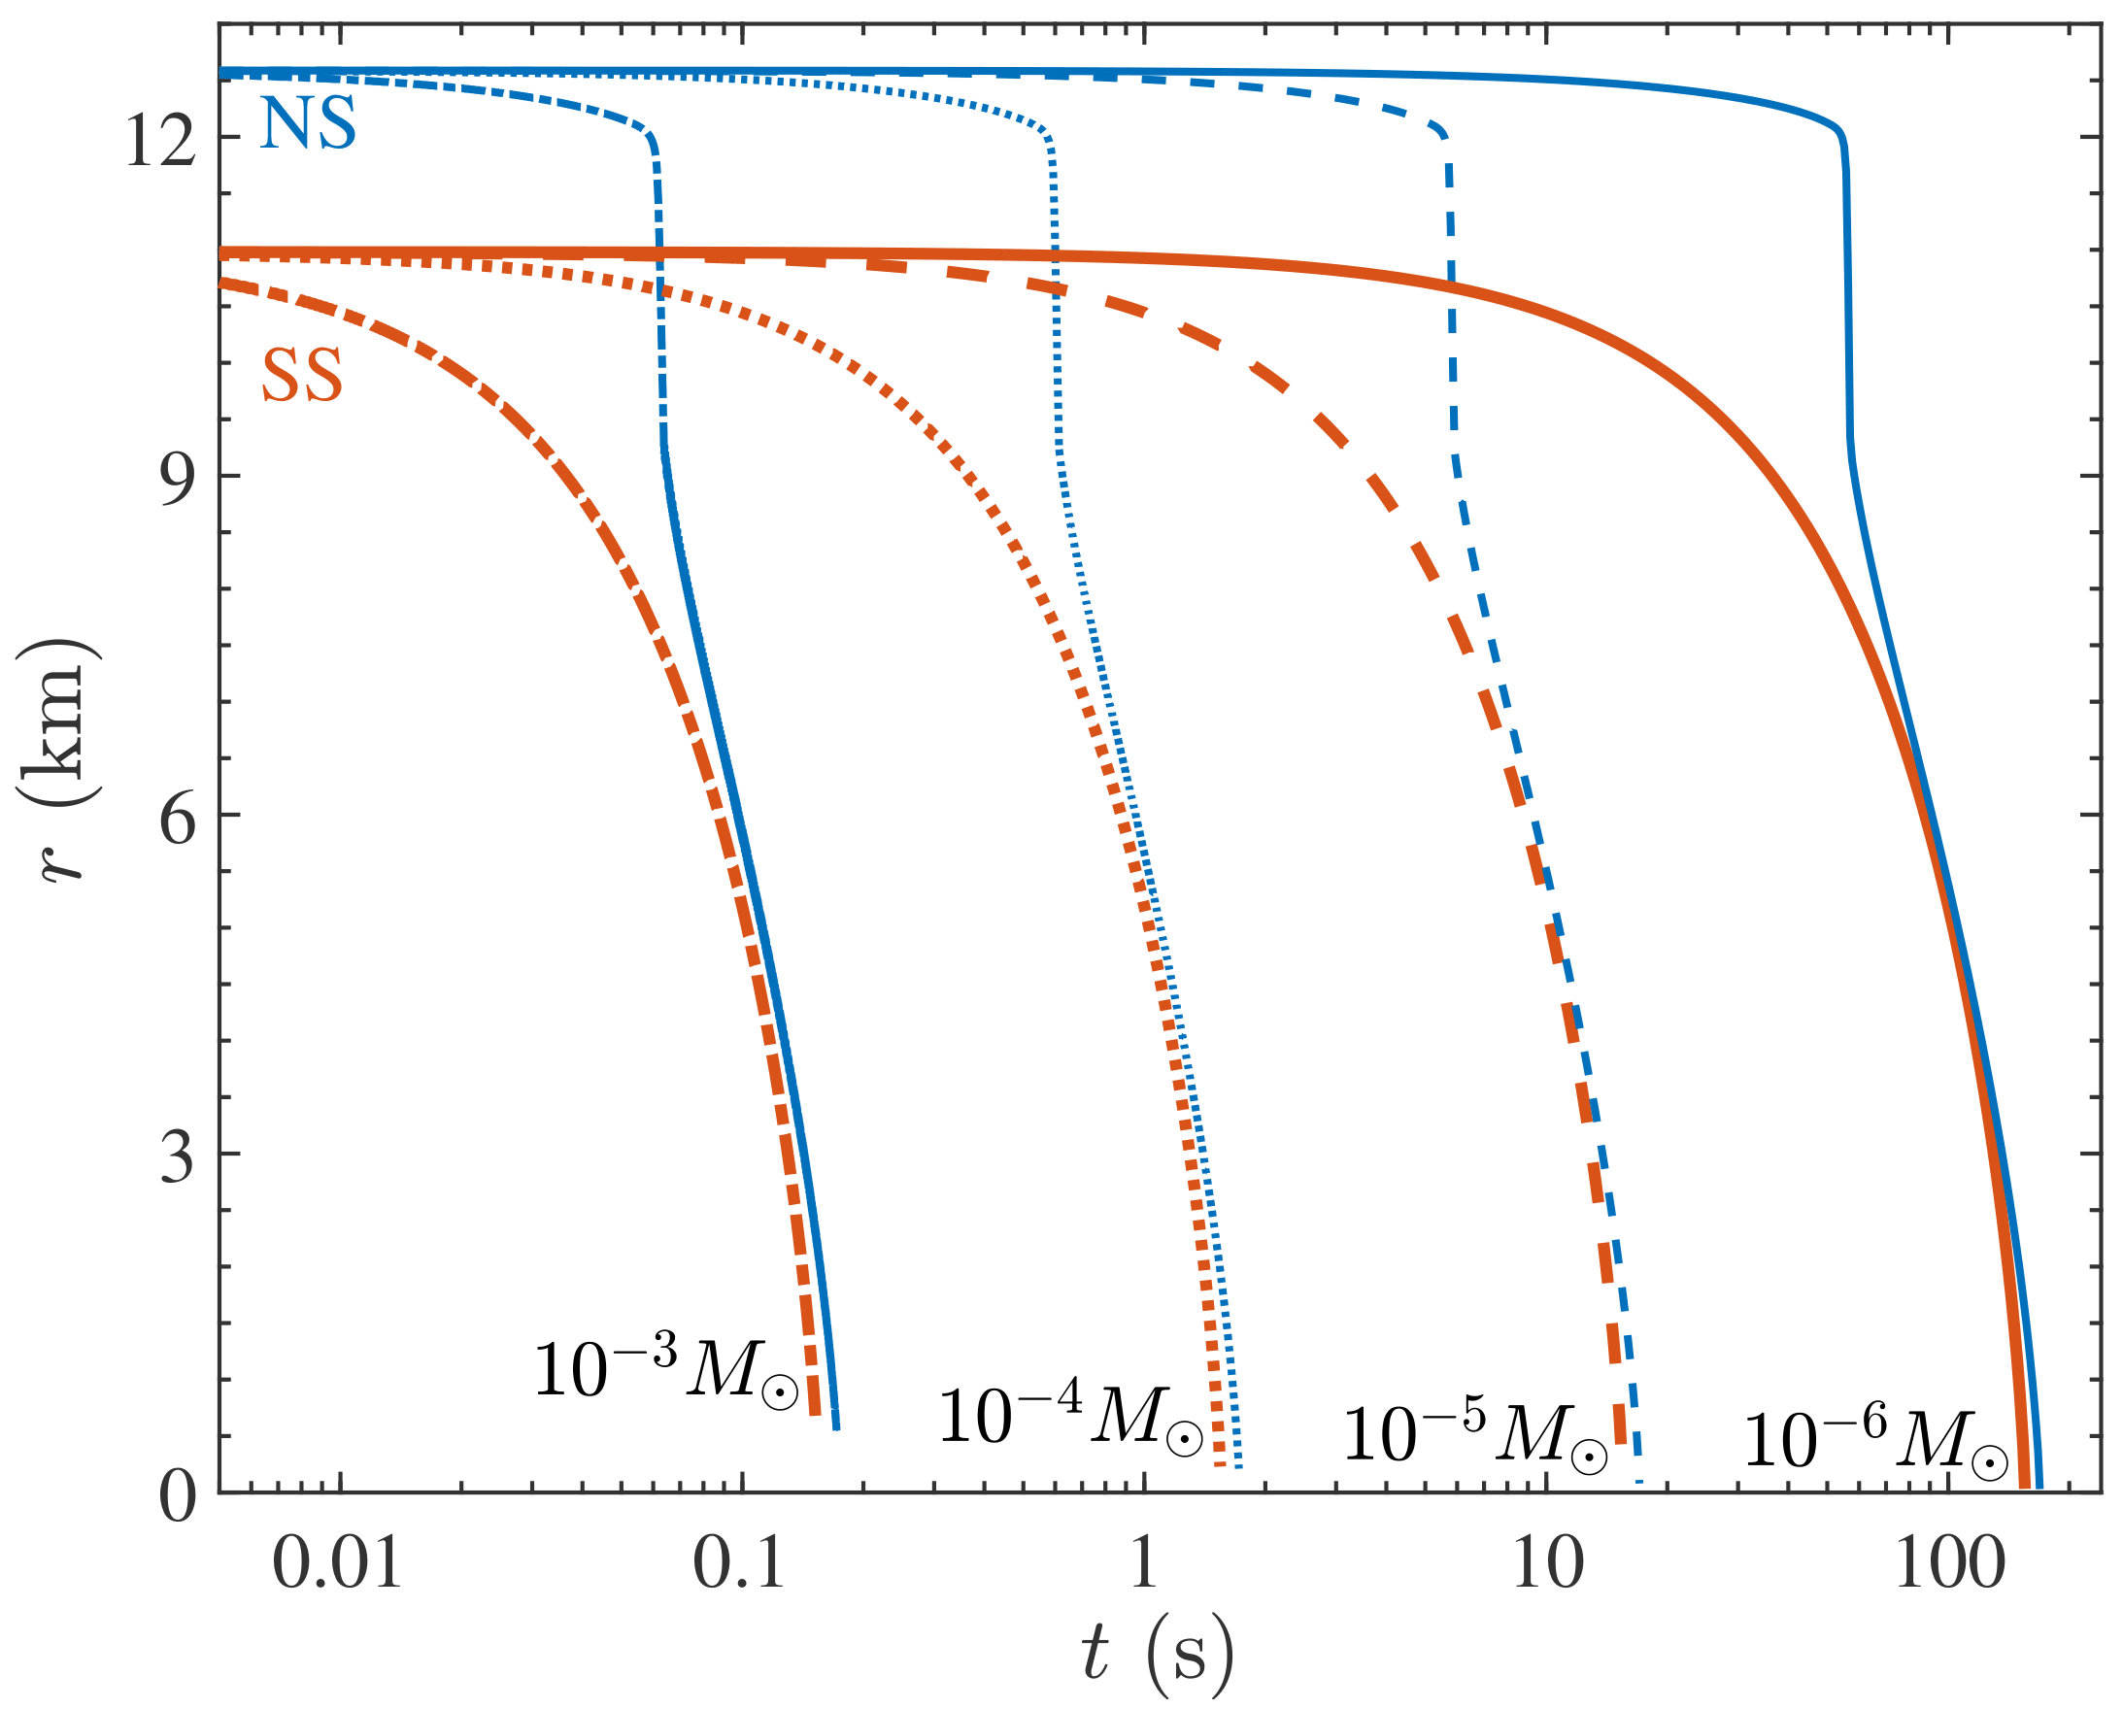
Binary Evolution
Zou & Huang (2022)

Slide 9
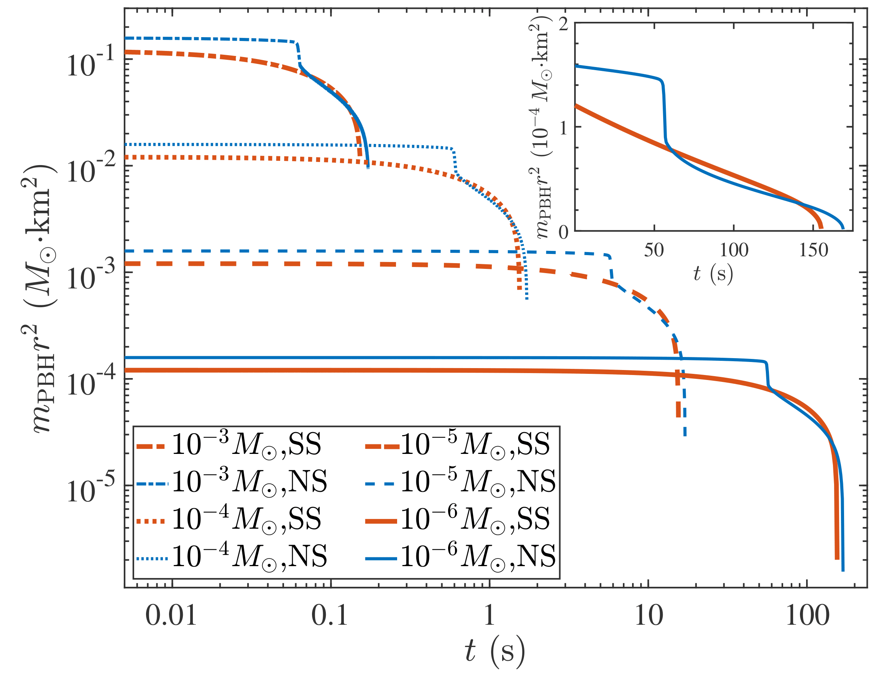
m_{PBH}r² is not constant
Zou & Huang (2022)

Slide 10
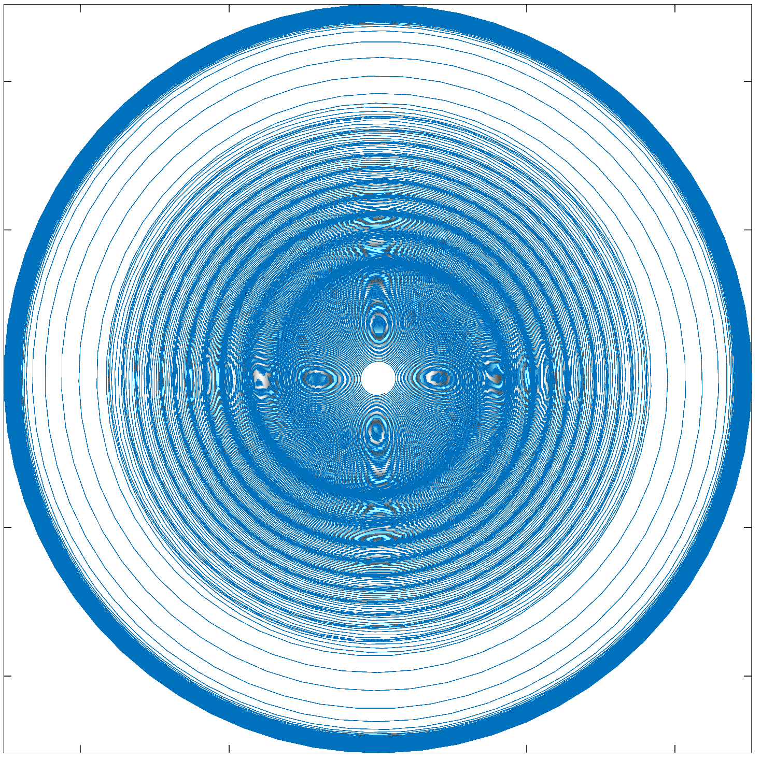
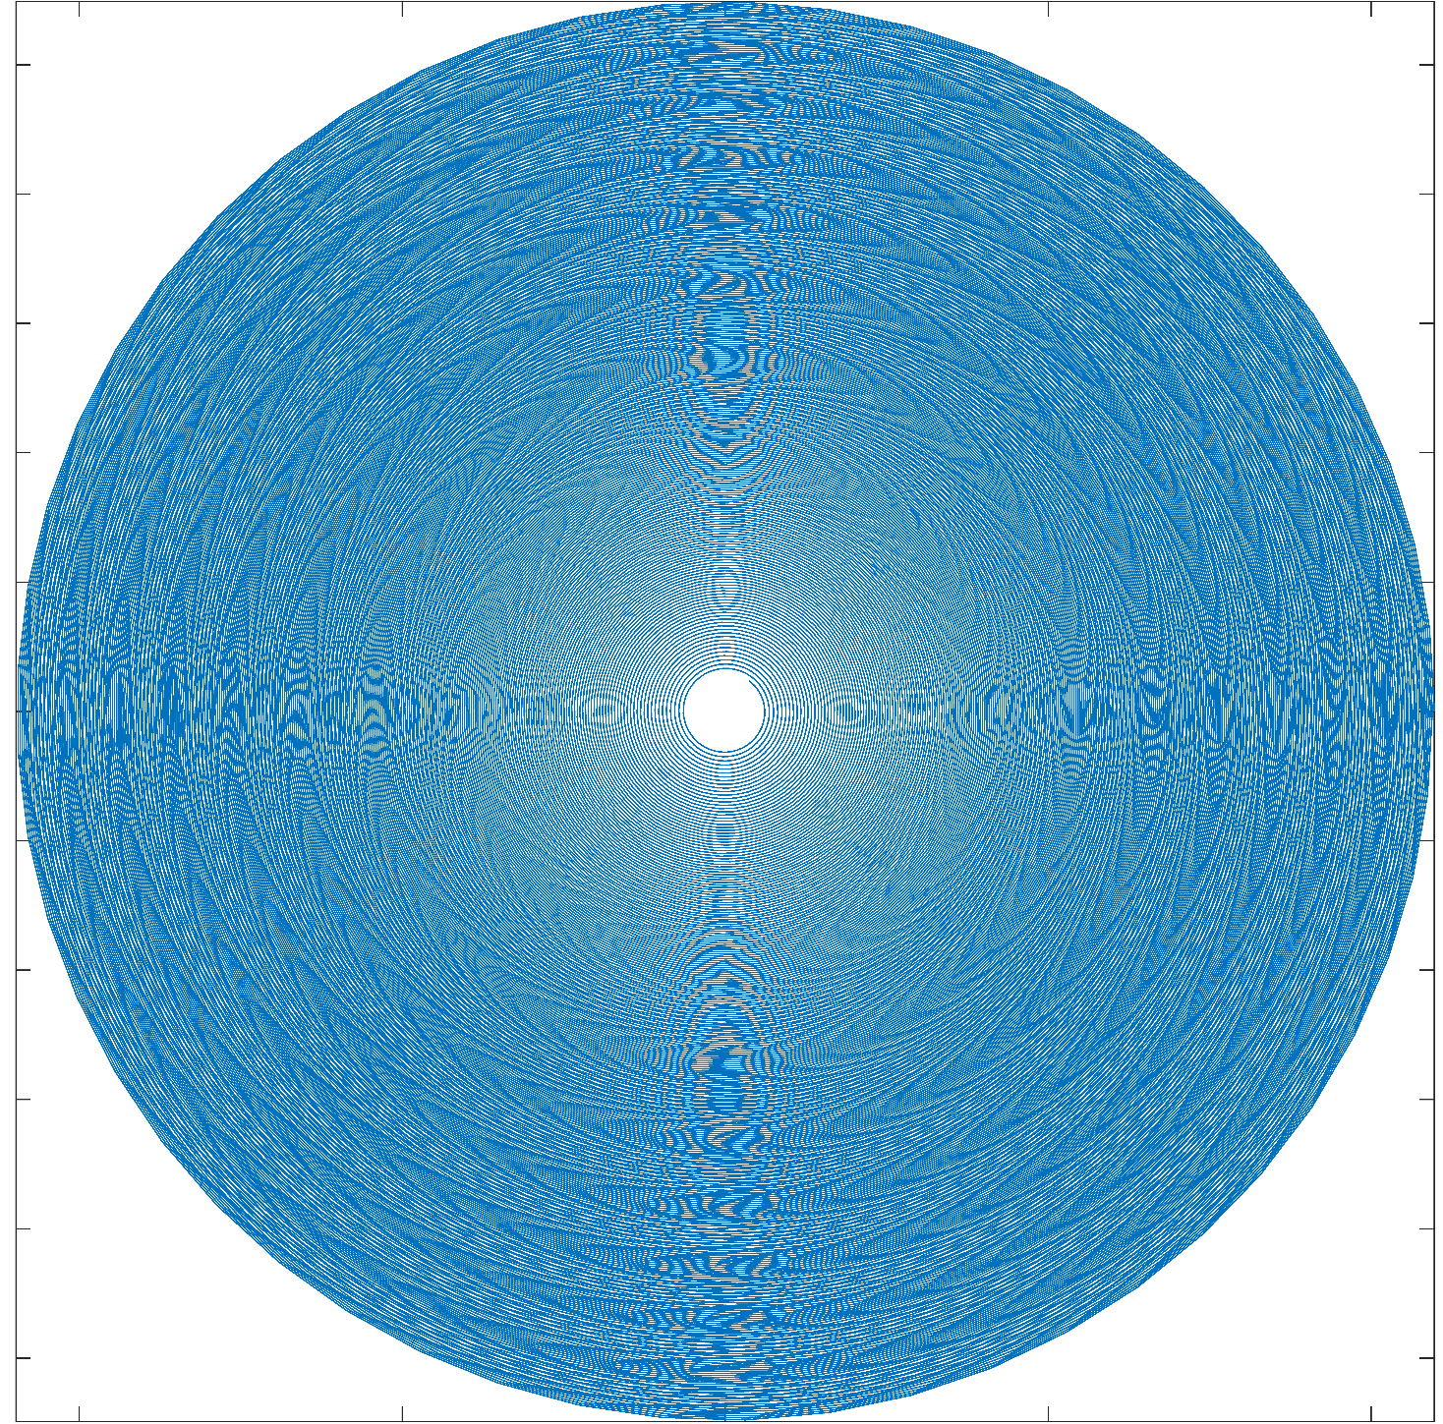
Orbit: Neutron star vs. Strange star

Slide 11
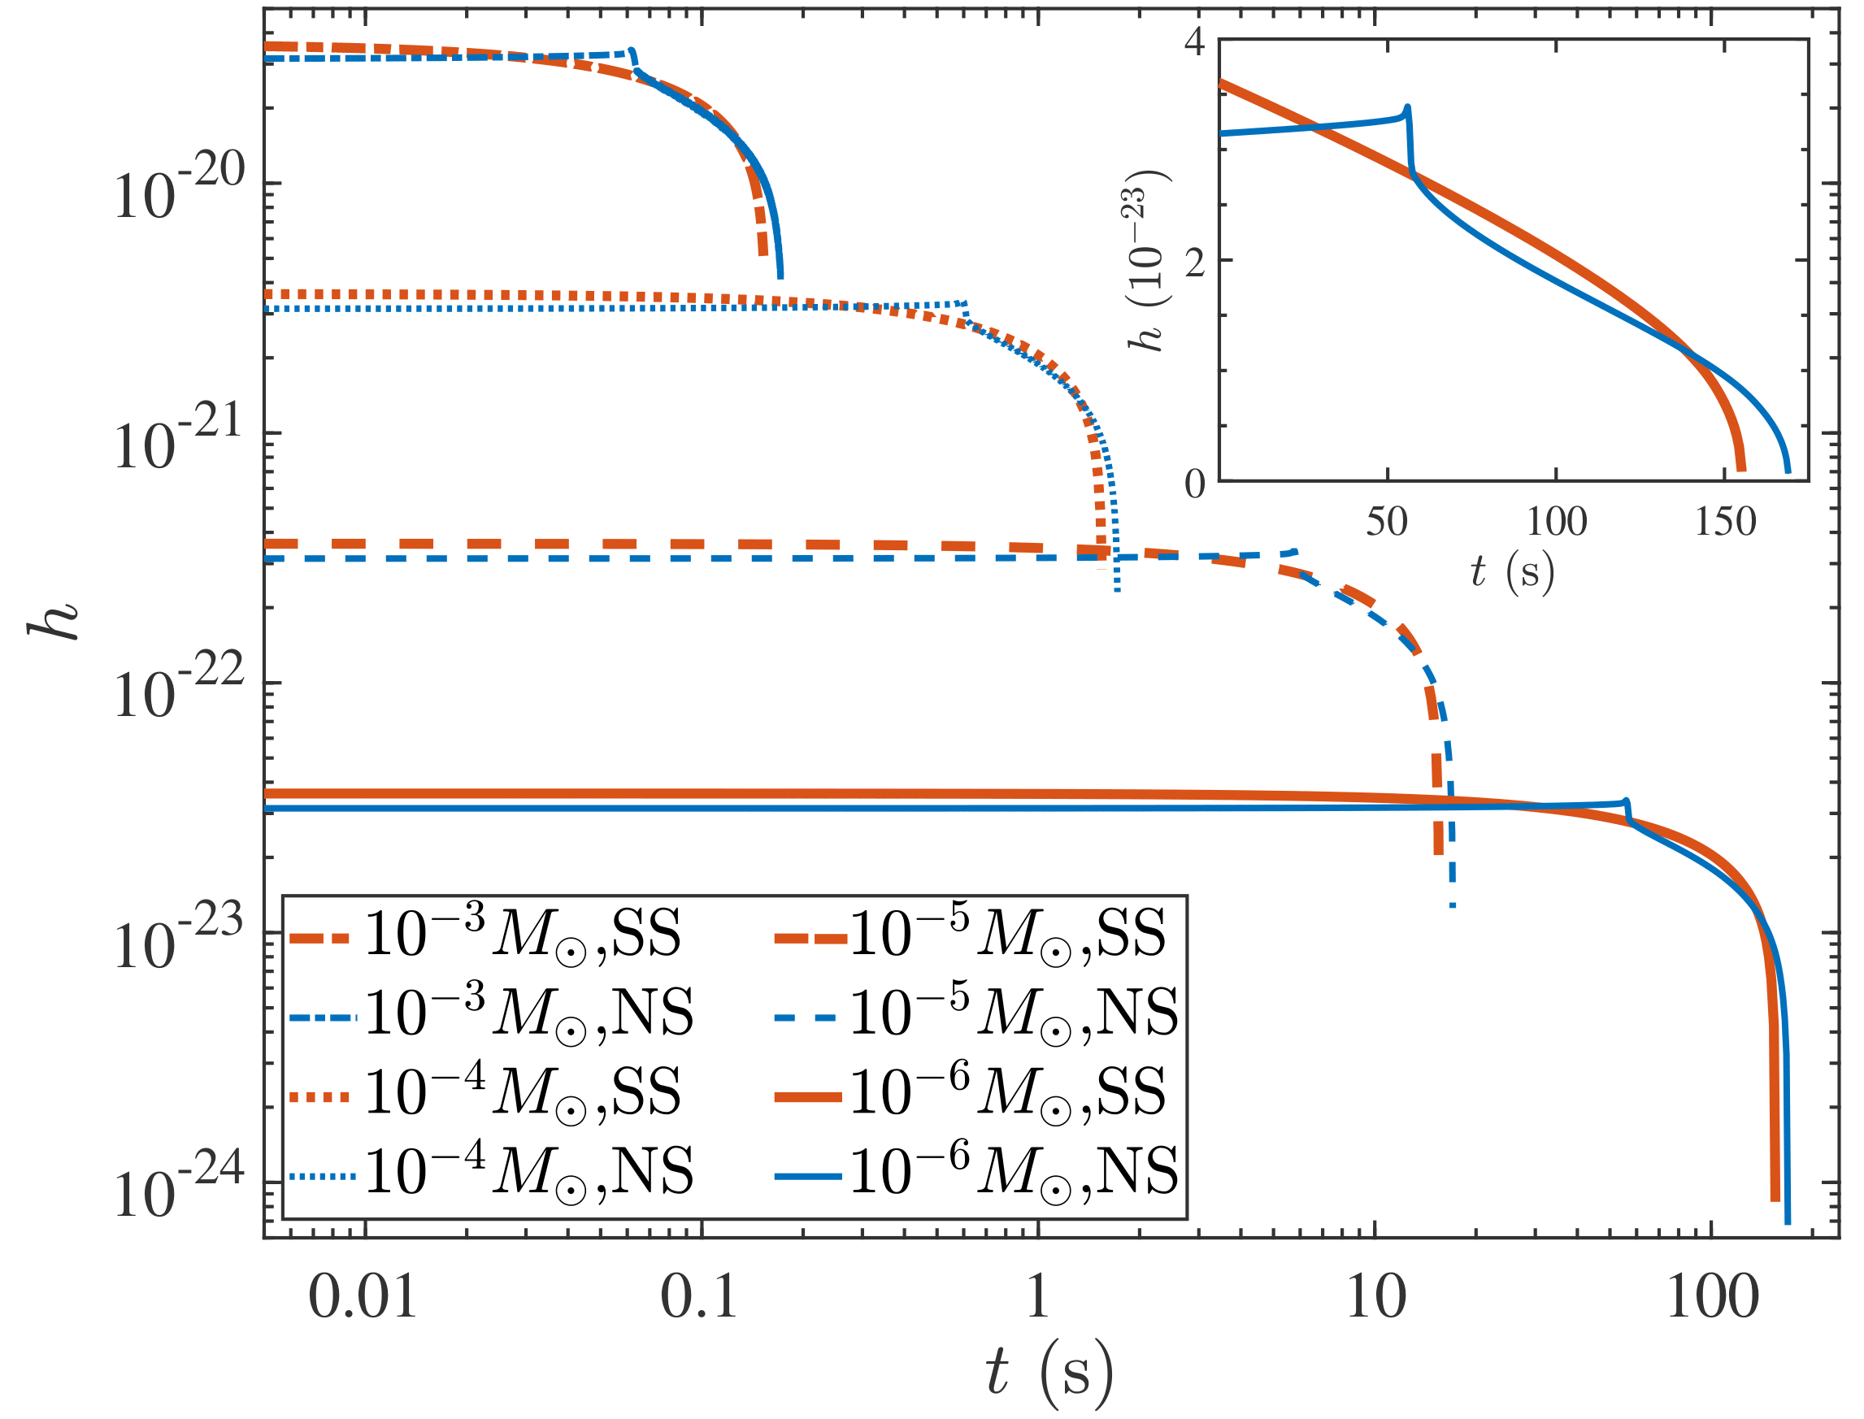
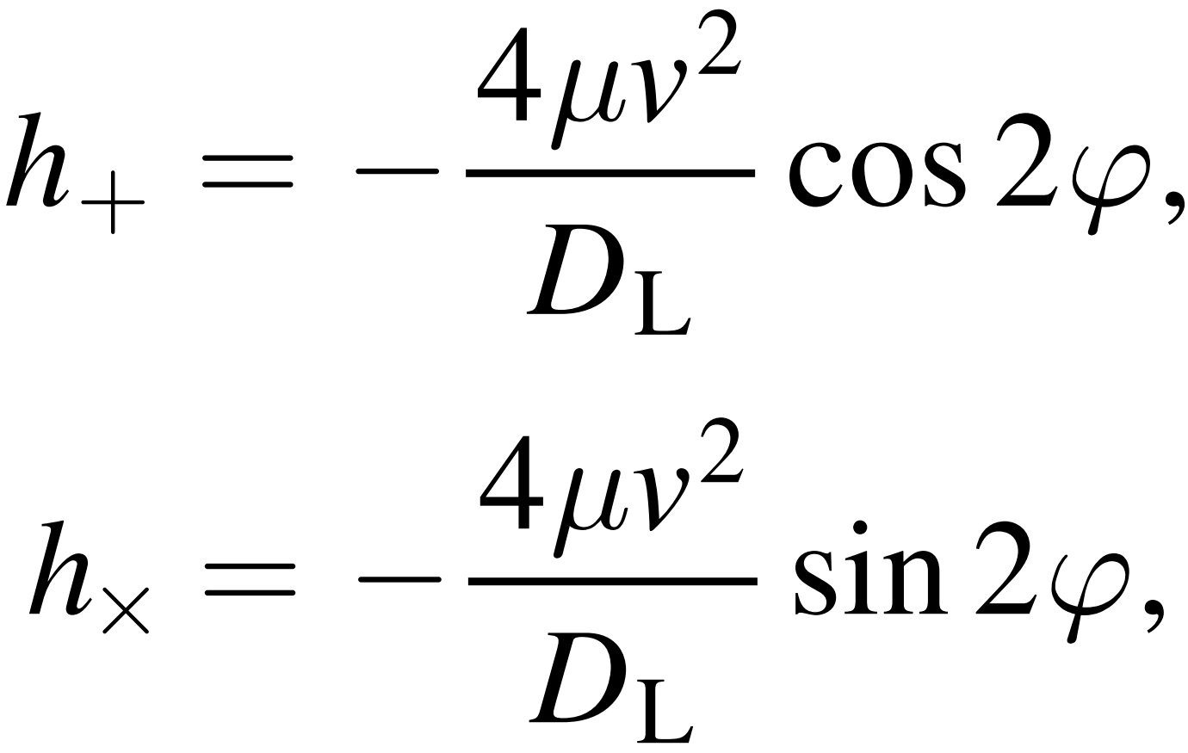
Gravitational Wave
Zou & Huang (2022)

Slide 12
Gravitational Wave
Zou & Huang (2022)

Slide 13
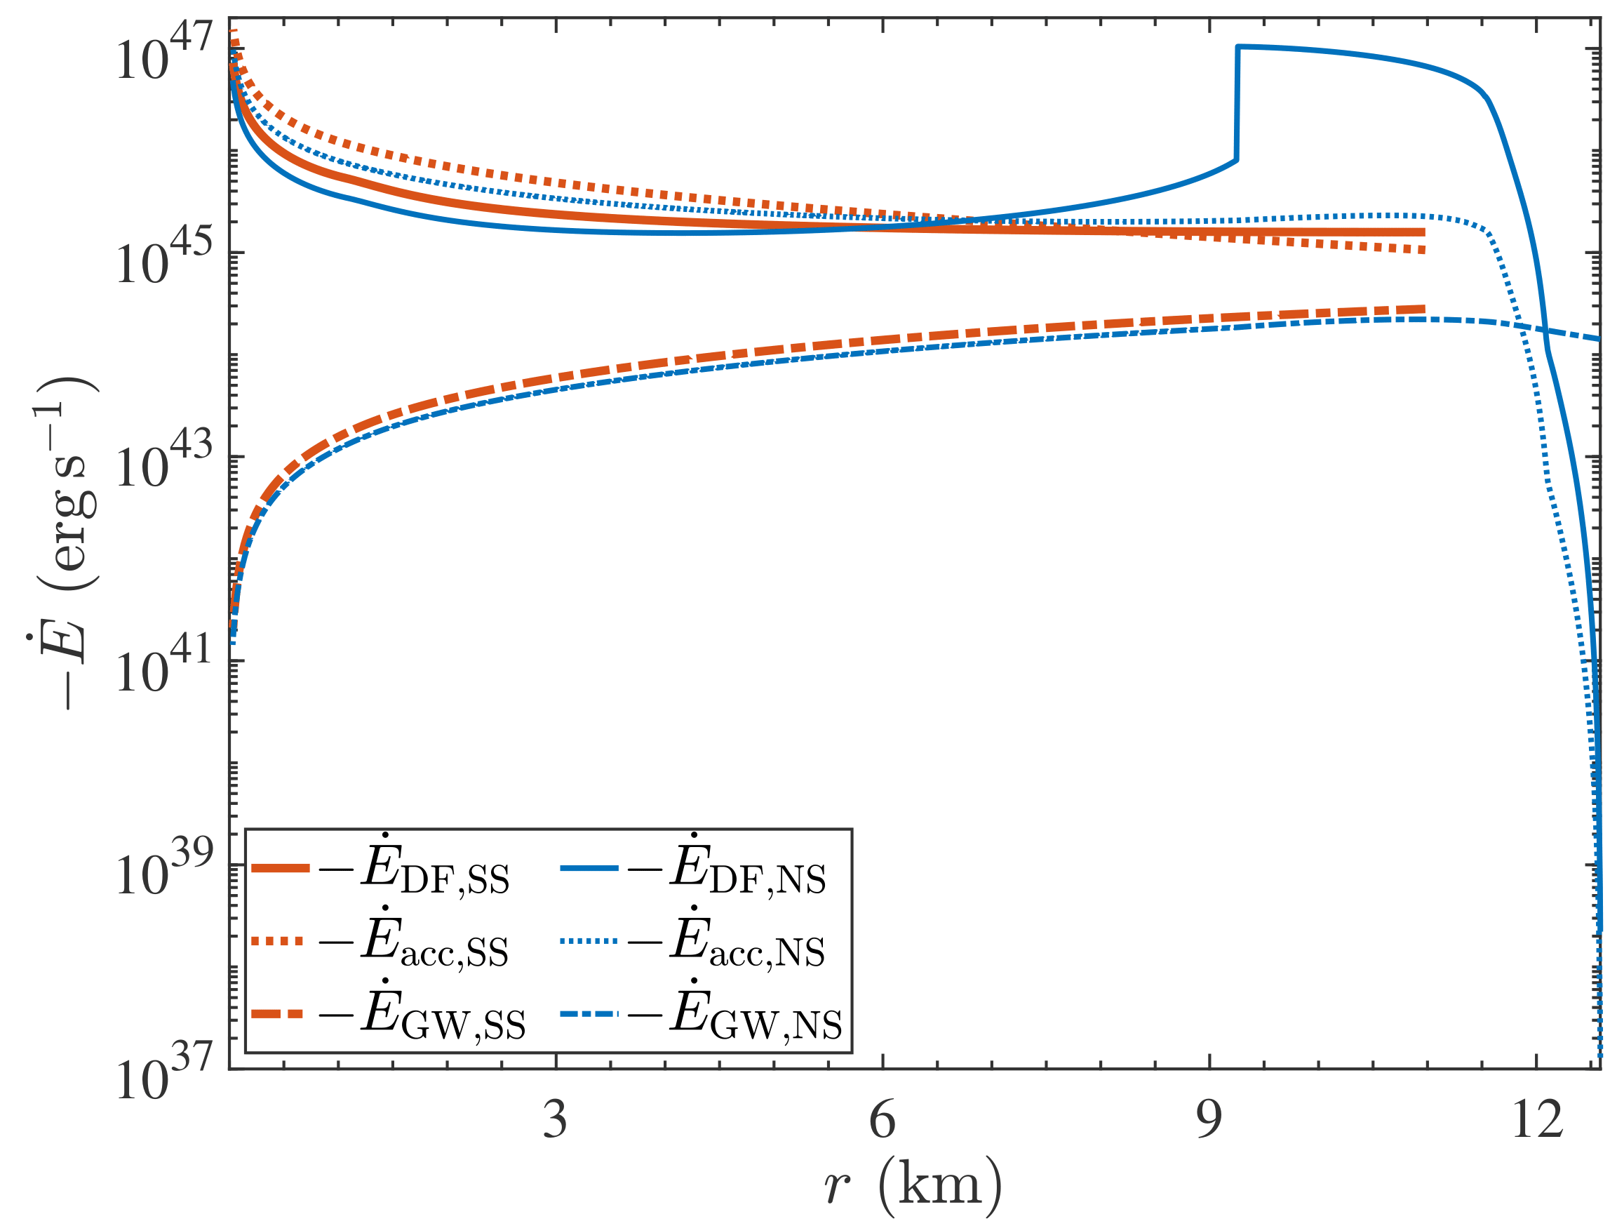
Energy-losing Channels
Zou & Huang (2022)

Slide 14
Summary
GWs from PBH inspiraling inside compact star:
constrain PBHs’ fraction of dark matter
probe the dense matter EoS
Thank you!

Slide 15
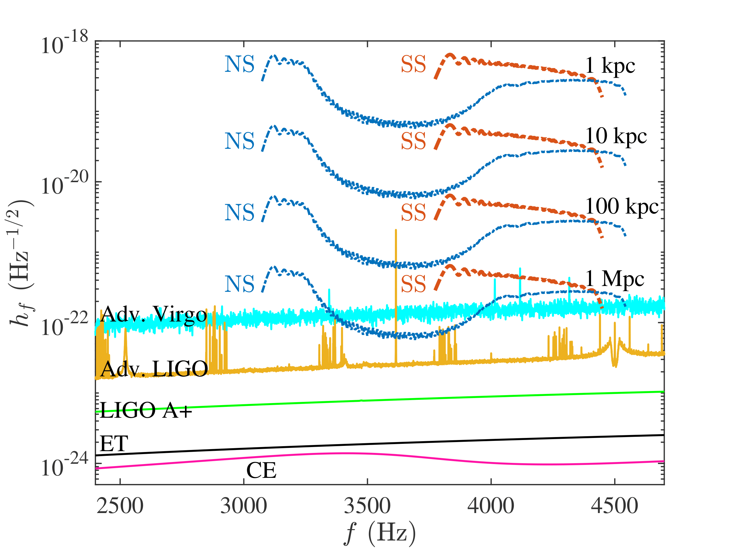
Distance
Zou & Huang (2022)

