Slide 1
PSR B0943+10:
Orthogonally polarized radiation,
Mode switch and Polar cap geometry
2023.7.5
Reporter: 曹顺顺
(Shunshun Cao)
Peking University

Slide 2
Contents
Introduction
Observation
Result
Discussion

Slide 3
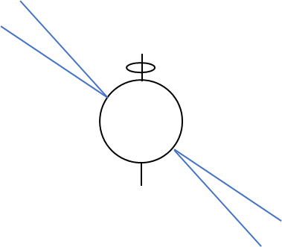
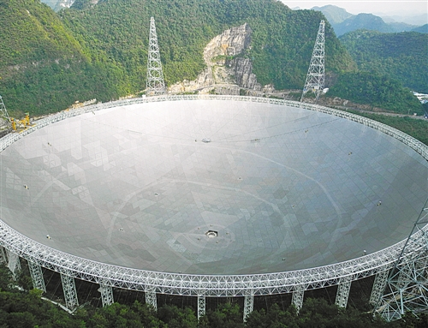
I. Introduction
Radio pulsars’ signals:
psr.pku.edu.cn
Single pulses sequence
……
……
Integrated (Averaged) profiles:
Some pulsars appear to be
Mode
Changing
Mode 1
Mode 2
We don’t know why mode switches happen…
[may be related to magnetosphere activities (Timokhin 2010)]

Slide 4
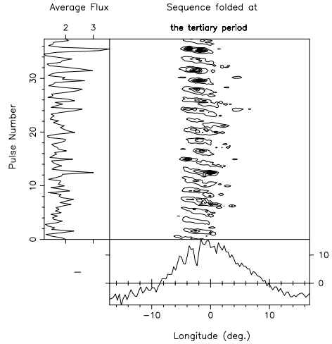
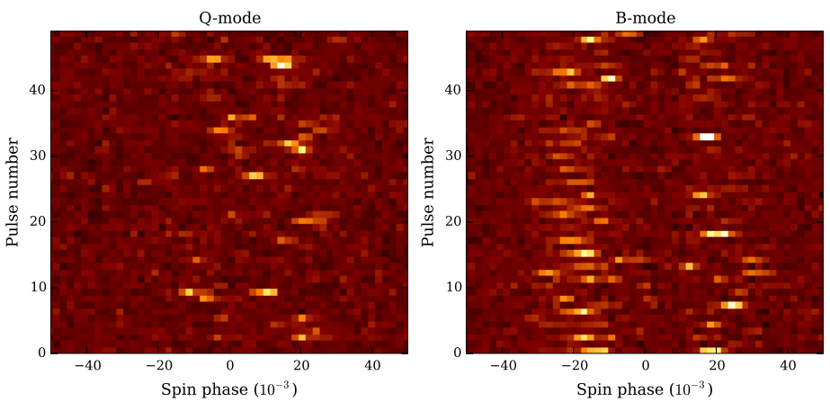
Basic radiation facts on PSR J0946+0951 (B0943+10):
·Mainly two stable modes: B (burst, with drifting subpulses) and Q (quiet, disorganized).
Bilous et al. 2018
Deshpande & Rankin 2001

Slide 5
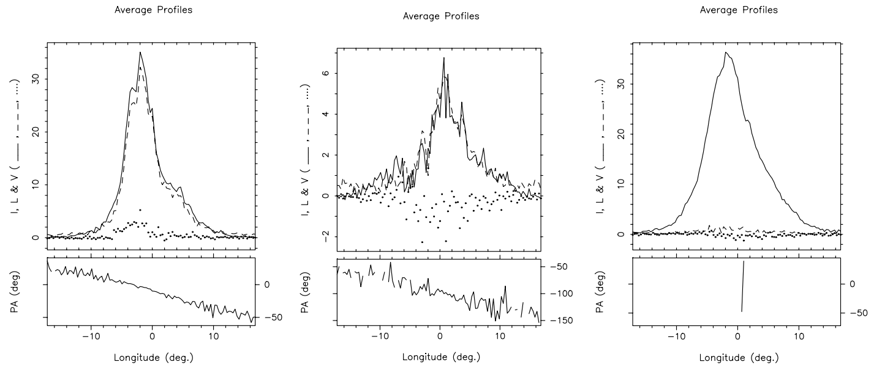
Basic radiation facts on PSR J0946+0951 (B0943+10):
Two fully polarized orthogonal modes yielded from “repolarization” technique:
PPM
SPM
Unpolarized
(UP)
Deshpande & Rankin 2001

Slide 6
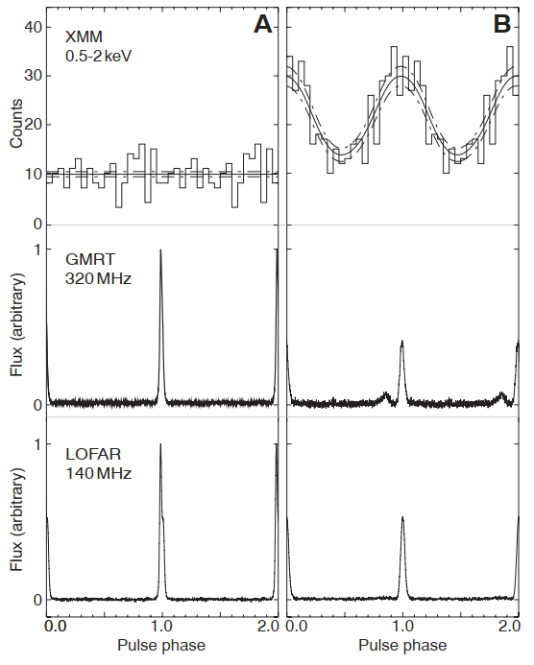
Basic radiation facts on PSR J0946+0951 (B0943+10):
·X ray observation:
B
Q
Hermsen et al. 2013

Slide 7
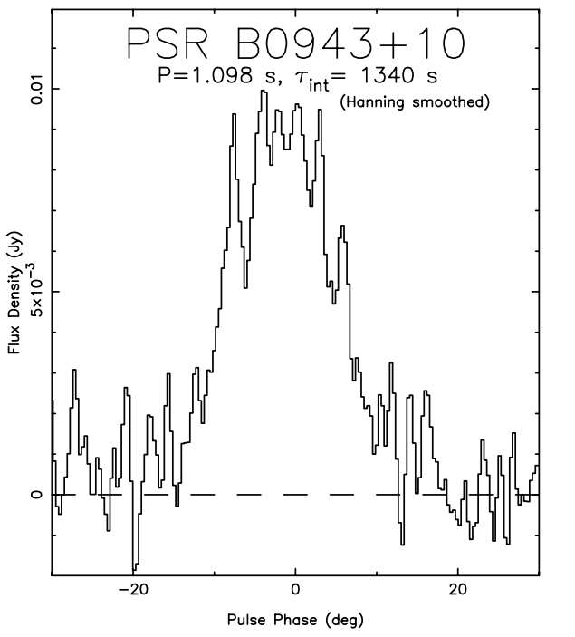
FAST’s advantages on studying J0946+0951:
Study on higher frequencies (1-1.5GHz L band).
(ii) More polarization study (high sensitivity).
Single pulses study.
……
Modes and polarization…
(Arecibo 1.418GHz)
Weisberg et al. 1999

Slide 8
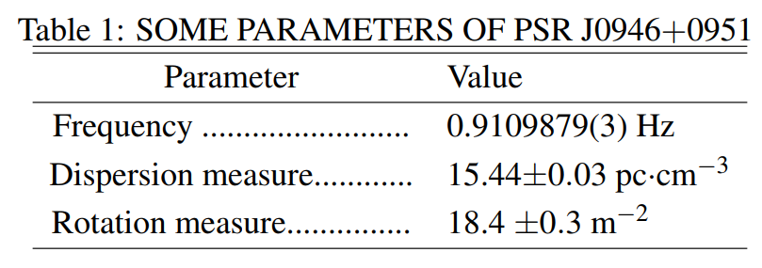
II. Observation
Two sessions PI: Shunshun Cao (20220902) and Zhichen Pan (20220517)
https://fast.bao.ac.cn/observation_log/observed_source_search
Data processing: DSPSR, PSRCHIVE and TEMPO2 software packages.

Slide 9
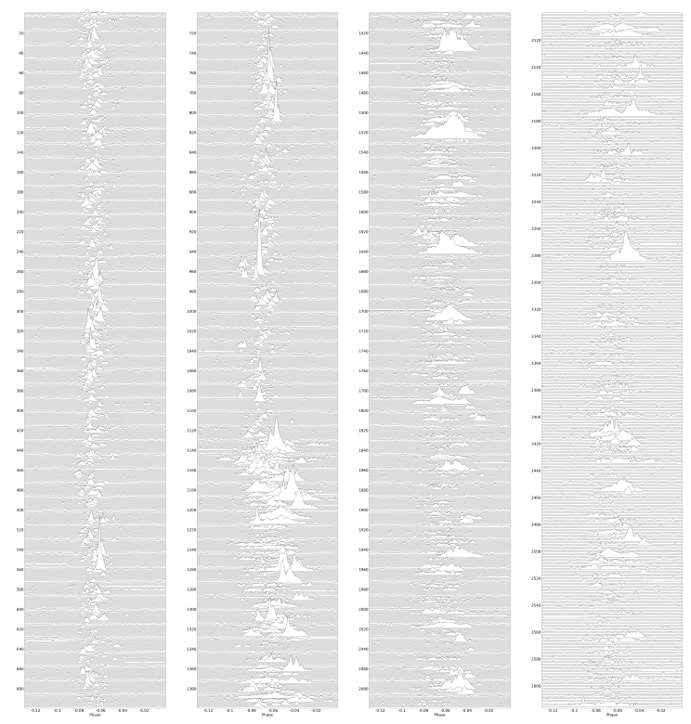
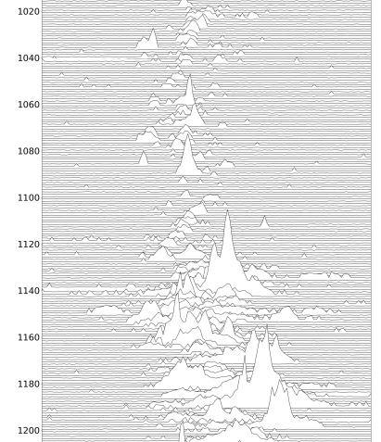
III. Results
Profile evolution around mode switch in 50 min’s observation:
Mode change

Slide 10
Way to identification profile evolution:
Search for eigen modes (Li et al. in prep.) based on MLE.
i-th sub-integration
Phase j ➔ pij
Measurement noise
“eigen mode” 1
“eigen mode” 2
Assume the measurement noise
follow the Gaussian distribution.
i
j
pij
Likelihood:

Slide 11
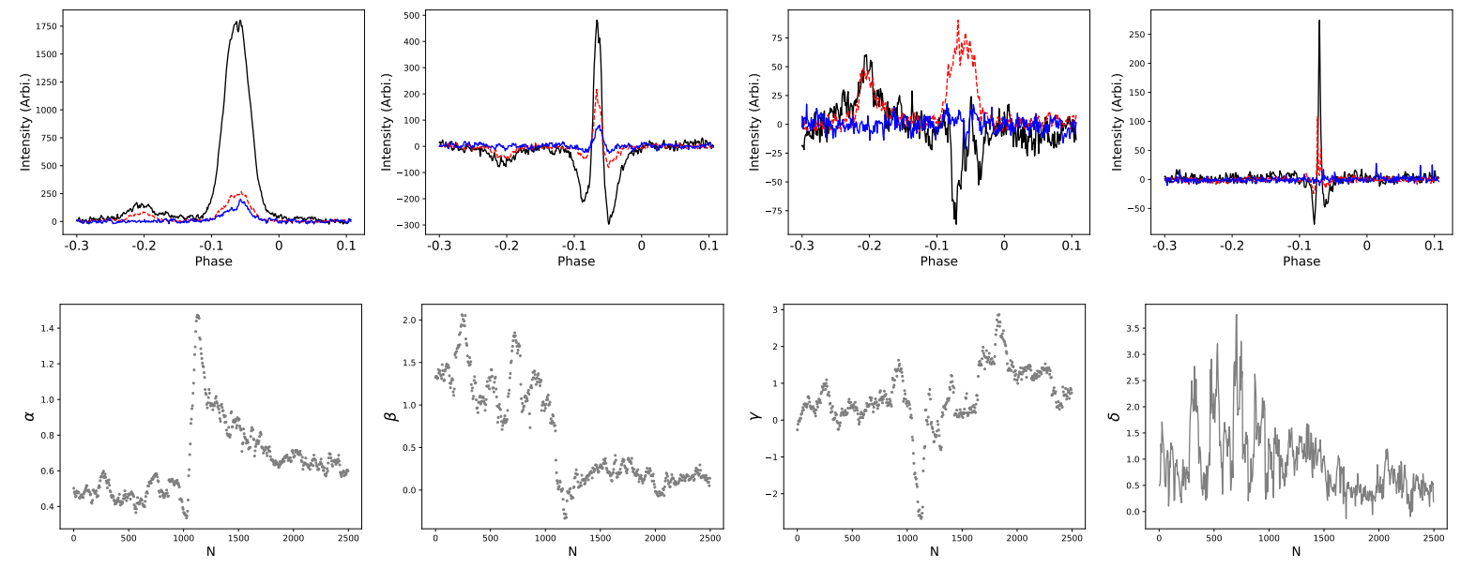
Apply on our data:
50 min observation ➔ 500 subints (length=100 pulses, every 5 pulses):
4 eigen modes and mixture weights:
Mixture weights: quantitative description of profile’s width and shape.

Slide 12
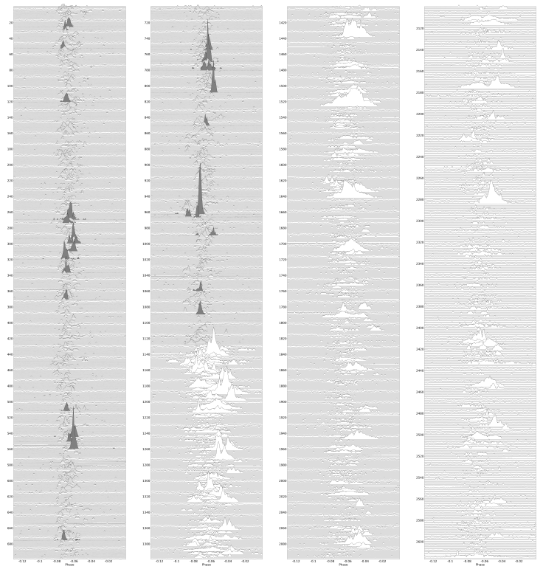
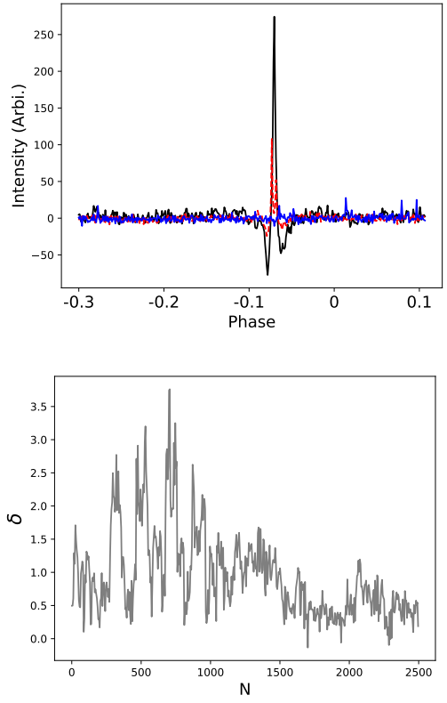
Waterfall:

Slide 13
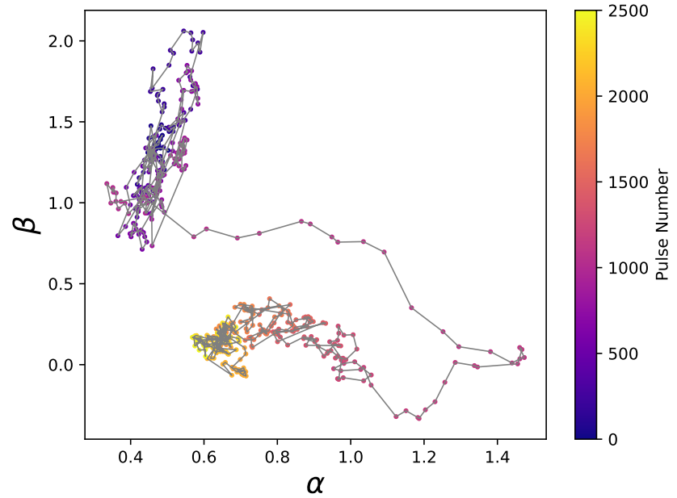
First two modes’ weights on a 2D plane:
Like strange attractor?

Slide 14
Two modes: B and Q
B:
Q:
Dots:
Green – Polarization position angle (PA)
Purple – Elliptical angle (EA)
Lines:
Black – Intensity ( I )
Red – Linear polarization
Blue – Circular polarization (V )

Slide 15
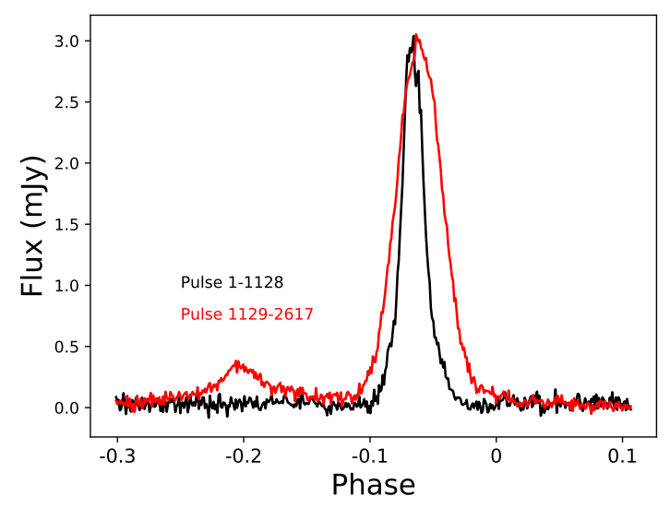
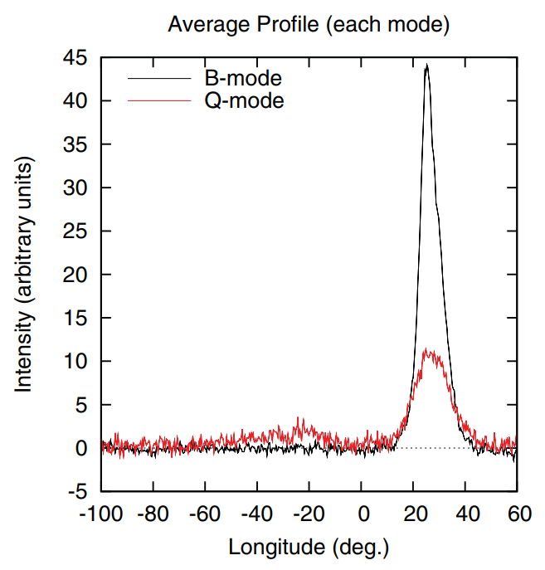
Flux estimation:
1250MHz
Backus, Mitra and Rankin 2011
(GMRT 325MHz)
B and Q: different in frequency evolution.

Slide 16
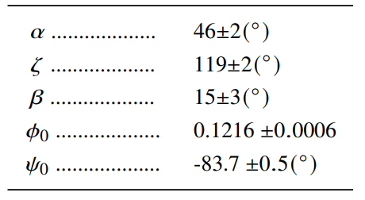
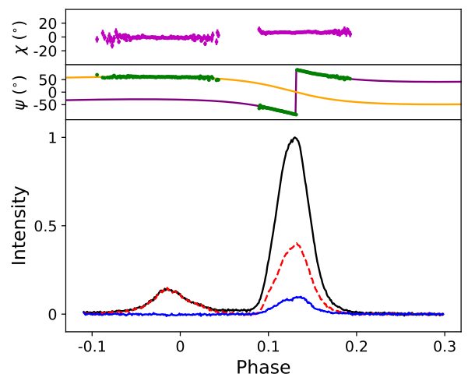
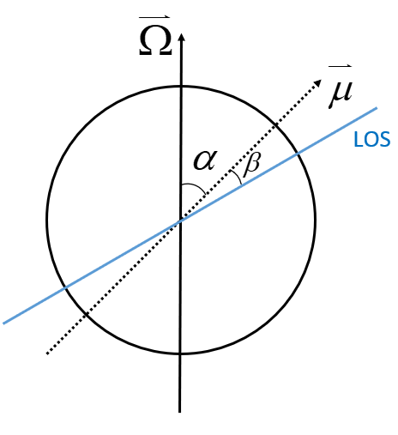
(ii) Radiation geometry and single pulses’ polarization
Rotating Vector Model (RVM, 1969) fitting:
⬅➔move precursor component 90°
90°

Slide 17
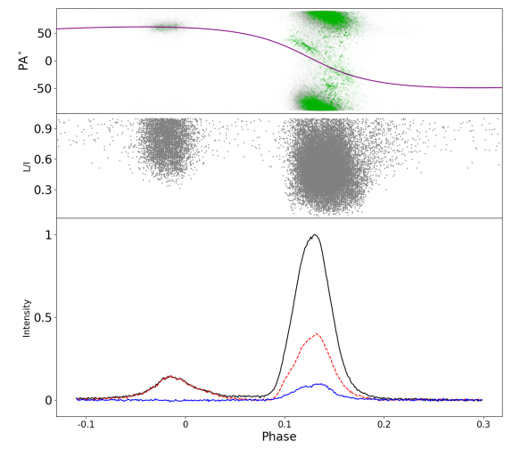
➔Single pulses’ distributions of L/I and PA (2h observation)
Wave mode 1
Wave mode 2
OPMs

Slide 18
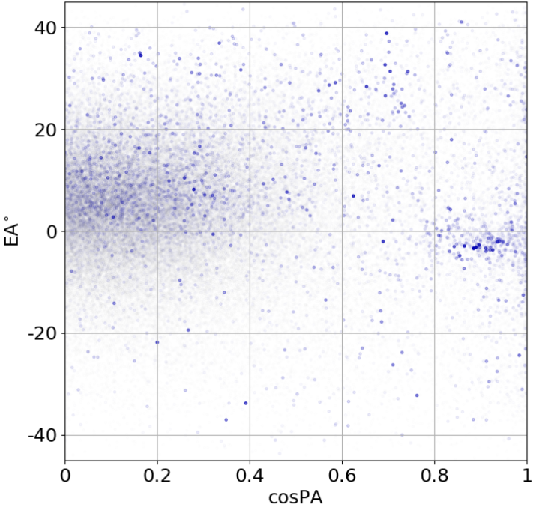
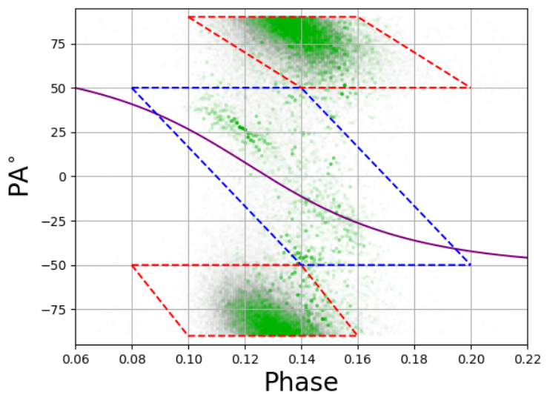
PA and EA ( ) distribution (phase range 0.1~0.17):
SPM
PPM
Different orthogonal modes tend to have different signs of V

Slide 19
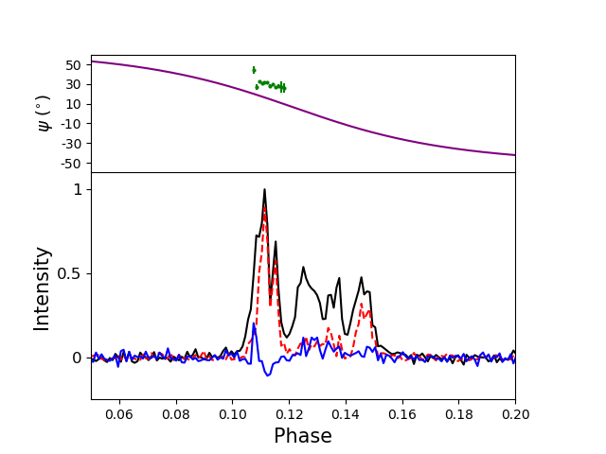
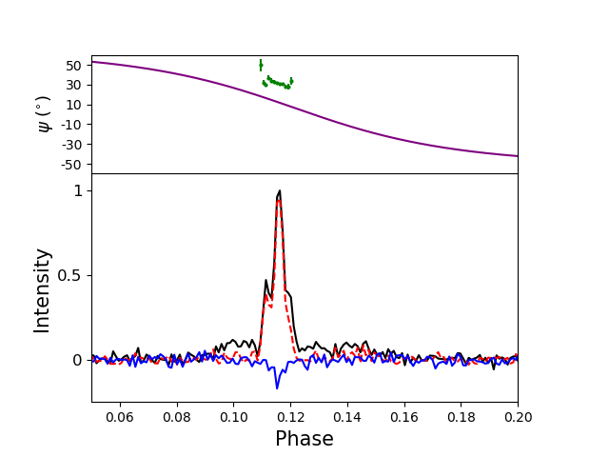
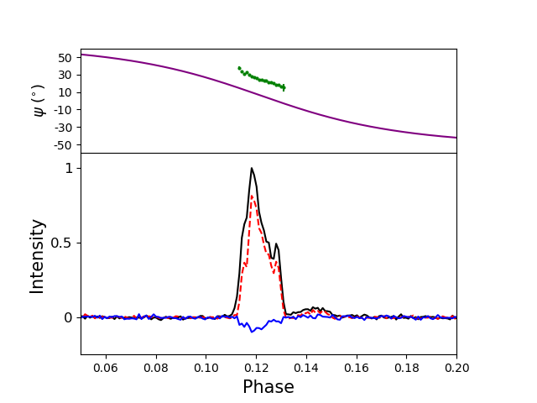
Some single pulses with SPM: PAs not align to RVM curve.

Slide 20
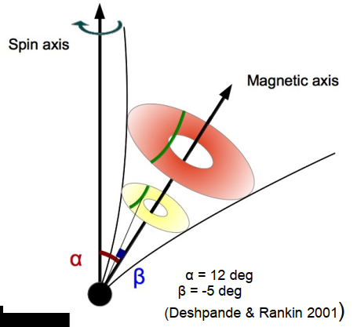
IV. Discussion
Former geometry of B0943+10: cone models and profile evolution (Rankin 1993).
Geometry measure by FAST performs better for explaining thermal X-ray observations.
Hot spot
B
Q
Old geometry
Hot spot
New geometry
From Anya Bilous’s slides.
X-ray obs From Hermsen et al. 2013

Slide 21
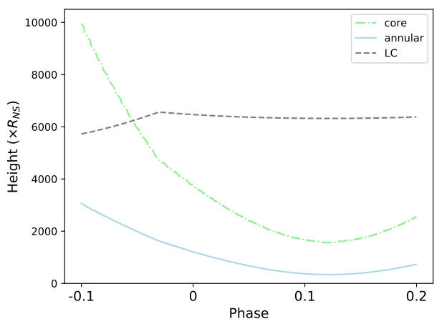
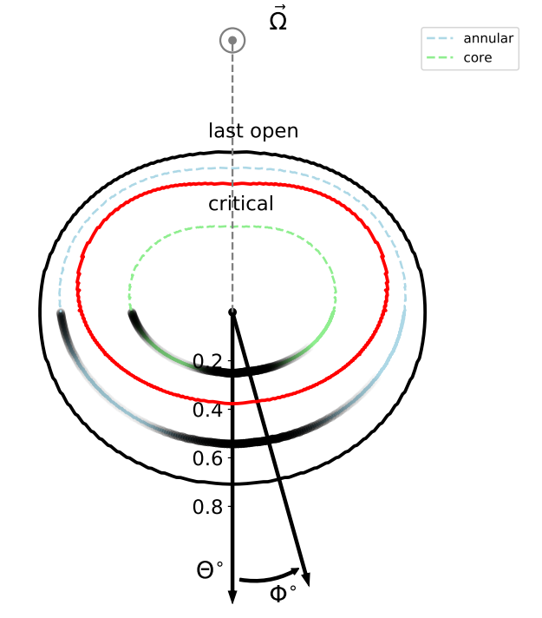
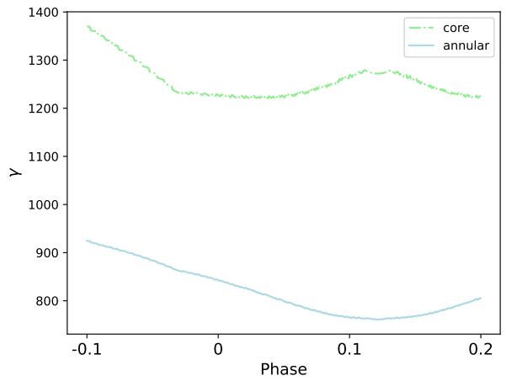
Mapping to pulsar surface (Wang et al. in prep.):
Precursor component
has larger initial Lorentz
factors?
➔hotter hotspot?

Slide 22
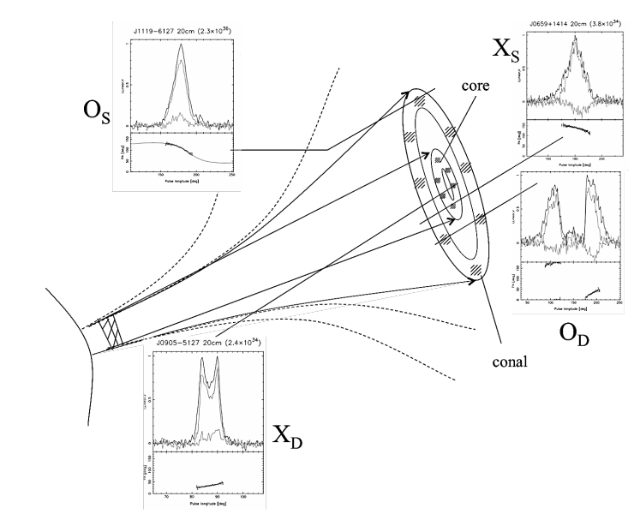
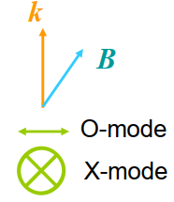
OPMs and V: Consistent with the result of Kravtsov-Orlov equation:
A kind of radiation transform equation in plasma…
(Kravtsov & Orlov 1990, Andrianov & Beskin 2010
and Beskin & Philippov 2012)
O mode
X mode
O mode
X mode
X mode
O mode
https://science.nrao.edu/science/meetings/
2014/3rd-china-us-workshop/presentation.pdfs/
WangC_Pulsar Orthogonal Polarization.pdf
Predicted orthogonal modes have different signs of (dPA/dΦ)*V

Slide 23
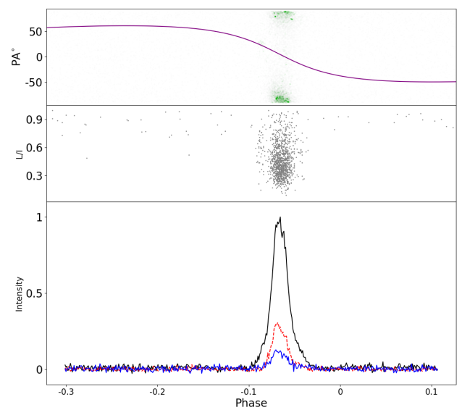
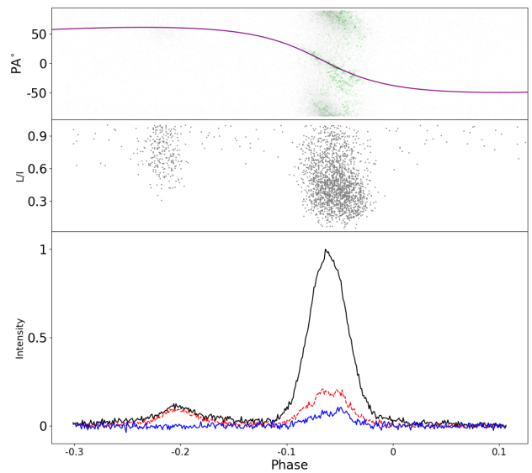
B-to-Q mode switch:
B
Q
A change in magnetosphere ➔➔ different OPMs propagate differently.

Slide 24
Mode switch ⬅?⬅ Magnetosphere change.
Mode switch ⬅?⬅ Pulsar surface change
Thank you for your attention ☺

Slide 25
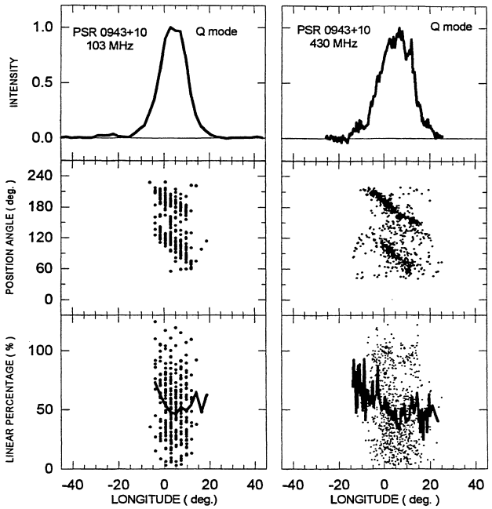
B-to-Q mode switch: OPMs’ proportion differs in frequency

