Slide 1
Periodic Nulling of long-period pulsar:
single pulse study of PSR J1909+0122
Reporter: Chen Yutong (陈语桐, NAOC)
2023.07.04 Nanyang

Slide 2
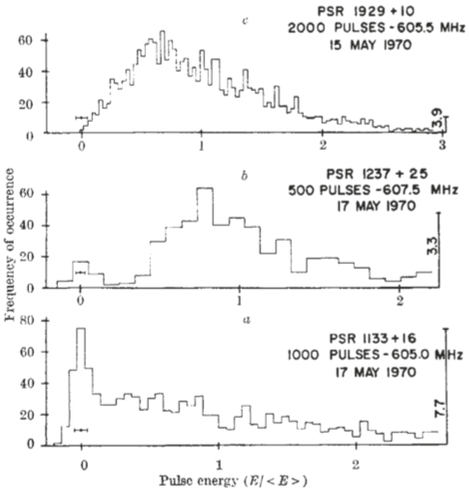
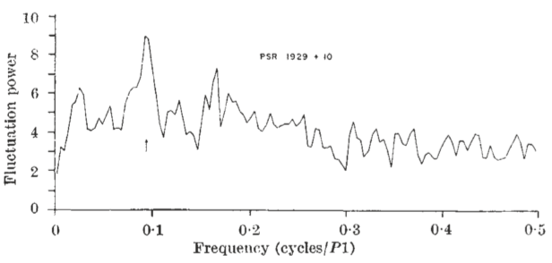
Background: nulling and periodic nulling
Nulling:
first reported in Backer(1970)
Quasi-periodicity？
Fluctuation power spectrum of the spacings of null pulses in twenty sequences of 256 pulses from 1929+10 smoothed over two frequency components. (Backer 1970)

Slide 3
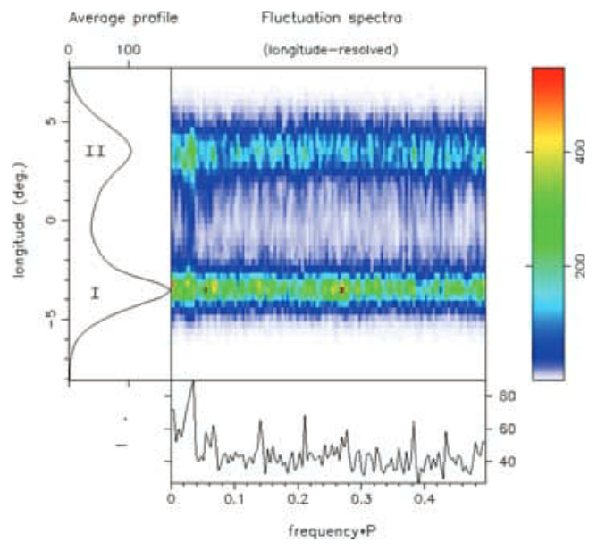
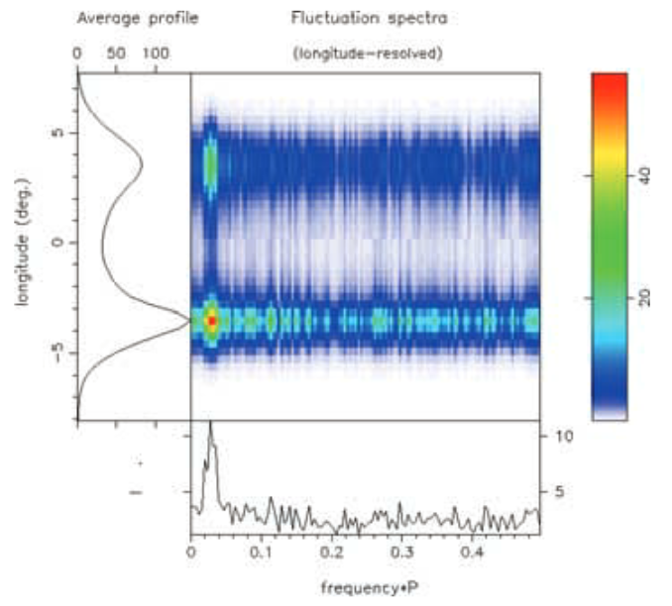
Background: nulling and periodic nulling
Periodic nulling:
first reported in Herfindal & Rankin (2007)
for PSR B1133+16
‘clean’

Slide 4
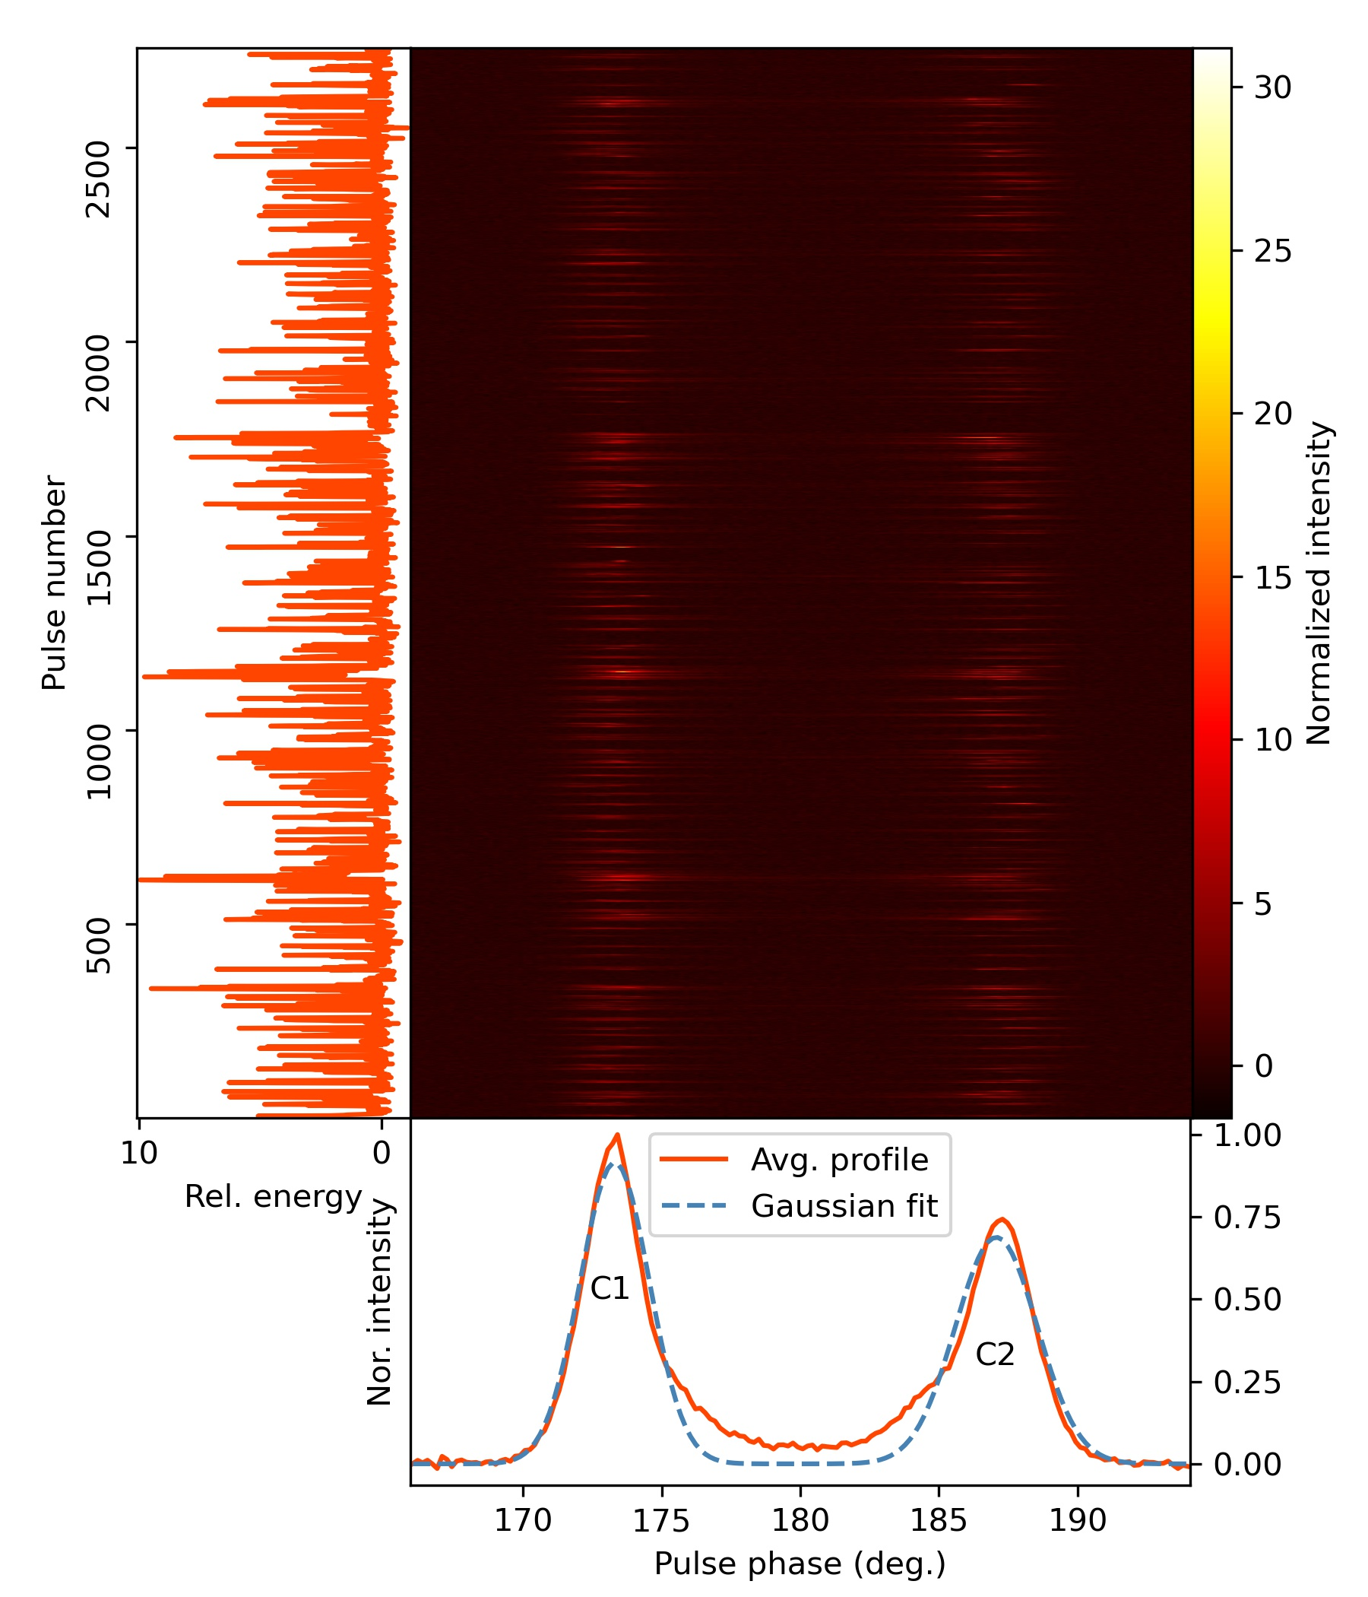
PSR J1909+0122: discovery
·First discovered by CRAFTS drift-scan
pulsar survey in 2020.2
·P = 1257.38(1)ms
DM (Dispersion Measure) = 186.2
·Long period,
Double components,
Nulling: NF (Nulling Fraction)～63%
Pulse stack of PSR J1909+0122

Slide 5
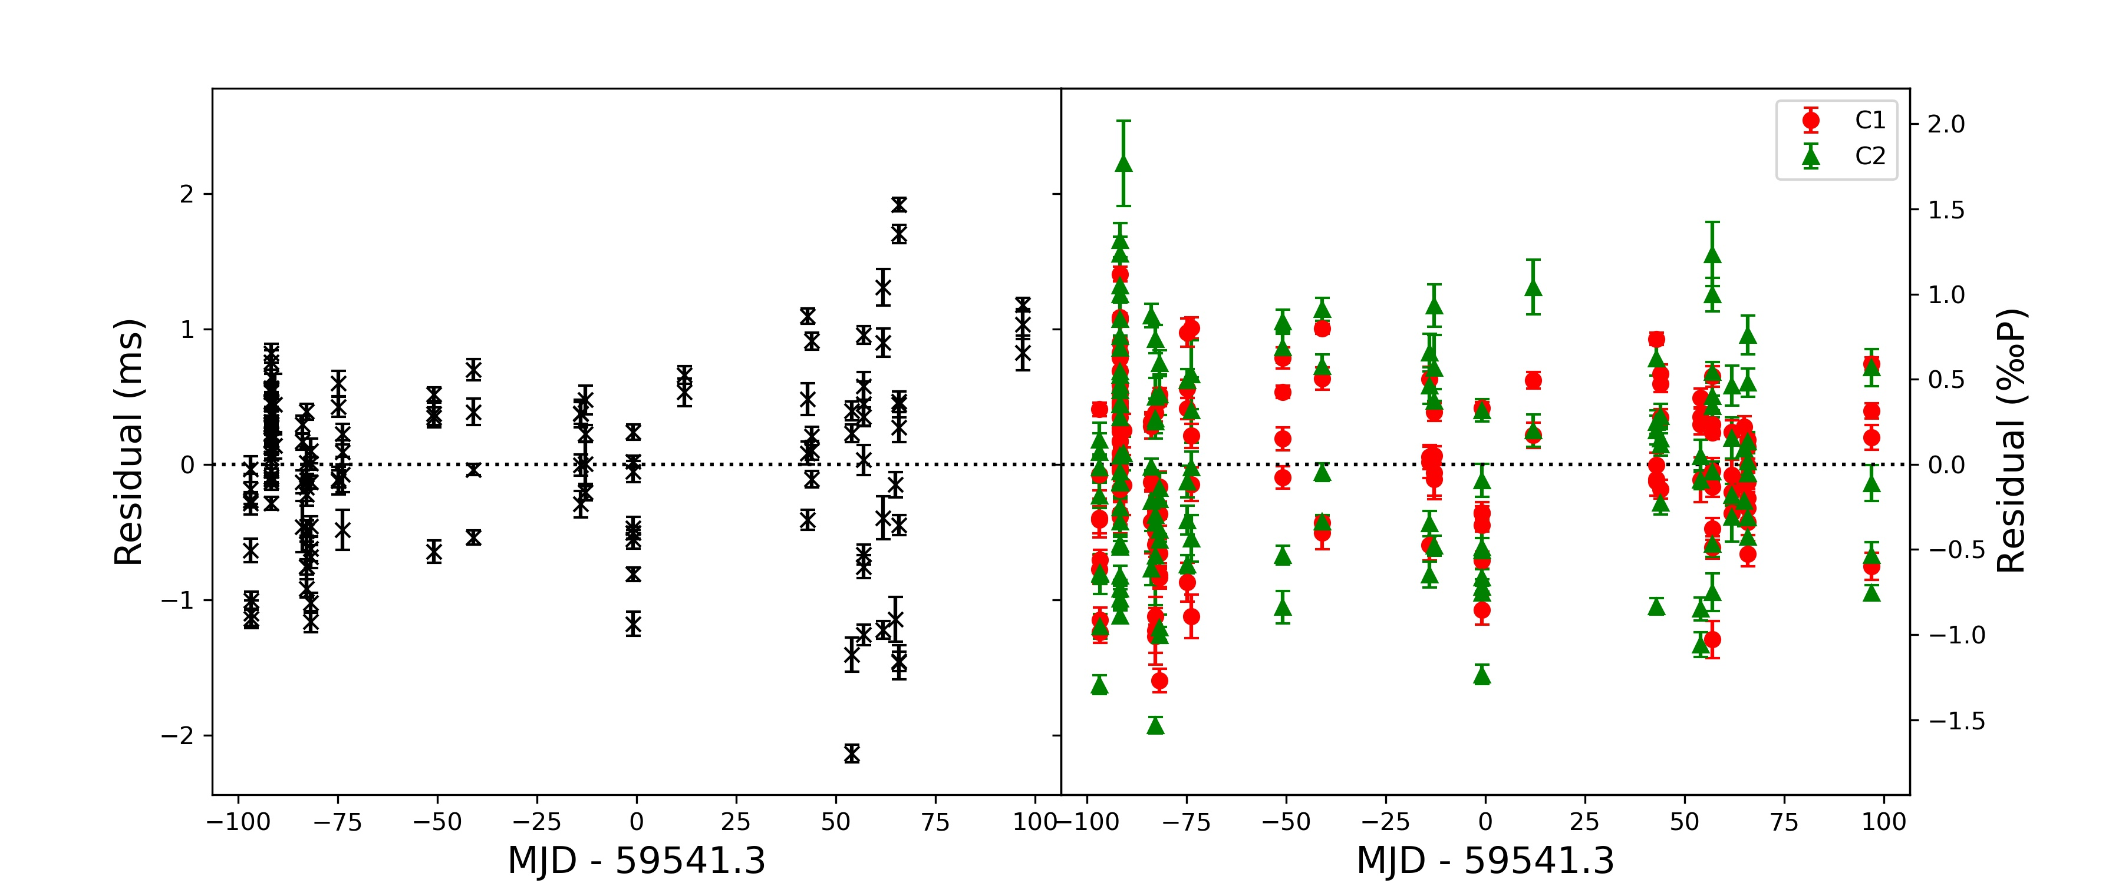
PSR J1909+0122: timing
Timing residuals of PSR J1909+0122
Observations from 2021-08-18 to 2022-02-28
No difference between the two methods
Agree with results in
millisecond pulsars
(Feng et al. 2021)
“normal”timing
&
single-component timing

Slide 6
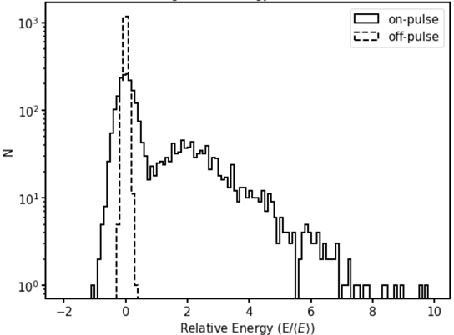
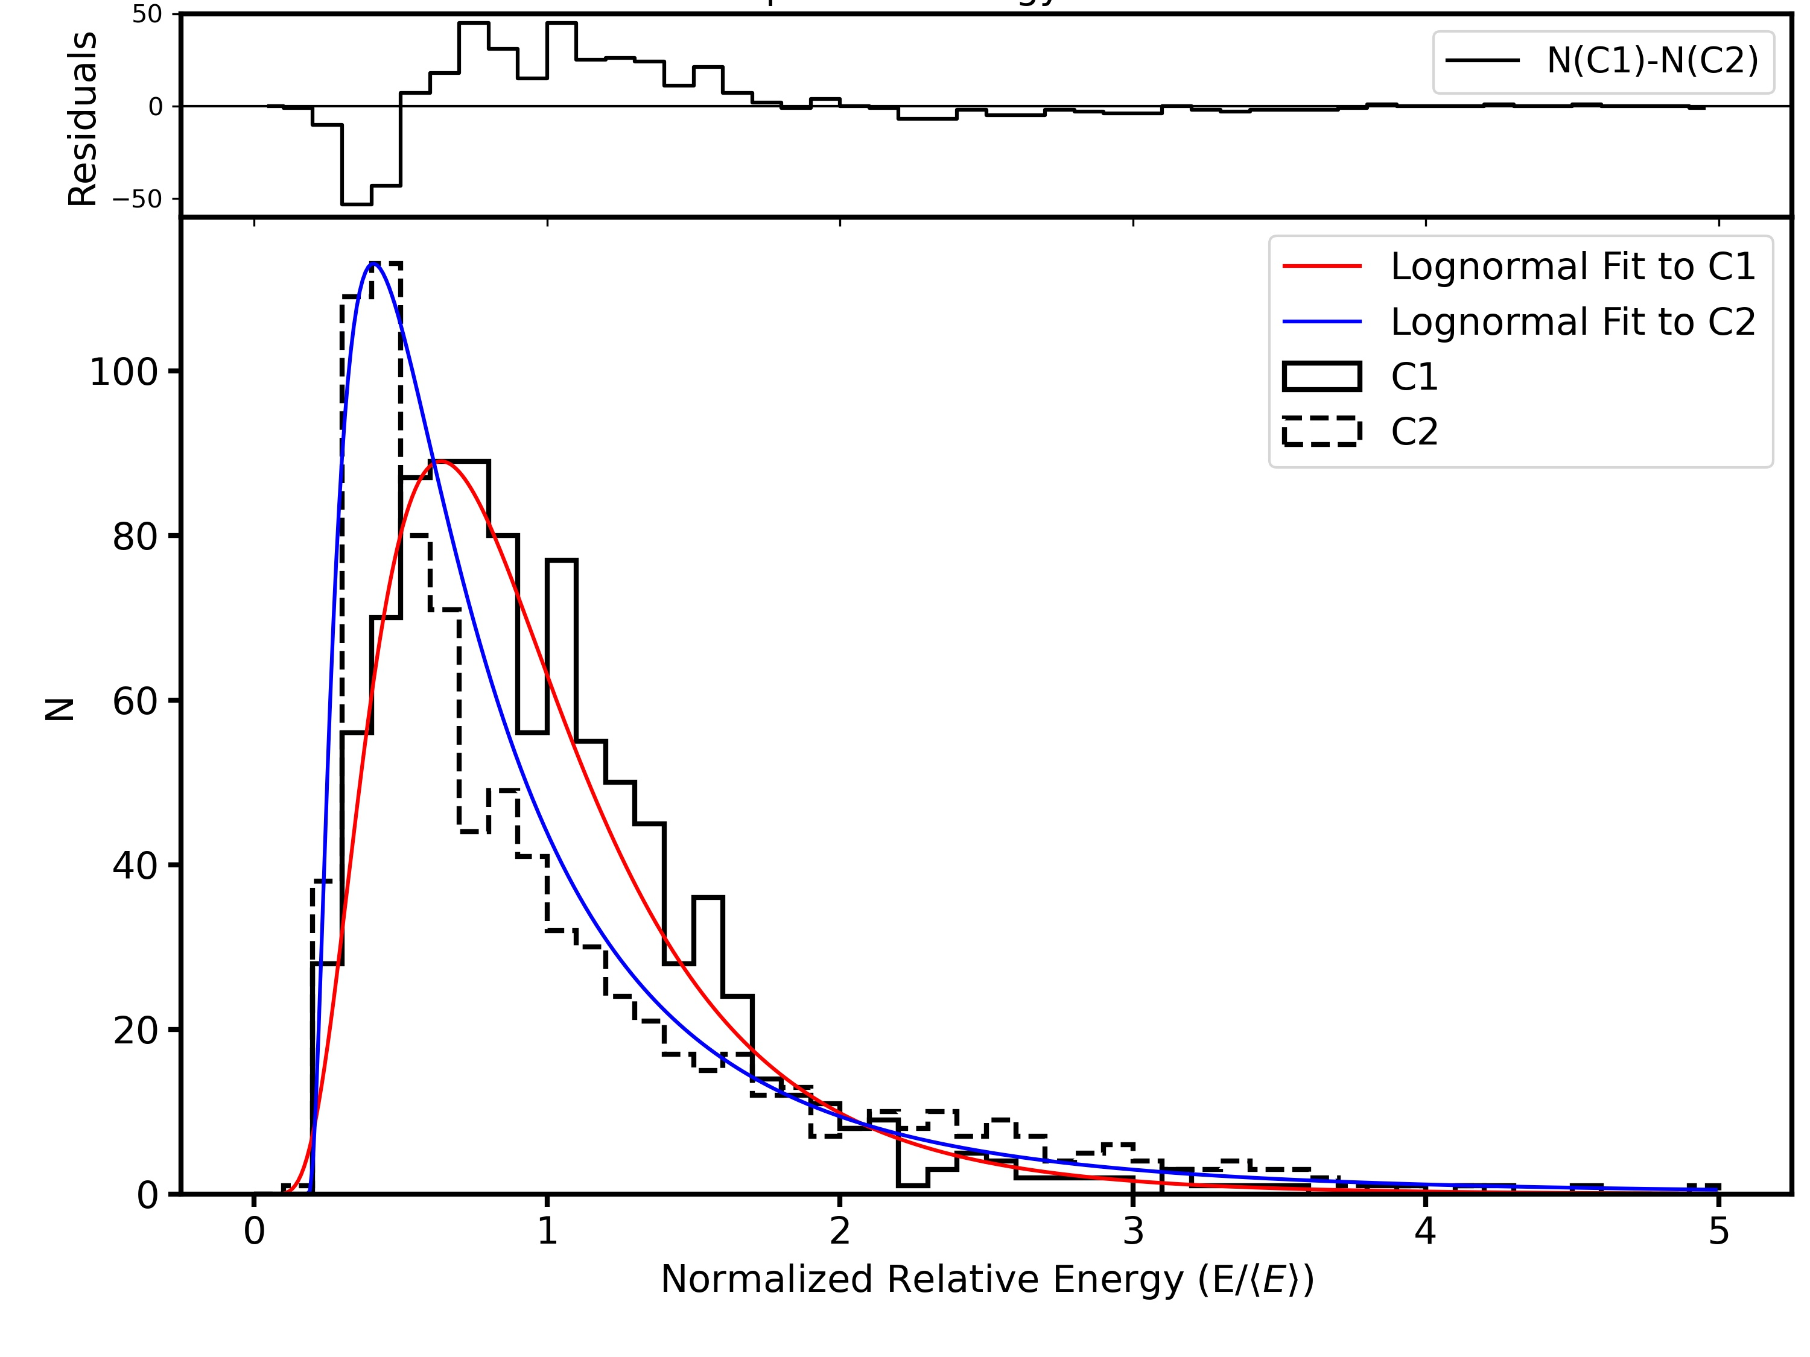
PSR J1909+0122: pulse energy distribution
Energy distribution of pulses
Energy distribution of components
Not the same

Slide 7
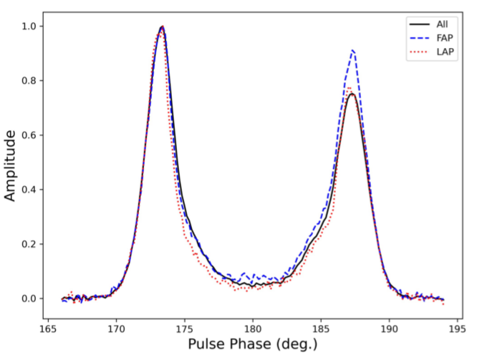
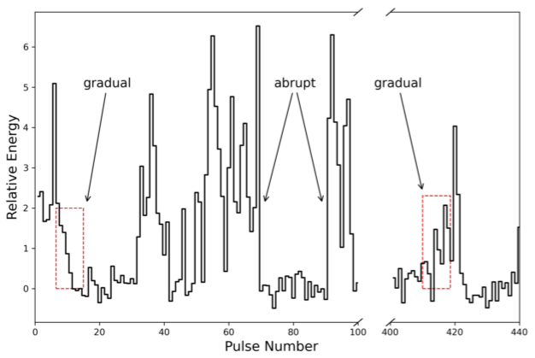
PSR J1909+0122: nulling behavior
Transition patterns of PSR J1909+0122 are both abrupt and gradual
Average, FAP and LAP profiles

Slide 8
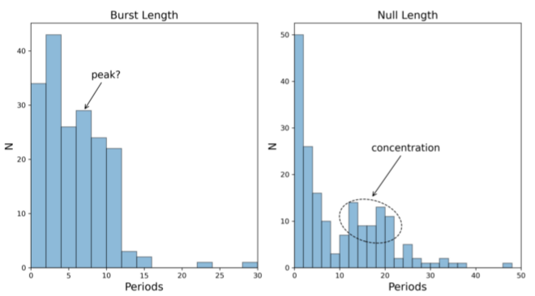
PSR J1909+0122: nulling behavior
Short bursts/nulls appears
most frequently,
while they have their own concentrated areas
Burst and null length distribution

Slide 9
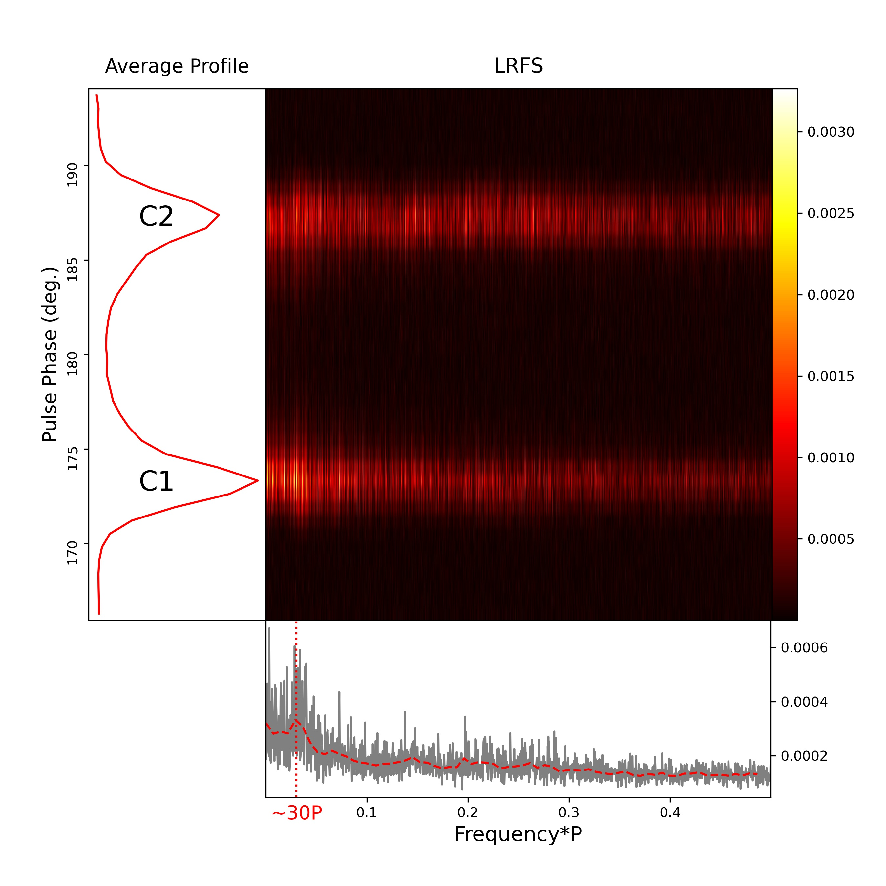
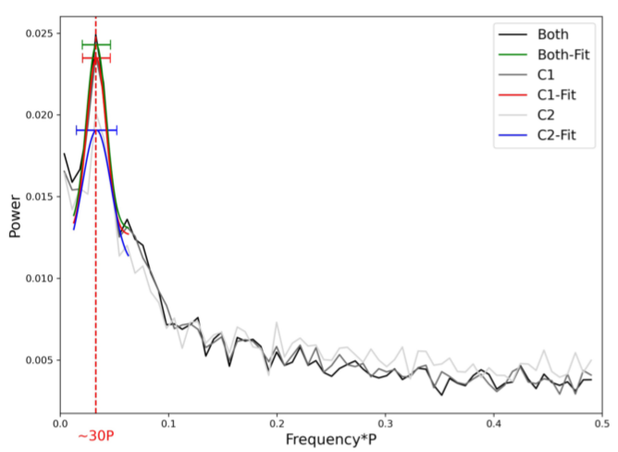
PSR J1909+0122: nulling behavior
Fourier spectrum of binary pulse sequence
LRFS of PSR J1909+0122

Slide 10
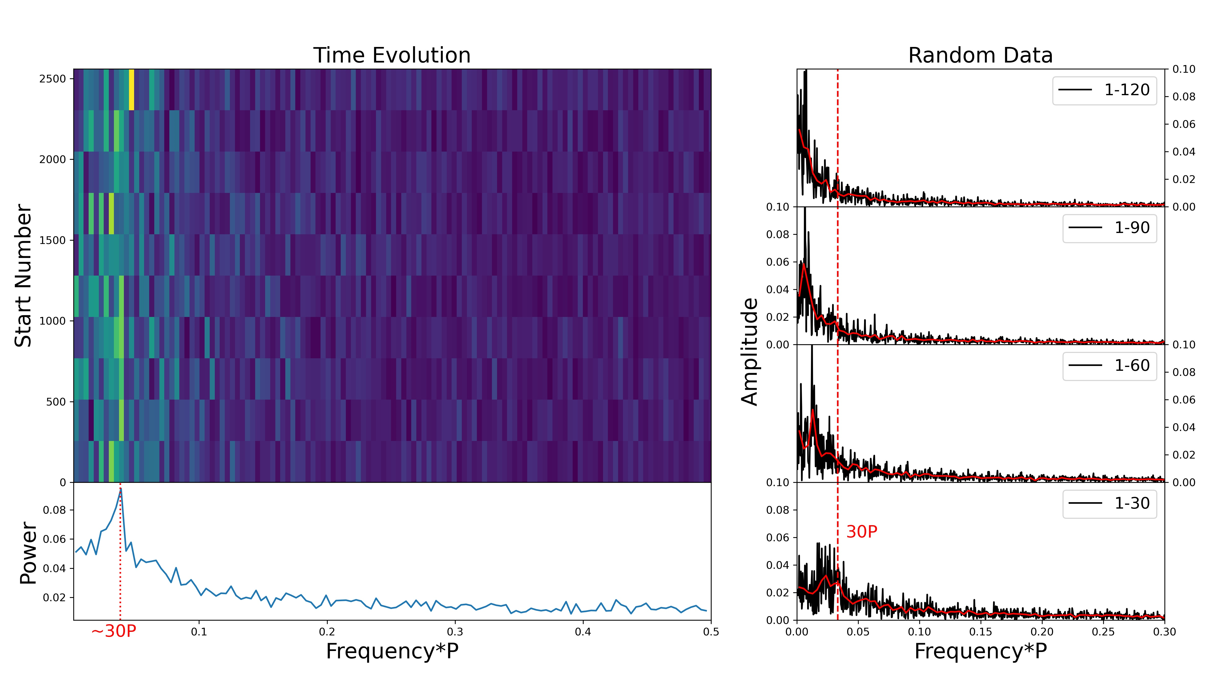
PSR J1909+0122: nulling behavior
Time evolution of nulling FFT spectra

Slide 11
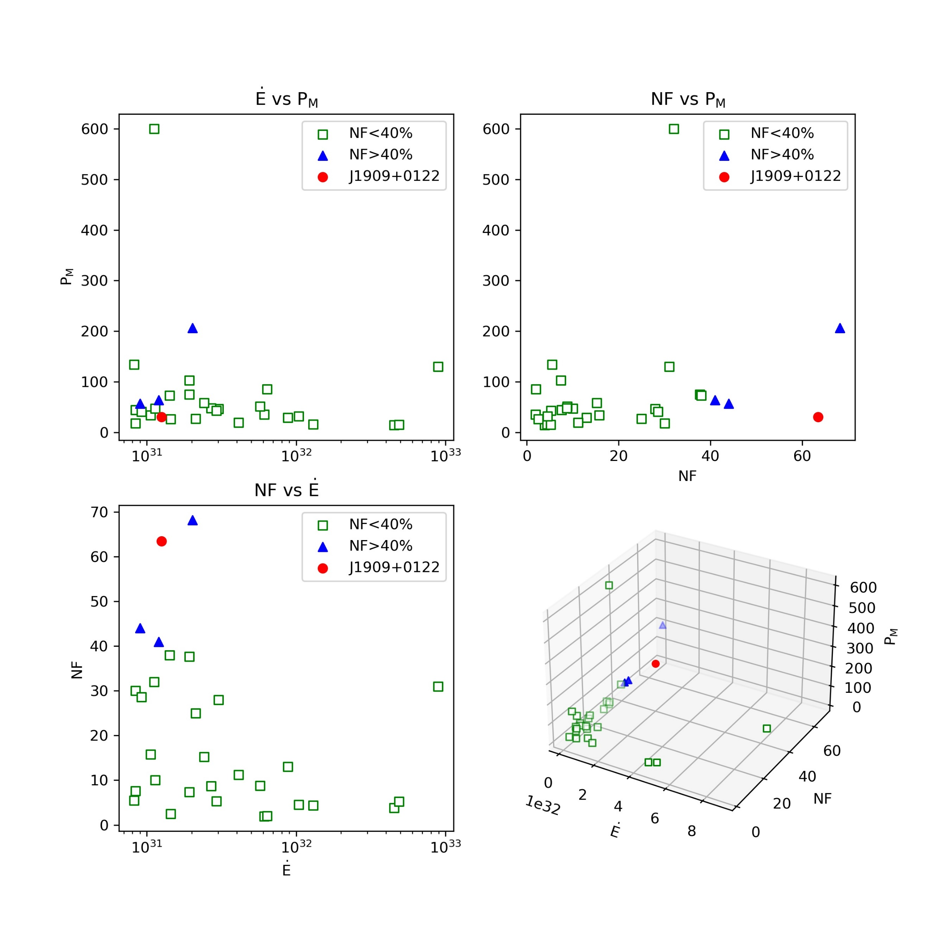
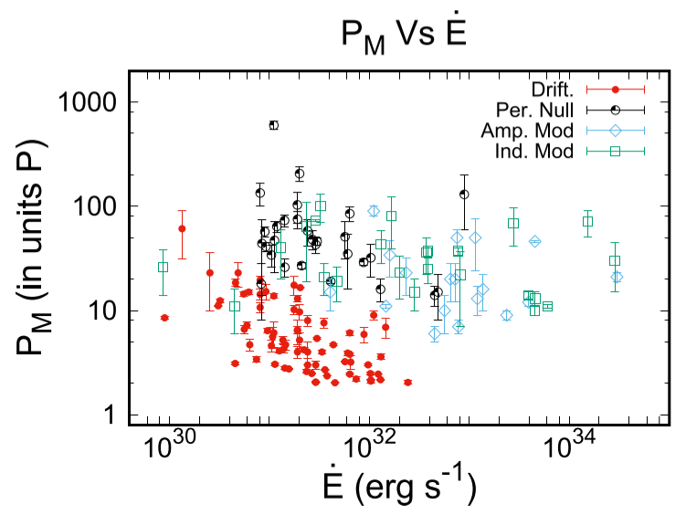
Discussion
1. Periodicity in Pulsars
What are the common properties of the periodic-nulling pulsars? And what about other periodic modulations?
PSR J1909+0122 compared to
other periodic-nulling pulsars
(Basu et al. 2020a)

Slide 12
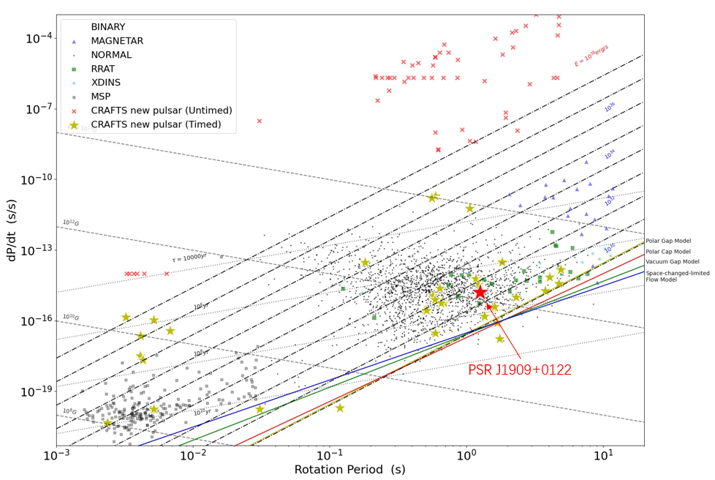
Discussion
2. Properties and evolution of long-period pulsars
· Long-period pulsars
cross the death line
(Timed CRAFTS pulsars
lacking single pulse study)
· Evolutionary path of
long-period pulsars
(nulling pulsars and
RRATs)

Slide 13
Thank you!

Slide 14
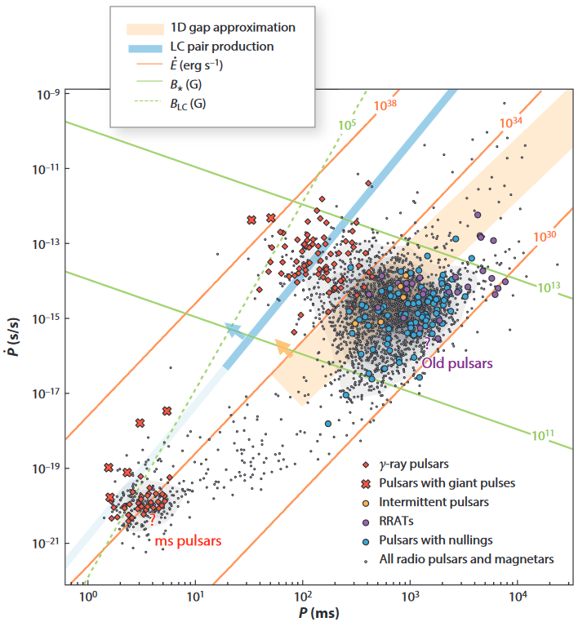
Supplement
(Philippov & Kramer 2022)

Slide 15
Supplement
Models for nulling phenomena (Konar et al., 2019):
Intrinsic Causes
Geometrical Effects
·The loss of coherence conditions
(Filippenko & Radhakrishnan 1982)
·The line-of-sight passing
between emitting subbeams
giving rise to‘pseudo-nulls’
(Herfindal & Rankin 2007; Herfindal &
Rankin 2009; Rankin & Wright 2008)
·A complete cessation of primary particle production
(Kramer et al. 2006b; Gajjar et al. 2014)
·Changes in the current flow conditions in the
magnetosphere (Timokhin 2010)
·Occurrence of various
unfavourable changes in the
emission geometry
(Dyks, Zhang, & Gil 2005; Zhang, Gil,
& Dyks 2007)
·A transition to a much weaker emission mode(or an
extreme case of mode changing) (Esamdin et al. 2005; Wang,
Manchester, & Johnston 2007; Timokhin 2010; Young et al. 2014)
·Time-dependent variations in an emission‘carousel
model’
(Deshpande & Rankin 2001; Rankin & Wright 2007)
·…

