Slide 1
Multiple Origins of Normal Radio Pulsars ? Some Implications from Statistical Results
Speaker: 崔翔翰 cuixianghan@nao.cas.cn
Cooperators: 张承民、李菂、张见微
2023.07
Cui et al., 2021, MNRAS, https://doi.org/10.1093/mnras/stab2498
Zhang et al., 2022, PASP, https://doi.org/10.1088/1538-3873/ac9ad8

Slide 2
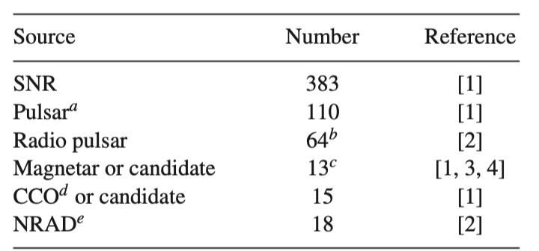
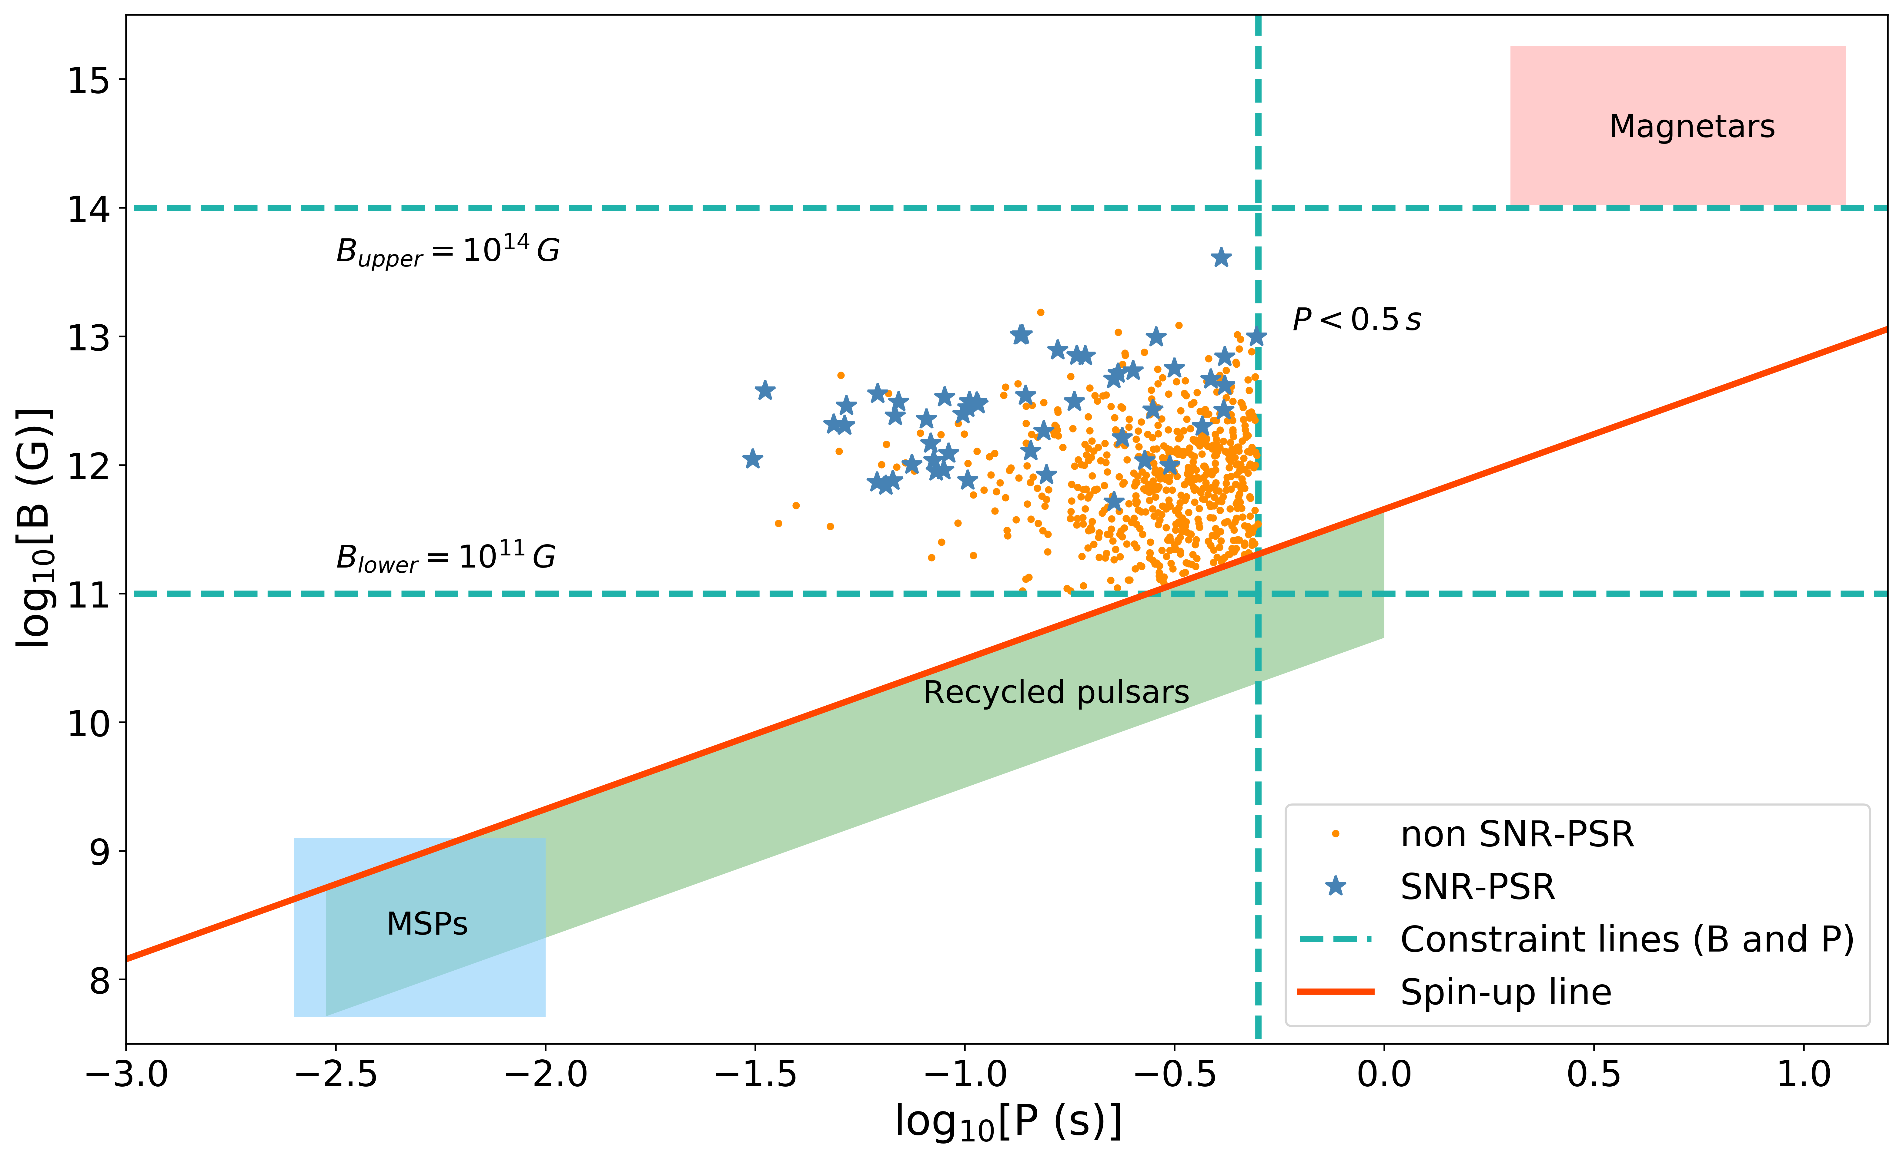
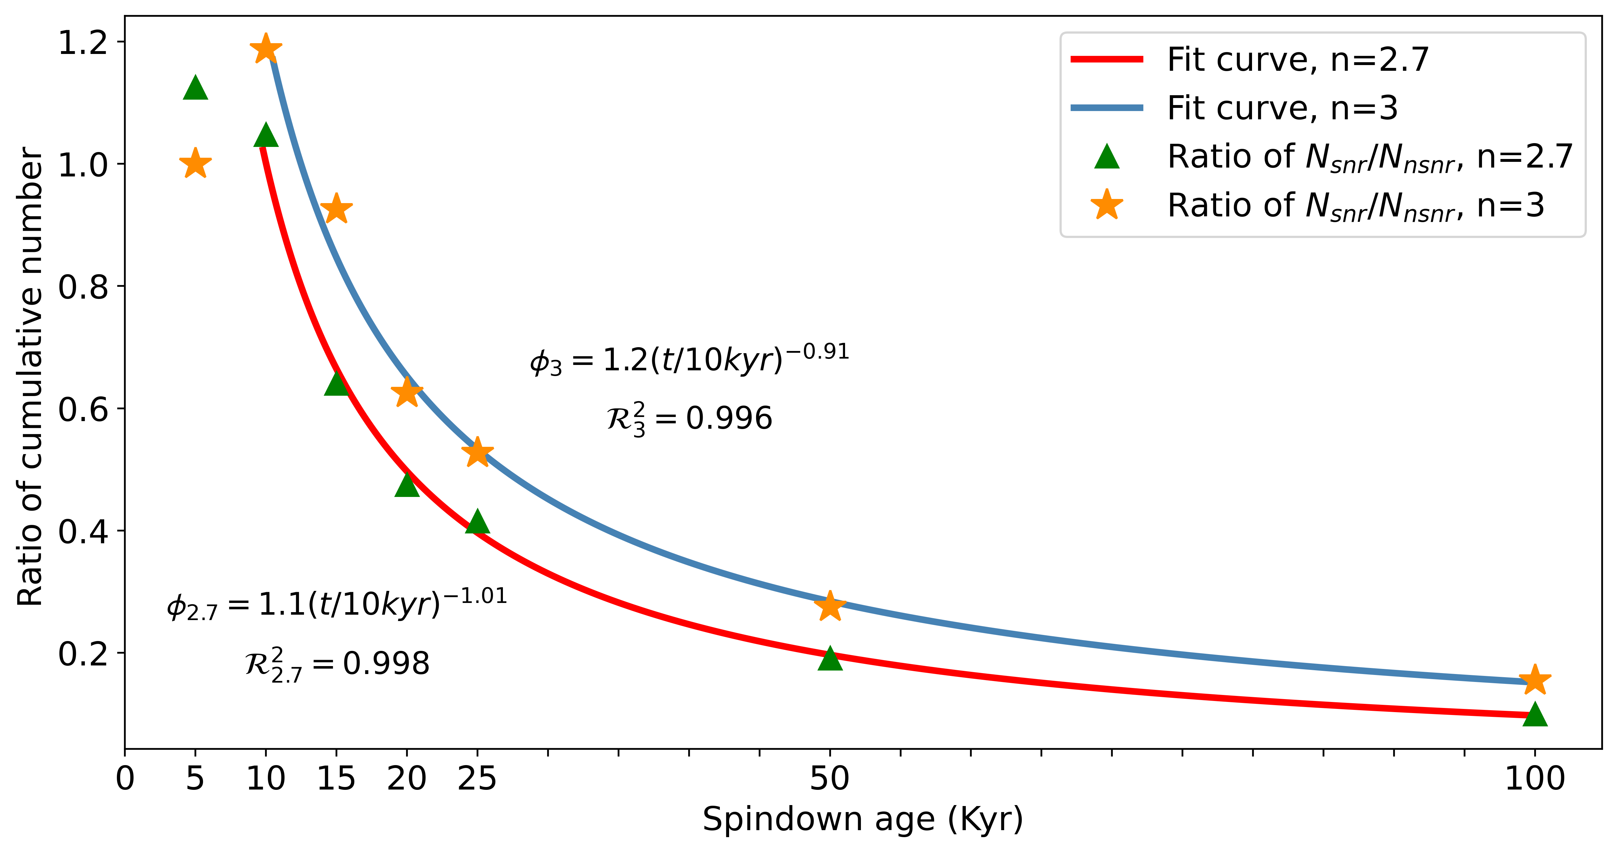
Outline
Background
Analysis
Implications
Conclusions

Slide 3
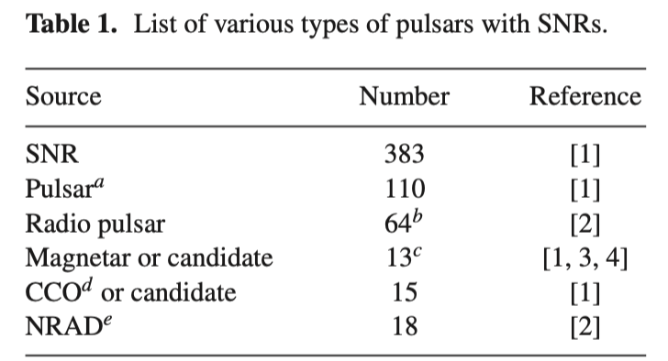
1. Background
In Milky Way galaxy: $3500+pulsars$
$\sim 100 SNR pulsars,\sim 400 SNRs$
Lifetime of SNRs $\sim 3×{10}^{5} yr$ $→$ young pulsars ^{[1]}
Two questions of pulsar-SNR relation:
Where is the pulsar in SNR?
Where is the SNR of young radio pulsars?
Credit: [1] Gaensler & Johnston 1995

Slide 4
1. Background
Answers for questions:
Low luminosity of young radio pulsar ^{[1]}, or NS not pulsar ^{[2,3]}
High kick velocity ^{[4]}
Non-isotropic pulsar wind nebulae (PWNe), $\sim 50$ PWNe ^{[5]}
Beaming fraction ^{[3,6]}
Q1√ Q2? (Where is the SNR of young radio pulsars?)
Credit: [1]Stollman 1987; [2]Radhakrishnan & Srinivasan 1980; [3]Lorimer et al. 1993; [4] Frail, Goss, & Whiteoak 1994;
[5] Gaensler & Slane 2006; [6]Taylor & Manchester 1977

Slide 5
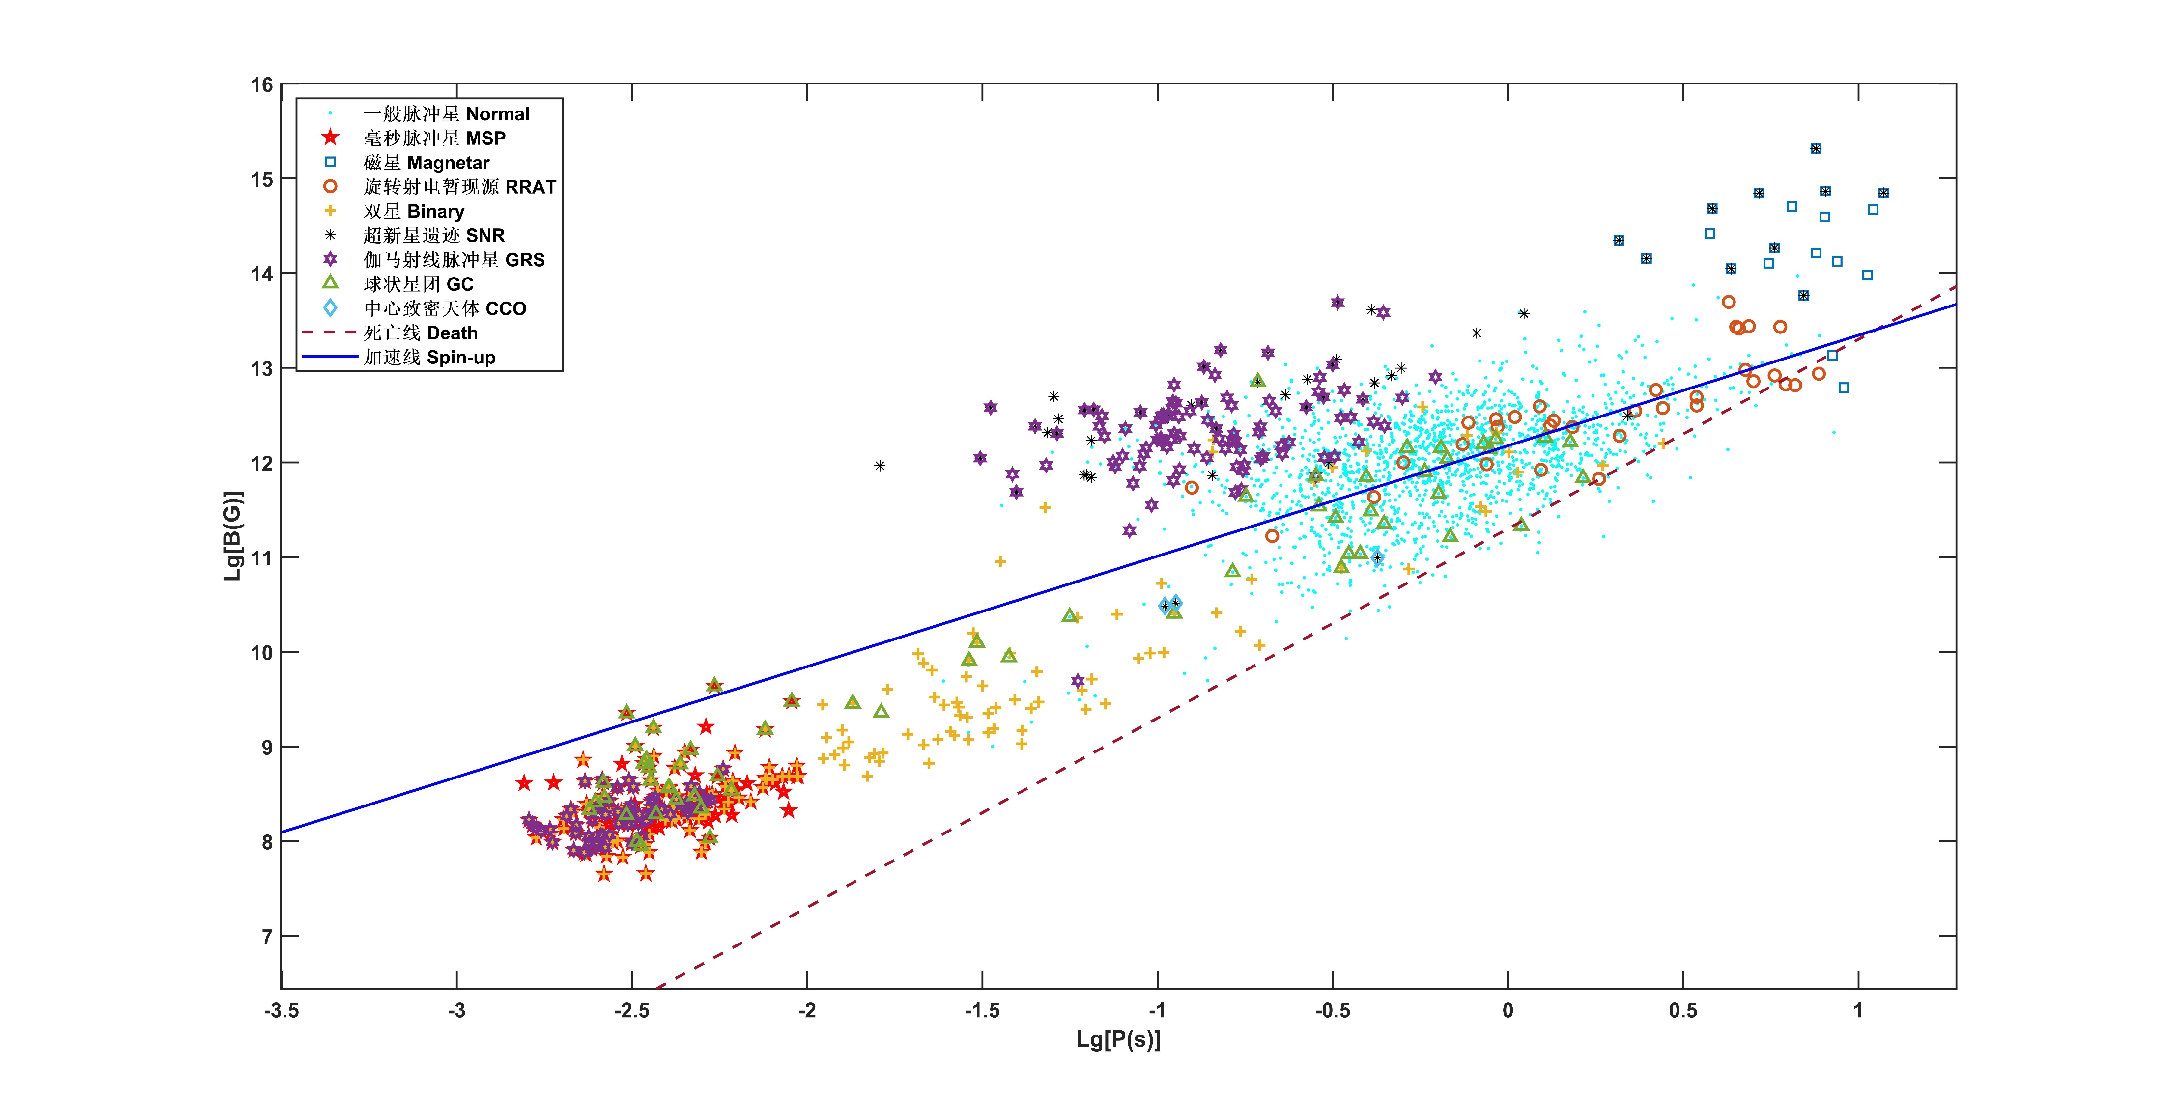
2. Analysis – data selection
Spin period (P) $→$ age, P < 500 ms
B-field: ${10}^{11}−{10}^{14} G$
Above spin-up line
Exclude special pulsars

Slide 6
2. Analysis – data selection
Young pulsar
Spin period (P) $→$ age, P < 500 ms
Normal radio pulsar
B-field: ${10}^{11}−{10}^{14} G$
Above spin-up line
Exclude special pulsars
Pulsars with SNR (SNR-PSRs): 52
Pulsars without SNR (non SNR-PSRs): 630
Credit: https://www.atnf.csiro.au/research/pulsar/psrcat/
http://snrcat.physics.umanitoba.ca/SNRtable.php
Cui et al., 2021, MNRAS

Slide 7
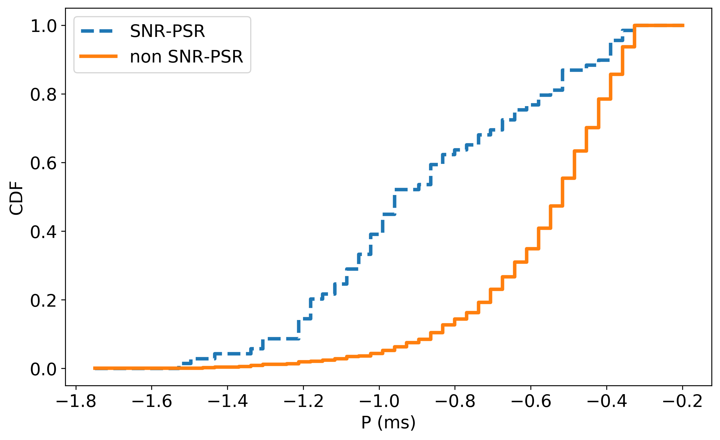
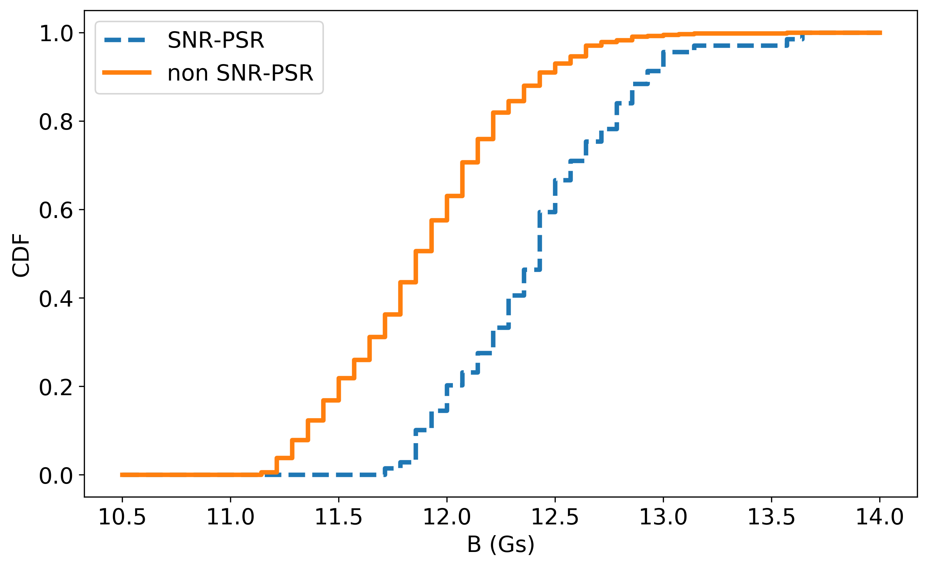
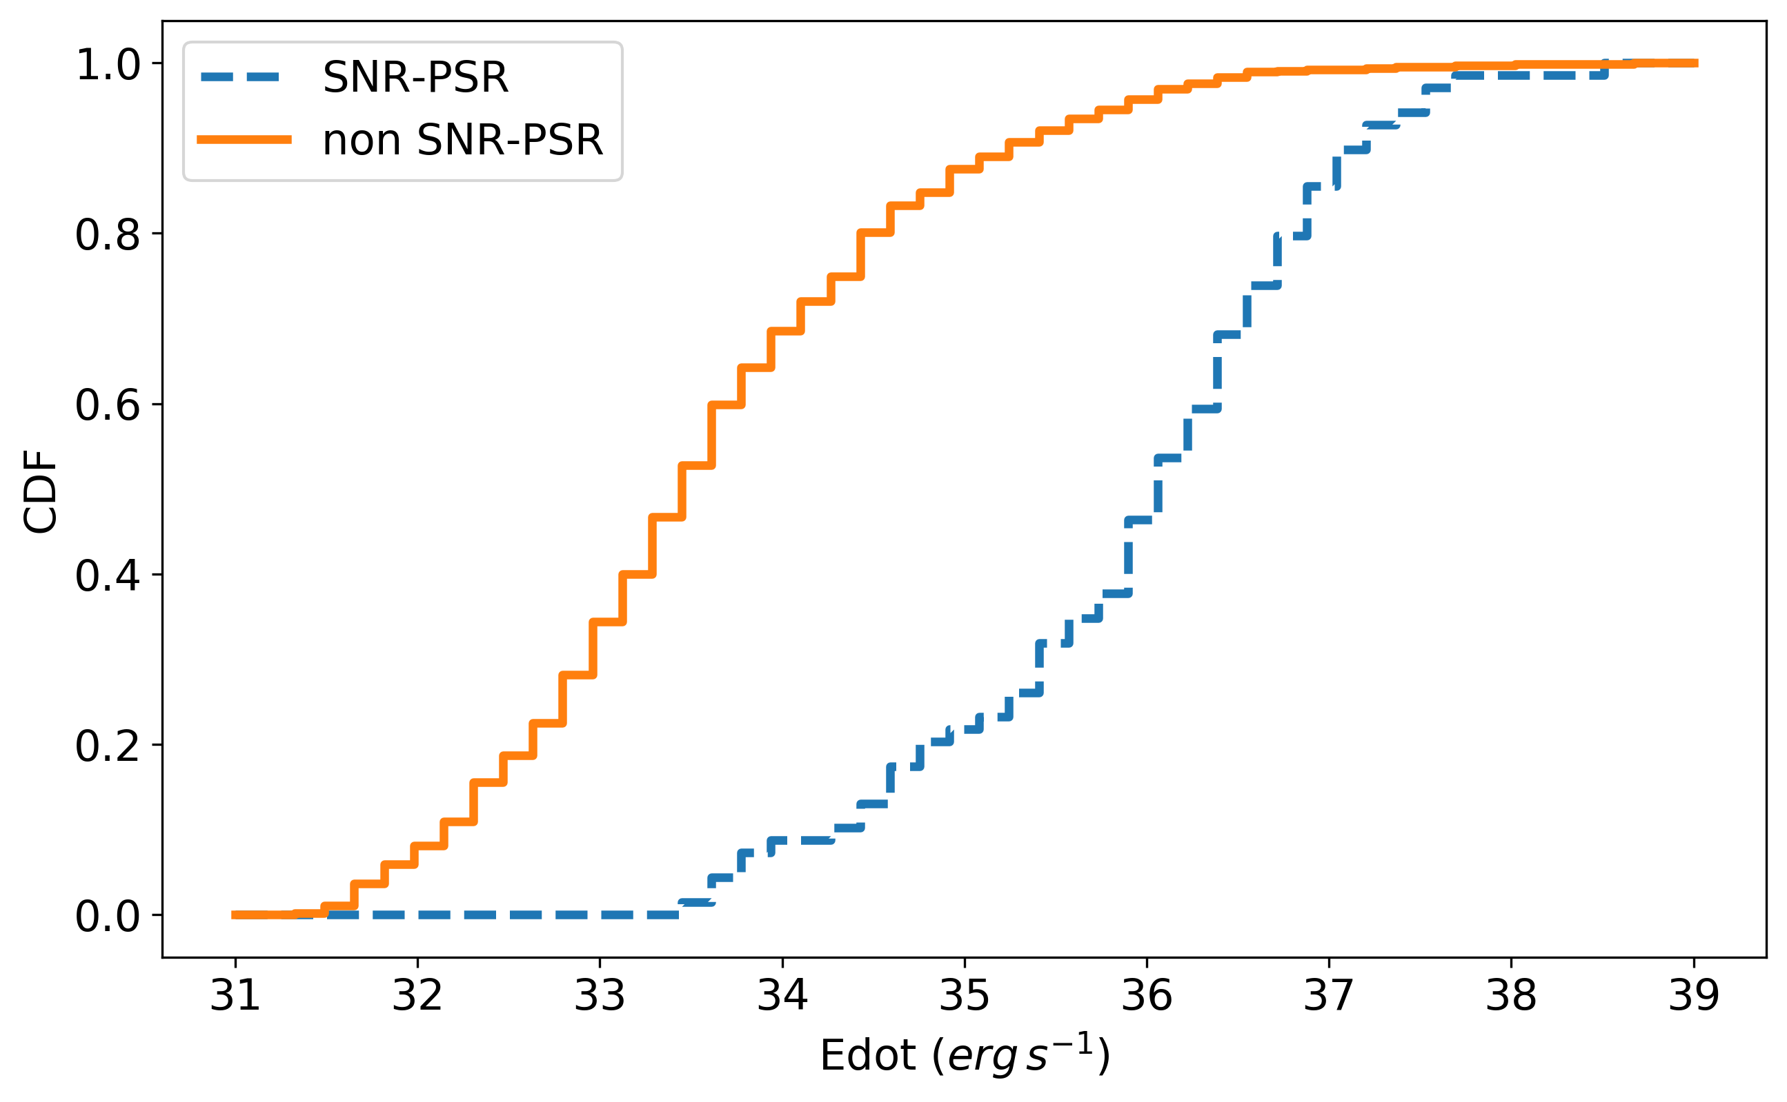
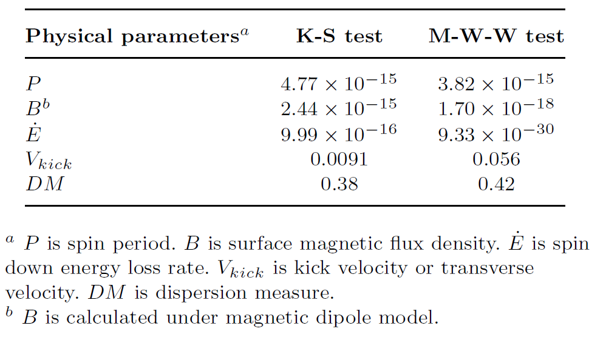
2. Analysis – CDF and statistical tests

Slide 8
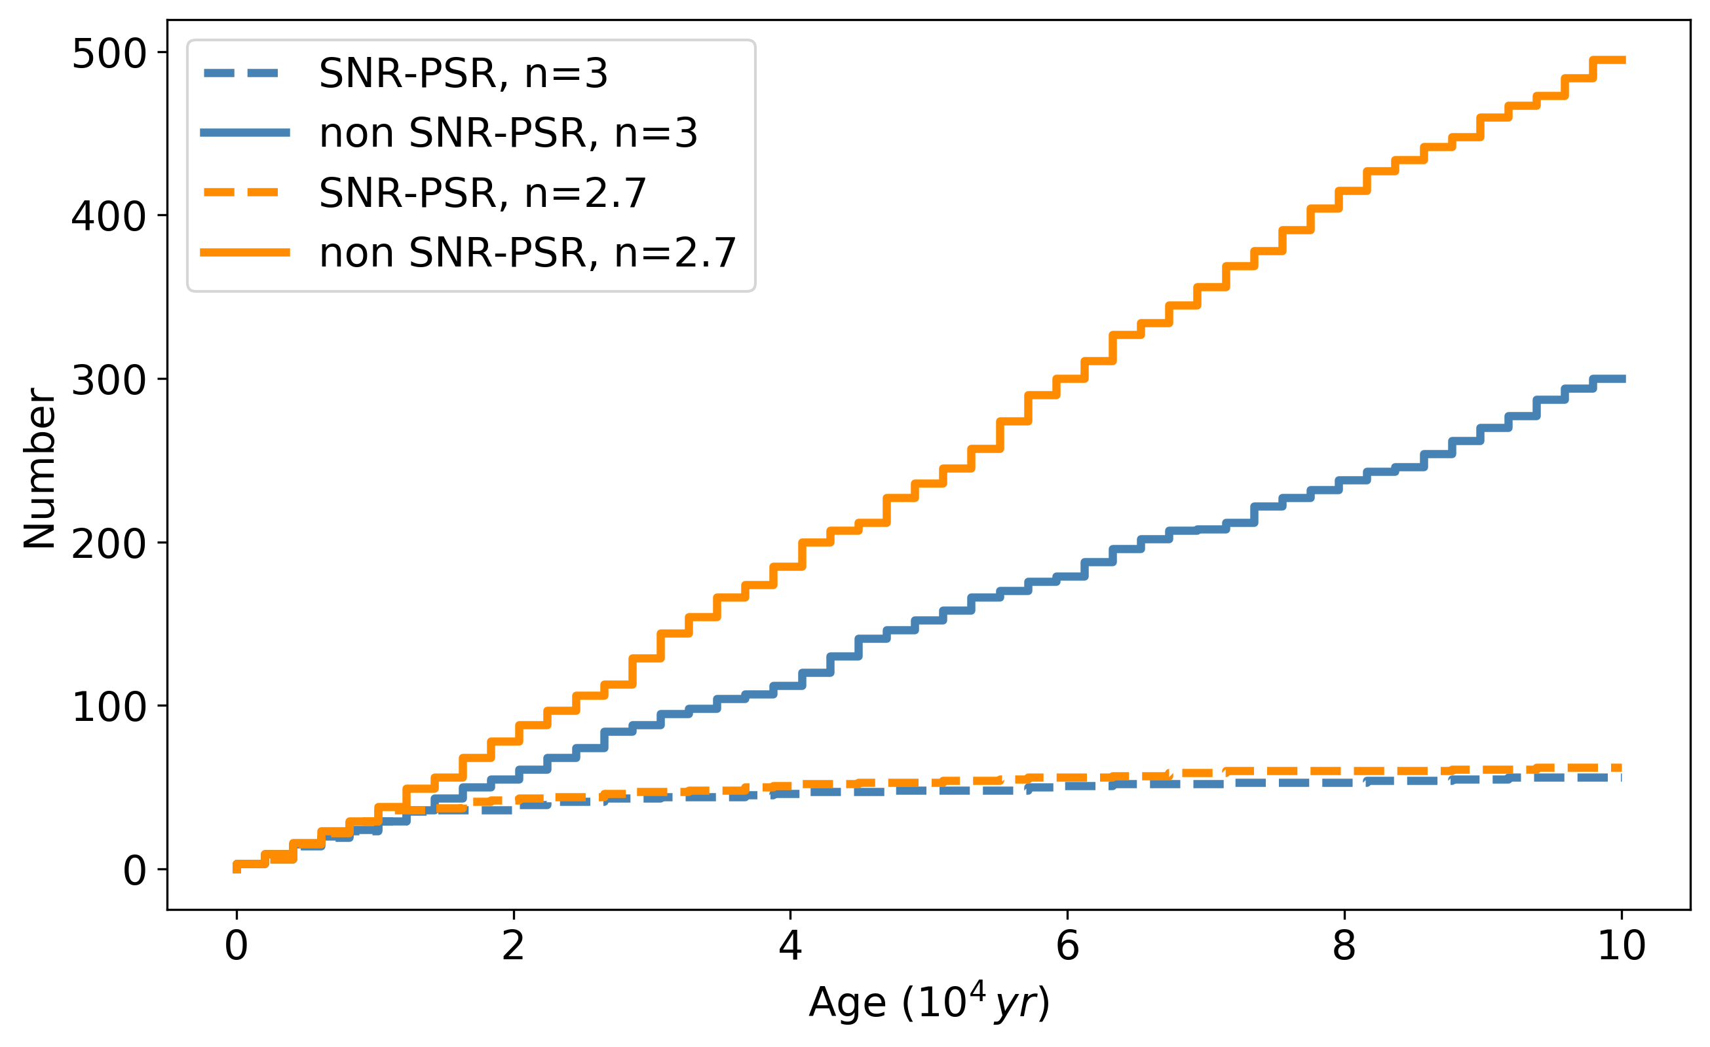
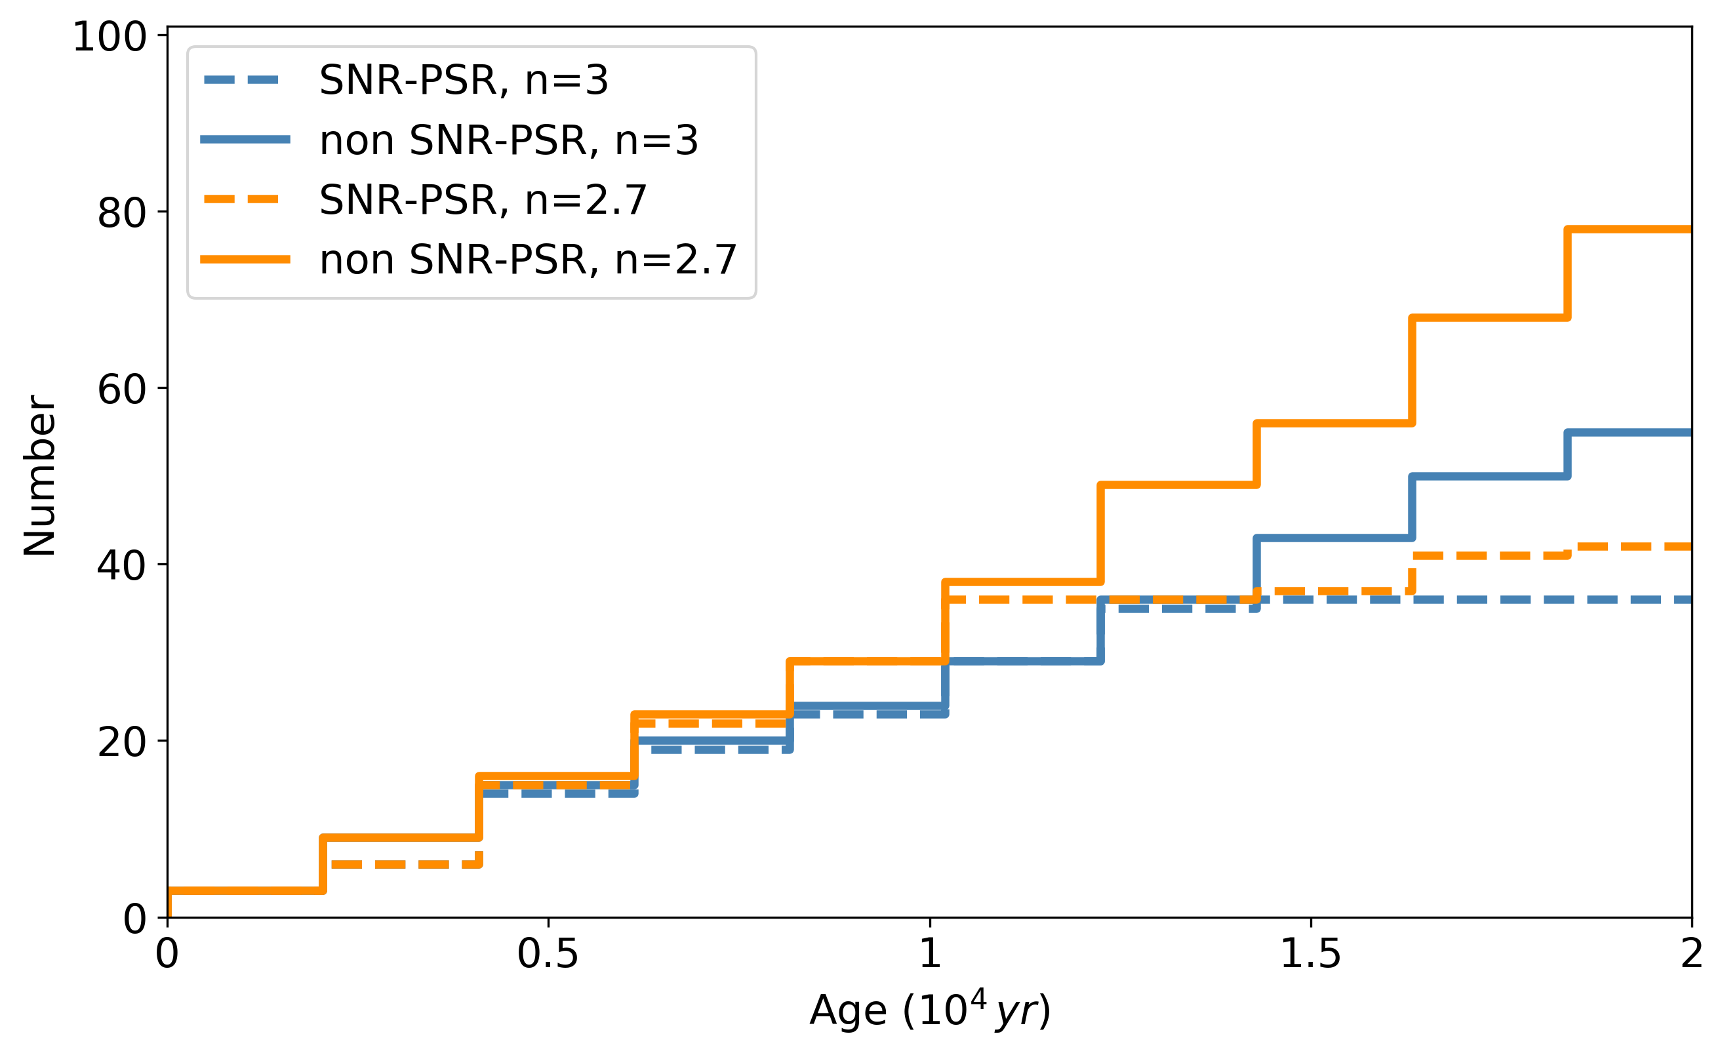
2. Analysis – two distributions?
n=3
n=2.7

Slide 9
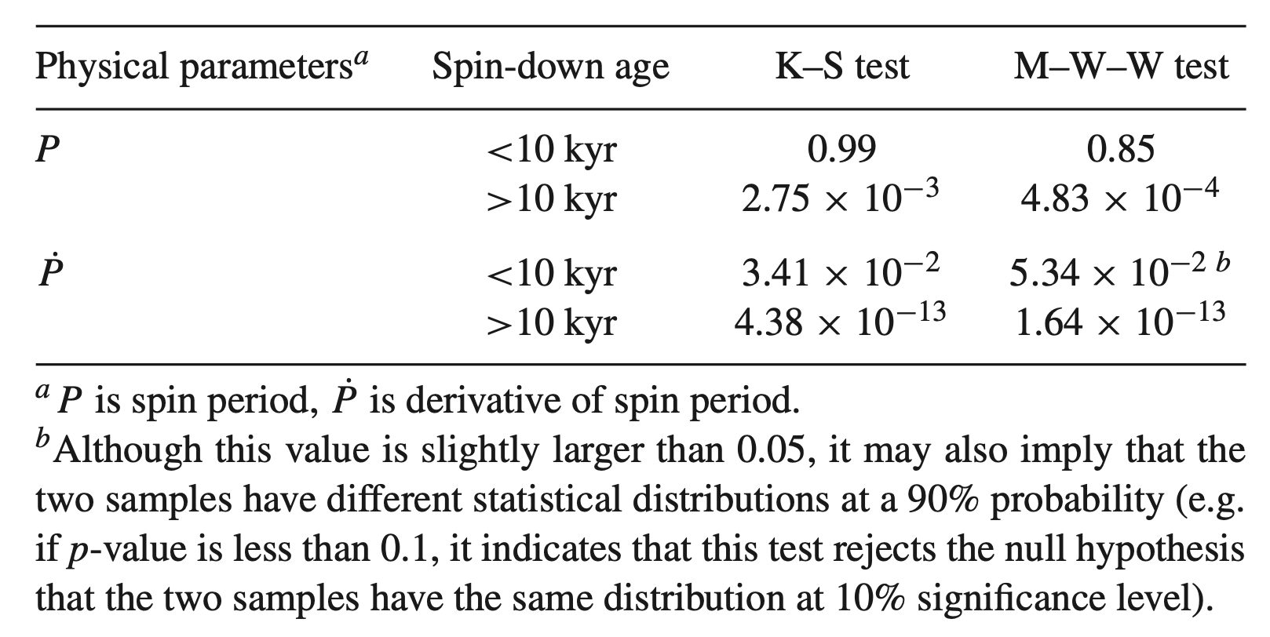
3. Implications – two production ways

Slide 10
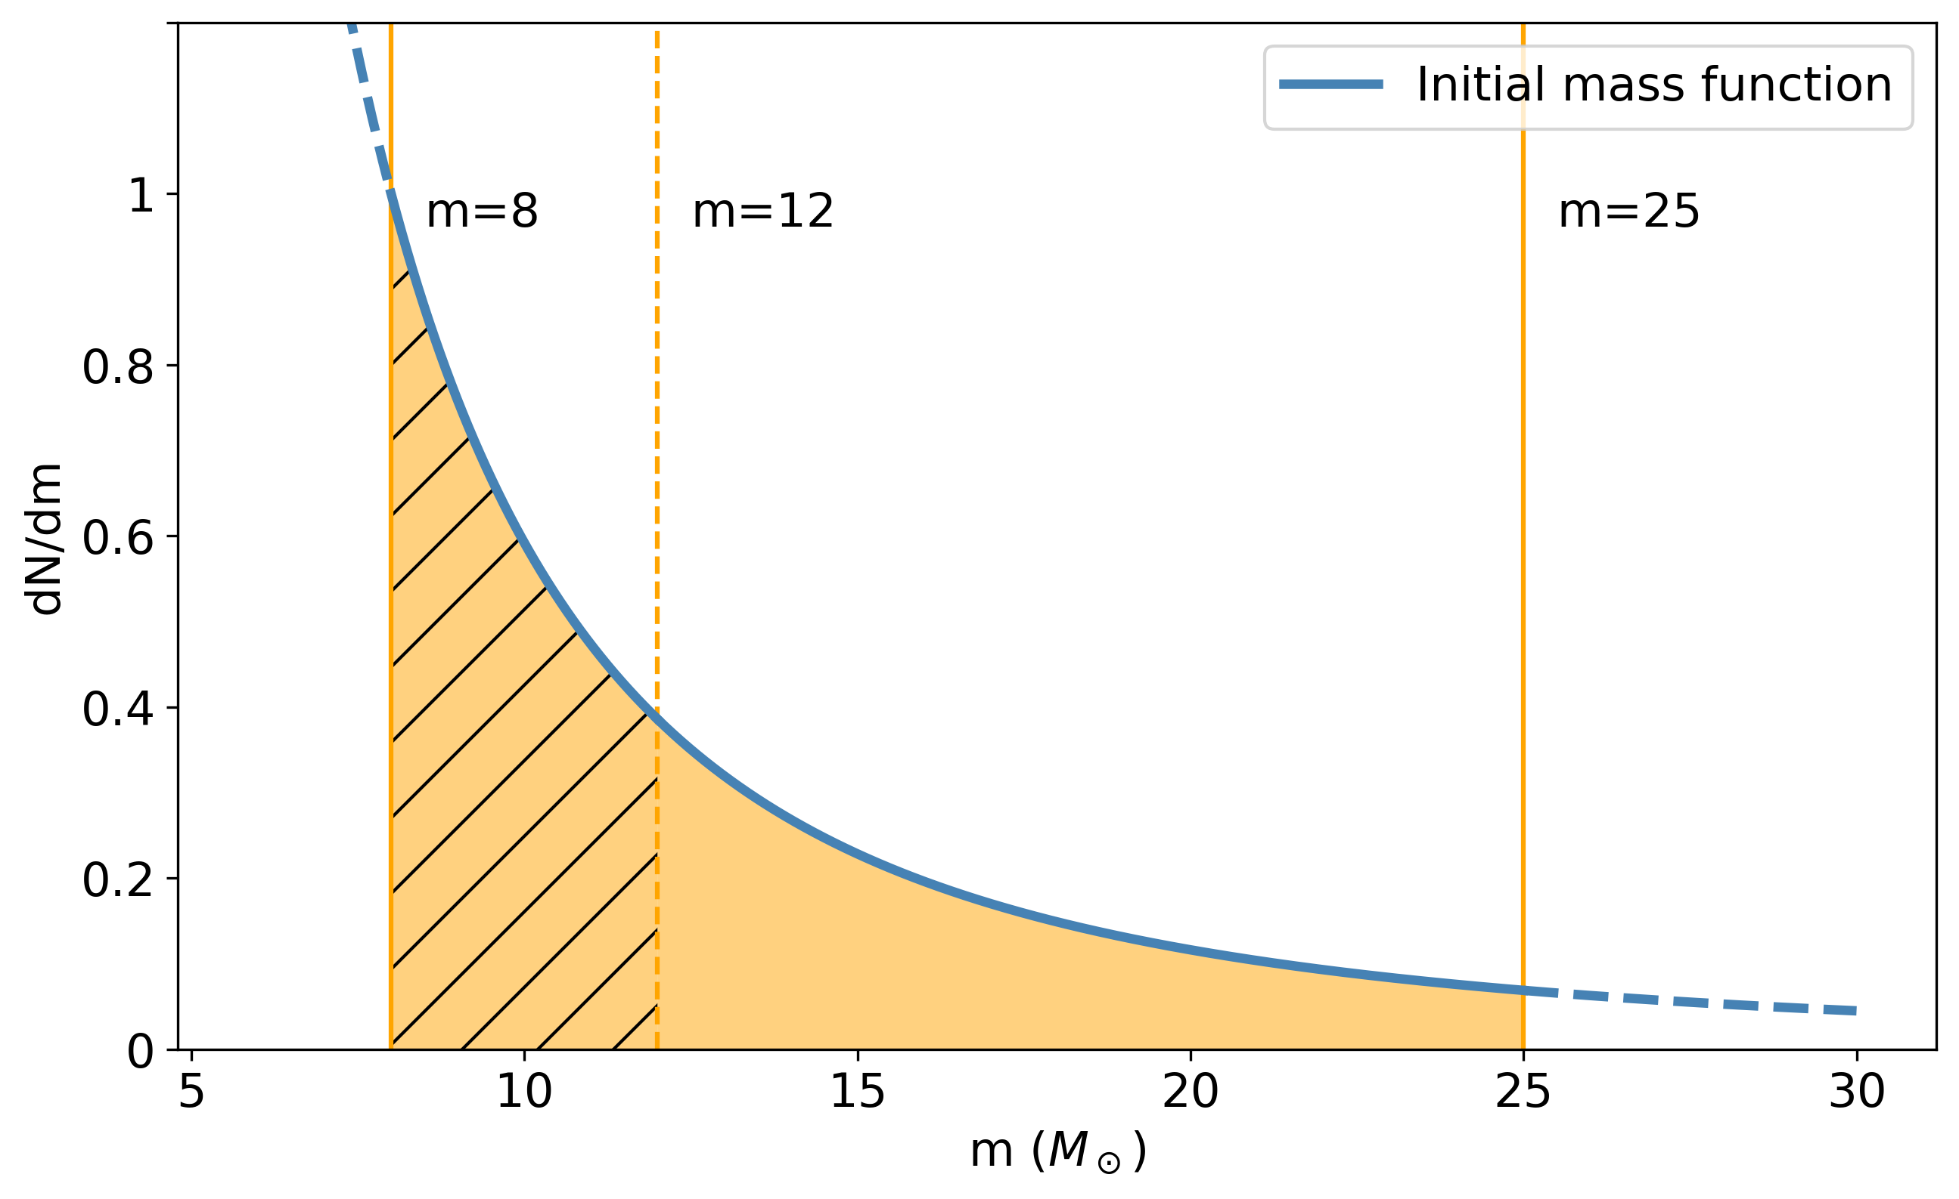
3. Implications – high/low-energy supernovae
$\sim 8−12M_{⊙}$low-mass stars
$→$low-energy supernovae
$→$ short lifetime$\sim 10 kyr$
$→$ non SNR-PSR
$\sim 12−25M_{⊙}$high-mass stars
$→$ high-energy supernovae
$→$ long lifetime $>\sim 10 kyr$
$→$ SNR-PSR
Electron capture ^{[1,2]} ?
Iron core collapse ^{[3]}
Credit: [1] Miyaji et al. 1980; [2] Nomoto 1984; [3] Heger et al. 2003

Slide 11
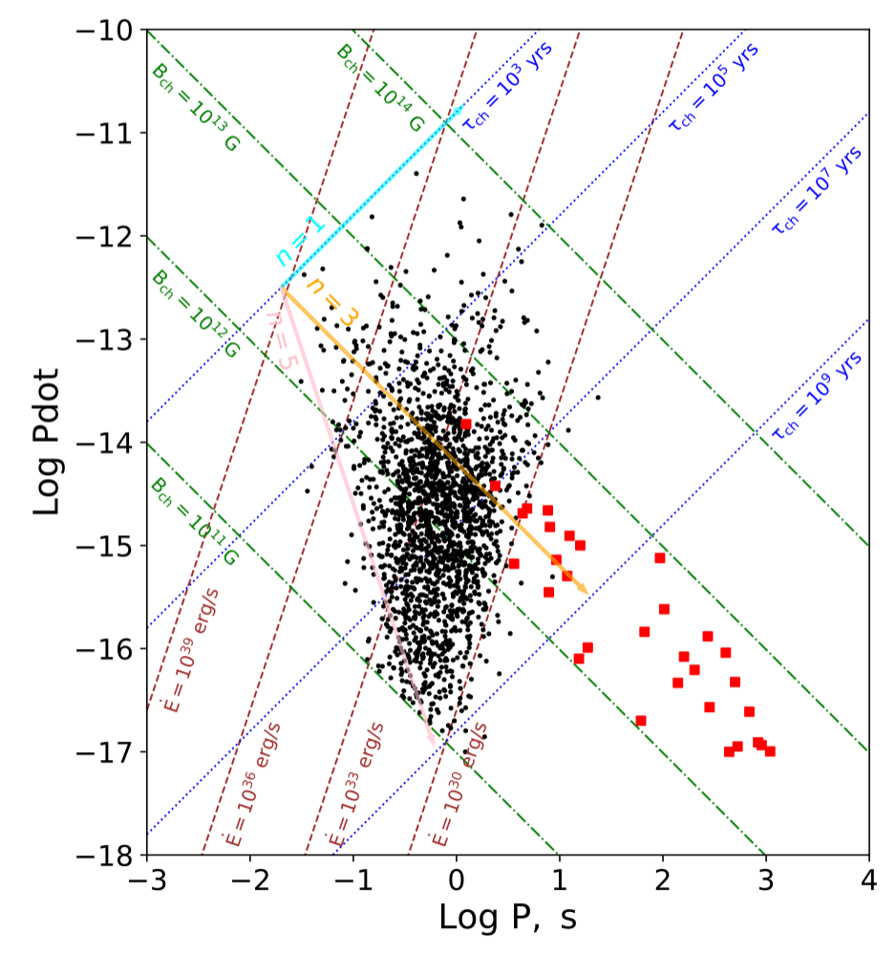
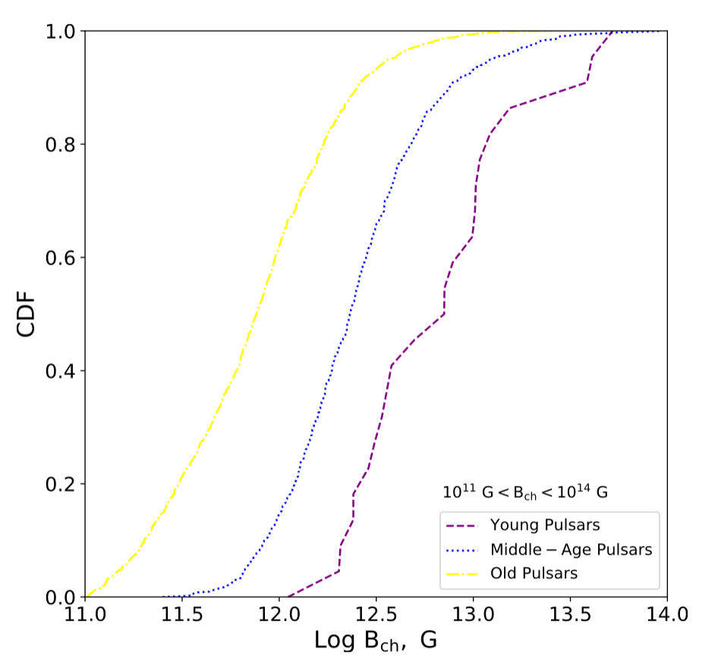
3. Implications – for middle age and old samples?
All normal radio pulsar: $\sim$2000
Divided by characteristic age:
Young (24), middle age (739), old (1207)
Characteristic age is not the real age!
Different distributions of characteristic B
Multiple origins
Zhang et al., 2022, PASP

Slide 12
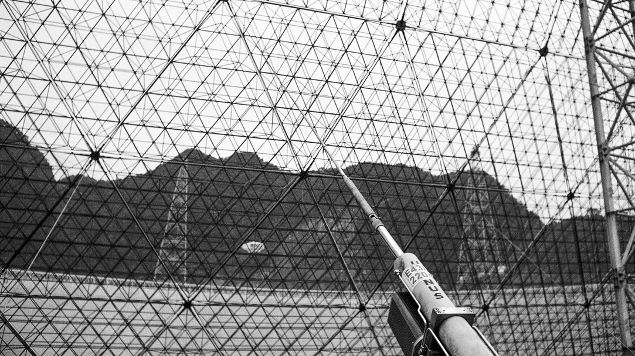
4. Conclusions
Focus on young normal radio pulsars
P, Pdot, B, Edot have different distributions for SNR-PSR and non SNR-PSR
10 kyr may be the dividing point between the lifetime of the two types of SNR
12 𝑴⊙ perhaps the separation mass of the two types of pulsar progenitors
All normal radio pulsars
Different evolution trends support multiple origins
Thank you for your Listening

Slide 13
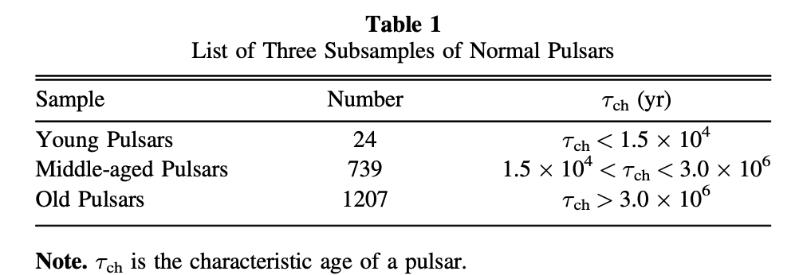
Supplement

Slide 14
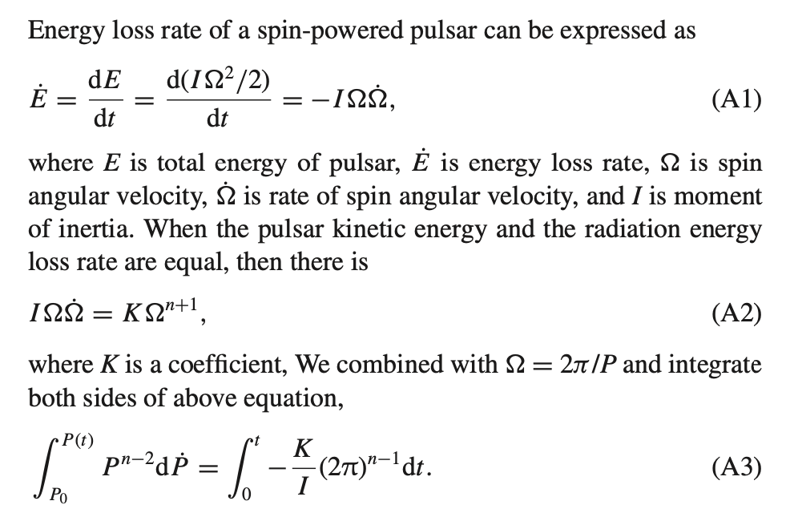
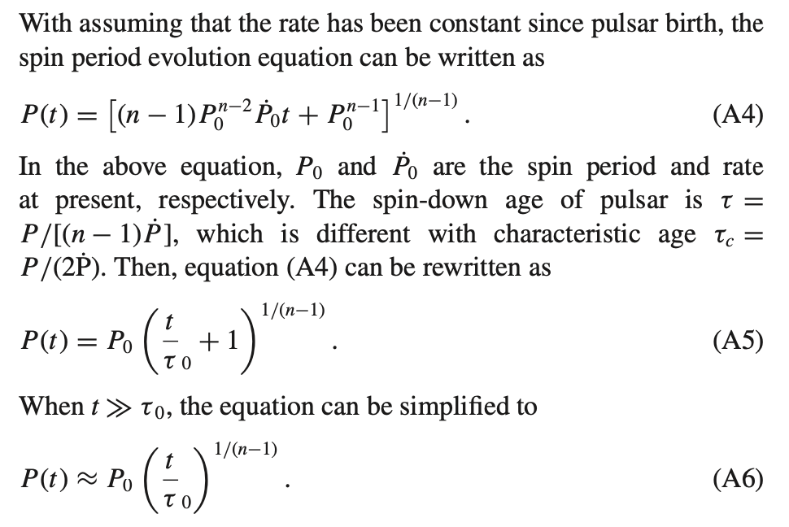
Supplement

Slide 15
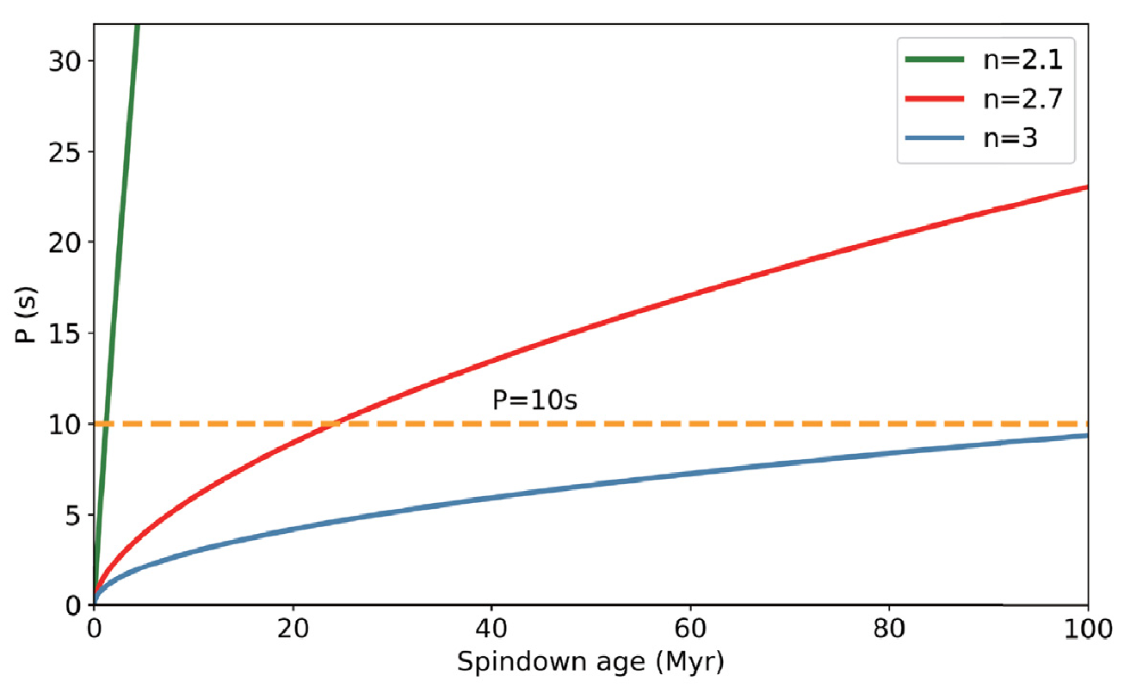
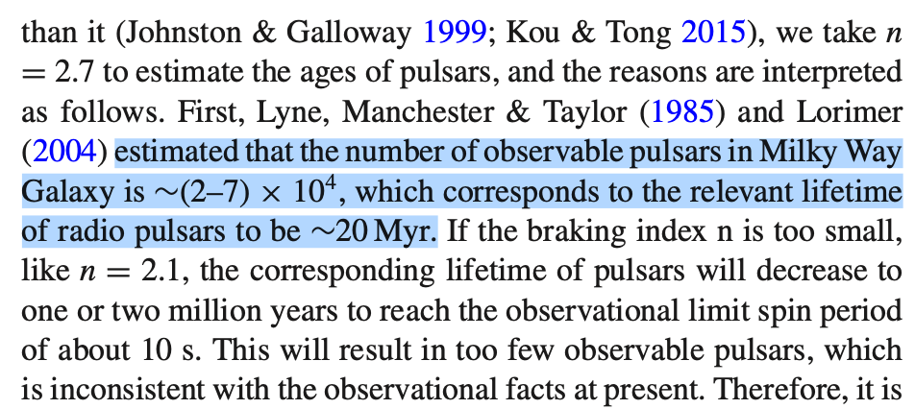
Supplement

