Slide 1
Pseudo-redshifts of Gamma-Ray Bursts Derived from the L-T-E Correlation
Speaker：Chen Deng (邓晨)
Collaborators: Yong-Feng Huang*, Fan Xu
Nanyang, July 4, 2023

Slide 2
Outline
1. Background
2. L-T-E correlation as a redshift estimator
3. Summary

Slide 3
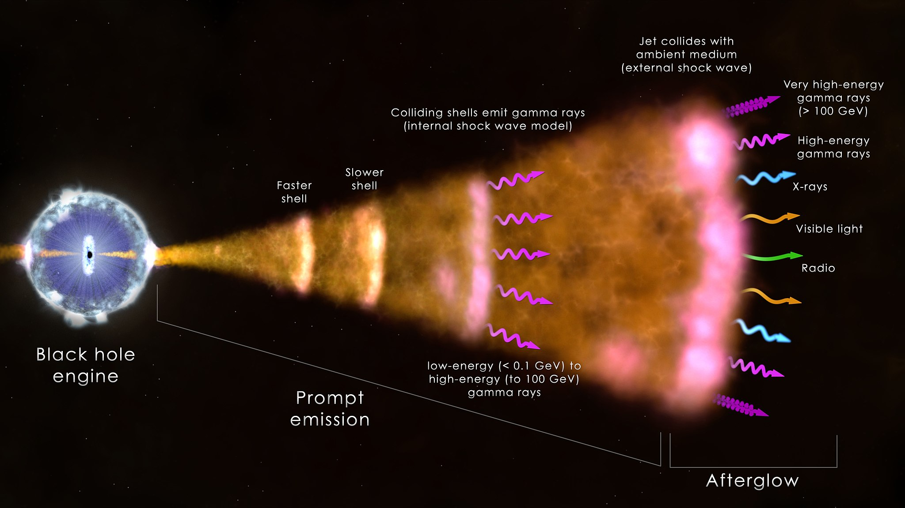
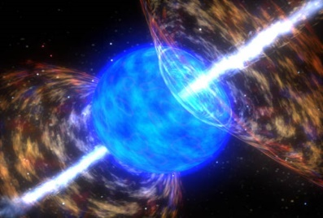
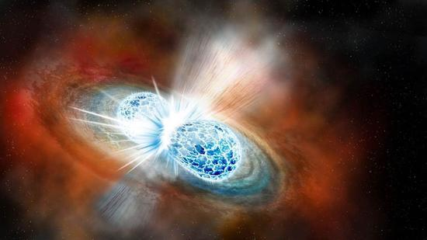
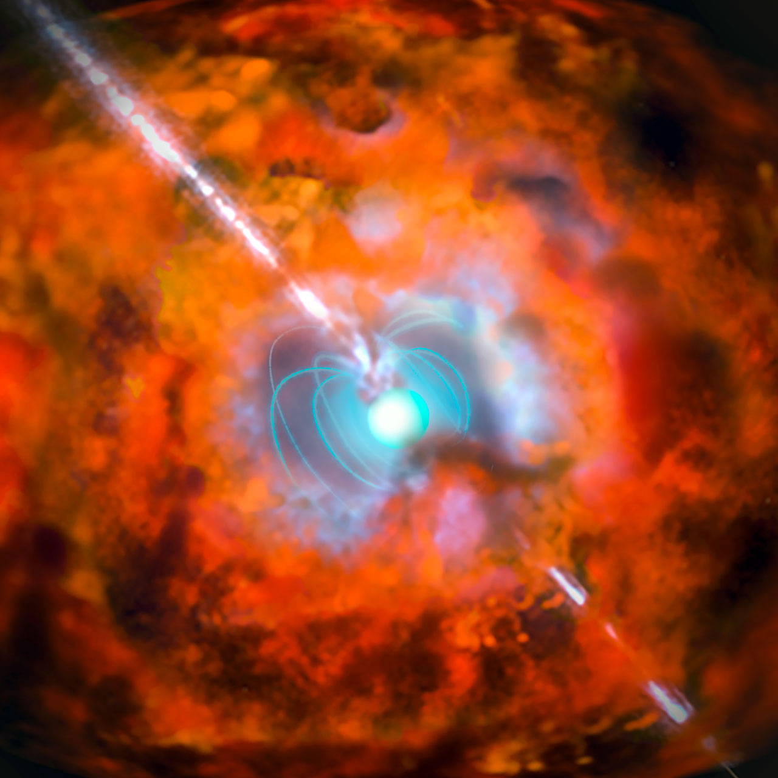
Background
Collapse of a massive star
T₉₀ > 2 s
LGRBs
T₉₀ < 2 s
SGRBs
or
Millisecond magnetar
Collision of binary neutron star
NASA's Goddard Space Flight Center
http://www.eso.org/public/images/eso1527a/

Slide 4
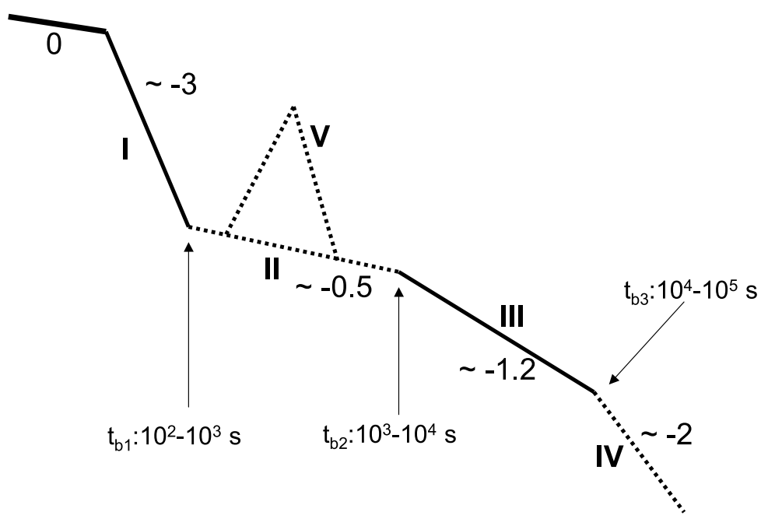
Background
Canonical lightcurve of X-ray afterglow
Explanations of the origin of the plateau phase:
Continuous energy injection from the central engine
Evolving microphysical parameters
A two component jet model
Coasting of moderately relativistic jets in a wind-like mediums
High-latitude emission from the structured jet
(Dai & Lu 1998, Geng et al. 2016)
(Ioka et al. 2006)
(Racusin et al. 2008)
(Dereli-Bégué et al. 2022)
Zhang et al. 2006
(Oganesyan et al. 2020)

Slide 5
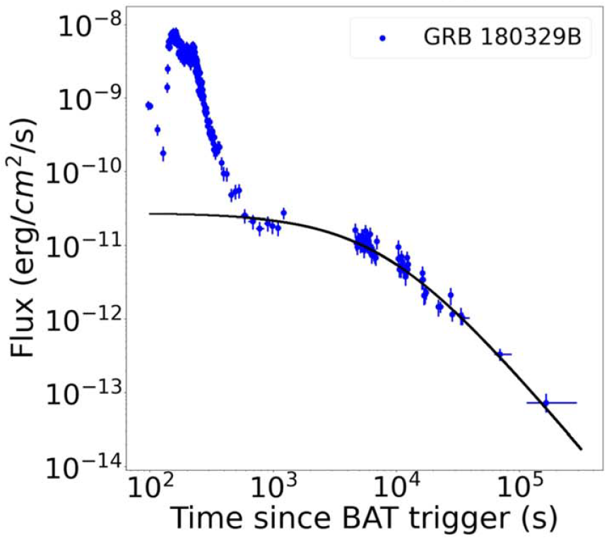
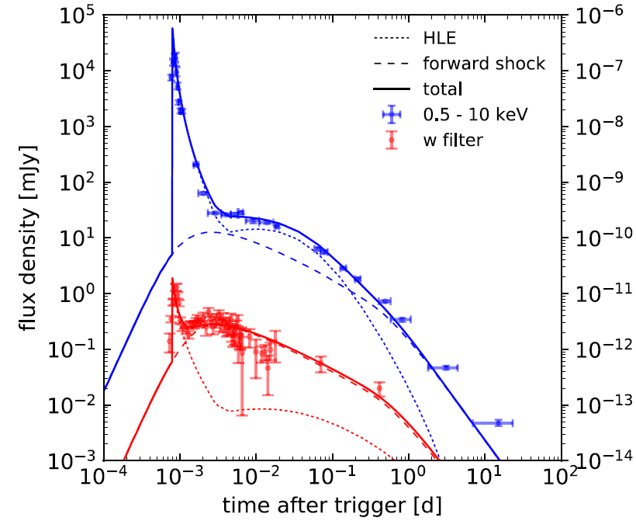
Background
Explanations of the origin of the plateau phase:
Continuous energy injection from the central engine
Evolving microphysical parameters
A two component jet model
Coasting of moderately relativistic jets in a wind-like mediums
High-latitude emission from the structured jet
(Dai & Lu 1998, Geng et al. 2016)
Wang et al. 2022
(Ioka et al. 2006)
(Racusin et al. 2008)
(Dereli-Bégué et al. 2022)
(Oganesyan et al. 2020)
Oganesyan et al. 2020

Slide 6
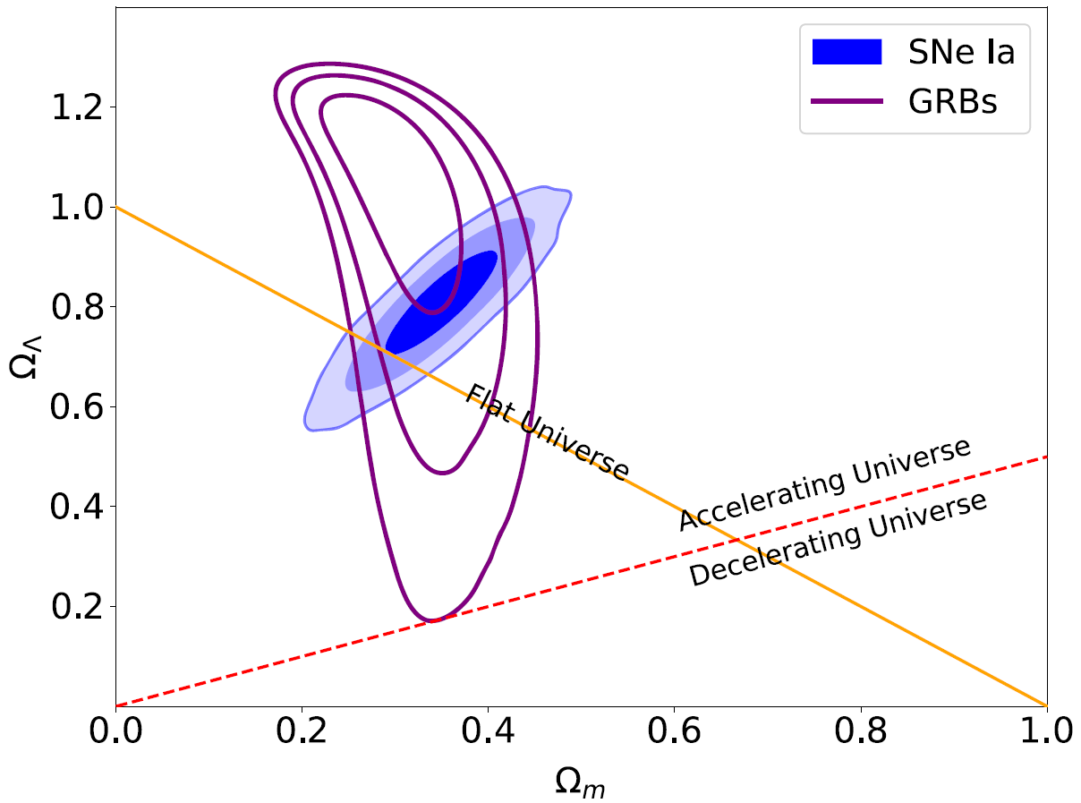
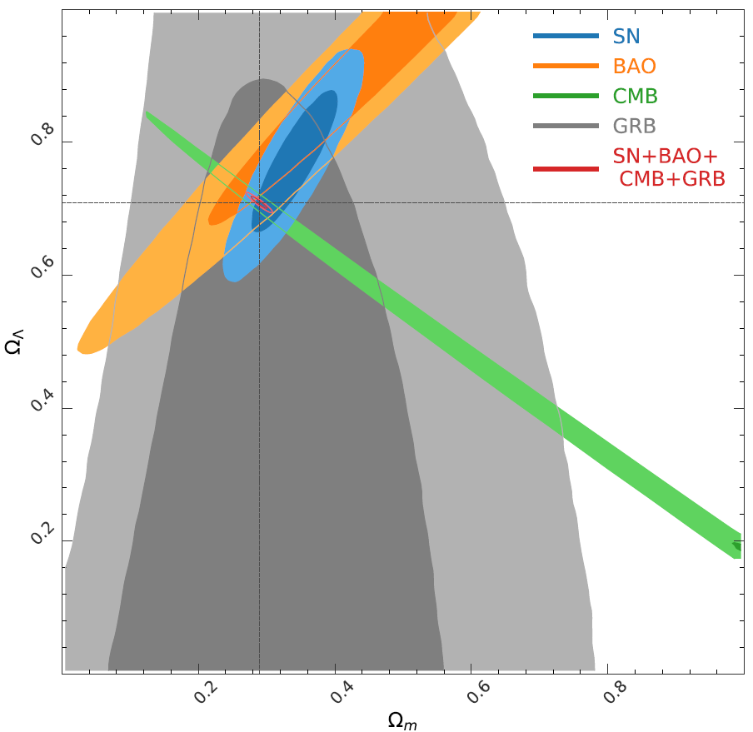
Background
empirical correlations regarding X-ray plateau
$L_{X}−T_{a}$ (Dainotti relation)
$L_{X}−T_{a}−E_{γ,iso}$ (Xu-Huang relation)
$L_{X}−T_{a}−E_{p}−α$ (Combo relation)
$L_{X}−T_{a}−E_{p}$
Dainotti et al. (2008, 2010)
Wang et al. 2022
Xu & Huang 2012, Tang et al. 2019
Izzo et al. 2015, Muccino et al. 2021
Xu et al. 2021
Xu et al. 2021

Slide 7
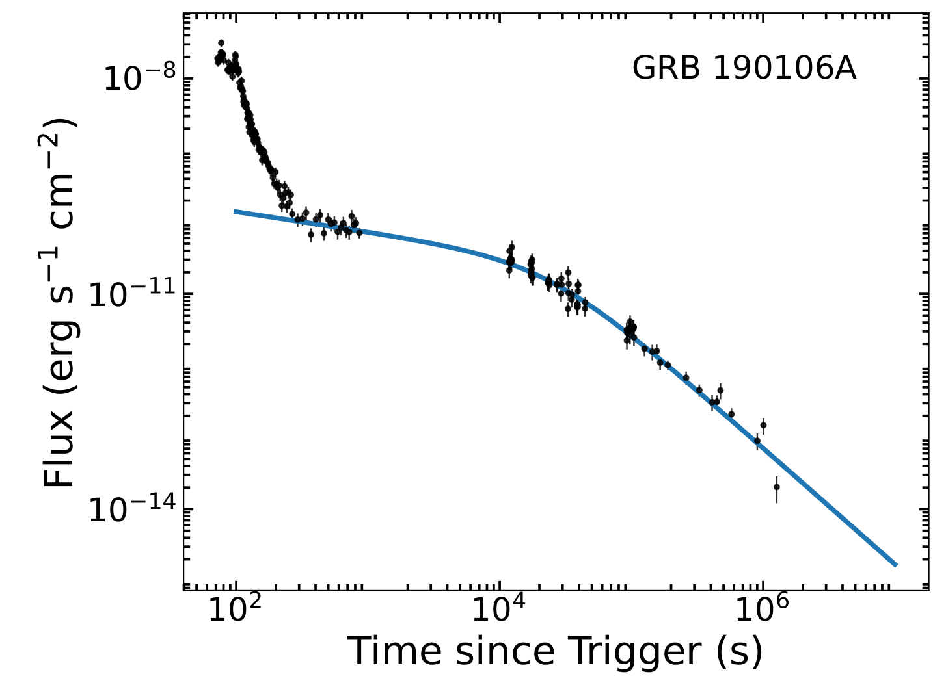
L-T-E correlation as a redshift estimator
Sample Selection
Starting Sample (210 GRBs):
The slope of the plateau is in the range of -1 to 1
Abundant data points are available in the plateau phase
The redshift of these GRBs should well defined
Target Sample (130 GRBs)

Slide 8
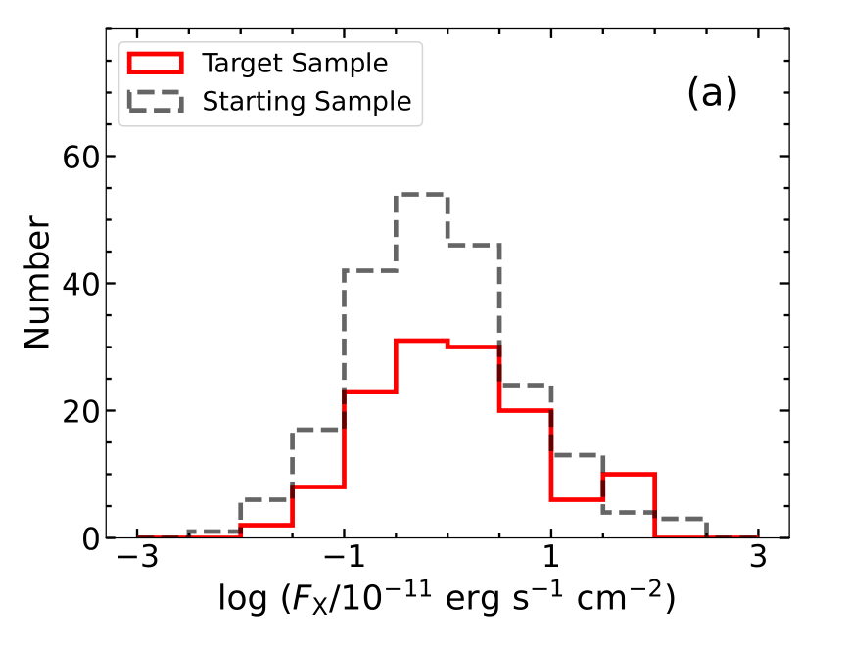
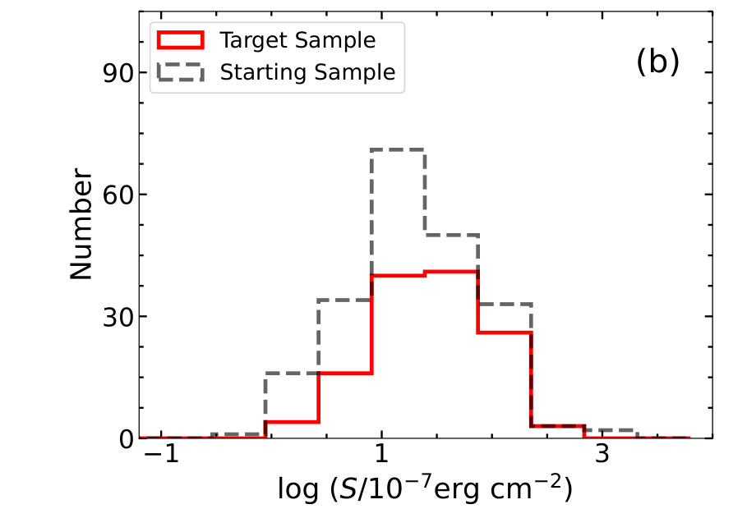
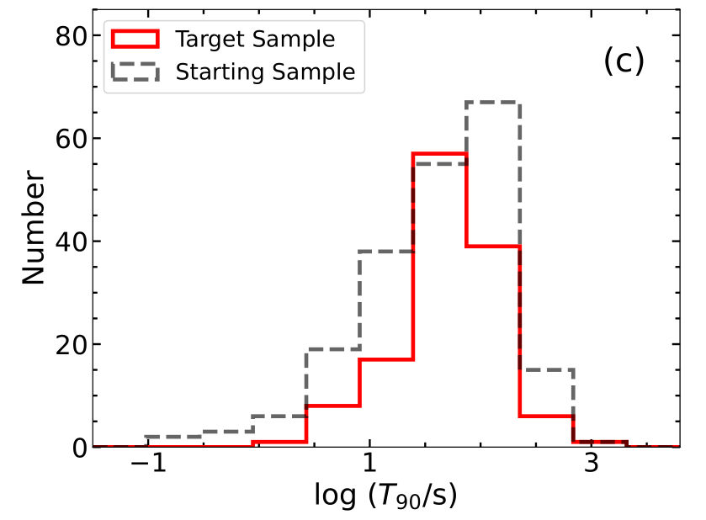
L-T-E correlation as a redshift estimator
Fitting results and relevant parameters of two samples

Slide 9
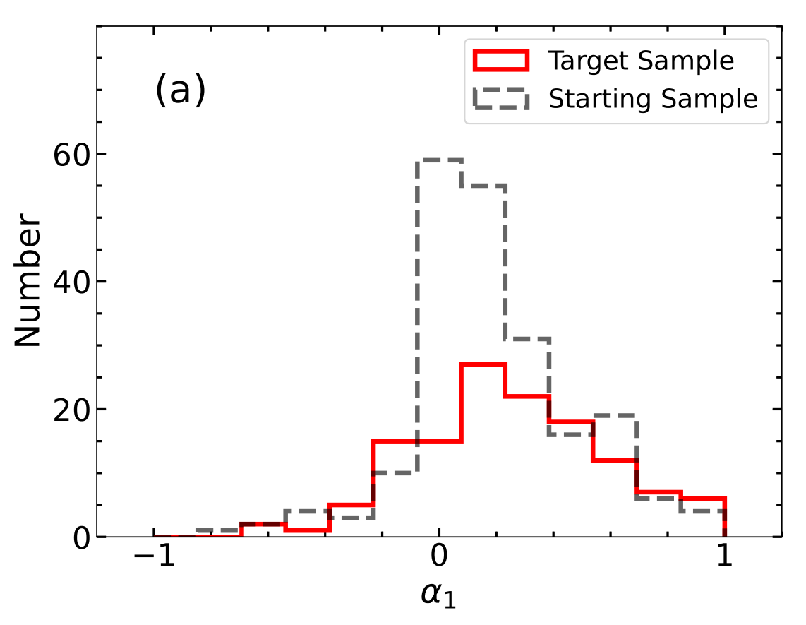
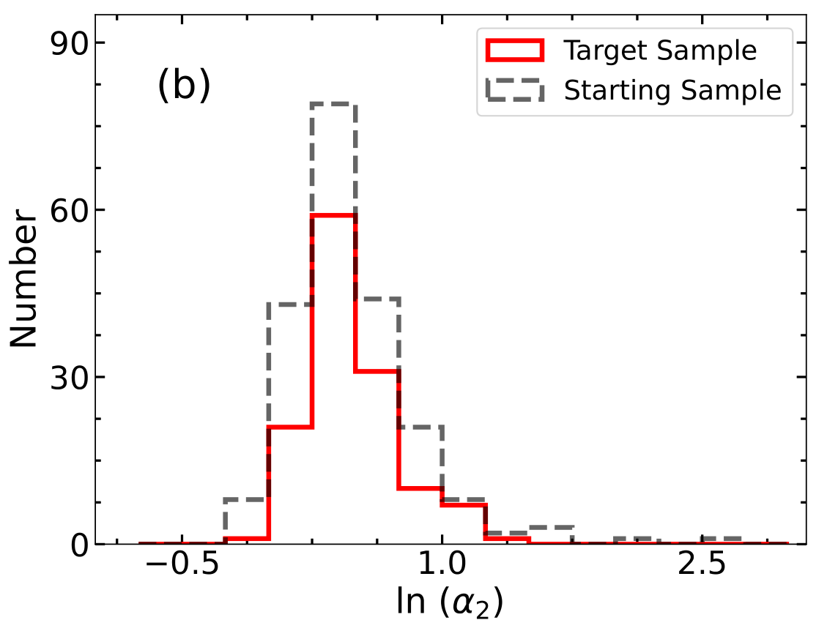
L-T-E correlation as a redshift estimator
Fitting results and relevant parameters of two samples

Slide 10
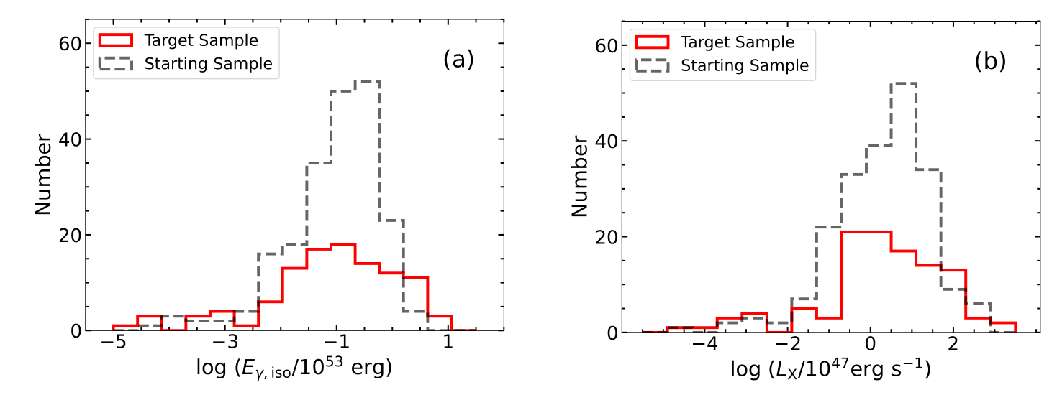
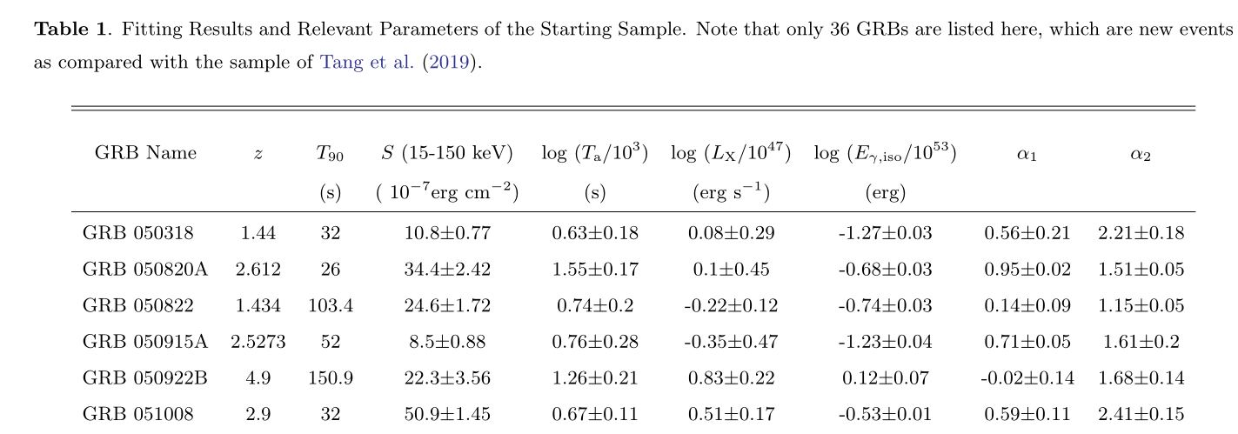
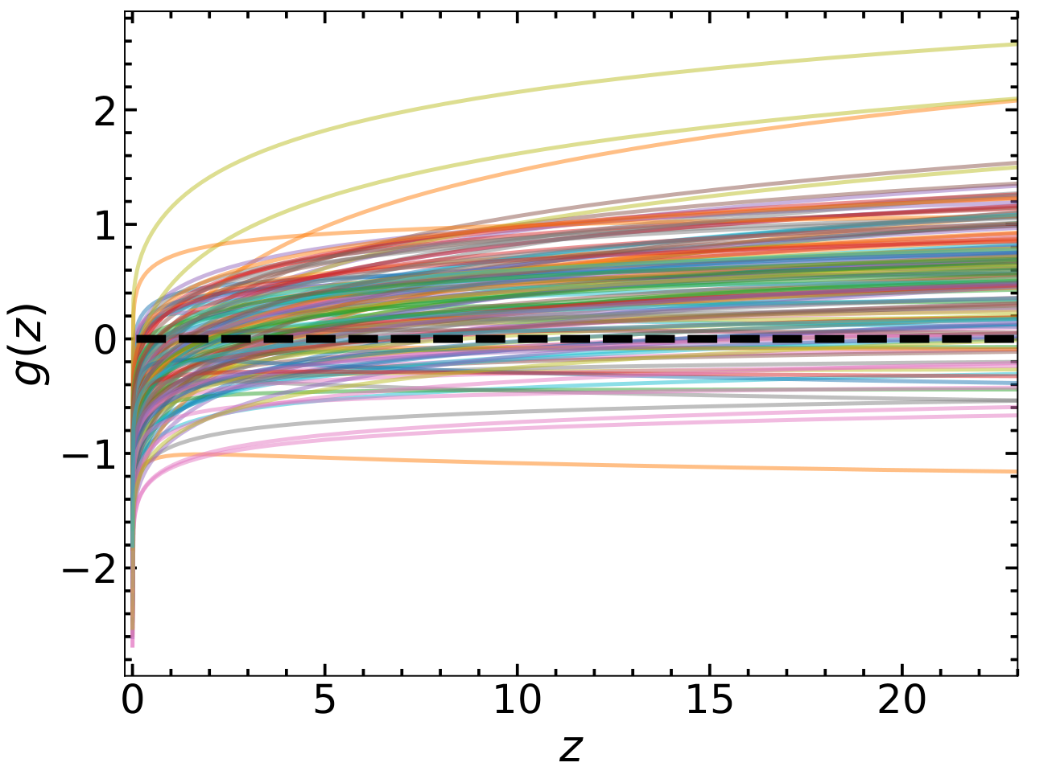
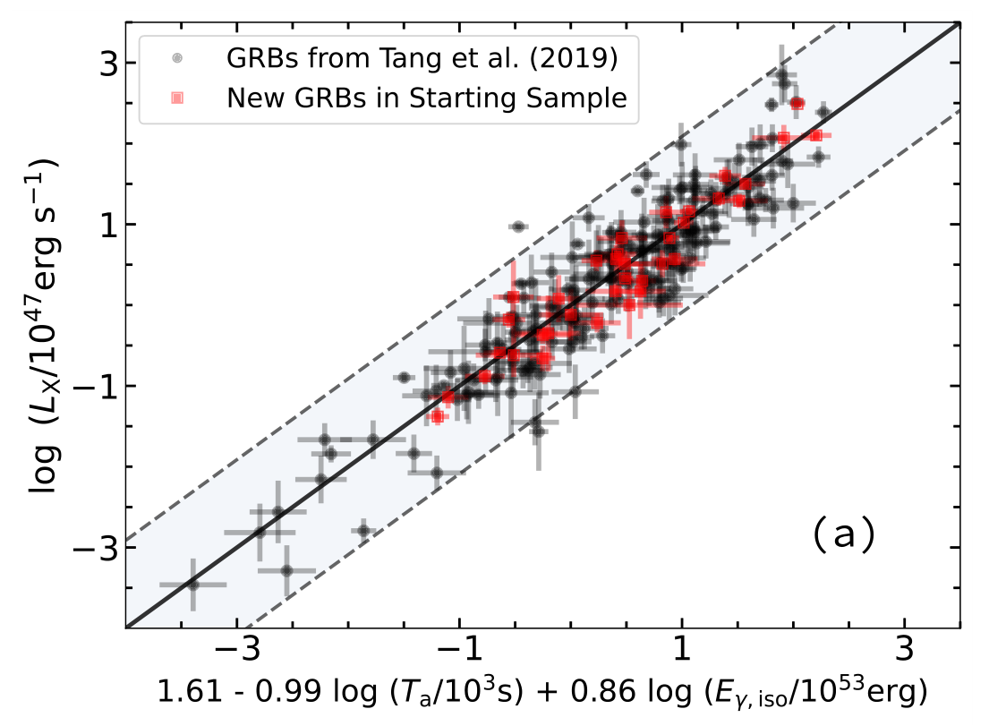
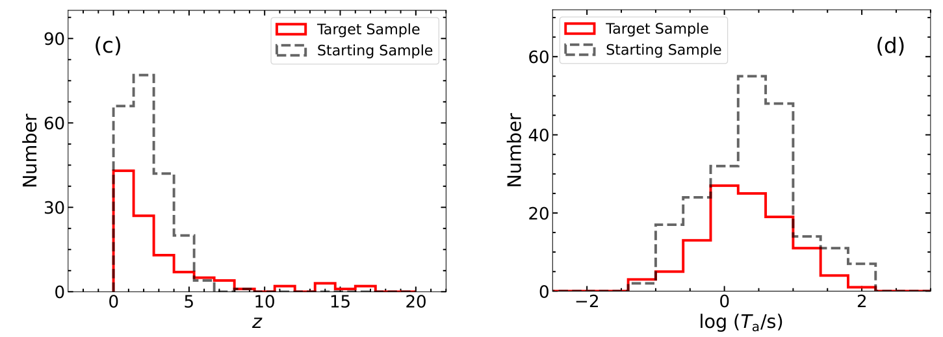
L-T-E correlation as a redshift estimator

Slide 11
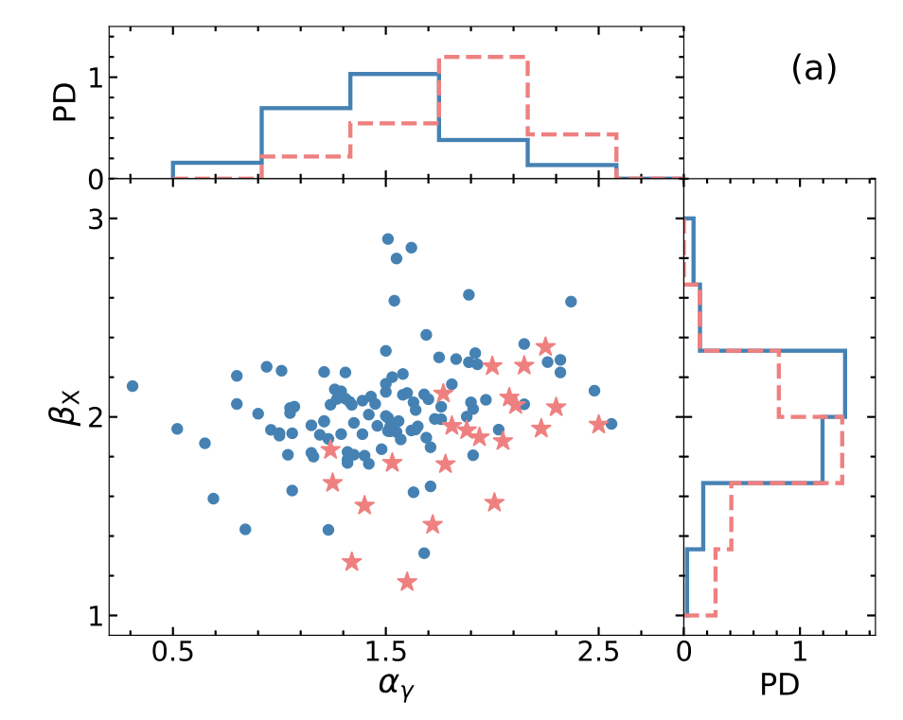
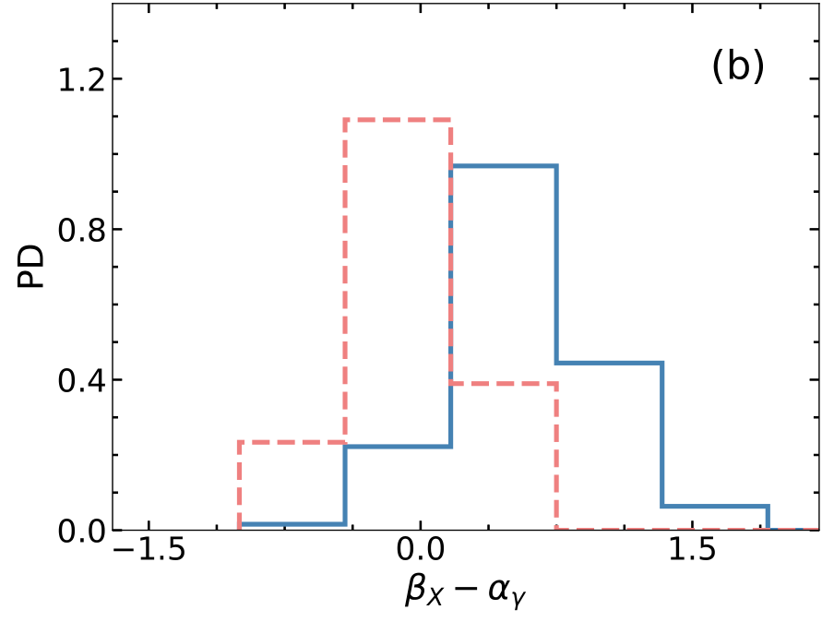
L-T-E correlation as a redshift estimator

Slide 12
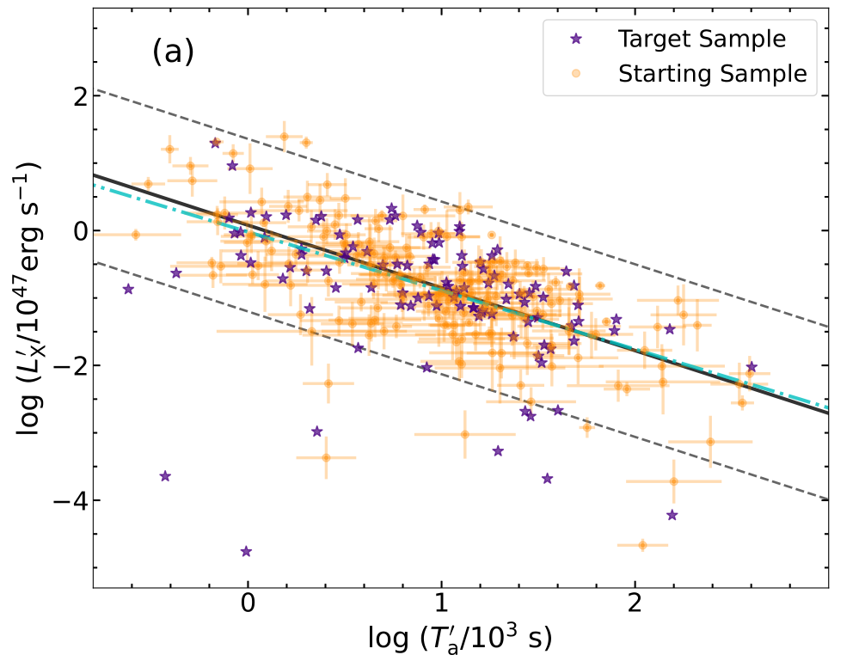
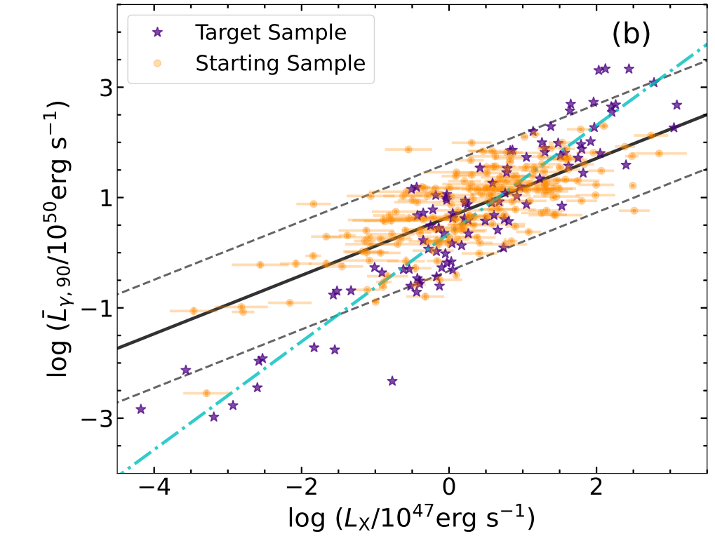
L-T-E correlation as a redshift estimator
Dainotti et al. 2022

Slide 13
Summary
We have collected 210 plateau GRBs and confirmed the L-T-E correlation as
L-T-E correlation supports that millisecond magnetar can serve as the central engine of plateau GRBs
A tighter L-T-E correlation could help improve the reliability of the derived pseudo-redshifts
arXiv:2212.01990
Thank You!

