Slide 1
Multimessenger observations of DNSs in the Galactic disk with gravitational and radio waves
Wen-Fan Feng (冯文凡)
Supervisor: Yan Wang (王炎)
Collaborators: Jie-Wen Chen (陈洁文), Soumya D. Mohanty, Yong Shao (邵勇)

Slide 2
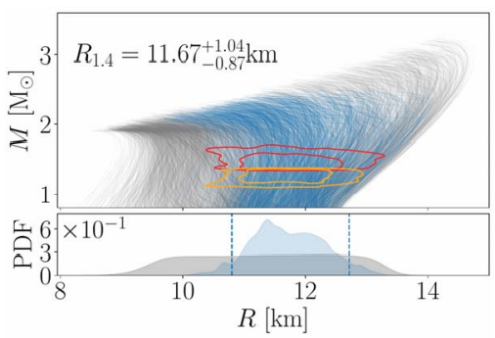
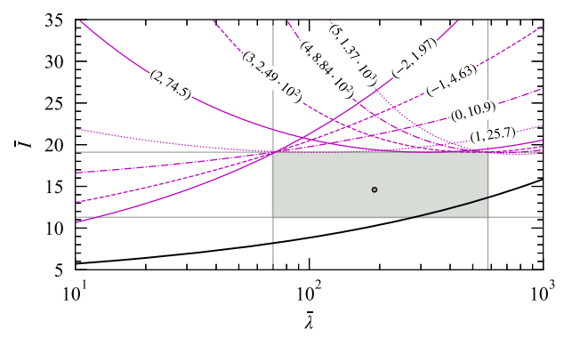
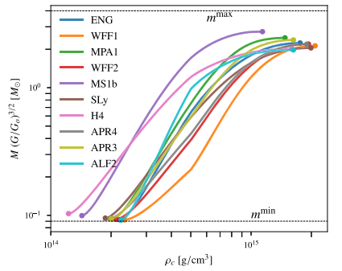
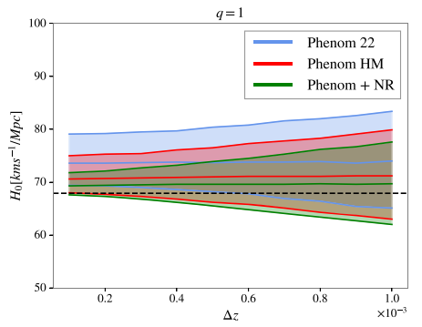
Double Neutron Star: Astrophysical Laboratory
Equation
of State
General
Relativity
T. Dietrich et al. Science 370 (2020)
H. O. Silva et al. Phys. Rev. Lett. 126 (2021)
Gravitational
constant
Hubble
constant
A. Vijaykumar et al. Phys. Rev. Lett. 126 (2021)
J. C. Bustillo et al. Astrophys. J. Lett. 912 (2021)

Slide 3
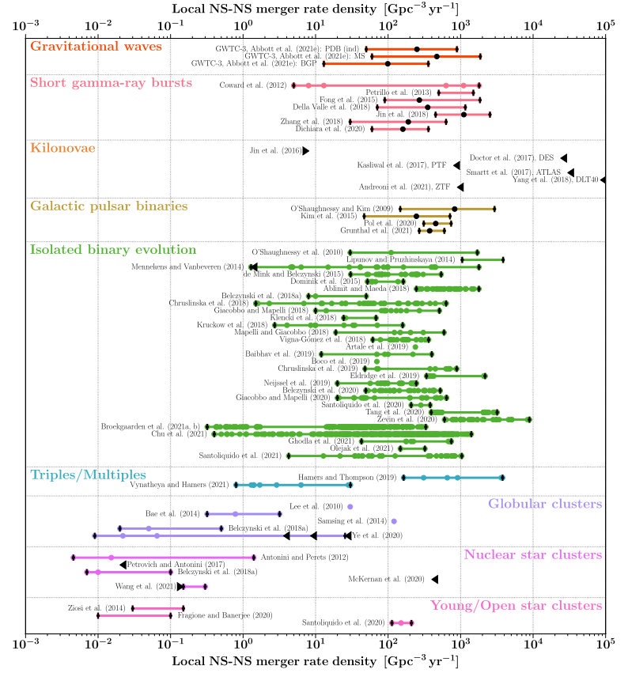
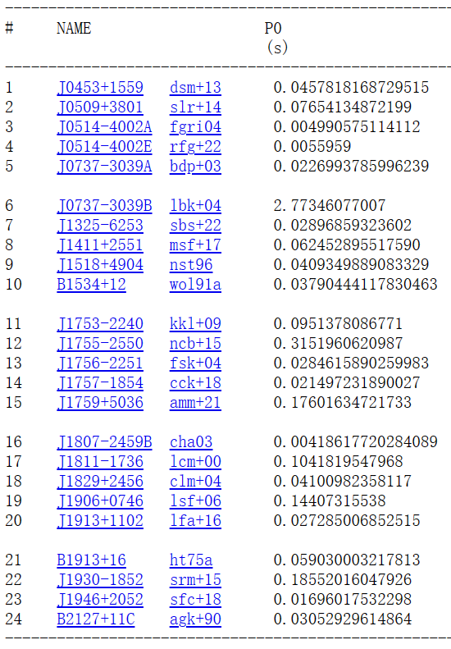
DNS Simulation & Detection
DNS merger
rate density
Radio
observations
GW
observations
GW170817
GW190425
Abbott et al. PRL (2017)
Abbott et al. ApJL (2020)
ATNF Pulsar Catalogue: https://www.atnf.csiro.au/research/pulsar/psrcat/
I. Mandel & F. S. Broekgaarden, Living Rev. Relativity 25 (2022)

Slide 4
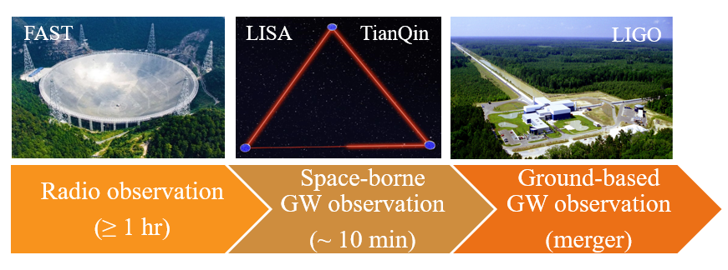
DNS Multimessenger Observation
Challenges: Doppler smearing from radio observation for short-period DNSs
Larger total mass from GW observation for a coalescing DNS
B. P. Abbott et al. Astrophys. J. Lett. 892 (2020)
detected undetected detected
LIGO
GW + Radio pulse

Slide 5
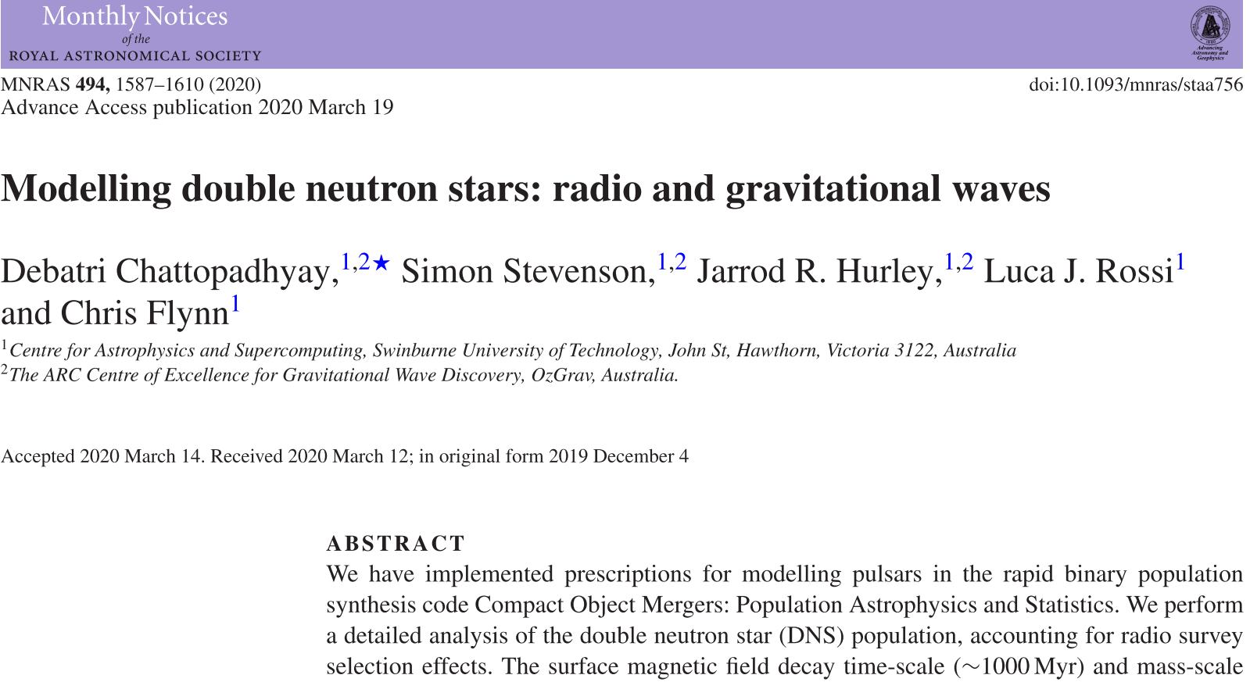
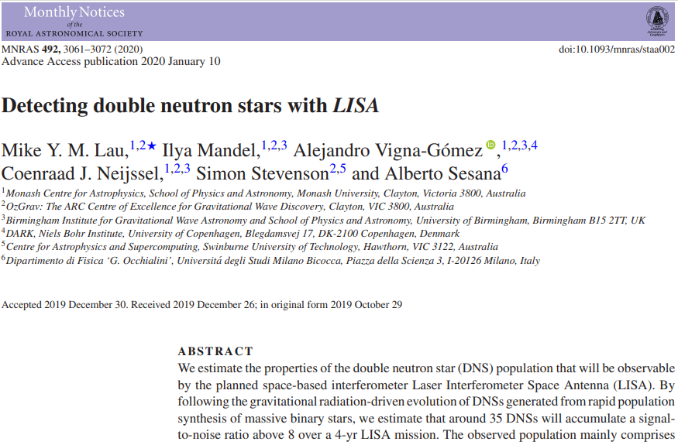
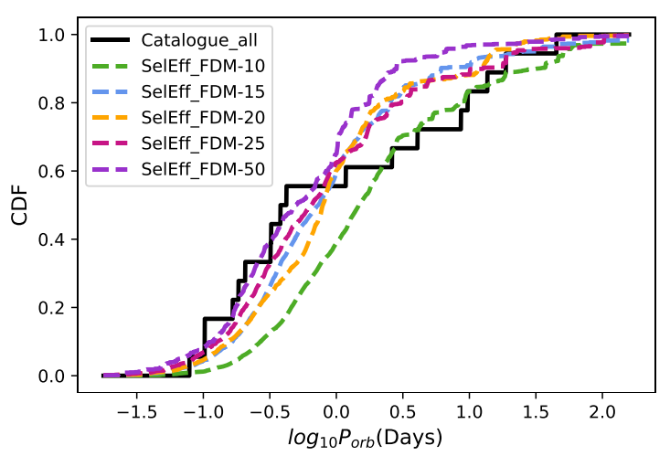
DNS Multimessenger Observation
LIGO
Too long orbital period to be detected by LISA
No radio simulation
Our work: Radio follow-up of the Galactic TianQin (+LISA) DNSs

Slide 6
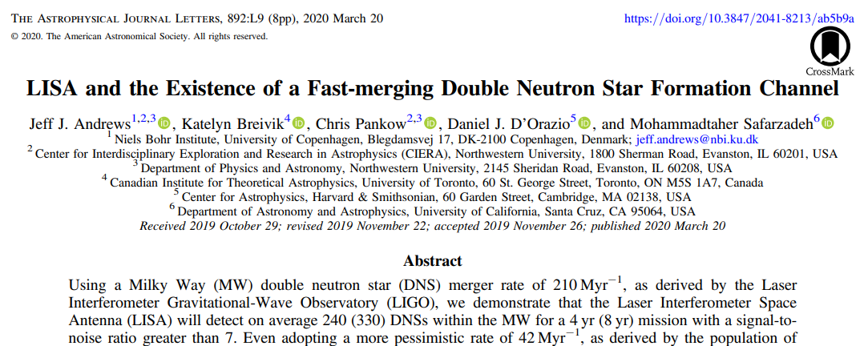
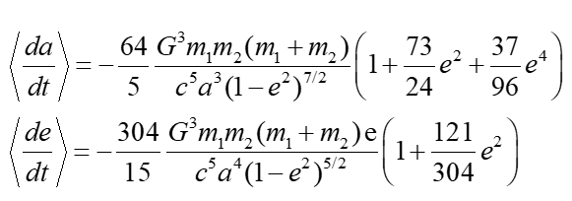
The Galactic DNS Population
Time Backward Model
for Orbital Parameters
P. C. Peters Phys. Rev. 136 (1964)
Reference: PSR B1913+16
T = 10Myr before merger
T = merger
(There is no need to extend to longer merger times because of the LISA sensitivity)
Generate 2100 random merger times from a uniform distribution U[0, 10Myr], Obtain Porb and ecc at any time before merger by integrating da/dt and de/dt.

Slide 7
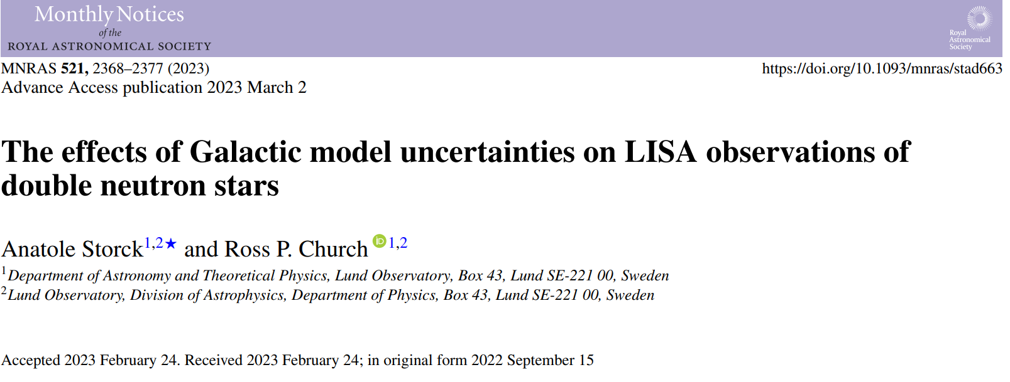
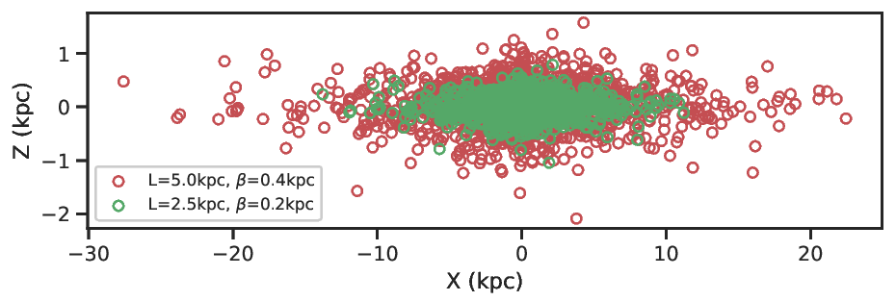
Notes on the Galactic Model
Galactic model in our work
G. Nelemans et al. Astron. Astrophys. 375 (2001)
Spatial distribution of the LISA DNSs is insensitive to
the choice of Galactic models
Our trivial test for the Galactic model and the kick effect on the detectable DNSs
We do not expect these simulation variations to significantly change our results.

Slide 8
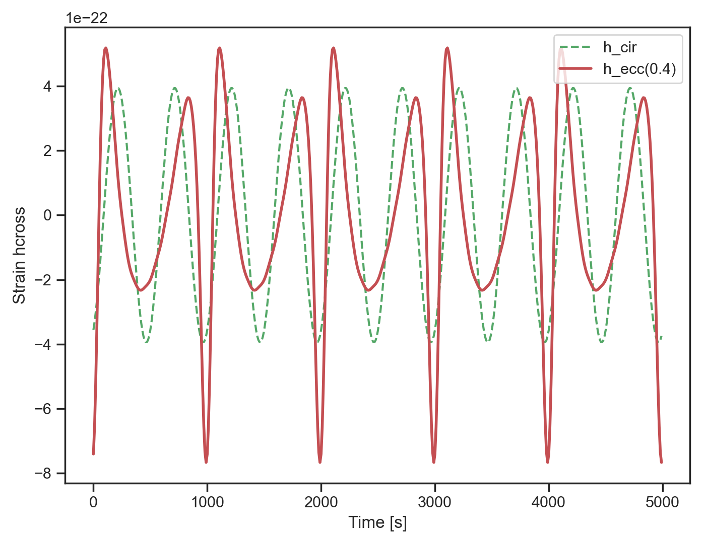
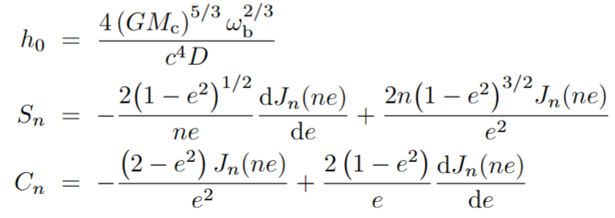
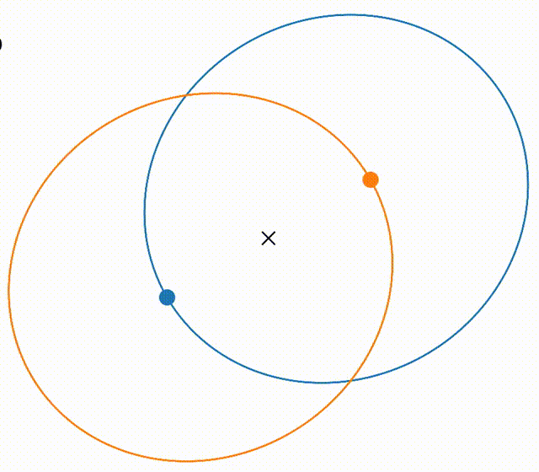
Eccentric Waveforms from DNSs
C. Moreno-Garrido et al. Mon. Not. R. Astron. Soc. 274 (1995)
strain signal with antenna response F
(Animation: zingale)

Slide 9
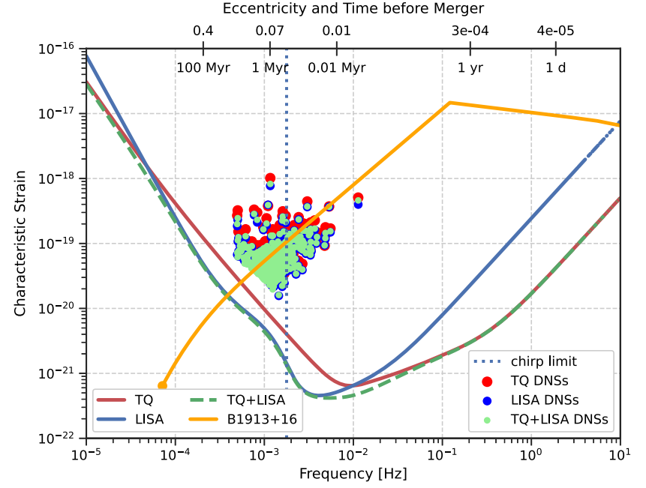
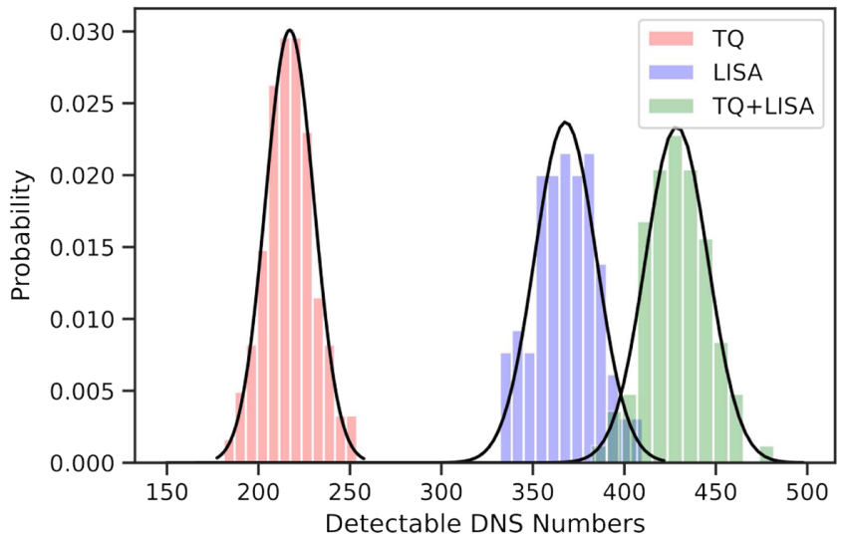
Characteristic Strain of Detectable DNSs
n=2 ρ_{th}=7
Chirp frequency limit
Monte Carlo simulations
Sensitivity of LISA (T. Robson et al. Class. Quantum Grav. 36 (2019)) and TianQin(S.-J. Huang et al. Phys. Rev. D 102 (2020)) and their combination comes from M. Tinto and J. C. N. de Araujo, Phys. Rev. D 94 (2016)

Slide 10
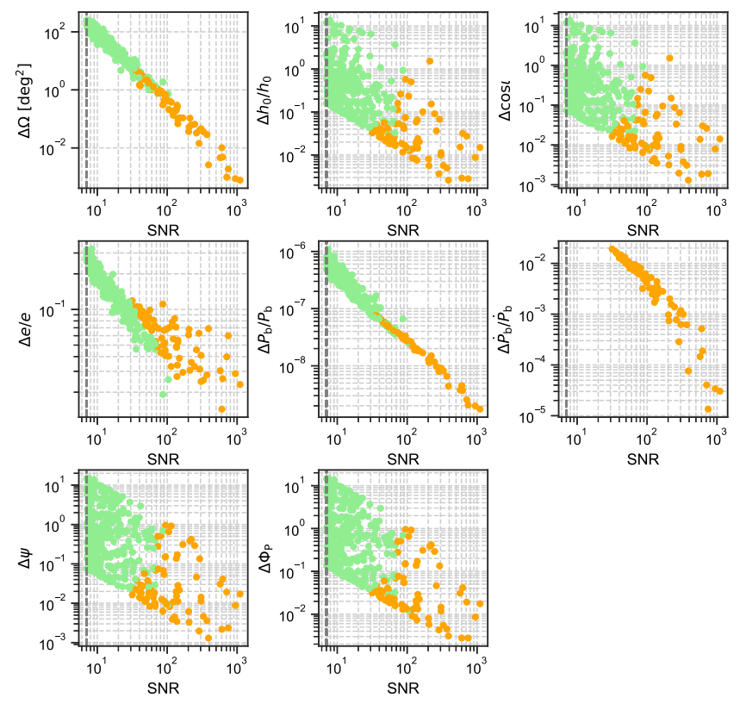
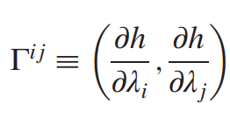
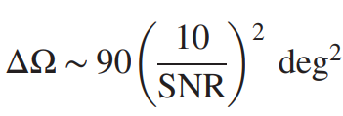
Parameter Estimation Accuracy
Fisher information matrix
C. Cutler and E. E. Flanagan, Phys. Rev. D 49 (1994)
Sky localization
C. Cutler, Phys. Rev. D 57 (1998)
Parameter correlation
S. Shah et al., Astron. Astrophys. 544 (2012)
TQ+LISA
8D & 9D
Scaling relation
e.g.

Slide 11
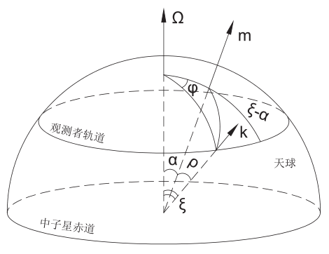
Pulsar Beam Geometry
Radio beam modeling for the Galactic DNSs
rotation axis
Observable condition for main pulse
magnetic axis
line of sight
Observed pulse width W
in longitude of rotation
J. Gil, Acta Physica Polonica. 12 (1981)
J. Gil, Astron. Astrophys. 132 (1984)

Slide 12
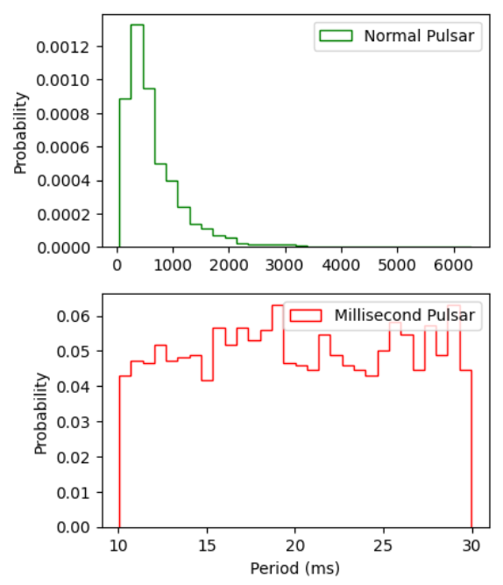
Pulsar Empirical Distributions
Suppose a DNS consists of a normal pulsar (NP) and a millisecond pulsar (MSP)
Observations & standard evolution scenario
T. M. Tauris et al. Astrophys. J. 846 (2017)
Spin periods for isolated NPs (P > 30 ms)
D. R. Lorimer et al. Mon. Not. R. Astron. Soc. 372 (2006)
Spin periods for MSPs (P ≤ 30 ms)
Pulsar pseudo luminosity and flux density
Emission cone angular radius
C. A. Faucher-Giguère, V. M. Kaspi, Astrophys. J. 643 (2006)
M. Kramer et al. Astrophys. J. 501 (1998)

Slide 13
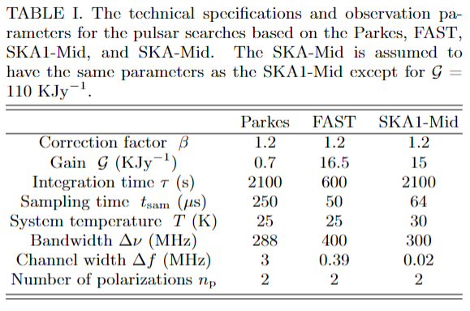
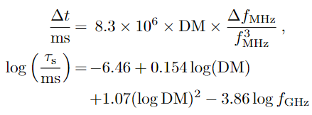
Pulsar Signal-to-Noise Ratio
ρ_{th}=9
Effective pulse width
Dispersion and scattering broadening
R. N. Manchester et al. Mon. Not. R. Astron. Soc. 328 (2001)
R. Smits et al. Astron. Astrophys. 505 (2009)
R. Smits et al. Astron. Astrophys. 493 (2009)
R. T. Schilizzi et al. Preliminary Specifications for the Square Kilometre Array. (2007)
R. N. Manchester et al. PASA 30 (2013)
L. Qian et al. Sci. China-Phys. Mech. Astron. 62 (2019)
G. Janssen et al. AASKA14 037 (2015)
YMW16 model
D. R. Lorimer et al. Mon. Not. R. Astron. Soc. 372 (2006)
J. M. Yao, R. N. Manchester, N. Wang, Astrophys. J. 835 (2017)

Slide 14
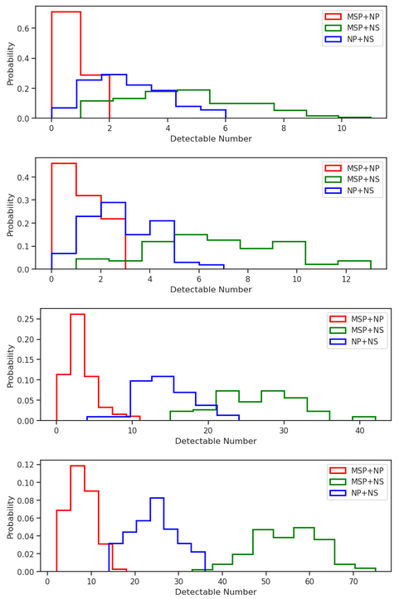
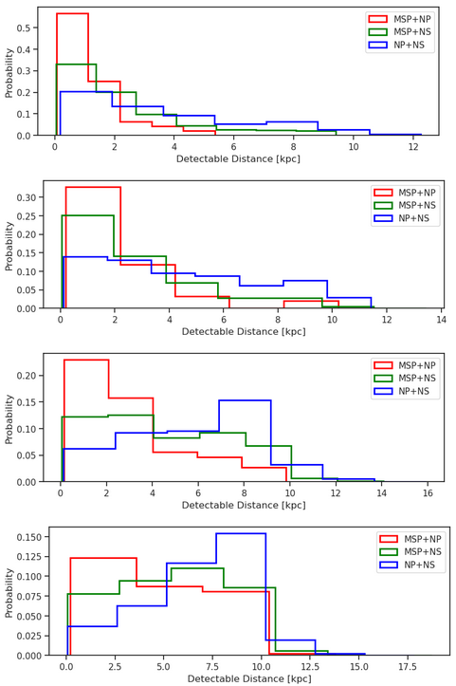
Number & Distance of GW+Radio Detectable DNSs
TQ+LISA+Parkes
100 independent Monte Carlo simulations
TQ+LISA+Parkes
TQ+LISA+FAST
TQ+LISA+FAST
Average number of DNSs detectable by the follow-up pulsar searches using the Parkes, FAST, SKA1, and SKA are 8, 10, 43, and 87, respectively.
TQ+LISA+SKA1-Mid
TQ+LISA+SKA1-Mid
Average distances of these GW-detectable pulsar binaries vary from 1 to 7 kpc.
TQ+LISA+SKA-Mid
TQ+LISA+SKA-Mid

Slide 15
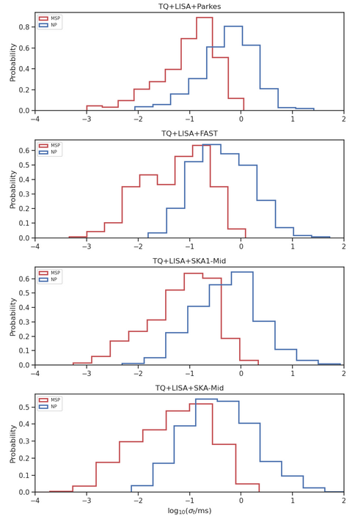
Timing Accuracy of GW+Radio Detectable Pulsars
The total rms error of TOA measurement (σ_{t}) is mainly determined by the radiometer noise (σ_{r}) and the pulse phase jitter noise (σ_{j}) .
J. M. Cordes, R. M. Shannon, arXiv:1010.3785 (2010)
Y. Wang, Proceedings of Journal of Physics Conference Series, 012019 (2015)
The timing accuracy of these GW-detectable pulsars can be as low as 70 ns while the most probable value is about 100 μs.

Slide 16
Conclusions
Simulate the DNS population in the Galactic disk that will merge within the next 10 Myr.
Obtain the numbers of the detectable DNSs and parameter estimation accuracies with TianQin (and LISA).
Model the pulsar population from the Galactic DNS population.
Get the numbers and distances of GW-detectable DNSs comprising radio pulsars with Parkes, FAST, SKA1-Mid, and SKA-Mid.
Estimate the timing accuracies of the TOAs for these pulsars by evaluating their dominate radiometer and jitter noises.
Caveats
Set the orbital parameters of B1913+16 at the merger as the benchmark in DNS population.
Assume the distribution of MSP spin periods obeys a uniform distribution.
Assume the luminosity distribution of the pulsars in tight binaries is the same as that of the normal pulsars.
Our results are expected to be improved by advances in theoretical modeling.

