Slide 1
Tidal deformability of compact stars admixed with scalar fields
报告人：高端塬
华中科技大学
指导老师：周恩平

Slide 2
content
Background
Method
Result
Conclusion and prospect

Slide 3
Background

Slide 4
Background

Slide 5
Background
C. J. Horowitz published a series of articles to estimate how dark matter (scalar field) in neutron stars change their gravitational wave.
Horowitz, C. J. and Reddy, S., “Gravitational Waves from Compact Dark Objects in Neutron Stars”,
Physical Review Letters, vol. 122, no. 7, 2019. doi:10.1103/PhysRevLett.122.071102.

Slide 6
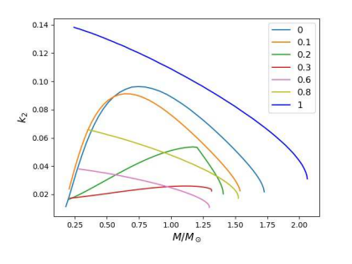
Background
Kwing-Lam Leung, Ming-chung
Chu, and Lap-Ming Lin used effective
energy momentum tensor to calculate
the tidal love number.
$T_{μν}^{(tot)}= T_{μν}^{(FS)}+$ $T_{μν}^{(φ)}$
where
Leung, K.-L., Chu, M.-. chung ., and Lin, L.-M., “Tidal deformability of dark matter admixed neutron stars”,
<i>Physical Review D</i>, vol. 105, no. 12, 2022. doi:10.1103/PhysRevD.105.123010.

Slide 7
Methods

Slide 8
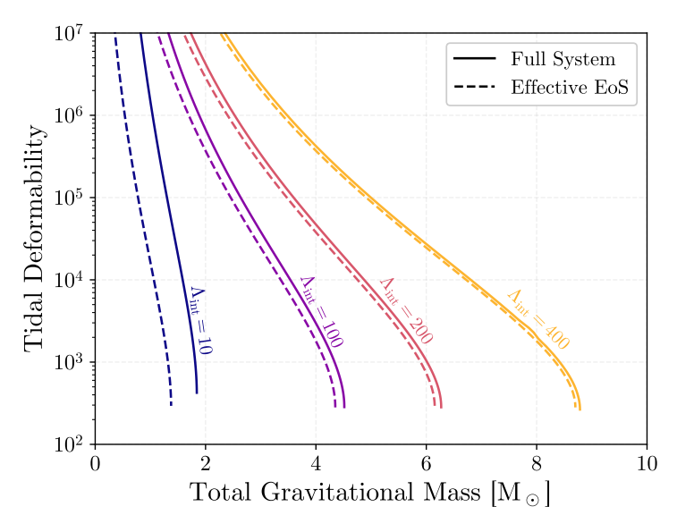
Methods
Robin Fynn Diedrichs et.al used full form of energy momentum tensor and calculate the Scalar field by Klein-Gordon equation:
$$∇_{μ}∇^{μ}φ=φ\frac{dV}{d\left({\left|φ\right|}^{2}\right)}$$
Where V is the scalar field’s potential
$$V=m^{2} \overline{φ}φ+4πm^{2}Λ_{int} {\left(\overline{φ}φ\right)}^{2}$$
here m is the particle mass and $Λ_{int}$ is the effective selfinteraction parameter.
Fynn Diedrichs , R.,et.al., “Tidal Deformability of Fermion-Boson Stars: Neutron Stars Admixed with Ultra-Light Dark Matter”, arXiv e-prints, 2023. doi:10.48550/arXiv.2303.04089.

Slide 9
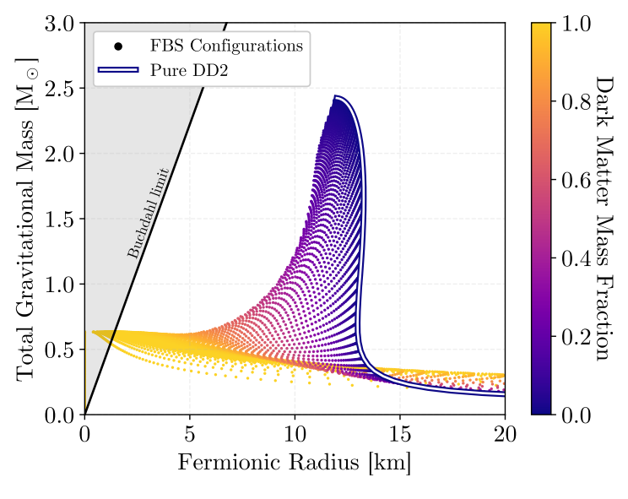
Equilibrium solutions
They calculated static spherical symmetric equilibrium solutions first.
Fynn Diedrichs, R.,et.al(2023)

Slide 10
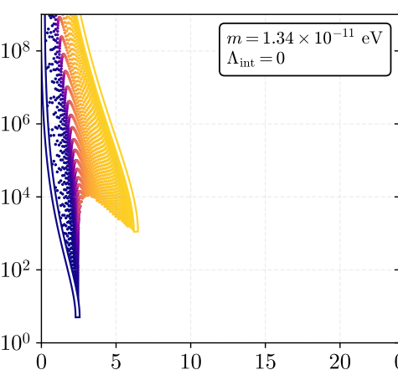
Tidal deformability
Tidal Deformability $Λ_{tidal}$
Then, they calculate the system
with perturbations proportional to
the (l, m) = (2, 0) spherical harmonic
and extract the tidal deformability.
Total Gravitational Mass ${[M}_{sun}]$
Fynn Diedrichs ,R.,et.al(2023)

Slide 11
Quark stars
We expand their solution into quark stars. This means different equation of state and modified tidal deformability.

Slide 12
Results

Slide 13
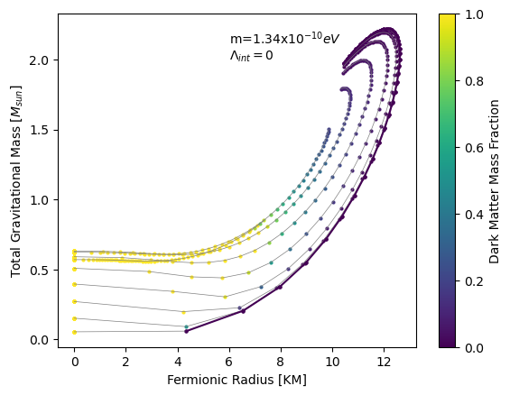
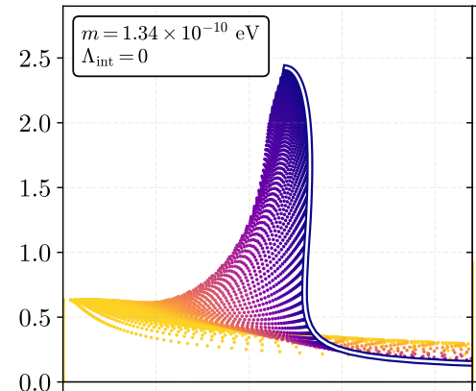
Comparing with their results
Total Gravitational Mass $M_{sun}$
Fermionic Radius [KM]
Fynn Diedrichs,et.al(2023)
Our results approaches quark star’s mass radius relation when dark matter mass fraction is low
but their solution approaches neutron star’s mass radius relation.

Slide 14
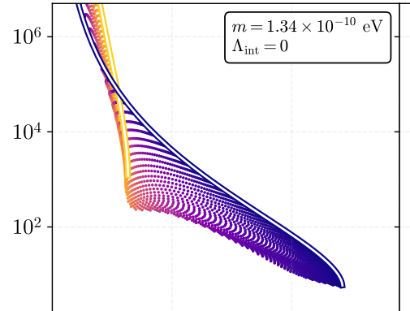
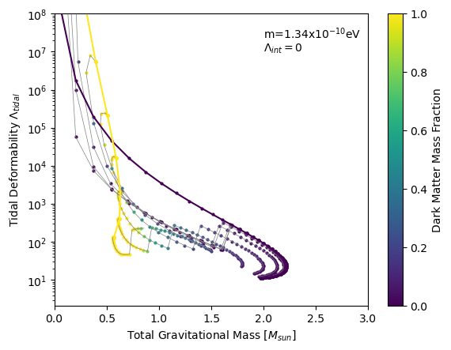
Comparing with their results
Tidal Deformability $Λ_{tidal}$
Total Gravitational Mass ${[M}_{sun}]$
Fynn Diedrichs,et.al(2023)
Our results almost same with them in tidal deformability.

Slide 15
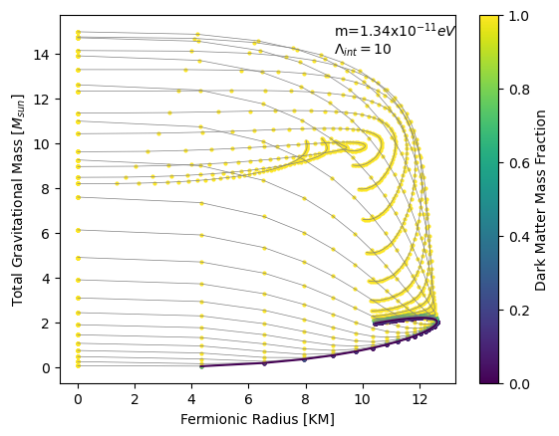
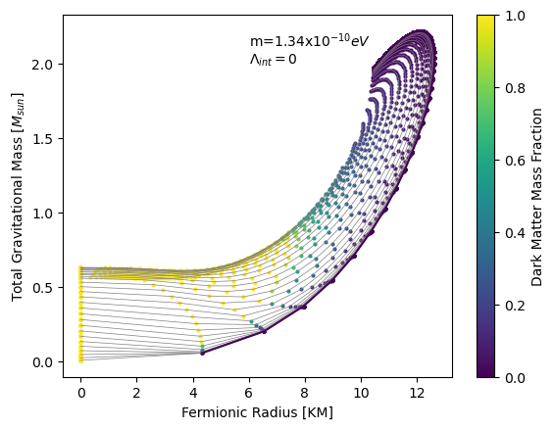
Comparing with different parameters
Lager effective selfinteraction parameter $Λ_{int}$ and lighter particle mass m causes
heavier total gravitational mass.

Slide 16
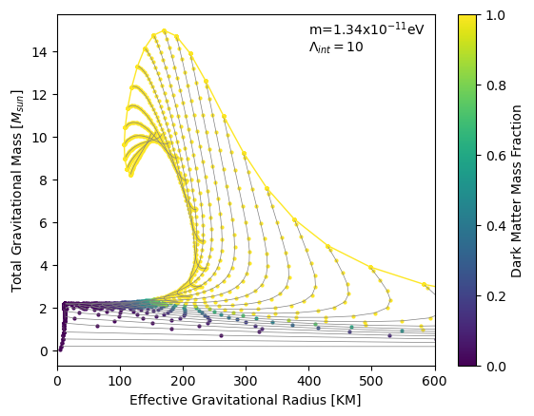
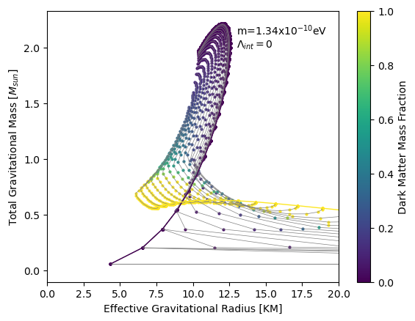
Comparing with different parameters
Lager effective selfinteraction parameter $Λ_{int}$ and lighter particle mass m also causes
Lager effective gravitational radius. We can see in the first case stars has a dark matter
halo outside and in second case stars has a dark matter core inside.

Slide 17
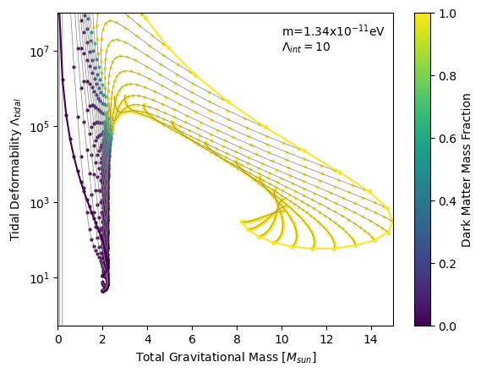
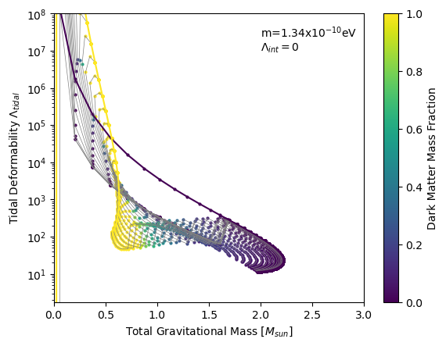
Comparing with different parameters
Lager effective selfinteraction parameter $Λ_{int}$ and lighter particle mass m causes
lager tidal deformability, because in the first case dark matter halo outside expand
effective gravitational radius and in second case dark matter core inside enhance
self gravity of stars .

Slide 18
Conclusion and prospect

Slide 19
Conclusion and prospects
We use this model to prove Horowitz’s idea about dark matter cores in compact stars.
We loose the constraints of tidal deformation on quark stars.
We will calculate the f mode in star quake of neutron stars and quark stars with scalar field in the future.

Slide 20
Thanks

