Slide 1
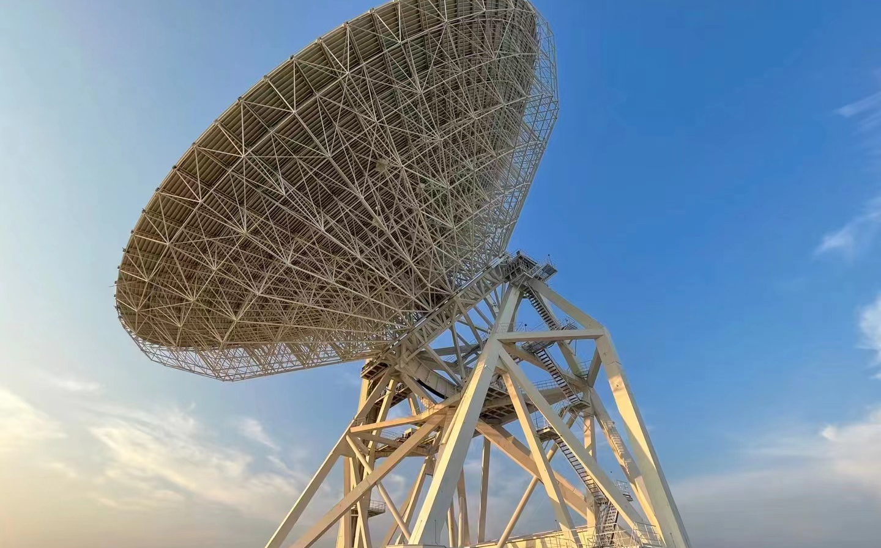
Simultaneous 2.25/8.60 GHz observations of the magnetar XTE J1810-197
Reporter:黄志鹏
Institution：Shanghai Astronomical Observatory, CAS
Co-author: 闫振，沈志强，仝号(GZHU)，袁建平(UAO)，林琳(BNU)，赵融冰，吴亚军，刘杰(GZHU)，王睿，王啸威

Slide 2
Contents
1. Background of magnetars and XTE J1810-197
2. Observation
3. Result
4. Summary

Slide 3
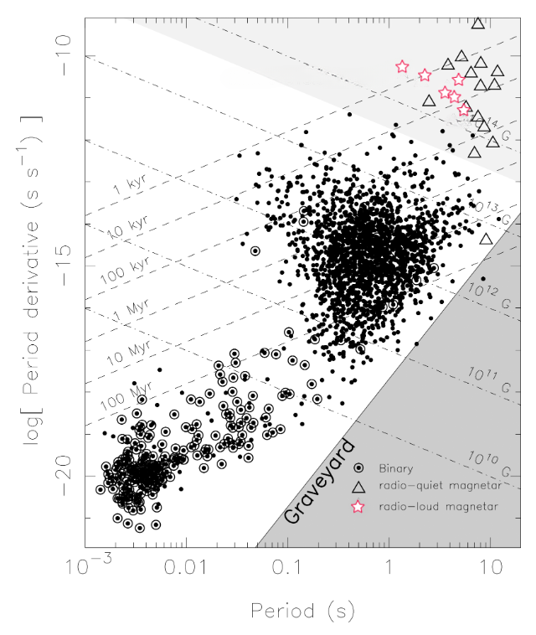
Background——Magnetars
32 magnetars: 18 SGRs (14 confirmed, 4 candidates), and 14 AXPs (12 confirmed, 2 candidate)
Powered by decay of magnetic fields
Strong magnetic fields: $>{6.1×10}^{12} G$
Long period: 1-12 s
Only 6 detected radio signal

Slide 4
Background ——XTE J1810-197
Found at X-ray band in 2003
First magnetar detected at the radio band in 2004 (transient radio pulsations )
Continued radio emission were also detected in 2006
Dimmed in late 2008
Reactivated in late 2018 at both X-ray and radio band
XTE J1810-197
Parameter | XTE J1810-197
Observation bands | X-ray, radio, infrared
DM | 178 ${cm}^{−3}pc$
Period | 5.54 s
$$B_{surf}$$ | $$2.1×{10}^{14} G$$
Active period | 2003-2008 2018-now

Slide 5
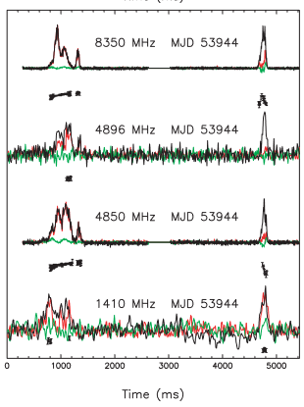
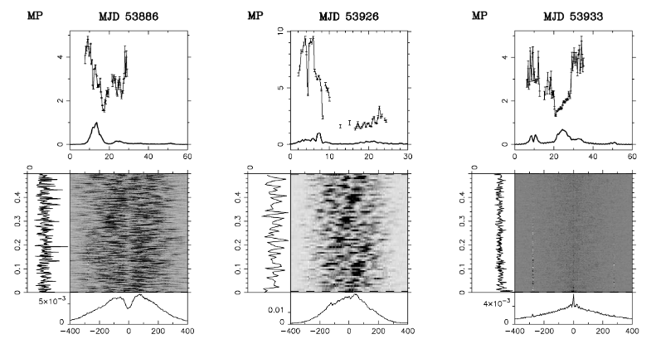
Background——XTE J1810-197 (2004-2008)
2006.08
2007.04
Variable integrated profile
Frequent and bright interpulse (IP)
Profile evolution with frequency
Spiky emission
2008.09
2008.09
Integrated profile at 2 GHz (Camilo et al. 2016)
Simultaneous multi-band observation on MJD 53944 (Kramer et al. 2007)

Slide 6
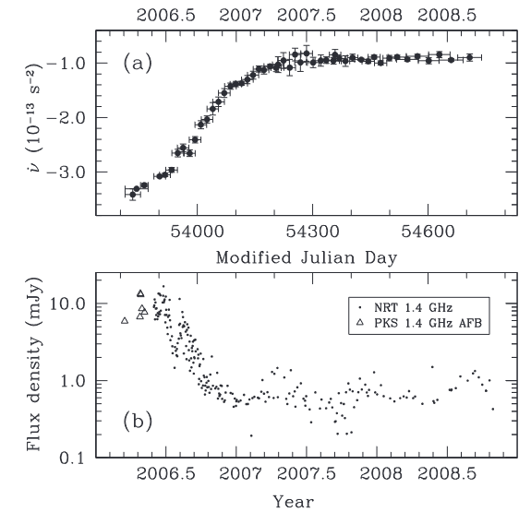
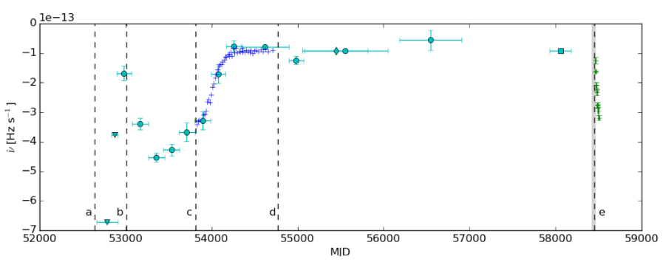
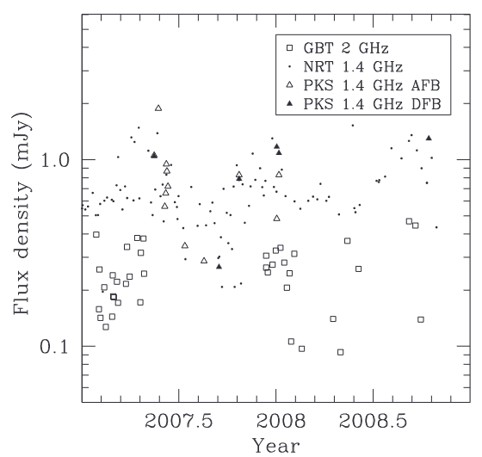
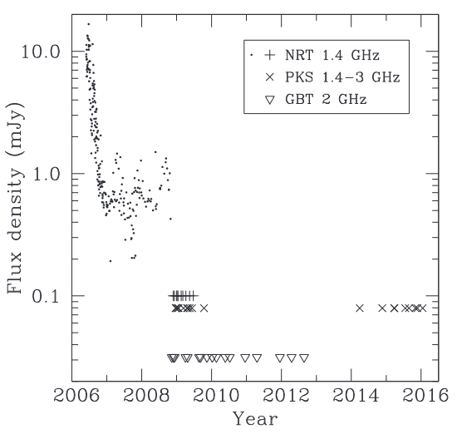
Background——XTE J1810-197 (2004-2008)
Last active period (2003-2008)
inactive period (2008-2018)
Spin-down history (Levin et al.2019)
$$α>−1.5$$
$$α≈−3$$
$\dot{υ}$ and flux in last active period (Camilo et al. 2016)
Flux density in active period and inactive period (Camilo et al. 2016)

Slide 7
XTE J1810-197
Before Reactivated on 2018.12.08
Reactivated on 2018.12.08
Integrated profile:
Variable
Frequent and bright IP
Spiky emission
$\dot{υ}$:
Stable increase trend in radio active period
Relatively stable during the inactive period
Flux density:
Downward trend
Spectral index:
Variable but relatively flat spectrum
Integrated profile:
Stable or variable?
Evolution with frequency?
$\dot{υ}$:
The trend the same for the two active periods?
Spectral index:
Stable in active period?

Slide 8
TMRT 2.25/8.60 GHz simultaneous observations
Observation range | MJD 58501-59427 UTC 2019.01.18-2021.08.01 (reactivate on 2018.12.08) Spin 926 days 194 observations
Frequency | S 2.20-2.30 GHz
 | X 8.20-9.00 GHz
Observation mode | incoherent de-dispersion and online-folding observation mode
Phase bin | 1024
Channel | 512
Sub-integration length | 30 s

Slide 9
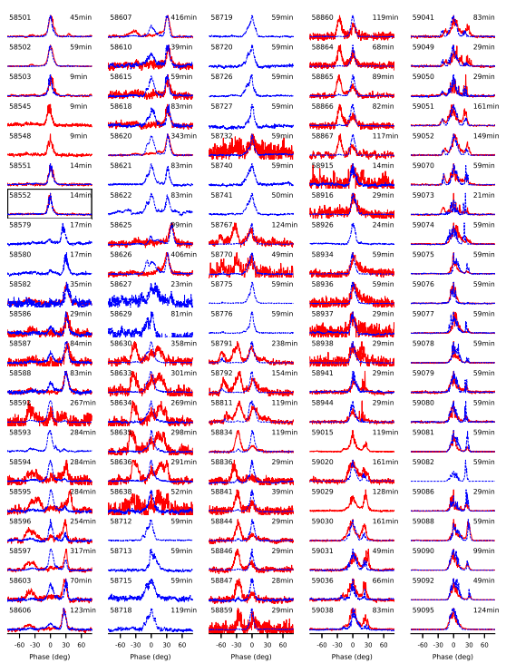
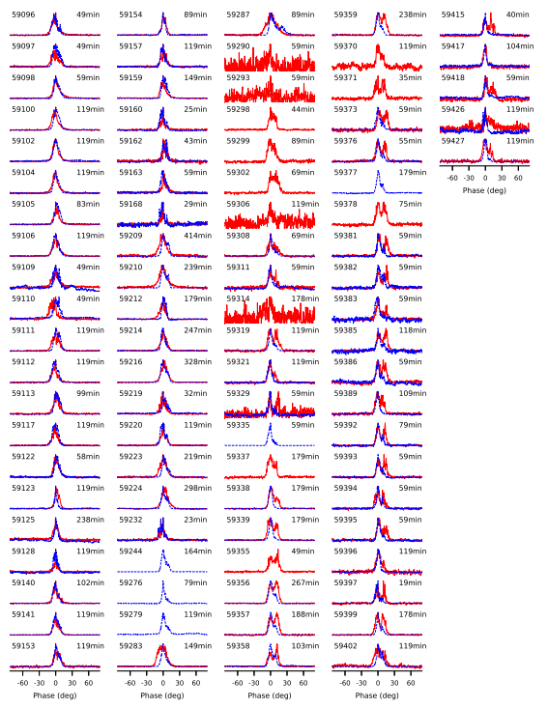
Integrated profile
Variable integrated profile
Relatively stable for a timescale from a few days to tens of days
Only possible interpulse (IP) at 8.60 GHz on MJD 58552
Red:
2.25 GHz
Blue:
8.60 GHz

Slide 10
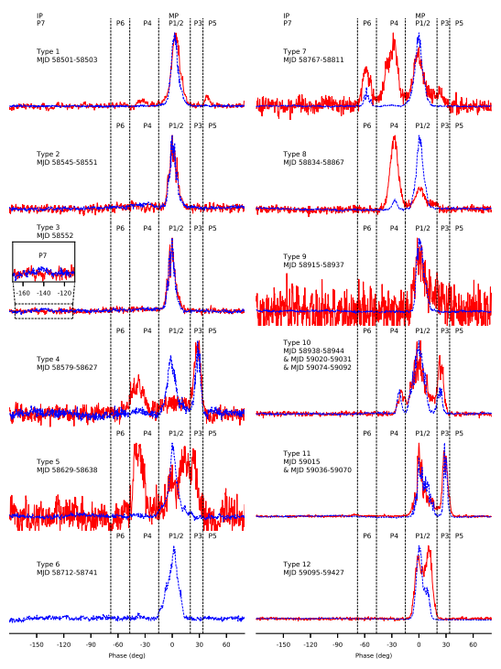
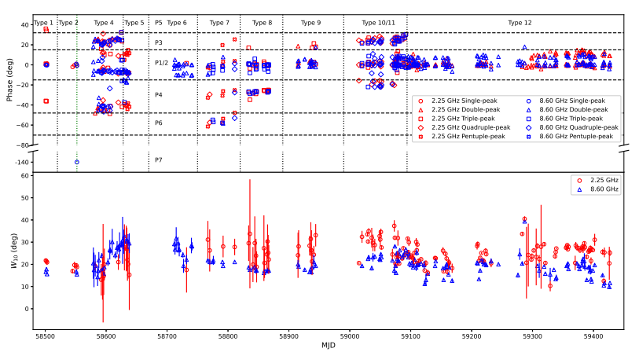
Integrated profile
IP inspection: DM 178→0 ${cm}^{−3}pc$; S/N 3.76→1.92
Different components change differently with frequency at the same time
Spiky pulse after MJD 59015

Slide 11
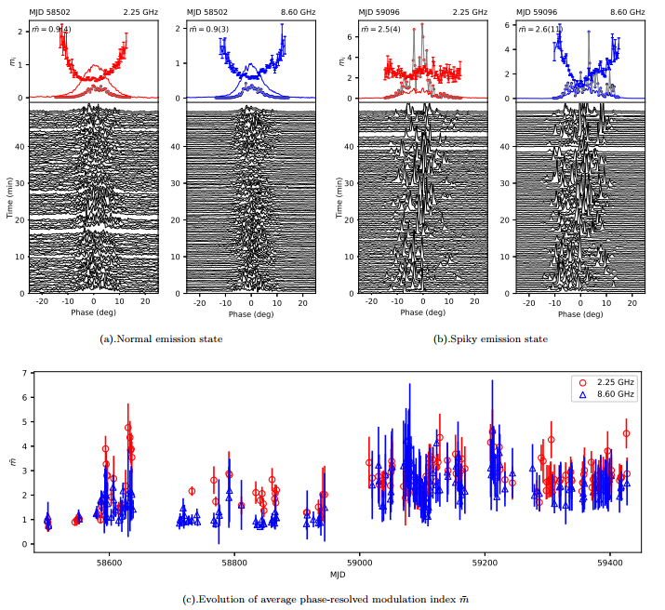
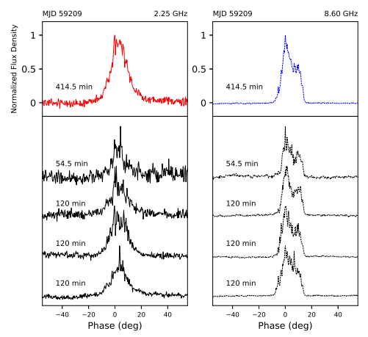
Profile changes on the short timescale
Integrated profile on 7 hours timescales at the spiky emission state on MJD 59209.
Example of emission state and evolution of average phase-resolved modulation index

Slide 12
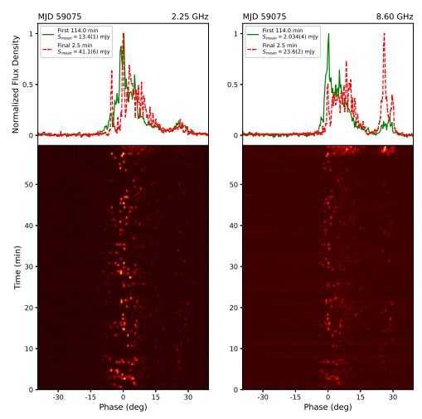
Profile changes on the short timescale
2.25 GHz
First 144 min 13.4(1) mJy
Final 2.5 min 41.1(6) mJy
8.60 GHz
First 144 min 2.034(4) mJy
Final 2.5 min 23.6(2) mJy
Abrupt variation on MJD 59075

Slide 13
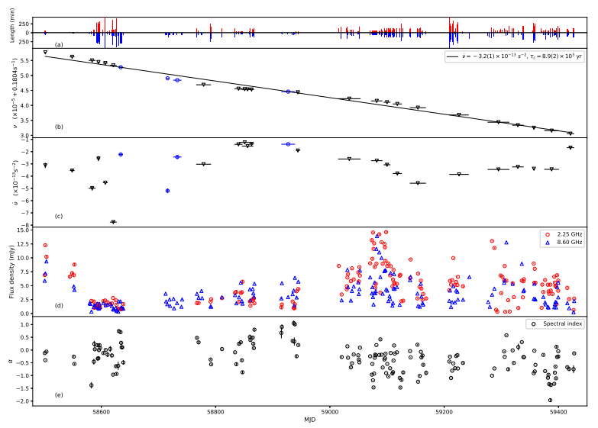
Timing, Flux density and Spectral index
Best fit $\dot{υ}$: $−3.2×{10}^{−13}s^{−2}$ Corresponding $τ_{c}=8.9×{10}^{3}yr$
Flux densities went through three stages: sharp decrease, stabilization and day-to-day fluctuations.
Relatively flat spectrum with α mostly (134/151) greater than −1.

Slide 14
Emission height
Ideal dipole magnetic field
Twisted dipole magnetic field
$7.5\left(9\right)×{10}^{4}km$ at 2.25 GHz
$2.38\left(7\right)×{10}^{4} km$ at 8.60 GHz
ρ represents the twist of the magnetic field, ρ = 1 for the dipole case and ρ = 0 for the split monopole case. (Tong 2019, Tong et al. 2021)

Slide 15
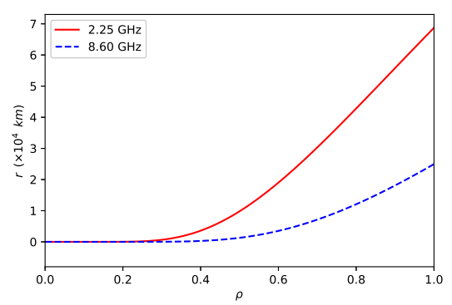
Emission height
ρ represents the twist of the magnetic field, ρ = 1 for the dipole case and ρ = 0 for the split monopole case.
The emission height reaches a maximum at the dipole case with ρ = 1, which is $7.5(9)×{10}^{4}$ and $2.38\left(7\right)×{10}^{4} km$ at 2.25 and 8.60 GHz, respectively.
Evolution of emission height r at 2.25 and 8.60 GHz with twist of the magnetic field ρ.

Slide 16
Summary
194 epochs of simultaneous 2.25/8.60 GHz observations of XTE J1810−197 in 926 d shortly following its re-activation in 2018
Classified integrated profiles into 12 types according to phase areas of active radiation components
One possible IP was detected at 8.60 GHz, although it was frequently detected during the last active period
Long-term evolution of $\overline{m}$ and emission switch around MJD 59015
Long-term evolution of $υ, \dot{υ},$flux density and spectral index
Emission height

Slide 17
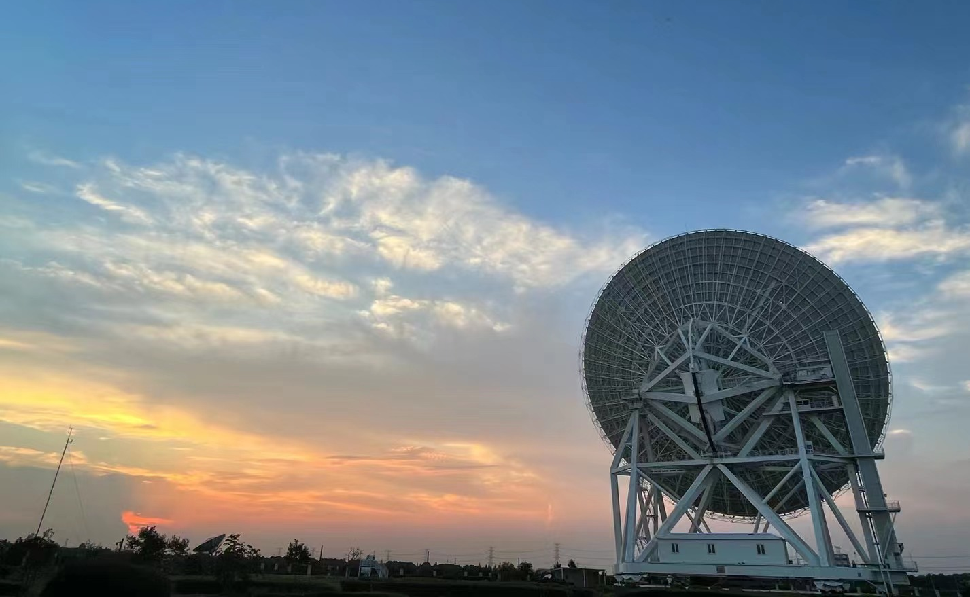
Thanks！

