Slide 1
Studys of timing and scintillation for pulsars in M3
李保达(BaodaLi)
Guizhou University
cooperator：Liyun Zhang、Zhichen Pan、Jumei Yao、Lei Qian、Yifeng Li、Minghui Li
Nanyang 2023.7.4

Slide 2
Outline
Pulsars in M3
Scintillation in M3
Conclusion

Slide 3
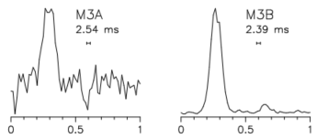
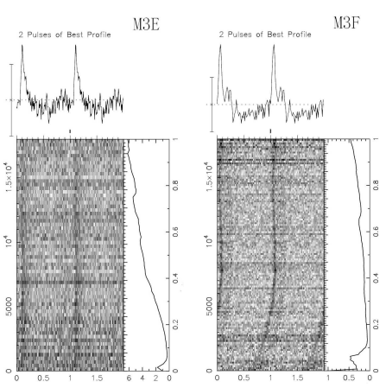
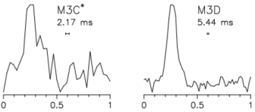
Pulsars in M3
NGC5272 (M3)，galactic longitude 42.22°，galactic latitude78.71°，distance 10.2 kpc^{[1]}.
certified (M3A, B, D, E and F), need confirmation (M3C).
Pulse profiles of M3A, B, C and D ( Hessels et al. 2007 )
Pulse profiles of M3E and M3F( Pan et al. 2020 )
[1]https://people.smp.uq.edu.au/HolgerBaumgardt/globular/fits/ngc5272.html

Slide 4
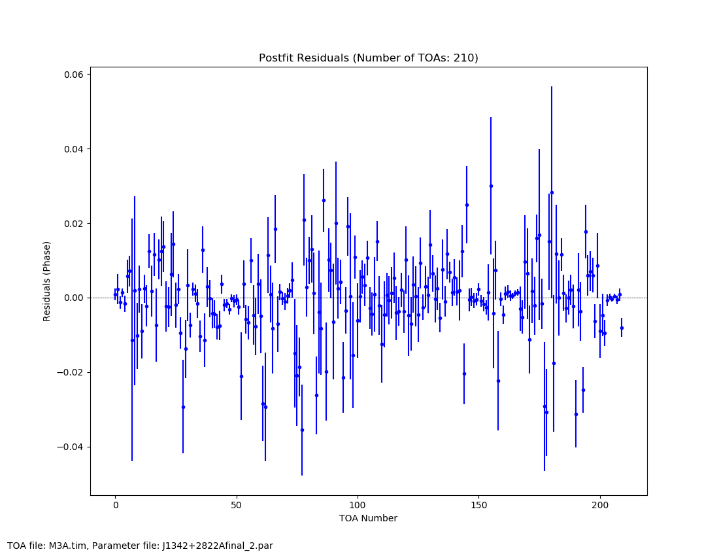
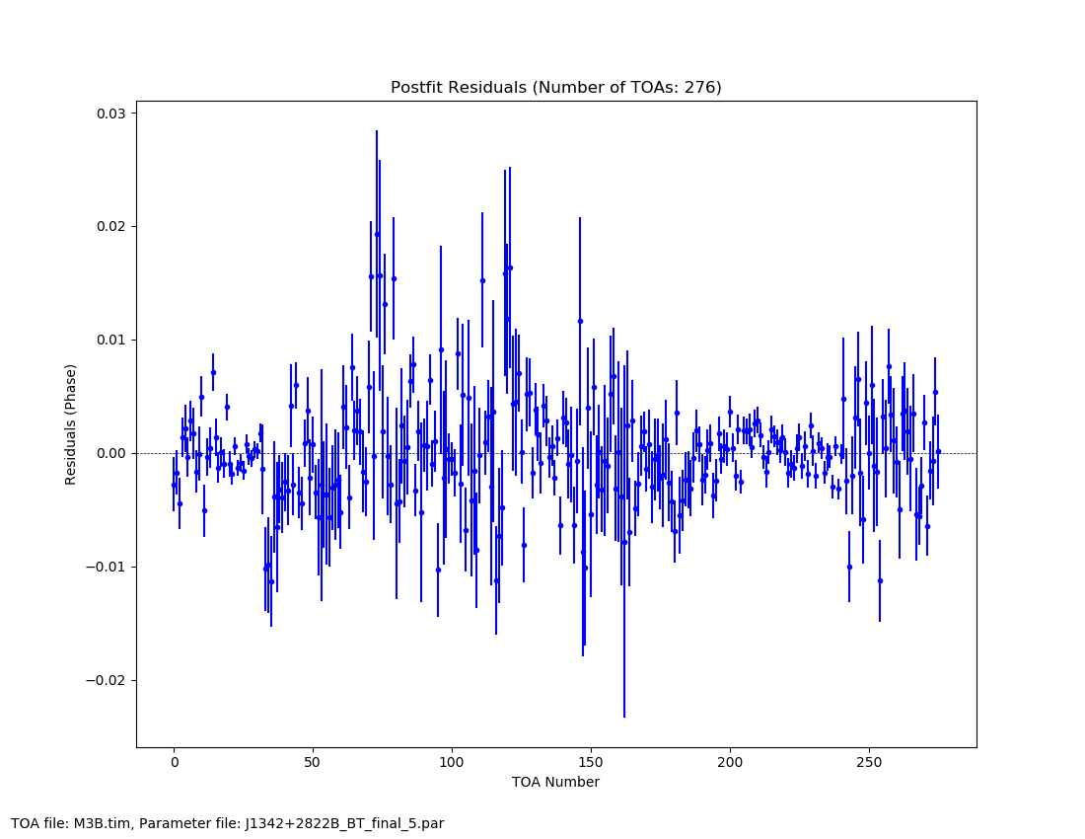
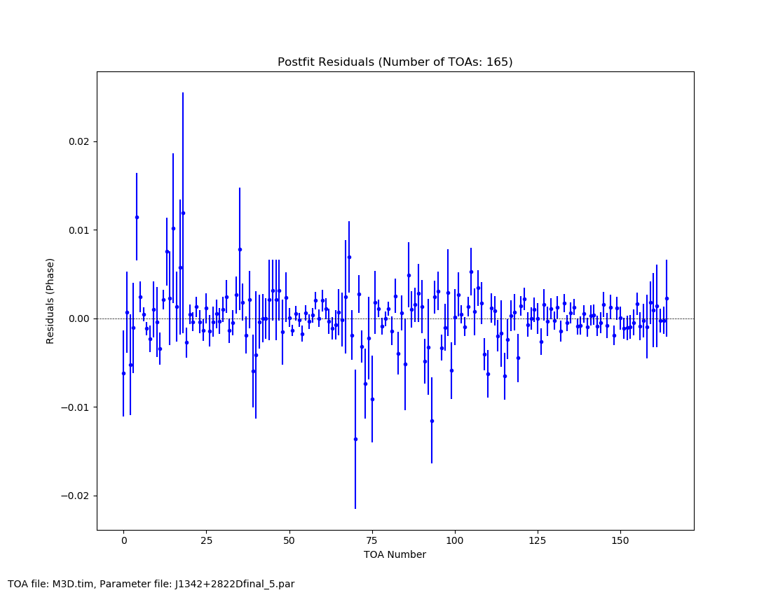
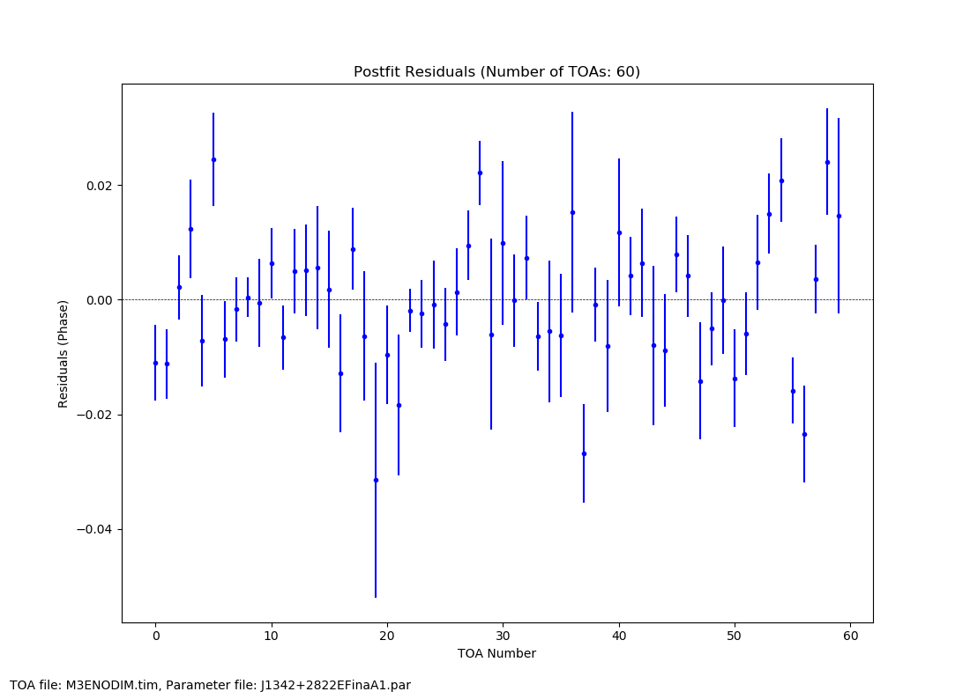
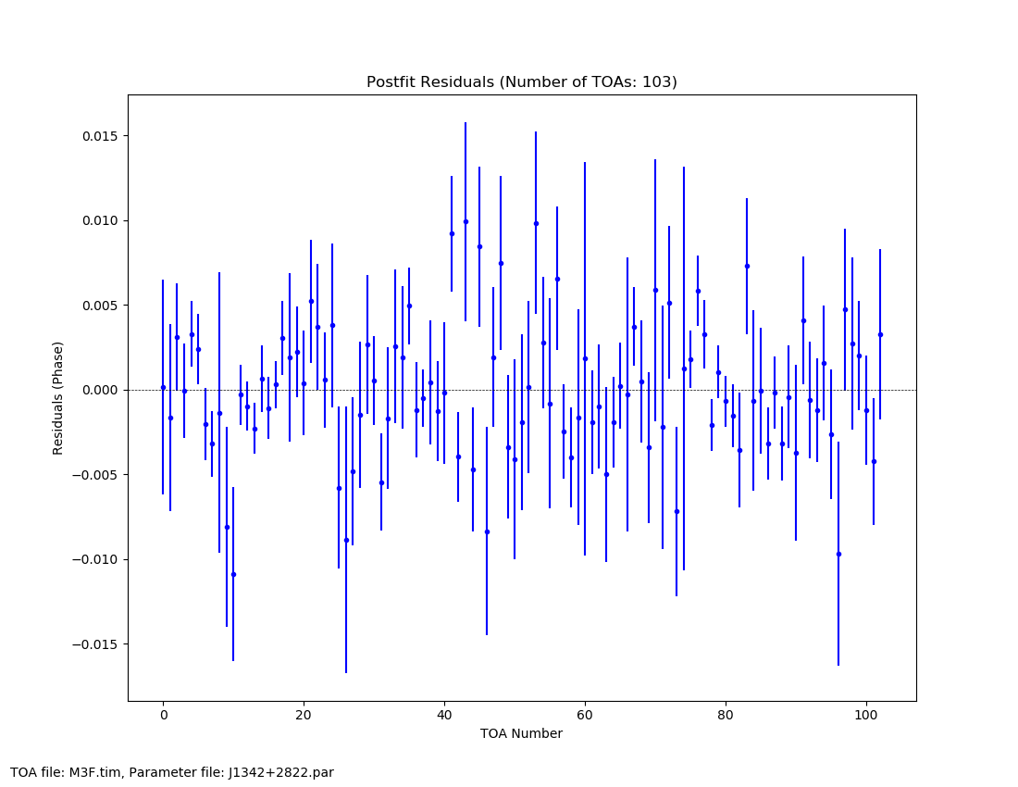
Timing residuals of pulsars in M3
M3A
M3B
M3D
M3E
M3F
Li et al. in prep

Slide 5
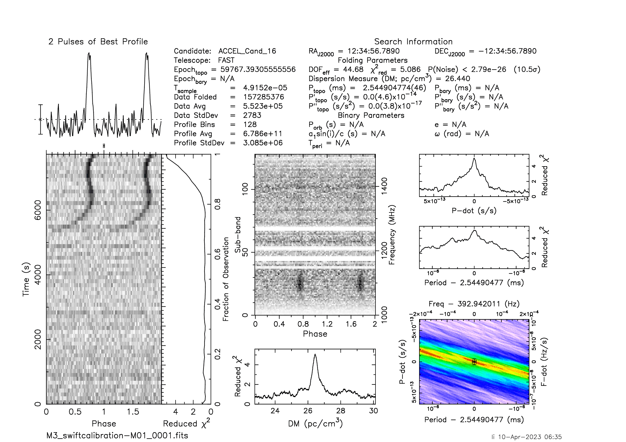
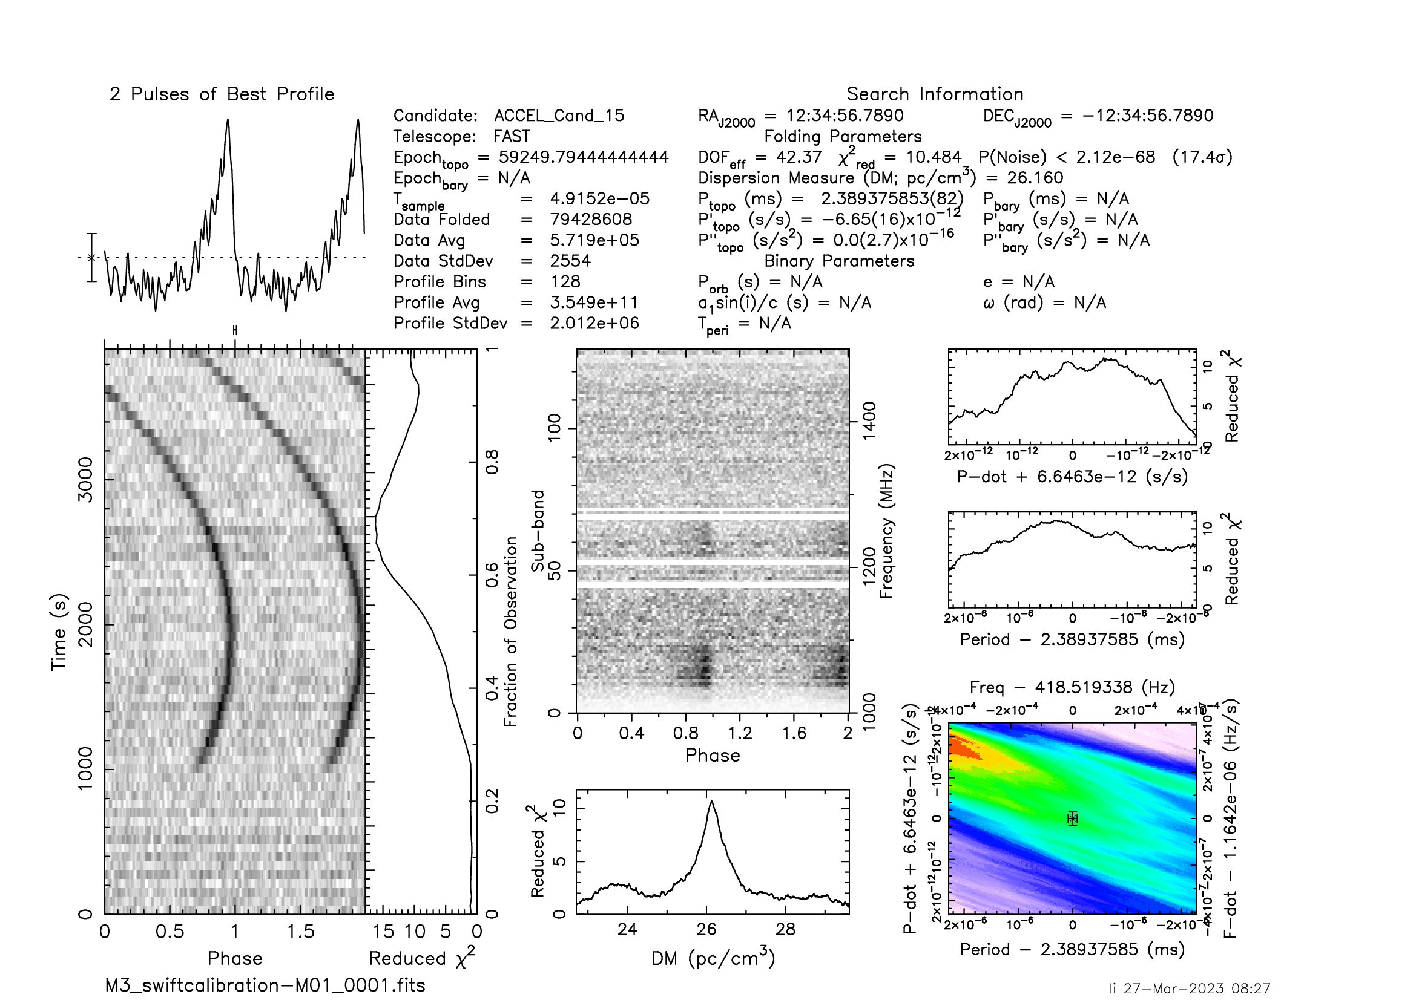
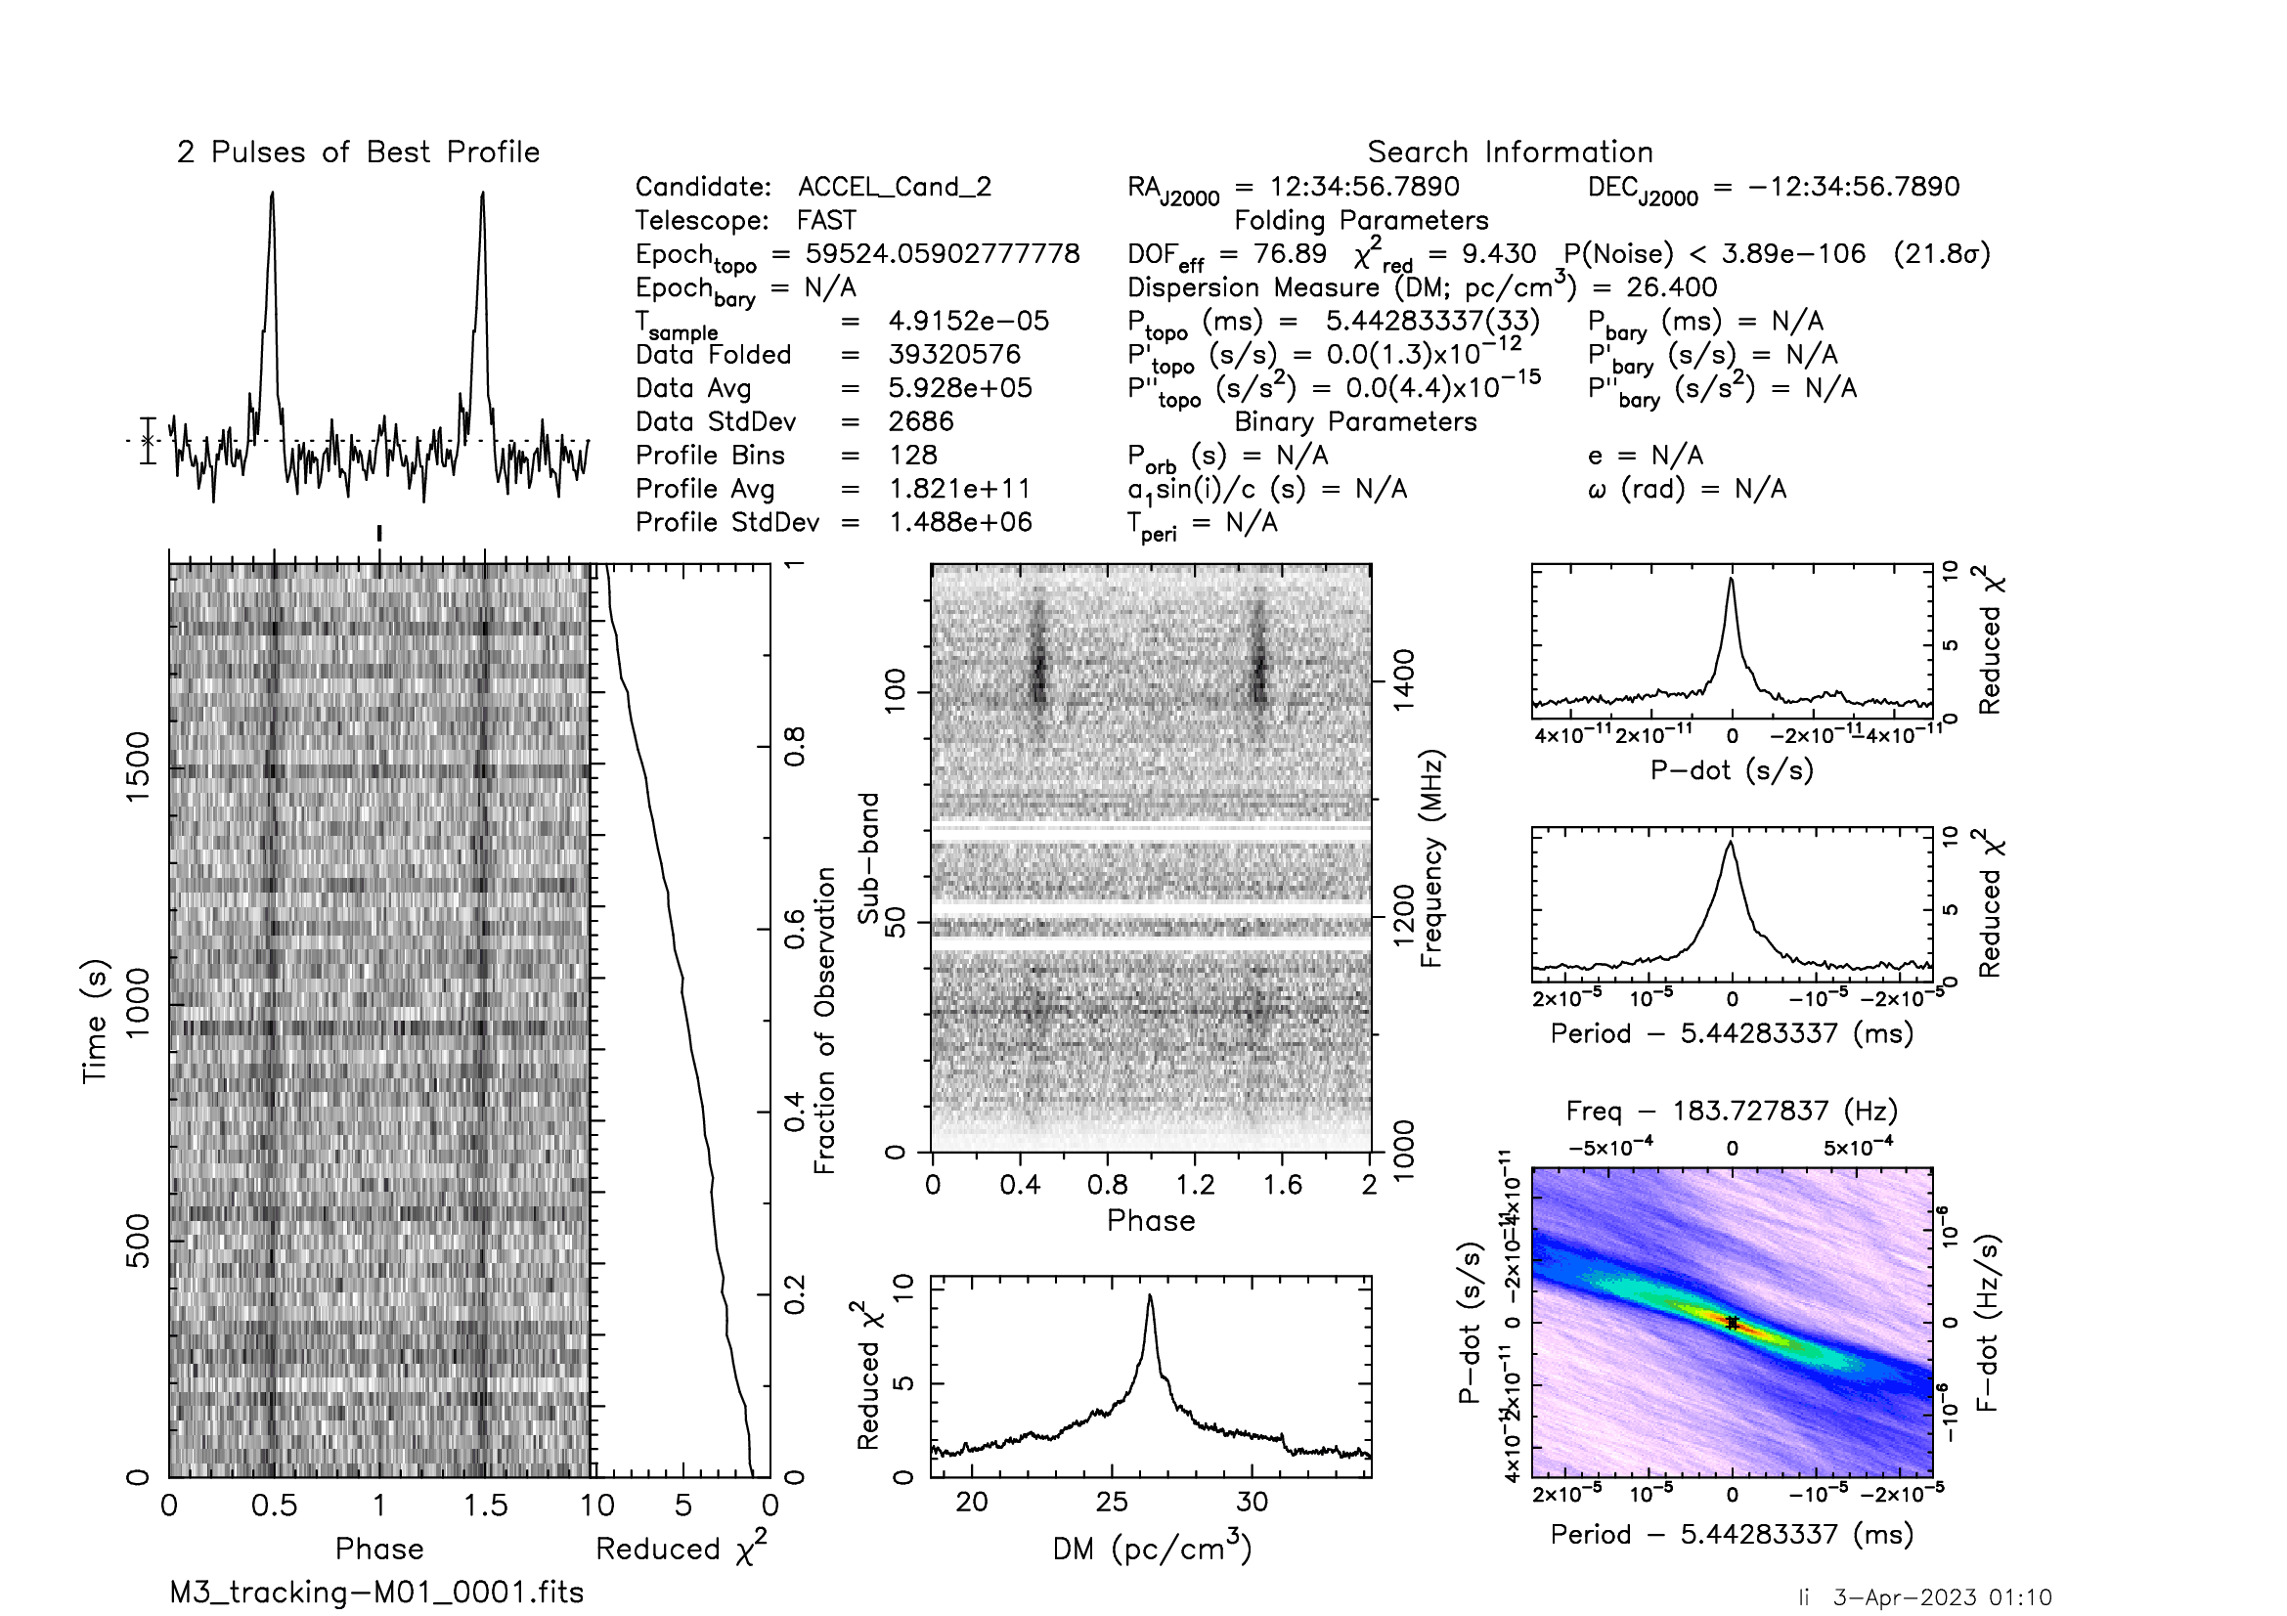
Pulsars in M3
M3A
M3B
M3D
Name | Period (ms) | DM (pc/cm3) | Porbit (days) | Min MC (0.21 M⊙) | References
M3A | 2.545 | 26.5 | 0.136 | 0.0125 | Hessels et al. 2007; Pan et al. 2020
M3B | 2.389 | 26.2 | 1.4 | 0.21 | Hessels et al. 2007
M3D | 5.44 | 26.3 | 129 | 0.21 | Hessels et al. 2007

Slide 6
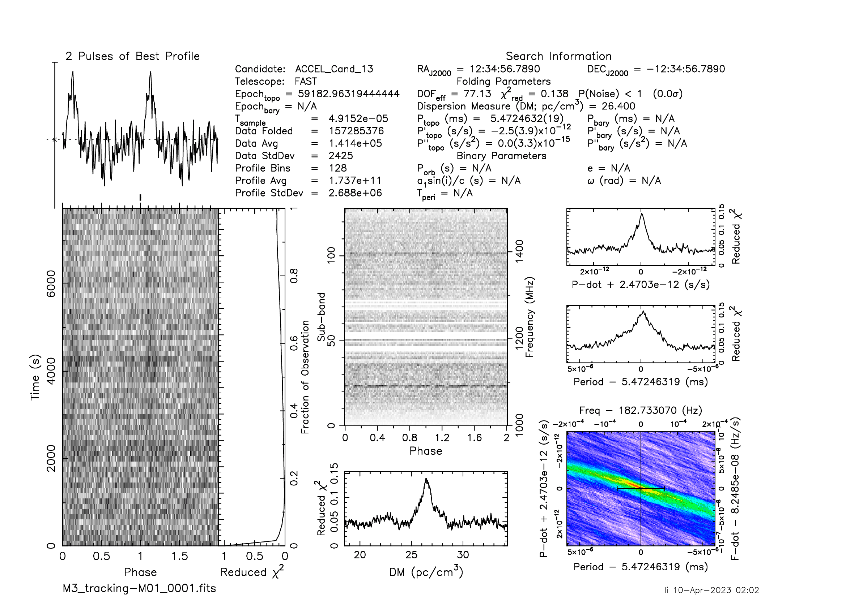
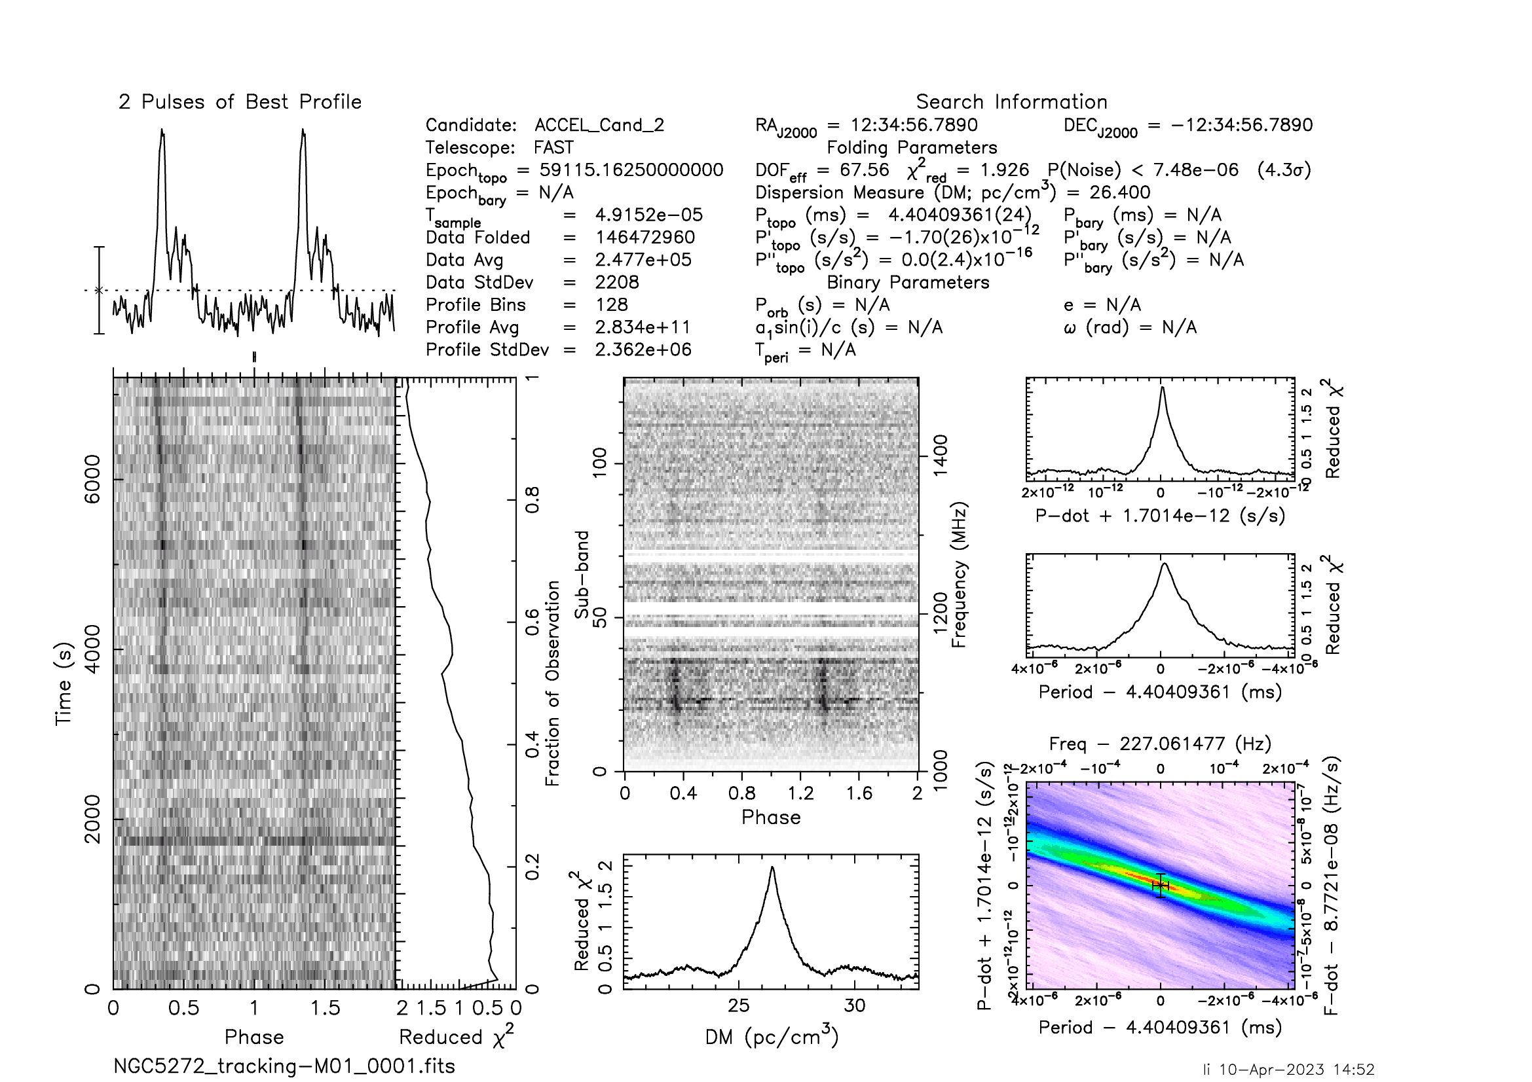
Pulsars in M3
M3E
M3F
Name | Period (ms) | DM (pc/cm3) | Porbit (days) | Min MC (0.21 M⊙) | References
M3E | 5.472 | 26.541 | 7.097 | 0.203 | Pan et al. 2020; Li et al. in prep
M3F | 4.404 | 26.467 | 2.992 | 0.147 | Pan et al. 2020; Li et al. in prep

Slide 7
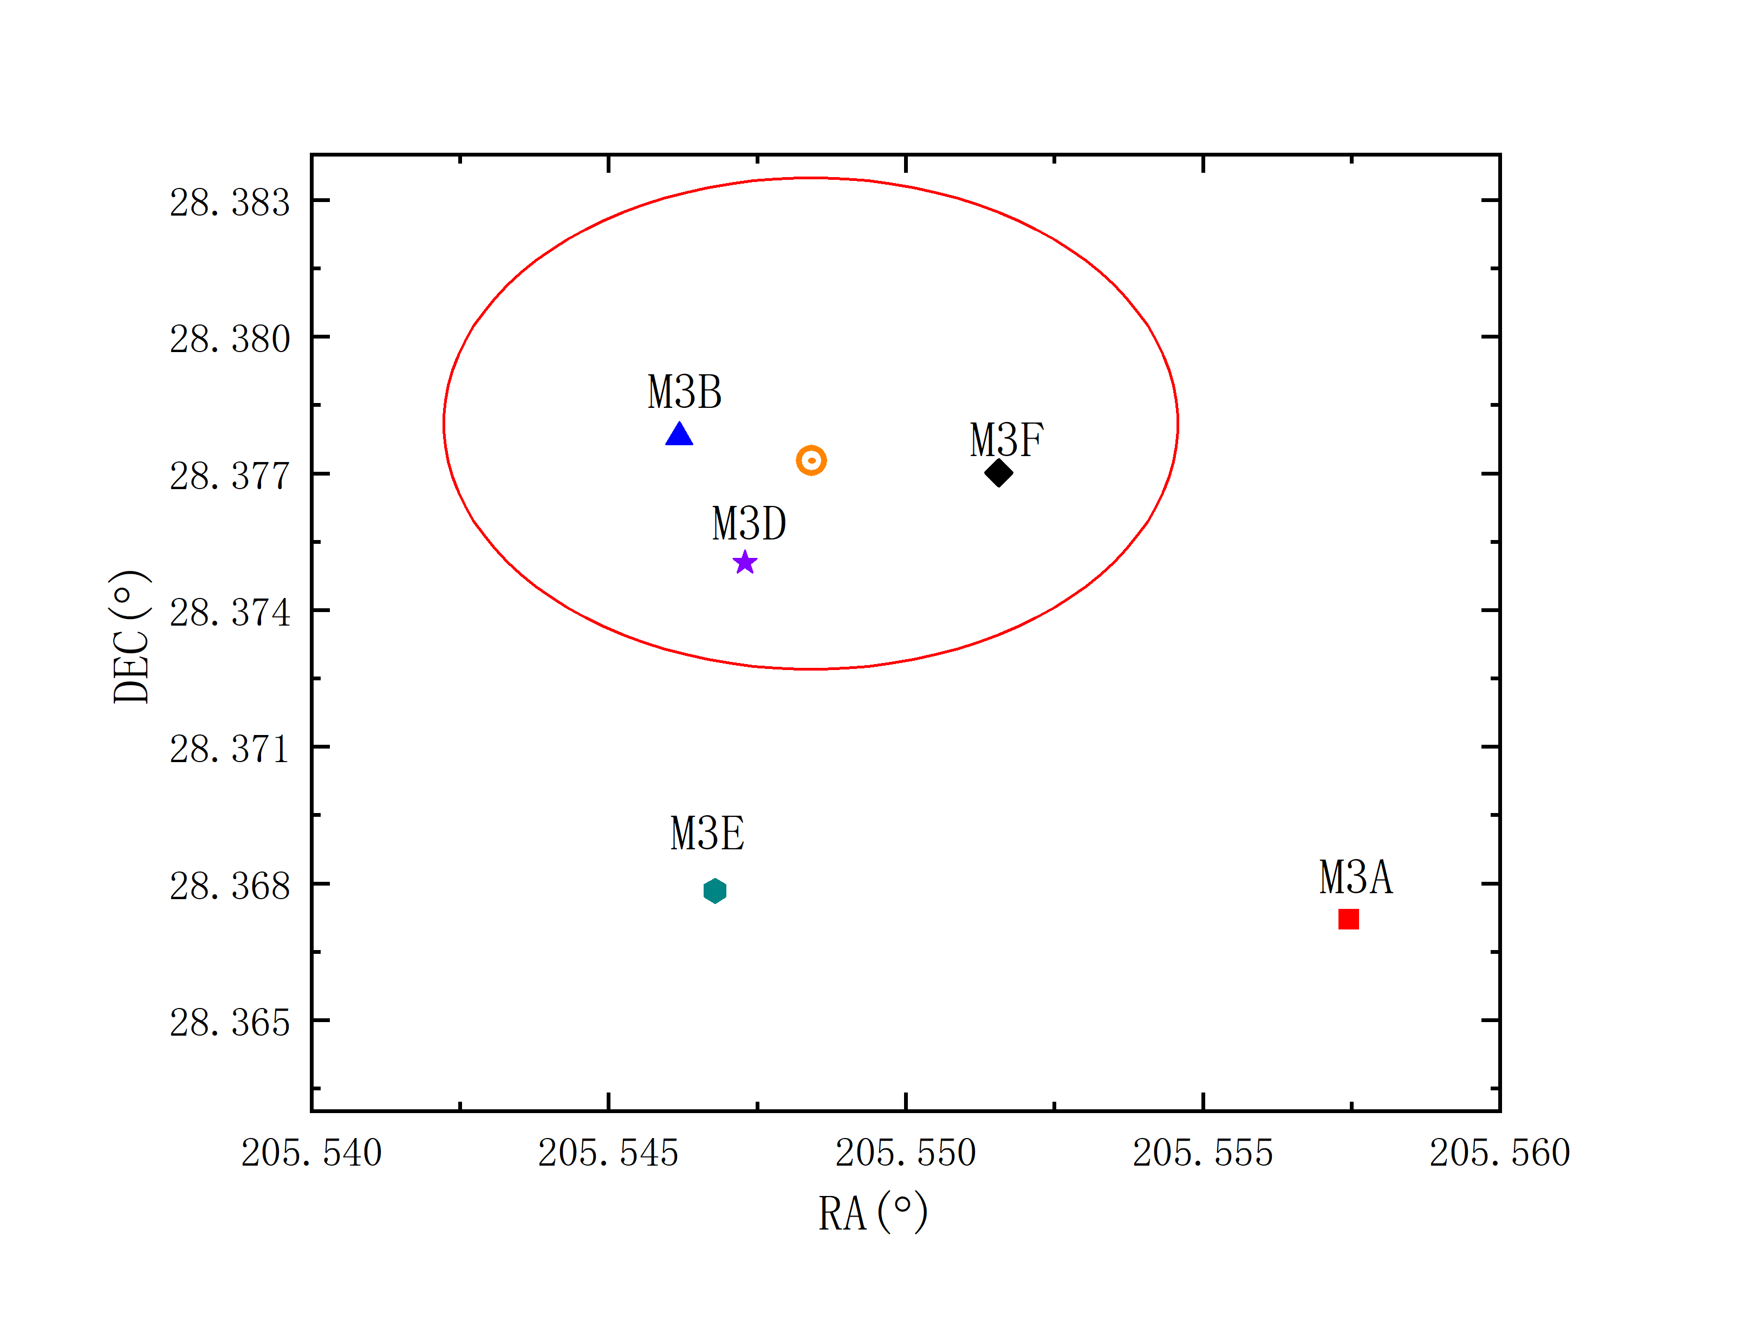
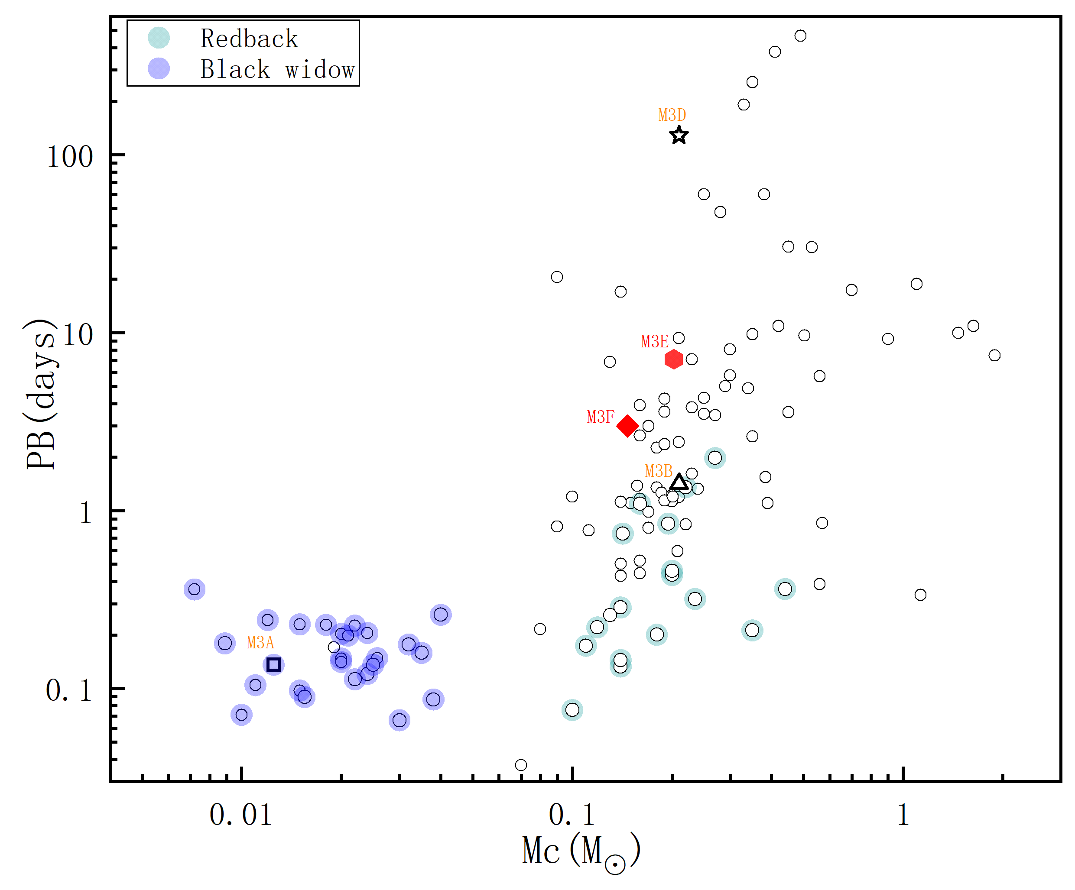
Pulsars in M3
Position
Companion mass and orbital period
Li et al. in prep

Slide 8
Detection rate of 41 observationsin M3
Name | Hessels et al. 2007 Det./Bbs.(%) | FAST archive data Det./Obs.(%)
M3A | 3/78 | 26/41
M3B | 16/78 | 37/41
M3D | 12/78 | 30/41
M3E | / | 17/41
M3F | / | 31/41
M3C ? | 1/78(Uncertified) | 0/41

Slide 9
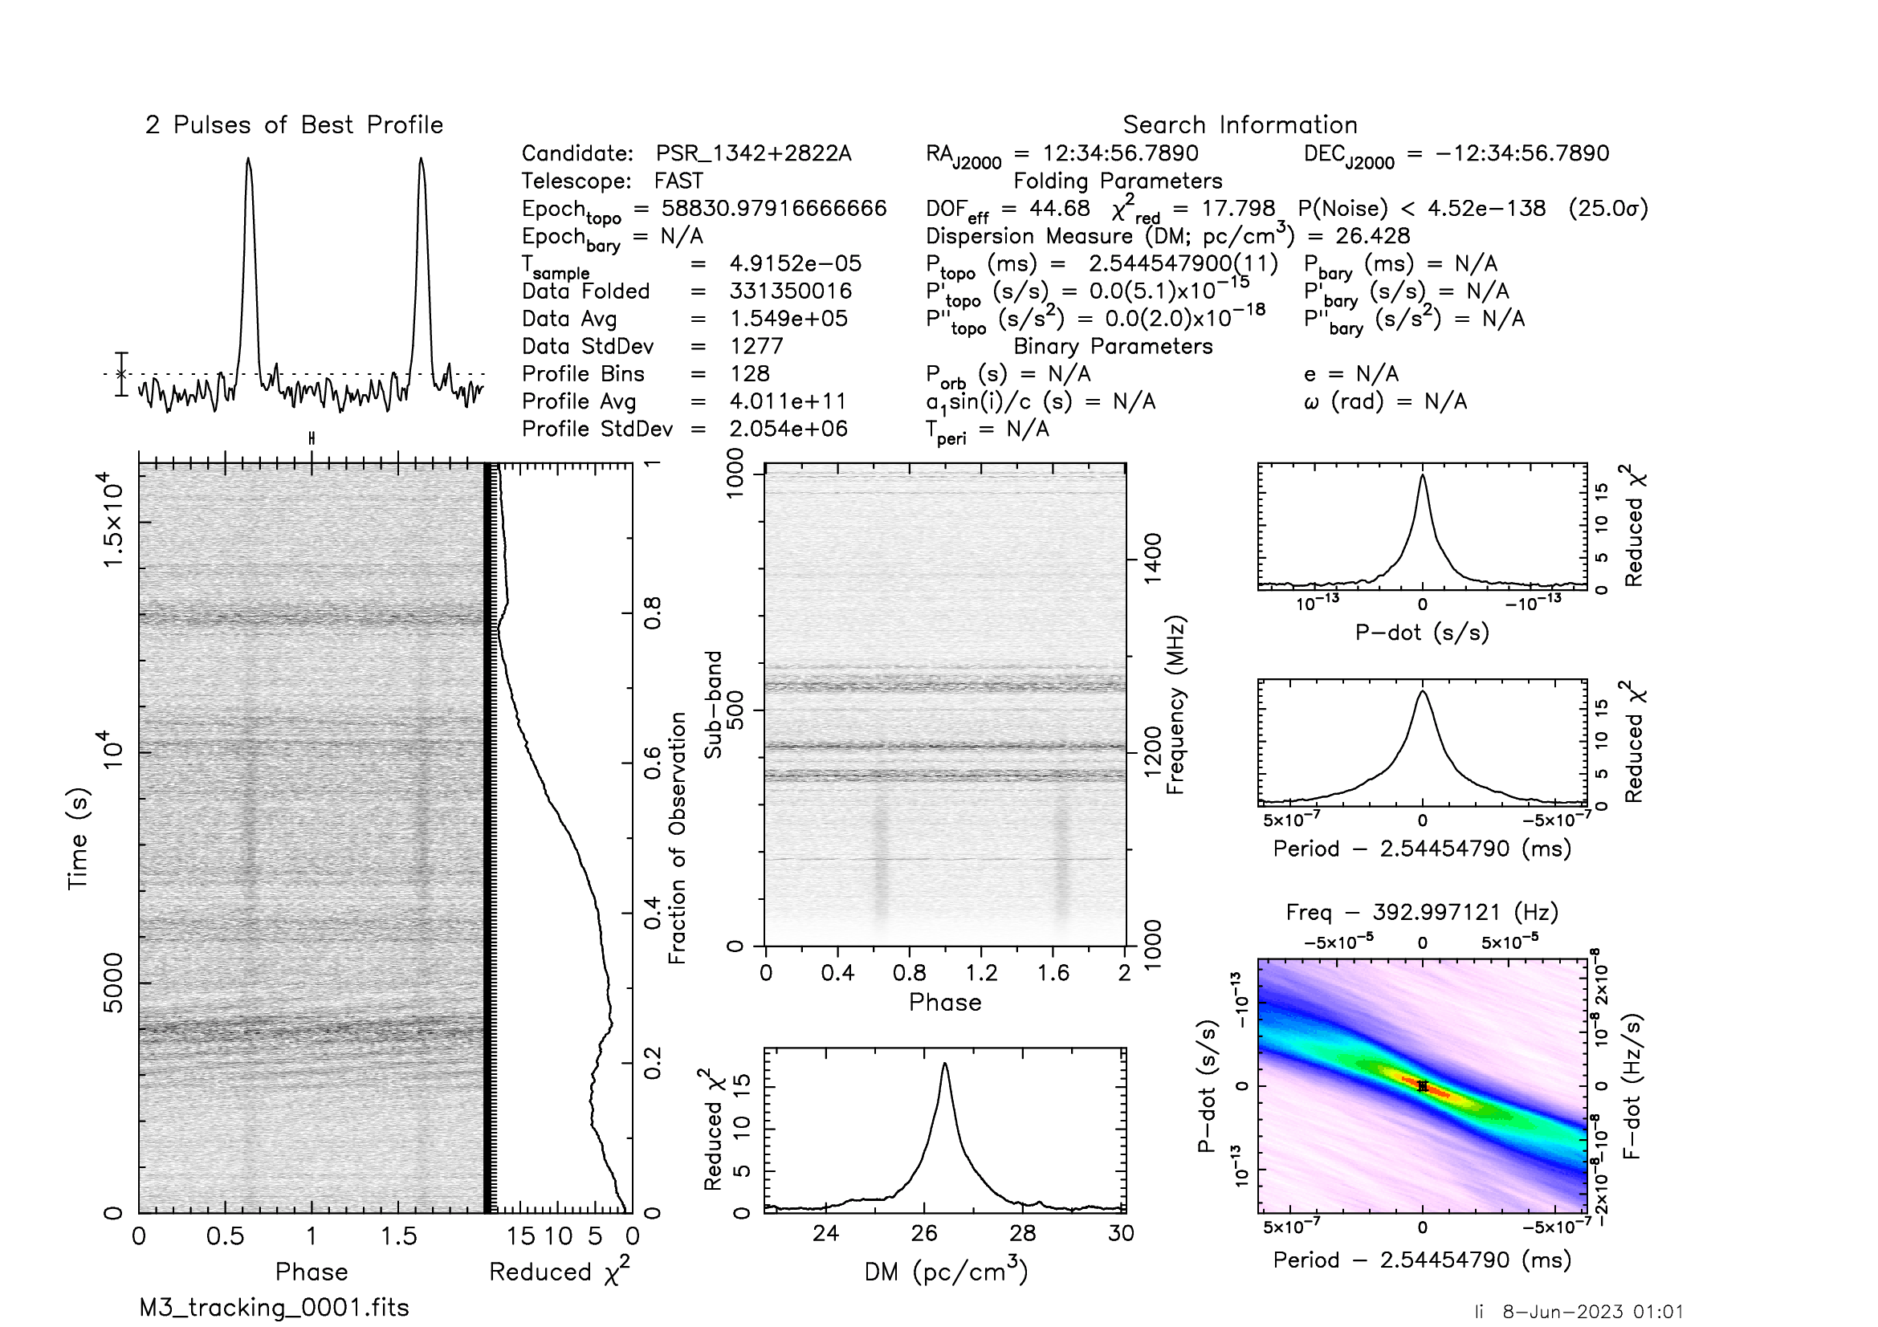
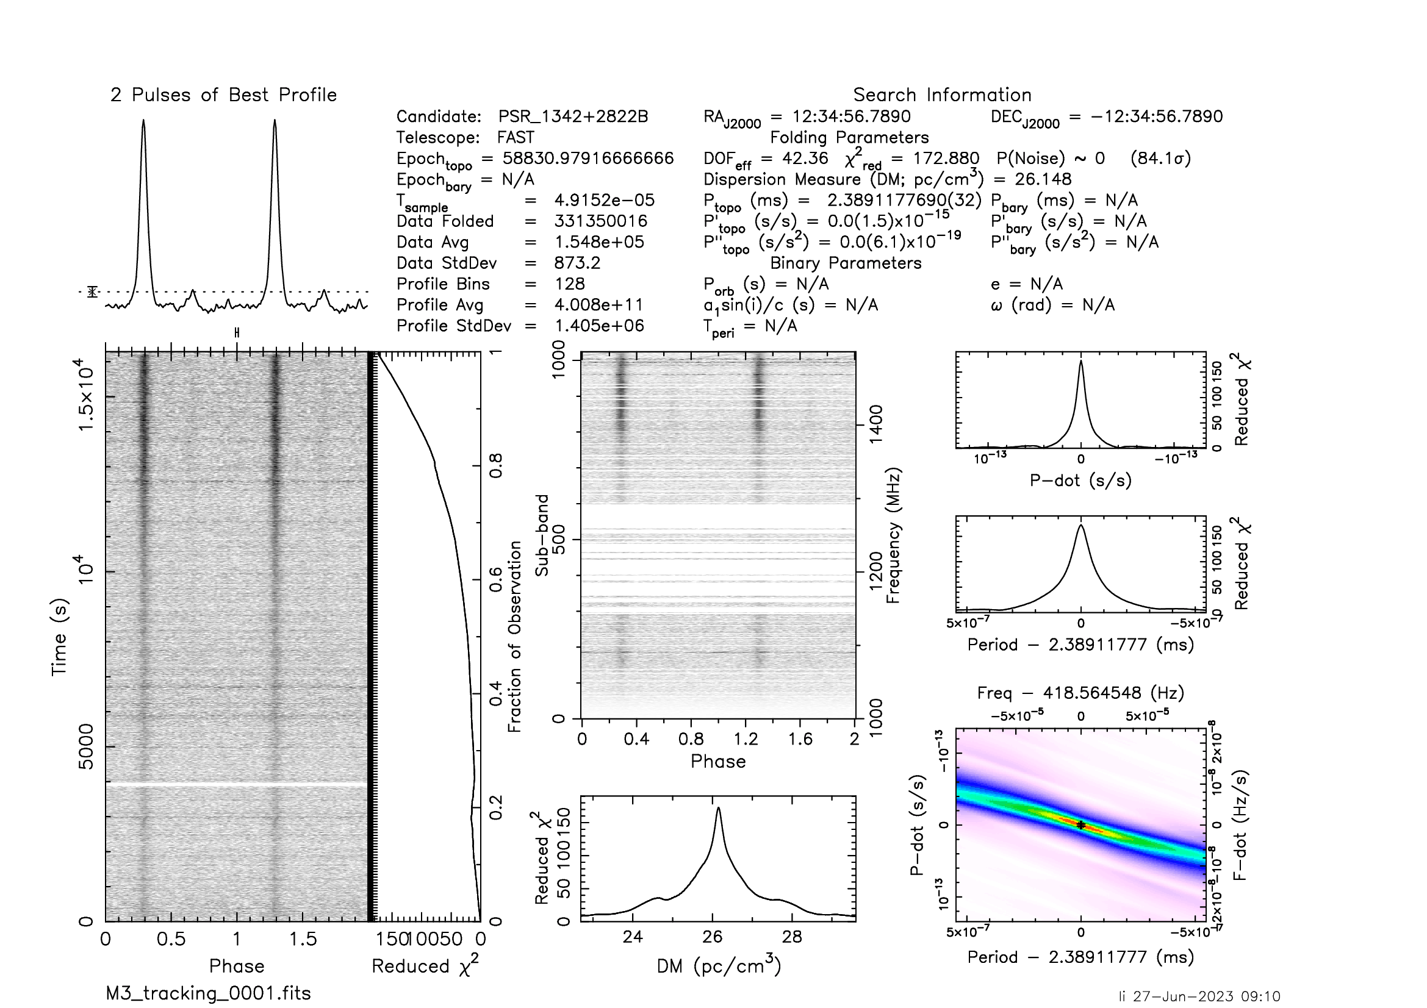
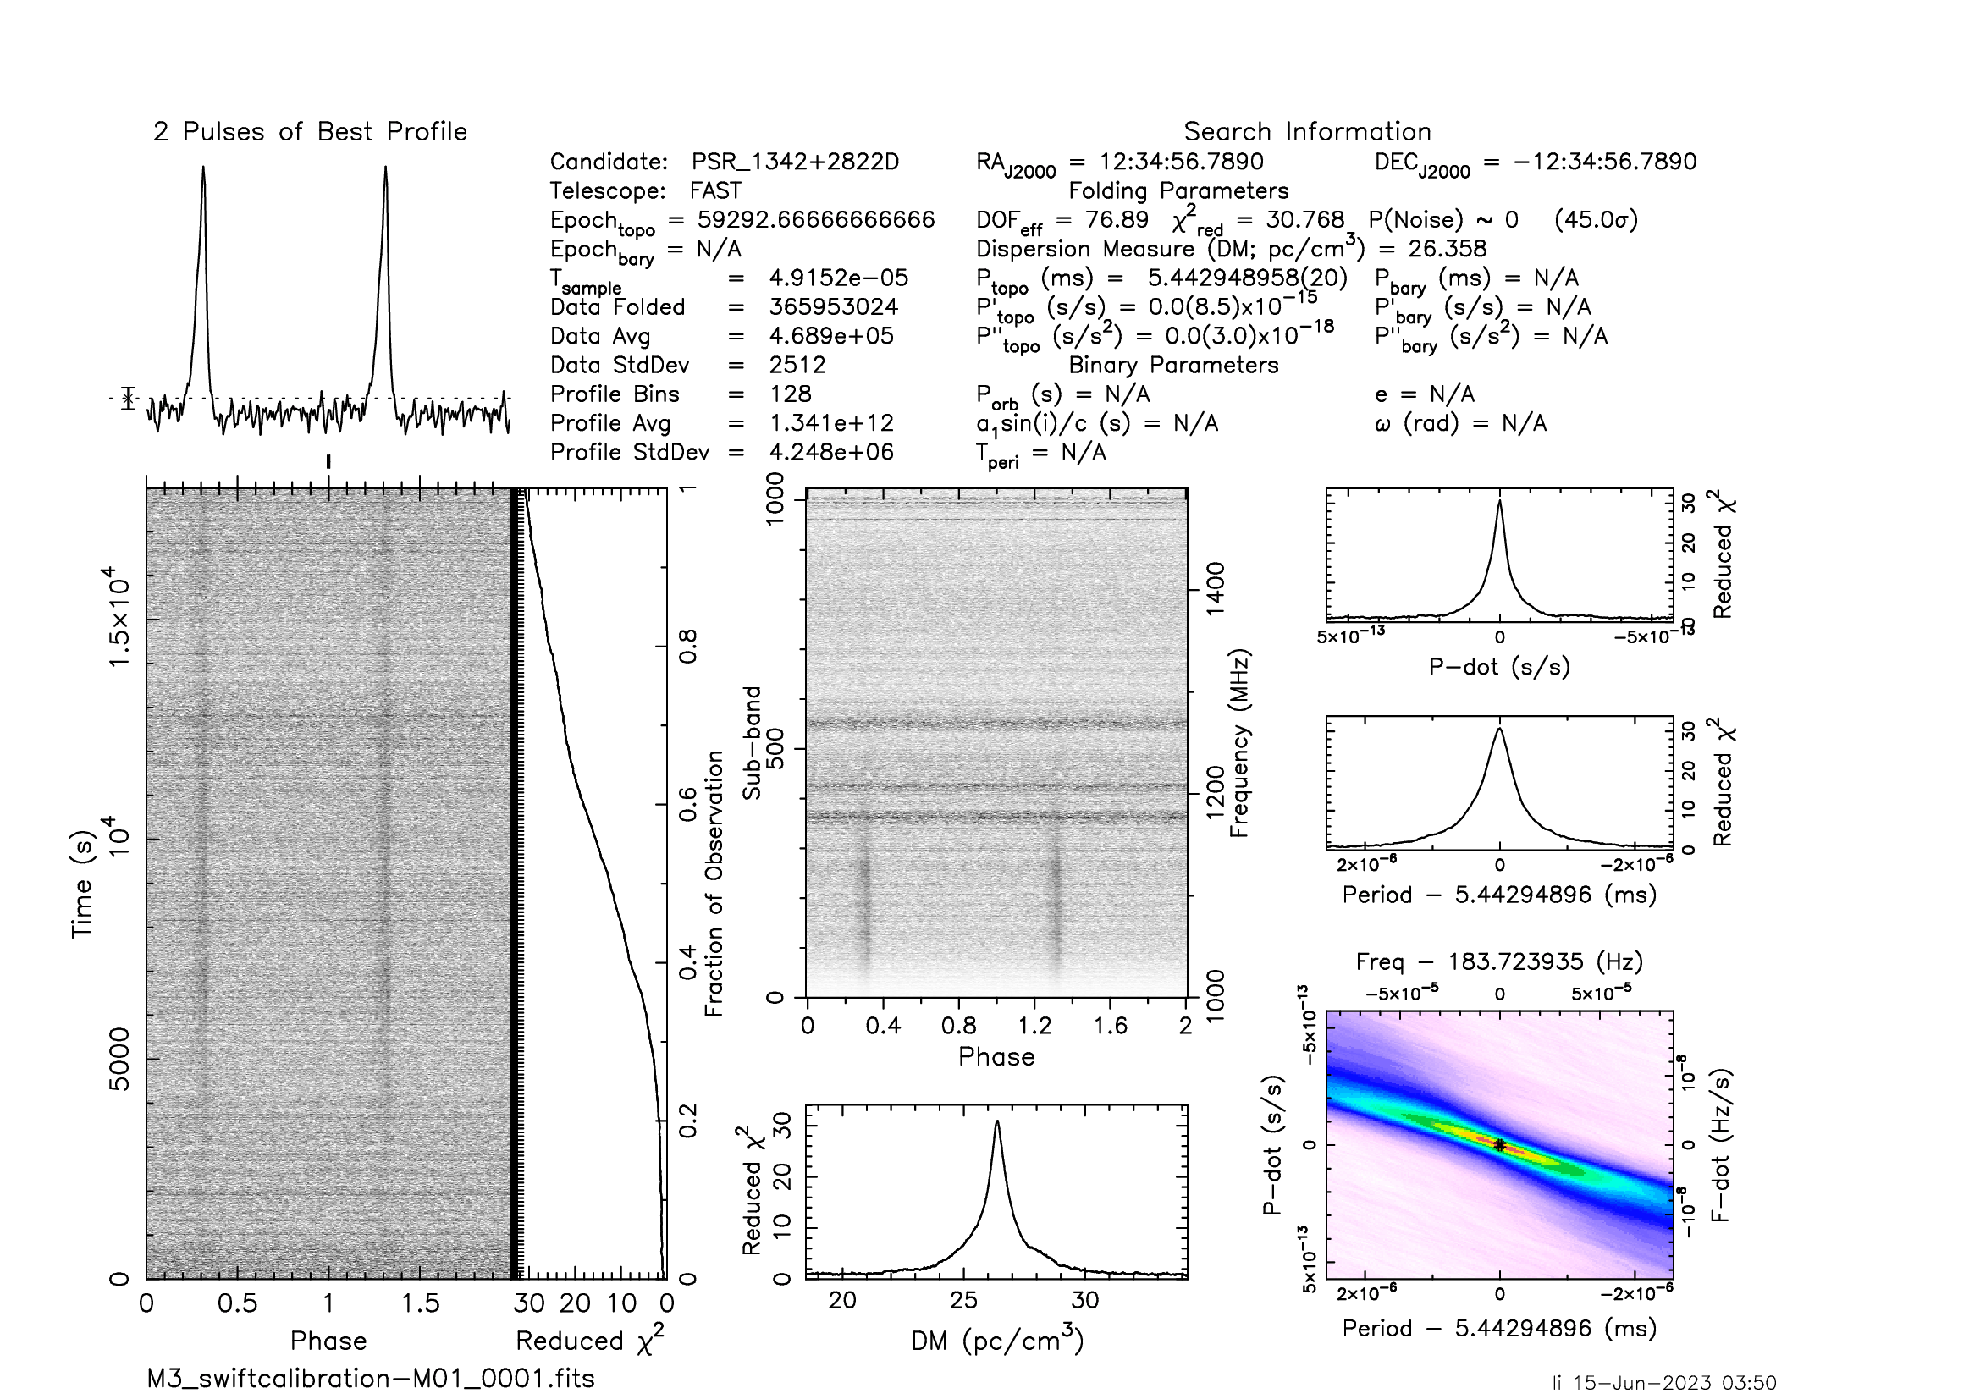
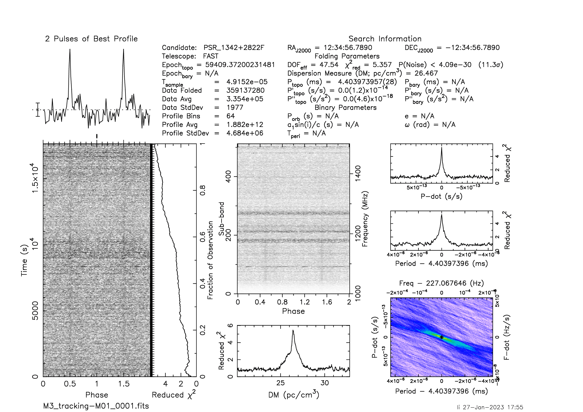
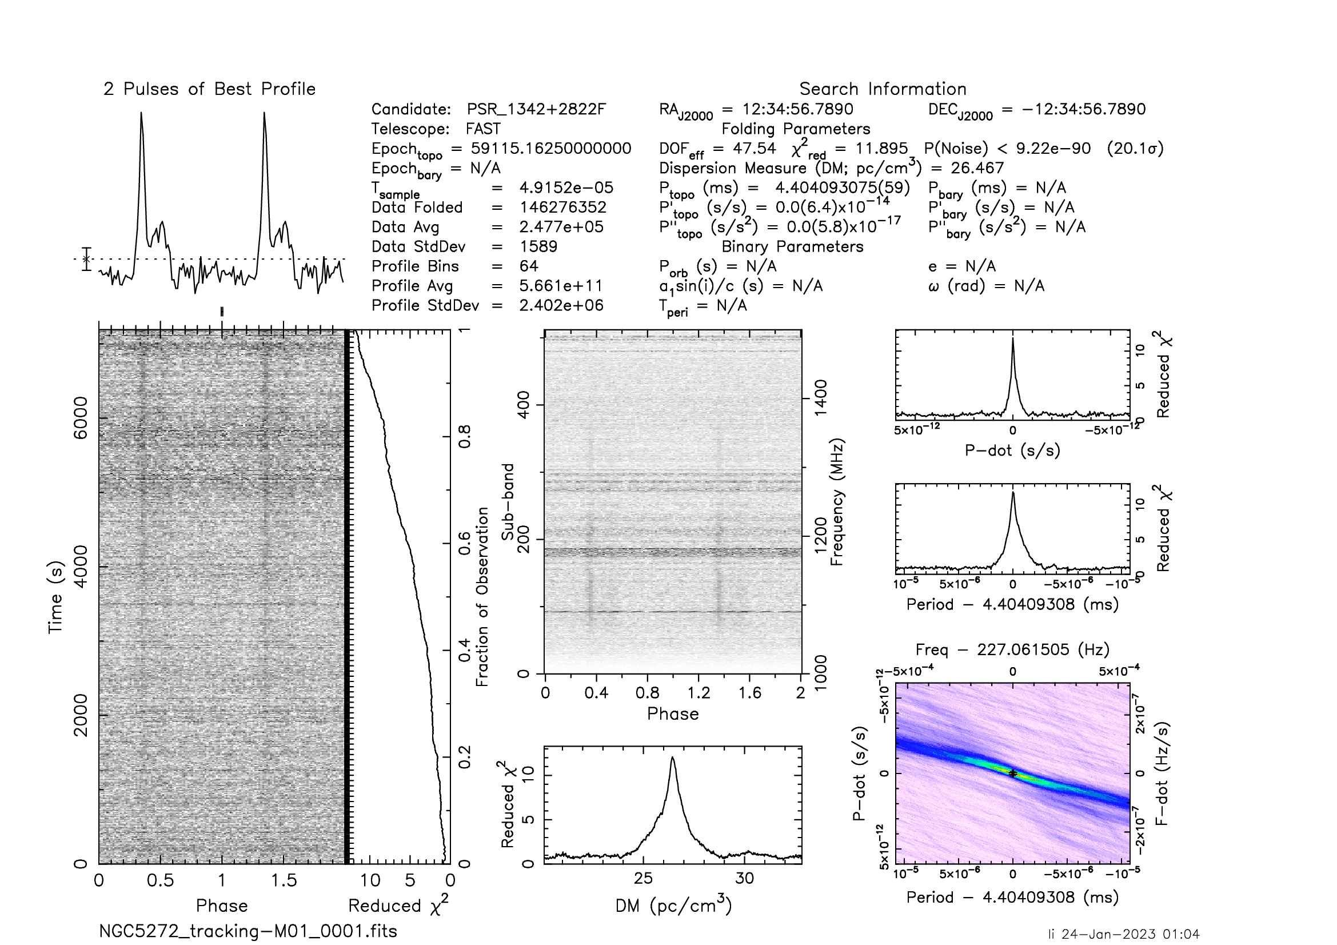
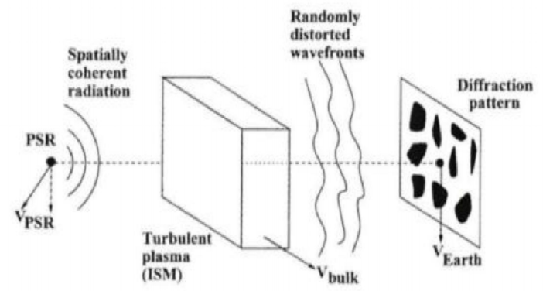
Scintillation pulsars in M3
M3A
M3B
M3D
M3E
M3F
( Cordes J, M. 2002 )
Interference + Relative motion of earth, pulsar and interstellar medium

Slide 10
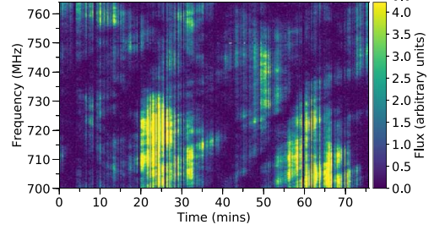
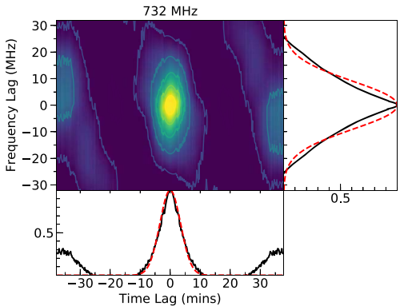
Autocorrelation function (ACF) of dynamic spectrum
By using two parameters: scintillation bandwidth νd and scintillation time scale τd. the average characteristics of scintillation of each observation can be quantified. τd is the half width of ACF at 1/e along the time axis,，νd is the half width at the half maximum along the frequency axis（Cordes 1986）。
J2048−1616dynamic spectrum (Chen et al, 2022)
①
②
③
④
⑤
J2048−1616ACF (Chen et al, 2022)

Slide 11
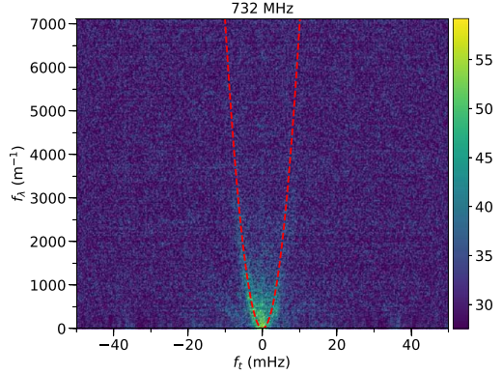
Secondary spectrum of dynamic spectrum
A "cross" pattern can be seen in some observed dynamic spectra (Hewish. 1980). In order to study the "slope" or "cross" scintillation, Cordes et al. (1984) proposed a secondary spectrum by two-dimensional Fourier transform of the dynamic spectrum.
①
J2048−1616动态谱( Chen et al, 2022 )
Fit
②
Arc
③
④
J2048−1616二次谱( Chen et al, 2022 )

Slide 12
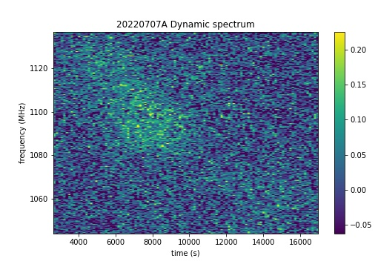
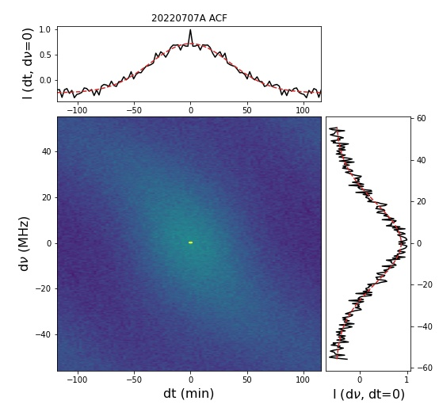
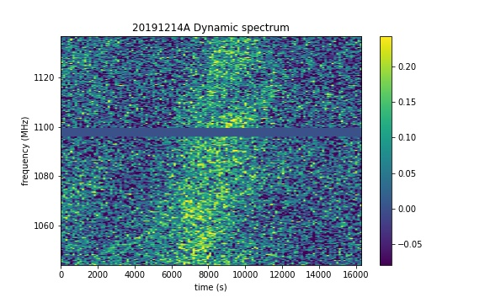
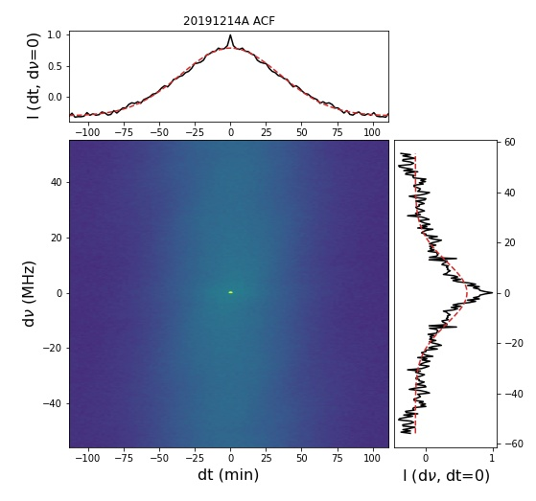
ACF of dynamic spectrum in M3A
M3A
Δν_{d} = 22.868 +- 0.493 MHz
Δτ_{d} = 49.987 +- 1.279 min
Δν_{d} = 14.573 +- 0.567 MHz
Δτ_{d} = 49.602 +- 0.618 min
ACF spot tilt. anisotropic medium
The lumpy scintillation.
Li et al. in prep

Slide 13
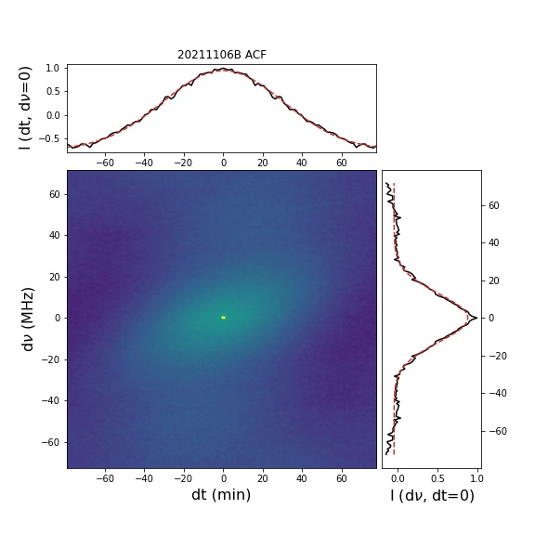
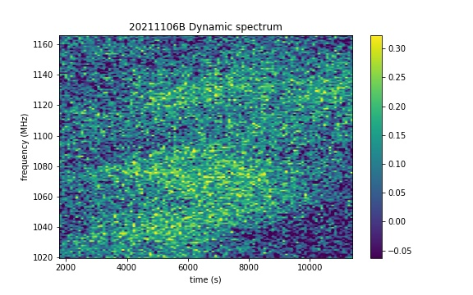
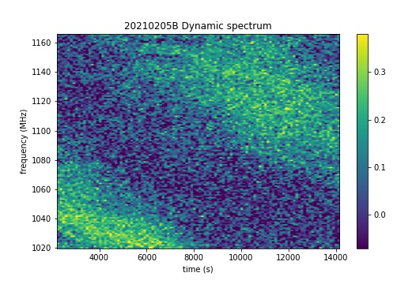
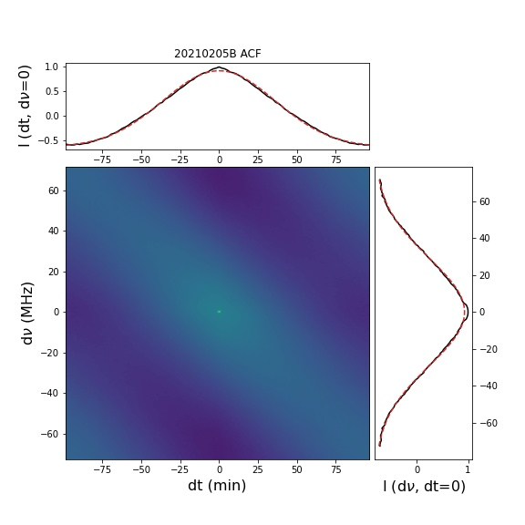
ACF of dynamic spectrum in M3B
M3B
20211106
Δν_{d} = 15.181 +- 0.216 MHz
Δτ_{d} = 43.227 +- 0.462 min
20210205
Δν_{d} = 34.387 +- 0.201 MHz
Δτ_{d} = 51.070 +- 0.344 min
ACF spot tilt. anisotropic medium
The lumpy scintillation.
Li et al. in prep

Slide 14
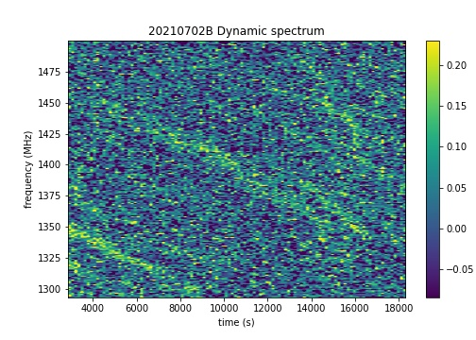
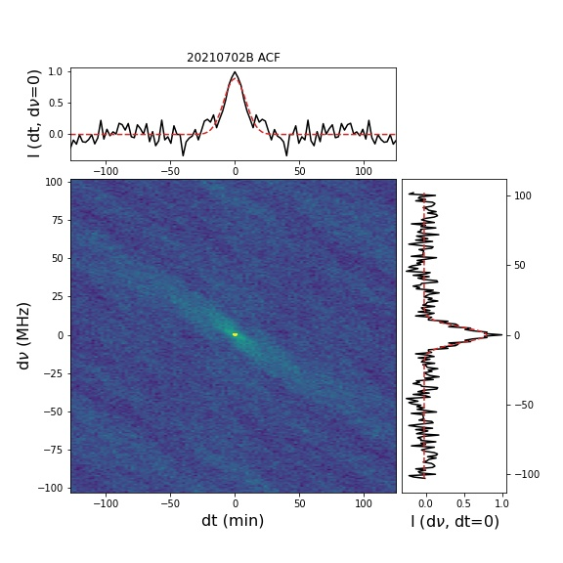
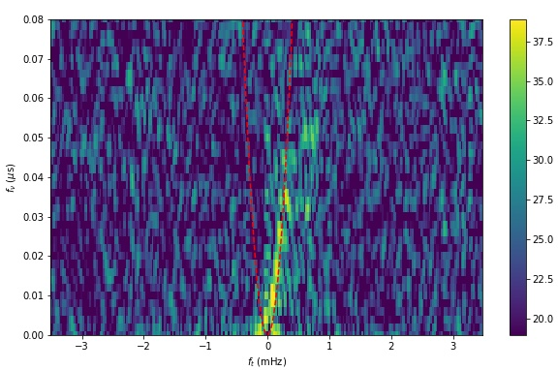
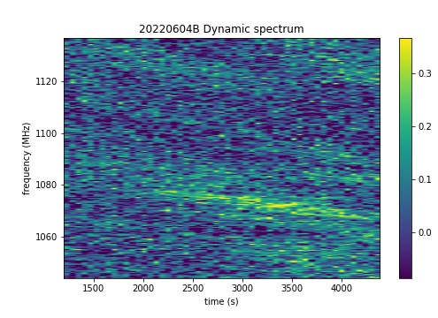
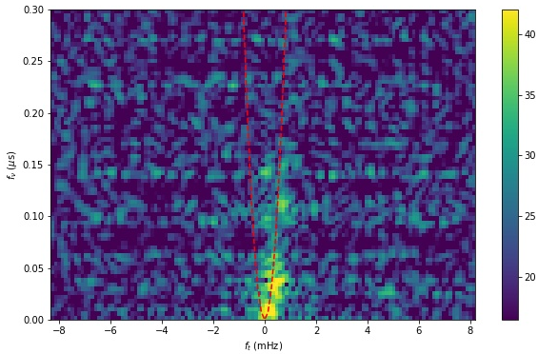
ACF and secondary spectrum of dynamic spectrum in M3B
M3B
Δν_{d} = 7.947 +- 0.319 MHz
Δτ_{d} = 9.140 +- 0.258 min
η = 0.4967 +- 0.0039
Δν_{d} = 6.520 +- 0.460 MHz
Δτ_{d} = 11.910 +- 0.968 min
η = 0.4391 +- 0.0542
ACF spot tilt. anisotropic medium
Stripes scintillation, with smaller scintillation time scale and scintillation bandwidth.
Captured scintillation arc, asymmetry
Li et al. in prep

Slide 15
Conclusion
The timing solutions of M3A, B and D are updated, which are consistent with the predecessors. M3C was not detected.
The timing solutions of two new pulsars M3E and F are obtained.
The dynamic spectra of M3A and B are obtained. ACF analysis shows that scintillation may come from anisotropic media.
Two different scintillation states were found in M3B.
The scintillation arc is captured in the two stripe scintillation of M3B，the fitted value of the curvature arc is ~ 0.47.

Slide 16
Thanks for listening !
gs.bdli21@gzu.edu.cn

