Slide 1
Type I X-ray Burst as a tool to probe the physics of neutron stars
Helei Liu (刘荷蕾)
Xinjiang University
In collaboration with
Renxin Xu (Peking Univ.), Guoqing Zhen(Xinjiang Univ.), Akira Dohi (RIKEN)
2023.7.6

Slide 2
Contents
Introduction
  LMXBs and X-ray burst
  The physics inside bursting NSs
The impacts of NS structure and base heating on type I X-ray burst
EoSs dependent mQPO in low-mass X-ray binaries
Summary and future work plan

Slide 3
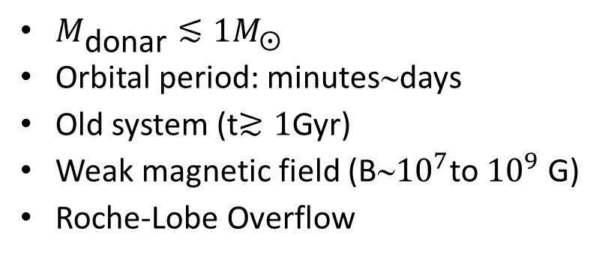
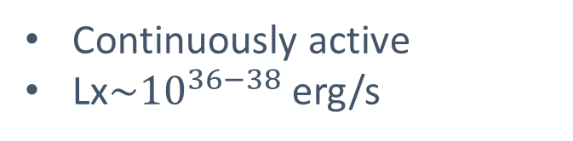

Low-Mass X-ray Binary (LMXB)
Persistent sources
$M_{\text{donar}}≲1M_{⨀}$
Orbital period: minutes∼days
Old system (t$≳1$Gyr)
Weak magnetic field (B∼${10}^{7}$to ${10}^{9}$ G)
Roche-Lobe Overflow
Continuously active
Lx$\sim {10}^{36−38}$ erg/s
Transient sources
  Switched on
    accretion induced outburst
    Lx∼10³⁶⁻³⁸ erg/s
  Switch off (requires sensitive X-ray telescope)
    Quiescence
    Lx∼10³¹⁻³⁴ erg/s (thermal emission)
(NASA website)

Slide 4
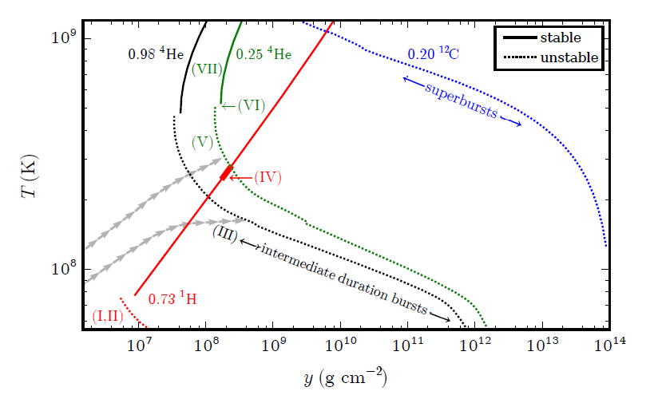
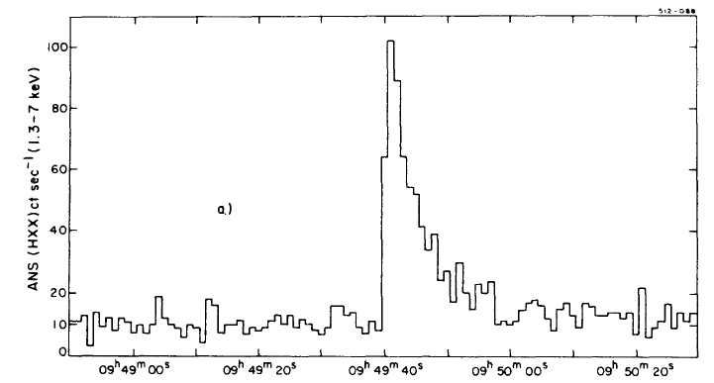
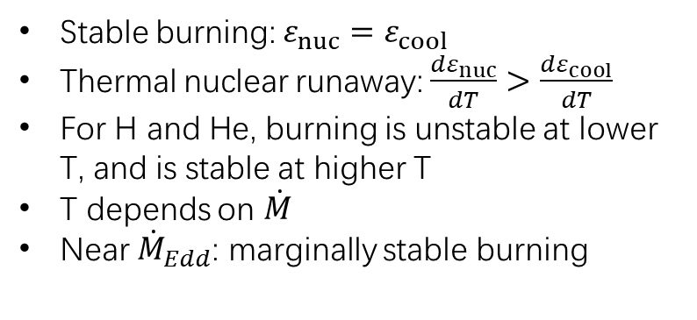
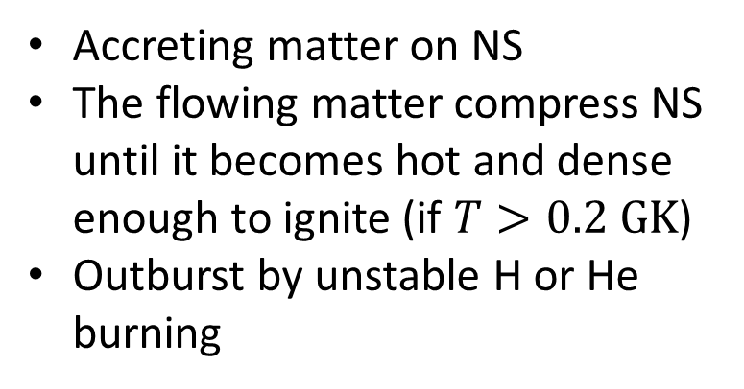
Thermonuclear X-ray burst
Galloway, et al. 2017
Accreting matter on NS
The flowing matter compress NS until it becomes hot and dense enough to ignite (if $T>0.2 GK$)
Outburst by unstable H or He burning
⇒ Type-I X-ray burst
3A 1820-30
Stable burning: $ε_{nuc}=ε_{cool}$
Thermal nuclear runaway: $\frac{dε_{nuc}}{dT}>\frac{dε_{cool}}{dT}$
For H and He, burning is unstable at lower T, and is stable at higher T
T depends on $\dot{M}$
Near ${\dot{M}}_{Edd}$: marginally stable burning
Grindlay, 1976, ApJ

Slide 5
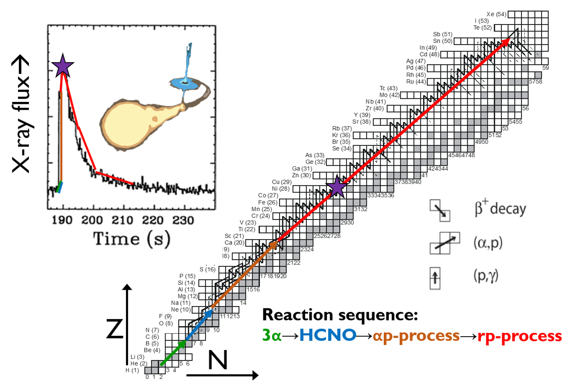
Nucleosynthesis in X-ray Burst
Meisel, 2018

Slide 6
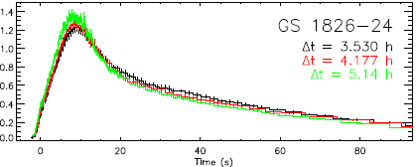

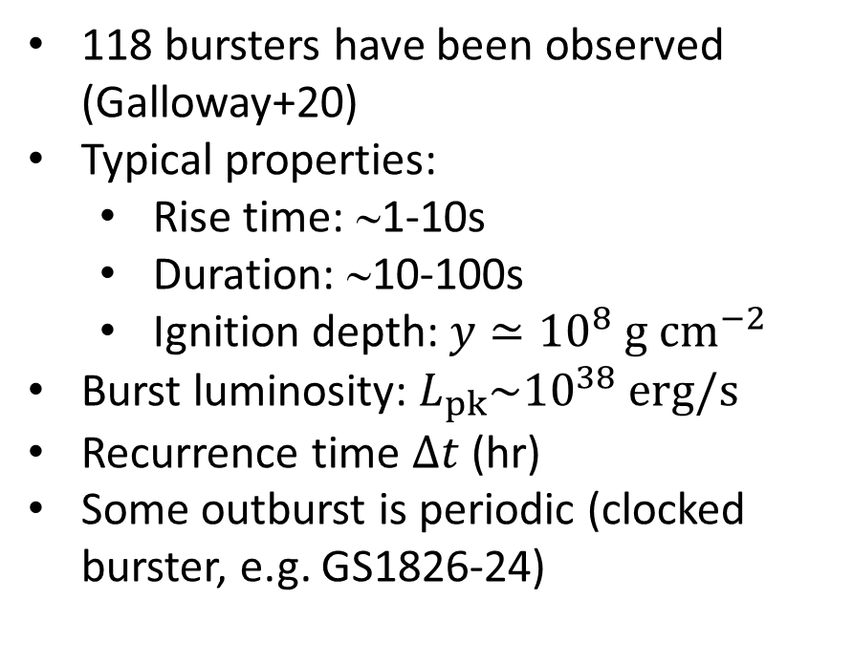
Observation of X-ray burst
Galloway et al. (2017)
118 bursters have been observed (Galloway+20)
Typical properties:
  Rise time: ∼1-10s
  Duration: ∼10-100s
  Ignition depth: $y≃{10}^{8} g {cm}^{−2}$
Burst luminosity: $L_{pk}\sim {10}^{38} erg/s$
Recurrence time $∆t$ (hr)
Some outburst is periodic (clocked burster, e.g. GS1826-24)
Galloway et al. (2010)

Slide 7
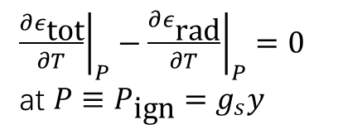

Energy Sources in Accreting NS
Ignition condition:
Outer physics of NS
  Release of gravitation
  Nuclear burning
Inner physics of NS
  Crust heating (Haensel & Zdnick 90,03,08)
  Shallow heating (Deibel, 2016)
  ν emission (slow+Fast cooling)
  EOS properties
${\left.\frac{∂ε_{\text{tot}}}{∂T}\right|}_{P}−{\left.\frac{∂ε_{\text{rad}}}{∂T}\right|}_{P}=0$
at $P≡P_{\text{ign}}=g_{s}y$
3α reaction→HCNO cycle
（Wallance & Woosley 1981）
→αp process→rp process
(Woosley & Weaver 1981,84)
→SnSbTe cycle (Schatz+2001)
what’s the origin of $ε_{\text{tot}}$?
⇒
burst phenomenon is related to not only outside but also inside physics of NS

Slide 8
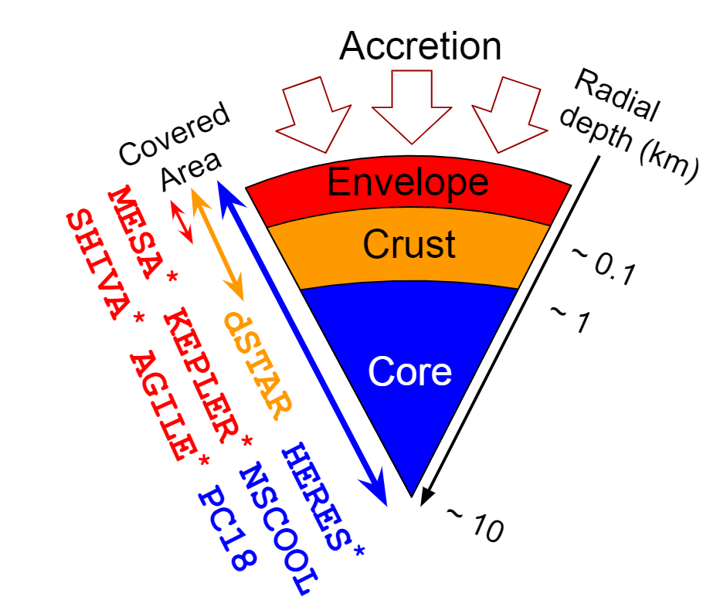
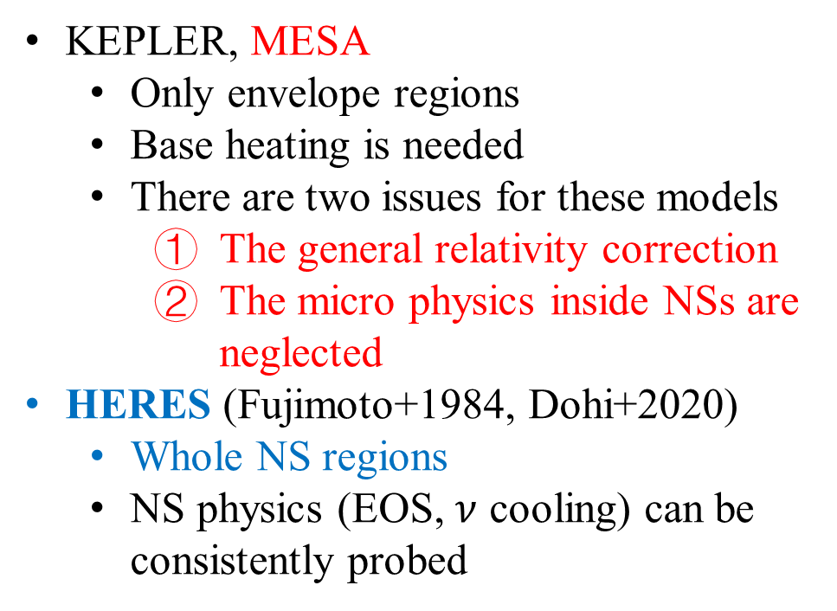
Different X-ray burst models
KEPLER, MESA
  Only envelope regions
  Base heating is needed
  There are two issues for these models
    The general relativity correction
    The micro physics inside NSs are neglected
HERES (Fujimoto+1984, Dohi+2020)
  Whole NS regions
  NS physics (EOS, $ν$ cooling) can be consistently probed
Zhen et al, 2013
HERES: Hydrostatic Evolution of RElativistic Stars

Slide 9
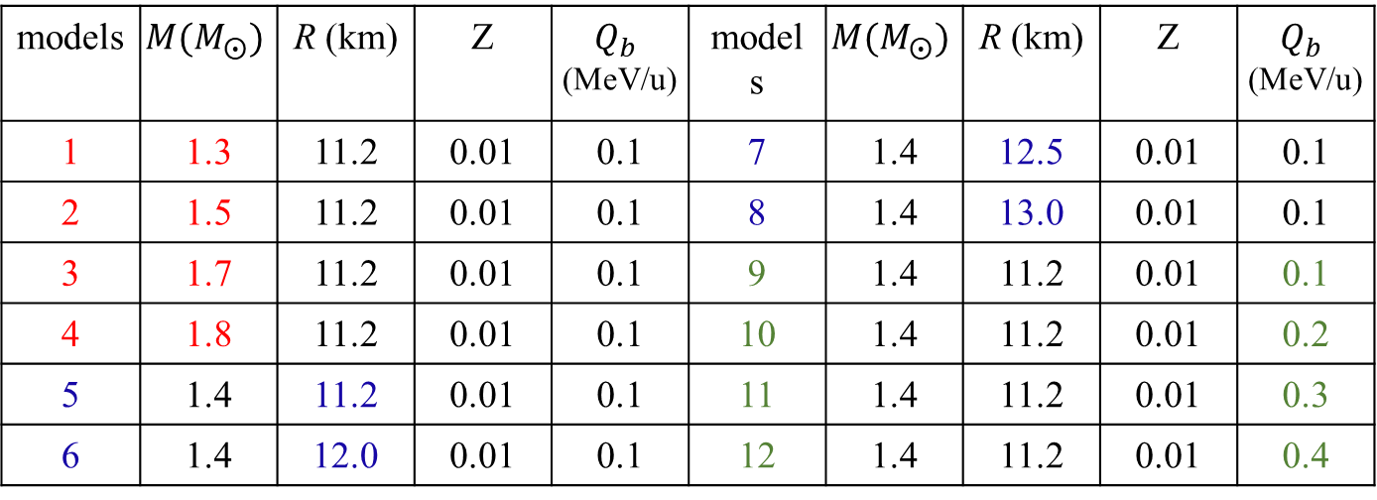
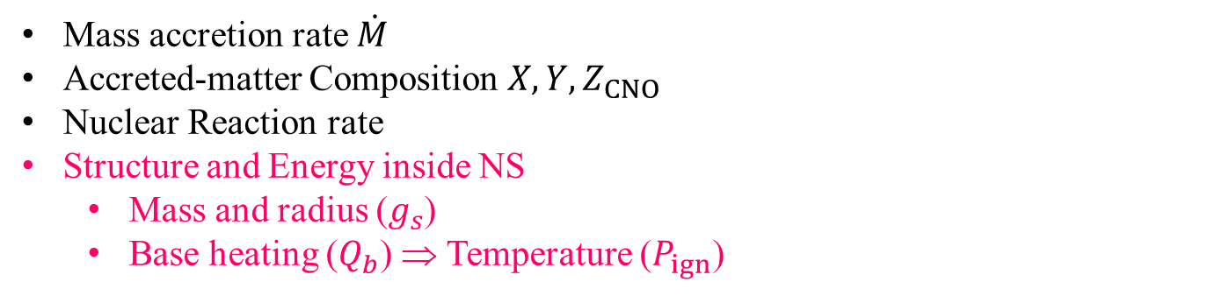
Model parameters to describe X-ray burst
Mass accretion rate $\dot{M}$
Accreted-matter Composition $X,Y,Z_{CNO}$
Nuclear Reaction rate
Structure and Energy inside NS
  Mass and radius ($g_{s}$)
  Base heating ($Q_{b}$) ⇒ Temperature ($P_{ign}$)
models | $$M(M_{⨀})$$ | R (km) | Z | $Q_{b}$ (MeV/u) | models | $$M(M_{⨀})$$ | R (km) | Z | $Q_{b}$ (MeV/u)
1 | 1.3 | 11.2 | 0.01 | 0.1 | 7 | 1.4 | 12.5 | 0.01 | 0.1
2 | 1.5 | 11.2 | 0.01 | 0.1 | 8 | 1.4 | 13.0 | 0.01 | 0.1
3 | 1.7 | 11.2 | 0.01 | 0.1 | 9 | 1.4 | 11.2 | 0.01 | 0.1
4 | 1.8 | 11.2 | 0.01 | 0.1 | 10 | 1.4 | 11.2 | 0.01 | 0.2
5 | 1.4 | 11.2 | 0.01 | 0.1 | 11 | 1.4 | 11.2 | 0.01 | 0.3
6 | 1.4 | 12.0 | 0.01 | 0.1 | 12 | 1.4 | 11.2 | 0.01 | 0.4

Slide 10
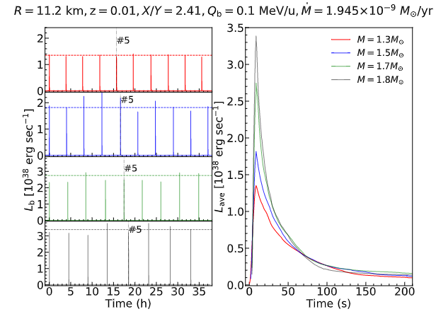
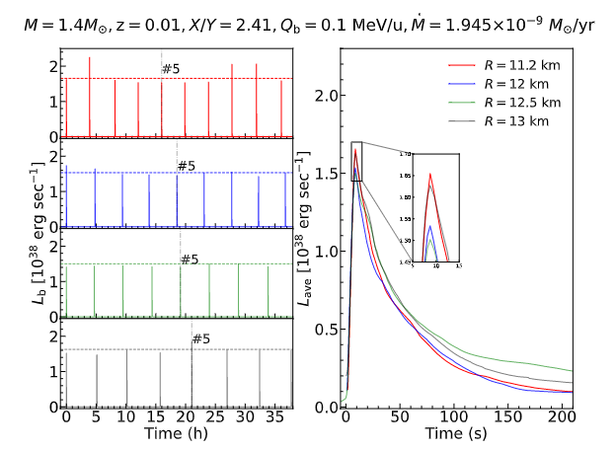
NS Mass, radius and base heating dependent Type I x-ray bursts
Our formulation
We use MESA burst models
  The NS envelope is 0.01 km thick, with several inner boundaries of NSs
  Post-Newtonian Hydrodynamic model
  304-nuclei network for H/He burning using reaction rates from the REACLIB V2.2 library

Slide 11
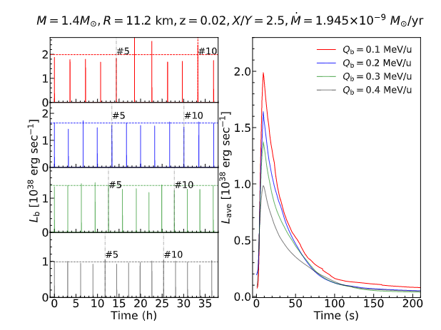
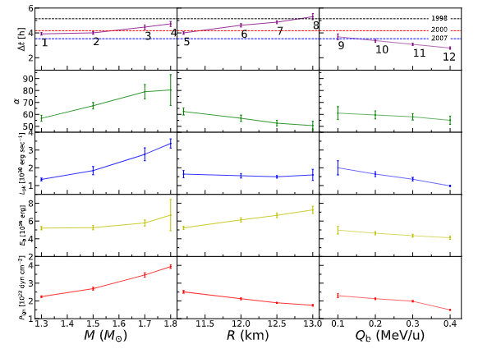
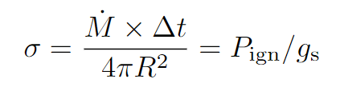

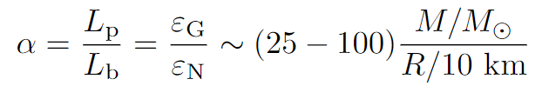
NS Mass, radius and base heating dependent burst parameters
Zhen et al. 2023，ApJ

Slide 12
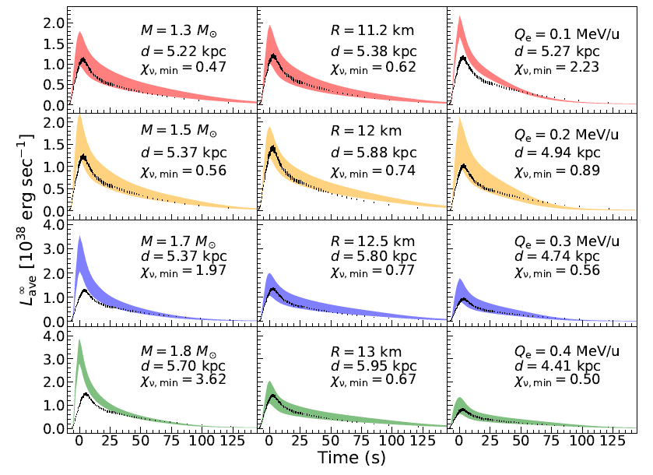
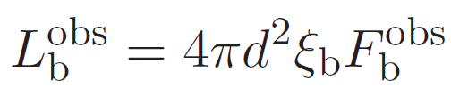
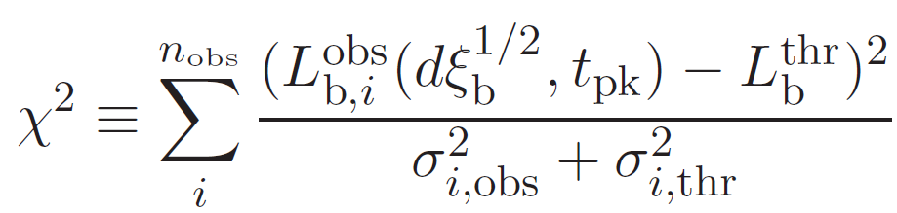
Model-observation comparisons
The observed light curve of GS 1826-24 in 2007 is adopted

Slide 13
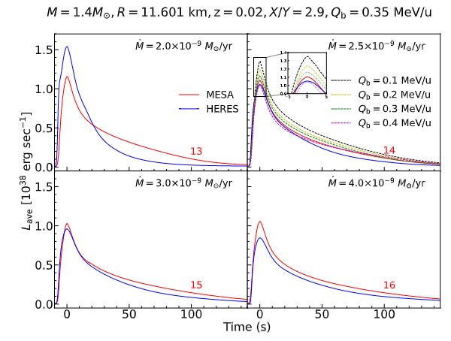
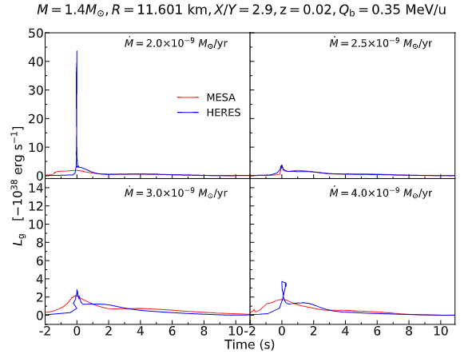
Code comparisons
Zhen et al. 2023, ApJ
The differences for the peak luminosity at low accretion rate caused by the high compressional heating luminosity
The high luminosity at the tail parts possibly be caused by the nuclear reaction energy and compositions

Slide 14
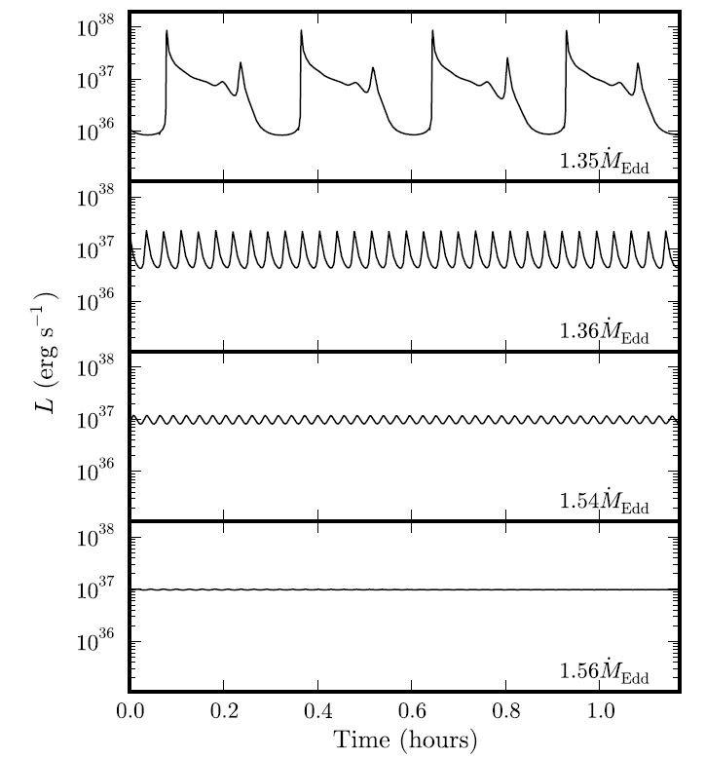
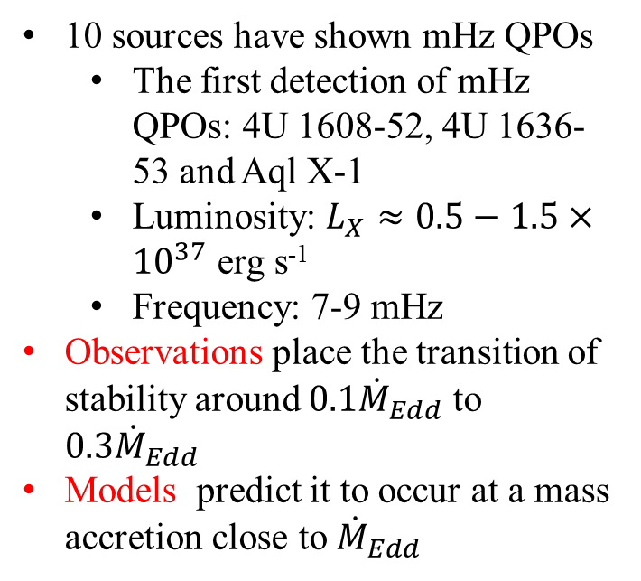
EoS dependent mHz QPO in low mass X-ray binaries
Revnivtsev et al, 2001
10 sources have shown mHz QPOs
  The first detection of mHz QPOs: 4U 1608-52, 4U 1636-53 and Aql X-1
  Luminosity: $L_{X}≈0.5−1.5×{10}^{37}$ erg s⁻¹
  Frequency: 7-9 mHz
Observations place the transition of stability around $0.1{\dot{M}}_{Edd}$ to $0.3{\dot{M}}_{Edd}$
Models predict it to occur at a mass accretion close to ${\dot{M}}_{Edd}$
bursts
marginally stable burning
Stable burning
The discrepancy is close to an order of magnitude!!
Keek et al, 2014

Slide 15
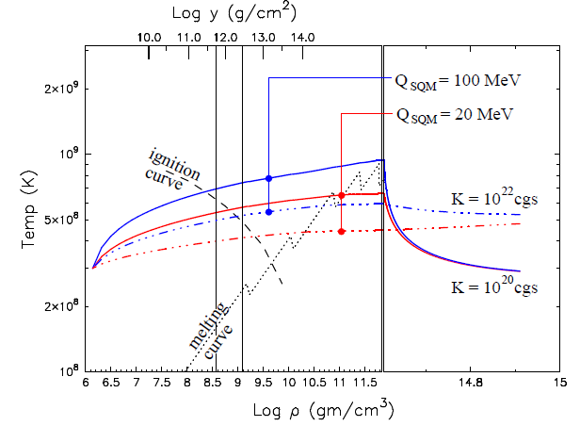
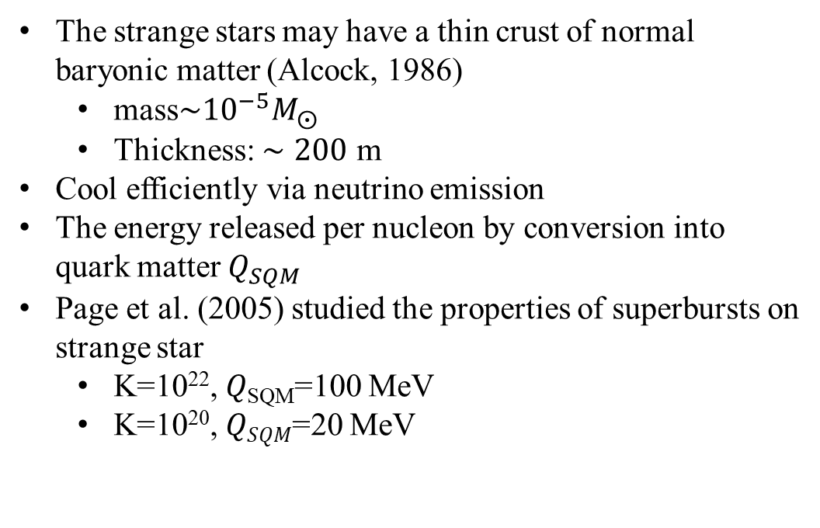
Thermal nuclear burning from strange star
The strange stars may have a thin crust of normal baryonic matter (Alcock, 1986)
  mass$\sim {10}^{−5}M_{⨀}$
  Thickness: $∼200$ m
Cool efficiently via neutrino emission
The energy released per nucleon by conversion into quark matter $Q_{SQM}$
Page et al. (2005) studied the properties of superbursts on strange star
  K=10²², 𝑄_{SQM}=100 MeV
  K=10²⁰, 𝑄_{𝑆𝑄𝑀}=20 MeV
X-ray burst phenomena on the surface of accreting strange star has not been explored

Slide 16
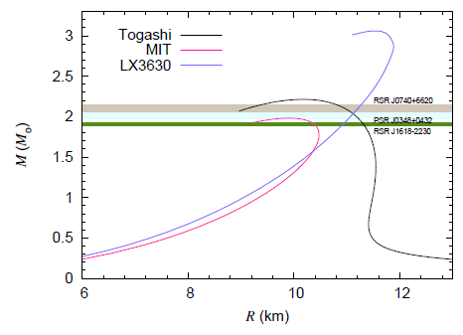
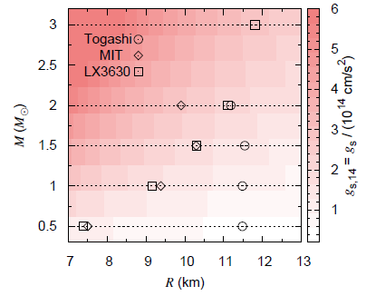
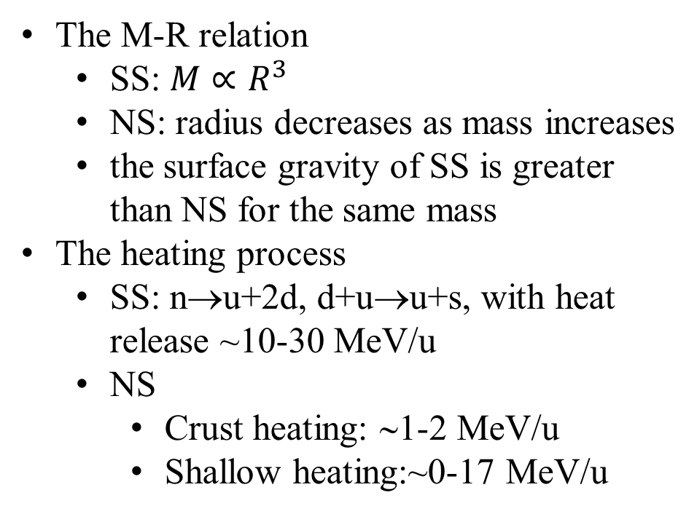
The differences between NS and SS
The M-R relation
  SS: $M∝R^{3}$
  NS: radius decreases as mass increases
  the surface gravity of SS is greater than NS for the same mass
The heating process
  SS: n→u+2d, d+u→u+s, with heat release ~10-30 MeV/u
  NS
    Crust heating: ∼1-2 MeV/u
    Shallow heating:~0-17 MeV/u

Slide 17
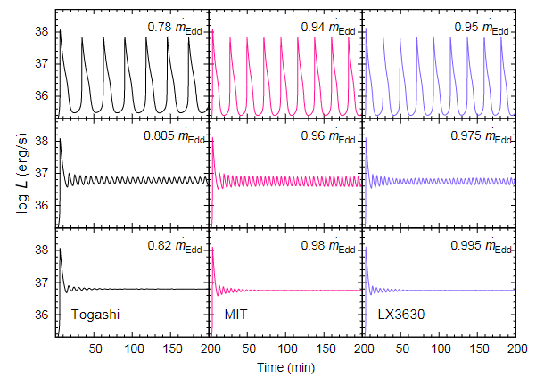
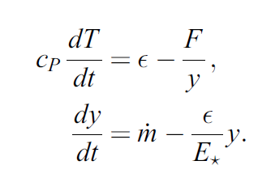
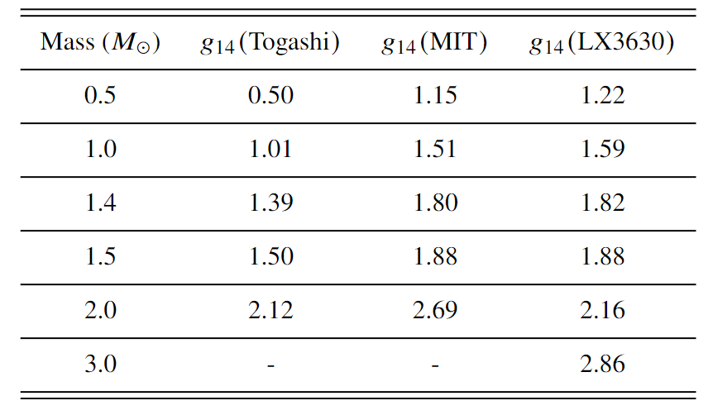


One-zone model
The entire NS/SS envelope is reduced to a single zone
$M=1.4M_{⨀}$, $Q_{b}=0.15$ MeV/u, $X_{0}=0.7$
$P=g_{s}y$ （1）
（2）
（3）
Surface gravity
The more compact the star, the greater the transition mass accretion rate.
Base flux

Slide 18
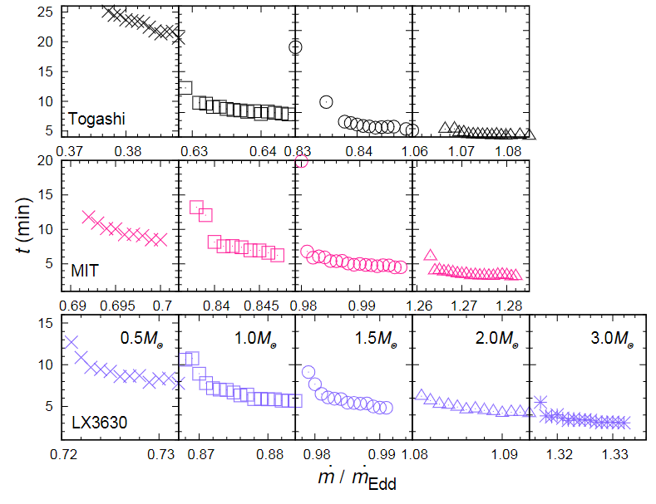


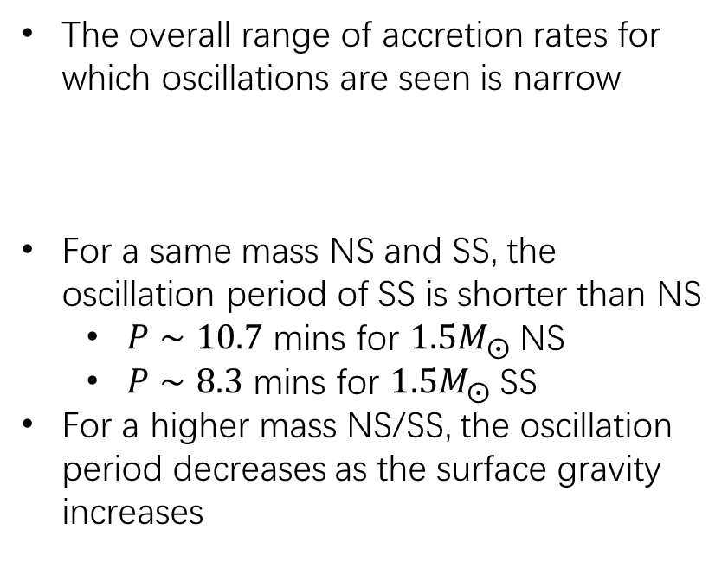
Oscillation period
$X_{0}=0.7$, $Q_{b}=0.15$ MeV/u
The overall range of accretion rates for which oscillations are seen is narrow
For a same mass NS and SS, the oscillation period of SS is shorter than NS
  $P∼10.7$ mins for $1.5M_{⨀}$ NS
  $P∼8.3$ mins for $1.5M_{⨀}$ SS
For a higher mass NS/SS, the oscillation period decreases as the surface gravity increases
$$\frac{Δ\dot{m}}{\dot{m}}≈1\%$$

Slide 19
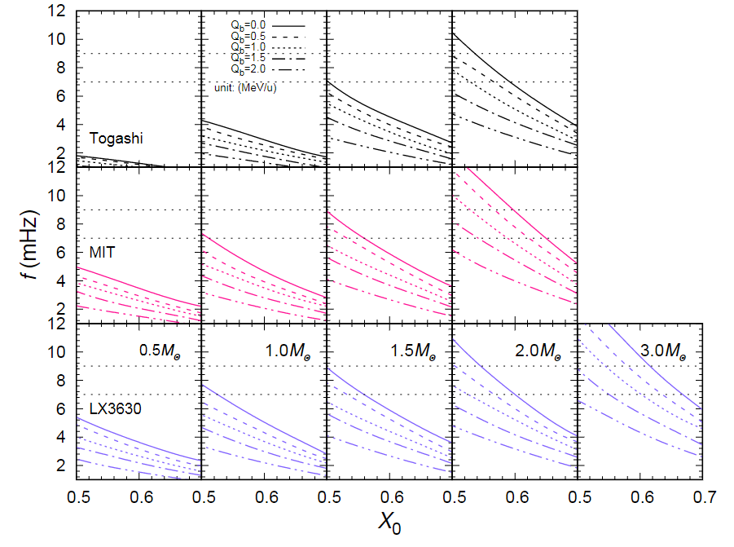
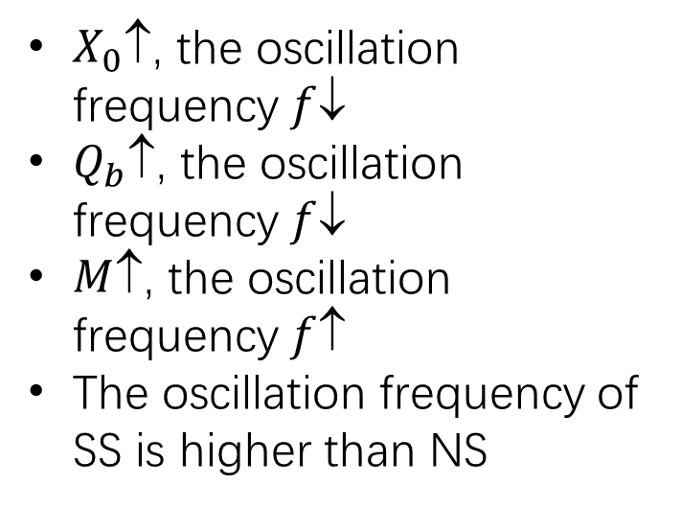
Oscillation frequency from NS/SS
$X_{0}$↑, the oscillation frequency $f$↓
$Q_{b}$↑, the oscillation frequency $f$↓
$M$↑, the oscillation frequency $f$↑
The oscillation frequency of SS is higher than NS

Slide 20
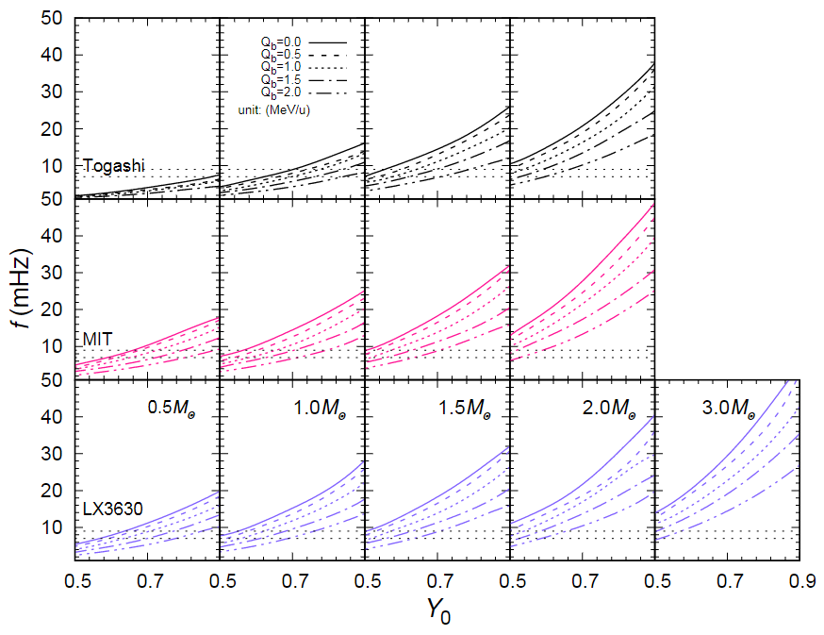
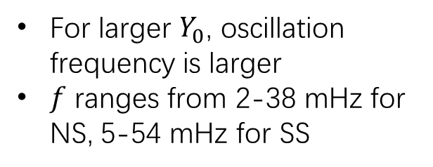
Oscillation frequency from NS/SS
For larger $Y_{0}$, oscillation frequency is larger
$f$ ranges from 2-38 mHz for NS, 5-54 mHz for SS

Slide 21
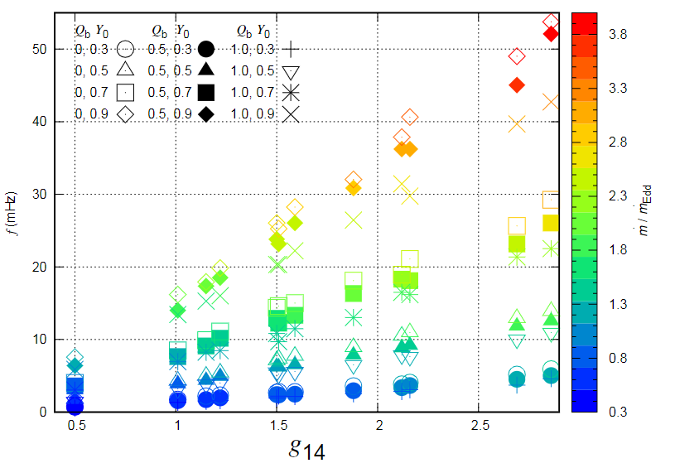
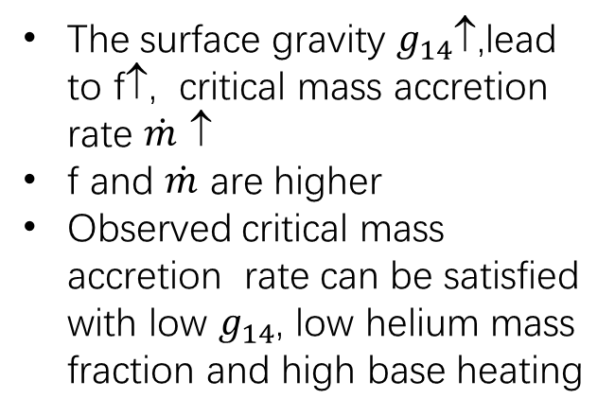
Oscillation frequency vs. surface gravity
The surface gravity $g_{14}$↑,lead to f↑, critical mass accretion rate $\dot{m}$ ↑
f and $\dot{m}$ are higher
Observed critical mass accretion rate can be satisfied with low $g_{14}$, low helium mass fraction and high base heating
Liu et al, 2023, submitted to MNRAS

Slide 22
Summary of My Talk
We calculated X-ray burst considering several mass and radius of NS and base flux by using MESA models
We calculated the EoS-dependent mHz QPO in LMXBs using simple one-zone model
**In future work**
Investigation with more EoSs to understand burst physics with HERES code
Compare theory with more observations
  Multi-peak burst
  mQPO
  Final products
THANKS!

