Slide 1
A multi-band study of pulsar glitches
with Fermi-LAT and Parkes
Peng Liu (刘鹏)
Collaborators: Jian-Ping Yuan（袁建平）
Ming-Yu Ge（葛明玉）
Ang Li（李昂）
Department of Astronomy, Xiamen University Xinjiang Astronomical Observatory, Chinese Academy of Sciences Key Laboratory of Particle Astrophysics, Institute of High Energy Physics, Chinese Academy of Sciences Centre for Astronomical Mega-Science, Chinese Academy of Sciences School of Physics and Astronomy, Sun Yat-Sen University School of Physics and Electronic Science, Guizhou Normal University
FAST/Future Pulsar Symposium 12 (FPS12), Nanyang, Henan, 2023. 7. 4

Slide 2
Outline:
1. Background and significance
2. Timing data and analysis
3. Results
4. Discussion
5. Conclusion

Slide 3
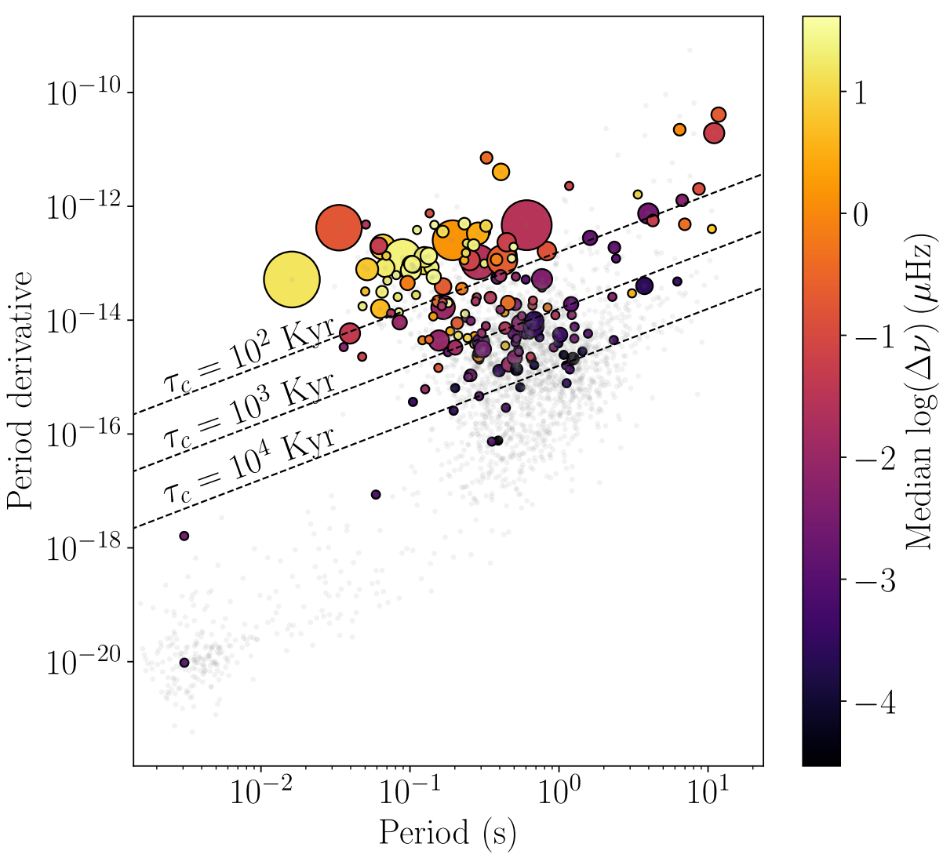
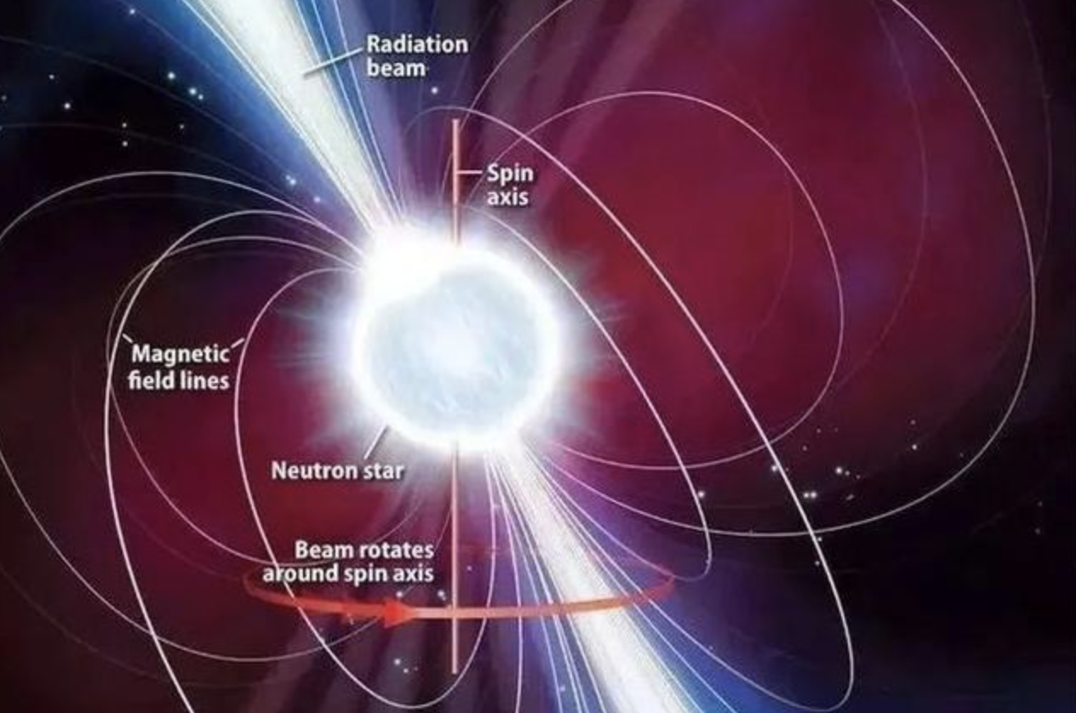
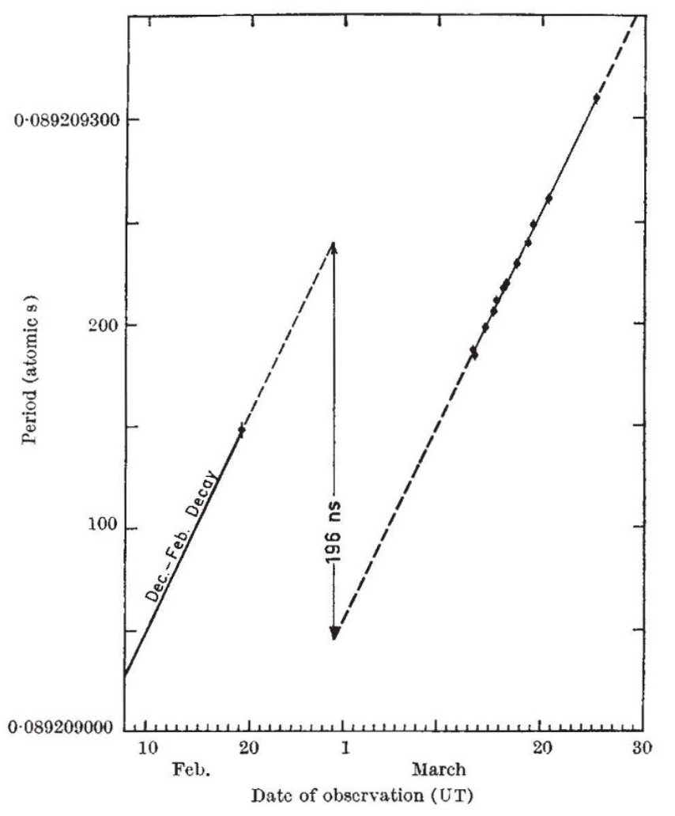
1. Background and significance
In 1969, Radhakrishnan & Manchester first discovered the glitch in Vela pulsar.
669 glitches have been detected in more than 207 pulsar （ATNF/JB）
Normal pulsar、Millisecond pulsar, ﻿RRAT, magnetar ,
binary pulsar
﻿Basu et al. 2021 ﻿MNRAS
Minimum: PSR J0613$−$0200 $\frac{∆ν}{ν}\sim {2.5×10}^{−12}$
Maximum: SXP 1062 $\frac{∆ν}{ν} \sim {1.37×10}^{−3}$
Understand the internal structure and magnetosphere of neutron stars
﻿(Radhakrishnan & ﻿Manchester 1969 ﻿Nature)

Slide 4
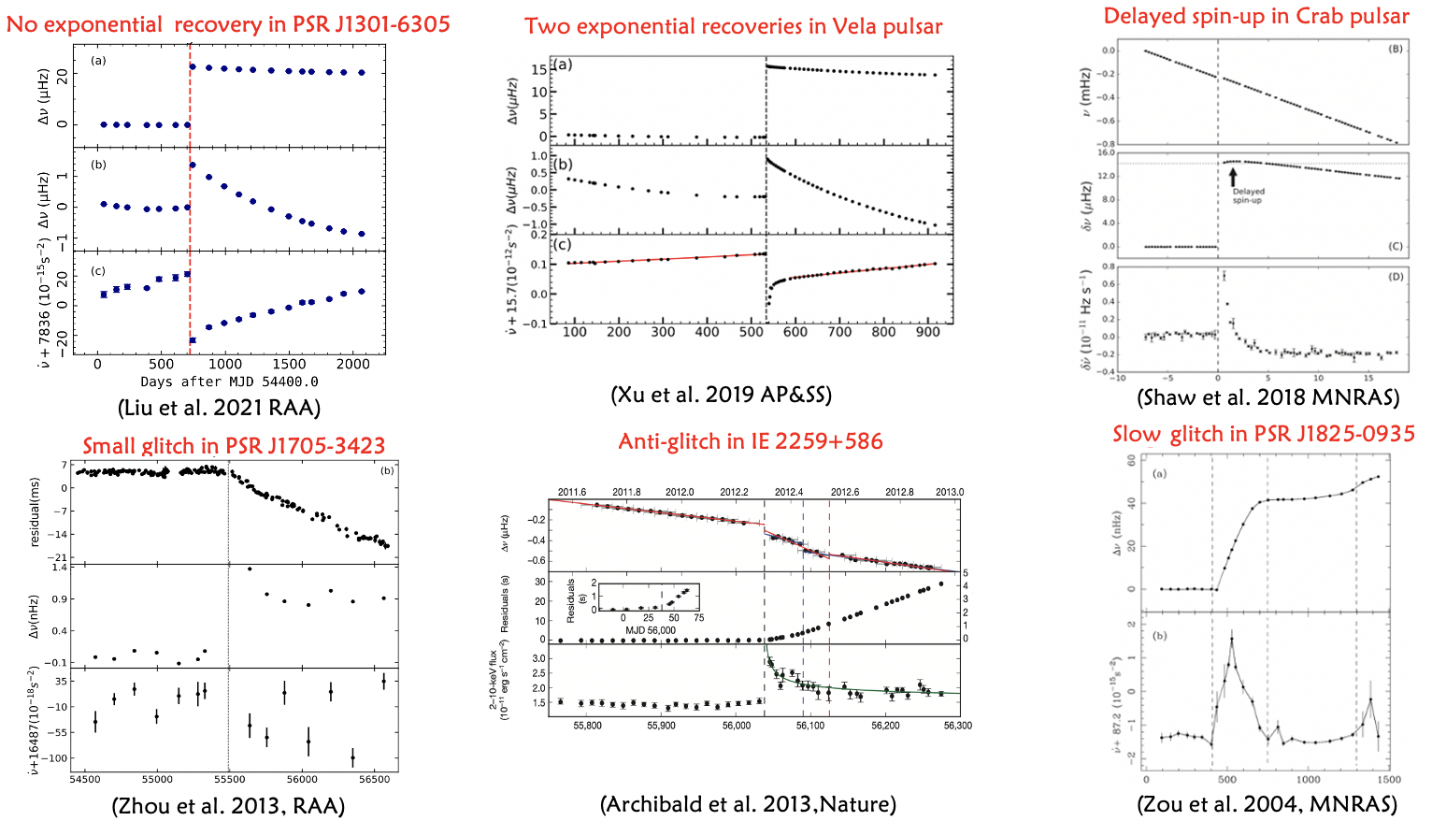
1. Background and significance

Slide 5
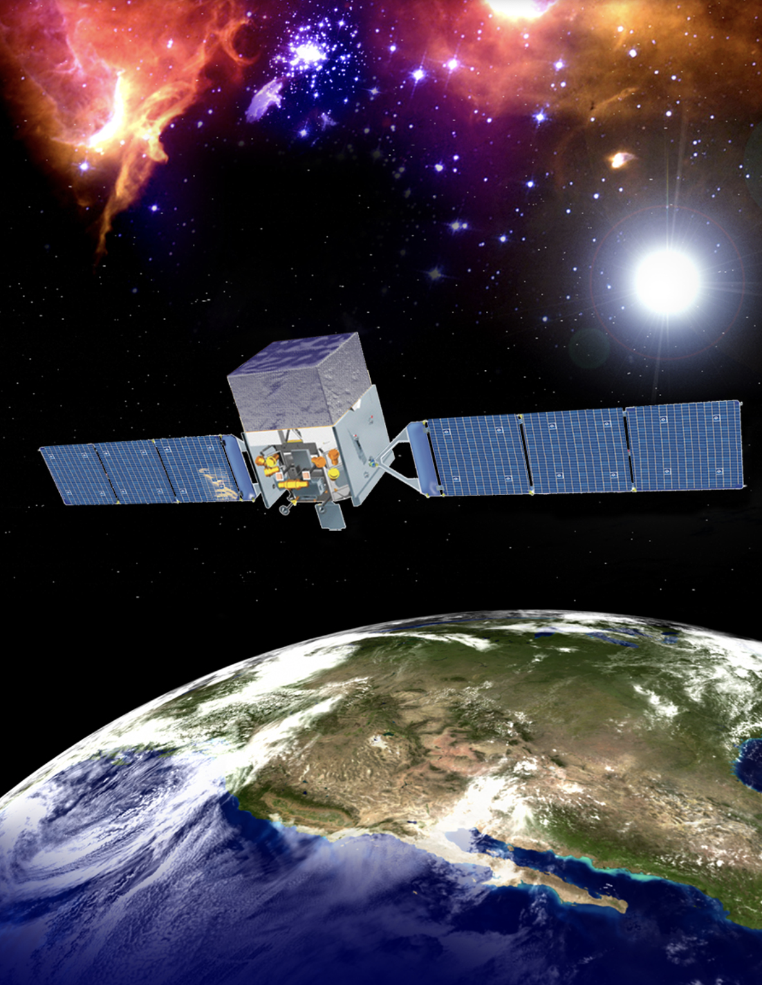
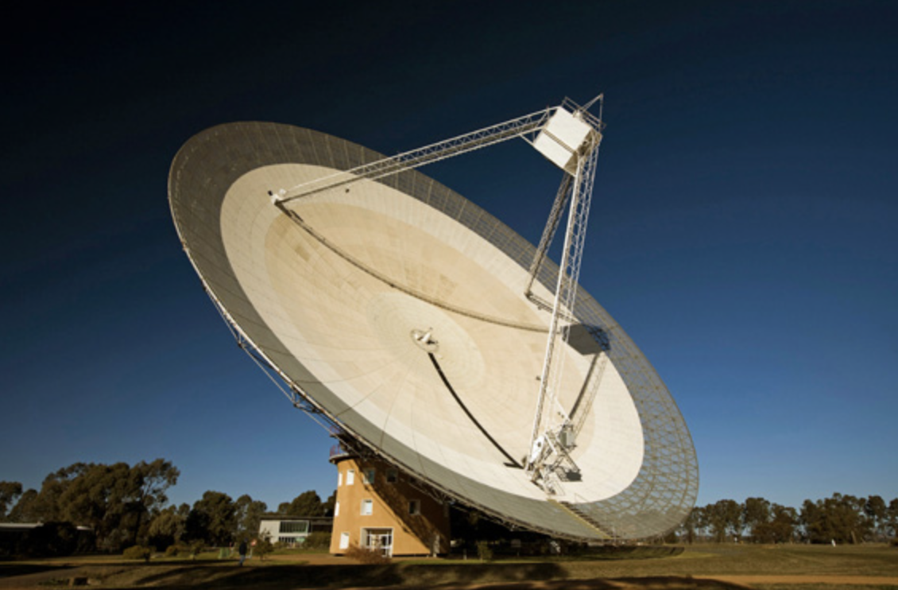
2. Timing data and analysis
Fermi-LAT
Parkes-64m

Slide 6
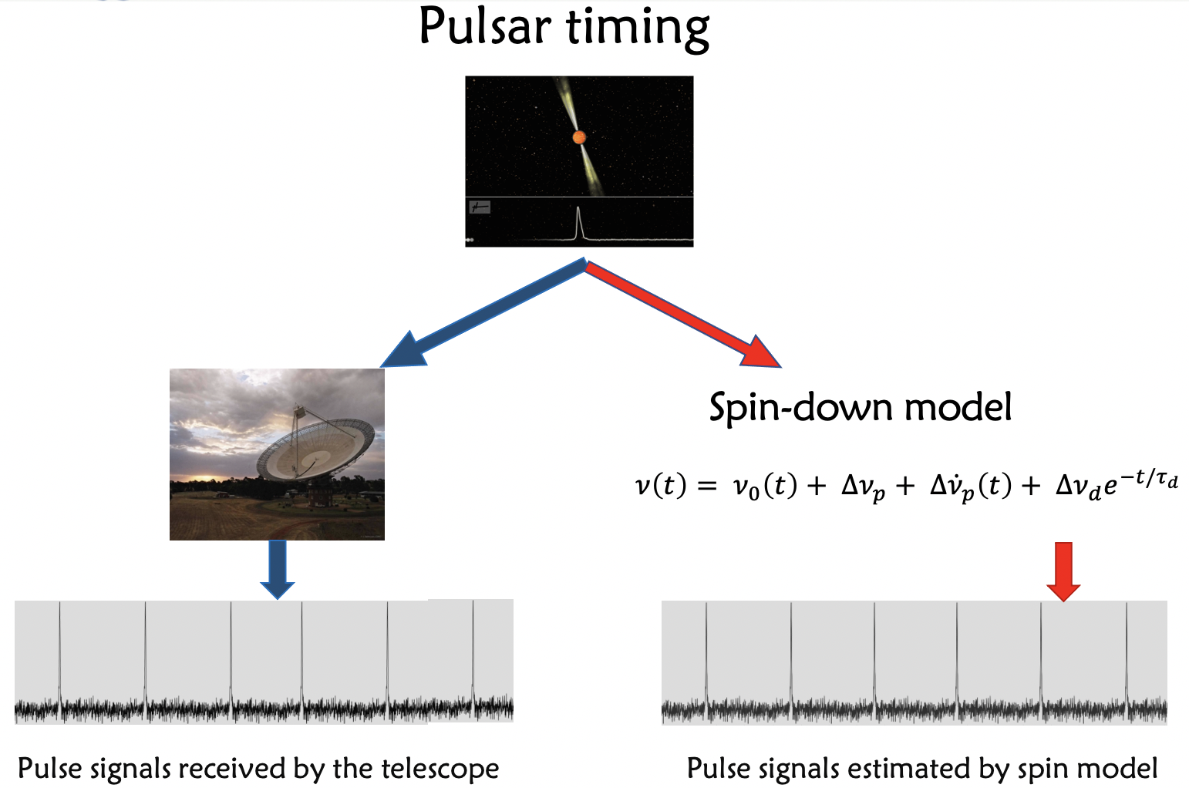
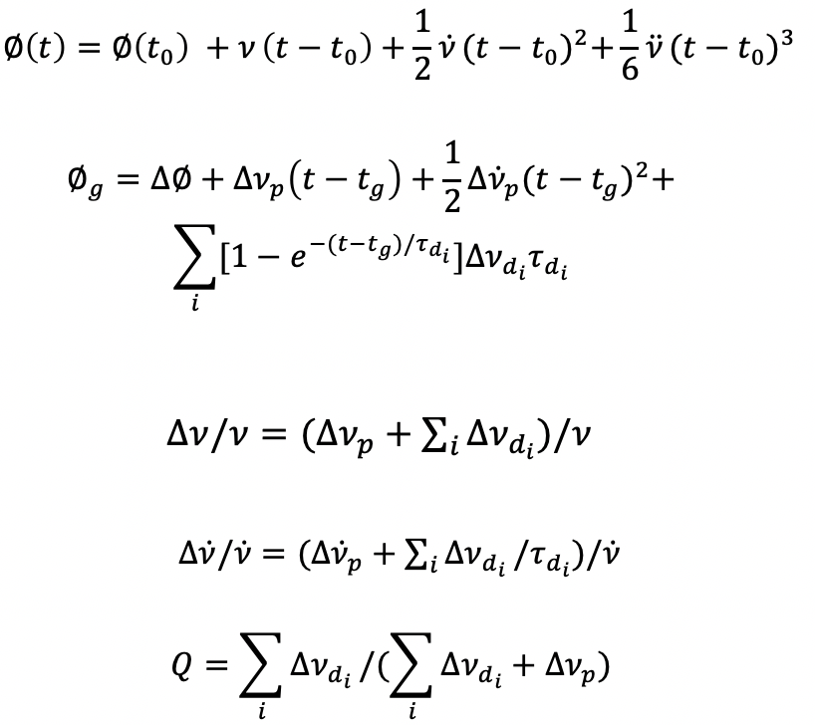
2. Timing data and analysis
Spin-down model:

Slide 7
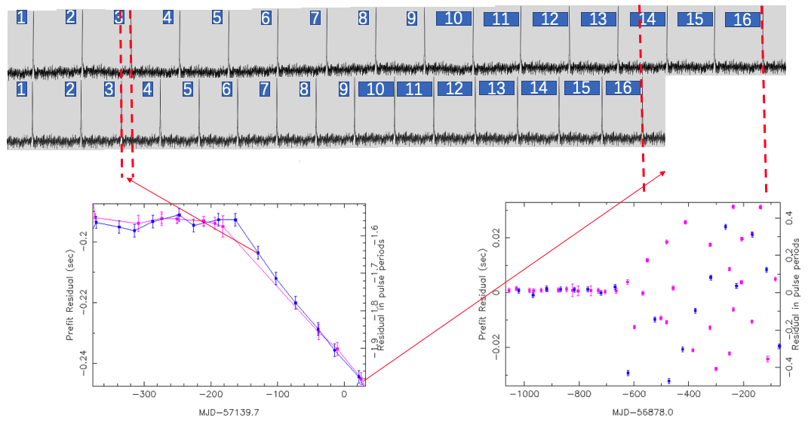
2. Timing data and analysis
Timing residual = observed pulse times-of-arrival $−$estimated pulse times-of-arrival by the model

Slide 8
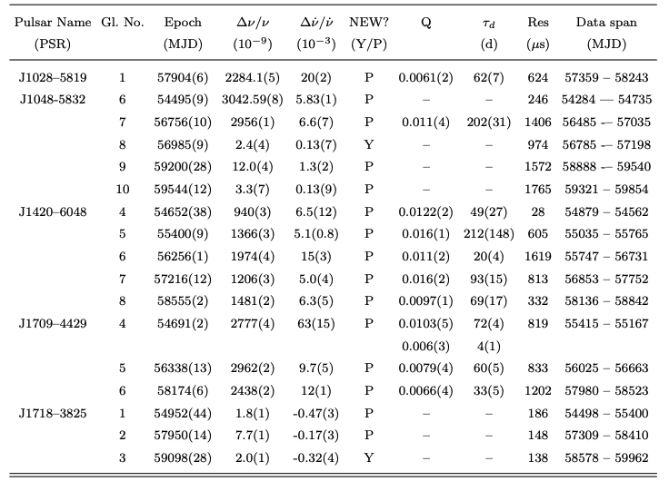
3. Results

Slide 9
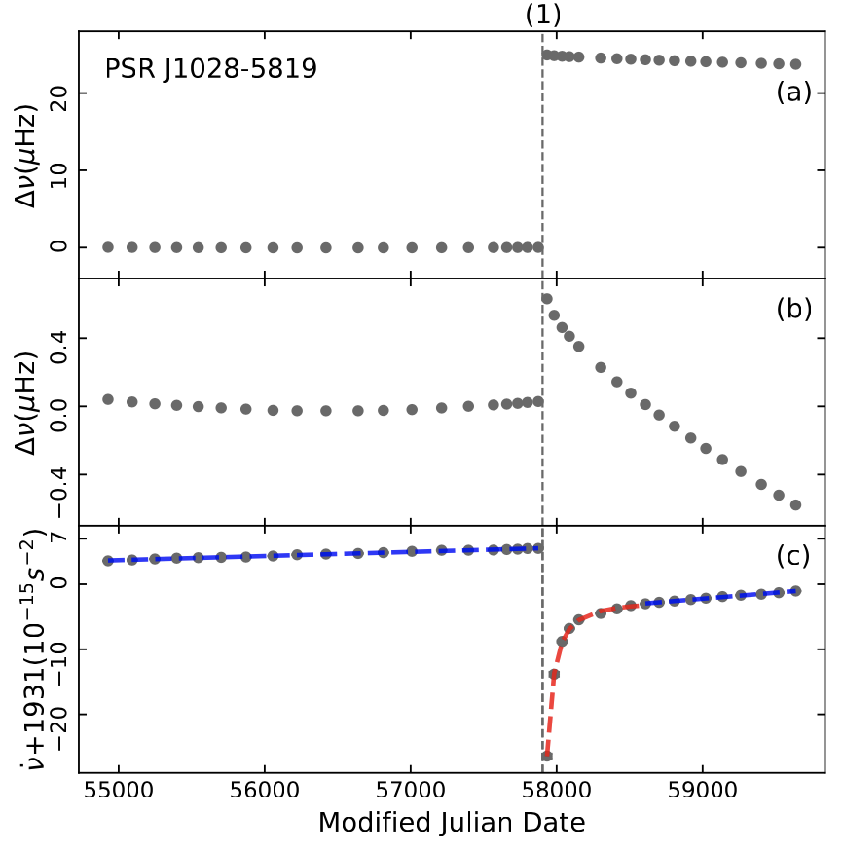
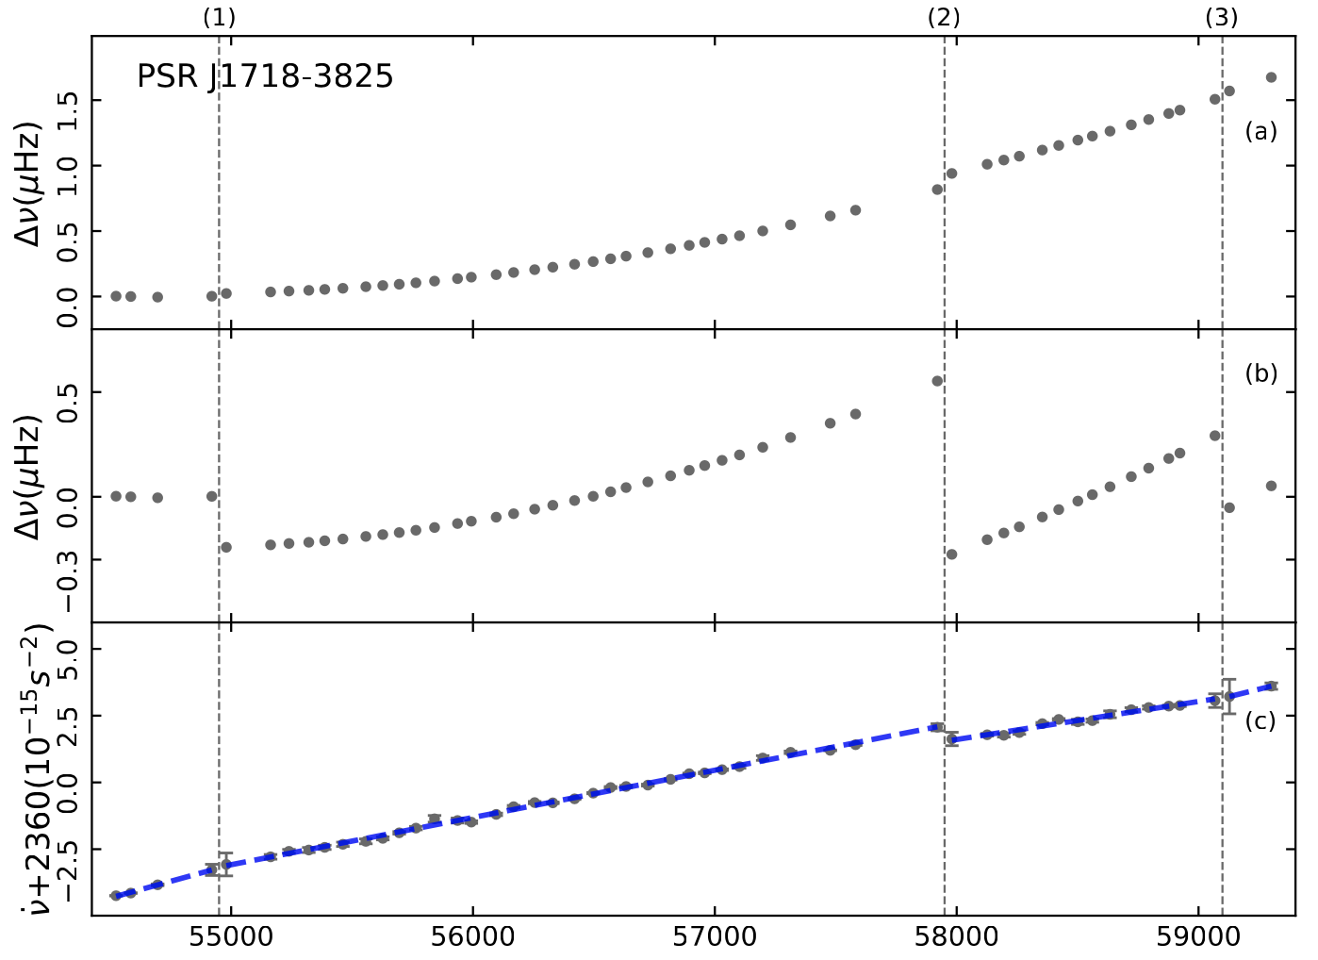
3. Results - PSR J1028$−$5819 and J1718$−$3825
Glitch 8: MJD ~ 59098(28)
${∆ν}/{ν=\text{2.}\text{0}\text{(}\text{1}\text{)}}×{10}^{−9}, { ∆\dot{ν}}/{\dot{v}=\text{−0.32(4)}}×{10}^{−3}$
Braking index: 49.85(7), 41.4(8)
Spectral Exponent : 5
Braking index: 21.66(4), 62.8(4)
Spectral Exponent : 4

Slide 10
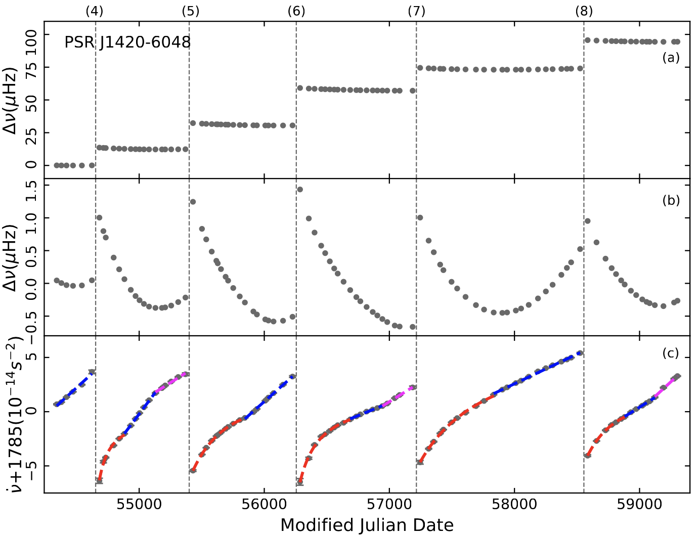
3、Results - PSR J1420$−$6048
Glitch 8:
Q = 0.0097(1)
$τ_{d} =$69(17)
Glitches 4, 6, 8:
have two linear recoveries
Glitch 5:
exponential recovery to linear recovery have significant deviation.
Pulse profile:
Gamma-ray pulse profile structures ﻿ significant variation but radio pulse profile no change.
﻿Lin et al.2021 ﻿MNRAS

Slide 11
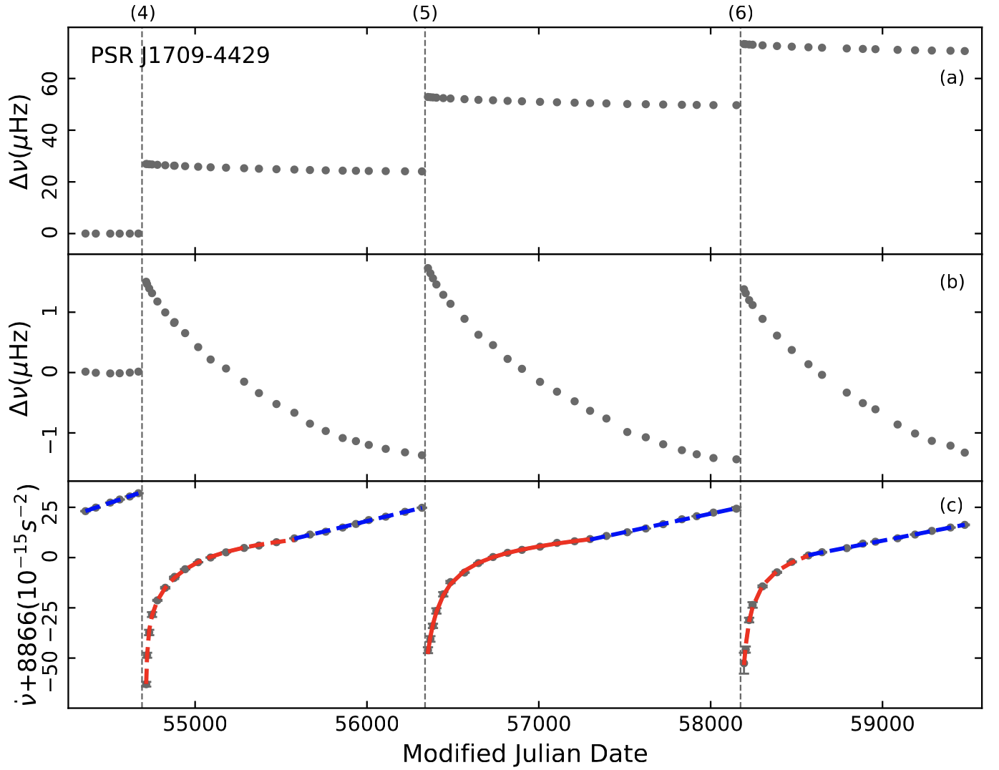
3、Results - PSR J1709$−$4429
Glitch 4:
two exponential recovery.
Q1 = 0.0103(5)
$τ_{d} =$72(4)
Q2 = 0.006(3)
$τ_{d} =$4(1)

Slide 12
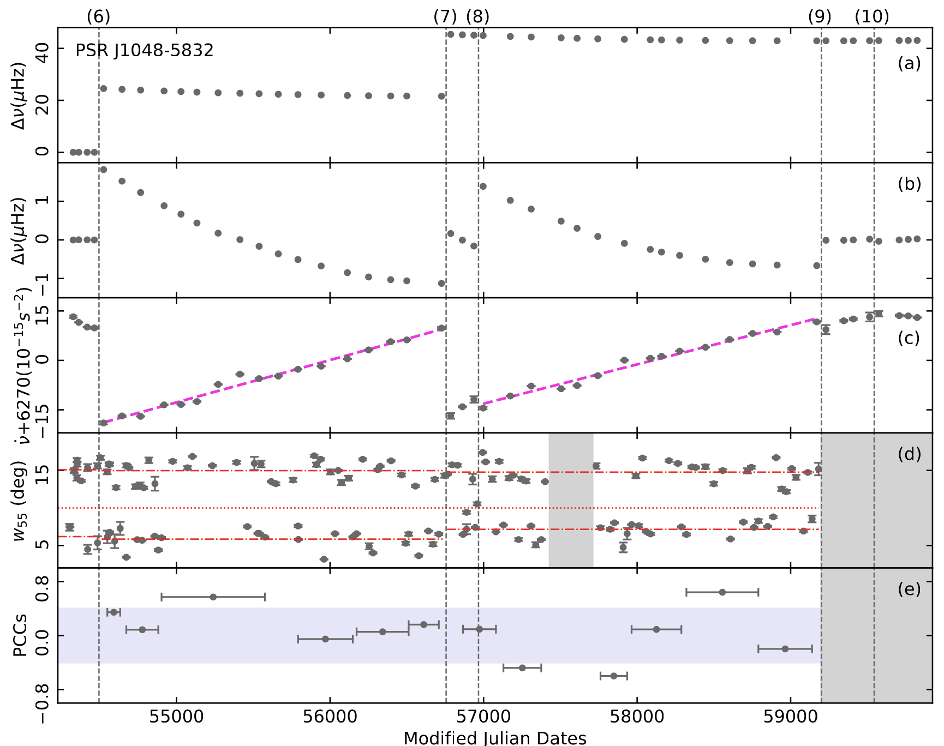
3、Results - PSR J1048$−$5832
Glitch 8: MJD 56985(9)
${ ∆ν}/{ν=\text{2.4(4)}}×{10}^{−9}$
${ ∆\dot{ν}}/{\dot{v}=\text{0.13(7)}}×{10}^{−3}$
Evolution of integrated pulse profiles in the radio band:
The pulse width $W_{55 }$ at 55% of the peak.
$W_{55 }$have two modes: wide and narrow.
Pearson cross-correlation coefficients (PCCs) between $\dot{v}$ and $W_{55 }$: −0.4 ≤ α ≤ 0.4

Slide 13
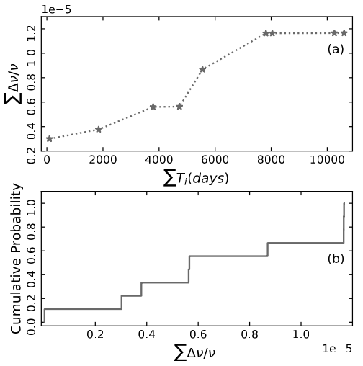
4. Discussion - PSR J1048$−$5832
$$\dot{L}=2πI_{c}\sum_{1}^{n}{\frac{∆ν_{i}}{T_{i}}}$$
﻿Eya et al. 2017 ApJ
$\sum{∆ν/ν}$ : Lilliefors test : p = 0.1, follow normal distribution.
Indicates: these glitches originate from similar superfluid layers.
$$FMI= \frac{I_{r}}{I_{c}}=− \sum_{1}^{n}{\frac{1}{\dot{ν}}\frac{∆ν_{i}}{T_{i}}}$$
﻿Eya et al. 2017 ApJ
﻿Fractional moment of ﻿inertia(FMI): 8.08 $×{10}^{−5}$~ 0.48
When considering the effect of entrainment:
$\left(\frac{m_{n}^{∗}}{m_{n}}\right)$ = 5
﻿Chamel N. 2017, J. Low Temp. Phys
$$FMI= \frac{I_{r}}{I_{c}}=−\frac{m_{n}^{∗}}{m_{n}} \sum_{1}^{n}{\frac{1}{\dot{ν}}\frac{∆ν_{i}}{T_{i}}}$$
Glitch 2: $FMI$ = 2.5(3) > 1
Becase: $T_{ }$ = 90(9) , $∆ν_{ }$/$ν=2.995\left(9\right)$ $×{10}^{−6}$

Slide 14
5. Conclusion
In combination with the timing observation data of Fermi-LAT and Parkes for more than 13 years, we identified 17 glitches in the five pulsar, two of which were new small glitches.
We update the parameters related to the previously reported glitches and detected new exponential recovery in PSR J1420$−$6048 and J1709$−$4429.
For PSR J1420 − 6048, there may be two linear recoveries in glitches 4, 6, and 8.
We found that the integrated mean pulse profile of PSR J1048$−$5832 in the radio band changed after a glitch, but no change was detected in the pulse profile of the gamma-ray band.
The $W_{55 }$ of PSR J1048$−$5832 integral pulse profile has two modes: wide and narrow, and a jump occurs after glitch 7.

Slide 15
Thanks

