Slide 1

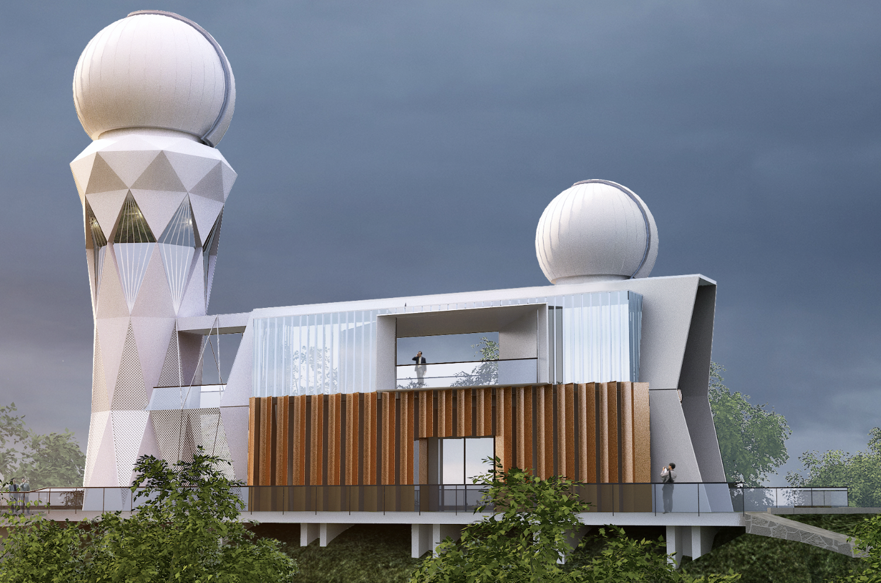

The Formation of the Eccentric Millisecond Pulsar by the Accretion-induced Collapse of the Massive White Dwarf
Reporter：王迪
Supervisor：龚碧平 教授
华中科技大学天文系

Slide 2
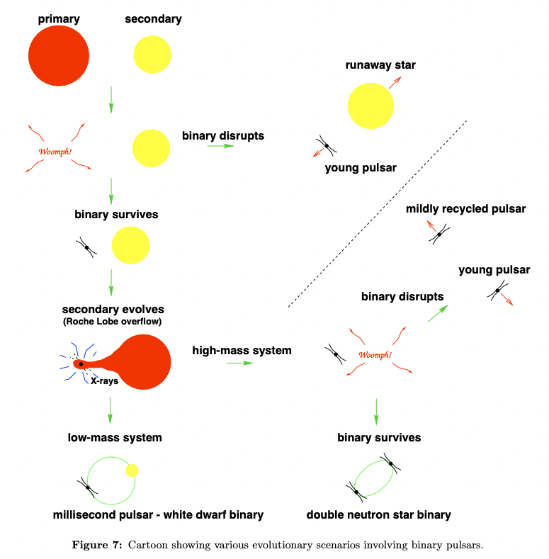
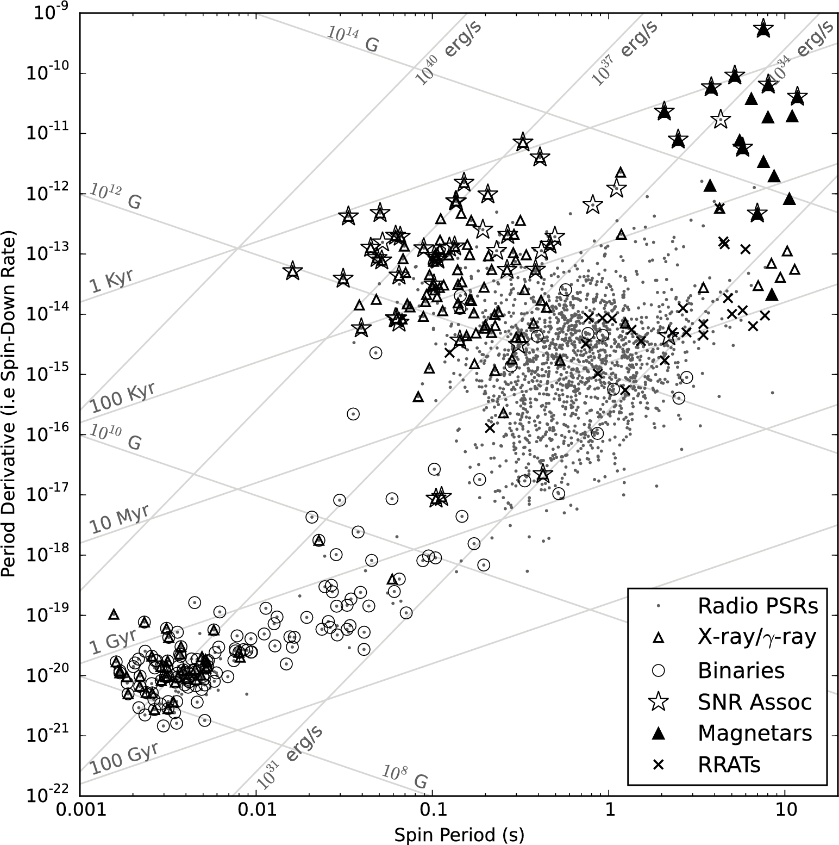
Millisecond Pulsar(MSP)
Classical evolutionary path
Circular orbit due to tidal circularization
Condon & Ransom 2016
Lorimer 2008
Notes:
自转周期在毫秒量级、低磁场，大部分毫秒脉冲星都在双星系统中
由于潮汐圆化，是圆轨道

Slide 3
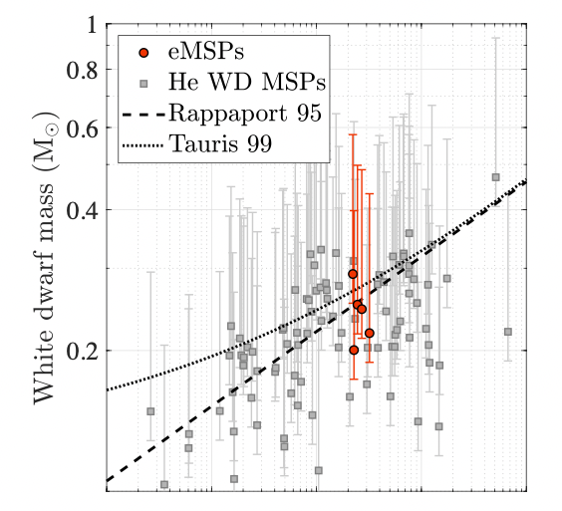
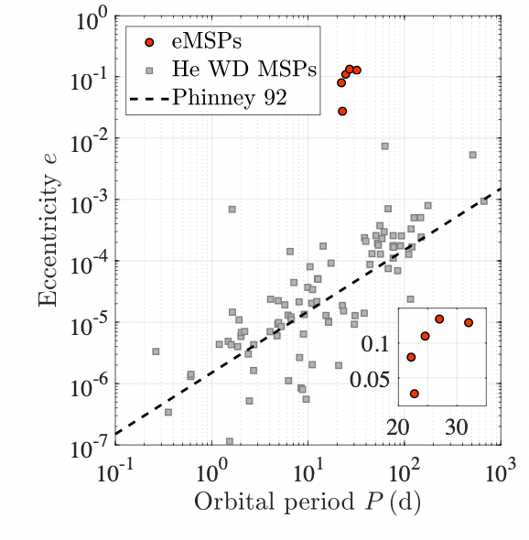
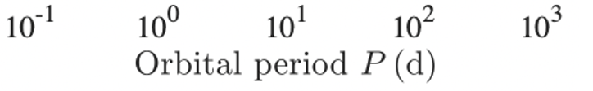
Eccentric Millisecond Pulsars(eMSPs)
Ginzburg & Chiang 2021

Slide 4
Models
Rotationally Delayed Accretion-induced Collapse (RD-AIC) of Massive White Dwarfs (Freire & Tauris 2014) or Neutron stars (Jiang et al. 2015)
Circumbinary Disk Model (Antoniadis 2014)
Asymmetrical Mass Ejection from Proto-white Dwarf (Han & Li 2021)
Resonant Convection (Ginzburg & Chiang 2021)
Notes:
前三个不能很好的解释窄周期范围，我们的工作和第一个模型类似。

Slide 5
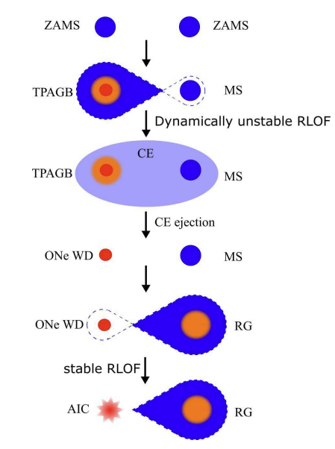
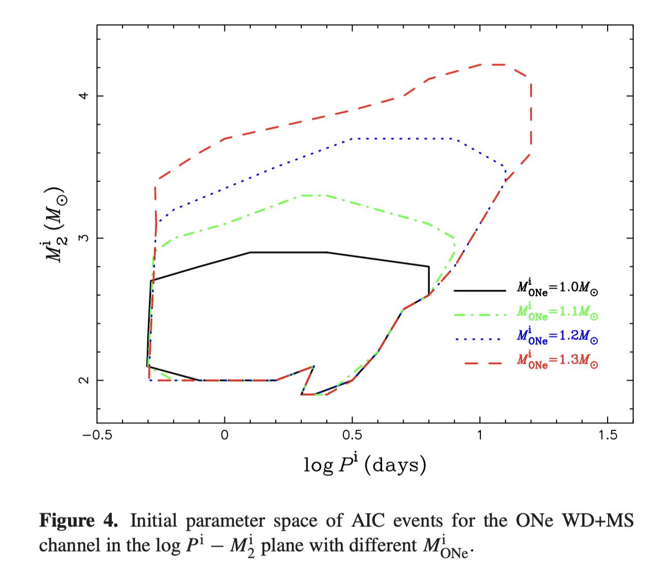
Accretion-induced Collapse(AIC) of White Dwarf
Wang & Liu, 2020
RG Channel
Formed MSP-WD system is expected to be circular due to tidal circularization (Tauris et al. 2013)
Wang 2018

Slide 6
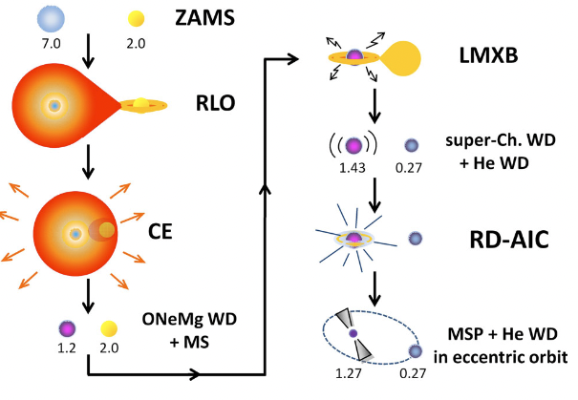
RD or Direct AIC?
If the remaining lifetime of RG is shorter than the circularization timescale, delay is not necessary
Direct AIC with insufficient circularization can form eMSPs
Demanding conditions may lead to narrow orbital period range
Freire & Tauris 2014

Slide 7
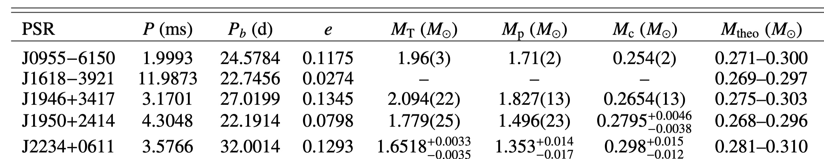
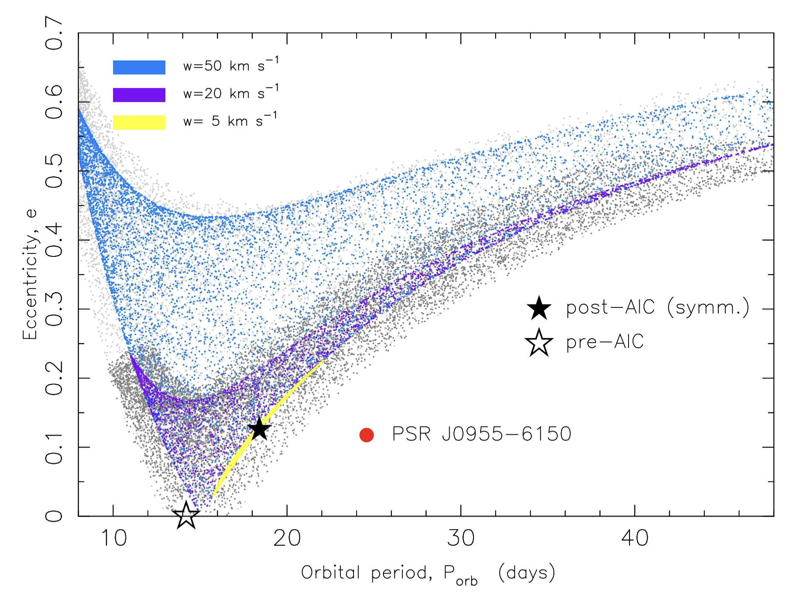
Direct AIC with insufficient circularization
Low WD mass of J0955-6150 rule out all models (Serylak et al.2022)
Pure kick models always predict larger eccentricity. Insufficient circularization in direct AIC can explain it.
Pure Kick
insufficient circularization
Serylak et al.2022

Slide 8
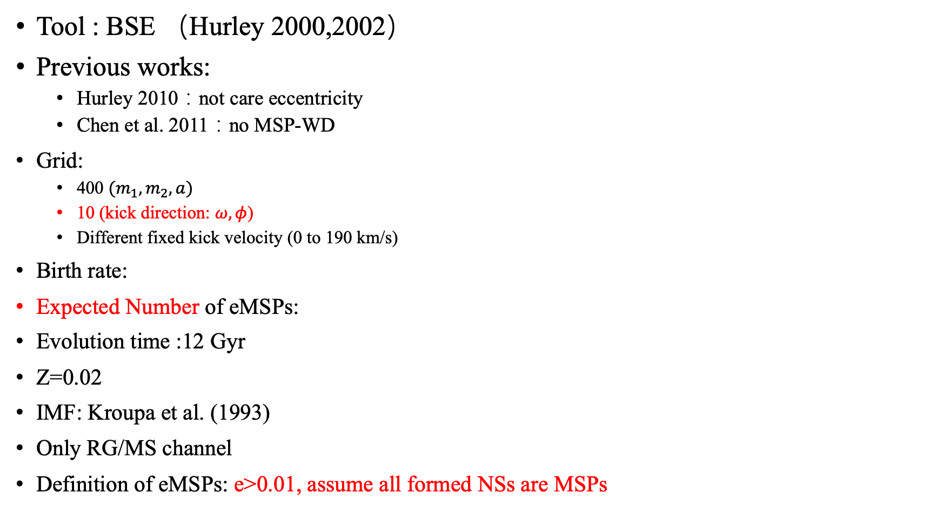
Binary Population Synthesis(BPS)
Tool : BSE （Hurley 2000,2002）
Previous works:
  Hurley 2010：not care eccentricity
  Chen et al. 2011：no MSP-WD
Grid:
  400 $(m_{1},m_{2},a)$
  10 (kick direction: $ω,φ$)
  Different fixed kick velocity (0 to 190 km/s)
Birth rate:
Expected Number of eMSPs:
Evolution time :12 Gyr
Z=0.02
IMF: Kroupa et al. (1993)
Only RG/MS channel
Definition of eMSPs: e>0.01, assume all formed NSs are MSPs
No kick grids, results are unstable
Notes:
假设形成的中子星都是msp

Slide 9

Expected number depends on $v_{kick}$
Detectable systems: 0.1d < pb < 1000d (Hurley 2010)

Slide 10

Parameter Distribution（$α=1$）

Slide 11

Parameters Distribution（$α=3$）

Slide 12
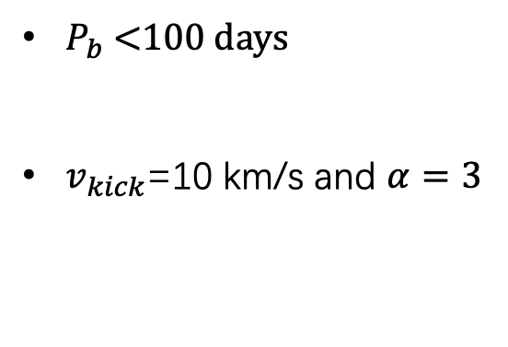
Comparison with the Observation
$P_{b}$ <100 days
$v_{kick}$=10 km/s and $α=3$
Z=0.02
Z=0.001

Slide 13
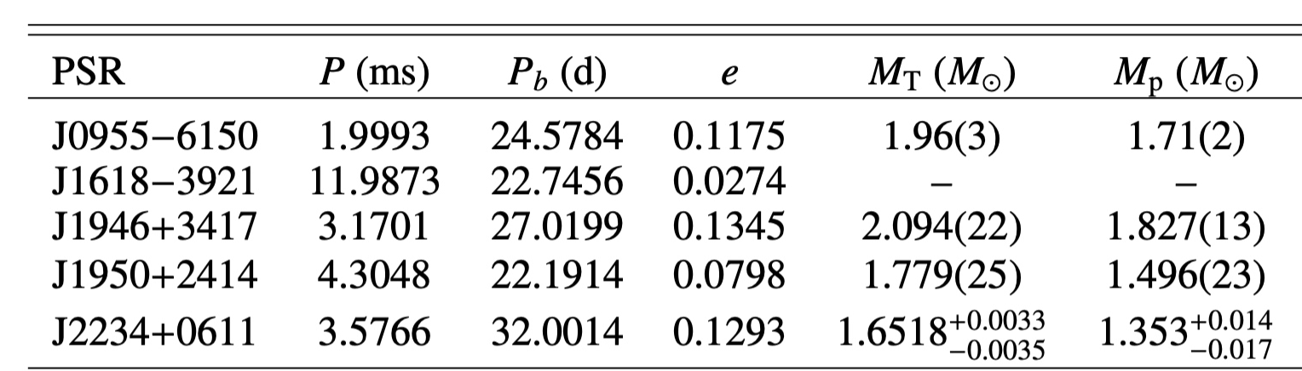
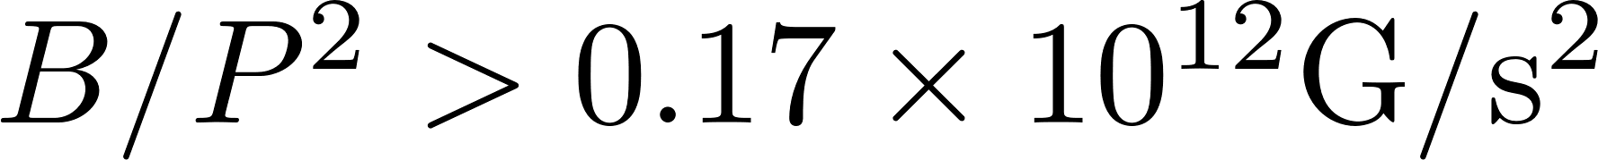
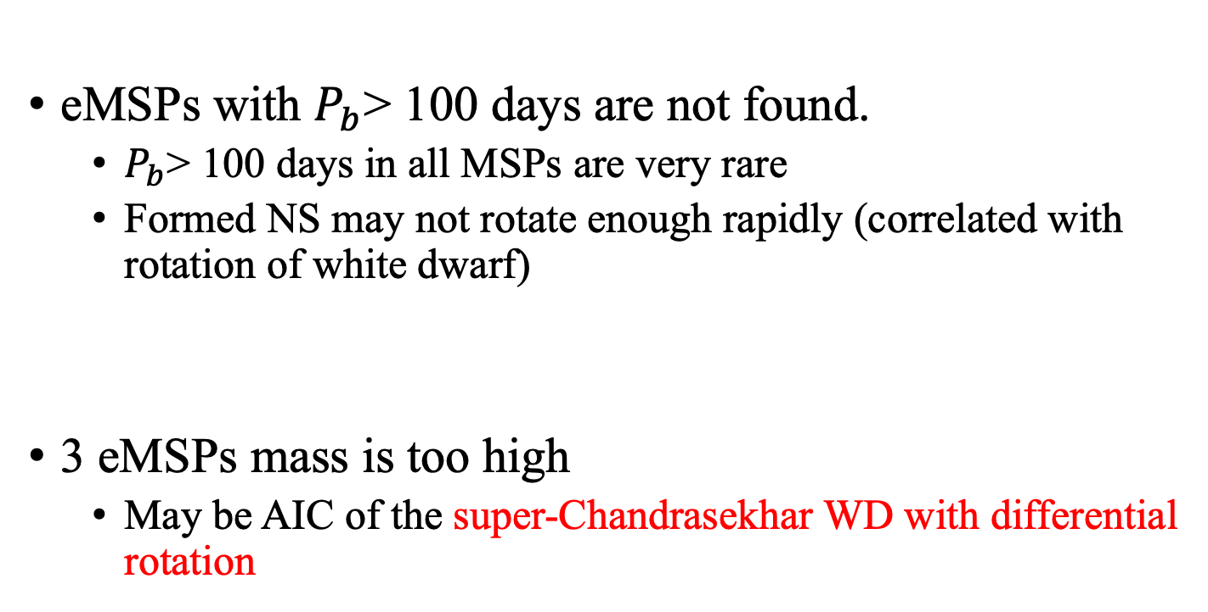
Pulsar mass and long orbit
eMSPs with $P_{b}$> 100 days are not found.
  $P_{b}$> 100 days in all MSPs are very rare
  Formed NS may not rotate enough rapidly (correlated with rotation of white dwarf)
3 eMSPs mass is too high
  May be AIC of the super-Chandrasekhar WD with differential rotation
Differential rotation evolution of WD need to be considered

Slide 14
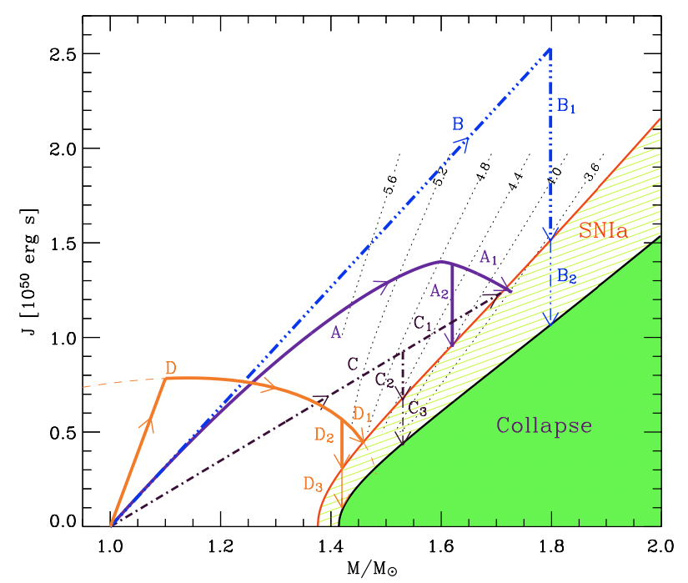
Differentially rotational super-Chandrasekhar WD
Angular momentum change:
  Accretion
  GW radiation
There path depend on the accretion history:
  Direct AIC of Chandrasekhar WD (this work)
  Direct AIC of super-Chandrasekhar WD
  RD-AIC of super-Chandrasekhar WD(Freire & Tauris 2014 no BPS)
Comprehensive simulation will be made in the future.
Yoon & Langer 2005

Slide 15
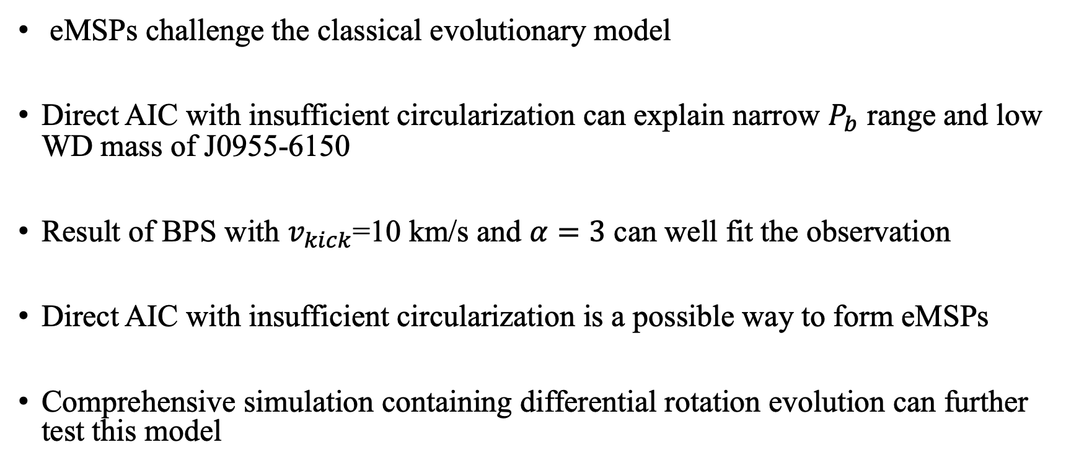
Summary
eMSPs challenge the classical evolutionary model
Direct AIC with insufficient circularization can explain narrow $P_{b}$ range and low WD mass of J0955-6150
Result of BPS with $v_{kick}$=10 km/s and $α=3$ can well fit the observation
Direct AIC with insufficient circularization is a possible way to form eMSPs
Comprehensive simulation containing differential rotation evolution can further test this model

Slide 17
Parameter Distribution（$α=1$）

Slide 18
Parameters Distribution（$α=3$）

