Slide 1
Simultaneous 2.25 and 8.60 GHz Interstellar Scintillation Observation of PSR B0740-28
Reporter:Rui Wang(王睿)
Shanghai Astronomical Observatory, Chinese Academy of Sciences(SHAO)
Coorperator：Zhen Yan，Zhiqiang Shen, Zhipeng Huang，Xiaowei Wang
Nanyang 2023.7.4

Slide 2
1、Background
2、Observation
3、Analysing & Result
4、Summary

Slide 3
The interstellar space is filled by interstellar medium, which is usually too thin to be directly detected. Pulsars can be used as probe to investigate the distribution and turbulence of these interstellar medium.
01

Slide 4
Pulsar interstellar scintillation
Similar to twikle of starlight due to the turbulent clusters in the atmosphere, inhomogeneous interstellar medium will cause the fluctuation of the flux density of pulsar.
Plasma with fluctuations of electron density was regarded as a scintillation screen. The motion of diffraction fringes results diffraction scintillation (DISS), the focusing and diverging effects of the screen causes refractive scintillation (RISS).
The spectrum of fluctuations of electron density can be regarded as ${P3n(q)=C}_{N}^{2}q−β$ ,
${ C}_{N}^{2}$ discribes fluctuations of electron density and usually be expressed by ${lgC}_{N}^{2}$, β is spectrum index.
Taken from “Hand book of pulsar Astronomy” Lorimer & Kramer

Slide 5
Gum Nebula(Gum 12)
The Gum Nebula and pulsars along this direction
Gum is a nearby supernova remnant. In recent paper(Yao et al 2017, Apj), the central of Gum is set to be 450 pc away and radius is 170 pc.
Prior observations have provided some indirect evidence about its influence on pulsar scintillation.
However, the precise positions of the scintillation screens of these pulsars hadn’t been determined.
VTSS Hα map

Slide 6
PSR B0740-28
Basic parameters in ATNF Pulsar Catalogue
Among these pulsars, PSR B0740-28, is chosen as the primary target for observation.
No known nebula locates closer than the Gum Nebula in the direction of B0740-28, confirming the influence of the Gum Nebula is easier.

Slide 7
PSR B0740-28
This table is fomer observation about PSR B0740-28, shows B0740-28 needs higher observation frequency, such as TMRT’s 2.25&8.60 GHz. But in pioneer’s observation, such frequency data is few, and some of them only gave partly parameters.

Slide 8
Observation
We detected 21 epoches of obvious DISS at both 2.25 and 8.60 GHz observations of PSR B0740-28 using TMRT. It contains three kinds of figure:
The dynamic spectrum is firstly obtained.
The auto-correlation functin of the dynamic spectrum
The 2D-FFT result of the dynamic spectrum, called secondary spectrum,
02

Slide 9
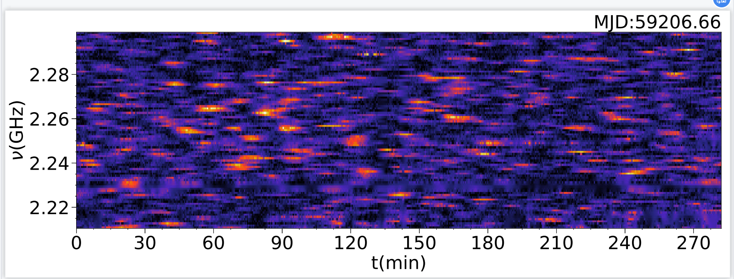
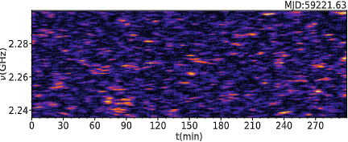
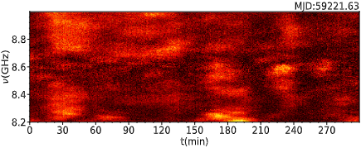
Dynamic spectrum
Dynamic spectrum is the image of pulsar flux density varying with time and frequency, and the most intuitive reflection of interstellar scintillation.
Here displays two pairs of dynamic spectra of B0740-28 at 2.25/8.60GHz, with a time interval of half a month. It shows distinctive scintillation patterns at both frequency.

Slide 10
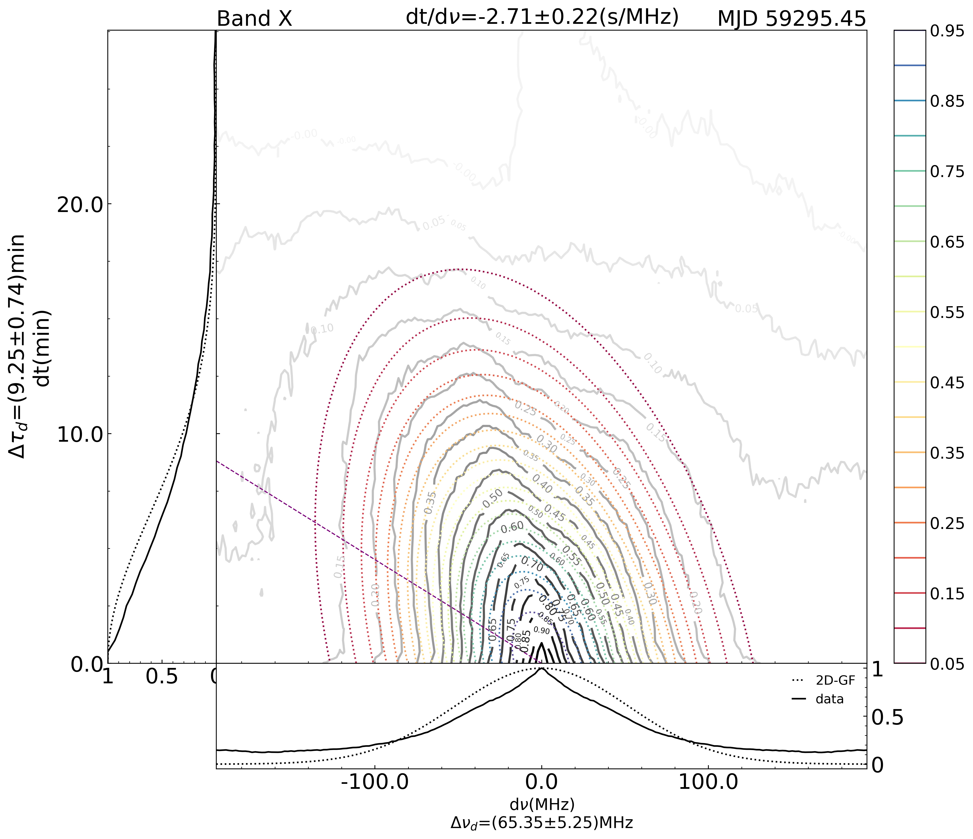
ACF
We use 2D elliptical Gaussian function to fit ACF data, then get reliable decorrelation time (Δτ_{d}), decorrelation bandwidth (Δν_{d}) and slope (dt/dν)(Gupta et al 1994, MNRAS).

Slide 11
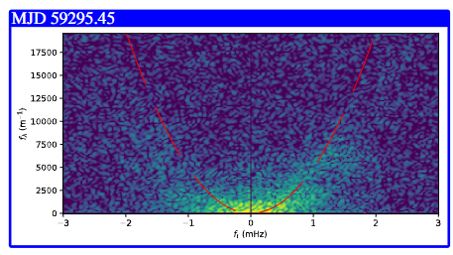
Secondary spectrum
When scintillation occurs in a relatively small fractional portion (thin screen condition) and the angular broadening function has a well-defined core and an outer halo are both satified, arc appears in secondary spectrum.

Slide 12
Analysing & Result
1
V_{iss}
2
β$,C_{N}^{2}$
03
3
Arc

Slide 13
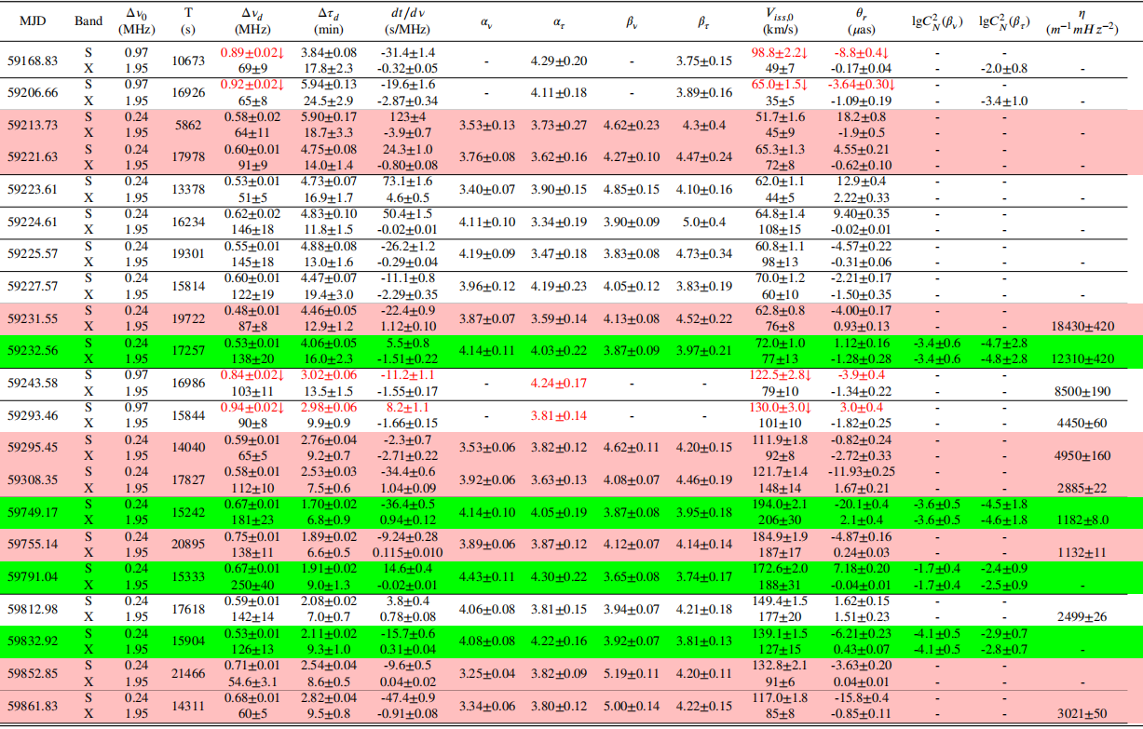
Result

Slide 14
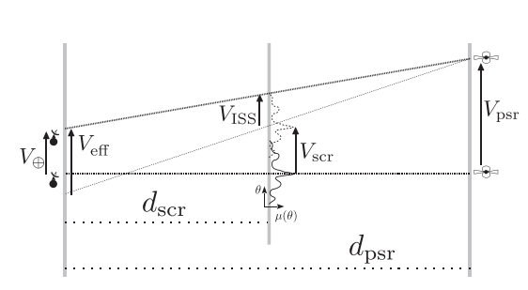
V_{iss}
In another way, theory gives that the value of V_{iss} can be obtained by :
$$V_{iss}=A0\frac{\sqrt{∆νdxD}}{Δτdν}$$
D is the distance of pulsar, ν is the observation frequency, A₀ is model-dependence parameter.
V_{iss} or V_{eff} is made of V_{earth}, V_{scr} and V_{psr}. The vector expression is $\vec{V}\text{is}\text{s}\text{=}\text{x}\vec{V}\text{p}\text{+}\vec{V}\text{earth}\text{−(}\text{1}\text{+}\text{x}\text{)}\vec{V}\text{scr}$
Here x=d_{scr}/(d_{psr}-d_{scr})
Gupta et al 1995 Apj

Slide 15
For a solitary pulsar, V_{iss} experiences an annual modulation due to Earth’s revolution as
V_{iss}²=[xV_{p,δ}−(1+x)V_{scr,δ}+V_{e}(cosAsinδcosω−sinAsinδcosω)]²+ [xV_{p,ω}−(1+x)V_{scr,ω}+V_{e}(cosAsinω+sinAcosω)]² (Bogdanov et al 2002 Apj)
A is the Elong. of earth. δ and ω is the Elat. and Elong. of pulsar.

Slide 16
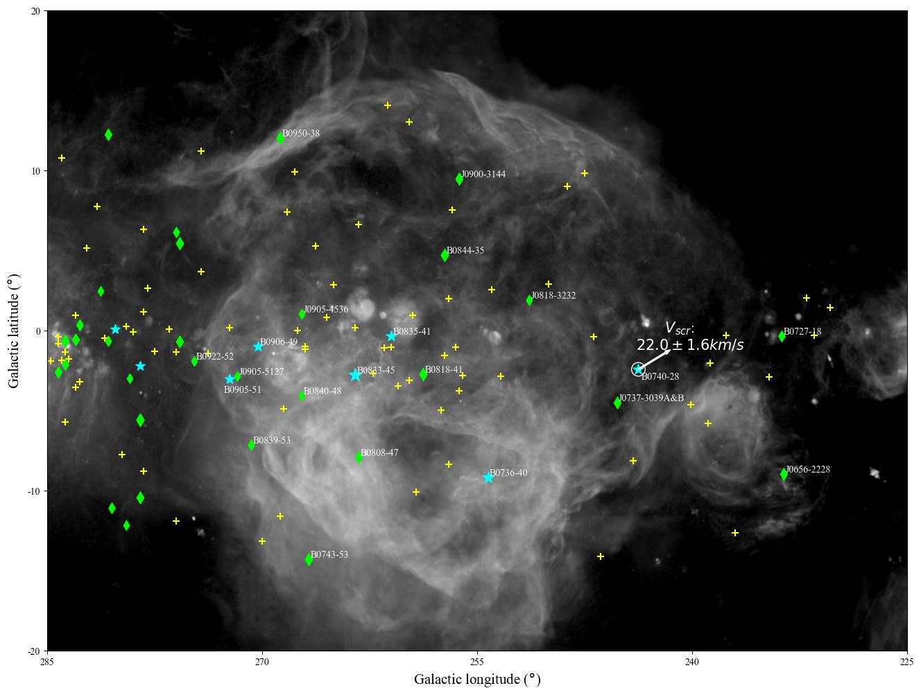
The expansion velocity of gum is about 13km/s, if we add the velocity of galaxy rotation (~10km/s), it is coincident with V_{scr}.
x=0.14±0.02, means that d_{scr} is 250±40 pc.
The geometry model gives the forward edge of gum in front of B0740-28 is about 300pc away from earth.

Slide 17
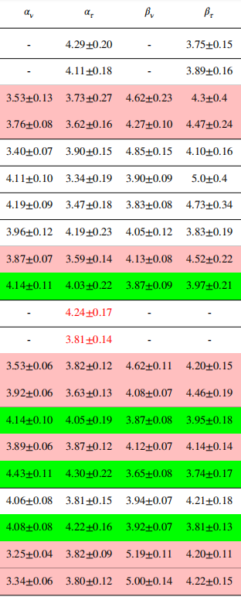
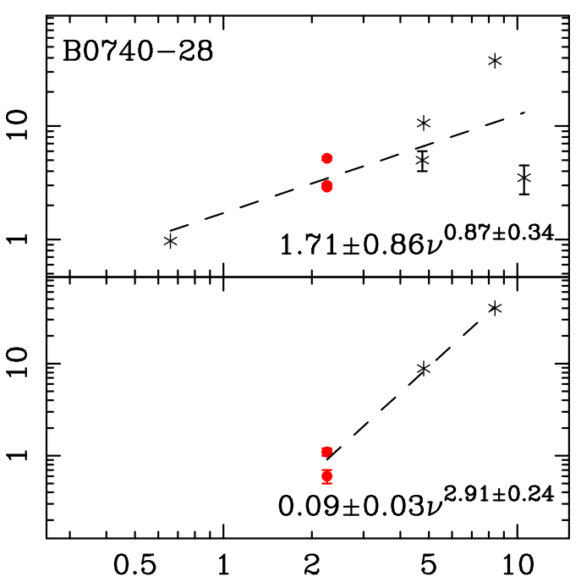
β
Δν_{d}~ν^{α}，Δτ_{d}~ν^{(α−2)/2} , if β≤4，α=2β/(β−2), or α=8/(6−β), this relationship indicates that α≥4. When β>4, scintillation is insensitive with frequency, incoincidence with our result. Consequently, we assume β<4(Krishnakumar et al 2019 Apj).
In our availiable simultaneous 2.25/8.60 GHz interstellar scintillation observations, Δτ_{d} and Δν_{d} will give α_{ν}, α_{τ} seperately.
Pioneers got α_{ν}=3.74±0.68, α_{τ}=2.91±0.24, but their data is in not simultaneous, can not exclude that different clump of plasma is observed.
Wang et al 2018 A&A

Slide 18
${lgC}_{N}^{2}$
When β<4, $C_{N}^{2}$ can be obtained by an analytical expression(Cordes et al 1985 Apj).
Avaliable epochs gives that it ranges between -1.7 to -4.7, similar to other pulsars but incoincident with pioneers about B0740-28. This is because ${lgC}_{N}^{2}$ is sensitive with β, pioneers assume β=11/3, if we use β=11/3, ${lgC}_{N}^{2}$ ranged between -1.5~-1.9.

Slide 19
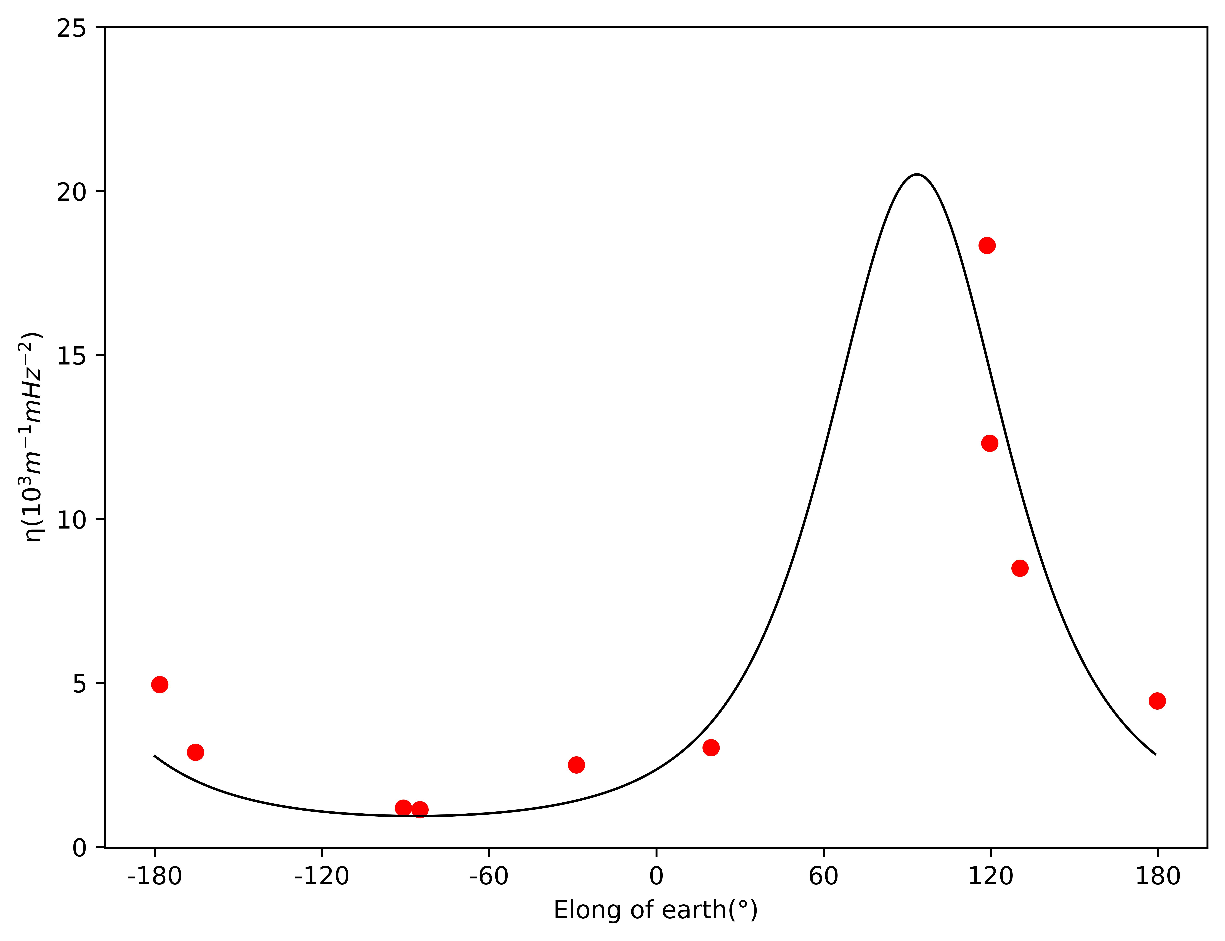
Arc
Later than MJD 59225, arc somtimes arised from 8.60GHz Secondary spectrum.
η is the curvature of arc, η=$\frac{Dx}{2(Veff\cos{ψ)2}}$, ψ is the angle between V_{eff} and the long axis of the scattering(Cordes et al 2006 Apj).
The fitting result gives the direction of long axis of the scattering.

Slide 20
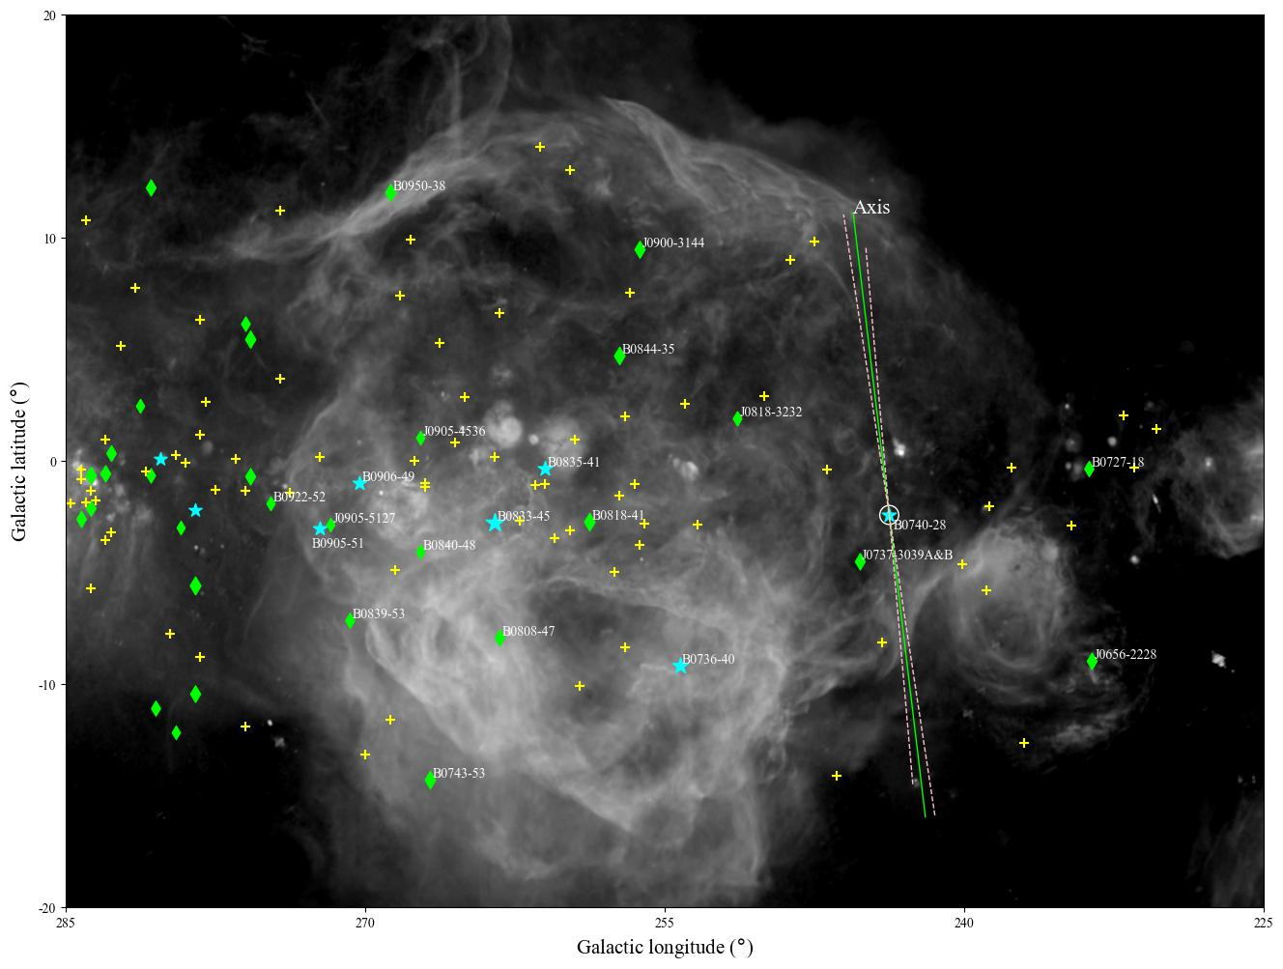
According to relationship between plasma distribution and scattering. It means that the fluctuation of electron density is along the axis, coincident with the structure shown in the Hα map.

Slide 21
Summary
There is obvious DISS of PSR B0740-28 at both 2.25 and 8.60 GHz
d_{scr} and V_{scr} of the scattering screen is fitted successfully, it is near the forward edge of gum and the velocity is similar.
β<4.0 is shown in only 4 epochs of our observation, while 8 epochs of observation could not be clearly explained by relevent theory in the error range.
Obvious arcs arises in some secondary spectrum of 8.60 GHz observations, while simultaneous 2.25 GHz observations not.
The long axis of the scattering is coincident with structure of the Gum nebula.
04

Slide 22
Thanks for attention

