Slide 1
Pulsar J1906+0746 at FAST
a unique exploration of radio-pulsar beam maps
Yuyang Wang (王宇阳)
Anton Pannekoek Institute for Astronomy,
University of Amsterdam
Supervisor: Joeri van Leeuwen
FAST/Future Pulsar Symposium 12, Nanyang
Notes:
Hello everyone, I’m Yuyang Wang, a PhD student from University of Amsterdam. My main collaborator is Joeri van Leeuwen. Thanks for the organizers giving such a chance. It’s my great pleasure to give the talk at the FPS12. I will introduction a highly relativistic binary pulsar system J1906+0746, which is previously mentioned in Lingqi Meng’s talk, I will go into more depth of its basic propertry and its study with FAST.

Slide 2
Outline
Background
Geodetic precession and beam mapping
FAST observation and data processing
Preliminary results
Summary
Notes:
So, this is the outline of my talk. First, I will introduce the background information of the system. And what is geodetic precession and how it leads to beam mapping. Then I will introduce the FAST observation and data processing. At the last, I will show some preliminary results and give a summary.

Slide 3
PSR J1906+0746
Young binary pulsar found in PALFA observations in 2004 (archival data can date back to 1998)
Spin period $P$ ∼ 144 ms
Very short 4-hr orbit around another neutron star, with an eccentricity of 0.085
Credit: Joeri van Leeuwen
Notes:
(play the animation) So, PSR J1906+0746 is a young binary pulsar whose characteristic age is 10^5 years. It’s found in PALFA observations with Arecibo in 2004 and the archival data can date back to 1998. The pulsar is a normal pulsar and has a spin period of 144 ms and is in a very short 4 hours orbit around another neutron star with an eccentricity of 0.085. In binary systems, the old recycled pulsars are very common, but the young pulsars are very rare. The animation shows the binary motion and beam rotating of J1906. There is no sign of mode changing behavior in the dense sampling after the discovery, and thus no sign of magnetospheric instabilities

Slide 4
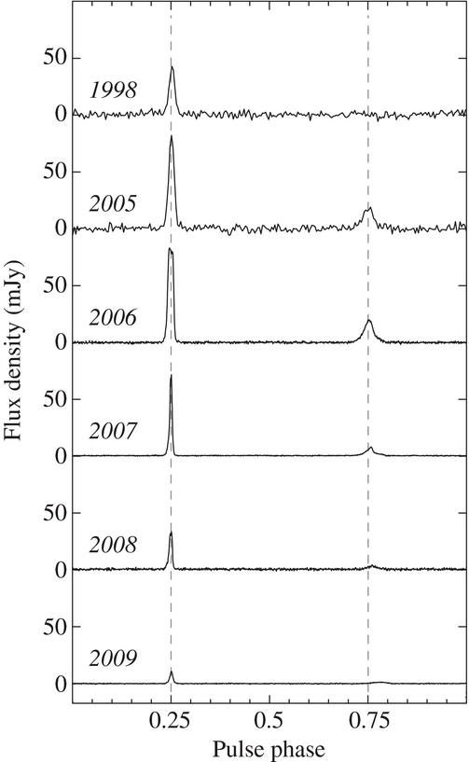
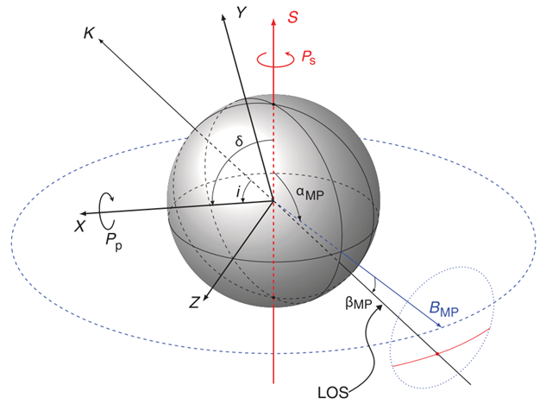
PSR J1906+0746
Main pulse and interpulse emissions from opposite magnetic poles
Total mass ∼ 2.61 $M_{⊙ }$ and companion mass ∼ 1.32 $M_{⊙ }$
Dispersion measure ∼ 217.75 pc cm$^{−3}$
van Leeuwen et al. (2015)
Desvignes et al. (2019)
Notes:
So, since discovered, J1906 shows both a main pulse and interpulse, which indicates a nearly orthogonal geometry where emission from both magnetic poles is visible. The total mass of the system is high, about 2.61 solar mass, and the companion mass is 1.32 solar mass. The dispersion measure is 217 pc per cubic centimetre.

Slide 5
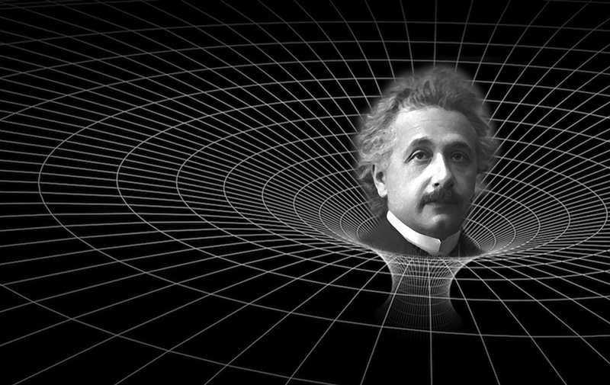
Geodetic precession
In general relativity, the spacetime is curved by mass.
Notes:
Now, let’s go to the most interesting part of this pulsar, geodetic precession. So, what is geodetic precession and why we say it enable the beam mapping of the pulsar? In general relativity, the spacetime is curved by mass.

Slide 6
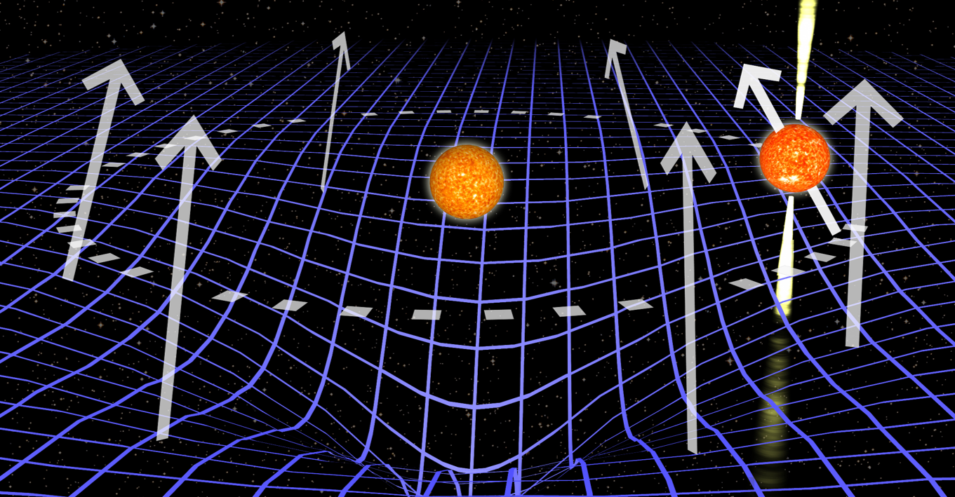
Geodetic precession
In curved spacetime, the spin vectors will precess around the total angular momentum of the system.
Notes:
In the curved spacetime, when the pulsar moves in the orbit, the direction of the spin vector will not be preserved. It will precess around the orbital angular momentum and no longer be aligned with the initial direction.

Slide 7
Geodetic precession
The evolution of the pulsar spin axis is
where
For J1906+0746, we have
Short orbital period: 4 hrs
High companion mass: 1.32 $M_{⊙ }$
→ high precession rate: ${\sim 2.2}^{°}$ per year
The spin precession leads to a change in viewing geometry
Notes:
The evolution of the pulsar spin axis is given by the cross product of the orbital angular momentum vector Omega_spin1 and the pulsar spin vector. Its magnitude is given by this formula. The So, why the geodetic precession enables the beam mapping?

Slide 8
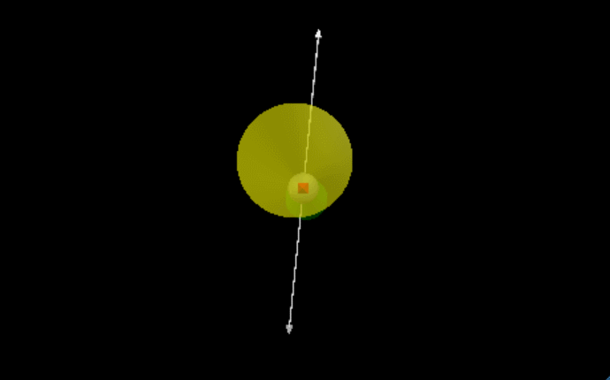
No precession
Geodetic precession
Notes:
When there is no precession, we can see only a fixed part of the beam. In the gif, the red cross indicate the line-of-sight direction, when the beam rotates, the line-of-sight will sweep a fixed slice of the beam.

Slide 9
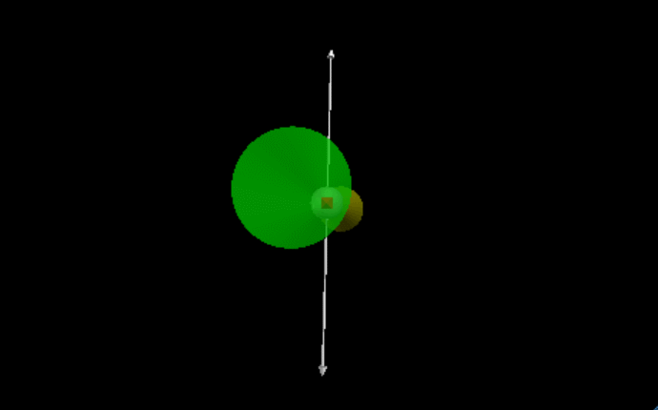
Precession → beam mapping
Geodetic precession
Notes:
On the contrary, if there is precession, it allow us to see the different parts of the emission beam. You can see in the gif, the spin axis is rotating, the line-of-sight sweep across different latitudes of the beam.

Slide 10
Beam maps of the radio emission
Adapted from Desvignes et al. (2019)
Notes:
So, with the complete determination of the geometry of the system, we can use the observed pulse profiles recorded at different epochs to reconstruct the beam map of the radio emission. This figure shows the beam maps of the radio emission flux from both poles. The left panel is emission from main pulse while the right panel is from the interpulse. The main pulse is no longer visible around 2018, while the interpulse is still visible with FAST observation but will disappear around 2028 by prediction. The latitudinal extent of a pulsar beam determines the pulsar “beaming fraction”.

Slide 11
Beam maps of the polarization
Desvignes et al. (2019)
Notes:
Similarly, for the polarization, this figure shows its beam maps. Panel A and B show the fractional linear polarization while C and D show the fractional circular polarization. This pulsar has a high linear polarization and nearly no circular polarization.

Slide 12
FAST observations overview
Settings:
Receivers: 19-beam (central)
Number of channels: 4K
Bandwidth (MHz): 500
Sampling time (μs): 49.152
Search mode, incoherent dedispersion
Sources:
J1906+0746: Swift Calibration / Tracking
PKS2209+80 (calibrator): OnOff
Observing dates
2022 (nine sessions between 8 March and 11 October, each ~2hrs)
2023 (Ongoing)
Notes:
So, let’s come to the FAST observation, For the backend settings, we use the 19-beam central, 4k channels and 49 microsecond sampling time. For the pulsar, we use the swift calibration and tracking mode, while for the flux calibrator, we use a quasar and the onoff mode. The observing time in 2022 is divided into 9 sessions between March and October, each session around 2 hrs. And the 2023 observation is still ongoing.

Slide 13
Data processing
Dspsr (folding)
PSRCHIVE
pam (data reducing)
paz (RFI cleaning)
pac, fluxcal (polarization / flux calibration)
pas, pat (making template and TOAs)
…
Tempo2 (timing)
Notes:
For the data processing, we use the dspsr to fold the fits file and then use PSRCHIVE for RFI cleaning, polarization / flux calibration, making template and TOAs and so on. And we use tempo2 for timing analysis.

Slide 14
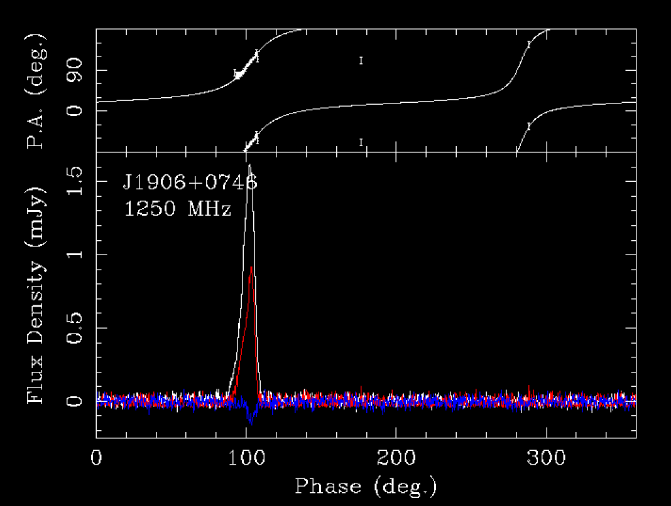
Pulse profile
Wang et al. in prep.
Notes:
So , after folding, the pulsar is visible from the pulse from 2 hrs data in the left figure with very high signal-to-noise ratio. The right figure shows the polarization position angle, the flux and linear and circular polarization.

Slide 15
Pulse profile
Interpulse
Main pulse
Interpulse
2022
van Leeuwen et al. (2015)
Wang et al. in prep.
Notes:
The profile variation is a natural result of the geodetic precession. The left figure shows the profile variation across ten years. The main pulse increased then faded. And disappeared around 2018. In the 2022 FAST data, the main pulse is gone, and we can only see the very weak interpulse. The flux is only 1 mJy. Thanks to FAST high sensitivity, we are still able to timing this pulsar precisely.

Slide 16
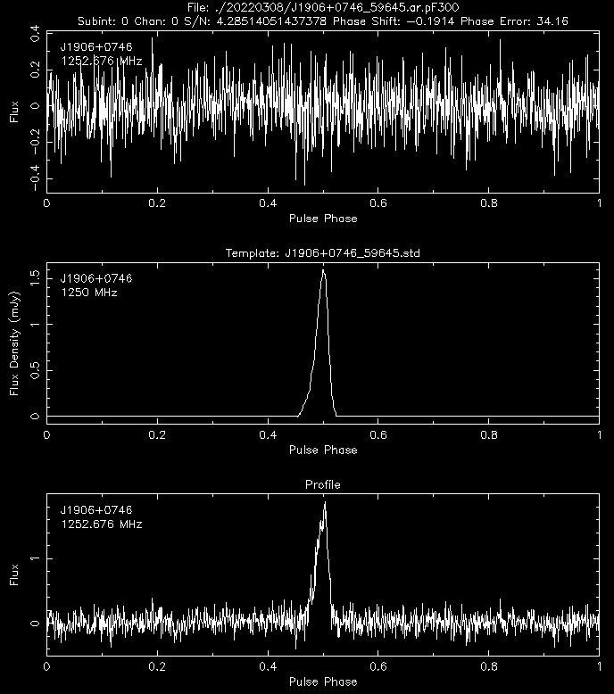
Time of arrivals
The observed time of arrival (TOA) of a pulse reflects the time of emission at the pulsar
Flux residuals
Profile template
TOAs
Integrated profile
Notes:
The time of arrival of a pulse reflects the time of emission at the pulsar. This figure shows how we obtain the TOA from profile template and integrated profile. When the template is perfectly subtracted from the integrated profile, we would have flux residuals like white noise.

Slide 17
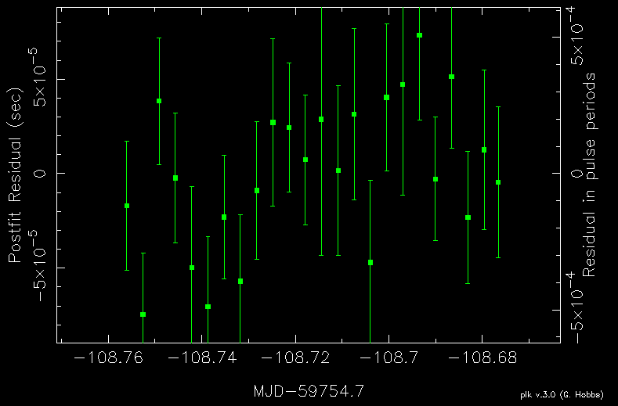
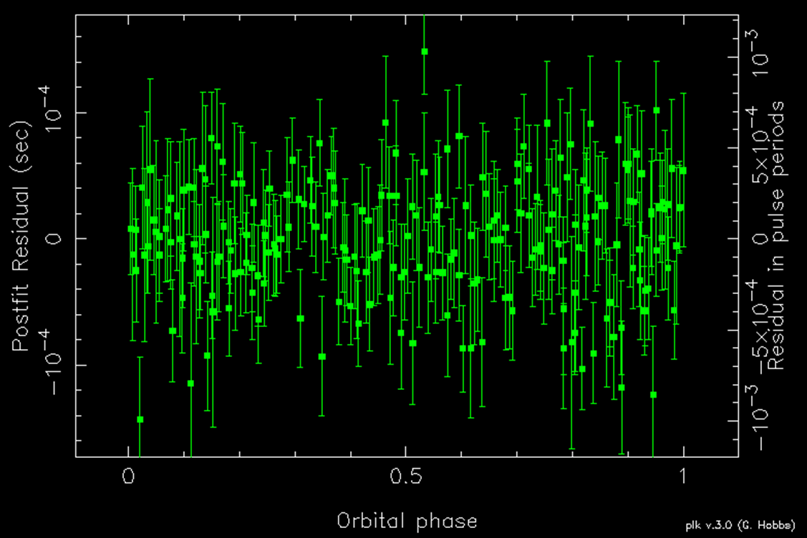
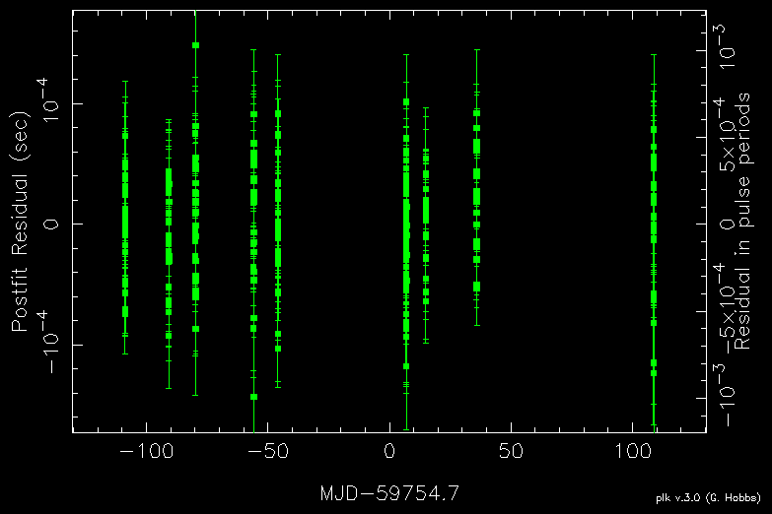
Timing residuals
The TOA differences between observations and model predictions
Zooming-in
Notes:
The timing residuals is the TOA differences between observations and model predictions. The left figure is the timing residuals as a function of the observing dates from the 2022 FAST data. The right is a zooming-in figure of one day’s residuals.

Slide 18
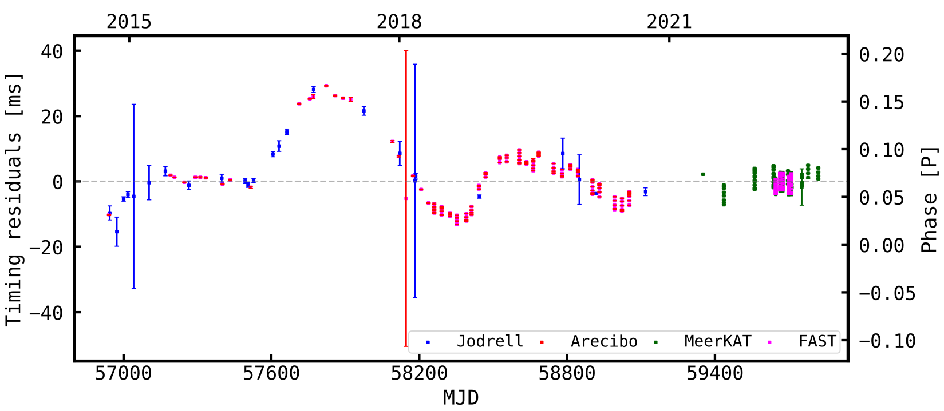
Long-term residuals
intrinsic timing noise
Vleeschower Calas et al. in prep.
Notes:
This is the long-term timing residuals of this pulsar from our collaborators. The data is from Jodrell, Arecibo, MeerKAT and FAST. It shows large intrinsic timing noise which is related to the profile variation and unstable nature of this young pulsar.

Slide 19
Measuring post-Keplerian parameters
Desvignes et al. (2019)
To be done with FAST data
Notes:
This figure shows the constraints on the component mass from post-Keplerian parameters from previous work. This part is still to be done with FAST data.

Slide 20
Summary
J1906+0746 provides a great opportunity to study both the General Relativity (GR) and the radio pulsar emission
The FAST high precision timing observation of this pulsar, mapping out the edge of the interpulse region
Notes:
So, in summary, J1906 is provides a great opportunity to study both the General Relativity (GR) and the radio pulsar emission. And FAST high precision timing enable us to map out the very weak interpulse region.

Slide 21
Thanks for your listening!
Notes:
Thanks for your listening.

