Slide 1
The physical origin of the standard candle relation in gamma-ray bursts
Reporter：Fan Xu (许帆)
Collab.：Yong-Feng Huang* , Jin-Jun Geng, Xue-Feng Wu, Xiu-Juan Li, and Zhi-Bin Zhang
2023.7.5

Slide 2
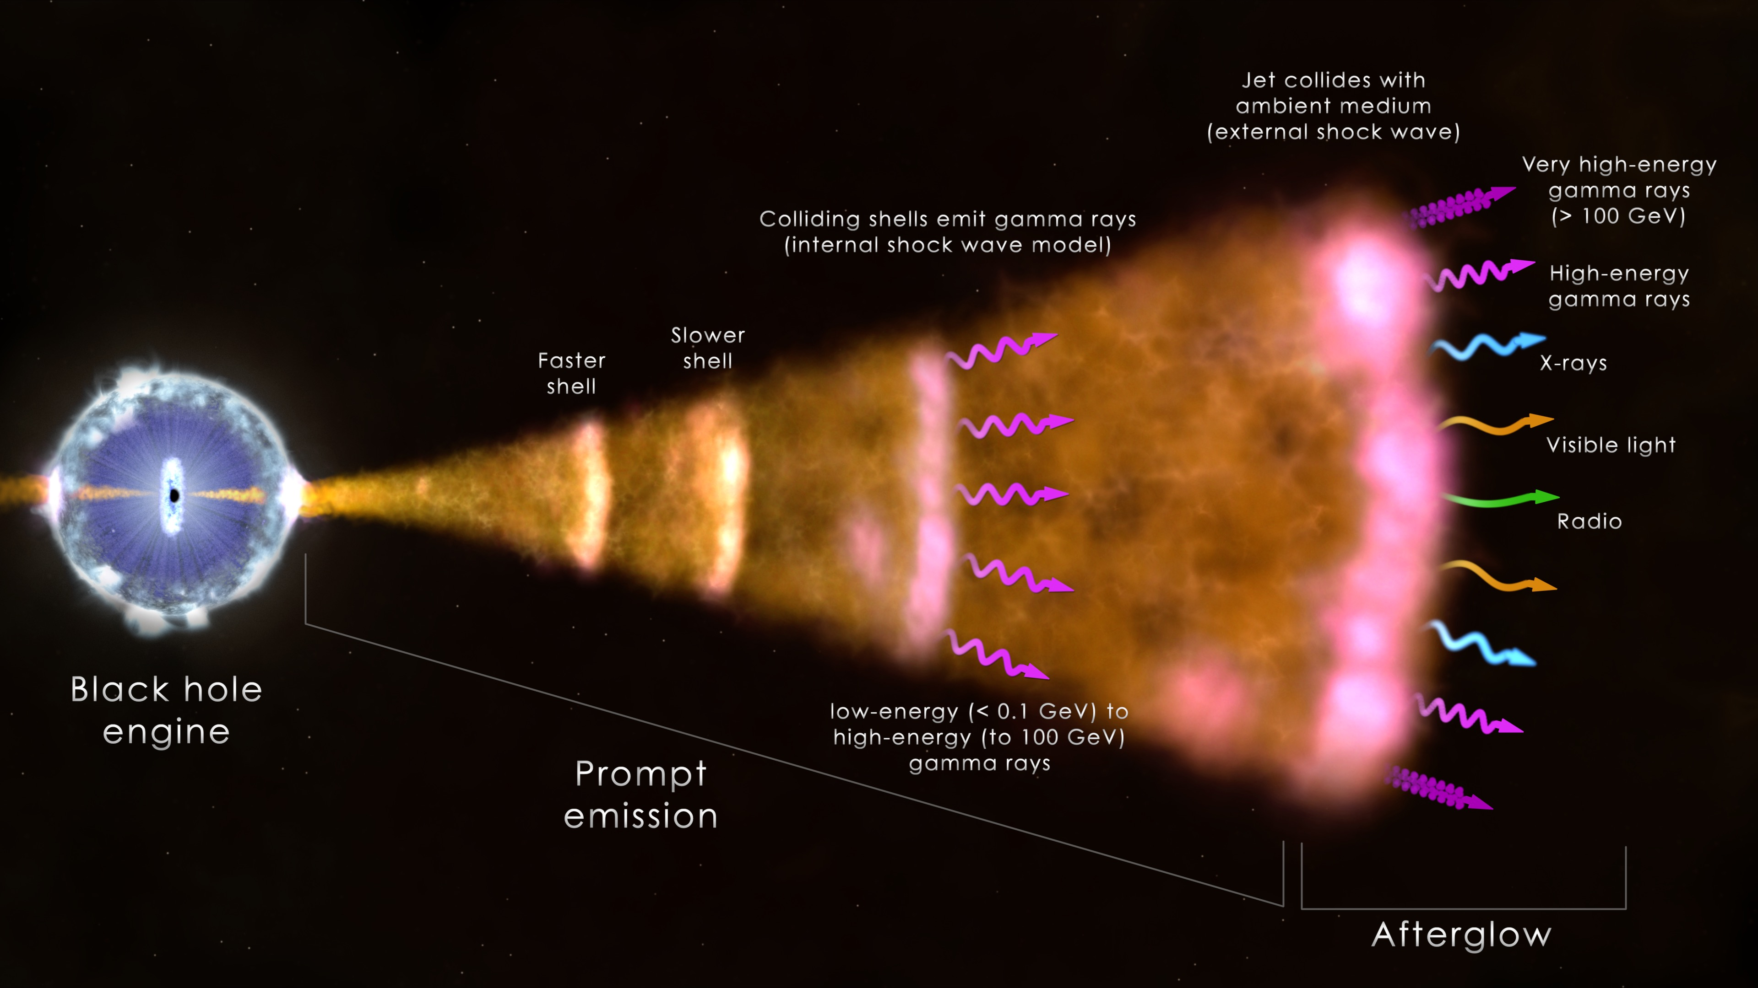
https://en.es-static.us/upl/2019/11/gamma-ray-burst-mechanism-lg.jpg

Slide 3
GRB correlations
$E_{p}−E_{iso}$ relation (Amati relation)
Prompt emission
$E_{p}−L_{p}$relation (Yonetoku relation)
$E_{p}−E_{γ}$ relation (Ghirlanda relation)
… …
$L_{X}−T_{a}$ relation (Dainotti relation)
Afterglow
$L_{X}−T_{a}−E_{iso}$ relation (Xu-Huang relation)
$L_{X}−T_{a}−E_{p}$ relation
… …

Slide 4
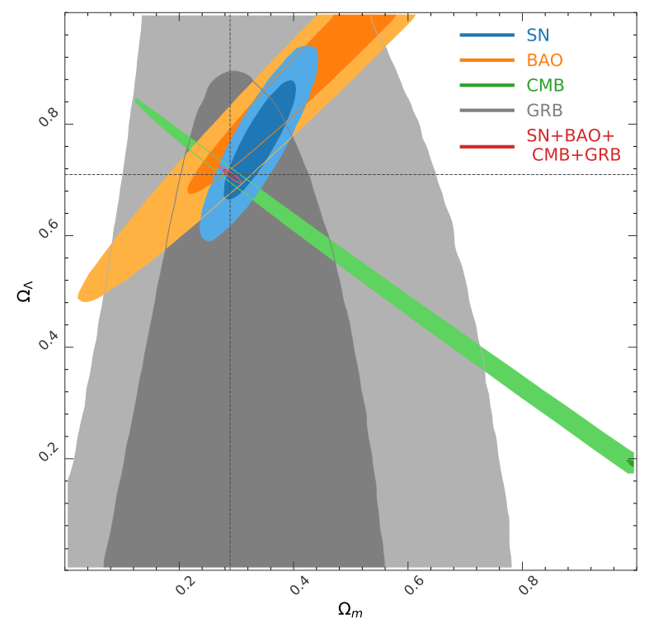
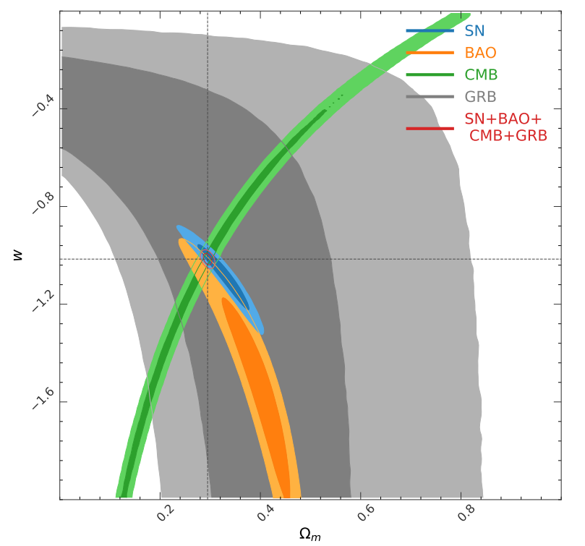
GRB correlations
Cosmological parameters constrain from $L_{X}−T_{a}−E_{p}$ relation and other probes.
$$Ω_{Λ}$$
$$w$$
$$Ω_{m}$$
$$Ω_{m}$$
Xu et al. ApJ, 2021

Slide 5
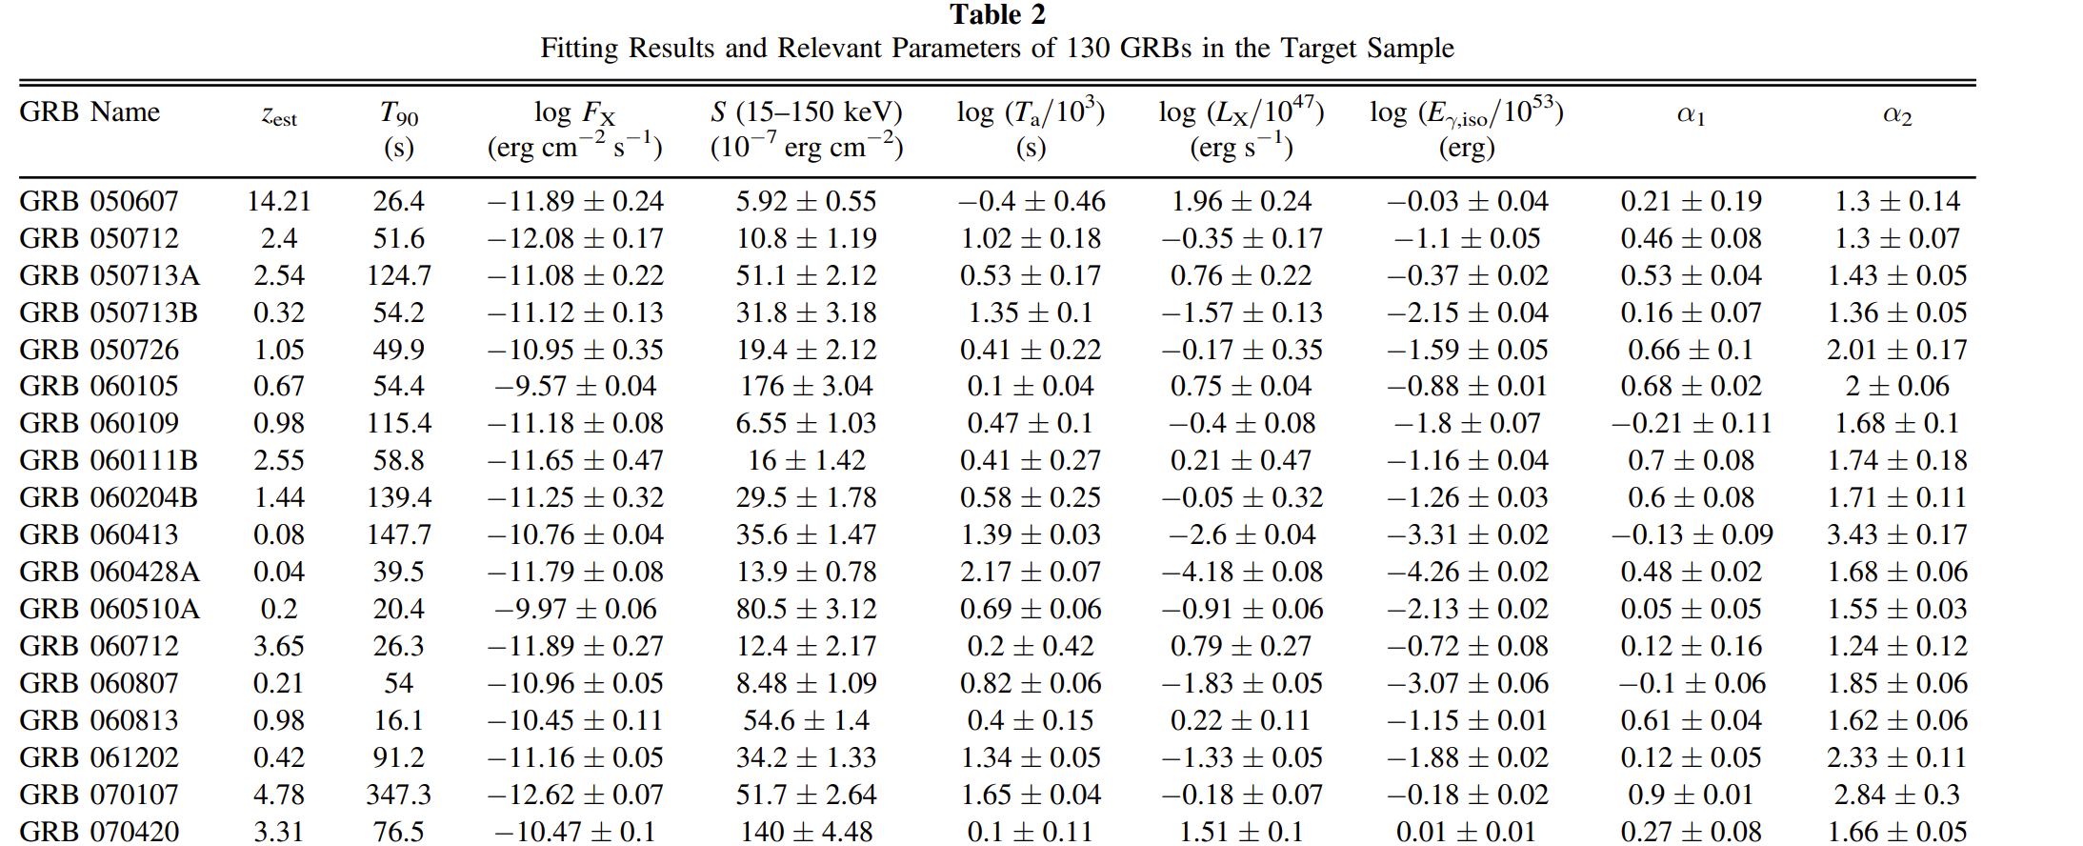
GRB correlations
Pseudo-redshifts from $L_{X}−T_{a}−E_{iso}$ relation
Deng et al. ApJ, 2023

Slide 6
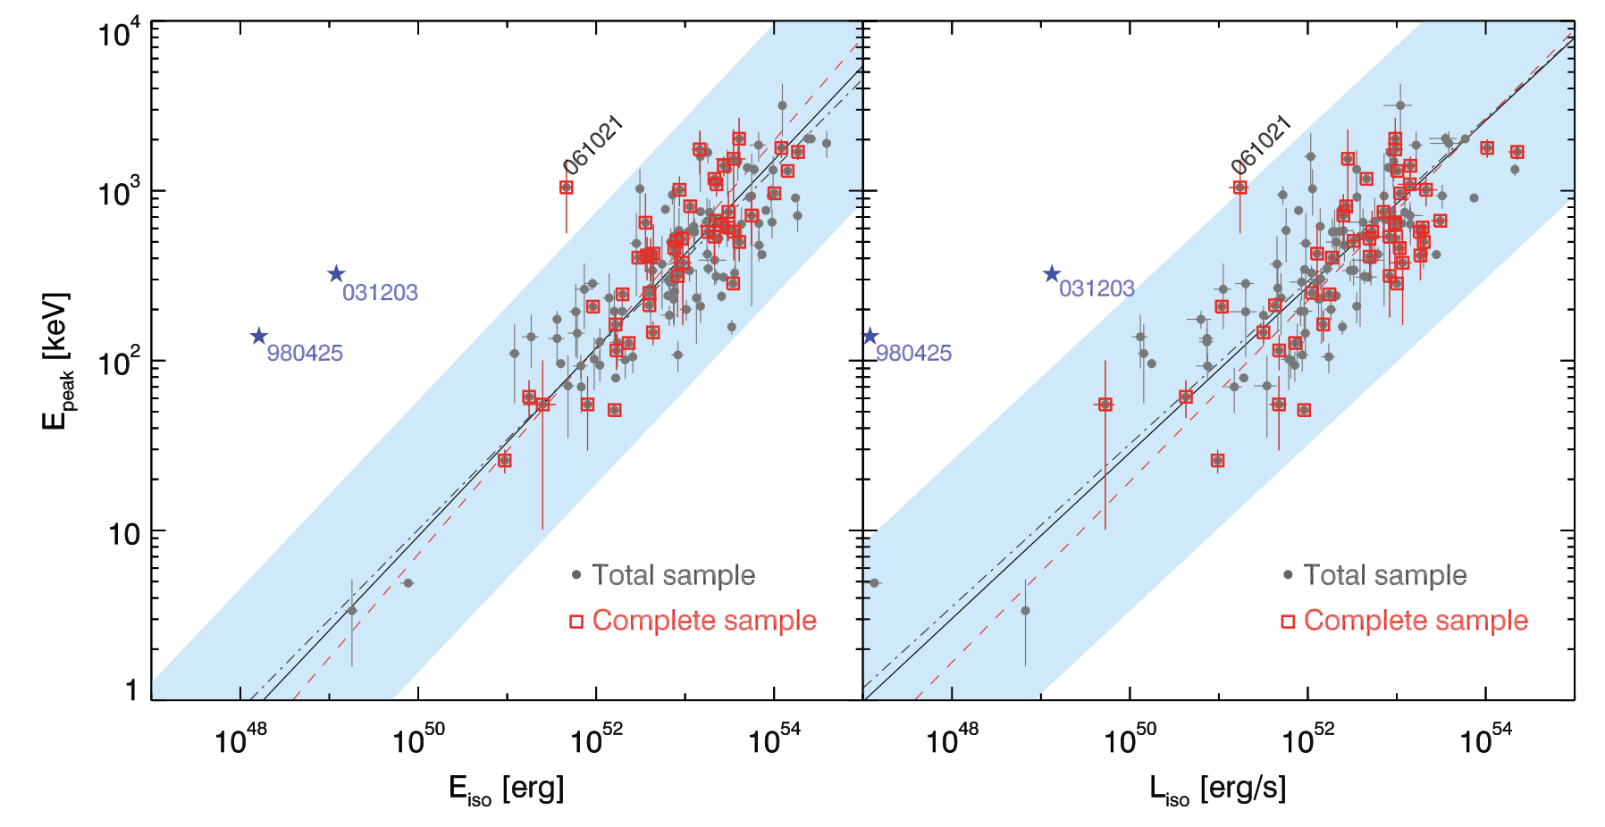
GRB correlations
Amati relation
Yonetoku relation
$$E_{p}∝E_{iso}^{0.53±0.02}$$
$$E_{p}∝L_{p}^{0.48±0.04}$$
Nava et al. 2012

Slide 7
Model
1.Geometry:
Top-hat jet
2.Prompt emission mechanism:
Internal shock model
3.Radiation process:
Flash and curvature effect
4.Radiation mechanism:
Synchrotron radiation
On-axis ($θ_{jet}>θ_{obs}$)
Off-axis ($θ_{jet}<θ_{obs}$)
Xu et al. 2023

Slide 8
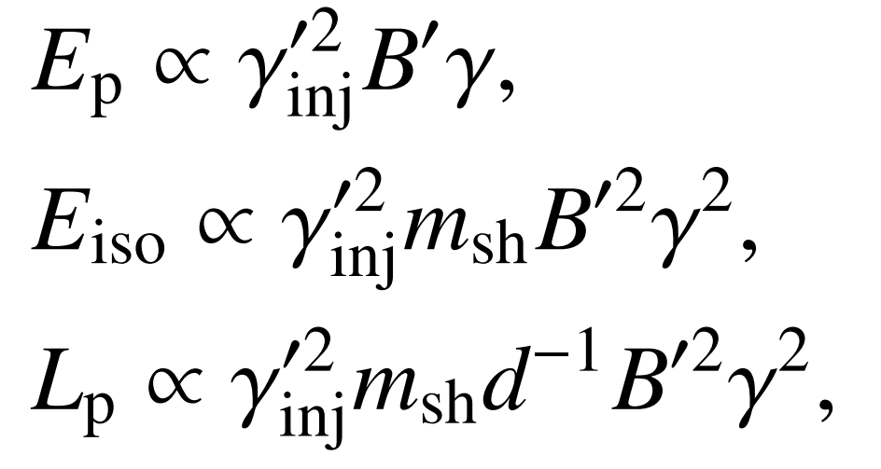
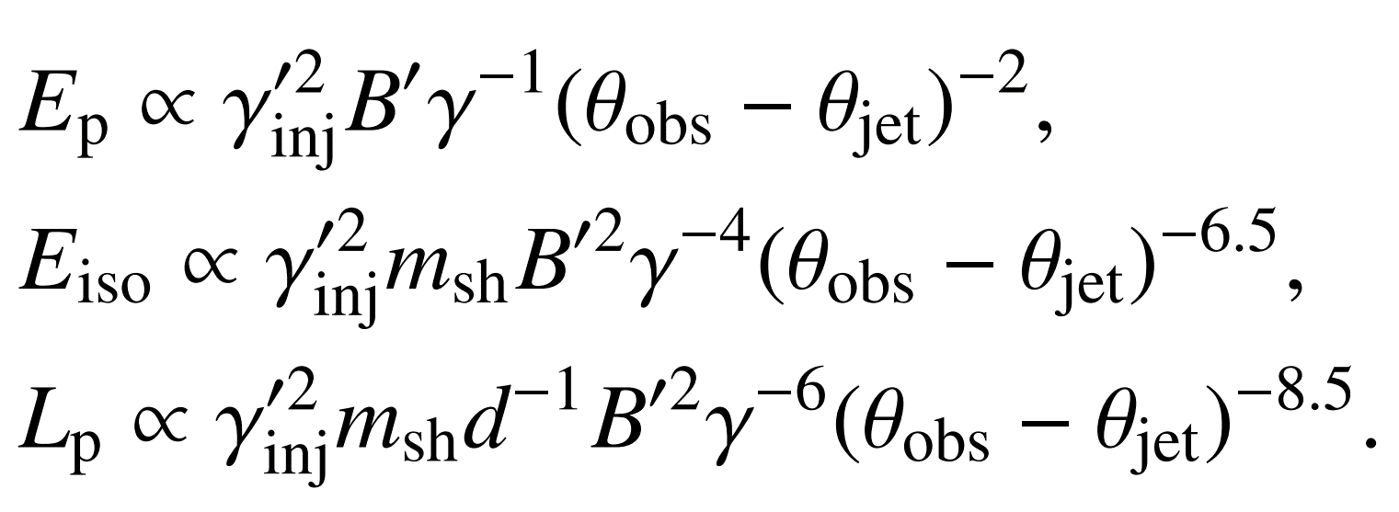
Analytic derivation of $E_{p}$, $E_{iso}$, and $L_{p}$
On-axis case
Off-axis case

Slide 9
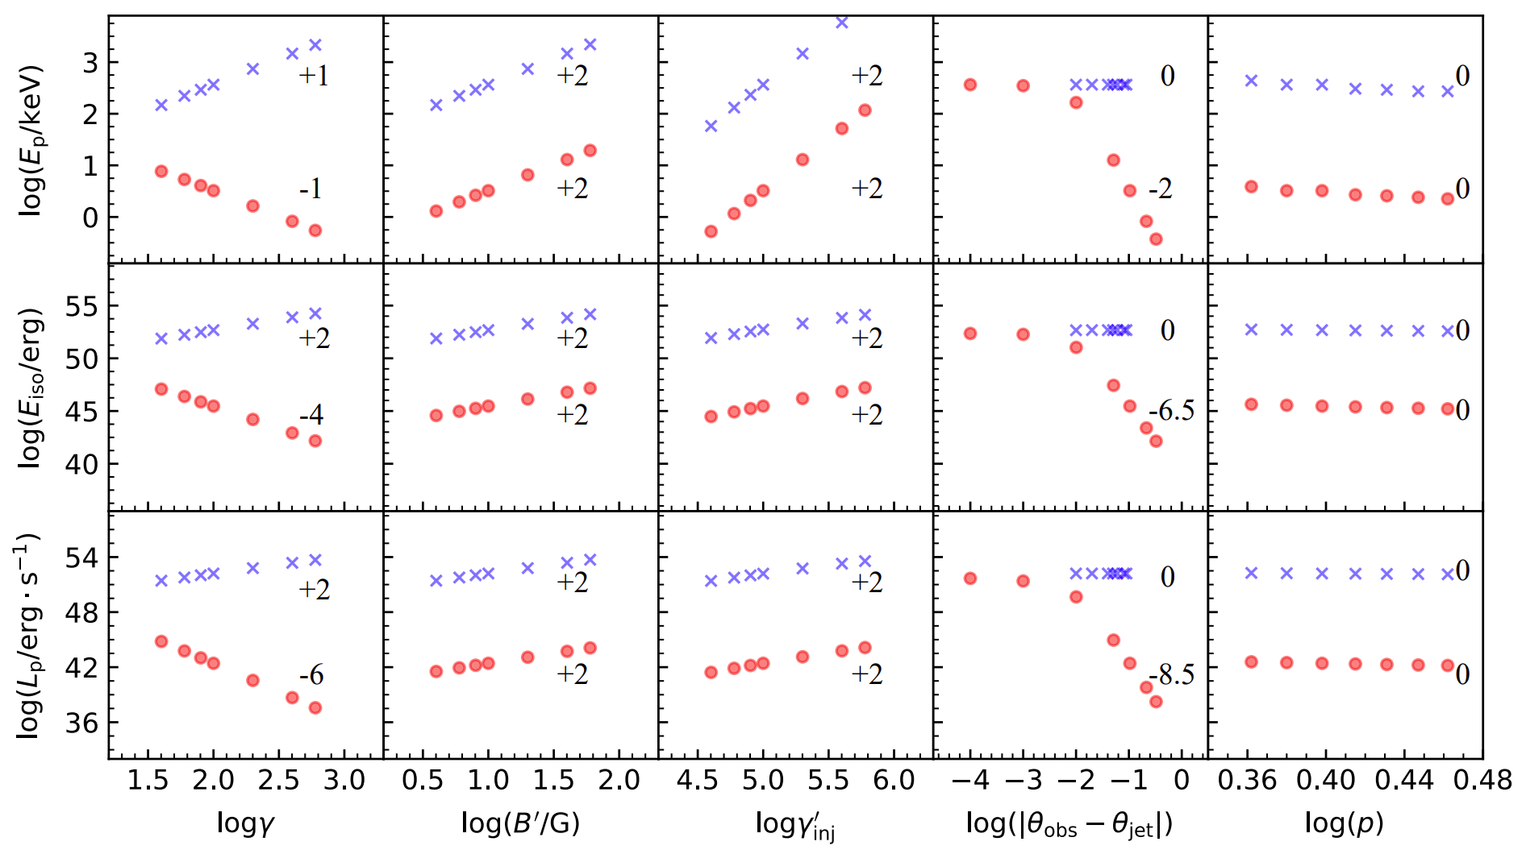
Numerical simulations
On-axis case
Off-axis case
Xu et al. 2023

Slide 10
Relations between $E_{p}$, $E_{iso}$, and $L_{p}$
On-axis case
$$E_{p}∝E_{ iso}^{ \frac{1}{2}}$$
Amati relation
$$E_{p}∝L_{ p}^{ \frac{1}{2}}$$
Yonetoku relation
Off-axis case
$$E_{p}∝E_{ iso}^{ \frac{1}{4} \sim \frac{4}{13}}$$
$$E_{p}∝L_{ p}^{ \frac{1}{6} \sim \frac{4}{ 17}}$$

Slide 11
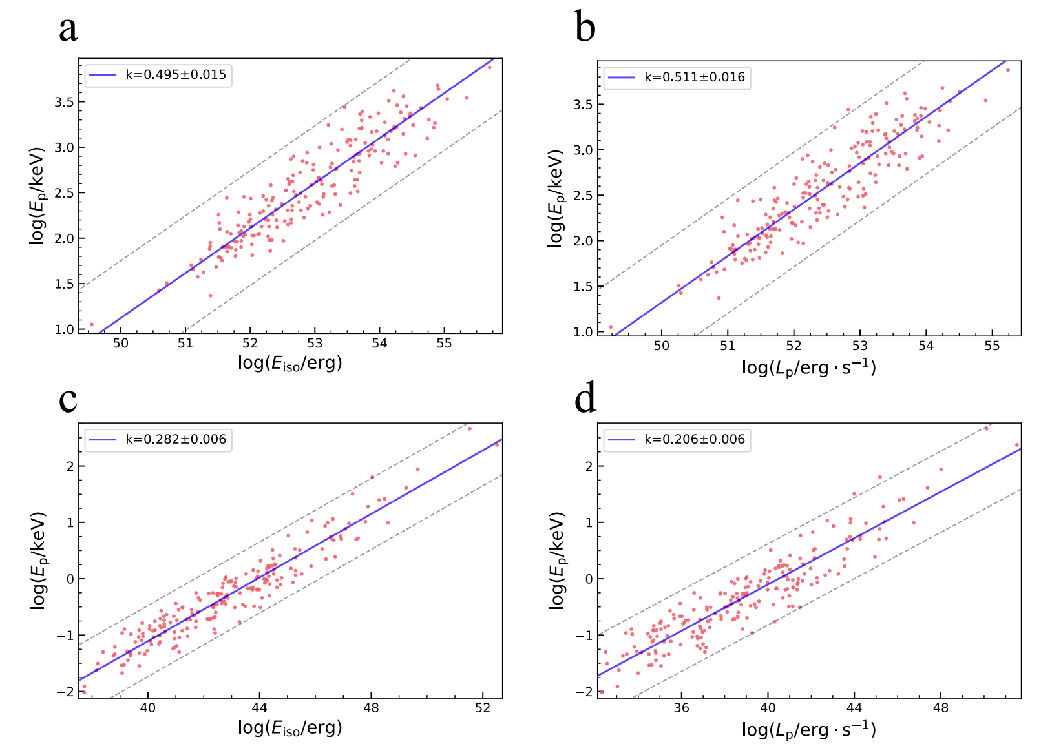
Monte Carlo simulations
$$E_{p}∝E_{ iso}^{ \frac{1}{2}}$$
$$E_{p}∝L_{ p}^{ \frac{1}{2}}$$
$$E_{p}∝E_{ iso}^{ \frac{1}{4} \sim \frac{4}{13}}$$
$$E_{p}∝L_{ p}^{ \frac{1}{6} \sim \frac{4}{ 17}}$$
Xu et al. 2023

Slide 12
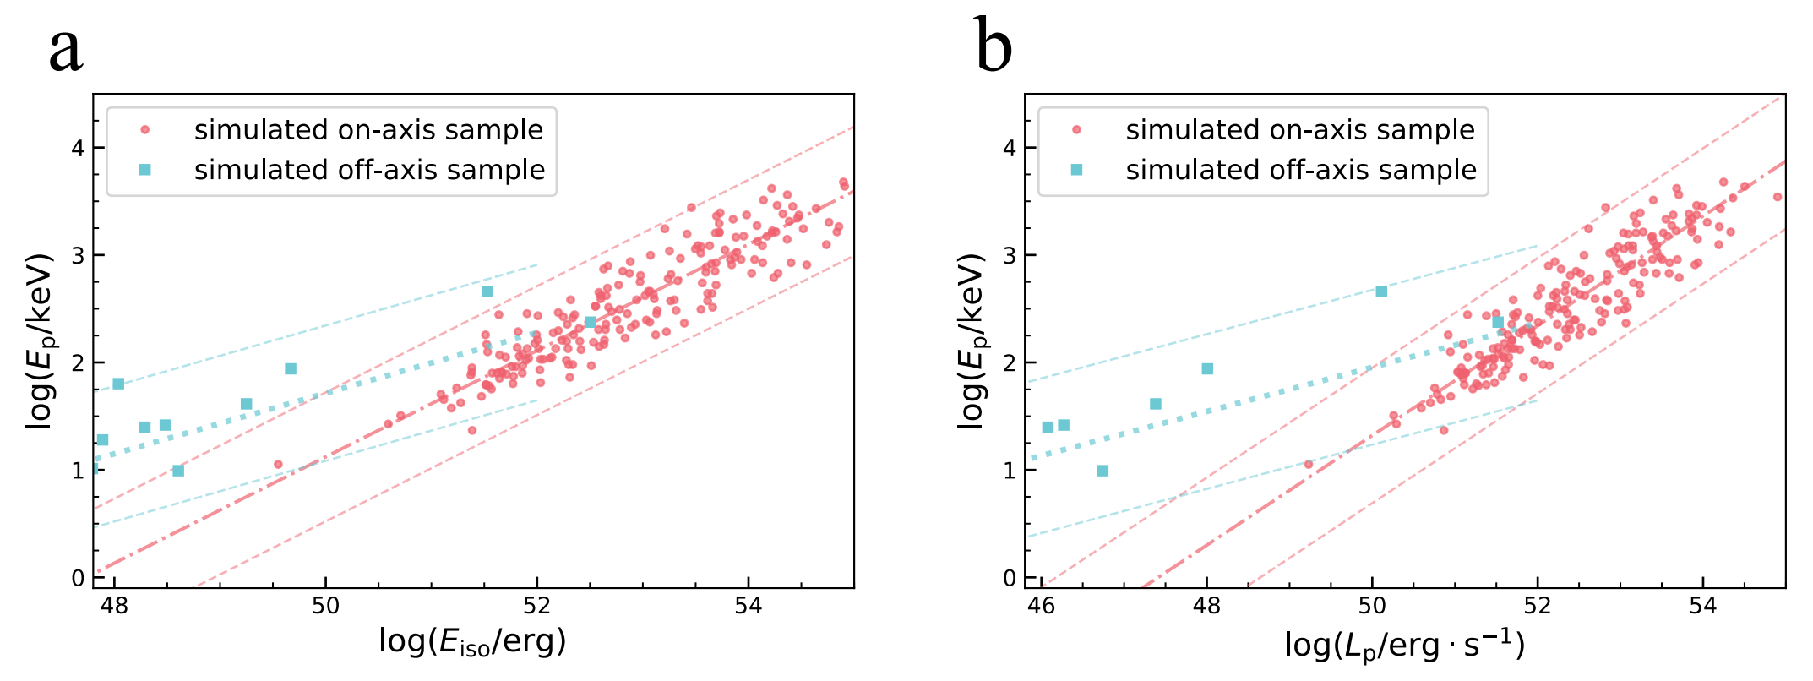
Monte Carlo simulations
Xu et al. 2023

Slide 13
Comparison with observations
$E_{p}−E_{iso}$ relation
Simulation
Observation
$$E_{p}∝E_{ iso}^{ 0.282±0.006}$$
Outliers of Amati relation
$$E_{p}∝E_{ iso}^{ 0.495±0.015}$$
172+10
Xu et al. 2023

Slide 14
Comparison with observations
$E_{p}−L_{p}$ relation
Simulation
Observation
$$E_{p}∝L_{ p}^{ 0.206±0.006}$$
$$E_{p}∝L_{ p}^{ 0.511±0.016}$$
45+10
Xu et al. 2023

Slide 15
Summary
Through analytical derivation and numerical simulation, we find that the main parameters affecting the relation between $E_{p}$, $E_{iso}$, and $L_{p}$ are $γ$ and $(θ_{obs}−θ_{jet})$.
Our analytical derivation suggests that there should be $E_{p}∝E_{ iso}^{ \frac{1}{2}}$ and $E_{p}∝L_{ p}^{ \frac{1}{2}}$ for on-axis case and $E_{p}∝E_{ iso}^{ \frac{1}{4} \sim \frac{4}{13}}$ and $E_{p}∝L_{ p}^{ \frac{1}{6} \sim \frac{4}{ 17}}$ for off-axis case, which is consistent with results of Monte Carlo simulation.
The results of the Monte Carlo simulation and the observed data also fit well.
Please check our paper, if you are interested:
A&A, Volume 673, Page id A20
Thank You!!

