Slide 1
Pulsar discovery prospect of the FAST Array (FASTA)
Mengyao Xue
collaborators: Weiwei Zhu, Xiangping Wu, Renxin Xu, and Hongguang Wang
国家天文台
北师大前沿所
北京大学
广州大学
2023-07-05 FPS 12, Nanyang

Slide 2
Pulsar surveys & Advanced radio instruments
Our understanding of the Galactic pulsar population
Pulsar surveys
One of the most successful pulsar survey:
Parkes Multi-beam Pulsar Survey (PMPS, Manchester et al. 2001)
discovered ∼800 pulsars initially, ∼ 1000 after many passes of searches
a large sample of pulsar detections with uniform instrument settings
Galactic pulsar population analysis (e.g. spatial, period, and luminosity distribution)
FAST has now discovered over 700 new pulsars
Notes:
对于每一代的前沿
我们对于xxx的理解，主要来源于，比如Parkes PMPS …发现超过1000，提供了一个xxx的样本。现有对于银河系population的研究包括x, x, x dist。大多都是基于PMPS的样本。
同时，我们对于银河系pop的理解，也可以对我们未来脉冲星巡天参数设置提供指导性帮助。
现在，距离Parkes PMPS巡天已经过去了20多年。我们现在也有了

Slide 3
KARST -> FAST -> FASTA?
A proposed concept of the SKA, making use of the karst landscape in southwest China
In early 1990s
∼30×200m diameter spherical reflectors
(Kilometer-square Area Radio Synthesis Telescope, KARST)
(Peng & Nan 1998; Nan et al. 2002)
FASTA
haven’t been selected as the final design for the SKA
led to the birth of FAST
Notes:
FAST的前身是我国提出的早期SKA concept之一，虽然没有被选为SKA的最终方案，但是脱胎于此的FAST取得了巨大的成功，之后也有了建造FASTA的潜在可能。

Slide 4
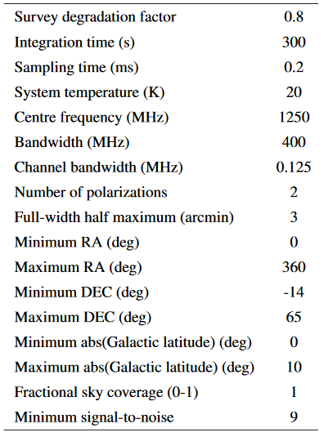
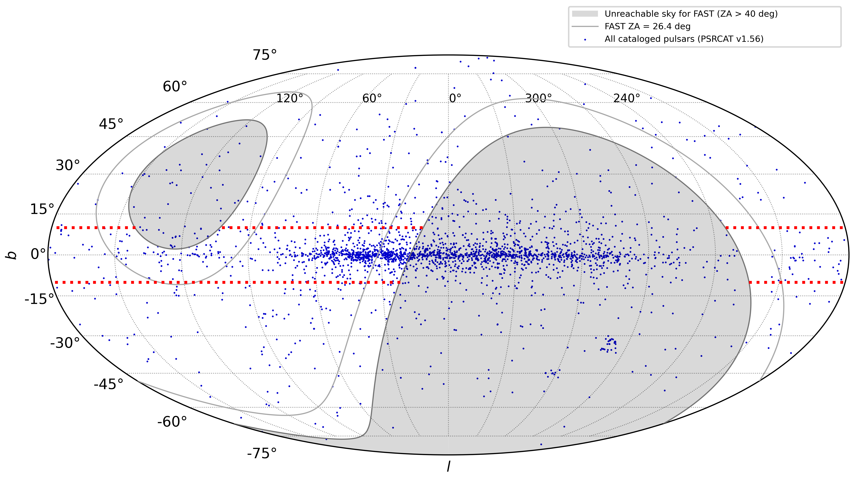
Estimate the pulsar discovery prospect of the FAST Array
Simulated survey parameter
proposed sky in Galactic coordinate
4035 deg²
Notes:
于是我们对于利用FAST阵列进行脉冲星巡天的discovery prospect 进行了一下估测。左表。右图

Slide 5
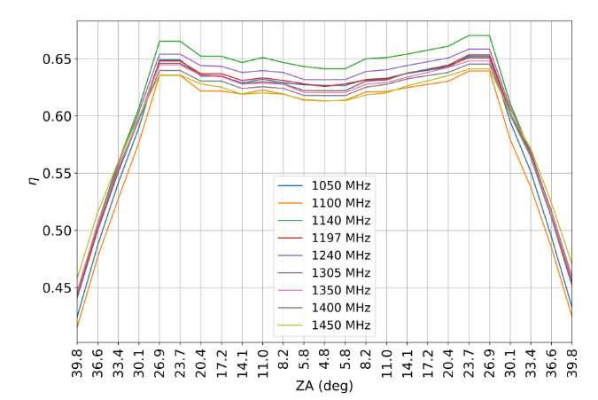
Gain of FAST
Telescope efficiency 𝜂 of FAST as a function of ZA
$$G=η G_{0}$$
For FAST, $G_{0 }$= 25.2 K/Jy.
ZA<26.4°:
𝜂 stays constant at ~0.63
$G$ ~16.1K
26.4°<ZA<40°:
linearly decrease with ZA
$G$ ~11.3K when ZA=40°
$$G=G_{zenith}×\text{[1−0.0216(}\text{ZA}\text{−26.4}°\text{)]}$$
Jiang et al. 2019
Notes:
呈线性迅速下降。

Slide 6
FASTA phase-I & phase-II
FASTA phase-I: 3 × existing FAST
FASTA phase-II: 6 × existing FAST
Coherent and incoherent combination
coherent:
incoherent:
$$G_{array}=η_{c} N×G_{antenna}$$
$$η_{c}=0.94$$
$$G_{array}=\sqrt{N}×G_{antenna}$$
The value listed in this row are the gain value when pointing to ZA<26.4°
Notes:
对于FASTA 阵列的增益，我们分别计算了3个和6个 FAST组成阵列的情况，分别用FASTA3 和 FASTA6表示。同时，也分别考虑了各个望远镜之间，它们的信号是进行相干波束合成，还是非相干叠加。

Slide 7
Galactic pulsar population synthesis
Lorimer et al. (2006), Bates et al. (2014)
PsrPopPy
Existing survey result & survey parameters
Simulated Galactic pulsar population realization
generate synthetic pulsars
(selected P-dist, L-dist, spatial dist)

Slide 8
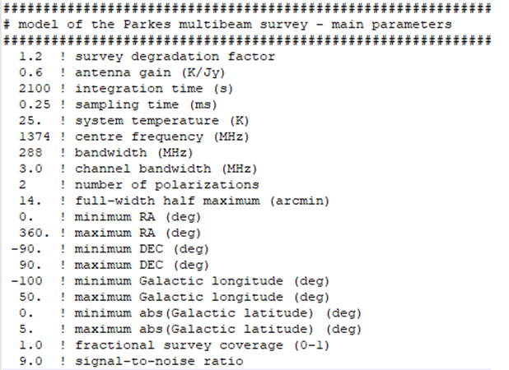
Galactic pulsar population synthesis
Lorimer et al. (2006), Bates et al. (2014)
PsrPopPy
Existing survey result & survey parameters
Simulated Galactic pulsar population realization
(e.g. 1038 for PMPS)
generate synthetic pulsars

Slide 9
Galactic pulsar population synthesis
Lorimer et al. (2006), Bates et al. (2014)
PsrPopPy
Existing survey result & survey parameters
Simulated Galactic pulsar population realization
Future survey forecast
generate synthetic pulsars
(selected P-dist, L-dist, spatial dist)
perform simulated surveys
canonical pulsars / MSPs

Slide 10
Galactic canonical pulsar detection prospect
L06: Lorimer et al. (2006)
YK04: Yusifov & Kucuk (2004),
FK06: Faucher-Giguere & Kaspi (2006)

Slide 11
Galactic MSP detection prospect
L15: Lorimer et al. (2015)
L06: Lorimer et al. (2006)
YK04: Yusifov & Kucuk (2004),
FK06: Faucher-Giguere & Kaspi (2006)

Slide 12
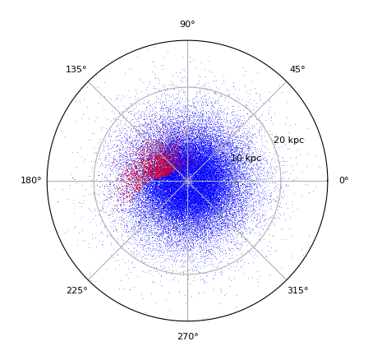
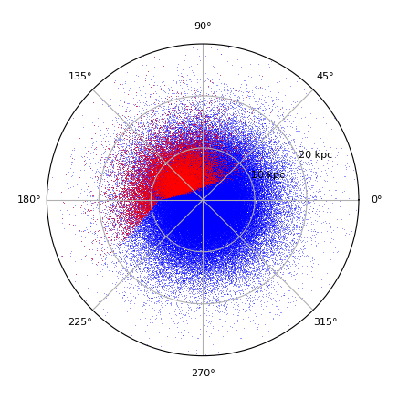
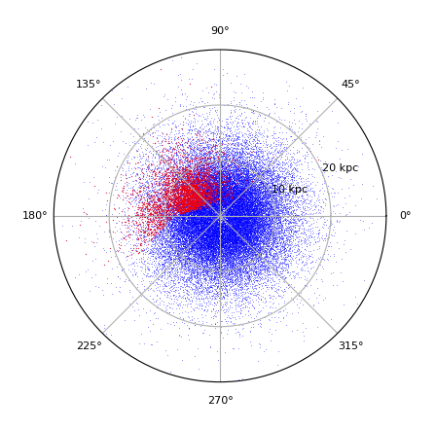
FAST
expected to detect
4200 ~ 8460 canonical pulsars
expected to detect
520 ~ 1480 MSPs
FASTA6
expected to detect
8380 ~ 17330 canonical pulsars
expected to detect
1140 ~ 4680 MSPs

Slide 13
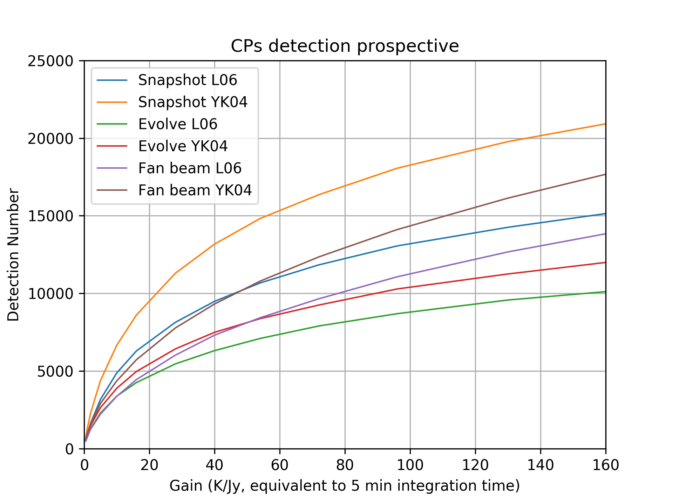
Survey time estimation
target sky area: 4035 deg²
assume a FWHM of 30’ (PAF)
need 20550 pointings in total
5min T_{int} -> 1713 hr obs
additional 10 min overhead for each pointing…
Simulated pulsar detection numbers
(snapshot model with L06 radial distribution)
Notes:
我们模拟的这个FASTA脉冲星巡天所覆盖的天区面积有4035deg2
假设一次pointing的FWHM是30’，那么……
那么从总观测时间和脉冲星探测数目的增加比例这个角度而言，那么提高积分时间是否可以提升脉冲星探测效率？

Slide 14
M31
Following similar method with Smits et al. 2009
Distance: 776±22 kpc
covering M31 in 17 pointings
Considering a time integration of 2 hours for each pointing, the total survey time ∼37 hours (including 10-min overhead)
 | L-band luminosity detection threshold | snapshot model FK06 L-dist | evolutionary model FK06 L-dist | evolutionary model fanbeam L-dist
FAST | 670 mJy kpc² | 1 | 12 | 34
FASTA3-i | 380 mJy kpc² | 3 | 29 | 55
FASTA6-i | 270 mJy kpc² | 7 | 47 | 77
FASTA3 | 240 mJy kpc² | 9 | 60 | 92
FASTA6 | 120 mJy kpc² | 28 | 164 | 188
Notes:
我们还估测了FASTA对于 近邻星系M31中脉冲星

Slide 15
Single pulse search
high sensitivity instrument – good for single pulse search
but we do not have high completeness single pulse pulsar discovery sample set.
considering existing pulsar survey with high sensitivity instrument:
Deneva et al. (2009) found that the singlepulse search led to 13% extra pulsar discoveries from Arecibo PALFA survey
Han et al. (2021) found a14% extra yield from FAST GPPS survey
as a drift scan survey with each point source drifts acrossthe 3’ beam in 12 s, the CRAFTS survey of FAST benefits more from single pulse search and has discovered∼31% additional pulsars using this method
thus, there possibly an extra 10-20% of detectable pulsars using single pulse search
Notes:
对于灵敏度非常高的射电望远镜

Slide 16
Summary
Estimated the Galactic pulsar (CPs/MSPs) discovery prospects of FASTA
(with different Galactic pulsar population models and instrumental parameter combinations)
Estimated the potential yield if the FASTA is used to search for pulsars from the nearby spiral galaxy M31
(would probably discover around a hundred new radio pulsars)
In terms of the T_{obs} and N_{detection}, 5-min integration time is an optimal choice
(comparing with longer integration time for each pointing)
Our knowledge of the real Galactic pulsar population is limited, ongoing FAST pulsar surveys and future FASTA pulsar surveys with good completeness will provide significantly better constraints on the Galactic pulsar population and its distribution parameters.

