Slide 1
What can the timing data of young pulsars tell us about the physics of neutron stars?
报告人：颜宇龙
合作者：程泉，郑小平
华中师范大学天体物理研究所
2023.7 @FPS12, Nanyang

Slide 2
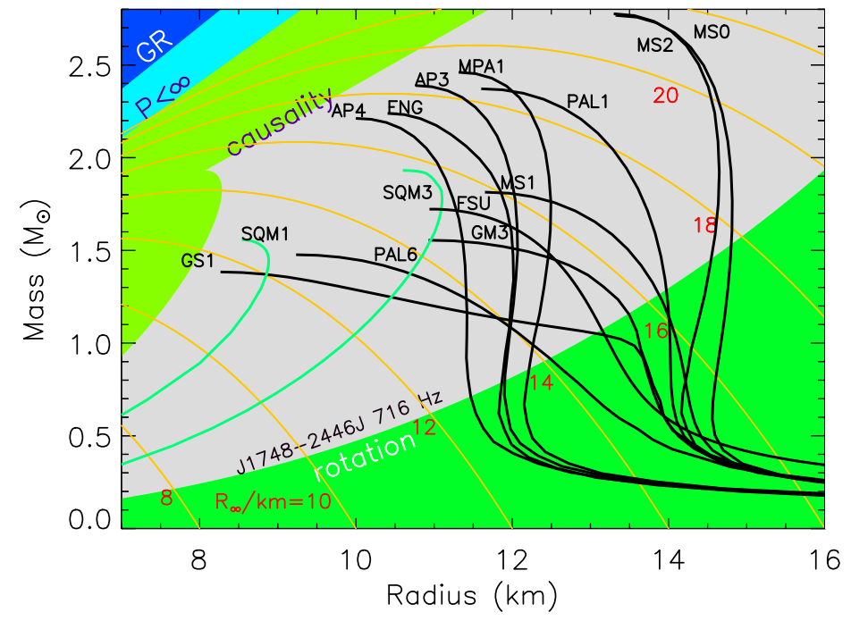
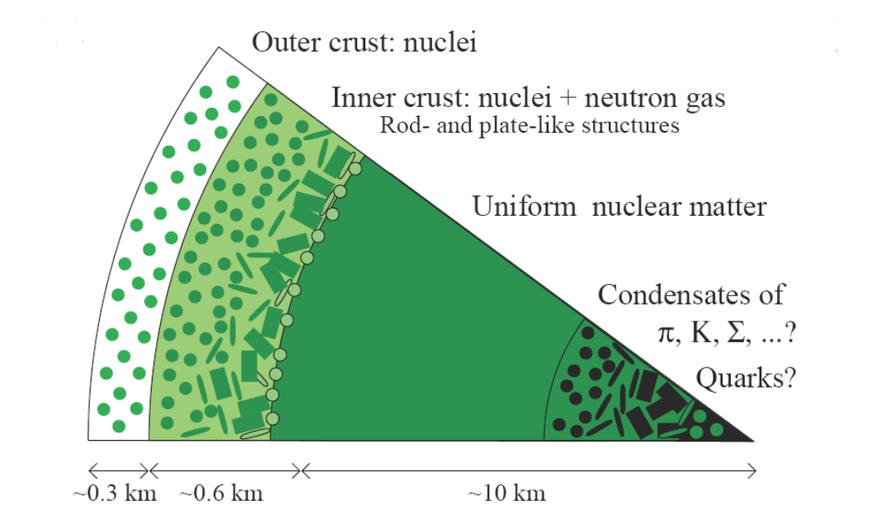
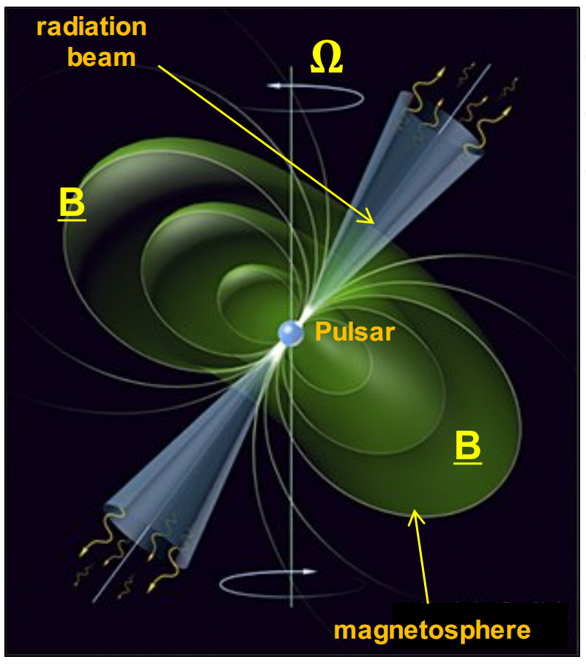
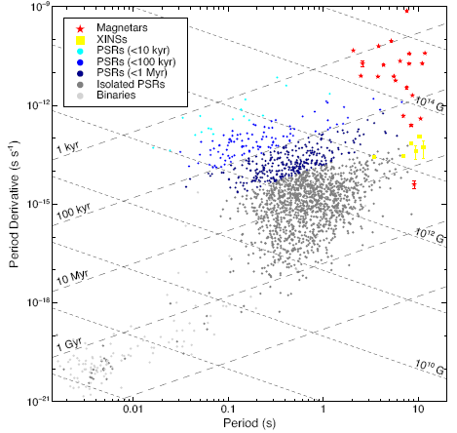
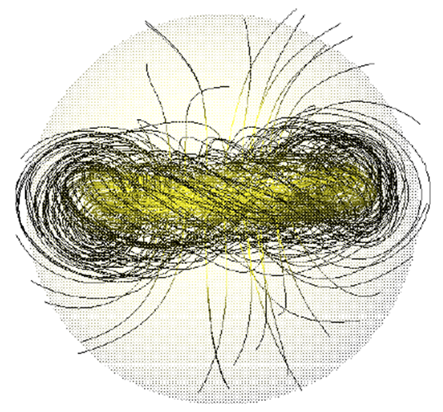
Some main issues about neutron stars
Lattimer & Prakash 2016
Pizzochero 2016
Olausen & Kaspi 2014
Braithwaite & Spruit 2004
We mainly focus on:
1) internal interaction
2) magnetic field

Slide 3
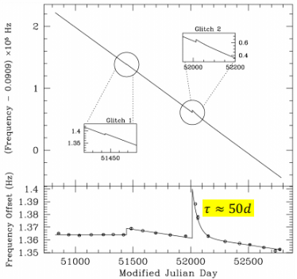
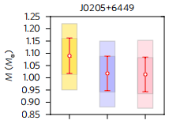
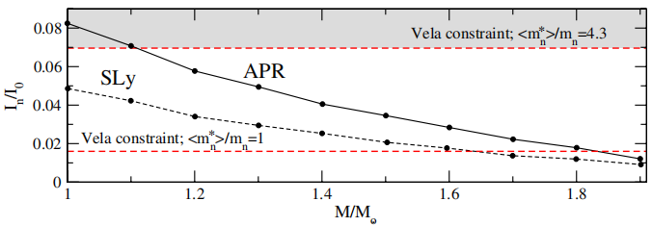
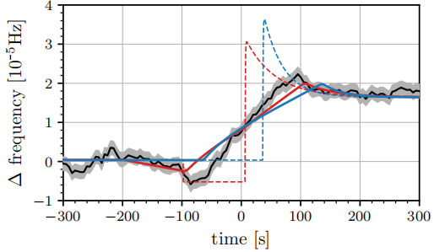
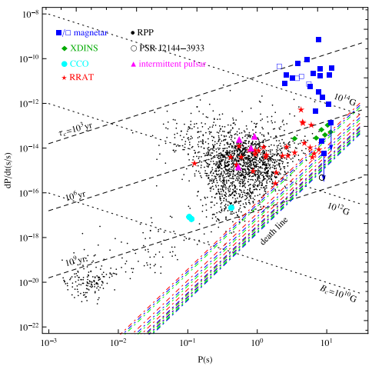
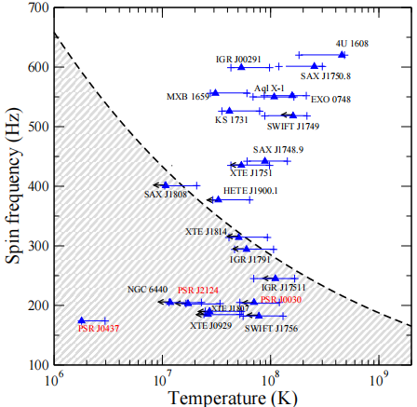
Pulsar Timing as a probe of NS physics
1) Pulsar glitch
superfluid mutual friction coeffificient
2) Long period radio pulsar
3) Model oscillation: r-mode
Manchester 2018
Pizzochero et al. 2017
Andersson et al. 2012
Ashton et al. 2019
Zhou et al. 2017
Haskell 2015
Zhou et al. 2023

Slide 4
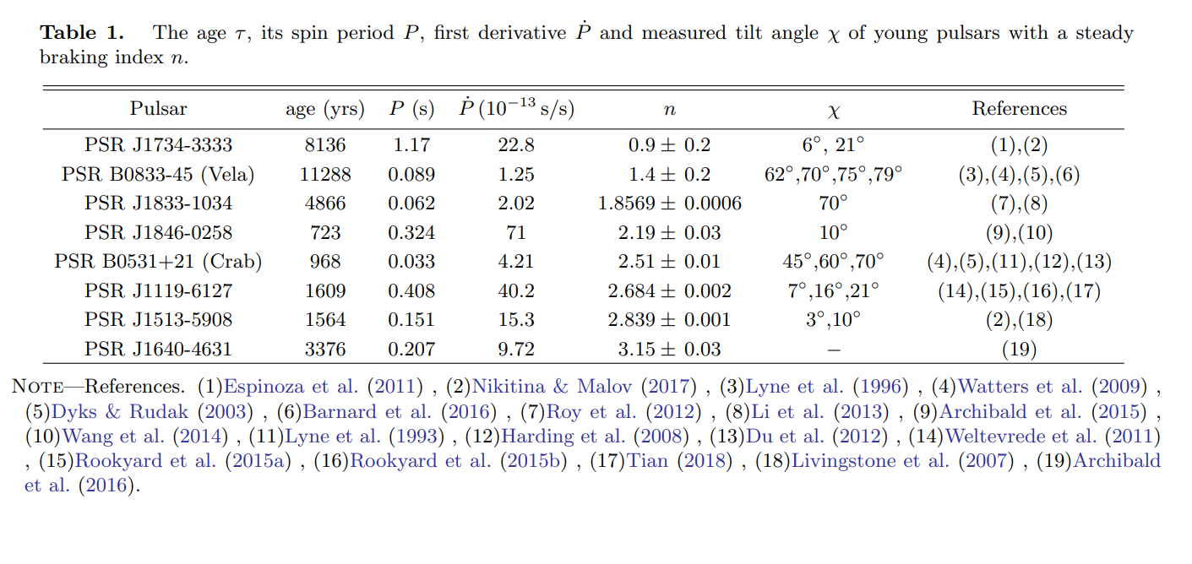
Timing data
Yan et al. 2023b, to be submitted

Slide 5
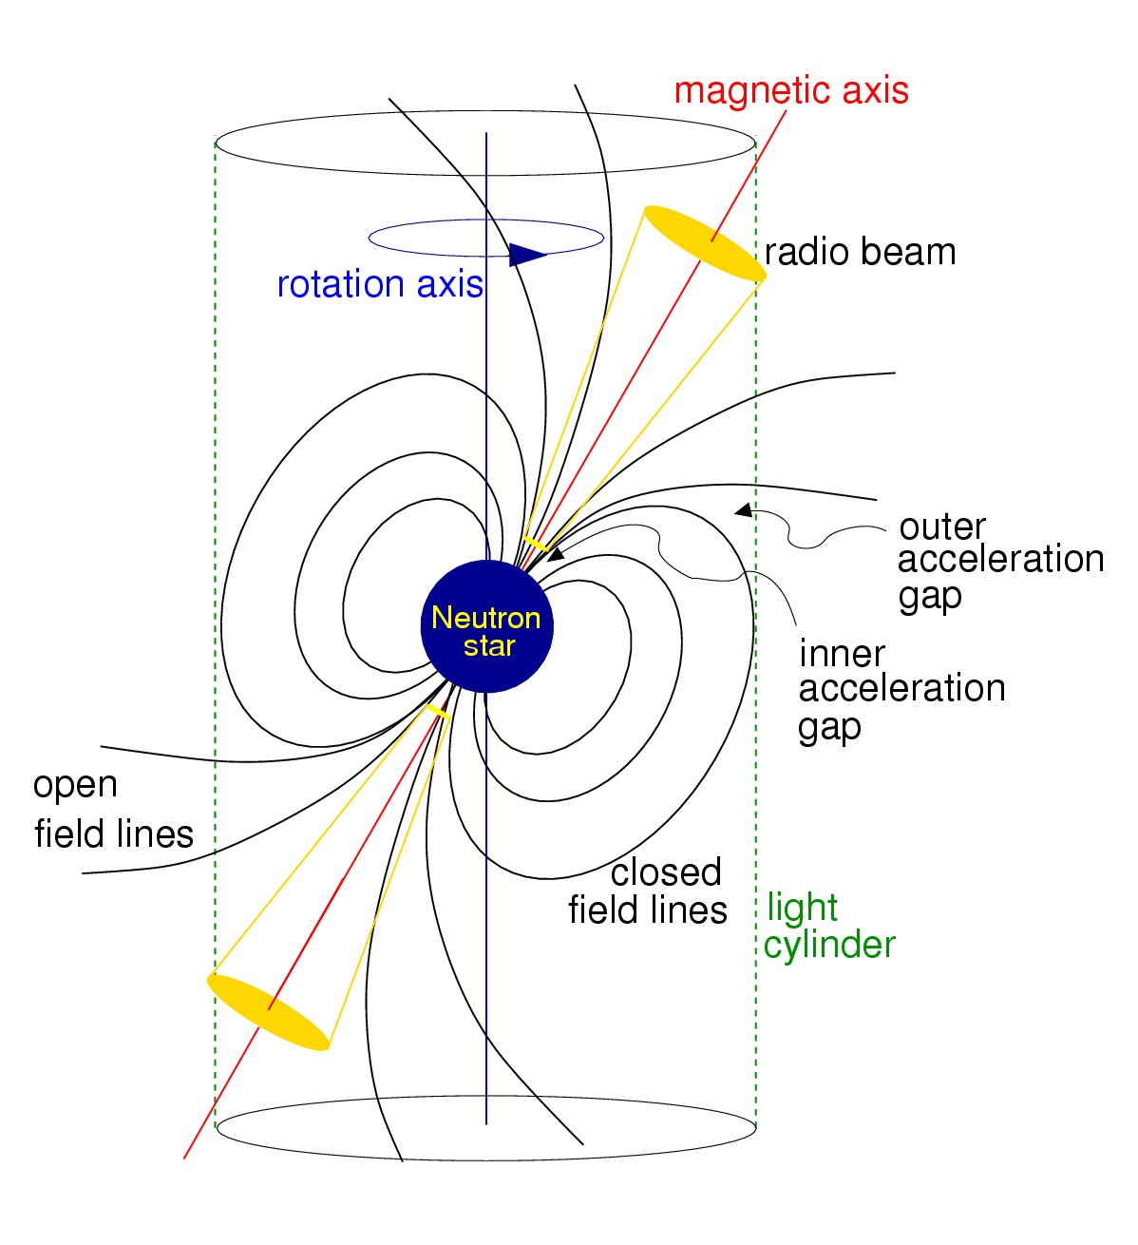
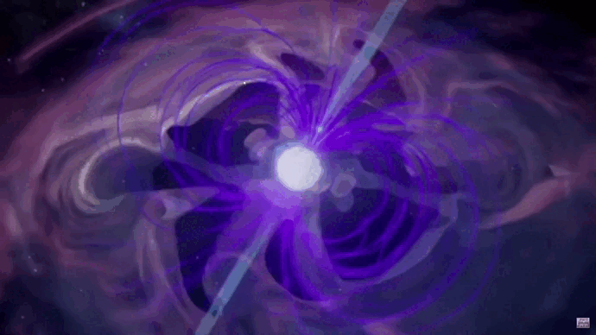
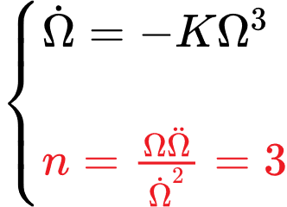
Magnetic dipole radiation
Magnetic braking by magnetic dipole radiation:
De Araujo et al. 2016

Slide 6
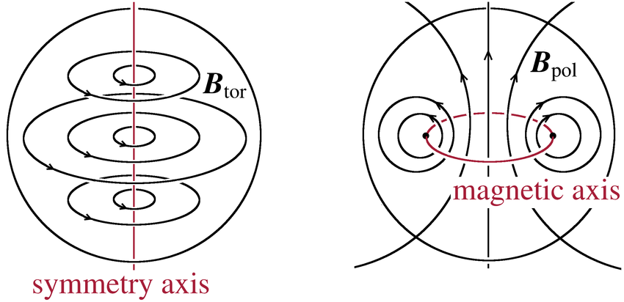
Poloidal-dominated or toroidal-dominated?
oblate
Poloidal-dominated internal field:
Toroidal-dominated internal field:
prolate
Weber et al. 2015; Marlene Herbrik et al.2015; Lander 2013; Akgun & Wasserman 2008

Slide 7
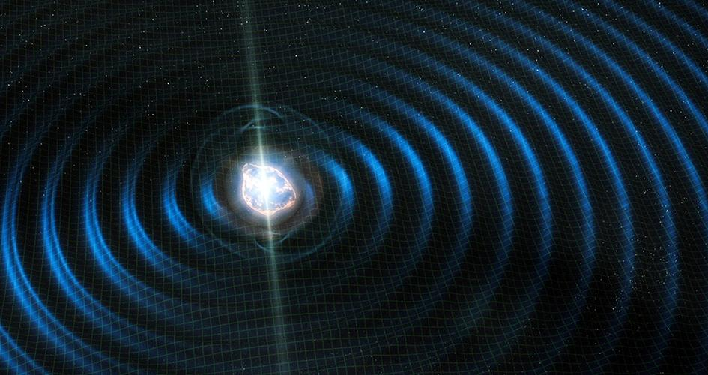
Gravitational wave radiation
General relativity framework:
Magnetic deformation-induced GWE:
Magdalena etal.2019; De Araujo et al. 2016

Slide 8
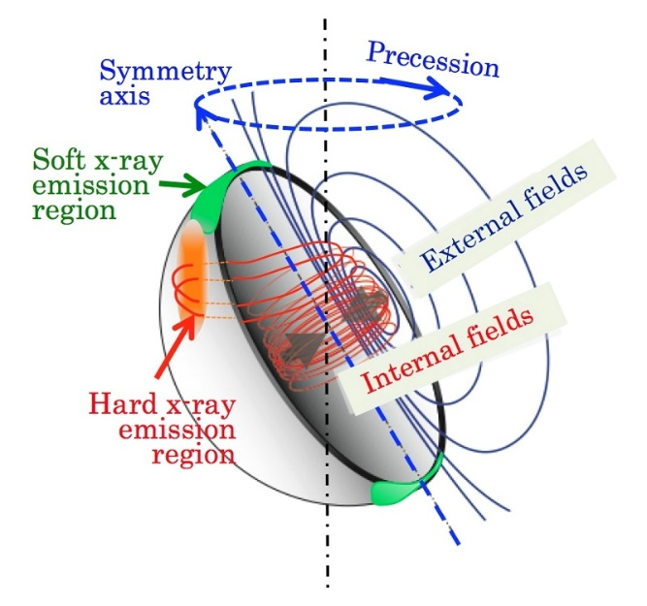
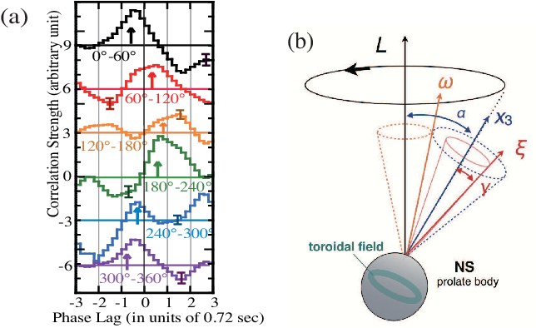
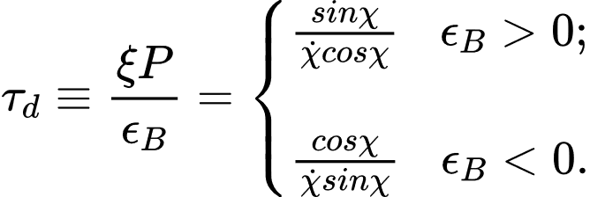
Free precession of neutron star
Kinetic energy:
Precession energy:
Possible evidence for free precession of a strongly magnetized neutron star in the magnetar 4U 0142+61.
Damping time-scale:
Makishima et al.2018; Dall’Osso et al.2009; Jones &Andersson 2001; Lander &Jones 2018

Slide 9
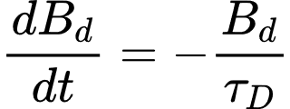
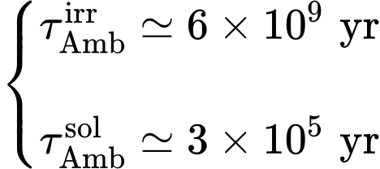
Decay of dipole magnetic field
1) Exponential form:
2) Nonlinear form:
3) Power-law form:
We focus on!
The governing equation for the magnetic field:
Ohmic decay
Hall drift
Ambipolar diffusion
Dall’Osso et al. 2012; W.C.G et al. 2012; Goldreich & Reisenegger (1992); Bransgrove et al. 2018; Glampedakis et al.2018

Slide 10
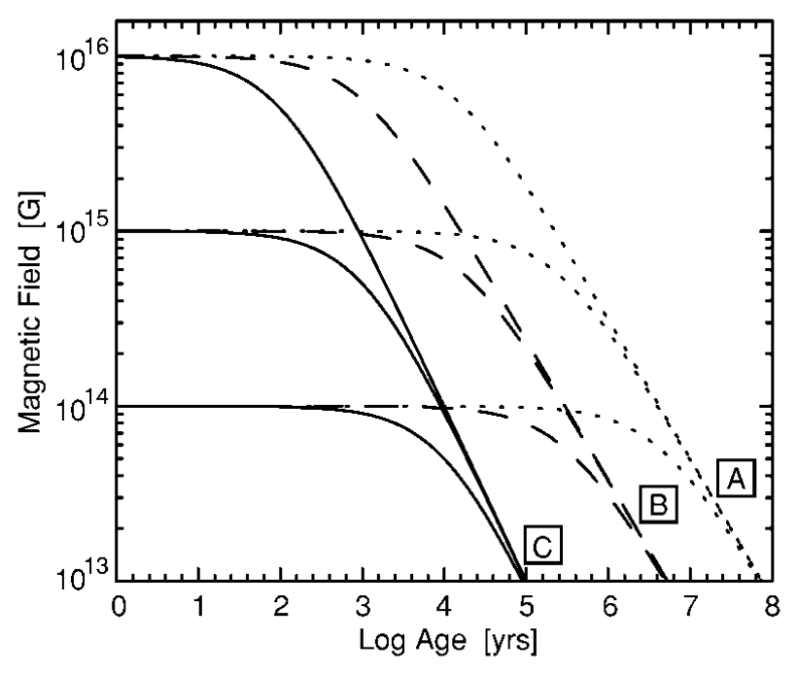
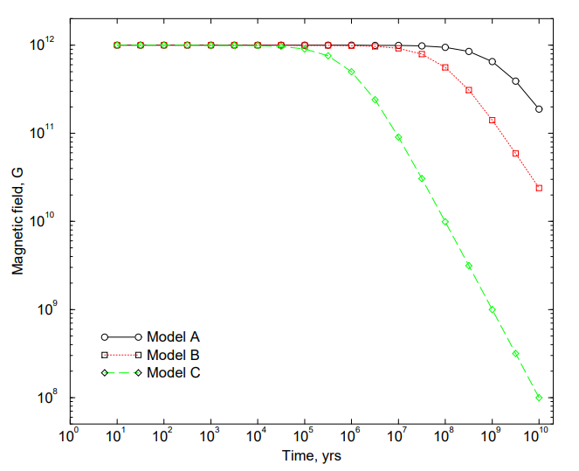
Can the power-law form be applied to ordinary pulsars?
magnetars
applicable to ordinary pulsars?
✔ or ❌
ordinary pulsars
Magnetic field evolution in avenues A (ambipolar diffusion in the irrotational mode:$a=0.01$ and $α=5/4$ ), B (ambipolar diffusion in the solenoidal mode: $a=0.15$ and $α=5/4$ ), and C (crustal Hall cascade: $a=10$ and $α=1$ ) for various initial field strengths following $B(t)=\frac{B_{0}}{{[1+aαB_{0}^{α}t]}^{1/α}}$ .
Colpi et al. 2000；Popov &Prokhorov 2001

Slide 11
Model
where
verify
Braking index $n$ is possibly associated with the interior physics of NSs, e.g. internal magnetic fields, superfluid mutual friction. Meanwhile, we also aim to verify whether the power-law decay form can be applied to ordinary pulsars.

Slide 12
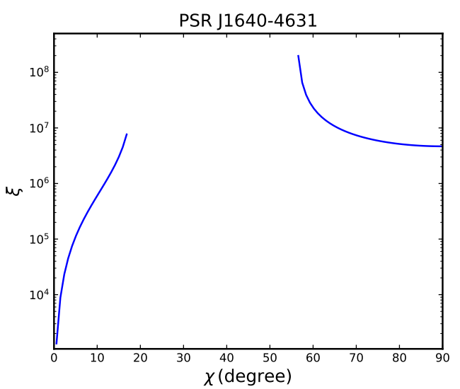
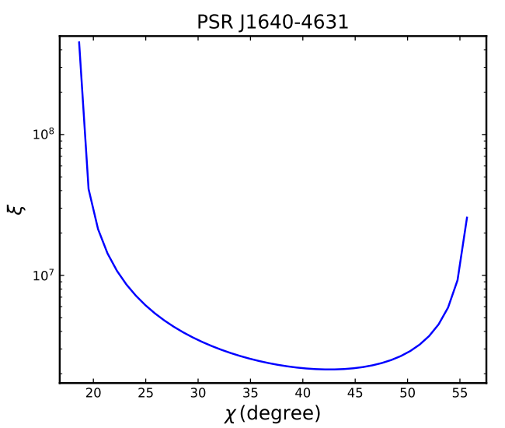
Results for the power-law form
poloidal-dominated
toroidal-dominated
Yan et al. 2023a, submitted

Slide 13
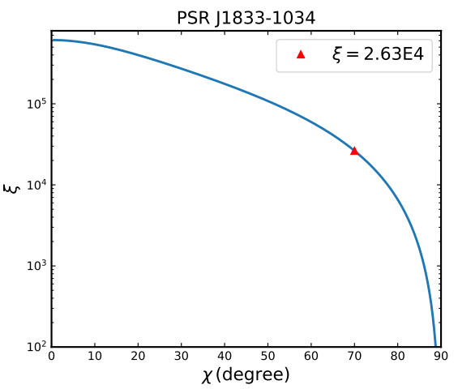
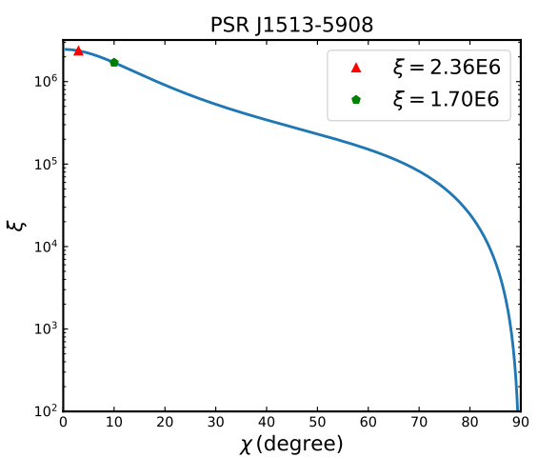
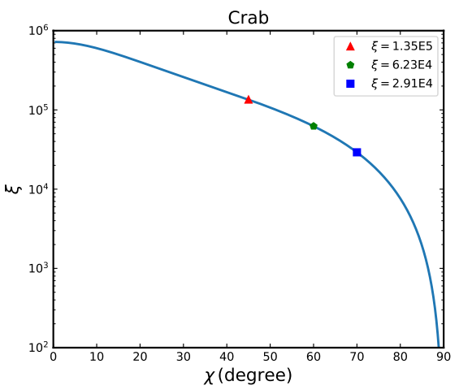
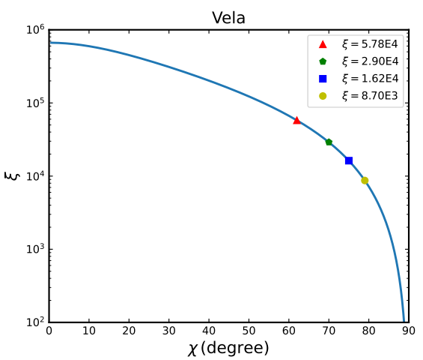
Results for the power-law form
toroidal-dominated
Yan et al. 2023a, submitted

Slide 14
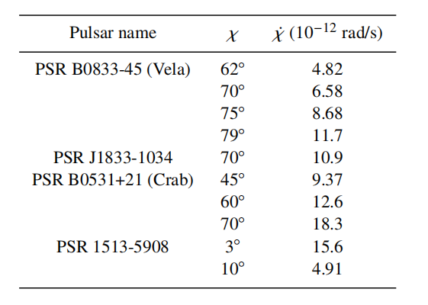
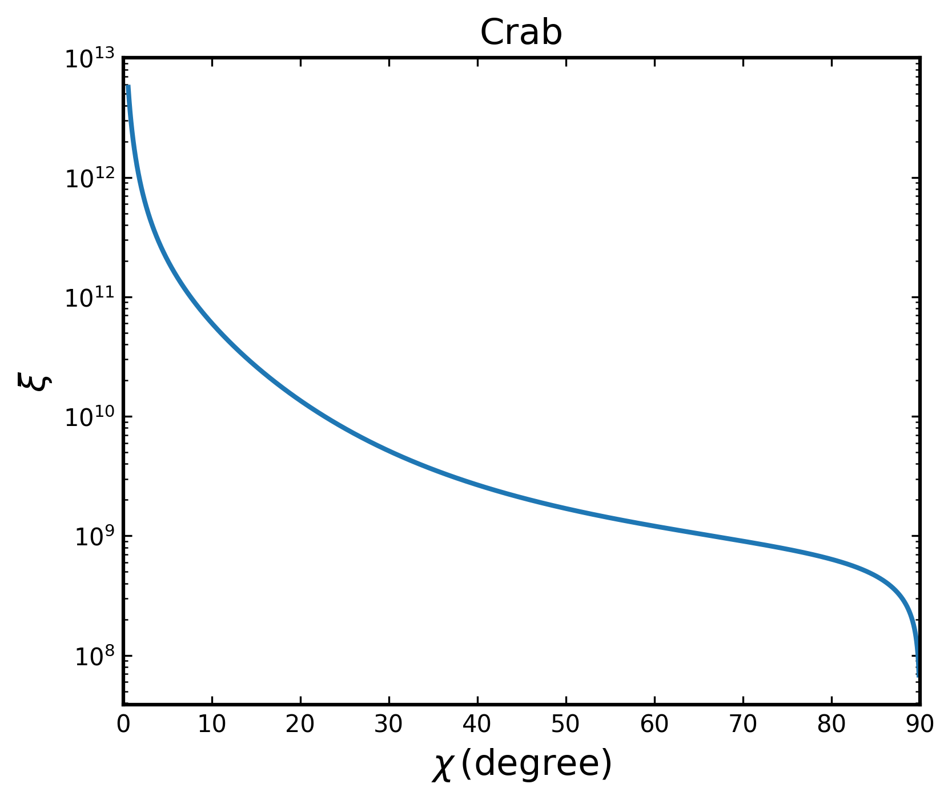
Inadequacy of power-law model
For the Crab pulsar, the predicted tilt angle change rate is larger than the observed value $0.62°± 0.03°$/100 yrs.
Lyne at al. 2013
To satisfy all Crab observations, an unreasonable large $ξ$ is required.
The power-law model may be disfavored by Crab observations!
Yan et al. 2023a, submitted

Slide 15
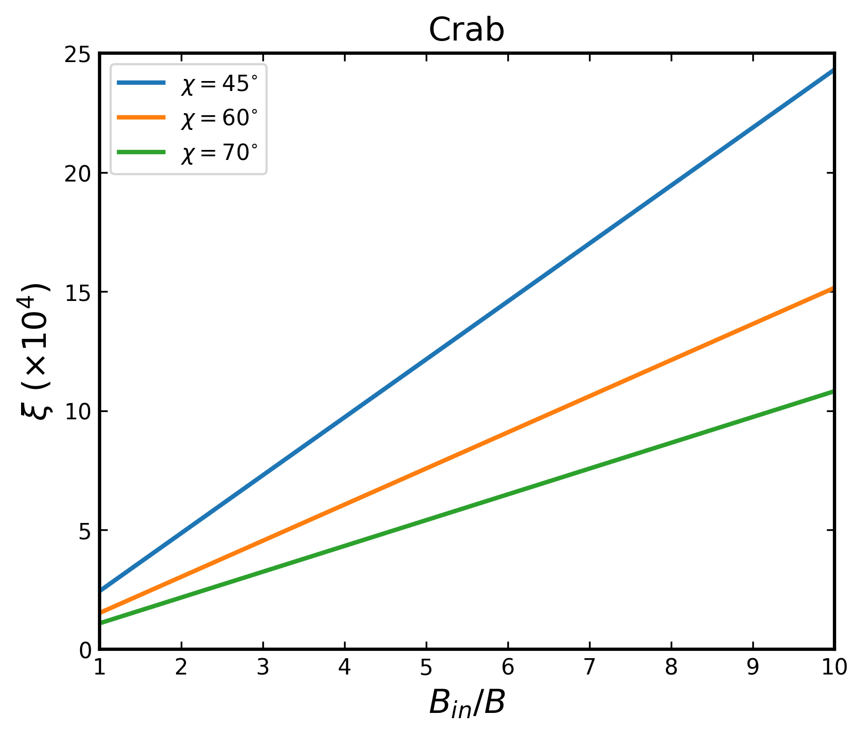
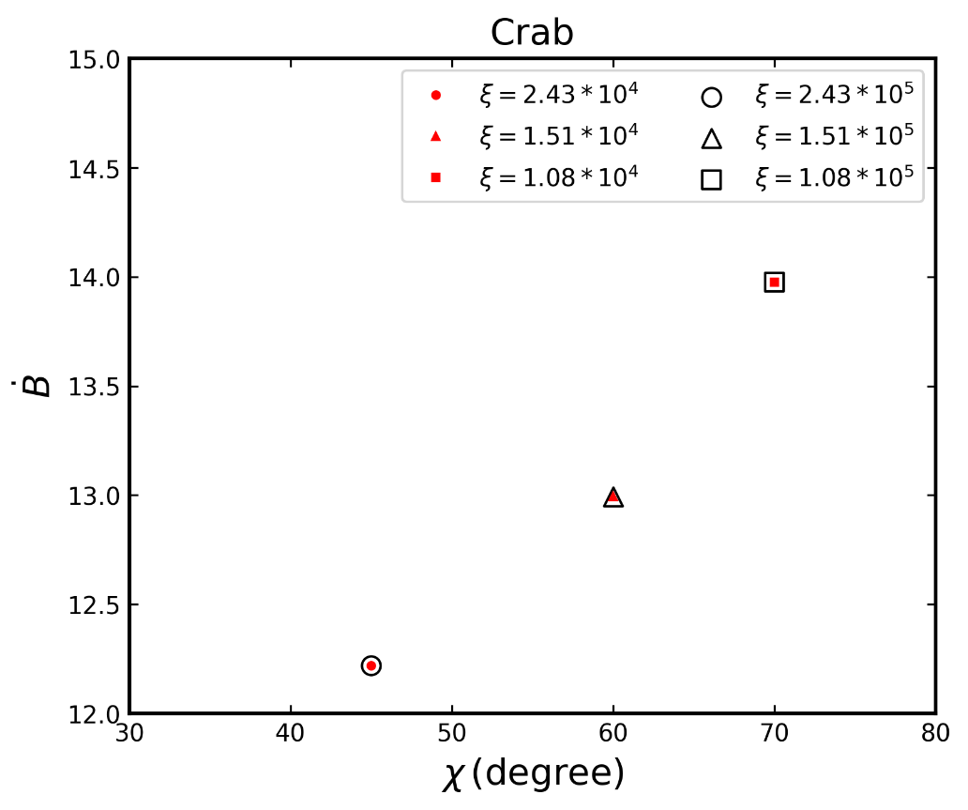
Increase of the dipole field
For the Crab, its dipole field may increase with time, e.g., $\dot{B}>0$.
To satisfy all observations of Crab, we can obtain the range of $ξ$. Moreover, its dipole field is required to increase at a rate of 12−14 G/s.
Yan et al. 2023a, submitted

Slide 16
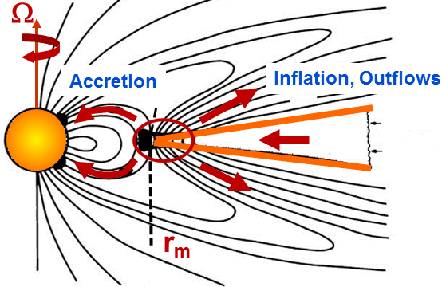
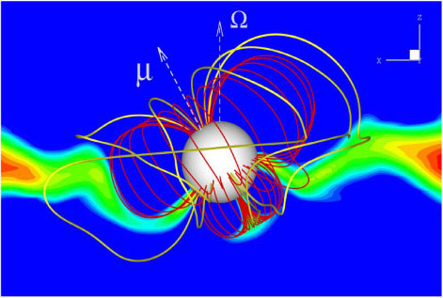
Burial and re-emergence of dipole field
The growth rate of magnetic field:
M.Romanova & Stanley P. 2016; Shibazaki et al. 1989; Fu & Li 2013

Slide 17
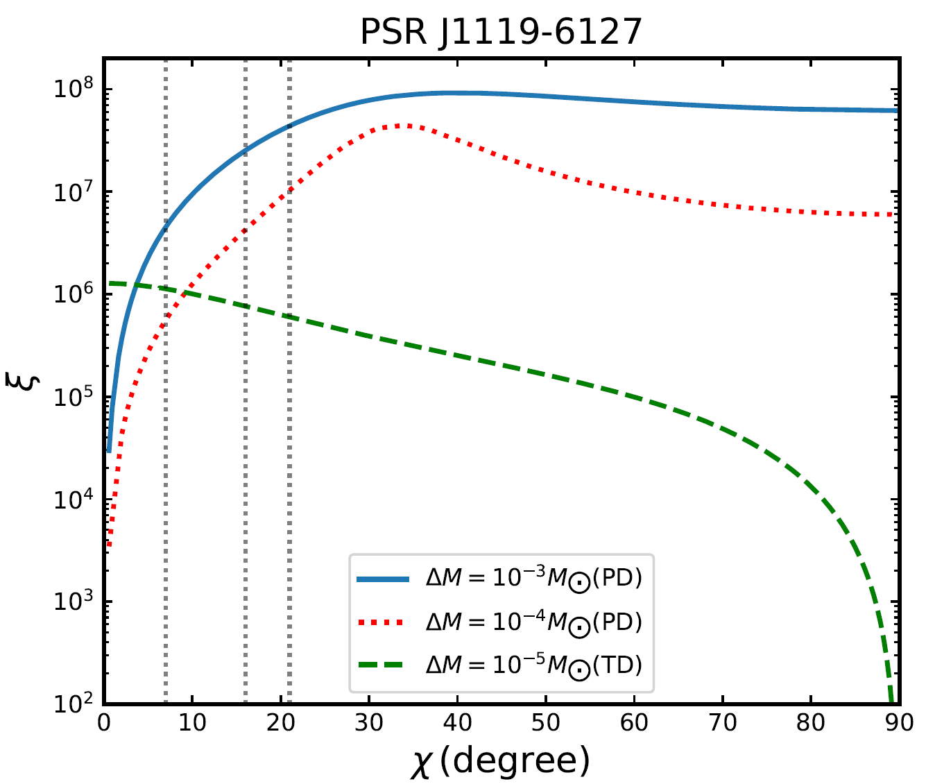
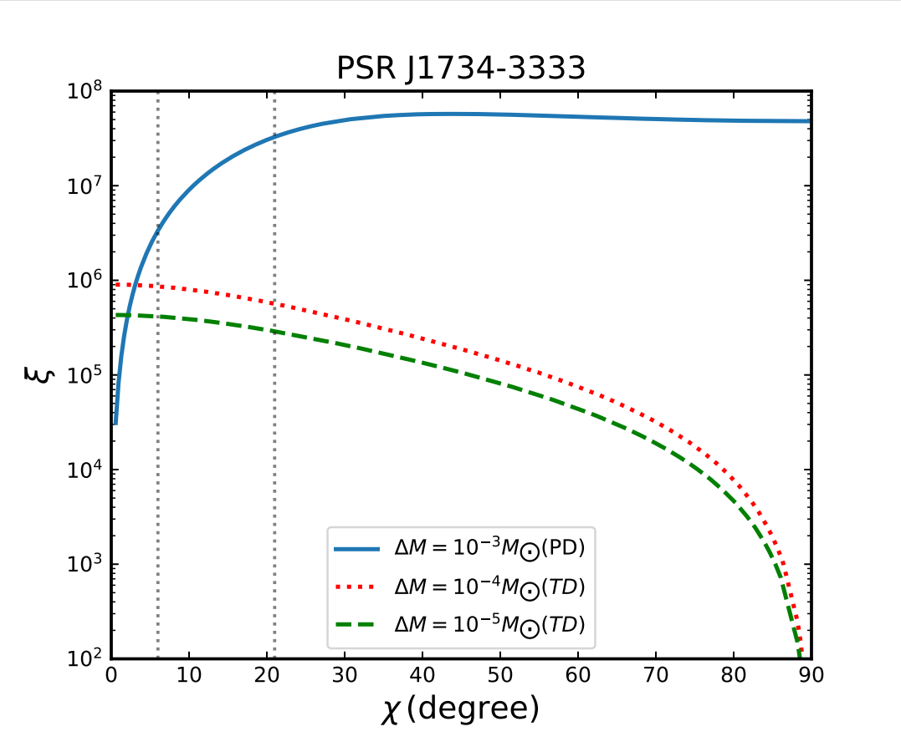
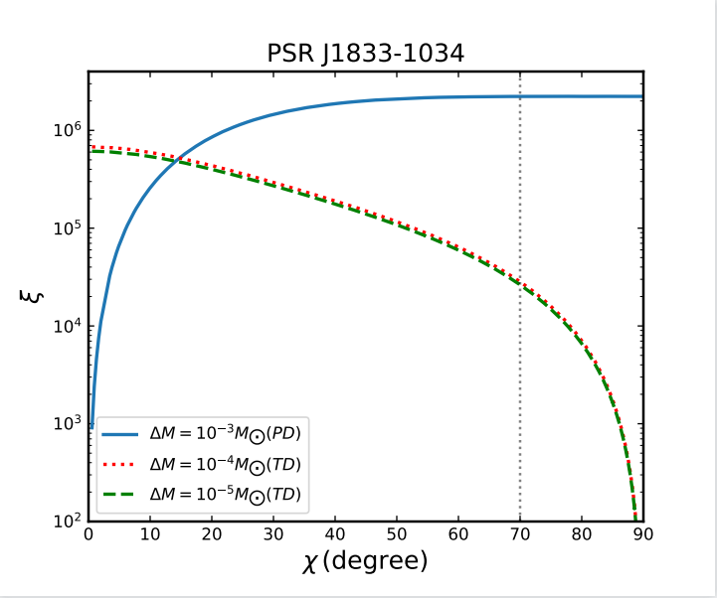
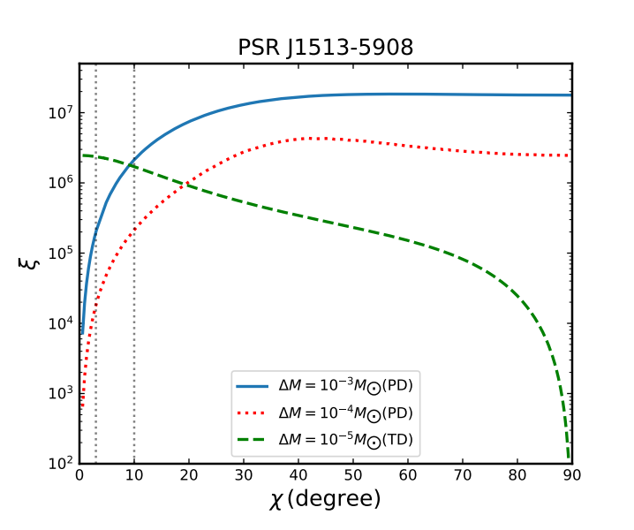
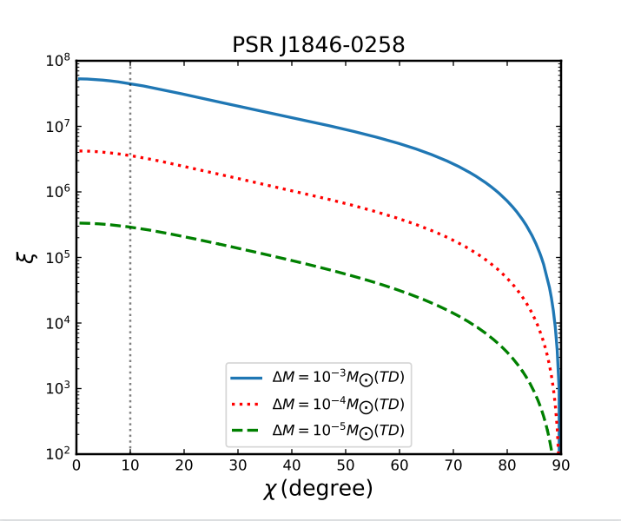
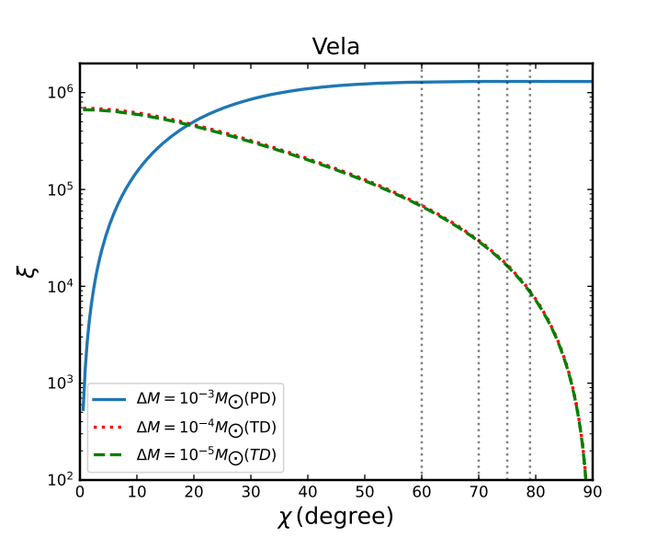
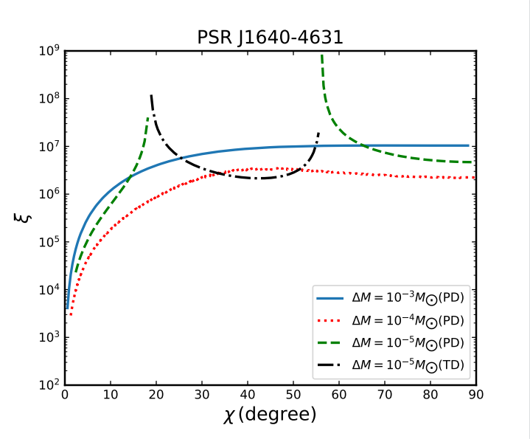
Results for re-emergence model
Yan et al. 2023b, to be submitted

Slide 18
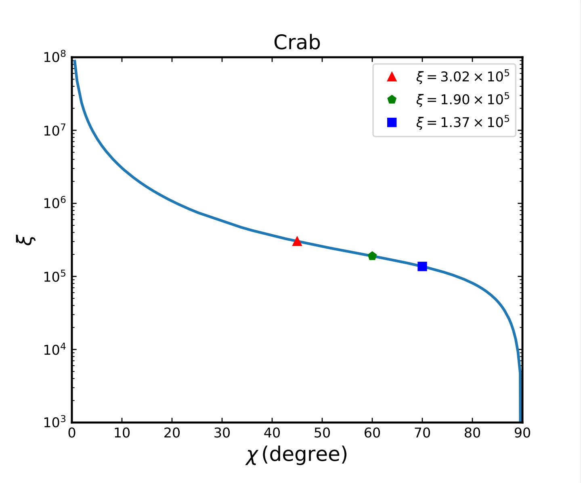
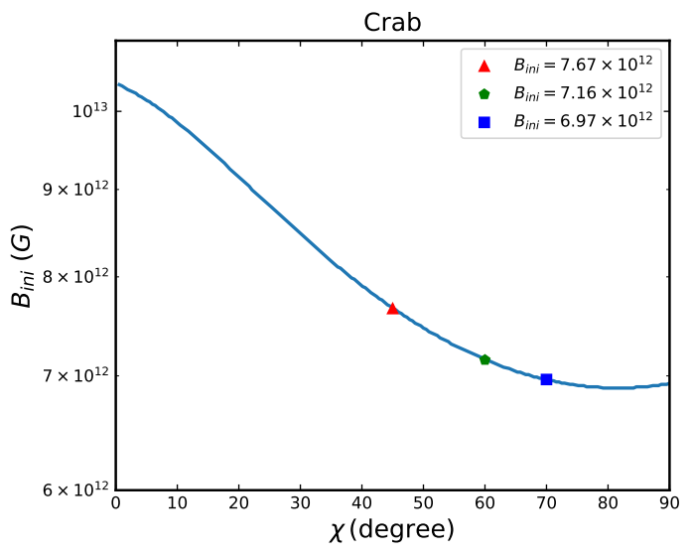
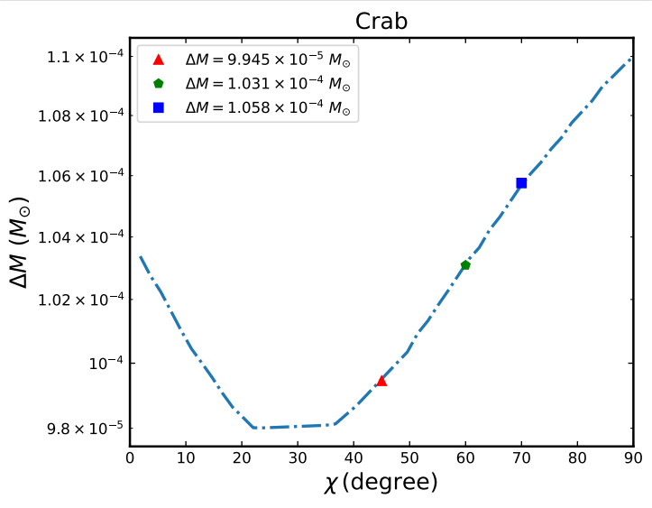
Results for re-emergence model
Since $\dot{χ}$ of the Crab was observed, we can detemine ξ, ΔM, and $B_{ini}$ at different $χ$ measured.
Yan et al. 2023b, to be submitted

Slide 19
Concluding remarks
1. The power-law decay model is inconsistent with observations of the Crab and thus may not be applied to ordinary pulsars. However, a definite conclusion may be drawn if $\dot{χ}$ of other pulsars can be measured.
2. To satisfy the Crab's obsevrations, its dipole field should increase at a rate 12−14 G/s, suggesting a dipole field reemergence model.
3. In the reemergence scenario, we obtained the number of precession cycles ξ and the initial magnetic field $B_{ini}$ at different ΔM. Furthermore, from the Crab’s observations we have ξ$≈{10}^{5}$, $ΔM≈{10}^{−4} M_{⨀}$, and $B_{ini}≈7×{10}^{12}$ G.

Slide 20
Thanks！

