Slide 1
Spinning-down strangeon stars and the implication on GRB X-ray afterglow
Fast/Future Pulsar Symposium 12
报告人：杨细艳
Yangtze University 长江大学
指导老师: 来小禹 (湖北第二师范学院)

Slide 2
Outline
Pulsars: neutron stars or strangeon stars?
Spinning-down of neutron/strangeon stars
The energy injection to GRB afterglow
Summary

Slide 3
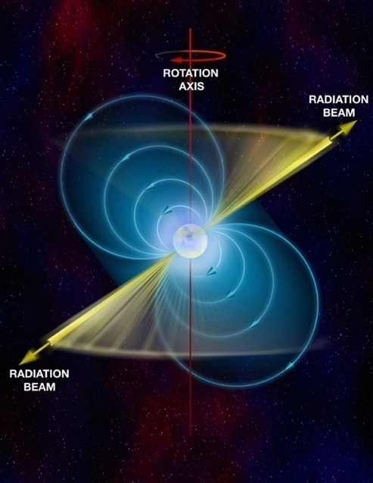
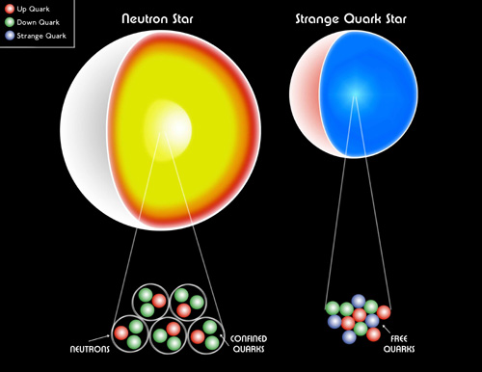
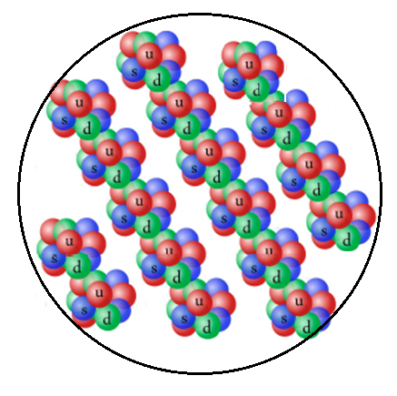
The nature of pulsar-like compact stars ?
M ~ 1.4 M⊙
R~10 km
（ ρ₀ ≈ 2.8×10¹⁴ g/cm³：nuclear matter density）

Slide 4
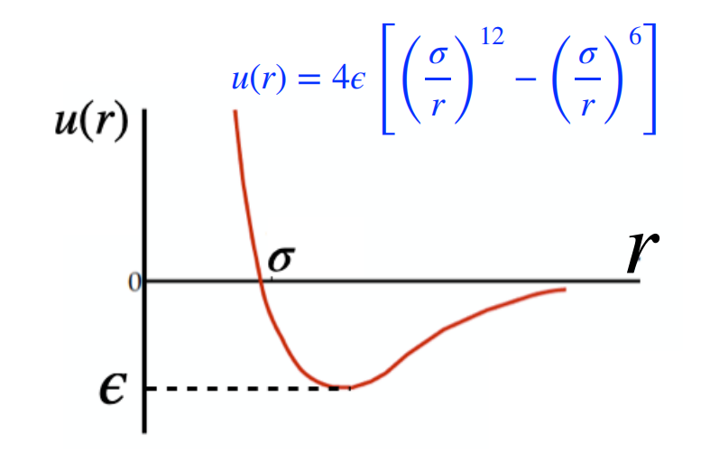
Strangeon stars
V (r)
r
V(r) has a strong repulsive core
Lennard-Jones model
$$ρ=2ε{(A}_{12}σ^{12}n^{5}−A_{6}σ^{6}n^{3})+nN_{q}m_{q}c^{2}$$
$P=n^{2}\frac{d\left(\frac{ρ}{n}\right)}{dn}=4ε(2A_{12}σ^{12}n^{5}−A_{6}σ^{6}n^{3})$
(Lai & Xu, 2009)

Slide 5
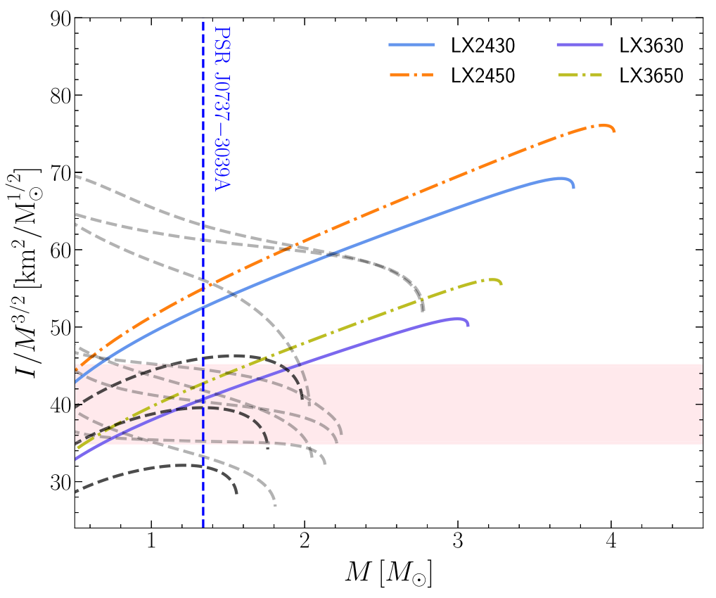
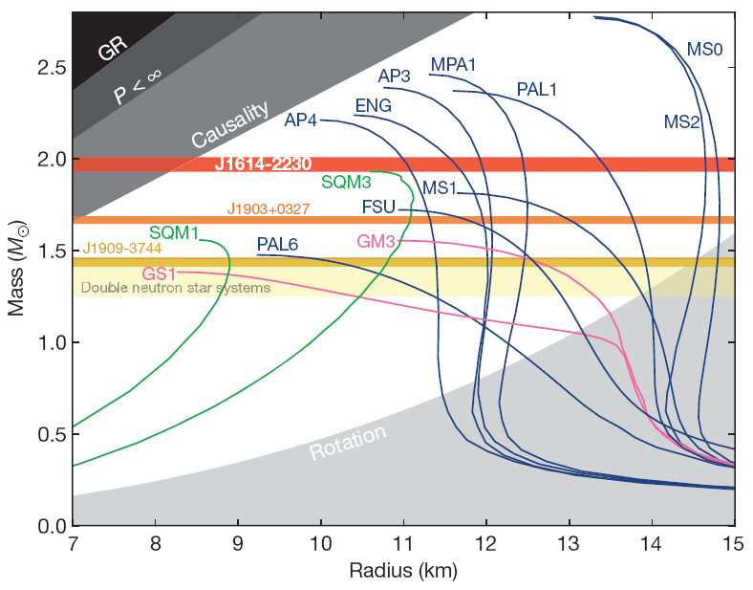
EOS of neutron stars and strangeon stars
Neutron stars: AP4
Strangeon stars: LX3630($N_{q}=18$): $n_{s}=0.36fm^{−3}$, $ε=30MeV$
Demorest et al. 2010
Gao et al. 2022

Slide 6
Slowly rotating compact stars
Hartle-Thorne formalism （$Ω≪Ω_{c}=\sqrt{\frac{GM}{R^{3}}}）$
$$ds^{2}=−e^{v\left(r\right)}\left[1+2h\left(r,θ\right)\right]dt^{2}+e^{λ\left(r\right)}\left[1+\frac{2m^{∗}\left(r,θ\right)}{r−2m\left(r\right)}\right]dr^{2}$$
$$+r^{2}\left[1+2k_{2}\left(r,θ\right)\right]\left\{dθ^{2}+\sin^{2}{θ}{\left[dϕ−w\left(r\right)−w1\left(r,θ\right)−w3\left(r,θ\right)dt\right]}^{2}\right\}+O(Ω^{4})$$
Hartle J. B., ApJ, 1967; Hartle and Thorne, ApJ, 1968
First order
moment of inertia
Second order
Gravitational mass, baryonic mass
Third order
Corrections to the moment of inertia

Slide 7
In the constant baryonic mass sequence
——LX3630($N_{q}=18$): $n_{s}=0.36fm^{−3}$, $ε=30Mev$
——AP4
Gravitational mass decreases & radius decreases

Slide 8
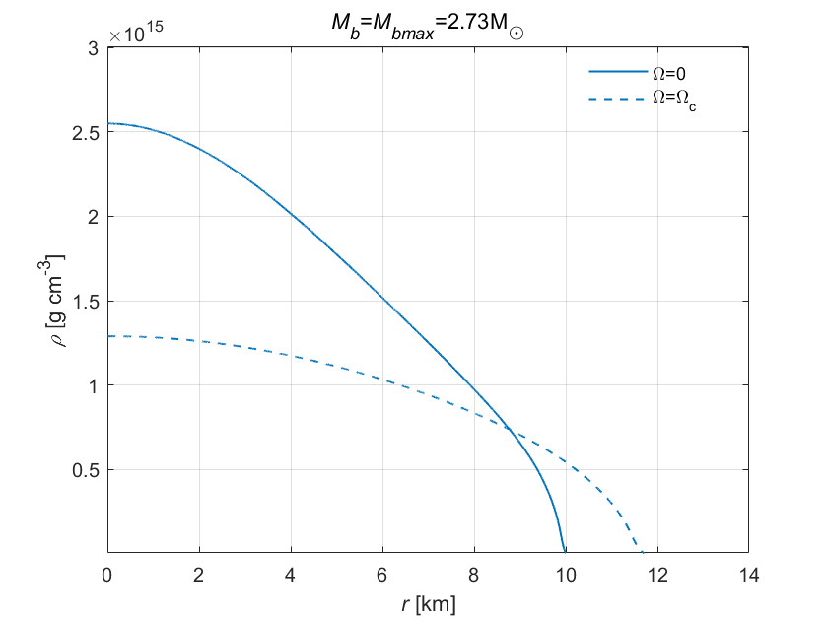
Energy density distribution inside the star
LX3630(Nq=18)
AP4
AP4
$$δρ\sim 97.67\%$$
$$δρ\sim 11.72\%$$
During the spinning down:
The radius decreases and the central density increases
The contraction of the core of NS is more significant than that of SS

Slide 9
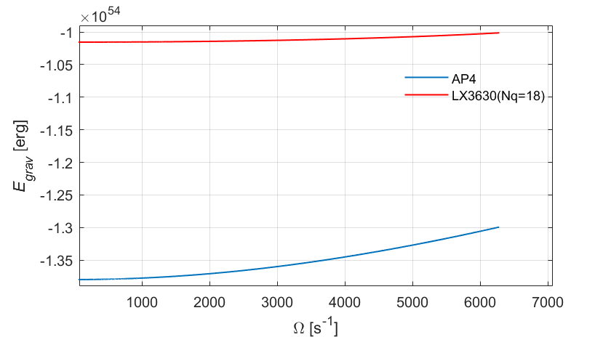
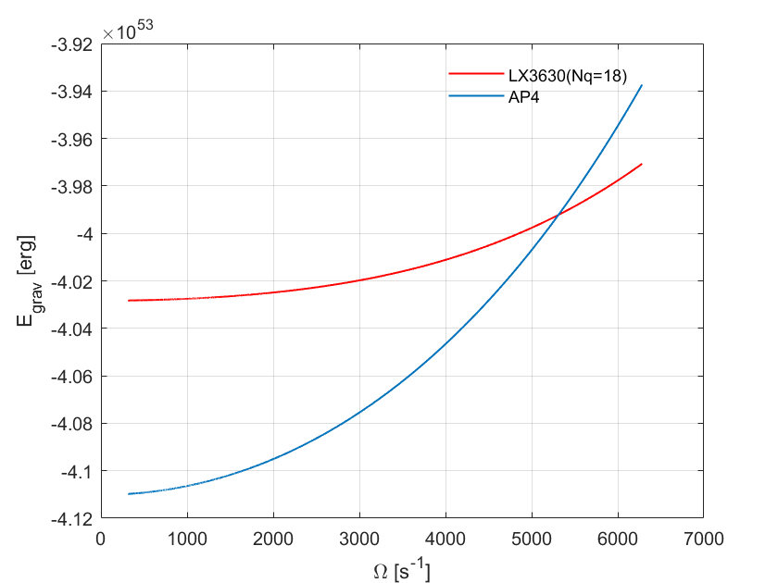
Gravitational energy
$M_{0}=2.2M_{⊙}$ , $P_{0}=1ms$
$M_{0}=1.4M_{⊙}$ , $P_{0}=1ms$
$E_{grav}=Mc^{2}−M_{p}c^{2}−E_{kin}$
$Ω$decrease, $E_{grav}$decrease
$\frac{dE_{grav}}{dΩ}$ of neutron stars is bigger than strangeon stars

Slide 10
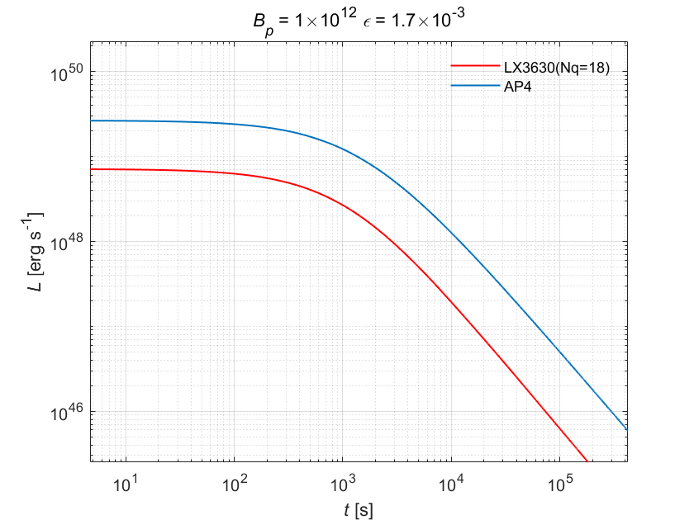
Luminosity of gravitational energy
Spin-down law (magnetic dipole radiation and GW radiation)
$${\dot{E}}_{kin}=IΩ\dot{Ω}=−\frac{32GI^{2}ε^{2}Ω^{6}}{5c^{5}}−\frac{B_{p}^{2}R^{6}Ω^{4}}{6c^{3}}$$
Gravitational energy
→ luminosity
$L_{grav}={\dot{E}}_{grav}$
Shapiro & Teukolsky, 1983
$M_{0}=2.2M_{⊙}$ , $P_{0}=1ms$

Slide 11
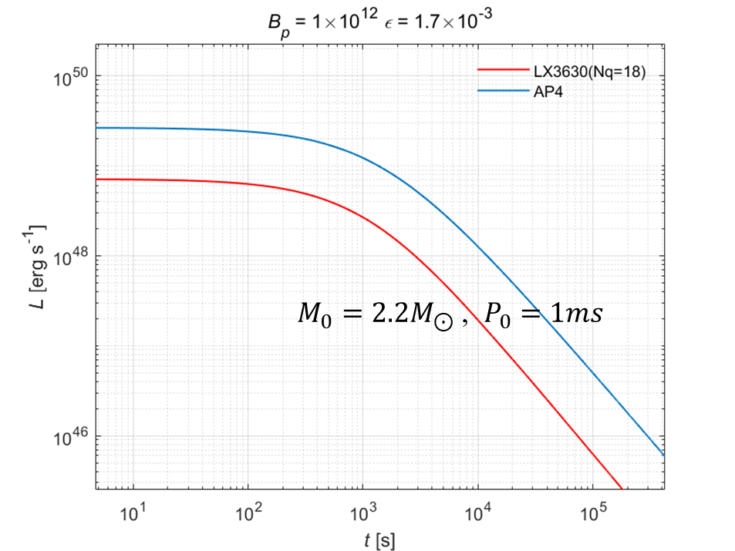
What can $L_{grav}$ do?
$L_{grav}=L_{bb}$
→ $kT≈6.04Mev (SS)$ 、$8.6Mev (NS)$
Can the gravitational energy surve as the energy injection of the plateau of GRB afterglow ?
$L=ηL_{grav}$

Slide 12
Short gamma-ray bursts
$M_{0}=2.2M_{⊙}$ , $P_{0}=1ms$
SGRB130603B
SGRB090426
SGRB051221A
The plateau of short GRB X-ray afterglow can be fitted

Slide 13
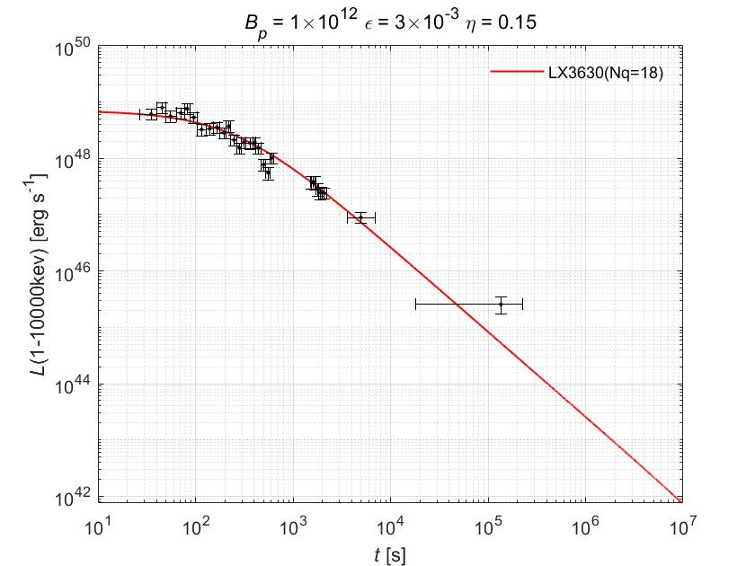
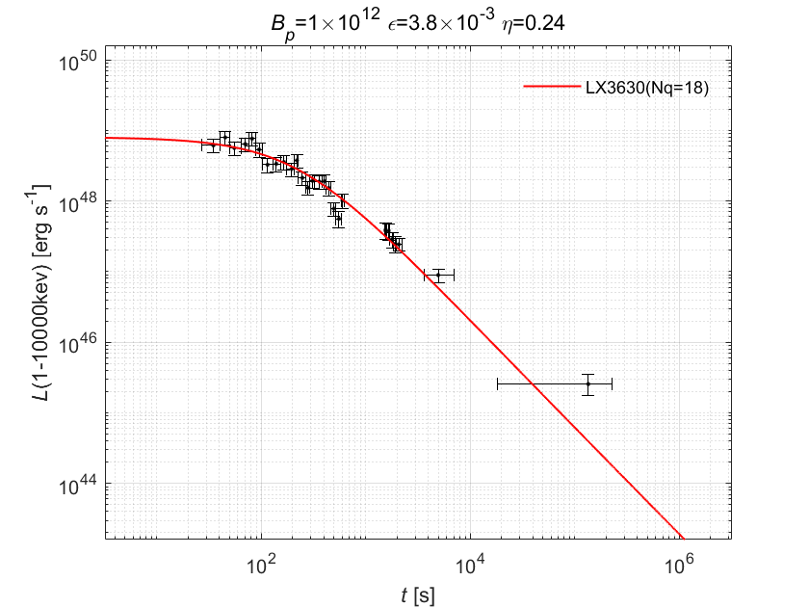
Short gamma-ray bursts
$M_{0}=2.4M_{⊙}$ , $P_{0}=1ms$
For a same burst, lager $M_{0}$, lower $B_{p}$ and $η$
SGRB090426
$M_{0}=2.2M_{⊙}$ , $P_{0}=1ms$

Slide 14
Summary
We study the spinning-down neutron/strangeon stars in slow-rotation approximation.
During the spinning down, the contraction of NS is more significant than that of SS.
Gravitational energy can surve as the energy injection of the plateau of SGRB afterglow.
The energies of thermal photons are different between NS and SS
Thanks!

