Slide 1
FAST Discovery of New Pulsars in Globular Cluster NGC 6517
尹德江
张立云 (贵州大学)、潘之辰、钱磊 (NAOC)
FAST/Future Pulsar Symposium 12 Nanyang Normal University, Nanyang, Henan, China
2023/07/05

Slide 2
OUTLINE
1. New Pulsars in NGC 6517 discovered with FAST
2. Galactic Globular Cluster pulsar population simulation

Slide 3
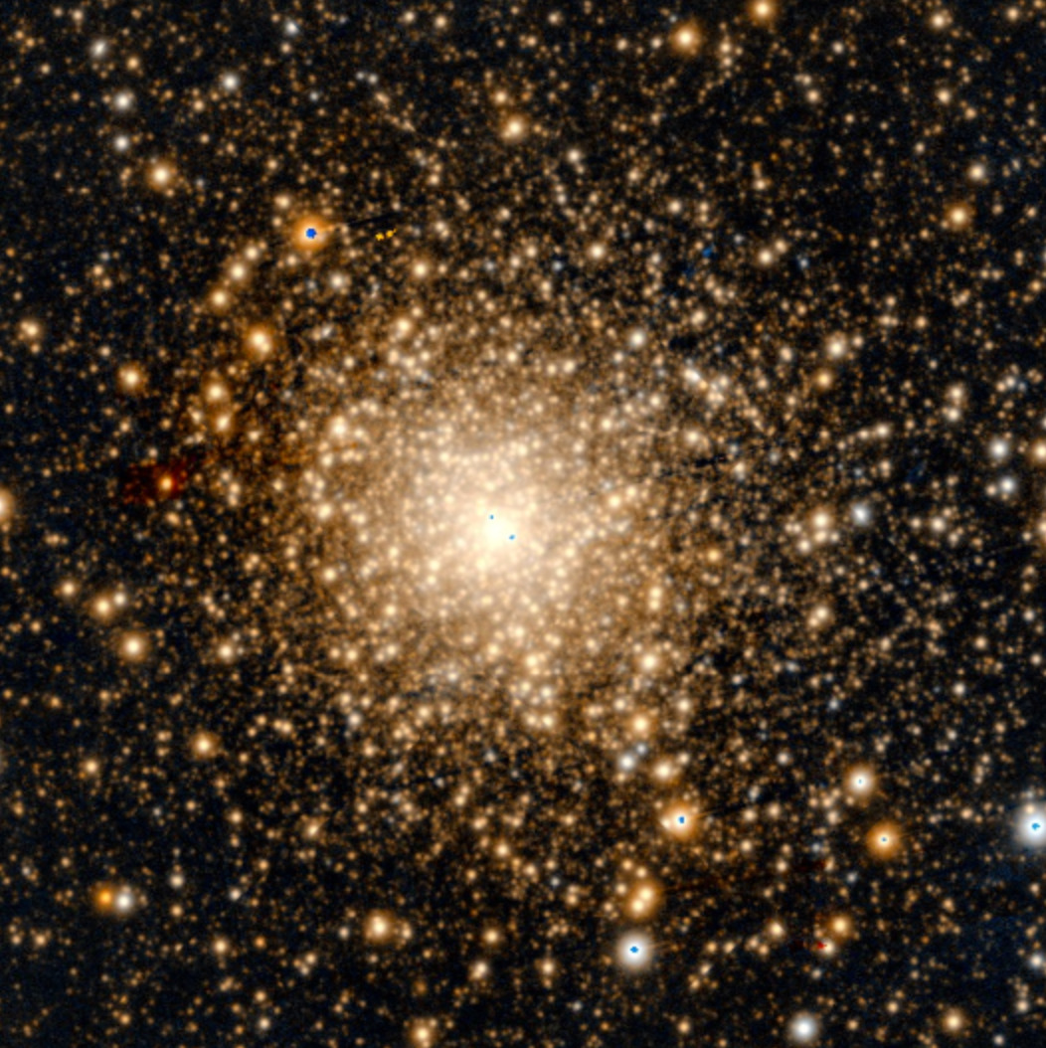
NGC 6517
NGC 6517
RA: 18:01:50.52; DEC: -08:57:31.6; R_sun: 10.6 kpc (Harris. 2010); Mass: 2.16 ± 0.24 x 10⁵ M☉ ; T = 12 Gyr (Baumgardt et al. 2023)
The densest cluster in FAST sky, ρ₀ = 10^{5.29} L⊙pc⁻³ (13 in all GCs, Harris. 2010).
Image Credit: PanSTARRS DR1, PS1 Science Consortium

Slide 4
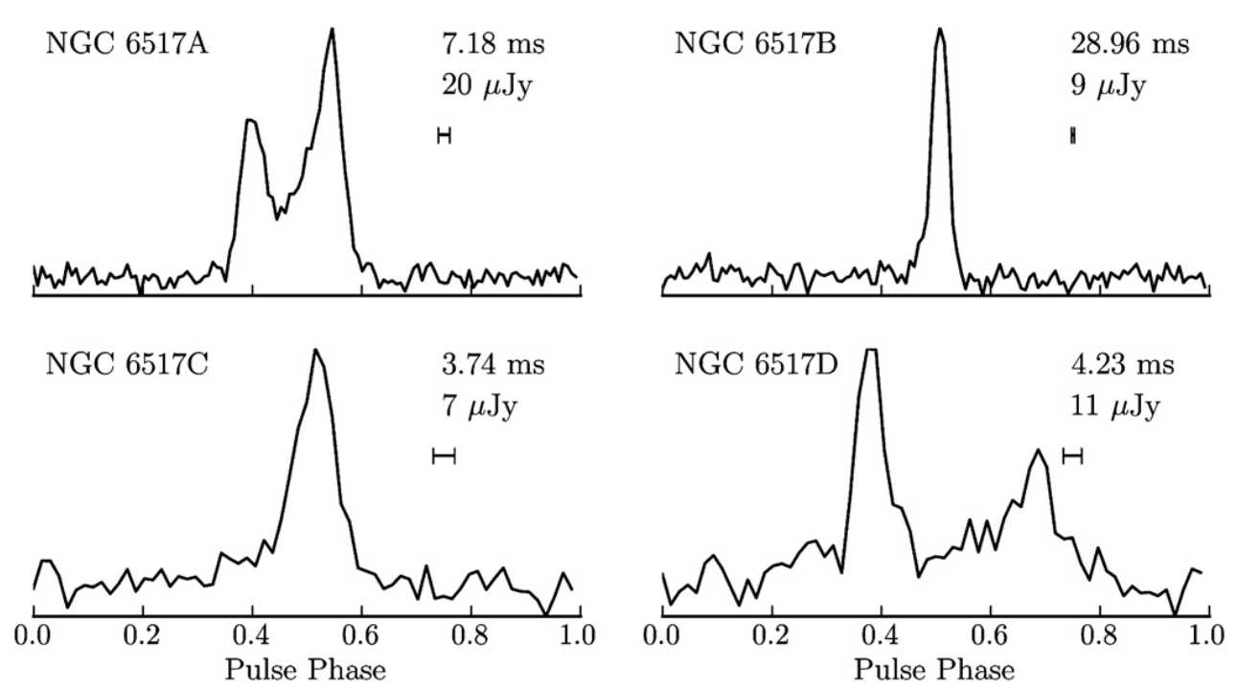
The first pulsars in NGC 6517
1. Dispersion Measures (DM) range:
J1801−0857A to C (NGC 6517A to C): ~182.4 cm⁻³ pc
NGC 6517D: ~174.7 cm⁻³ pc.
2. Only NGC 6517B is in binary system (~59.9 days PB)
3. By analyzing the luminosity function of the pulsars in NGC 6517, NGC 6517 was predicted to harbor roughly 12 pulsars (Lynch et al. 2011).
Average pulse profiles of the newly discovered pulsars in NGC 6517 with Green Bank Telescope (Lynch et al. 2011).

Slide 5
More pulsars in NGC 6517 with FAST
New Pulsars:
1. NGC 6517E to I, K and L are isolated and NGC 6517J is possible in a binary system.
2. These new pulsars are faint with DM range of 177.8 to 185.6 cm⁻³ pc.
Why?
1. The high sensitivity of FAST
2. New algorithm used to check and sifting possible candidates
The discovery plot of NGC6517 E. Left panel is the PRESTO folding result and right panel is the DM to SNR plot from JinglePulsar code (Pan et al. 2021).
8 new pusars NGC 6517E, F, G, H, I, J, K, L with FAST
(Pan et al. 2021a,b)

Slide 6
FAST observation data of NGC 6517
1. Observation span:
2019/06/25 - 2022/12/31
2. The longest observation :
9000 s (2.5 h, J,K,L)
(Yin et al. in prep)

Slide 7
Reproducing FAST data of NGC 6517
1. The time delay between two frequencies :
2. For NGC 6517:
(181.3) ± 16 cm⁻³ pc (165 -198 cm⁻³ pc)
DM step: DDplan.py routine of PRESTO (0.05 cm⁻³ pc)
3. Candidates sifting and diagnose
3.1. ACCEL_sift.py routine in PRESTO
3.2. JinglePulsar code
3.3. New pipeline
∆DM ≡ DM_{max}−DM_{min} in each GC (Yin et al. 2023).
M 53 (5 psr, Lian et al. 2023); NGC 6624 (12 psr, Abbate et al. 2022). The upper bound:

Slide 8
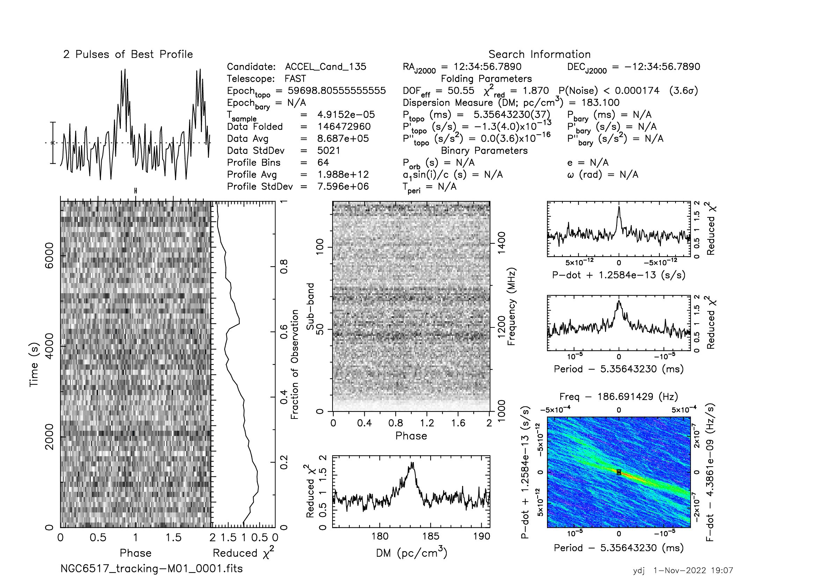
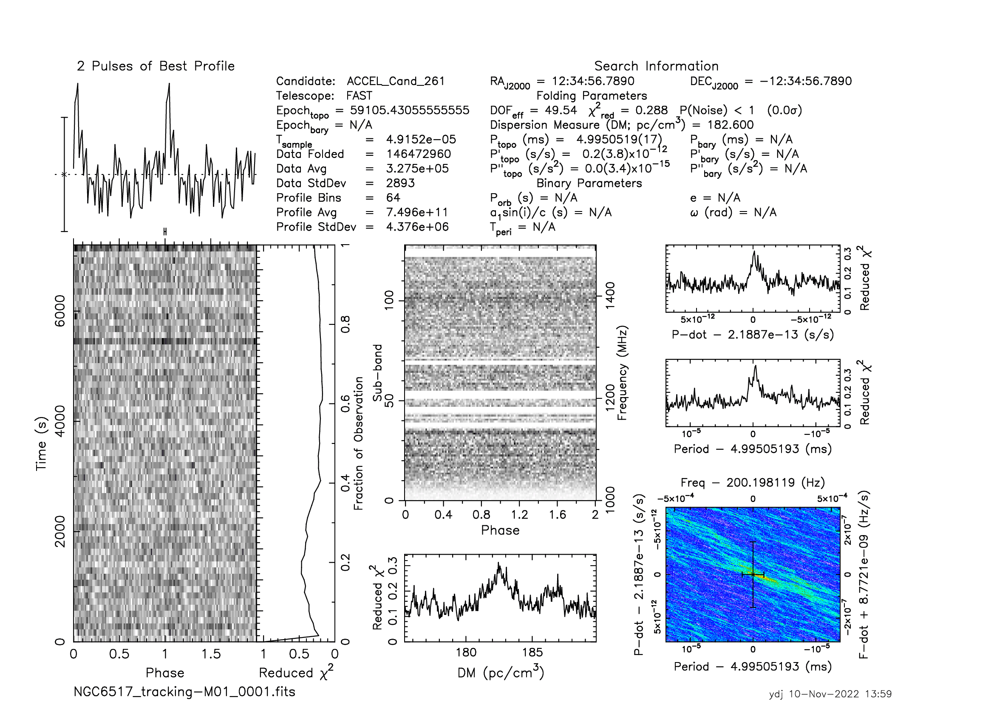
More new pulsars
The discovery plots of NGC 6517M to R from PRESTO
NGC 6517M (p~5.36 ms)
NGC 6517N (p~4.99 ms)
NGC 6517O (p~4.29 ms)
NGC 6517P (p~5.53 ms)
NGC 6517Q (p~7.26 ms)
NGC 6517R (p~6.58 ms)

Slide 9
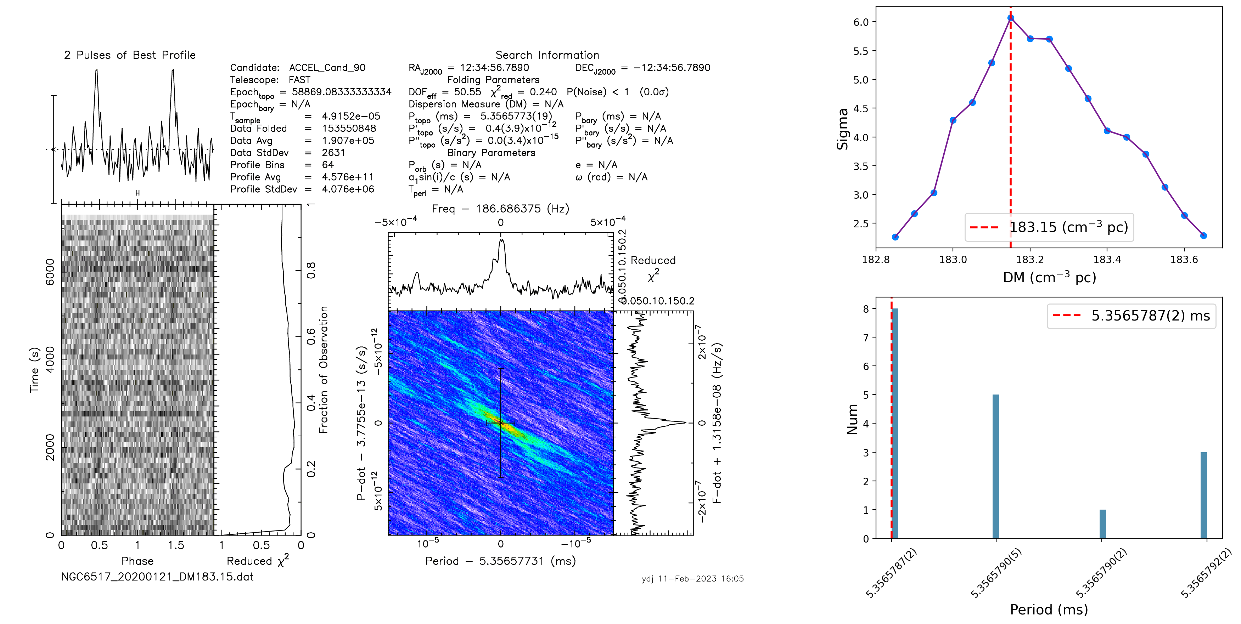
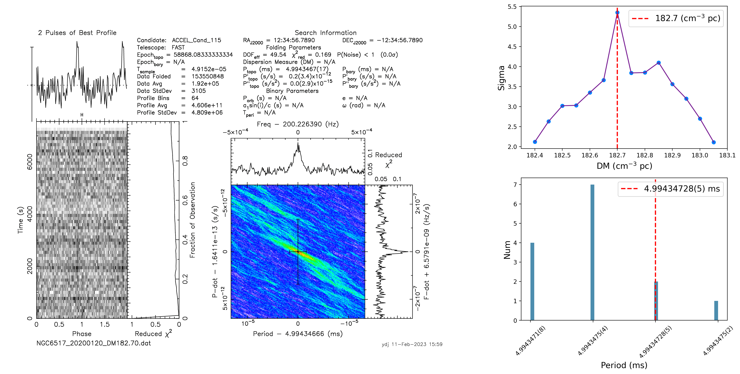
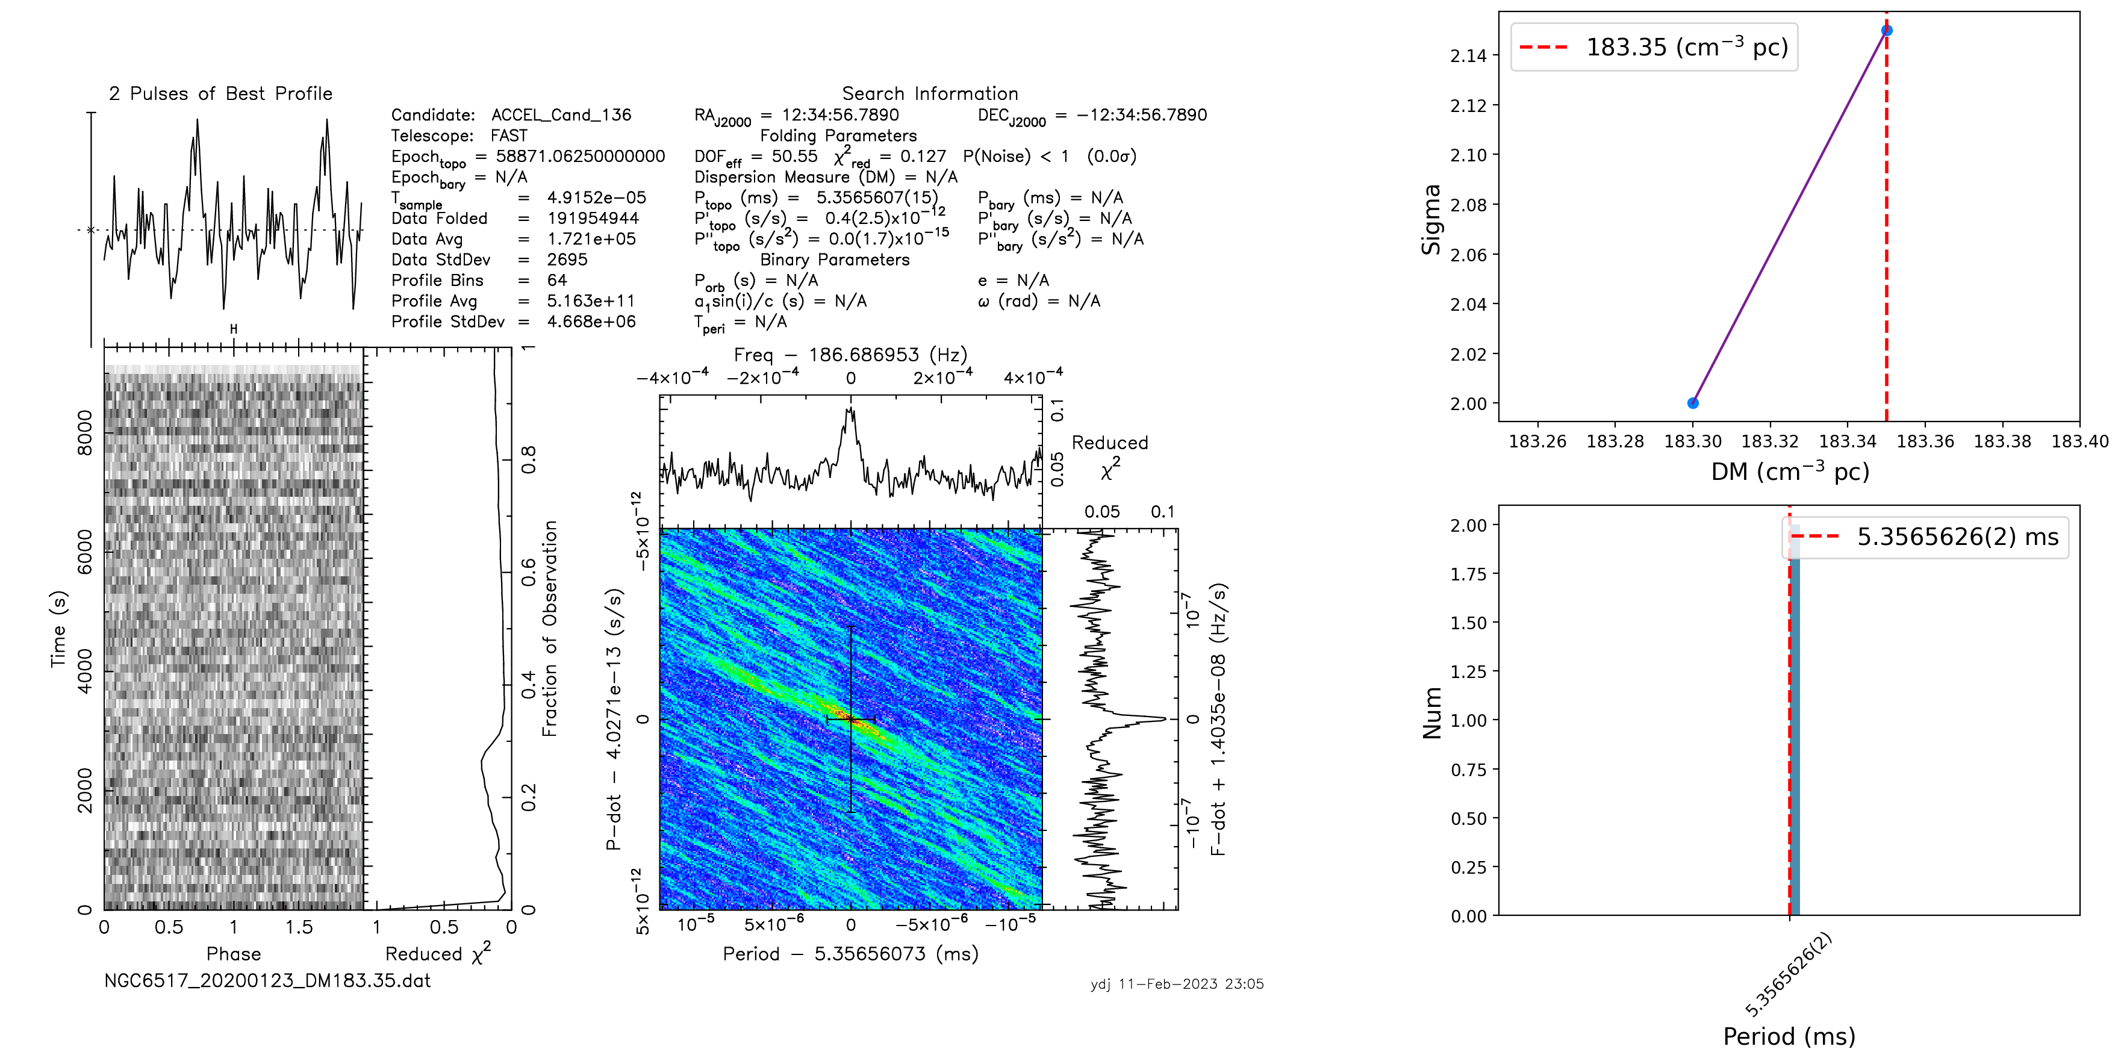
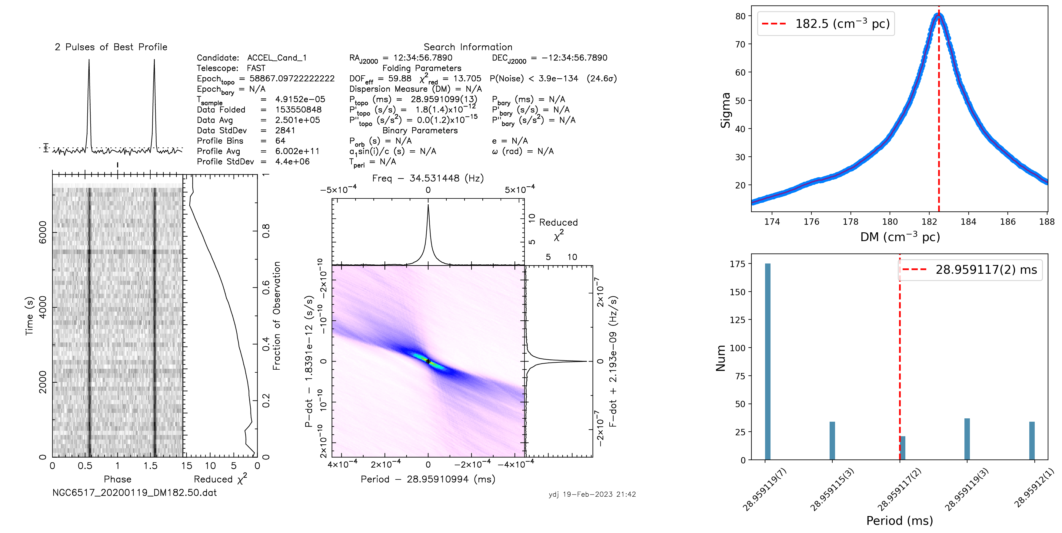
New Pipeline
NGC 6517M
NGC 6517N
NGC 6517M
NGC 6517B
(Pulsar candidate diagnose plots, Yin et al. in prep)

Slide 10
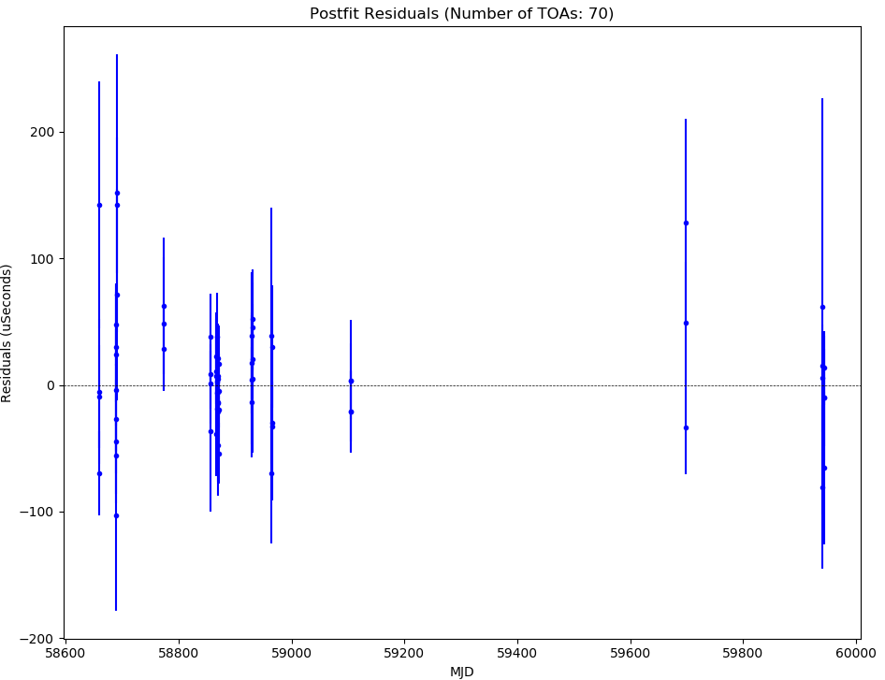
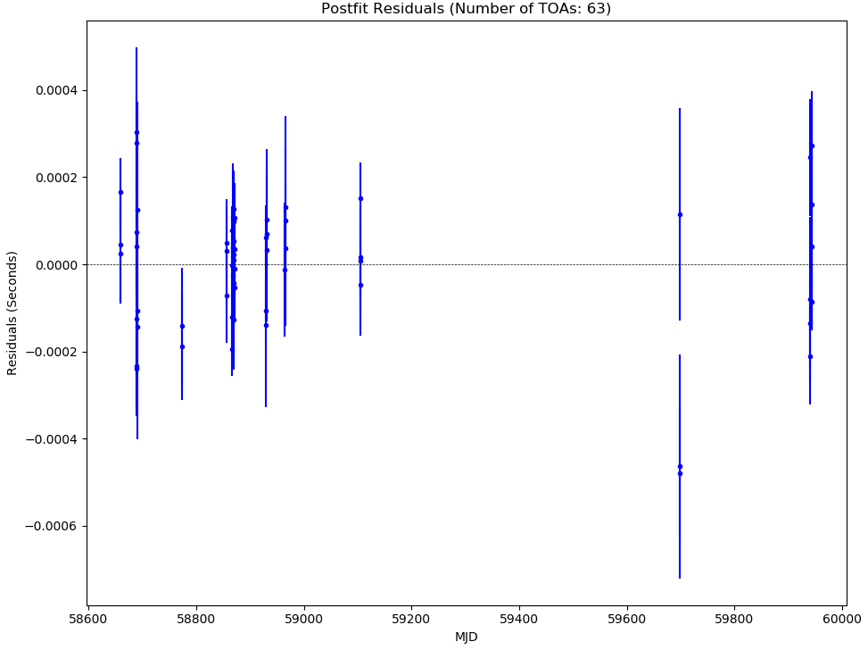
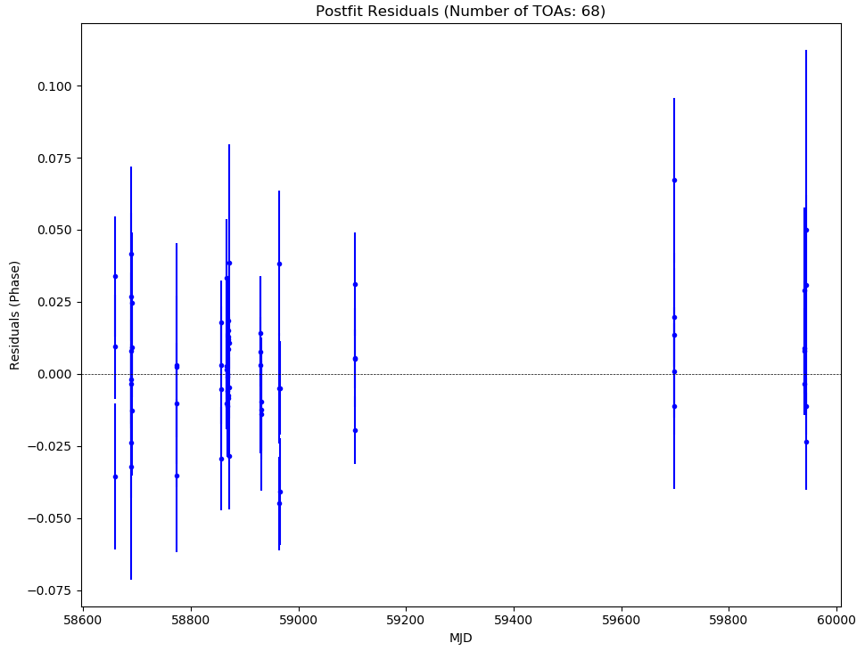
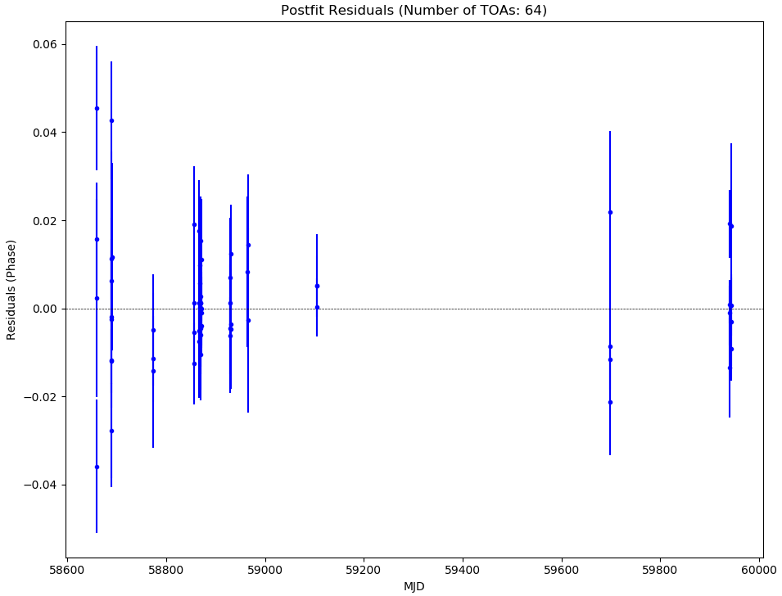
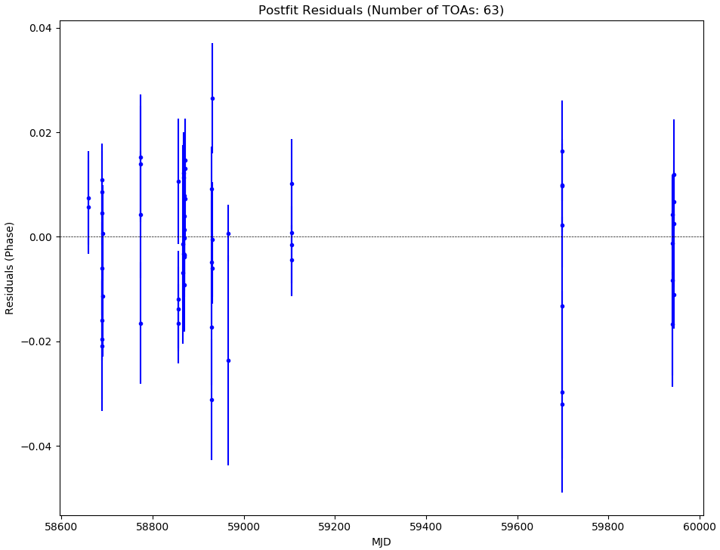
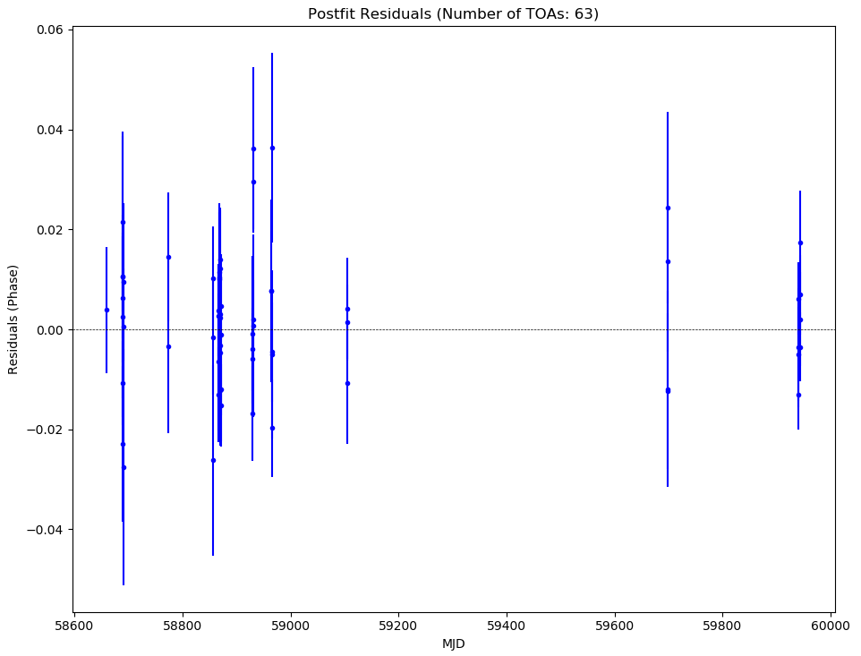
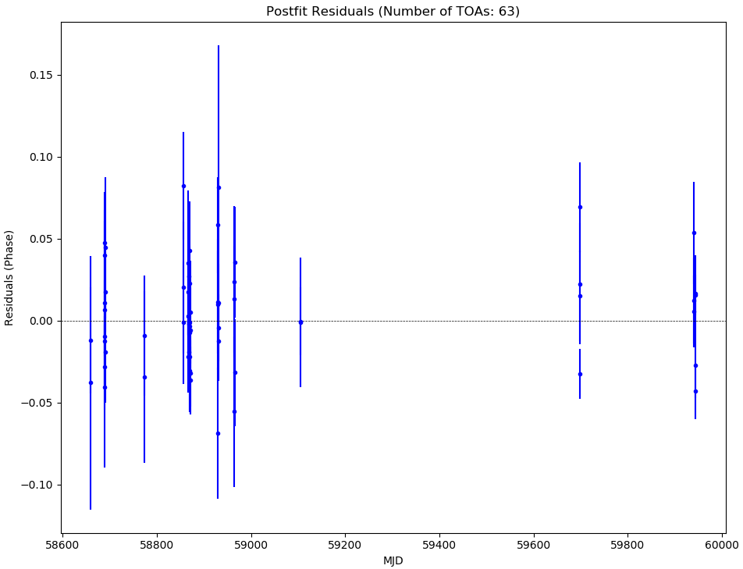
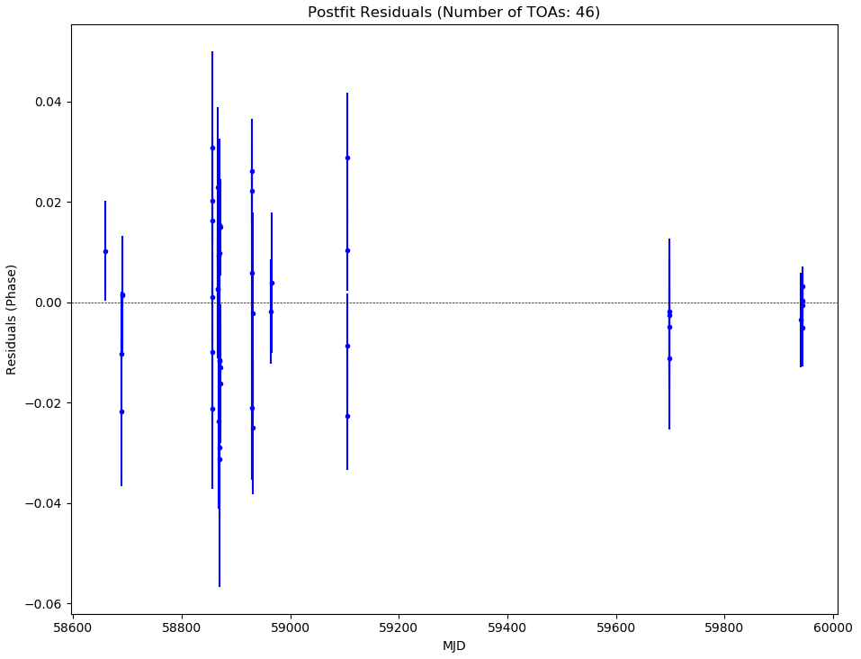
Timing solutios of new pulsars
NGC 6517I
NGC 6517K
NGC 6517L
1. Up to now, a total of 18 pulsars in NGC 6517, Only NGC 6517B is in binary system, NGC 6517J is possible a binary.
2. Their are almost isolated, consistent with the expectation of core-collapse clusters (Verbunt & Freire 2014).
3. 1st Spin Period derivative, Pdot (s s⁻¹) :
positive: NGC 6517B, D, G, H, K, M , O and R.
negative: NGC 6517A, C, E, F, I, L, N and P.
NGC 6517M
NGC 6517N
NGC 6517O
NGC 6517P
NGC 6517R
DM: 182.5 - 183.6 cm⁻³ pc

Slide 11
Their positions
1. Optical center?
(Terzan 5 (48), 47 Tuc (29))
2. Clock, polarization correction...
Positions of pulsars in NGC 6517, plotted offset from the NGC 6517 optical center (α_{J2000} = 18h01m50.52s and δ_{J2000} = −08°57′31.6′′, Harris 1996, 2010 edition). The color bar on the right is the range of pulsar DM (Yin et al. in prep).

Slide 12
Galactic Globular Cluster pulsar population simulation
Method: An empirical Bayesian model described in Turk & Lorimer. (2013). In this model, the number of underlying detectable pulsars in a GC is scaled by its stellar encounter rate, Γ.
1. The predicted numbers of pulsars in the FAST sky more than outlined in Turk & Lorimer. (2013) due to a larger detection rate of GC pulsars in the northern hemisphere.
2. Further pulsar discoveries in this cluster ?(30).
(Yin et al. in prep)
( ,where ρ₀ is the central mass density and r_{c} is the core radius, Pooley et al. 2003).

Slide 13
Conclusion
1. Six new pulsars were discovered, a total of 18 pulsars in NGC 6517 now (14 from FAST!); the number of pulsars ranks 4th in all GCs with known pulsars.
2. The phase-connected timing solutions of all pulsars except NGC 6517J and Q are obtained. The isolated pulsars dominate the pulsar population in NGC 6517.
3. The predicted numbers of pulsars in the FAST sky more than outlined in Turk&Lorimer.(2013) due to a larger detection rate of GC pulsars in the northern hemisphere. Many extremely faint pusars are underlying detectable ?

Slide 14
THANKS!
Email: dj.yin@foxmail.com

