Slide 1
Collision of White Dwarf- White Dwarf in AGN Disk
SKA脉冲星科学专题研讨会暨第十二届全国脉冲星年会
Ye-Fei Yuan (袁业飞)
Department of Astronomy, USTC
yfyuan@ustc.edu.cn 2023-07-06
Collaborators： 张书瑞、罗沿、吴小骏、王建民、 Luis Ho

Slide 2
Outline
Collisions of binary COs in AGN disks
Collisions of BWDs in AGN disks
HE Transients after the Collisions of BWDs
Conclusions and discussions

Slide 3
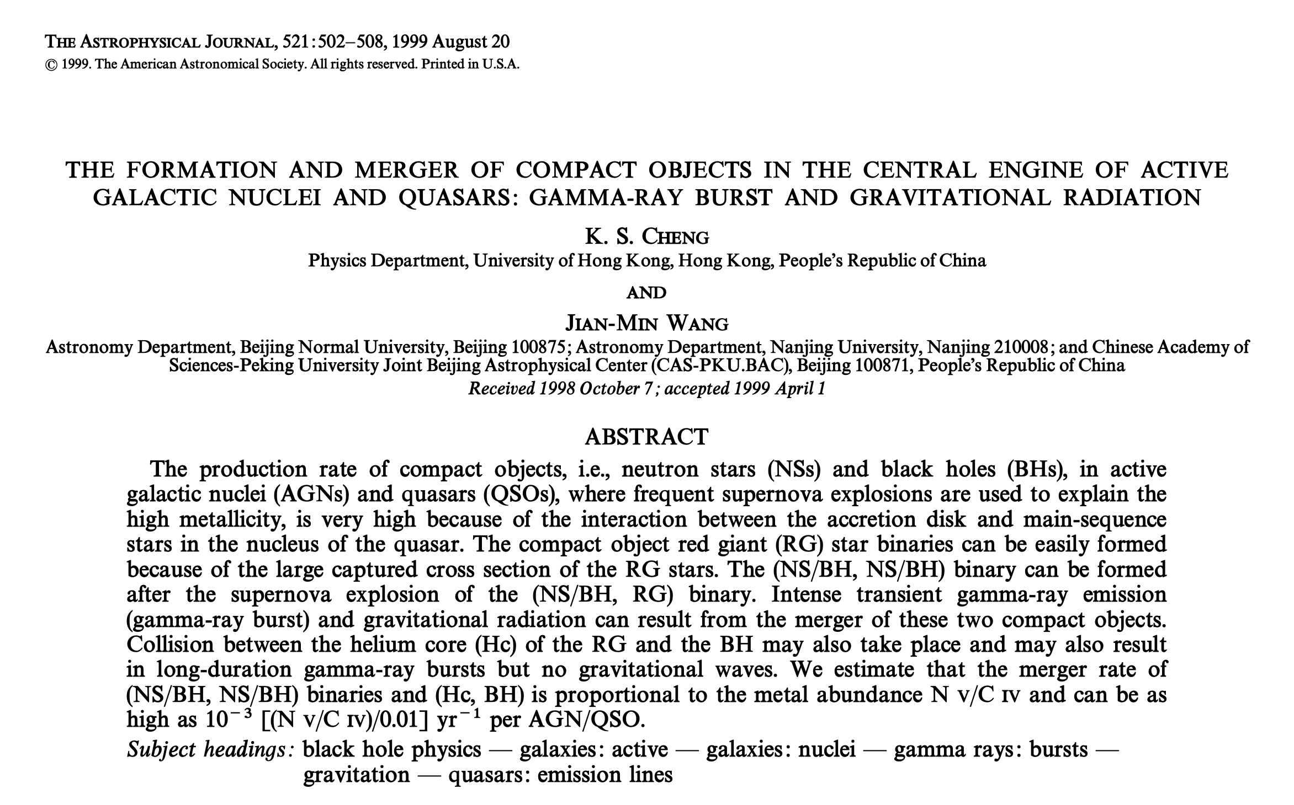
Collisions of binary COs in AGN disks
Cheng & Wang 1999
GRAVITY Collaboration et al (2018)

Slide 4
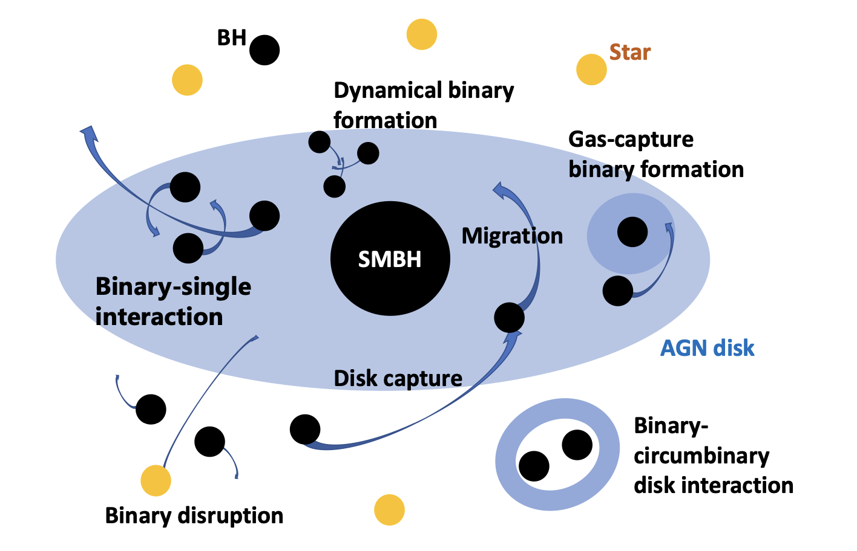
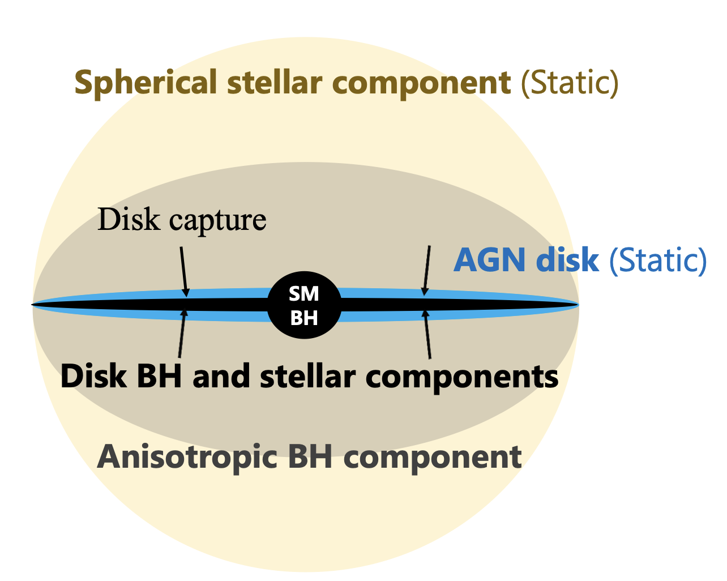
Collisions of binary COs in AGN disks
BH+BH
e.g. Tagawa et al. 2020
GRAVITY Collaboration et al (2018)

Slide 5
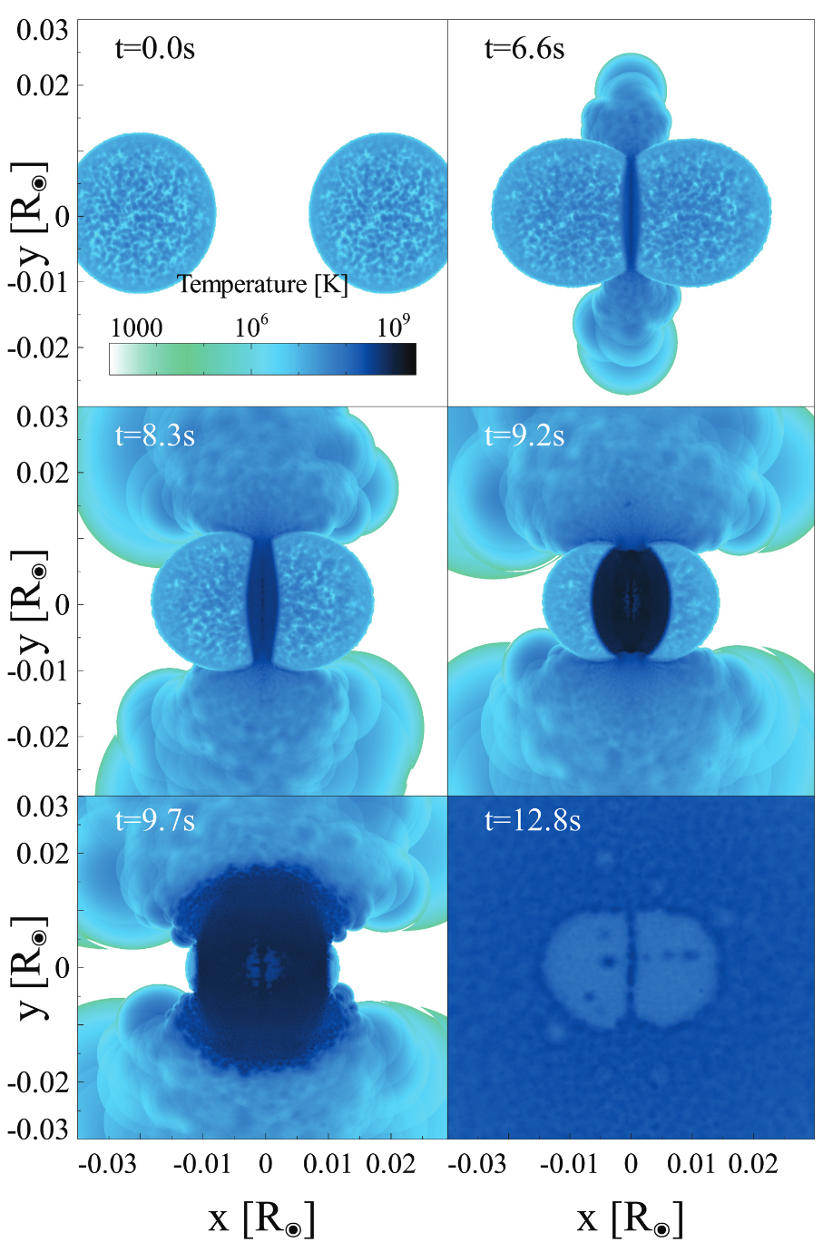
Simulation of BWD Collisions
The outcome depends on several factors: their masses and nuclear compositions; their relative speed; and the distance of closest approach.
The velocity of the supernova photosphere is 13,000-16,000 ${km s}^{−1}$, slightly higher than that observed in average SNe Ia.
Rosswog, S., Kasen, D., Guillochon, J., & Ramirez-Ruiz, E. 2009, ApJ, 705, L128
(Raskin et al. 2009)
Notes:
产生的${}_{ }^{56}{Ni}$的量可能被低估了！(Raskin et al. 2009)

Slide 6
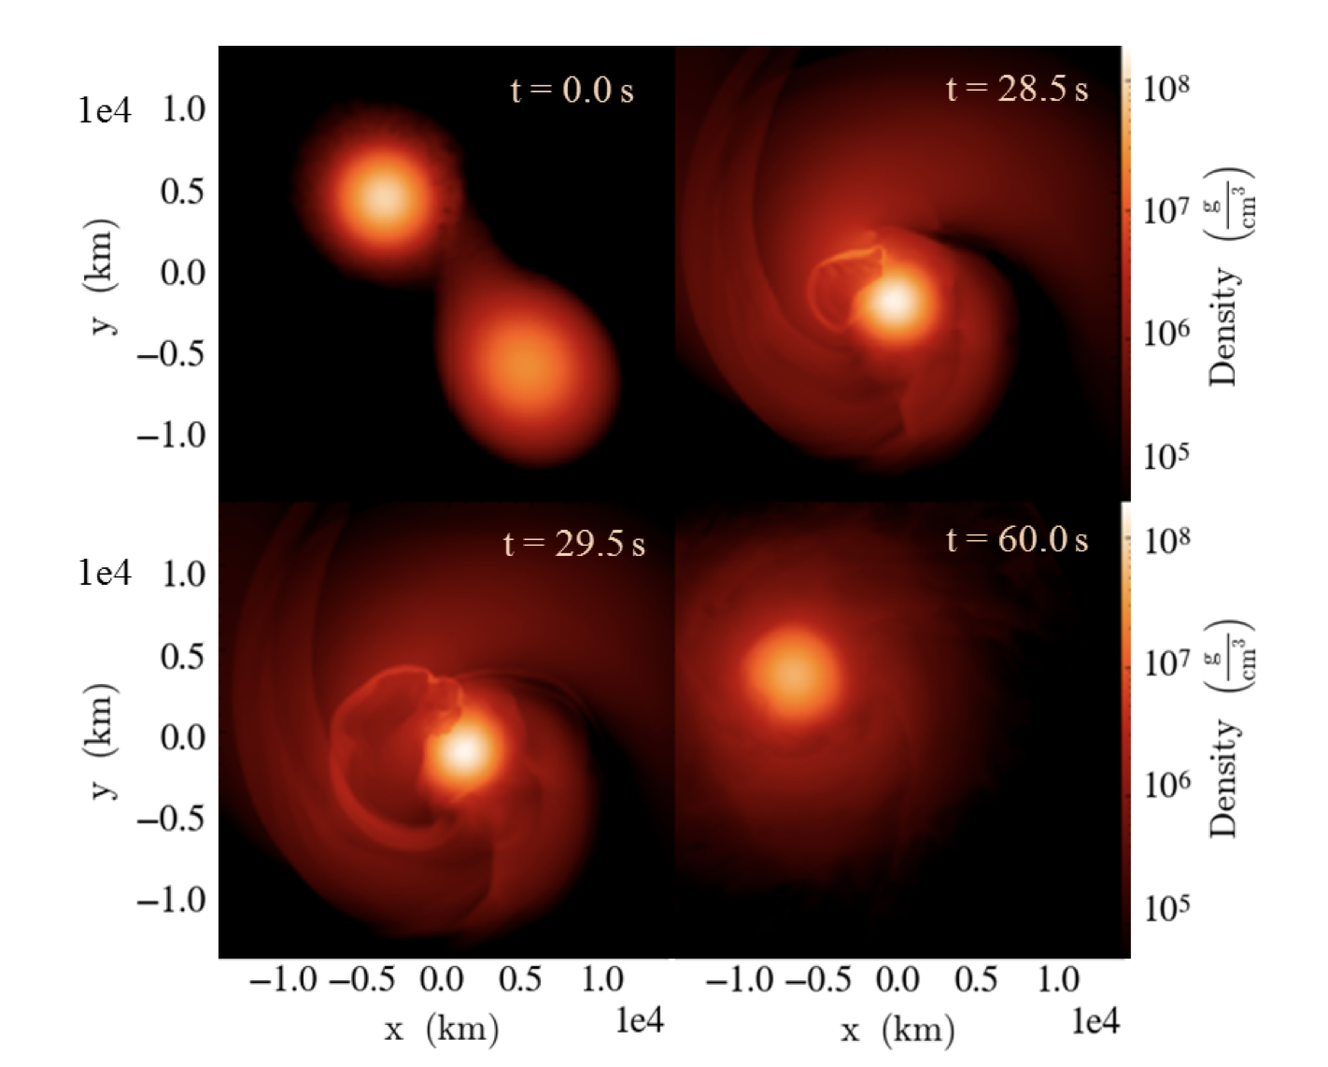
Collisions of binary WDs：SNIa？
Kashyap et al. 2018
GRAVITY Collaboration et al (2018)

Slide 7
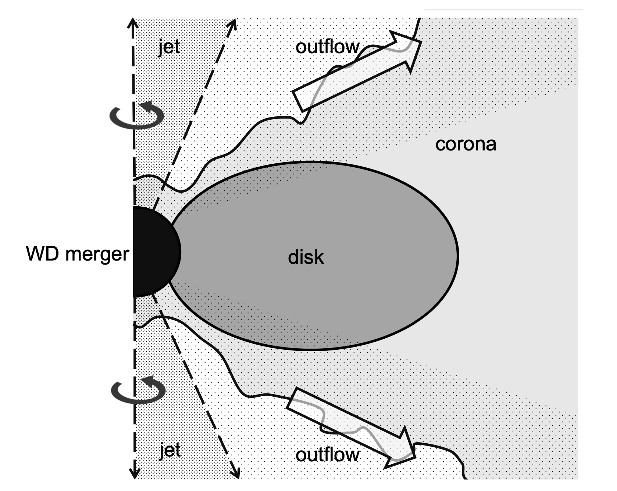
Collisions of binary WDs
Ji et al. 2013
GRAVITY Collaboration et al (2018)

Slide 8
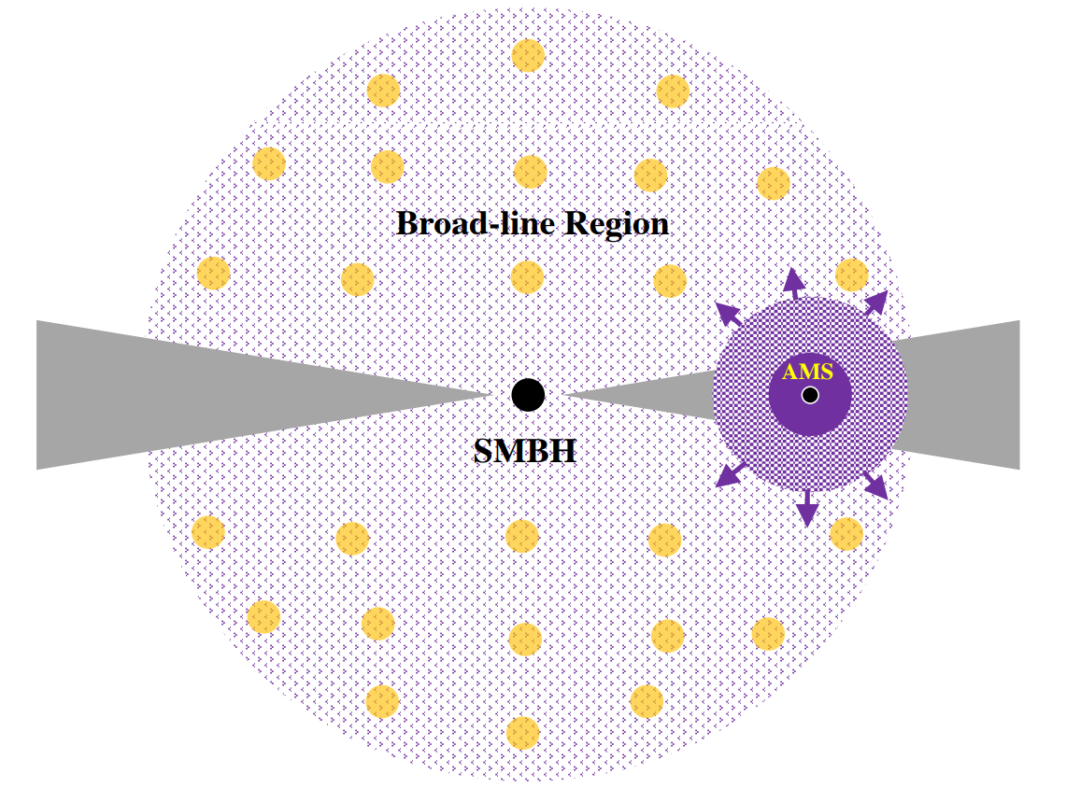
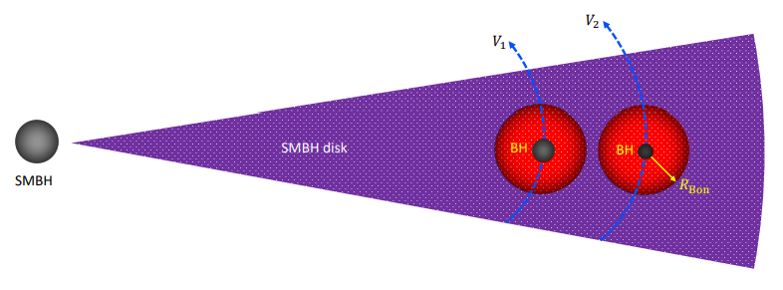
Accretion-modified Stars（AMS） in AGN Disks
Compact objects inevitably form AMSs in the extremely dense environment of SMBH-disks;
AMS black holes are episodically accreting with hyper-Eddington rates (∼${10}^{9}L_{Edd}/c^{2}$) and duty cycles of ∼ ${10}^{−5}$.
Wang, Jian-Min, et al. ApJL 911 (2021): L14.

Slide 9
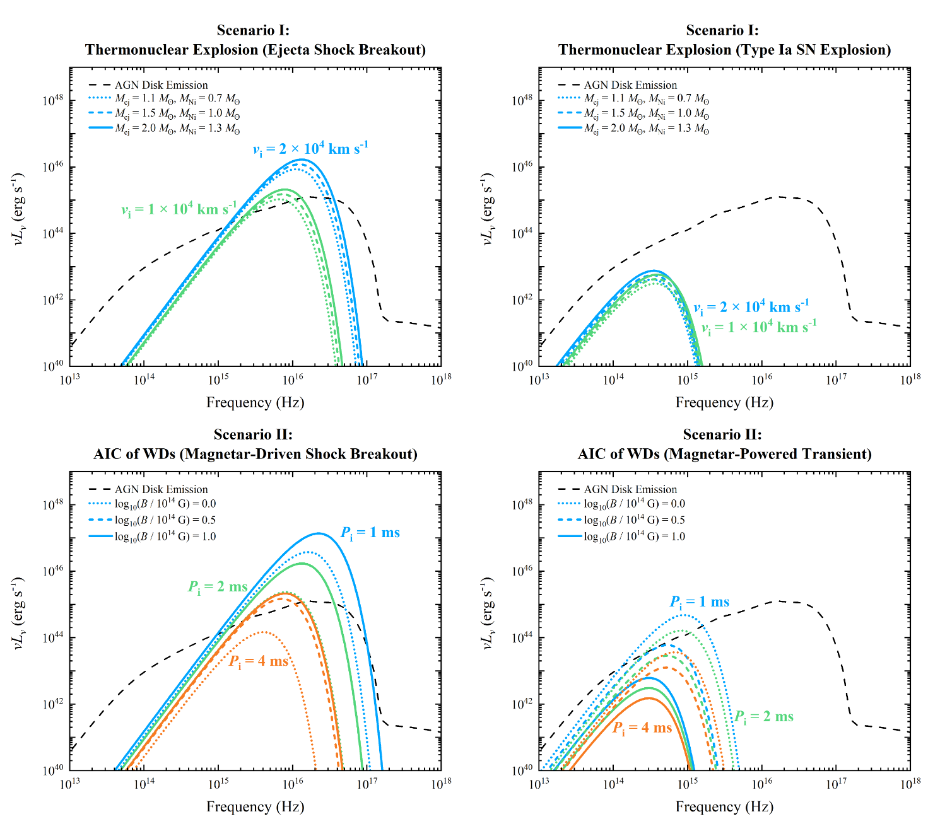
Supernova explosions in AGN disks
Grishin, E., Bobrick, A., Hirai, R., Mandel, I., & Perets, H. B. 2021, MNRAS, 507, 156
Zhu, J.-P., Yang, Y.-P., Zhang, B., et al. 2021, ApJL, 914, L19
Notes:
（Moranchel-Basurto, A., Sánchez-Salcedo, F. J., Chametla, R. O., & Velázquez, P. F. 2021, The Astrophysical Journal, 906, 15）给出了三维模拟
所面临的问题：1、起因不明确；2、限制太强，没考虑后续效应

Slide 10
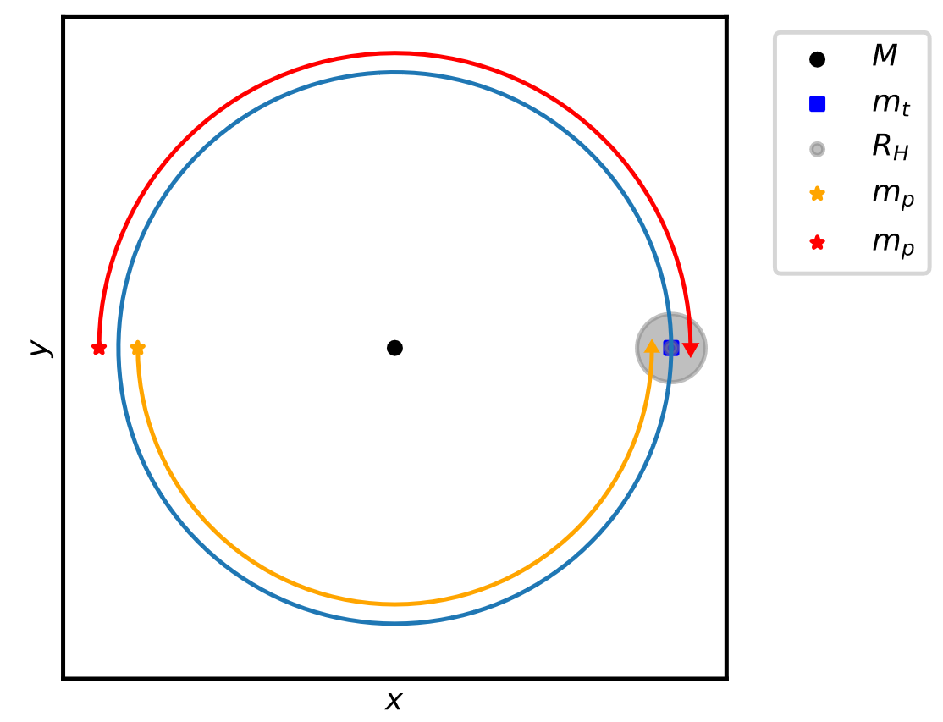
On the Jacobi capture origin of binaries
3-body simulations:
After the two BHs are captured, these BH binaries will merge in a few binary orbits.
Their mergers will exhibit high eccentricities and a board distribution of orbital inclinations relative to the original AGN disk;
Boekholt, T. C. N., Rowan, C., & Kocsis, B. 2023, MNRAS
Li, J., Lai, D., & Rodet, L. 2022, ApJ, arXiv:220305584

Slide 11
WDs Close Encounters in an AGN disk
For $M_{SMBH}$~${10}^{6}M_{⊙},$and two WDs $m_{1}=m_{2}=1.4M_{⊙}, R_{WD}$~${10}^{4}Km$.
$$R_{H}≡\frac{a_{1}+a_{2}}{2}{\left(\frac{m_{1}+m_{2}}{3M}\right)}^{\frac{1}{3}}≈{10}^{−2}a_{1}$$
$a_{1}$=${100GM/c}^{2}$ $≈{1.5×10}^{8}km$, $R_{H}$ $≈{1.5×10}^{6}km$
If two WDs orbital separation is less than $R_{H12}$, the orbits are dynamically unstable. For the two unstable WDs to be captured into a bound binary requires lose energy enough due to GW emission
$∆E_{GW}≳η\frac{Gm_{1}m_{2}}{R_{H12}}$ $⟹ \frac{r_{cap}}{R_{H12}}≈{10}^{−4}$ $⟹$ $r_{cap}≈150km$
$r_{cap}≈150km$much less than WD radius~ ${10}^{4}km$, this indicates that the collision occurred before the formation of bound binary WD !!
Notes:
$a_{1}$=${100GM/c}^{2}$是根据Migration traps来取的（即使有的AGN没Migration traps ，100rg-1000rg也是最容易有观测效应的区域）

Slide 12
WDs Close Encounters in an AGN disk
The collision of two WD might produce type Ia supernovae.
WDs in AGN disk is hard to grow to the Chandrasekar limit（Pan, Z., & Yang, H. 2021). This indicates that SNe Ia in AGN disk may be dominated by collisions of two WDs rather than single-degenerate or usual binary merger.
Collision rate: 300${Gpc}^{−3}{yr}^{−1}$, about 1% of the observed SNe Ia. (Luo et. al. 2023)

Slide 13
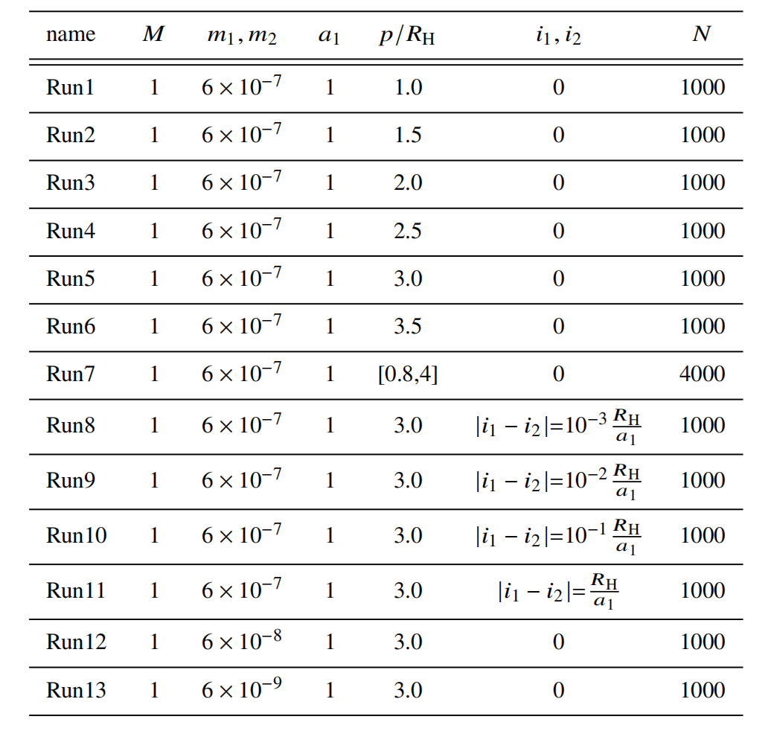
Numerical simulations
Luo, Yan et al. 2023, submitted
GRAVITY Collaboration et al (2018)

Slide 14
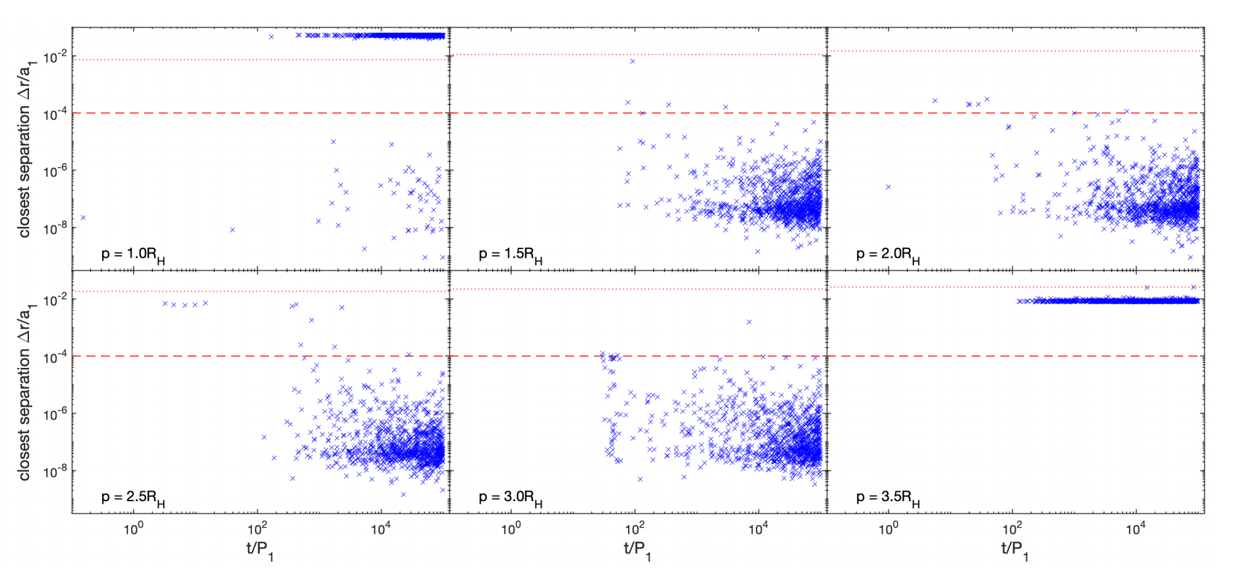
Evol of the closest separation of BWD
Luo, Yan et al. 2023, submitted
GRAVITY Collaboration et al (2018)

Slide 15
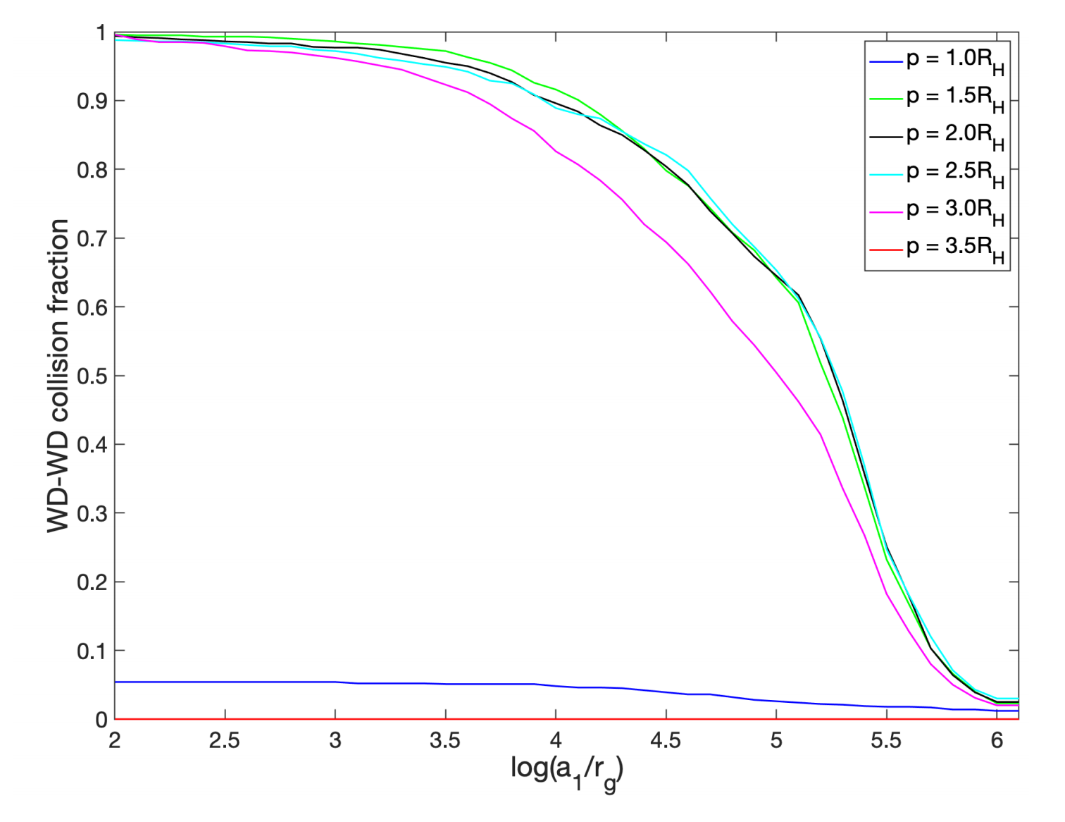
Collision fraction of BWD vs a_1
Luo, Yan et al. 2023, submitted
GRAVITY Collaboration et al (2018)

Slide 16
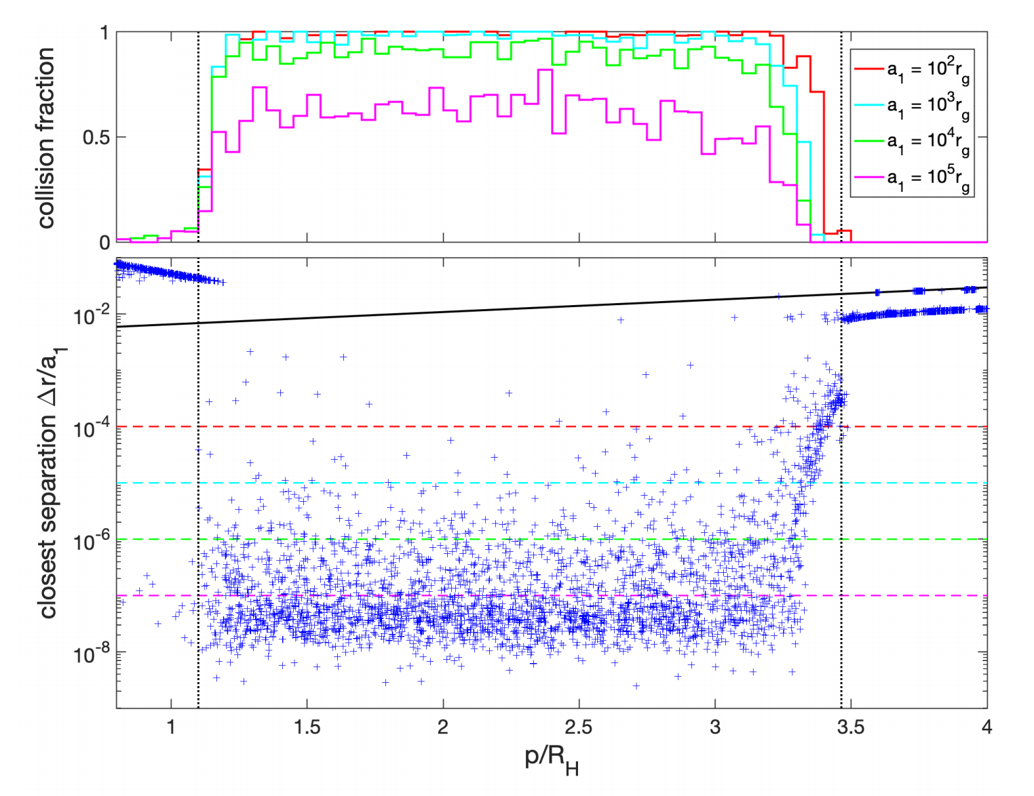
Collision fraction of BWD vs p
Luo, Yan et al. 2023, submitted
GRAVITY Collaboration et al (2018)

Slide 17
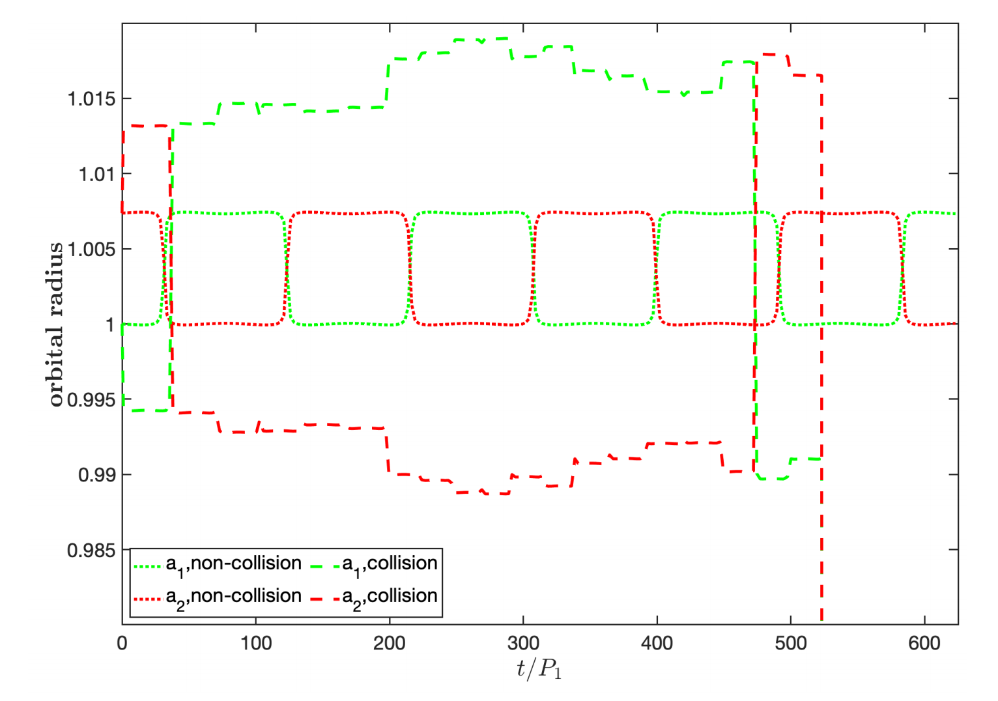
Orbits evolution of BWD at p = R_H
Luo, Yan et al. 2023, submitted
GRAVITY Collaboration et al (2018)

Slide 18
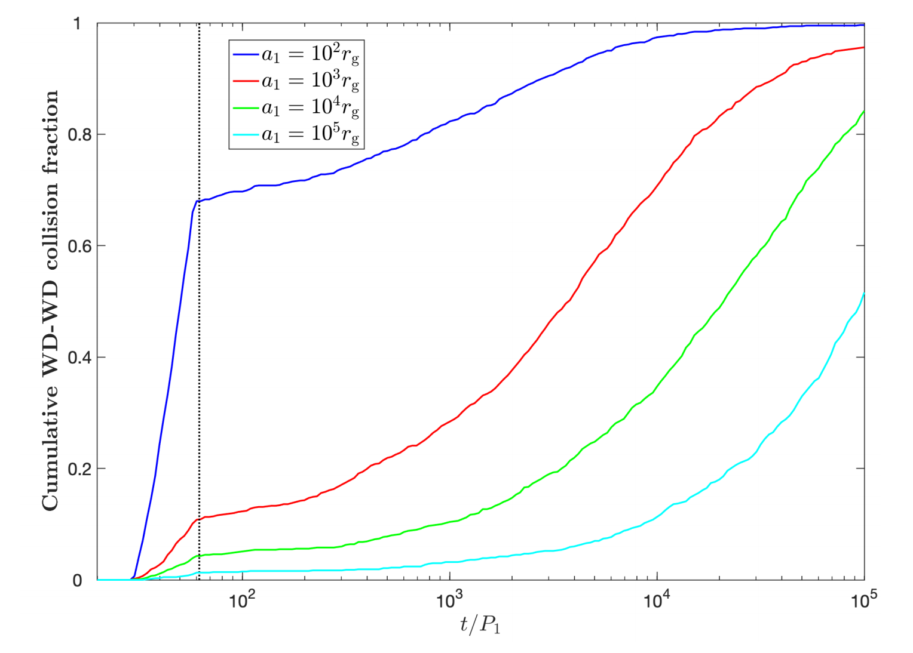
Cumulative collision fraction distribution
Luo, Yan et al. 2023, submitted
GRAVITY Collaboration et al (2018)

Slide 19
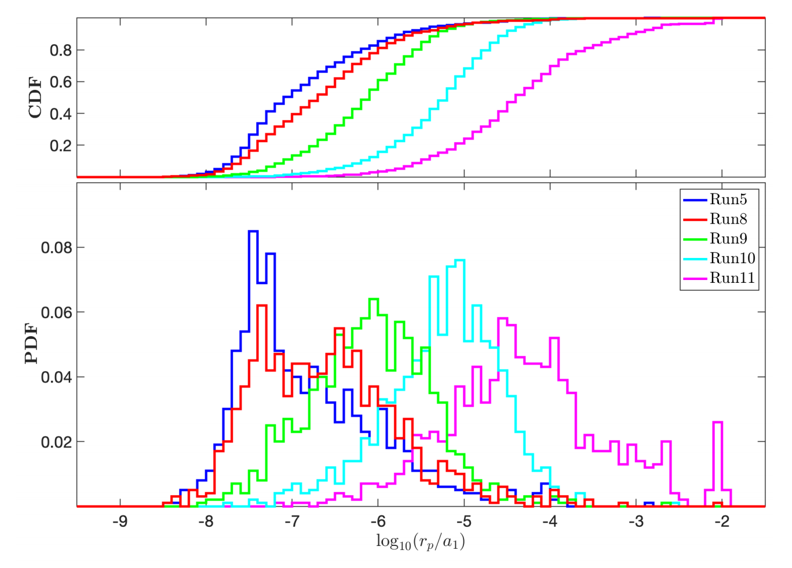
Probability density function of r_p：
Effects of orbital inclination
Luo, Yan et al. 2023, submitted
GRAVITY Collaboration et al (2018)

Slide 20
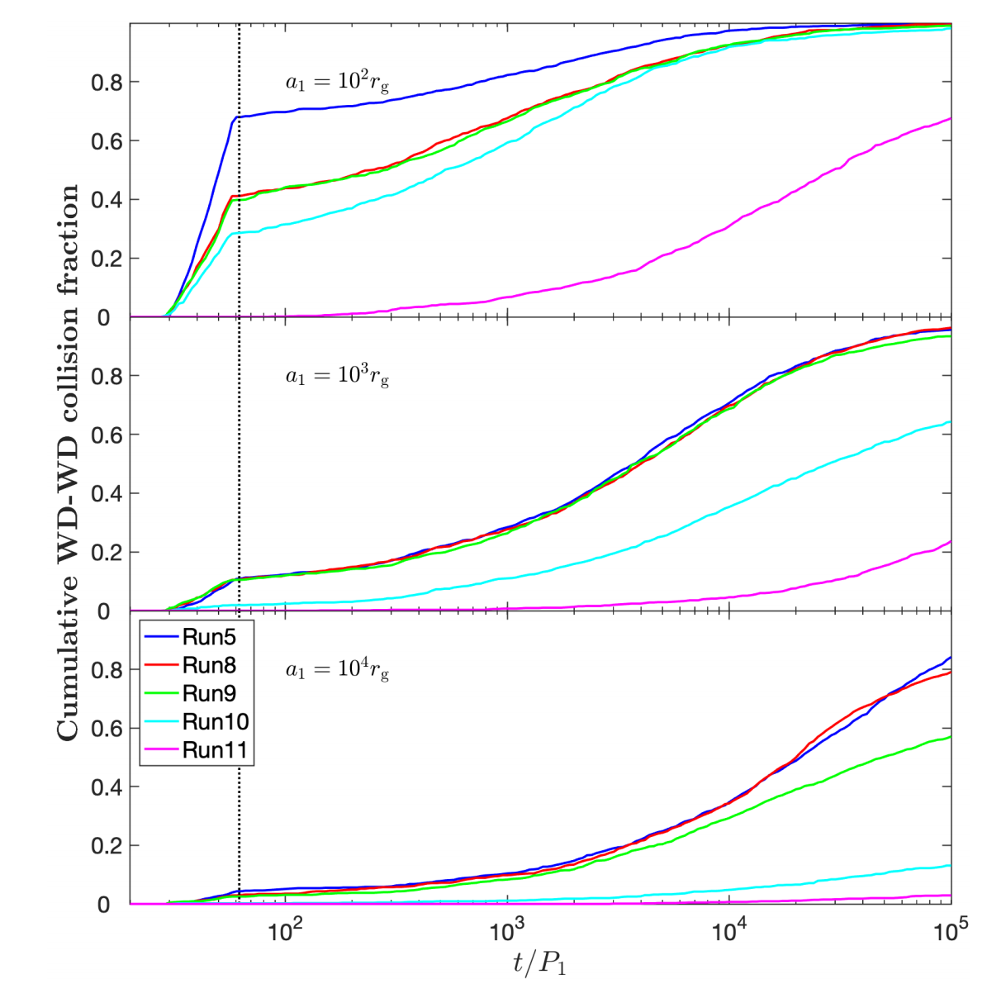
Cumulative collision fraction distribution
Luo, Yan et al. 2023, submitted
GRAVITY Collaboration et al (2018)

Slide 21
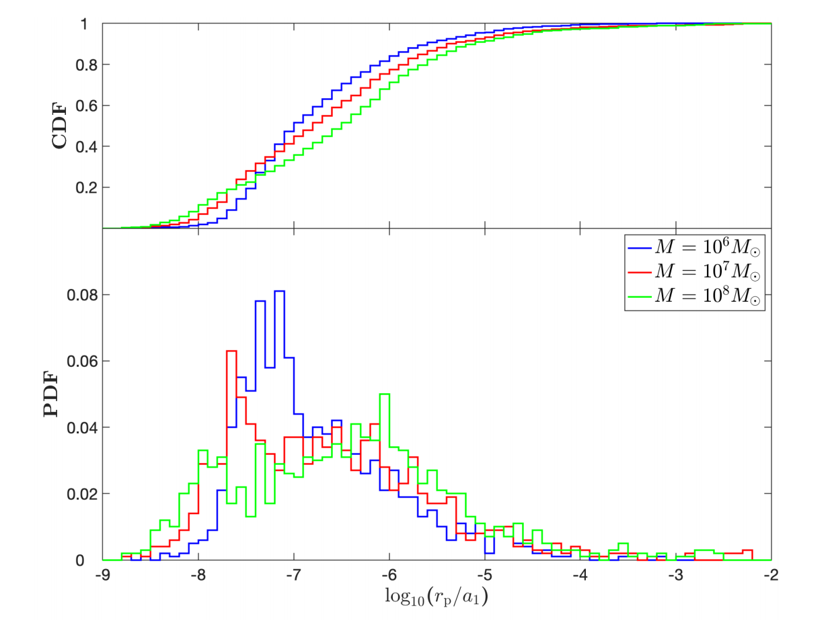
Effects of the mass of SMBHs
Luo, Yan et al. 2023, submitted
GRAVITY Collaboration et al (2018)

Slide 22
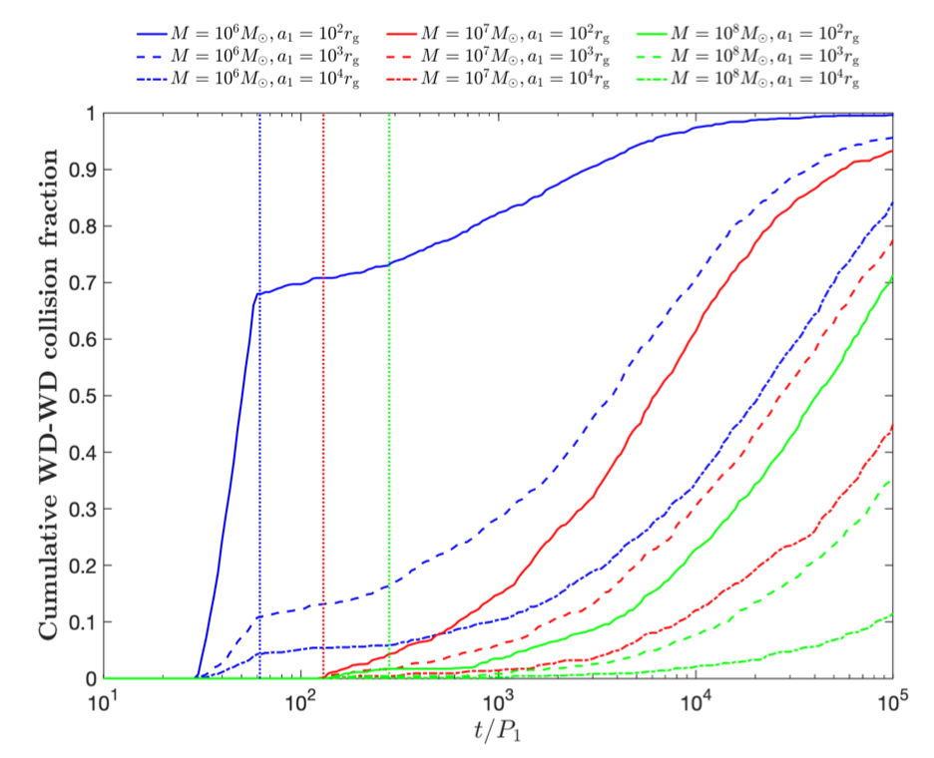
Collision fraction of BWD: M_BH & a_1
Luo, Yan et al. 2023, submitted
GRAVITY Collaboration et al (2018)

Slide 23
Cosmic collision rate of BWD

Slide 24
Main results
Close encounters of BWD only occur at p<2√3R_H
As p<1.1R_H, the close encounters become rare
The collision fraction of BWDs decrease with the increase of a1
The collision fraction of BWDs decrease with the increase of the orbital inclination
The collision fraction of BWDs decrease with the mass of central BH
Collision of BWDs in AGNs ∼ 300/Gpc^3/yr

Slide 25
Swept disk mass when explosion
$M_{SMBH}={10}^{6}M_{⊙}$，$\dot{m}$= 0.1，$α$ = 0.1
$$Explosion radius$$ | 100$r_{g}$ | 200$r_{g}$ | 500$r_{g}$ | 1000$r_{g}$
Swept disk mass (g) | 2.51$×{10}^{27}$ | 7.78$×{10}^{27}$ | 3.31$×{10}^{28}$ | 9.0$0×{10}^{29}$
$M_{SMBH}={10}^{7}M_{⊙}$，$\dot{m}$= 0.1，$α$ = 0.1
Explosion radius | 100$r_{g}$ | 200$r_{g}$ | 500$r_{g}$ | 1000$r_{g}$
Swept disk mass (g) | 2.51$×{10}^{29}$ | 7$.78×{10}^{29}$ | 3$.31×{10}^{30}$ | 9$.70×{10}^{30}$
$M_{SMBH}={10}^{8}M_{⊙}$，$\dot{m}$= 0.1，$α$ = 0.1
Explosion radius | 100$r_{g}$ | 200$r_{g}$ | 500$r_{g}$ | 1000$r_{g}$
Swept disk mass (g) | 2.51$×{10}^{31}$ | 7.7$8×{10}^{31}$ | 3$.31×{10}^{32}$ | 9$.70×{10}^{32}$
AGN disk is based on disk model of Kato et al. (2008).
Notes:
事件发生的位置是根据Migration traps 选的（即使有的AGN没Migration traps ，100rg-1000rg也是最容易有观测效应的区域），也是Jacobi capture 能发生的位置。

Slide 26
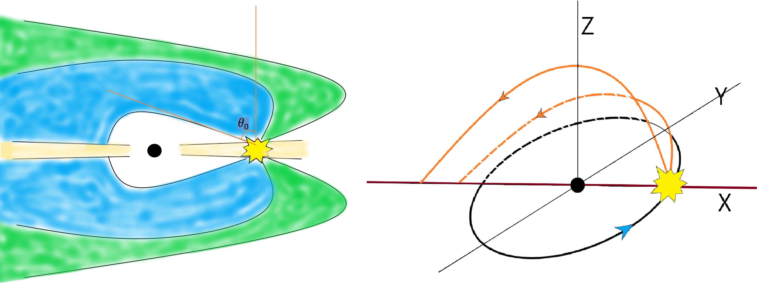
Model
Most fallback debris collide with AGN disk on X-axis；
Some ejecta in hyperbolic orbit can also fall back to the AGN disk.
Notes:
对称的！！
两个重要成分：SMBH引力和gas

Slide 27
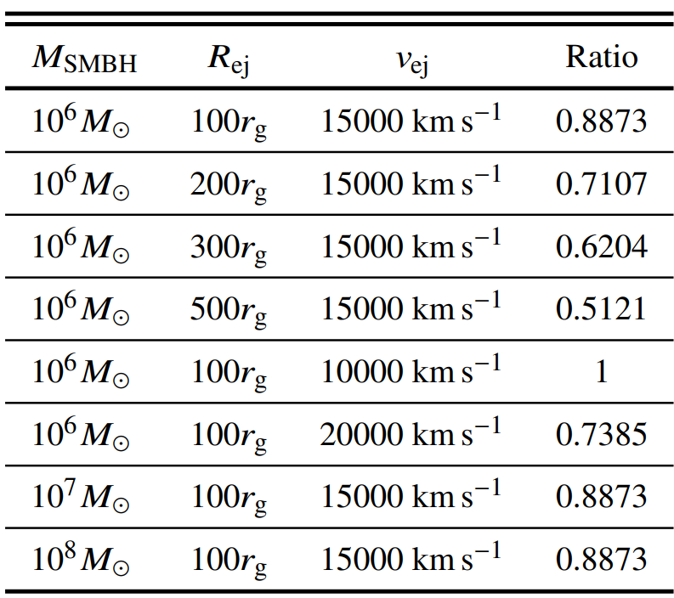
Ratio of fallback ejecta
Fiducial setting: $M_{SMBH}$=10⁷$M_{⊙}$, Explosion radius=100Rg, Explosion Velocity=15000km/s: Fallback to AGN disk debris ratio = 0.8873
Zhang, Shu-Rui et al. 2023, MNRAS, accepted

Slide 28
The falling information of each part of ejecta for fiducial model
Zhang, Shu-Rui et al. 2023, MNRAS, accepted

Slide 29
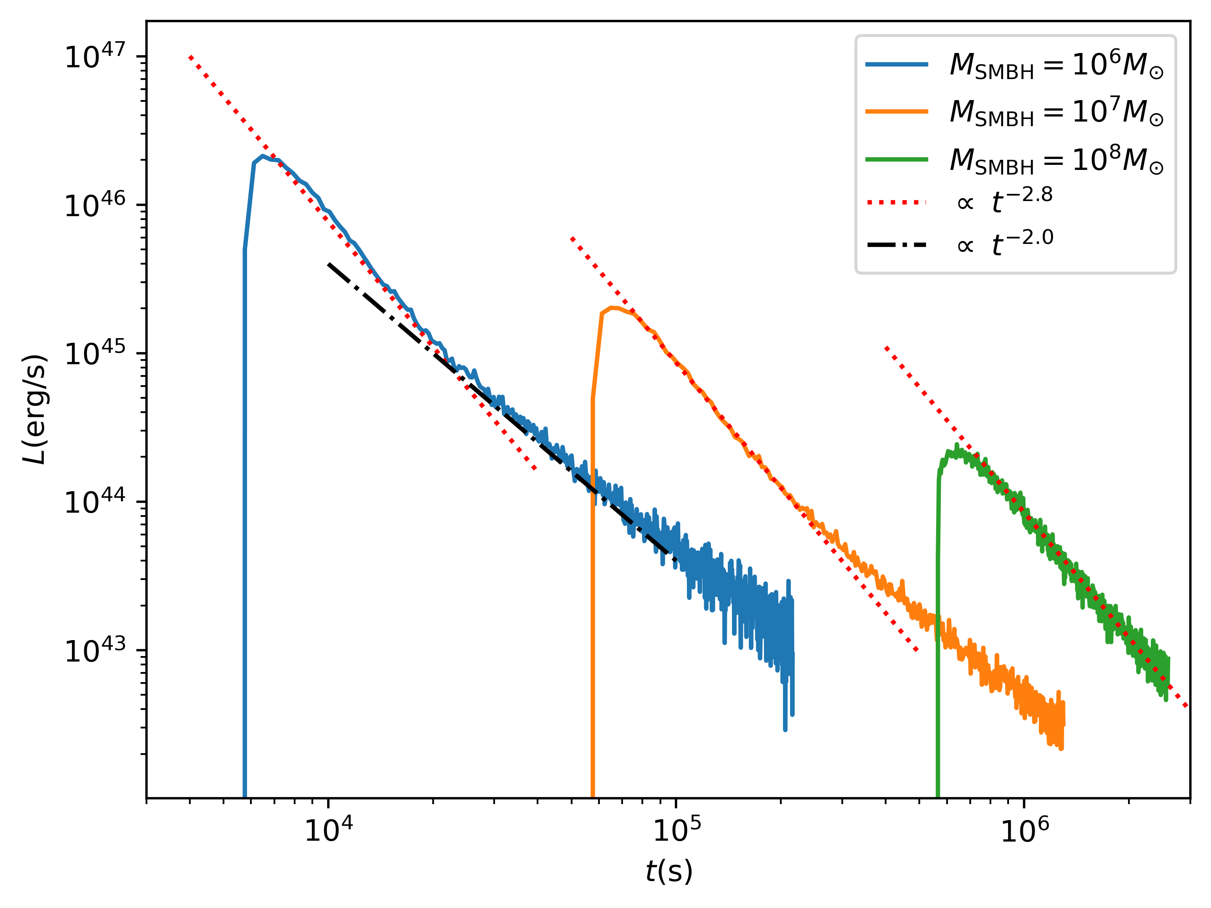
Mass fallback rate and Light curves
Radiation efficiency ∼5%
Zhang, Shu-Rui et al. 2023, MNRAS, accepted

Slide 30
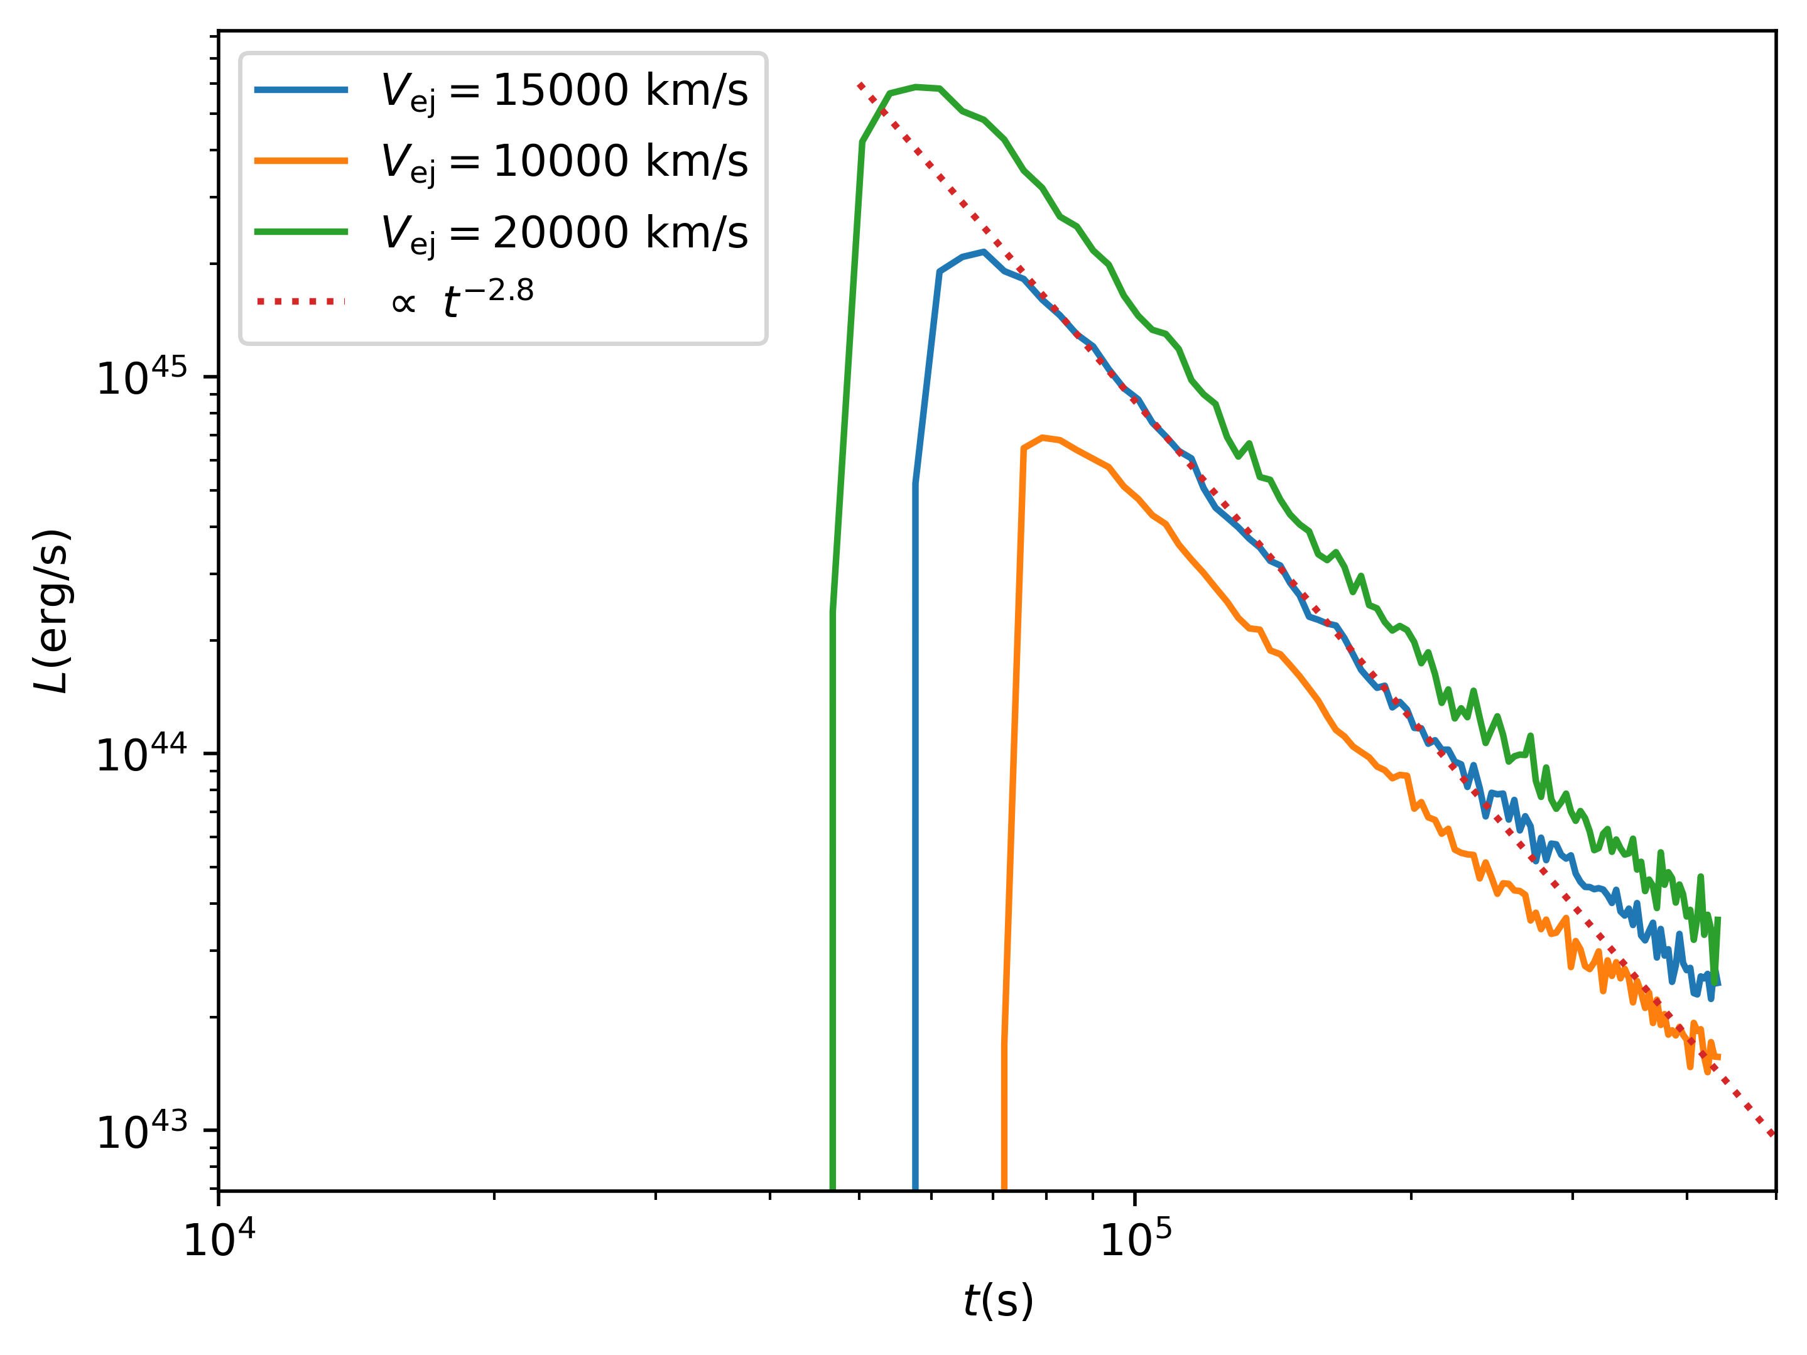
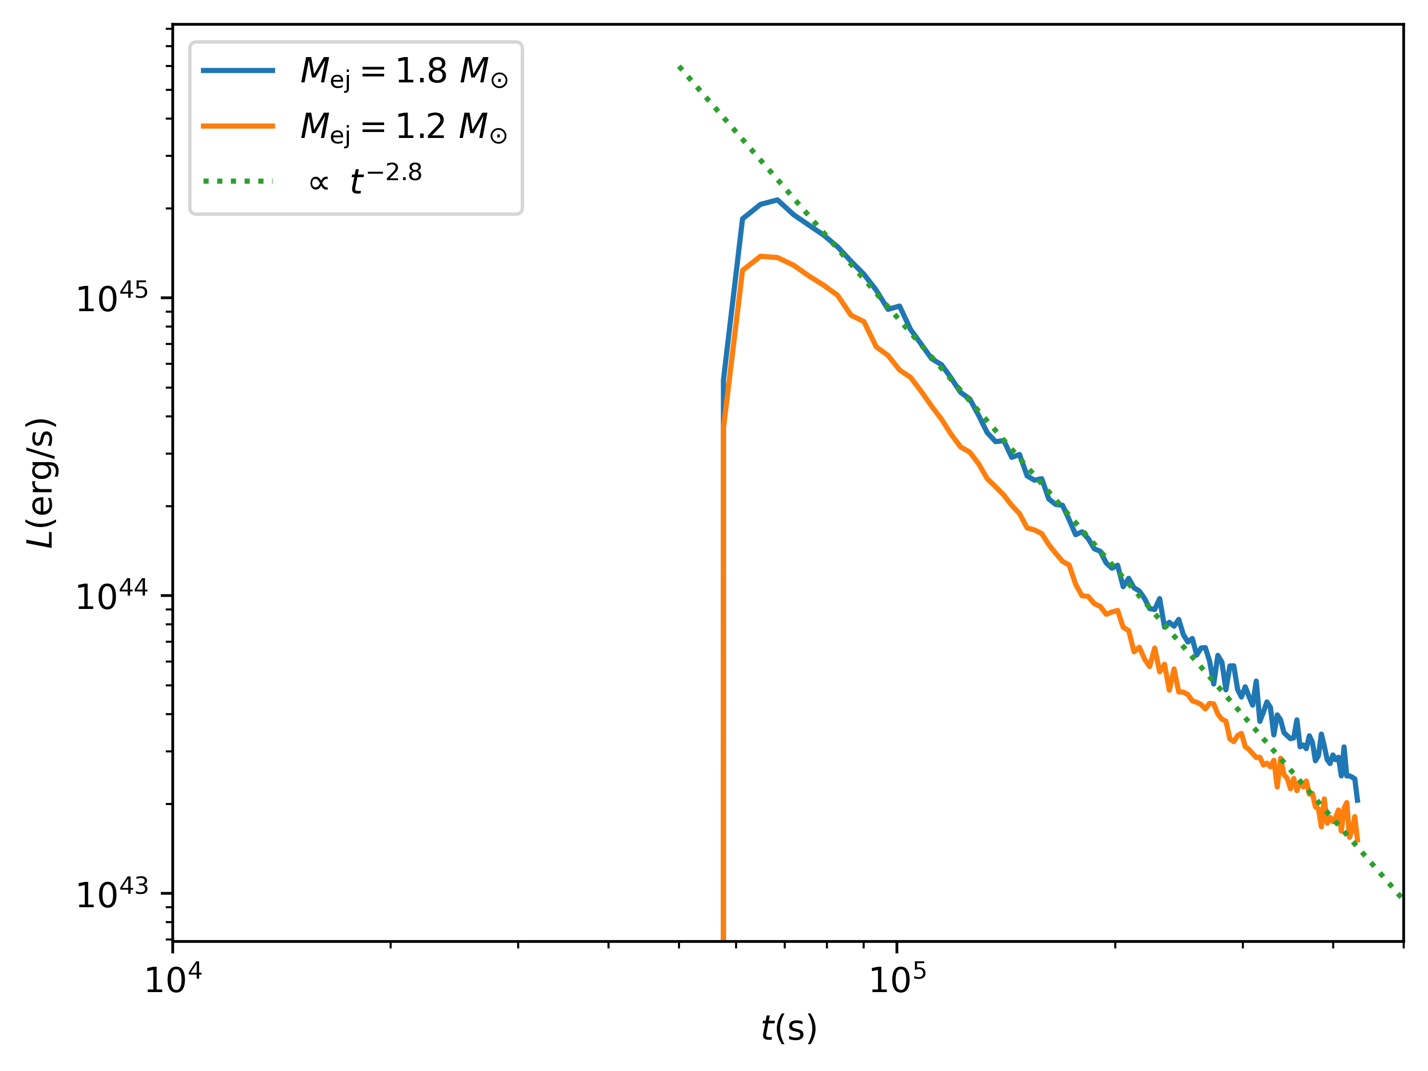
Light curve with other parameters
Zhang, Shu-Rui et al. 2023, MNRAS, accepted

Slide 31
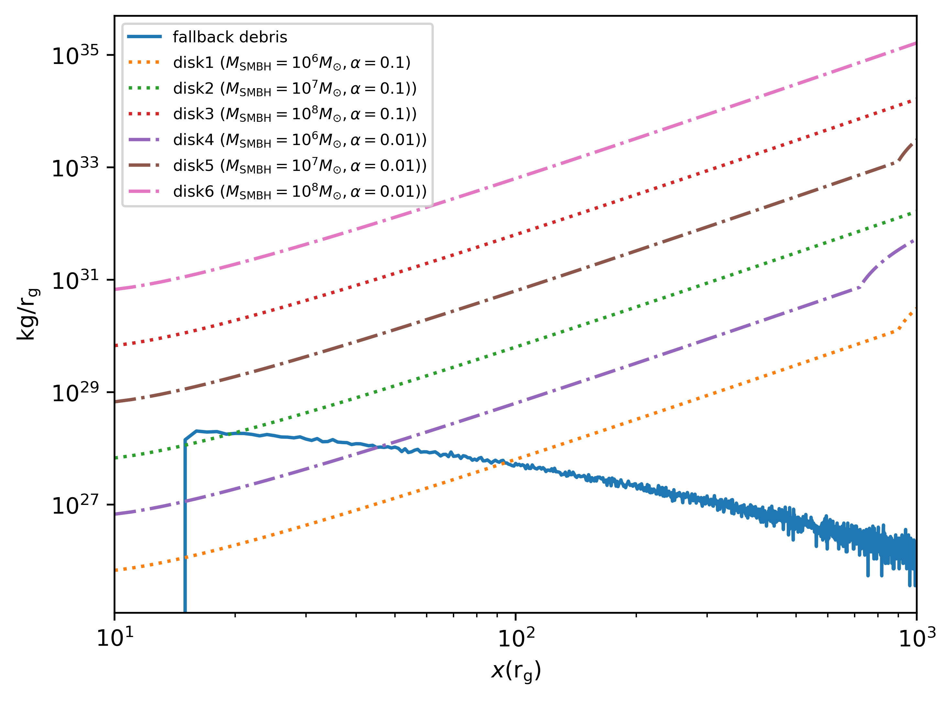
Distribution of falling ejecta
Zhang, Shu-Rui et al. 2023, MNRAS, accepted
Notes:
回落的的一部分物质离
Suppose that the ejecta falling to the AGN disk and the kinetic energy is converted into internal energy.
But for ${M_{SMBH}=10}^{6}M_{⊙}$, this assumption does not hold in the inner AGN disk, since the falling ejecta stream is heavy than disk steam.
SMBH较近，相对论效应明显？

Slide 32
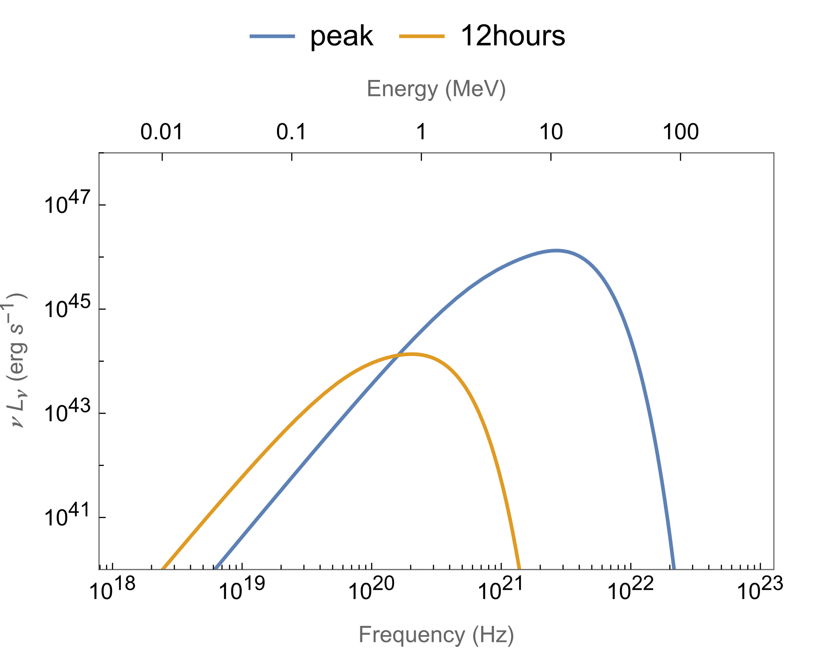
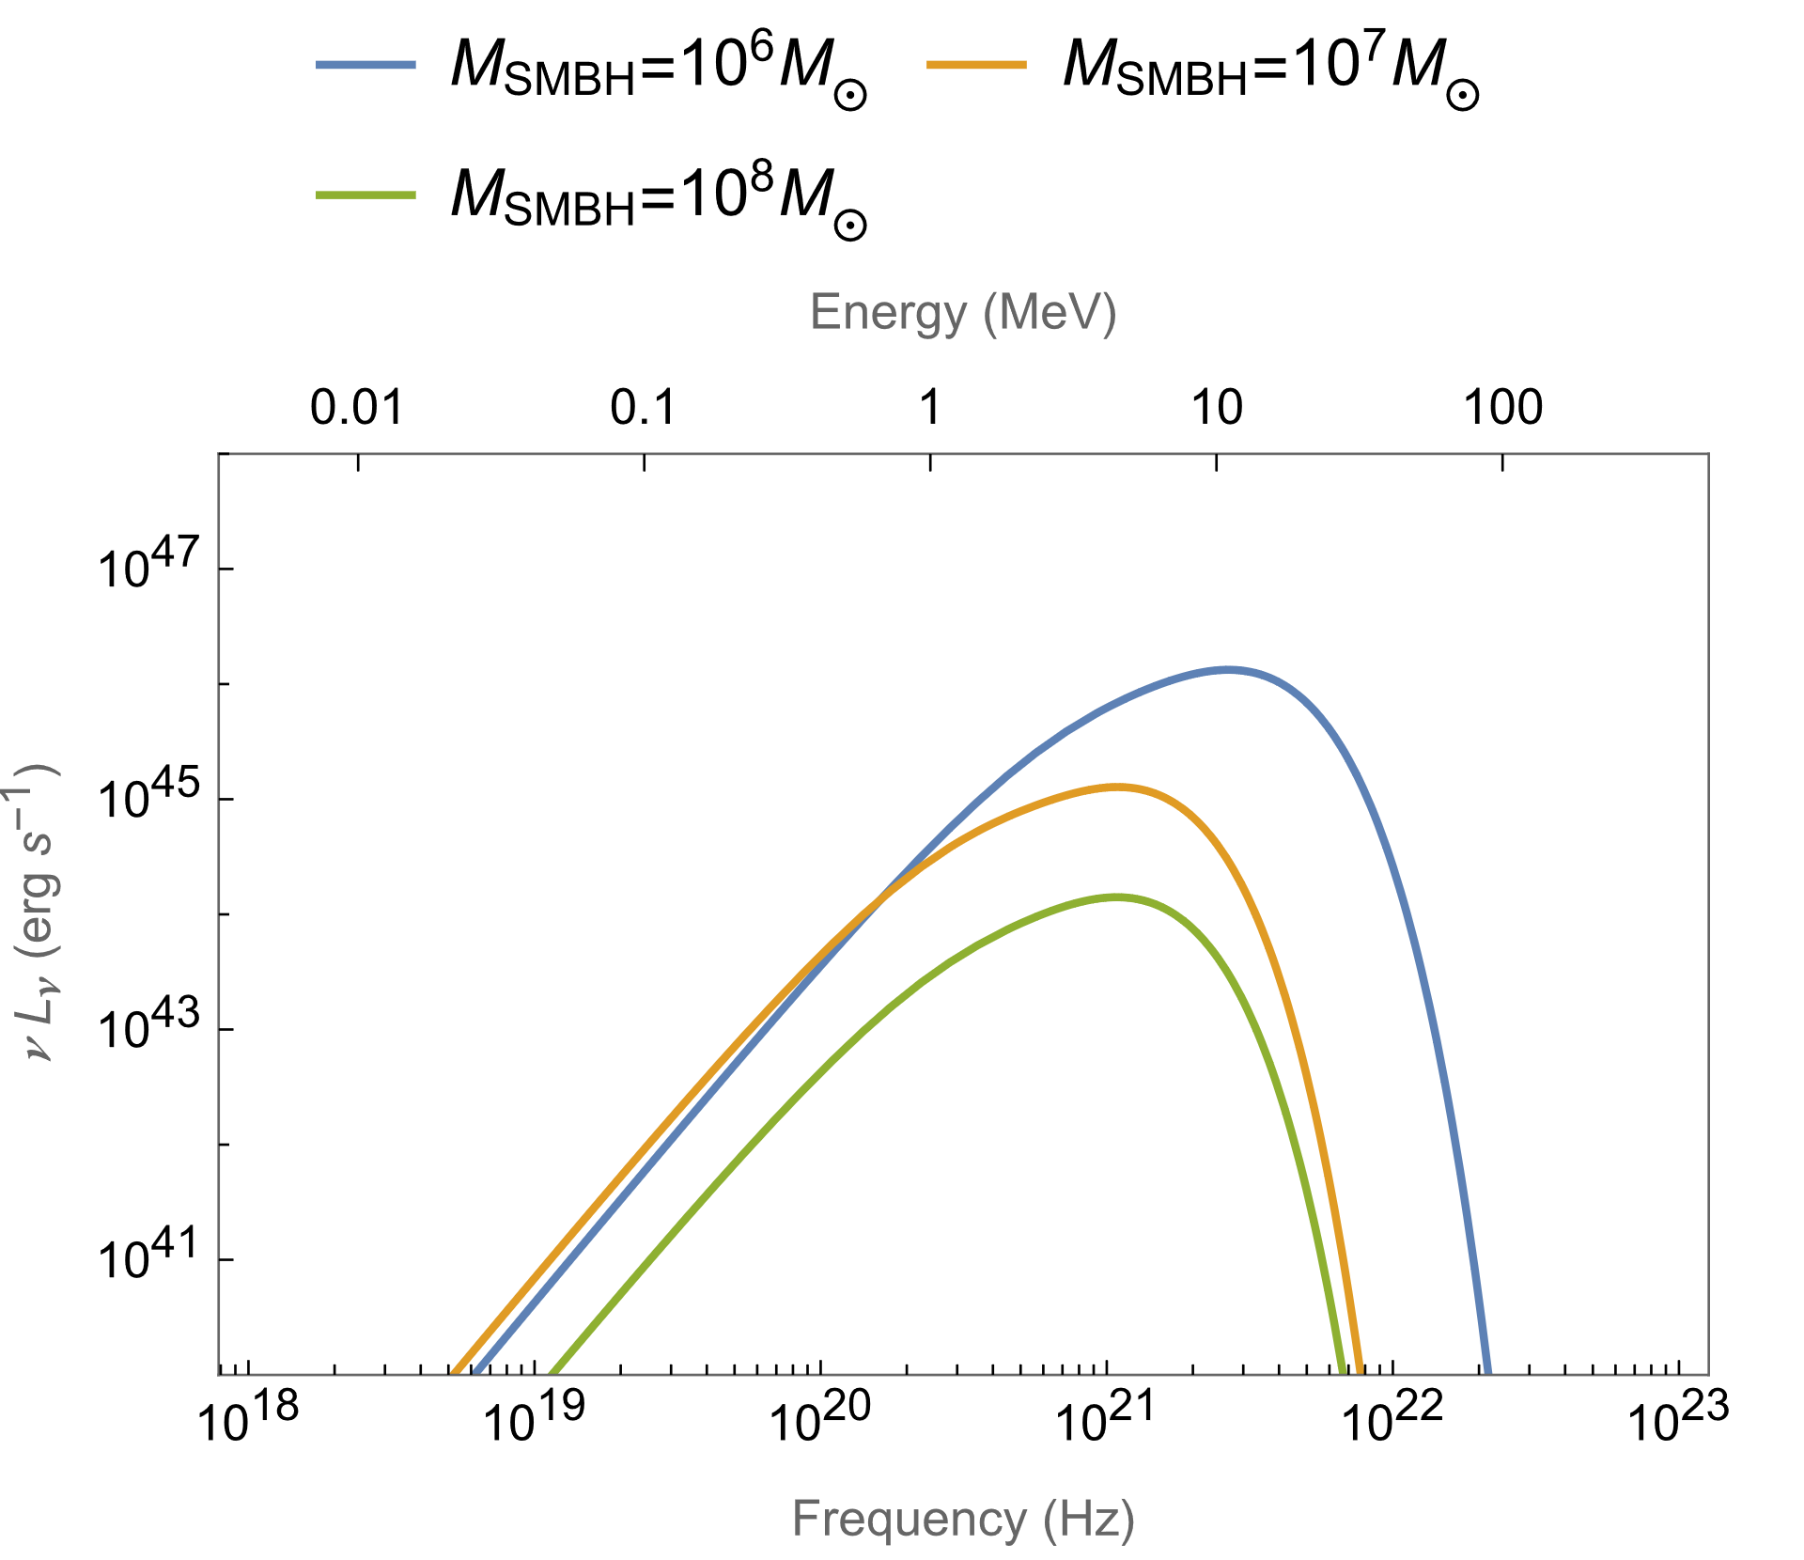
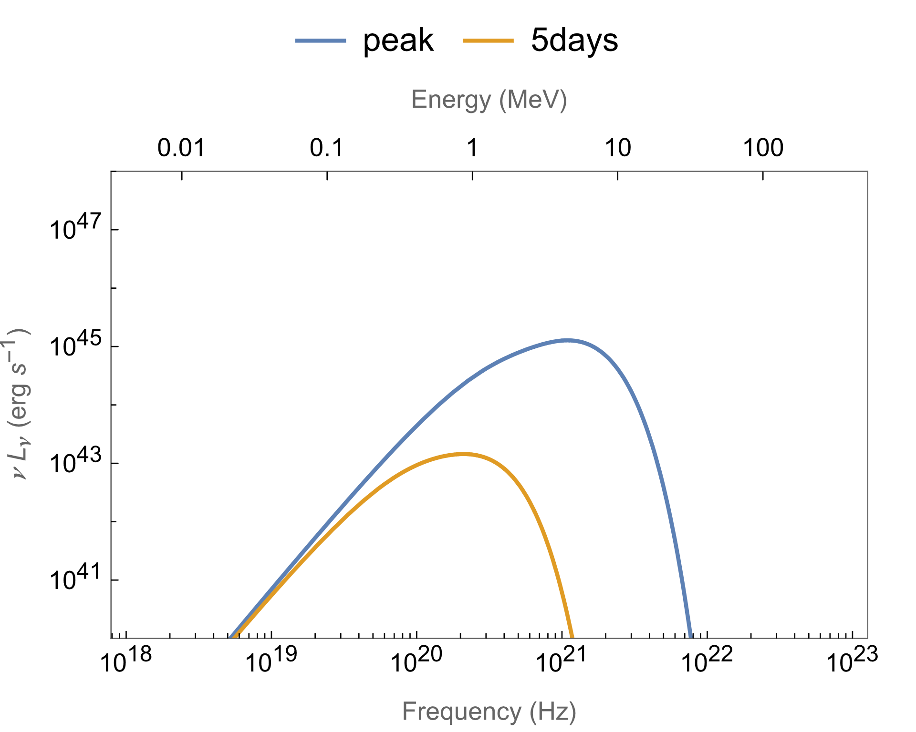
SED
$${M_{SMBH}=10}^{6}M_{⊙}$$
$${M_{SMBH}=10}^{7}M_{⊙}$$
Zhang, Shu-Rui et al. 2023, MNRAS, accepted
Notes:
计算方法：以计算光变曲线peak处100秒的谱为例，设每份回落物动能全部转化为热能，就能计算出其温度$T_{i}≃\frac{m_{H}{v_{rel}}^{2}}{5k_{B}}$ ($M_{SMBH}={{10}^{7}M}_{⊙}$、${10}^{8}M_{⊙}$)、$T_{i}≃\frac{m_{H}{v_{rel}}^{2}}{2k_{B}}$ ($M_{SMBH}={{10}^{6}M}_{⊙}$)；每份等效面积$S_{i}=\frac{L_{i}}{σT^{4}}$，则可得到一份物质在100秒内平均的vLv。再对100秒内所有回落物的SEDi叠加，即得到vLv. 同理可计算出其它时间处的SED，但实际计算时考虑不同的时间间隔，如对于靠光变曲线尾端处的谱，由于单位时间内回落物质少，因此100秒不足以反应该处的SED，就应把时间间隔拉长。
为了计算方便和可靠，计算不同时间以及不同中心SMBH对应的谱时，取的时间间隔不一样。${M_{SMBH}=10}^{6}M_{⊙}$、${{10}^{7}M}_{⊙}$、${10}^{8}M_{⊙}$的峰值处，取的时间间隔分别是100s、1000s、10000s；${{M_{SMBH}=10}^{7}M}_{⊙}$的5day处取的时间间隔是8640s
同样的处理谱的过程也适用于考虑不同其它参数时，如不同初始爆炸速度，喷出物的量，爆炸位置。。。

Slide 33
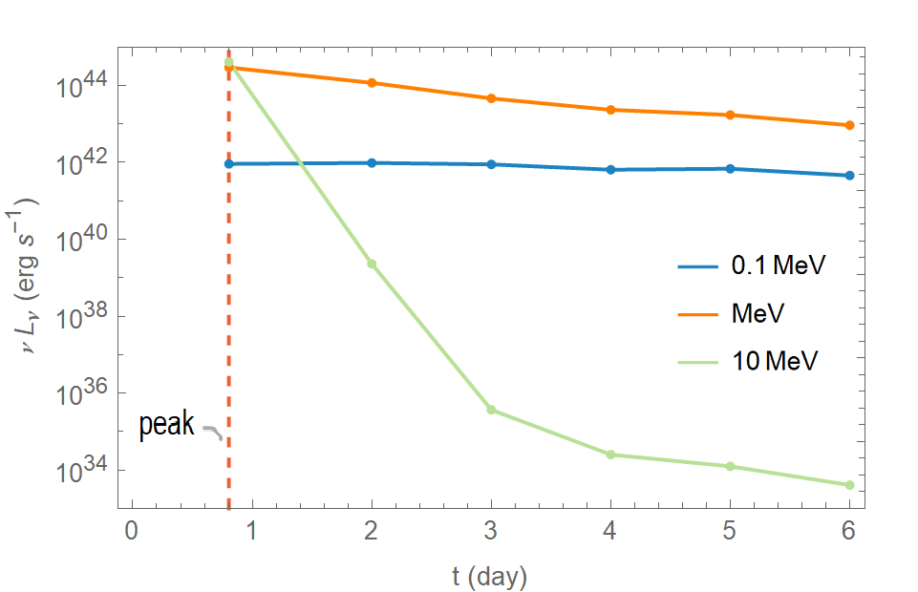
Light curves in different bands
Zhang, Shu-Rui et al. 2023, MNRAS, accepted
Notes:
The higher the energy, the faster the curve varies.
These trends are the same for different SMBH, but the time scales vary with the SMBH correspondingly.
The luminosity of 0.1MeV band is increase (rather than decrease) after the peak of total luminosity for ${M_{SMBH}=10}^{6}M_{⊙}$.
In contrast, the initial explosion and radioactive decay of the SNe Ia are not affected by the SMBH mass, because the half-life of the radioactive elements are constants

Slide 34
Main Conclusions
Light curves: rising rapidly, and decaying with 𝐿$∝t^{−2.8}$. The variation time scale ranging from hours to weeks depends on the mass of the SMBH.
The hitting between the ejecta and AGN disk can generate high-energy radiation from hard X-ray to soft-𝛾 range.

Slide 35
Thank you!
Suggestions and comments are welcomed!

Slide 36
Energetics of supernovae
From Wikipedia term: Supernova

