Slide 1
Galactic Interstellar Scintillation Observed from Four Globular Cluster Pulsars by FAST
张丹丹
合作者: 支启军, 朱炜玮，姚菊枚，袁懋，石询 李菂，Michael Kramer，王培，张蕾
Guizhou Normal University
2023.07.05

Slide 2
1
Research Background
CONTENTS
Interstellar scintillation results
2
3
Discussion and conclusions

Slide 3
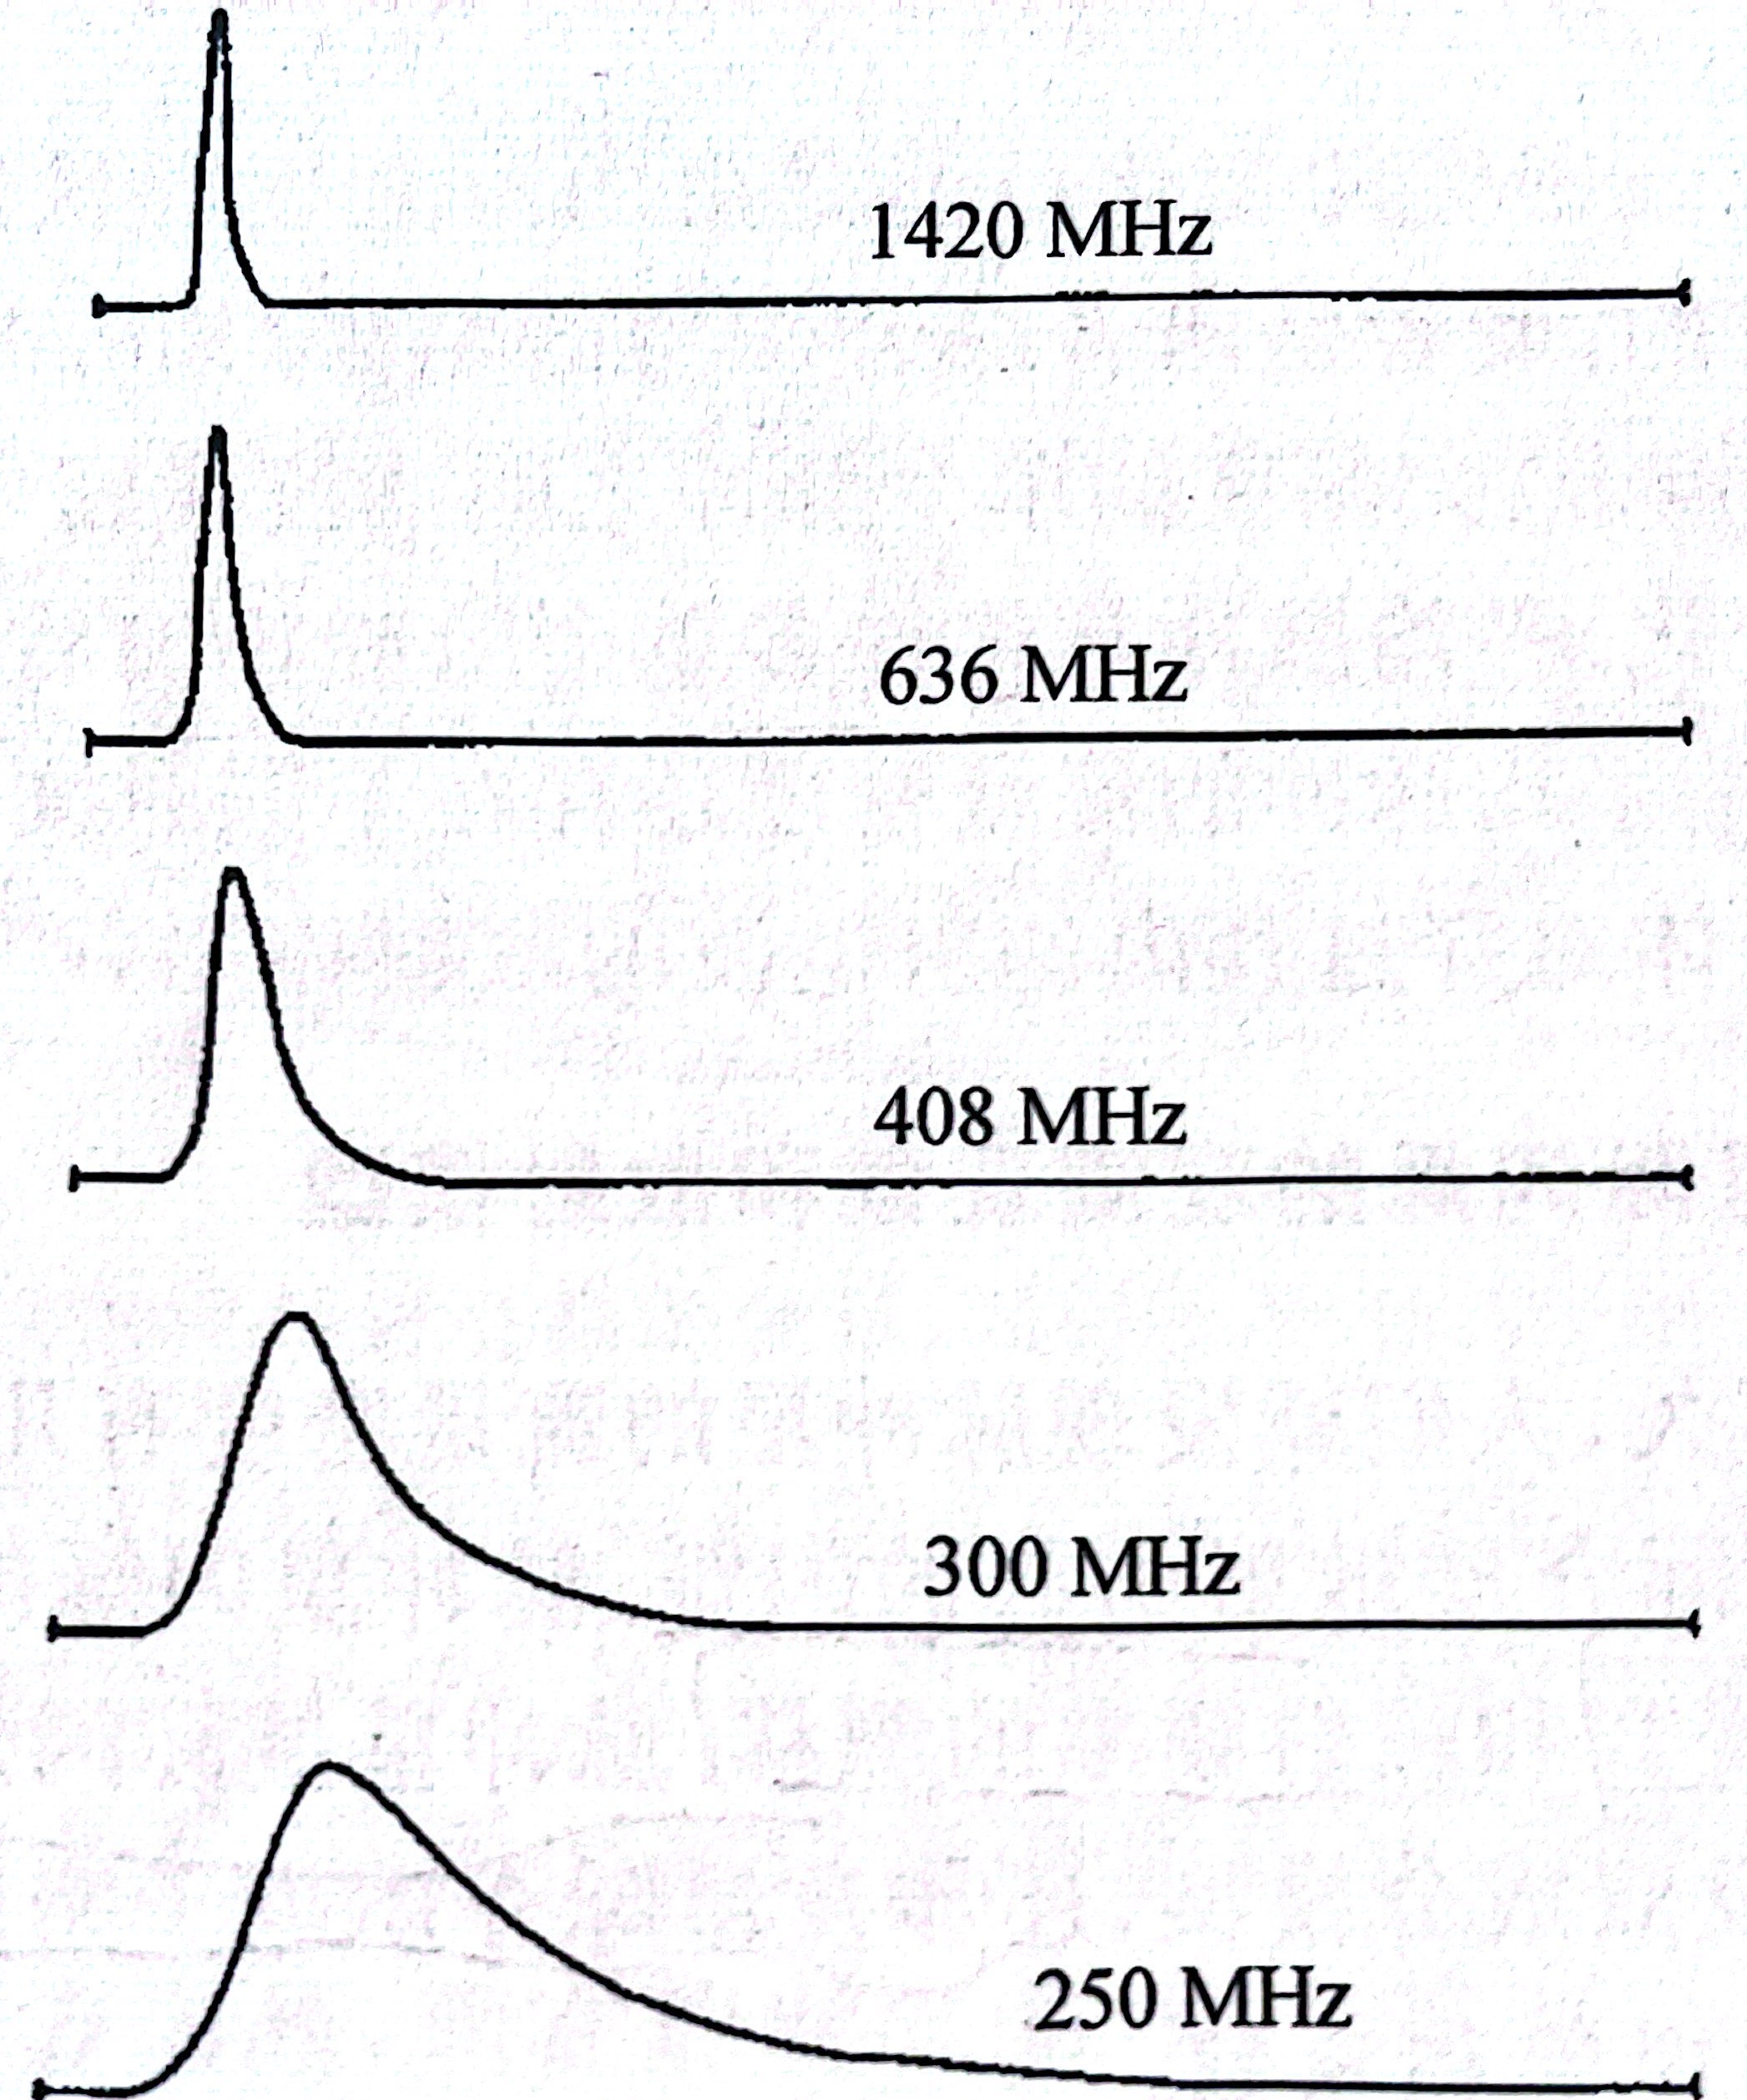
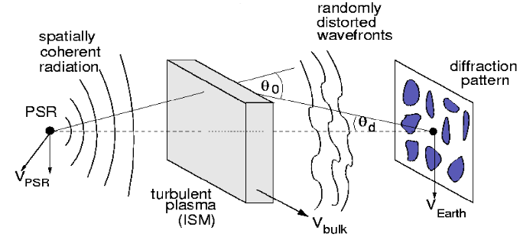
Research Background
Model of a thin scattering screen with scintillation
scattering screen
Pulse profile broadened
PSR B0833-45 Ables, et al .(1973)
Flux density varies
From "Handbook of Pulsar Astrono my "by Lorimer & Kramer
Stinebring, et al .(2000)

Slide 4
Classification: (timescale, ${∆t}_{d}$)
Significance:
to estimate the distance and better konw the properties of ISM.
to measure the velocity of pulsars and orbital parameters.
to increase timing precision
diffractive scintillation
${∆t}_{d}$: mins – hrs
refractive scintillation
${∆t}_{d}$: days – months

Slide 5
Interstellar scintillation results
Data
Pulsar parameters
Cluster | PSR | DM (cm⁻³pc) | Period (ms) | Dist (kpc) | S1400 (mJy) | Number of observations
M5 | B1516+02A | 30.08 | 5.55 | 7.48 ± 0.06 | 0.12 | 4
 | B1516+02C | 29.31 | 2.48 |  | 0.039
M13 | B1639+36A | 30.44 | 10.38 | 7.42 ± 0.08 | 0.14 | 4
M15 | B2127+11A | 67.31 | 11.07 | 10.71 ± 0.1 | 0.2 | 6

Slide 6
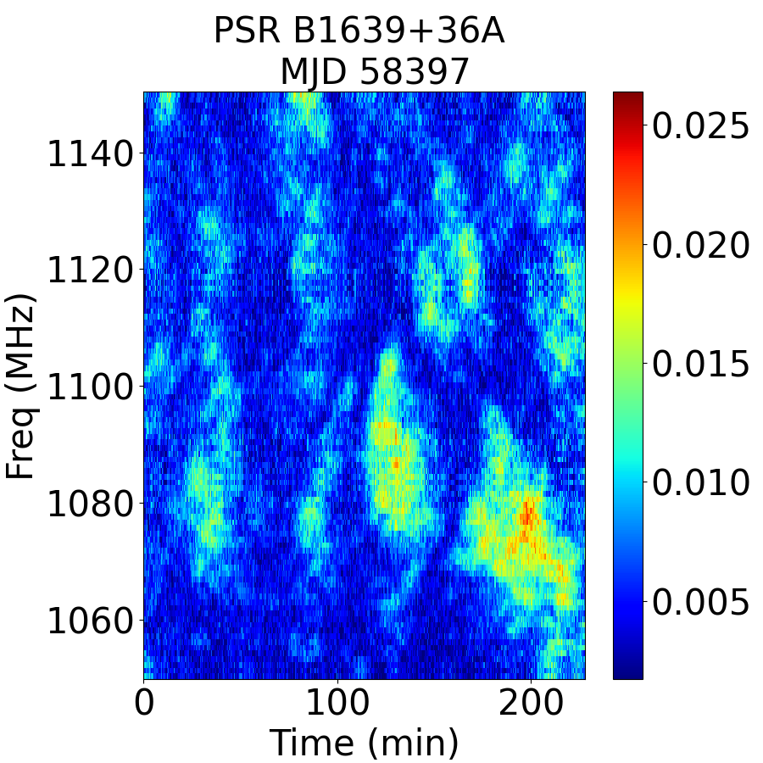
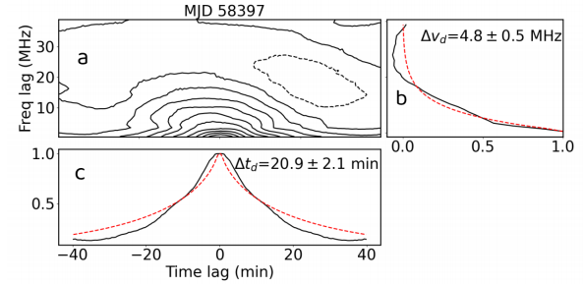
Dynamic spectrum
scintillation parameters: timescale and bandwidth
$$C(0,∆t)=A exp\left[−{\left|\frac{∆t}{∆t_{d}}\right|}^{\frac{5}{3}}\right]$$
$$C(0,0)=A +W$$
$$C(∆v,0)=A exp(−\left|\frac{∆v}{∆v_{d}/ln2}\right|)$$
Dynamic spectrum of PSR B1639+36A
ACF:
$$C(∆v,∆t)=\sum_{v}{\sum_{t}{∆}}S(v,t)∆S(v+∆v,t+∆t)$$
$$ρ(∆v,∆t)=C(∆v,∆t)/C(0,0)$$
2D ACF for PSR J1639+36A at 1100 MHz

Slide 7
Dynamic spectrum of PSR J1641+3627A （B1639+36A）
scintillation parameters to exhibit variation over time
$l_{d}$: spatial scale of the diffractive scintillation pattern
$$∆t_{d}=\frac{l_{d}}{V_{ISS}}$$
$$V_{ISS}=V_{eff}/s$$
$$V_{eff}=(1−s)V_{psr}+sV_{obs}−V_{screen}$$
$$∆v_{d}∝l_{d}^{2}f_{obs}^{2}$$
$$s=D_{sp}/D_{op}$$
$$s→1 :screen→Earth$$

Slide 8
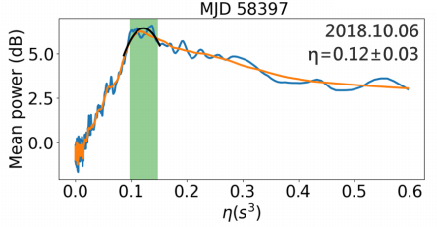
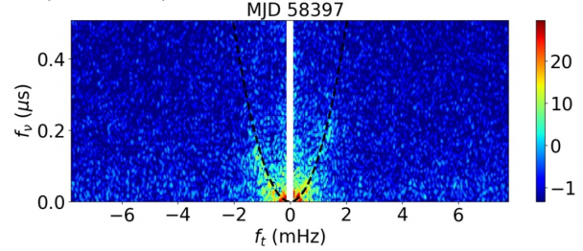
Secondary spectra
$$S(v,t)→S^{†}(f_{v},f_{t})$$
$$η=4625\frac{D_{op}s(1−s)}{f_{obs}^{2}{(\left|V_{eff}\right|cosφ_{s})}^{2}}$$
$$S_{2}(v,t)={\left|S^{†}(f_{v},f_{t})\right|}^{2}$$
$$f_{v}=ηf_{t}^{2}$$
$$D_{screen}=D_{op}(1−s)$$
$$η:arc curvature$$
$D_{op}$ : pulsr distance
Daniel et al. (2020)
fitting results of arc curvature
Secondary spectra for PSR J1641+3627A at 1100 MHz
https://github.com/danielreardon/scintools

Slide 9
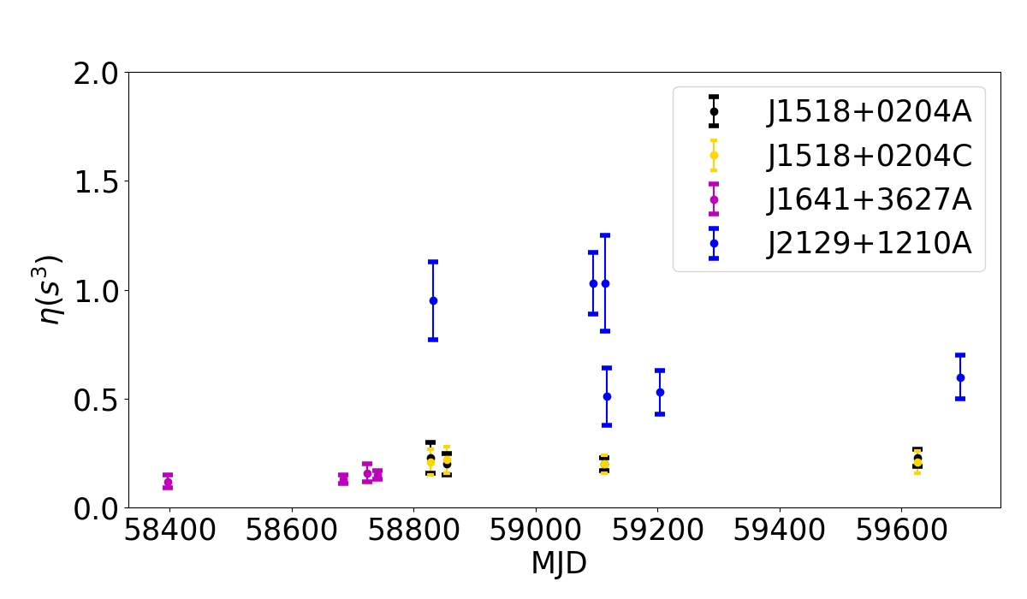
assume: the scattering screen is highly anisotropic
$$η(t,s,V_{screen},α_{s})=4625\frac{D_{op}s(1−s)}{f_{obs}^{2}{(\left|A\right|cos(α_{s}−α_{v})−V_{screen})}^{2}}$$
where
$$A=(1−s)V_{psr}+sV_{obs}$$
Measurements of the arc curvature η of the four pulsars
Dec
$$A$$
$$α_{s}$$
$$α_{v}$$
major axis

Slide 10
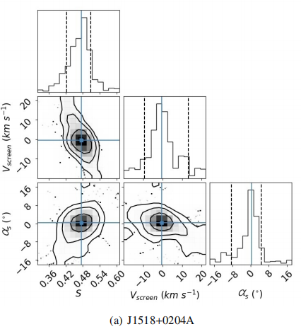
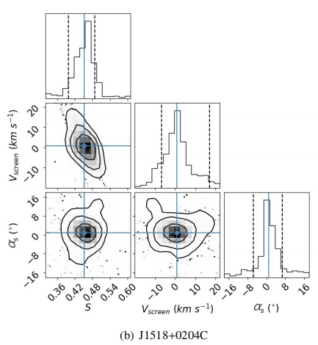
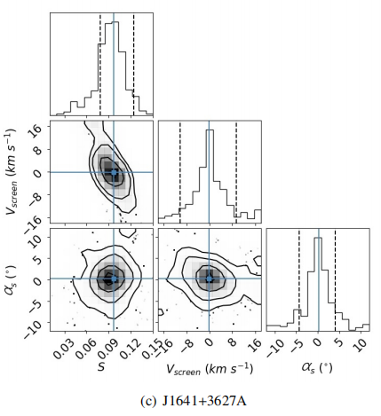
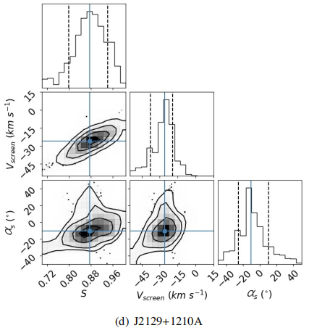
Corner plots of MCMC
results of four pulsars

Slide 11
Fitted scattering screen parameters are obtained by fitting the MCMC model
PSR | S | $$α_{s} （°）$$ | $$V_{screen}(km s^{−1})$$ | $D_{s }$(kpc) | $D_{z }$(kpc)
B1516+02A | $${0.47}_{−0.05}^{+0.03}$$ | $${0.3}_{−9}^{+4}$$ | $${−0.4}_{−9}^{+14}$$ | $${4.0}_{−0.4}^{+0.2}$$ | $${2.9}_{−0.3}^{+0.1}$$
B1516+02C | $${0.45}_{−0.05}^{+0.04}$$ | $${0.9}_{−2}^{+6}$$ | $${0.9}_{−8}^{+16}$$ | $${4.1}_{−0.4}^{+0.3}$$ | $${3.0}_{−0.3}^{+0.2}$$
B1639+36A | $${0.10}_{−0.02}^{+0.03}$$ | $${0.2}_{−10}^{+9}$$ | -${0.2}_{−10}^{+9}$ | $${6.7}_{−0.2}^{+0.2}$$ | $${4.4}_{−0.1}^{+0.1}$$
B2127+11A | $${0.88}_{−0.09}^{+0.07}$$ | $${−11}_{−15}^{+21}$$ | ${26}_{−12}^{+7}$ | $${1.3}_{−1.0}^{+0.7}$$ | $${0.6}_{−0.5}^{+0.3}$$

Slide 12
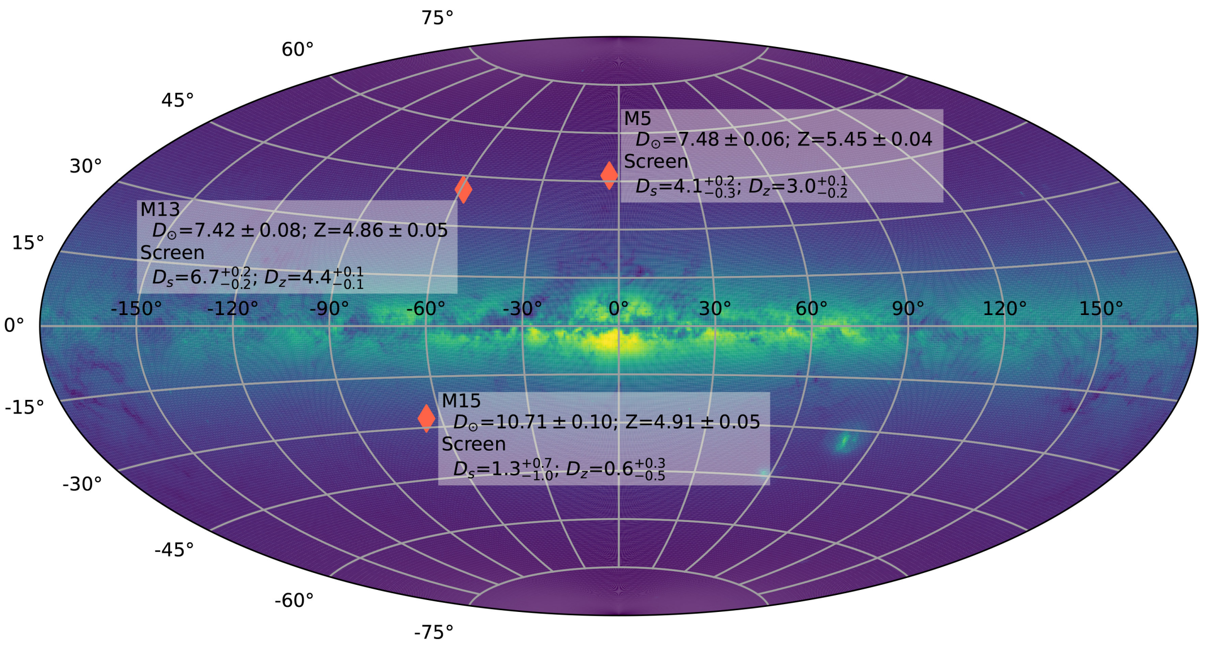
Discussion
D⊙: globular clusters to the Earth.
Z : globular clusters to the plane.
Ds: scattering screens to the Earth.
Dz: scattering screens to the plane.
Distribution of M5, M13 and M15 in the Milky Way
PSR J1141-6545： ${D_{s}=7}_{−3}^{+4} kpc$; $D_{z}={0.5}_{−0.2}^{+0.3} kpc$ ；PSR J1543-0620: $D_{s}=1.56±0.3 kpc; D_{z}=0.9 ±0.2 kpc$

Slide 13
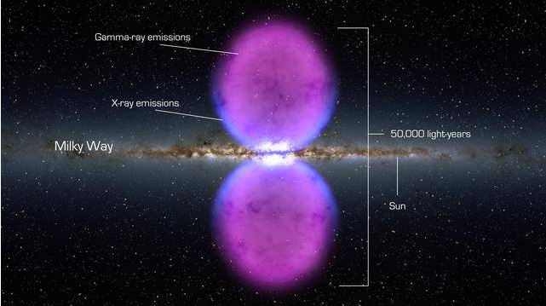
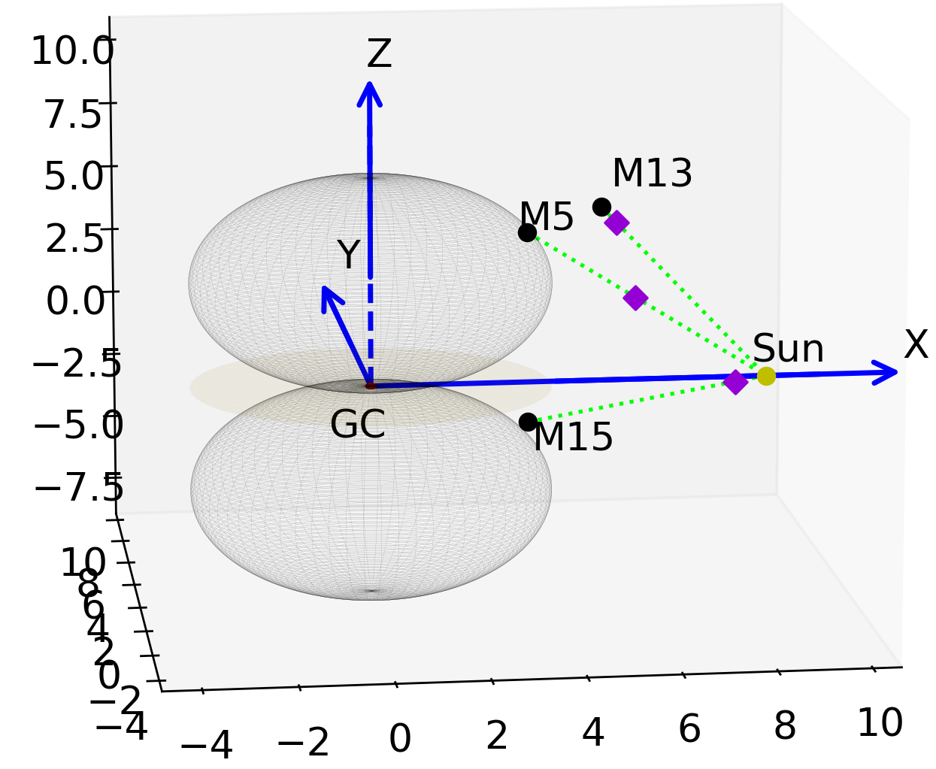
Image source: https://m.kekenet.com/read/201508/394624.shtml
3D distribution of M5, M13 and M15 in the Milky Way

Slide 14
the global matter circulation of our Galaxy
Supernova explosions can break through the galactic disk and inject hot gas into a galactic halo, perhaps driving a "galactic fountain", wherein the gas cools and condenses, and eventually recycles matter into the galactic disk.
scattering screens candidates:
The interface between the high-latitude cold gas and the galactic halo

Slide 15
Conclusion
The scintillation arcs for pulsars in globular clusters M5, M13 and M15 for the first time using FAST.
The most distant off-plane scattering screens to date through pulsar scintillation.
provides a new way to study the 3D distribution of the galactic interstellar medium

Slide 16
https://www.sciengine.com/SCPMA/doi/10.1007/s11433-023-2138-5;JSESSIONID=0f1a961d-7008-4acf-8e91-ff58ebf7ac6b
Thank you

