Slide 1


Diverse origins for non-repeating fast radio bursts: Rotational
radio transient sources and cosmological compact binary merger
remnants
Zi-Liang Zhang (张子良)
Institute of Astrophysics, Central China Normal University
Supervisor & Collaborator: Yun-Wei Yu, Xiao-Feng Cao
Based on arXiv: 2303.14695

Slide 2
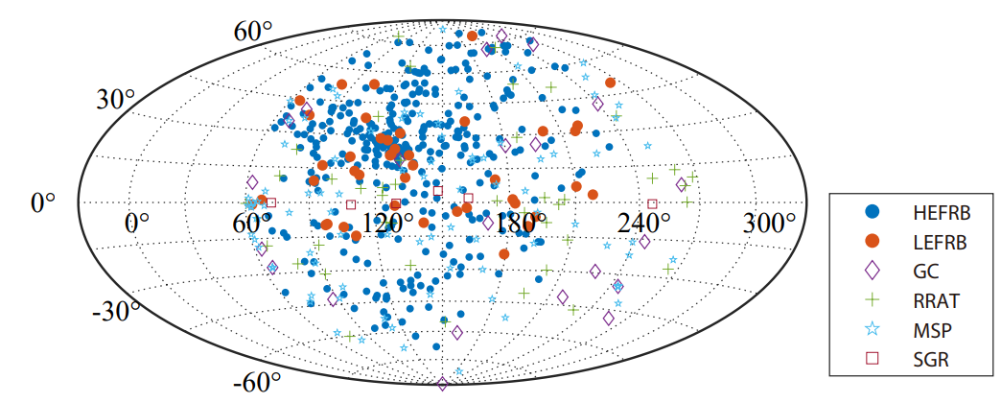
Brief Summary
Low-energy FRBs (LEFRBs) may exist
LEFRBs are concentrated towards the Galactic plane
Notes:
首先是这个工作的小结，我们认为有两类非重复FRB，除了公认的宇宙学FRB，我们认为可能存在一类趋近于银盘低银纬的低能FRB。

Slide 3
Outline
Introduction to FRB and statistical approach
The distributions of low-energy FRBs
The origin of high-energy FRBs (cosmological)
Summary

Slide 4
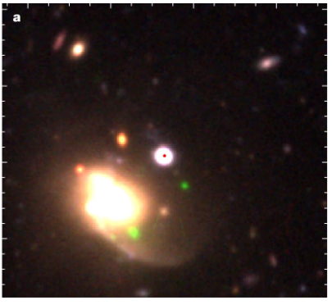
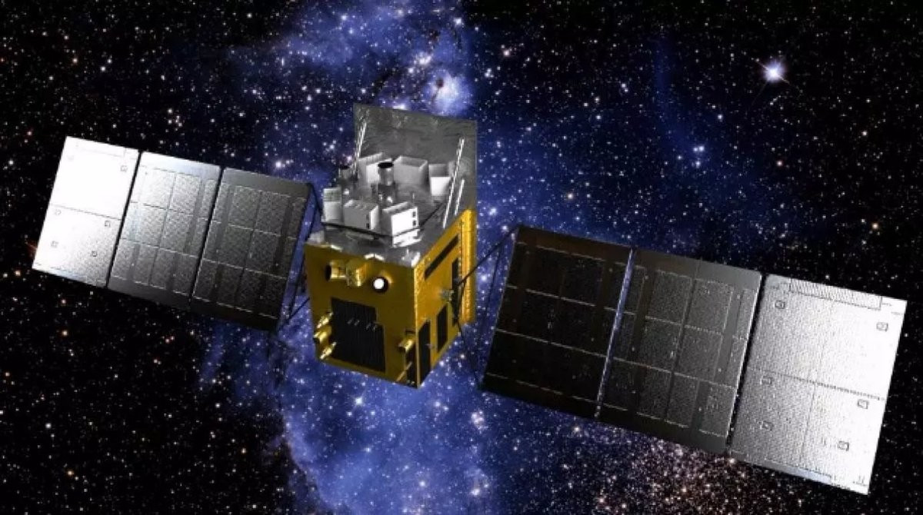
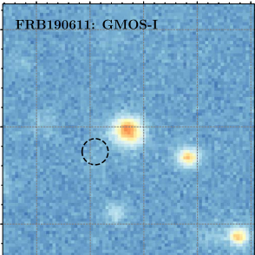
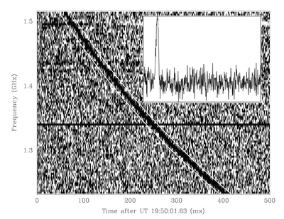
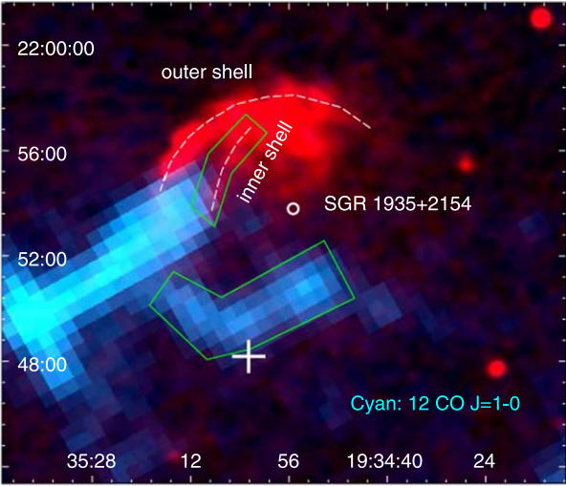
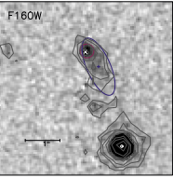
Introduction
FRBs are mysterious transients. What is the progenitor of FRB?
FRB 20200120E
Short duration and high energy
NS/Magnetar?
FRB 20200428 confirm
SGR 1935+2154 is associated with supernova remnant
Young
FRB 20200120E is localized in a globular cluster of M81
Old
Origin diversity?
Kirsten et al. (2022)
More constrain are needed
FRB 190611
FRB 200428
HXMT
FRB 121102
Lorimer et al. (2007)
Heintz et al. (2020)
Zhou et al. (2020)
Bassa et al. (2017)

Slide 5
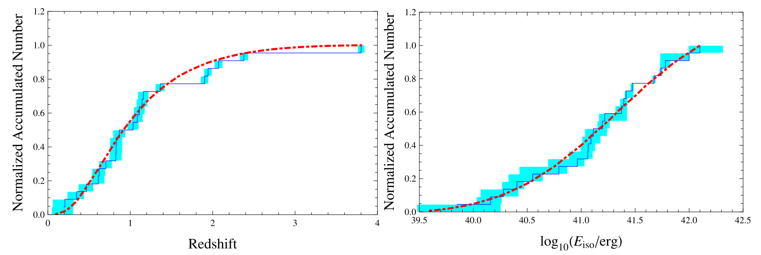
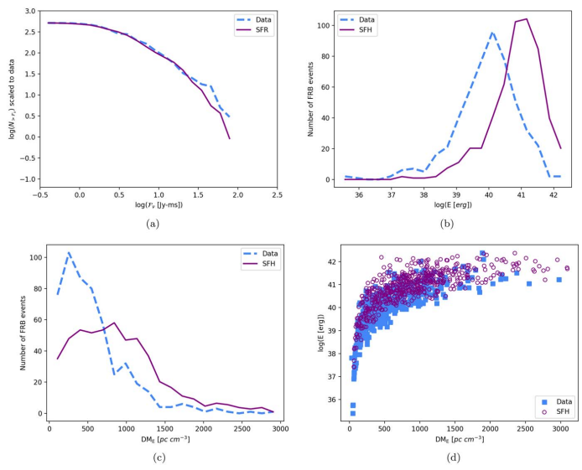
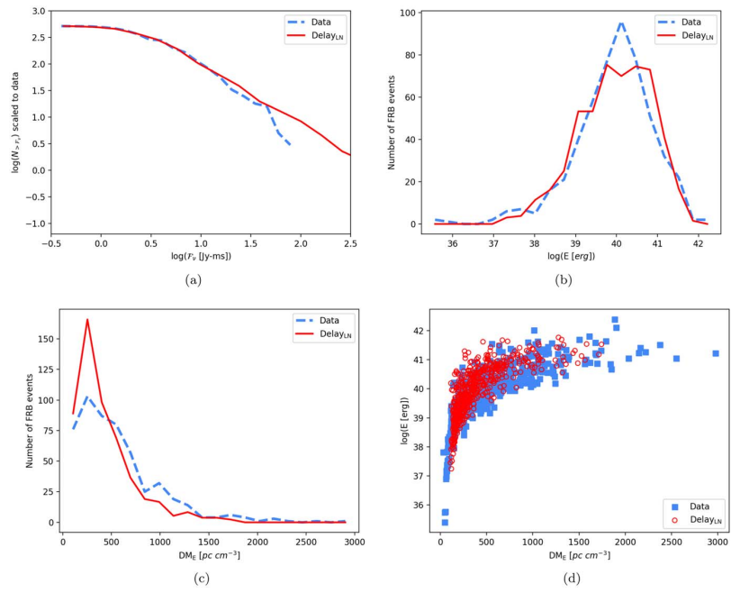
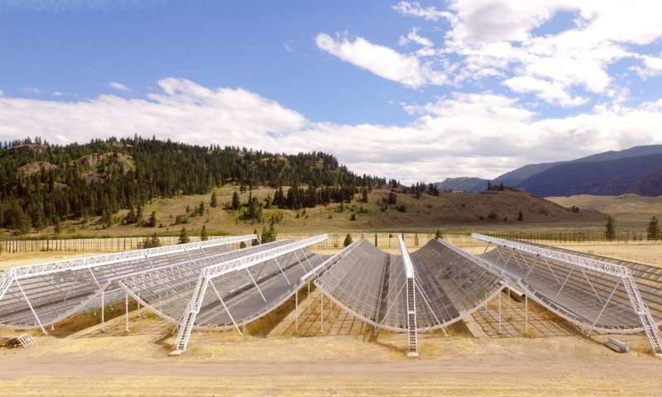
Statistical approach
Cao, Yu, Zhou, 2018, ApJ, 858, 89
Yu et al. 2014, JCAP, 11, 040
Disfavor young population
10Gyr delay
CHIME
Zhang, R. C., & Zhang, B. (2022)
Notes:
可惜这种直接的成协事件甚至是有红移定位的FRB太过稀少。那么除了孤立观测的直接推断，我们还可以利用统计手段帮助限制FRB的起源。

Slide 6
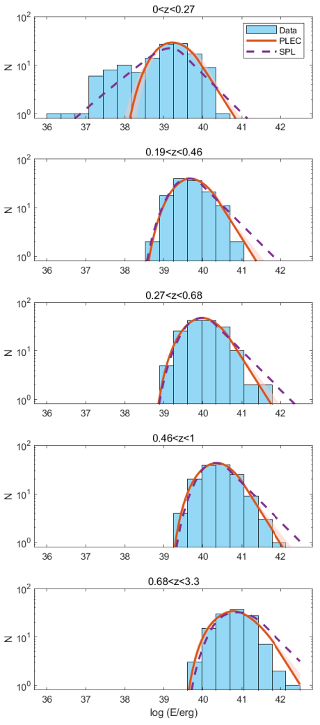
Energy distribution
arXiv: 2303.14695

Slide 7
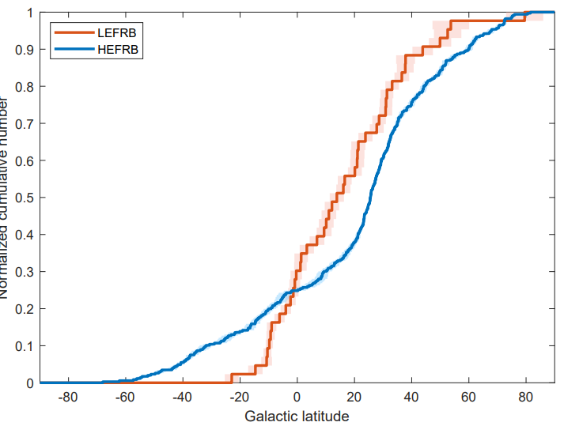
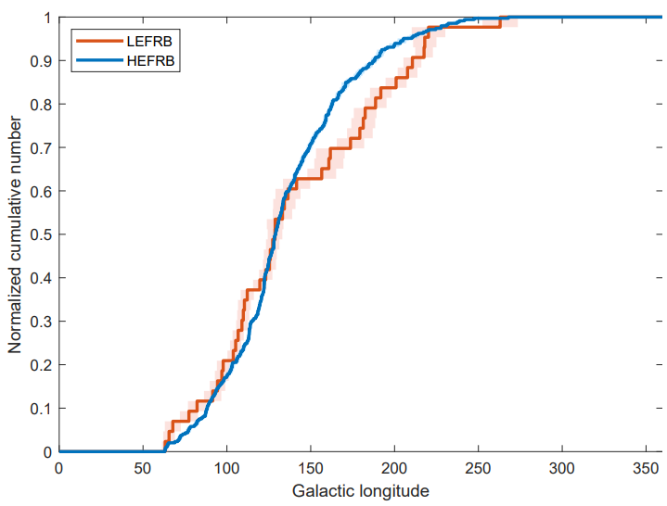
Spatial distribution
arXiv: 2303.14695
P=0.014
P=0.272
Notes:
低红移和高红移不能用同一个能量函数来描述。这些低能的FRB在下一个红移区间迅速消失，这可能意味着它和高红移FRB的不同起源，离我们比较近。
可以看到，那些高能的蓝色FRB在低中高银纬的分布是比较均匀的，这与FRB的宇宙学起源是符合的。

Slide 8
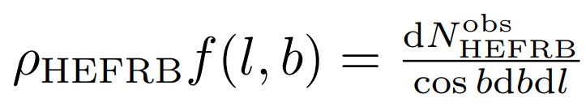

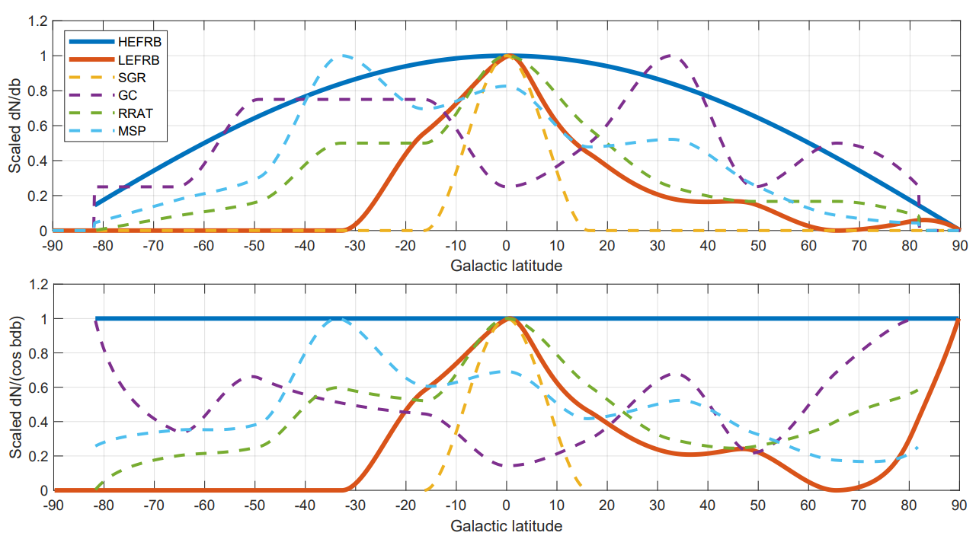


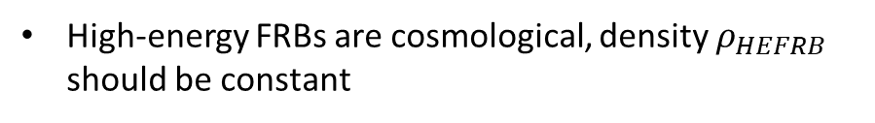
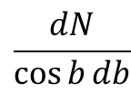
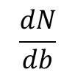
Galactic latitude distribution
arXiv: 2303.14695
High-energy FRBs are cosmological, density $ρ_{HEFRB}$ should be constant
describe the direction-dependence of the detection efficiency
Thus, the density of Low-energy FRBs can be obtained by
$$\frac{dN}{db}$$
$$\frac{dN}{\cos{b}db}$$
RRAT is more similar compared to other objects
Notes:
为了进一步验证我们的猜想，我们需要把CHIME望远镜的观测选择效应扣除。CHIME的直接观测在天球上不是均匀的，这点可以从FRB的在天球上分布看到，明显北边观测到的FRB更多。

Slide 9
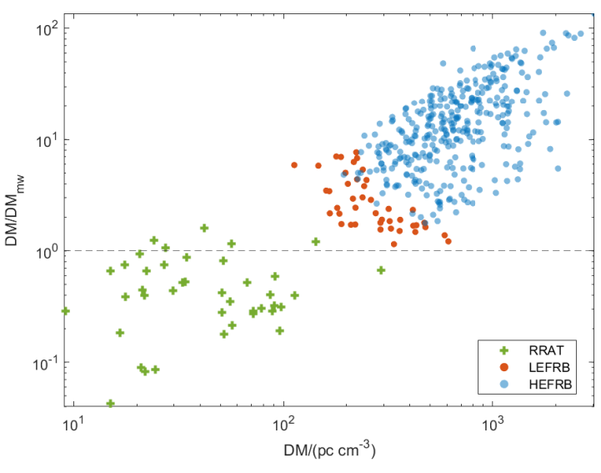
Is LEFRB a special type of RRAT?
RRATs (rotational radio transients) are a group of sporadically pulsing sources (McLaughlin et al. 2006)
RRAT are indistinguishable from FRB pulses in appearance except for their different DMs (Keane 2016)
If LEFRB belong to the milky way, 3 possible explanation:
The environment of the LEFRBs might be much denser than those of normal RRATs
Galactic electron density model might have missed some ionised gas
LEFRBs locate in the Galactic halo and the halo might have a more significant DM contribution
arXiv: 2303.14695
Notes:
有研究认为，从单脉冲的形状上来看，FRB和RRAT是不可区分的，特别是有些RRAT只看到过一次脉冲。现在区分FRB和RRAT主要使用色散量DM，如果这个单脉冲DM大于这个方向基于银河系电子密度模型能提供的DM，那么这个单脉冲就会被认定为FRB，如果小于就认定为RRAT。所以我们前面的假设有一些现在被标记为FRB的单脉冲其实是属于银河系，这也是有可能的。在右边的这幅图里，从RRAT可以自然地延伸到FRB，这可能暗示着他们之间存在着某种联系，或者说这些红点可能是特殊的绿点。

Slide 10
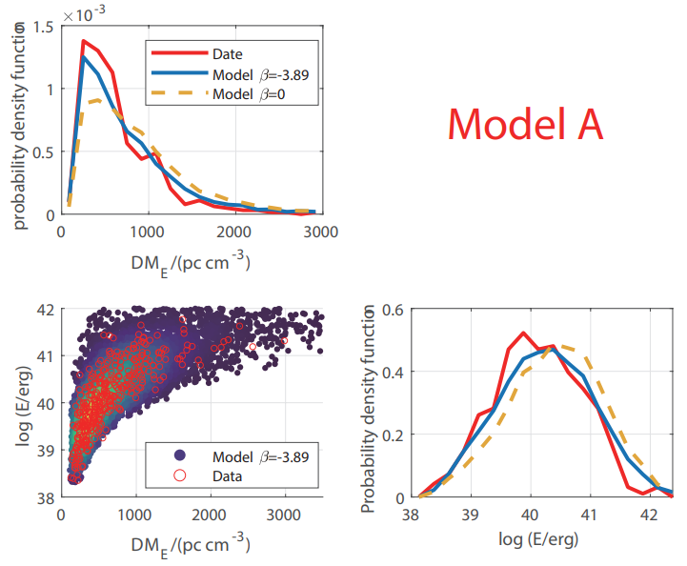
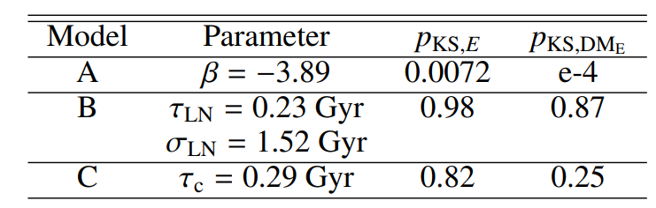
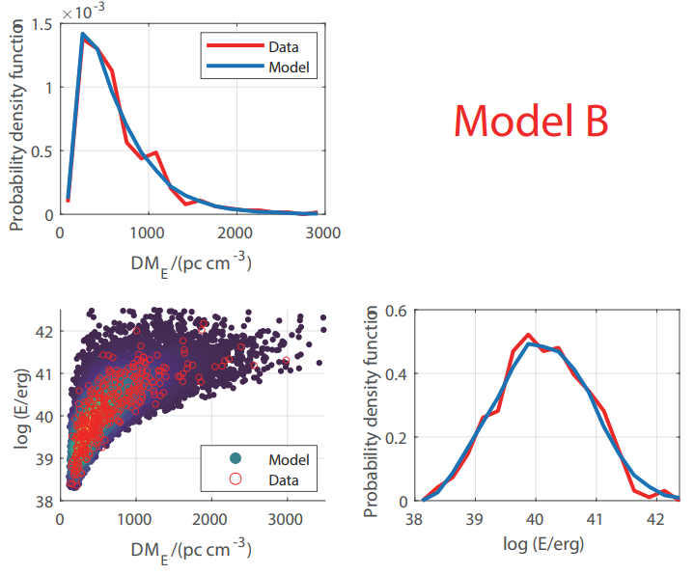

The origin of HEFRBs
arXiv: 2303.14695
Core-collapse origin model deviates from the observation
Compact star mergers models are favored again
Delay time is reasonable

Slide 11
Summary
arXiv: 2303.14695
We investigated the statistical distributions of the non-repeating FRBs detected by CHIME and find:
Low-energy FRBs (LEFRBs) may exist
LEFRBs are concentrated towards the Galactic plane
LEFRBs might compose a special type of RRAT with only one pulse, high energy and high DM
High-energy FRBs (cosmological) can be produced by remnant of NSs of compact binary mergers with reasonable delay time

Slide 12
Technical details

Slide 13
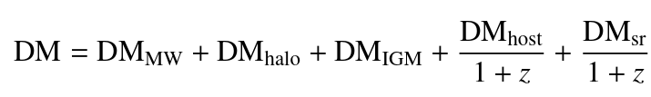
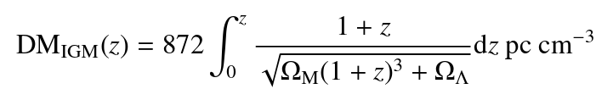

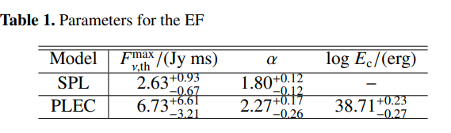
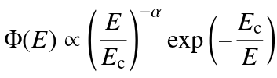


Pseudo redshift and energy distribution
Pseudo redshift
Energy estimation
Energy distribution
Observational energy distribution
is detection efficiency

Slide 14

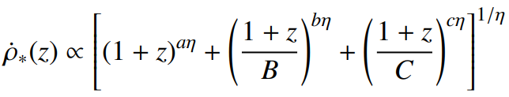
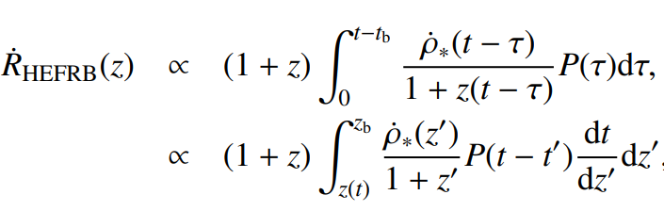
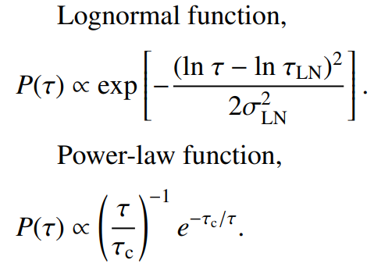
Redshift distribution of HEFRBs
Core-collapse origin model
arXiv: 2303.14695
Compact star mergers models

Slide 15
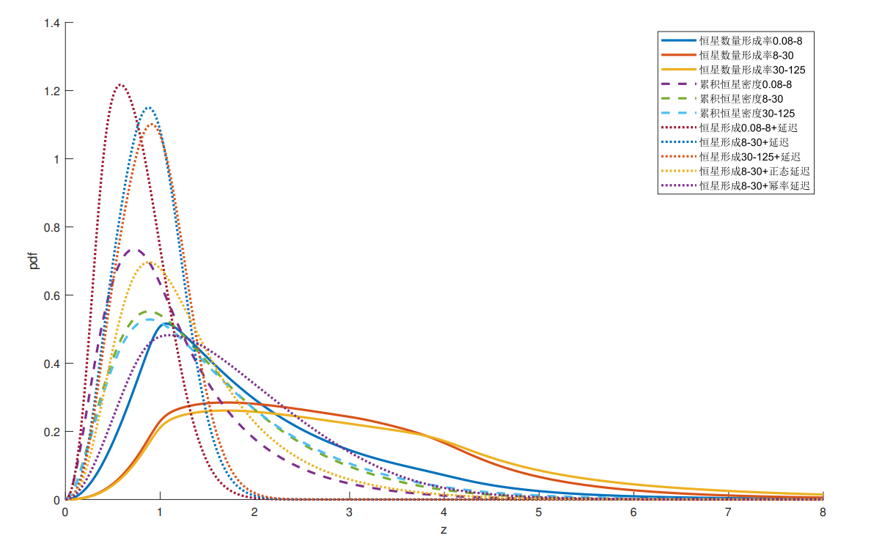

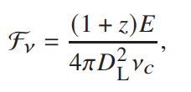
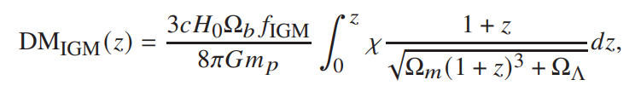
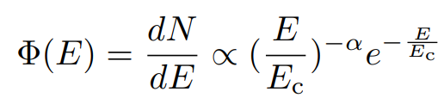
Monte Carlo Method
蒙特卡洛方法模拟的一个FRB事件（E, z）
蒙特卡洛方法模拟的一个FRB事件的红移
观测DM
观测流量
蒙特卡洛方法模拟一个能量
DM 选择效应
流量 选择效应
观测到“FRB”
15

Slide 16
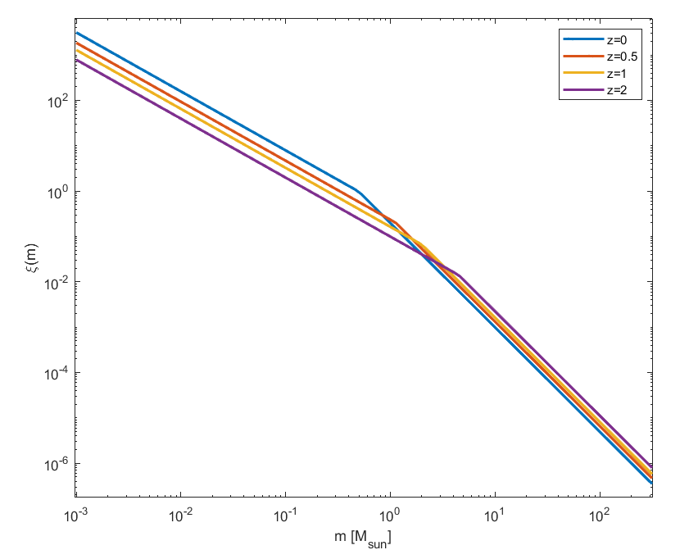
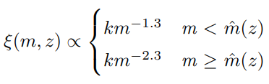
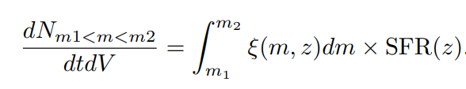
Evolving initial mass function
不同质量恒星诞生的比例与环境有关
随红移演化的初始质量函数(initial mass function; IMF) :
红移越大，大质量的恒星越多
不同质量的恒星形成率：

Slide 17
Correcting direction-dependent detection efficiency

Slide 18
Outline

