Slide 1
Search for pulsars in globular clusters based on stacking power spectra
Speaker: 戴印丰(GZU)
Supporter: 潘之辰(NAOC),钱磊(NAOC),张立云(GZU),etc
FPS 13·Kunming
June 14, 2024

Slide 2
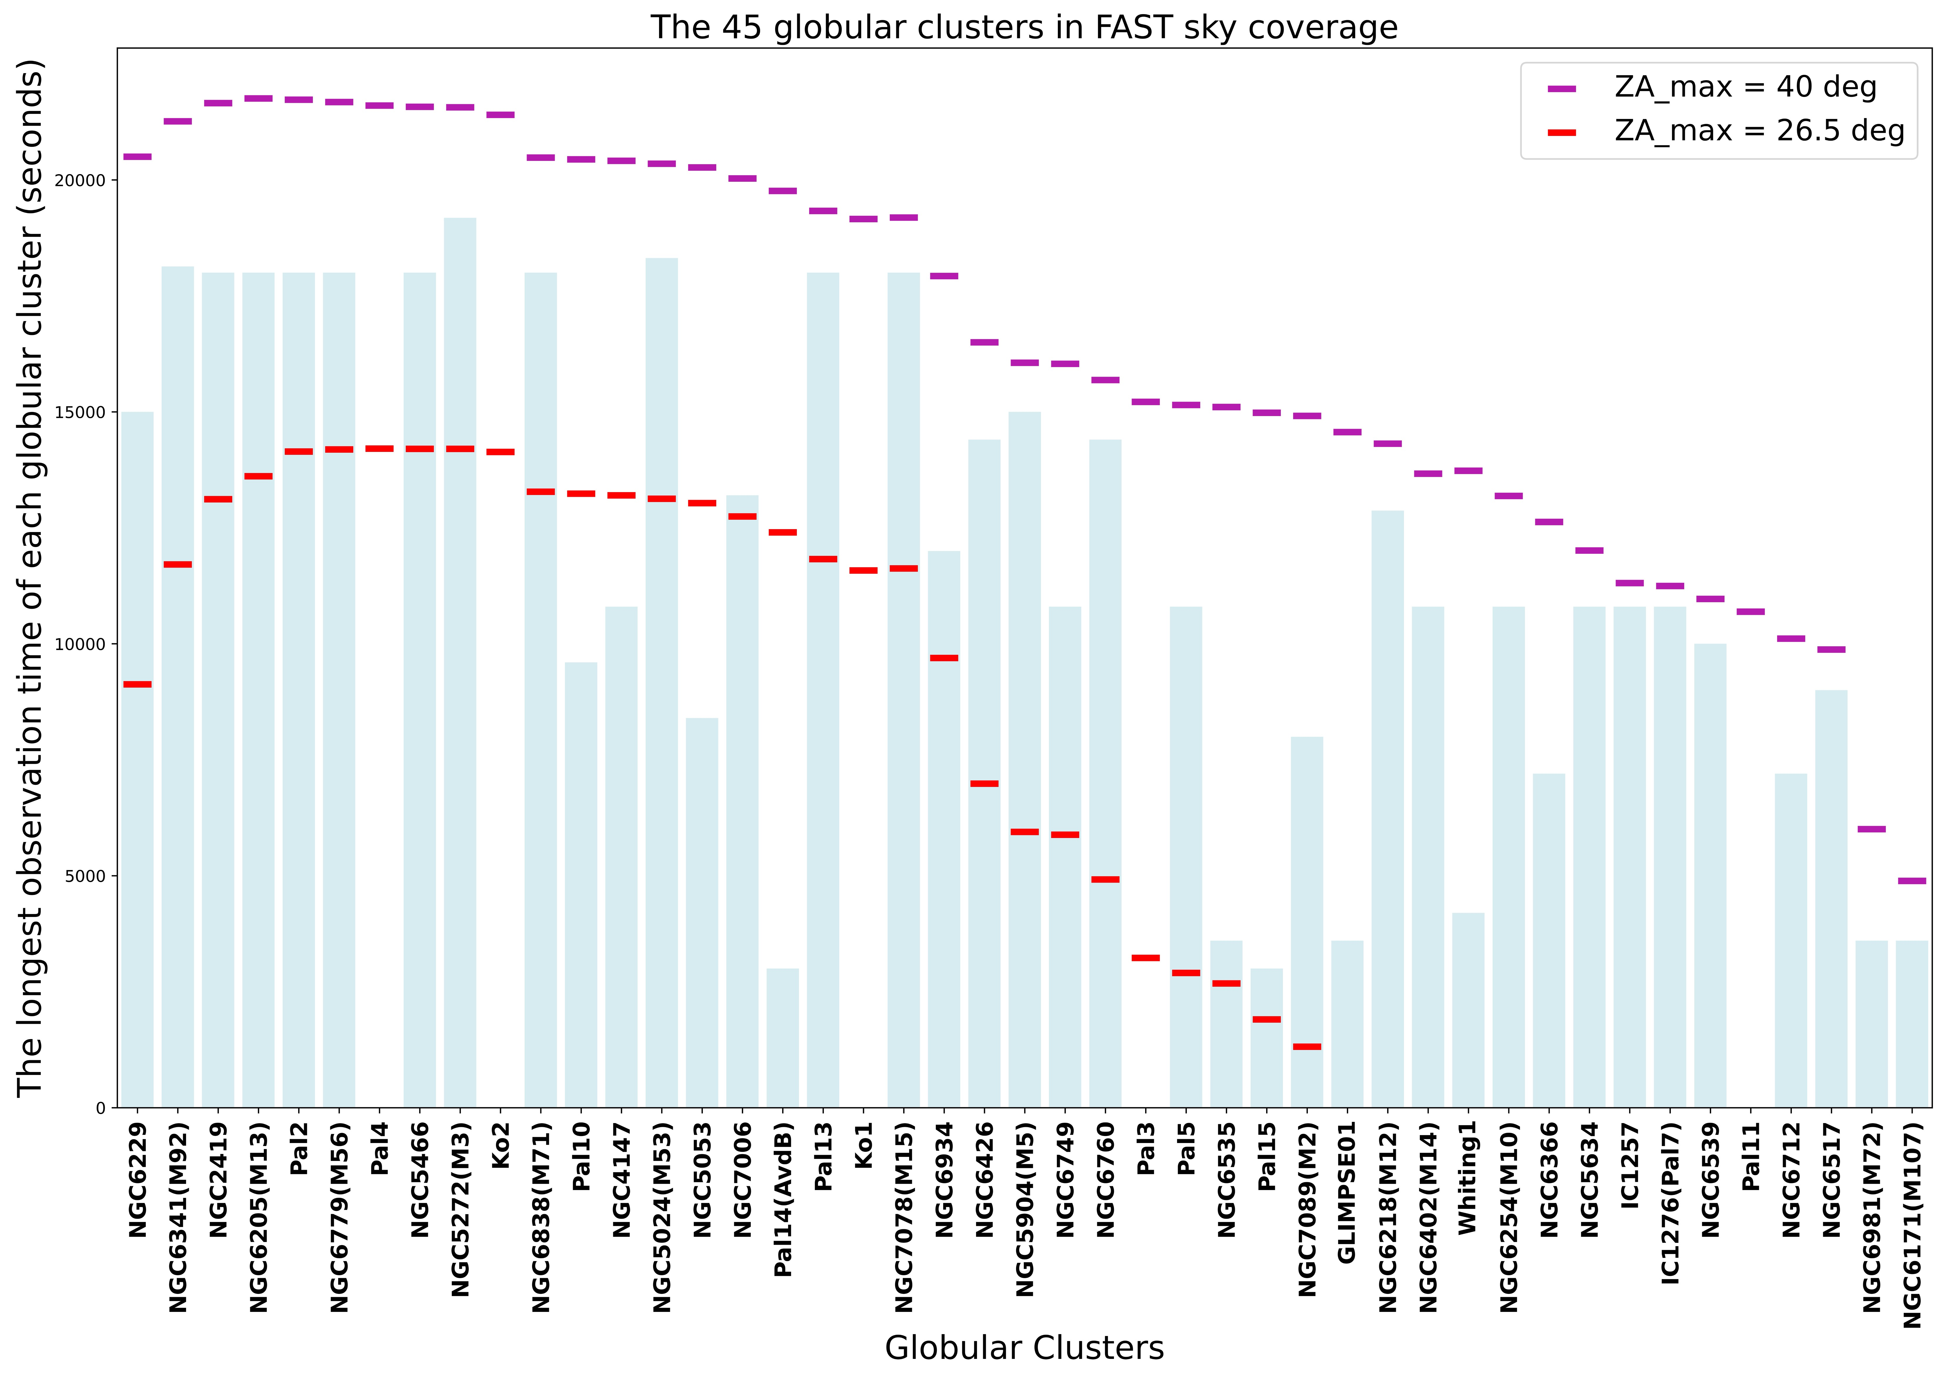
Typical Search Process
Based on the analysis of a single and long time sequence of data
The minimum detectable flux density for a pulsar (Dewey et al. 1985) :

Slide 3
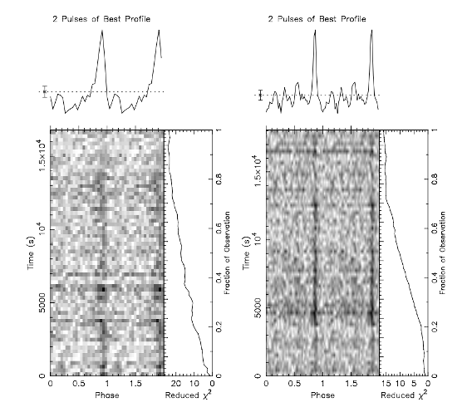
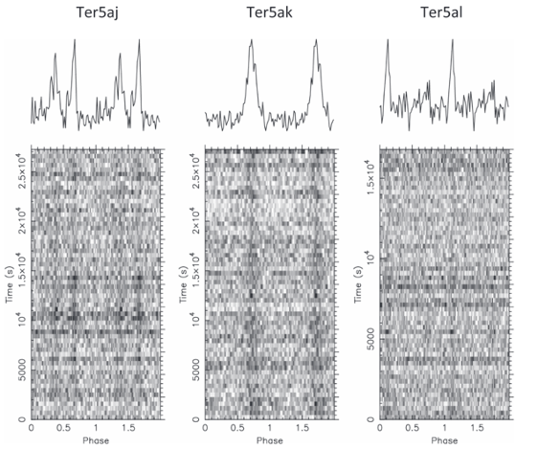
Stacking Power Spectra
By incoherently stacking the power spectra obtained from
all the available observations
A similar procedure has been already successfully implemented in M15 by Anderson(1993).
In Terzan 5 by Sulman et al. (2005), leading to the discovery of 3 isolated millisecond pulsars.
( Pan et al. 2016 )
( Cadelano et al. 2018)
Telescope: Parkes
Data length: 1100 h
The cluster: 47 Tuc
Discovery: 2 millisecond pulsars
Telescope: Green Bank
Data length: 206 h
The cluster: Terzan 5
Discovery: 3 millisecond pulsars

Slide 4
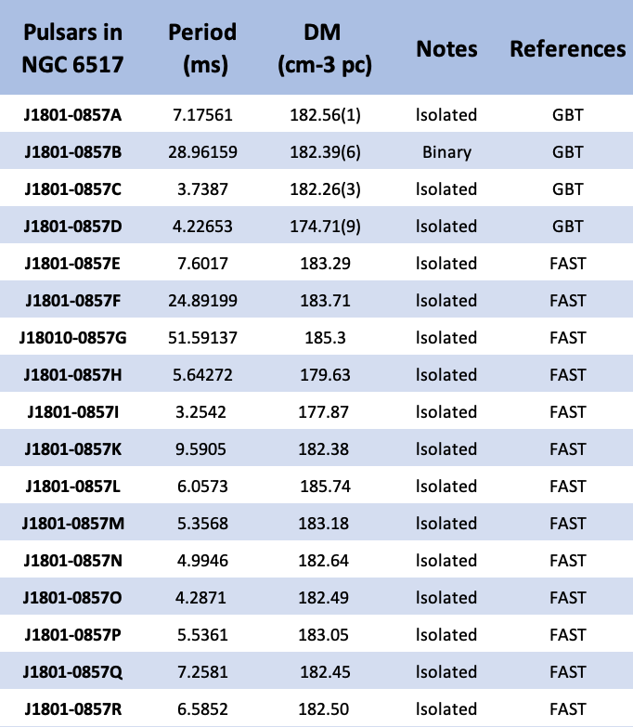
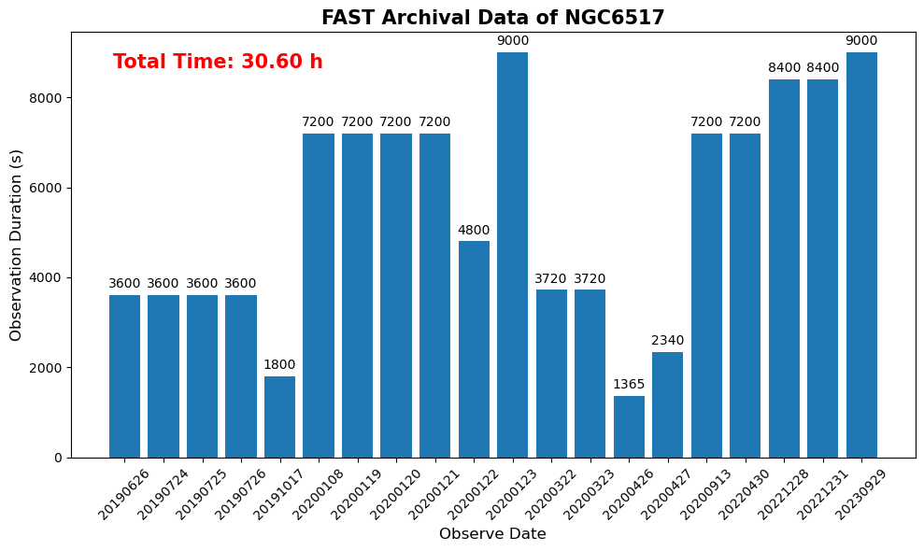
Search Process (NGC6517)
(https://www3.mpifr-bonn.mpg.de/staff/pfreire/GCpsr.html)
2019/06/26 —— 2023/09/29 20 days
17 pulsars(16 isolated; 1 binary) in NGC6517
(Yin et al. 2024)

Slide 5
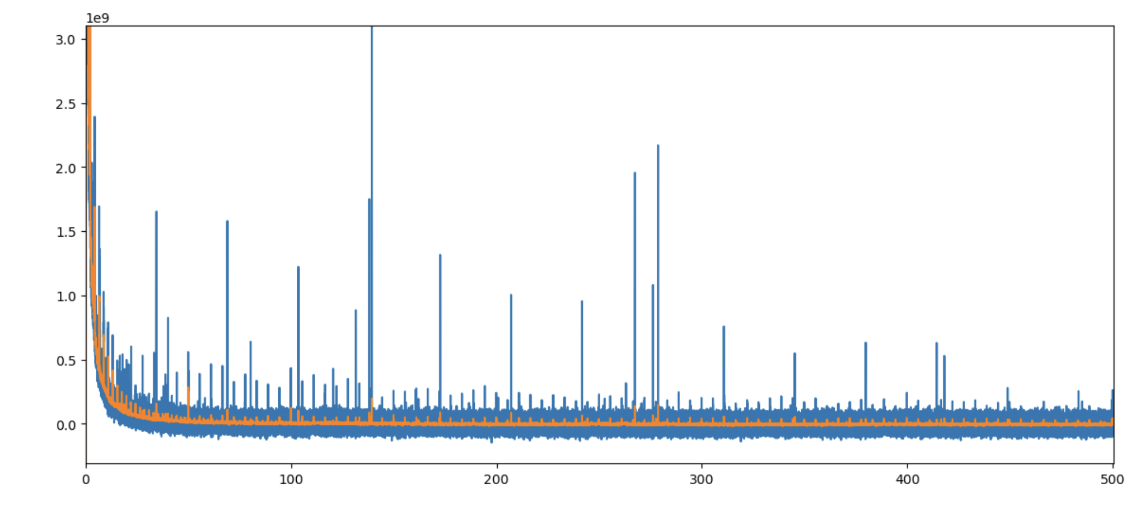
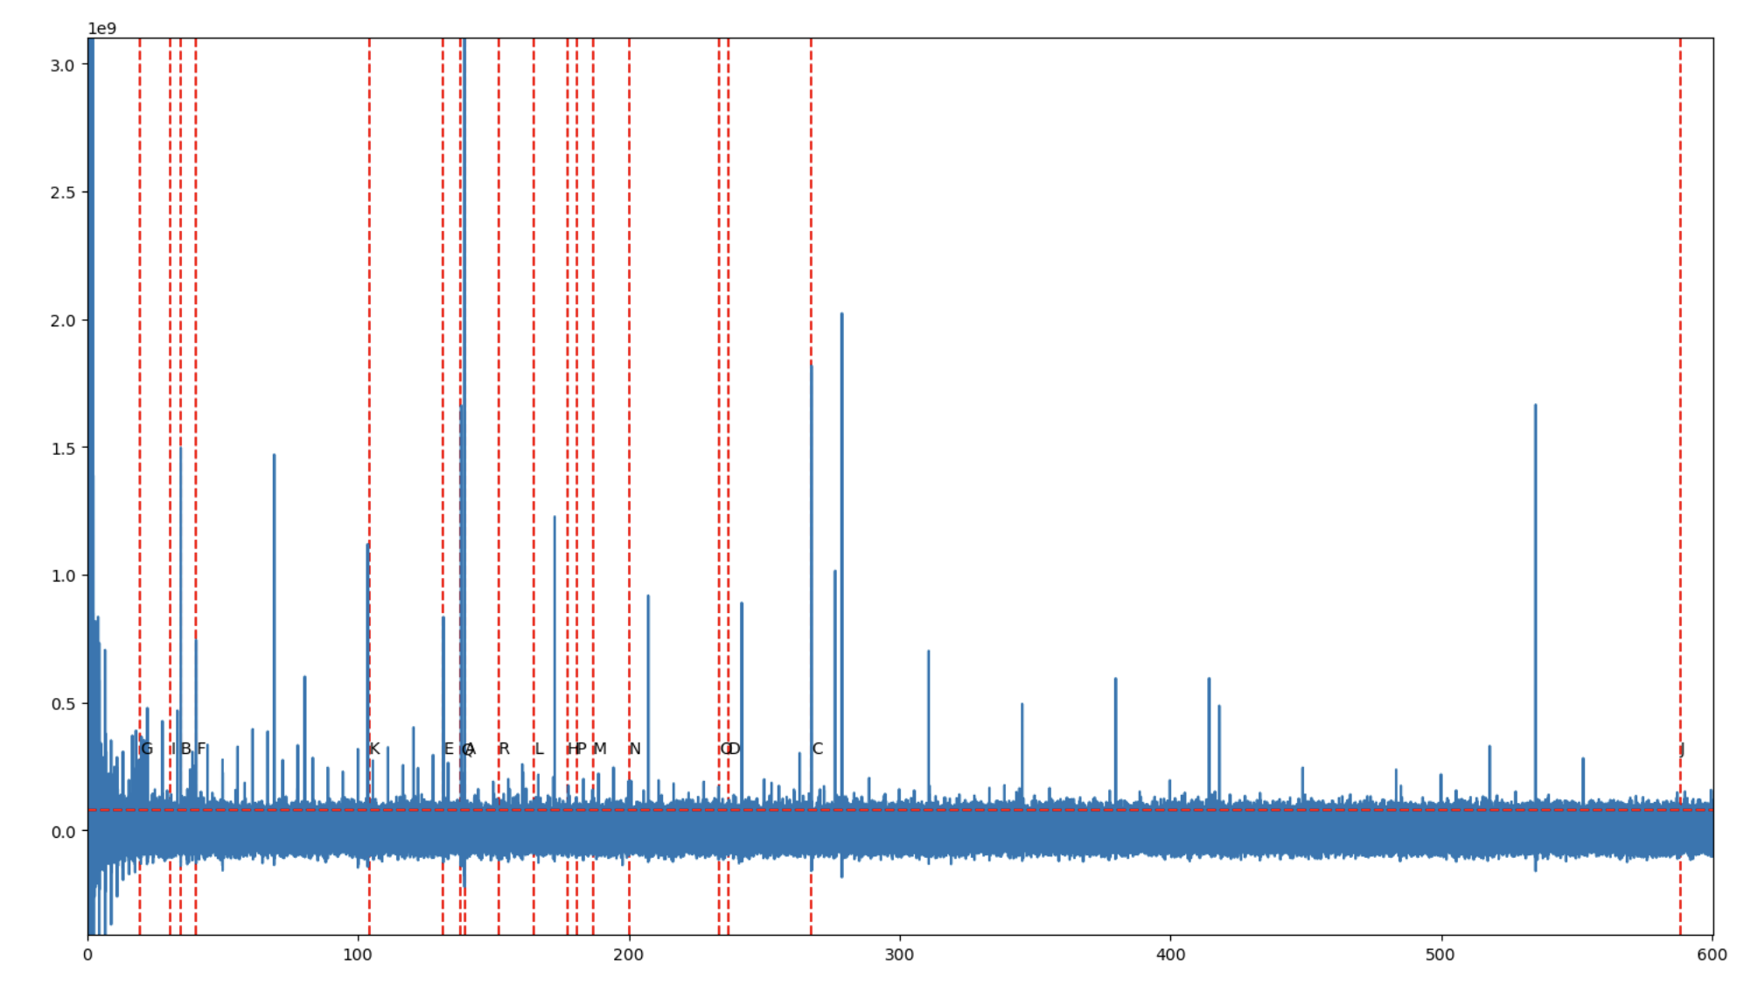
Search Process (NGC6517)
ArPLS(Asymmetrically Reweighted Penalized Least Squares)
Rfifind & Prepdata
(Baek et al. 2015 )
NGC6517 DM182.50
Number of bins in the time series
= 192000000
Time-domain signal
Power
FFT
Number of bins in the Frequency series
= 192000000/2
Frequency-domain signal
Frequency(Hz)
NGC6517 DM182.50
Subtract baseline
Stacked power spectrum
Frequency range: 0~10172.52 Hz
Power
Frequency search accuracy: 0.0001059 Hz
Remove rednoise
Frequency(Hz)

Slide 6
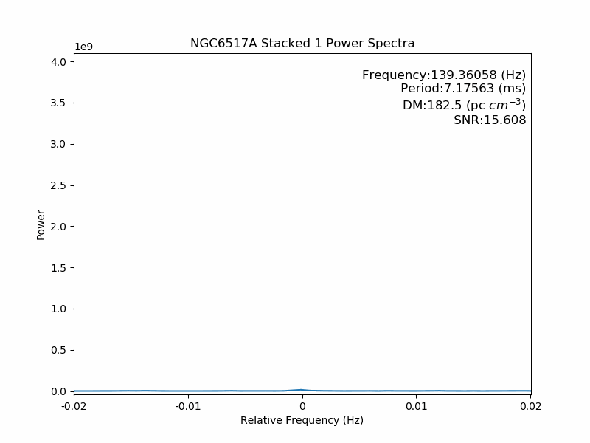
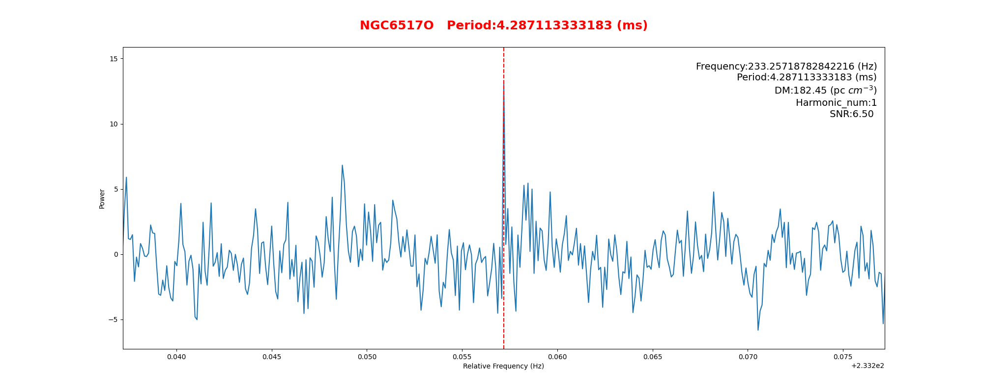
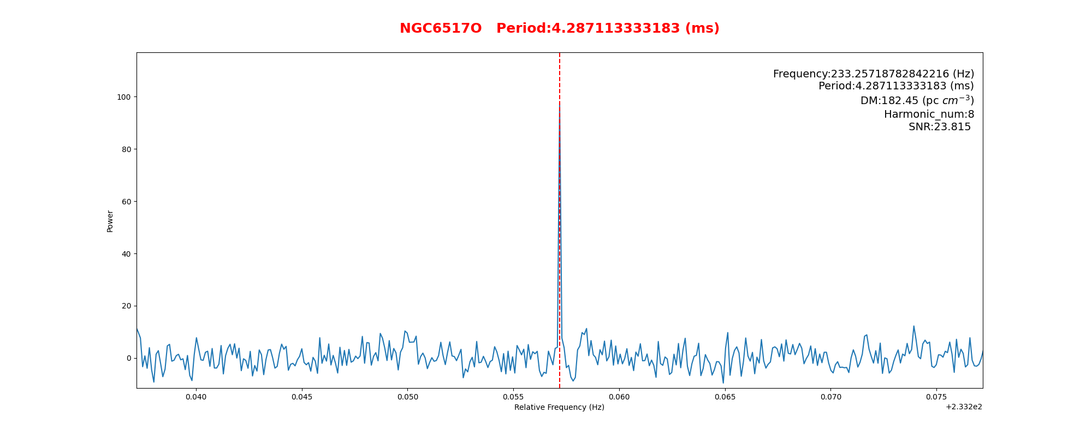
Search Process (NGC6517)
Stacking power spectra
Harmonic sum
(NGC6517O as an example)
Harmonic_num: 1 SNR: 6.5 Harmonic_num: 8 SNR: 23.815
Harmonic_num: 2 SNR: 20.26 Harmonic_num:16 SNR: 22.544
Harmonic_num: 4 SNR: 23.795 Harmonic_num:32 SNR: 20.344

Slide 7
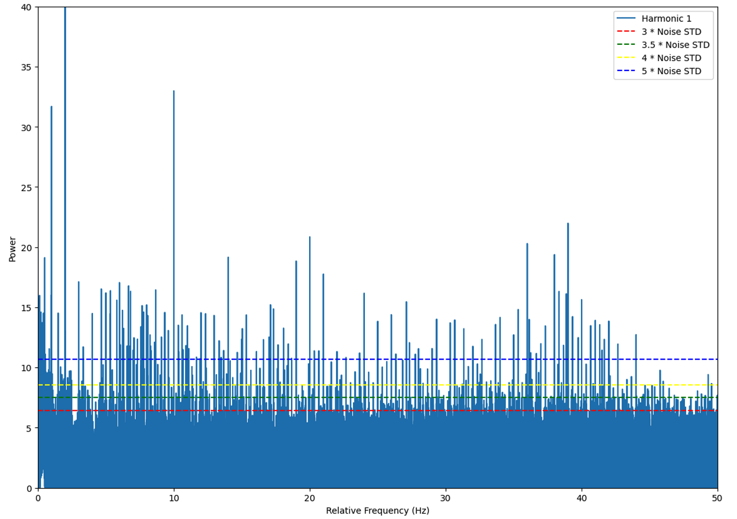
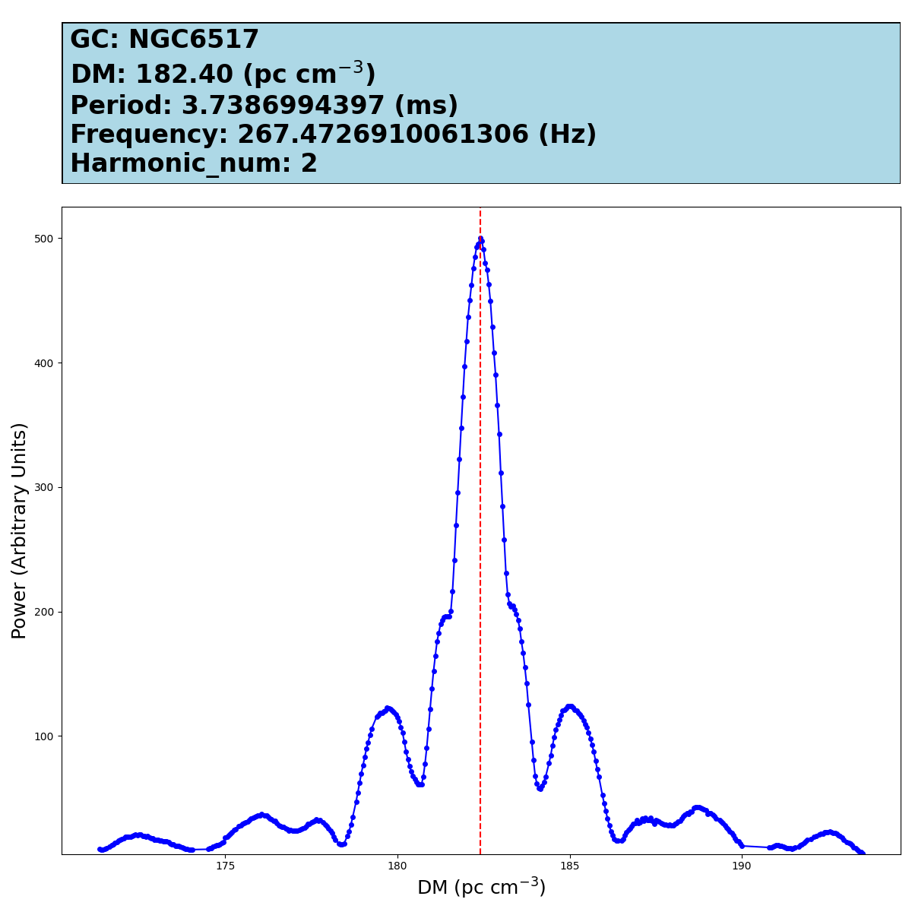
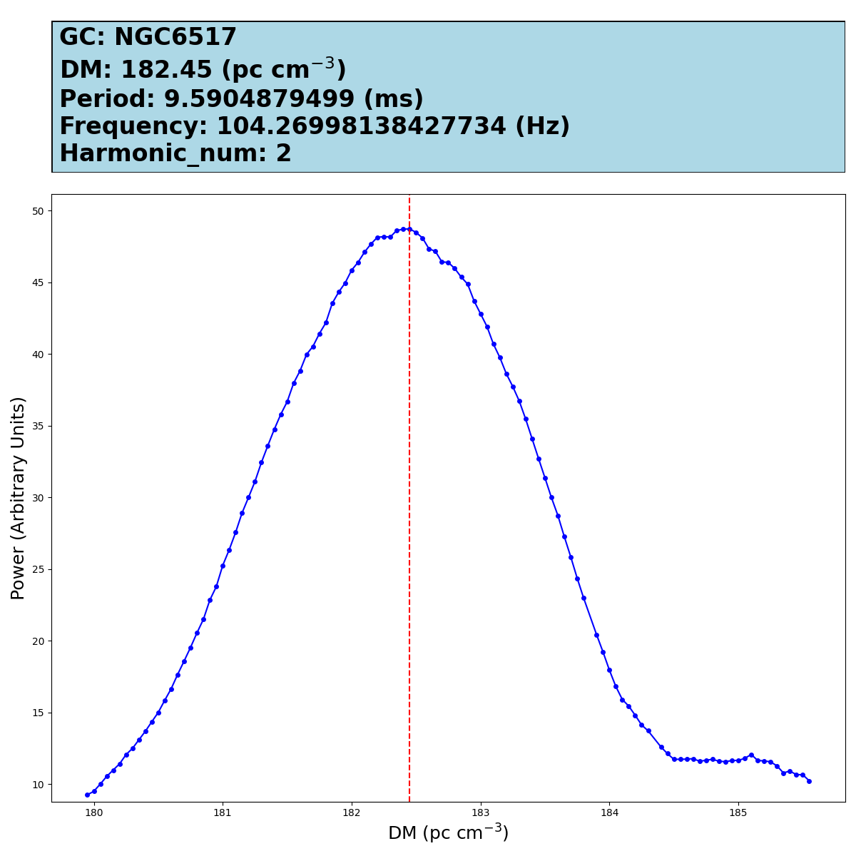
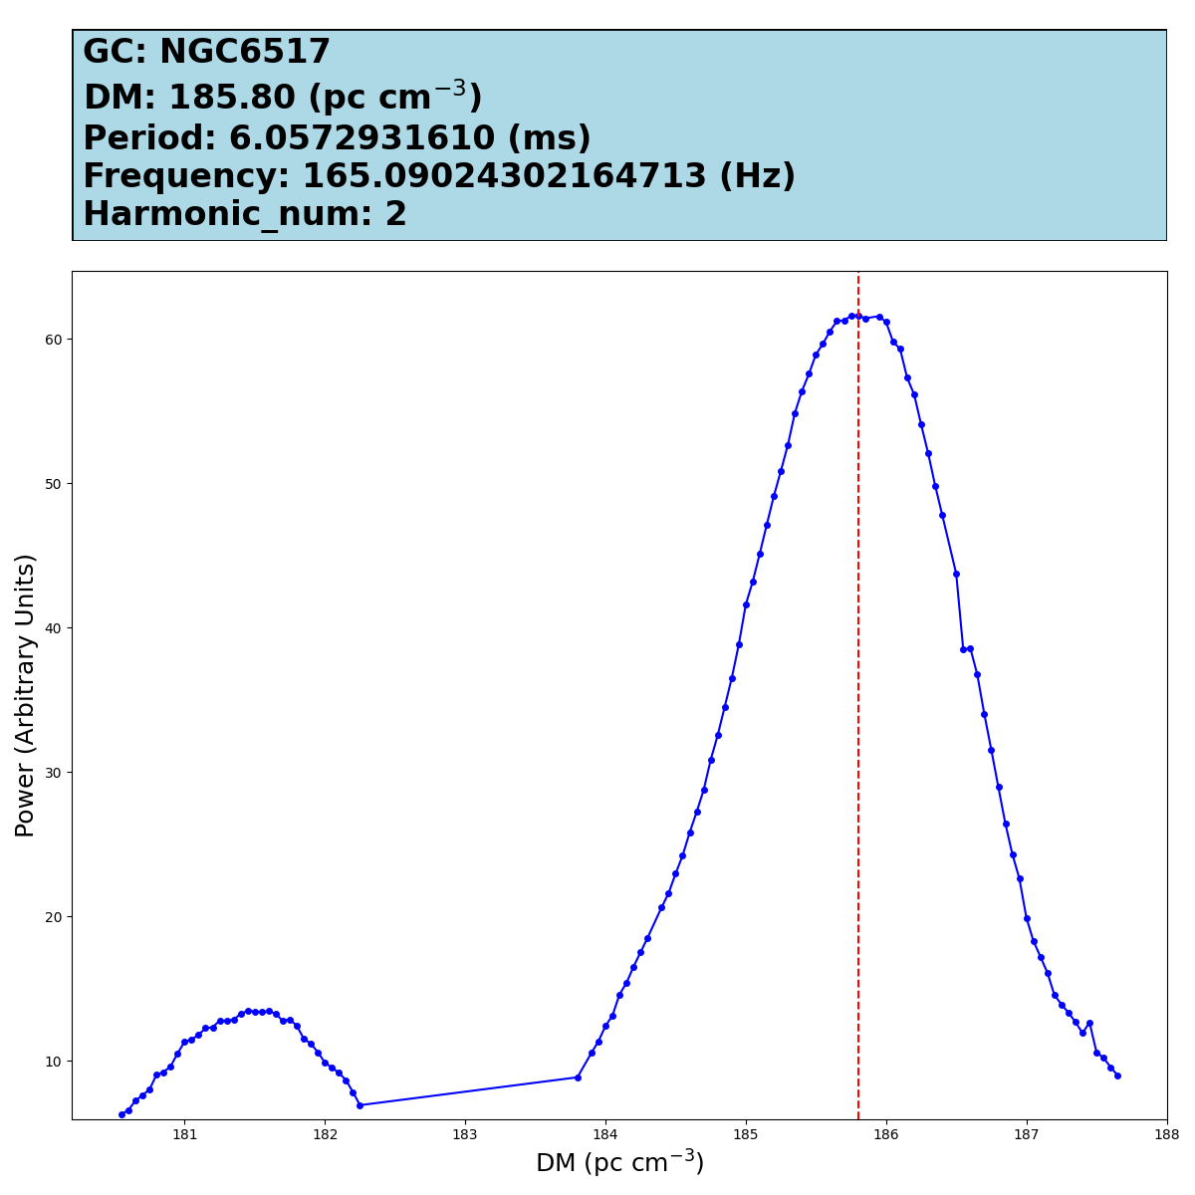
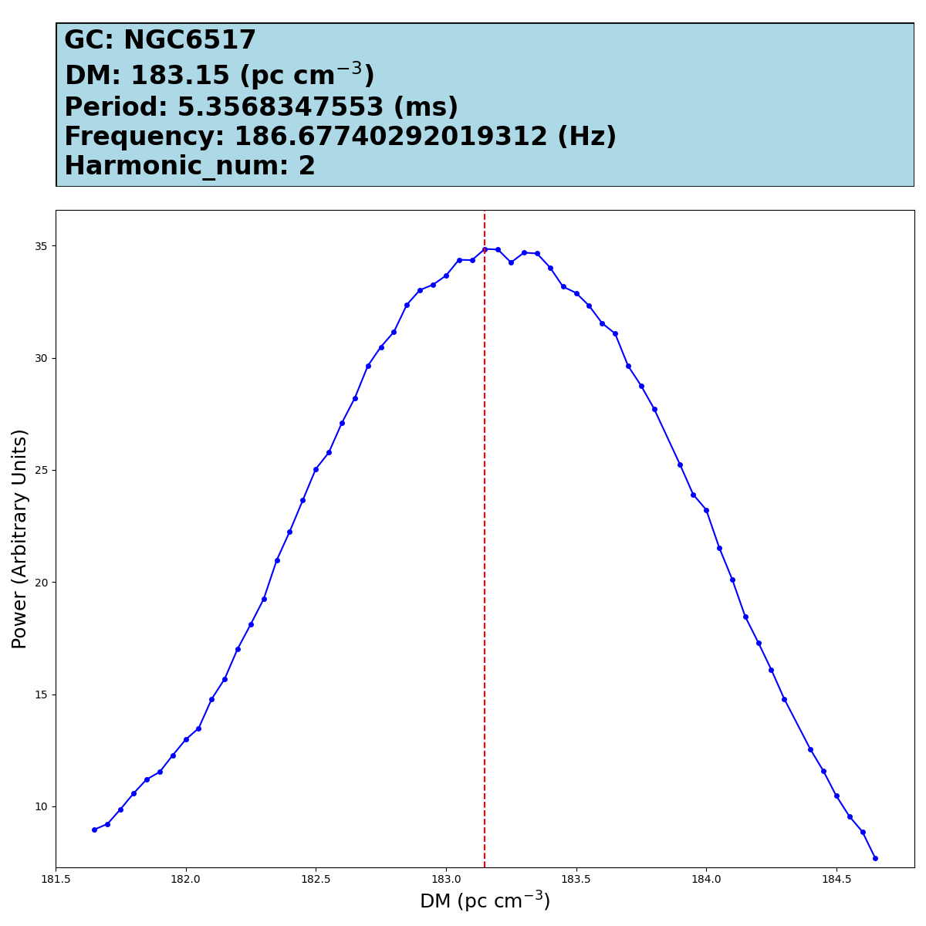
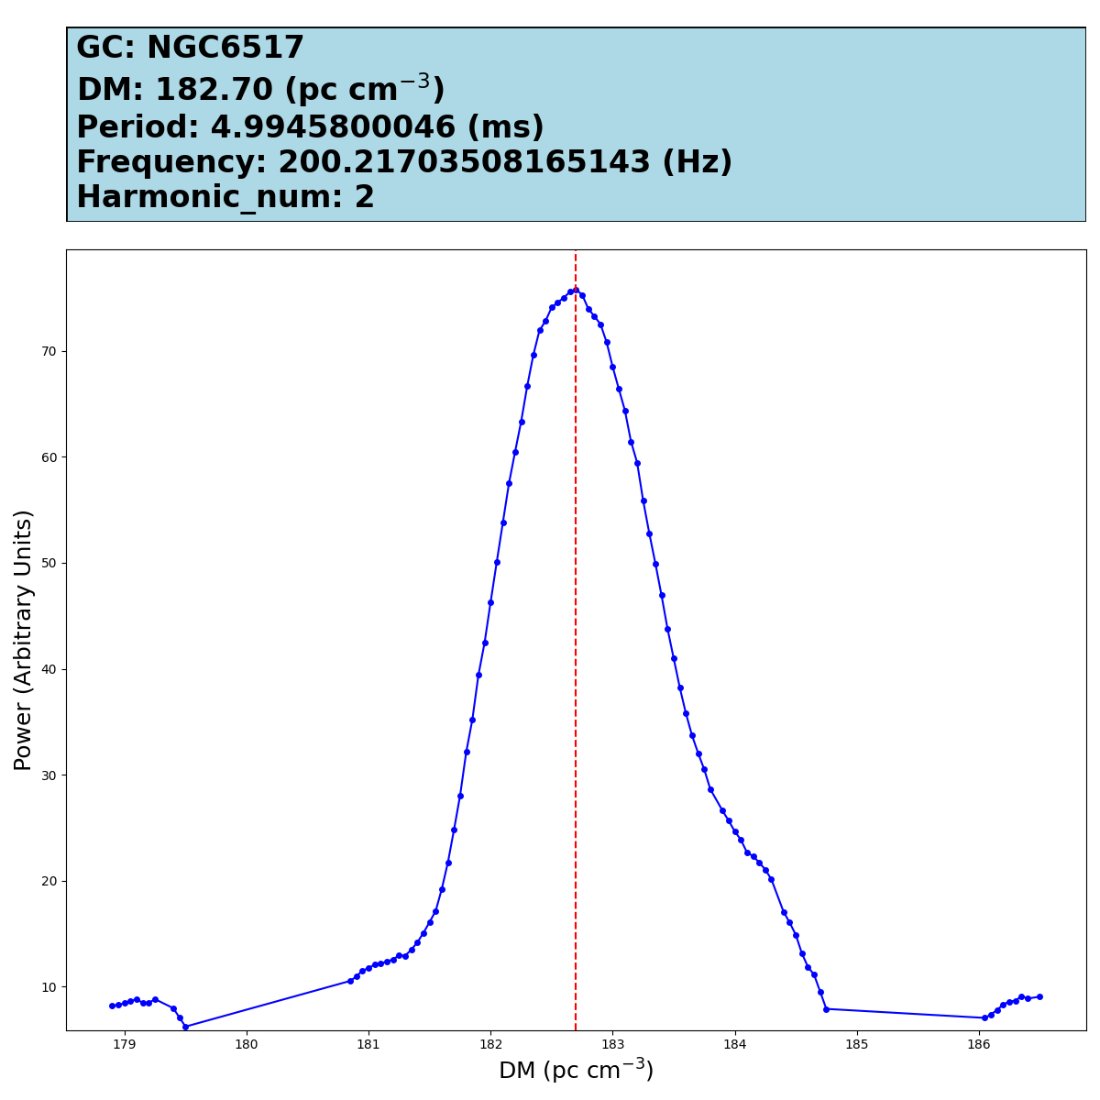
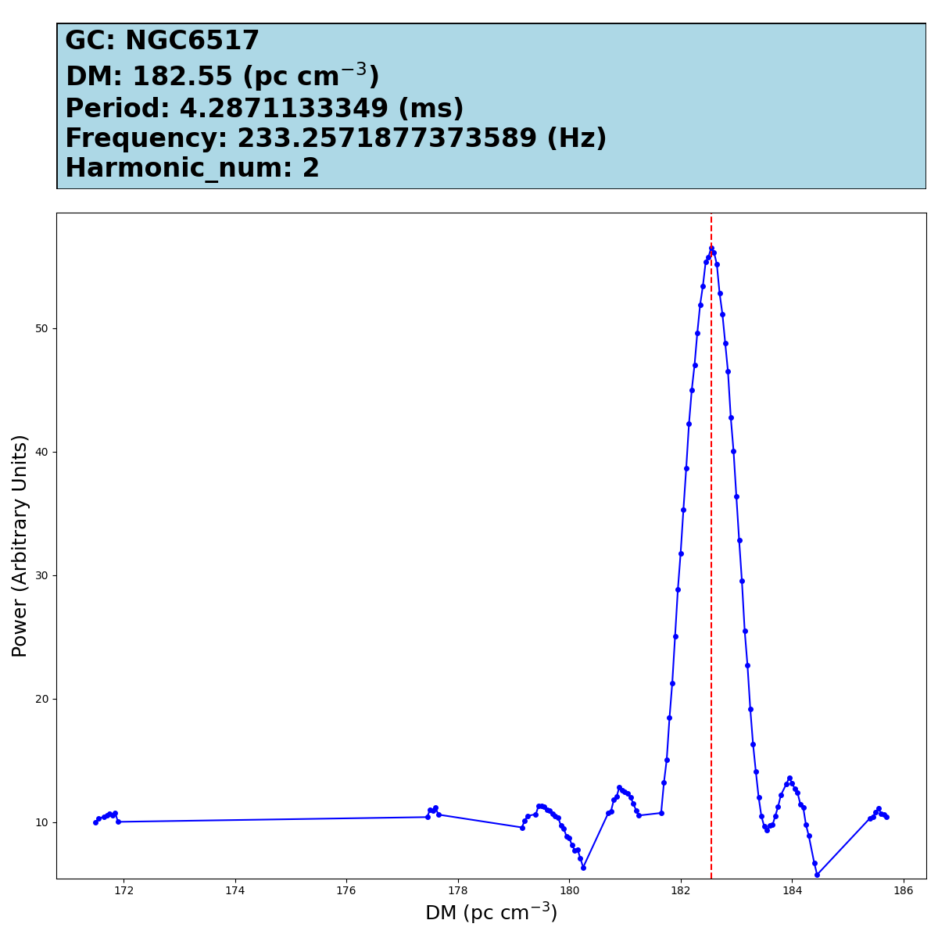
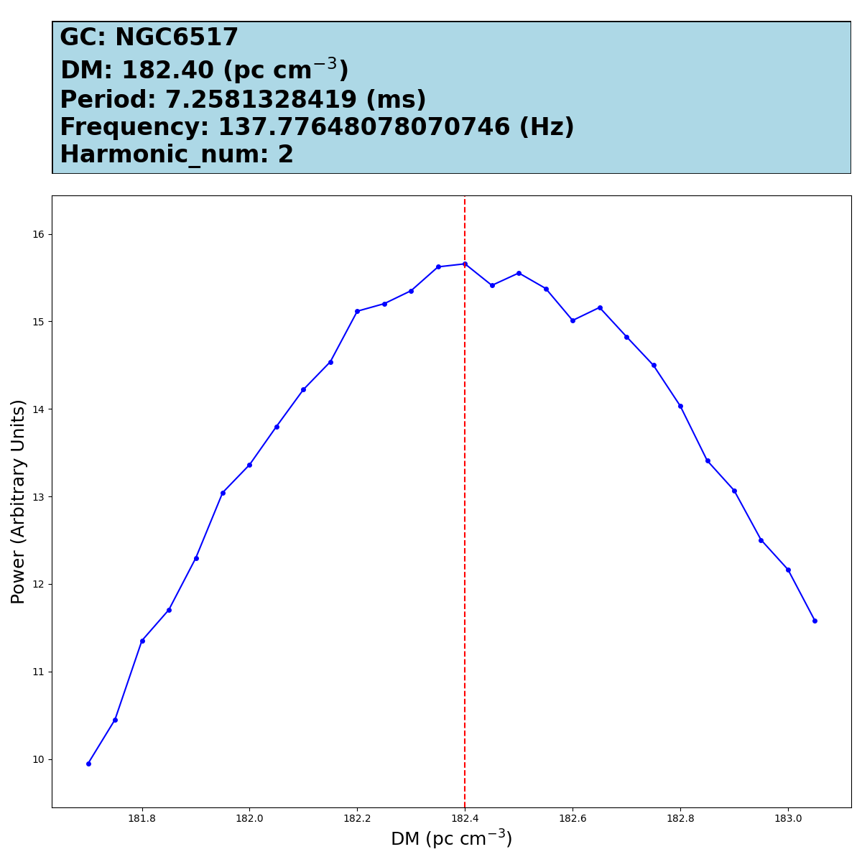
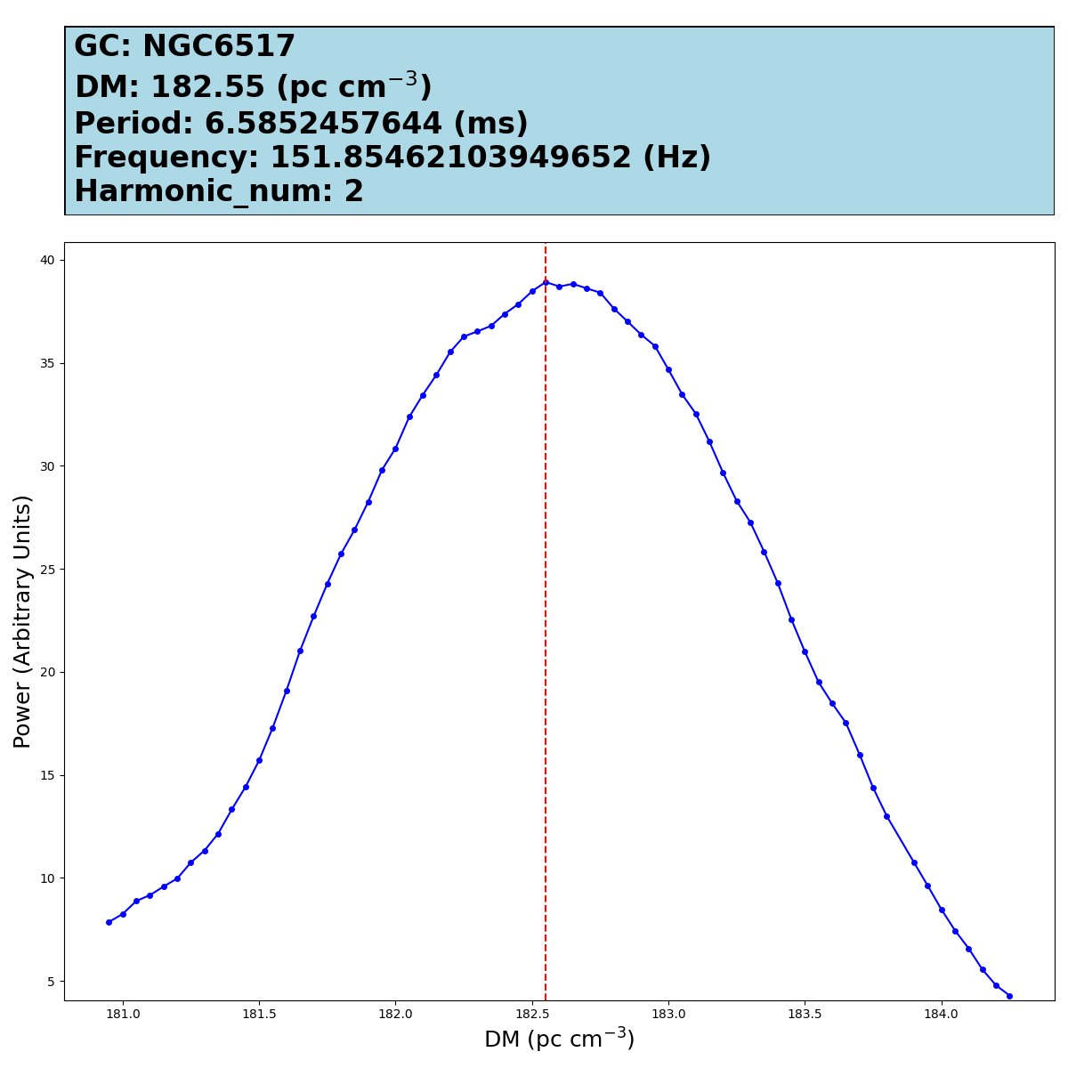
Search Process (NGC6517)
Sifting the candidate
Output results
NGC6517 DM182.5
C
K
L
5 sigma
M
N
O
1371 candidates
P
Q
R

Slide 8
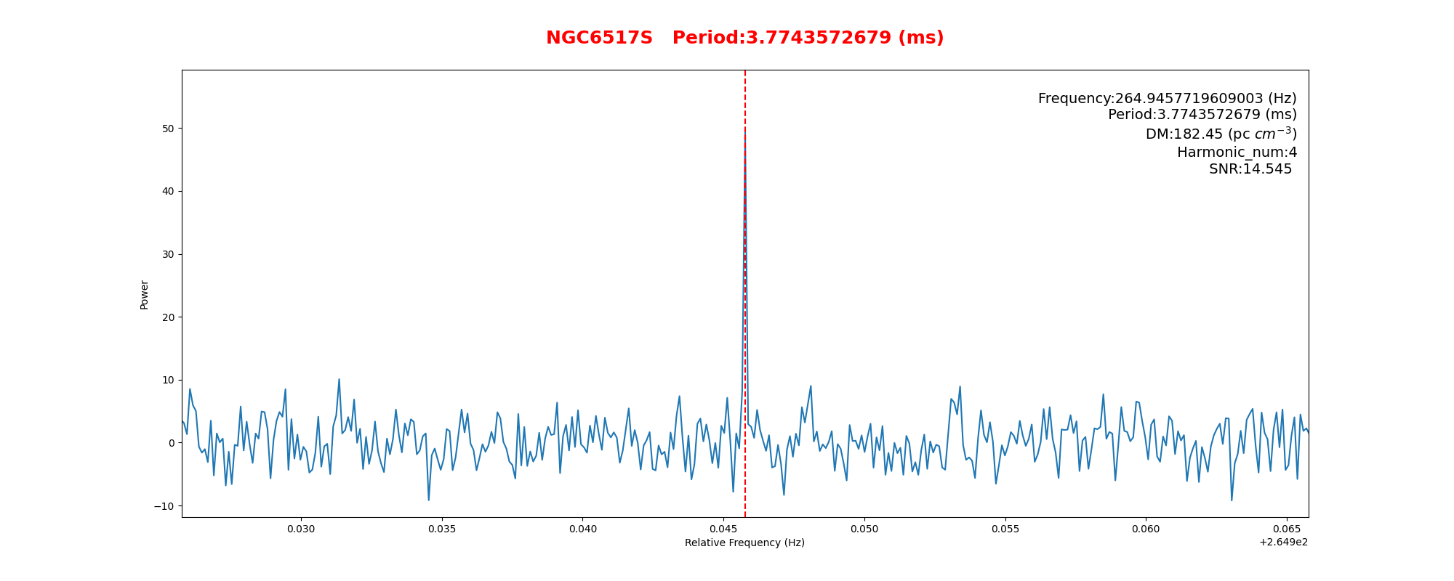
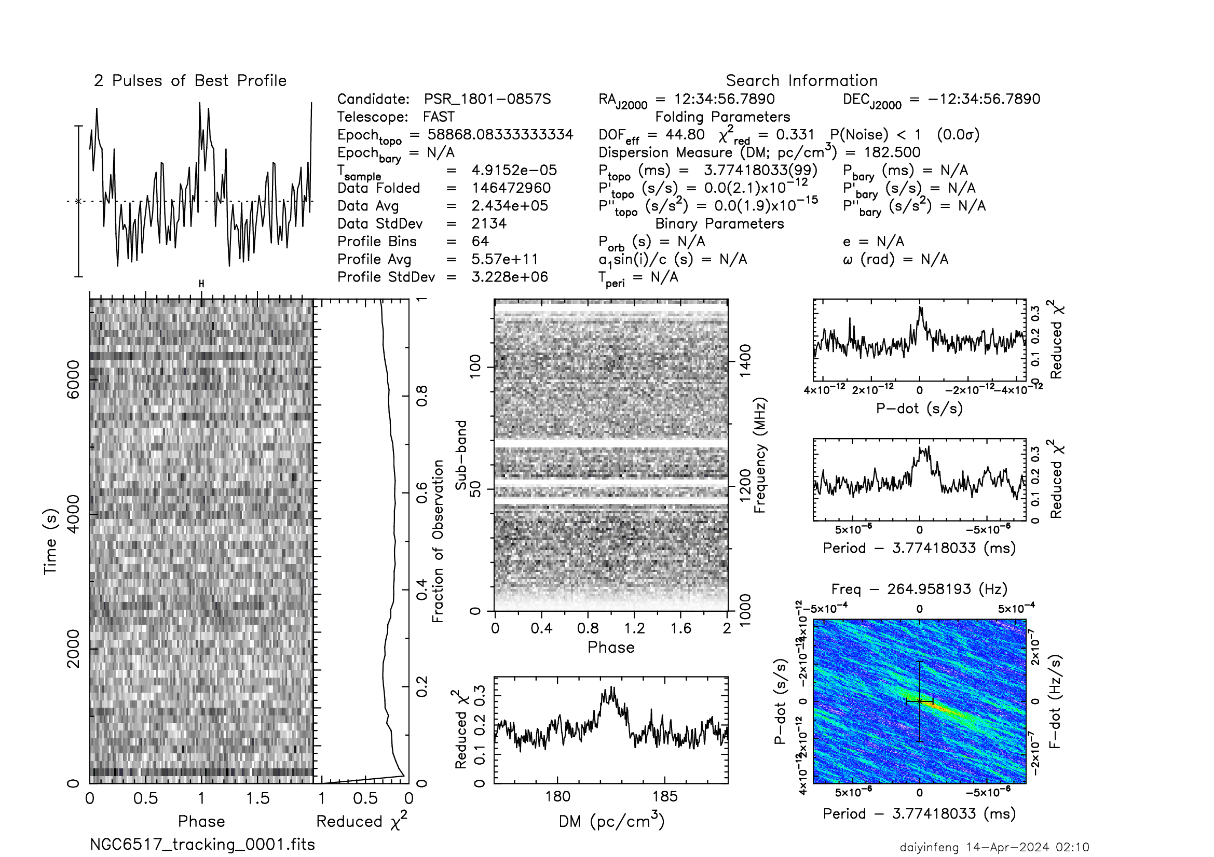
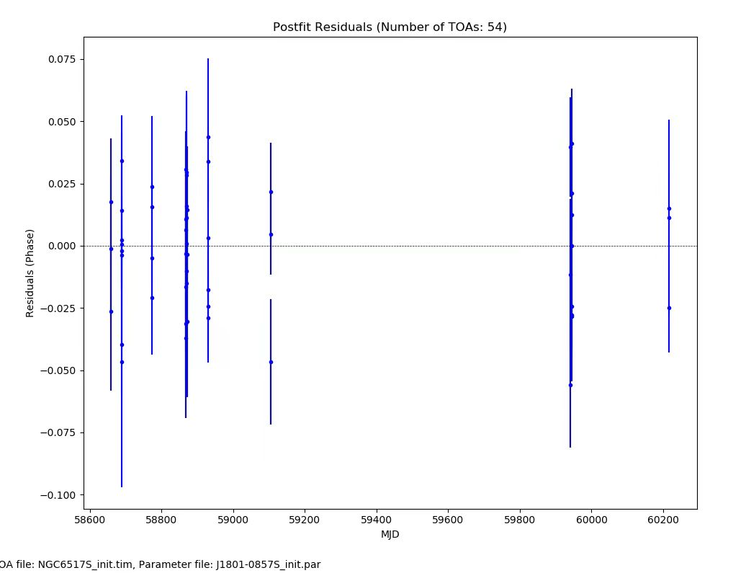
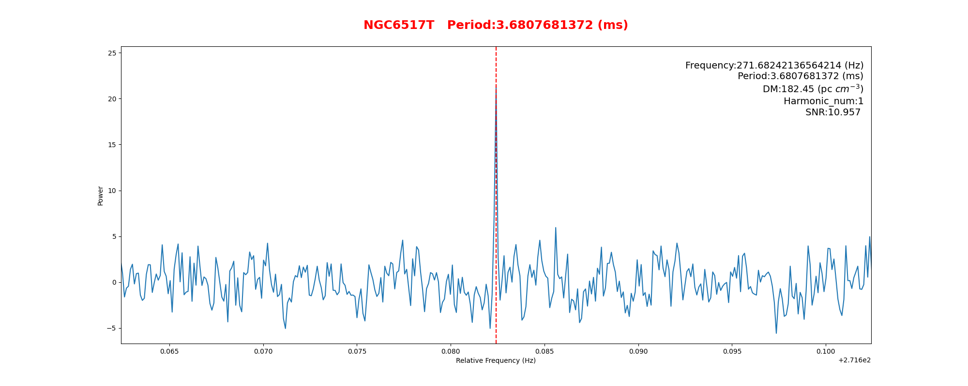
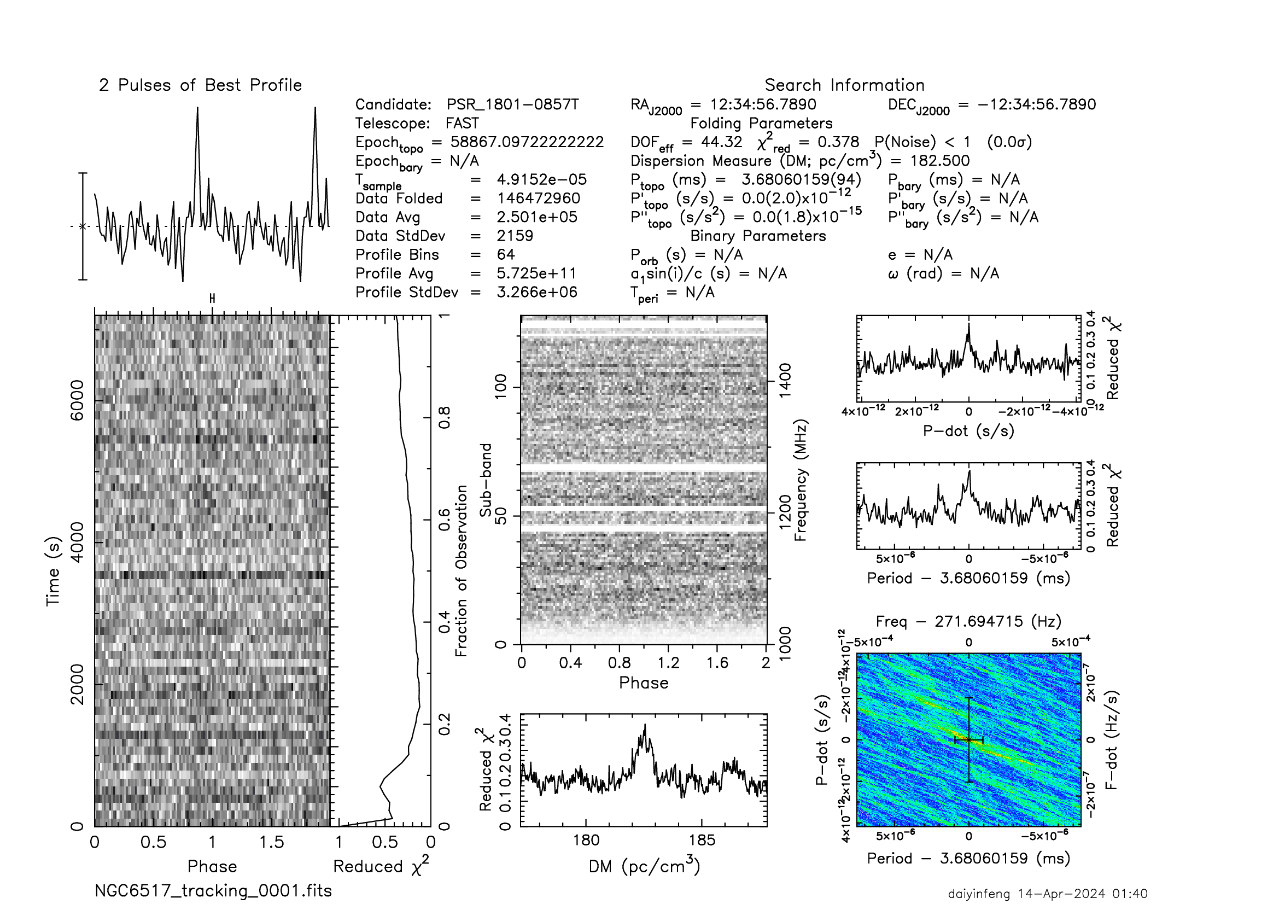
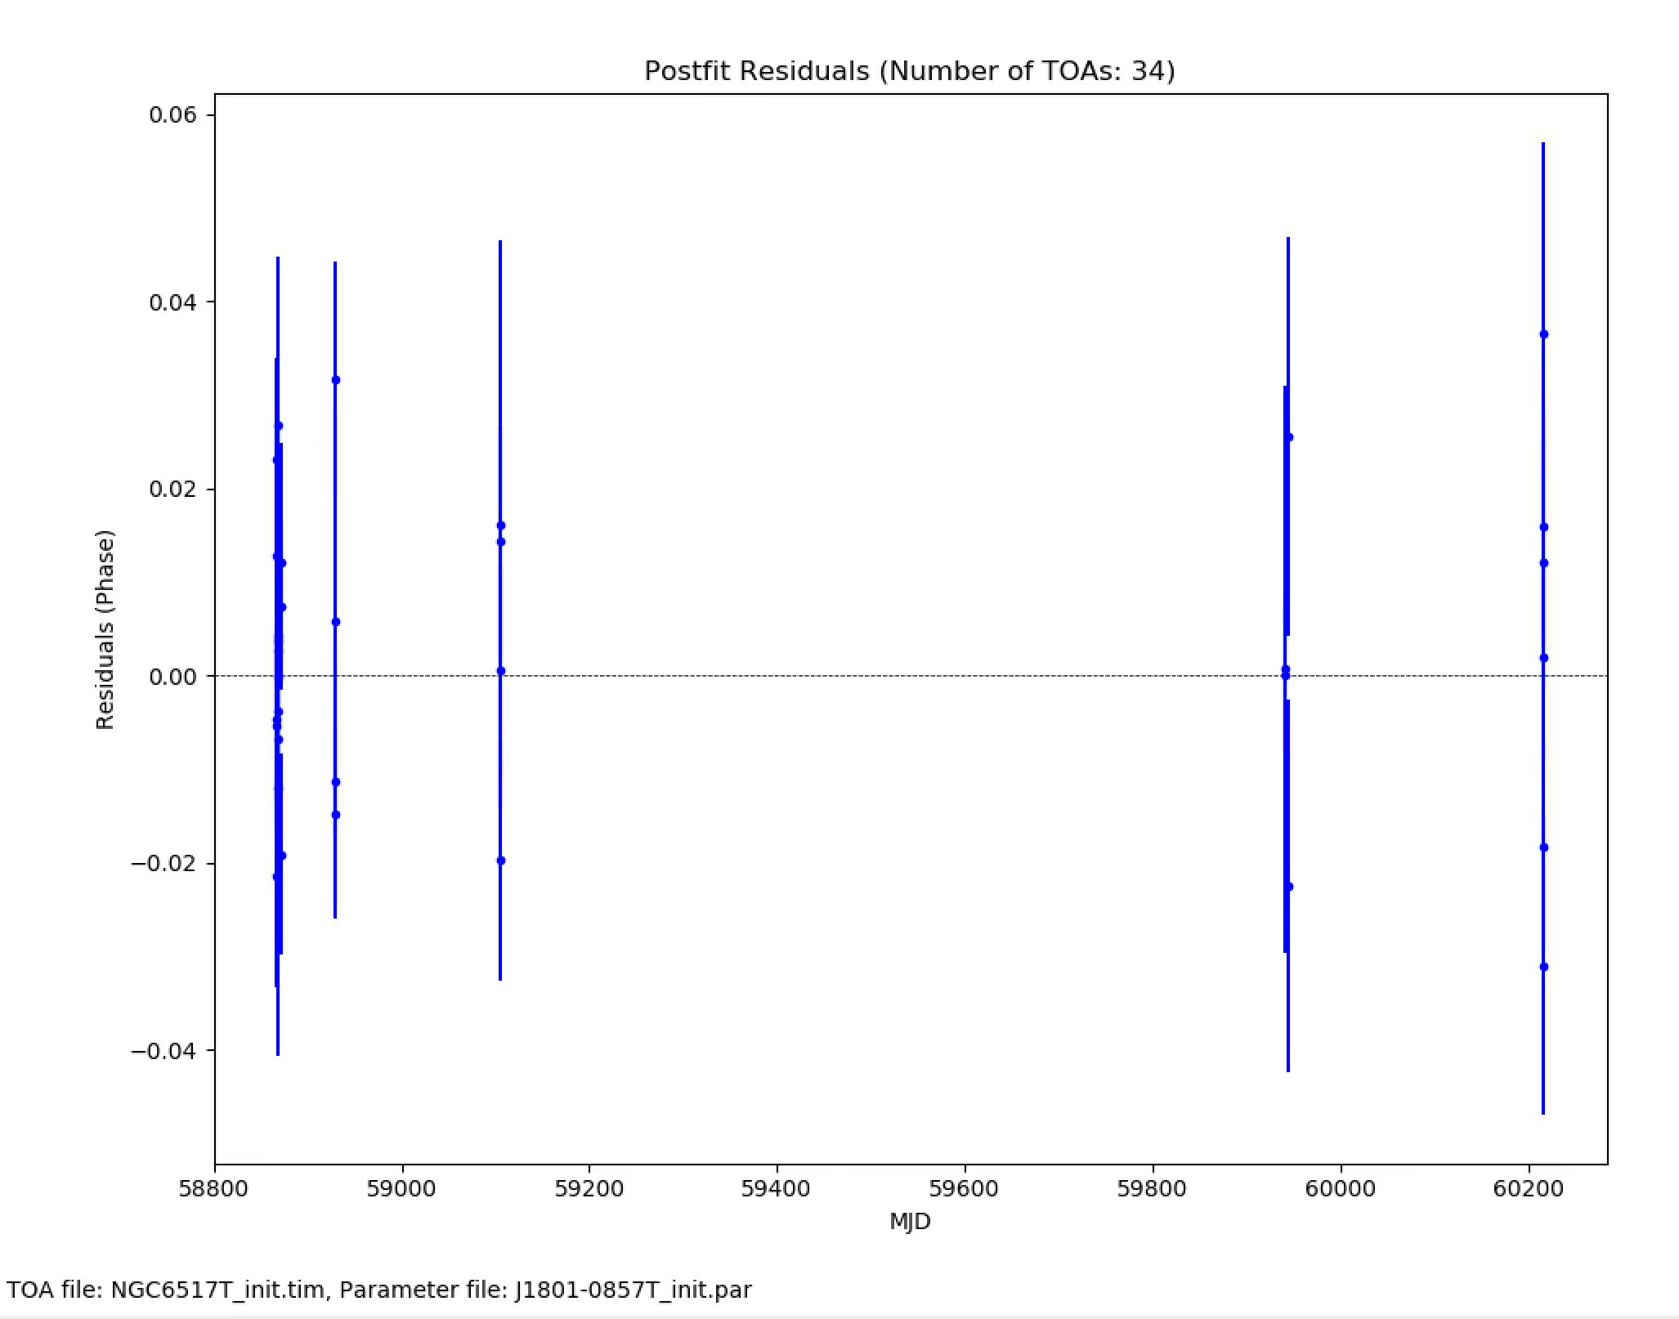
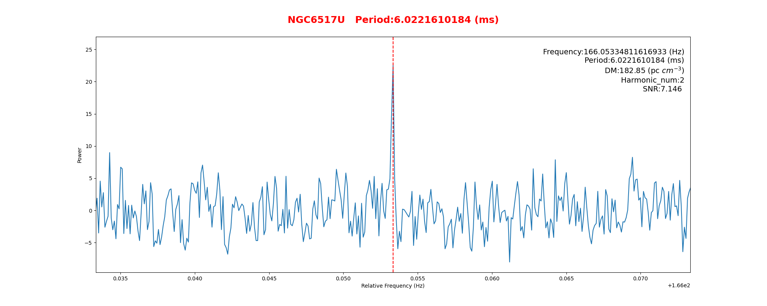
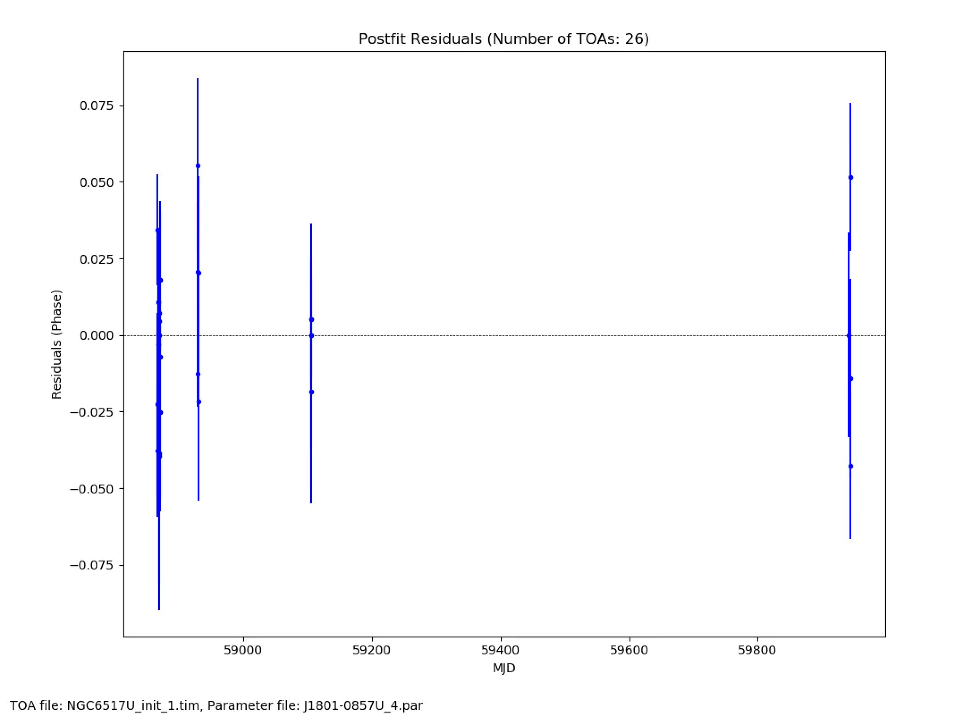
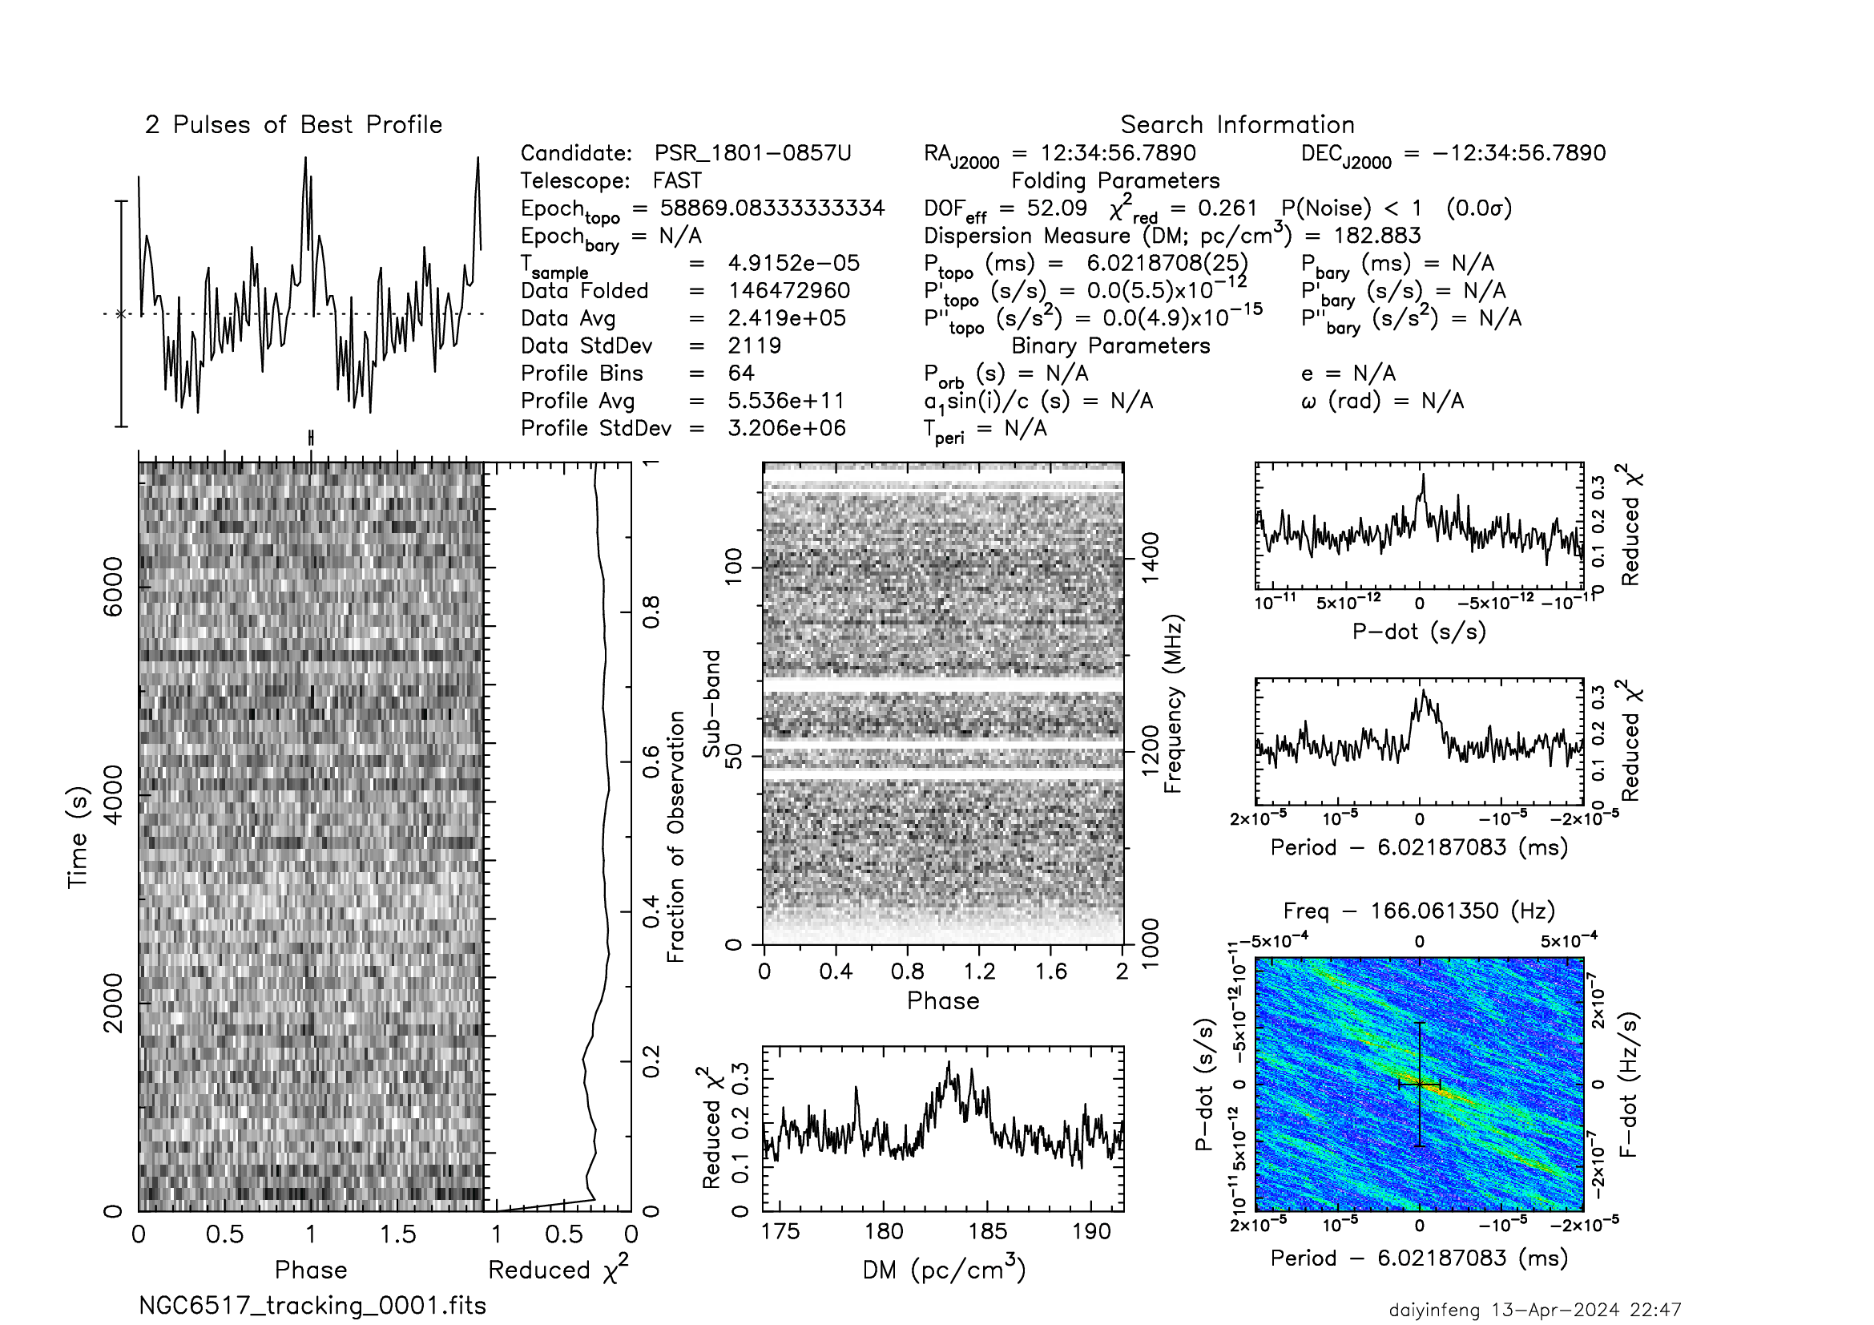
Search Process (NGC6517)
Detected new Pulsars
J1801-0857S
J1801-0857T
J1801-0857U

Slide 9
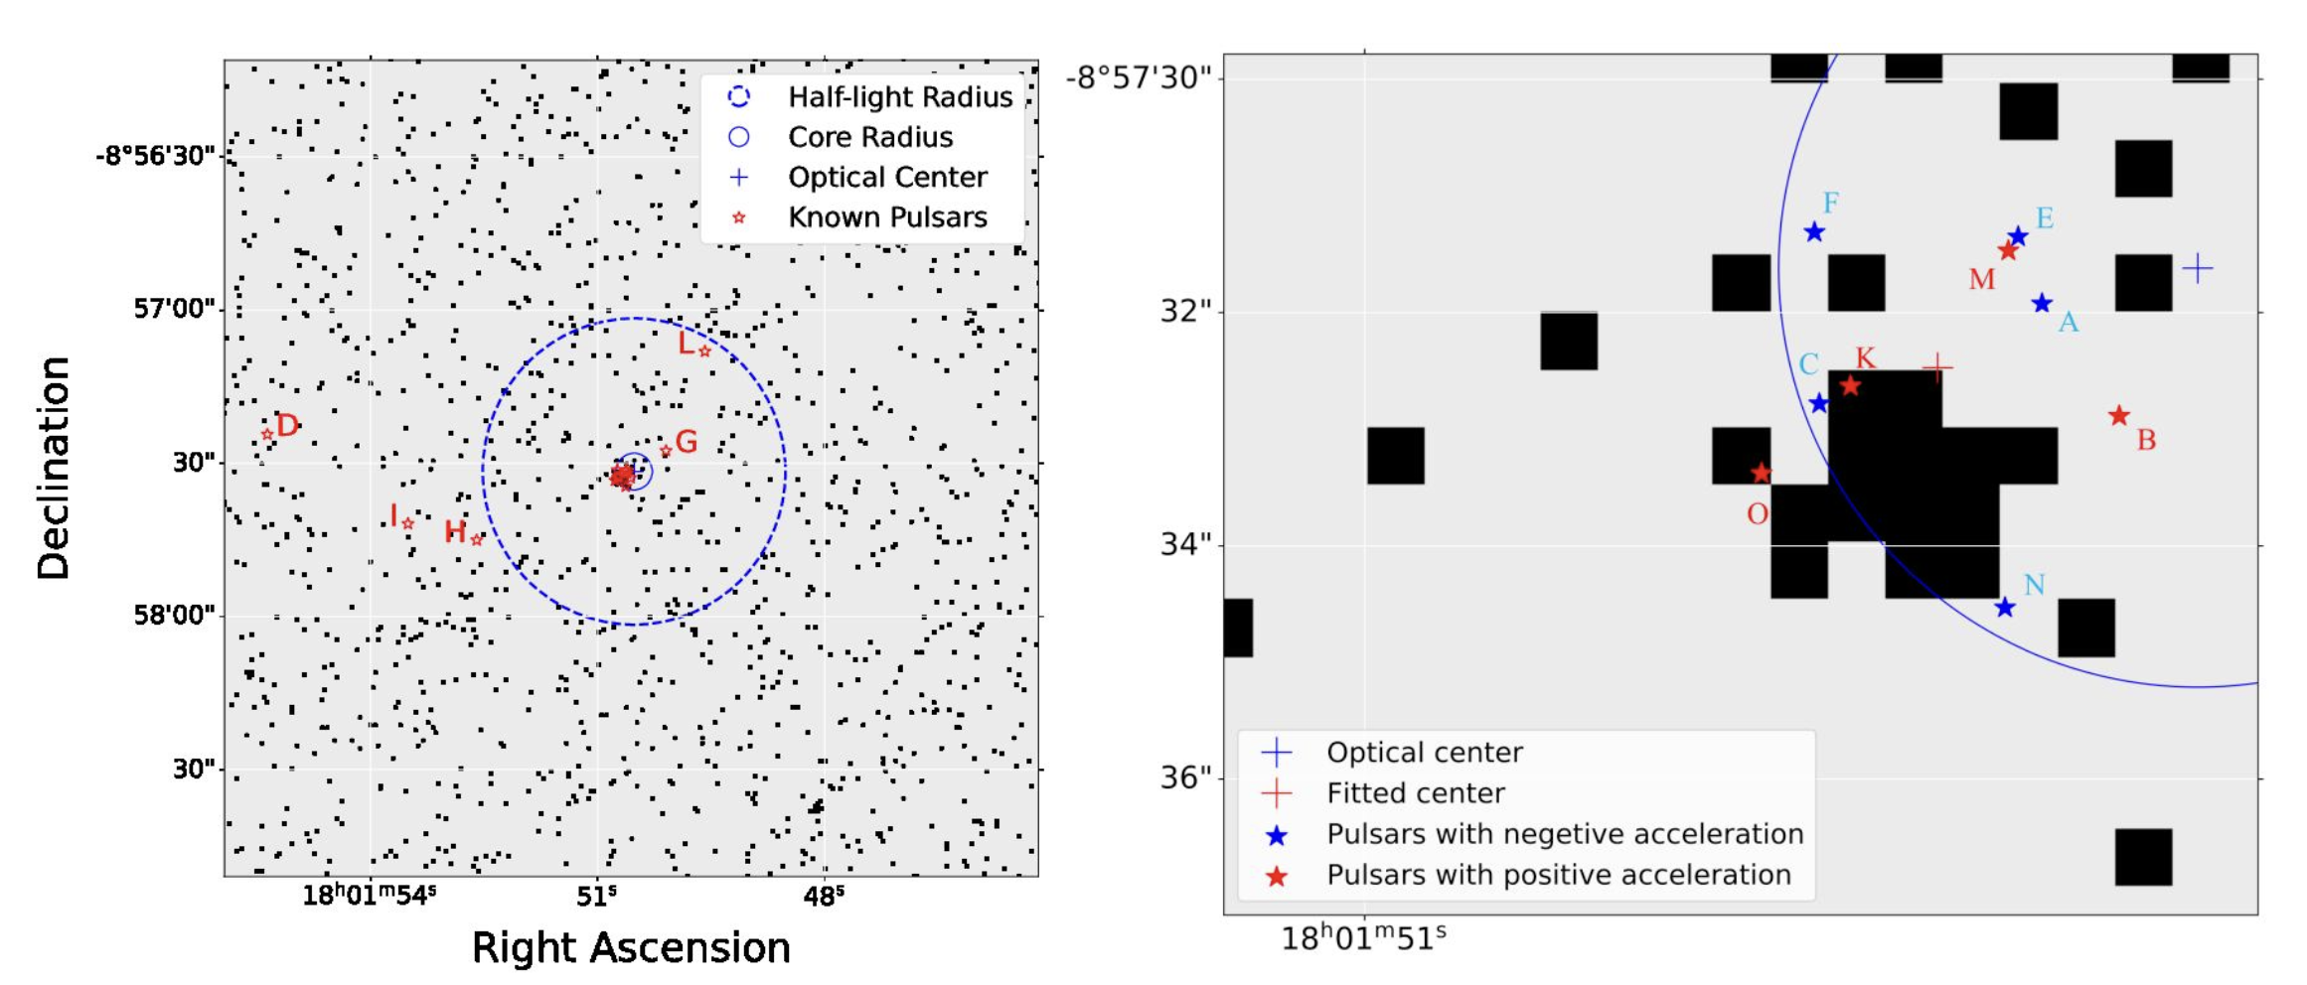
Search Process (NGC6517)
(Lian et al. in prep)

Slide 10
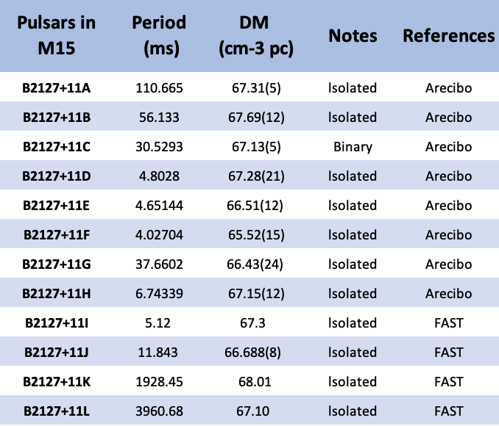
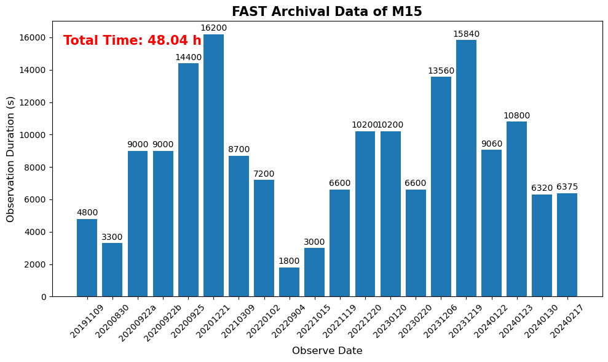
Search Process (M15)
(https://www3.mpifr-bonn.mpg.de/staff/pfreire/GCpsr.html)
2019/11/09 —— 2024/02/17 20 days
12 pulsars(11 isolated; 1 binary, K and L has a long period) in M15

Slide 11
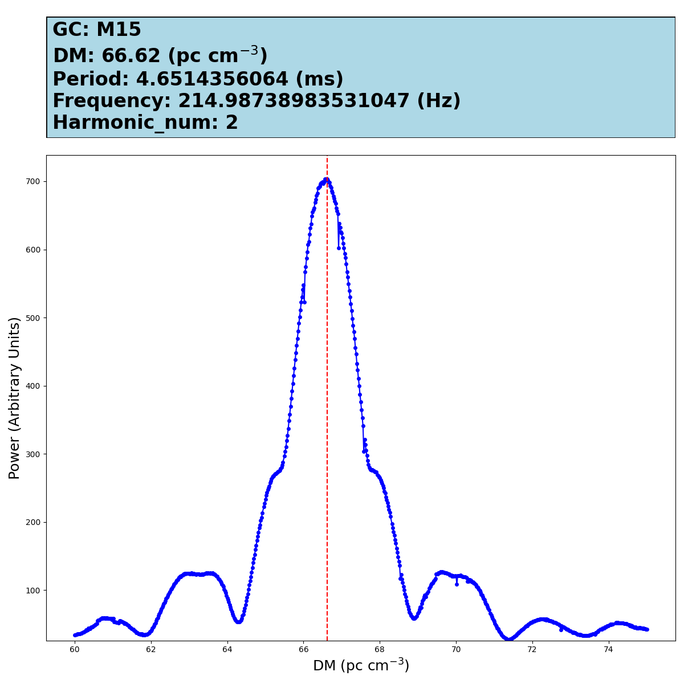
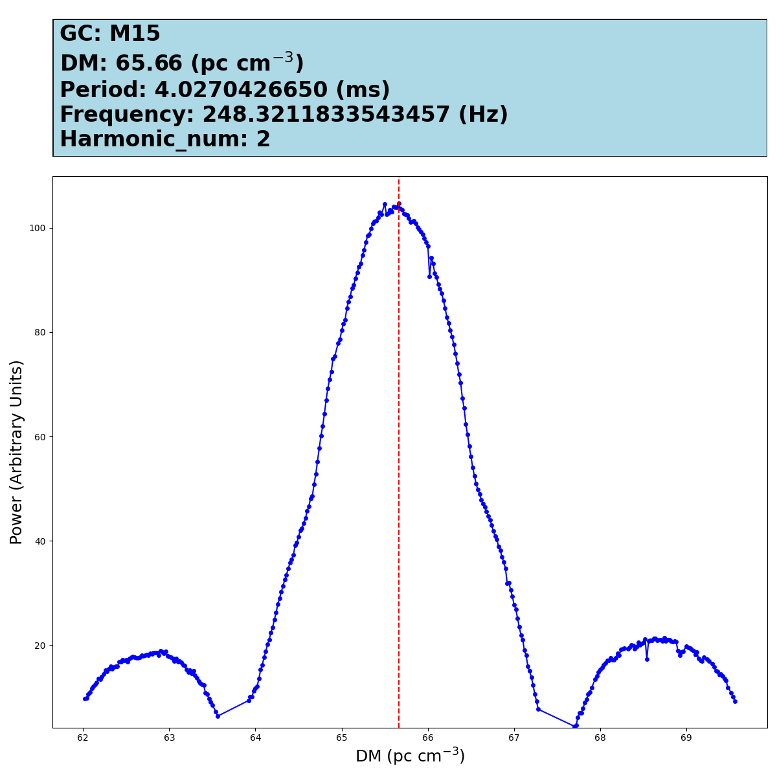
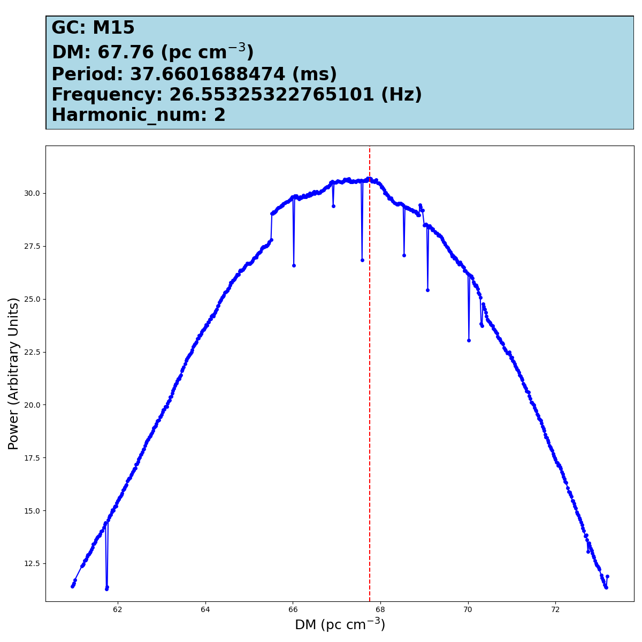
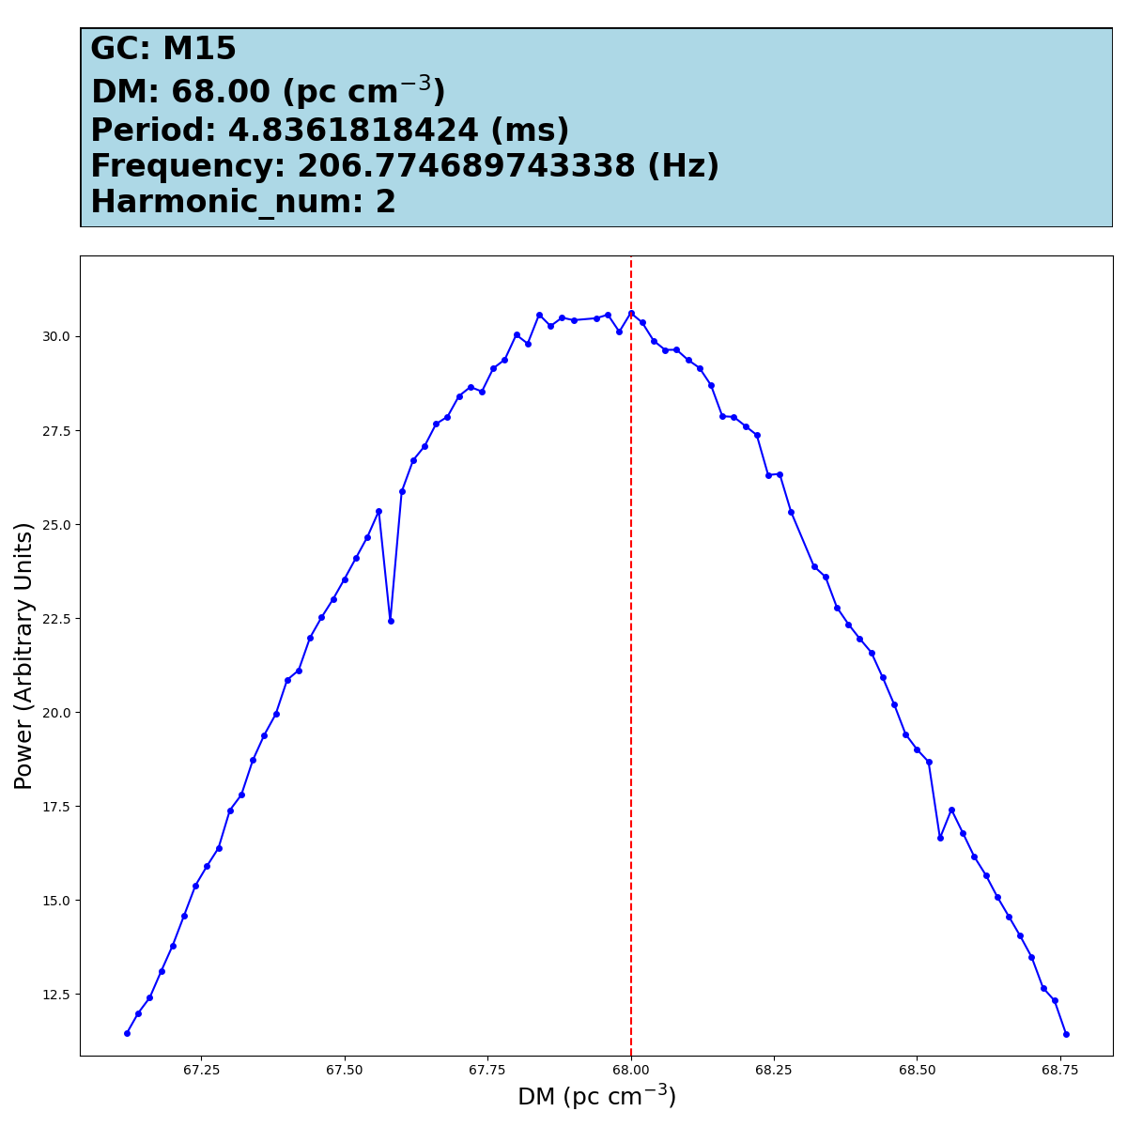
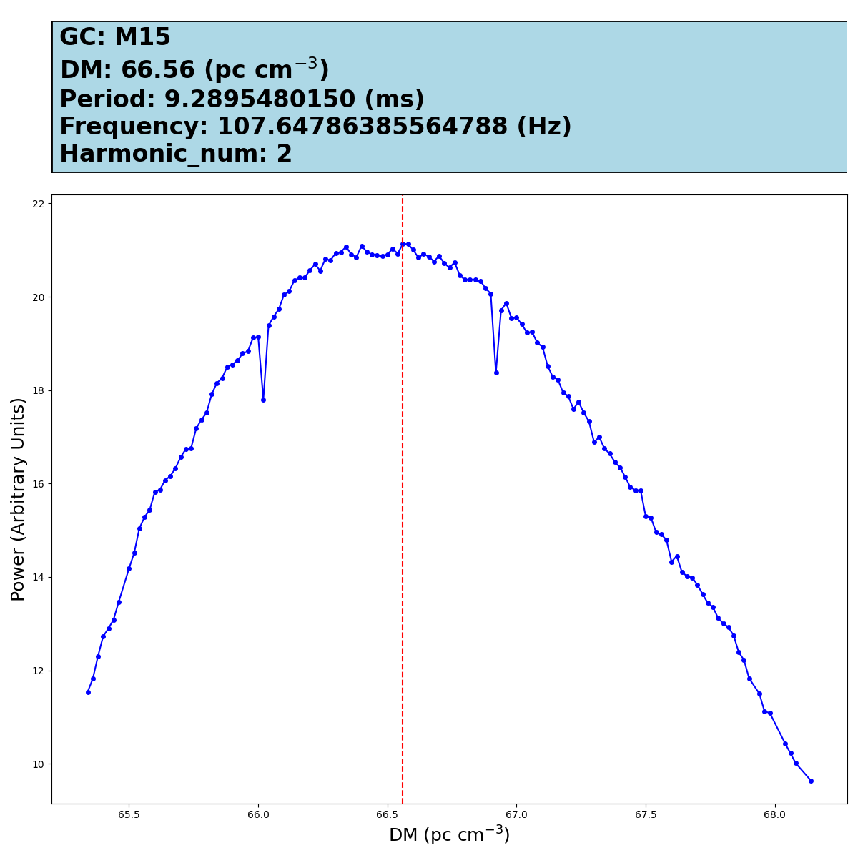
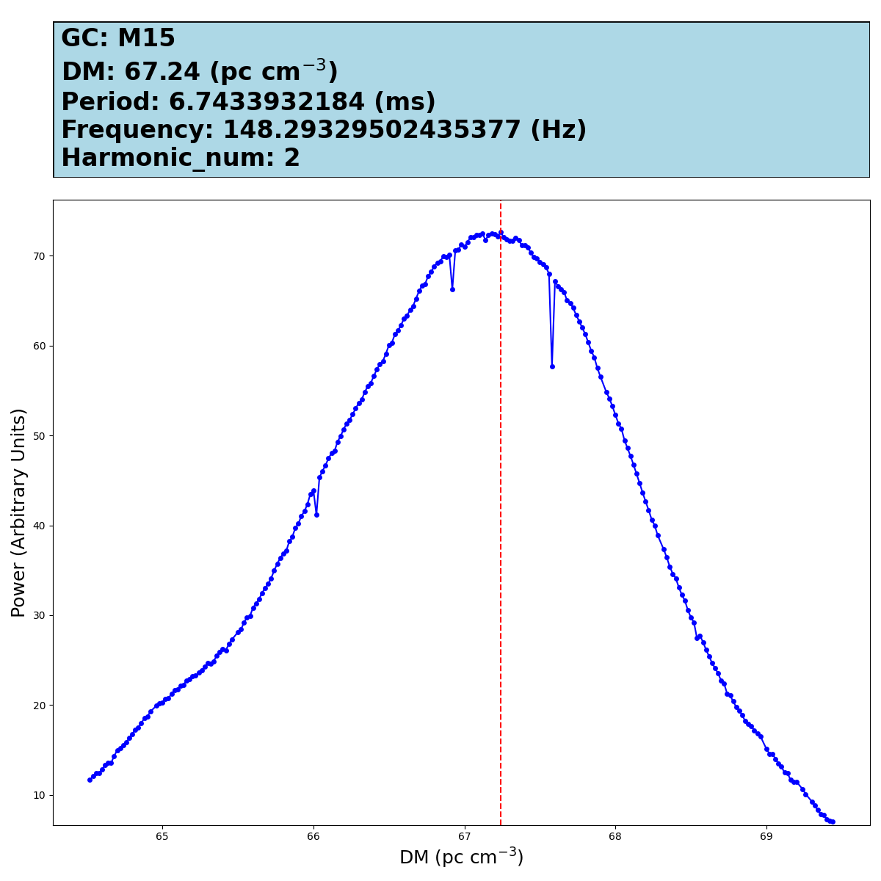
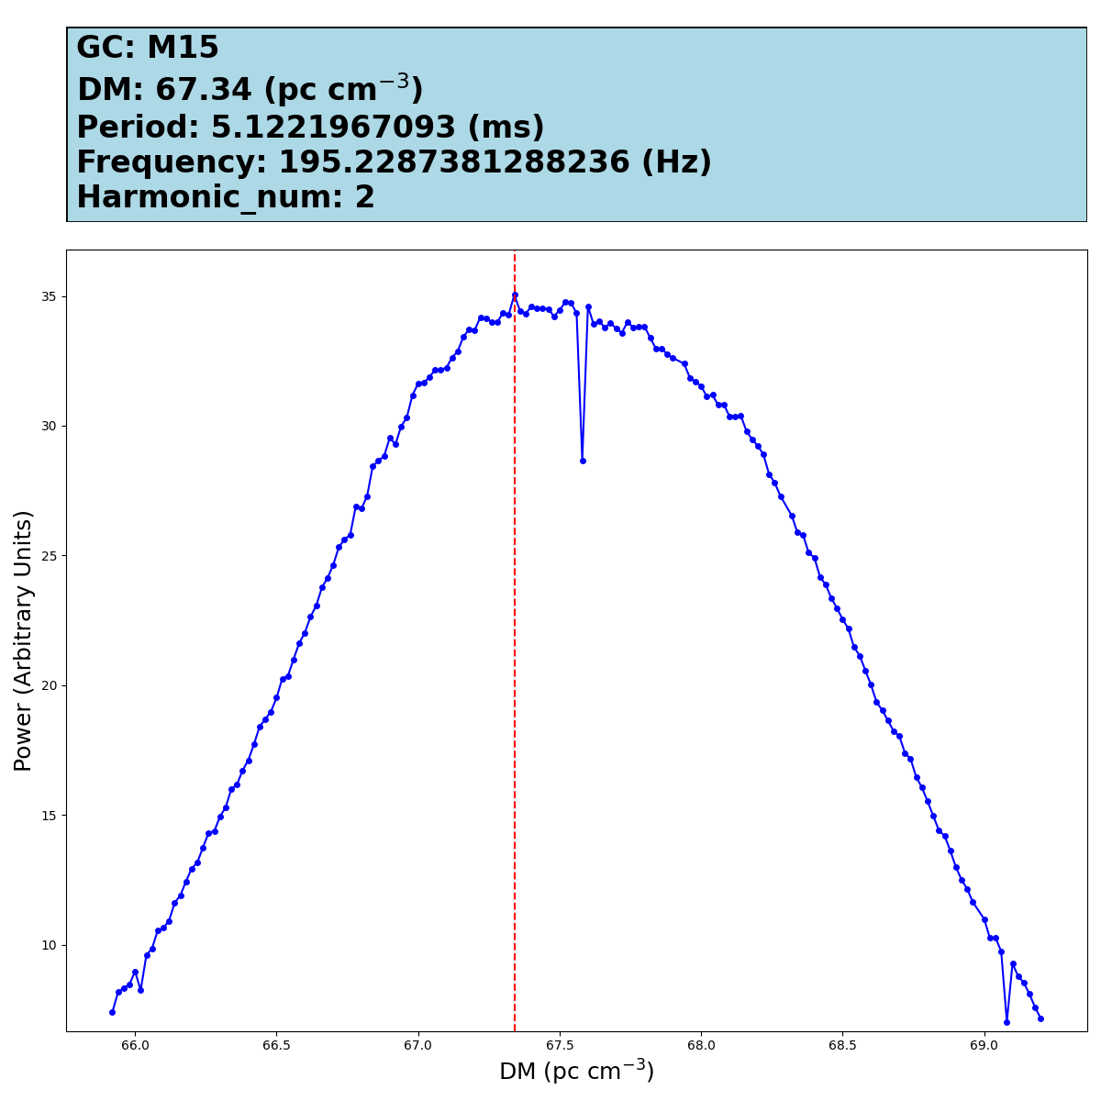
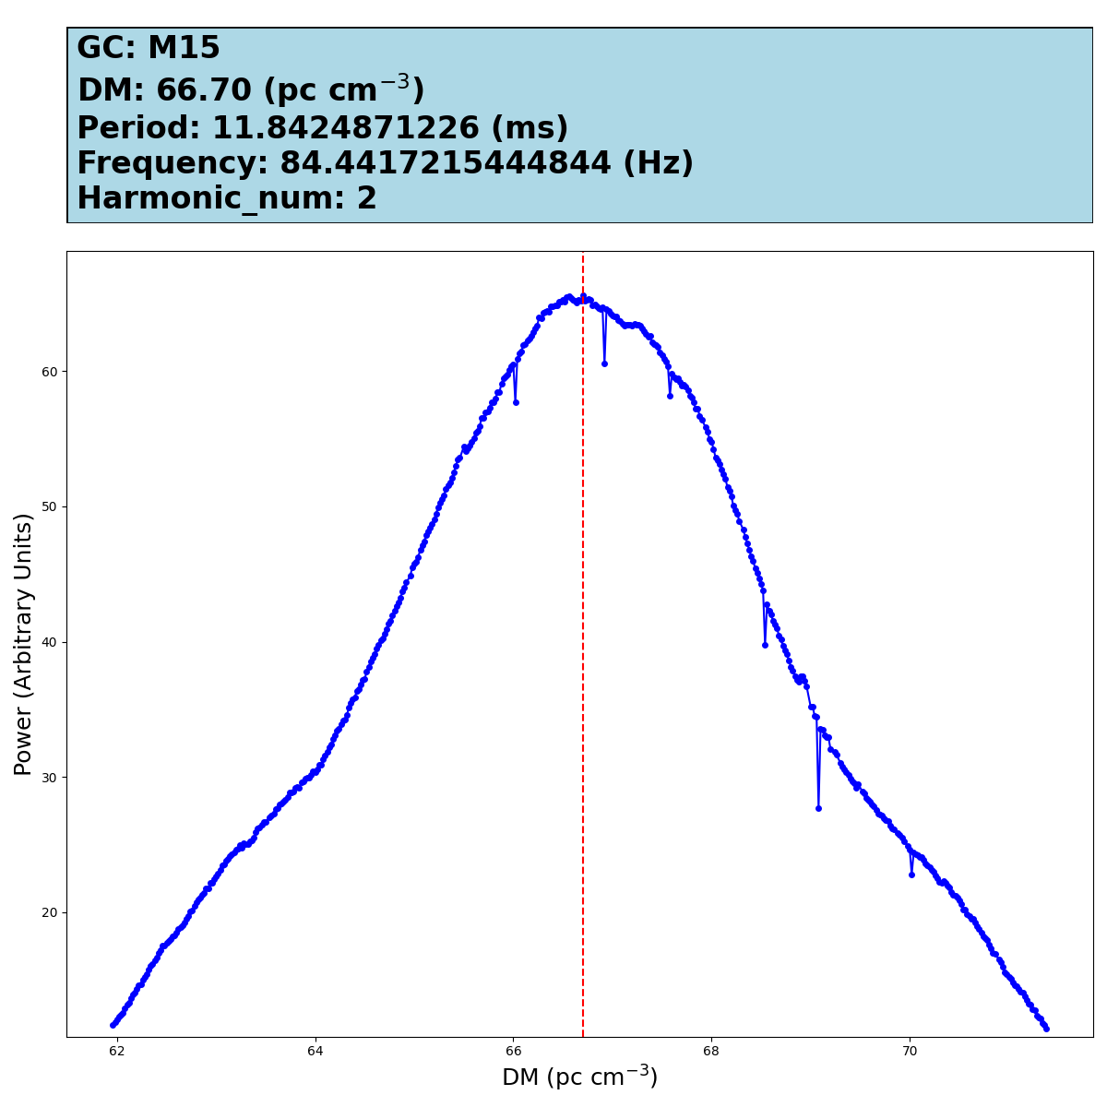
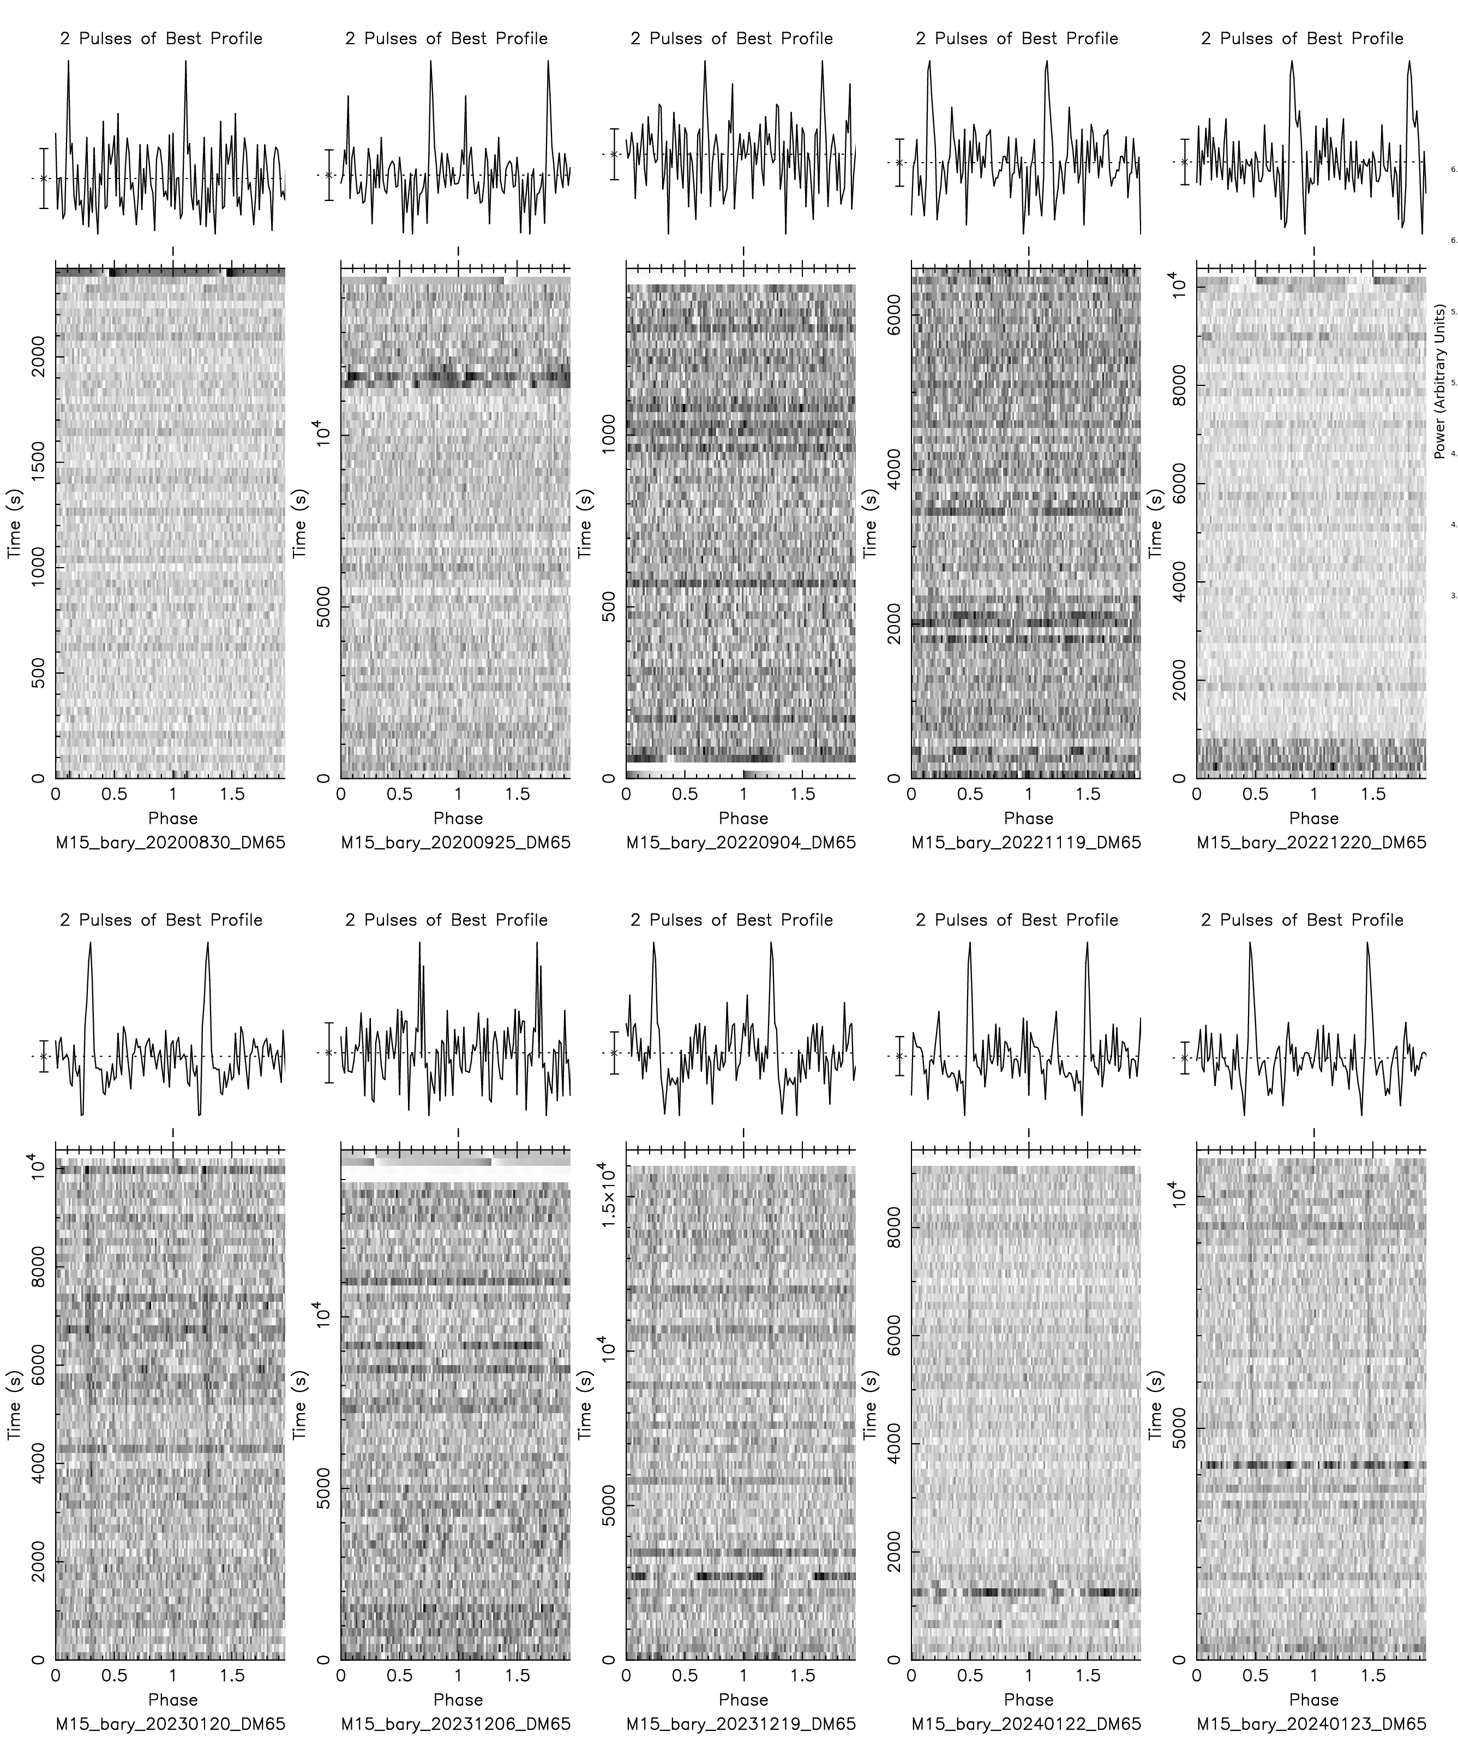
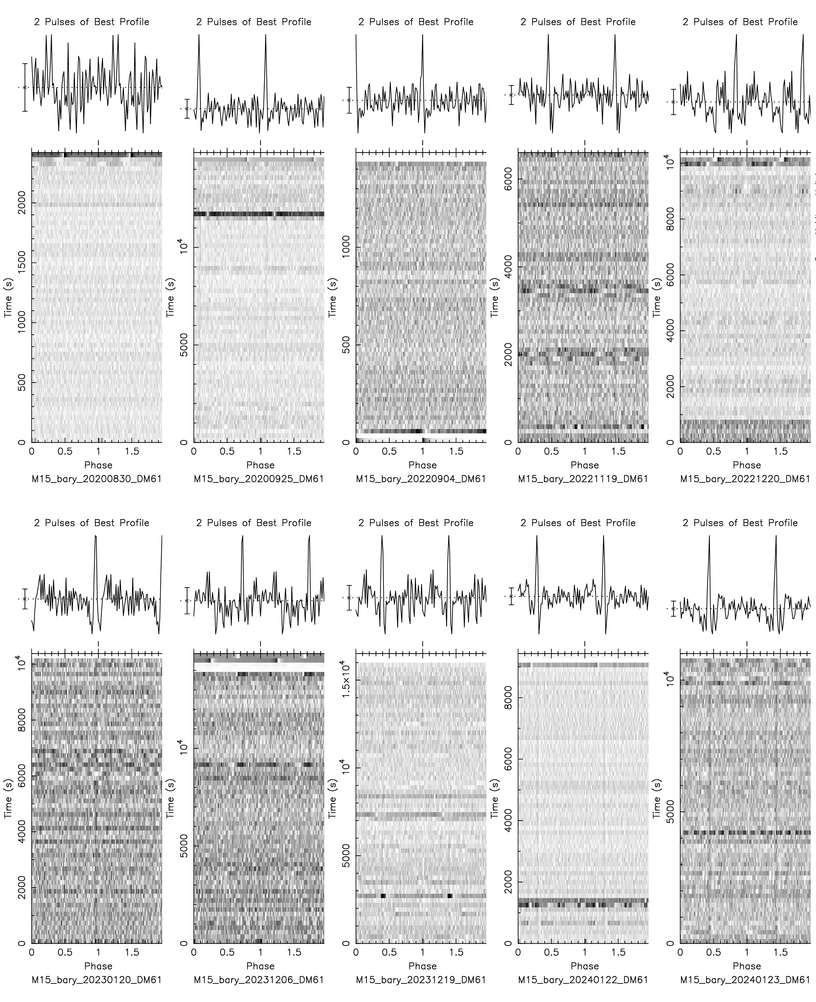
Search Process (M15)
5 sigma 4513 candidates
Detected new Pulsars
E
F
G
M
N
H
I
J
K
L

Slide 12
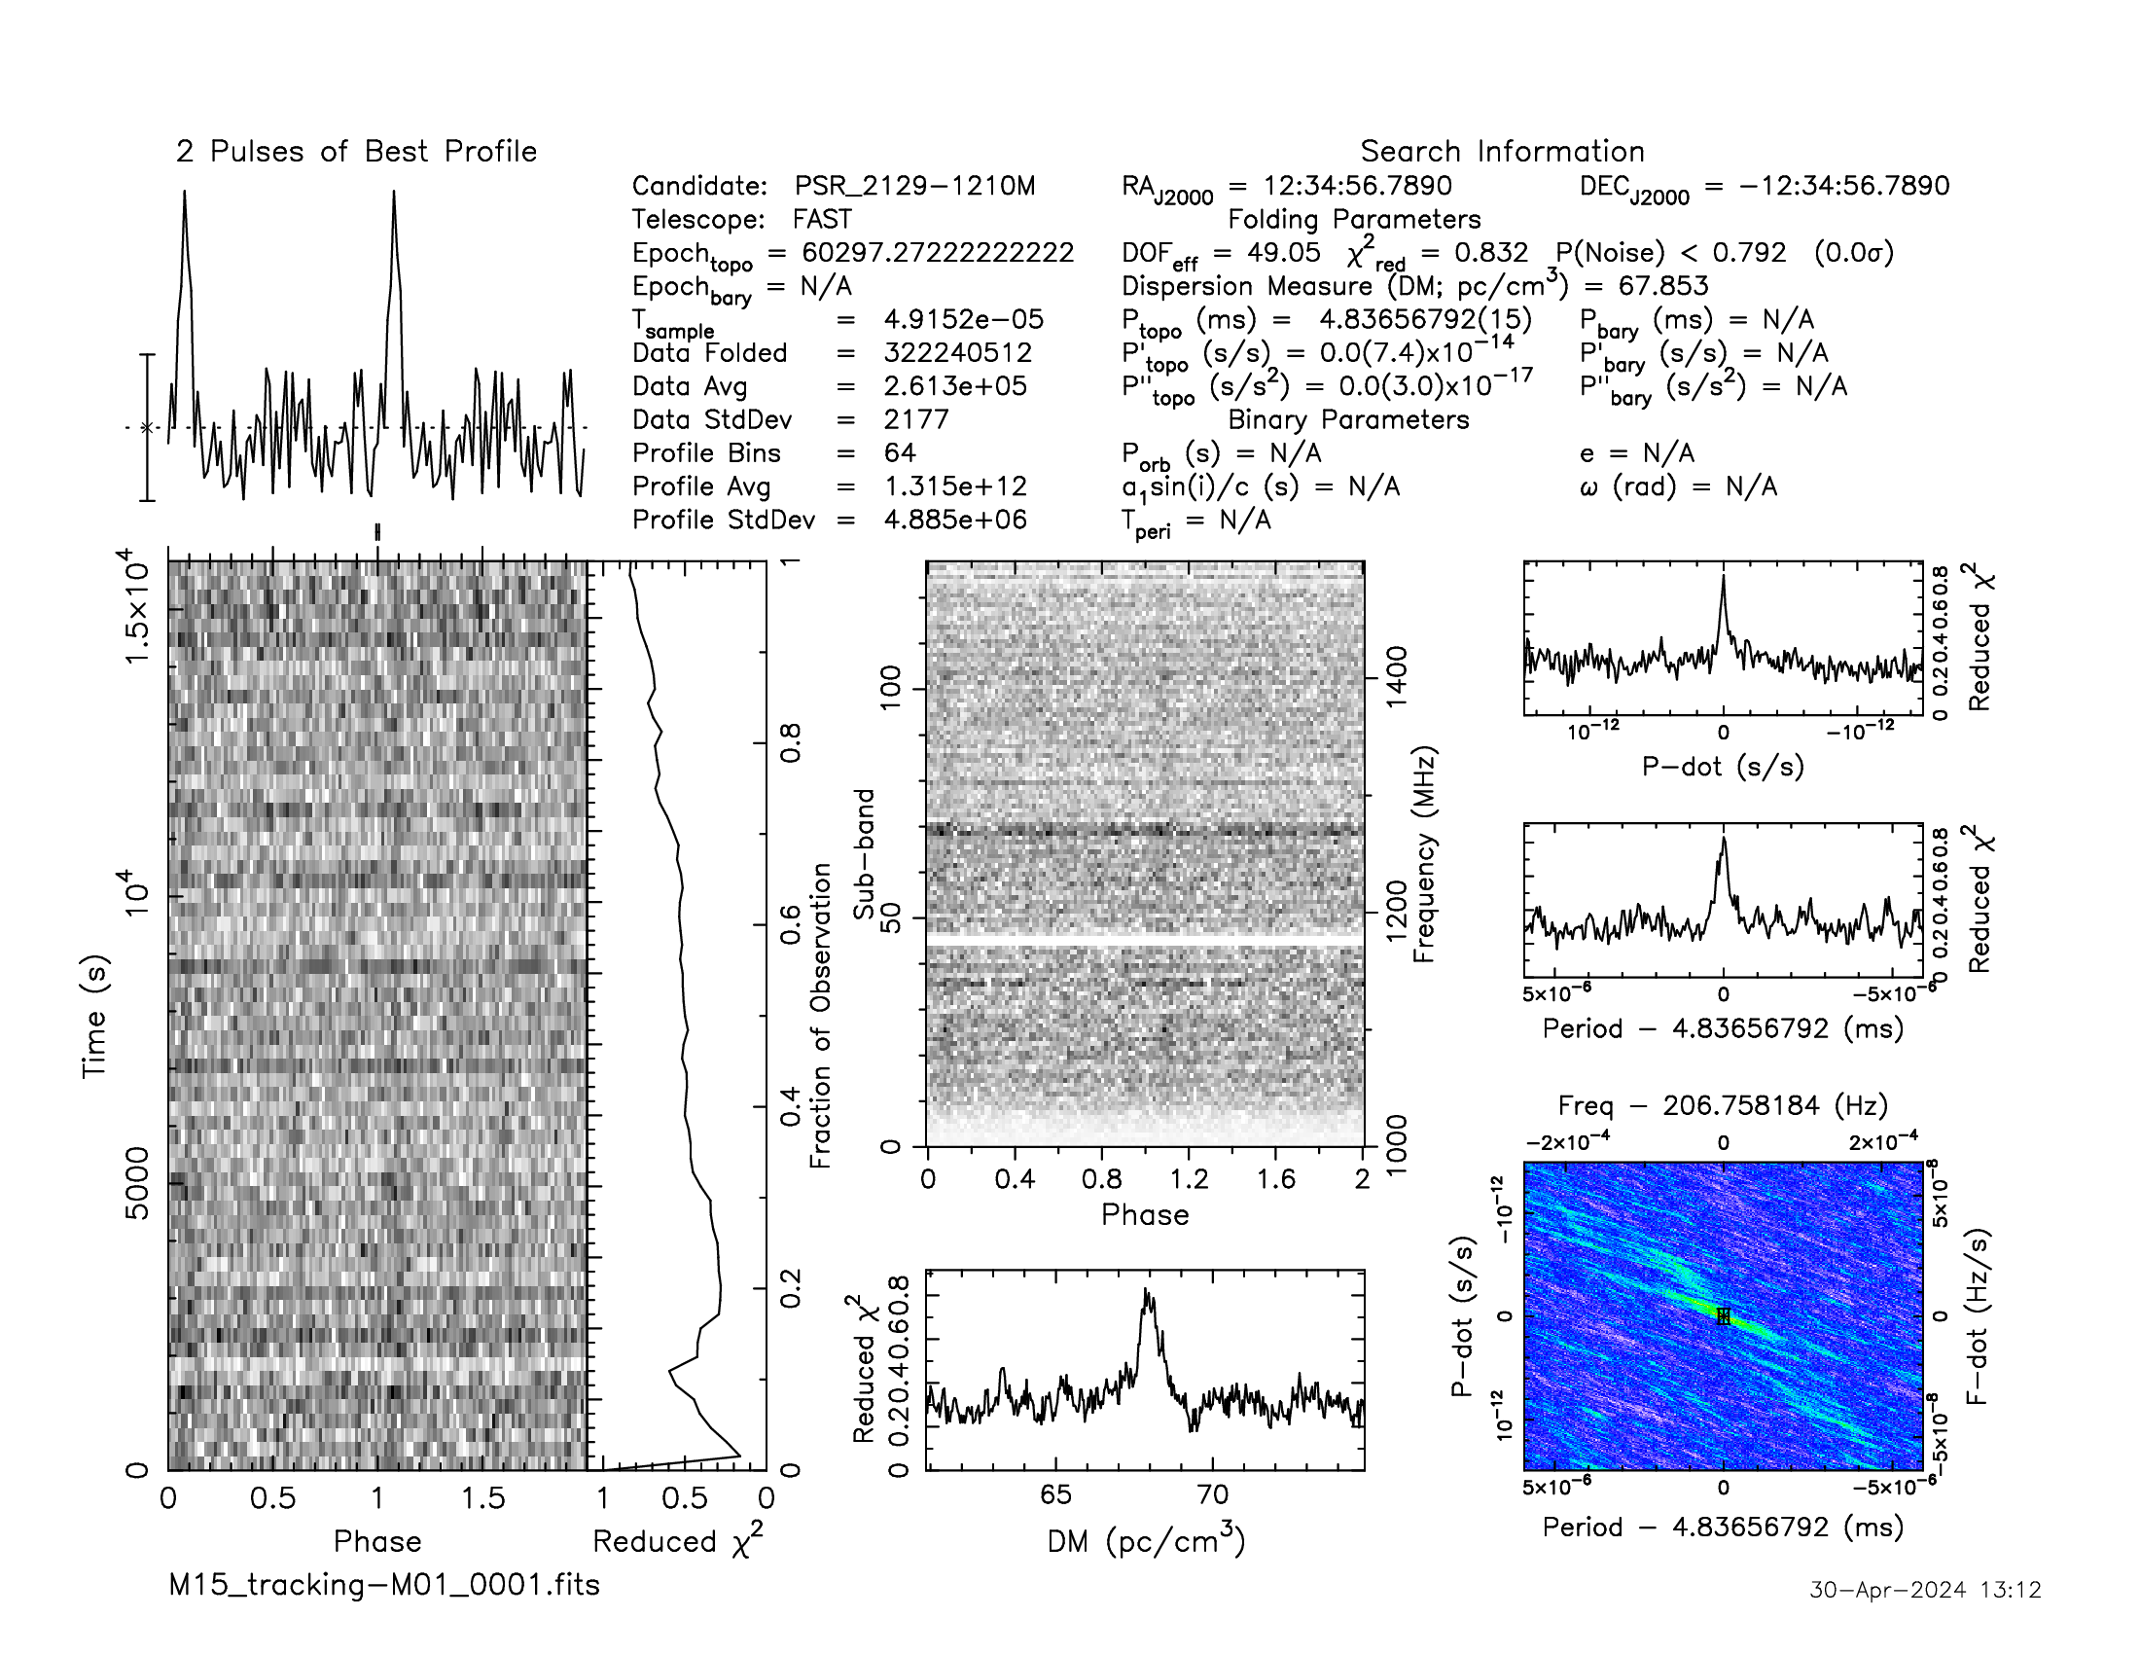
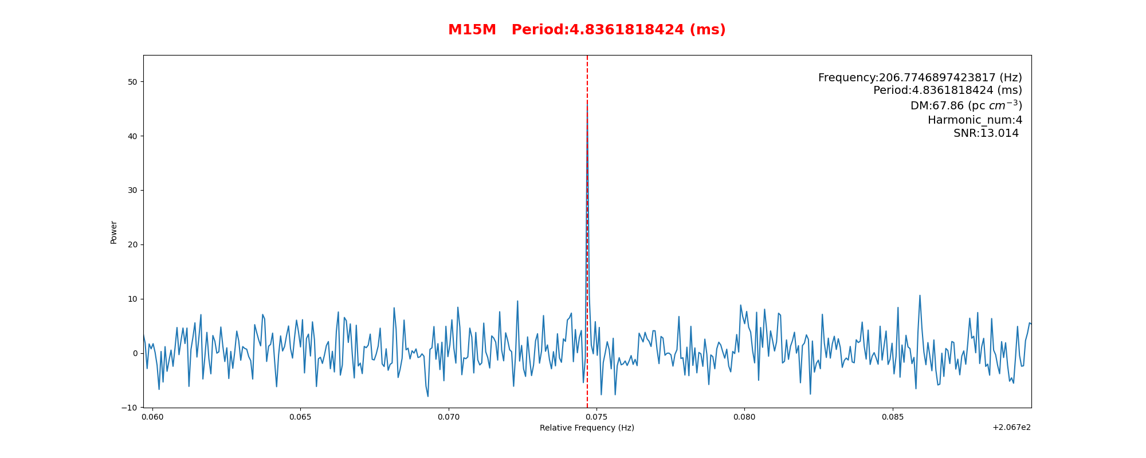
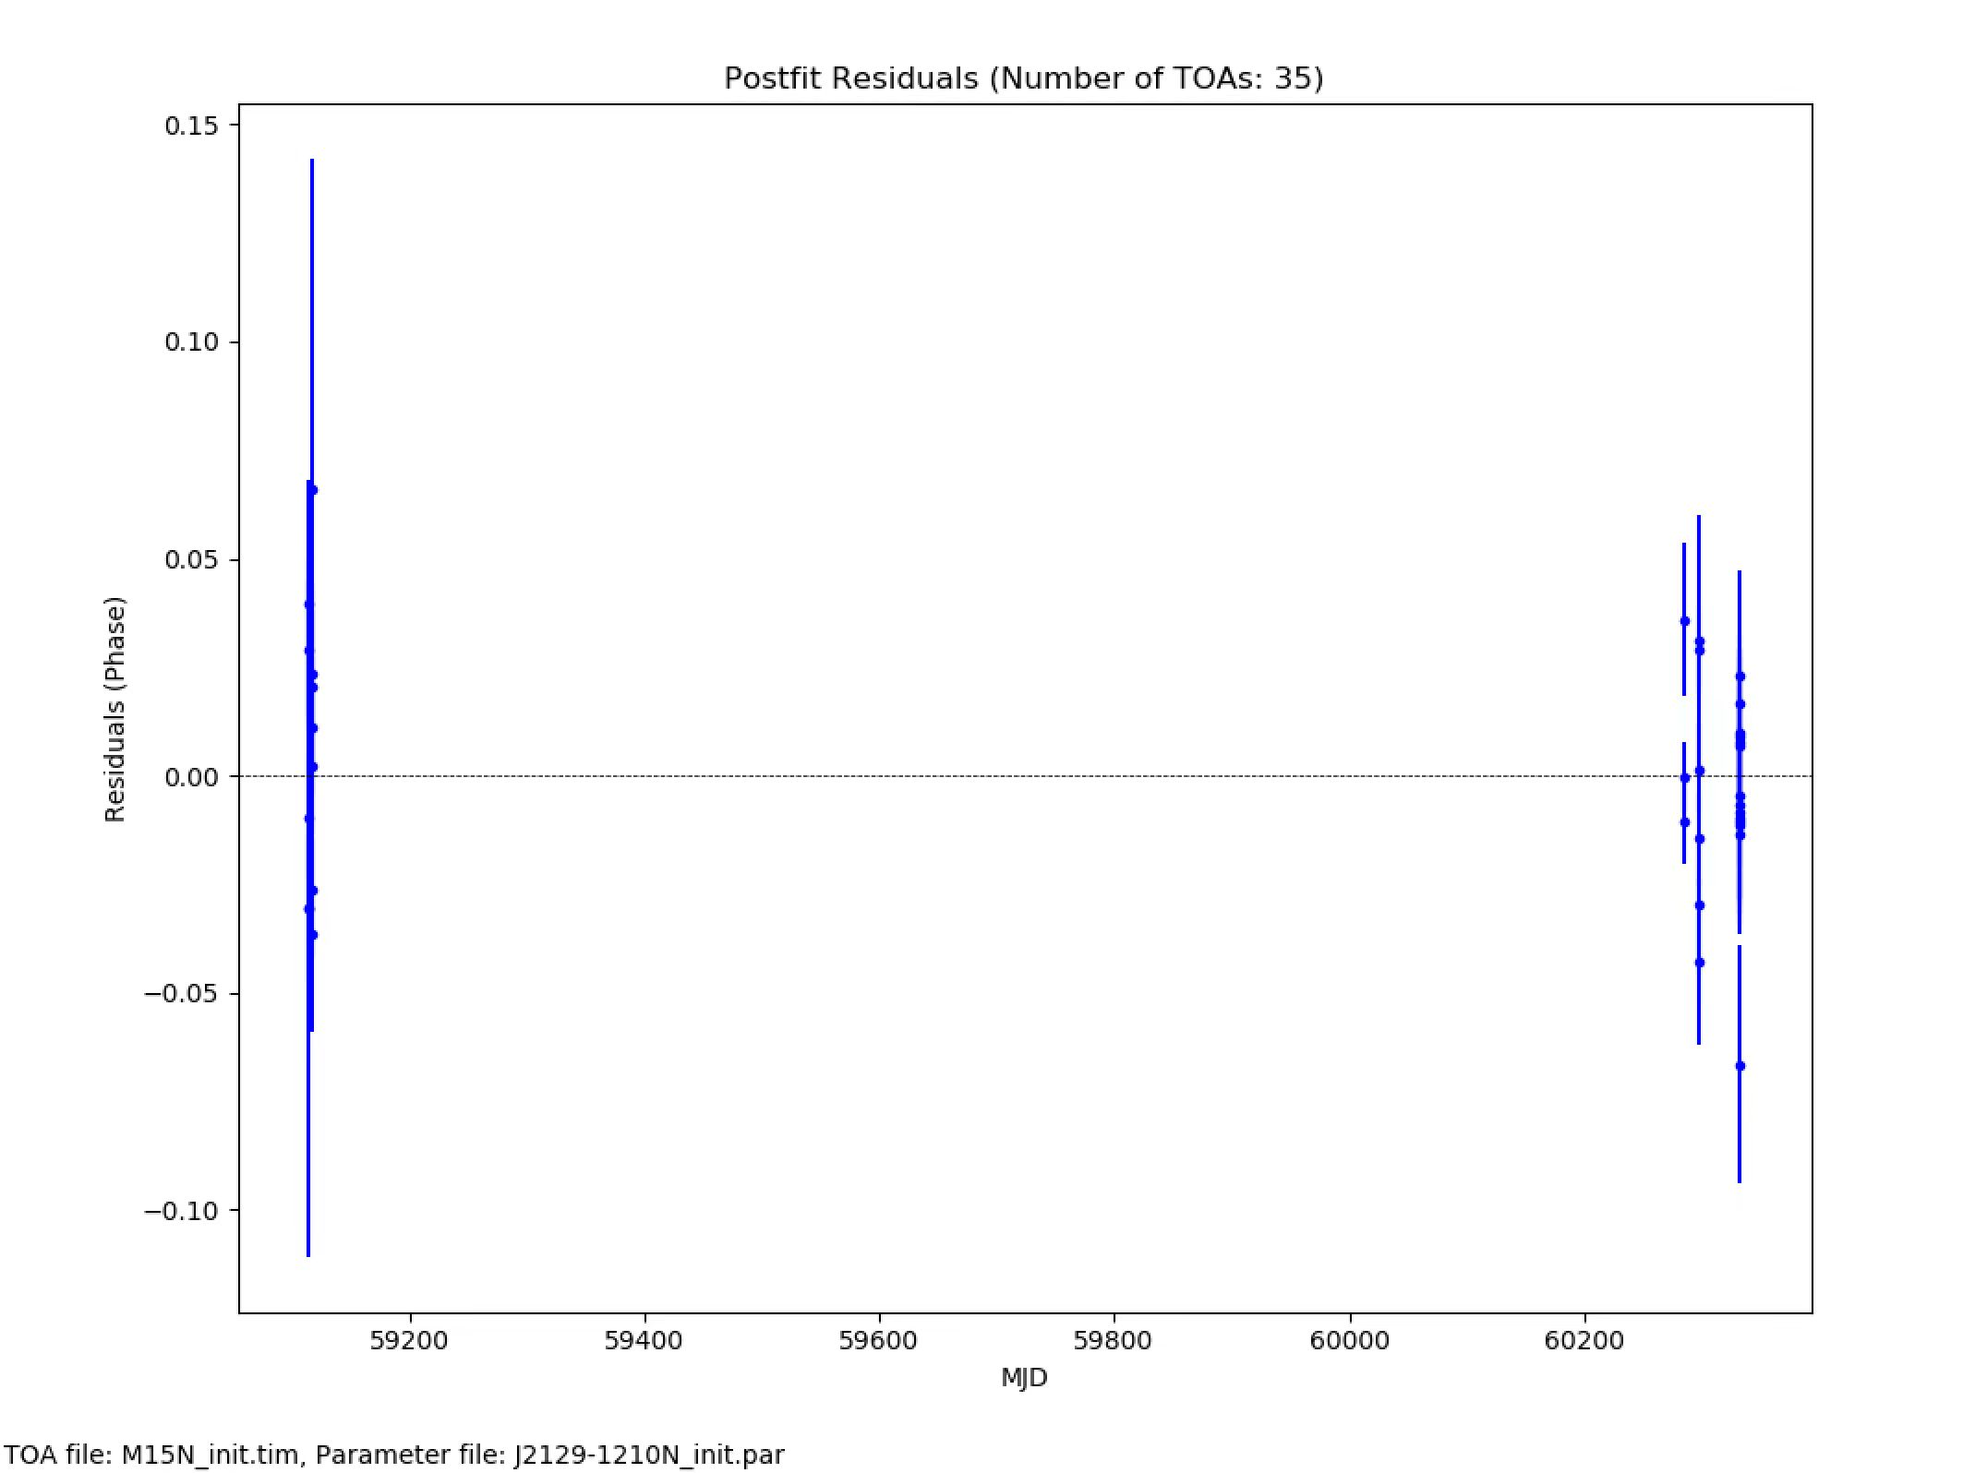
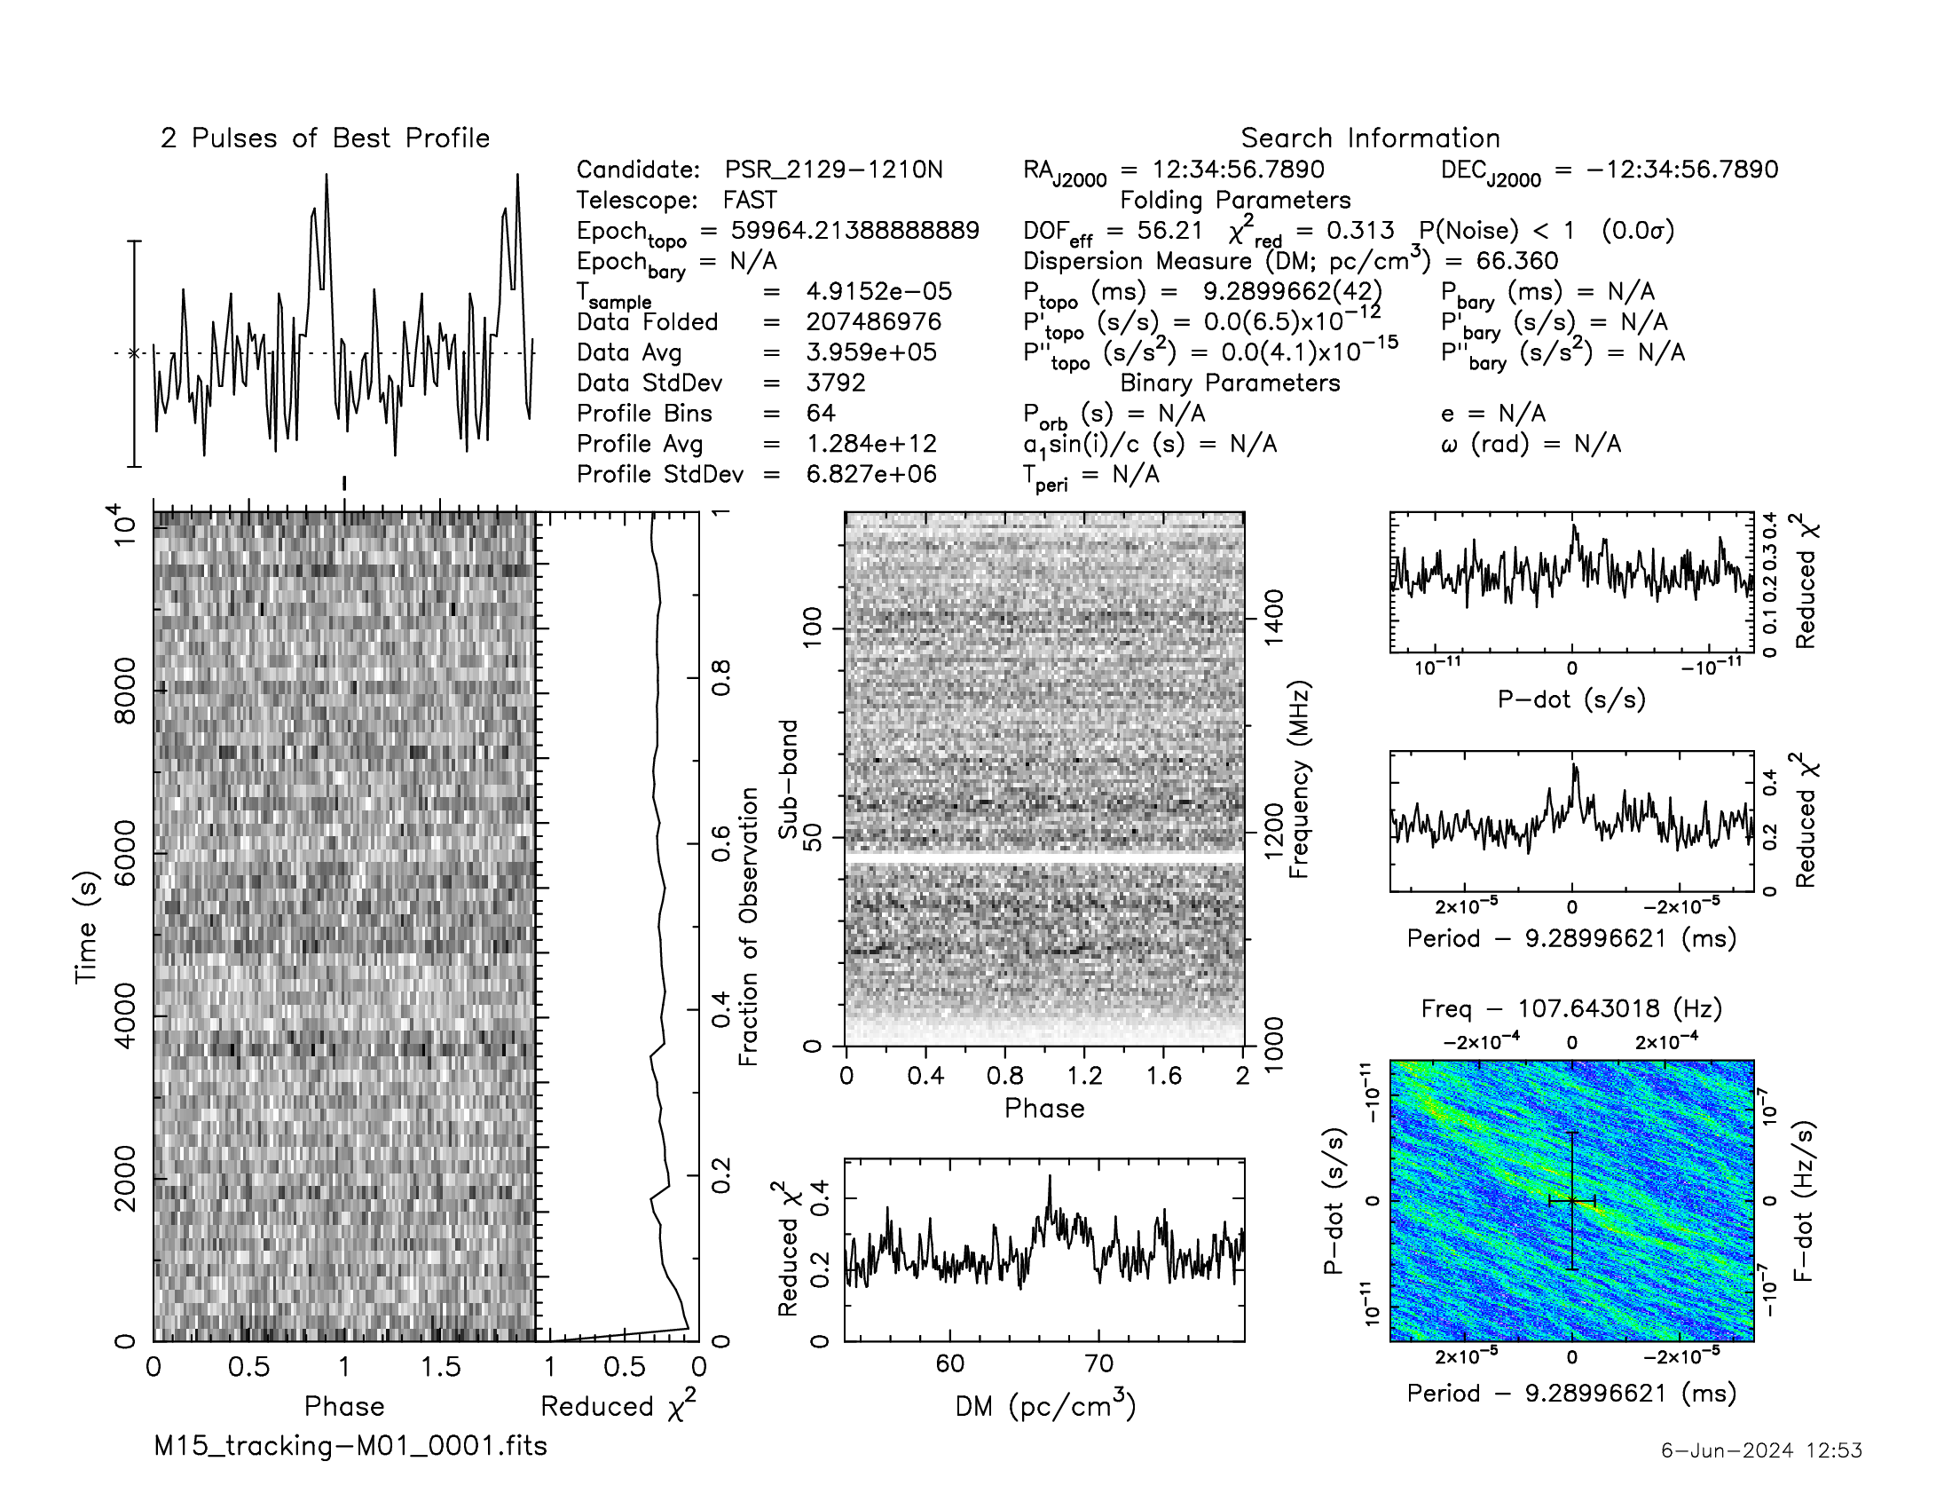
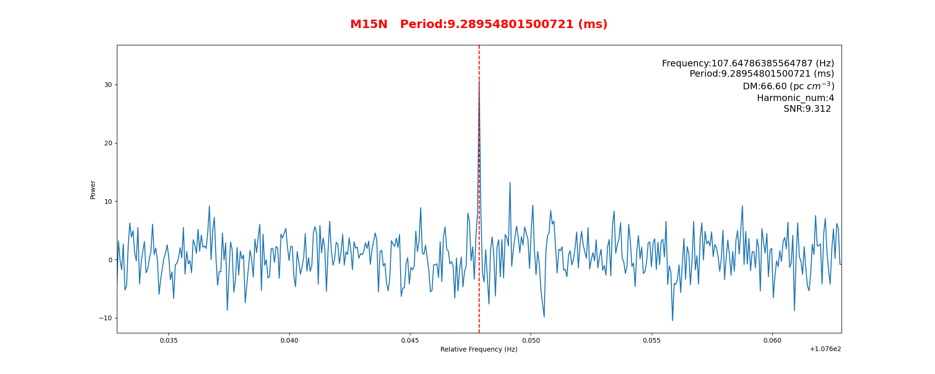
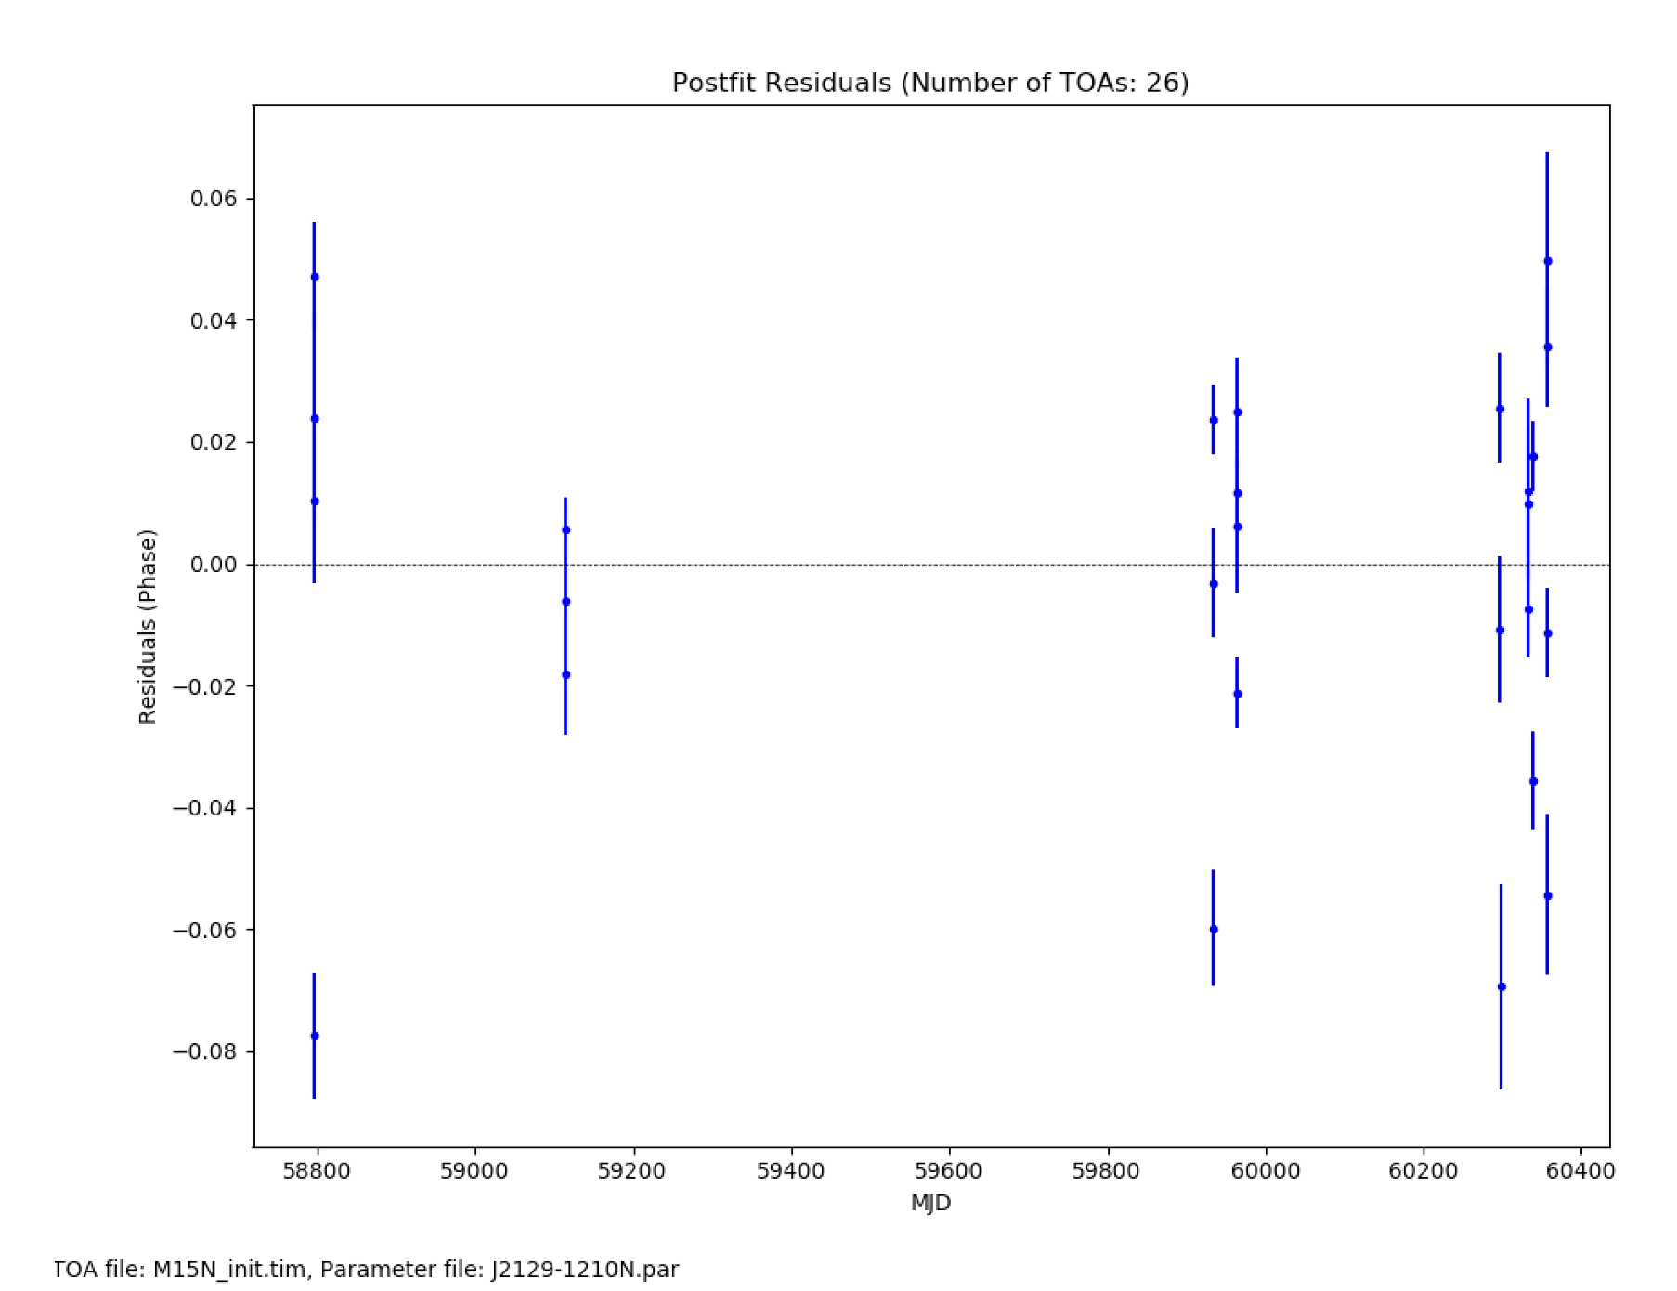
Search Process (M15)
B2127+11M
B2127+11N
The faintest pulsar in history ???

Slide 13
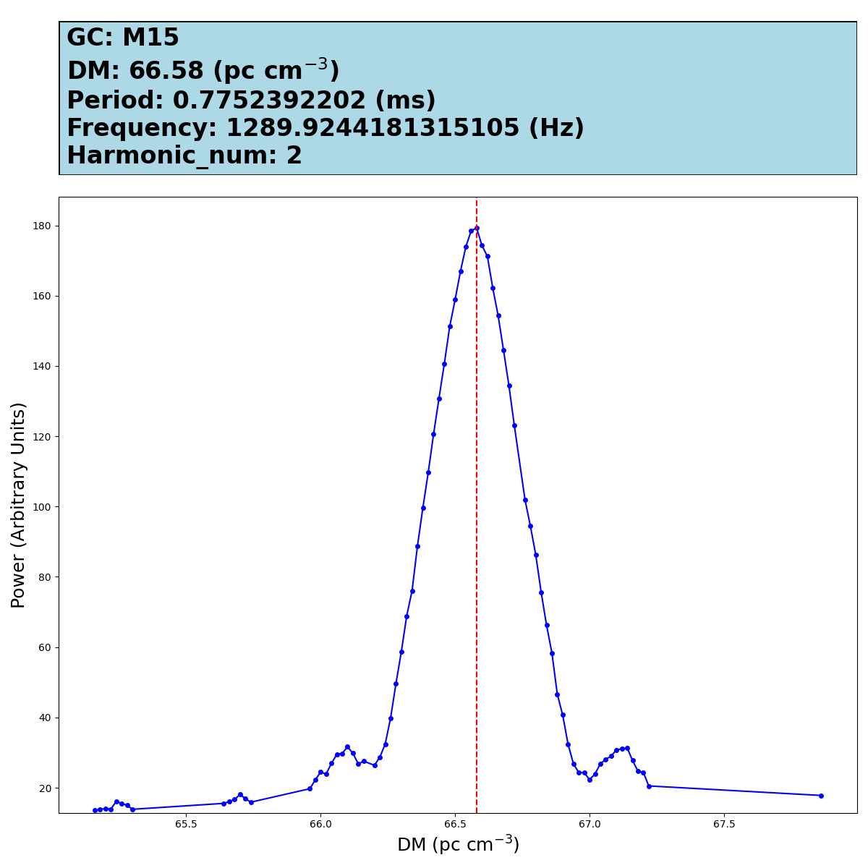
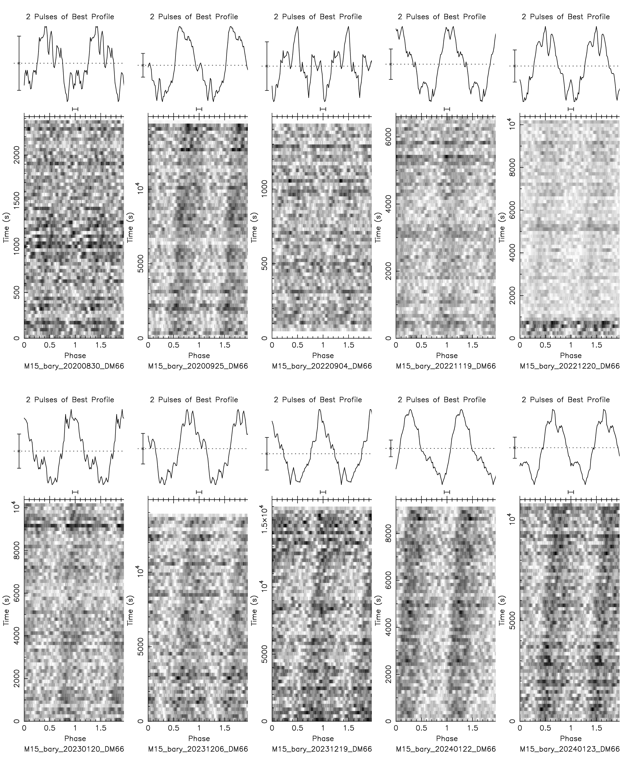
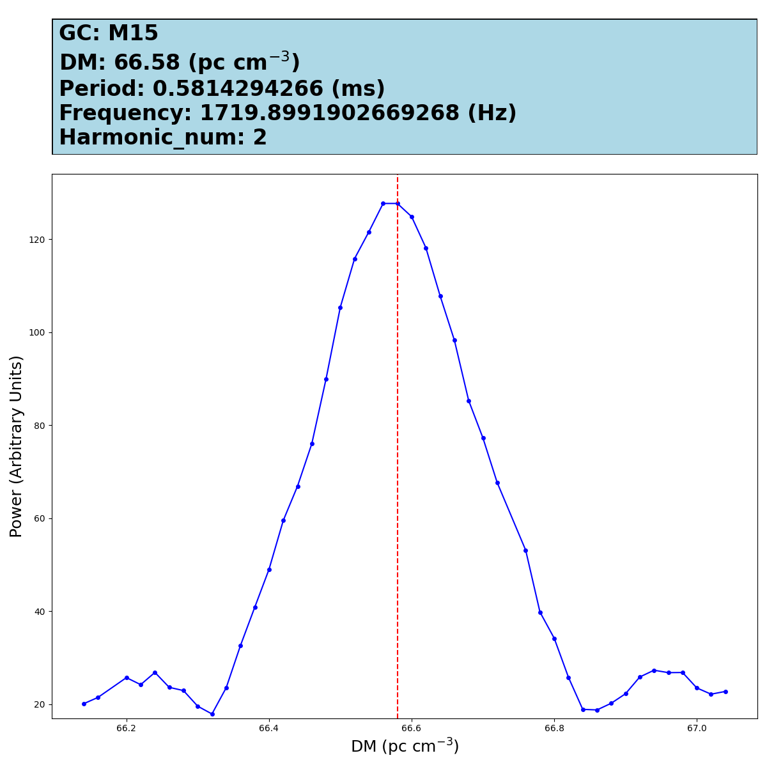
Sub-millisecond pulsars Search
Frequency search range: 0.1~10172 Hz
M15E period 1/6
0.775239 ms
M15E period 1/8
0.581429 ms

Slide 14
Binary Search
Long orbital period binary
Short orbital period binary
M71B
Binary～466.97 days
M71A
Binary～0.17 days
NGC6517
Binary～59.8 days
M71E
Binary～0.037 days

Slide 15
Binary Search
Short Orbital Period Binary
T_obs > 1.5 P_orb
M5C
Binary～0.086 days
（Ransom et al. 2003）

Slide 16
Summary
All known pulsars in NGC6517 and M15 can be found；5 new millisecond pulsars（NGC6517S，T，U and M15M,N）have been detected;
With very high sensitivity, detected sub-millisecond pulsars are possible if there are;
Searching for binaries using this method is possible, especially short-orbit binaries；
Searching for unknown pulsars in other globular clusters is continuing；
Not only globular clusters, but other data too. eg.FRB (Contact PI)

Slide 17
THANKS！
Email: yfeng.dai@foxmail.com

