Slide 1
Improving pulsar search efficiency with artificial intelligence
FAST/Future Pulsar Symposium 13
Qiuyang Fu
Supervisor：WeiWei Zhu
2024.7.14
Kunming,Yunnan

Slide 2
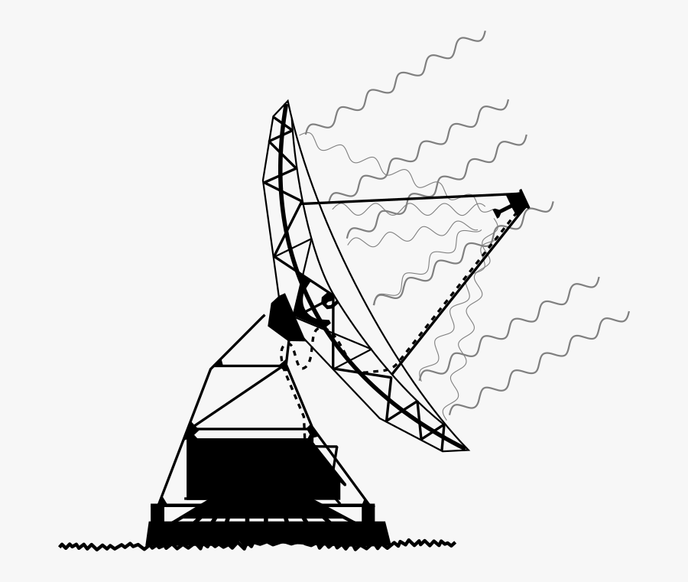
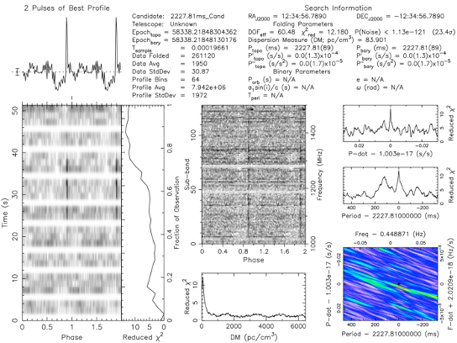
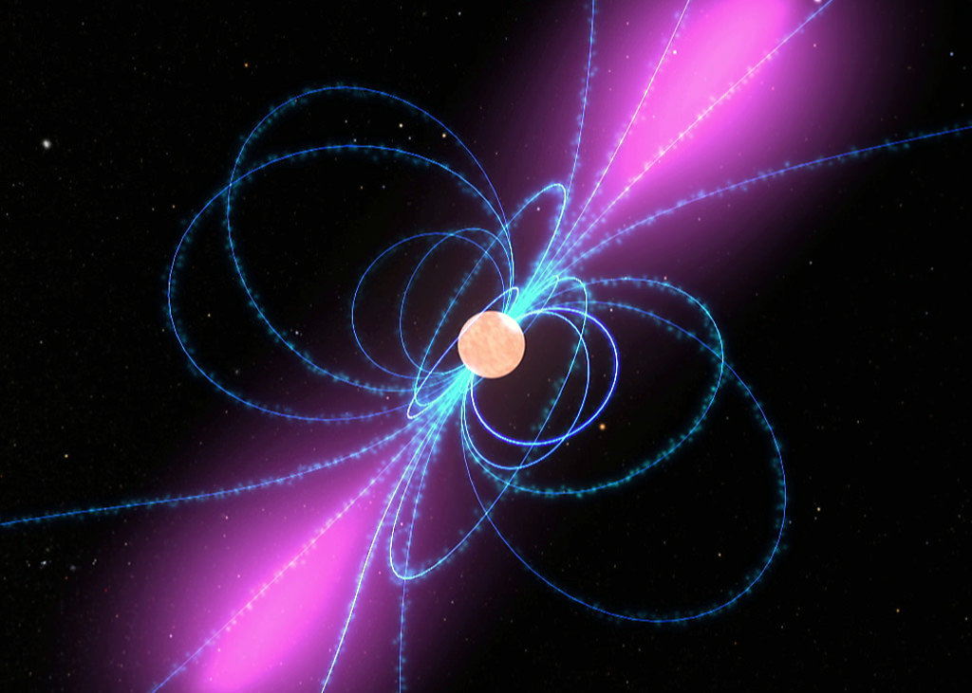
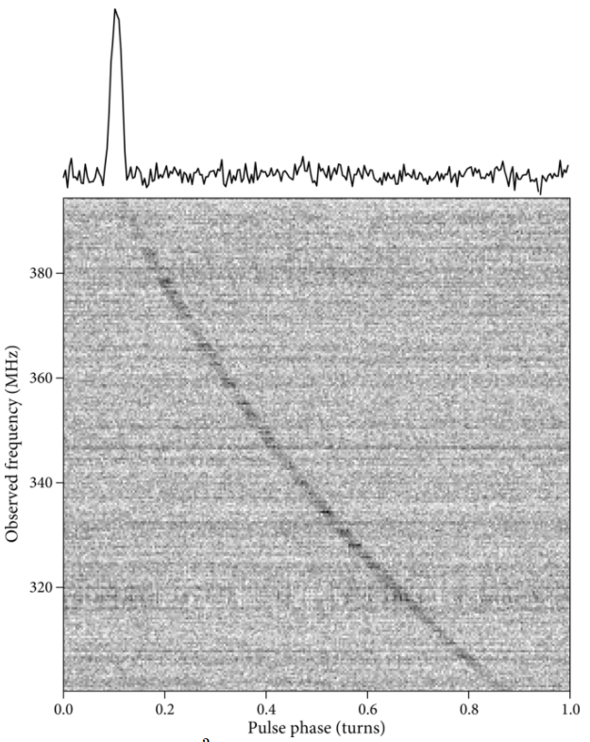
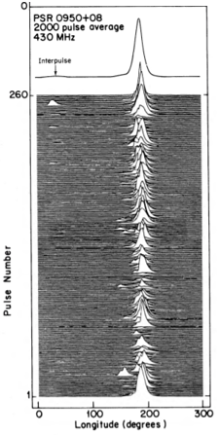
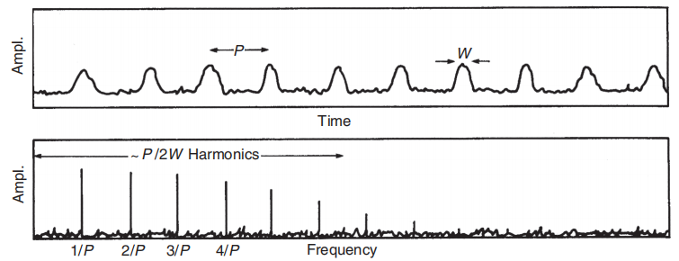
Background
Data
Search algorithm
Pulsar
candidates
sifting
Pulsar
1.Dispersion Measure
2. A single pulse signal is weak
Integrated pulse profiles according to the period
3. Fourier transform
Pulsar period
Credit: Pulsar Astronomy
Credit: Essential Radio Astronomy
Credit: Hankins &Cordes, 1981
01/12

Slide 3
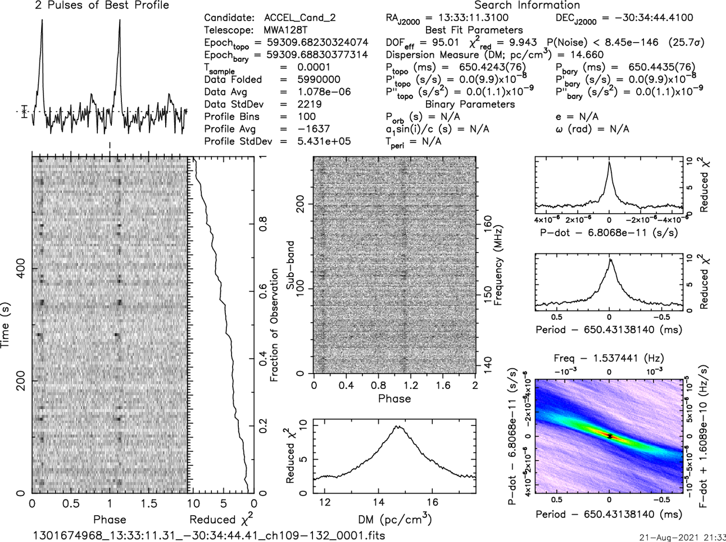
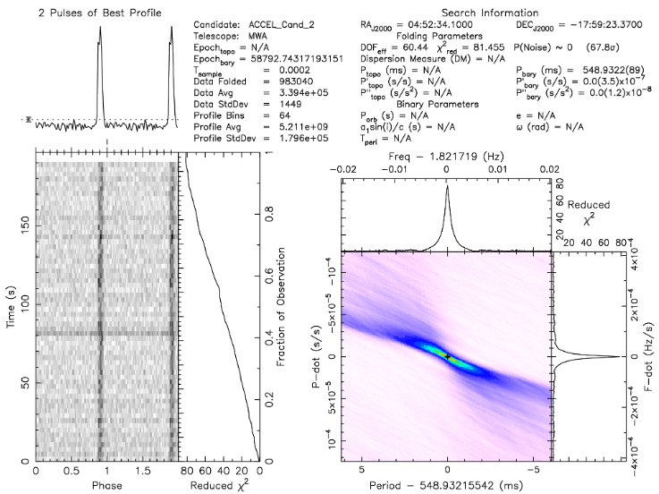
Method
a
b
c
d
a
b
Software: PRESTO
02/12

Slide 4
Method
a
a.profile -> 1-Dimension (nbin x 1)
nbin (prepold parameters):
The number of bins in the profile
(Defaults to the number of sampling bins which correspond to one folded period)
b
Different number bin
Different SNR
But
The neural network needs input data of the same size
b.time vs phase -> 2-Dimension (nbin x nbin)
image
PRESTO
Search
Data
Candidates
.pfd file(information)
03/12

Slide 5
Method
Data: MWA SMART Pulsar Survey candidates
pulsar samples:142 (nbins = 100)
PICS needs to downsample to 48 bins.
classification result (threshold>0.5):
PALFA, HTRU : 67 / 142
PALFA,HTRU, FAST : 76 / 142
classification result (threshold>0.1):
PALFA, HTRU : 108 / 142
PALFA,HTRU, FAST : 104 / 142
MWA SMART Survey
(Dwell time 4800s)
80 min search data(no polarization)
=138GB for every point
64
resize
Different bins
96
multi-input combinedModel
128
PICS AI Credit: Weiwei Zhu
SMART Survey Credit: N. D. R. Bhat
04/12

Slide 6
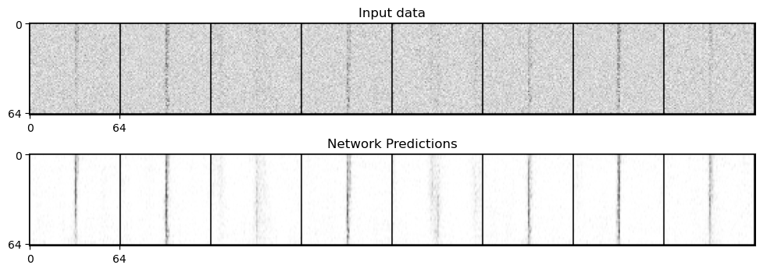
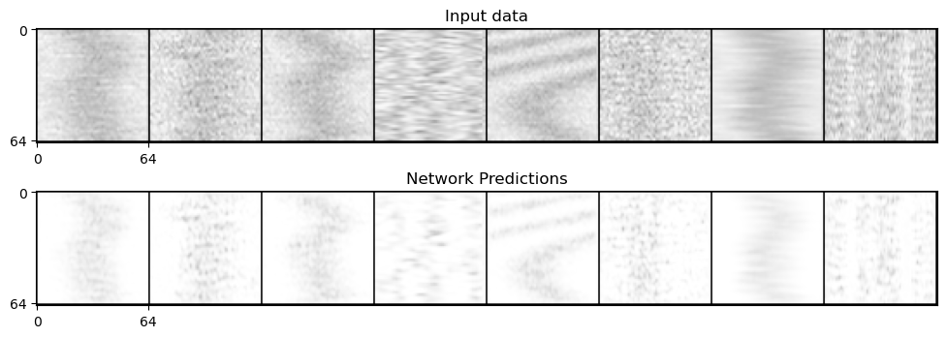
Method
Data preprocessing
(Denoising Diffusion Probabilistic Models)
Positive samples
x
Add noise
noisy_x
Negative samples
UNet
pred = UNet (noisy_x)
Minimize the loss_fn(pred, x)
05/12

Slide 7
Method
Data preprocessing
(Denoising Diffusion Probabilistic Models)
Positive samples
1-D data
pfd file
2-D data
Diffusion Model
Denoised 2-D data
Negative samples
2-D data
1-D data
resize x3
Denoised 2-D data
Classifier
06/12

Slide 8
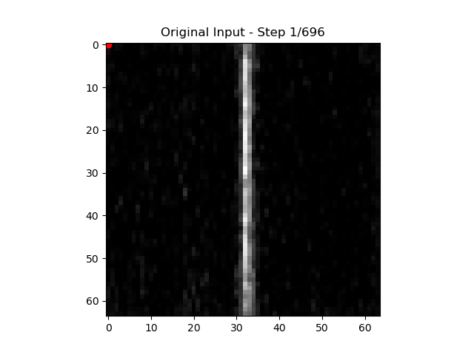
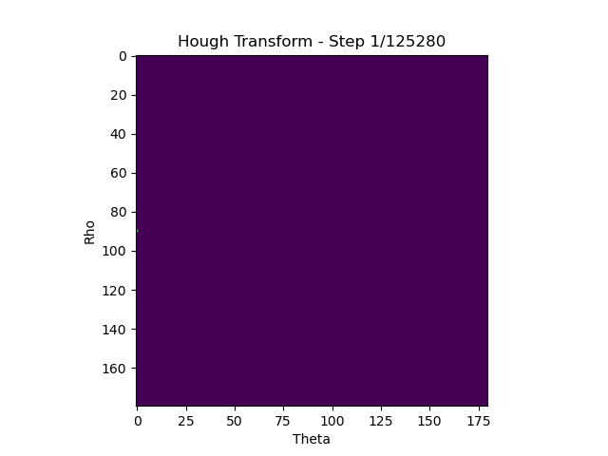
New Feature
Positive samples
Hough Transform
Negative samples
07/12

Slide 9
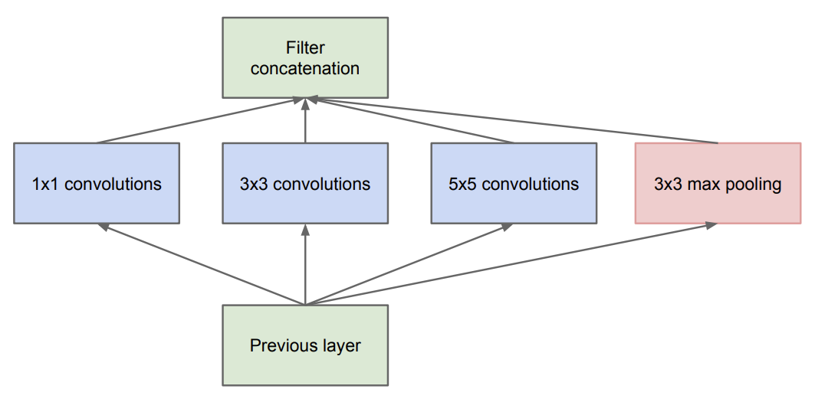
Model
Wider or Deeper ？
GoogleNet
Wider
Deeper
Credit: Szegedy, Christian, et al. "Going deeper with convolutions."
08/12

Slide 10
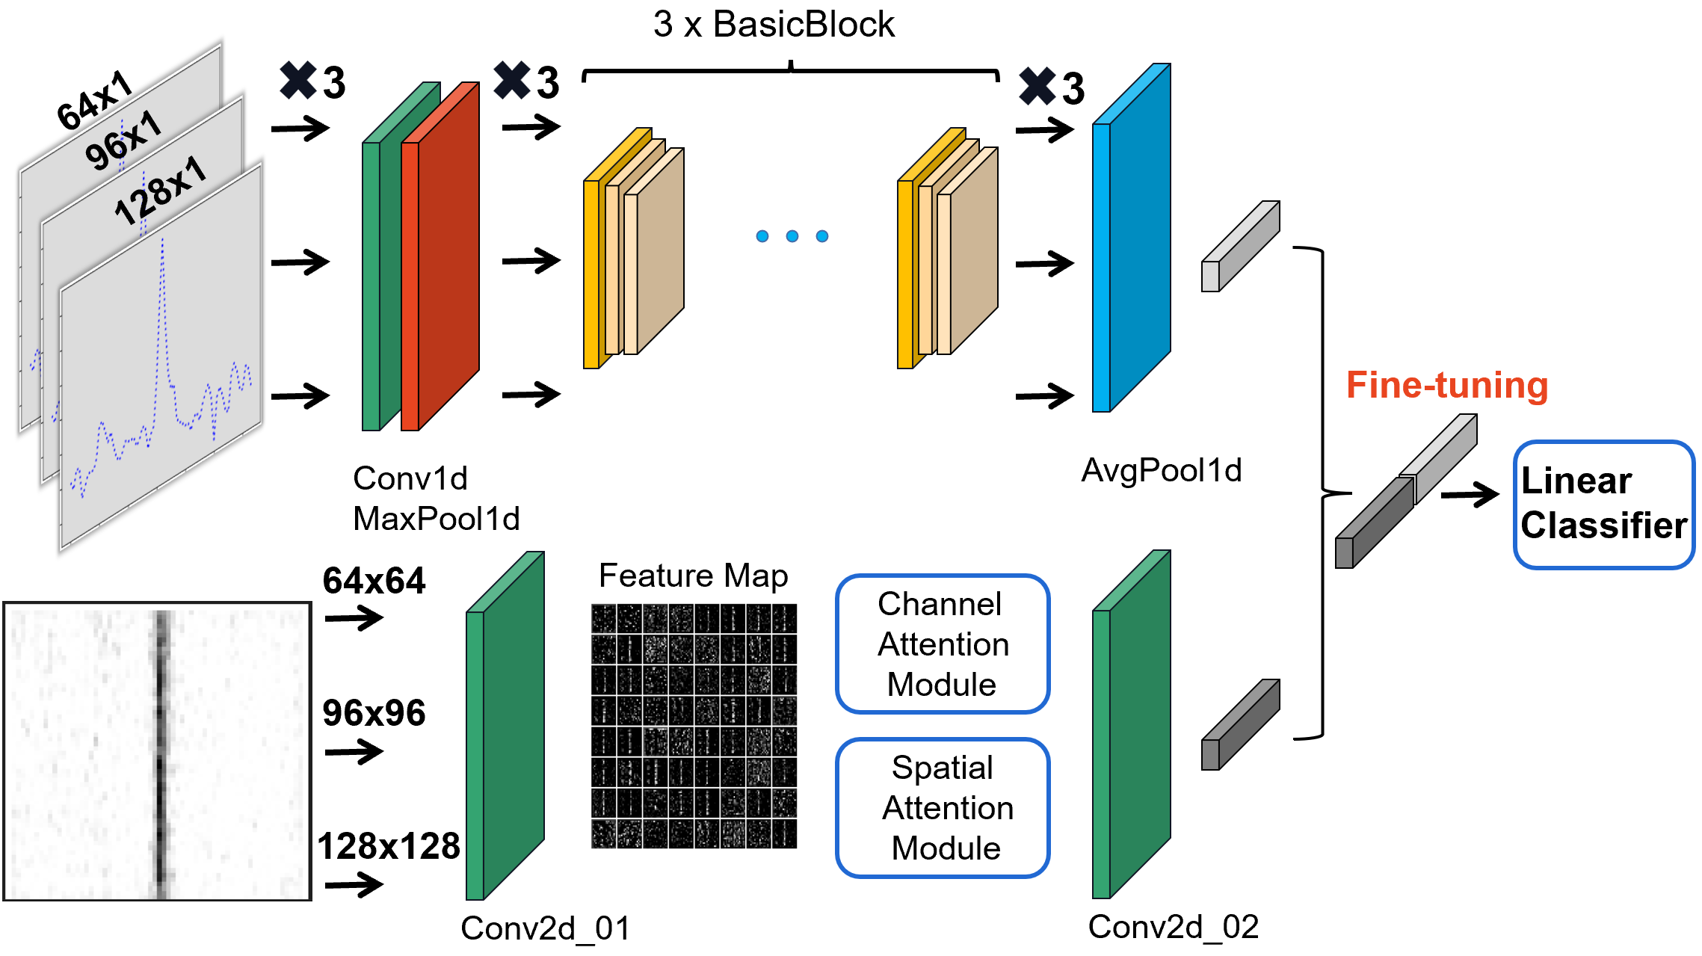
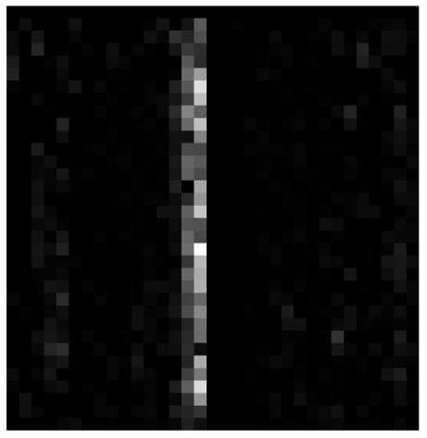
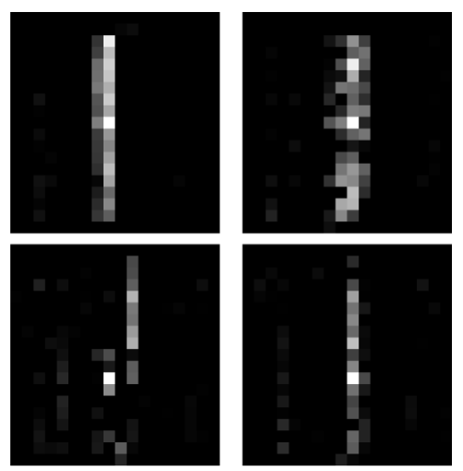
Model Architecture
(1-D data): ResNet
(2-D data): CNN + Attention
Attention
What?
Where?
64x64
09/12

Slide 11
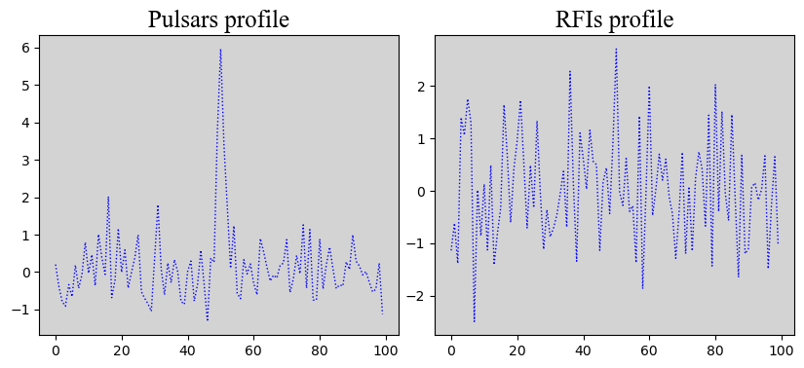
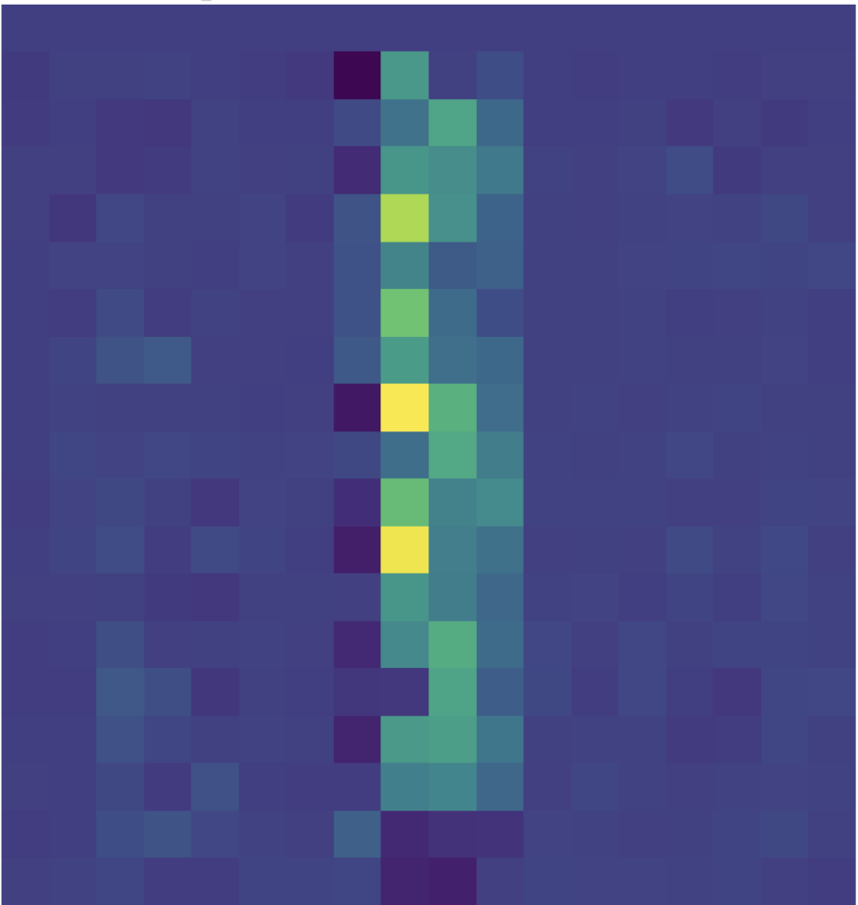
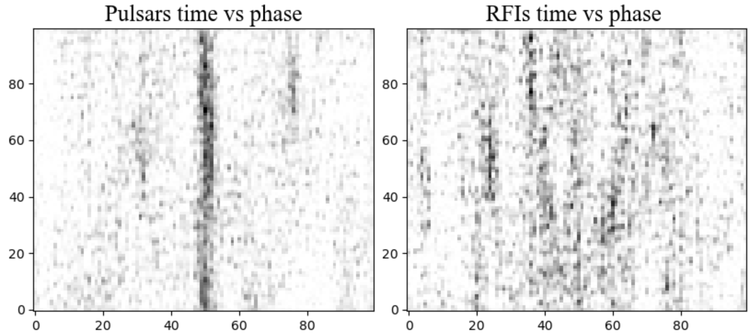
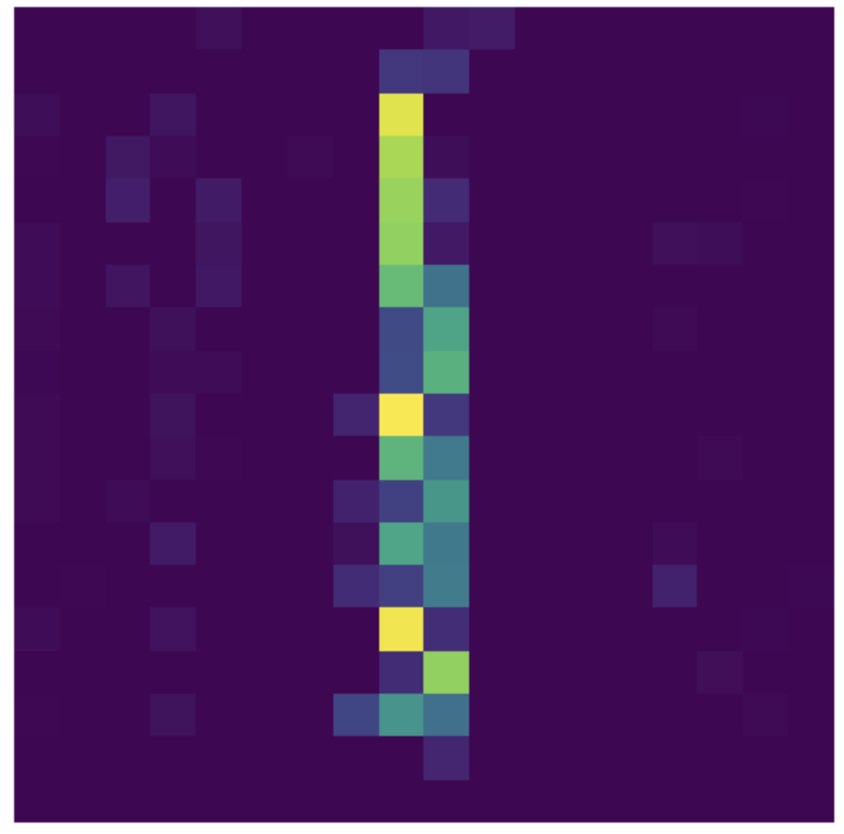
Fine-tuning
Feature extraction
Fine-tuning
x Channel Dimension
W₁
x₁
a₁
W_{ALL}
W₁
x_{n}
W₂
True
W_{m-1}
False
x_{n+1}
x Channel Dimension
W_{m}
a_{k}
x_{2n}
W_{j}
Linear Classifier
10/12

Slide 12
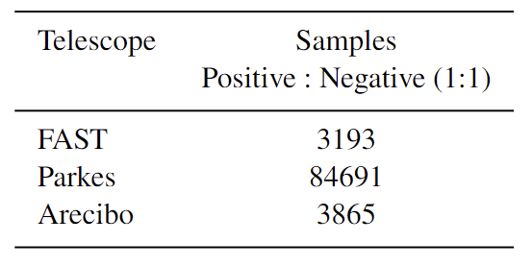
Results
Data:
GBNCC
Method Fundamental(56) Harmonic(221) RFI(3776)
PICS(>0.5) 53 207 42
PICS(>0.1) 56 216 510
Multi(>0.5) 56 213 479
Multi(>0.1) 56 218 570
SMART
Method Pulsar(142) Nonpulsar(5000)
PICS(>0.5) 67 86
PICS(>0.1) 108 537
Multi(>0.5) 133 646
Multi(>0.1) 140 948
PICS AI Credit: Weiwei Zhu
Multi multi-input combinedModel
11/12

Slide 13
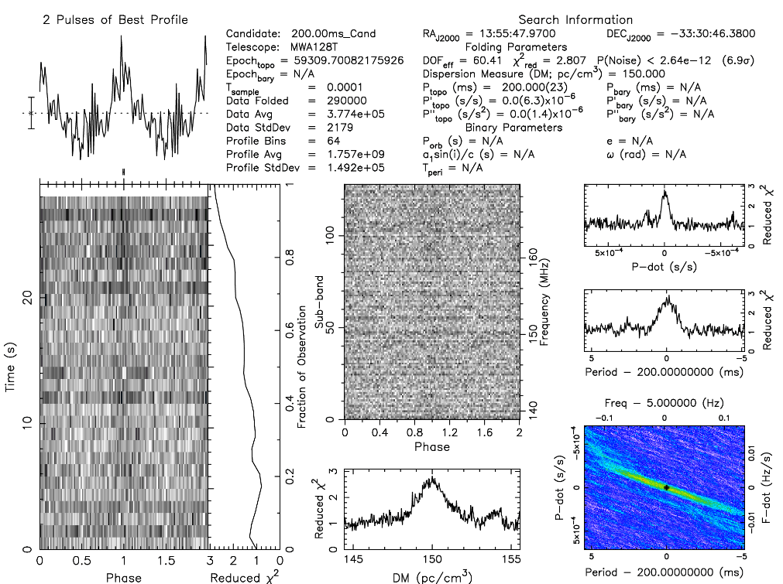
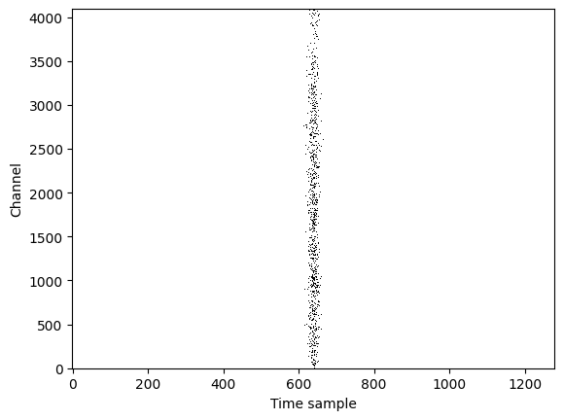
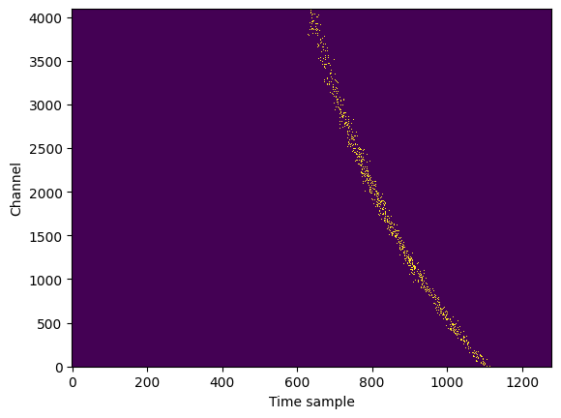
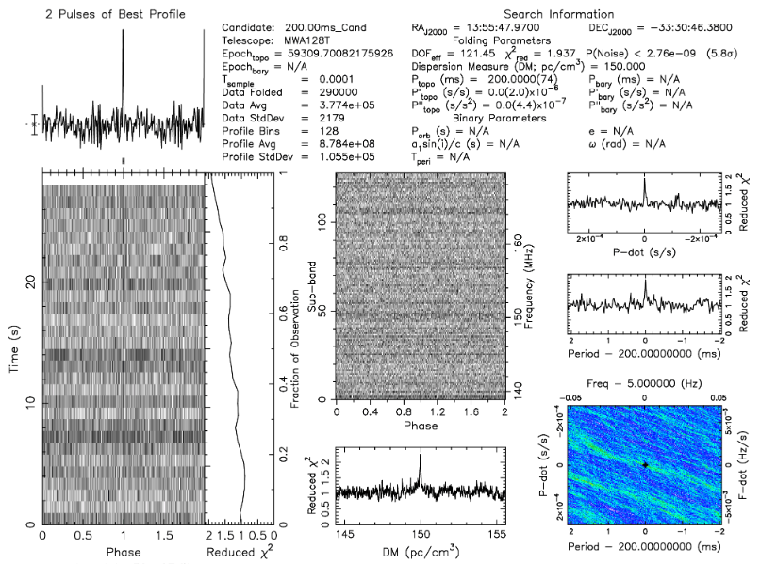
Simulation
Pulsar Signal Simulation Program
Example:
Injecting periodic simulated signals into real observational data
Simulated Signals from Real Single Pulses
Add dispersion delay
Generating Simulated Pulsar Constructing Training Data or
Validating Search Performance
12/12

Slide 14
FAST/Future Pulsar Symposium 13
Thanks！

