Slide 1
Difference between quark stars and neutron stars in universal relations and their effect on gravitational wave
报告人：高端塬
导师：周恩平

Slide 2
CONTENTS
Background
F-mode properties
Universal relations
Tidal dephasing

Slide 3
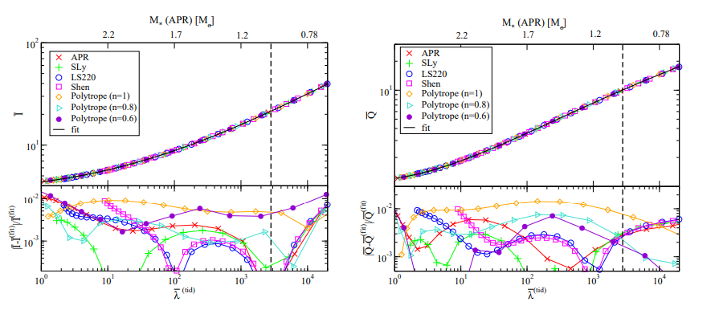
I-love-Q relation
Kent Yagi and Nicol´as Yunes(2017)

Slide 4
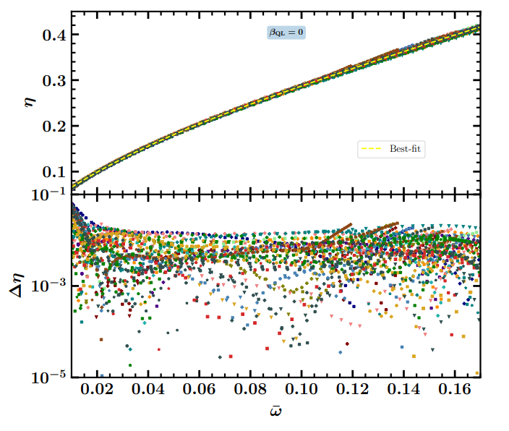
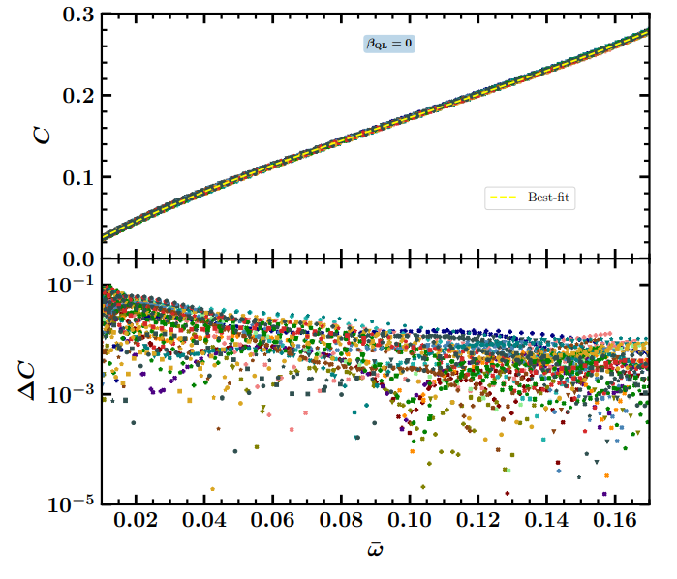
I-C-f relation
Sailesh Ranjan Mohanty et al(2023)

Slide 5
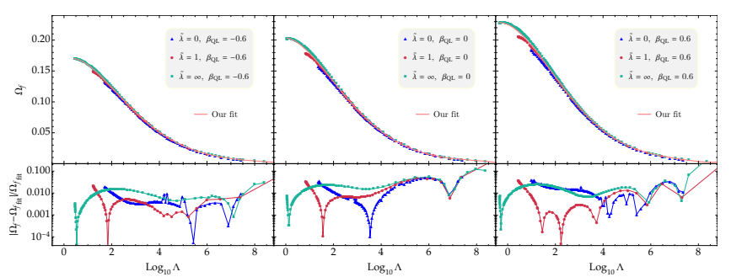
For Quark stars
Juan M. Z. Pretel, and Chen Zhang(2024)

Slide 6
GW frequency “at amplitude maximum”
No way to distinguish
QS and NS from the
GW during the
inspiral phase?
Rezzolla and Takami, PRD 93, 124051 (2016)

Slide 7
Dynamic tides
https://www.aei.mpg.de/196425/tides-in-binary-star-systems

Slide 8
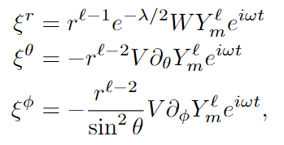
F-mode
Regge-Wheeler metric
Lagrangian displacement vector

Slide 9
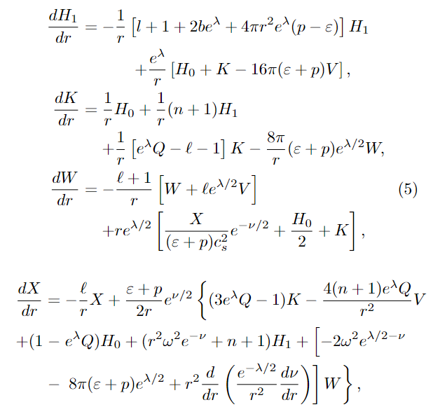
Ode equations
L. Lindblom and S. L. Detweiler(1983)

Slide 10
Boundary conditions
At r = 0
At r = R

Slide 11
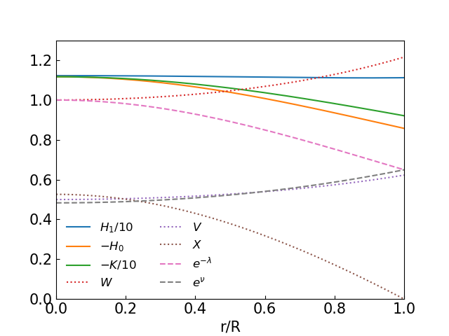
Solution inside quark star

Slide 12
Ode equations
L. Lindblom and S. L. Detweiler(1983)

Slide 13
Zerilli equation

Slide 14
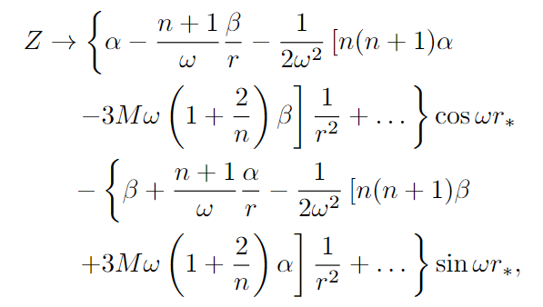
F-mode frequency and Tidal overlap
S. Chandrasekhar
and V. Ferrari(1991)
Zhiqiang Miao et al(2024)

Slide 15
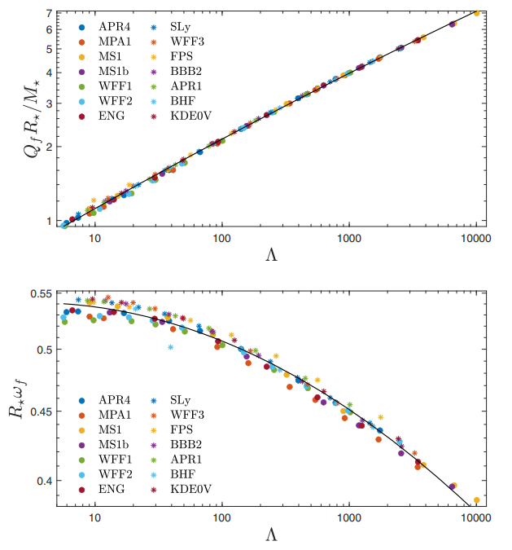
Other universal
relations
H.-J. Kuan et al(2022)

Slide 16
Difference between NS and QS

Slide 17
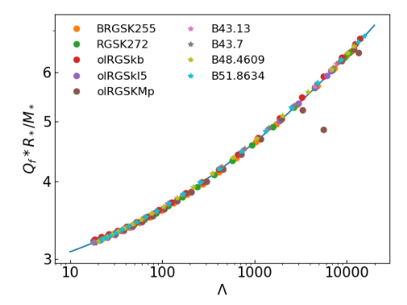
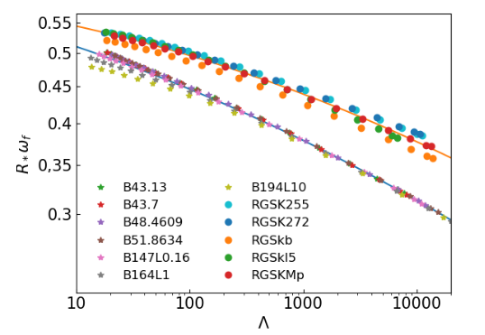
Universal relations

Slide 18
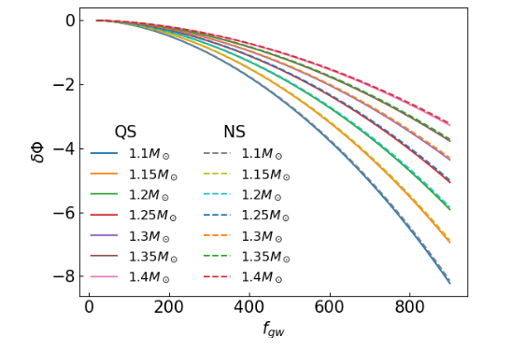
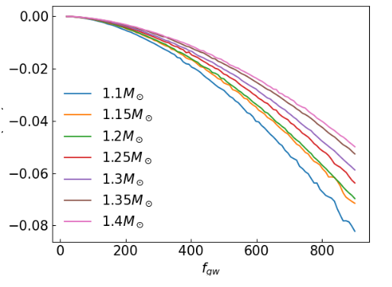
Tidal dephasing

Slide 19
Thanks

