Slide 1
Pulsars in M3 and New Pulsars in M2
BaodaLi
Guizhou University
cooperator：Liyun Zhang、Zhichen Pan、Jumei Yao、Lei Qian、Minghui Li、Yu Pan、Ralph P. Eatough、Kuo Liu et al.
FPS 13
Kunming 2024.7.14
Notes:
My name is Baoda Li, my supervisor is prof. Zhang. The topic of my report today is pulsars in globular cluster M3. This is my first time to make a report in English. Please correct me.

Slide 2
Outline
Pulsars in M3 and new pulsars in M2
Scintillation in M3
Conclusion

Slide 3
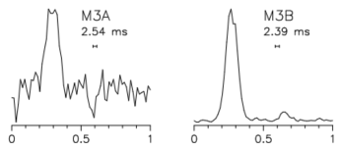
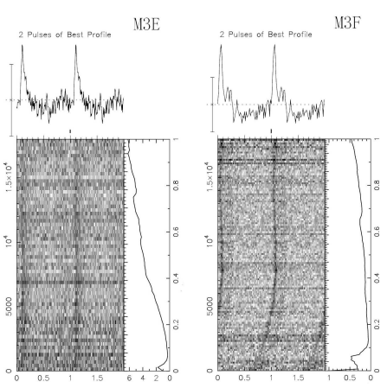
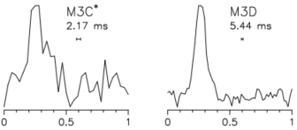
Pulsars in M3
NGC5272 (M3)，galactic longitude 42.22°，galactic latitude78.71°，distance 10.2 kpc^{[1]}.
certified (M3A, B, D, E and F), need confirmation (M3C).
Pulse profiles of M3A, B, C and D ( Hessels et al. 2007 )
Pulse profiles of M3E and M3F( Pan et al. 2020 )
[1]https://people.smp.uq.edu.au/HolgerBaumgardt/globular/fits/ngc5272.html
Notes:
NGC5272 (M3)，[ɡəˈlaktɪk] galactic [ˈlɒŋɡɪtjuːd] longitude 42.22°，[ɡəˈlaktɪk] galactic [ˈlætɪtjuːd] latitude 78.71°，the distance is 10.2 kpc from us. There are six radio pulsars in M3.，These six pulsars are all binary systems。Among them, M3A to D were discovered by Hessel using the Arisi telescope, and M3C was only detected once in seventy-eight 78 observations, which needs to be confirmed. M3E and F are two newly pulsars discovered by FAST, and we know nothing about them except the [ˈpɪəriəd] period and dispersion [dɪˈspəːʃ(ə)n] value.

Slide 4
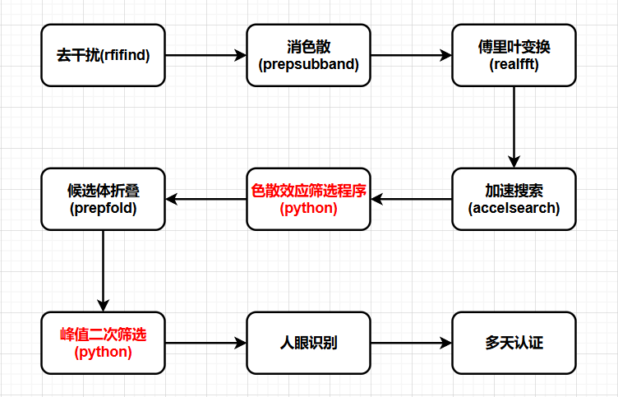
New pulsar search pipeline
极小色散步长
Li et al. In prep.

Slide 5
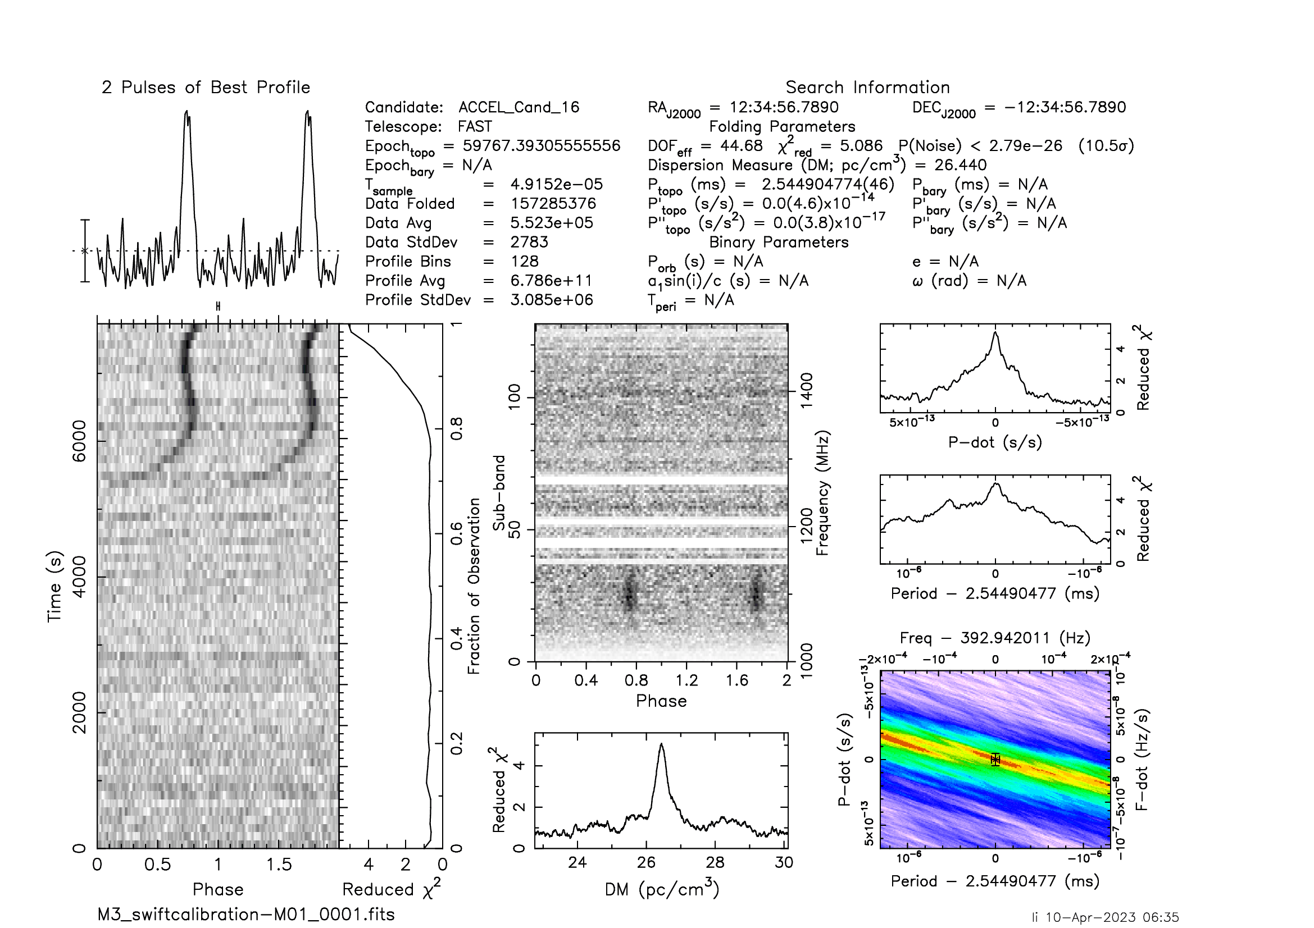
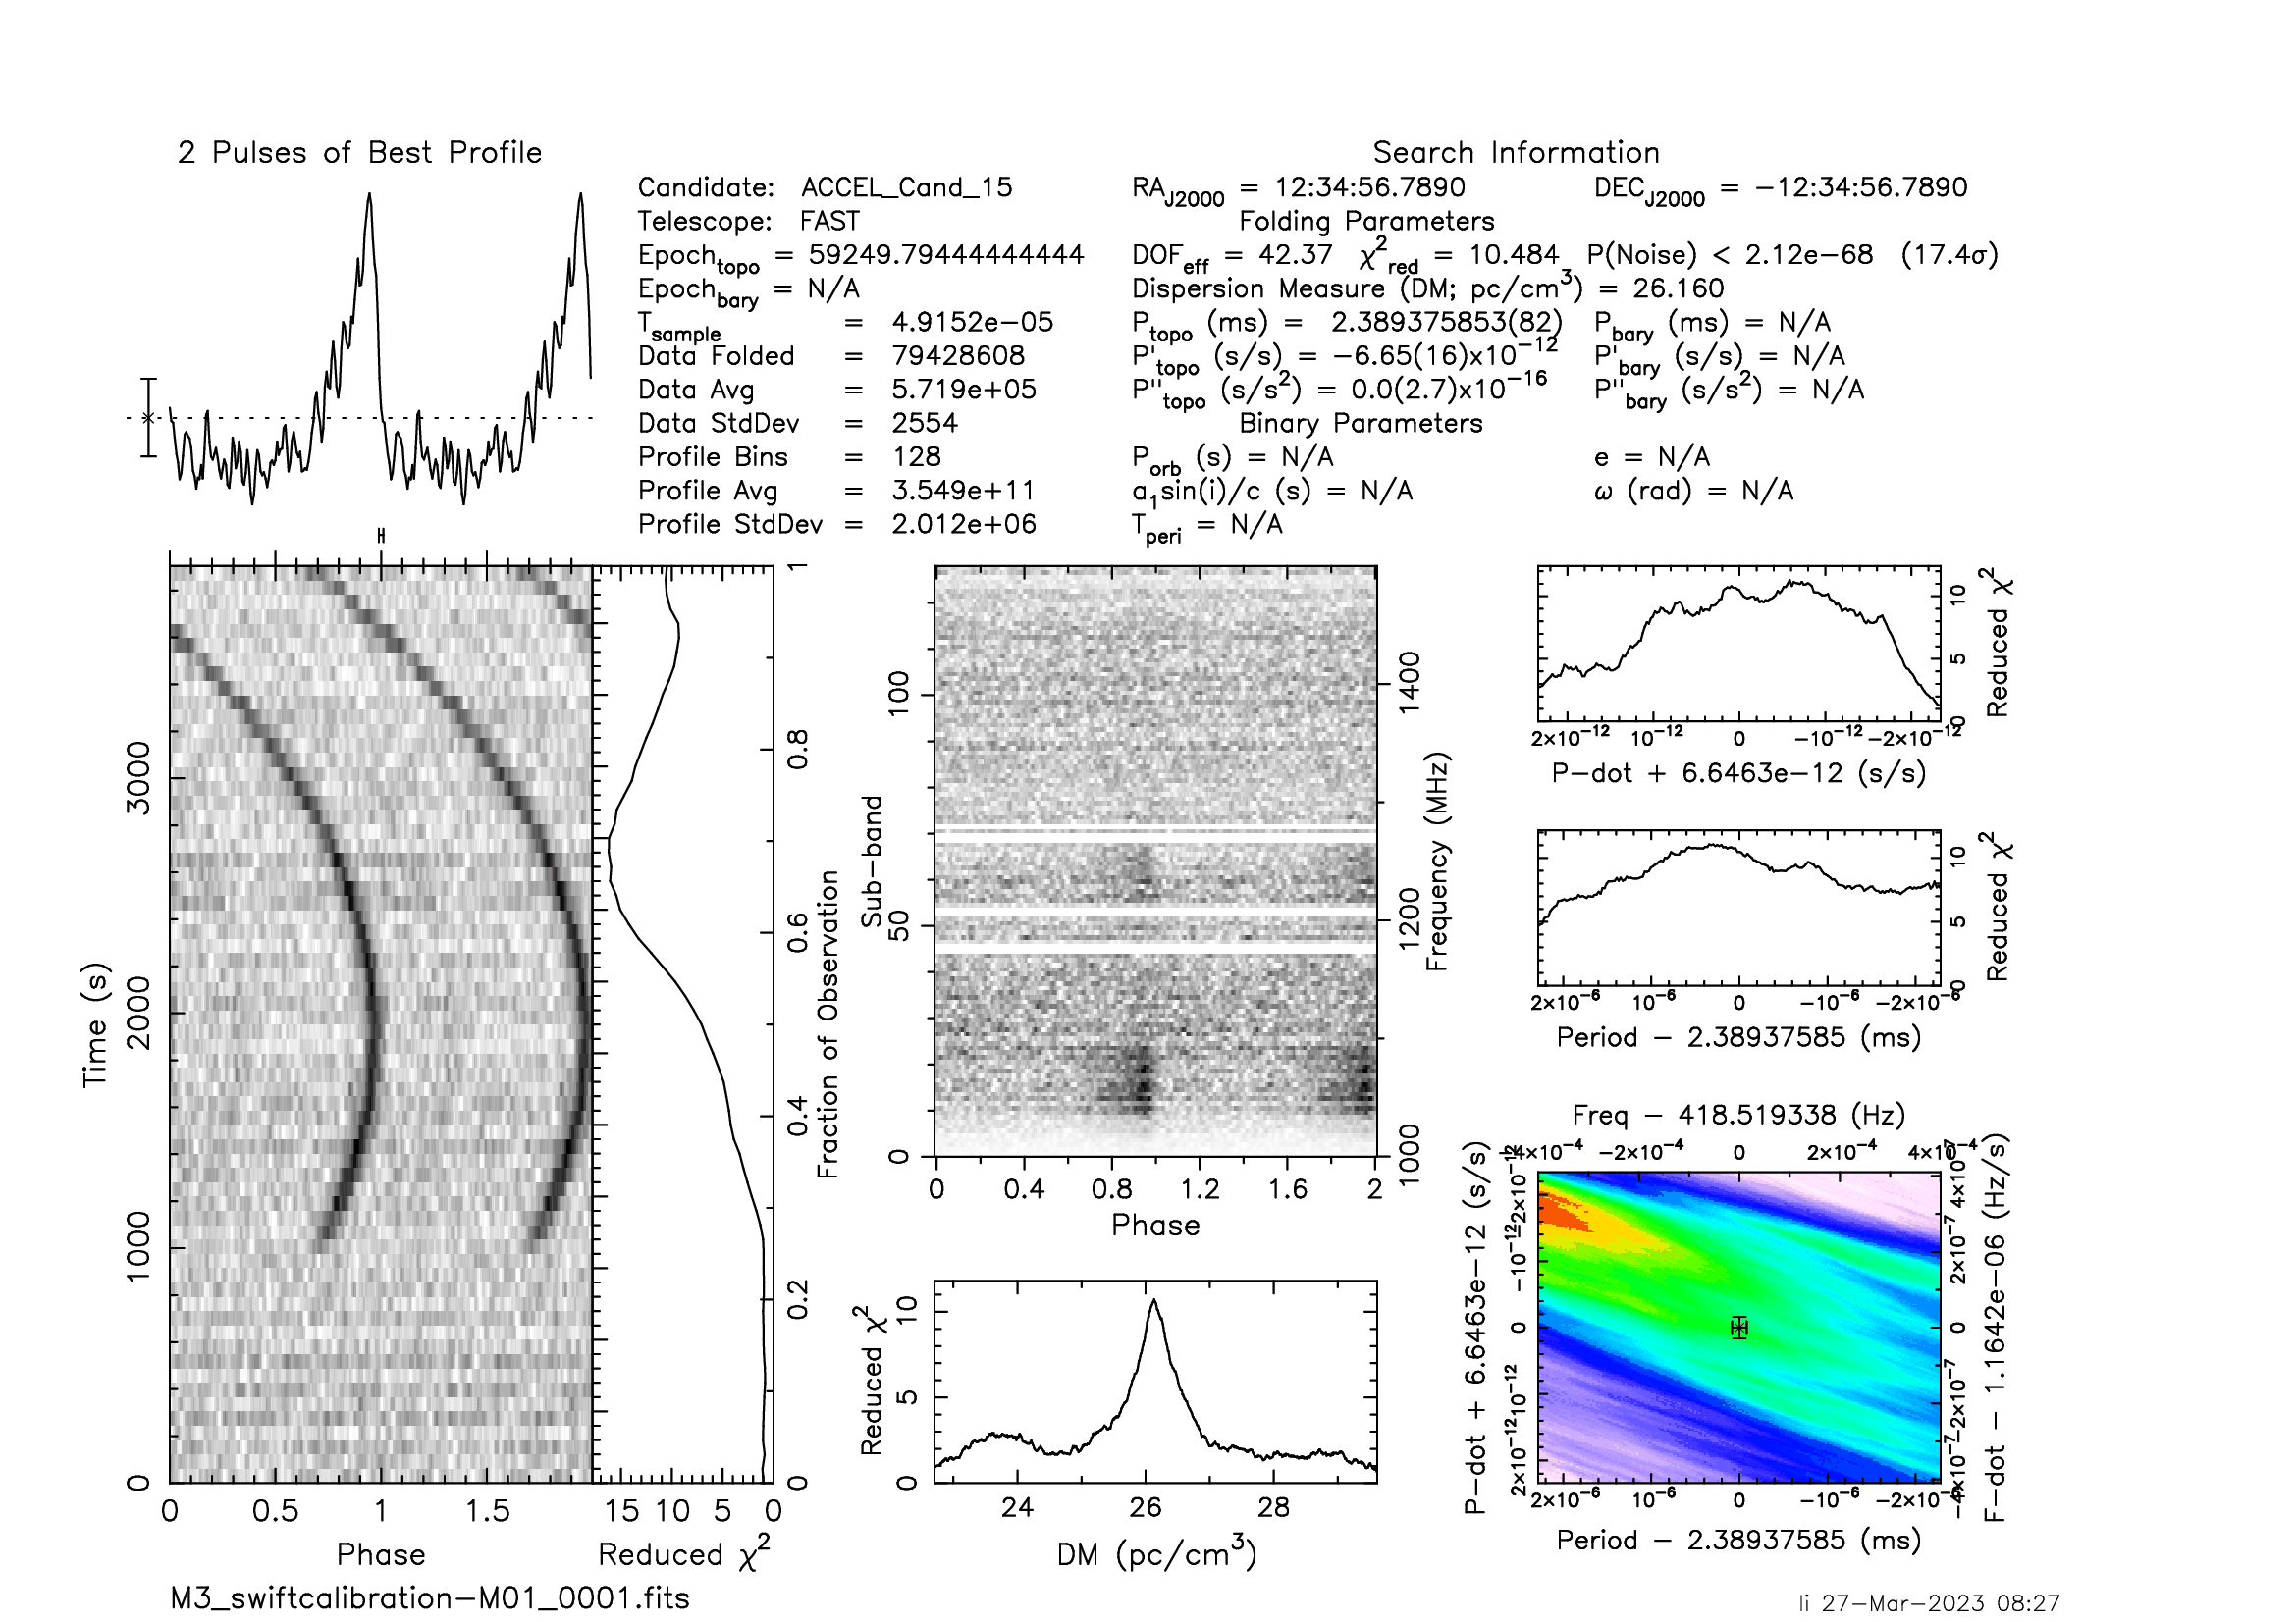
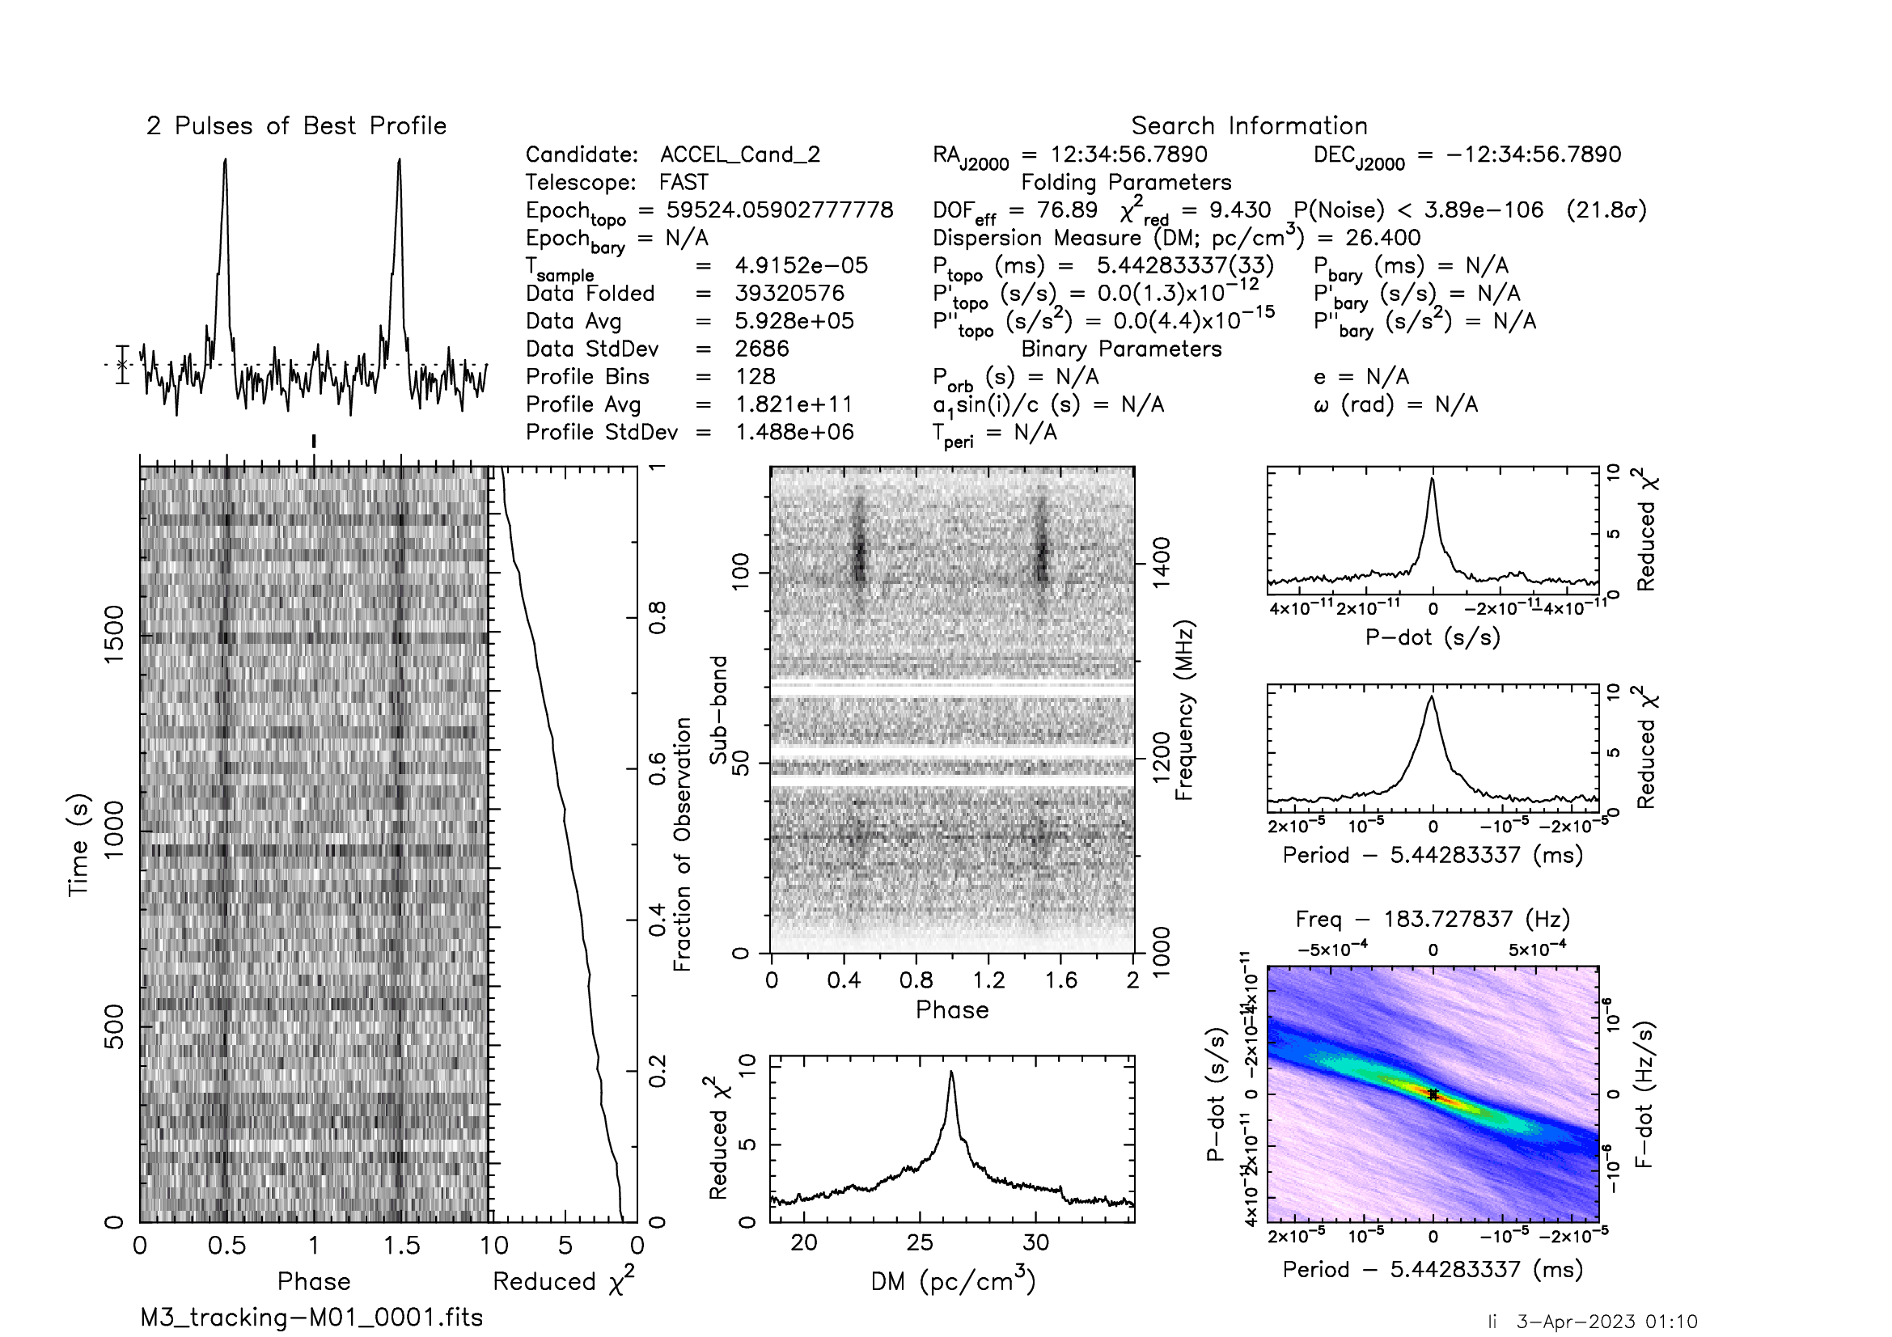
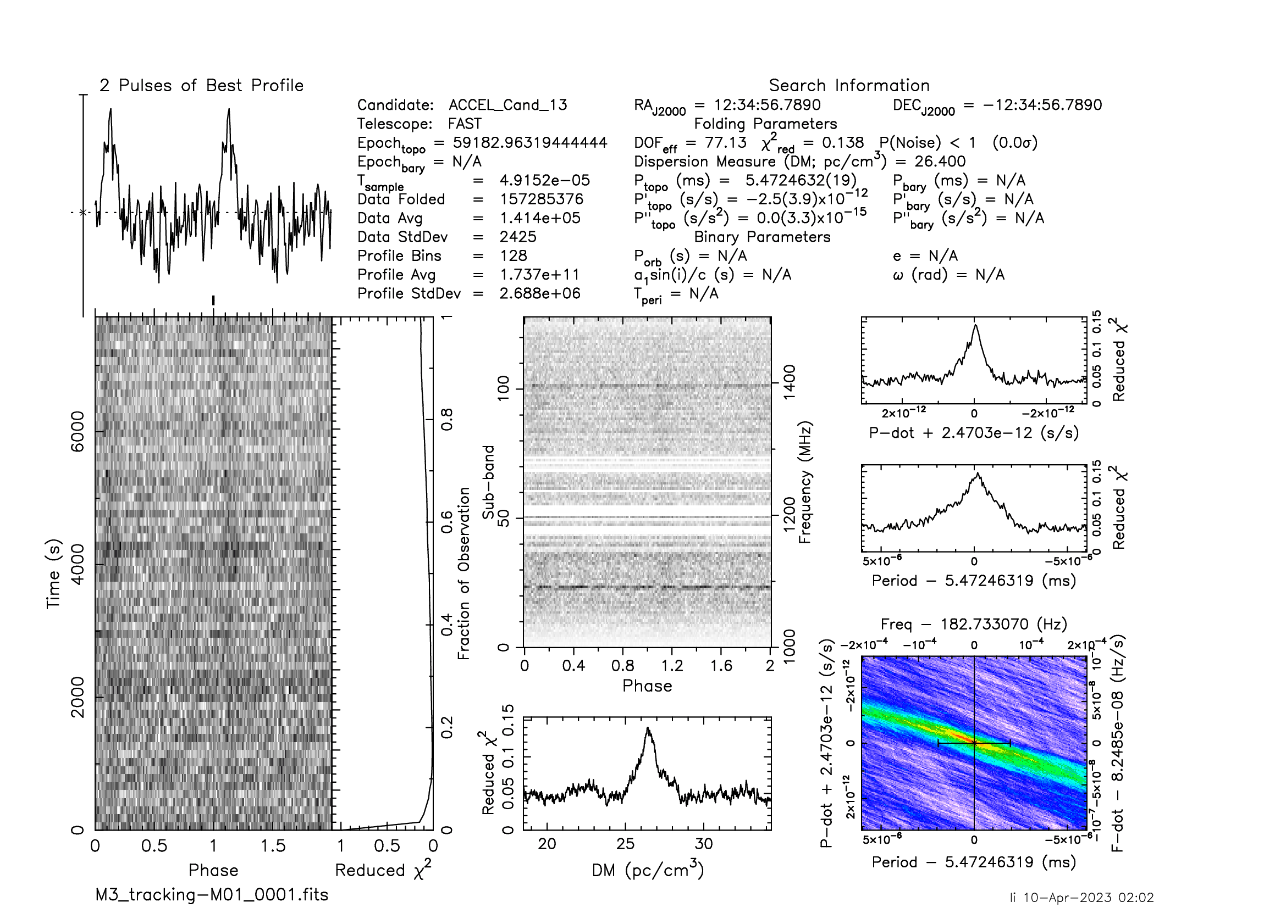
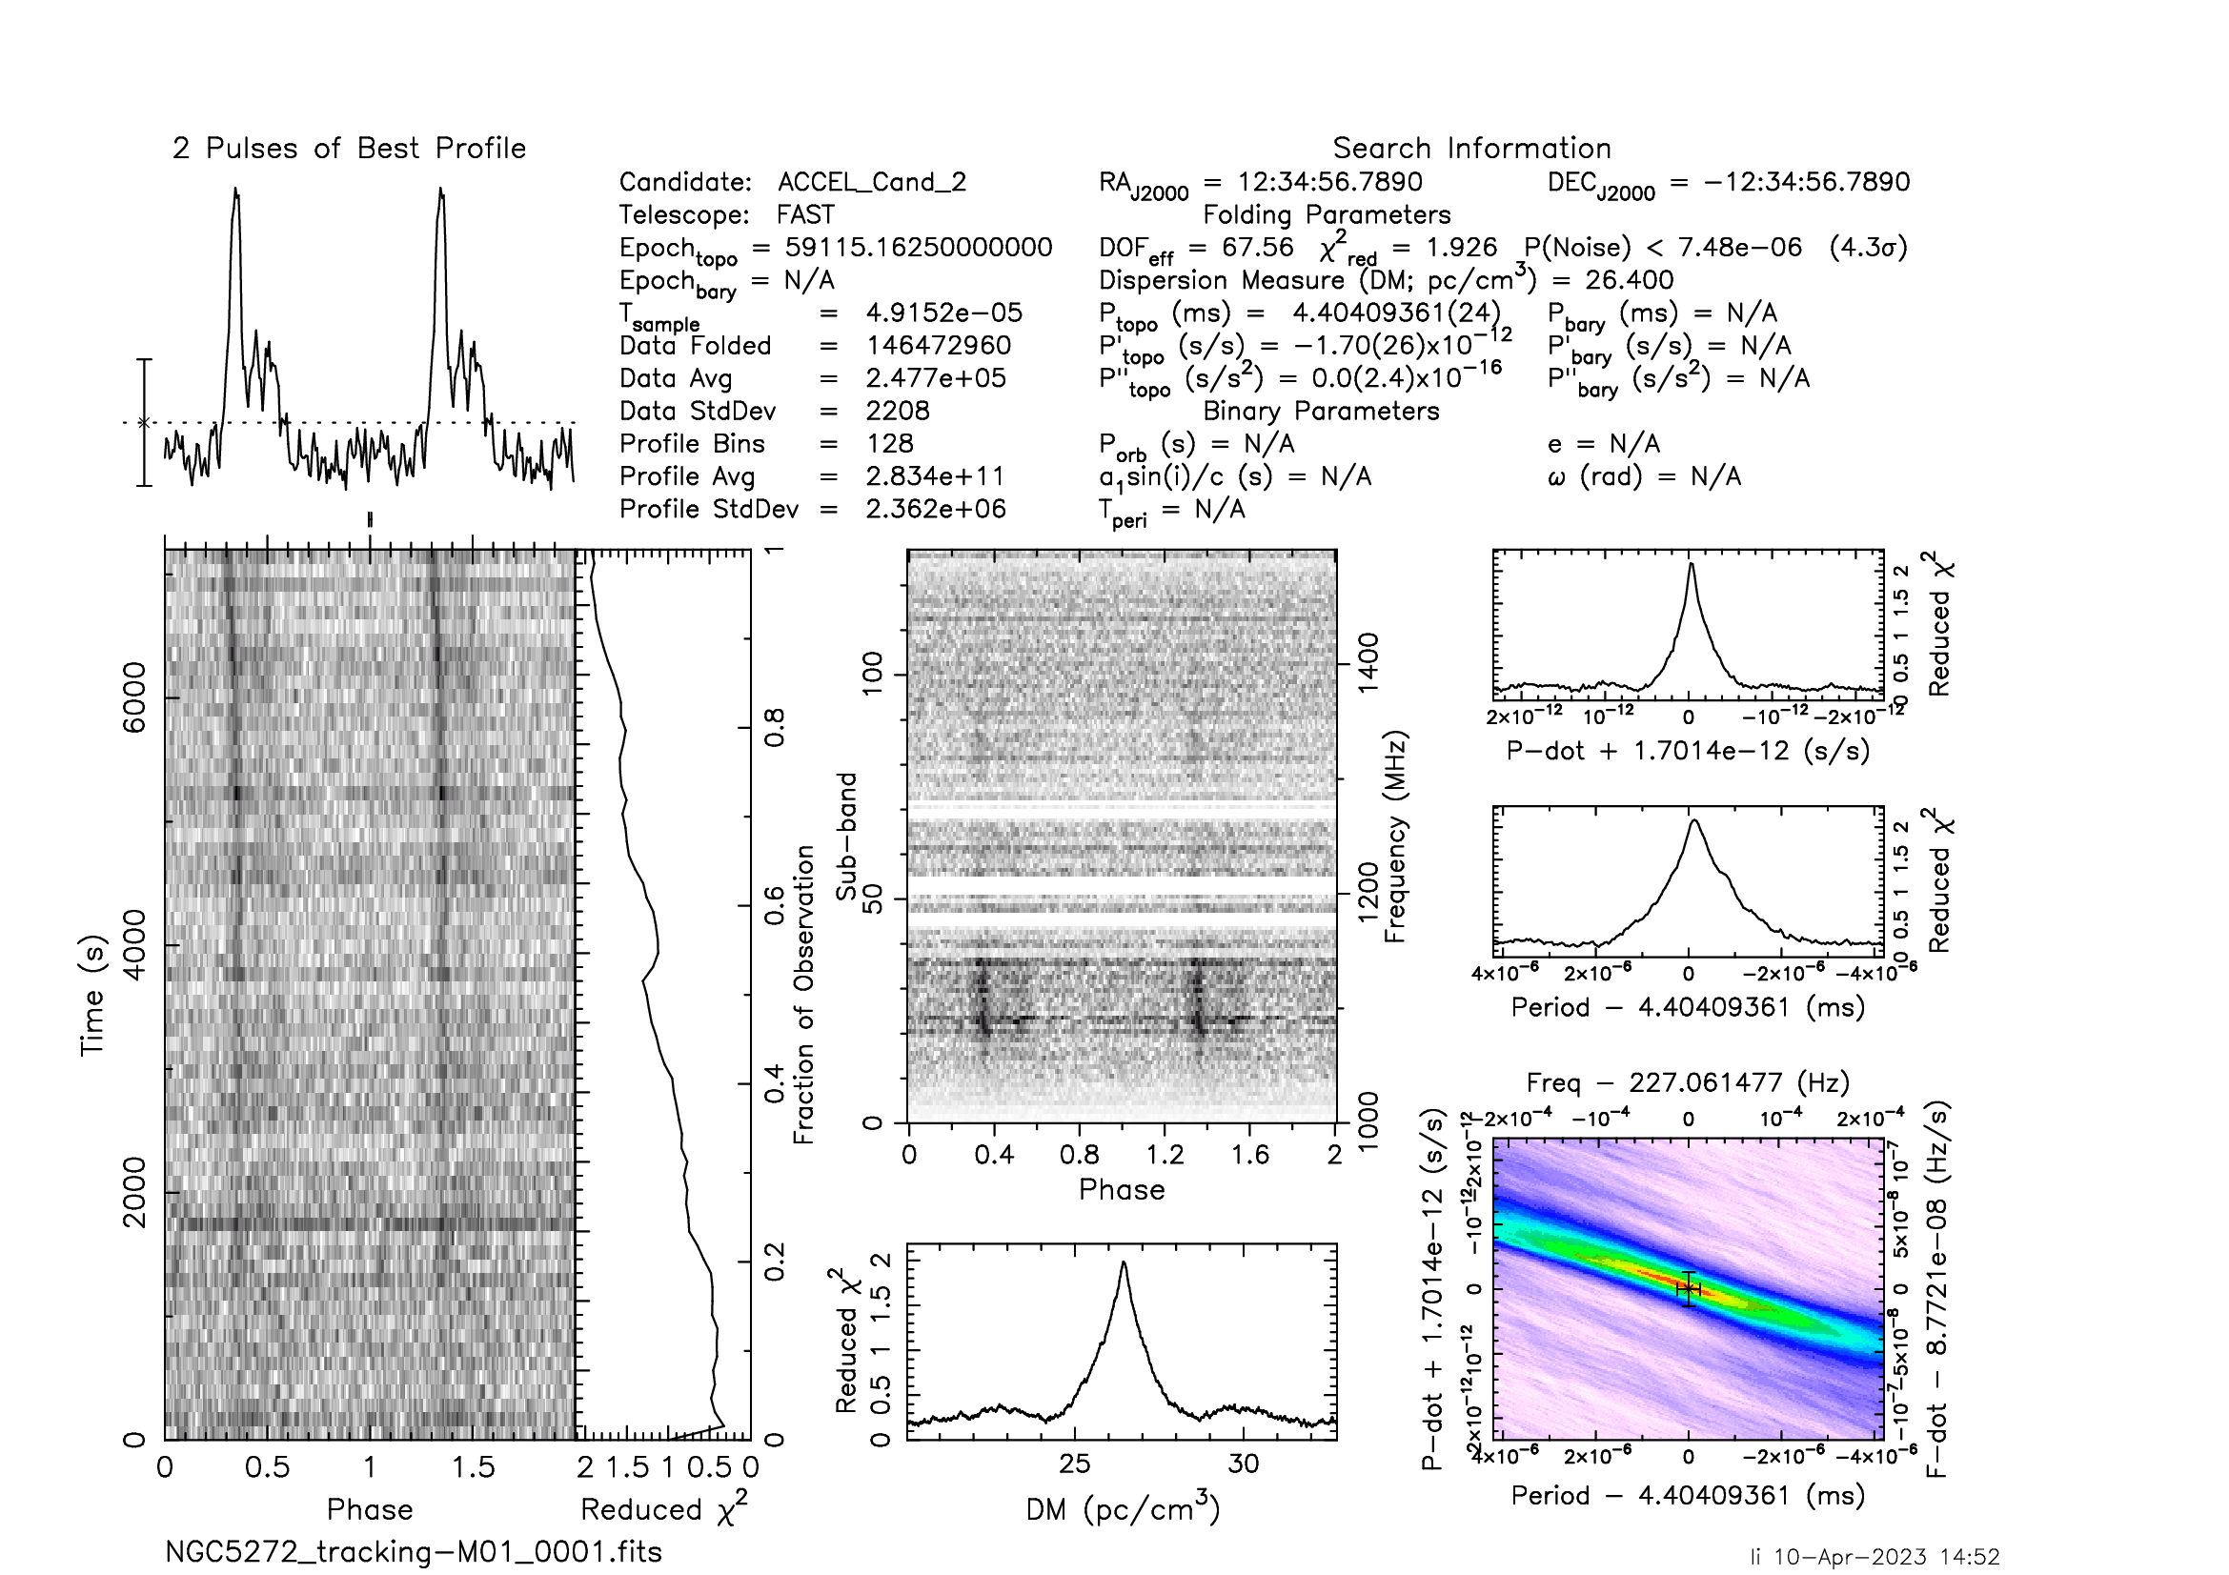
Pulsars in M3
M3A
M3B
M3D
M3E
M3F
Notes:
Similarly, we found the pulsars in M3 many times.

Slide 6
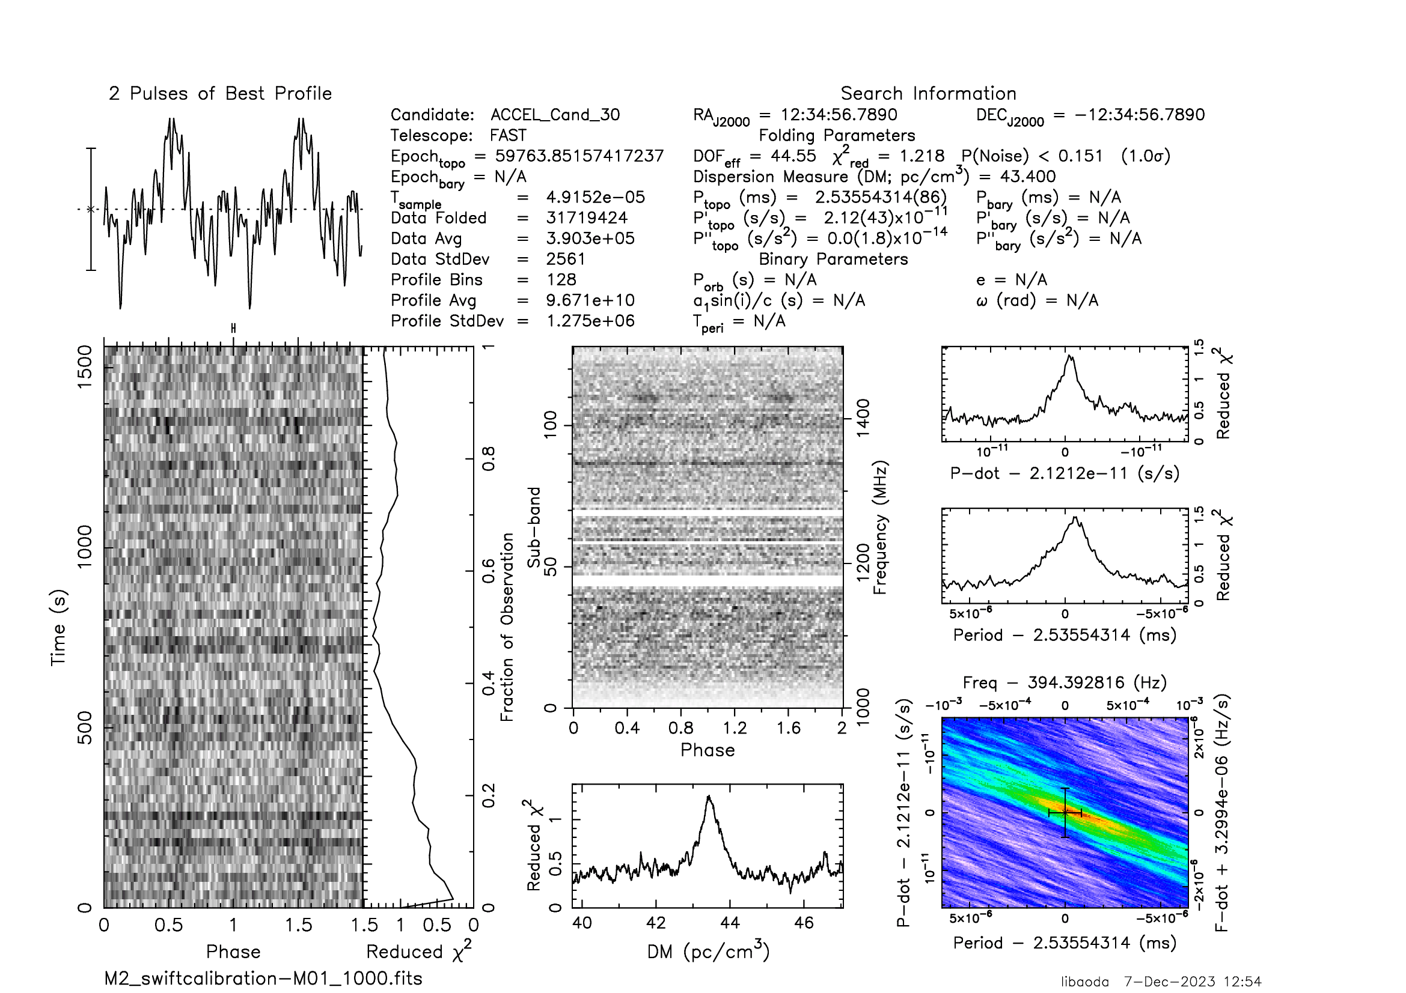
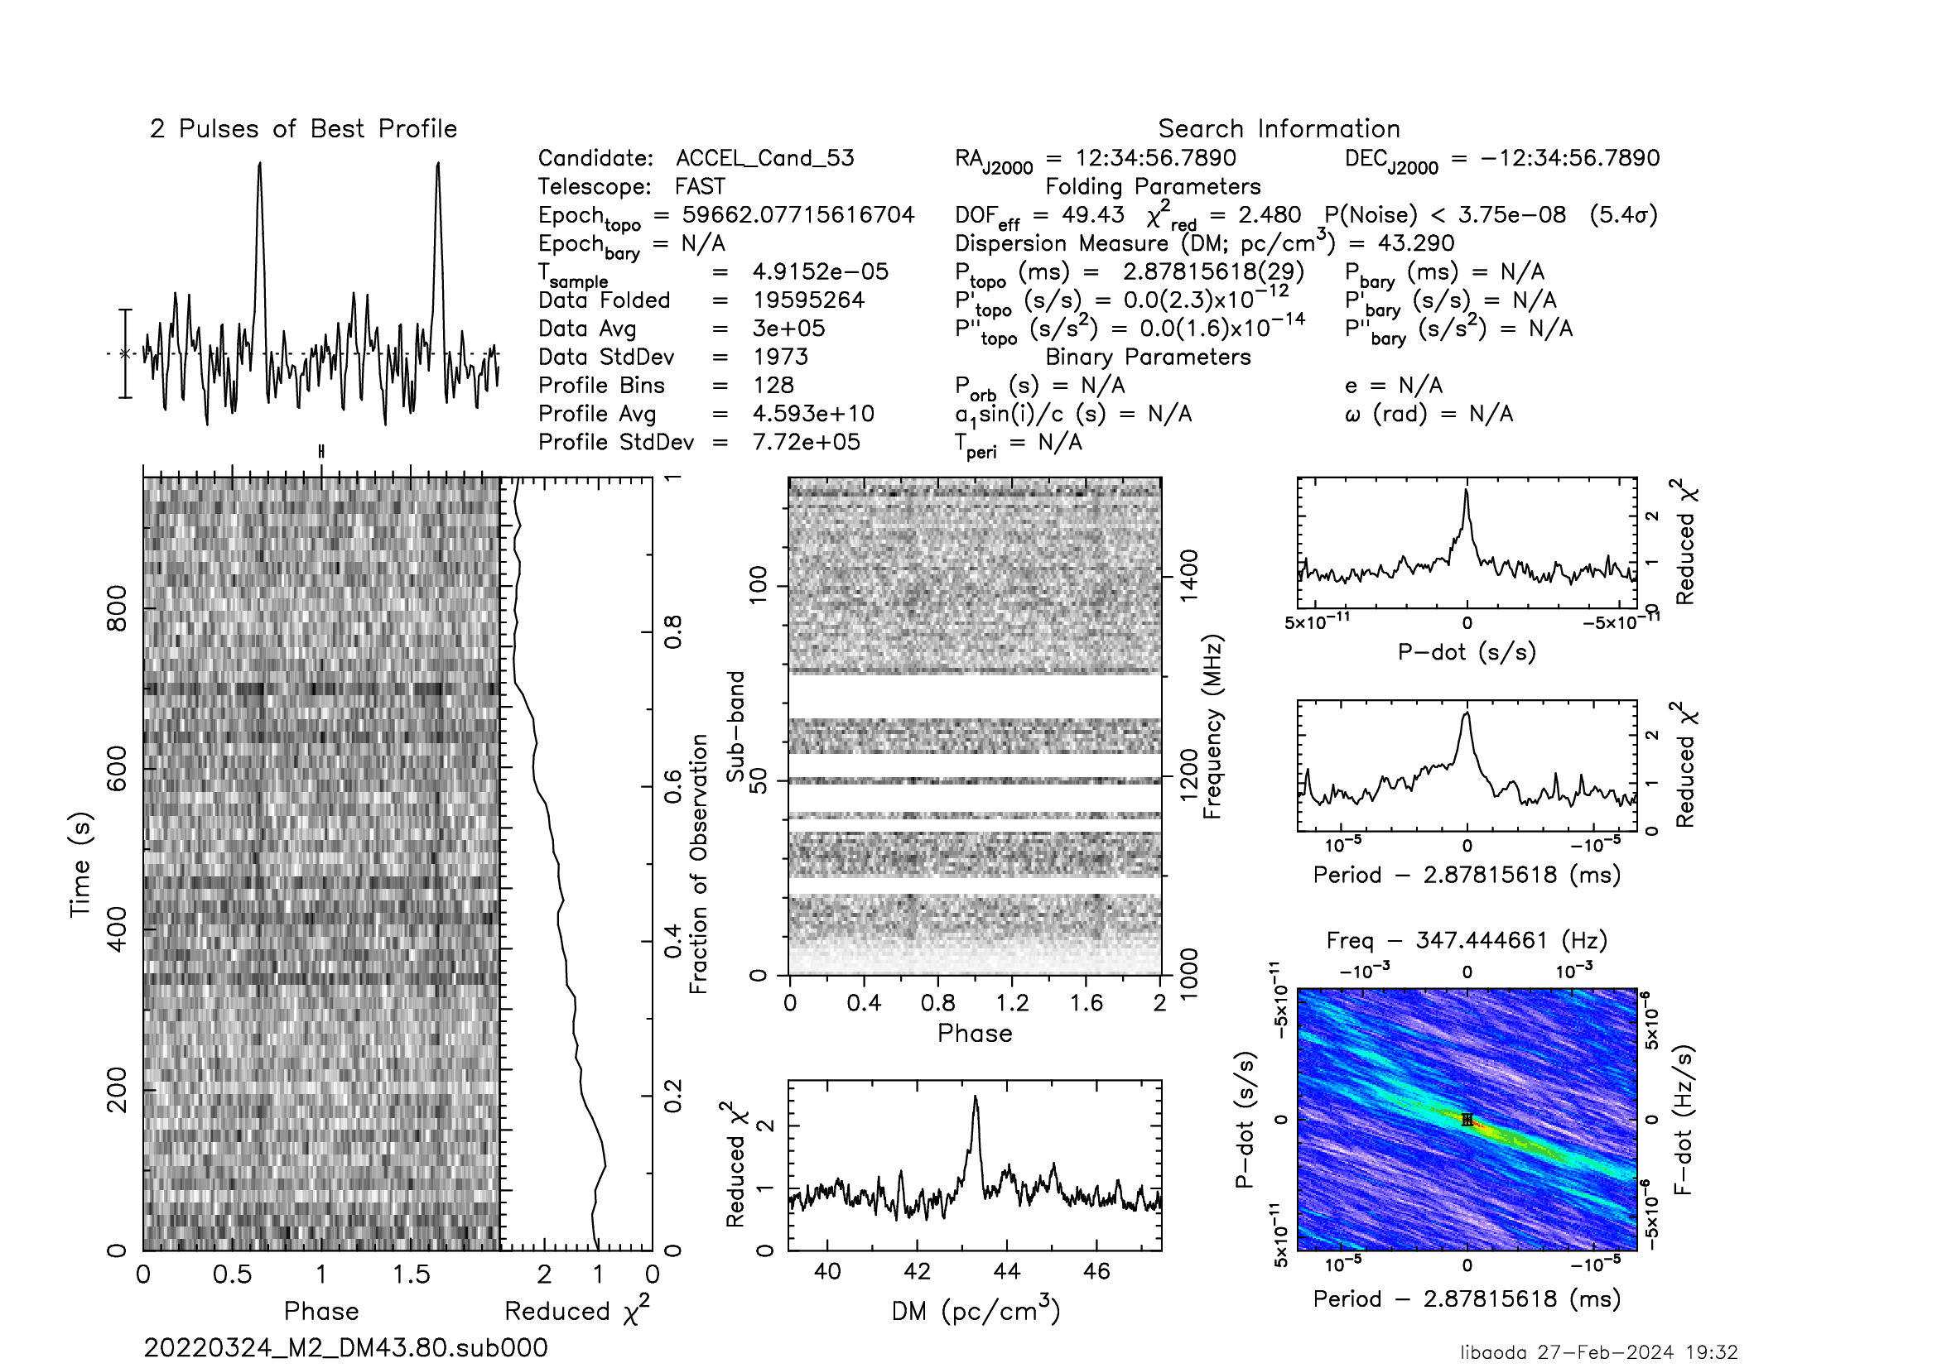
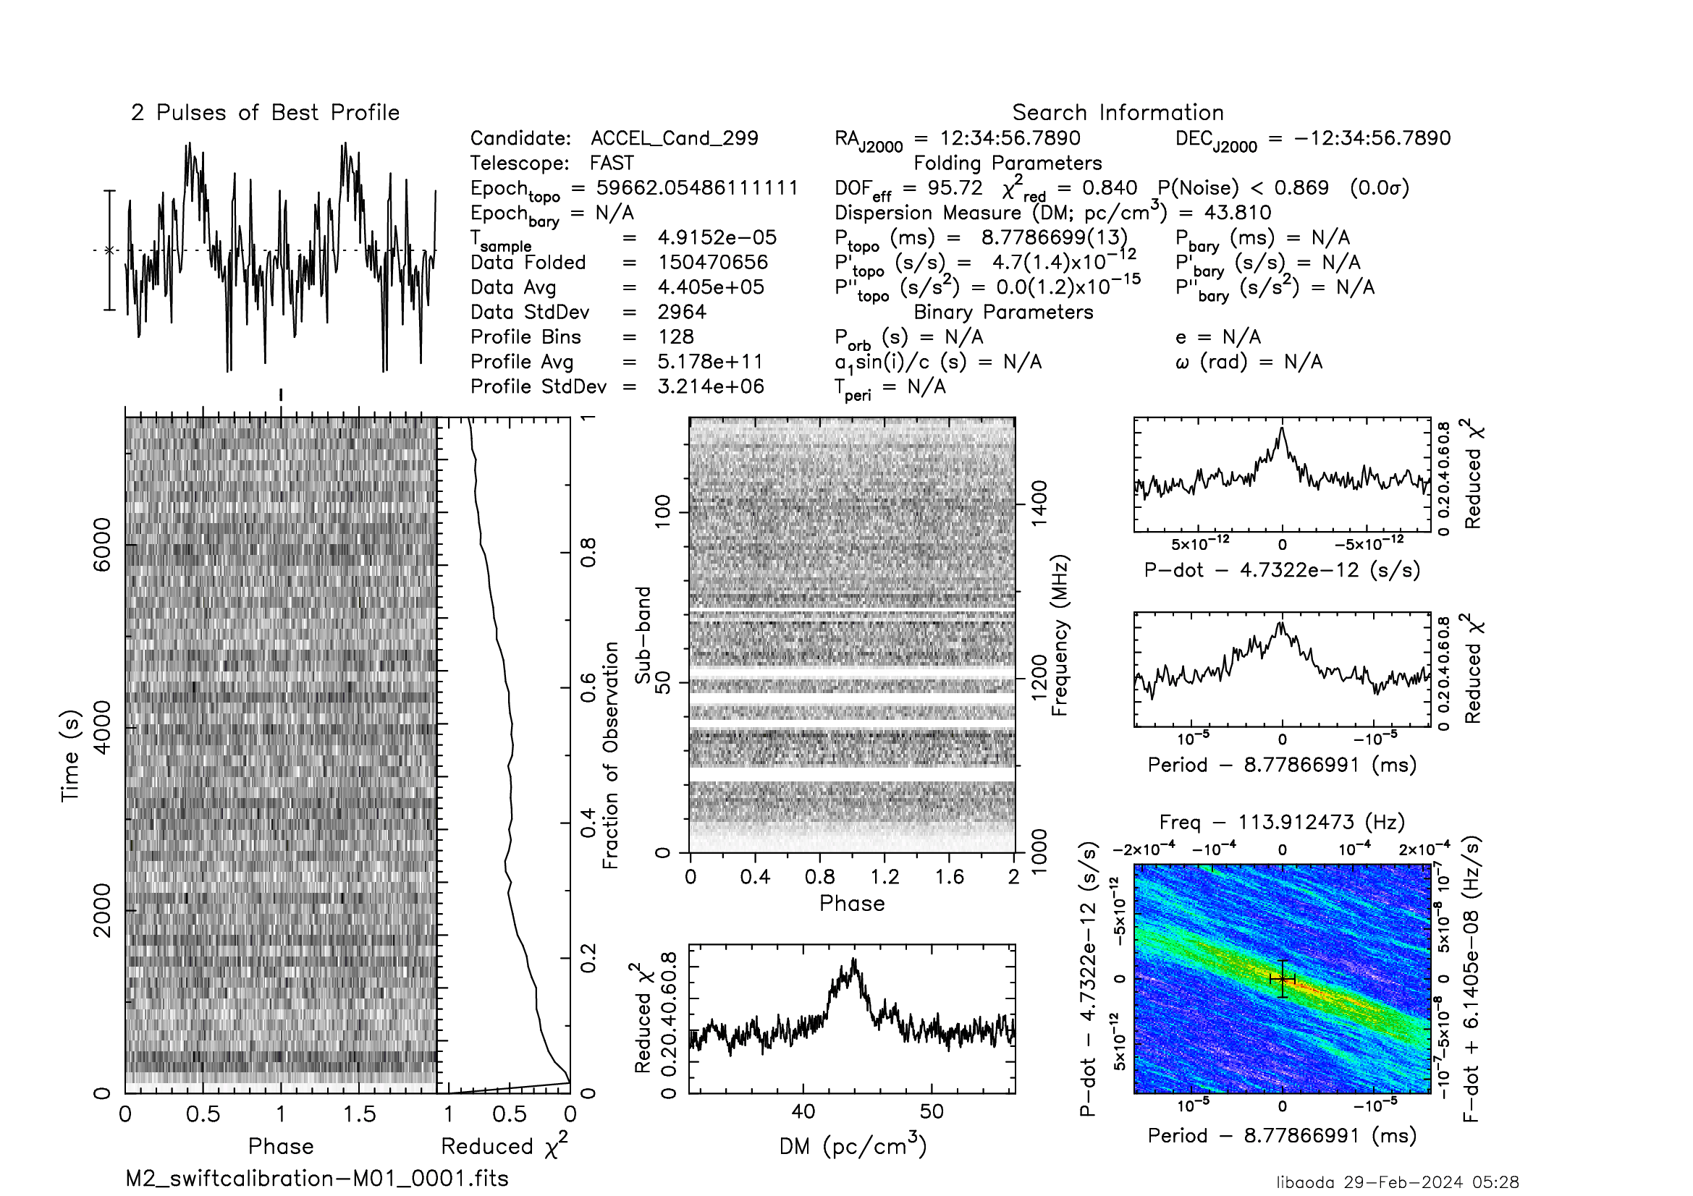
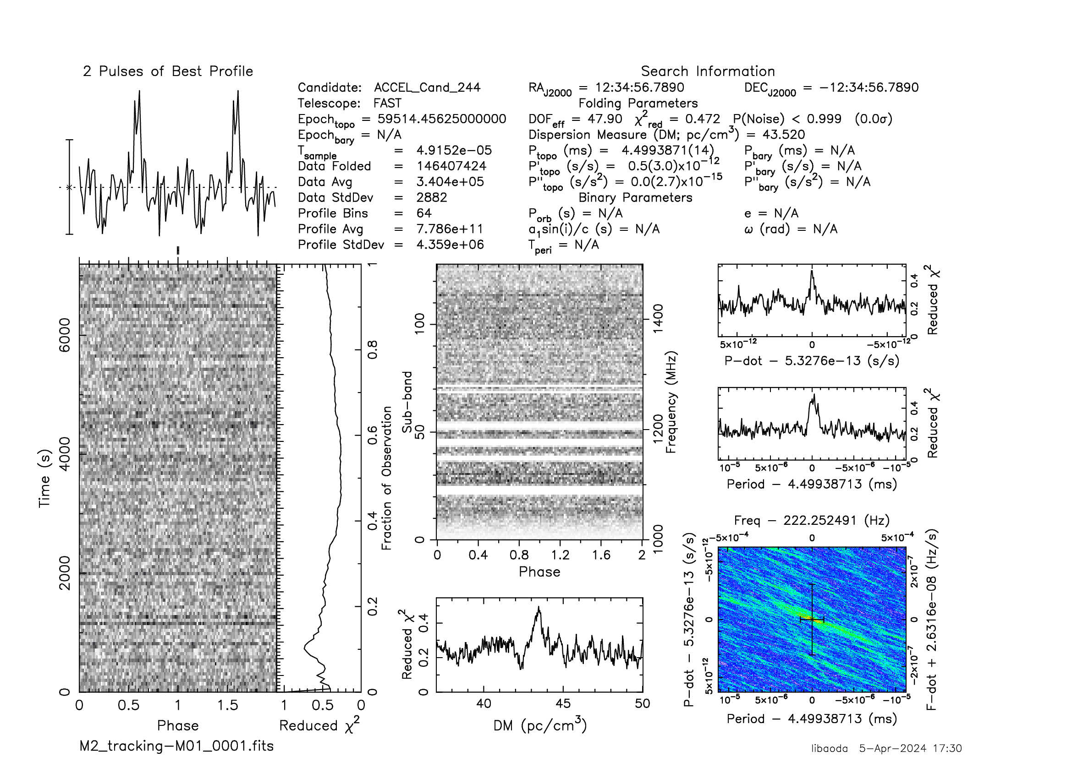
New pulsars in M2
M2G ~ 4.50 ms Pb ~ 0.12 day
M2H ~ 2.878 ms
M2I ~ 8.78 ms
M2J ~ 4.50 ms
Li et al. In prep.

Slide 7
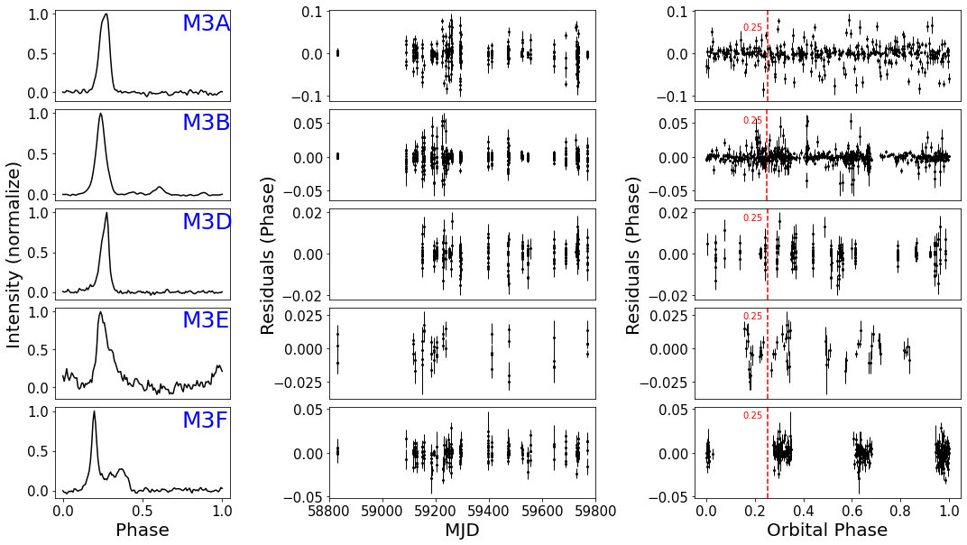
Timing residuals of pulsars in M3
Notes:
Based on the 41 archive data of FAST, we obtained the timing solutions of M3A,B,D,E and F, and we did not find any possible signals of M3C. The panel on the left shows the [ˈæ və rɪ dʒ] average pulse profiles of these five pulsars. The middle [ˈpænl] panel shows the timing [rɪ ˈzɪ dju əl] residual as a function of the times. The [ˈpænl] panel on the right shows the timing residual as a function of orbital phase, and the place with orbital phase of 0.25 is marked with a red [ˈvɜː tɪ kl] vertical line. [ɪkˈ se pt] Except M3F is not covered, we have not detected the phenomenon of radio [ɪˈk lɪ ps] eclipse in other pulsars.

Slide 8
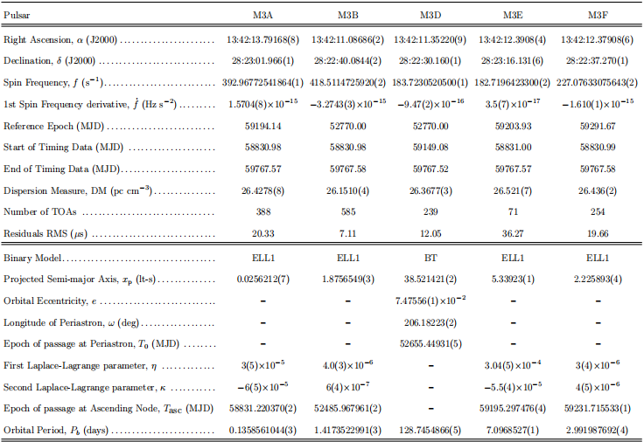
Pulsars in M3
Li et al. 2024.
Accepted by ApJ.

Slide 9
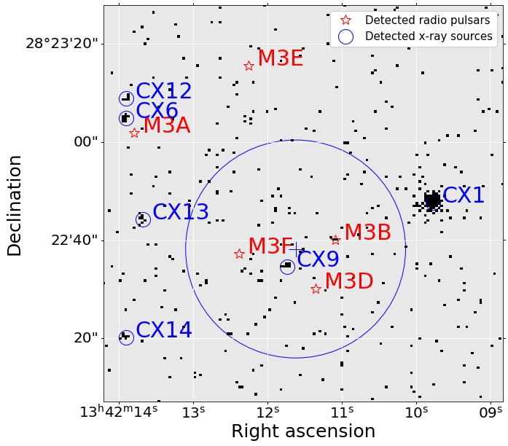
Pulsars in M3
Pulsar positions and X-ray sources from Chandra
M3B may have a weak X-ray emission ?
Binary system 100%，
Low stellar density
Notes:
the picture shows the position of M3 pulsars and the X-ray image of archival Chandra data.
The pulsars in M3 are all located near the core density [ˈdensəti] [ˈreɪdiəs] radius of 0.37 Arc second,
which is consistent [kənˈsɪstənt] with the position distribution of most pulsars in GCs, such as M13.
The positions of six bright X-ray sources near the core density radius detected by CXO are indicated by blue circles [ˈsɜːklz]. The known pulsars are represented [ˌreprɪˈzentɪd] by the red five-pointed stars. We find that there are three photons ['fəʊˌtəns] in M3B position. If this is really a weak emission from M3B. Then it may either [ˈaɪðə(r)] come from a [ˈsɪŋ krə (ʊ) trɒn] synchrotron-emitting standing shock driven by the [ˌɪntə rˈækʃn] interaction of the pulsar wind with outflowing material from the close companion, or it may be defined [dɪˈfaɪnd] by a magnetic [mæɡˈnetɪk] pole [poul] cap [ˈθɜːmo] thermal mode like the X-ray [ˌreɪdiˈeɪʃn] radiation of most millisecond [ˈmɪlɪsɛk(ə)nd] pulsars in NGC 104. As for M3 other pulsars, we don't find any evidence of X-ray emission, which may be due to their weak emission or long distance.

Slide 10
Detection rate of 41 observationsin M3
Name | Hessels et al. 2007 Det./Bbs.(%) | FAST archive data Det./Obs.(%)
M3A | 3/78 | 26/41
M3B | 16/78 | 37/41
M3D | 12/78 | 30/41
M3E | / | 17/41
M3F | / | 30/41
M3C ? | 1/78(Uncertified) | 0/41
Notes:
Due to the influence of interstellar scintillation, not every observation can detect these pulsars. This table shows the detection [dɪˈtekʃn] rate from M3A to F. For known pulsars, compared with Arecibo,
the detection [dɪˈtekʃn] rate of M3A, B and D in FAST were improved for 15, 4, and 5 times, respectively.

Slide 11
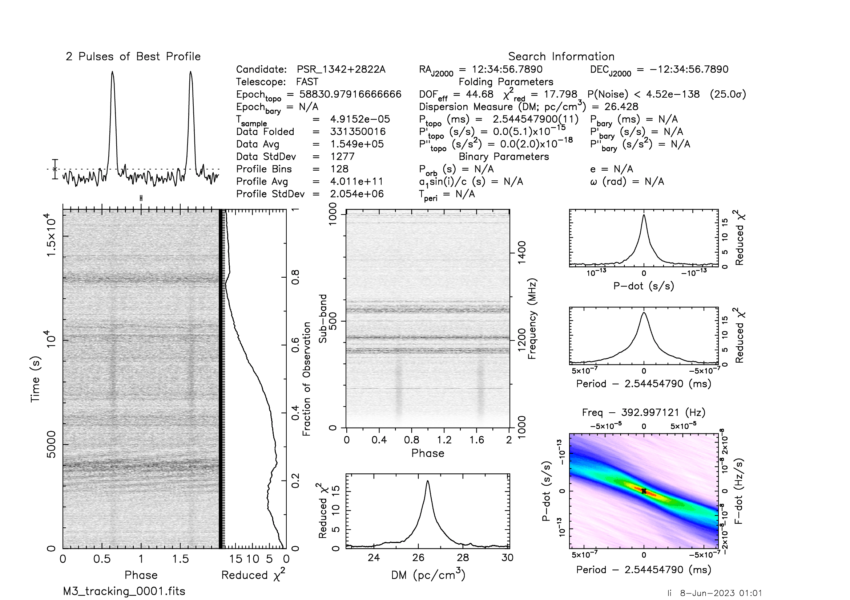
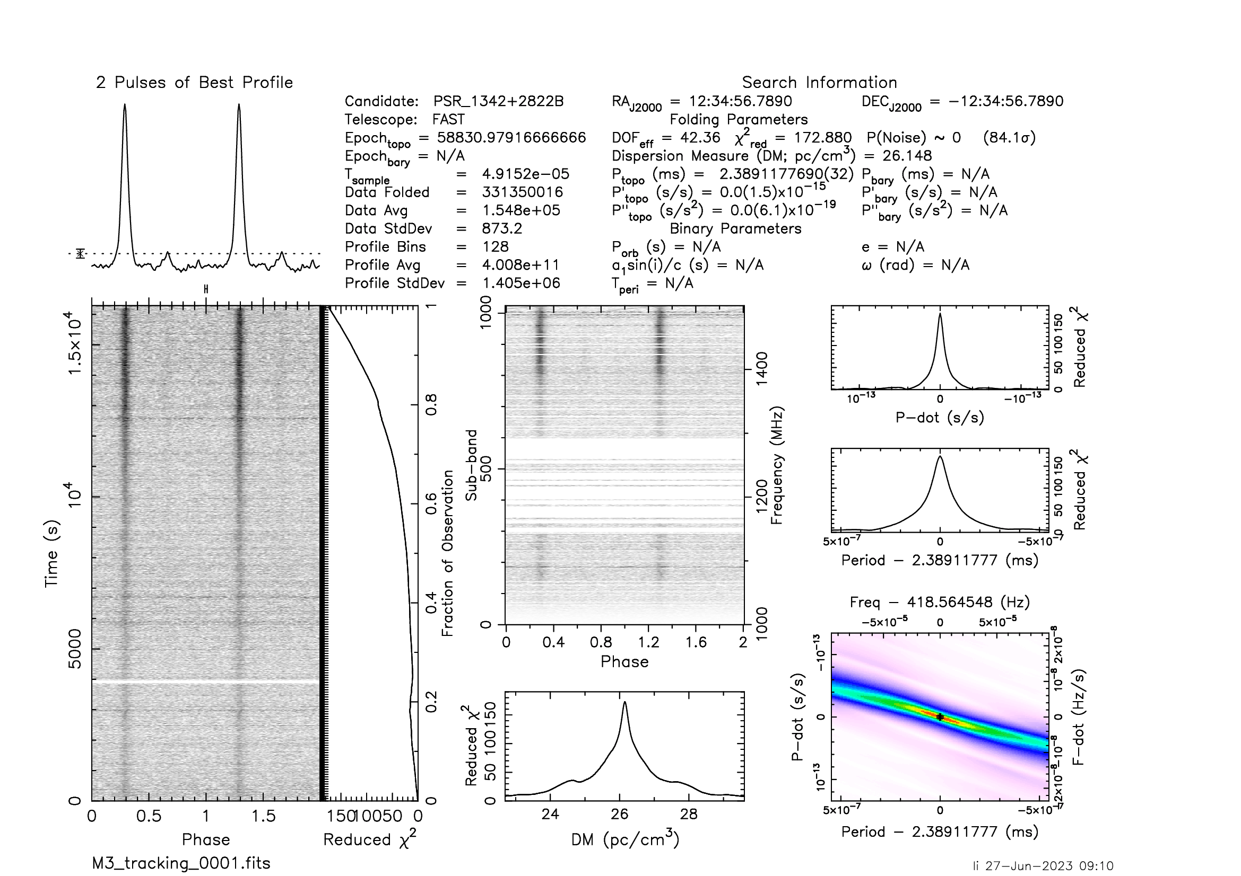
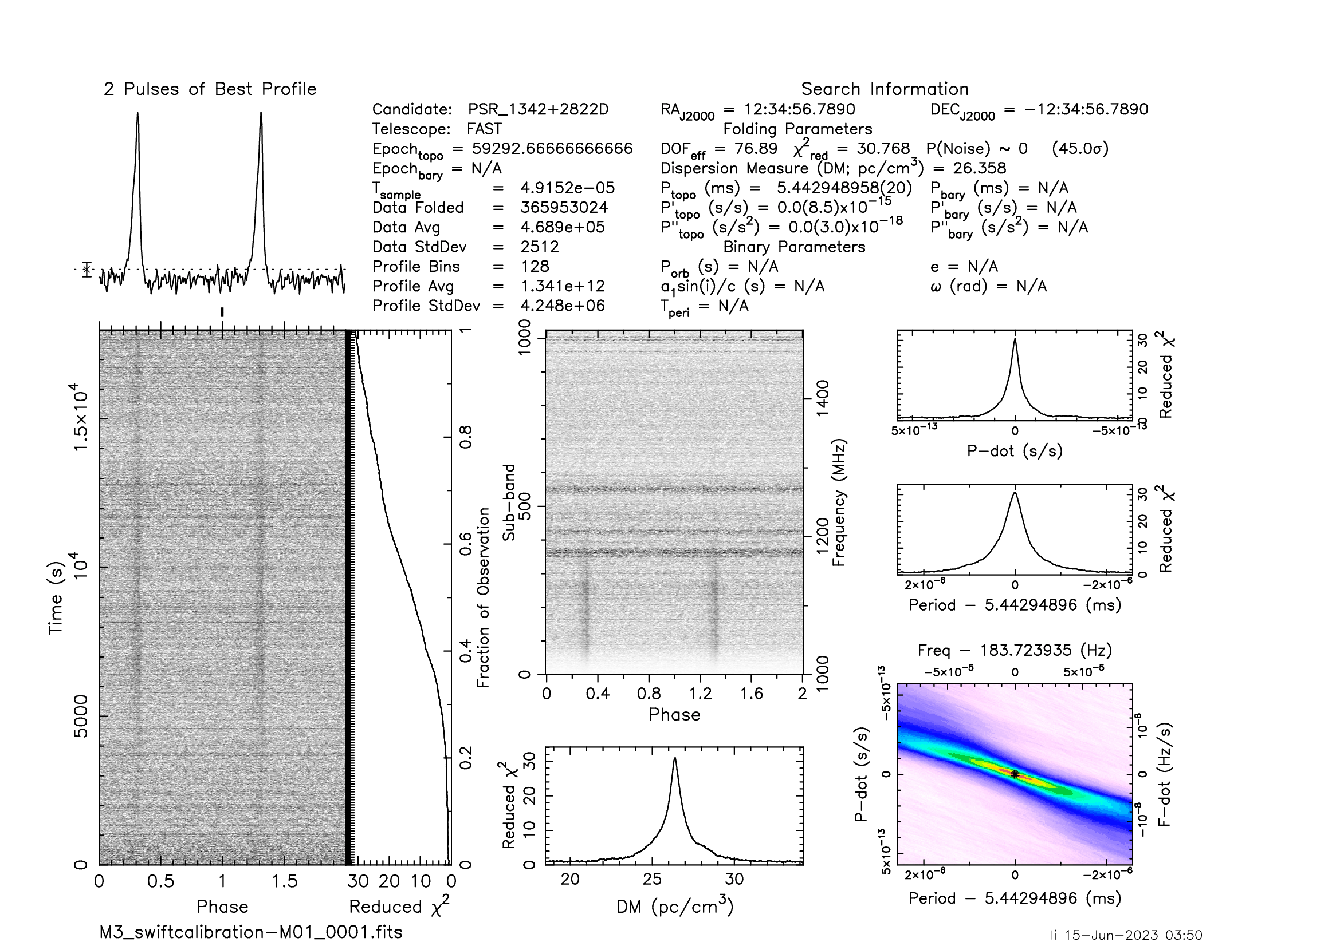
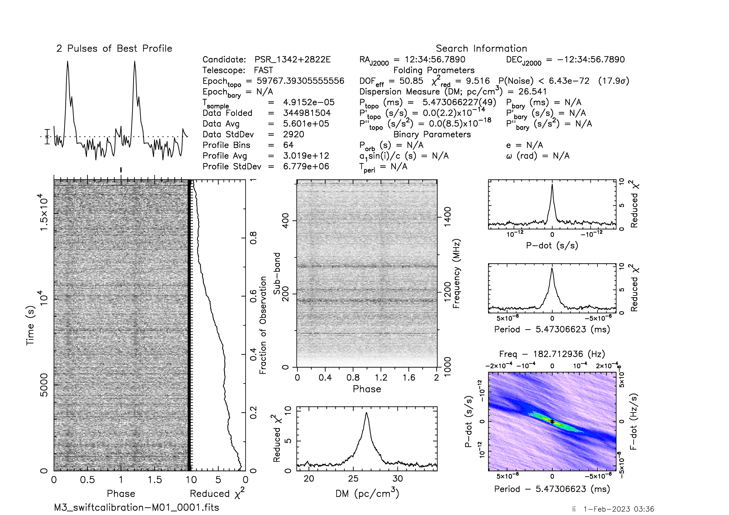
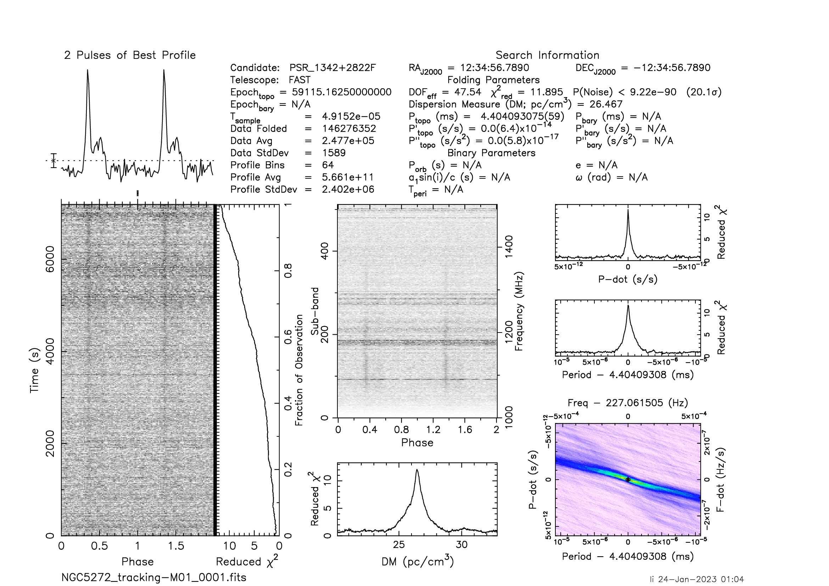
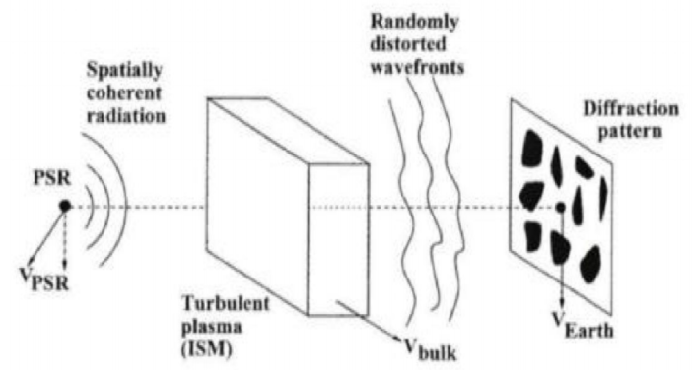
Scintillation pulsars in M3
M3A
M3B
M3D
M3E
M3F
( Cordes J, M. 2002 )
Interference + Relative motion of earth, pulsar and interstellar medium
Notes:
Pulsars M3A,B,D,E and F are shown here. It can be noted that the intensity [ɪnˈten sə ti] of each pulsar [ˈflʌk tju ei ts] fluctuates strongly in both time domain and frequency domain. For example, in Figure 1, we can see the signal in this part, but it disappears in this part. This is a scintillation [fəˈnɒ mɪ nən] phenomenon.

Slide 12
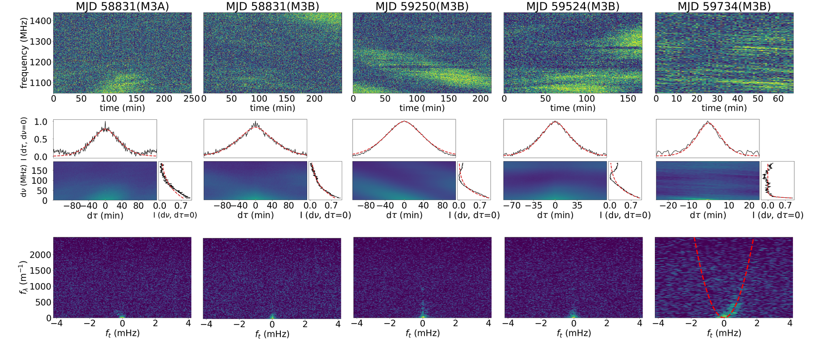
Dynamic spectra, ACF and secondary spectra of M3A and B
In the secondary spectrum, we only detected a clear scintillation arc of M3B. The fitted arc curvature is 649±23 m⁻¹ mHz⁻²
Li et al. 2024. Accepted by ApJ.

Slide 13
Scintillation parameters
The dynamic spectra of M3A and M3B are analyzed by ACF, and we get the following conclusions.
1、The scintillation bandwidths of M3A and M3B are basically the same at MJD 58831. The scattering of M3A and B may be dominated by the same scattering screen.
2、The scintillation time scale varies from ~ 7 to ~ 60 min and the scintillation bandwidth varies from ~ 5 to ~ 57 MHz.

Slide 14
Thanks for listening !
Conclusion
The timing solutions of M3A, B and D are updated, which are consistent with the predecessors. M3C was not detected.
The timing solutions of two new pulsars M3E and F are obtained.
For M3A and M3B, the scintillation timescale varies from ~ 7 to ~ 60 min. The scintillation bandwidth varies from ~ 5 to ~ 57 MHz.
The scintillation arc is captured in the stripe scintillation of M3B，the fitted value of the scintillation arc is ~ 649±23 m⁻¹ mHz⁻².
Discovery of four new millisecond binary pulsars in M2, namely M2G to J.
Notes:
M3E is at an orbit of 7 days with a companion mass of 0.24 Solar mass. M3F is at an orbit of 3 days with a companion mass of 0.17 Solar mass.
Because the motion of M3B is not well limited, the research on the position and properties of the medium screen will be our next work.

