Slide 1
Search for pulsars in globular clusters with the Fast Folding Algorithm
Guizhou University Yaowei Li
supervisor：Lei Qian，Zhichen Pan，Liyun Zhang, Lin Wang
FAST/Future Pulsar Symposium 13
Yunnan University, Kunming, Yunnan, China
July 14-16, 2024

Slide 2
Outline
01
02
Background
Searching process
03
04
Searching result
Summary

Slide 3
01. Pulsars in the globular clusters
https://www3.mpifr-bonn.mpg.de/staff/pfreire/GCpsr.html
330 pulsars discovered in 44/160+ GCs .
45 GCs in the FAST sky, 97 pulsars located in 17 GCs.
Notes:
At present, there are over 160GCs, and 330 pulsars have been discovered in 44 of them. There are 45 GCs in the FAST sky, of which 17 contain pulsars, for a total of 97 pulsars.
Most pulsars in GCs are millisecond pulsars, with only 14 pulsars having a spin period exceeding 100 ms.

Slide 4
01. The methods of pulsar search
Acceleration Search (FFT)
Fast Folding Algorithm (FFA）
Phase Modulation Search

Slide 5
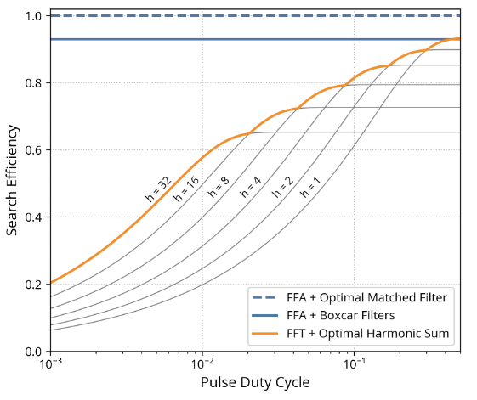
01. Fast Folding Algorithm
The emergence of FFA method roughly coincided with the discovery of pulsars.(Staelin 1969)
Due to the fact that FFA searches for periodic signals in the time domain, it has higher sensitivity than FFT.
Morello et al. 2020

Slide 6
Time cost test (FAST 1.5 hour observation data)
FFA | period range | Acceleration Search | zmax
~25 min | 1 ms - 100 s | ~20 min | 0
~30 min | 10 ms - 100 s | ~105 min | 100
~20 min | 100 ms - 100 s | ~370 min | 300
~14 min | 500 ms - 100 s | ~830 min | 600
Actual processing (M71) 71 time series parallel: 15
date | observation duration | cost
20200305 | 1927 s | ~1.5 h
20220617 | 3775 s | ~4.1 h
20220730 | 3145 s | ~3.3 h

Slide 7
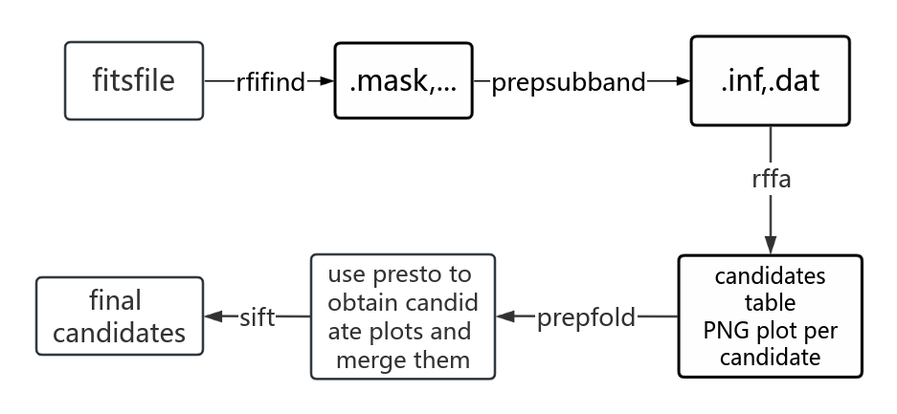
02. The flowchart of FFA search

Slide 8
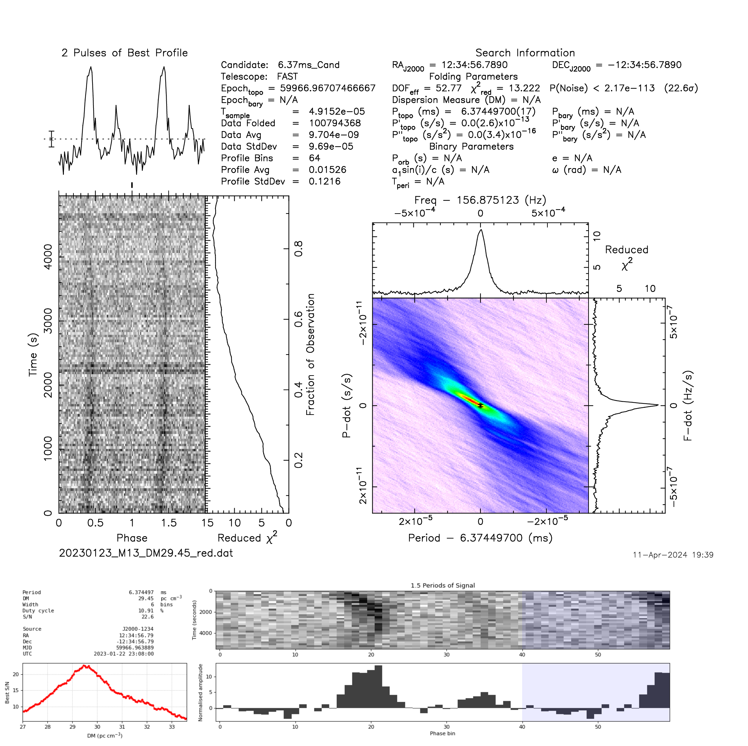
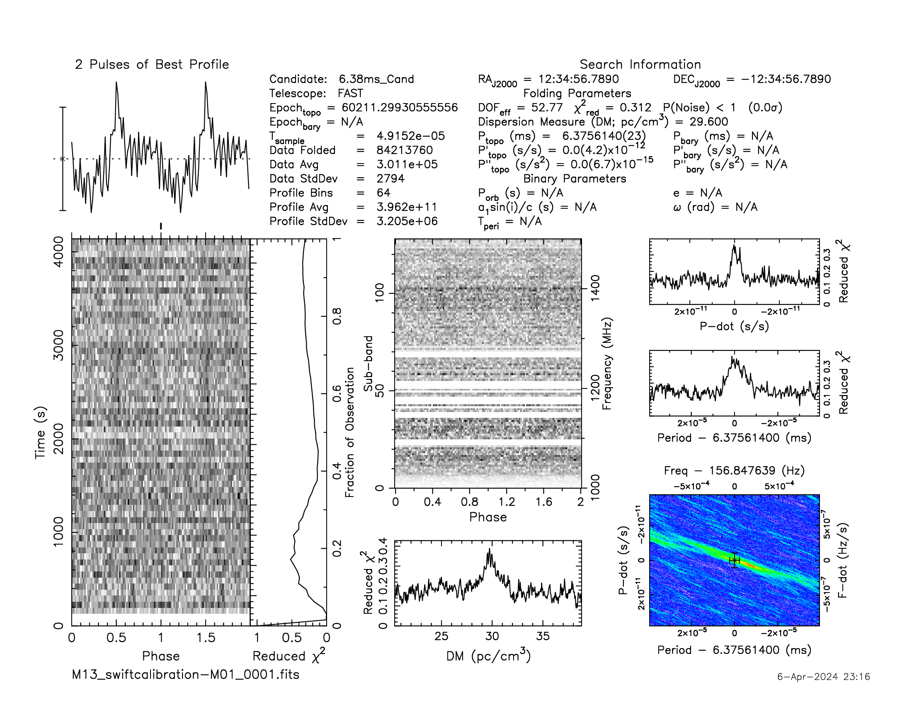
03. New pulsar M13I

Slide 9
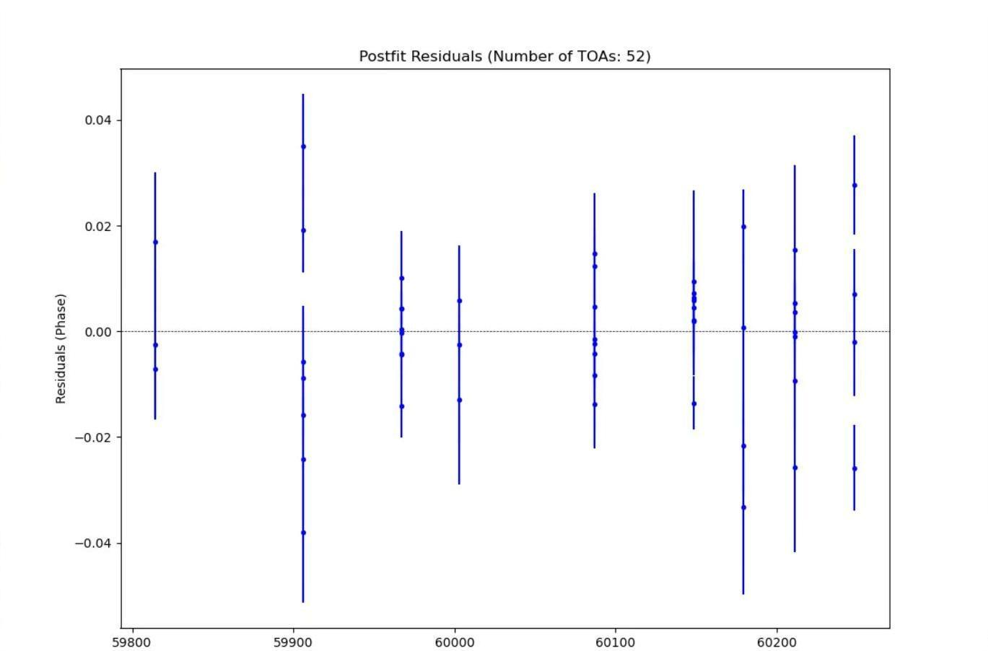
03. Timing result
P ~ 6.37 ms
PB ~ 18.23 days
A1 ~ 20.73
e ~ 0.0642
Companion mass (M⊙) :
0.4544 < 0.5414 < 1.3707
Timing residual of M13I

Slide 10
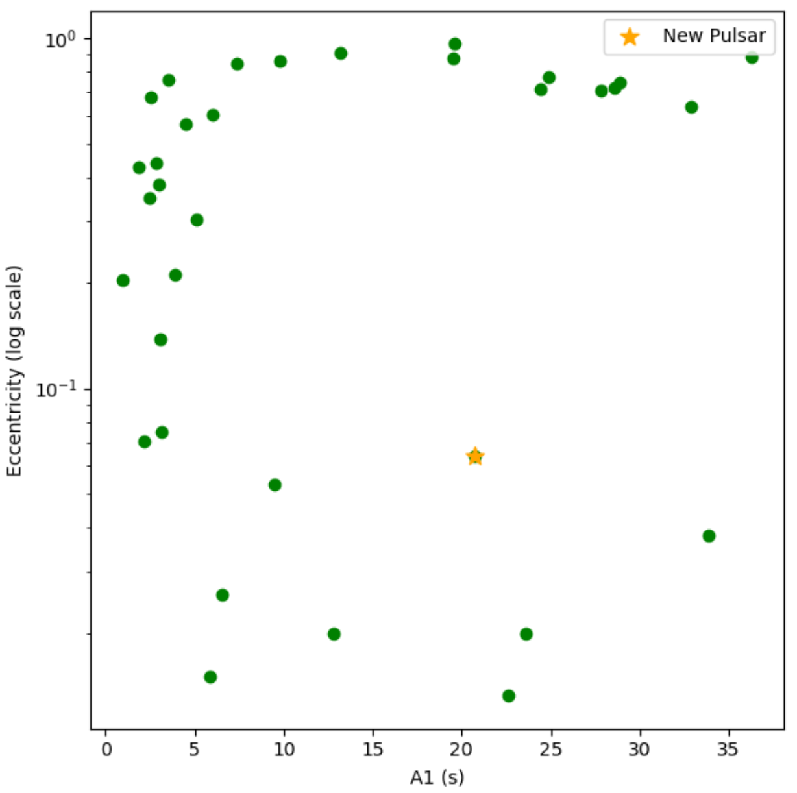
03. Relationship diagram of A1 and E
More FAST observations
A1 VS E
Notes:
From the relationship between A1, PB, and e, this pulsar seems to be in a peculiar position. Additionally, its companion star has a relatively large mass, we may be able to measure its post-Keplerian parameters.

Slide 11
03. Comparison between PRESTO and FFA
PRESTO search:
20181207, 20221123, 20230123, 20230523, 20230723, 20230823, 20230924
FFA search:
20181207, 20221123, 20230123, 20230523, 20230723, 20230823, 20230924, 20220201, 20220218, 20220823, 20230228, 20231031

Slide 12
03. Searching result：
Cluster Name | M10 | M12 | M13 | M14 | M15 | M2 | M3 | M53 | M5 | M71 | M92
Number of pulsars | 2 | 2 | 9 | 5 | 14 | 10 | 5 | 5 | 7 | 5 | 2
Detect with FFA | 2 | 1 | 6 | 2 | 12 | 10 | 4 | 5 | 7 | 5 | 1
The number of pulsars in GCs and the detection rate of FFA

Slide 13
03. Searching result：
Cluster Name | NGC6517 | NGC 6539 | NGC6712 | NGC 6749 | NGC 6760
Number of pulsars | 20 | 1 | 1 | 1 | 2
Detect with FFA | 19 | 1 | 1 | 1 | 2
The number of pulsars in GCs and the detection rate of FFA

Slide 14
03. Searching result：
We have processed data from some globular clusters where no pulsars were found, includes:
IC1257, IC1276, M56, Mercer5, NGC2419, NGC5466, NGC6229, NGC6366, Pal10, Palomar11, Pal13, Pal14, Pal15, and Pfleiderer2 (all 14 GCs).

Slide 15
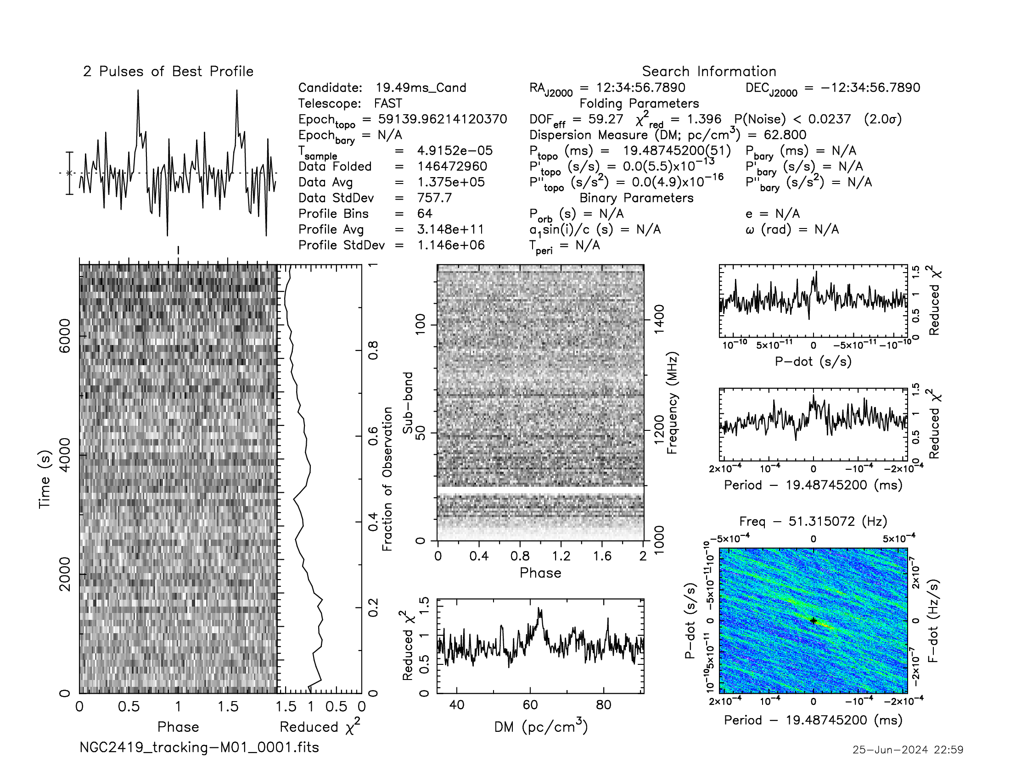
03. A candidate in NGC2419

Slide 16
04. Summary
We used FFA to process some globular clusters data in the FAST sky.
In M13, we discovered a new pulsar in a binary system with the orbital period of ~ 18.23 days and its spin period of ~ 6.37 ms.
Additionally, we found several candidates. In the future, we plan to continue processing data from other globular clusters in the hope of discovering more pulsars.
THANKS ！

