Slide 1
4FGL J1318.2+6754: A long orbital-period redback candidate
Jie Lin
Xiamen University
Collaborators: Chen Hailiang, Wang Bojun, Xu Renxin
Lin Jie., Chen Hailiang., Wang Bojun., Xu Renxin., 2024, ApJL, 960, L5
July 14, 2024

Slide 2
Outline
Searching for MSP candidates with 4FGL-DR3/Gaia-DR3
Optical spectra and photometry
Constraints on the inclination and MSP mass
Discussion and conclusions

Slide 3
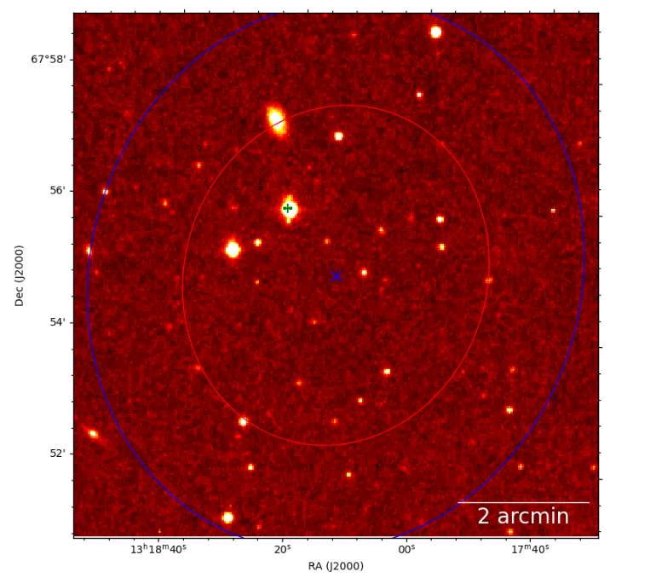
Searching for MSP Candidates with 4FGL-DR3/Gaia-DR3
Gaia DR3 contains > 181000 orbital solution for single-lined spectroscopic binaries (SB1s)
The fourth Fermi Large Area Telescope catalog (4FGL-DR3) provides 6658 gamma-ray sources
The Digitized Sky Survey (DSS) image of the 4FGL J1318.2+6754. The red and blue ellipses show 68% error ellipse and 95% error ellipse of 4FGL catalog, respectively. The small pink plus is the position determined by the SB1 of Gaia DR3, which located at a 95% confidence level of 4FGL J1318.2+6754.

Slide 4
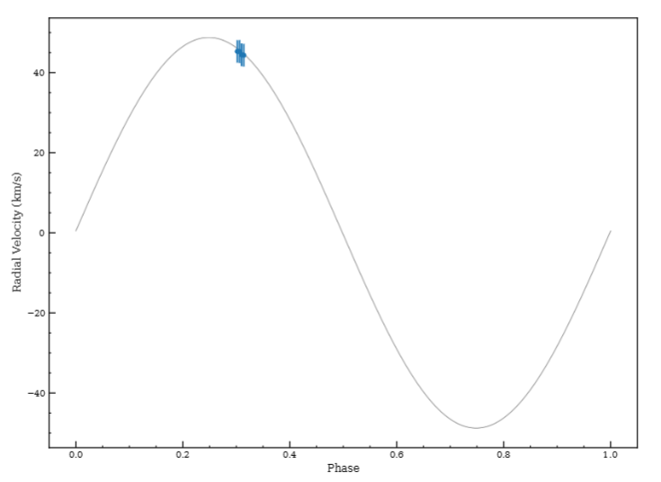
Optical spectra and photometry
The radial velocity (RV) solutions of the Gaia DR3:
$$P=\text{4.129265937434151}±\text{0.0005006378} day$$
$$e=\text{0.05}±\text{0.0}\text{3}$$
$$K=\text{48.713}±\text{1.13 }\text{km}\text{/}\text{s}$$
$$γ=\text{−14.95}±\text{0.762 }\text{km}\text{/}\text{s}$$
The mass function:
$$f\left(M\right)=\frac{P_{orb}K^{3}{(1−e^{2})}^{3/2}}{2πG}=\frac{M_{NS}\sin^{3}i}{{(1+q)}^{2}}≃0.049M_{⨀}$$
The observed radial velocities for the J1318 as a function of the orbital phase obtained in 4 epochs from the LAMOST, with radial velocity solution of the Gaia DR3, plotted.

Slide 5
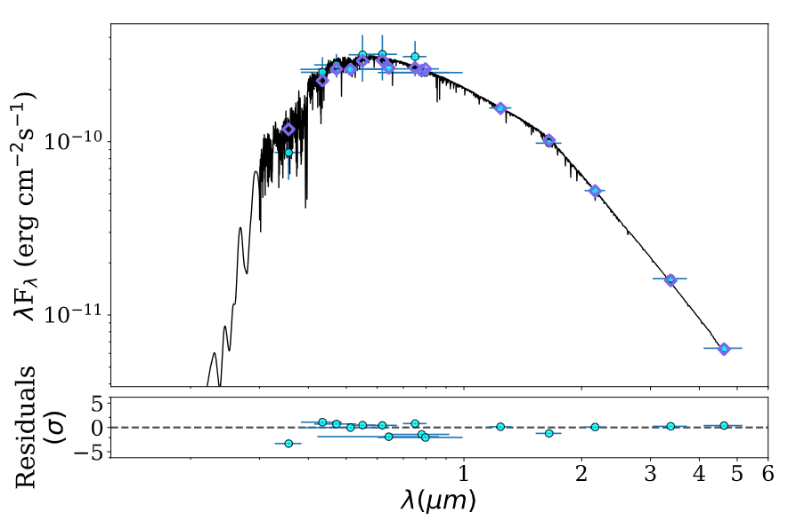
Optical spectra and photometry
$T_{eff}={5891}_{−52.4}^{+49.62} K$
$$R= {1.356}_{−0.035}^{+0.013}R_{⊙}$$
The best-fitting SED model for J1318 after fixing the extinction parameters Av=0. The black curve is the best-fitting model. The green pluses and circles are the retrieved photometric measures. The blue diamonds are synthetic photometry.

Slide 6
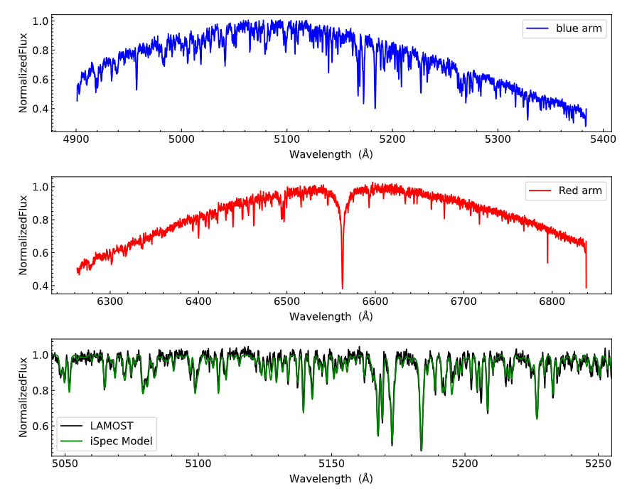
Optical spectra and photometry
$$T_{eff}=5891K$$
$${[Fe}/{H]}=−0.55±0.13$$
$$logg=4.07±0.32$$
Upper: the mid-resolution LAMOST spectra of the blue arms is shown. Middle: the mid-resolution LAMOST spectra of the red arms is shown. Lower: a model spectrum in the blue arms using the atmospheric parameters derived from iSpec is shown in green.

Slide 7
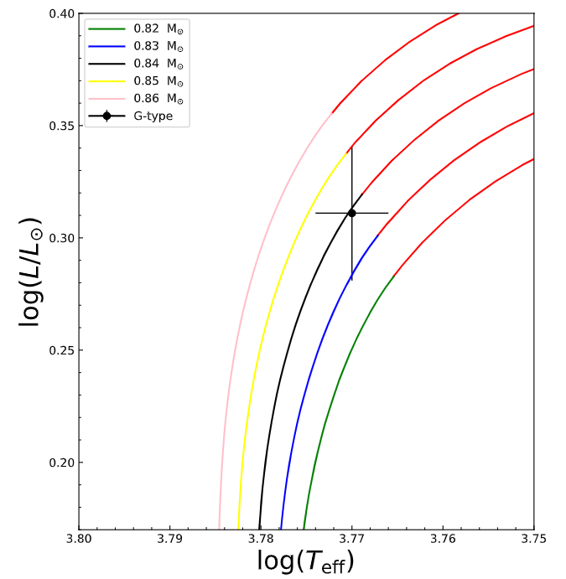
Optical spectra and photometry
$$M_{G}=0.84±0.02M_{⨀}$$
The position of the G-type main-sequence star is shown in black, comparing to sing-star MIST evolutionary with [Fe/H]=-0.5. Here, the red lines is the subgiant branch.

Slide 8
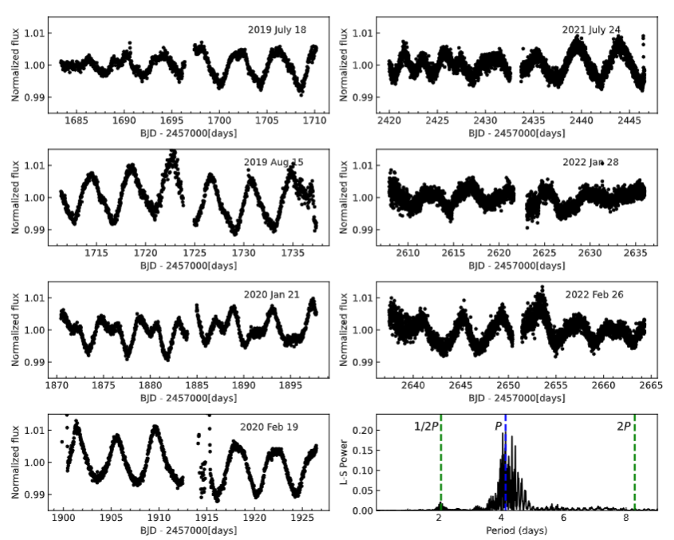
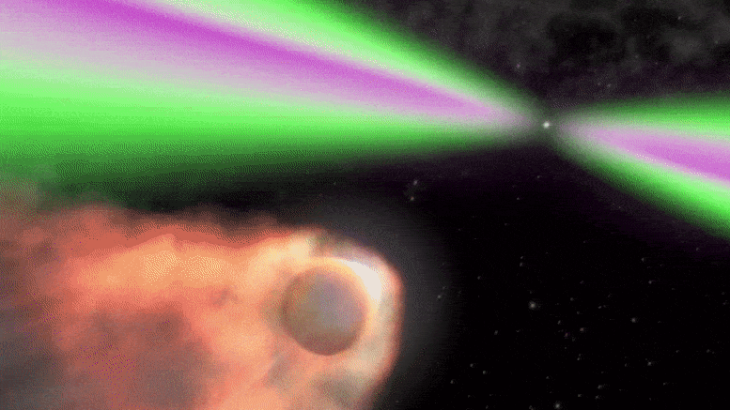
Optical spectra and photometry
credit: Wikipedia
The TESS light curves for J1318 from 2019 July to 2022 February. The Lomb-Scargle periodgram of the TESS light curve, showing a clear peak around 4.13 d.
Spider pulsars: “redbacks” and “black widows”. The side of the companion star facing the pulsar is heated due to direct bombardment by pulsar wind particles.

Slide 9
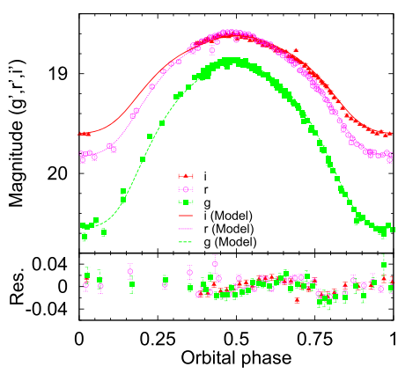
Constraints on the inclination
$$T_{irr}^{4}=T_{day}^{4}−T_{night}^{4}$$
$$ηL_{sd}=4πa^{2}σT_{irr}^{4}$$
$T_{irr}$ ,$T_{day}$and $T_{night}$are the irradiation temperature, the temperatures of the companion’s dayside and nightside, respectively. $η$ and a are the orbital separation and the heating efficiency, respectively.
A case for a “redback” binary MSP. The light curve of PSR J2215+5135 Linares, M., et al. 2018.

Slide 10
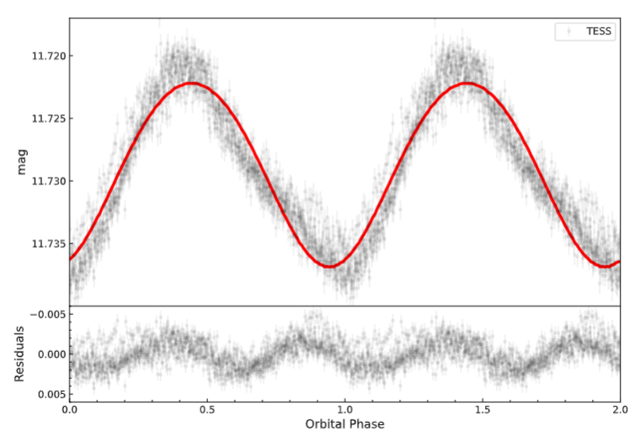
Constraints on the inclination and MSP mass
With radial velocity solution of the Gaia DR3 and, the radius and temperature from SED.
The best-fit ELC code model:
$${i=27.9}^{°}$$
$$L_{irr}=5×{10}^{34}erg{ s}^{−1}$$
$$f\left(M\right)≃0.049M_{⨀}$$
$$M_{G}=0.84M_{⨀}$$
$$M_{MSP}=1.30M_{⨀}$$
$$L_{sd}=2.0×{10}^{35}ergs^{−1},η=0.3$$
The typical for energetic millisecond pulsar $L_{sd}∼{10}^{34−35}erg{ s}^{−1}$
TESS optical photometry of J1318 in August 2019. The red lines show the best-fit ELC code model. Lower panels show residuals for the difference between the observed and calculated magnitudes

Slide 11
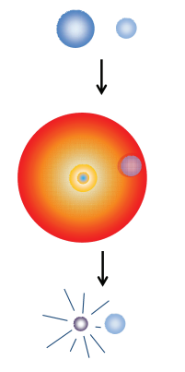
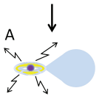
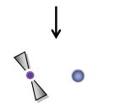
Discussion and conclusions
Standard recycling scenario: A neutron star is spun up to MSPs via accretion of mass and angular momentum from a companion star in a low-mass X-ray binary.
Challenging the recycling scenario
The Roche-lobe radius and a small filling factor of about 0.3:
$$R_{L}={({2M_{G}GP^{2}}/{81π^{2}})}^{1/3}=4.71R_{⨀}≫R=1.36R_{⨀}$$
Where $M_{G}=0.84M_{⨀}$ and
$$P=\text{4.129265937434151}$$
Standard recycling scenario, Tauris et al.2011

Slide 12
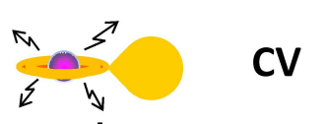
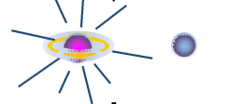
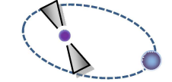
Discussion and conclusions
The dynamical effect of the AIC:
The change of the binary semi-major axis
$\frac{a}{a_{0}}=[\frac{1−(∆M/M_{0})}{1−2\left(\frac{∆M}{M_{0}}\right)−{\left(\frac{ω}{v_{c}}\right)}^{2}−2cosθ(\frac{ω}{v_{c}})}]$
The post-AIC eccentricity:
$e=\frac{M_{Ch}−M_{NS}}{M_{NS}+M_{2}}$
Their predicted small space velocities:
10-$30 km{ s}^{−1}$
Super-Ch. ONeMg WD
AIC
The properties of 4FGL J1318.2+6754 :
$\text{The} \text{small} \text{space} \text{velocities}\text{:}$
$$V_{sys}\sim 20.92 km s^{−1}$$
The eccentricity:
$e=\frac{M_{Ch}−M_{NS}}{M_{NS}+M_{2}}∽0.04$
MSP + G-type star
Illustration of Accretion-induced collapse (AIC)
Tauris et al. 2013, Freire & Tauris 2014

Slide 13
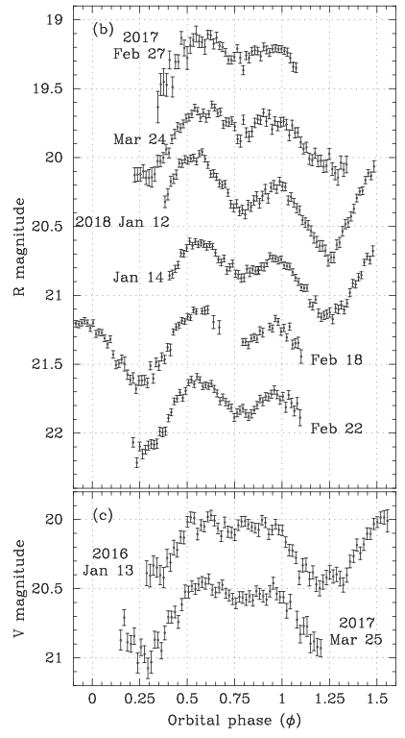
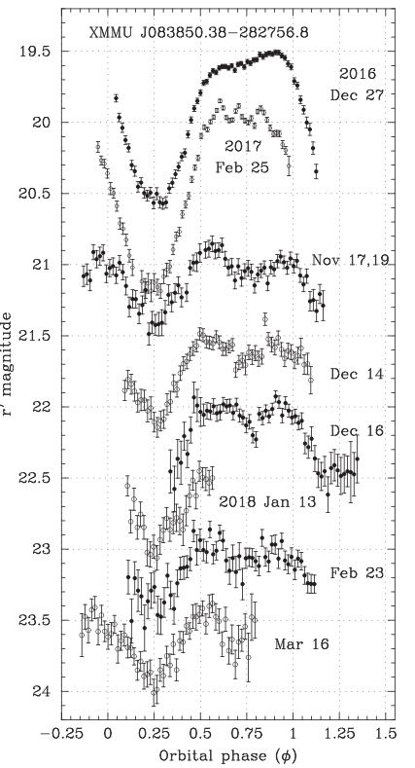
Discussion and conclusions
Possibilities: intrabinary shock distorted by orbital motion or direct channeling of the pulsar wind by magnetic field intrinsic to the companion star or companion stellar activity
A symmetric heating light curve shown in other redback pulsar. Optical light curves of PSR J1048+2339 and XMMU J083850.38−282756.8 as a function of orbital phase, respectively.
Tang et al. 2014; Romani & Sanchez 2016; van Staden & Antoniadis 2016; Sanchez & Romani 2017; Halpern et al. 2017

Slide 14
Discussion and conclusions
We report a new candidate redback millisecond pulsar binary, which could be the longest one for known redback if confirmed.
This candidate redback millisecond pulsar binary may be created via accretion-induced collapse (AIC) of an ONeMg WD.
if the candidate redback millisecond is confirmed, which will help us understand the formation of millisecond pulsar.
THANKS

