Slide 1
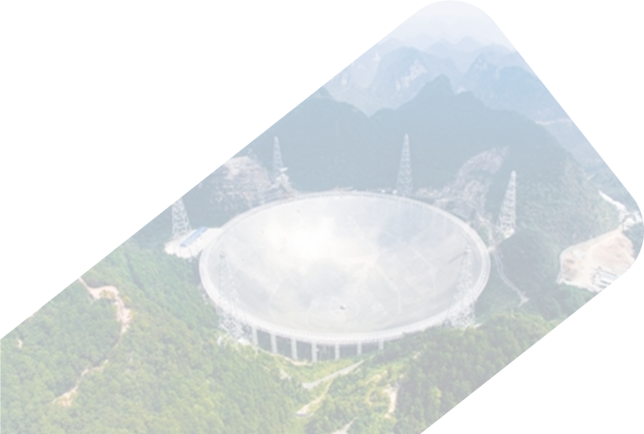
Selection Effects in Statistical Analysis of Repeaters
Xiao-Hui Liu
Collaborators: Wei-Yang Wang*, Wei-Cong Jing, Xue-Lei Chen* and Jin-Lin Han
National Astronomical Observatories, CAS

Slide 2
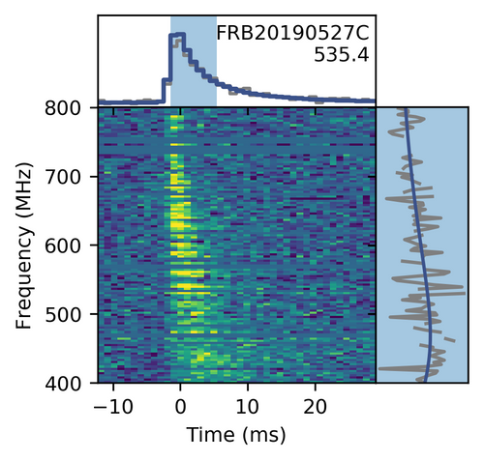
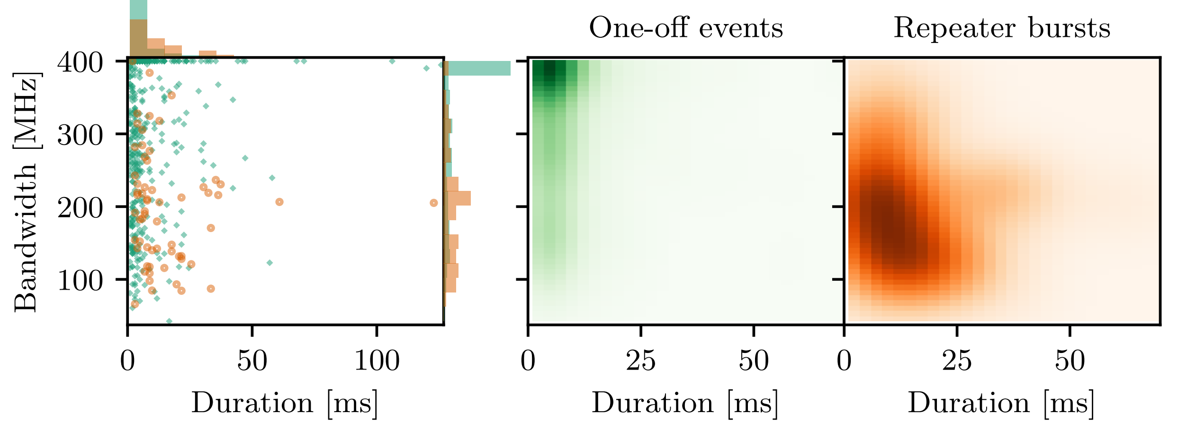
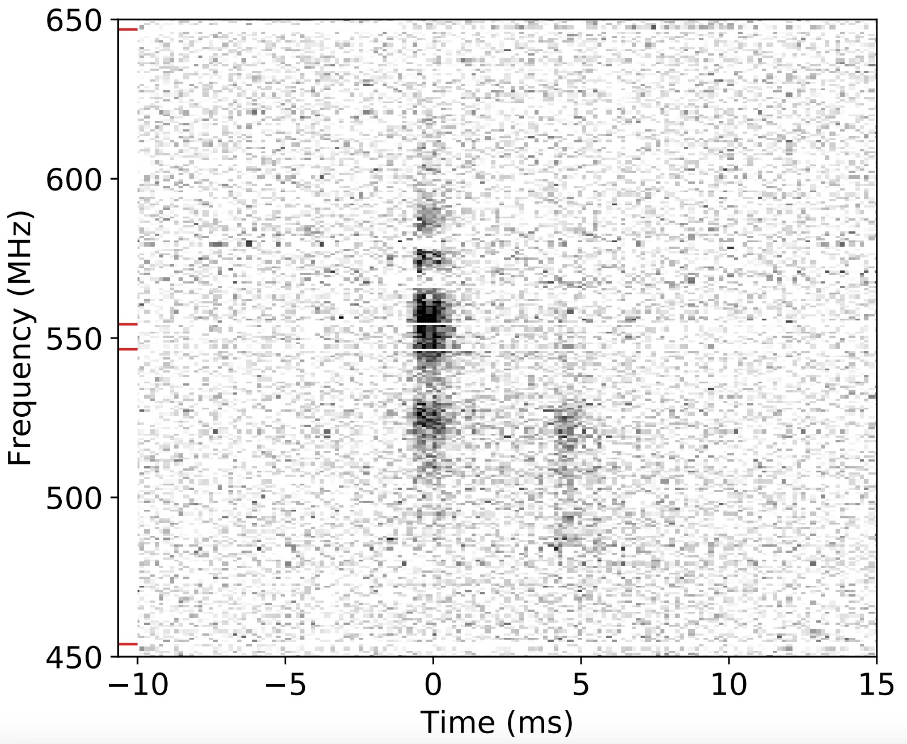
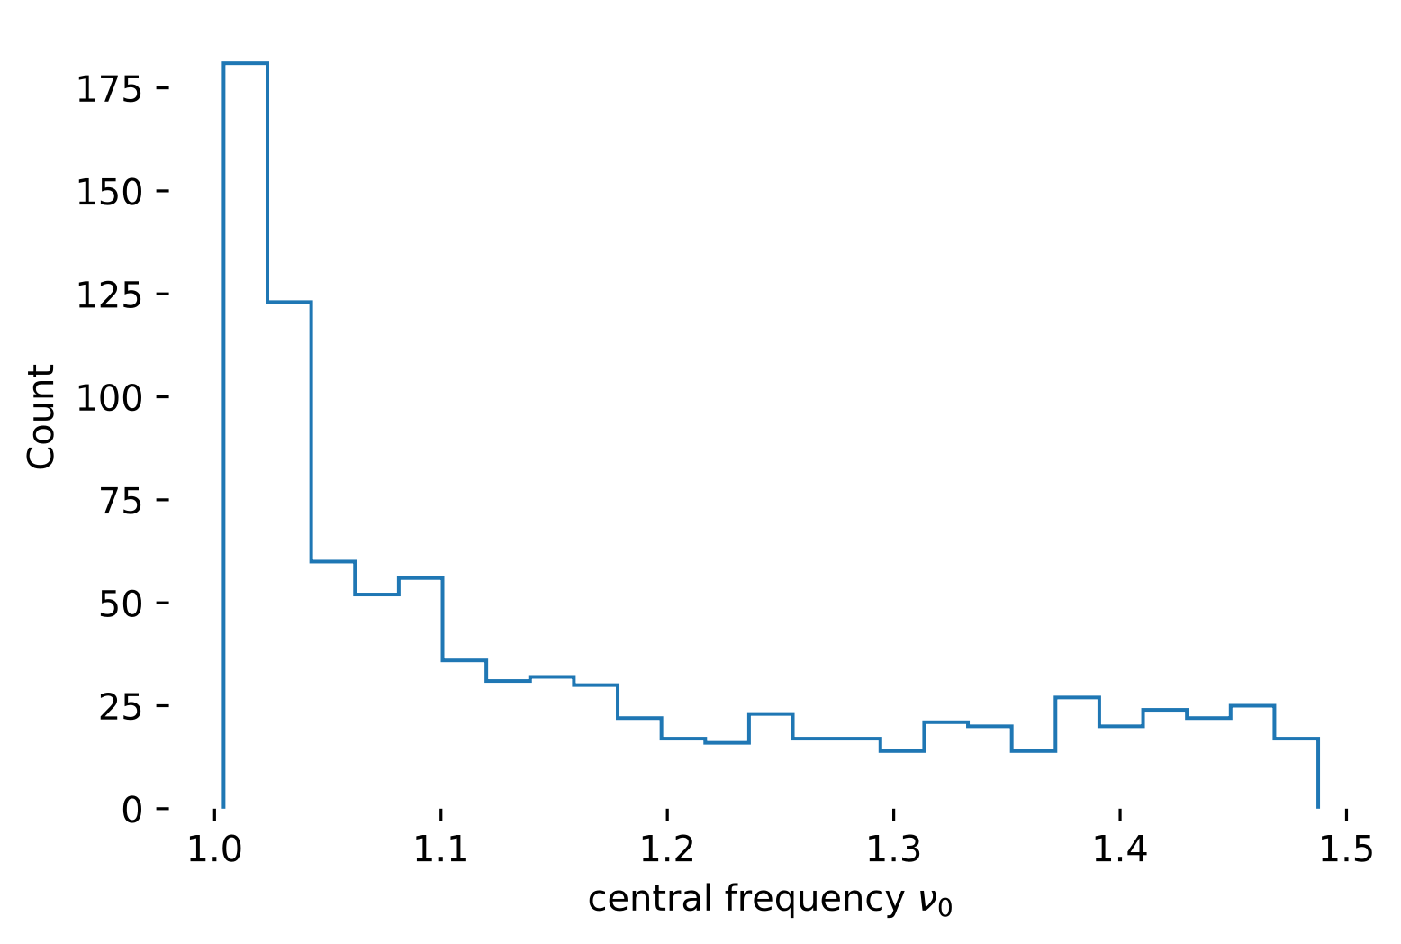
Fast Radio Bursts
Repeaters:
shorter duration
broader bandwidth
one-off
CHIME/FRB Collaboration et al. 2021
Pleunis et al. 2021
Repeaters:
longer duration
narrower bandwidth
frequency preference
CHIME/FRB Collaboration et al. 2019

Slide 3
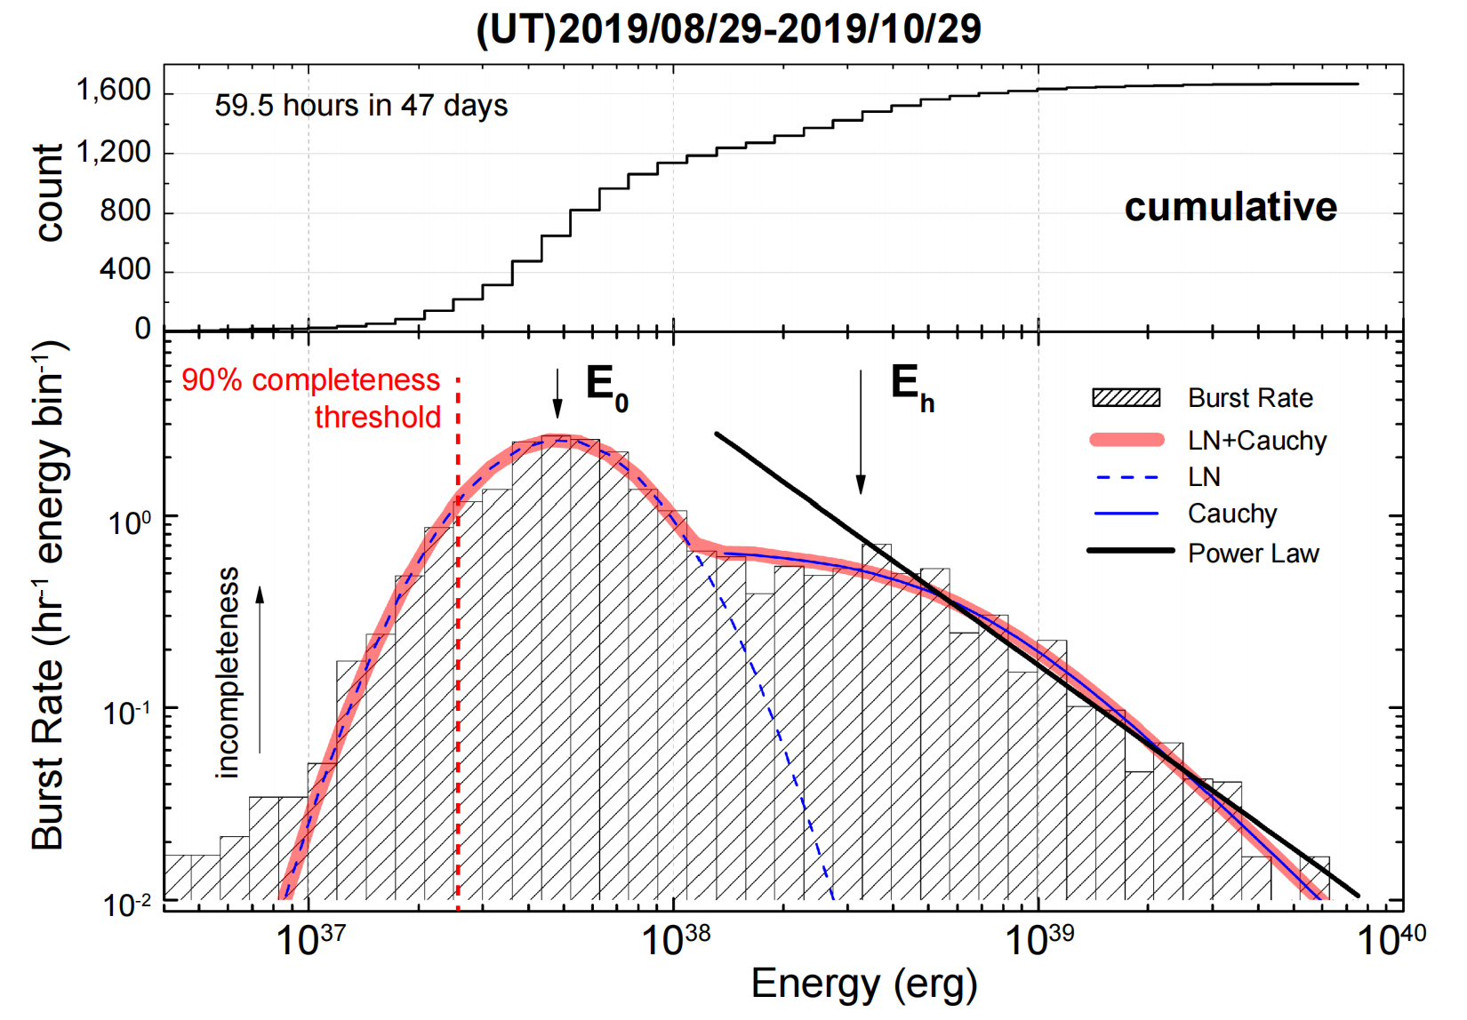
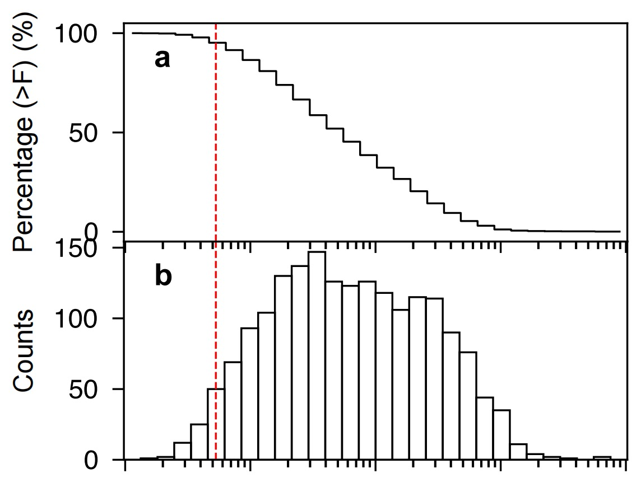
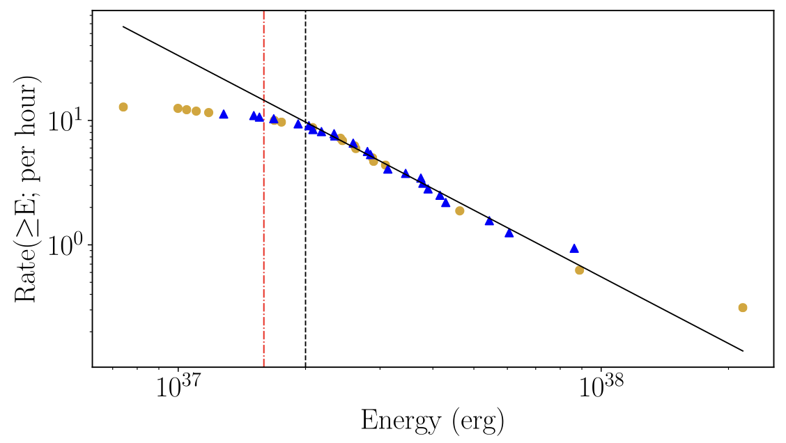
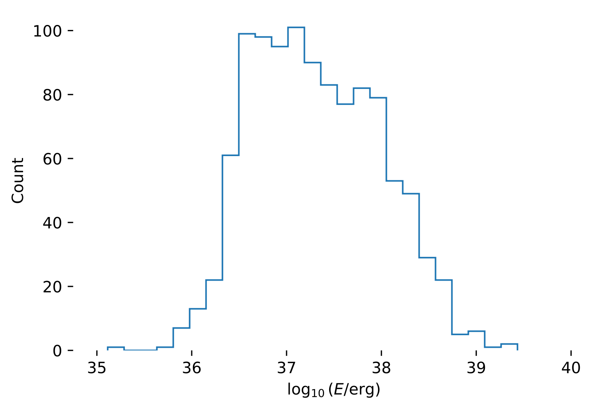
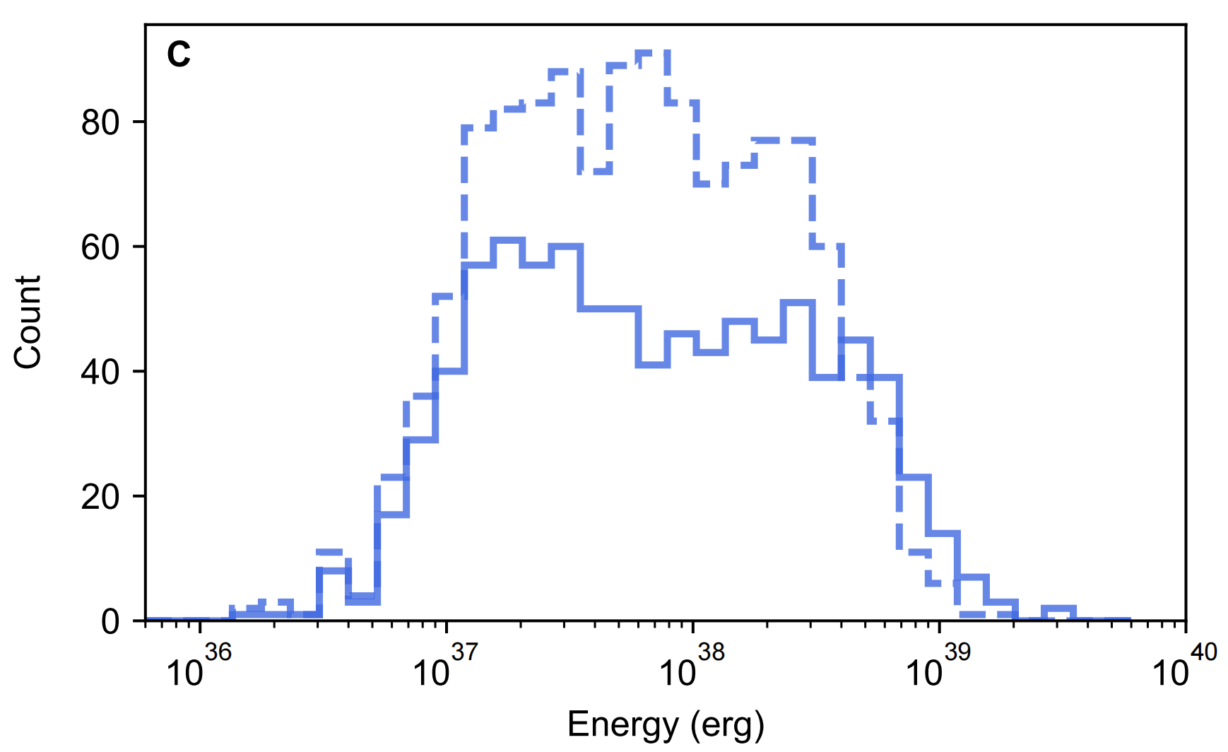
Bimodal Energy Functions
FRB 20121102A
FRB 20201124A
the bright sample follows the power-law or Schecter function
Li et al. 2021
Xu et al. 2022
FRB 20201124A
Gourdji et al. 2019
Zhang et al. 2023
Zhang et al. 2022

Slide 4
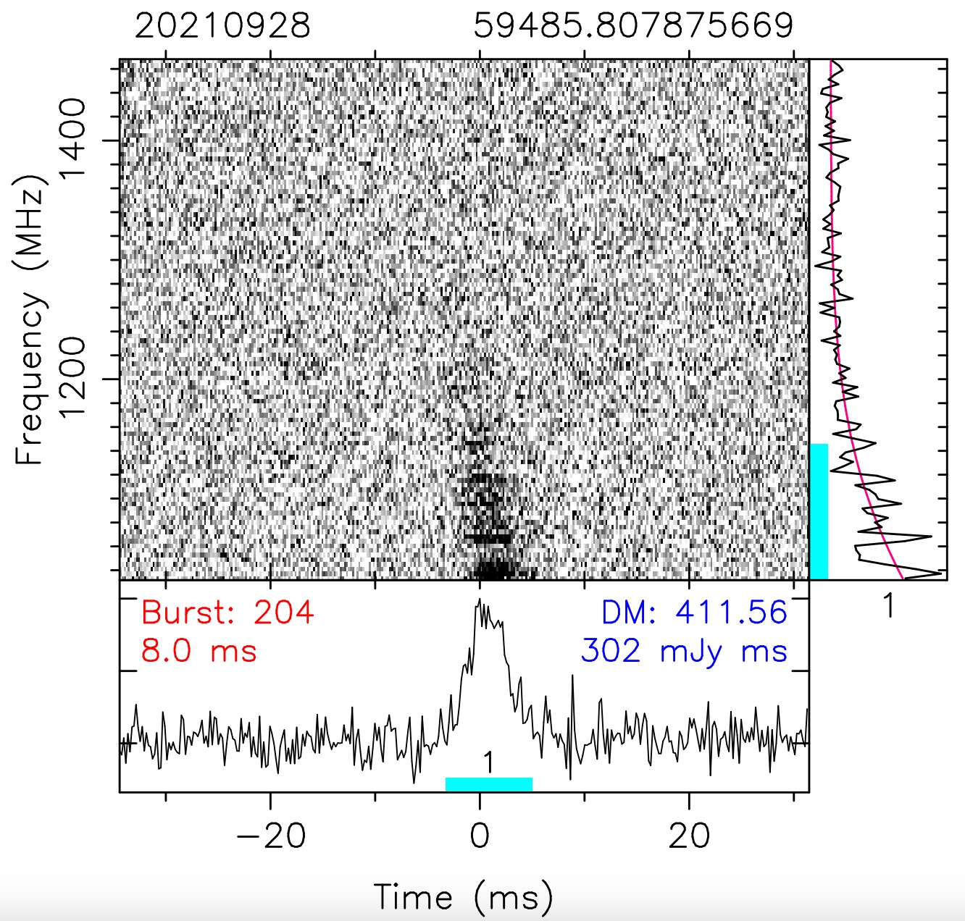
Origion of Bimodality
the possible origions of the bimodal energy distribution:
(1) selection effects (2) $E−ν_{0}$ correlation (3) intrinsic property
(Aggarwal 2021; Lyu et al. 2024)
beaming effect
gravitational self-lensing (Dall’Osso et al. 2024)
propagation effects
multiple radiation mechanisms
Zhou et al. 2022
Our focus is the first two scenarios.

Slide 5
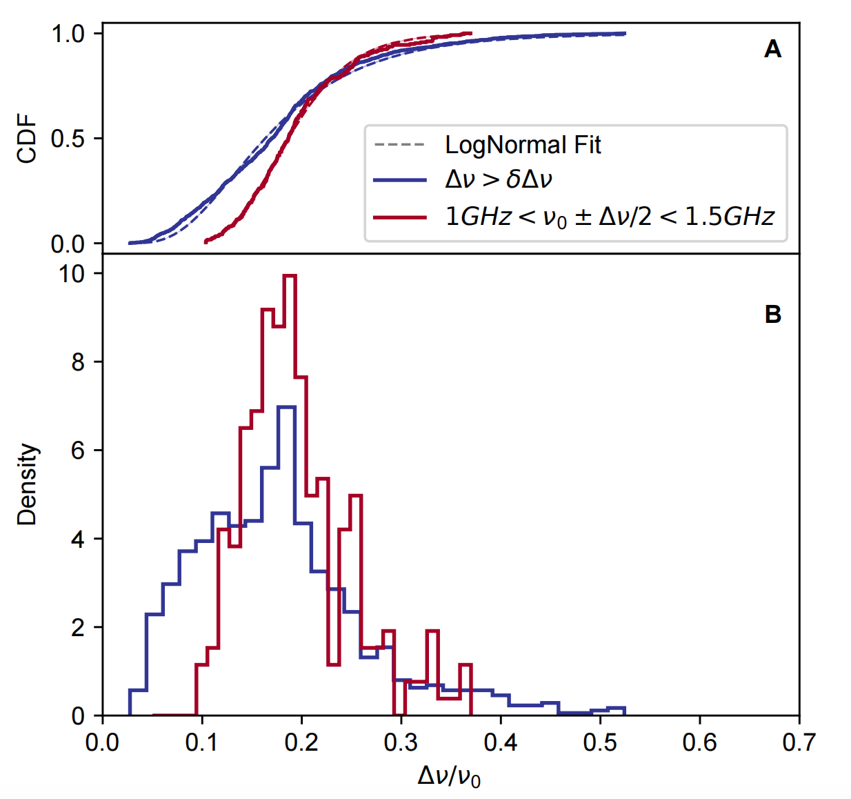
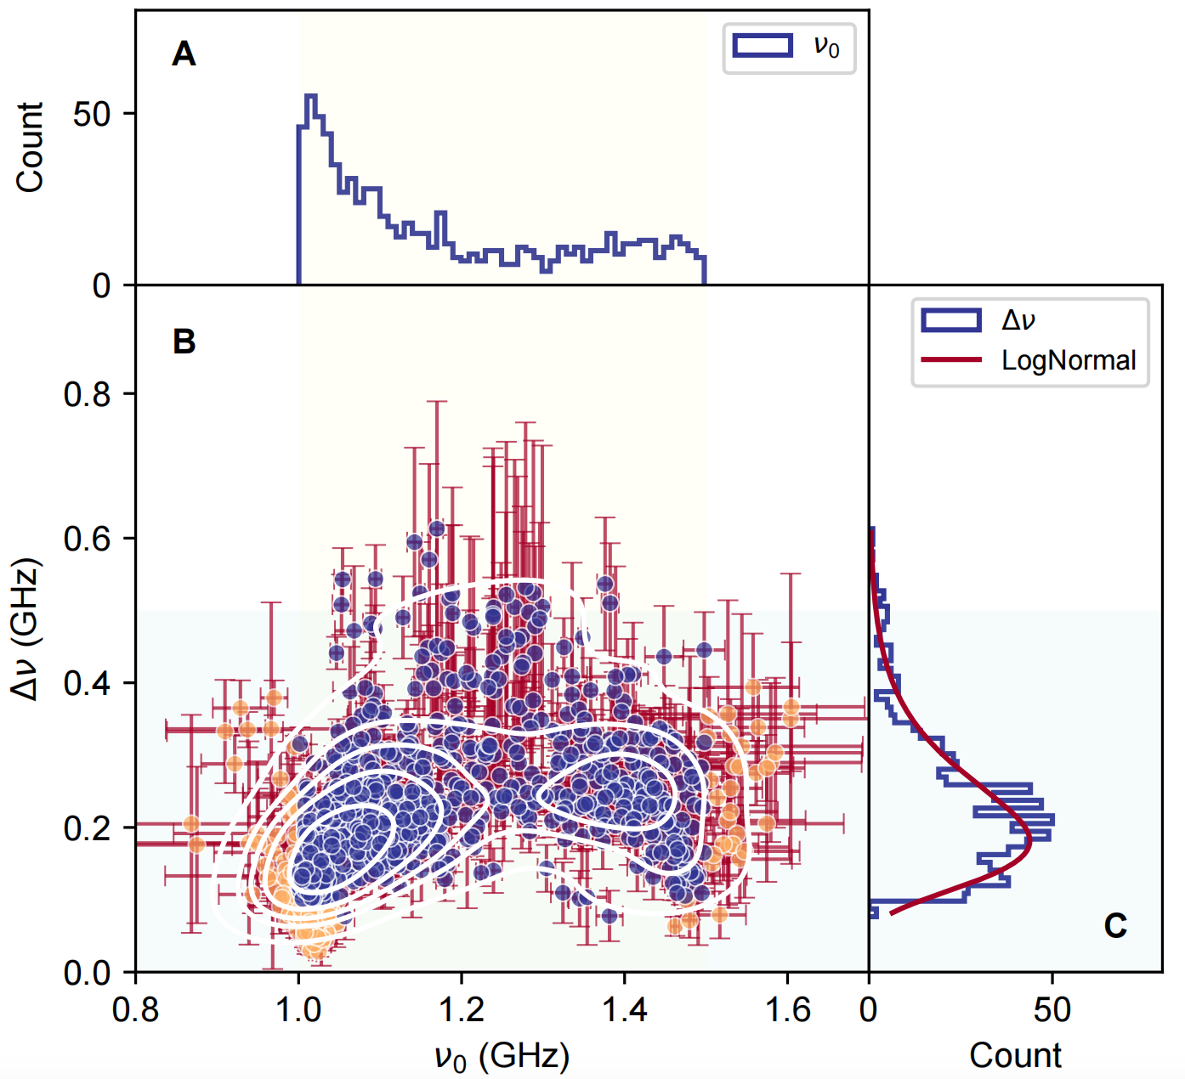
FRB 20220912A
Discovered by CHIME
FAST observed 1076 bursts within 8.67 hours
Clean and stable environment
high brightness and activity
z= 0.0771, $D_{L}$=360.87 Mpc
Zhang et al. 2023
narrow spectrum
low frequency preference (<1GHz)

Slide 6
Population of Bursts
$$p’(E_{int},θ)$$
$$p_{obs}(E_{obs},θ)$$
mock bursts
detected sample
$$p(E_{int},θ)$$
SNR
>= threshold
$$E_{int},ν_{0}, {BW}_{50}, W_{50}$$
< threshold
missing
$$p’(E_{int})$$
$$p_{obs}(E_{obs})$$
Gaussian spectrum $F_{obs}=F_{int}\int_{1.0}^{1.5}{G(f|ν_{0},σ)}df$
We fix z, $D_{L}$, $p({BW}_{50})$, $p(W_{50})$ to match the FAST observation of FRB 20220912A
$$E_{int}={10}^{39}erg \frac{4π}{1+z}{\left(\frac{D_{L}}{{10}^{28} cm}\right)}^{2}\frac{F_{int}}{Jy ms GHz}$$

Slide 7
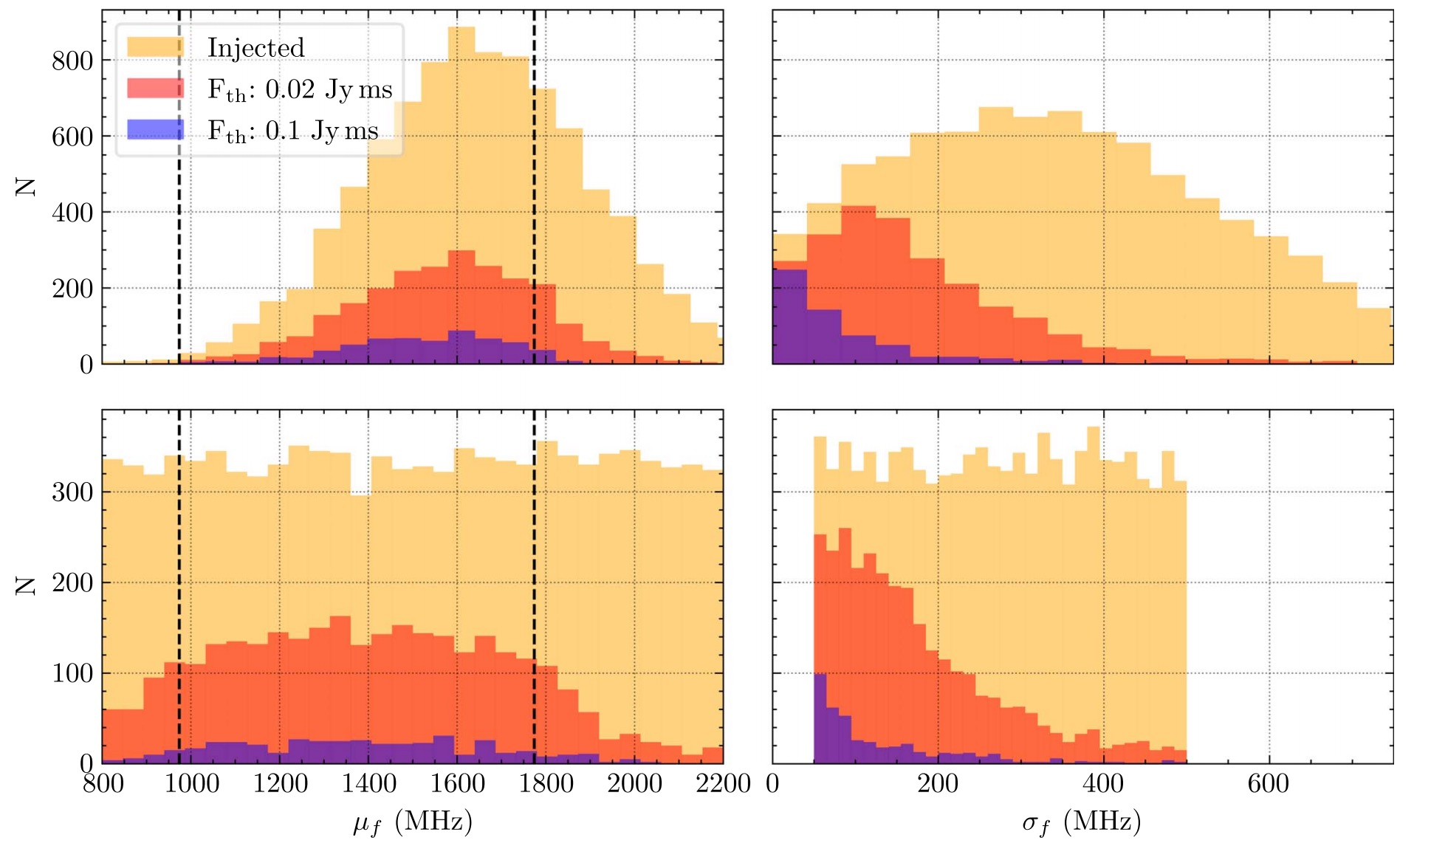
Influence of Selection Effects
Aggarwal 2021
key hypothesis: p($E_{int}$) ~ Power Law

Slide 8
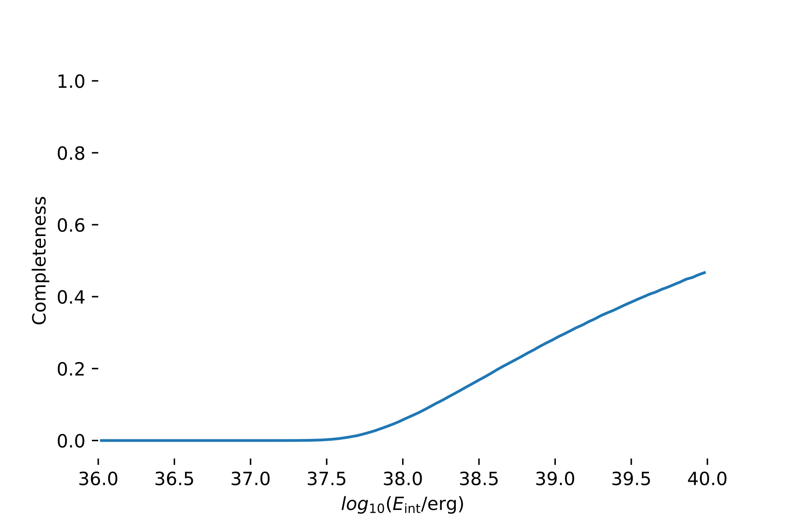
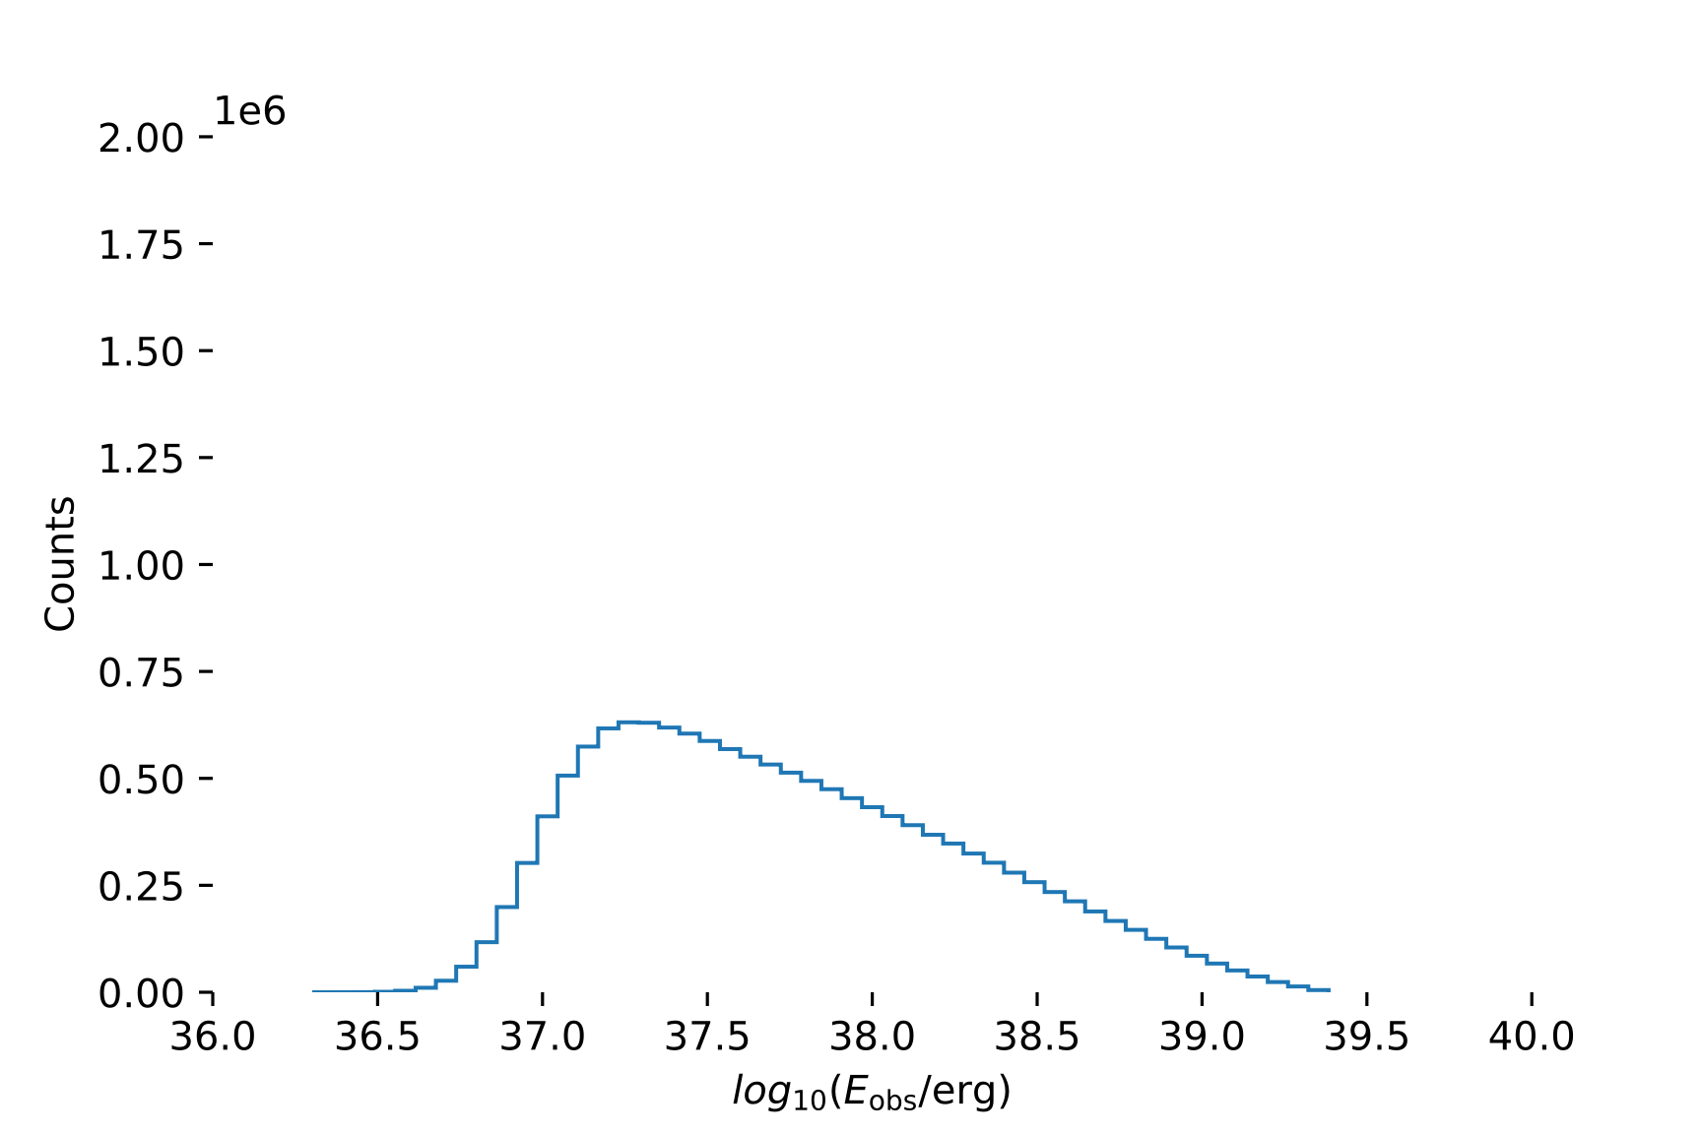
Influence of Selection Effects
Models: $ν_{0}$~constant, $\log_{10}(E_{int})$~$𝒰(35, 40)$
$E_{int}$ $E_{obs}$
$ν_{0}$>1: intrinsic nearly intrinsic
$ν_{0}$<1: lost most bursts peak

Slide 9
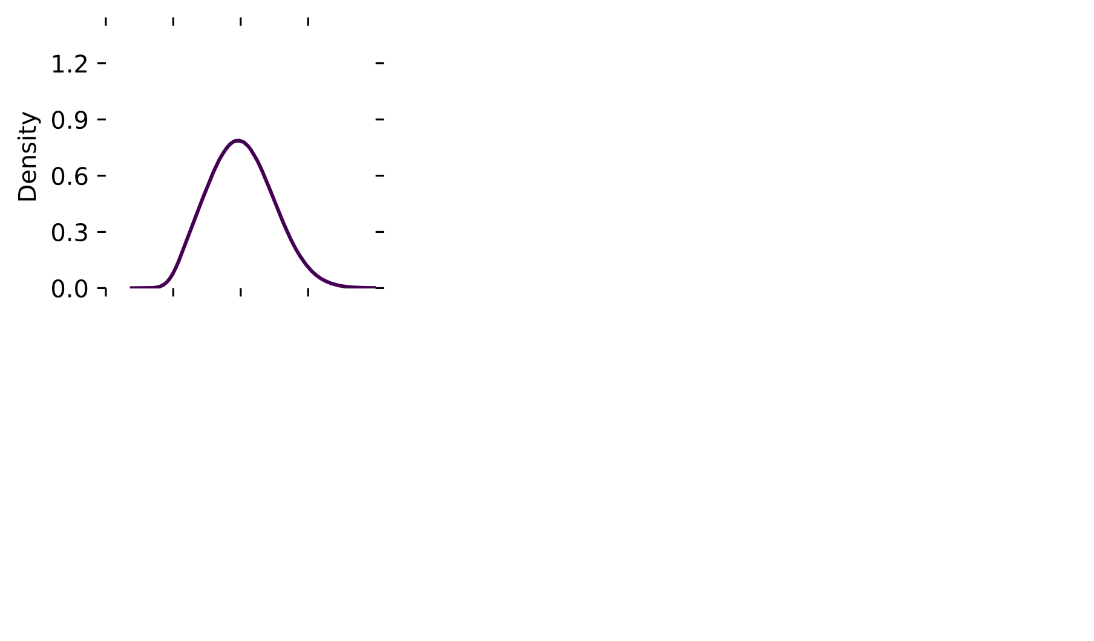
Bimodal Distribution from Simulation
Models: $ν_{0}$~$αG(ν|ν_{1},0.1)+(1−α)G(ν|1.25,0.1)$
$$E_{int}\sim ℒ𝒩(log({10}^{38}),1.2)$$
two bases $α=0, 1$
$p_{obs}(E_{obs})$ is a linear combination of them
The selection effects have the potential to generate a bimodal pattern.

Slide 10
Population Features
central frequency $∈$ [$1.25−Δf, 1.25+Δf$] GHz

Slide 11
Population Features

Slide 12
Population Features
Bursts with $ν_{0}∈$ [1.05, 1.45] constitute a clean sample
$k_{\log_{10}(E_{int})}=−0.275±0.228$ (1 $σ$) $E−ν_{0}$ correlation (❌)

Slide 13
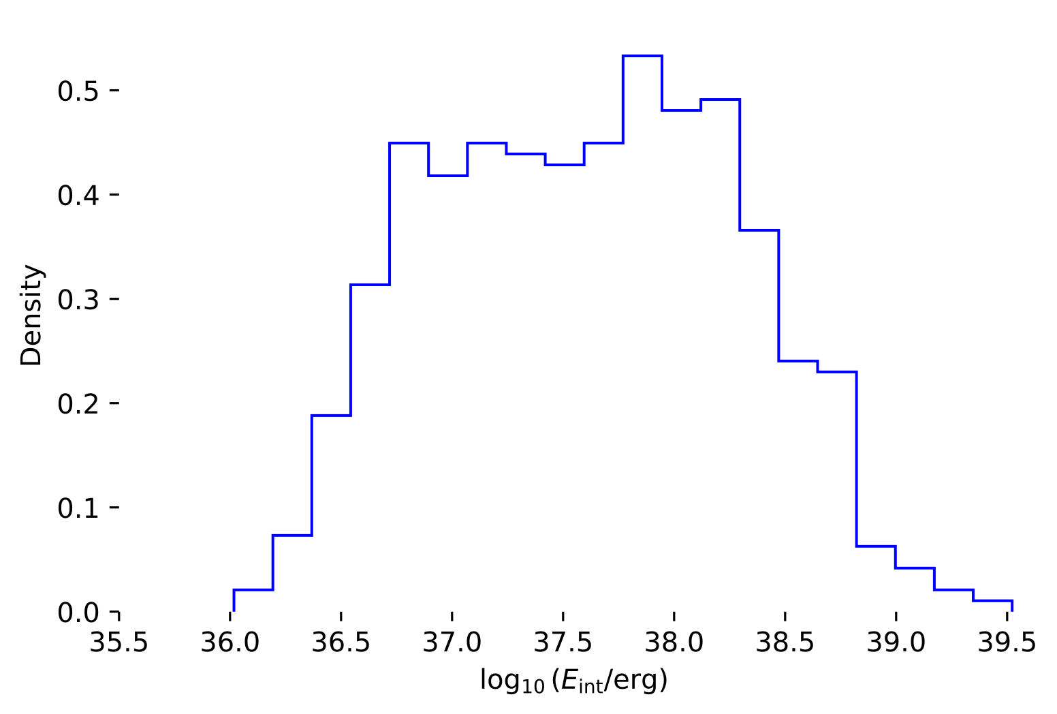
Energy Function
FRB 20220912A
546 bursts $ν_{0}$ $∈\left[1.05, 1.45\right]$
log-nomral ($E_{c}\sim 8.13×{10}^{37}$ erg) + power-law (index = $−1.011±0.028$)
Difference: 1) the low energy peak disappears;
2) the more dramatic decline at the high-energy tail
The bimodal distribution still exists even after mitigating the selection effects and heavily contaminated sub-sample
selection effects (❌)

Slide 14
Conclusion
1. Selection effects have the potential to generate bimodal distribution.
(1) bursts whose $ν_{0}$ falls within the observing band are complete at most energy range;
(2) bursts whose $ν_{0}$ falls outside the observing band contribute to a low energy peak in $p_{obs}(E_{obs})$.
2. The possible origions of the bimodal energy distribution (FRB 20220912A):
(1) selection effects (❌) (2) $E−ν_{0}$ correlation (❌) (3) intrinsic property
(Aggarwal 2021; Lyu et al. 2024)
Thank you!

