Slide 1
Detecting Strangeon Nuggets with Acoustic Messenger
Reporter: Haoyang Qi
Mentor: Renxin Xu
2024 – 07 – 15 FPS13

Slide 2
Contents
Motivations
Introduction to Strangeon Nuggets (StN)
Acoustic detection of StN pass-through event in normal matter
Discussions and conclusions

Slide 3
Motivations

Slide 4
Developing of idea
Neutron star (Landau 1932)
Quark star (Witten 1984 as a representative)
Strangeon star (Xu 2003)

Slide 5
Motivations of this work
Implication in:
dark matter, for its low hadronic charge-mass ratio
pulsar, as a probable equation of state
and acoustic detection, as a new messenger

Slide 6
Introduction to Strangeon Nuggets (StN)

Slide 7
Strangeonization
$p_{F}=2πℏn^{1/3}{(3/4π)}^{1/3}≈480 MeV/c for n=0.25 {fm}^{−3}$
Strange quark $m_{0}≈95 MeV/c^{2}$, perturbation QCD energy scale $E≳1 GeV$
Three-flavor symmetry
Xu, R., Lai, X., & Xia, C. (2021). Astron. Nachr., 342(1-2), 320-325.
Yuan, W. In prep.

Slide 8
Intrinsic characteristics
$ρ_{StN} \sim 4.2 ×{10}^{14} g/{cm}^{3}$ ($for n=0.25 {fm}^{−3} at p=0$)
Baryon number$A\sim {10}^{30}$ (Critical baryon number $A_{c}≲{10}^{9}$)
Mass $m_{StN}\sim 1.7×{10}^{6} g$
Radius $r_{0}={\left(\frac{3m_{StN}}{4πρ_{StN}}\right)}^{1/3}=1.6×{10}^{−3} cm∙{\left(\frac{A}{{10}^{30}}\right)}^{1/3}{\left(\frac{ρ_{StN}}{{10}^{14} g/{cm}^{3}}\right)}^{−1/3}$
Hadronic charge-mass ratio $δ_{e}=\frac{N_{e}}{A}={10}^{−7}\sim {10}^{−4}$
Farhi, E., & Jaffe, R. L. (1984). PRD, 30(11), 2379-2390.

Slide 9
Other characteristics
$v=220 km/s$ $or 0.1c$(for dark matter or merger remnant)
Number density $n=3.2×{10}^{−31} {cm}^{−3}$(Single component, $ρ_{DM}=0.3 GeV/{cm}^{3}$)
Event rate: $nv=7.04×{10}^{−24} s^{−1}{cm}^{−2}∙{\left(\frac{A}{{10}^{30}}\right)}^{−1}∙\frac{v}{220 km/s}$
(Consider $πR_{⨁}^{2}=1.28$ $×{10}^{18}$ ${cm}^{2}$, event rate is ~280 / yr)

Slide 10
Magnetic field of StN
Wave function of identical particles without spin-orbit coupling $Ψ_{1,2}\left(r_{1},r_{2},s_{1},s_{2}\right)=ψ_{1,2}\left(r_{1},r_{2}\right)χ_{1}(s_{1})χ_{2}(s_{2})$
S=1 $→χ_{1}χ_{2}$ is exchange symmetric $→ψ_{1,2}\left(r_{1},r_{2}\right)$ is exchange anti-symmetric $→$ when$r_{1}=r_{2}$, $ψ_{1,2}=0$ $→E_{em}$ get lower
Transfer from one spin direction to another $→$ kinetic energy of electron $E_{k}$ get higher

Slide 11
Spontaneous magnetization of electron spin magnetic moment
${∆E}_{em}=\frac{1}{2}\frac{e^{2}}{4πε_{0}\overline{d_{e}}}, \overline{d_{e}}={\left(\frac{3}{4π}\right)}^{\frac{1}{3}}∙\frac{2πℏ}{p_{F}}, ∆E_{k}=\frac{p_{F}∙2∆p∙c}{\sqrt{{(m_{e}c)}^{2}+{p_{F}}^{2}}}≈2∆p∙c$
$ξ{∆E}_{em}$=$∆E_{k}$ (Multi-body interaction and $r^{−1}$ potential: $ξ>1$)
$\frac{∆p}{p_{F}}=ξ{\left(\frac{4π}{3}\right)}^{\frac{1}{3}}\frac{α_{em}}{8π}≈$0.064$ξα_{em}$
$p_{F}≈10 MeV/c$ for $δ_{e}=$ ${10}^{−5}$
$∆p≪p_{F}≪480 MeV/c$
$$p_{F}$$
$$p_{F}$$
$$∆p$$
Fermi ball of electrons,
gray means two spins are filled
After spin reverse,
blue means only one spin is filled

Slide 12
Magnetic field of StN
$μ_{e−total}=\frac{4πp_{F}∙2∆p}{\frac{4π}{3}p_{F}^{3}}N_{e}μ_{B}=0.38ξα_{em}∙δ_{e}A∙μ_{B}$
$B_{0}=ξμ_{0}\frac{μ_{e−total}}{\frac{4π}{3}r_{0}^{3}}=2.0×{10}^{11} G∙ξ∙\frac{δ_{e}}{{10}^{−5}}∙\frac{ρ_{StN}}{{10}^{14} g/{cm}^{3}}$
Take $B_{0}={10}^{12} G$ as (Surface dipole magnetic field of the StN, strangeon star may have extra magnetic field from collective movement of electrons)

Slide 13
Acoustic detection of StN pass-through event in normal matter

Slide 14
Incident and ionize
$r_{0}=1.6×{10}^{−3} cm∙{\left(\frac{A}{{10}^{30}}\right)}^{1/3}{\left(\frac{ρ_{StN}}{{10}^{14} g/{cm}^{3}}\right)}^{−1/3}$, normal matter can be considered as continuous medium
Aerodynamic heating $∆T=\frac{v^{2}}{2c_{p}}$ (For $SiO_{2}$, $c_{p}=7×{10}^{6} erg/(g∙K)$)
$∆T=7×{10}^{7} K∙{\left(\frac{v}{220 km/s}\right)}^{2}{\left(\frac{c_{p}}{7×{10}^{6} erg/(g∙K)\text{)}}\right)}^{−1}$, enough to ionize (OVIII $→$ OIX $∆E=871.4 eV=1.011×{10}^{7} K$)
Ionization zone may be small (discuss later)

Slide 15
Magnetopause of StN
$Kρ_{p}v^{2}=\frac{2B^{2}}{μ_{0}}, B=B_{0}\frac{r_{0}^{3}}{r_{m}^{3}},K=1→r_{m}={\left(\frac{2B_{0}^{2}r_{0}^{6}}{μ_{0}Kρ_{p}v^{2}}\right)}^{\frac{1}{6}}$
$r_{m}=0.316 cm∙{\left(\frac{A}{{10}^{30}}∙\frac{B_{0}}{{10}^{12} G}\right)}^{\frac{1}{3}}∙{\left(\frac{ρ_{med}}{1 g/{cm}^{3}}\right)}^{−\frac{1}{6}}∙{\left(\frac{ρ_{StN}}{{10}^{14} g/{cm}^{3}}∙\frac{v}{220 km/s}\right)}^{−\frac{1}{3}}$
$\frac{r_{m}}{r_{0}}=196∙{\left(\frac{B_{0}}{{10}^{12} G}\right)}^{\frac{1}{3}}∙{\left(\frac{ρ_{med}}{1 g/{cm}^{3}}\right)}^{−\frac{1}{6}}$ $∙{\left(\frac{v}{220 km/s}\right)}^{−\frac{1}{3}}$
$$r_{0}$$
$$r_{m}$$
VanDevender, J. P., VanDevender, A. P., Sloan, T., et al. (2017). Sci. Rep., 7(1), 8758.

Slide 16
Cross section and penetration depth
$σ_{m}=π{r_{m}}^{2}=0.320 {cm}^{2}∙{\left(\frac{A}{{10}^{30}}∙\frac{B_{0}}{{10}^{12} G}\right)}^{\frac{2}{3}}∙{\left(\frac{ρ_{med}}{1 g/{cm}^{3}}\right)}^{−\frac{1}{3}}∙{\left(\frac{ρ_{StN}}{{10}^{14} g/{cm}^{3}}∙\frac{v}{220 km/s}\right)}^{−\frac{2}{3}}$
$\frac{σ_{m}}{m_{StN}}=1.92$ $×{10}^{−7} {cm}^{2}/g∙{\left(\frac{B_{0}}{{10}^{12} G}\right)}^{\frac{2}{3}}∙{\left(\frac{A}{{10}^{30}}∙\frac{ρ_{med}}{1 g/{cm}^{3}}\right)}^{−\frac{1}{3}}∙{\left(\frac{ρ_{StN}}{{10}^{14} g/{cm}^{3}}∙\frac{v}{220 km/s}\right)}^{−\frac{2}{3}}$
$F_{m}=σ_{m}Kρ_{p}v^{2}=−\frac{dE_{k}}{dx}, K=1$
$E_{k}=\frac{1}{2}m_{StN}v^{2}=4.1×{10}^{20} erg∙\frac{A}{{10}^{30}}∙{\left(\frac{v}{220 km/s}\right)}^{2}$
$x=7.88×{10}^{6} cm∙{\left(\frac{A}{{10}^{30}}\right)}^{\frac{1}{3}}∙{\left(\frac{ρ_{StN}}{{10}^{14} g/{cm}^{3}}\right)}^{\frac{2}{3}}∙{\left(\frac{B_{0}}{{10}^{12} G}∙\frac{ρ_{med}}{1 g/{cm}^{3}}\right)}^{−\frac{2}{3}}∙(v_{0−220}^{\frac{2}{3}}−v_{x−220}^{\frac{2}{3}})$

Slide 17
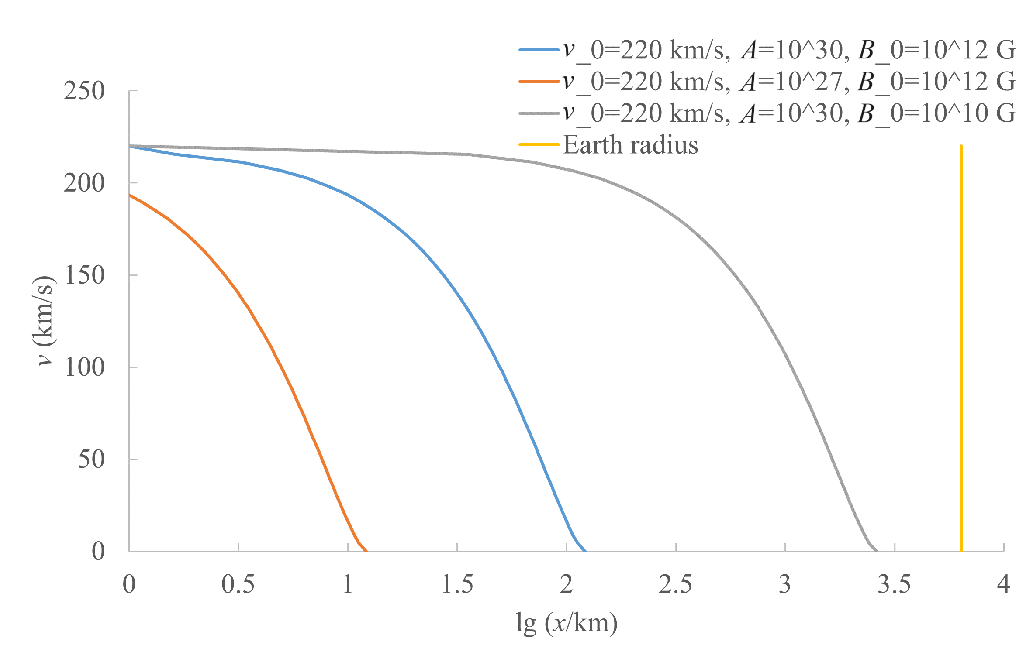
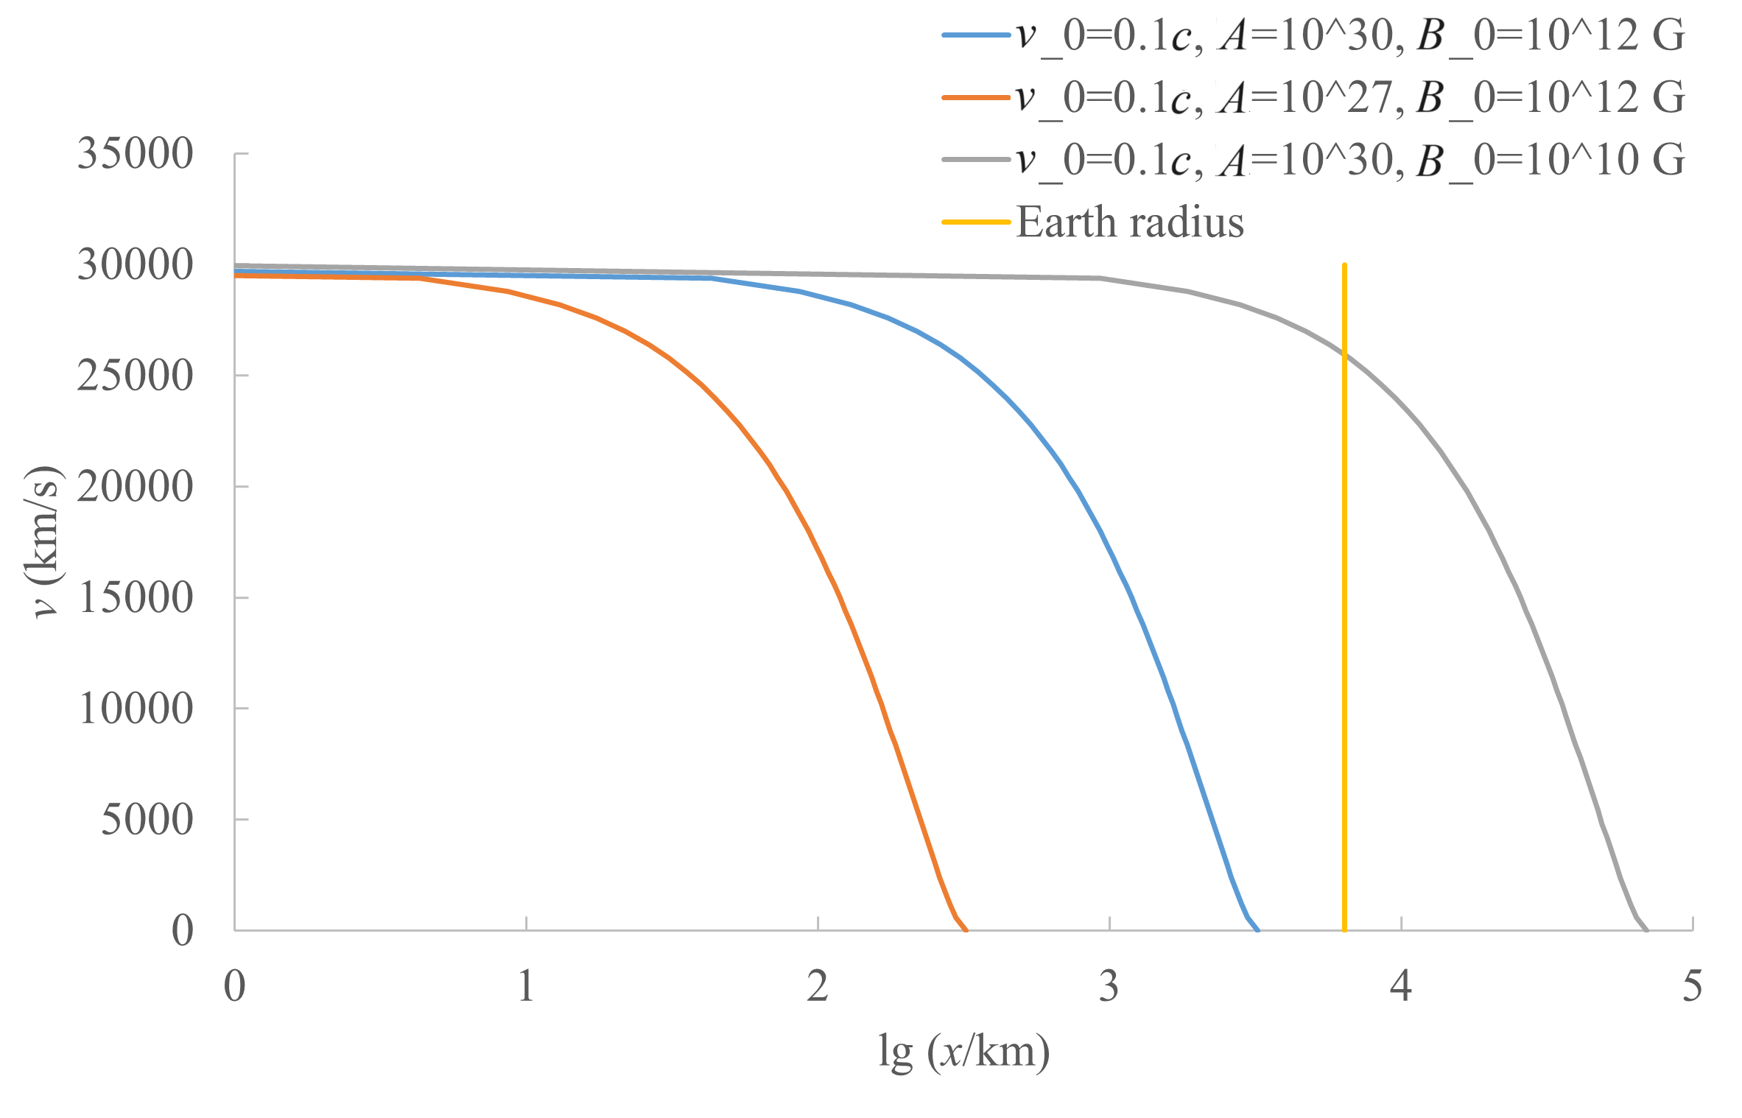
Penetration depth
Passing through earth atmosphere: $A≳{10}^{20}$

Slide 18
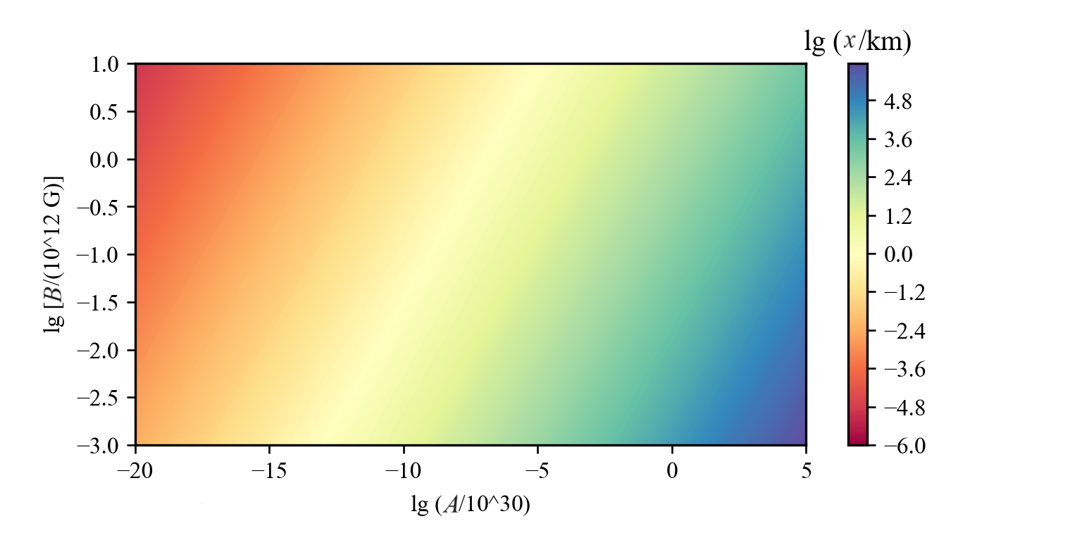
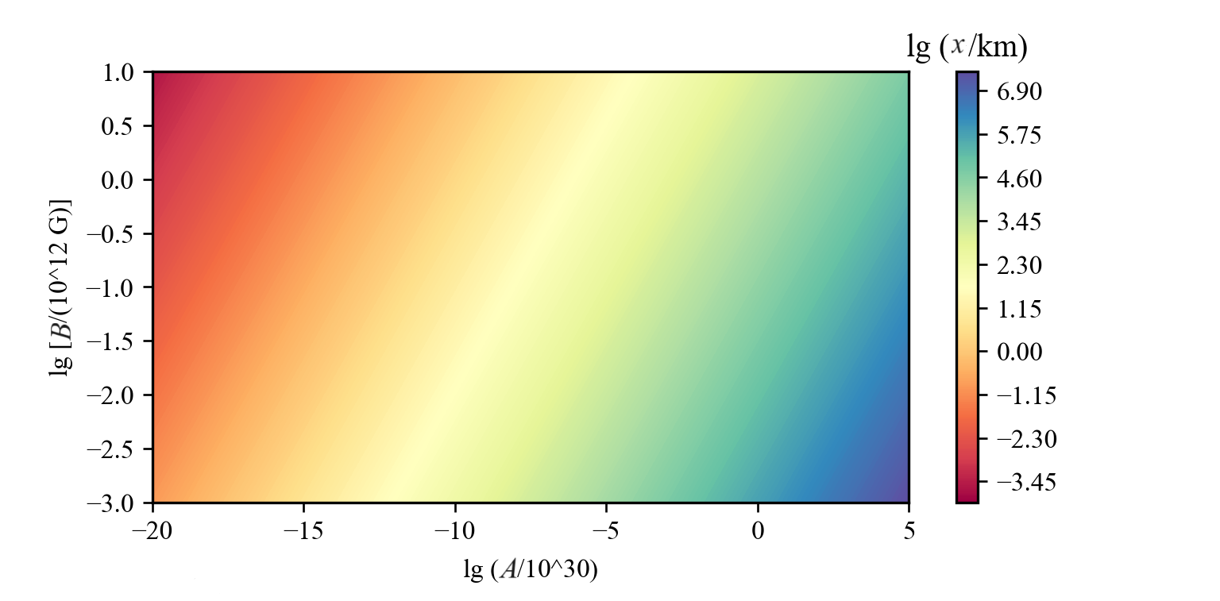
Penetration depth

Slide 19
Characteristics of acoustic signal
Sound pressure and energy: $\frac{p^{2}}{ρ_{med}c_{s}}∙2πRdx∙t_{shock}=dE_{sound}$
$t_{shock}=1.82\frac{2r_{m}}{c_{s}}{\left(\frac{vR}{{c_{s}kr}_{m}}\right)}^{\frac{1}{4}}=0.336 ms∙{\left(\frac{R}{1 km}\frac{A}{{10}^{30}}\frac{B_{0}}{{10}^{12} G}\right)}^{\frac{1}{4}}{\left(\frac{c_{s}}{1 km/s}\right)}^{−\frac{5}{4}}$ ${\left(\frac{ρ_{StN}}{{10}^{14} g/{cm}^{3}}\right)}^{−\frac{1}{4}}$ ${\left(\frac{ρ_{med}}{1 g/{cm}^{3}}\right)}^{−\frac{1}{8}}$ ${\left(\frac{k}{100}\right)}^{−\frac{1}{4}}$
Mach shockwave
$$c_{s}$$
$$R$$
$$t_{shock}$$
StN trajectory
$$x$$
$$c_{s}$$
Maher, R. (2006). 2006 IEEE 12th D. S. P. Workshop & 4th IEEE S. P. E. Workshop, 257–261.

Slide 20
Characteristics of acoustic signal
Attenuation: geometric, scattering, and absorption (exponential decay for the last item)
Absorption: viscosity, thermal conduction, and relaxation
${dE}_{sound}$= ${dE}_{sound−0}e^{−αR}$, $α=\frac{ω^{2}}{2ρ_{med}c_{s}^{3}}∙[\frac{4η^{′}}{3}+χ\left(\frac{1}{C_{V}}−\frac{1}{C_{p}}\right)+\sum_{i}{\frac{η_{i}^{′′}}{1+ω^{2}τ_{i}^{2}}}]$
In pure crystal medium and pure water: $\frac{1}{α}>R_{⊕}$ ($ω≈{10}^{3} Hz$)
Sea water or real rock: not pure and uniform medium

Slide 21
Characteristics of acoustic signal
Take $∆t≈1 ms, c_{s}=1.5 km/s$
Experiments in real water:
$${dE}_{sound}=ηdE_{k}e^{−R/{9.01×{10}^{3} cm}}, p_{noise}≈1 erg/{cm}^{3},η={1.1×10}^{−6}$$
Critical detectable distance:
$$ηF_{m}e^{−R/{9.01×{10}^{3} cm}}=\frac{2πR}{ρ_{med}c_{s}}p_{noise}^{2}∆t$$
VanDevender, J. P., VanDevender, A. P., Sloan, T., et al. (2017). Sci. Rep., 7(1), 8758.

Slide 22
Acoustic critical detectable distance
$R∙exp⁡(R/{0.0901 km})=\frac{ηF_{m}ρ_{med}c_{s}}{2πp_{s}^{2}∆t}=3.66×{10}^{10} km∙\frac{η}{{10}^{−6}}∙{\left(\frac{A}{{10}^{30}}∙\frac{B_{0}}{{10}^{12} G}∙\frac{{10}^{14} g/{cm}^{3}}{ρ_{StN}}\right)}^{\frac{2}{3}}∙{\left(\frac{v}{220 km/s}\right)}^{\frac{4}{3}}∙{\left(\frac{ρ_{med}}{1 g/{cm}^{3}}\right)}^{\frac{5}{3}}∙\left(\frac{c_{s}}{1.5 km/s}\right)∙{\left(\frac{1 erg/{cm}^{3}}{p_{s}}\right)}^{2}∙\left(\frac{1 ms}{∆t}\right)$
Attention there are another characteristic length: $0.0901 km$ rather than $3.66×{10}^{10} km$

Slide 23
Acoustic critical detectable distance

Slide 24
Discussions and conclusions

Slide 25
Cosmic dusts
If there is atmosphere: burnt
$E_{k}=\frac{1}{2}m_{dust}v^{2}=4.1×{10}^{20} erg∙\frac{A}{{10}^{30}}∙{\left(\frac{v}{220 km/s}\right)}^{2}$
$F_{dust}=πr_{0}^{2}Kρ_{p}v^{2}, K=1$ (ram pressure)
$F_{dust}=3.9×{10}^{18} dyn∙{\left(\frac{A}{{10}^{30}}\right)}^{\frac{2}{3}}∙{(\frac{ρ_{dust}}{3 g/{cm}^{3}})}^{−\frac{2}{3}}∙{\left(\frac{v}{220 km/s}\right)}^{2}∙\frac{ρ_{med}}{1 g/{cm}^{3}}$
$x_{dust}=\frac{E_{k}}{F_{dust}}=106 cm∙{\left(\frac{A}{{10}^{30}}\right)}^{\frac{1}{3}}∙{\left(\frac{ρ_{dust}}{3 g/{cm}^{3}}\right)}^{\frac{2}{3}}∙{\left(\frac{ρ_{med}}{1 g/{cm}^{3}}\right)}^{−1}$

Slide 26
Energy losing efficiency and accumulation in celestial bodies
Ionize energy loss (~0.01 time of influence of plasma ram pressure)
$λ_{D}=1.26×{10}^{−7} cm∙{\left(\frac{T}{{10}^{7} K}\right)}^{\frac{1}{2}}∙{\left(\frac{ρ_{med}}{1\frac{g}{{cm}^{3}}}\right)}^{−\frac{1}{2}}∙α^{−\frac{1}{2}}∙{\left(\frac{m_{atom}}{20m_{u}}\right)}^{\frac{1}{2}}≪r_{0}$
$\frac{r_{Landau}}{r_{0}}=9.48∙{\left(\frac{B_{0}}{{10}^{12} G}\right)}^{\frac{1}{3}}$
$\frac{r_{v_atom∙B=E}}{r_{0}}=7.52∙$ ${\left(\frac{B_{0}}{{10}^{12} G}\right)}^{\frac{1}{3}}Z^{−\frac{1}{6}}{\left(\frac{r_{atom}}{a_{Bohr}}\right)}^{\frac{1}{2}}$
$\frac{r_{v_StN∙B=E}}{r_{0}}=3.50∙$ ${\left(\frac{B_{0}}{{10}^{12} G}\right)}^{\frac{1}{3}}Z^{−\frac{1}{3}}{\left(\frac{r_{atom}}{a_{Bohr}}\right)}^{\frac{2}{3}}$

Slide 27
Conclusions
Strangeon nugget have a strong dipole magnetic field ~${10}^{12} G$ because of spontaneous magnetization of electron spin magnetic moment.
Stangeon nugget impact event may can be detected by microphone array in several km distance to the trajectory and can be distinguished from cosmic dust impact event.
The radius of magnetosphere of StN passing through medium may be smaller, make StN harder to detect and will not to be trap by celestial bodies in every event.
Thanks!

