Slide 1
An investigation of
the state changes of PSR J2021+4026
Reporter: H.H Wang (王惠惠)
Email:wanghh33@mail.sysu.edu..cn
Sun Yat-sen university(SYSU)&
Henan university of Science and technolog(HAUST)
collaborators: J. Takata, L.C.-C. Lin and P.-H. T. Tam
pulsar

Slide 2
outline
The background of pulsar
Our work of pulsar:PSR J2021+4026
The background of PSR J2021+4026
Date reduction and results
The conclusion of pulsar PSR J2021+4026
pulsar

Slide 3
outline
The background of pulsar
Our work of pulsar:PSR J2021+4026
The background of PSR J2021+4026
Date reduction and results
The conclusion of pulsar
pulsar

Slide 4
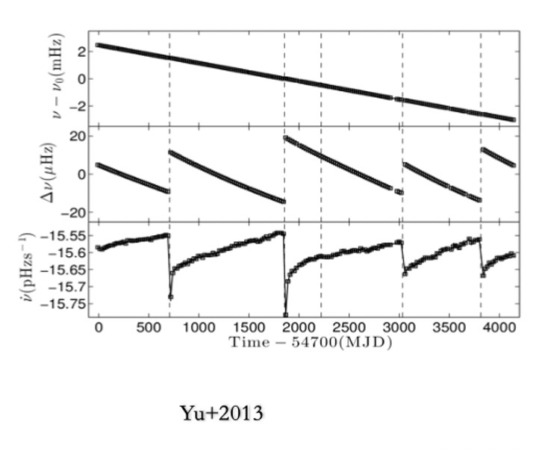
Glitch
Pulsar glitches are sudden increases in the observed rotation frequency of a spinning-down neutron star

Slide 5
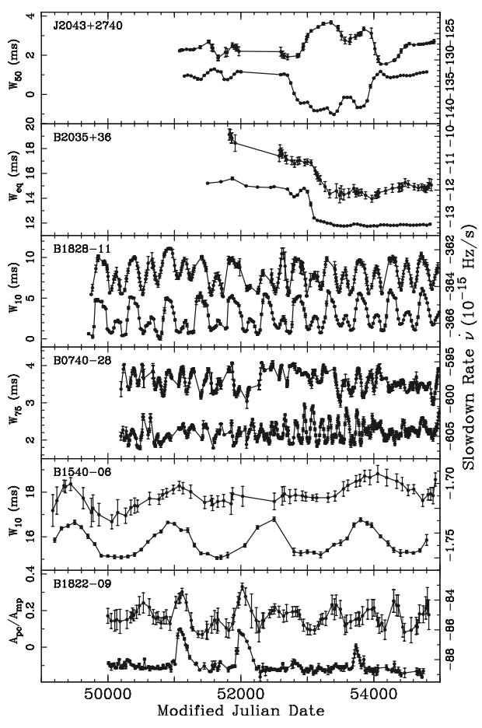
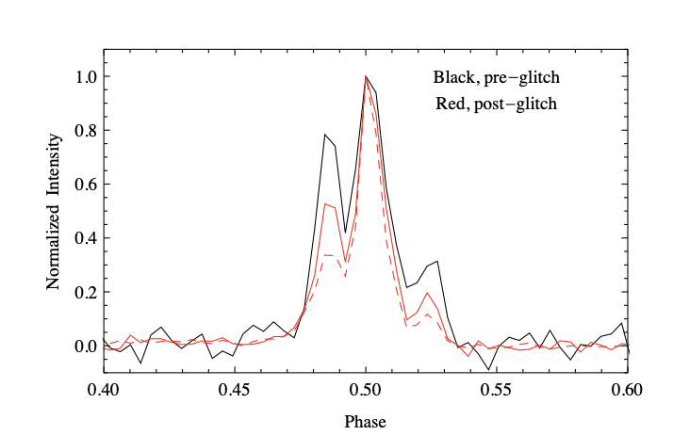
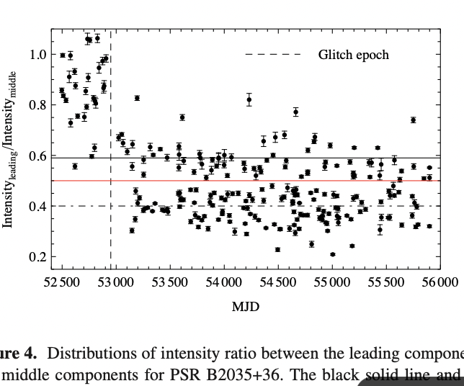
Mode change
Mode- switching predominantly manifests as changes in the pulse profile
PSR B2035+36
Kou et al 2018
Lyne,et al 2010

Slide 6
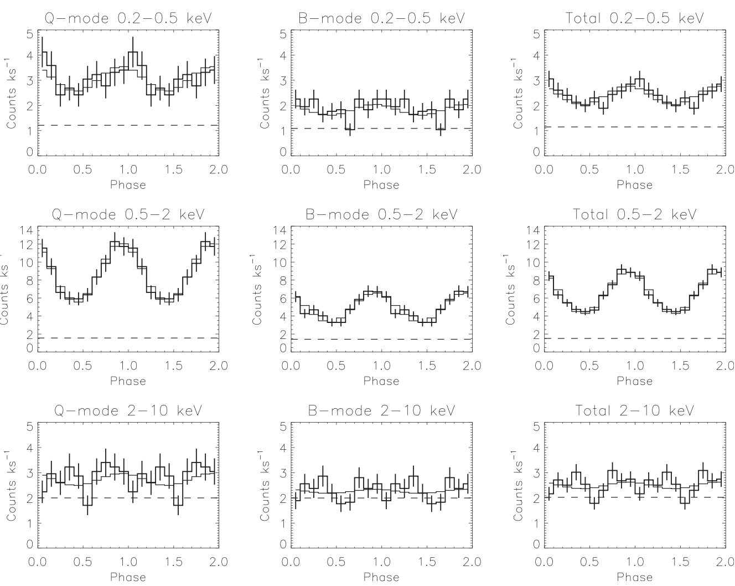
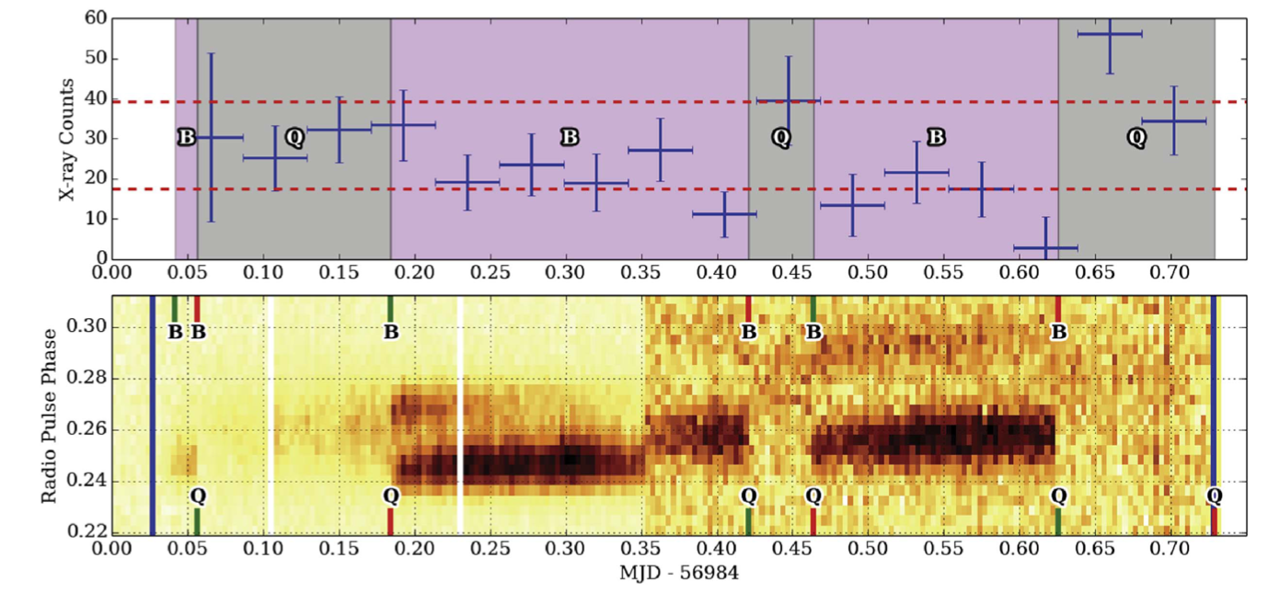
(X-ray pulse coincident with radio mode switching )
Mode change
PSR B0943+10 undergoes simultaneous X-ray and radio mode-switching, characterized by thermal X-ray pulsations exhibiting a greater flux when the radio flux is lower
The start/stop times of B/Q-modes are indicated by the green/red ticks at the top/bottom of the panel
Mereghetti et al(2016)

Slide 7
Model
Mode changes of the pulsar signify clear manifestation of electric current flow redistribution within the magnetosphere.
Several mechanisms suggested to trigger the mode change:
usual glitching process of the neutron star .
precession of the neutron star .
impact of debris disks and asteroid belts.
……

Slide 8
outline
The background of pulsar
Our work of pulsar:PSR J2021+4026
The background of PSR J2021+4026
Date reduction and results
The conclusion of pulsar
pulsar

Slide 9
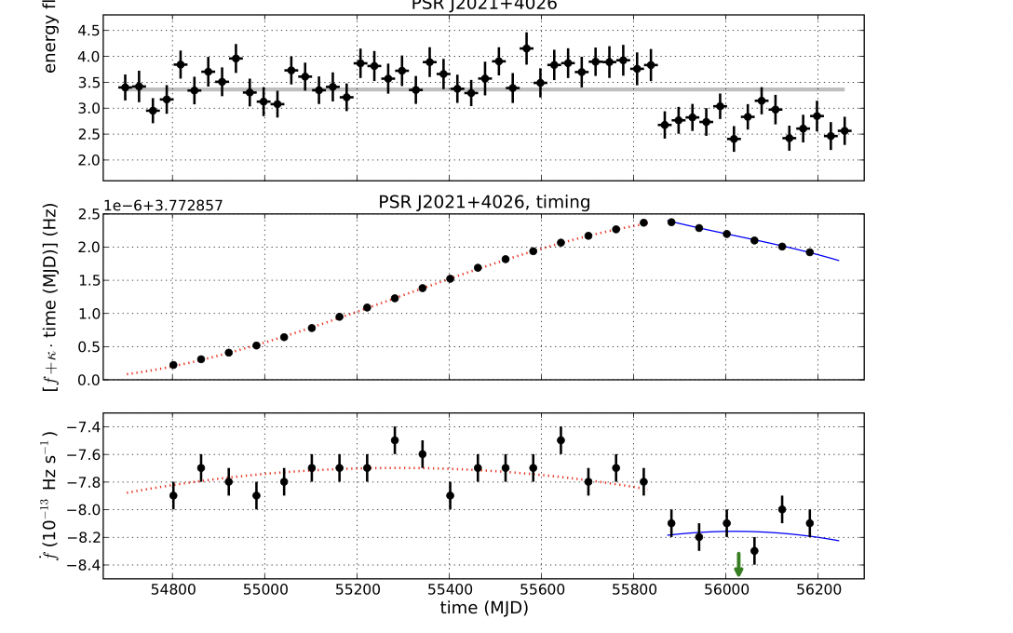
PSR J2021+4026
Characteristic age $τ_{c}∼$77 kyr
${\dot{E}}_{SD}∼$ ${10}^{35}$erg/s
$B∼4×{10}^{12}$ G
f ~3.8 Hz (P~265 ms)
$\dot{f}∼−8×{10}^{−13}$Hz/s
Radio quiet
Allafort+2013
It is the first and only radio quiet gamma- ray pulsar that shows a repeated "state change" in gamma-ray emission properties accompanied by a change in the spin-down rate.

Slide 10
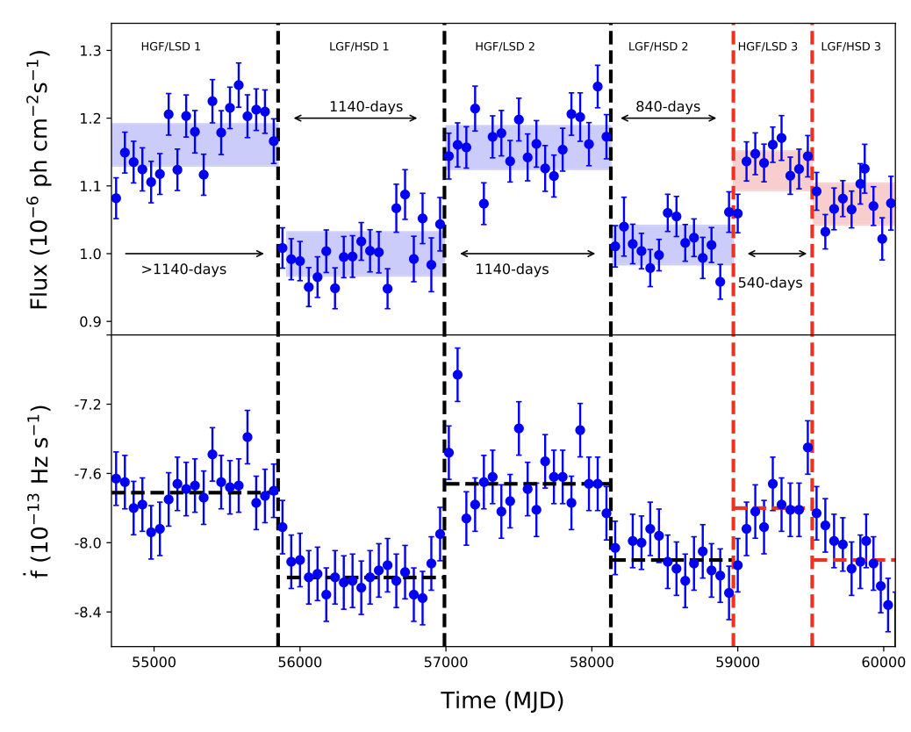
PSR J2021+4026
2008-2019
2008-2023
Takata+2020
Wang+2023
the time interval between the starting of a specific HGF/LSD is about 6-7 years.
We found that the waiting time in LGF/HSD 2 (∼ 840 days) and HGF/LSDF 3 (∼ 530 days) were shorter than the previous corresponding states (∼ 1140 days), indicating that the state change is quasi-periodic event.

Slide 11
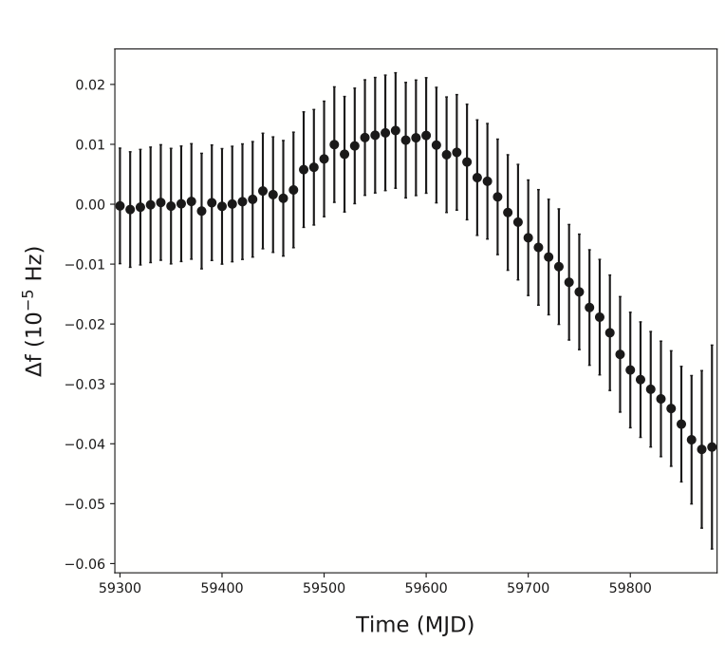
PSR J2021+4026
Mode change or glitch?
Difference between the observed frequency and predicted frequency from the ephemeris. Can not confirm the existence of a glitch….
could be difficult to explain with a free precession interpretation.
While, a. damp precession could be…….

Slide 12
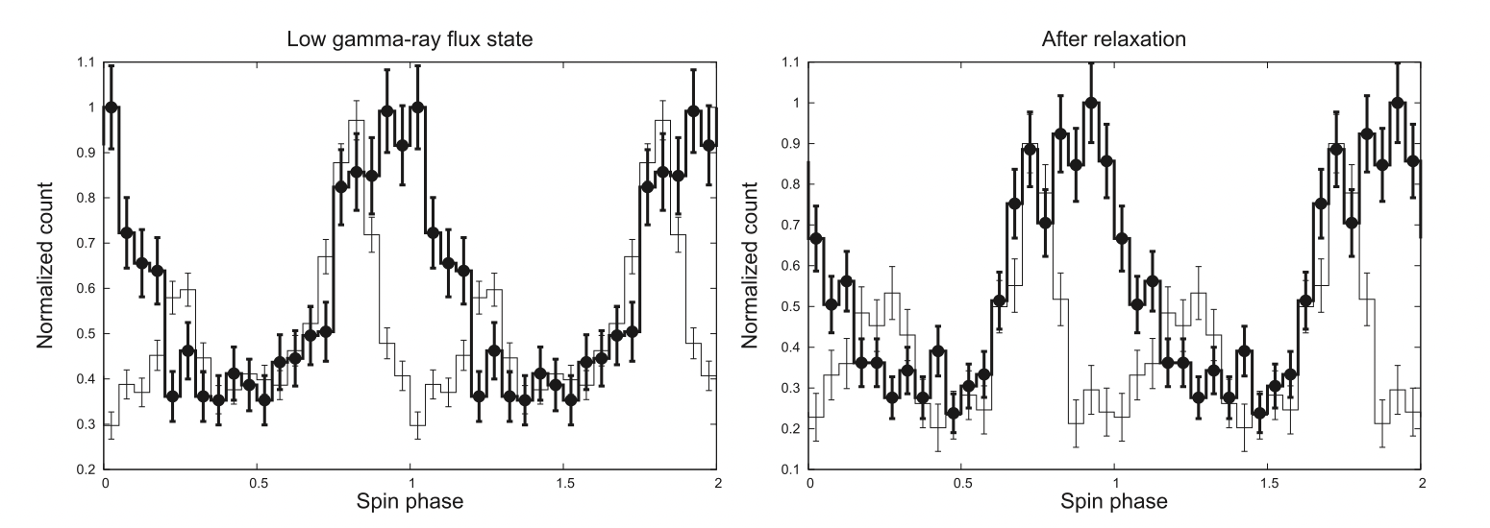
PSR J2021+4026
Wang+2018
Compare the X-emission activities
The emission property of the blackbody component is consistent with the emission from the polar cap heated by the back-flow bombardment of the high- energy electrons or positrons that were accelerated in the magnetosphere.
no significant change in the pulse shape of the X-ray before and after the relaxation is found.

Slide 13
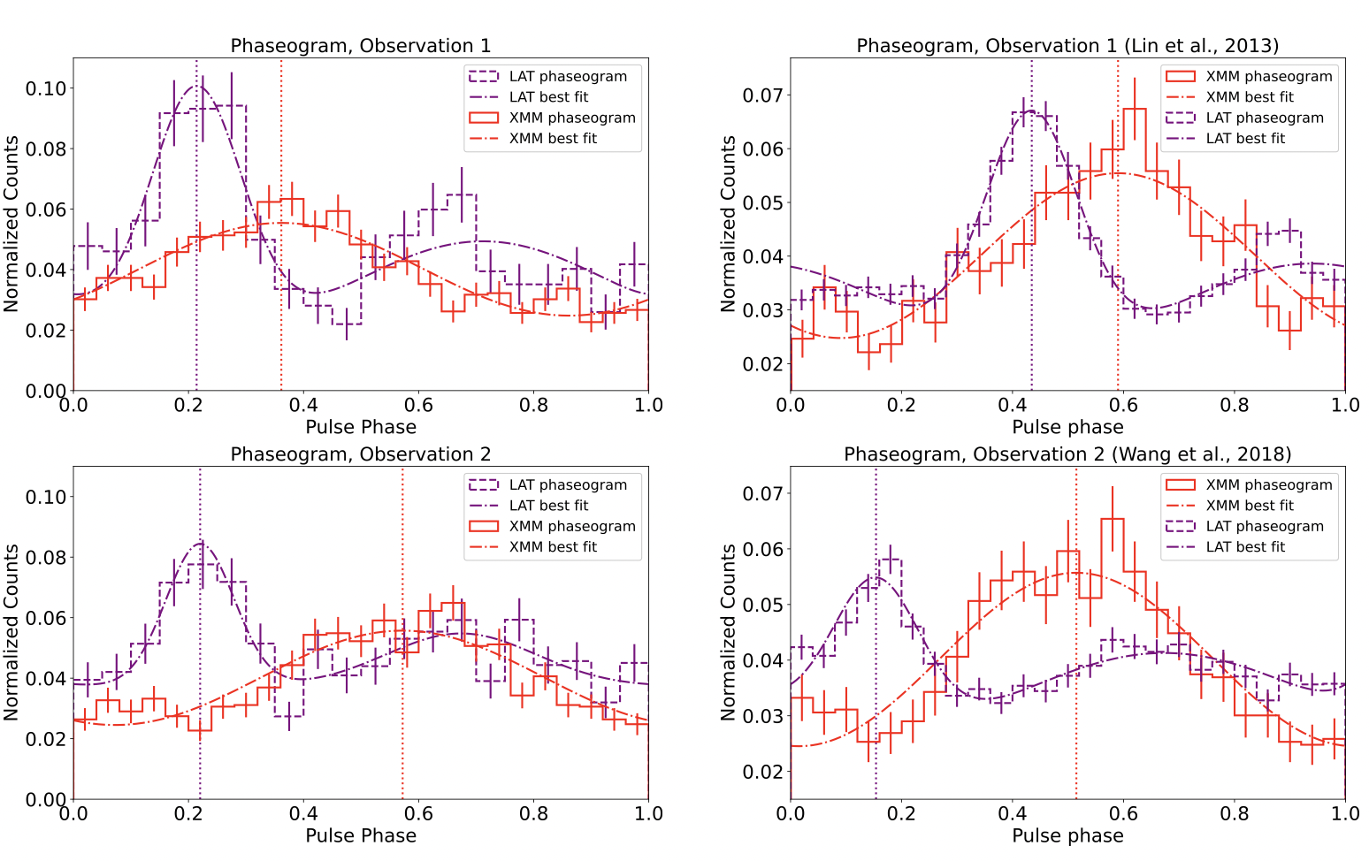
PSR J2021+4026
LGF
Razzano et al. (2023) argue that the presence of a quadrupole component in the magnetic field.
this phase shift as a change in the connection of dipole field lines with inner quadrupole field components close to the stellar surface.
HGF
Razzano+2023
The resulting phase delay between the two observations is 0.21 ± 0.02.

Slide 14
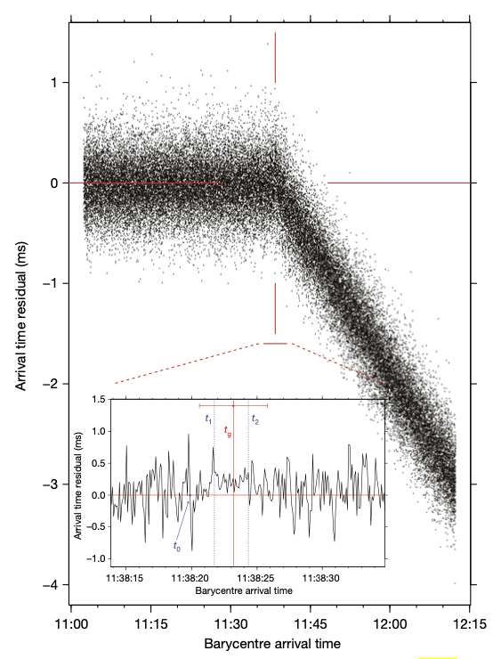
Vela pulsar---glitch activities
Glitch
Vela pulsar
Radio band
detected on 2016 December 12 at 11:36 universal time
sudden changes in the pulse shape
coincident with the glitch event:
This sequence was followed by a 2.6-second interval during which pulses arrived later than usual, indicating that the glitch affects the magnetosphere.
Palfreyman et al (2018)

Slide 15
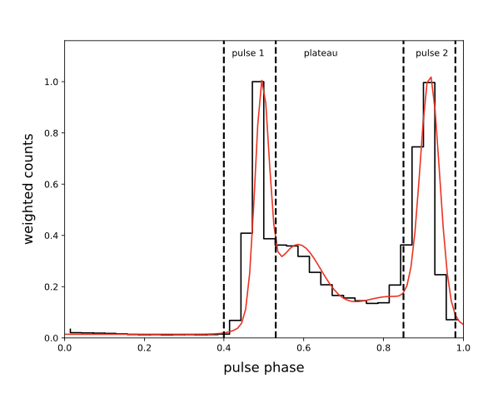
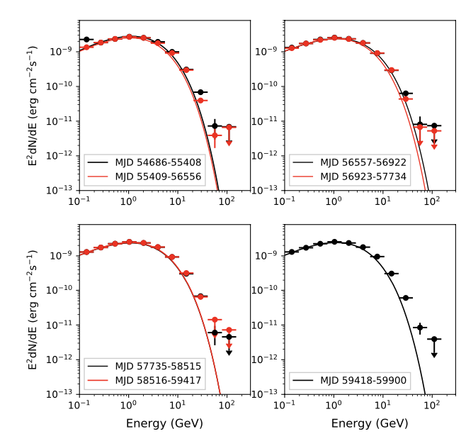
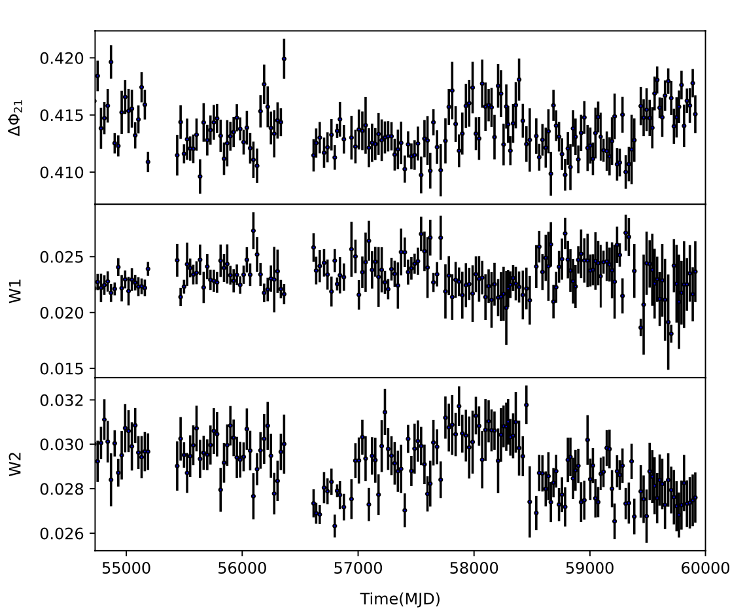
Vela pulsar in gamma-ray
gamma-ray flux
we do not confirm any significant state change in the spectral and flux properties associated with the glitch.

Slide 16
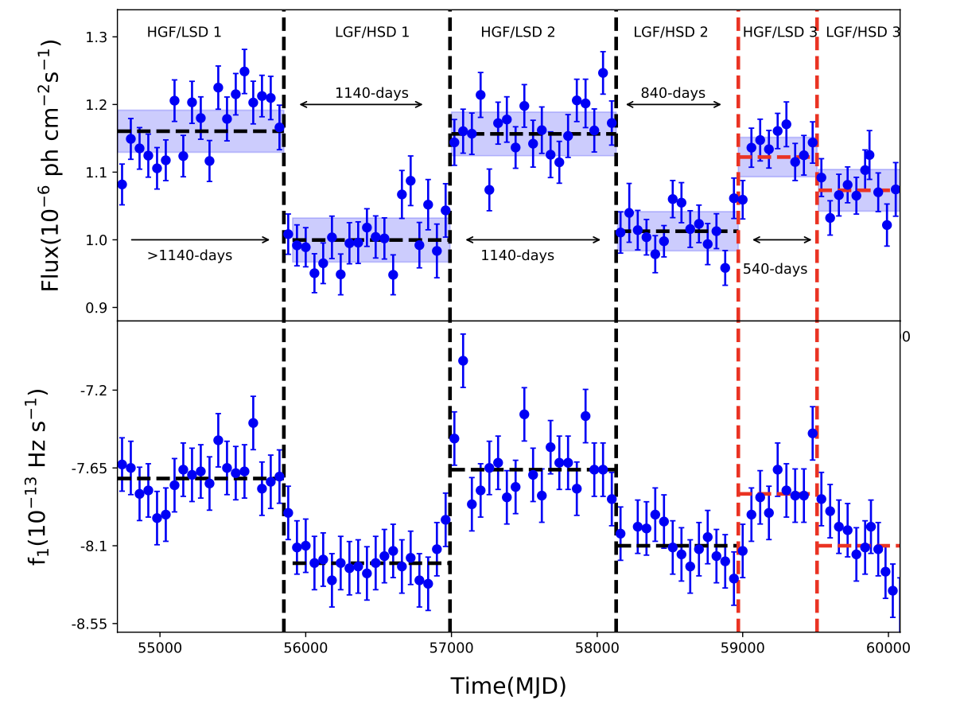
conclusion
We found that the waiting time, the change in the flux and the first-time derivative of frequency , the change in the shape of the pulse profile are smaller than previous events.
We could not find any significant change of the gamma-ray emission properties of Vela pulsar.
Our results confirm that the state change of PSR J2021+4026 is not regularly repeated but quasi-periodically repeated with the different magnitude of change in the gamma-ray flux and the spin-down rate.

Slide 17
Thank you for your listening
Welcome to
河南科技大学
in 洛阳

Slide 21
PSR J2021+4026
the current density:
$$J=cρ\frac{E×B}{B^{2}}+σE_{||}$$
Drift velocity
ρ is the charge density
spin-down luminosity L in terms of the σ of their dissipative global models :
emission asymmetrical or variations in the local magnetic field structure can affect the pulse shape.
If J is constant

