Slide 1
8600 MHz observations of 170 pulsars with TMRT
Speaker: Xiaowei Wang (王啸威)
Collaborators: Zhen Yan (闫振), Zhiqiang Shen (沈志强), Rongbing Zhao (赵融冰), Yajun Wu (吴亚军), Zhipeng Huang (黄志鹏), Rui Wang (王睿), Jie Liu (刘杰) et al.
2024/07/15 FPS13, Kunming

Slide 2
Outline
Motivation
Method and observation
Results
Summary

Slide 3
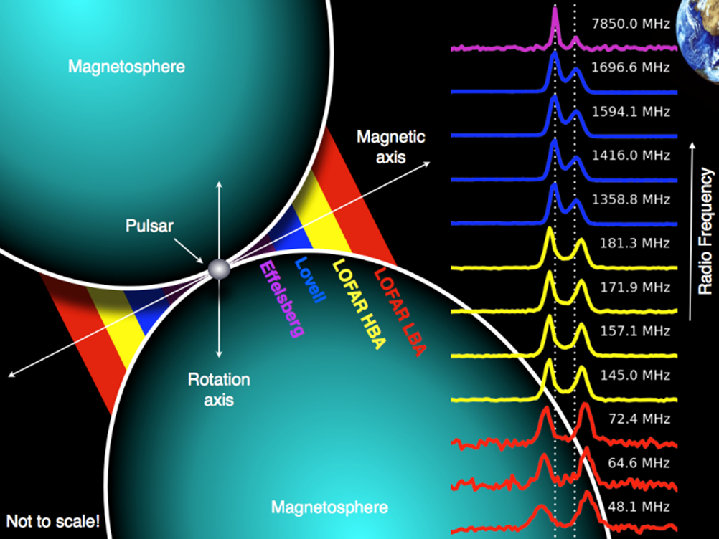
1.1 Importance of high-frequency pulsar observations
Few high-frequency data
Provide insights into the unclear emission mechanism for pulsars
Explore the deeper part of magnetosphere with multifrequency profile evolution
(Radius-to-frequency mapping, Cordes 1978)
Constrain the spectral behavior in a wider frequency range
Some special applications, e.g. searching Galactic Center pulsars …
Credit: T. Hassall
Many high-quality data at low frequencies from FAST, LOFAR, MWA…
(e.g. Johnston et al 2006, Eatough et al. 2021)
3

Slide 4
1.2 Current shortage of high-frequency observations
Some historical observations above 8 GHz
Pulsars that been observed above 8 GHz are sparse (around 80 pulsars) compared to the 3649 known pulsars in ATNF catalogue (till 2024/06/28)
Reference | Telescope | Frequency (GHz) | N_{psr}
Bartel et al. 1978 | Effelsberg | 14.8, 22.7 | 8
Morris et al. 1981 | Effelsberg | 8.7, 14.8 | 15
Kramer et al. 1994 | Effelsberg | 10.6 | 15
Xilouris et al. 1995 | Effelsberg | 10.6 | 19
Xilouris et al. 1996 | Effelsberg | 32 | 8
Maron et al. 2004 | Effelsberg | 8.4 | 3
Johnston et al. 2006 | Parkes | 8.4 | 32
Lohmer et al. 2008 | Effelsberg | 8.4, 32 | 9
Keith et al. 2011 | Parkes | 24 | 9
Maron et al. 2013 | Effelsberg | 8.4 | 12
Zhao et al. 2017 | TMRT | 8.6 | 26
Wang et al. 2024 | TMRT | 8.6 | 9
Low high-frequency flux due to steep spectra
${ S}_{ν}∝ν^{α}$(mean α ~ -1.6, Jankowski et al. 2018)
about 40% of the total number
Large telescope
Wider bandwidth
Lower T_{sys}
Longer integration times
How to make further breakthrough with TMRT ?
4

Slide 5
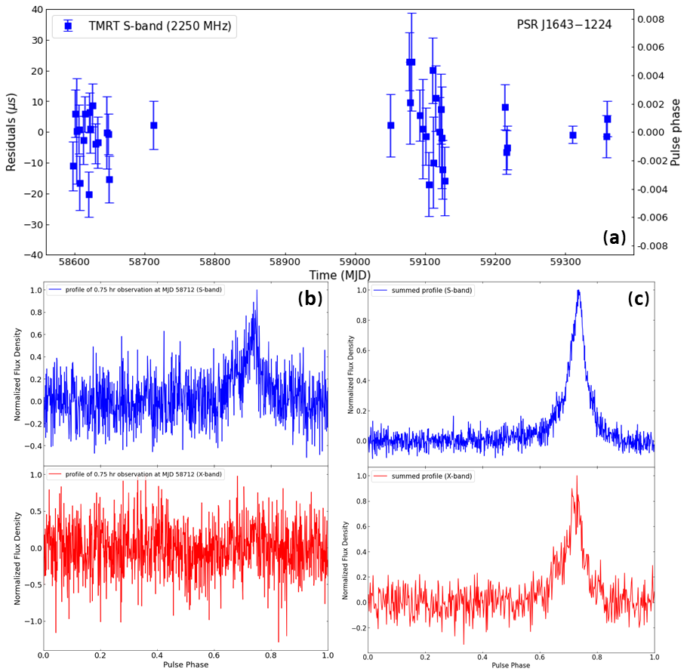
2.1 Method and observation
Simultaneously S/X band observations with TMRT
Timing analysis with S-band data
Effectively extend the integration times !
Align and add X-band data with new ephemerids
Data span: 2017 September - 2024 March
S/X dual-frequency receiver
S-band: 2200-2300 MHz
X-band: 8200-9000 MHz
Incoherent de-dispersion and online-folding mode
Typical integration time: 5-30 min
0.75 h
20.6 h
5

Slide 6
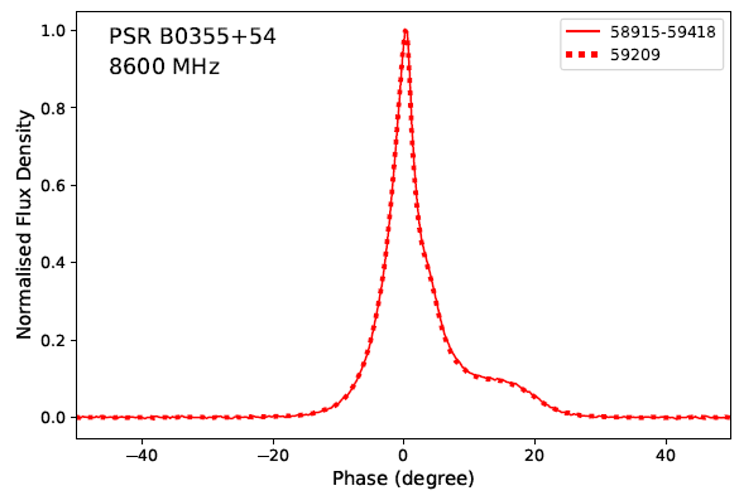
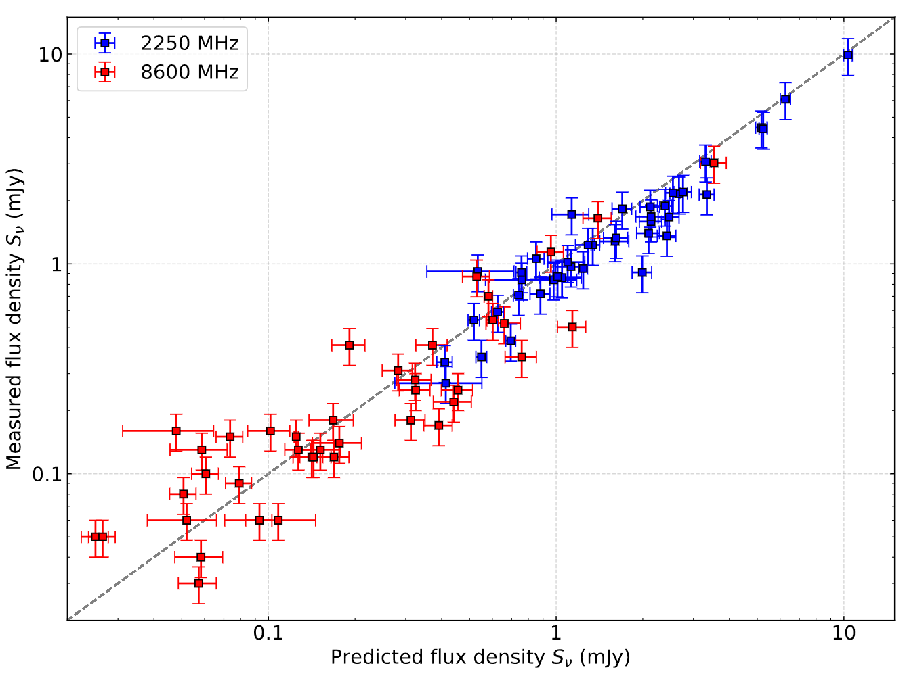
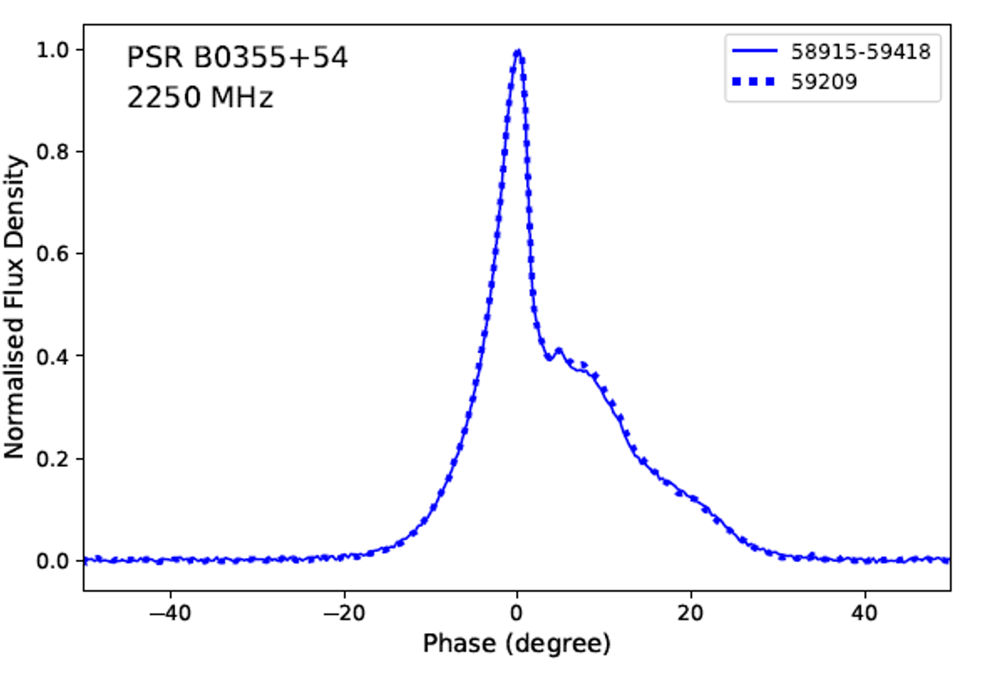
2.2 Technical verification: profile and flux
$$\frac{S_{2250}}{S_{p}}=0.88±0.23$$
$$\frac{S_{8600}}{S_{p}}=1.19±0.72$$
Consistent integrated profiles from single and multi-epoch observations
Measured flux densities are identical to the predicted ones
(classified as simple power-law in Jankowski et al. 2018)
Wang et al. 2024
6

Slide 7
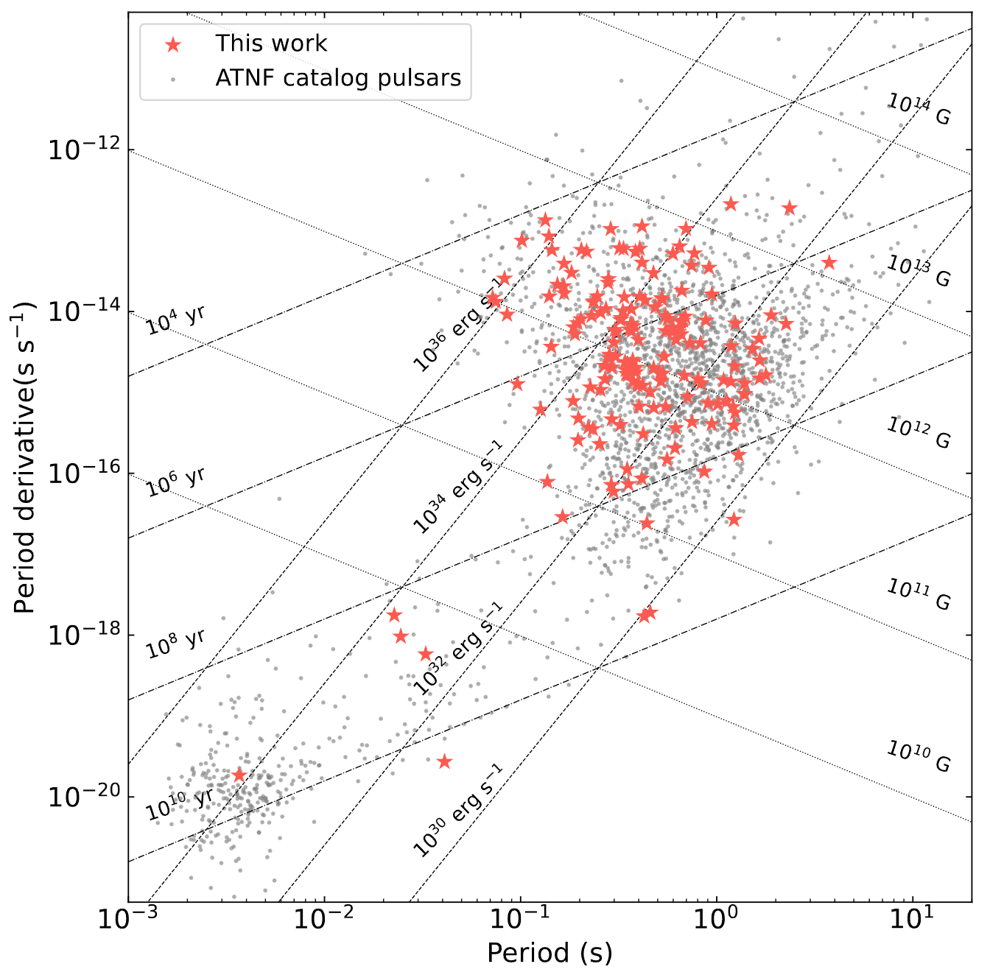
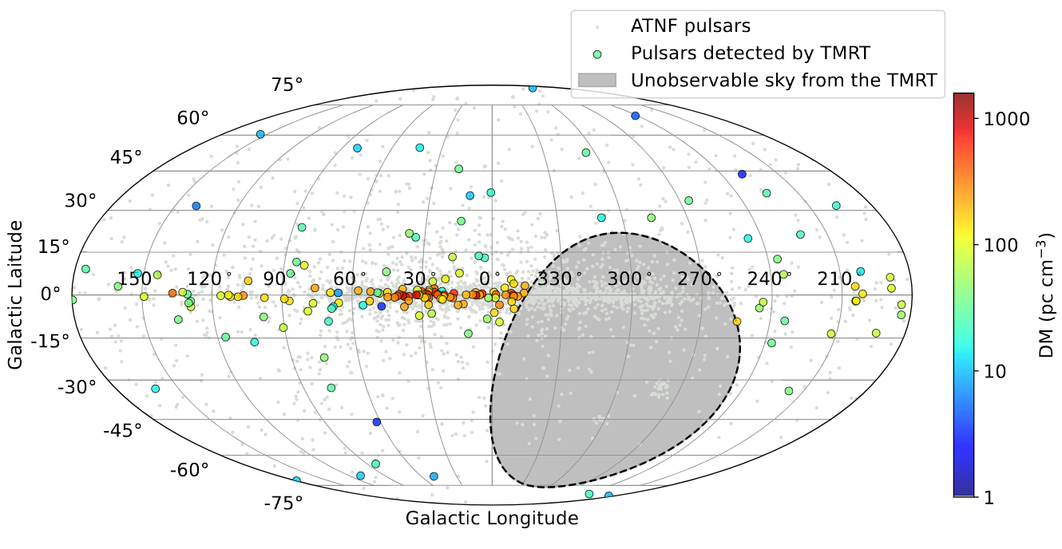
2.3 Sample of pulsars
Apply the method to a sample of 170 pulsars
3 millisecond pulsars
167 normal pulsars
A wide sky coverage of Declination > -40°
DMs range from 3.0 to 1067.8 cm^-3 pc
A relatively comprehensive coverage in the sky map and P-Pdot diagram
7

Slide 8
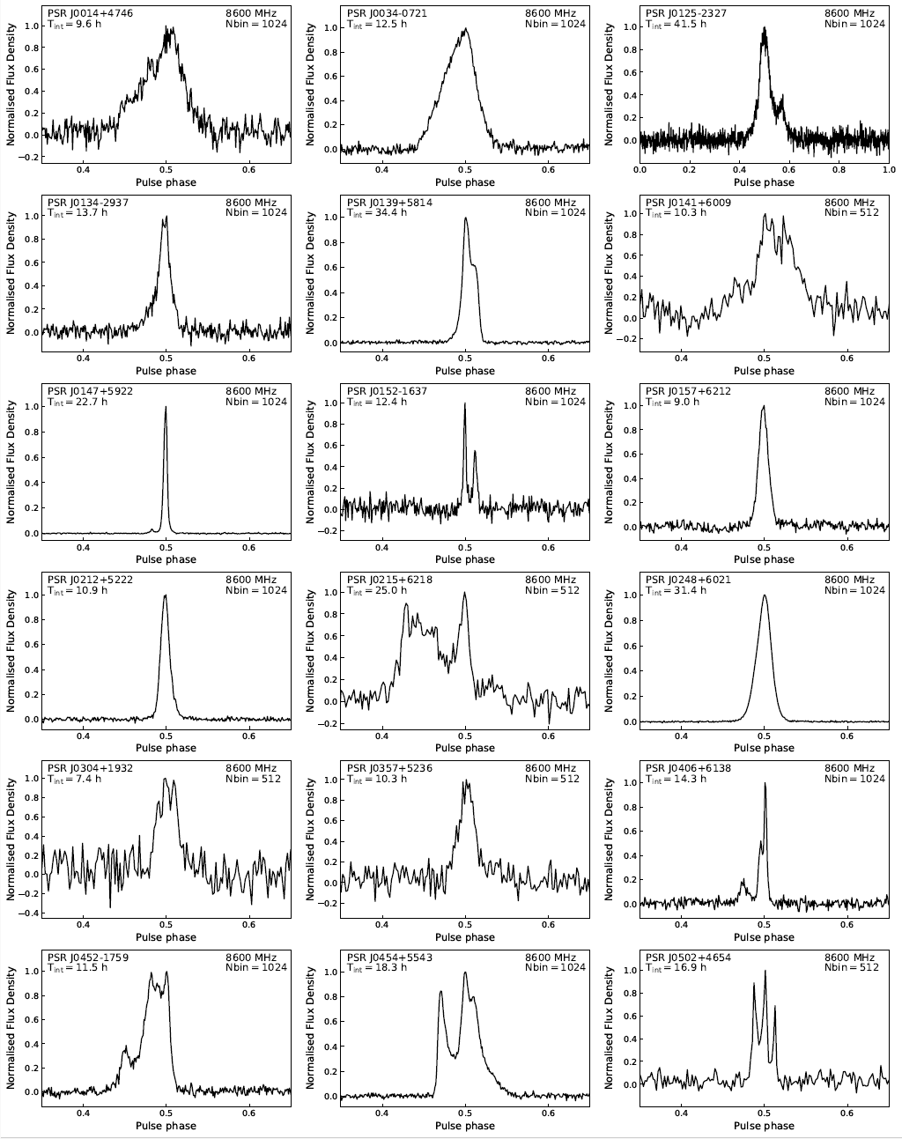
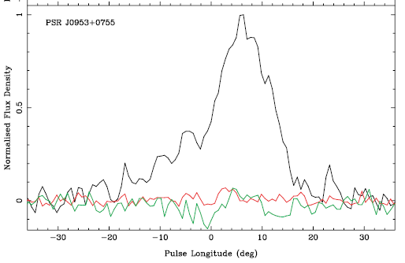
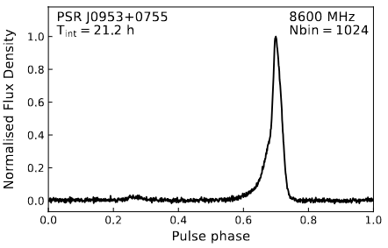
3.1 Integrated profiles at 8600 MHz
Successfully obtain the 8600 MHz profile for 170 pulsars
126 pulsars are first observed above 8 GHz
Better S/N for the profile of other 44 pulsars
Detect the interpulse (IP) in 8 pulsars
Almost tripled the existing number !
Parkes telescope 8.4 GHz
0.5 h integration time
(Johnston et al. 2006)
Weak IP (IP/MP ~ 0.03)
8

Slide 9
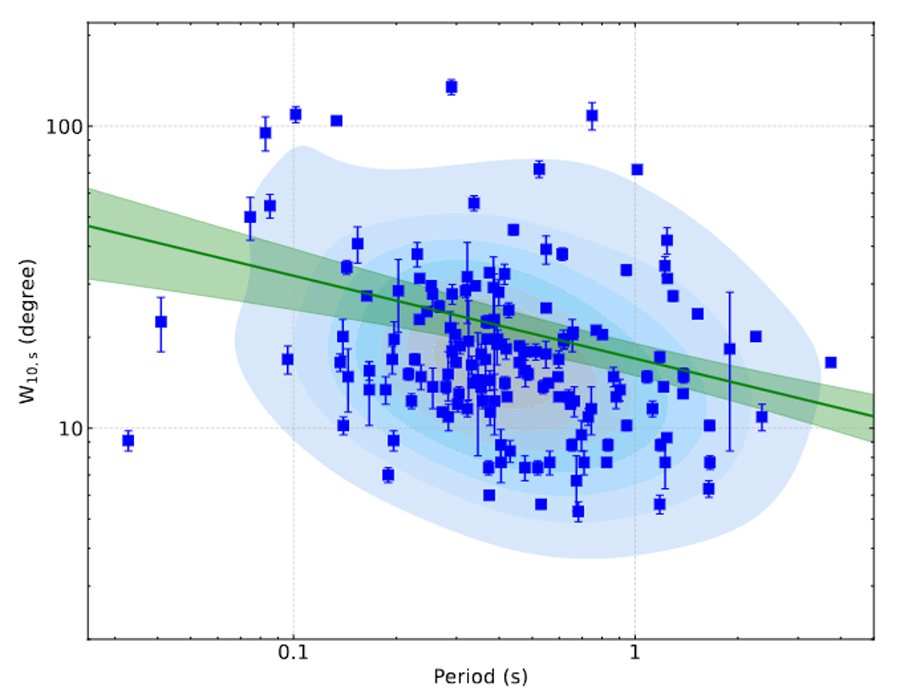
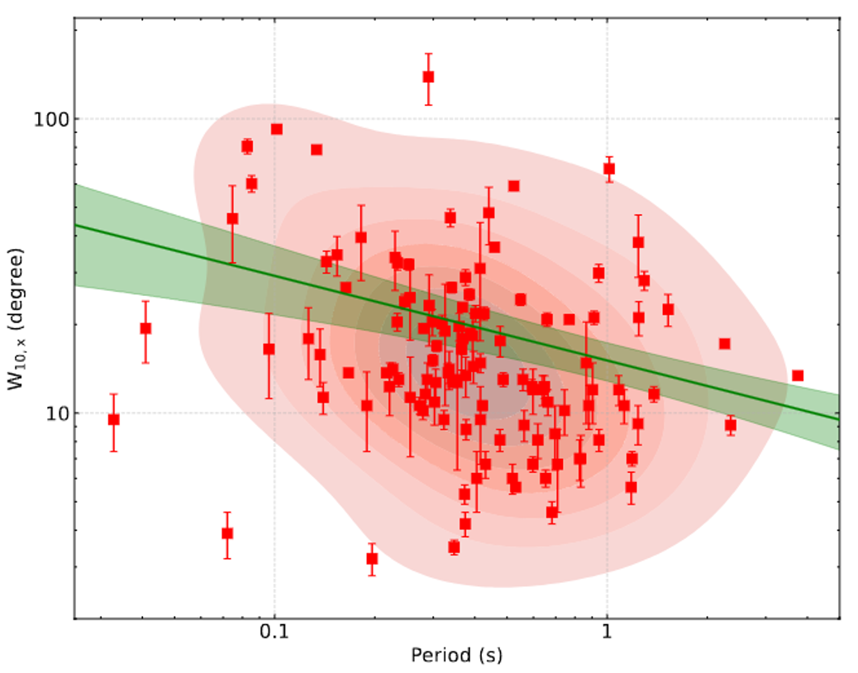
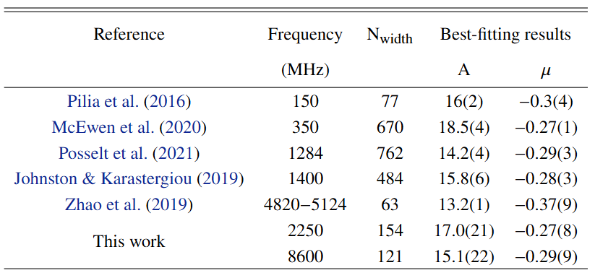
3.2 Profile width W₁₀ vs. period
2250 MHz
8600 MHz
Assuming ${ W}_{10}∝P^{μ}$
Obtain the mean slope μ of -0.27 and -0.29 for 2250 and 8600 MHz in log-log space
The slope seems identical at different frequencies
9

Slide 10
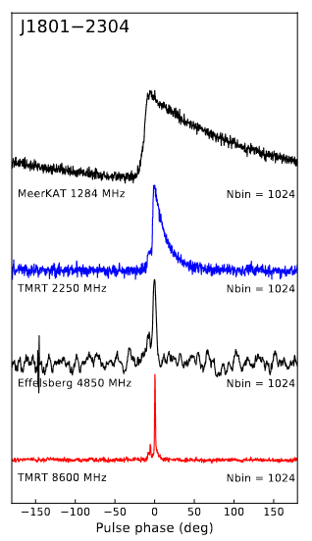
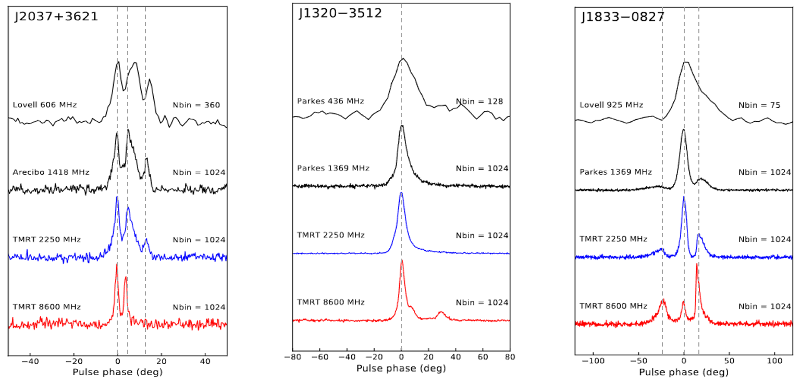
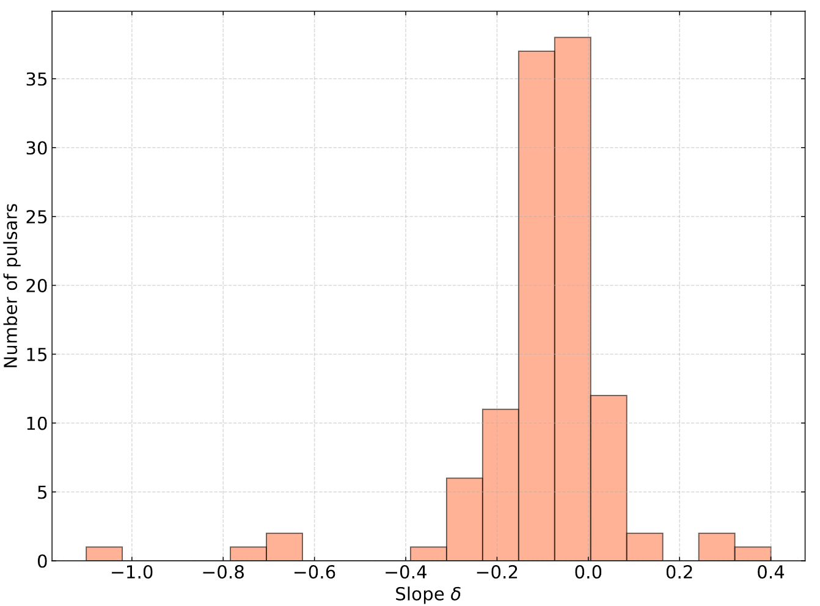
3.3 Multifrequency profile evolution
DM: 1067.8 cm^-3 pc
Intrinsic pulse shape for 7 scattering pulsars
Slight RFM (mean slope of -0.09) between 2250 and 8600 MHz (-0.19 between 333 and 618 MHz found by Mitra et al. 2016)
Width increasing for some pulsars towards high frequencies
$$W_{10}∝ν^{δ}$$
mean δ of -0.09
10

Slide 11
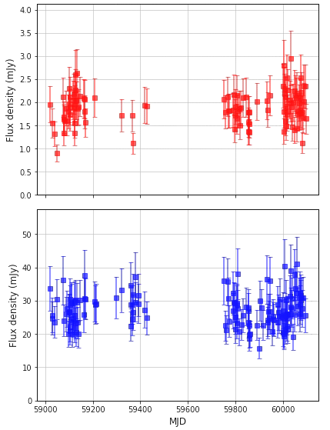
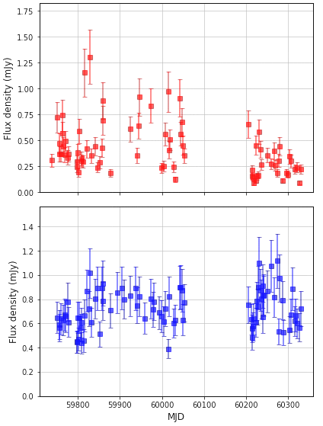
3.4 Unignorable scintillation effect at 8600 MHz
J0953+0755
DM: 3.0 cm^-3 pc
Few modulation
Obvious flux density variations for some pulsars at 8600 MHz
J0627+0649
DM: 86.6 cm^-3 pc
Evident modulation
Interstellar scintillation effect at such a high frequency ?
11
Red: 8600 MHz Blue: 2250 MHz

Slide 12
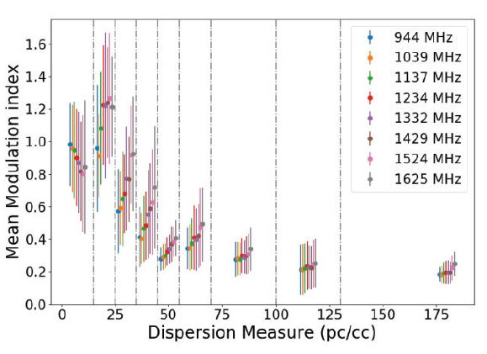
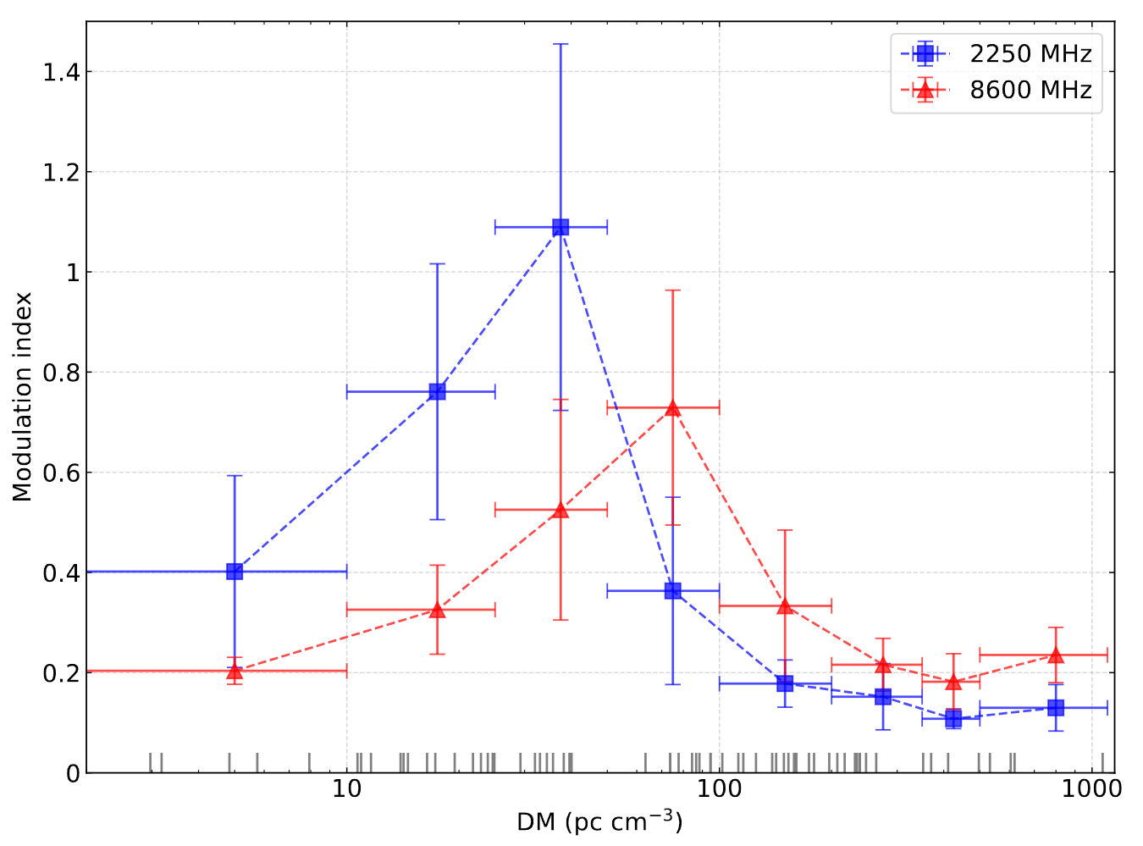
3.4 Unignorable scintillation effect at 8600 MHz
Gitika et al. 2023
Quantify the variation of the flux with modulation index ${ m}_{ν}=\frac{σ_{S_{ν}}}{\left\langle S_{ν}\right\rangle }$
$m_{ν}$ varies with the DM and frequency
Large modulation in pulsars with moderate DMs (~ 50-100 cm^-3 pc) at 8600 MHz
The peak of the distribution of $m_{ν}$ shifts towards higher DMs with increasing frequencies
Weak scintillation
Strong scintillation
Refractive scintillation
12

Slide 13
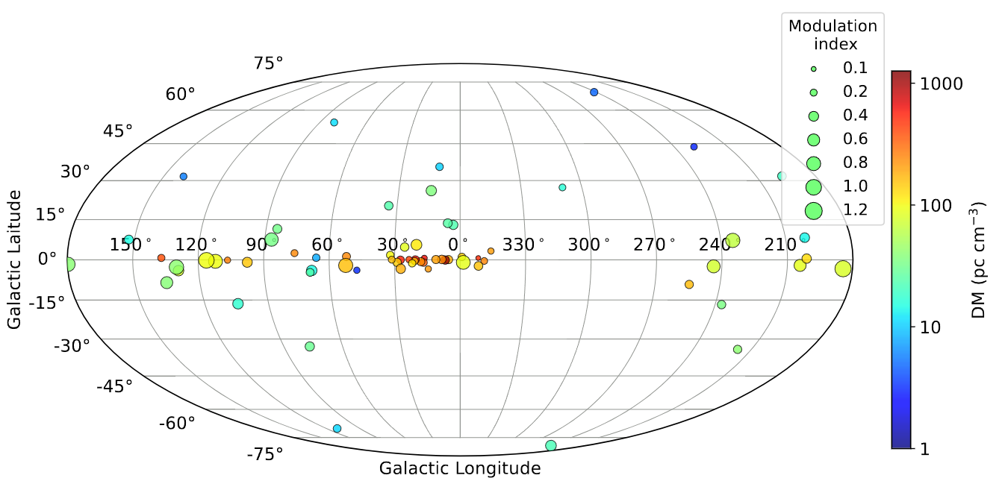
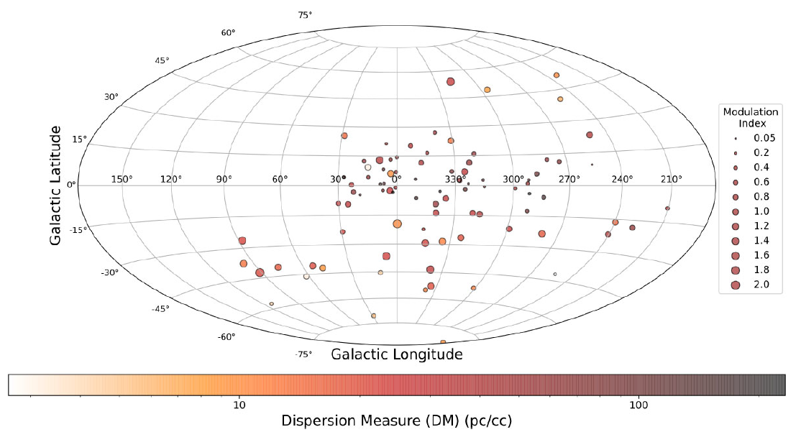
3.4 Unignorable scintillation effect at 8600 MHz
Gitika et al. 2023
TMRT 8600 MHz
MeerKAT 1429 MHz
Higher $m_{ν}$ ($>0.4$) for low galactic longitudes pulsars ($\left|b\right|<10°$) at 8600 MHz
Higher frequencies (L to X band) lower $\left|b\right|$ for highly modulated pulsars
Guide the target selection for future high-frequency scintillation studies !
13

Slide 14
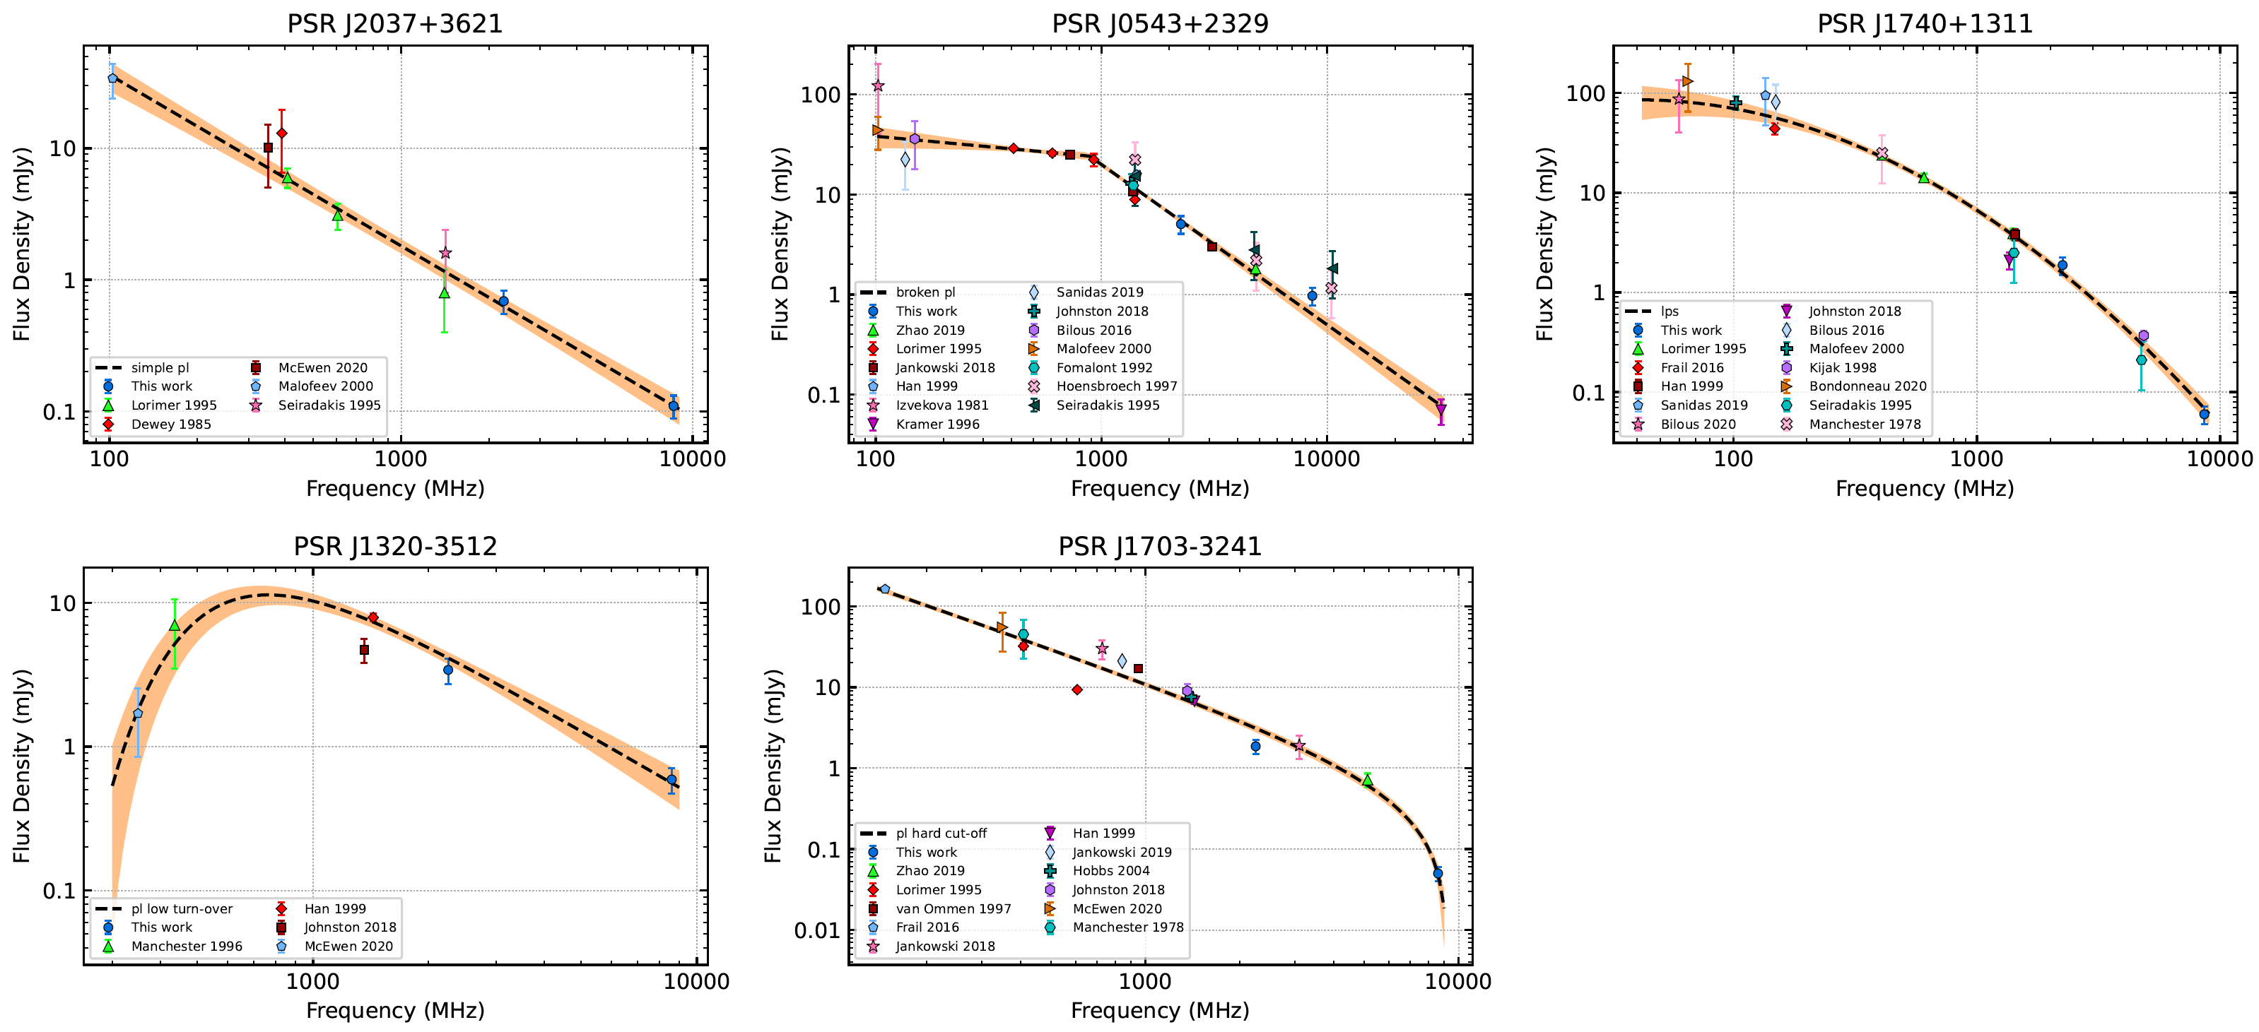
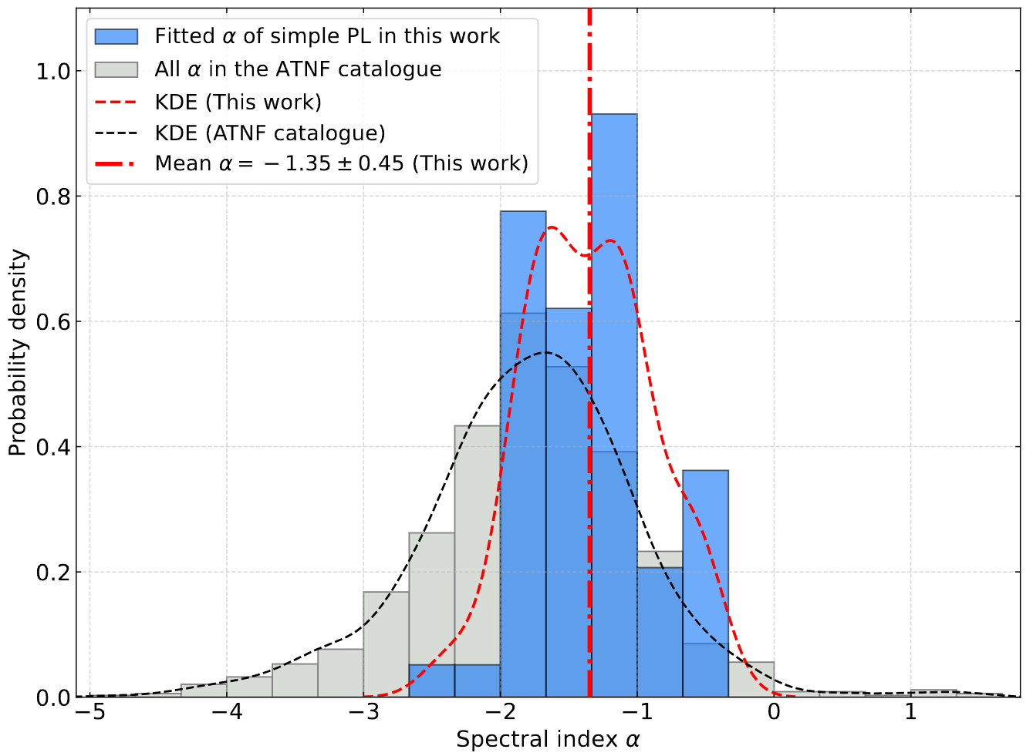
3.5 Spectral complexity and spectral indices
(a)
(b)
(c)
(d)
(e)
Select 5 spectral models (Jankowski et al., 2018):
Simple power law (PL) (34 per cent)
Broken PL (17 per cent)
Log-parabolic spectrum (20 per cent)
PL with low-frequency turn-over (24 per cent)
PL with high-frequency cut-off (5 per cent)
The percentage of simple PL is lower than in previous works (79% for 441 pulsars in Jankowski et al. 2018)
A flatter mean $a$of -1.35 for 58 pulsars with simple PL spectra
No positive $a$(> 0) is observed
14

Slide 15
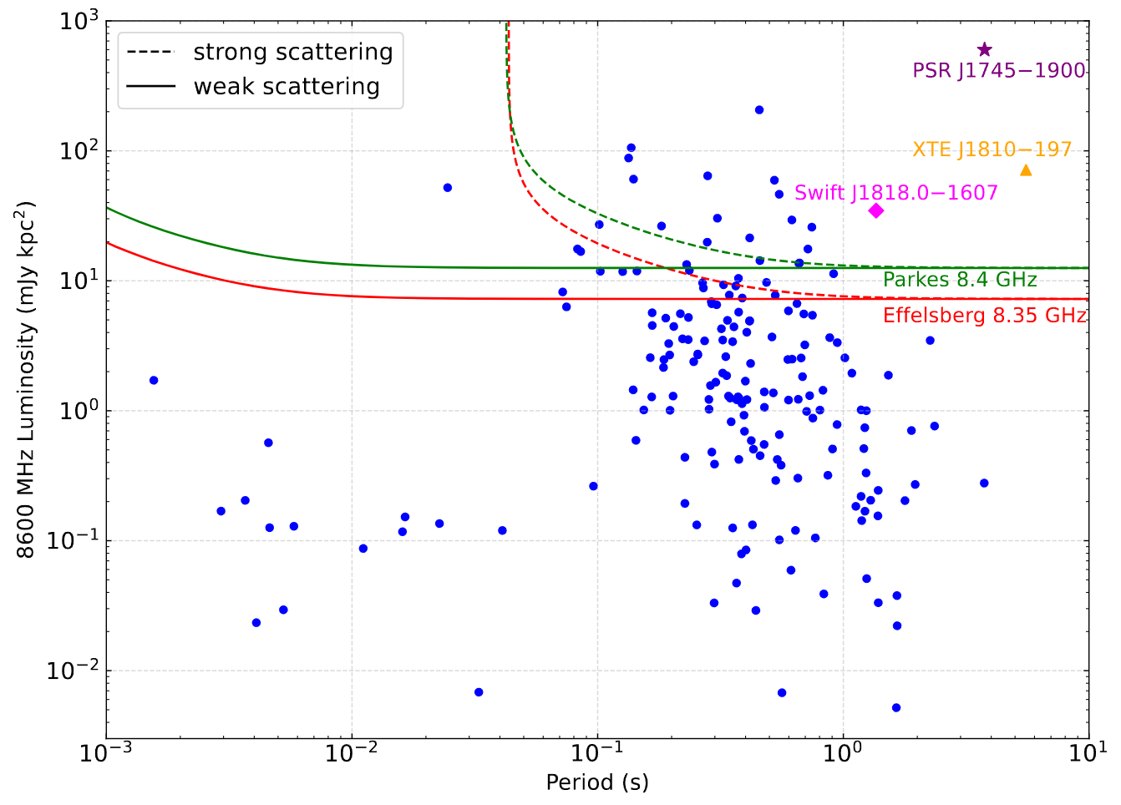
3.6 Constrain on detection of GC pulsars at X-band
Pseudo-luminosity : $L_{ν}=S_{ν}∙d^{2}$
Detection limit:
Parkes 8.4 GHz survey: ~200 μJy (Johnston et al. 2006)
Effelsberg 8.35 GHz survey: ~105 μJy (Eatough et al. 2021)
Scattering scenarios (Macquart et al. 2015)
Weak scattering: $τ_{s}=1.3{\left(\frac{ν}{1 GHz}\right)}^{−3.8}$ms
Strong scattering: $τ_{s}≈210{\left(\frac{ν}{1 GHz}\right)}^{−4}$ms
Future deeper surveys at X-band are necessary !
15

Slide 16
4. Summary
Detect 170 pulsars at 8600 MHz using simultaneous S/X band observations with TMRT, that almost triples the number of pulsars with high-frequency (> 8 GHz) observations
The derived slope for W₁₀-period relation at 8600 MHz is similar to those at low frequencies
Slight RFM is observed between 2250 and 8600 MHz, meanwhile some pulsars show width broadening towards high frequencies
Modulation index varies with frequencies, DMs and galactic location, pulsars with moderate DMs (~50-100 cm^-3 pc) tend to show large modulation at 8600 MHz
The percentage of simple PL spectrum is lower than that found by other works after adding high-frequency flux data
Future deeper X-band surveys could have chance to detect high luminosity normal pulsars in the GC
Thanks !
16

