Slide 1
Probing the Interstellar Medium from Scintillation of the Swooshing Pulsar B0919+06
Reporter：Zhen Wang
Supervisor： Jianping Yuan
Xinjiang Astronomical Observatory, CAS
July 2024 @ Kunming

Slide 2
Outline
Introduction
Observations and Data Reduction
Results
Discussion
Summary

Slide 3
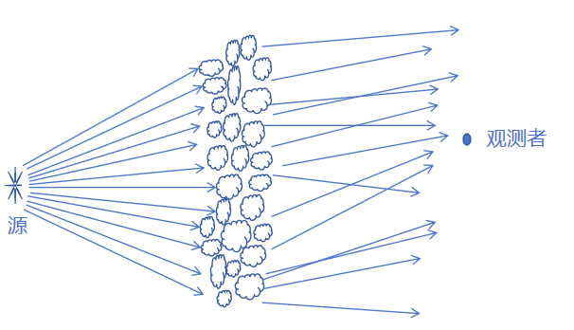
Introduction
Interstellar scintillation
PSR B0919+06
Rotational Period (P): 431 ms
Dispersion Measure (DM): 27.30 pc cm⁻³
Distance: 1.21 kpc (Stovall et al. 2015)
FAST observed two scintillation arcs
Parabolic curvatures： 0.0025 ± 0.0004 and 0.01 s³ （1.25 GHz）
Fractional screen distance： 0.07 ≤ s ≤ 0.2 and 0.3 ≤ s ≤ 0.5s (Ocker et al. 2024)
0.14 and 0.52（Putney&Stinebring.,2006）
Pulsar scintillation observations play a crucial role as probes of the magnetoionic plasma present in the interstellar medium of our Galaxy, as the radio waves are scattered by electron inhomogeneities within the interstellar medium.
Diagram of the scintillation scattering screen model

Slide 4
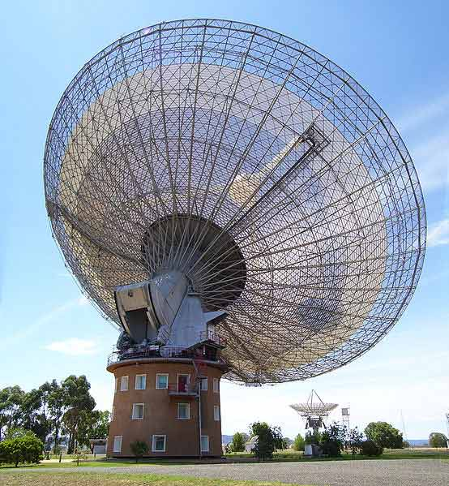
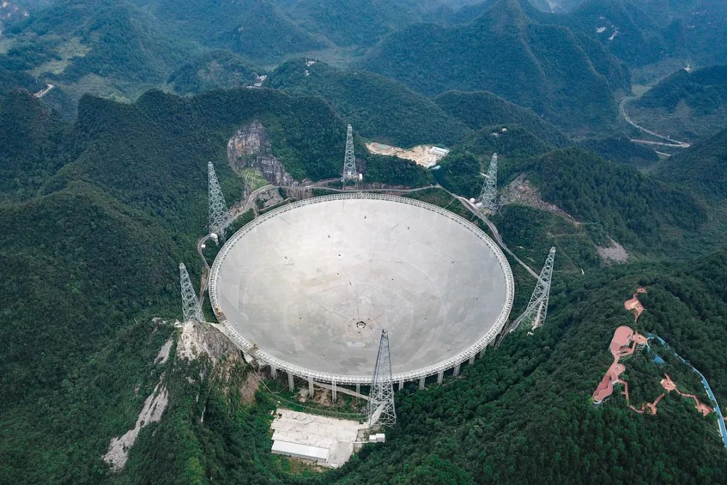
Observations and Data Reduction
FAST Observations
Frequency coverage：1000~1500 MHz
Time resolution：49.1522 μs
The FAST observations consists of 10 epochs
Cadence：1-2 months
epochs：32~111 min
Parkes Observations
UWL：704~4032 MHz
Time resolution：128 μs
epochs：3.5 h
Observational Parameters of PSR B0919+06 with the FAST and Parkes Radio Telescopes

Slide 5
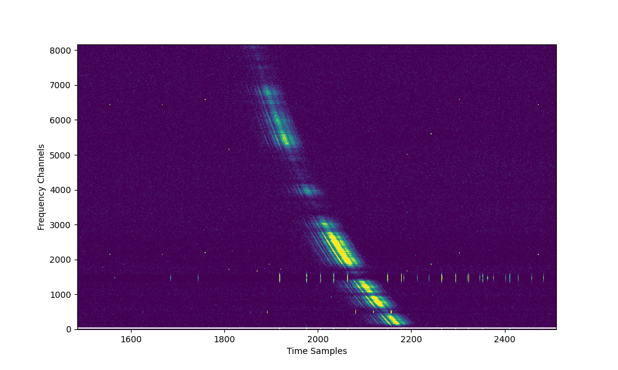
Observations and Data Reduction
Data Processing
Median filter：RFI were identified and removed
Time and Frequency domain： the variable baseline was subtracted
Dedispersion
Folding：The spectra were accumulated with a subintegration time of 4.3 s (equivalent to 10 pulsar rotations)

Slide 6
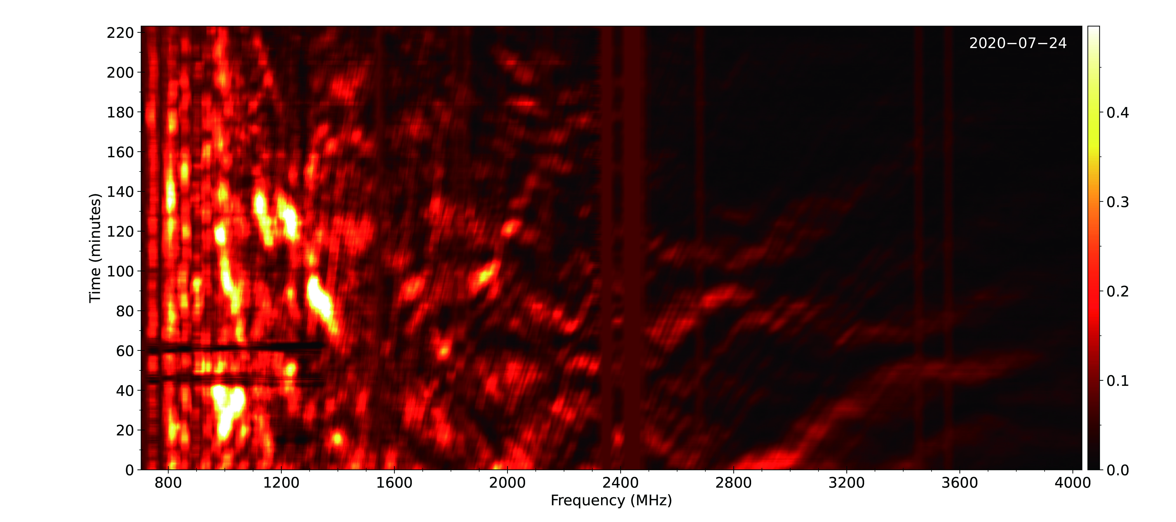
Results
Dynamic Scintillation Spectra
（Parkes）
Observational Results: Through multiple observations with the FAST and Parkes telescopes, rapid intensity modulation patterns over time and frequency have been revealed.
Scintillation Characteristics: The scintillation broadens at lower frequencies and narrows as the frequency increases.
（FAST）

Slide 7
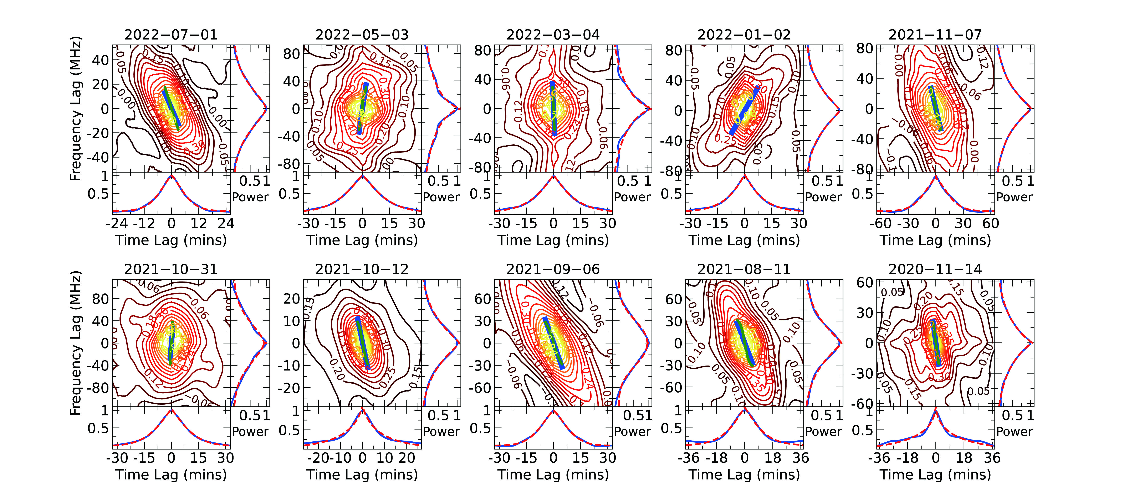
Results
2D ACF
2D Autocorrelation Function:
Normalized Autocorrelation Function:
2D fast Fourier transform (FFT)
Inverse 2D FFT
(FAST)

Slide 8
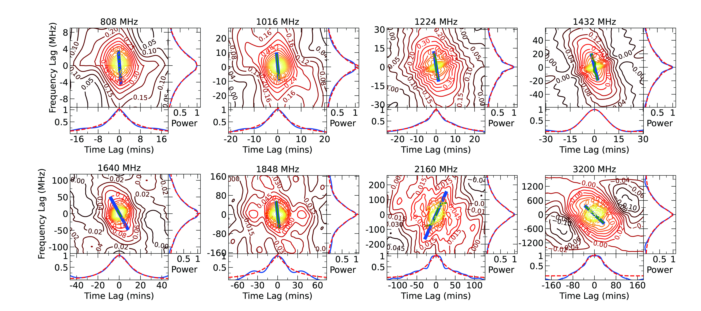
Results
2D ACF
Performing least squares fits of analytical exponential models to one-dimensional cuts through the center of the 2D ACF along thefrequency and time lag axes .
Timescale( ):
The width along the time lag axis.
Decorrelation bandwidth ( ) :
The half-power width along the frequency lag axis.
(Parkes)

Slide 9
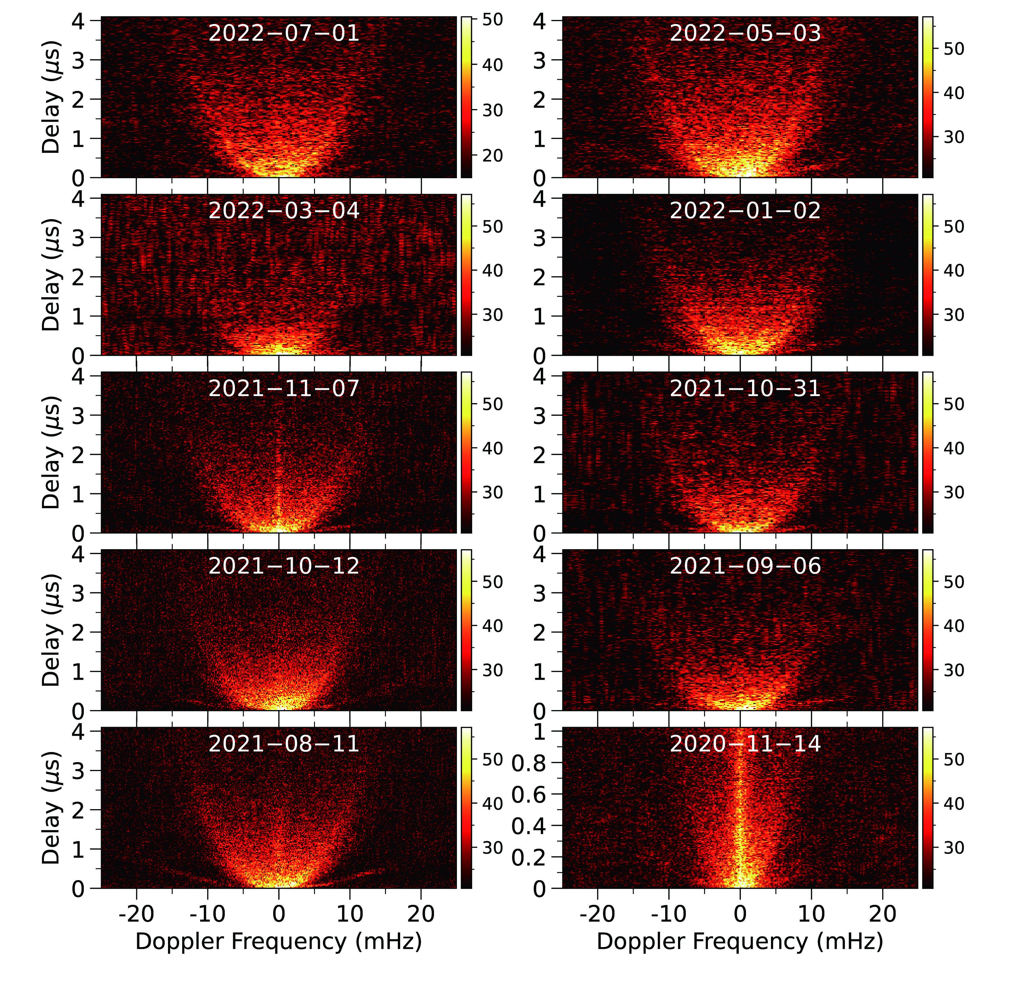
Results
Secondary Spectra
Characteristics of Scintillation Arc shape
FAST observed two scintillation arc structures.
The outer arc exhibits a relatively shallow and significantly truncated arc shape.
The inner structure displays a diffuse and filled-in arc shape.
（FAST）

Slide 10
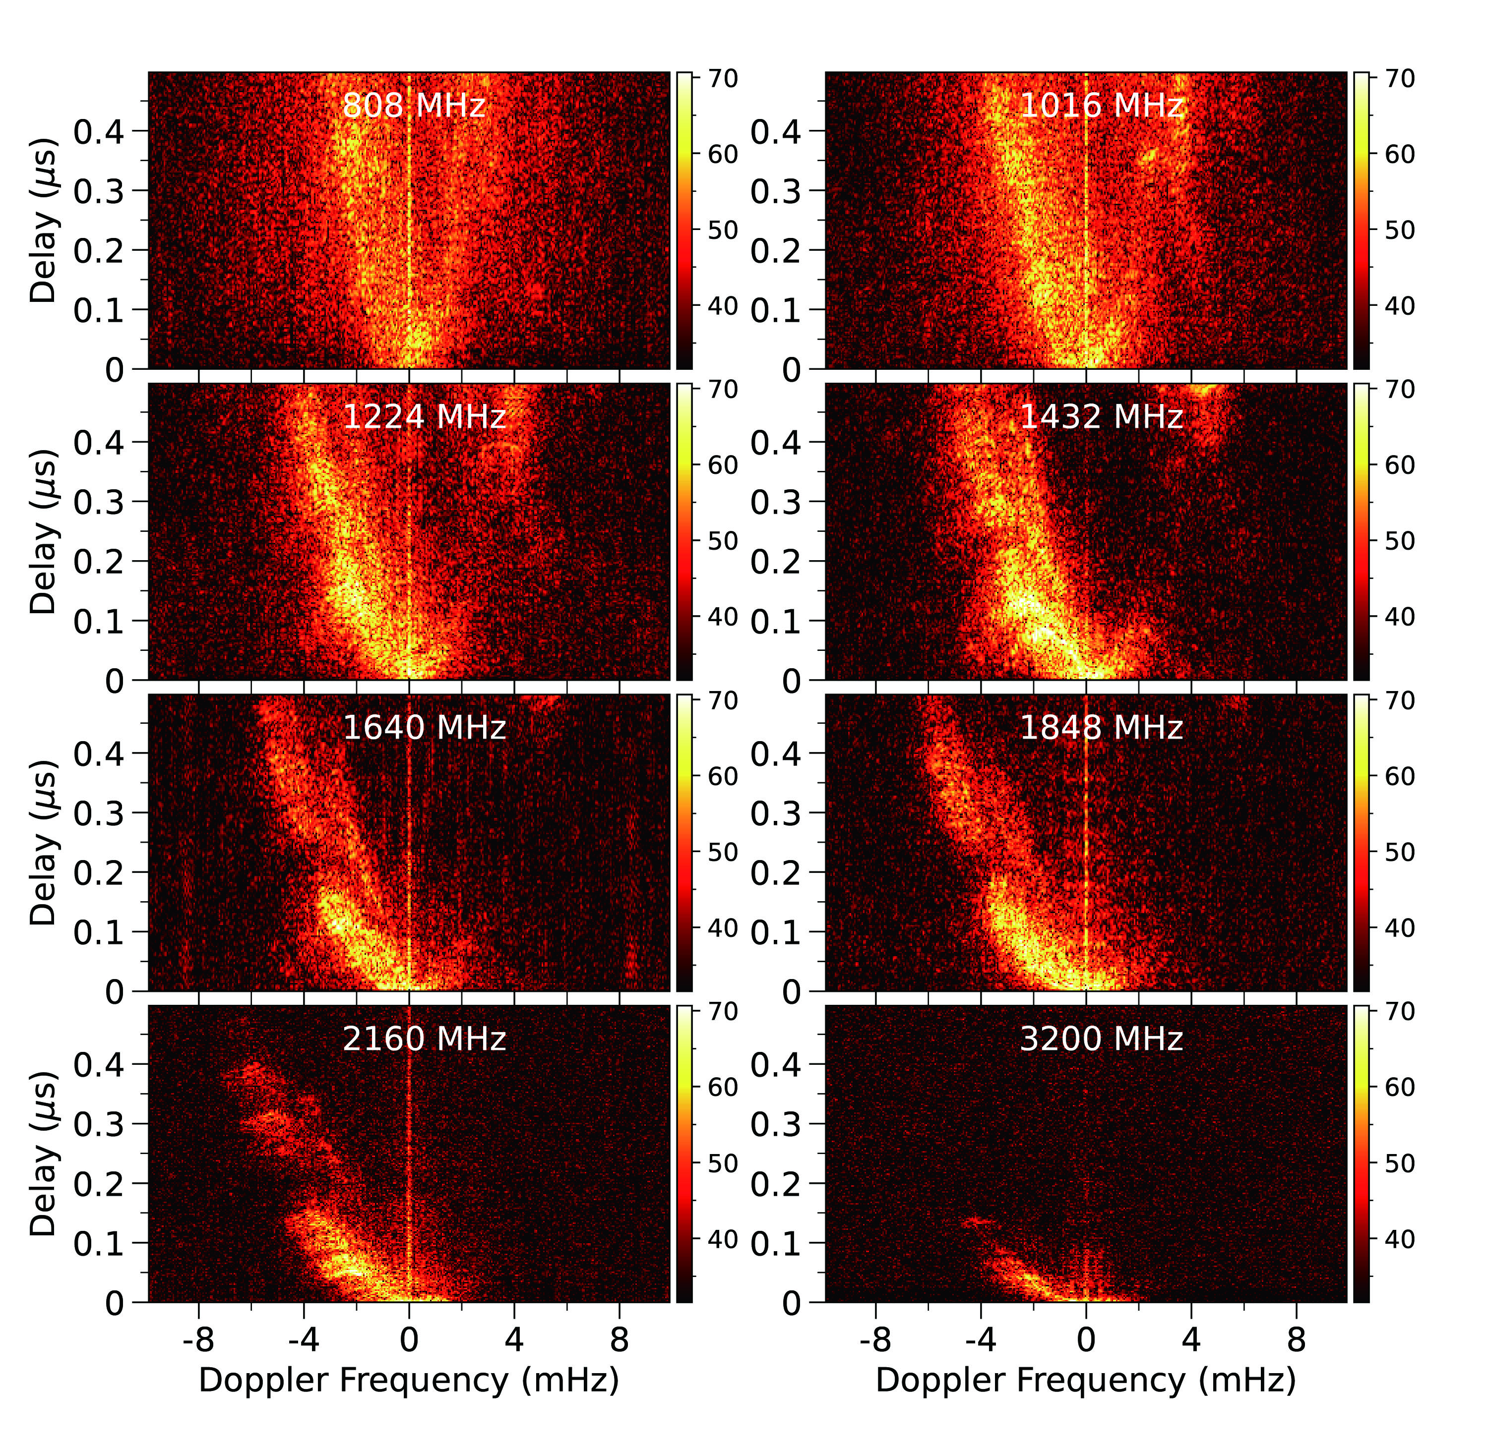
Results
Secondary Spectra
Characteristics of Scintillation Arc shape
The outer arc is undetectable across the entire observing frequency band with the Parkes telescope.
Scintillation arcs are a broadband phenomenon.
The scintillation arcs exhibit significant asymmetry.
This asymmetry persists across the entire observing frequency band and becomes more pronounced with increasing frequency.
（Parkes）

Slide 11
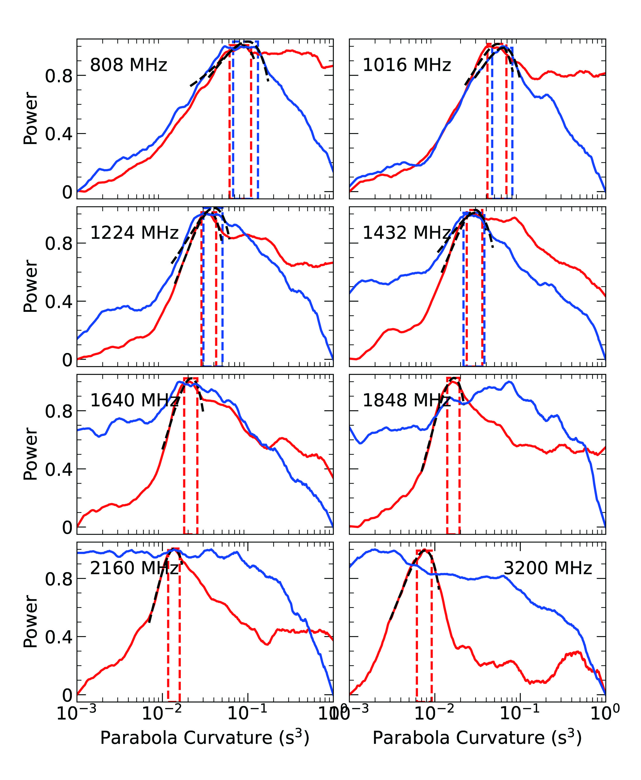
Results
Arc curvature
Generalized Hough
transformation
At eight frequencies, a distinct single peak is observed at the negative differential Doppler frequencies.
The latter four positive differential Doppler frequencies lack a single peak, revealing the absence of scintillation arcs on the right half of the secondary spectrum.
The latter four negative differential Doppler frequencies and positive differential Doppler frequencies show inconsistent variations, revealing the high asymmetry of the scintillation arcs.
The red and blue solid curves represent the linear summations for the negative and positive differential Doppler frequency, respectively. The measurement and uncertainty regions for the parabolic arcs are flagged by vertical bands by defining a width at 95% of the peak. The central frequency is indicated in each panel.

Slide 12
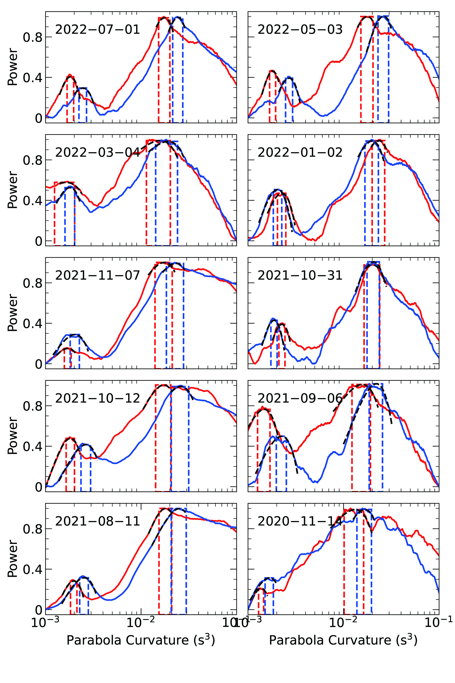
Results
Arc curvature
At eight frequencies, distinct single peaks are observed at both the negative and positive differential Doppler frequencies, revealing the presence of two scintillation arcs in the secondary spectrum
The red and blue solid curves represent the linear summations for the negative and positive differential Doppler frequency, respectively. The measurement and uncertainty regions for the parabolic arcs are flagged by vertical bands by defining a width at 95% of the peak. The central frequency is indicated in each panel.

Slide 13
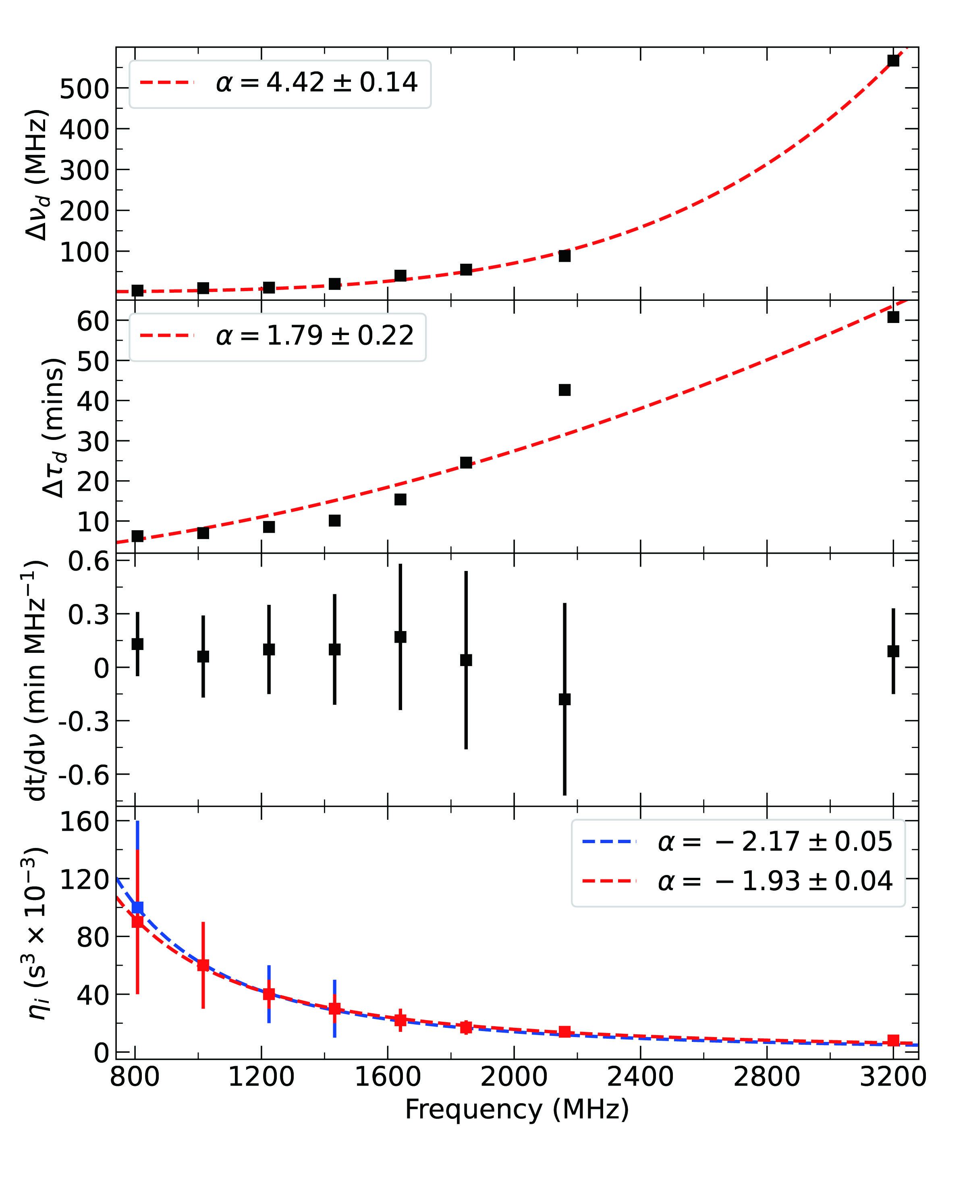
Discussion
The electron density fluctuations in the interstellar medium are characterized by a power-law spectrum. In the Kolmogorov case with a spectral index of 11/3:
The slope in the power spectrum of the 2D ACF:
(Gupta et al. 1994;).

Slide 14
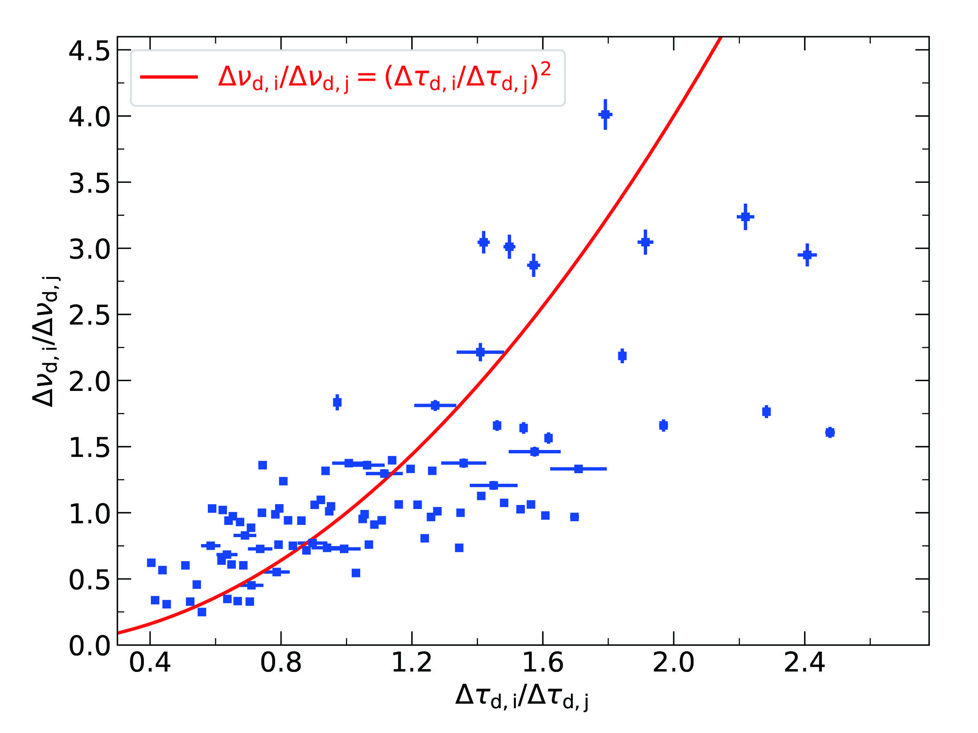
Discussion
In the thin screen model, there is a specific relationship between the scintillation parameters for two paired observations 𝑖and 𝑗(Wang et al.,2018).
The result is consistent with the prediction.

Slide 15
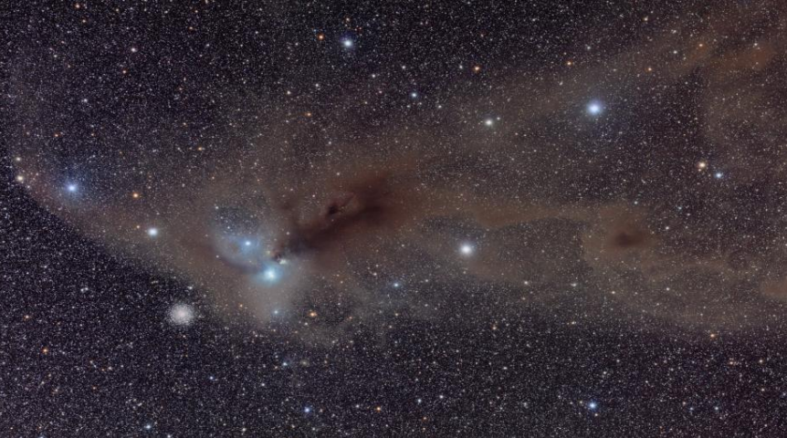
Discussion
Two important equations：
By assuming a single thin screen, the partial or fully one-dimensional scattering predicts the arc curvature to be:
The effective transverse velocity is then given as:

Slide 16
Discussion
Locations of the scattering screens
Parameters
Distance of the observer from the pulsar（ ）
Transverse pulsar proper motion（ ）
Transverse component of the Earth’s velocity （ ）
transverse velocity of the scattering screen itself （ ）
Arc curvature （ ）
Observing frequency （ ）
is dominated by the pulsar velocity
Fractional screen distance:

Slide 17
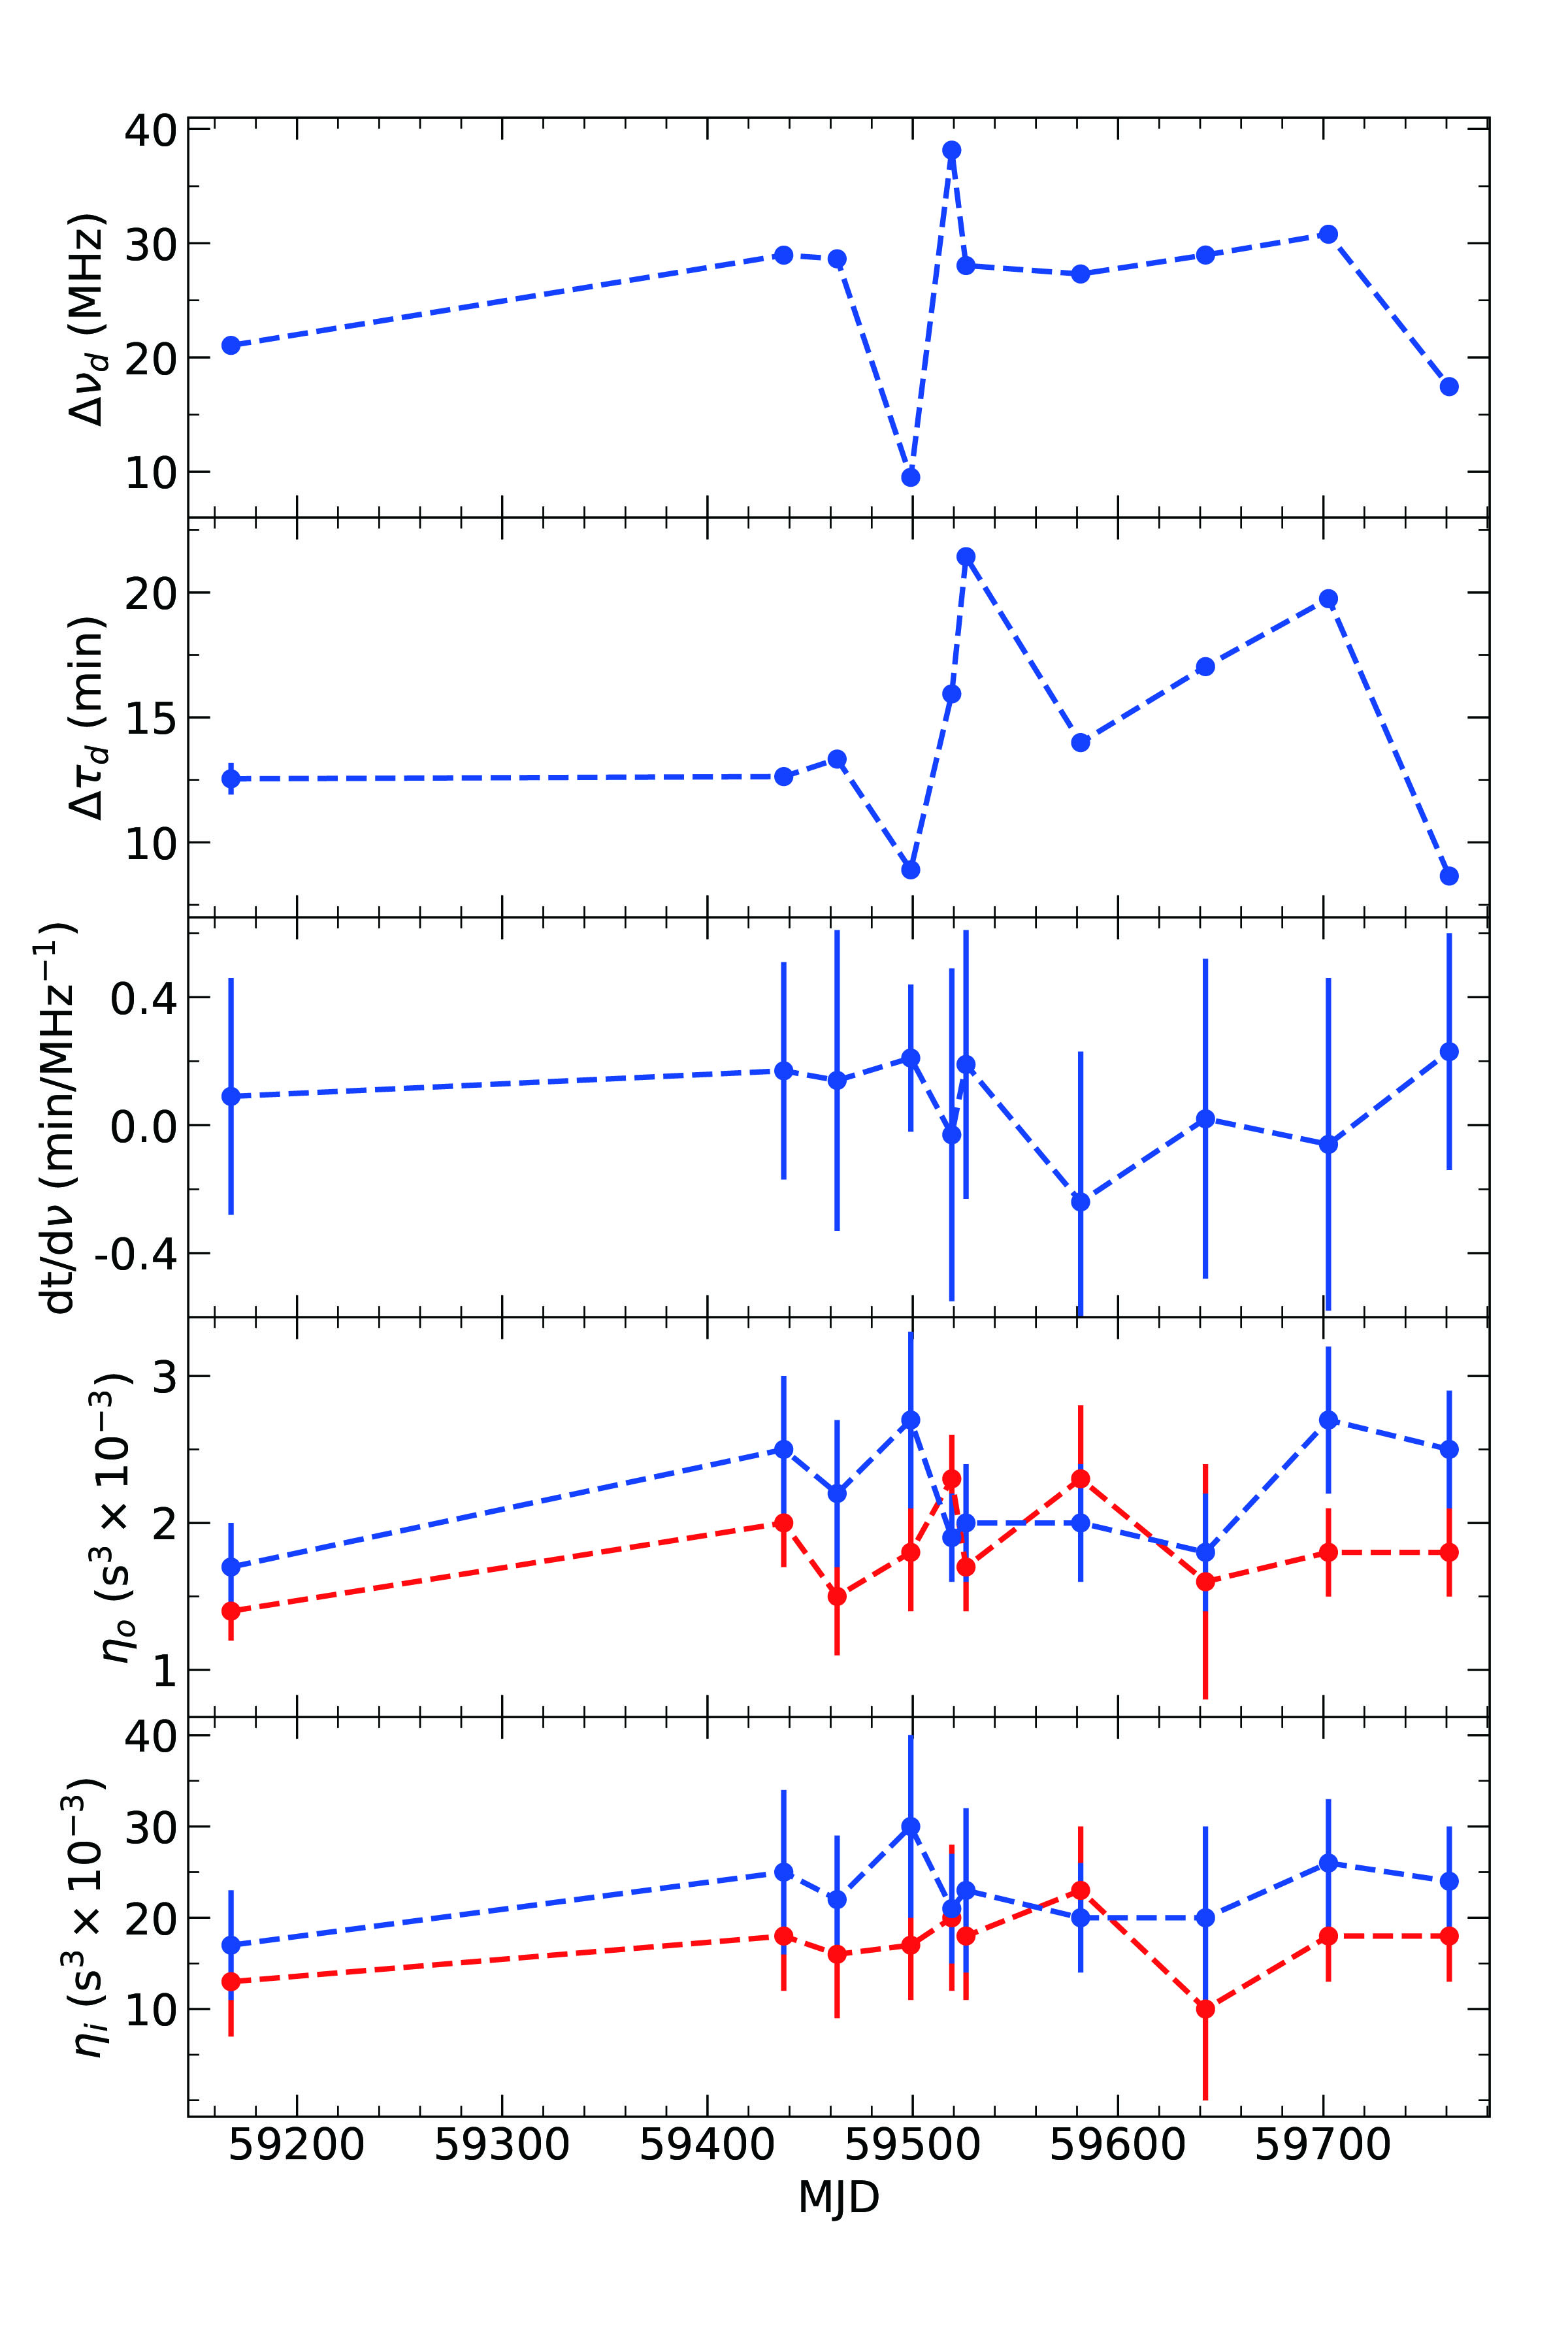
Results
Locations of the scattering screens
The average curvatures of the outer and inner scintillation arcs observed by FAST are respectively:
and
For isotropic scattering in thin screens with，
Corresponding to distances of 157.3 ± 36.8 and 726.0 ± 126.1 pc from the pulsar to the scattering screens.

Slide 18
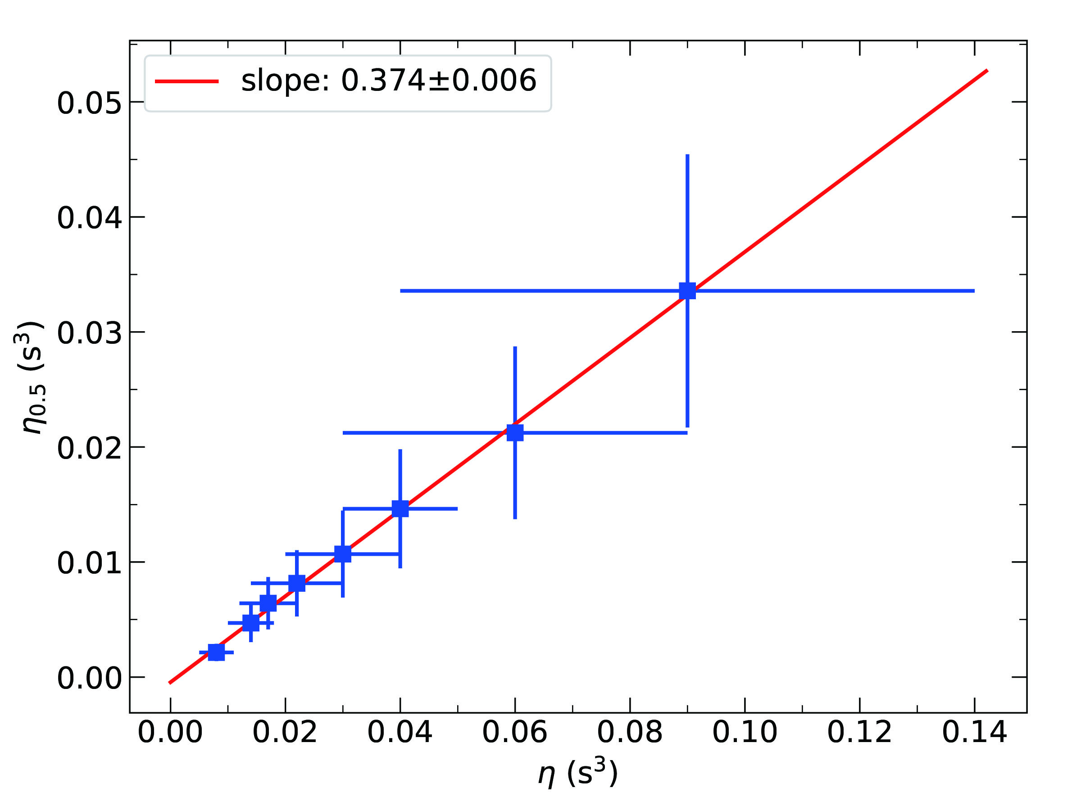
Discussion
Under the thin screen anisotropic scattering assumption, the curvature is also represented as
The fractional screen distance is found to be
for .

Slide 19
Summary
Summary
The scintillation parameters such as decorrelation bandwidth, timescale, and fringe slope for B0919+06 have been calculated.
The curvatures of the inner and outer arcs were calculated.
The locations of the scattering screens corresponding to the inner and outer scintillation arcs were estimated.
The electron density fluctuations in the interstellar medium approximately follow the Kolmogorov spectrum.
Under the assumption of anisotropic scattering from a single screen, the inferred size of the scattering screen deviates from the expectations of the thin screen model.
More sophisticated models will be needed in the future to accurately characterize the scattering properties of the interstellar medium.

Slide 20
Thanks for your attention!

