Slide 1
Evidence for the eclipse of pulsar B1929+10’s radio emission by its plasma outflow
Zhengli Wang (GXU)
Supervisors: Renxin Xu (PKU), Enwei Liang (GXU)
July 15, 2024 Kunming

Slide 2
Outline
Extremely flux density event
The DM event and the frequency-dependent DM
Pulsar timing results
Behavior of the pulse shape
Scintillation phenomenon
FRB-like behavior
Origin of the event
Summary

Slide 3
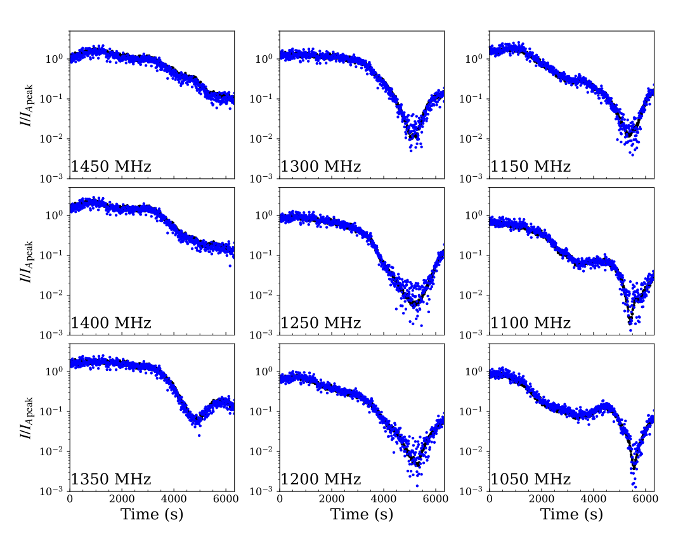
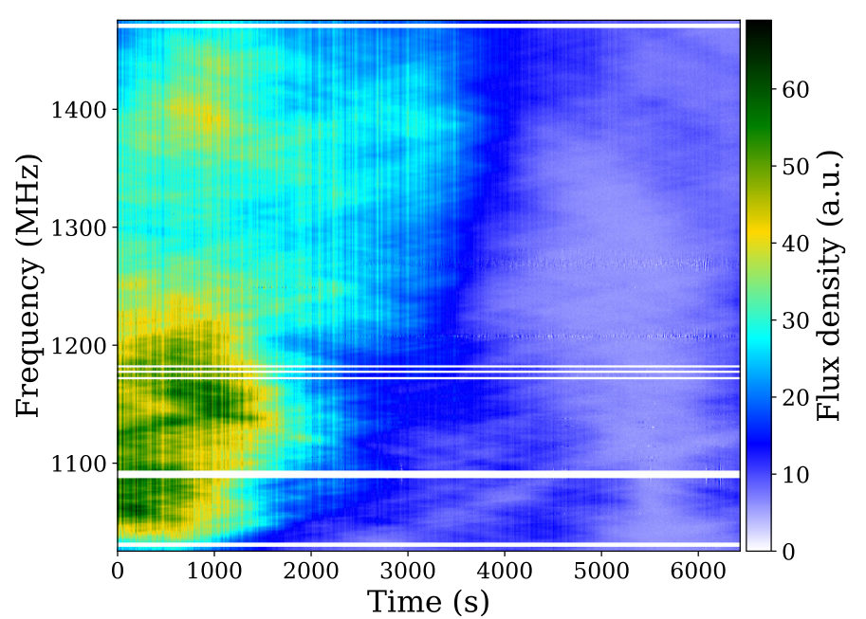
Extremely flux density event
The variation in flux density: ${10}^{−2}∼{10}^{−3}$
Plasma lensing event
Short time scale: 10 minutes

Slide 4
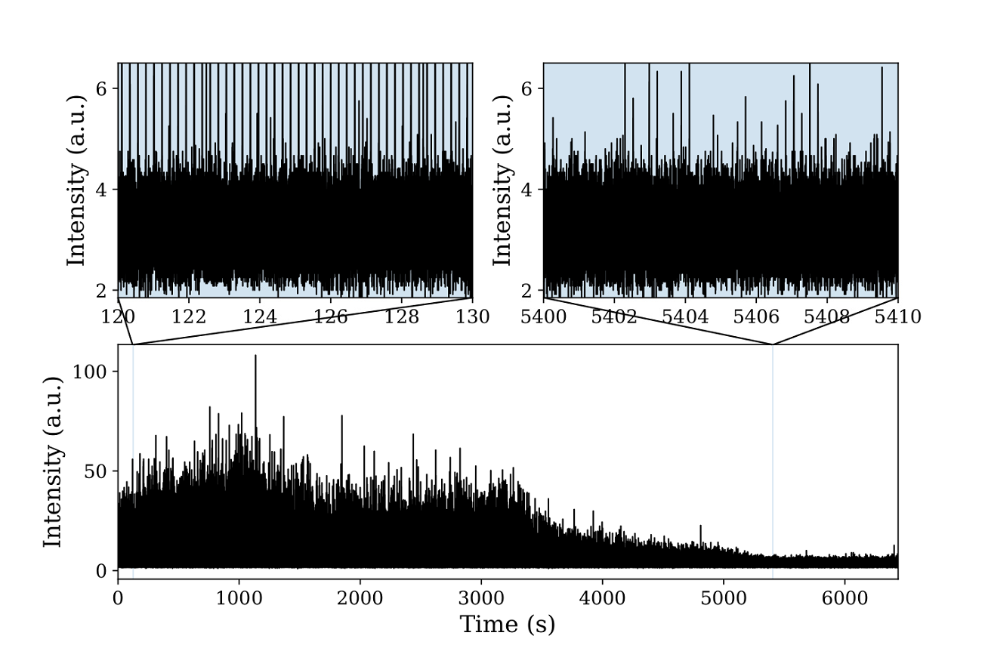
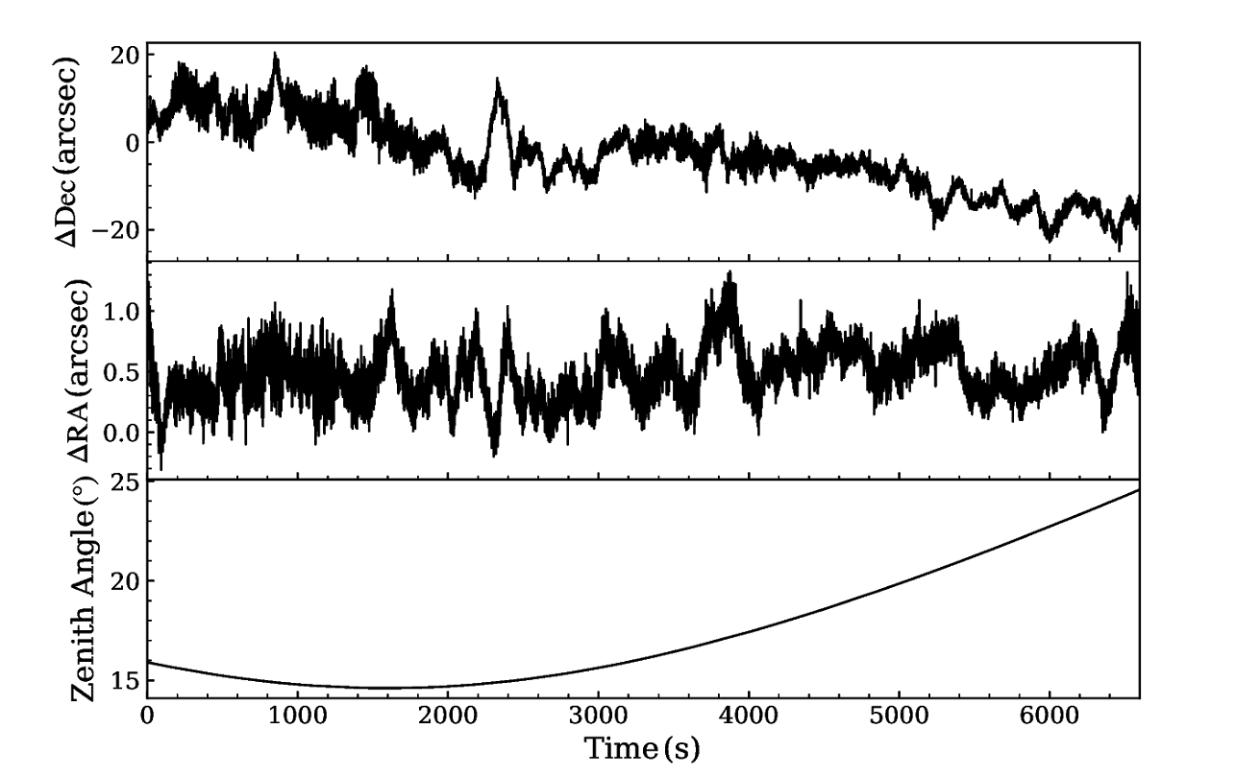
Observation and system noise check
Our observation is ok!

Slide 5
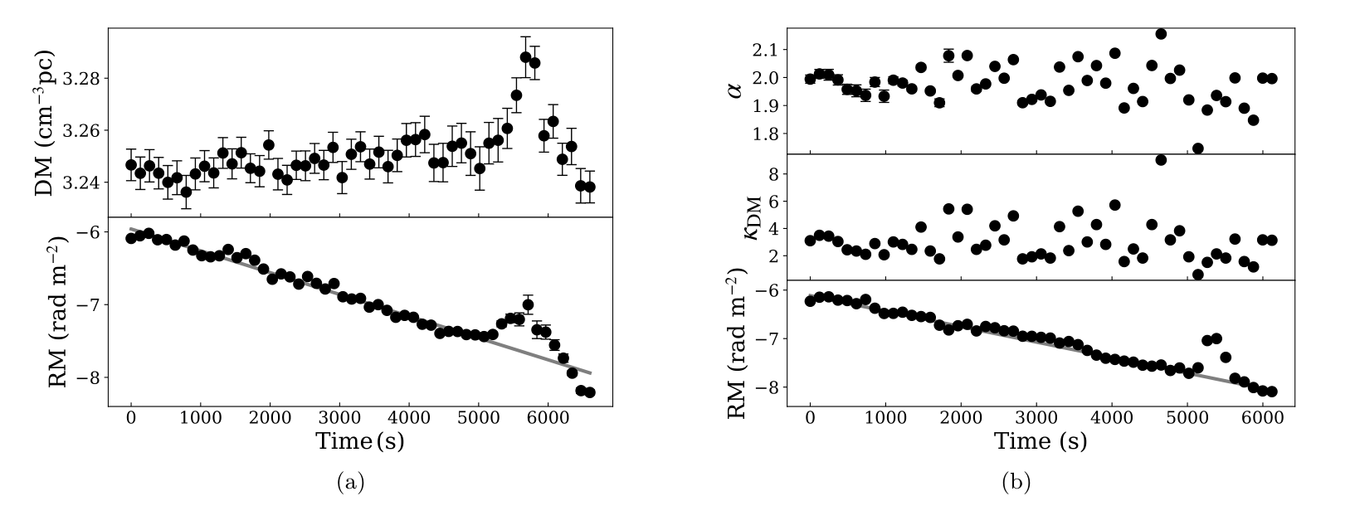
The DM event and the frequency-dependent DM

Slide 6
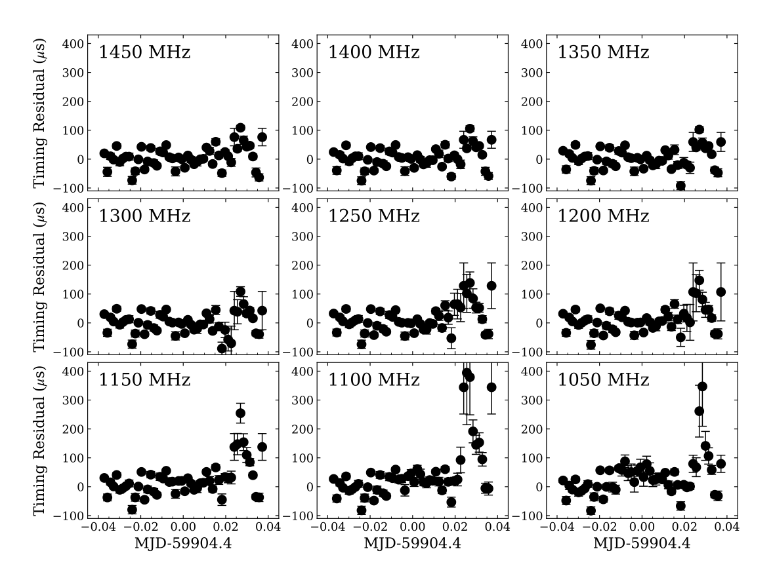
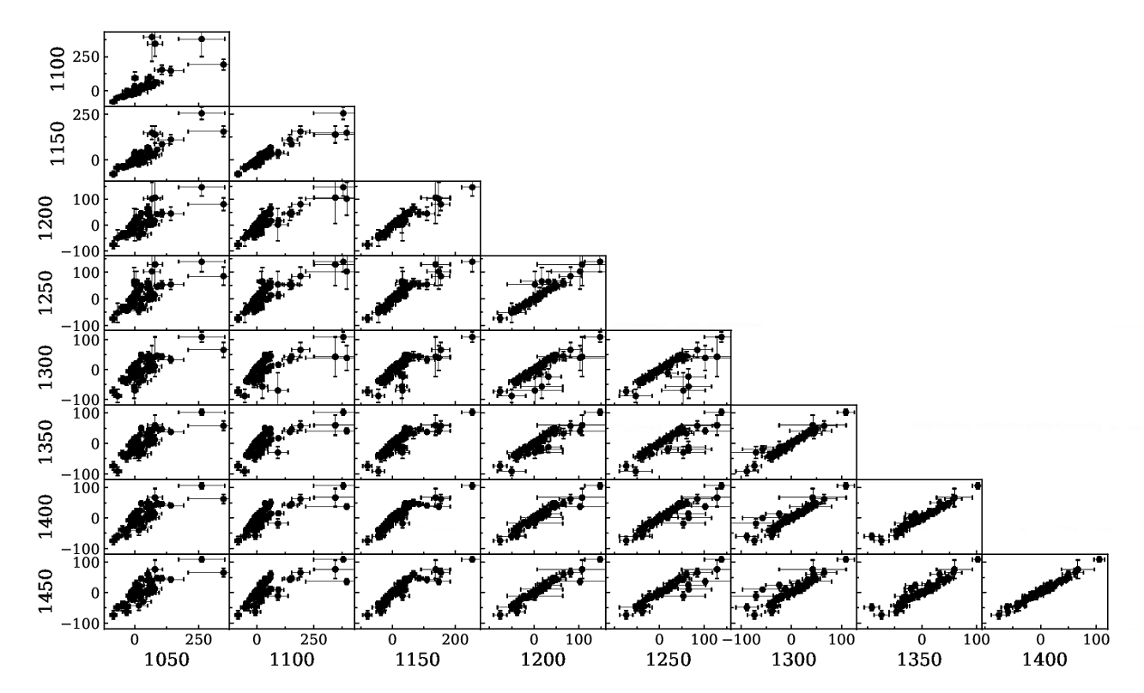
Narrowband pulsar timing
Nine narrow bands
Correlations between pairs of frequencies

Slide 7
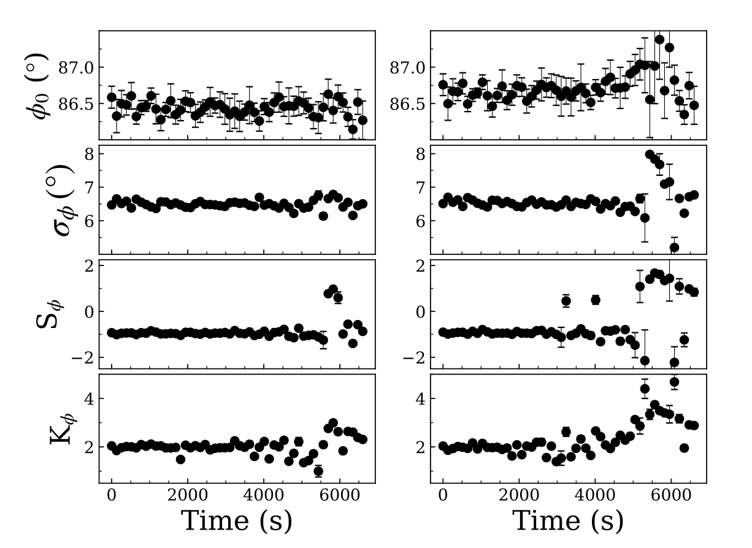
Behavior of pulse shape
$$Δφ_{0}∼0^{∘}.6$$
Changes in the pulse shape intrinsic to the pulsar

Slide 8
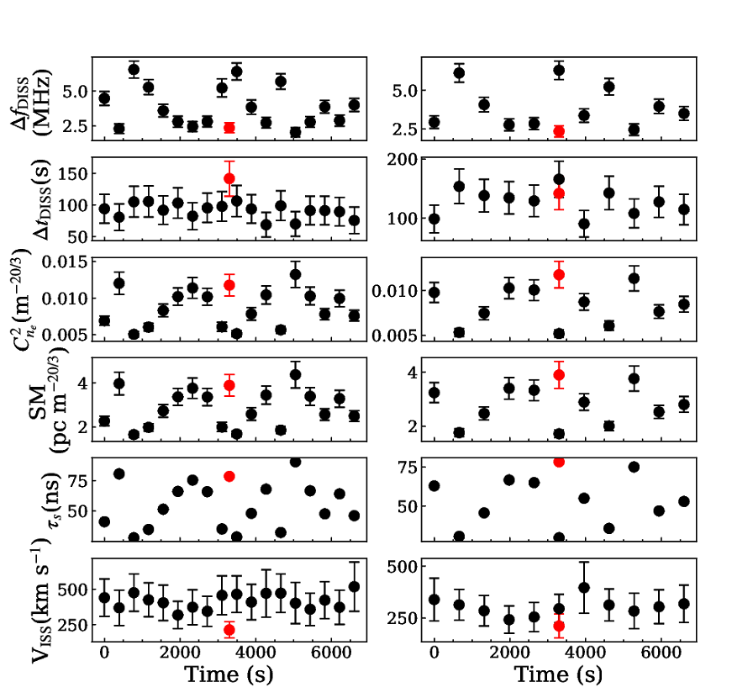
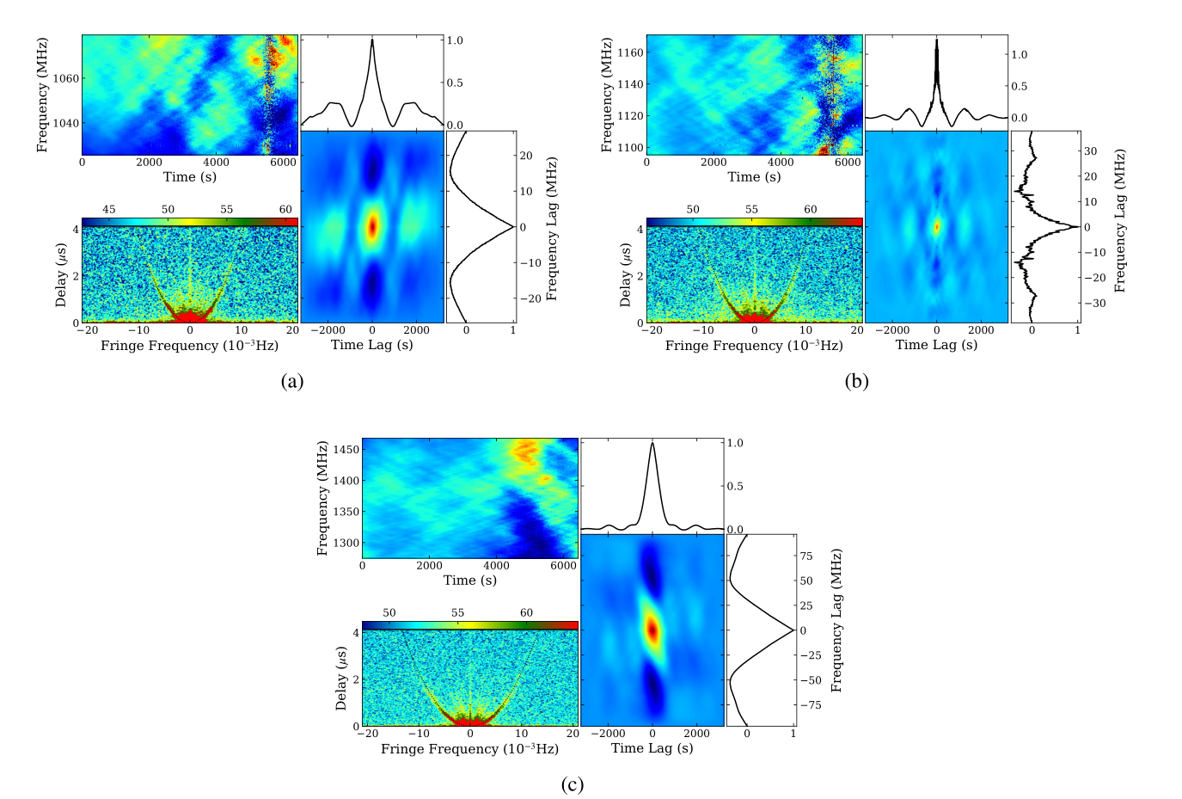
Scintillation
Extremely weak scintillation phenomenon

Slide 9
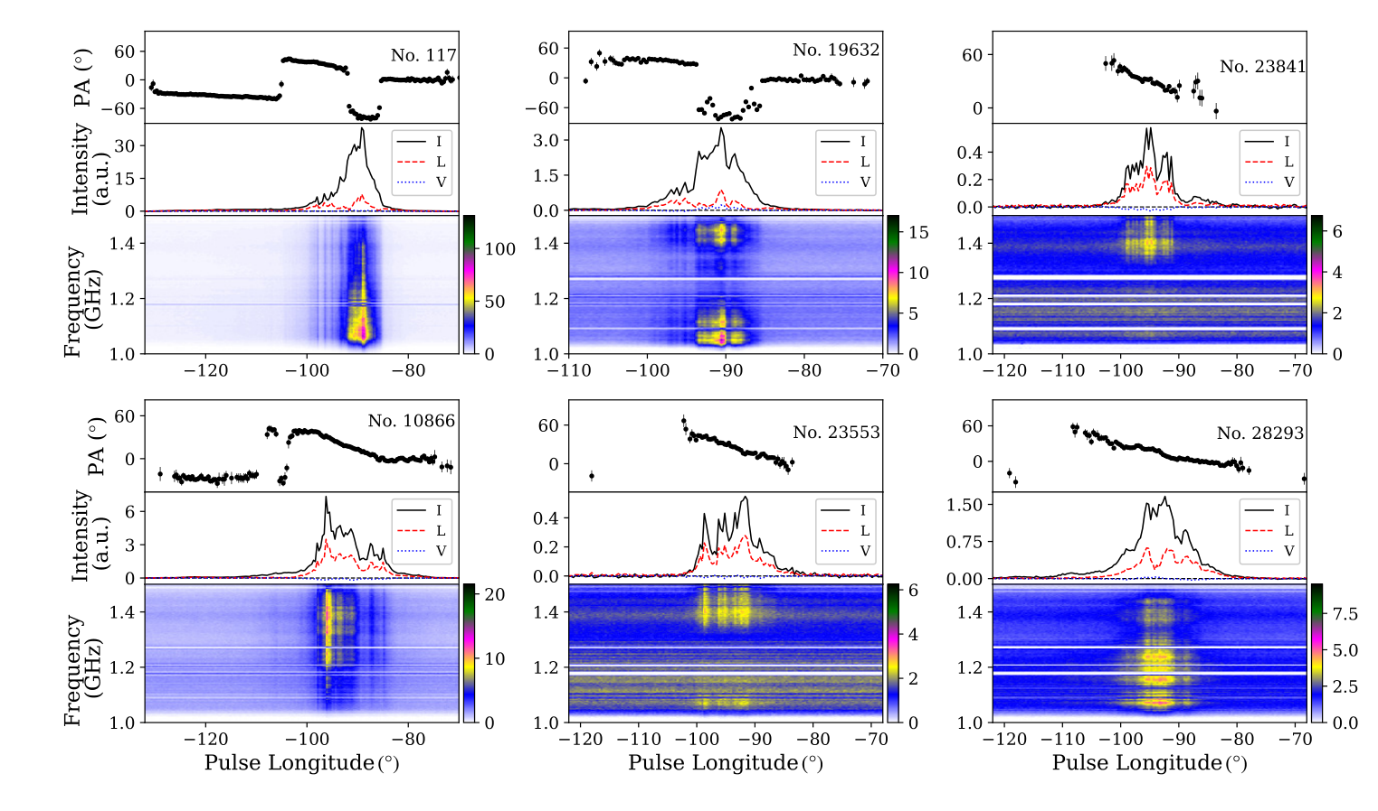
FRB-like frequency drifting
FRB-like behavior is
detected during the event

Slide 10
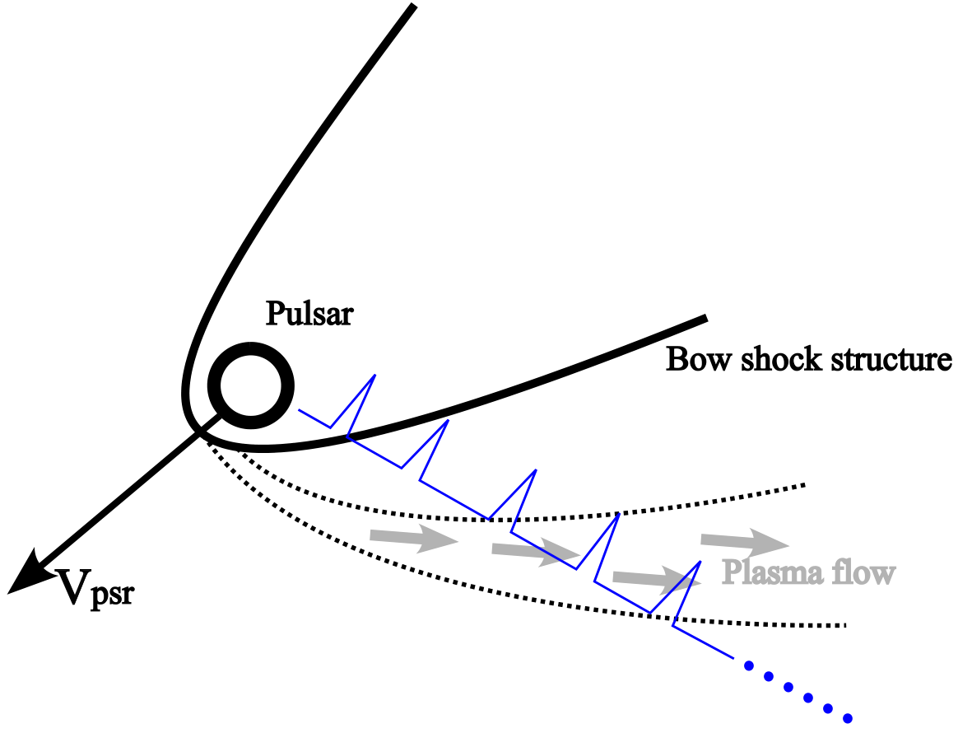
Origin the event
Size: $77$km
Mass: ${250×10}^{3}$kg
Other possible origins:
A new celestial object
The pulsar’s motion
The solar system event

Slide 11
Summary
The flux density event and the plasma lensing within a rapid time scale are first observed
in the radio emission of the pulsars;
The variation in DM and RM before the event implies that the magnetic field must change;
The DM and RM have a jump in the event;
Frequency-dependent DM is directly detected for the first time but still extremely weak;
FRB-like phenomenon is detected during the event;
Pulsar timing results both contributed by the DM effect and the changes in the pulse shape;
The outflows may be just from the pulsar since its electron density is up to ${10}^{10}{cm}^{−3}$. But
other possible origins can not be completely ruled out.

