Slide 1
FAST Observation Results for
Core-Collapsed Globular Cluster M15
Yuxiao Wu
Chongqing University of Post and Telecommunications
Collaborator: Scott Ransom, Paulo Freire, Ralph Etough, et al.
Advisors: Yu Pan (CQUPT) , Zhichen Pan (NAOC) & Lei Qian (NAOC)
Kunming China, 15 July 2024

Slide 2
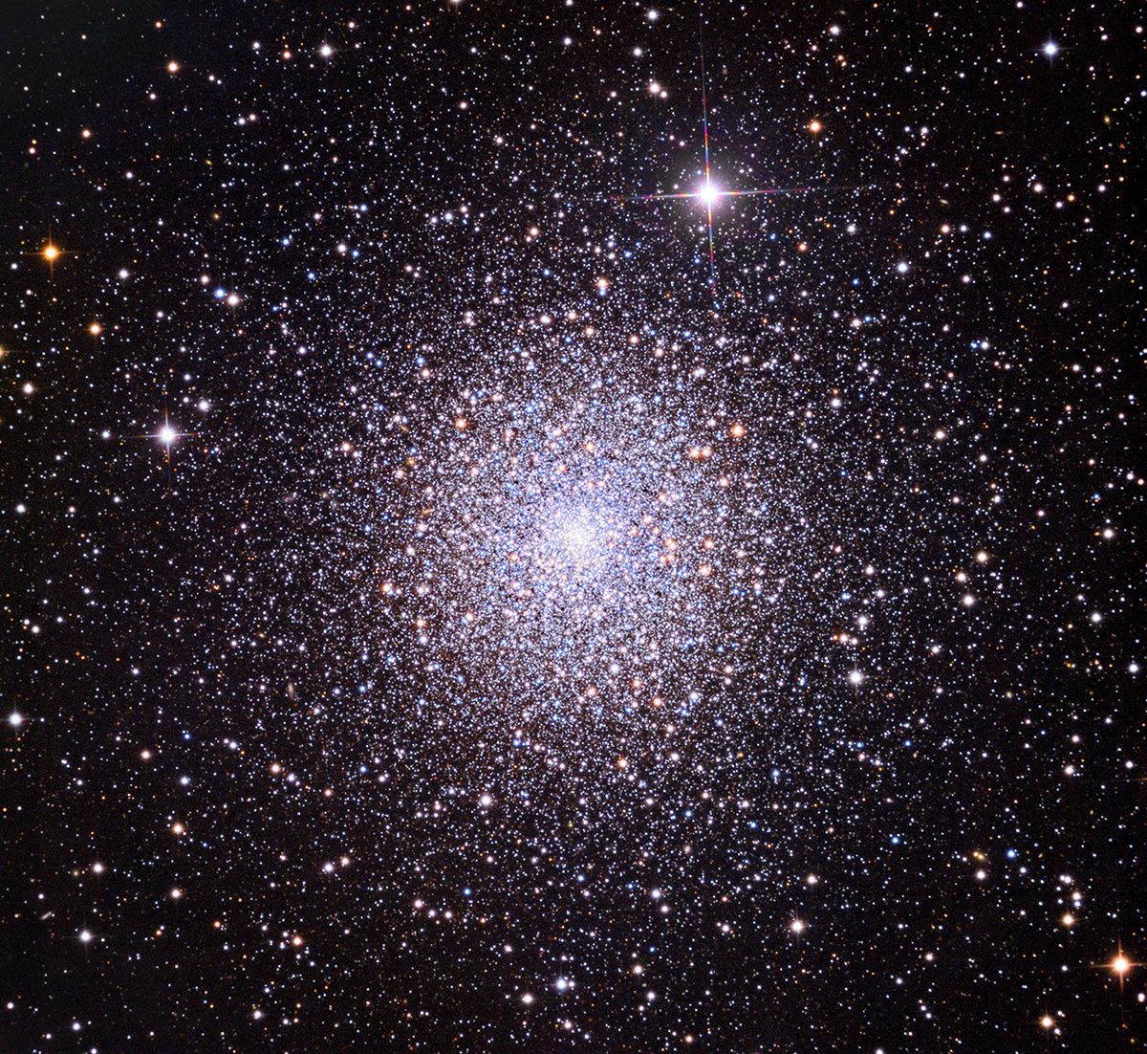
DESIGN
M15
Core-collapsed Globular Cluster
RA:21:29:58.33 DEC:12:10:01.2 (DE200/J2000)
14 pulsars was discovered in it (5 in recent one year!)

Slide 3
Motivation
Most of the research on M15 was completed in the 1980s and 1990s (Anderson, 1993). The only update on timing work was the 2006 results for M15A, B, and C (Jacoby et al., 2006).
Since the discovery of the eight pulsars M15A - H in the 1990s, there were no new pulsar discoveries reported in M15 for nearly 30 years until 2019, despite predictions of a high number of pulsars in M15.
Pulsar
Timing
Pulsar Search

Slide 4
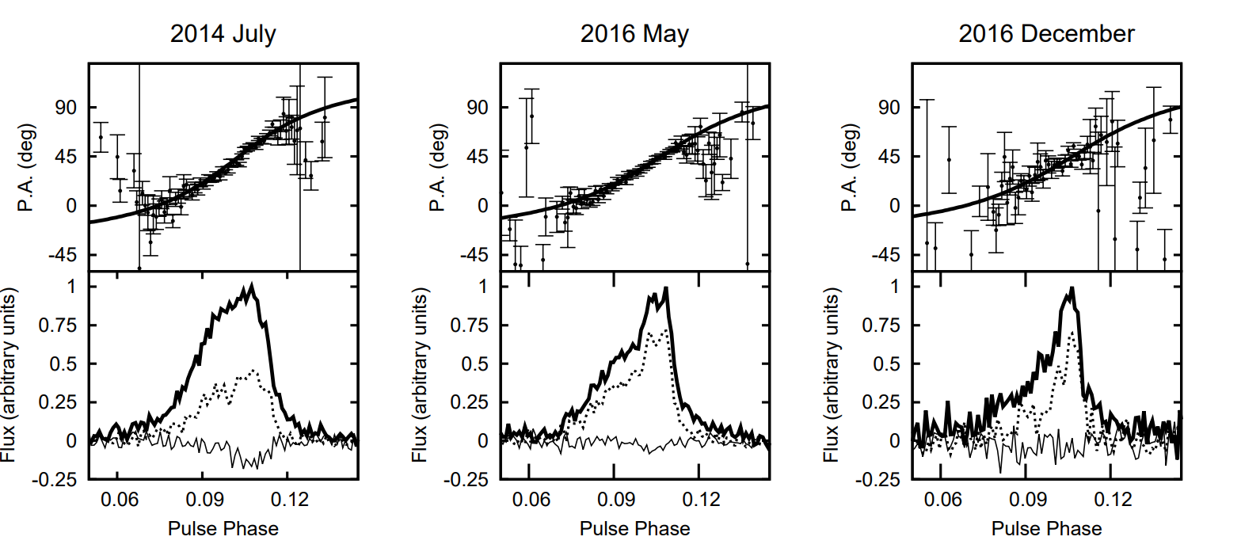
Motivation
M15C
Likely in precessing
Continuous decay in flux density, significant changes in pulse profile and polarization
A.Ridolfi et al.(2017)

Slide 5
2019
2020
2023
2024
Dr.Pan was suggested by Scott Ransom to study M15
I started to study on the process the pulsar data
Discovered three new pulsars and submitted our manuscipt to ApJL
Still under review

Slide 6
OUTLINES
Search Results
Contact
2017213252@stu.cqupt.edu.cn

Slide 7
Search Routine
Observation
RFI removal
De-dispersion trials
Detrend
FFT search (PRESTO)
FFA search (Riptide-FFA)
Confirm Candidates
Confirm Candidates

Slide 8
Discovery of M15J
The sub-harmonic of M15J leads to the discovery

Slide 9
Discovery of M15K&L
M15K
M15L

Slide 10
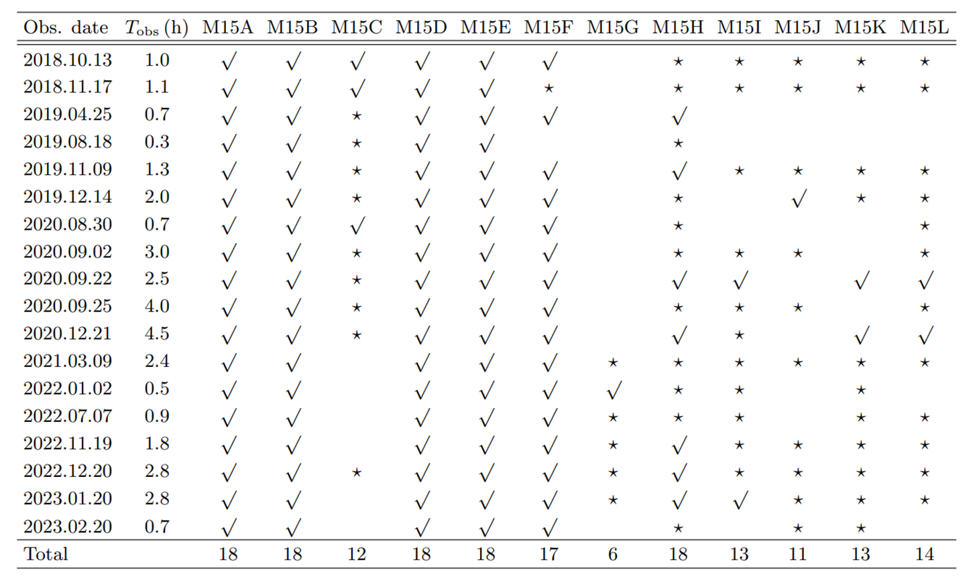
Search Results in General

Slide 11
OUTLINES
Timing Results
Contact
2017213252@stu.cqupt.edu.cn

Slide 12
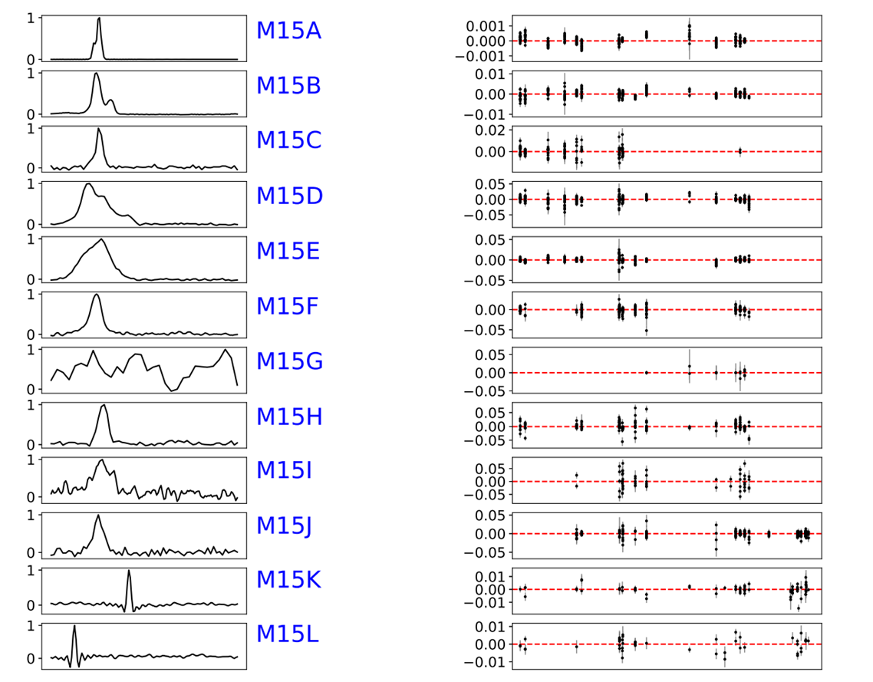
Timing
We have phase-connected timing solution for M15A-F,H,J-L.
M15G was detected only 6 times and M15I was too faint, so that we did not obtained their timing solutions.

Slide 13
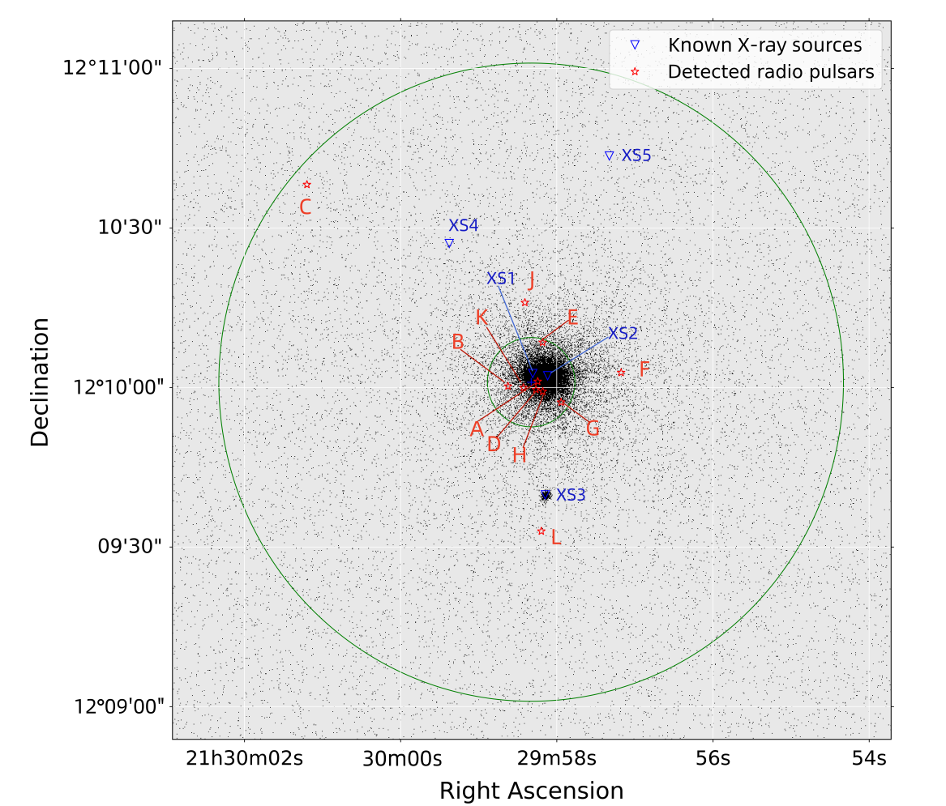
Positions
None of the pulsars has a X-ray counterpart
Both M15K and M15L are within the half-light radius of M15!
Both of them are associate with M15.

Slide 14
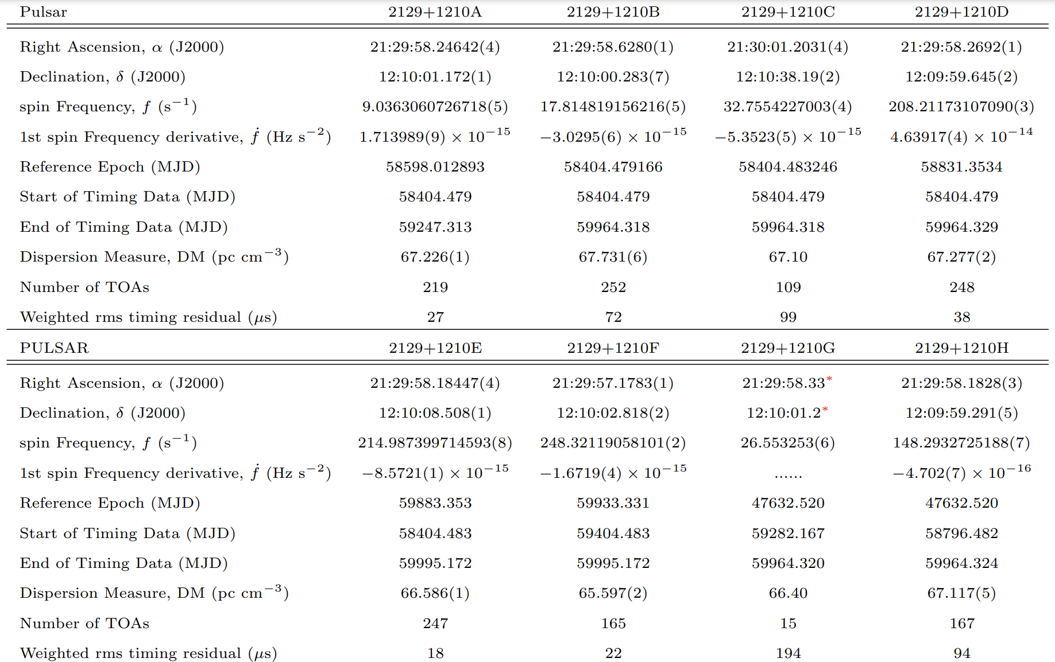
Timing Parameters
We have phase-connected timing solution for M15A-F, H, J-K.
They are consistent with those from Anderson 1993.

Slide 15
OUTLINES
M15C&M15I
Contact
2017213252@stu.cqupt.edu.cn

Slide 16
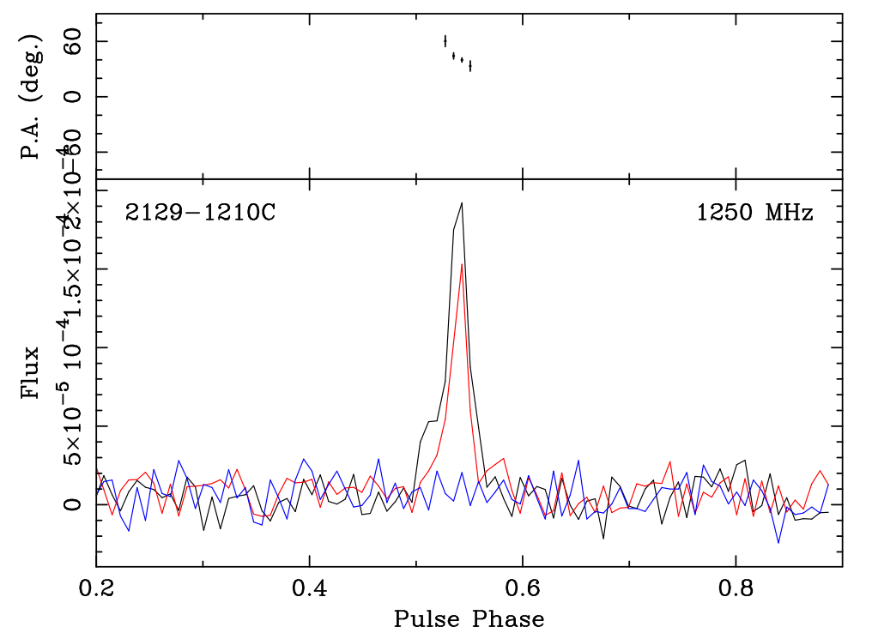
Polarization of M15C
Our result agree with the research before, M15C has a high degree of linear polarization

Slide 17
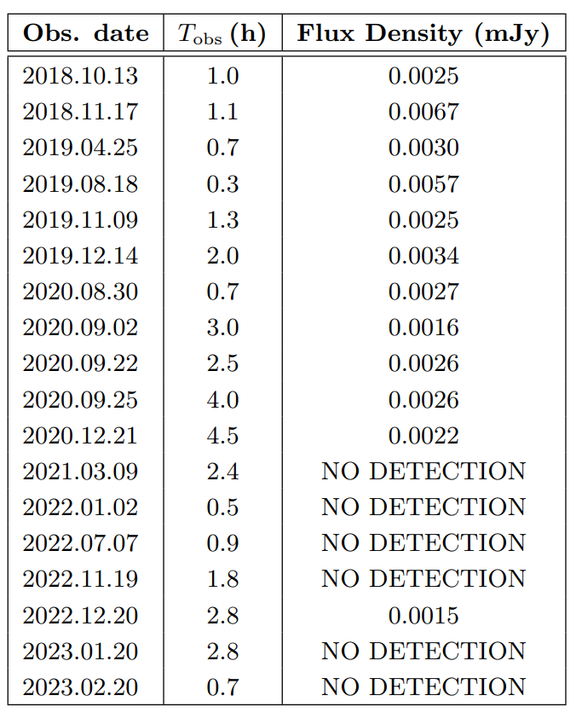
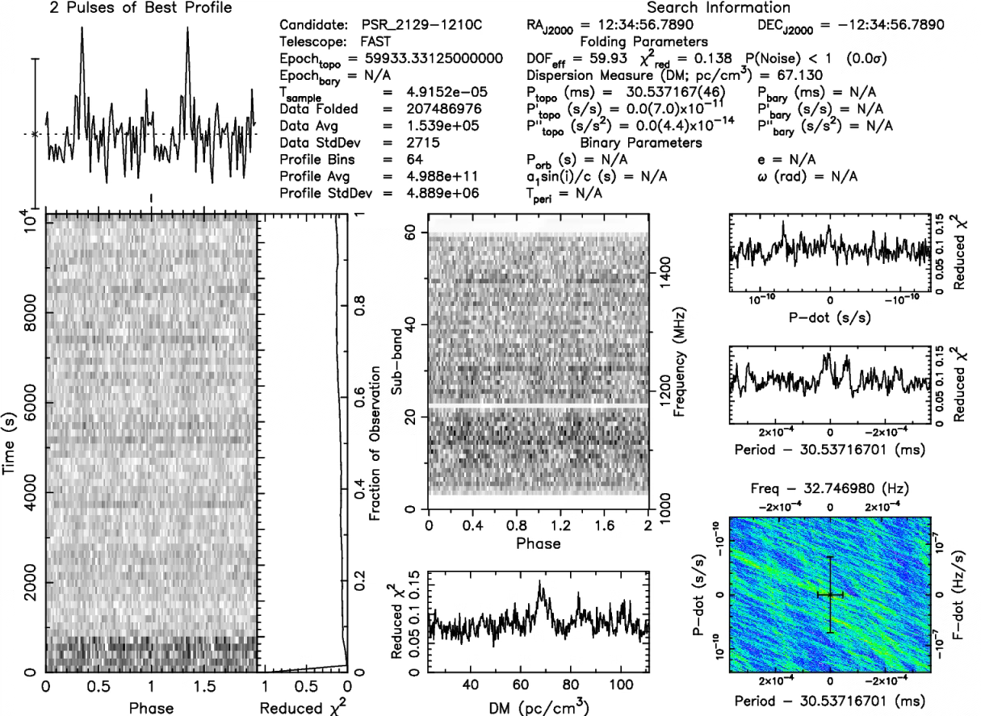
We made a new timing solution
The M15C signal from Dec 20 2022, observation last for 3h
Indicating it might be almost out of our line of sight
Estimated flux density of M15C

Slide 18
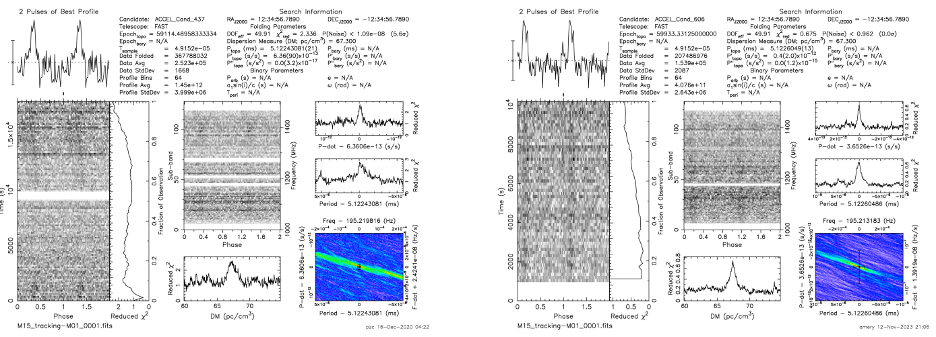
M15I
M15I was believed to be a binary, but in our result we can fold all the data better and obtain a
better reduced chi2 for the TOAs assuming the pulsar is isolated.

Slide 19
Conclusion
1. Timing updates are consistent with Anderson 1993.
2. Three new pulsars are discovered in M15, they are all isolated.
3. M15K and M15L are long-period pulsars and both of them are associated with M15.
4. M15C still shows a high degree of linear polarization and almost can not be detected.
5. M15I is likely in the deep potential of M15.

Slide 20
OUTLINES
Thank you!
Contact
2017213252@stu.cqupt.edu.cn

