Slide 1
Search for axion dark matter with FAST
Speaker: Xue Zihan
Advisor: KJLee

Slide 2
Outline
Introduction
Theoretical modeling
Intensity & polarization
Propagation effects
Observation & data analysis
Constraints on axion-photon coupling
Conclusion

Slide 3
Physics thrives on crisis
Since 1970s, QCD has been the most successful description of all interations other than gravity
Matter-anti-matter asymmetry
Strong CP problem
Vanishing small electric dipole moment for neutron
Fine tuning problem
Modern astronomy, cosmology
Cold dark matter
1977 Peccei-Quinn-Weinberg-Wilczek, …

Slide 4
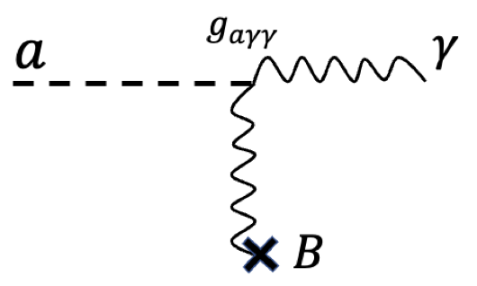
What is axion
Pseudo-scalar particle
Axion mass
Interactions
Axion-like particle
Ultralight dark matter
$$m_{a}≈6×{10}^{−6} eV\left(\frac{{10}^{12} GeV}{f_{a}}\right)$$
$$\frac{a}{f_{a}}G_{μν}{\tilde{G}}^{μν}$$
$$\frac{a}{f_{a}}F_{μν}{\tilde{F}}^{μν}$$
$$\frac{1}{f_{a}}∂_{μ}a\overline{ψ}γ^{μ}γ_{5}ψ$$
$$g_{aγγ}aE⋅B$$
(Credit: Sandbox Studio, Chicago, Symmetry Magazine/Fermilab and SLAC)

Slide 5
Why axion + pulsar?
Make the most of strong astrophysical magnetic field to transfer energy from axion field into photons
Plasma generates effective mass for photon, allow axion and photon dispersion relations to intersect, thus making the conversion resonant
Strong surface magnetic field (up to ~${10}^{15}$ G)
Magnetosphere, plasma frequency neV~meV
Narrow spectral line at a frequency determined by axion mass
Ideal environment
Notes:
3-4min

Slide 6
Theoretical model
Axion electrodynamics
$$−∂_{t}^{2}a+∇^{2}a=m_{a}^{2}a−g_{aγγ}E⋅B$$
$$−∇^{2}E+∇\left(∇⋅E\right)=ω^{2}D+ω^{2}g_{aγγ}aB$$
$$P_{a→γ}≡\frac{F_{γ}}{F_{a}}≃\frac{1}{ω^{2}}{\left|\frac{E_{y}}{a}\right|}^{2}=\frac{πg_{aγγ}B_{t}^{2}}{2ω_{p}^{′}\left(x_{c}\right)v_{c}}$$
$$ω_{p}=m_{a}$$
Magnetosphere
$$n_{GJ}(r)=\frac{2Ω⋅B}{e}\frac{1}{1−Ω^{2}r^{2}\sin^{2}θ}$$
Polarization
100% linearly polarized
Incoherent emission
Basis
$$y=Ω×k$$
$$x=k×y$$
Dark matter density
$$f(r_{CS},v)=f_{∞}(r_{∞},v_{∞})$$
$$ρ(r)=\frac{2ρ_{∞}^{DM}}{\sqrt{π}}\sqrt{\frac{2GM}{r}}\frac{1}{v_{0}}$$
$$I≡⟨E_{1}E_{1}^{∗}⟩+⟨E_{2}E_{2}^{∗}⟩$$
$$Q≡⟨E_{1}E_{1}^{∗}⟩−⟨E_{2}E_{2}^{∗}⟩$$
$$U≡⟨E_{1}E_{2}^{∗}⟩+⟨E_{2}E_{1}^{∗}⟩$$
$$V≡−i(⟨E_{1}E_{2}^{∗}⟩−⟨E_{2}E_{1}^{∗}⟩)$$
ZHX et al. 2023

Slide 7
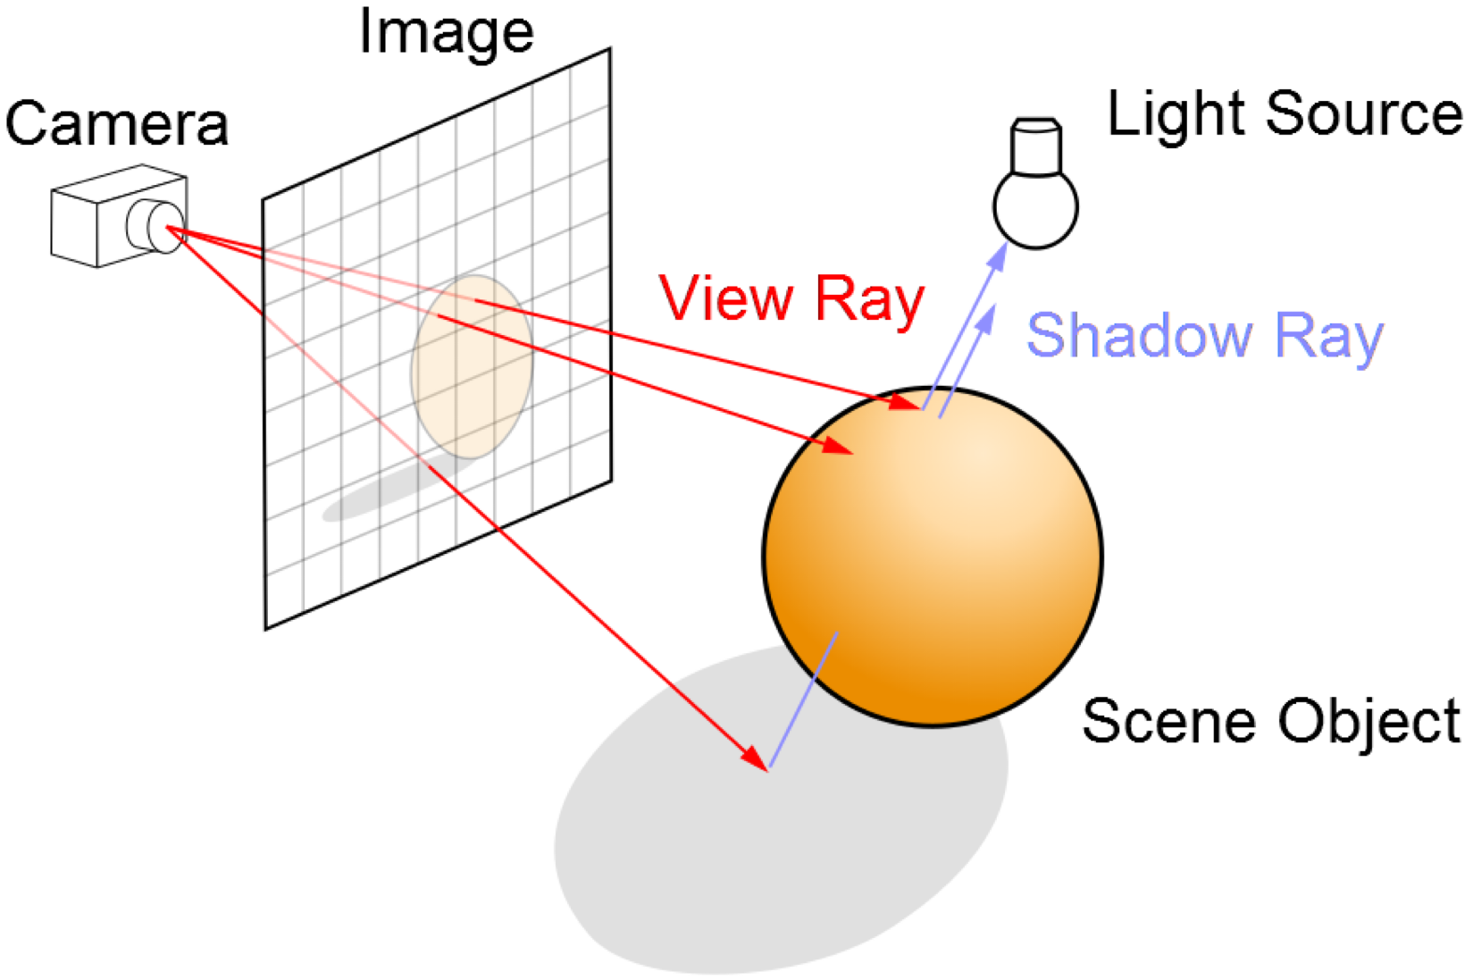
Ray-tracing method
Rendering techique to simulate lightning scenes
Tracing the path of light
Procedures:
Grid the image plane
Determine ray path
Trace ray backward (propagation effect)
Vacuum: straight-line
Plasma: $\frac{d^{2}x^{μ}}{dλ^{2}}+Γ_{νρ}^{μ}\frac{dx^{ν}}{dλ}\frac{dx^{ρ}}{dλ}=−\frac{1}{2}∂_{μ}ω_{p}^{2}$, $\frac{I}{n^{2}ν^{3}}=const$
Sum contributions from all pixels
https://commons.wikimedia.org/wiki/File:Ray_trace_diagram.svg

Slide 8
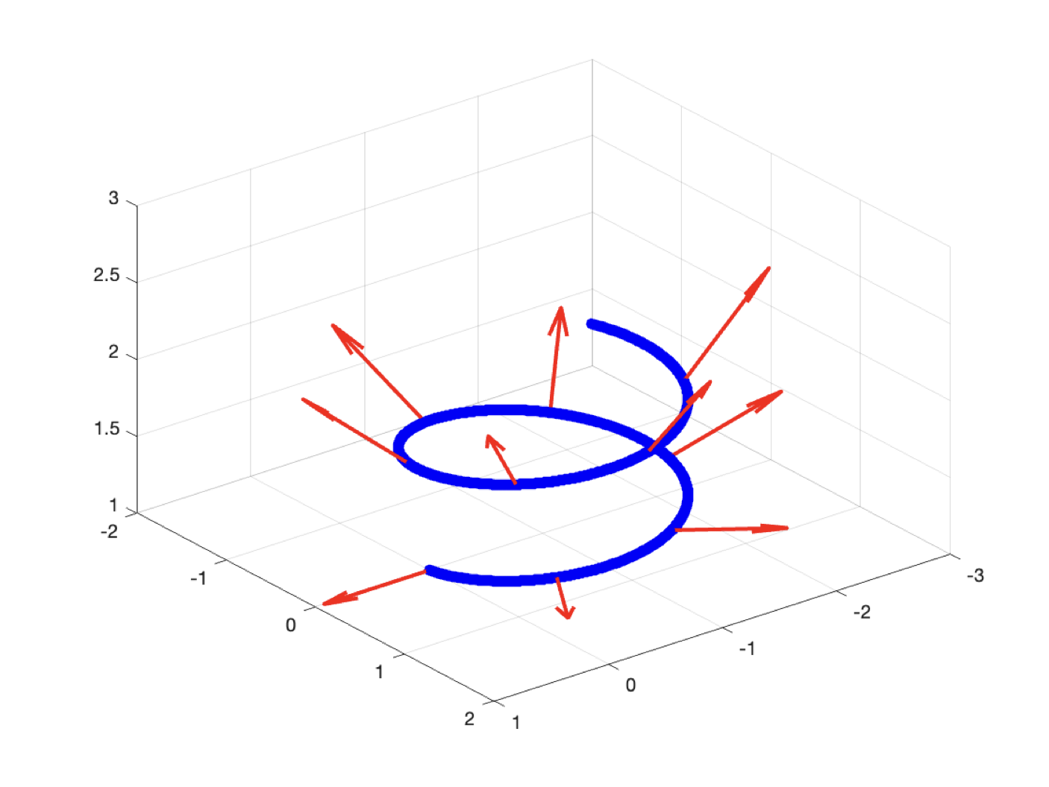
Polarization transport
$\frac{d^{2}x^{μ}}{dλ^{2}}+Γ_{νρ}^{μ}\frac{dx^{ν}}{dλ}\frac{dx^{ρ}}{dλ}=−\frac{1}{2}g^{μν}∂_{ν}ω_{p}^{2}$, $k^{μ}=\frac{dx^{μ}}{dλ}$
$\frac{dk}{dλ}≠0$
Propagation law for unit polarization vector
Derived from Maxwell’s equation
Fermi-Walker transport in 3 dimension
$\frac{df}{ds}−\left(\frac{dk}{ds}k⋅f−k\frac{dk}{ds}⋅f\right)=0$
Parallel transport with effective line element
$dσ^{2}=n^{2}\left(dx^{2}+dy^{2}+dz^{2}\right)$
$$y=Ω×k$$
$$x=k×y$$
$$\frac{df}{ds}=−f\left(f⋅\frac{dk}{ds}\right)$$
(Throne & Blandford 2017)
ZHX et al. 2023

Slide 9
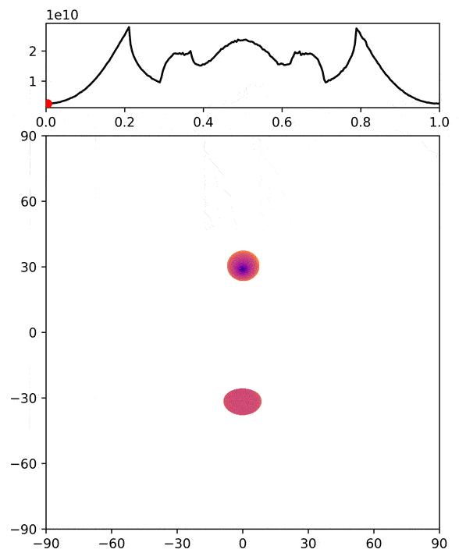
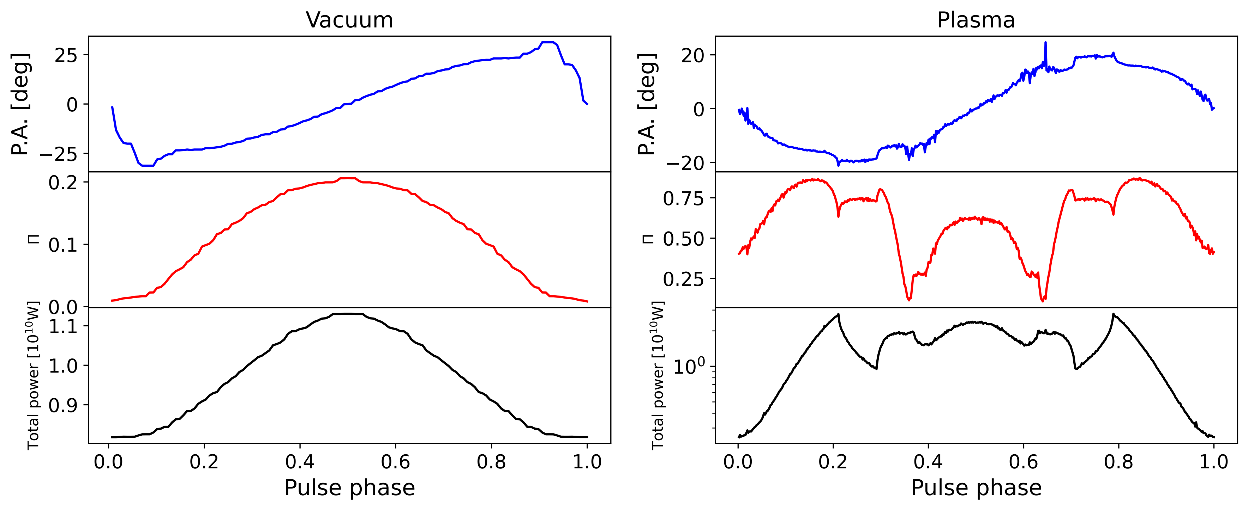
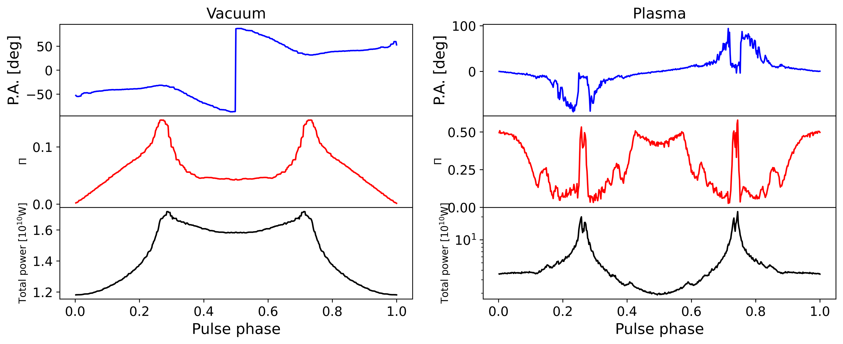
Results
Notes:
7-8min

Slide 10
Summary of AIRS
Narrow-band $\sim {10}^{−6}m_{a}$
Periodic, period=pulsar spin period
Periodicity is persistent
Appear at similar frequencies for all observations
Linearly polarized, distinct polarization feature

Slide 11
Observation & analysis
RX J1308.6+2127
RX J2143.0+0654
2 hours * 3
High-frequency resolution dynamic spectra
524288 frequency channel
0.95 kHz

Slide 12
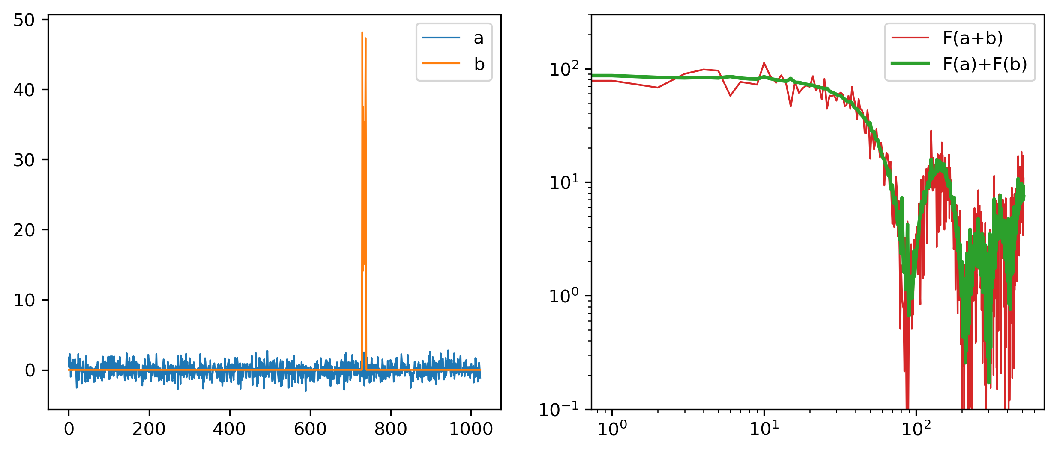
RFI
RFI magnify noise
RFI detection
Time domain
Frequency domain
Both
1) RFI occur in only one frequency channel; 2) dispersion; 3) unphysical broadening

Slide 13
RFI removal
Divide time sequence into small segments
Detect RFI in for each segment

Slide 14
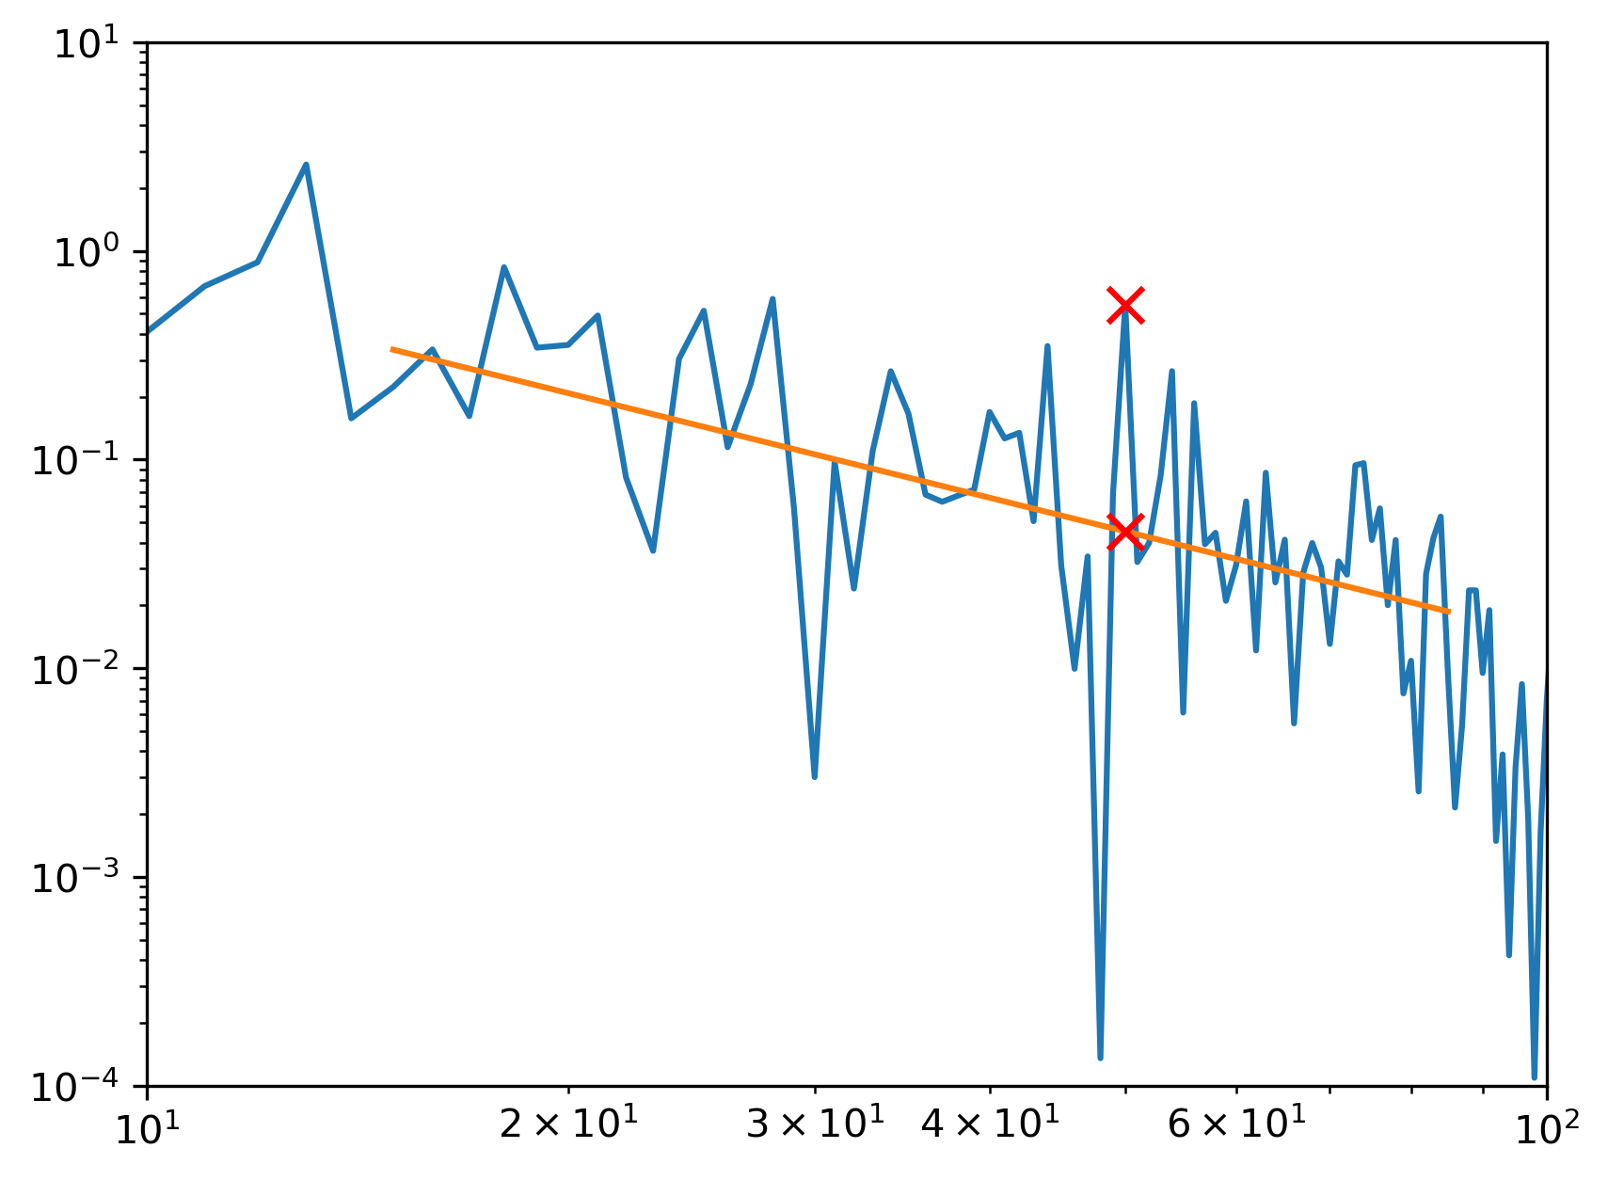
Detection statistics
$$ℱ=\sum_{j=1}^{8}{\frac{I\left(f_{j}\right)−\hat{p}\left(f_{j}\right)}{{\hat{σ}}_{f_{j}}}}$$
Generalized periodic signal
Non-sinusoidal
Maximum likelihood
In absence of signal
$χ^{2}$ distribution

Slide 15
Results
No points exceed 5$σ$
4$σ$:
1) independent frequency
2) no points appear at similar frequencies
3) further analysis

Slide 16
Further analysis
Divide data into 10-min segments
Do FFT to each segment
Periodic signal is not persistent
No evidence of axion conversion

Slide 17
Limits on $g_{aγγ}$ (preliminary)
MeerKAT
Breakthrough Listen
FAST 95% upper limit
$$ℱ=\sum_{j=1}^{8}{\frac{I\left(f_{j}\right)−\hat{p}\left(f_{j}\right)}{{\hat{σ}}_{f_{j}}}}$$
FAST radiometer
Notes:
11min

Slide 18
Conclusion
https://doi.org/10.1103/PhysRevD.108.083009
Axion-induced radio signal
Intensity & polarization
Propagation effect
Nontrivial polarization structures
Observation & data analysis
RFI removal
Detection statistics
Limits on axion-photon coupling
Thanks

